Slide 1

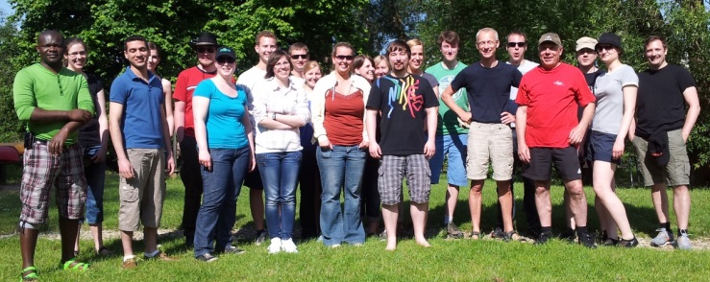


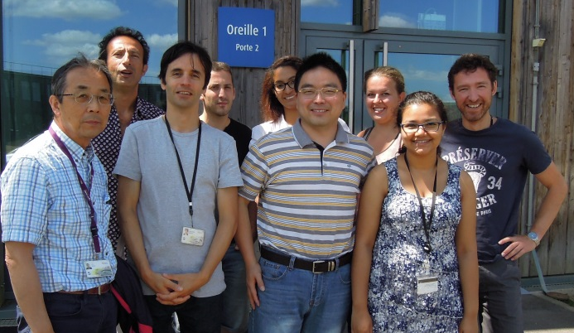
Dr. Julia Krüger
01.04.2011 - 31.10.2014
Phd Studies in the Graduate School of Chemistry and Biochemistry
Specialization: Physical Chemistry
01.11.2014 - 31.12.2015
Post-Doc on the DESIRS beamline
Synchrokin (ANR granted project)

Slide 2
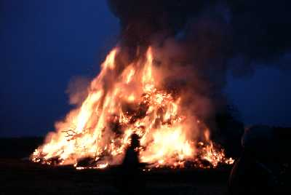



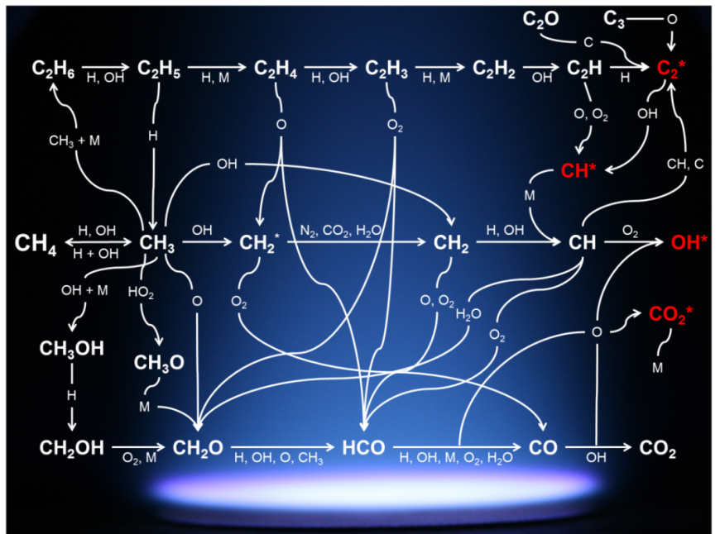
Gas Phase Chemical Reactions
influence on the human health
Understanding of the complex chemical reactions
plenty of different species different concentrations
Increase of efficiency
Reduction of pollutants

Slide 3
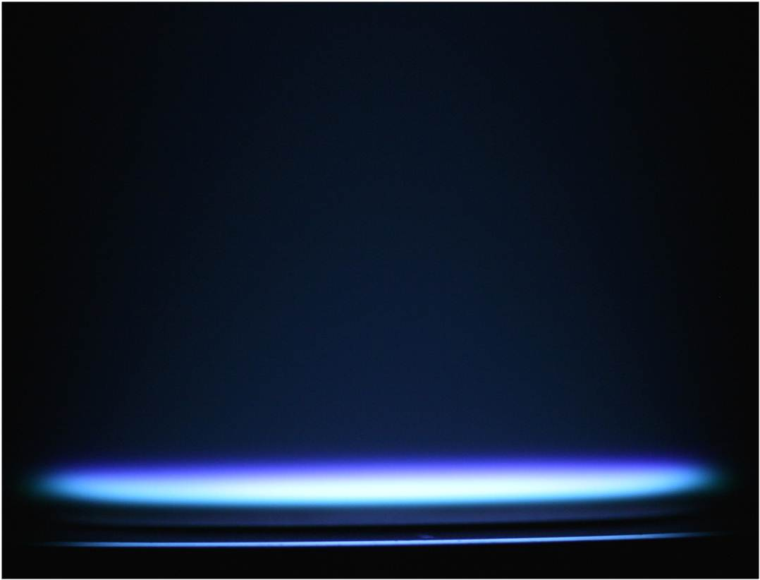
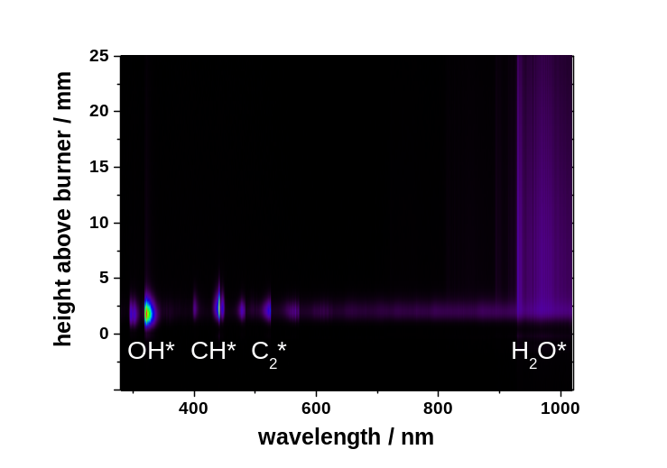
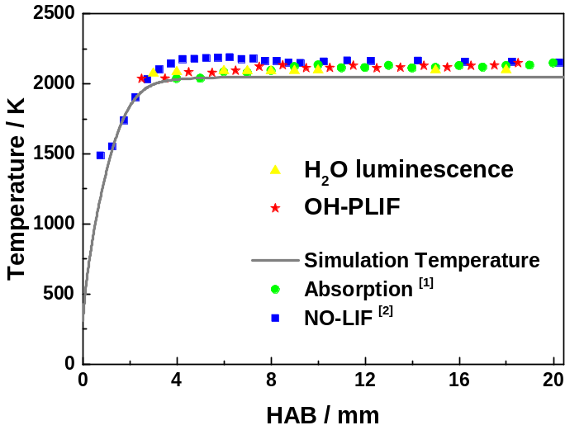
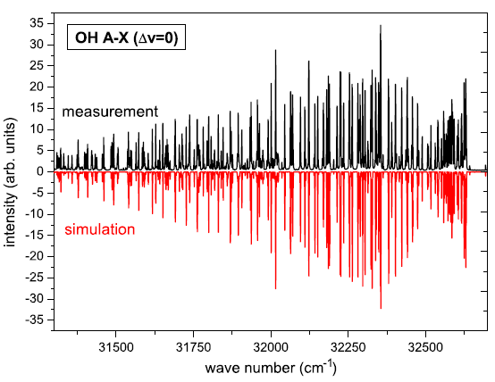
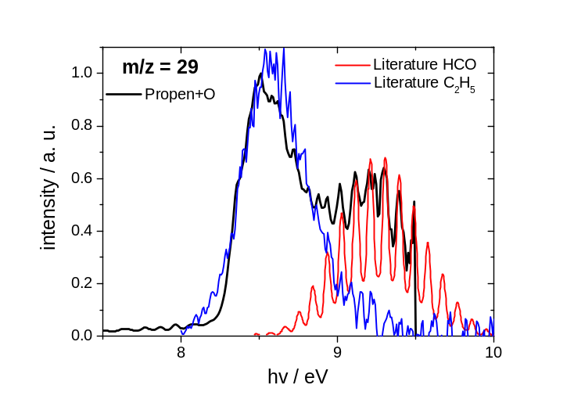
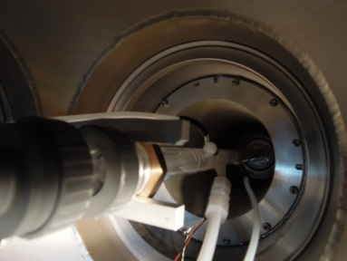
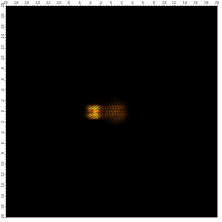
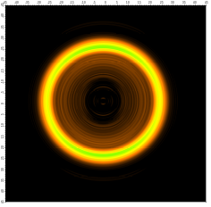
UV-VIS Spectroscopy
Temperature Measurements
Characterization of combustion processes
&
Development of new diagnostic techniques
Photoelectron-Photoion Coincidence Spectroscopy
unique and world-leading instrument
coupled to coincidence detection of photoelectron-photoion TOFMS

Slide 4
Thank you
for
your attention!

