Slide 1
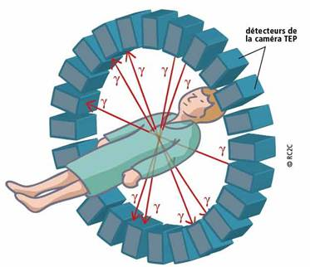
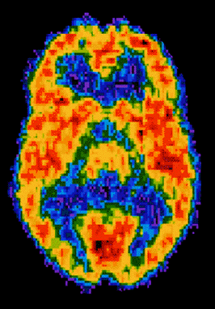
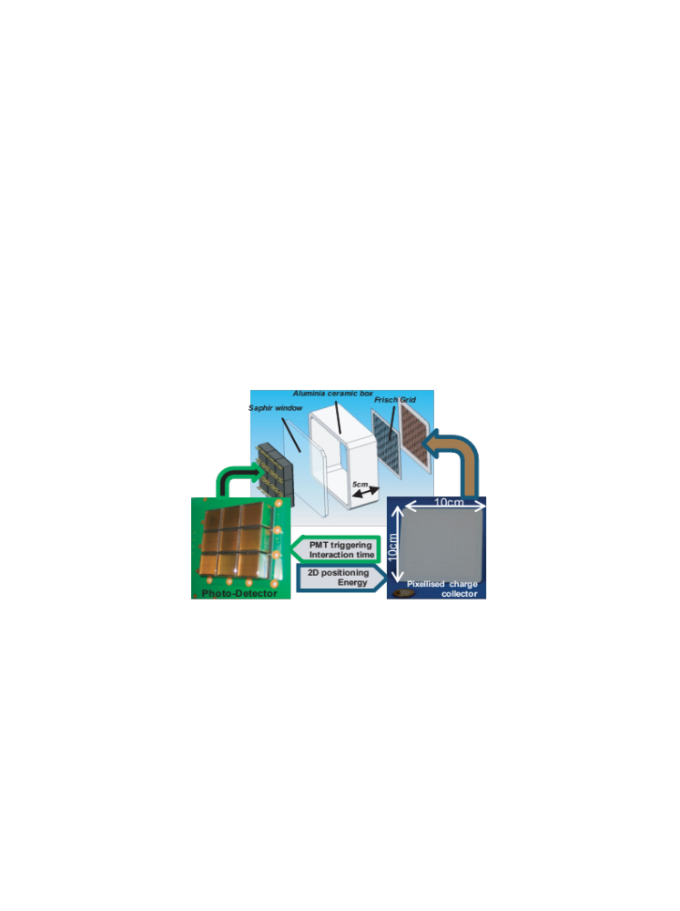
Technologie détecteur de charge ultravide multipixellisé avec électronique ASIC bas bruit et ultrapurification
Physical principle
Ultrapurification
Single pixel detector
Electronics
Measurements
Conclusion
Xavier Mancardi

Slide 2
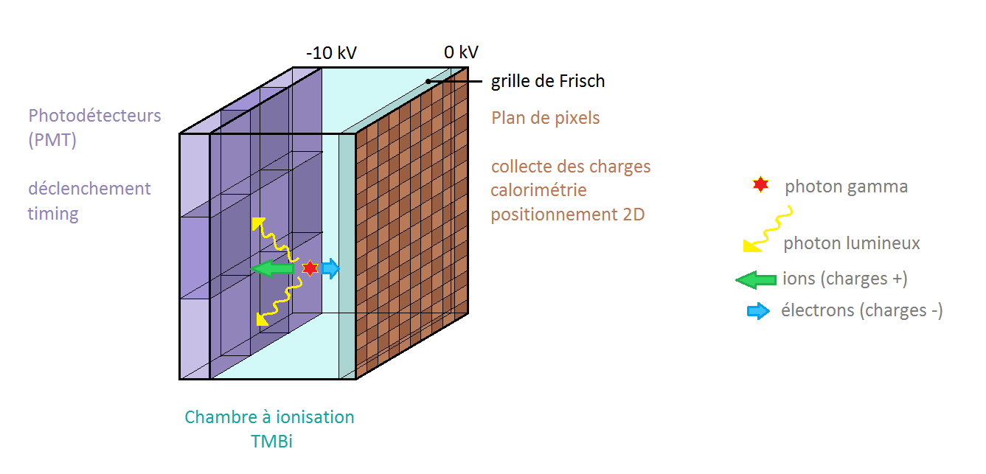
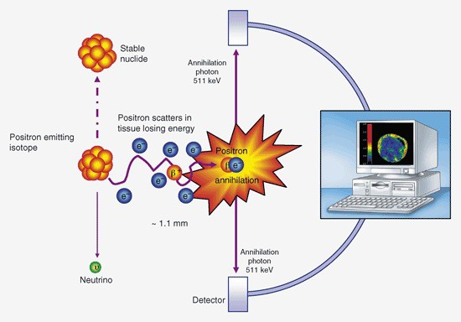
Physical principle
Optical detector
Time resolution
Cherenkov Emission
CaLIPSO
Z position*
Expected performances:
  → 3D positioning: 1 mm³
  → time resolution ~ 100 ps
  → energy resolution ~ 10%
Ionisation
XY position, Z position*
Electrons drift
Ionization detector
Energy
PET principle
CaLIPSO detector principle
Xavier Mancardi

Slide 3
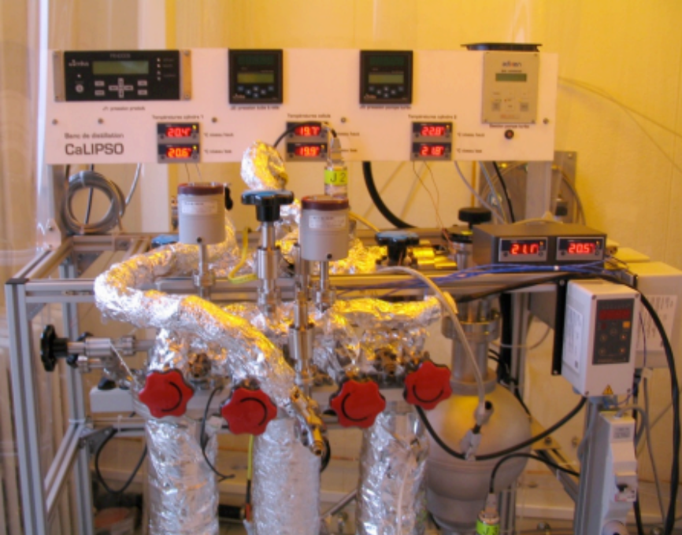
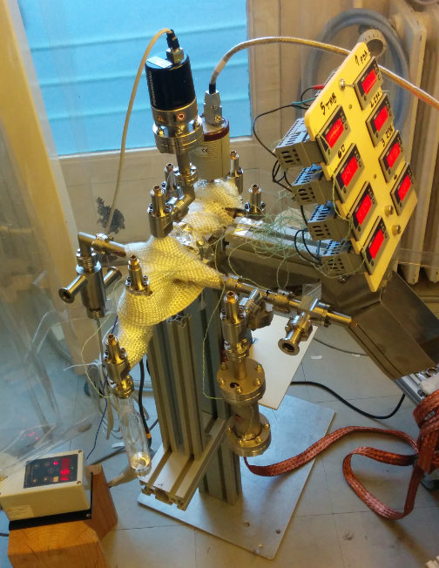
ultrapurification
Electronegative impurities reduce the signal by capturing electrons
→ ultrapurification < 0,1 ppm oxygen equivalent (electrons lifetime > 10 µs)
→ molecular sieve (3A, 4A, 5A and 13X zeolites)
→ batch and column devices
Batch (r.) and column (u.) ultrapurification stations
Xavier Mancardi

Slide 4
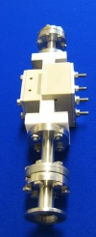
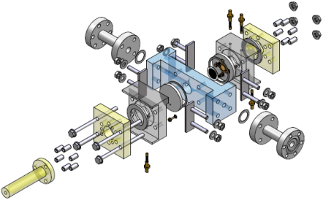
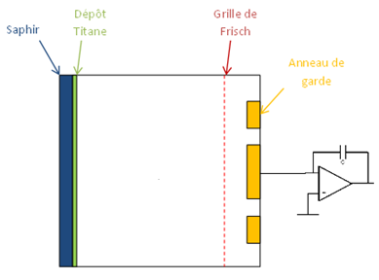
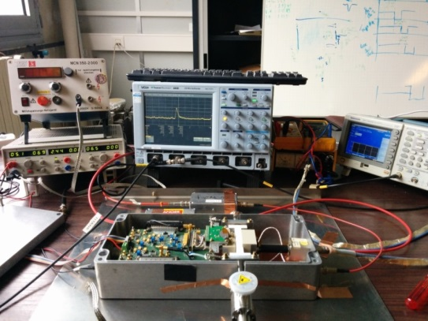
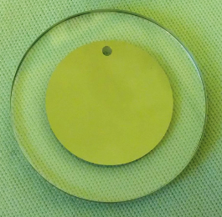
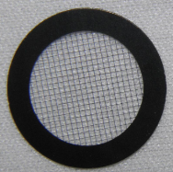
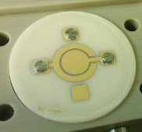
Single Pixel Detector
Ionization chamber
Very weak signals (pA, fC) → Eliminate every noise sources
Single pixel cell
Optical Demonstrator
E₁
E₂
Single pixel cell picture
Titanium layer on sapphire
Frisch grid
Charge collection surface
Single pixel cell electronic readout
Xavier Mancardi

Slide 5
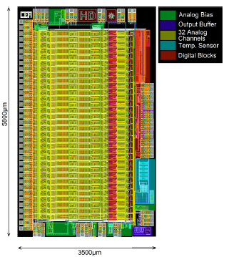
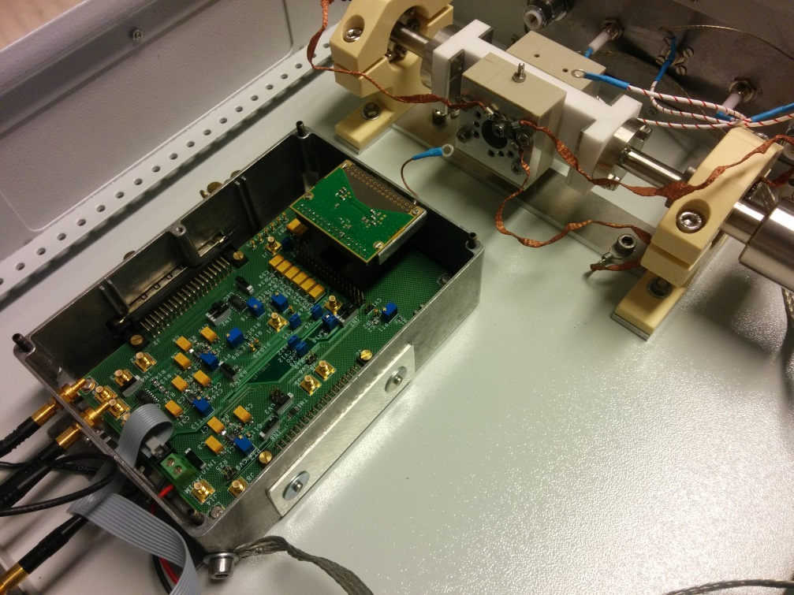
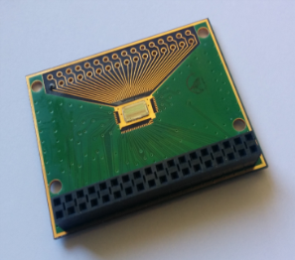
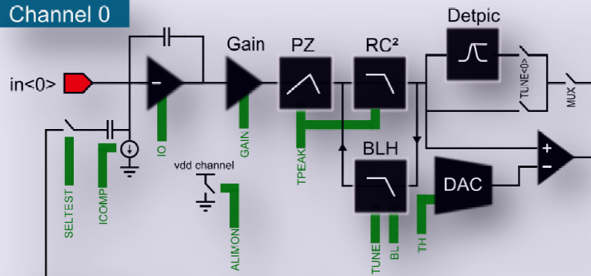
Electronics
Charge pre-amplifier → Low-noise iDeF-X electronic developed at SEDI (O. Gevin et al.)
  Equivalent Noise charge (ENC) = 33 e⁻ + 5,5 e⁻/pF
  Gain max = 200 mV/fC
  32 independent channels (ASIC)
<
IDef-X chip
Test environment
Schematic of an IDeF-X channel
Xavier Mancardi

Slide 6
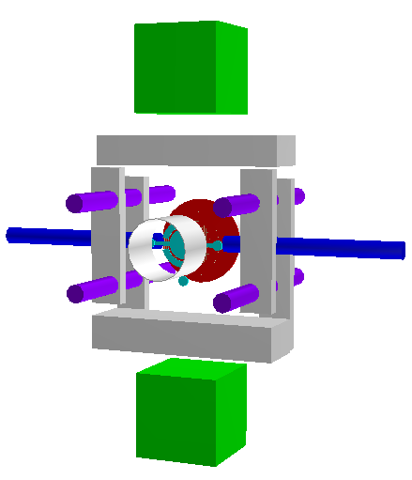
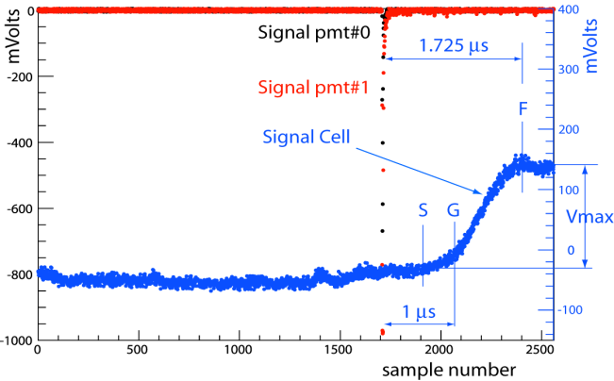
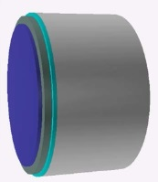
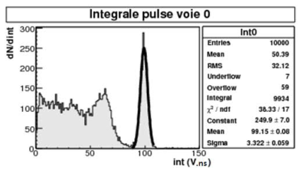
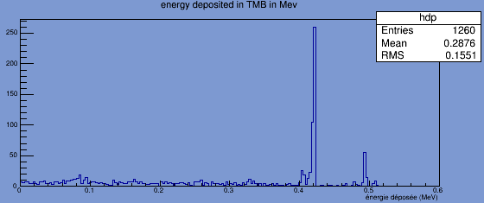
Measurements: 3 methods
Detection in coincidence of a muon on two scintillators : Electron mobility
  Current produced by a ⁶⁰Co gamma rays source : Charge production yield (Gfi)
  Detection in coincidence of two 511 keV γ from a β⁺ ²²Na source : Ultrapurification
Cobalt 60 source
µ
γ
2γ 511 keV
Xavier Mancardi

Slide 7
conclusion
Now Operational
  Optical detector
  Ionization electronic readout
  Single pixel cell modelisation
  First ionization signals after purification on 3A zeolites in powder form
On going
  TMBi ultrapurification
  Single pixel cell performance study
  Mechanical conception of final CaLIPSO detector with « bureau d’étude »
  Physical modelisation of final detector
Xavier Mancardi

Slide 8
Thank you for your attention
Xavier Mancardi

Slide 9
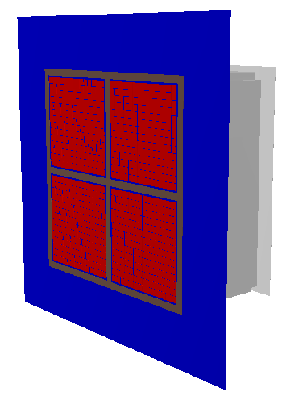
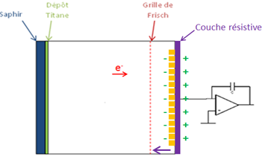
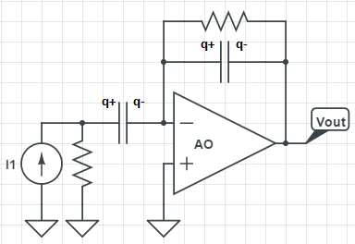
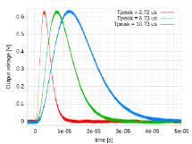
Future : multipixelisation – UHV Vacuum
Signal readout by capacitive coupling
No feedthrough ☺
Alumine 300 µm + resistive layer => readout by capacitive coupling
Thin film deposits on alumine performed by the CSNSM in Orsay (L. Dumoulin et L. Berge)
Pixellised detector
E₁
E₂
Capacitive readout principle
Xavier Mancardi

