Slide 1
Superconductivity In accelerators
Part I : introduction
Cours supraconductivité M2 GI | Claire ANTOINE
Magnets and RF cavities

Slide 2
Introduction

Slide 3
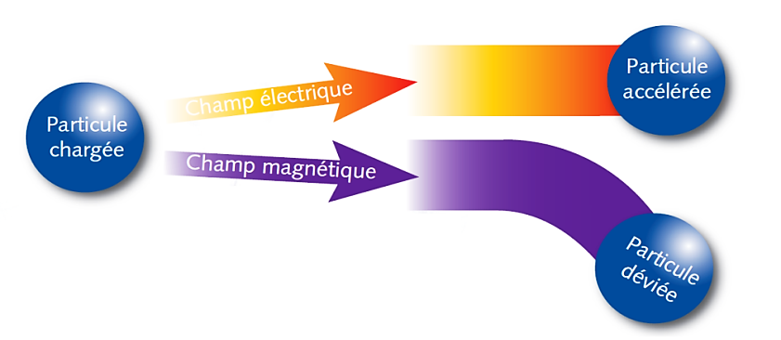
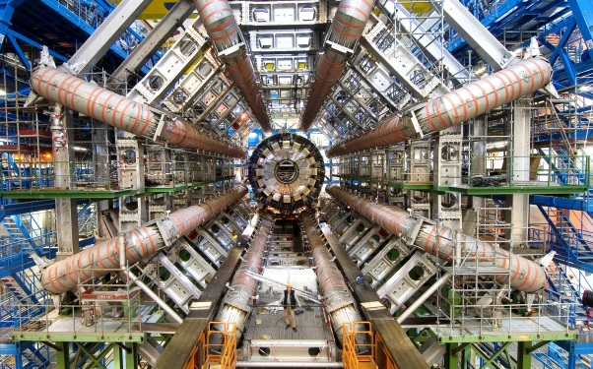
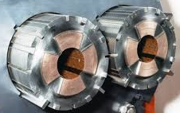
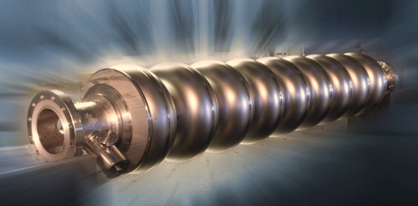
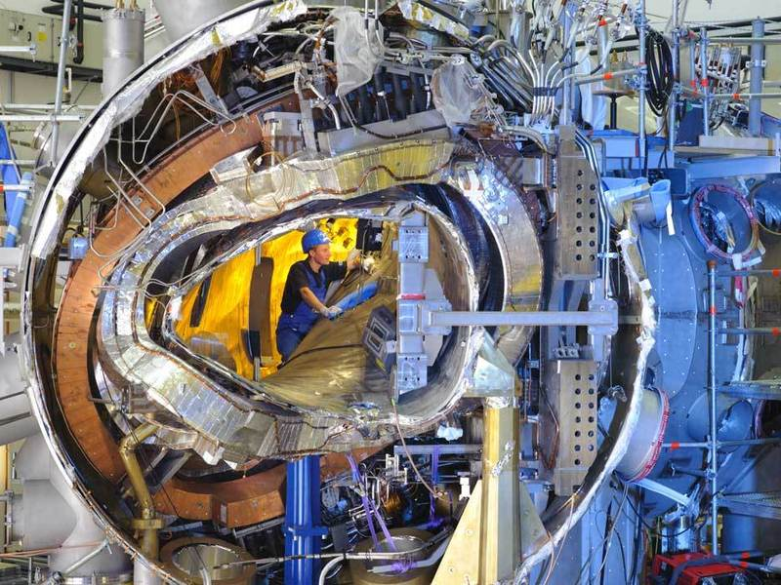
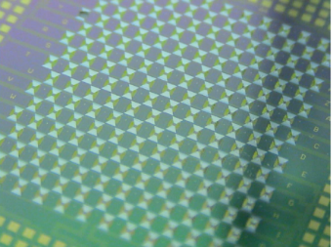
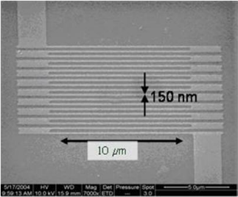


SC in accelerators: where ?
  Magnets (deviation)
    Curvature, focalization magnets
    Detectors
  RF Cavities (acceleration)
  Other close applications
    Magnets for medical imaging (at development origin)
    Fusion magnets
    Electrical engineering (high challenges!!!)
    Josephson Junctions
      SC electronics (RSFQ logic )
      SQUIDS
        Magnetic field detection
        Bolometers
    Nanodetectors (constrictions, wires…)
Notes:
Images from top to bottom: focusing quadrupoles LHC in NbTi, NbTi Atlas detector magnets, 9-cell cavity for Nb electrons (ILC, XFEL), NbTi W7X stellator coils, NbSi bolometer networks (SQUIDS, Application to spatial IR detection), single photon NbN detectors.
Electrical engineering: transport, storage, energy conversion. There are already SC current limiters, transmission lines, and coming soon: transformers and motors. Should allow enormous reductions in losses (Electricity transmission now generates significant energy losses by Joule effect.) For the electricity transmission network in France, these losses are estimated on average at 2.5% of the Consumption, ie 11.5 TWh per year) Main difficulty: manufacture of HTC SCcables (liquid nitrogen cooled) in long length (because HTC SC are ceramic)

Slide 4
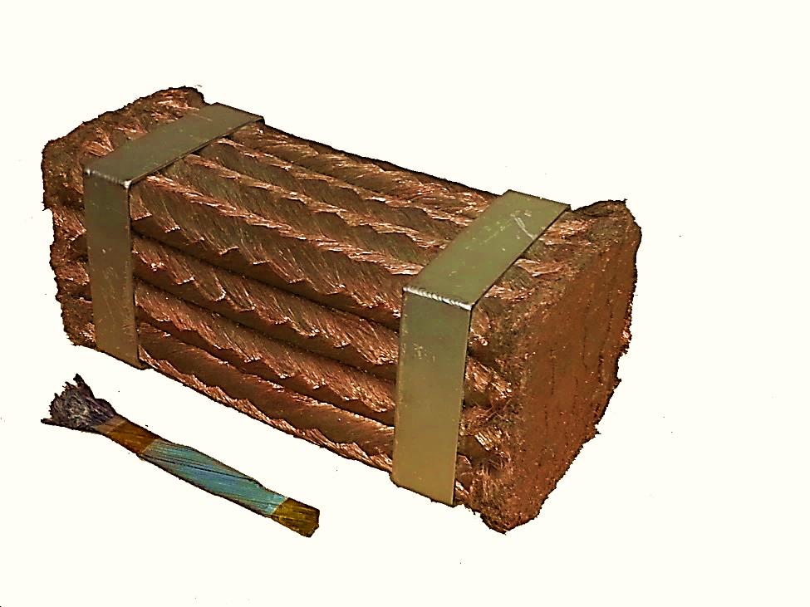
Why ?
  DC
Driving some10 000 A :
Copper Wire
NbTi SC wire (He cooled)
  Electromagnets
  Examples
    LHC @ CERN, NbTi magnets:
      27 km circumference, power ~1 energy plant (only cooling, cryogenic power).
      If magnets = Cu (+Fe) : 100 km circumference, power supply ~4 power plants,
    In detectors: allows increasing « transparency »
      Magnets needed for trajectory curvature. Occupied volume => no detection elements
Notes:
DC SC : gain in weight, and in volume (even accounting the cryostats).
No loss, all the energy consumed is used to cooldown.

Slide 5
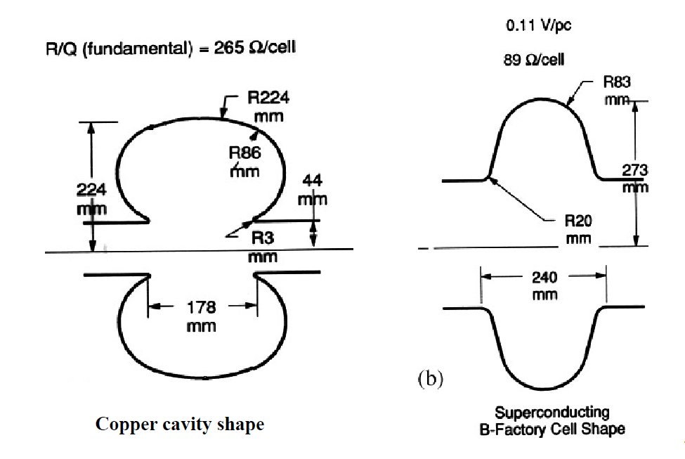
Why?
  RF Cavities
  More complex, depends a lot upon duty cycle
    Duty cycle = 1 (power 100% of the time) <= only superconductivity
  Example
    Proton linacs (neutrons sources):
  Other advantages
    Larger aperture => lower impedance =>easier alignment and lower wake field / better emittancy
 | Cuivre | Niobium (SC)
Surface resistance: R_{S} | 7mΩ | 10nΩ
Foreseeable accelerating field: E_{acc} | 1,6 MV/m | 10 MV/m
RF efficiency h_{RF}=P_{beam}/(P_{beam}+P_{cav}) | 15% | 100%
Cryogenic efficiency (h_{cryo}=h_{Carnot} x h_{thermo} avec h_{Carnot}=T_{froid}/(T_{chaud}-T_{froid})) | 100% | 0,2%
>Global efficiency P_{fournie au faisceau}/P_{à la prise} | 7.5% | 49%
Actual length to gain 1 GeV | 833 m | 286 m
Notes:
SC advantages more complicated inRF:
SC much better at high duty cycle, but copper can go to very high fields with very low duty cycle.
Another advantage is:
• Low frequencies can be used:
• design: cavity openings larger => lower impedance => reduced wake field => better emittance,
• in addition, alignment + easy with large openings (machines of several km)
One gains on the wake field resistance (a factor 100 000), but one loses on the cryogenic efficiency (Carnot yield ~ 0,15%, to be multiplied by a technical yield).
Plug power gain: between 2 and 100 times better with SC according to the applications

Slide 6

Some costs elements
For an arbitrary E, I :
  Linac costs
    ~ 1/3 tunnel, construction
    ~ 1/3 niobium, cryo
    ~ 1/3 RF, beam control
  ∃ Optimum accelerating field
    Low field => longer machine => cost ↑
    High field => RF costs ↑ for Cu and cryogenic costs ↑ for SC
  Cost↑ with Duty Cycle.
  Other example: CLIC vs ILC (e+/e- collider, Higgs factory)
    ILC : D.C. = 0,5 % @ 1,3 GHz
    CLIC : D.C. = 0,001 % @ 12 GHz
Costs
(investment
+ operation)
100
E_{acc}(MV/m)
50
0,1 %
Duty Cycle
1 %
10 %
100 %
log scale !!!
Cu
Supra
Notes:
For copper cavities, power dissipation is a huge constraint
Cavity design is driven by this fact (go to higher frequencies)
For SC cavities, power dissipation is minimal
the cavity design decoupled from the dynamic losses
freedom to adapt design to specific application
Lower frequencies available

Slide 7
Back to Basics

Slide 8
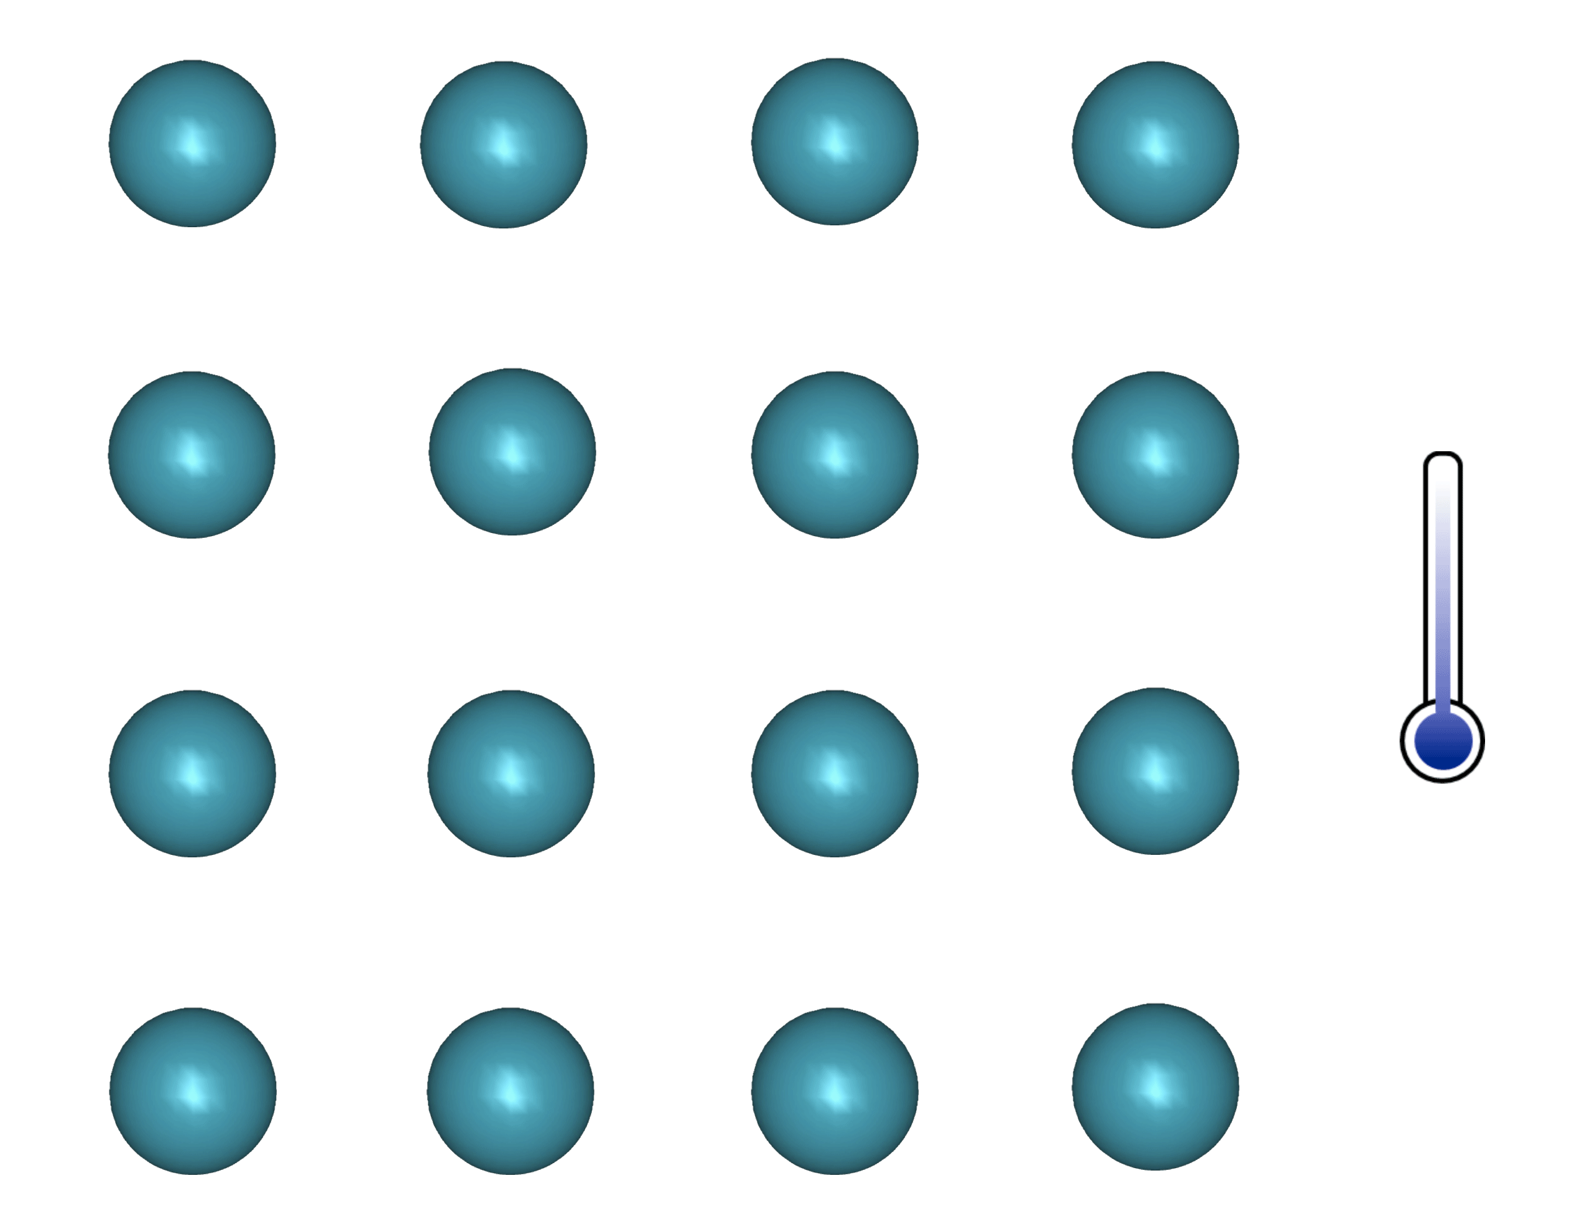
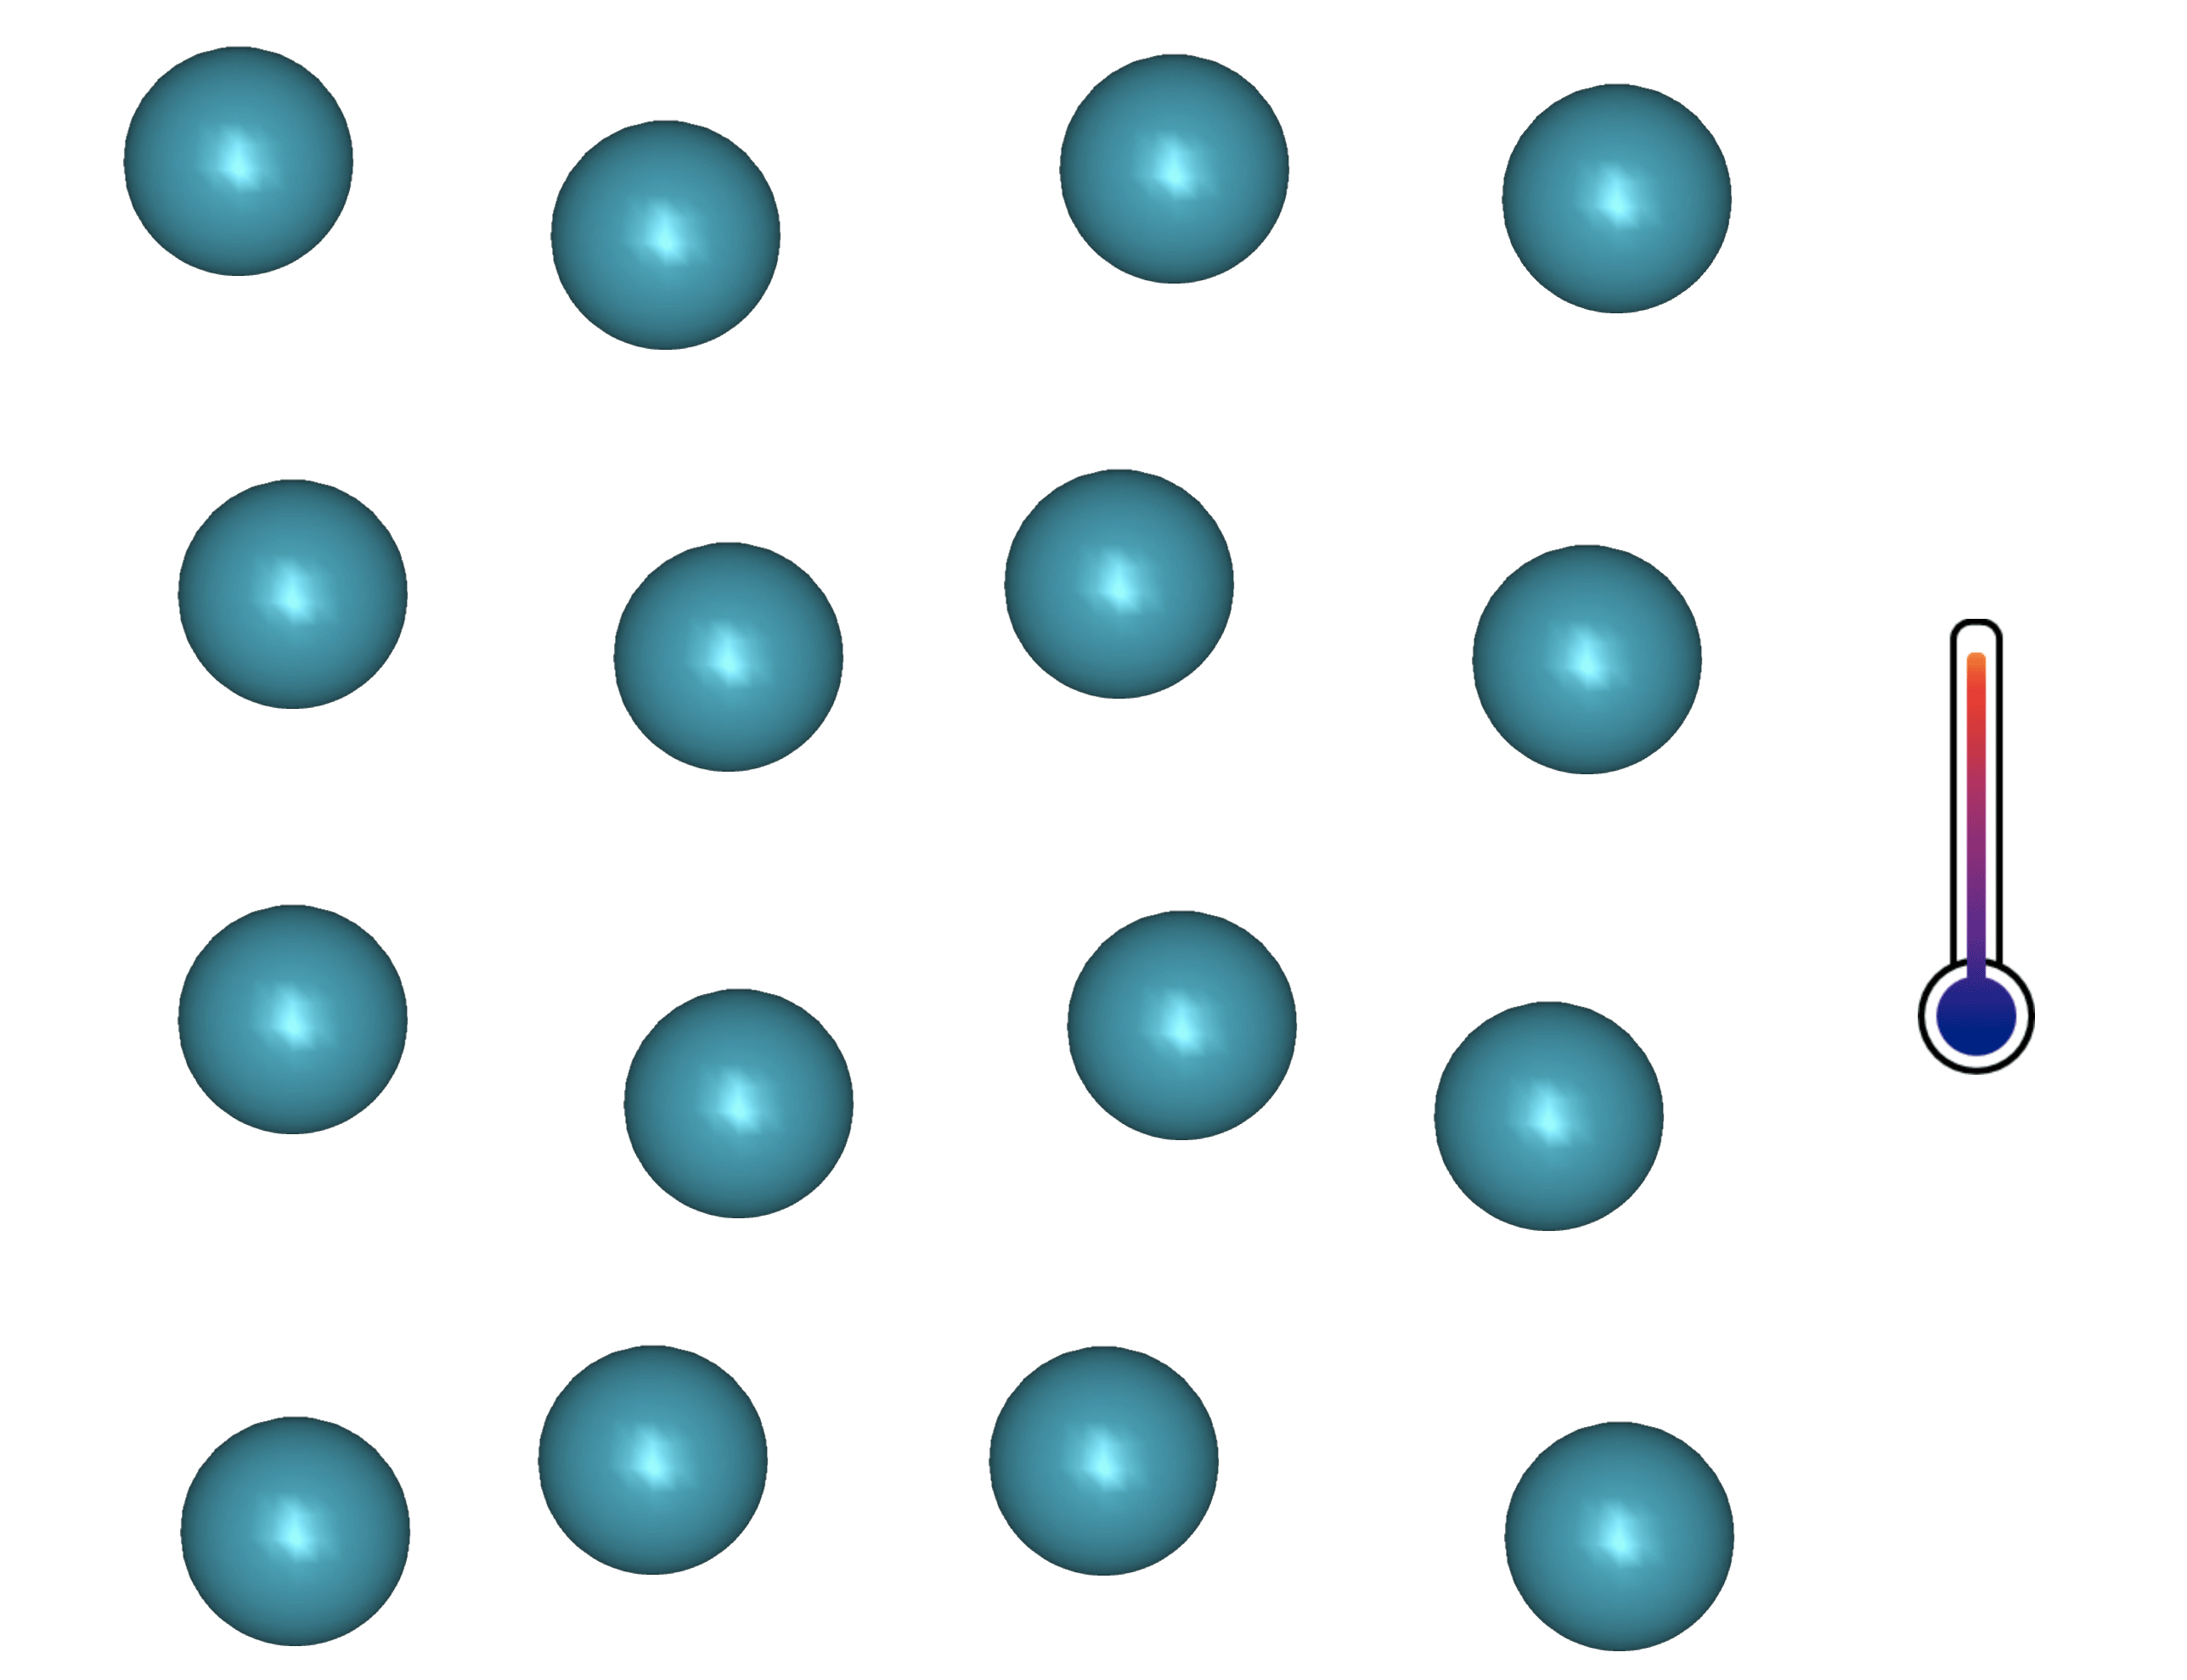
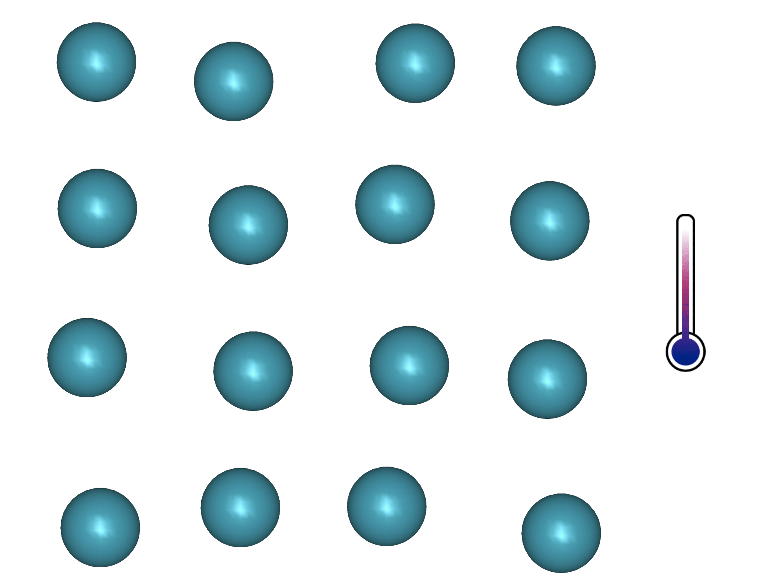
superconductivity
  Simplified principle:
  Coupling of e- via phonons
  Single e- = fermions, Cooper pairs = bosons
  Condensation (Bose-Einstein) + gap opening
  1! Wave function for all paired e- : macroscopic coherent state w. R=0 ( : not always true !!!)
Molecule
E
E
E
Semiconductor
or
insulator
E_{F}
E_{F}
E_{F}
Metallic bond
2 Δ(0)
2 D(T)

Slide 9
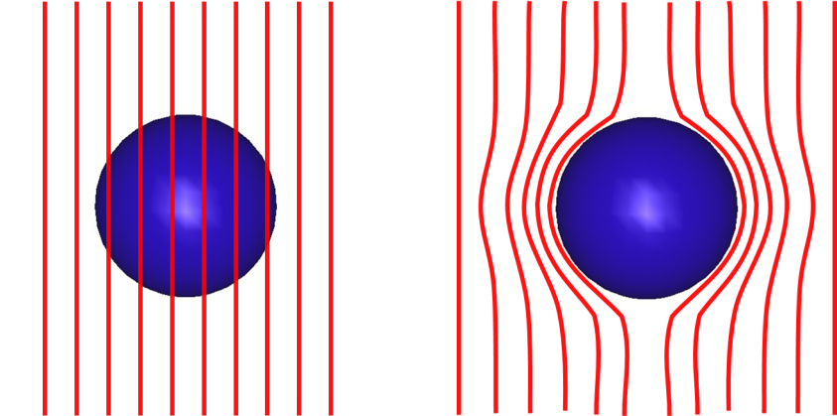
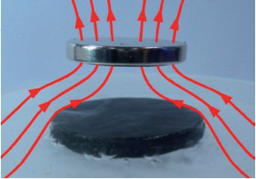
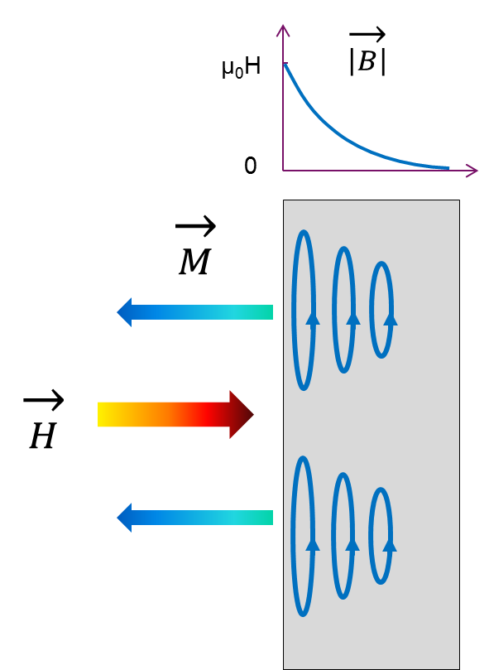






Meissner state, type I & II SC
Magnetic levitation
1,5
$$√2κ≤1$$
Type I
-4πM/H_{C}
$$\sqrt{2}κ=1,5$$
$$\sqrt{2}κ=2$$
Type II
$$\sqrt{2}κ=3$$
1
$$\sqrt{2}κ=5$$
Κ :a sc figure of merit (see below)
0,5
λ ∼ 50 nm (Nb)
Supercurrent >> GA/m²
Magnetization of
defect free SC
←
0
0
1
2
3
4
5
$\vec{B }= μ_{0 }(\vec{H }$ + $\vec{M }$) = 0
h = H/Hc
Notes:
In the Meissner state the field penetrates within a depth lambda of a few tens of nm and induces "supercurrents" which in turn generate a magnetic moment opposite to the applied field H
• the resulting field is strictly zero in the supra (except over lambda) These currents reach tens of billions of A / m2-essentially within 50 nm of the surface-
Beyond a certain field, a limit current (JD: depairing current: enough to cause the pairs to break) is reached and the SC is no longer able to screen the field.
The corresponding field: HC is the thermodynamic transition field for type I SC. But there are type II supra which have a different behavior: the field start to penetrate at a field weaker than HC but the superconductivity persists far beyond: it is the mixed state.

Slide 10




type I & II
  Important parameters:
  H_{C} : thermodynamic critical field (intrinsic)
  H_{C1} : 1st critical field (transition: Meissner state => Mixed state, depends on material’s state)
  H_{C2} : 2nd critical field (transition Mixed state => Normal Conducting state, depends on material’s state)
  κ : λ/ξ: Ginzburg-Landau parameter (depends on material’s state, T independent)
  λ : field penetration depth, ξ : Cooper pairs coherence length (see below)
1,5
$$√2κ≤1$$
Type I
$$\sqrt{2κ}=1,5$$
-4πM/H_{C}
$$\sqrt{2κ}=2$$
Type II
$$\sqrt{2κ}=3$$
1
$$\sqrt{2κ}=5$$
0,5
Magnetization of
defect free SC
←
0
0
1
2
3
4
5
H_{C1}
h = H/Hc
H_{C}
H_{C2}
Notes:
Remarks
• HC is still an intrinsic parameter (thermodynamics) of type II SC, but it is no longer directly accessible to the measurement (it is found via the formulas)
• influence of m.f.p.. : lambda0 ~ lambdaL: intrinsic, "clean“SC.
If impurities or disorder ("dirty" limit) it plays on the mean free path and changes lambda (it is no longer an intrinsic value).
• it also plays on the respective values ​​of HC1 and HC2: generally introducing defects (impurities, disorder) makes ↑ HC2 and ↓ HC1

Slide 11



Mixed state and vortex
  Mixed state : H > H_{C1}
  Field is not fully screened anymore
  Flux lines enter the material => normal zones surrounded by screening current (≡ vortex)
  Remaining material still in the superconducting state
2λ
2ξ
$$\vec{H }$$
$$\vec{H}>\vec{H_{c1} }$$
B
Ψ
(paramètre d’ordre)
ξ
λ
r
$$\vec{M}\sim −\vec{H_{c1} }$$
    Each votex contains 1! Quantum of flux Φ₀
    Screning currents extend over r ~ λ
NB : do not confuse intermediary state (type I SC, coexistence of normal zone and SC zones, WITHOUT vortex, if H is non uniform) with mixed state (vortex state, for type II SC)
    Φ₀ = h/(2e) = 2,06783376 × 10⁻¹⁵ Weber (T/m²)
Notes:
Suppression of Delta(r) for r< x because J(r) reaches J_{D} ; J_{D} = depairing current (see below) ~ current density sufficient to break the Cooper pairs

Slide 12
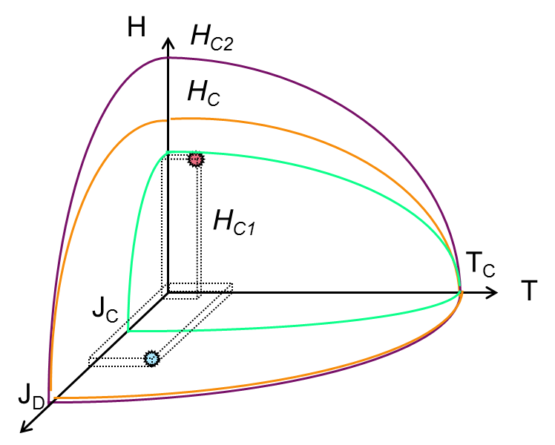
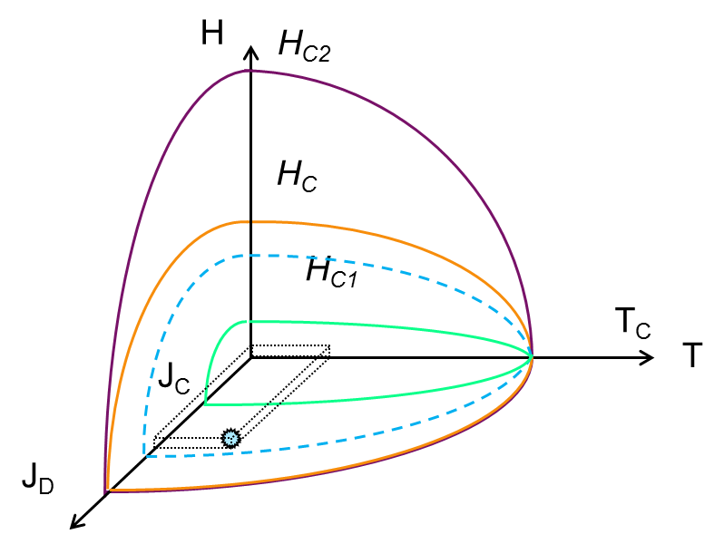
A complex phase diagram
Applications…
  type II SC : 3 main Phases
    Meissner state (SC, B=0 )
    Mixed state (SC + vortices (B≠0) )
    Normal conducting State
Cavities
Coils
  ∃ thousands of SC
  In practice:
      <10 are actually used
      They are all type II : low H_{C1} and high H_{C2} => mixed state… EXCEPT Nb ! (RF appli.)
    NB : JD depairing current dens. (intrinsic)
    ≠ JC critical current density (technical limit)
    Jc has no meaning in RF (see part II)
Notes:
Faire 2 transparents

Slide 13
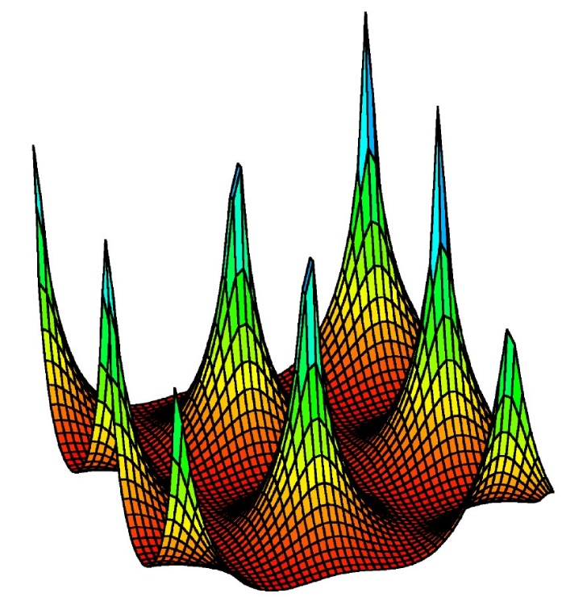
A complex phase diagram
Vortex behavior is conditioning the application limits
  Vortex (Vx)
    Centered hexagonal lattice (triangular)
    Can be pinned on cryst. defects (see part II)
    Several ≠ states
    H>H_{M} => R≠ 0 !
H_{M} ≡ H_{Irr}
H
Vx Liquid
Vx glass
H_{C2}
Vx Lattice
H_{C1}
T²
Notes:
HM "melting" or "moving": this is when the vortices start to move freely in the SC: this marks the beginning of the thermal dissipations (R is no longer = 0)
NB “glass” can be considered as a very (very!) viscous liquid…

Slide 14


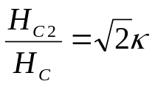

another way to look at…
→
MgB₂, NbTi (κ~40-50)
HTc
(κ~60-2000)
Thermodynamic phase diagram
      Type I => type II : depends on κ
      Nb: type II but close to type I
      Applications => type II SC : low H_{C1} and high H_{C2} => mixed state … except Nb ! (RF appli.)
      « superheating field » = metastable state (see « RF » § )
Pb
Nb
2.5
Normal state
2.0
1.5
Mixed state
Superheated state
1.0
Meissner state
0.5
Type I
Type II
0
0.4
0.6
1.2
1.6
2.0
GL parameter κ (= λ/ξ)
Notes:
Note SH field: metastable state;
Favored in parallel field, observable in DC and AC, but easier to see in pulsed RF
Metastable state: analogy with the supercooled state (very pure water remains liquid below 0 ° C and freezes as soon as in contact with something else http://www.koreus.com/video/surfusion-eau.html)

Slide 15





Demagnetization coefficient
Geometrical efects
  Elliptical samples : H = H_{C} everywhere
  Arbitrary shape : consider local deformation of flux lines
$$\vec{H }$$
$\vec{B }= μ_{0 }(\vec{H }$ + $\vec{M }$) =>
$\vec{B }= μ_{0 }(\vec{H }$ +(1-D) $\vec{M }$)
    Infinitively thin strip D → 1
    Sphere : D = 1/3
    Infinite cylinder: D = 0
$$\vec{H }$$
If field/shape is not uniform, some areas may transit before others !!!

Slide 16
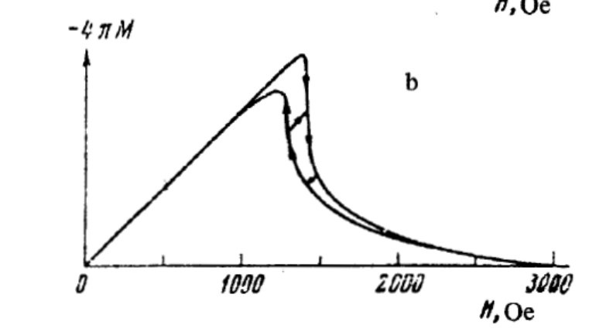
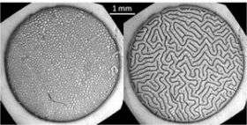
intermediary STATE
(Mixed intermediary for Nb)
  Observed on type I SC (also called Paramagnetic Meissner Effect)
    due to demagnetization effect (form factor => observed mostly on thin films),
    Several metastable equivalent configurations,
    Applications : fundamental ϕ: competition between repulsive long distance interaction and small distance attractive interaction.
  Niobium = type II, but…
  Close to H_{C1}:
@ H~H_{C1} behaves ~ type I SC
Meissner Zones
Mixed Zones, with vortex lattice
Type I SC : same T, same H, but
≠ magnetic history
http://phys.org/news/2007-07-superconductivity.html
    Depends on crystallographic quality, see part II
Notes:
Autres exemples :

Slide 17
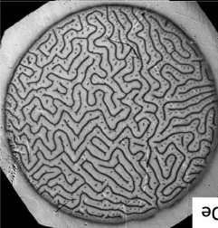
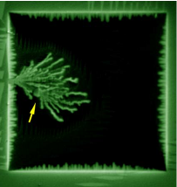
mesophases
    Repulsion only:
    Only 1! uniform phase
    Attraction only :
    2 phases
    Competition between Repulsion et Attraction :
    MESOPHASES
  Applies to numerous physical phenomena:
      Intermediary state in type I SC
      Transient states in type II SC
        Avalanche penetration, dendrites
      Magnetic materials, ferro-fluids
      Solidification/alloying , dendritic growth
      In a general way: propagation fronts, interfacial instabilities (Mullins-Sekerka Instabilities type )
  Complex mathematics
      Numerical treatment only
      Results depend widely on initial conditions
It is not the same thing!
Notes:
General knowledge…
Intermediate state: Normal region: the displacement of the interface generates eddy currents
SC Region : B = 0 At the interface, supercurrents of screening
Boundary conditions=> we have the same field on both sides B_i.ν_n = -D_B (〖∂B / ∂n)〗 _ i Plane interface => B = μ0HC whereas curved interface => B = μ0HC (1_d0 - n)
Analogy with the condition of Gibbs Thomson used e.g. in crystallization
The surface energy depends on the local normal vector ∇B is the largest near a bump The speed of movement of the interface is highest near a "bump" => the bumps grow even faster The phenomenon is stabilized by the surface tension but at small wavelengths => dendrites

Slide 18
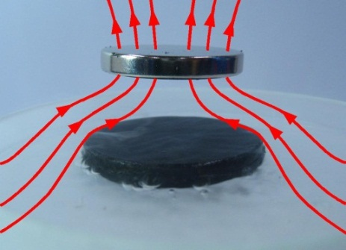
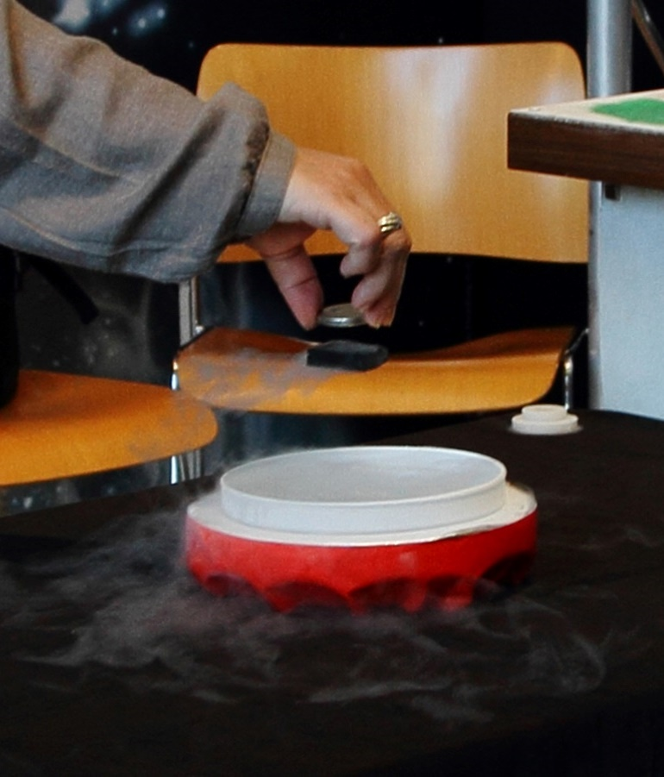
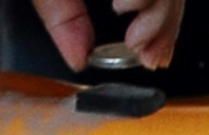
Mixed state: Levitation + stability
  Movement ≡ ΔH
    supercurrents produce - ΔM
    opposes to position change
    brings back the SC in the position “frozen” during cooldown
Only application : …. Impress people ☹
http://hebergement.u-psud.fr/supraconductivite/videossupra.html

Slide 19
Other superconductors ?
Material | T_{C} (K) | ρ_{n} (µΩcm) | µ₀H_{C1} (mT)* | µ₀H_{C2} (mT)* | µ₀H_{C} (mT)* | µ₀H_{SH} (mT)* | λ_{L} (nm)* | ξ₀ (nm)* | Type
Pb | 7,1 |  | n.a. | n.a. | 80 |  | 48 |  | I
Nb | 9,22 | 2 | 170 | 400 | 200 | 219 | 40 | 38 | II
NbN | 17,1 | 70 | 20 | 15 000 | 230 | 214 | 200-350 | < 5 | II
NbTi |  |  | 4-13 | >11 000 | 100-200 | 80-160 | 210-420 | 5,4
NbTiN | 17,3 | 35 | 30 |  |  |  | 150-200 | < 5 | II
2H-NbSe₂ | 7,1 | 68 | 13 | 2680- 15000 | 120 | 95 | 100-160 | 8-10 | II- 2gaps
Nb₃Sn | 18,3 | 20 | 50 | 30 000 | 540 | 425 | 80-100 | < 5 | II
Mo₃Re | 15 |  | 30 | 3 500 | 430 | 170 | 140 |  | II
MgB₂ | 39 |  | 30 | 3 500 | 430 | 170 | 140 | 10 | II- 2gaps
YBCO/Cuprates | 93 |  | 10 | 100 000 | 1400 | 1050 | 150 | < 3 | II d-wave
Pnictures Ba_{0.6}K_{0.4}Fe₂As₂ | 38 |  |  |  | 900 | 756 | 200 |  | II s-wave
* @ 0K
Notes:
À compléter

Slide 20
theories

Slide 21
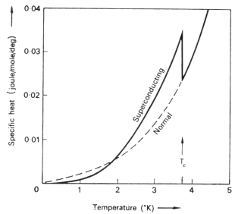
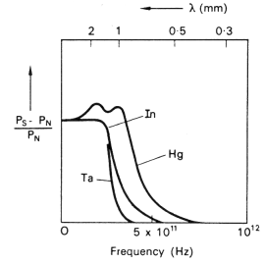
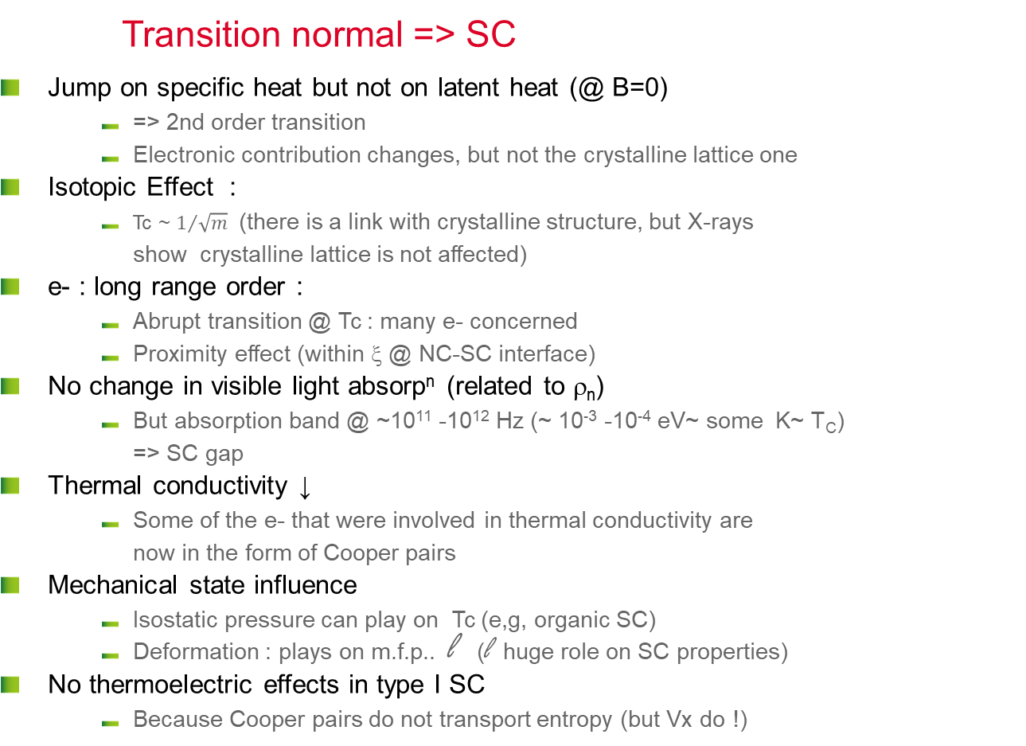
Other affected properties
Transition normal => SC
  Jump on specific heat but not on latent heat (@ B=0)
      => 2nd order transition
      Electronic contribution changes, but not the crystalline lattice one
  Isotopic Effect :
      Tc ~ $1/{\sqrt{m}}$ (there is a link with crystalline structure, but X-rays show crystalline lattice is not affected)
  e- : long range order :
      Abrupt transition @ Tc : many e- concerned
      Proximity effect (within ξ @ NC-SC interface)
  No change in visible light absorp^{n} (related to ρ_{n})
      But absorption band @ ~10¹¹ -10¹² Hz (~ 10⁻³ -10⁻⁴ eV~ some K~ T_{C}) => SC gap
  Thermal conductivity ↓
      Some of the e- that were involved in thermal conductivity are now in the form of Cooper pairs
  Mechanical state influence
      Isostatic pressure can play on Tc (e,g, organic SC)
      Deformation : plays on m.f.p.. l (l huge role on SC properties)
  No thermoelectric effects in type I SC
      Because Cooper pairs do not transport entropy (but Vx do !)
Notes:
The order parameter is discontinuous for the first-order transitions, continuous for those of the second order. Transitions of the second order correspond to cooperative phenomena. Physical quantities show singular behaviors at the point of transition and one can define universal critical exponents,
Proximity effect : normal conducting particles/films, with dimension comparable with xi in contact with a SC also become (poorly) superconducting.,,,
https://en.wikipedia.org/wiki/Room-temperature_superconductor :
…highly pressurized lanthanum decahydride (LaH₁₀), whose transition temperature is 250 K (−23 °C).^{[1]} Previously the record was held by hydrogen sulfide, which has demonstrated superconductivity under high pressure at temperatures as high as 203 K (−70 °C).^{[2]} By substituting a small part of sulfur in the latter with phosphorus and using even higher pressures, it has been predicted that it might be possible to raise the critical temperature to above 0 °C and achieve room-temperature superconductivity.^{[2]} Part of the research efforts are currently moving towards ternary superhydrides, where it has been predicted that Li₂MgH₁₆ would have a T_{c} of 473 K (200 °C) at 250 GPa^{[3][4]} (way hotter than what is normally considered room temperature).
At atmospheric pressure the record is still held by cuprates, which have demonstrated superconductivity at temperatures as high as 138 K (−135 °C).,,

Slide 22
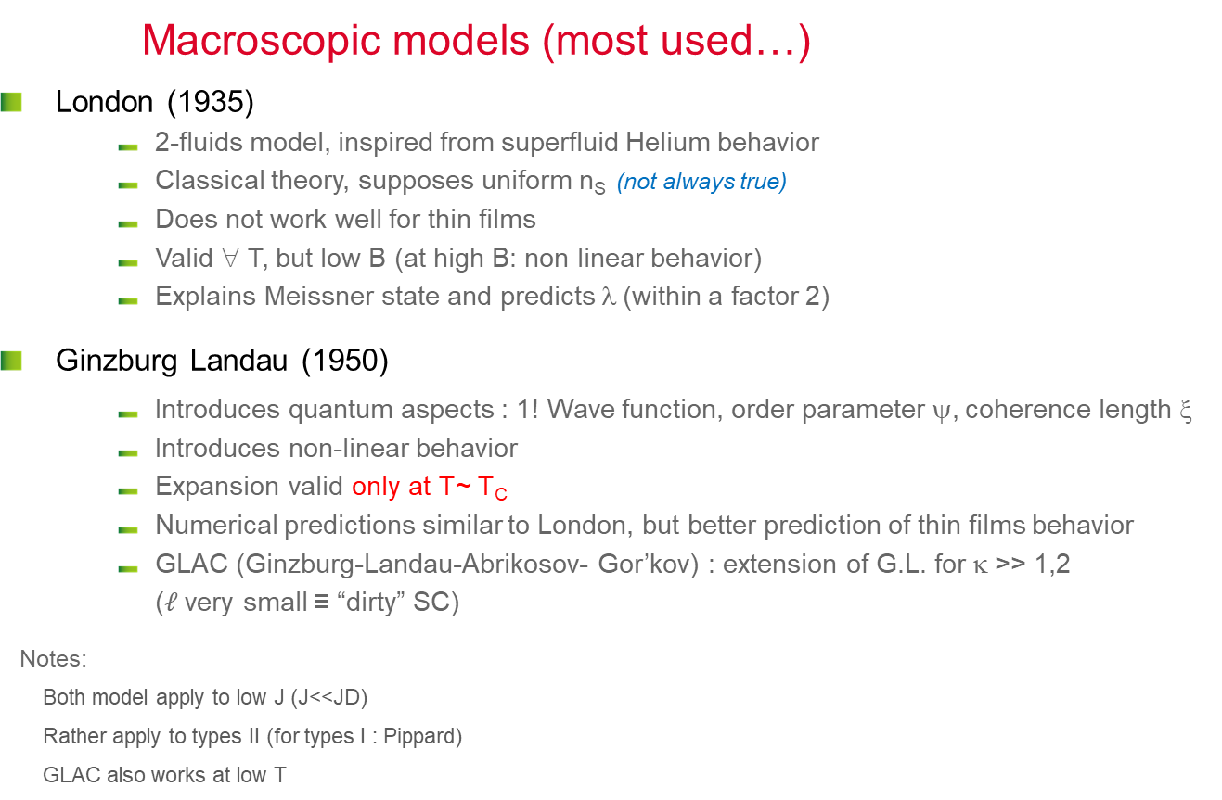
thEories… (1)
Macroscopic models (most used…)
  London (1935)
      2-fluids model, inspired from superfluid Helium behavior
      Classical theory, supposes uniform n_{S} (not always true)
      Does not work well for thin films
      Valid ∀ T, but low B (at high B: non linear behavior)
      Explains Meissner state and predicts λ (within a factor 2)
  Ginzburg Landau (1950)
      Introduces quantum aspects : 1! Wave function, order parameter ψ, coherence length ξ
      Introduces non-linear behavior
      Expansion valid only at T~ T_{C}
      Numerical predictions similar to London, but better prediction of thin films behavior
      GLAC (Ginzburg-Landau-Abrikosov- Gor’kov) : extension of G.L. for κ >> 1,2 ($ℓ$very small ≡ “dirty” SC)
    Notes:
        Both model apply to low J (J<<JD)
        Rather apply to types II (for types I : Pippard)
        GLAC also works at low T
-4πM/H_{C}
1
Thin film magnetization
(also exists for bulk mater. in a lesser extent)
0,5
0
h = H/Hc
0
1
Notes:
Model with 2 fluids proposed by Gorter and Casimir (1934). Used by F. & H. London (1935) to explain the Meissner effect.
Phenomenological theory; classic.
London: Explains Meissner effect and brings up lambda, works provided that Js is << JD and ns (superelectrons density) is uniform. But many phenomena appear in supra because ns is not uniform,
GL: Electromagnetism + thermodynamics. Based on second-order phase transitions. Parameter of order called "wave function of condensed electrons". This order parameter measures the symmetry breaking energy U in the superconducting state. Condensation energy is ½μ0Hc2; In the presence of H, ns can vary, free energy can be written as a Taylor development. The solution is found by minimizing psy (the wave function) and A (the vector potential) over all space, but developing order 1 or 2 valid only near TC, A second characteristic length appears: xi

Slide 23
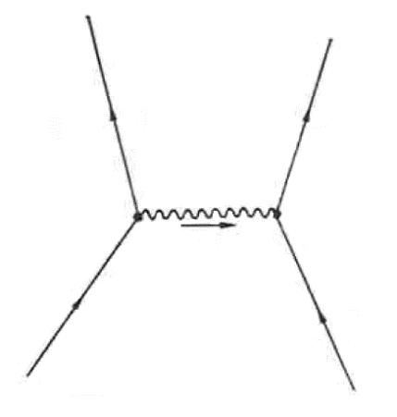
theories… (2)
Most complete…
  BCS (Bardeen-Schrieffer-Cooper) : (1957)
      Local, quantum theory
      In general not used for engineering predictions (too complex),
      Cooper pairs = electrons with opposed moments p and spins (at t)
      1 ! Wave function for all SC e-, correlated system, many exchanges between pairs
      Works for low coupling factor (type II)
      Allows to explain the main aspects of SC (gap, T_{C}, ….)
Other refinements
  Eliashberg
      Valid ∀ T , complex calculation
      High coupling factor (applies to Nb, although type II ?)
  Eilenberg
      Semi-classical theory, still not valid at lower T
      “clean “ type II : takes into account some inhomogeneity
  RF :
      Response to EM wave: Mattis-Bardeen @ weak field
      High current density (J~J_{D}) : “non linear R_{BCS}”
      (clean type II)
p’₁
p’₂
q
p₁
p₂
q = hν_{q} / s
Fréq, phonons
Vit, du son
SC:
      No complete theory ☹
      Many particular, complex developments
      Be careful : limited range of validity
      Many contradictions in literature
      Sometimes far from real world
Notes:
Pbme at the start: Coulombian repulsion: even if it was attractive, it is so intense that the gap could not be so small => find another mechanism of weak attraction!
1950 : Frolich shows that emission absoprtion of a phonon = attractive interaction
The total energy of the interacting pairs remains constant although their moments are constantly changing (quantic behavior, delocalization : a cooper pair does not concern 2 determined individual electrons but2 e- with opposed moments at each instant t)
BCS essentially used to make exact calculation and confort GL hypothesis (same results at T~TC)
Other developments : particular for each case
What’s new ? : Role of phonons, Cooper pairs, BCSgap : Replace the e / phonon interaction with an effective potential, and / or use the second order perturbation theory.
If strong interaction between pairs, it is necessary to make a variational approach
If strong coupling: one can no longer make a pertubative treatment, => Eliashberg: directly takes into account the coupling é- / phonon.
BCS ; Arbitrary l, Arbitrary T, Arbitrary H, weak coupling electron-phonon. 1957
Eliashberg; Arbitrary l, Arbitrary T, Strong coupling electron-phonon. 1960
Bogolubov-De Gennes: Arbitrary l, Arbitrary T, arbitrary H, weak coupling electron-phonon, order parameter depends on position. 1965
Eilenberger: Arbitrary l, Arbitrary T, Arbitrary H, type II. 1968
Usadel: Eilengerber with approx. dirty limit: l <<x. 1970
Ginzburg-Landau: T~Tc. 1950
London: lambda>>ksi (kappa>>1), H<<Hc2, order parameter constant in space. 1935

Slide 24
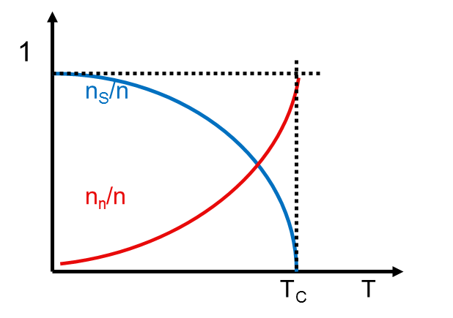

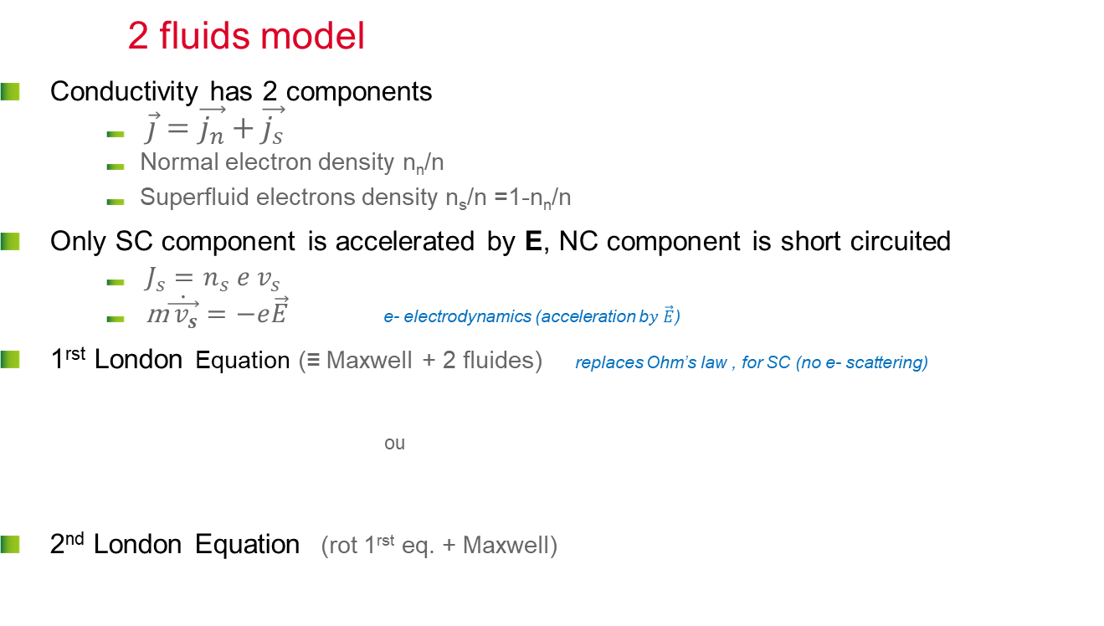


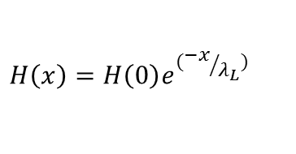

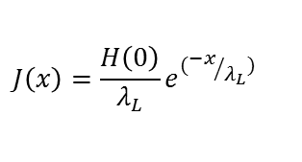


London (I)
2 fluids model
  Conductivity has 2 components
      $\vec{j}=\vec{j_{n}}+\vec{j_{s}}$
      Normal electron density n_{n}/n
      Superfluid electrons density n_{s}/n =1-n_{n}/n
  Only SC component is accelerated by E, NC component is short circuited
      $J_{s}=n_{s} e v_{s}$
      m$\dot{\vec{{ v}_{s}}}=−e\vec{E}$ e- electrodynamics (acceleration b$y \vec{E}$)
  1^{rst} London Equation (≡ Maxwell + 2 fluides) replaces Ohm’s law , for SC (no e- scattering)
    ou
  2nd London Equation (rot 1^{rst} eq. + Maxwell)
$$\frac{d\vec{J_{S}}}{dt}=\frac{e^{2}n_{S}}{m}\vec{E}=λ_{L}^{2}\vec{E}$$
$$\vec{J_{S}}=\frac{\vec{A}}{{μ_{0}λ}_{L}^{2}}$$
$$J\left(x\right)=\frac{H\left(0\right)}{λ_{L}}e^{({−x}/{λ_{L}})}$$
Electric field differs from 0 only if current density varies
  Perfect diamagnetism when x>>λ_{L}
$$∇×\vec{H}=\vec{J_{S}}$$
$$∇×\frac{d\vec{J_{S}}}{dt}=∇×λ_{L}^{2}\vec{E}$$
$∇^{2}\vec{H}=\frac{\vec{H}}{λ_{L}^{2}}$
$$H\left(x\right)=H\left(0\right)e^{({−x}/{λ_{L}})}$$
$$∇×\vec{E}=−μ_{0}\frac{d\vec{H}}{dt}$$
Notes:
If the current is constant, electric field E cannot appear in the superconductor because otherwise the super electrons would be continuously accelerated and the current would increase infinitely.
If there is no electric field, the normal electrons are at rest: only the super electrons carry the current in steady state, and they do not scatter on the impurities thanks to coherent state (see below)
All pairs are correlated, so to break 1 pairs, it would be necessary to provide energy to destroy all pairs.
First London eq shows that the electric field differs from zero only when the current density varies over time. It describes the ballistic flow of superelectrons in place of Ohm's law (which describes the viscous flow of electrons in a metal) and gives Js as a function of the vector potential A:
This equation suffers from the disadvantage that it is not gauge invariant, but is still true in the Coulomb gauge, where the divergence of A is zero. This equation holds for magnetic fields that vary slowly in space. Stationary case: one can neglect the displacement currents in Maxwell's 2nd eq. , then one replaces rot E by its Maxwell equivalent in the second eq and one integrates according to time

Slide 25
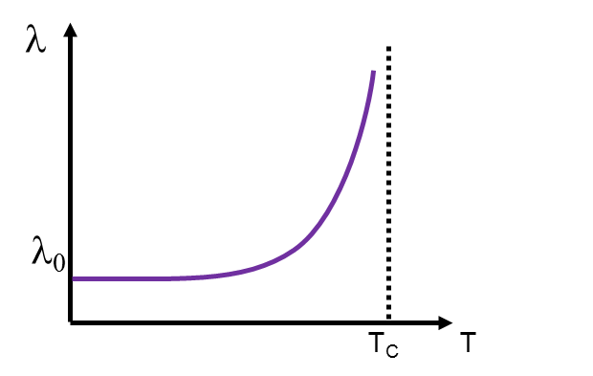






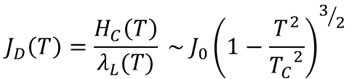
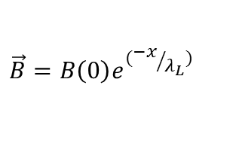
London (II)
$$λ_{L}=(\frac{m}{e^{2}n_{s}(T)µ_{0}})$$
Note: $predicted$ λ_{L} ~< 2 x λ experimental)
London explains Meissner state
  Field penetrates over λ_{L}
  Within this depth => complete screening of H₀
  B = 0 in the core of the SC
  NB. Maximum current density cannot exceed J_{D} (depairing current density)
y
x
$$H$$
$$⊗$$
$$B=0$$
$$JS$$
$$J_{D}\left(T\right)=\frac{H_{C}\left(T\right)}{λ_{L}(T)} \sim J_{0}{\left(1−\frac{T^{2}}{{T_{C}}^{2}}\right)}^{3/2}$$
$$\vec{B}=B\left(0\right)e^{({−x}/{λ_{L}})}$$
notes:
H_{C} : thermodynamic critical state
Can be defined as the field sufficient to break all the cooper pairs
Notes:
London makes it possible to explain Meissner effect (the supercurrents completely screen H, B = 0 inside), but underestimate lambda.
Note: As will be seen later all Cooper pairs have the same phase, if there is no current.
A phase gradient appears if a current appears
In fact, the value of the gap (see BCS theory) is influenced by the displacement velocity of the Cooper VS pairs and their momentum
± 〖p〗 _f: Δ (V_s) = Δ- p_f | V_s |
Thus at high current the gap decreases and more and more pairs are broken by thermal activation. See for example: http://accelconf.web.cern.ch/AccelConf/SRF2013/talks/moioc02_talk.pdf

Slide 26
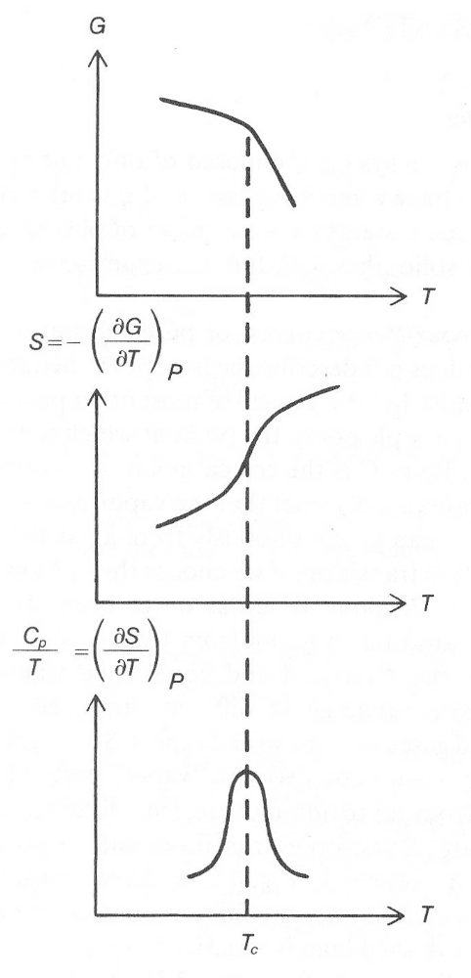
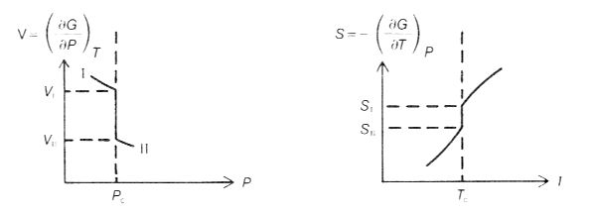
Ginzburg-Landau Model (I)
Reminder on 1er/2nd order transitions
  SC
      transition = 2nd order if B = 0
      transition =1^{rst} order if B ≠ 0
1rst order Transitions : discontinuous free energy, heterogeneous systems, transition does not happen everywhere at the same time, e.g. boiling water= liquid + gas mixture
2nd order transition: discontinuous free energy derivative, homogeneous system, all parts transit at the same time, e.g. ferromagnetic transition , nematic transition in liq. crystals
Phases before and after transition have different symmetries.
High energy phases are always uniform (s symmetry)
Low temperature phase present some order (specific symmetry appears)
Gibbs free energy and derivative for 2nd order phase transition
Gibbs free energy derivative for 1rst order phase transition

Slide 27
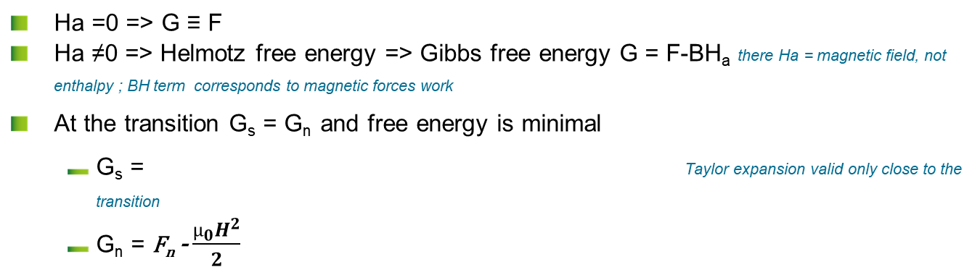
Thermodynamics reminders
Notations may differ with authors…
 | Helmotz free energy | Gibbs free energy
Order | 2nd order (field H_{a}=0) | 1^{rst} order (field H_{a}≠0)
System Variables | T, U (internal energy) | T, H (enthalpy)
Formula | F= U-TS+PV | G= H-TS+PV -µ₀H_{a}M
  Ha =0 => G ≡ F
  Ha ≠0 => Helmotz free energy => Gibbs free energy G = F-BH_{a} there Ha = magnetic field, not enthalpy ; BH term corresponds to magnetic forces work
  At the transition G_{s} = G_{n} and free energy is minimal
      G_{s} = Taylor expansion valid only close to the transition
      G_{n} = F_{n} - $\frac{µ_{0}H^{2}}{2}$
^{n}
Notes:
A revoir

Slide 28
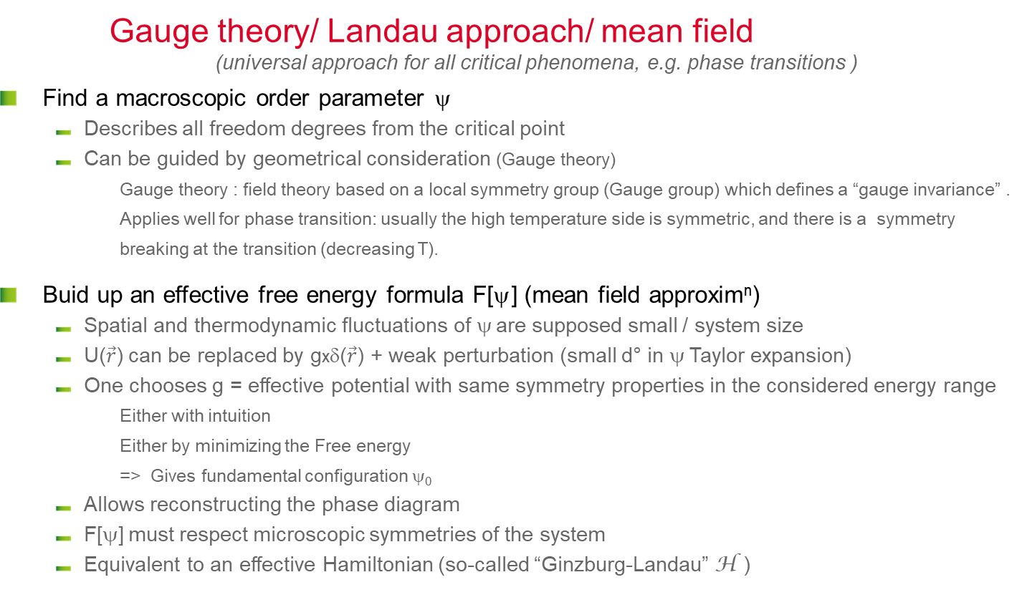



Ginzburg Landau model (II)
Gauge theory/ Landau approach/ mean field (universal approach for all critical phenomena, e.g. phase transitions )
  Find a macroscopic order parameter ψ
      Describes all freedom degrees from the critical point
      Can be guided by geometrical consideration (Gauge theory)
        Gauge theory : field theory based on a local symmetry group (Gauge group) which defines a “gauge invariance” . Applies well for phase transition: usually the high temperature side is symmetric, and there is a symmetry breaking at the transition (decreasing T).
  Buid up an effective free energy formula F[ψ] (mean field approxim^{n})
      Spatial and thermodynamic fluctuations of ψ are supposed small / system size
      U($\vec{r}$) can be replaced by gxδ($\vec{r}$) + weak perturbation (small d° in ψ Taylor expansion)
      One chooses g = effective potential with same symmetry properties in the considered energy range
        Either with intuition
        Either by minimizing the Free energy
        => Gives fundamental configuration ψ₀
      Allows reconstructing the phase diagram
      F[ψ] must respect microscopic symmetries of the system
      Equivalent to an effective Hamiltonian (so-called “Ginzburg-Landau” H )
U($\vec{r}$)
Effective potential
      “Gauge Invariant ”
g.δ($\vec{r}$)
$$\vec{r}$$
Notes:
Same approach possible for all other phase transitions: for example
• Ferroelectric transition: the parameter of order $$ = Ms spontaneous magnetization
• Water vapor transition the parameter of order $$= n the density of H2O
• Higgs Mechanism in elementary Particles
Analogy with model of harmonic oscillator in Quantum. M.: To simulate a bond (chemical, nuclear, etc.), we use a simplified model, only valid at low energy. If we want to go further: perturbation method (small in front of energy), if we want to go even further ... it becomes complicated ☹ ... but it is always with approximations.
So always the same problem: knowing when the approximations that we make are no longer valid quantitatively, even qualitatively, to avoid saying stupid things ...

Slide 29
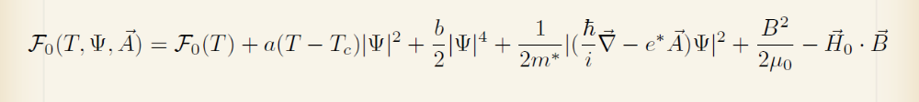
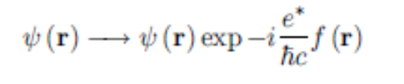

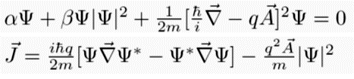
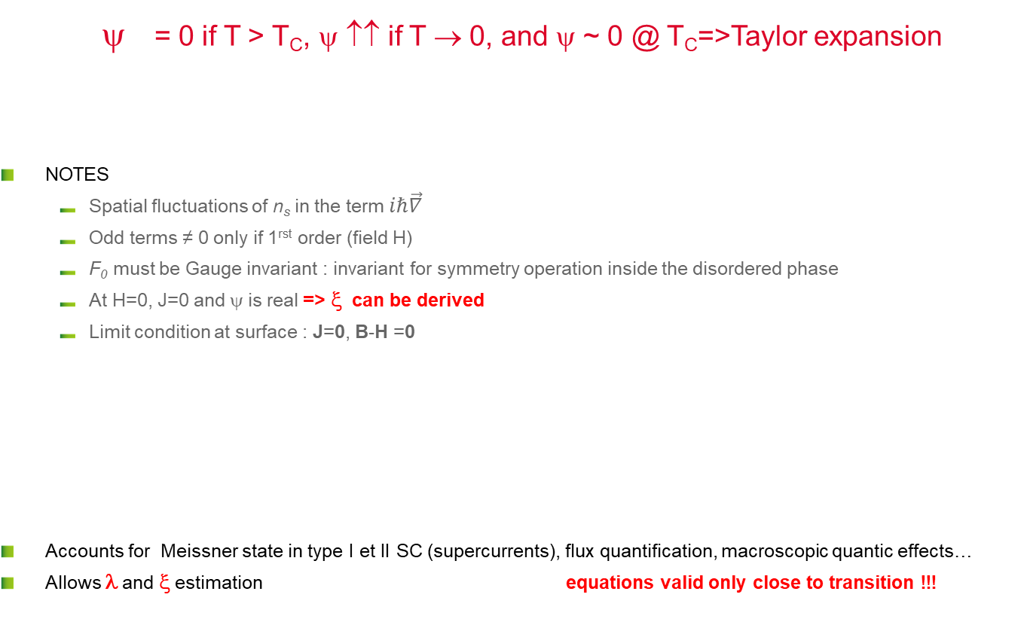
Ginzburg Landau Equations
Close to the transition: Can change T into H, works too
= 0 if T > T_{C}, ψ ↑↑ if T → 0, and ψ ~ 0 @ T_{C}=>Taylor expansion
  NOTES
      Spatial fluctuations of n_{s} in the term $iℏ\vec{∇}$
      Odd terms ≠ 0 only if 1^{rst} order (field H)
      F₀ must be Gauge invariant : invariant for symmetry operation inside the disordered phase
      At H=0, J=0 and ψ is real => ξ can be derived
      Limit condition at surface : J=0, B-H =0
  Accounts for Meissner state in type I et II SC (supercurrents), flux quantification, macroscopic quantic effects…
  Allows λ and ξ estimation equations valid only close to transition !!!
^{s}
^{n}
Minimization.
Long and complex calculation
Ginzburg Landau Equations
Oops ! coupled non linear differential equations…
=> Numerical treatments only
Notes:
Free energy of a system = energy available to provide work
At a given temperature T, the stable equilibrium state corresponds to a value of y which minimizes the free energy F (y, T).
Rem. GL approx=>Proposes a local relation between current and potential vector, but in reality the exact relation = nonlocal, unless 𝐴 ⃗ or the current have slow variations on the scale of xi0 => e.g. supra type II with l >> x0. In this case we have the right to use this approximation.
Au voisinage de la température de transition T₀, y est petit : on peut donc développer
F(y,T) = F0(T) + A₀(T) y + A(T) y² + B(T) y³ + C(T) y⁴ + ...
où F₀ est l'énergie de la phase haute température.
pour T > T₀, F doit être minimale pour y = 0 et A(T) > 0.
pour T < T₀, F doit être minimale pour y ≠ 0 et A(T) < 0
(concavité).
Le choix le plus simple est A(T) = a(T − T₀) avec a > 0.
Pour une transition du second ordre, on peut montrer que les termes impairs sont nuls (A₀(T) = B(T) = 0) et que C(T) = c > 0 donc
F(y,T) = F0(T) + a(T − T₀ y² + c y⁴, a > 0, c > 0
La valeur de y qui minimise F est solution de, @F@ y :
= 2a(T − T₀)y + 4c y³ = 0
pour T > T₀, la seule solution est y = 0
pour T < T₀, on a trois solutions : un maximum en y = 0 et 2 minima y = ± a(T₀ − T)/2c.
Au voisinage de T₀, le paramètre d'ordre se comporte comme T₀ − T.

Slide 30
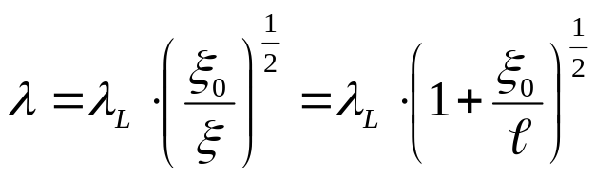
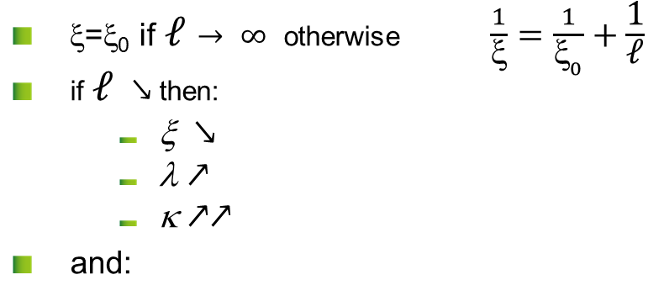

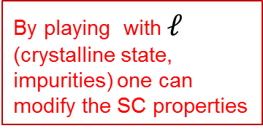
CHARACTERISTIC LENGTHS ξ₀, λ₀, l
Type I
Pippard ξ₀ > λ₀
l₀
Type II
London ξ₀ < λ₀
λ₀
ξ_{o}
ξ_{o}
  ξ=ξ₀ if $ℓ→ ∞$ otherwise $\frac{1}{\text{x}}=\frac{1}{{\text{x}}_{0}}+\frac{\text{1}}{\text{ℓ}}$
  if $ℓ$ $↘$then:
      ξ $↘$
      λ $↗$
      κ $↗↗$
  and:
$ℓ$mean free path
By playing with $ℓ$ (crystalline state, impurities) one can modify the SC properties
Notes:
x₀ = clean limit , estimated with G.L , calculated with BCS = coherence lentgh . x₀ corresponds ~ diameter where order parameter is 0 inside a vortex
x₀ depends on T and diverge @ T~Tc (typical behavior of a critical phenomenon).
$ξ_{0}\left(T\right)=\frac{{ℏv}_{F}}{πΔ(T)}$ and $λ_{0}(T)=\sqrt{\frac{{mc}^{2}}{4πe^{2}n_{S}(T)} }=\sqrt{\frac{m}{μ_{0}e^{2}n_{S}(T)} }$ ( « exacts » calculation from BCS)
The size of a Cooper pair is also assimilated to x₀ (at T=0) because it is a system coherence length (NB the size of a Cooper pair does not vary with T, only their number).
But do recall the the ξι parameter was introduced in the GL model to account for the variation of the order parameter at the vortex core
NB. They are strong corelations (exchanges) between superelectrons inside xi₀
Dirty limit : x~$\sqrt{ξ_{0}𝓁}$ et $λ\sim λ_{0}\sqrt{\frac{ξ_{0}}{𝓁}}$

Slide 31
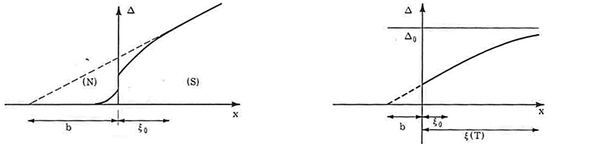


$ℓ$ < ξ : linear GL
Dirty SC: G.L. generalization ∀ T
(i. e. : @ GL scale: ~ ξ, λ >> ξ₀, one can assume that ψ, Δ changes are ~ linear)
  Only for very inhomogeneous cases (e.g. H~H_{C2}, or magnetic impurities…)
      H~H_{C2} (when H ↘) : SC phase just appeared, Ψ is very small
        non linear terms in ${\left|ψ\right|}^{4}$ can be neglected, only ${\left|ψ\right|}^{2}$ terms remain
      Screening of magnetic field can be neglected (H>> H_{C1}) so $\vec{Α} \sim \vec{Α_{appl}}$
        GL equations becomes decoupled
        Free energy minimization becomes: $ξ^{2 }\left(T\right){\left(∇+{ik}_{A}\right)}^{2}ψ\left(\vec{r}\right)=−ψ\left(\vec{r}\right)$
        ~ to Schrödinger equation for a particle with mass 2m, charge 2e) : Quantum mechanics sol^{ns} work well.
  For other cases: continuities solutions, variational methods, etc…
      e.g.: “dirty” SC : translation invariance is lost but …
        One add 1 more approximation (average value for all the impurities)
        Potential term due to impurities is treated like a weak perturbation => GLAC
ξ₀ : “Microscopic ”
ξ , λ : “Macroscopic”
Main model used for magnets
Does not apply for SRF
        If you use a model, check if it is valid in your case…
Notes:
Here ξι₀ is xi₀(T=0), while xi(T) et lambda (T) diverge for T ~Tc and/or H~H_{C2}, and they are very large
At equivalent T (<<T_{C}), we always have « dirty »x i<< xi₀ (clean) : ξ ~ $\sqrt{ξ_{0}𝓁}$ et l ~$λ_{0}$ $\sqrt{ξ_{0}/𝓁}$

Slide 32


BCS theory elements (I)
Effective interaction
(nucleus screening by e-, lattice vibrations, etc…)
  Jellium model :
      1) Effective potential due to all charged particles (ions + electrons ~ continuous media) ≡ Screened Coulomb interaction
      2) one consider delays due to phonons (ions move slower than electrons)
  Effective Hamiltonian H = H₀ + V
      H₀ = Hamiltonian for system without interaction (jellium)
      V = Perturbative potential (Interaction with phonons)
  Only electrons close to the Fermi level do “feel” a positive interaction => bound states
  Simplification :
      only e- with energy ev= ε_{F} ± 2ℏ𝜔_{𝐷} are submitted to a potential ~ –V/2
V_{eff} (q, ω)
~ 10⁻⁸ V /e-
ω
ω_{ph} (q)
V_{eff}
ε_{F} - 2$ℏ\text{w}\text{D}$
ε_{F}
ε_{F} + 2$ℏ\text{w}\text{D}$
E
-V/2
Notes:
It looks like a Bose-Einstein condensation of bosons (often described as), but it is not exactly one, (pairs are non-localized , they all have the same moment).
In the simplified model, we consider that the electrons from a small region of the phase space around the Fermi surface interact with each other by a constant attractive interaction (-V / 2)

Slide 33


BCS theory elements (II)
Matrix diagonalization :
  => gives new wave functions with lower energy (difference = Δ) compared to W.F. without interaction
  Variational Wave function describes the creation of Cooper pairs with $c_{k,↑}^{†}c_{−k,↓}^{†}$operator
  It explains:
      Superconducting state : Cooper pair condensation (~bosons)
      Phase lock-in
      Particles number is not fixed (uncertainty principle)
      Gap existence Δ ~$\left\langle c_{k,↑}^{†}.c_{−k,↓}^{†}\right\rangle$
$|\left.ψ\right\rangle$=$\prod_{k}{(u_{k}+v_{k}c_{k,↑}^{†}.c_{−k,↓}^{†})|\left.0\right\rangle }$
  Cooper pairs creation operator
  H₀ matrix elements
  V matrix elements
Same symmetry as the GL order parameter 𝜓 …, but not exactly the same value for the gap Δ_{BCS}
Calculations too complex in practice, => simpler formalisms are used
(London, G.L….)
Notes:
NB BCS approach also applies many other problems with n quantum bodies: e.g. ultra cold atomic gases, core of neutron stars, nucleons pairing , quarks, Anderson-Higgs Cooper pairs symmetry break (= 2 e of spin and quasi-pulse opposite).
Invariable by reversal of time unless presence of magnetic field.
Phase coherence = same idea of ​​departure as GL: but in G.L. single wave function; Does not account for exchange between pairs.
BCS identical individual wave functions for each pair but correlated system: everything is also at the same phase, it also takes into account the interactions between pairs and cooperative effects, (analogy with superfluid He : Cooper pairs flow as a superfluid)
(Rem the system is correlated because many Cooper pair overlap => macroscopic phase coherence)
Changing the state of a pair => destroying the state of all the system (would require enormous free energy: kBTc)
Near Tc GL and BCS give the same thing, but GL simpler to handle, BCS allows to justify certain assumptions taken in simpler models
Rem: BCS = weak coupling. Numerical applications not very good for super strong coupling as Pb or Hg (one move away from the relation 2delta (0) = 3: 54 kBTc), does not work either for HTC supra and pnictures

Slide 34


behavior in AC/RF
At high frequency: pinning is not affective anymore
  Measurement of complex (/effective) penetration depth: λ_{AC} = λ’ + iλ’’
      Typically used to determine pinning force in SC cables
      $φ_{ac}=\int{b_{ac} dS \sim 2λ_{ac}ℓ_{b}b_{0}}$
      At low frequency : λ’’ ~ δ_{RF} (δ_{RF}= penetration depth in normal state)
      At high frequency λ’ ~ λ’’ ~ λ_{L}<< δ_{RF}
’’
Same behavior if you increase T instead of ω : “one provides energy to de-pin the Vx
Electrodynamics of the vortex lattice in untwinned YBaCuO by complex impedance measurements Pautrat 2003

Slide 35





Resistive behavior in AC/RF
Cooper pairs inertia : field is not anymore perfectly screened within λ
  NC case : normal e⁻ are accelerated and dissipate
  Reminder : normal metal in AC
  Extension to SC:
      2 fluids model (London) : σ₁-iσ₂ in place of σ_{n}
      BCS => σ₁/σ_{n} and σ₂/σ_{n} can be numerically estimated (Mattis et Bardeen integrals)
  RF surface resistance R_{S}
  In the SC normal e- = quasiparticles, e.g Cooper pairs thermally broken at T>0 K
σ_{n} = 1 / ρ_{n} = DC conductivity @ T
δ = skin depth
~
For T < T_{c} / 2
and
~
~
Only valid at small field !!!
Notes:
Measurements show that in fact the surface resistance depends on l.p.m.
An electrical field appears inside the superconductor if the current value changes (and vice versa). The increase in current is not instantaneous because of the mass inertia of the superconducting charge carriers; The screen is thus imperfect and the normal electrons will undergo a force and move dissipatedly. In dynamic mode (AC and / or pulsed), the current is carried by both types of charge carriers and the process is dissipative. The electrical properties of an AC superconductor can be seen as a perfect inductance in parallel with a resistance.
Normal electrons at 0 <T <Tc: these are normal electron close to the fermi level in the conduction band, thus pairs dissociated mainly by thermal activation. Other effects dissociate the pairs are: strong current / strong field (this is the case in SRF), presence of magnetic impurities, .... Rem: to describe these "broken" pairs one sometimes speaks of quasiparticles (a rather vague concept).
Note: There is a limit frequency in AC (~ 100 GHz) where the photons produced by the electron accelerations (Bremsstrahlung) can excite the super electrons and make them normal (this is related to the IR absorption band; cf Slide #20).

Slide 36
First part Conclusion
Superconductivity :
  Quantic phenomenon observable at macroscopic scale
  No existing complete theory
    Many specific developments (phenomenological)
    Be careful with validity limits
    Many contradiction found in the literature (most of them due to misuse of the proper model)
  Theory often very far from real world (not very conclusive)
  In practice all applications use type II SC
  All of them in mixed state… except SRF acceleration application
  NB. they are some SC RF applications in SC electronics …@ mixed state

Slide 37
next:
Part II : mixed state & vortex

