Slide 1
Superconductivity in accelerators
Part II : mixed state
Cours supraconductivité M2 GI | Claire ANTOINE
Magnets and RF cavities

Slide 2



Why do vortices are so important ?
  Magnets ≠ RF Cavities !!!! !!!!
  Magnet (DC) :
    One aims at very high current densities with 0 resistance
    It means:
      Mixed state
      Non moving, trapped vortices (medium fields: H<H_{irr})
      Defects are voluntarily introduced to ↑ pinning and ↑ λ (↓ ↓ H_{C1} et ↑ ↑ H_{C2})
      J < J_{C} <<< J_{D}
  Cavities
    One aims at very high field with minimal dissipation (but ≠0 ☹)
      H variable, H_{max}~H_{SH} (= f(H_{C}))
      Vortices cannot keep pinned at this frequency => very high dissipations (!),
      One has to prevent Vx entering: keep in Meissner state !
      Reduce # of defects (promoting early Vx penetration), => ↑ ↑ effective H_{C1}
  Good SC for magnet application are bad for cavities!
  And vice versa !
For the recall:
1 => vortex, many => “vortices”

Slide 3
vortices (I): penetration inside the superconductor

Slide 4
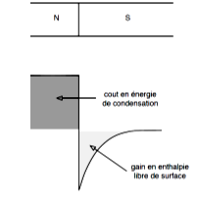
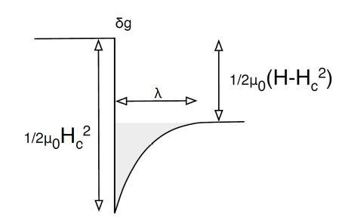
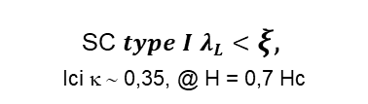



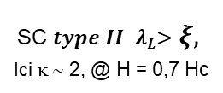



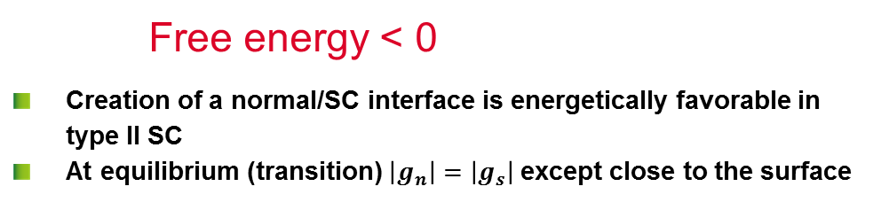


H>H_{C1}: Vortex = energetically favorable
δg_{m} ~ $µ_{0}\frac{H^{2}}{2}(1−e^{−\frac{x}{λ_{L}}})$
B ≠0 over λ
Magnetic energy
Condensation energy
Free energy
ns grows over ξ
δg_{c} ~ ${mµ}_{0}\frac{H_{C}^{2}}{2}\left(\frac{n(x)}{n_{s}}\right)$
SC 𝒕𝒚𝒑𝒆 𝑰 $λ_{L}<ξ,$
Ici κ ∼ 0,35, @ H = 0,7 Hc
SC 𝒕𝒚𝒑𝒆 𝑰𝑰 ${ λ}_{L}>ξ,$
Ici κ ∼ 2, @ H = 0,7 Hc
N
$$λ_{L}$$
SC
G
$$λ_{L}$$
SC
G
$\frac{1}{2}µ_{0}H_{c}^{2}$
$\frac{1}{2}µ_{0}H_{c}^{2}$
Cost in condensation energy
0
N
0
Gain in surface free energy
- $\frac{1}{2}µ_{0}H_{c}^{2}$
- $\frac{1}{2}µ_{0}H_{c}^{2}$
$$ξ$$
$$ξ$$
0
2
4
6
8
10
x/λ_{L}
0
2
4
6
8
10
x/λ_{L}
Free energy < 0
  Creation of a normal/SC interface is energetically favorable in type II SC
  At equilibrium (transition) $\left|g_{n}\right|=\left|g_{s}\right|$ except close to the surface

Slide 5
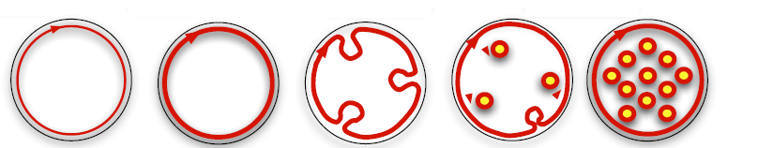
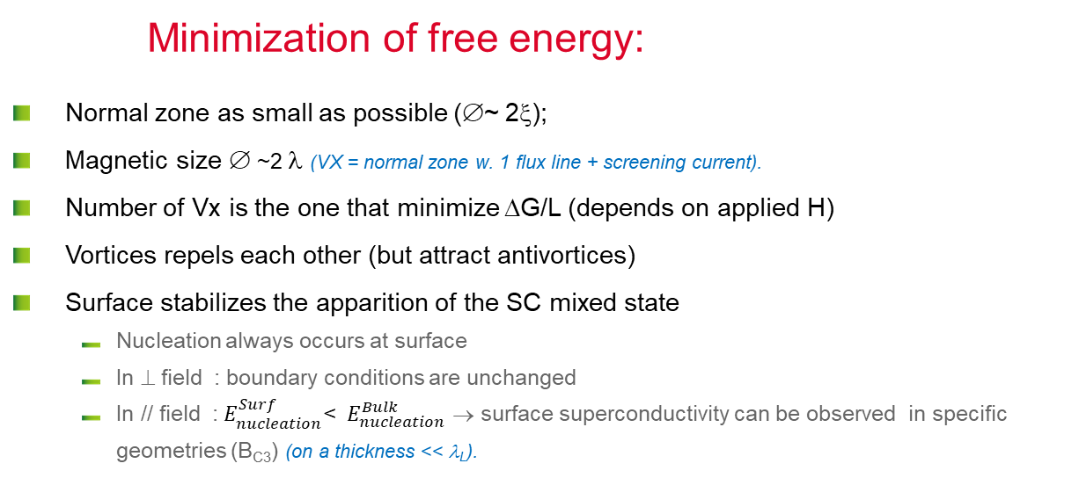


H>H_{C1}: Vortex = energetically favorable
Thin sample, ⊥ field
$$\vec{H }$$
$$H↗$$
Minimization of free energy:
  Normal zone as small as possible (∅~ 2ξ);
  Magnetic size ∅ ~2 λ (VX = normal zone w. 1 flux line + screening current).
  Number of Vx is the one that minimize ΔG/L (depends on applied H)
  Vortices repels each other (but attract antivortices)
  Surface stabilizes the apparition of the SC mixed state
      Nucleation always occurs at surface
      In ⊥ field : boundary conditions are unchanged
      In // field :${ E}_{nucleation}^{Surf}$< ${ E}_{nucleation}^{Bulk}$ → surface superconductivity can be observed in specific geometries (B_{C3}) (on a thickness << λ_{L}).
This holds only for ξ< λ
=> Type II SC

Slide 6



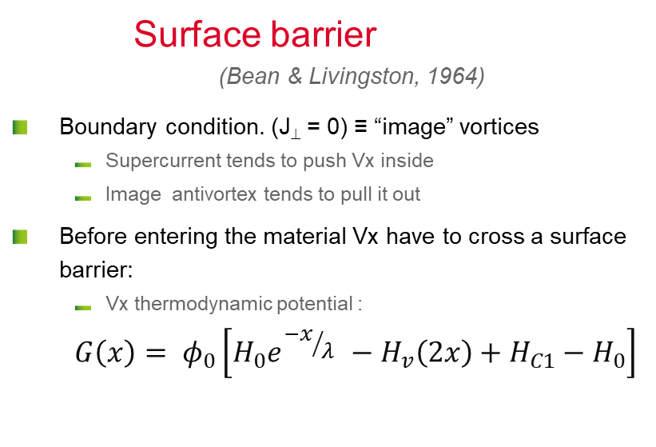
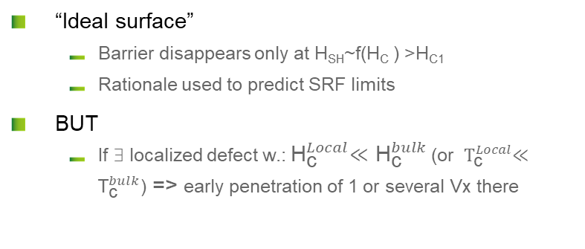

vortex Penetration with B // surface
Surface barrier
(Bean & Livingston, 1964)
  Boundary condition. (J⊥ = 0) ≡ “image” vortices
      Supercurrent tends to push Vx inside
      Image antivortex tends to pull it out
  Before entering the material Vx have to cross a surface barrier:
      Vx thermodynamic potential :
      $$G\left(x\right)= φ_{0}\left[H_{0}e^{{−x}/{λ }}−H_{v}\left(2x\right)+H_{C1}−H_{0}\right]$$
J
H₀
Image Vortex
⬄
J⊥ = 0
$$x$$
λ
G
Image
H₀ < H_{c1}
Meissner
  “Ideal surface”
      Barrier disappears only at H_{SH}~f(H_{C} ) >H_{C1}
      Rationale used to predict SRF limits
  BUT
      If ∃ localized defect w.:${ \text{H}}_{\text{c}}^{Local}≪{\text{H}}_{\text{c}}^{bulk}$ (or ${ \text{T}}_{\text{c}}^{Local}≪{\text{T}}_{\text{c}}^{bulk}$) => early penetration of 1 or several Vx there
H₀ = H_{c1}
$$x$$
H₀ > H_{c1}
H₀ = f(H_{c})
$$H0↗$$
Notes:
Bulk : periodic potential B(x)
Surface => singularity=> distortion in the potential B(x).
Introducing an image vortex allows to describe the shape of B(x) close to the surface
Analogy with « image electron » : to describe the change in the crystalline periodic potential brought by the surface in electrostatics

Slide 7






Demagnetization coefficient
Geometrical effects
  Elliptical samples : H = H_{C} everywhere
  Arbitrary shape : consider local deformation of flux lines
$$\vec{H }$$
    Infinitively thin strip D → 1
    Sphere : D = 1/3
    Infinite cylinder: D = 0
$\vec{B }= μ_{0 }(\vec{H }$ + $\vec{M }$) =>
$\vec{B }= μ_{0 }(\vec{H }$ +(1-D) $\vec{M }$)
$$\vec{H }$$
Strong influence of geometry, orientation edge effects be careful with measurements!!!
Classical magnetometry gives H_{P} not H_{C1}(convolution of SC properties with geometrical effects)

Slide 8
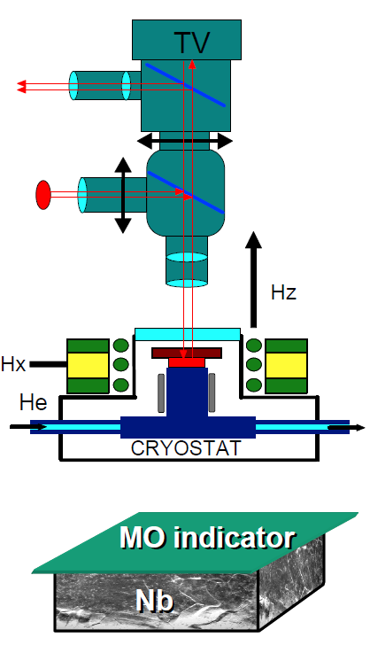

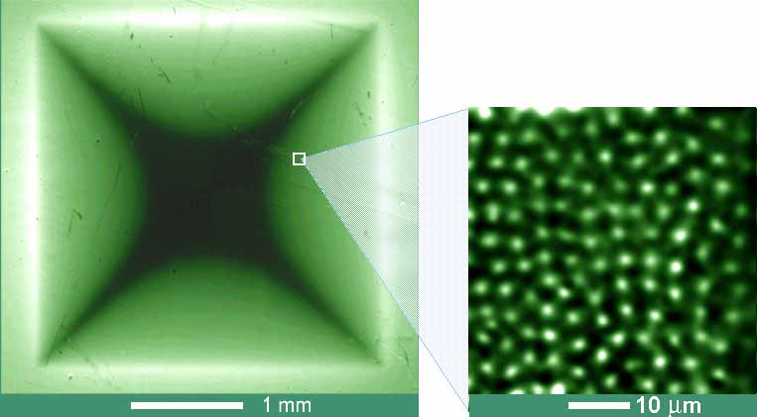

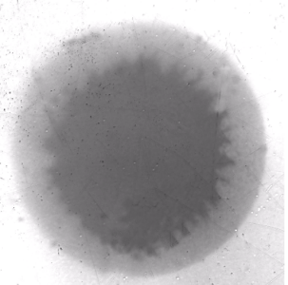
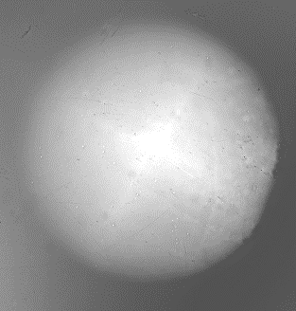

Vortex & (nearly) perfect material
  In ⊥ field : demagnetization effect , local field depends on the shape
$$\vec{H}$$
Nb₂Se
(Abrikosov Vx lattice)
Dark contrast: B=> 0
Light contrast : B↗
http://www.mn.uio.no/fysikk/english/research/groups/amks/superconductivity/mo/
Notes:
Movie in presentation mode

Slide 9
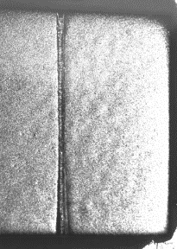
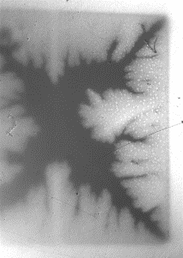
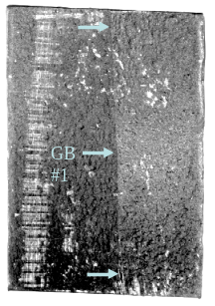
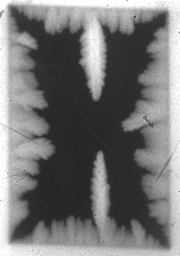
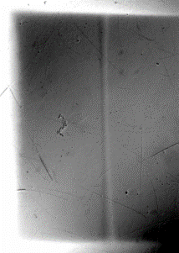
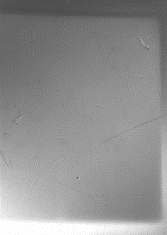
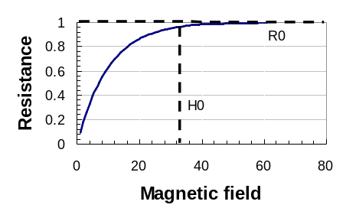
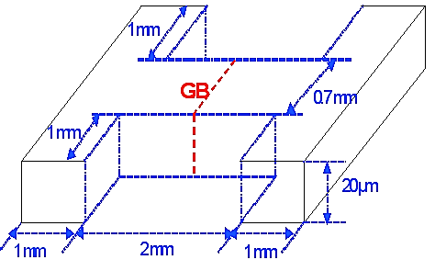
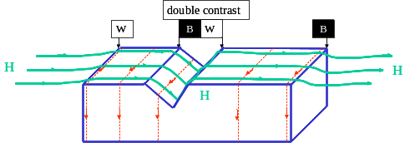
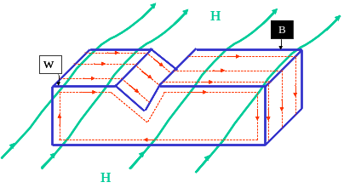
Effects that promotes V_{X} penetration
  Morphologic defects
  Grain boundary weak links (GB)
  Magnetic impurities….
MonoX Nb
H
H=40 mT T=7K
H ⊥ : notch has small impact on flux distribution even at higher T
H
0.5 mm
H // surface
    Josephson Vortex:
    Pinned on interface (GB)
    Current line distortion
T=5.6K
H
H
H
    @ 4.5 K
    H₀^{GB} ~ 32 mT
    H₀^{bulk} ~ 150 mT
MO contrast is double at the groove, when in-plane field perpendicular to groove
No MO contrast at the groove, when in-plane field parallel to groove
[A. Polyanskii,. H. Sung et al, FNAL/FSU]
Notes:
Particulièrement important pour les cavités : on peut avoir des prototypes en labo qui marchent bien, mais en production, les surface « quasi-industrielles » sont toujours loin de la perfection,

Slide 10
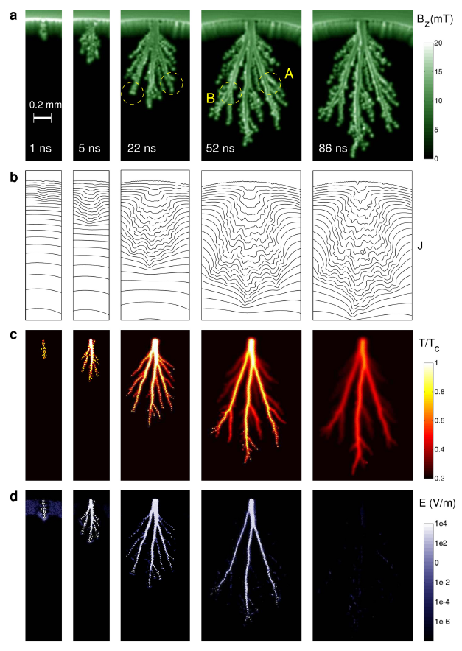
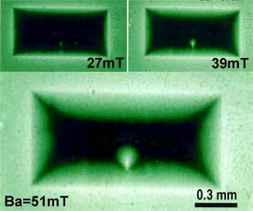

Defects and avalanches
  Localized defect effect…
YBa₂Cu₃O₇ film w. one single defect ↓
  http://www.mn.uio.no/fysikk/english/research/groups/amks/superconductivity/mo/
  Vx penetration (~100 µm) during 1! RF period (ns)
  “flux jumps” ≡ avalanche penetration, observed in transient state (so also expected in RF)
  http://www.nature.com/srep/2012/121126/srep00886/full/srep00886.html?message-global=remove&WT.ec_id=SREP-20121127
$$\vec{B}$$
  MgB_{2 →}
Notes:
“The avalanche stops propagating when heat removal to the substrate eventually balances the heat production. This is seen in the final panel, where the maximum temperature has already decayed to 0.7T_{c}. Shortly after that no thermal traces are left from this dramatic event where superconductivity was lost for a very short period of time” (source = Matsushita)

Slide 11
Vortex in presence of electric field and/or current
( )

Slide 12
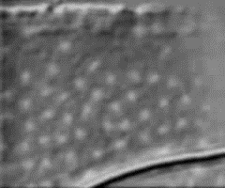

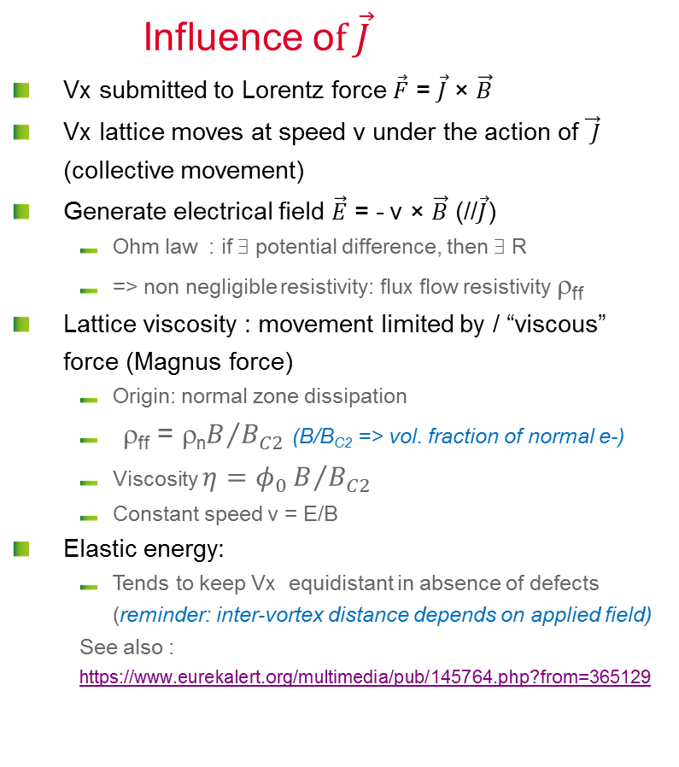
Moving Vortex
http://www.mn.uio.no/fysikk/english/research/groups/amks/superconductivity/sv/
NbSe →
25x35 µm
Influence o$f \vec{J}$
  Vx submitted to Lorentz force $\vec{F}$ = $\vec{J}$ × $\vec{B}$
  Vx lattice moves at speed v under the action of $\vec{ J}$ (collective movement)
  Generate electrical field $\vec{E}$ = - v × $\vec{B}$ (//$\vec{J}$)
      Ohm law : if ∃ potential difference, then ∃ R
      => non negligible resistivity: flux flow resistivity ρ_{ff}
  Lattice viscosity : movement limited by / “viscous” force (Magnus force)
      Origin: normal zone dissipation
      ρ_{ff} = ρ_{n}$B/{B_{C2}}$ (B/B_{C2} => vol. fraction of normal e-)
      Viscosity $η=φ_{0}B/{B_{C2}}$
      Constant speed v = E/B
  Elastic energy:
      Tends to keep Vx equidistant in absence of defects (reminder: inter-vortex distance depends on applied field)
      See also : https://www.eurekalert.org/multimedia/pub/145764.php?from=365129
V
$$\vec{J }$$
Notes:
Increasing J = same effect as increasing B

Slide 13
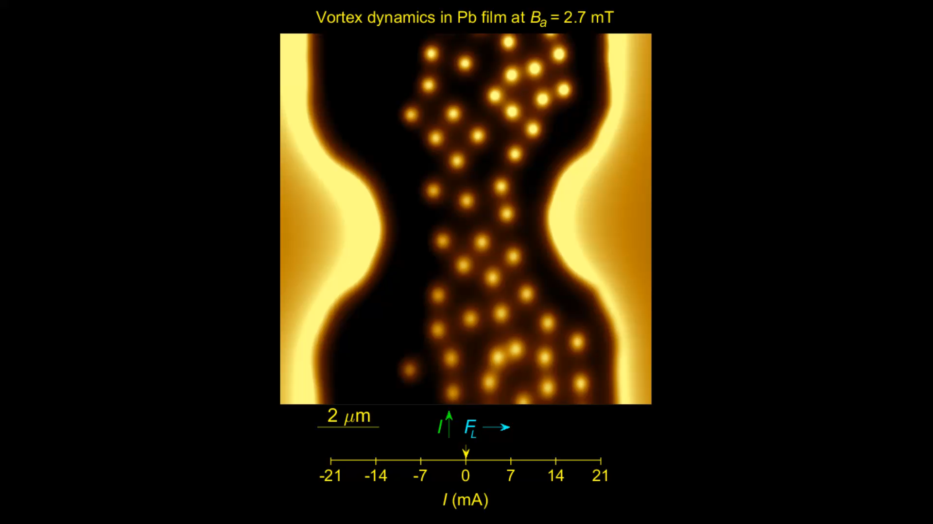
Vortices Avalanches
https://www.eurekalert.org/multimedia/pub/145764.php\
© Dr. Yonathan Anahory
Racah Institute of Physics
The Hebrew University of Jerusalem
Lead films
scanning SQUID-on-tip microscopy technique
allows magnetic imaging at magnetic sensitivity and high resolution (~50 nm)
At high currents (high drives) vortices move at 20 km/s and appear as smeared line.
Notes:
… vortices flowing through a thin superconducting film at rates of tens of GHz, and traveling at velocities much faster than previously thought possible -- up to about 72 000 km/hr. This is not only much faster than the speed of sound, but also exceeds the pair-breaking speed limit of superconducting condensate -- meaning that a vortex can travel 50 times faster than the speed limit of the supercurrent that drives it. This would be like driving an object to travel around the earth in just over 30 minutes. […]
They show a tree-like structure with a single stem that undergoes a series of bifurcations into branches. This channel flow is quite surprising since vortices normally repel each other and try to spread out as much as possible. Here vortices tend to follow each other, which generates the tree-like structure.
A team of theoretical physicists from the USA and Belgium, led by Professors Alexander Gurevich and Milorad Miloševi, partially explained this finding by the fact that when a vortex moves, the appearance of resistance locally heats the material, which makes it easier for following vortices to travel the same route.

Slide 14
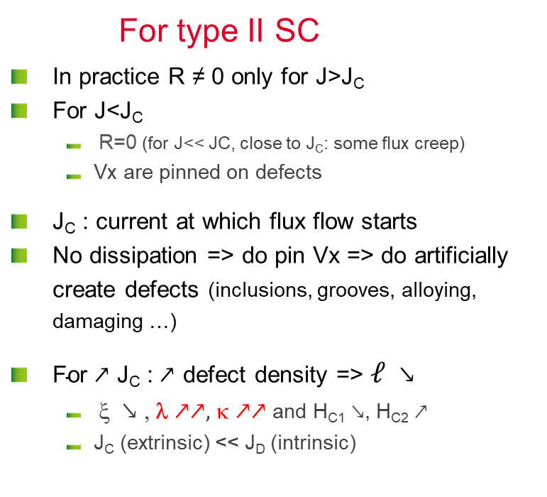
critical current density J_{C}
For type II SC
  In practice R ≠ 0 only for J>J_{C}
  For J<J_{C}
      R=0 (for J<< JC, close to J_{C}: some flux creep)
      Vx are pinned on defects
  J_{C} : current at which flux flow starts
  No dissipation => do pin Vx => do artificially create defects (inclusions, grooves, alloying, damaging …)
  $\text{For}↗\text{J}\text{C}\text{ :}↗$ defect density => $ℓ$ $↘$
      ξ $↘$ , λ $↗↗,$ κ $↗↗$ and H_{C1} $↘$, H_{C2} $↗$
      J_{C} (extrinsic) << J_{D} (intrinsic)
normal
E
flux flow
Pinning then flux flow
J_{C}
J
  RF Cavities : pinning is inefficient, J_{C} meaning less: always in the flux flow regime (that is why we want to prevent early Vx penetration and flux trapping during cooldown! )
Notes:
Flux flow resistance : only a fraction of the surface is normal conducting => resistance is proportional to the number of vortices.

Slide 15
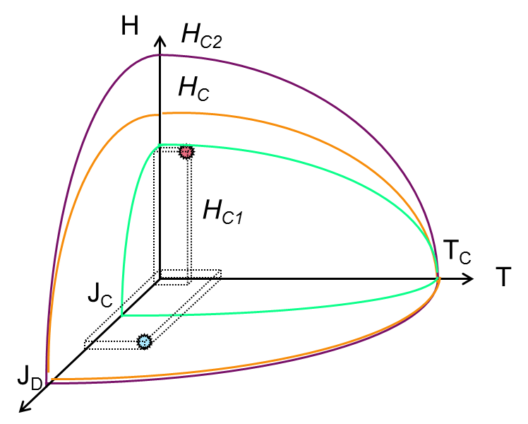
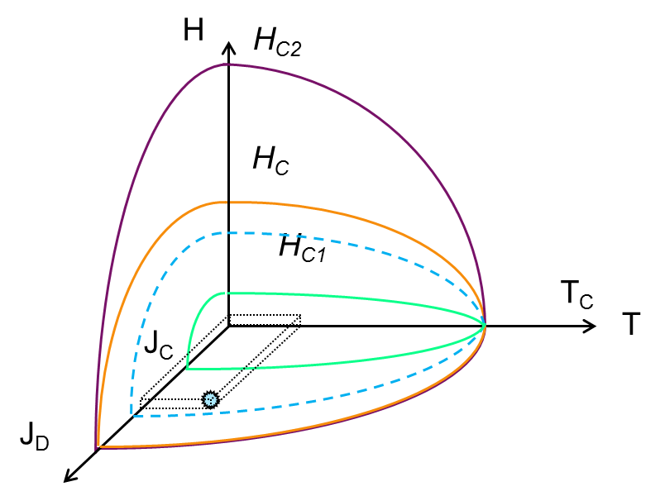
A complex phase diagram
Applications…
  type II SC : 3 main Phases
    Meissner state (SC, B=0 )
    Mixed state (SC + vortices (B≠0) )
    Normal conducting State
Cavities
Coils
  ∃ thousands of SC
  In practice:
      <10 are actually used
      They are all type II : low H_{C1} and high H_{C2} => mixed state… EXCEPT Nb ! (RF appli.)
    NB : J_{D} depairing current dens. (intrinsic)
    ≠ J_{C} critical current density (technical limit)
    Jc has no meaning in RF
Notes:
Faire 2 transparents

Slide 16
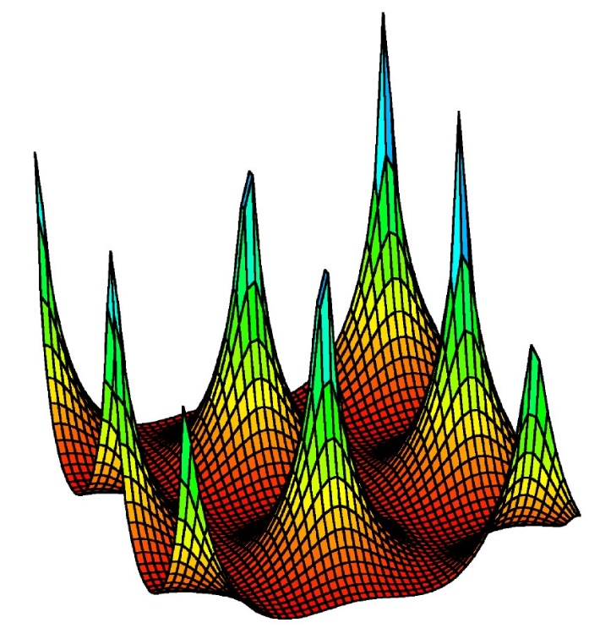
A complex phase diagram
Vortex behavior is conditioning the application limits
  Vortex (Vx)
    centered hexagonal lattice (triangular)
    can be pinned on cryst. defects (see part II)
    Several ≠ states
    H>H_{M} => R≠ 0
H_{M} defined as the H=f(T) line @ J_{C} (H,T) = 0 in the (H,J,T diagram)
H_{M} ≡ H_{Irr}
H
Vx Liquid
Vx glass
H_{C2}
Vx Lattice
H_{C1}
T²
Notes:
HM "melting" or "moving": this is when the vortices start to move freely in the SC: this marks the beginning of the thermal dissipations (R is no longer = 0)
NB “glass” can be considered as a very (very!) viscous liquid…

Slide 17
vortex (II): pinning on crystalline defects
(Introduction)

Slide 18
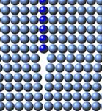
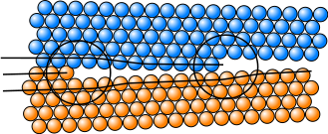
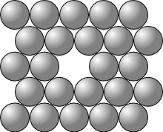
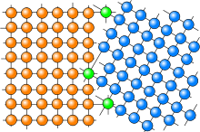
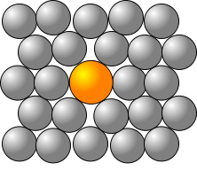
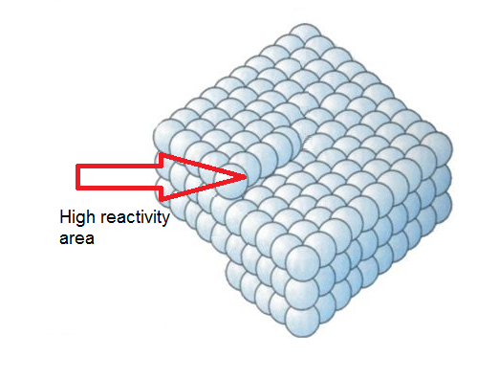
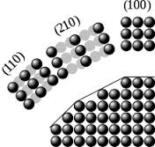
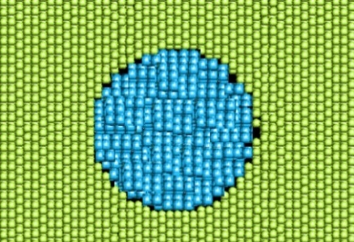
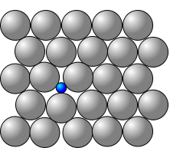
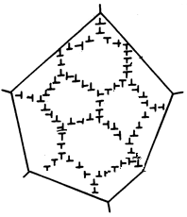
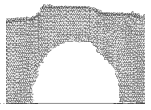
Examples of Crystalline defects
Punctual:
1D:
2D :
Vacancy
Edge dislocation
Surfaces, interfaces (GB)
Substitutional atom
Screw dislocation
3D :
Inclusions
Interstitial atom
Surface faceting
Voids
Dislocation cells
Notes:
Crystalline defects produce an elastic strain on the crystalline lattice. The highest the dimensionality, the highest the strain
En français :
Lacune
Interstitiel
Atome de substitution
Dislocations : coin ou vis
Facettage
Soufflure (vide)
Cellules de dislocations

Slide 19
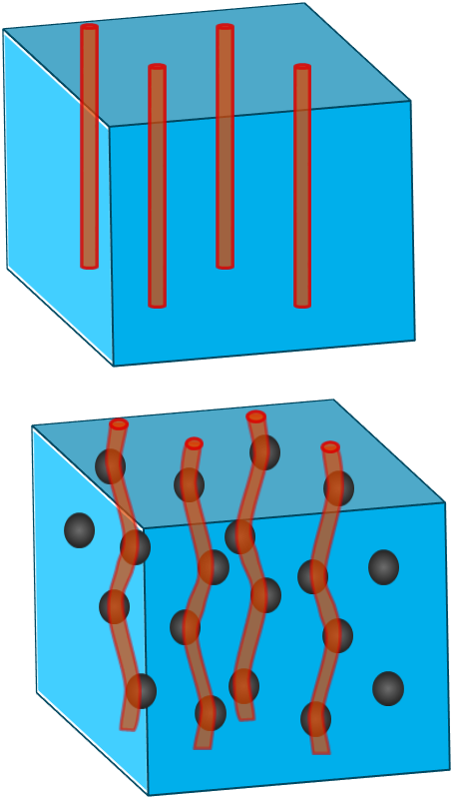

More details on pinning mechanisms
Matsushita : 4 mechanisms from the SC point of view
  A- Condensation energy variation (one saves condensation energy if ⱻ already a normal zone)
  B- Elastic interactions (lattice elastic moduli in SC state < elastic Mod. In normal state , NB => interacts strongly with lattice elastic deformation due to crystalline defects-see below)
  C- Magnetic interaction (if defects >>λ, you can treat it like an interface: image vortex + surface barrier => very strong effect)
  D- Kinetic energy interaction (areas with ≠ξ => ≠ in Vx velocities ?)
IN BRIEF : local effects !!!! (=>2 fluids model not fully OK)
∃ 2 kinds of pinning :
  Strong pinning (surface magnetic pinning) : twinning, voids, non SC aggregates, irradiation defects (columnar), nano-indentations : Dominant mechanism: A then C then D
  Weak pinning centers but many of them: «volume core pinning»
      Dominant mechanism: B ; B less efficient than C but if they are many pinning centers => results into strong pinning
      Mechanism B efficiency 3D → Interface (G.B) → dislocation → punctual defects
Notes:
if V pinning potential and ρ Vx density:
$E_{pinning}\sim \int{V\left(r\right)ρ\left(r\right)d^{3}r}$
Generally λ >a₀ (a₀ ~ ∅ pinning center)
So one can work with mean values over λ (continuum model/ Larkin volume)

Slide 20
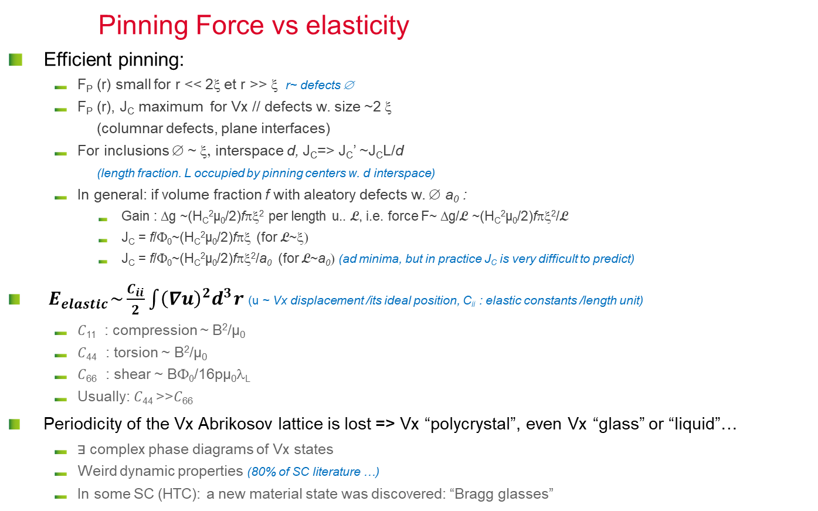
Forces at play
Pinning Force vs elasticity
  Efficient pinning:
      F_{P} (r) small for r << 2ξ et r >> ξ r~ defects ∅
      F_{P} (r), J_{C} maximum for Vx // defects w. size ~2 ξ (columnar defects, plane interfaces)
      For inclusions ∅ ~ ξ, interspace d, J_{C}=> J_{C}’ ~J_{C}L/d (length fraction. L occupied by pinning centers w. d interspace)
      In general: if volume fraction f with aleatory defects w. ∅ a₀ :
        Gain : Δg ~(H_{C}²µ₀/2)fπξ² per length u.. L, i.e. force F~ Δg/L ~(H_{C}²µ₀/2)fπξ²/L
        J_{C} = f/Φ₀~(H_{C}²µ₀/2)fπξ (for L~ξ)
        J_{C} = f/Φ₀~(H_{C}²µ₀/2)fπξ²/a₀ (for L~a₀) (ad minima, but in practice J_{C} is very difficult to predict)
  $E_{elastic}\sim \frac{C_{ii}}{2}\int{{\left(∇u\right)}^{2}d^{3}r}$ (u ~ Vx displacement /its ideal position, C_{ii} : elastic constants /length unit)
      𝐶₁₁ : compression ~ B²/µ₀
      𝐶₄₄ : torsion ~ B²/µ₀
      𝐶₆₆ : shear ~ BΦ₀/16pµ₀λ_{L}
      Usually: 𝐶₄₄ >>𝐶₆₆
  Periodicity of the Vx Abrikosov lattice is lost => Vx “polycrystal”, even Vx “glass” or “liquid”…
      ⱻ complex phase diagrams of Vx states
      Weird dynamic properties (80% of SC literature …)
      In some SC (HTC): a new material state was discovered: “Bragg glasses”
F_{P}
Pinning Force
2ξ
r

Slide 21
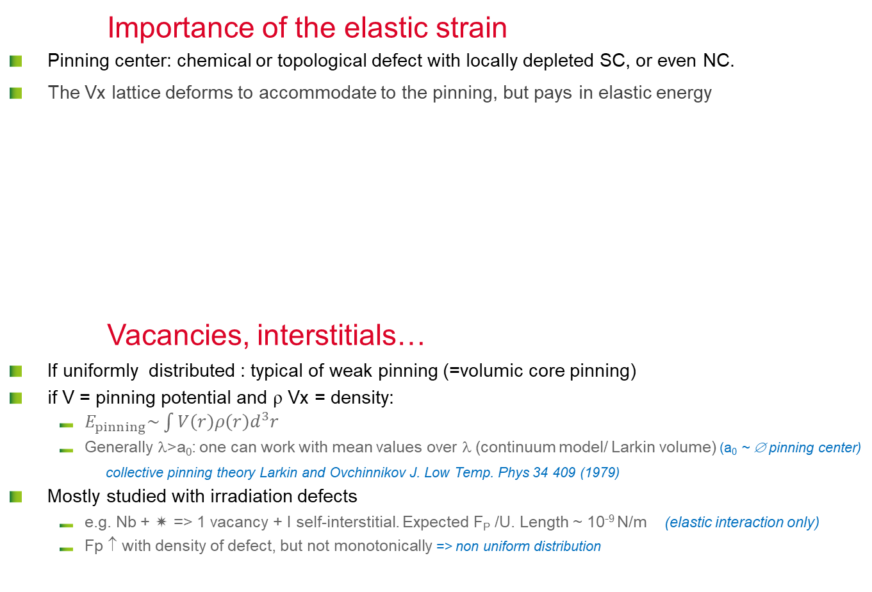
Effect of defects
Importance of the elastic strain
  Pinning center: chemical or topological defect with locally depleted SC, or even NC.
  The Vx lattice deforms to accommodate to the pinning, but pays in elastic energy
Vacancies, interstitials…
  If uniformly distributed : typical of weak pinning (=volumic core pinning)
  if V = pinning potential and ρ Vx = density:
      $E_{pinning}\sim \int{V\left(r\right)ρ\left(r\right)d^{3}r}$
      Generally λ>a₀: one can work with mean values over λ (continuum model/ Larkin volume) (a₀ ~ ∅ pinning center)
      collective pinning theory Larkin and Ovchinnikov J. Low Temp. Phys 34 409 (1979)
  Mostly studied with irradiation defects
      e.g. Nb +  => 1 vacancy + I self-interstitial. Expected F_{P} /U. Length ~ 10⁻⁹ N/m (elastic interaction only)
      Fp ↑ with density of defect, but not monotonically => non uniform distribution
.
⊥
⊥
⊥
°
⊥
⊥
Plays on SC parameters: l, κ...
3D
2D
1D
0D
Strain on the crystalline lattice
Interfaces (oxide layer, inclusions) > GB >⊥ cells > ⊥(=dislocations) > vacancies or interstitials
Notes:
Elastic interaction and segregation:
Atmosphere example : air molecules are free, but atmosphere = denser @see level (interaction with gravity)
Same with H @ T >150 K => Cottrell clouds around dislocations !!!
Elastic strain also affects SC and pinning !!!

Slide 22
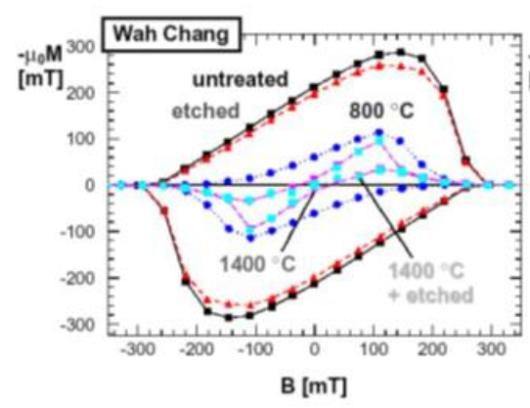
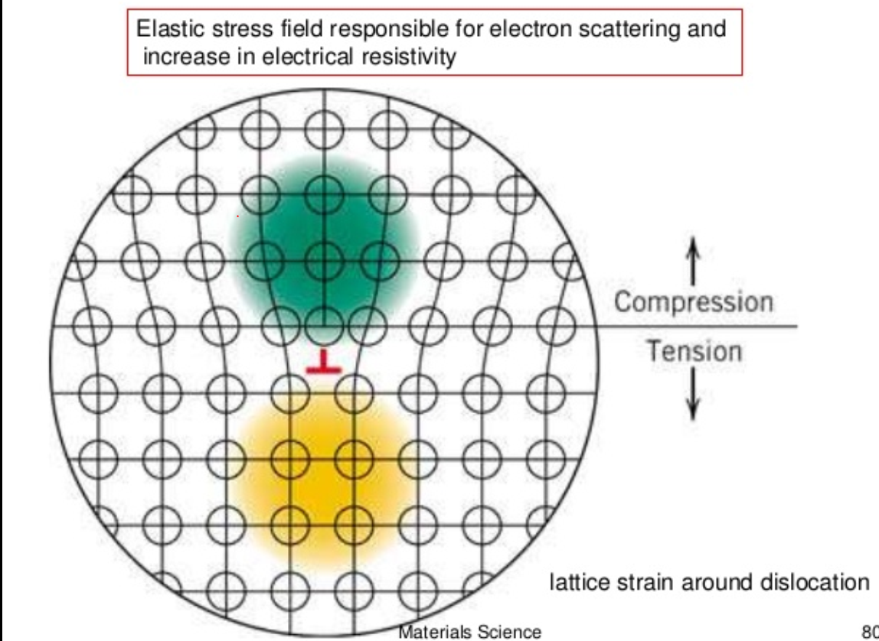
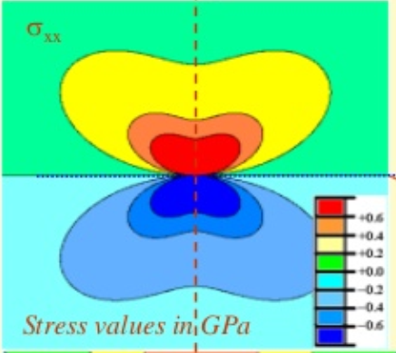
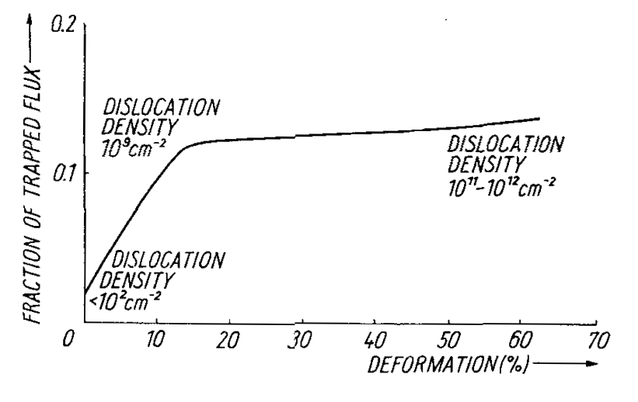
Individual Dislocations
[Bahte et al PAC 98]
  Source of the hysteresis in DC magnetometry
  Local elastic distortion of the lattice
+ 1 GPa
  Dominant mechanism 1! Disloc = B (effect < GB)
  but…
0
- 1 GPa
Stress map around an edge dislocation
http://www.slideshare.net/vamsikrishna393950/stress-fields-around-dislocation/
[Narlikar A, Dew‐Hughes D 1964 #1542]
  They are many dislocation inside Nb, even if well recrystallized
  Non linear behavior => Dislocation repartition is not uniform (not 1D anymore)
Nb | F_{P}/unit lenth or vol
1 ⊥ (H//) | ~10⁻⁶ N/m
5% deformed ~ 10⁸-10⁹ ⊥. cm⁻² | 2-5.10⁻⁵ N/m³
Notes:
See also Ulmaier # 1549. DY/Y (relative elasticity difference between SC and NC state depends on:
# defects=Z in volume ξ^3 (Z = nξ^3)
DY/Y  when ℓ and ξ
https://en.wikipedia.org/wiki/Dislocation :
The interface between a metal and an oxide can greatly increase the number of dislocations created. The oxide layer puts the surface of the metal in tension because the oxygen atoms squeeze into the lattice, and the oxygen atoms are under compression. This greatly increases the stress on the surface of the metal and consequently the amount of dislocations formed at the surface. The increased amount of stress on the surface steps results in an increase in dislocations.
In single crystals, the majority of dislocations are formed at the surface. The dislocation density 200 micrometres into the surface of a material has been shown to be six times higher than the density in the bulk
After chemical etching, small pits are formed where the etching solution preferentially attacks the sample surface around the dislocations intercepting this surface, due to the more highly strained state of the material . Thus, the image features indicate points at which dislocations intercept the sample surface. In this way, dislocations in silicon, for example, can be observed indirectly using an interference microscope. Crystal orientation can be determined by the shape of the etch pits associated with the dislocations

Slide 23




dislocation CELLS in Nb
  Dislocations gather in “cells” (as soon as 3-5% strain)
  Stress on dislocation pill-up = stress on 1! Disloc^{n} x 20 !!!
  => 2D defects, analogous to G.B. (ⱻ many more dislocations than GB)
  Expend over a distance larger than G.B. (~ to ξ,=> stronger pinning)
Etching figures revealing dislocation arrays on as received Nb sheet after light etch
Monocrystal, RRR = 5000
[Narlikar, 1964, #1542]
  « Bitter decoration » (Abrikosov lattice visualization)
      In well recrystallized: Abrikosov Lattice everywhere
      In deformed Nb: Abrikosov Lattice only in the core of D. cells, but all Vx close to dislocations cells are attracted and pinned there )
[Herring, 1974, #1544]
Notes:
Typically, for Nb the pinning force per unit length F_{p} is about 2.10⁻⁶ N/m for an isolated dislocation (to be compared to 9.1 10⁻⁴ N/m for a normal conducting precipitate [31]).
They are many more dislocations than grain boundaries in typical Nb used for SRF applications. Moreover, most of the time dislocations are gathered into dislocation cells where dislocations tangle and pill up into “walls” with high stress concentration and high stress gradients whereas the inner cell are nearly defect less. For heavily deformed material they prefigure future grain or sub-grain boundaries that will appear upon recrystallization. Those dislocation cells are clearly 2D defects similar to GB, rather than linear. Dislocation structure becomes non uniform in Nb for very small amounts of deformation (3-5 %, equivalent to a density of dislocation ~10⁸-10⁹ cm²) [30]. In heavily deformed metals dislocation density can reach 10¹¹-10¹² cm², but even a very carefully recrystallized material still hold dislocations even at temperatures close to the melting point. Examples of the effect of recrystallization on density of dislocation can be found e.g. in [57, 58].

Slide 24

Surface/interface PINNING (II)
Surfaces/Interfaces : NC precipitate
  “Image” vortices formalism (J⊥ = 0)
      Supercurrent tends to push Vx inside
      Image antivortex tends to pull it out
  Condensation energy savings => Strong pinning centers
      NC precipitate can trap several vortices
Surfaces/Interfaces :
Grain boundaries
  Disordered area over n atomic distances => local SC parameter affected
  Compare with ξ
      HTC SC : for some orientations n is ~10 (~3 nm) and ξ_{AB} ~ 2 nm => strong pinning
      Nb : n ~2-3 (~<1 nm) and ξ ~ 40 nm => weak pinning
https://areeweb.polito.it/ricerca/superconductivity/melt.htm
YBCO
3.6 nm
Material | F_{P}/unit length
Nb (H// GB) | 7.10⁻⁶ N/m
Nb₃Sn | 6.10⁻⁵-10⁻⁴ N/m
MgB₂ | 4.10⁻⁴ N/m

Slide 25


Grain boundaries in Nb
  Preferential penetration @ G.B. ($\vec{H}∥\text{G}\text{.}\text{B}$)
  H_{P}^{GB} <<H_{P}^{bulk}
  Dominant mechanism (see below)
      A if boundary is “thick” (e.g. YBCO)
      B if boundary is clean (local SC properties only modified over a few interatomic distances)
      Nb : rather B (clean boundaries, large ξ)
  NB monoXtal cavities ~ polyXtal cavities
      Same behavior : Qslope, performance…
H
    Josephson Vortex:
    Pinned on interface (GB)
    Current line distortion
H
Monocrystalline cavities
    @ 4.5 K
    H₀^{GB} ~ 32 mT
    H₀^{bulk} ~ 150 mT
[A. Polyanskii,. H. Sung et al, FNAL/FSU]
Notes:
Preferential penetration in GB when GB alignes with field (very few chances to occur in cavities)
SRF 2017 ‘retrouver qui ?) => some GB show easy way in, easy way out for the field, and for others have pinning behavior. NB some GB can be considered as array of dislocations, depends on relative orientations
GB indeed exhibit degraded SC properties, but it does not seem to affect RF behavior.
Since Xi is much larger than disordered volume around GB => not main pinning center

Slide 26








Surface/interface PINNING (I)
Surfaces/Interfaces : strong pinning
  Boundary conditions : ${\vec{J}}_{S}×\vec{n}$=$\vec{0}$ (J⊥ = 0)
  => Vx always exit ⊥ to the surface
  Equilibrium : pinning force = elastic force (line tension) If the Vx is curved , its length ↑ and thus the elastic return force also ↑ . Equilibrium => pinning force also increases as a consequence.
  Macro. scale : Vx must curve to satisfy B.C. (Vx is ⊥ to surface).
  Micro. scale : strong surface state influence
$$\vec{H}$$
  SC sphere
θ cr
n
http://journals.aps.org/prb/abstract/10.1103/PhysRevB.69.224504
$$\vec{H}$$
$${\vec{J}}_{S}$$
$I_{S}$ ~ M(B, T) sinθ
IC can increase with increasing surface roughness (=> thin films applications!!!)
Roughness scale in concern depends on the applied field (µm at low H, nm at high H !)
Notes:
Plays a huge role in thin films

Slide 27




Consequencies of GB/grain size
  Depinning frequency
  Theory: see e,g, Palmieri TFSRF 2010
  Measurement of complex (/effective) penetration depth: λ_{AC} = λ’ + iλ’’
      Typically used to determine pinning force in SC cables
http://fr.slideshare.net/thinfilmsworkshop/palmieri-rf-losses-trapped-flux
Easy to measure:
’’
$ℓ_{b}$
      $φ_{ac}=\int{b_{ac} dS \sim 2λ_{ac}ℓ_{b}b_{0}}$
      At low frequency : λ’~ δ_{RF} (δ_{RF}= penetration depth in normal state)
      At high frequency λ’ ~ λ’’ ~ λ_{L}<< δ_{RF}
Electrodynamics of the vortex lattice in untwinned YBaCuO by complex impedance measurements Pautrat 2003
Notes:
Measurements are done in BC3 regime (surface SC) => only ~10 nm of the surface is tested
If pinning is increased, signal decreases compared to NC situation and ω_{P} goes to higher frequency => this technique can be used to compare surface treatment and propensity to trap flux

Slide 28


sensitivity to trapped magnetic flux/depinning frequency
Pinning is very efficient for bulk but not for thin films Nb in the 100 Mhz-1 Ghz range
Thin films Nb
Depends on quality, can reach some 10 GHz; e.g. here 26 GHz,
Lütke-Entrup et al
http://arxiv.org/pdf/cond-mat/9705017.pdf
Bulk monoX Nb: 10 kHz
Gittleman et al
http://scitation.aip.org/content/aip/journal/jap/39/6/10.1063/1.1656632
See also
D. Janjušević et al
http://journals.aps.org/prb/abstract/10.1103/PhysRevB.74.104501
S. Hall
http://arxiv.org/abs/1507.04105
  High depinning frequency: measured on various SC, various film deposition technique, but can vary with quality of the films.
  e.g.: measurements from Glitterman on Nb₃Sn : ω₀ ~300 GHz!!!
  All thin films show low sensitivity to trapped magnetic flux: because all the flux is efficiently trapped !!!
Notes:
10 kHz is for extremely well recrystallized NB (RRR ~ 5000)
Mattia Checchin found ….

Slide 29

Sensitivity to trapped flux is related to pinning
Observations
  100% trapped flux on Nb samples /cavities (cf C. Vallet PhD + recent work)
  Sensitivity to trapped flux of bulk Nb varies
      From lab to lab (≠ measurement geometries, shielding, environment ???)
      From supplier to supplier (cf LCLS @ FNAL proto ≠ series)
      From sheet to sheet (recrystallization varies from batch to batch, and even in the same batch if the Tp° in furnace is not perfectly uniform)
  Highest sensitivity for:
      N doped cavities
      Nb₃Sn
  Lowest sensitivity for:
      Thin film Nb (at least at low field)
Comparative measurements of niobium sheet and sputter coated cavities
Arnold Mayer & Weingarten 1987
(here measured field is not RF field, but external field)

Slide 30
Dammage and SRF performances
Reproducibility
Main issue on large scale production
Main issue for lab to lab « recipe » transfer
Flux trapping sensitivity
Damage texture
Resistant to recrystallization
Reproducibility
issues
Hot spots:
High dislocation density !
Pinning centers !
Vortex oscillating in RF ?
Trapped or premature entrance ?
Hydride precipitates
Apparition of hot spots
Baking/Doping Interstitials density
Interstitials diffusion becomes non uniform
Affects mean free path !
Affects size of hydride pcp^{tates} !
Affects sensitivity to trapped flux !
  Reduce trapped flux due to hydrides
  Higher sensitivity to trapped flux at high concentration
Optimum distribution is yet to be found !
Larger hydrides:
Premature quench (Q-disease)
Strong pinning centers (flux trapping)
H diffusion slowed by O/N interstitials

Slide 31
More on pinning in niobium in the lecture:
"Material and surface aspects in SRF technology"

Slide 32
next:
Part III : APPLICATIONS in accelerators
Magnets & RF cavities

