Slide 1






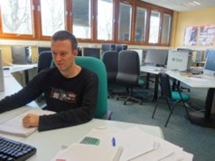
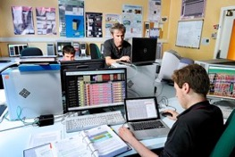
Institut de recherche sur les lois fondamentales de l’univers
Integrated circuit design team
P.Baron
F. Bouyjou
X.De-La Broïse
Y. Degerli
O. Gevin
F. Guilloux

Slide 2
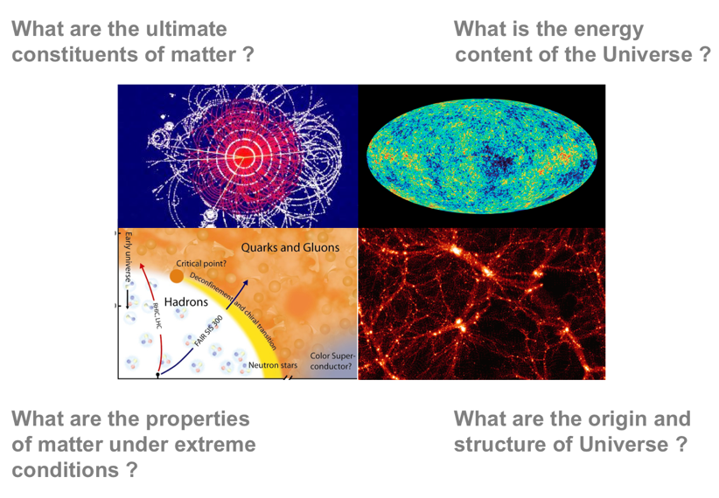
Mission: try to answer to these questions

Slide 3
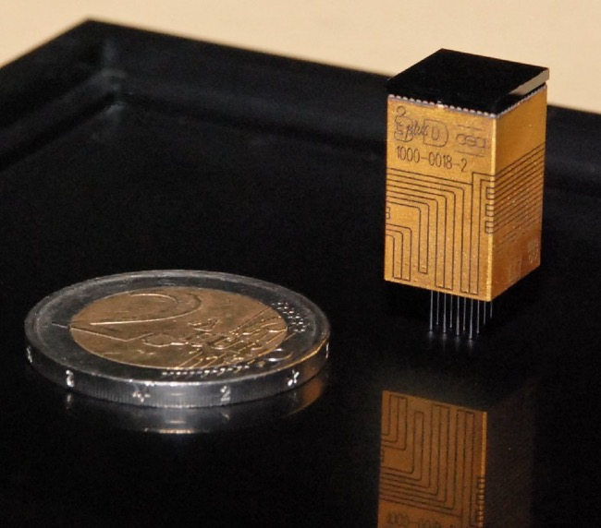
With exotic instruments
CALISTE

Slide 4
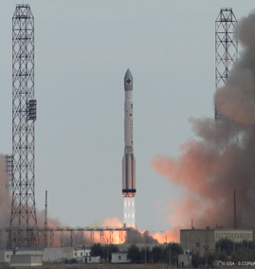
With exotic instruments
CALISTE
Space grade (radiations, vibration...)
X-rays spectro-imager
256 pixels, 1 type of sensors
8 ASICs, 1 Million devices
Modular
Will be launched in 2020
aboard Solar Orbiter ESA mission

Slide 5
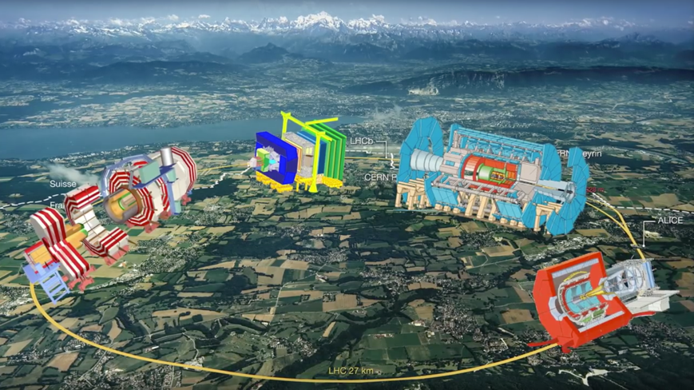
With exotic instruments
Huge Instruments around Large Hadron Collider at CERN

Slide 6
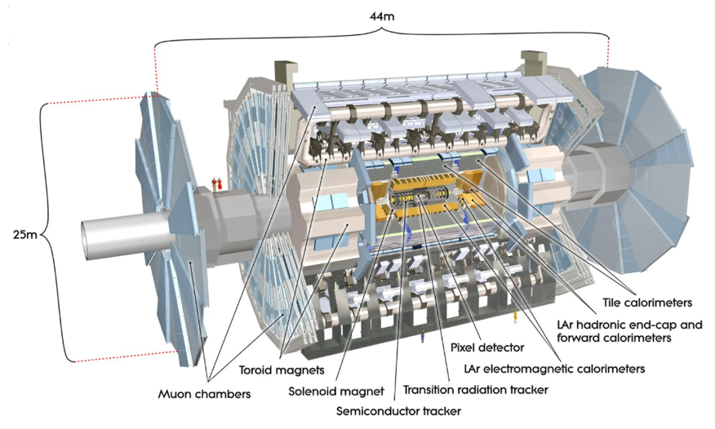
With exotic instruments
ATLAS

Slide 7
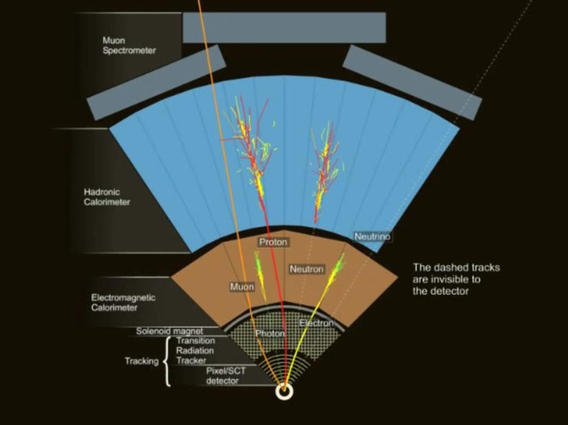
With exotic instruments

Slide 8
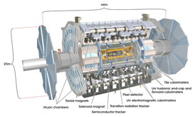

With exotic instruments
ATLAS
Particle Physics
The weight of Eiffel Tower
1 billion event per second
200 stored per second.
Predictable time of arrival
100 Millions of pixels
Large zoology of sensors
40 countries (Austria is part)
CALISTE
Astrophysics
Few grams
Few events per day
All stored and sent to earth
Random time of arrival
256 pixels
1 type of sensor
France

Slide 9
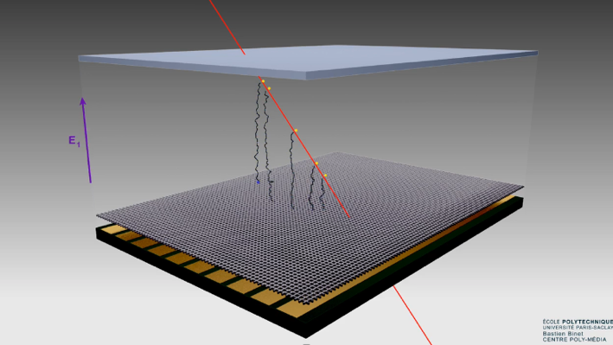

Made of radiation detectors
Micromegas detector for tracking: when particle passes thru matter, it ionizes the matter (here a gas). The electrons/holes drift thanks to electrical field and can be amplified in the avalanche region. The hit strip (or pixel) gives a projection of the track of the particle.
Drift region
Avalanche region

Slide 10
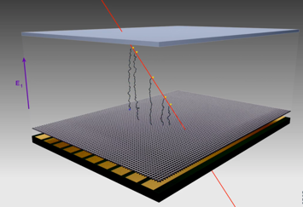
Made of radiation detectors
A charge is induced on each strip and the electronic circuit has to measure this charge and memorizes this measure for all readout channels (here, strips but it can be pixels). Time measurement of arrival of the charge gives access to the third dimension.
In practically all cases, the signal that the electronics has to process is a charge deposited in a short time scale.
For almost all detectors, the electronics needs to collect Q(x,y,t) and one channel needs to collect Q(t).
Most of the final detector used
are based on matter ionization,
photoelectric effect or Compton effect. Depending on the radiation we want to detect or measure, the process used for conversion, the material and the scale change but

Slide 11

Detector model
The detector can generally be very simply modelized:
Cd: detector capacitor: fF (silicon detectors) to hundreds of pF (ionization chambers)
IDC: Leakage current (for solid sate detectors for instance): 0 to hundreds of µA for irradiated detectors.
I(t) input signal. Generally modelized with a Dirac impulse:
I(t)=Q.δ(t)
Q: few electrons (el) to 10⁶ el
(1 fC = 6250 electrons)
Detector
Electronics

Slide 12
Electronic architecture
Detector
ASIC
Conversion
E=>Q
Conversion
Q=>ΔV
Filtering
V
Measure
V α E
Alert
E>E_{th}?
Multi-channel ASIC (from few to millions of channels)
Main functions of a channel:
Convert the signal of the detector
Filter the noise
Measure & Memorize the signal
Potentially Alert (self-triggered systems)
Measure the time of arrival of the signal

Slide 13
Electronic architecture
Detector
ASIC
Conversion
E=>Q
Conversion
Q=>ΔV
Filtering
V
Measure
V α E
Alert
E>E_{th}?
Multi-channel ASIC (from few to millions of channels)
Main functions of a channel:
Convert the signal of the detector
Filter the noise
Measure & Memorize the signal
Potentially Alert (self-triggered systems)
Measure the time of arrival of the signal

Slide 14
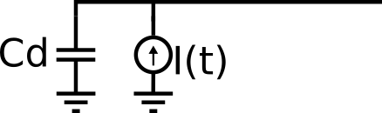
Q to V conversion
=Q.i(t)
Any idea to convert Q into V?
Detector
Electronics
?

Slide 15
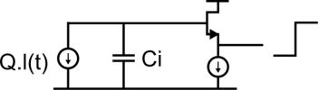
Q to V conversion in the detector
Detector
ΔV=Q/C_{i}
Conversion
E=>Q
Conversion
Q=> Δ V
The charge is integrated on an in-detector capacitor C_{i} and sent out the chip by a simple source follower or by a voltage amplifier.
Input signal of the ASIC: ΔV=Q/C_{i}
C_{i} can be very low:
=>Conversion factor very high and not determined by the readout electronics.
=>Very low noise (C_{i} low and C_{stray}≅0)
The best in terms of energy resolution.
Examples: Most of the silicon detectors.
CCD, pnCCD, DEPFET, SDD (not always), …

Slide 16
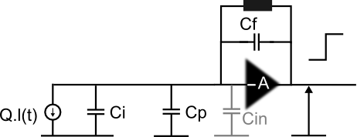
Q to V conversion between Detector and ASIC
Detector
ASIC
Voltage
amplifier
Conversion
E=>Q
Conversion
Q=> Δ V
The charge is integrated on an in-detector capacitor C_{i} and parasitic capacitor C_{p} due to connection between detector and electronics.
Input signal of the ASIC: ΔV=Q/(C_{i} +C_{p})
C_{p} not well defined and change from channel to channel from experiment to experiment!!
Notes:
Montrer un schéma

Slide 17
Q to V conversion between Detector and ASIC
Detector
ASIC
Voltage
amplifier
Conversion
E=>Q
Conversion
Q=> Δ V
The charge is integrated on an in-detector capacitor C_{i} and parasitic capacitor C_{p} due to connection between detector and electronics.
Input signal of the ASIC: ΔV=Q/(C_{i} +C_{p})
C_{p} not well defined and change from channel to channel from experiment to experiment!!
=>Gain is made by interconnection, not well defined and hugely dispersed !
=>Never used
Notes:
Montrer un schéma

Slide 18
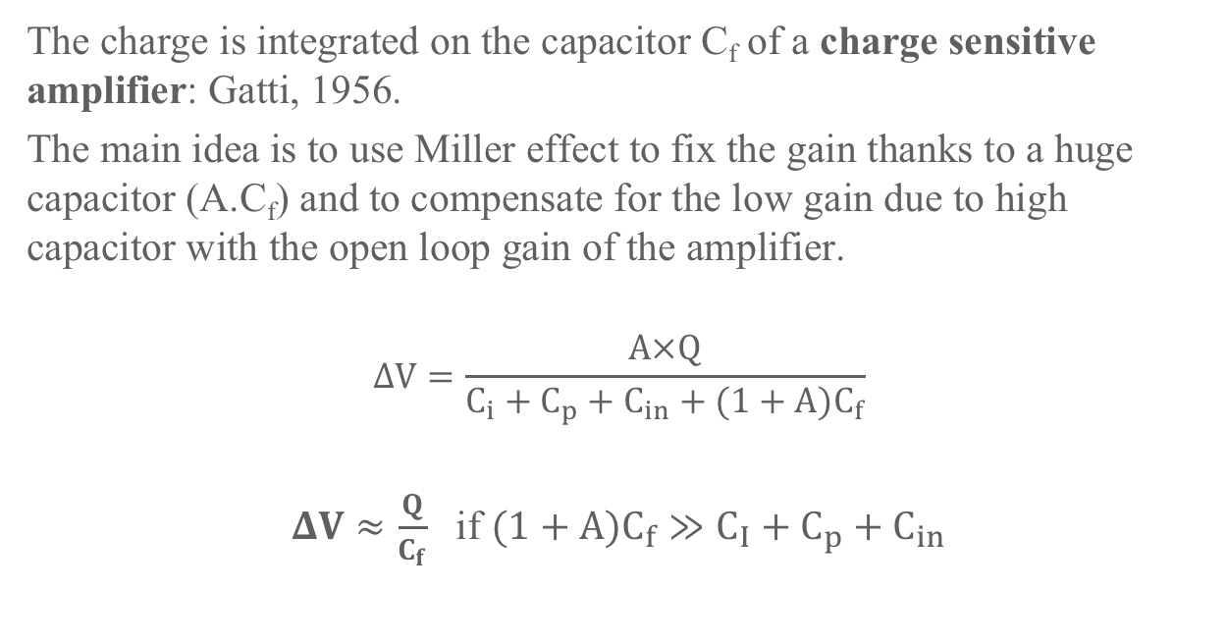
Q to V conversion in the ASIC
Detector
ASIC
ΔV=Q/C_{f}
Conversion
E=>Q
Conversion
Q=> Δ V
The charge is integrated on the capacitor C_{f} of a charge sensitive amplifier: Gatti, 1956.
The main idea is to use Miller effect to fix the gain thanks to a huge capacitor (A.C_{f}) and to compensate for the low gain due to high capacitor with the open loop gain of the amplifier.
$$ΔV=\frac{A×Q}{C_{i}+C_{p}+C_{in}+(1+A)C_{f}}$$
$ΔV≈\frac{Q}{C_{f}}$ if $(1+A)C_{f}≫C_{I}+C_{p}+C_{in}$
Notes:
Montrer un schéma

Slide 19
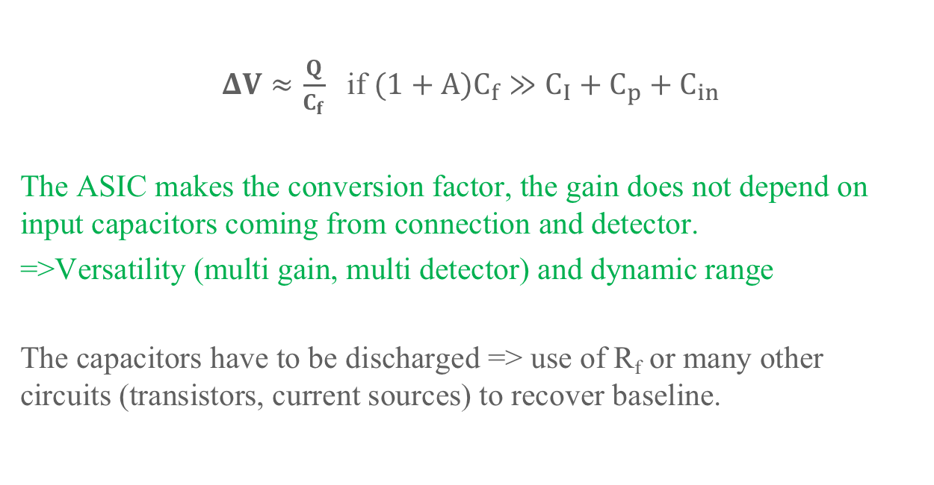
Q to V conversion in the ASIC
Detector
ASIC
R_{f}
ΔV=Q/C_{f}
Conversion
E=>Q
Conversion
Q=> Δ V
$ΔV≈\frac{Q}{C_{f}}$ if $(1+A)C_{f}≫C_{I}+C_{p}+C_{in}$
The ASIC makes the conversion factor, the gain does not depend on input capacitors coming from connection and detector.
=>Versatility (multi gain, multi detector) and dynamic range
The capacitors have to be discharged => use of R_{f} or many other circuits (transistors, current sources) to recover baseline.
Notes:
Montrer un schéma

Slide 20
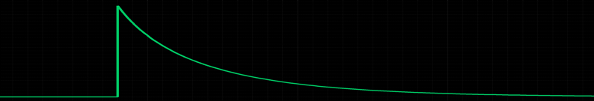
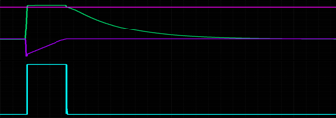
Q to V conversion in the ASIC
Detector
ASIC
R_{f}
ΔV=Q/C_{f}
Conversion
E=>Q
Conversion
Q=> Δ V
Maximum theoretical dynamic range: Q_{max}<V_{dd}.C_{f}
But there is a limit due to integration feasibility: C_{f} must keep integrable: generally C_{f} max < 100 pF => Q_{max}<100 pC.
To increase the dynamic range:
Time over threshold technique (TOT)
R_{f}C_{f} time constant
Q/C_{f}
Tot=a.Q
Notes:
Montrer un schéma

Slide 21
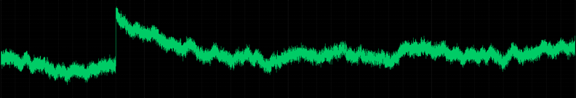
Q to V conversion in the ASIC
Detector
ASIC
ΔV=Q/C_{f}
Conversion
E=>Q
Conversion
Q=> Δ V
Noise sources degrade the signal and make measurements and experiments less accurate.
One have to use filters to increase the signal to noise ratio or to reduce the input referred noise.
Notes:
Montrer un schéma

Slide 22
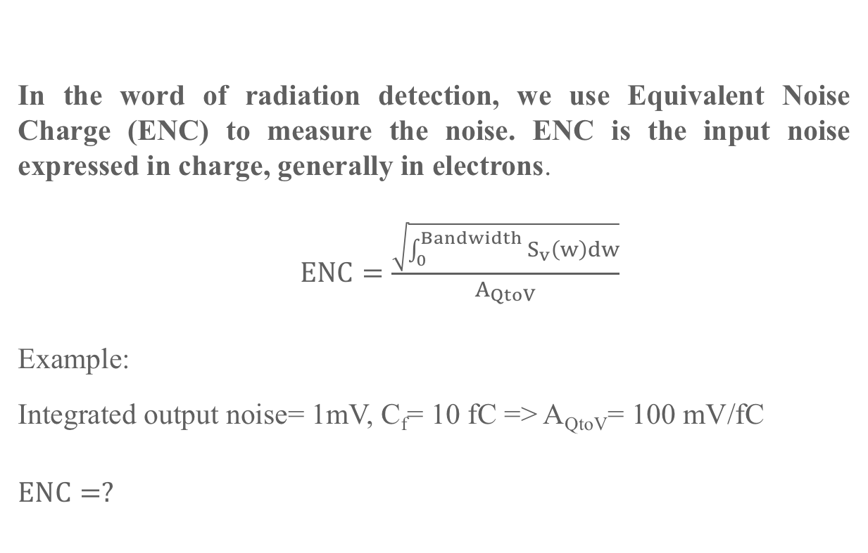
Equivalent Noise Charge
Detector
Q
ASIC
Q to V
V=A_{QtoV}.V
In the word of radiation detection, we use Equivalent Noise Charge (ENC) to measure the noise. ENC is the input noise expressed in charge, generally in electrons.
$ENC=\frac{\sqrt{\int_{0}^{Bandwidth}{S_{v}\left(w\right)dw}}}{A_{QtoV}}$
Example:
Integrated output noise= 1mV, C_{f}= 10 fC => A_{QtoV}= 100 mV/fC
$$ENC=?$$

Slide 23
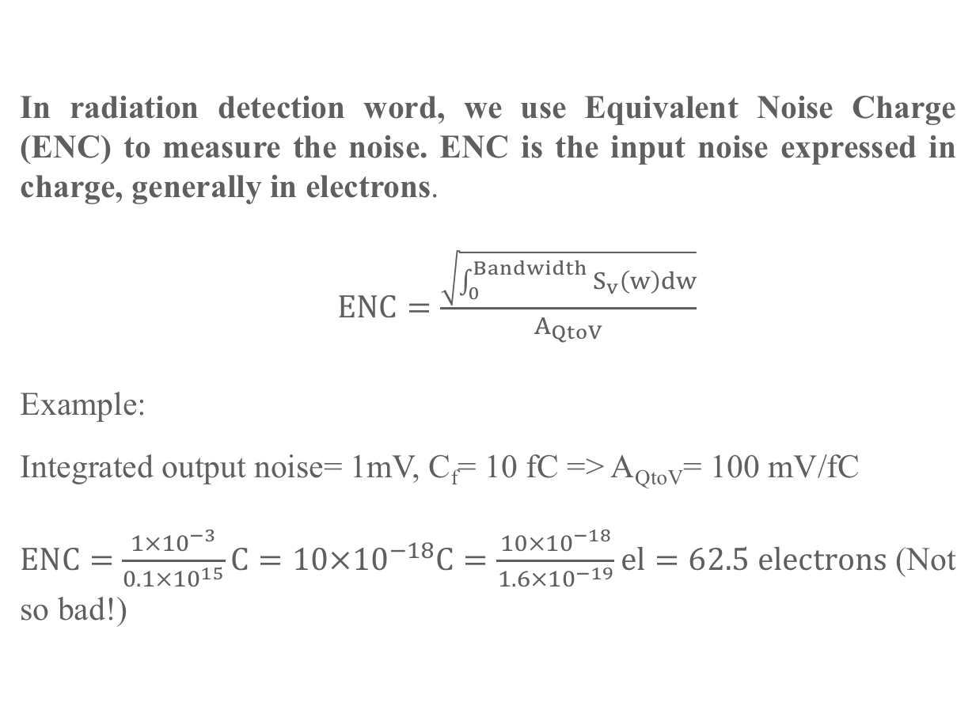
Equivalent Noise Charge
Detector
Q
ASIC
Q to V
V=A_{QtoV}.V
In radiation detection word, we use Equivalent Noise Charge (ENC) to measure the noise. ENC is the input noise expressed in charge, generally in electrons.
$ENC=\frac{\sqrt{\int_{0}^{Bandwidth}{S_{v}\left(w\right)dw}}}{A_{QtoV}}$
Example:
Integrated output noise= 1mV, C_{f}= 10 fC => A_{QtoV}= 100 mV/fC
$ENC=$ $\frac{1{×10}^{−3}}{0.1×{10}^{15}}C=10×{10}^{−18}C=\frac{10×{10}^{−18}}{1.6×{10}^{−19}}el=62.5 electrons$ (Not so bad!)
q

Slide 24
Architecture: filtering
Conversion
E=>Q
Conversion
Q=>ΔV
Filtering
V
Measure
V α E
Detection
E>E_{th}?
Goal of the filter: Reduce ENC (increase signal to noise ratio) and/or shorten the signal.
Theory of optimal filtering concludes that optimal filter is the infinite cusp filter, but it cannot be obtained with analog circuit.
Some of our applications sample and digitize the output of the charge amplifier and perform digital processing.
But in most of cases, one uses analog filters that emulate cusp filters.

Slide 25
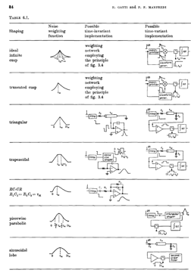

Architecture: filtering
Conversion
E=>Q
Conversion
Q=>ΔV
Filtering
V
Measure
V α E
Detection
E>E_{th}?
A wide range of filters more or less effective and complicated.
Which kind of basic filtering function do we have to perform?

Slide 26
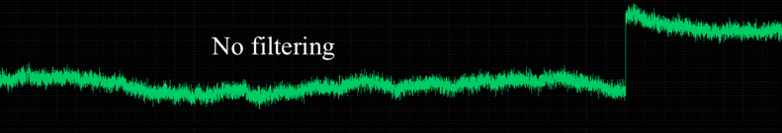
Q to V conversion in the ASIC
Detector
ASIC
ΔV=Q/C_{f}
Conversion
E=>Q
Conversion
Q=> Δ V
Main sources of noise:
Thermal noise of the input transistor of CSA (white)=>LP Filter
1/f noise of input noise of CSA (in 1/f)=>HP Filter
Shot noise due to leakage current (in 1/f²)=>HP Filter
Notes:
Montrer un schéma

Slide 27
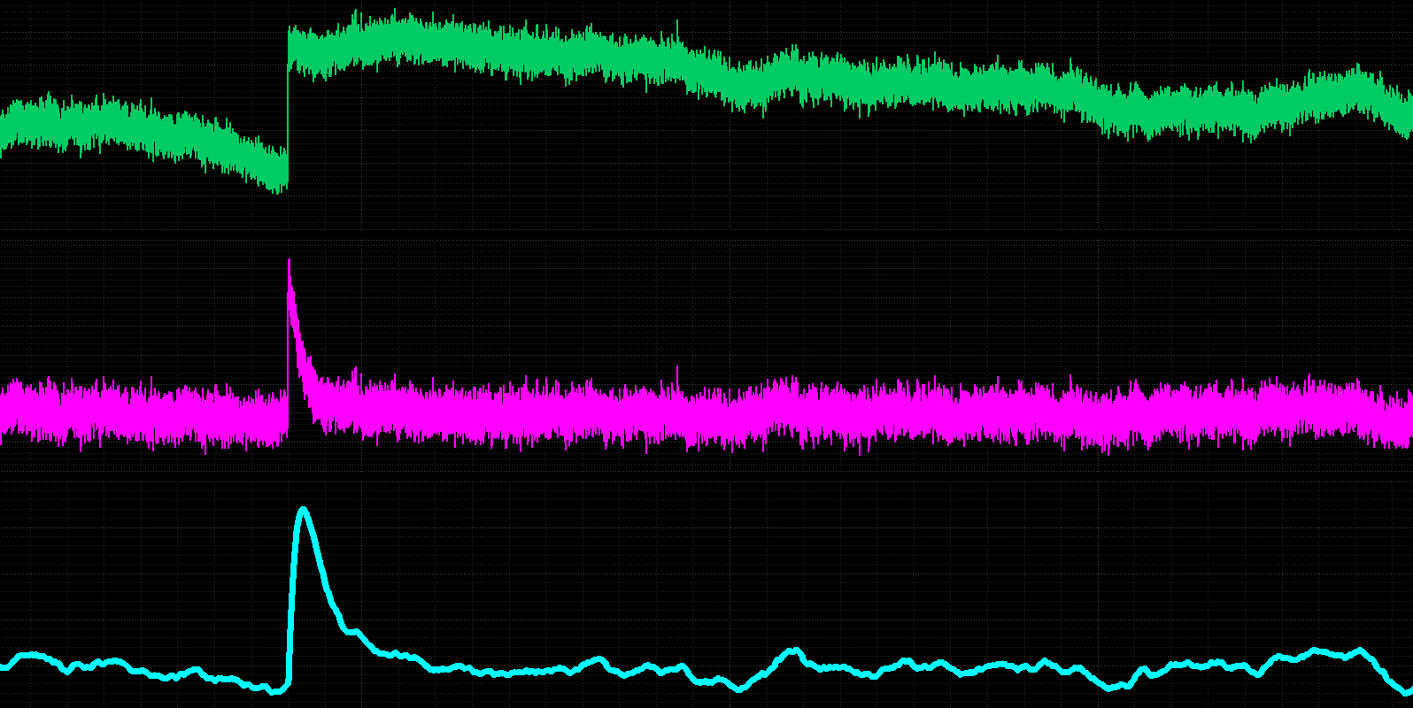
Architecture: filtering
Conversion
E=>Q
Conversion
Q=>ΔV
Filtering
V
Measure
V α E
Detection
E>E_{th}?
No filtering
+CR filter => reduces low frequency noise
+RC filter => reduces high frequency noise

Slide 28
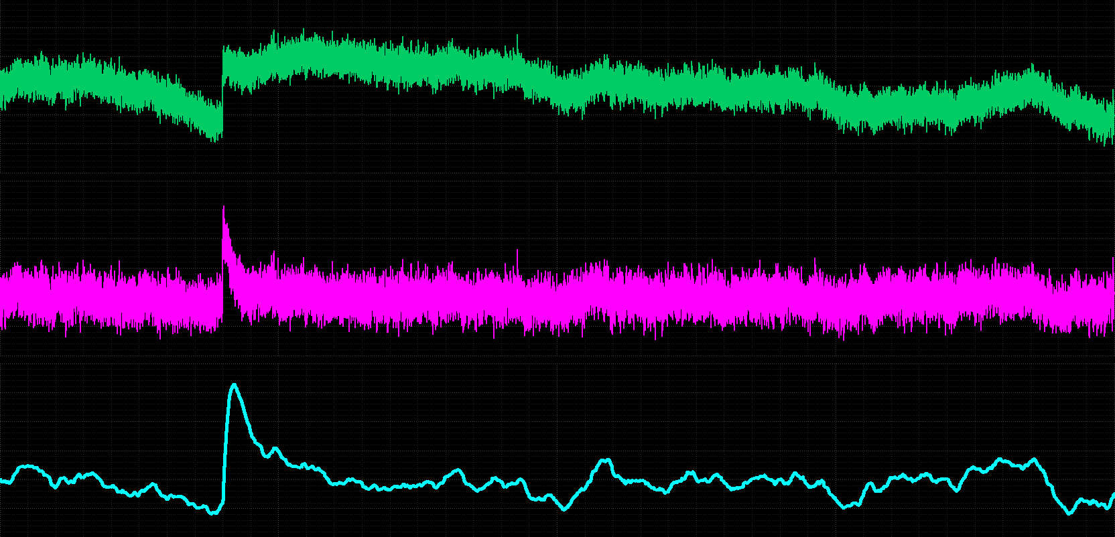
Architecture: filtering
Conversion
E=>Q
Conversion
Q=>ΔV
Filtering
V
Measure
V α E
Detection
E>E_{th}?

Slide 29
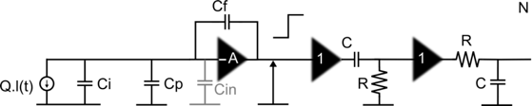
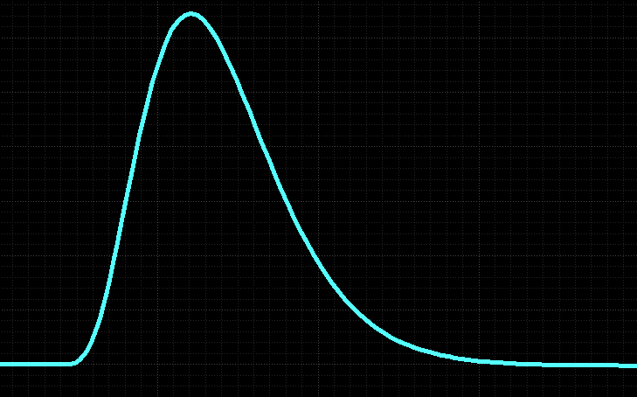

Architecture: filtering
Conversion
E=>Q
Conversion
Q=>ΔV
Filtering
V
Measure
V α E
Detection
E>E_{th}?
One of the most common filter, easy to integrate and very powerful is the classical CR-RC^{n} filter.
N infinite => gaussian shape
$$Amplitude=k×\frac{Q}{C_{f}}$$
T_{peak}=N.RC

Slide 30

Architecture: filtering
T_{peak}=N.RC
Main noise contributions at the output of the CR-RC^{N} filter :
Thermal noise of the input transistor of CSA
1/f noise of input noise of CSA (in 1/f)
Shot noise due to leakage current (in 1/f²)
Their relative contributions depend on the peaking time T_{peak}=N.RC The peaking time is an optimization parameter and is thus very often programmable.

Slide 31
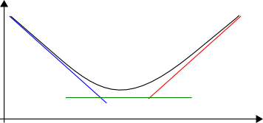
Architecture: filtering
T_{peak}=N.RC
Thermal noise of the input transistor of CSA: A*Ctot*T_{peak}^{-1/2}
1/f noise of input noise of CSA:ENC_{1/f}=C*Ctot
Shot noise (detector) due to leakage current: B*T_{peak}^{1/2}
In practically all readout circuits: 10 ns < T_{peak} < 10 µs
ENC²= ENC_{th}² + ENC_{1/f}² + ENC_{shot}²
Noise
Log(ENC)
-1/2
I_{leak}
1/2
Shot Noise
I_{bias}
Thermal Noise
C_{t} & T
Filtering time
Log(t_{peak})
1/f Noise
C_{t}

Slide 32
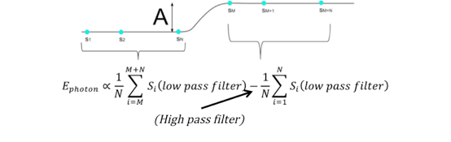
Architecture: filtering and measurement
Conversion
E=>Q
Conversion
Q=>ΔV
Filtering
V
Measure
V α E
Detection
E>E_{th}?
Time variant filters
Multi-Correlated Double Sampling (MCDS) Dual slope integrators
f
Filtering of 1/f noise (depends on the sampling frequency)
Filtering of high frequency noise (mean value)
Generally used in Active Pixel Sensors.
t_{m}
t_{m}
A α E_{photon}
Notes:
Les bruits dominants dépendent du type de détecteur. Et donc l’architecture de filtrage et de mesure aussi.
D’une manière générale, même si les architectures sont différentes, on a à la fois du bruit blanc et du bruit 1/f que ce soit en sortie de CSA ou de Suiveur. On a donc toujours un filtrage de type passe haut. Et presque toujours, suivant les architectures si nécessaire du filtrage passe bas.
Donc ici je vais décrire les deux grandes familles d’architecture qui bien sûr ont chacune une multitude de variantes ou de raffinements diverse.
On peut faire le différence entre les ASIC qui

Slide 33
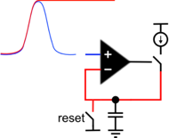

Architecture: measurement and memorization
Conversion
E=>Q
Conversion
Q=>ΔV
Filtering
V
Measure
V α E
Detection
E>E_{th}?
Sample & Hold
Simple
Bipolar
Needs a hold signal from a delayed trigger
Peak Detect and hold (Peak Stretcher)
Mono polarity.
Memorizes the highest value reached by the signal since the last reset.
“Analog CMOS peak detect and hold circuits”. Part 1&2. De Geronimo et al, NIMA 2001-2002 (theoretical study + offset suppression techniques)
“Noise distribution of a peak track and hold circuit”, Seller et al, Nuclear Instruments and Methods in Physics Research A, 2012, Volume 696, p. 129-135.
A α E_{photon}
-
+

Slide 34
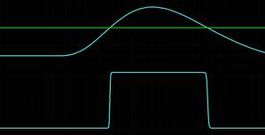
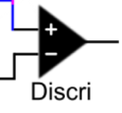
Architecture: detection and timing
Conversion
E=>Q
Conversion
Q=>ΔV
Filtering
V
Measure
V α E
Detection
E>E_{th}?
Self Triggered ASIC: the ASIC sends a flag when at least one of its channel has been hit (E>E_{th}). One uses a discriminator (comparator)
Hysteresis is needed to suppress multi-hit.
The threshold is made by an in-channel DAC, one per pixel to compensate for mismatches. If not, the worst pixel makes the threshold.
A global or between pixels builds a flag signal that is sent to external word.
Signal
DAC
CR-RC^{N}
Threshold
Output

Slide 35
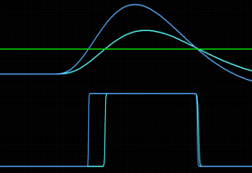
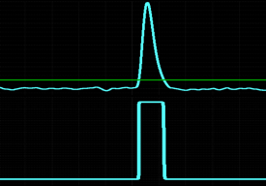
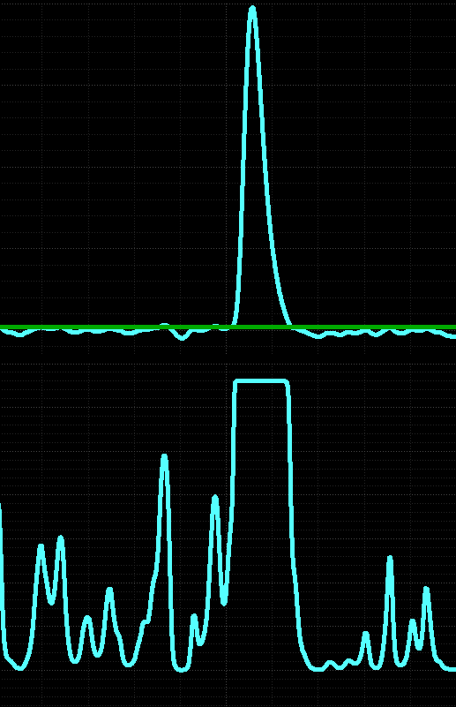
Architecture: detection and timing
Conversion
E=>Q
Conversion
Q=>ΔV
Filtering
V
Measure
V α E
Detection
E>E_{th}?
If timing is needed to memorize the time of arrival of the particle for instance, low peaking time and low threshold can be used:
Time walk is the delay between hit and trigger. For regular (leading edge) discriminators, time walk depends on the signal level. But it can be calibrated thanks to signal amplitude measurement. Constant fraction discriminator can also be used. To reduce time walk, peaking time must be reduced. The low threshold is the minimal charge detectable by the electronics, it is set by the noise level on the trigger path.
0<Time walk<T_{peak}

Slide 36
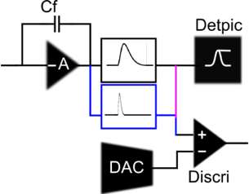
Architecture: detection and timing
Conversion
E=>Q
Conversion
Q=>ΔV
Filtering
V
Measure
V α E
Detection
E>E_{th}?
Two options:
Low energy detection: same shaper for energy and discrimination paths=>Time walk correction a posteriori
Timing, anticipation: Fast Shaper (but generally more noisy)

Slide 37
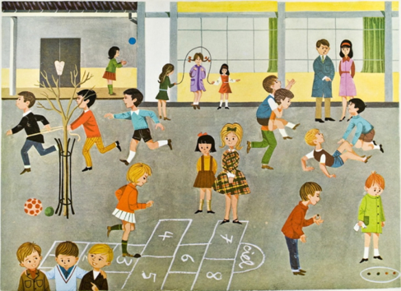
Erholung

Slide 38
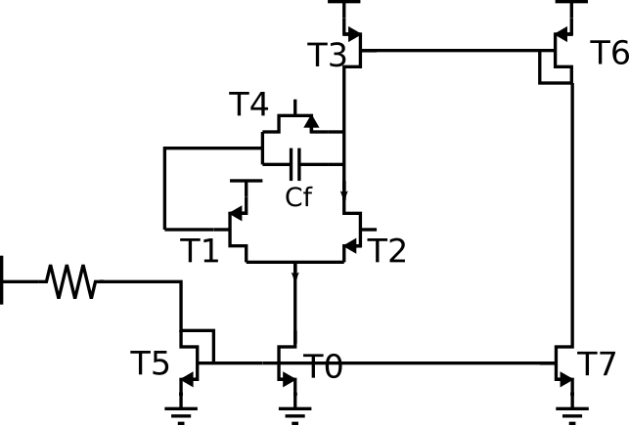
Find the function
Current mirror
Input Trans
Cascode
Other

Slide 39
Find the function
Current mirror
Input Trans
Cascode
Other

Slide 40
Find the function
Current mirror
Input Trans
Cascode
Other

Slide 41
Find the function
Current mirror
Input Trans
Cascode
Other

Slide 42
Find the function
Current mirror
Input Trans
Cascode
Other

Slide 43
Find the function
Current mirror
Input Trans
Cascode
Other
Folded cascode charge preamplifier

Slide 44
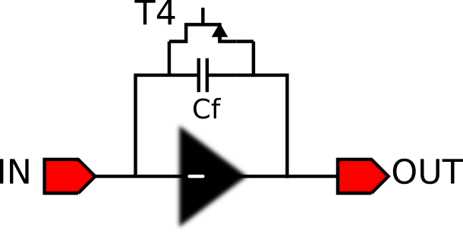
Find the function
Charge sensitive amplifier with folded cascode amplifier

Slide 45
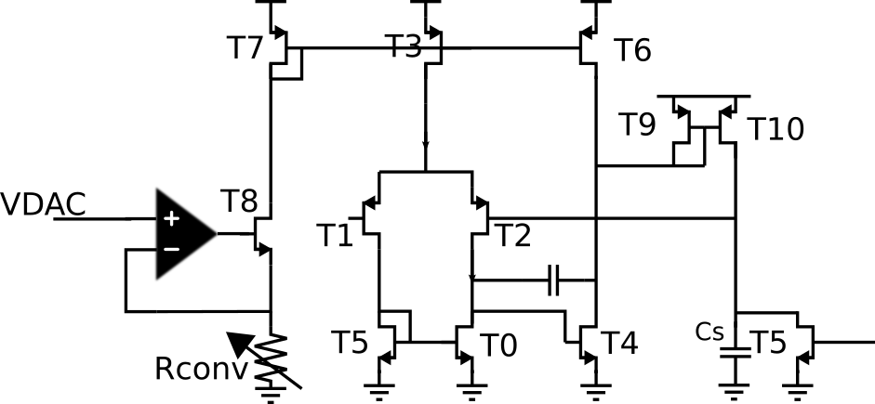
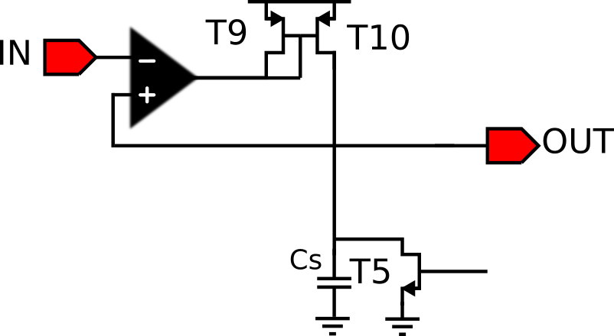
Find the function
Peak-stretcher with Miller OTA
T9 is used to increase the second pole during peak stretching by reducing output impedance for stability.
What is the feature of T5?

Slide 46
Peak stretcher

Slide 47
Ende

Slide 48
Microelectronic technologies
Theoretical guidelines.
  Special applications: high voltage, Cryogenic temperatures
  Longevity
  Performances: noise, speed, power, dynamic range, radiation hardness…
  Price
  Density (becomes to be important)
Practical guidelines.
  Special applications: high voltage, Cryogenic temperatures, radiations
  Try to re-use well known technology=>risk & development time are reduced
  R&D on new technologies for future missions
Notes:
This is the way we should choose the most appropriate technology for a mission.
The first question is do we need very specific technology: For instance for certain detector, one need high voltage technology. This is for instance the case of the chip that are driving Depfet of pn CCD detector. For such application you can use special technologies that can support few tens of volts.
You can need to cool down the electronics when it has to be very close to cryogenics sensors. This is the case for instance for ASICs micro-calorimeters. You can choose to use Silicon Germanium technology.
Then you have to consider the longevity of the technology. Since you begin a project with a potentially long development time you have to be sure that the technology will be still available five years or even more later.
Generally there is no information on this longevity, so you have to guess or you need to hurry.
Then of course you have to find the best technology that has the best performances and it is generally a trade off between many parameters.

Slide 49
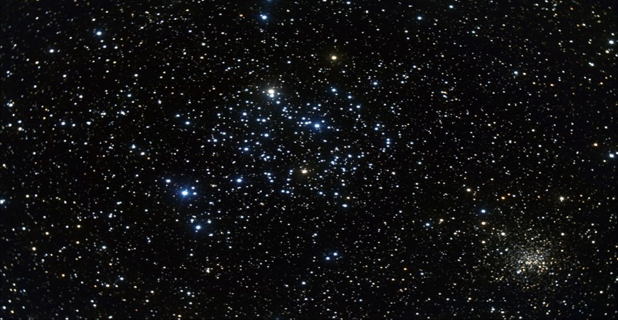
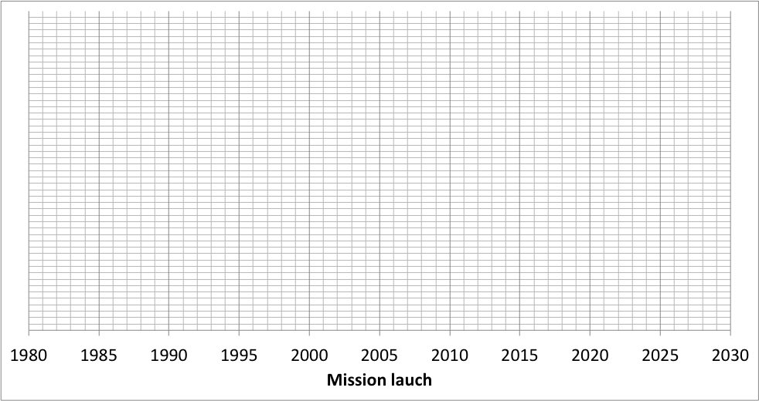

Technologies for space missions for astrophysics
Europractice MPW Service Creation
ASTROSAT
SRG
RXTE
GLAST
NICER
CHANDRA
BeppoSax
INT
COMPTON
NUSTAR
ASTROH
ATHENA
EGRAL
SWIFT
AGILE
COBE
ASCA
SV
XMM
OM
No ASIC
ASIC technology:
3.5µm
1.2 µm
0.8µm
0.6 µm
0.5 µm
0.35µm
?

Slide 50
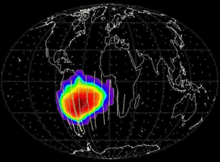
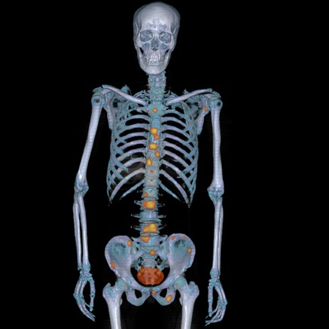
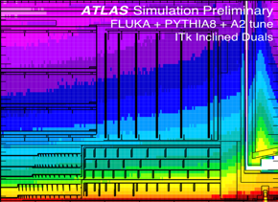
Microelectronic technologies
Radiation effects
In space, particle accelerators or hospitals, radiations can modified the performances and even destruct ASICs.

Slide 51
Microelectronic technologies
Dose effects
    Radiation-induced charges are trapped in the oxides of the IC=> V_{th} shifts and carrier mobilities degradation leakge current increase
    => performances shift (gain, noise, impedance…) and functionality can disappear...
Mitigation techniques
  Use “aggressive” technologies with thinner oxides (65nm is the most aggressive today, used for trackers)
  Shielding in the instrument (usual in satellites)
  Hardening by design: special structures (layout) to mitigate these effects.
The received Total Ionizing Dose is typically between few krad and 100 krad (1kGy) for space mission but can reach 1 Grad at LHC in the primary vertex center.

Slide 52
Microelectronic technologies
Single Event Effects
    Local Ionization induced by charged particles (heavy ions, protons) can have many effects in ICs:
      temporary (SEU, SET, SEFI)
      Permanent (SEL, SEGR)
Mitigation techniques
  Triplication techniques
  Technology: Silicon On Insulator (SEL free), special technology options (EPI layers, triple wells)
  Hardening by design: special structures (layout) to mitigate these effects: SEL (fight against thyristor) and SEU (hardened memory cells)
More informations here: ECSS-Q-HB-60-02A DIR2 Technique for radiation effects mitigation in ASICs and FPGAs handbook (ESA)

Slide 53

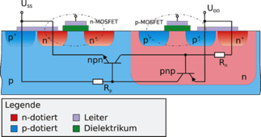



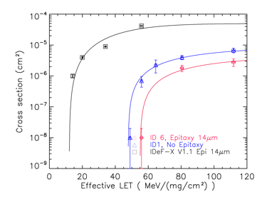
Microelectronic technologies
Single Event Effects can be an issue for ASICs.
SEUs induce Bugs and potentially false events. One have (at least) to be able to detect them.
SEL can be fatal at least for the ASIC since it causes a short circuit. One have to use SEL free ASICs or special anti-latchup circuits in the satellite.
Example: SEL mitigation steps in CMOS 0.35 µm technology:

Slide 54
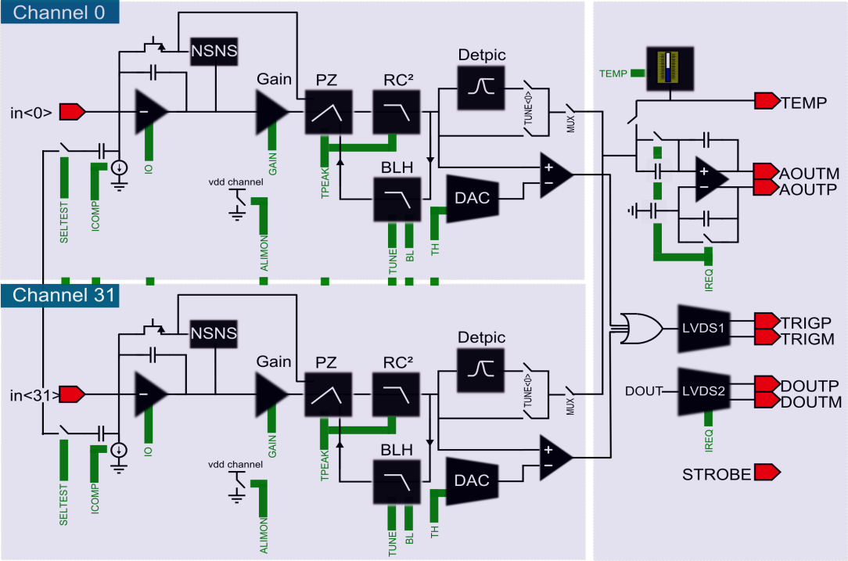
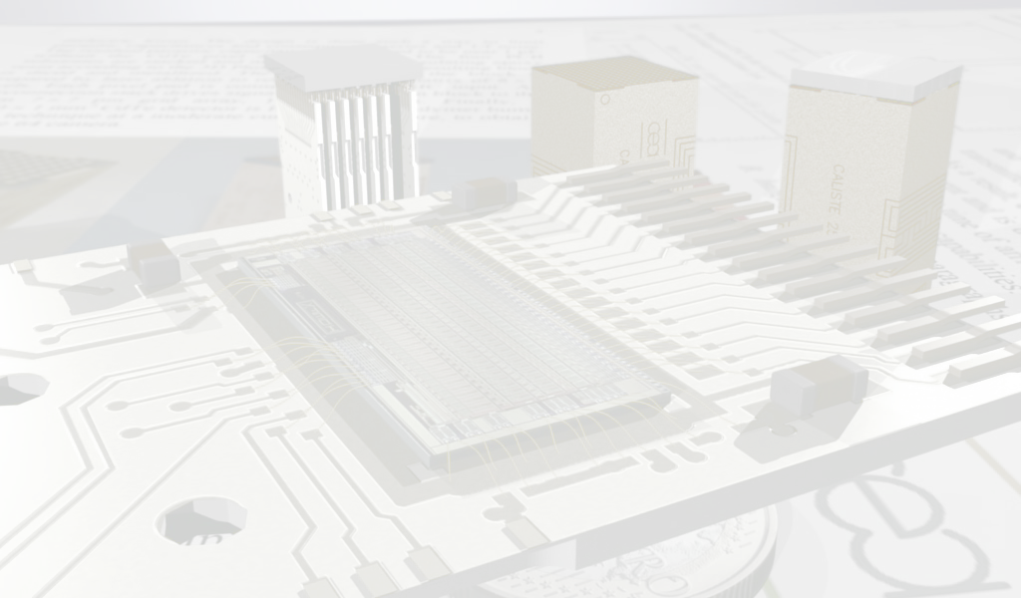
IDeF-X HD
Submitted:december 2009
Come back from fondry: february 2010
Picture of the layout with the different stages, dimensions, ratio between analog and digital part, presentation of the main parts of the layout.
Channel, temperature sensor, digital part, buffer….

Slide 55

IDeF-X HD
Submitted:december 2009
Come back from fondry: february 2010
Picture of the layout with the different stages, dimensions, ratio between analog and digital part, presentation of the main parts of the layout.
Channel, temperature sensor, digital part, buffer….
CMOS AMS 350nm
DIE area: 3500 x 5920
Pitch: 150µm
Power supply: 3.3V
ASIC Pin number: 84
Board Pin:
VDD(x4), GND(x2).
DIN(x2), DOUT(x2), STROBE(x2).
AOUT(x2), TEST, SEU.
CHIPSELECT(x3)
=>16 pins for 8 ASICs

Slide 56





CRASICs: cryogenics ASICs
R&D Brahms
  New Détectors : Micro-bolometer wit light polarization measurement
  Électronique :
    Test and validation of a prototype for technological characterization Readout for Bolometer.
    Design of a matrix chip 200pW/channel, 50-100mK.
Détecteur Bipol Spirales
Détecteur ULG15
Techno Above IC. CEA-LETI.
ASIC RoBo (CMOS AMS 0.35µm): Test structures (NMOS, PMOS, Res, HighRes, Cpoly1&2) for characterization à 50-100 mK.

Slide 57

ASICs cryogéniques
It works at 0.1 Kelvin! Even if some fanciful behaviors
Notes:
Herschell PACs : 300mK

Slide 58


ASICs cryogéniques
T°=100mK
Mesure T°=100mK
Simu 300K
gm=f(W/L)
PMOS à 10nA et 100nA
gm=f(I_{DS})
PMOS 10/10
Rhouni, A. et al. First-ever test and characterization of the AMS standard bulk 0.35 μm CMOS technology at sub-kelvin temperatures. J. Phys. Conf. Ser. 834, (2017).
Notes:
Herschell PACs : 300mK

Slide 59


Some of our ASIC families
    - Cryogenic ASIC
  ECLIPSE 750:
  CMOS AMS 350nm, 300 PADs. 50-100 mK, 1536 readout circuits, 1µW, 1.7 cm²
ECLIPSE 750
1 Pixel : 6 points élémentaires de lecture.

Slide 60




Some ASIC families
  Monlithic Active Pixel Sensor(MAPS) for tracking
The ASIC is the detector and the readout. Based on the same technologies as for visible imaging but readout optimized for particle tracking.

Slide 61

Some ASIC families
  FE-SCA type ASIC: designed for gaseous detectors and semi-conductor detector for high dynamic range.
Typical architecture
  Multi-channel architecture with, for each channel:
  CSA (multi-gain) + Filter (multi peaking time) + Sampling Capacitor Array (analog memory)
  This architecture memorizes for each event (validated by internal or external trigger) the waveform of the output of the filter:
AGET
1 channel
Σ 64 discri.
DAC
Discri
Trigger pulse
Charge range
inhibit
Hit register
SCAwrite
FILTER
SCA
x64in
CSA
512 cells
x68
ADC
tpeak
12-bit ADC
[ADS6422]
BUFFER
TEST
SLOW CONTROL
Power on
Reset
SCA MANAGER
Readout
Mode
Asic “Spy” Mode
W / R
CK
In Test
Serial Interface
Mode
CK
CSA;CR;SCAin;DISCRIin(N°1)

Slide 62

Muonic tomography: DREAM in Egypt
Muonic Tomography
Muons: particles produced by interactions between cosmic rays and atmosphere.
Natural source (free but rare)
Very penetrating
Straight propagation (in average)
*150/m²/s
Deviated or absorbed in matter depending on its density and thickness:
Can be used to make images
Deviation and absorption depend on density and length crossed.
=>Applications in vulcanology, archeology, exploration of underground, etc…
Matériau | Epaisseur | θ (deg) | P_{absorption}
Air | 100 m | 0.094 | 0.78%
Plomb | 10 cm | 1.01 | 2.9%
Eau | 1 m | 0.35 | 4.2%
Sol | 100 m |  | 99%
Notes:
Herschell PACs : 300mK

Slide 63




Muonic tomography: DREAM in Egypt
Technologie Bulk Micromegas (1996, 2005)
Pistes résistives X & Y (2010, 2012)
induction capacitif
Signal partagé sur plusieurs pistes
Lecture multiplexée génétiquement (2012)
  Multiplexage de 16
  8192 voie de détection, 512 voie elec
Une FEU pour 4 détecteurs du télescope
  8 plans de détection
  61 voies par plan – 1 Dream
µ
Coax faible capa.
50cm
Carte FEU
Notes:
Herschell PACs : 300mK

Slide 64



Muonic tomography: DREAM in Egypt
Projet SCANPYRAMID: Développement de trois téléscope pour mission d'imagerie archéologique sur la pyramide de Keops.
Passage du château d’eau à la pyramide:
              Télescopes : 1 → 3
              Châssis → valise
              Détecteurs : prototype (Cern) → série (Industriel Elvia)
              Durée de construction : 9 mois → 3 mois
              Poids : ~ 200 kg → ~ 130 kg
              Alimentation des détecteurs : indépendante de la température → f(T)
              Données : brutes → brutes + pré-analysées

Slide 65
Muonic tomography: DREAM in Egypt
Film “KHÉOPS : MYSTÉRIEUSES DÉCOUVERTES” sur FRANCE 5.
https://www.francetvpro.fr/france-5/communiques-de-presse/kheops-mysterieuses-decouvertes-8898148

Slide 66

Trends
Few trends in microelectronic design for fundamental physics community are:
Radiation hardness: this is mainly done by using more modern technologies: today 65 nm is used for trackers and 28 nm should be the next one.
Time measurement: for event reconstruction, one need more and more to get the fourth dimension. Increase of the time accuracy of our ASICs to make the event reconstruction more efficient. Many TDC in design today. We are in the 10 ps range (10 ps => 3 mm accuracy)
Go digital ASAP (not really new)
3D integration: use of TSV to increase speed, density, optimized technology.
Zukunft: The TechnoSandwitch
Pixelated detector
Very front-end in Analog
low-noise technology
ADC in fast
High density
technology
Notes:
CRASICs: HEMT+ Germanium silicon transistors ASIC for Metal Insulator Sensors, SQUIDS for Transition edge sensors,
From the end of the nineteen's, Because of the increase in detectors granularity, the use of front-end ASICs for high energy astrophysics has become almost systematic mainly because of the increase of the granularities of detection planes. This has been possible thanks to the use of relative low cost technologies radiation hardened by design. At the end the final performances of the spectro-imaging systems are linked to the design of the detectors, of the ASIC and to the way they are connected together (hybridization). Today the most used technology (350 nm intel I7:14nm) becomes to be very old and ASIC design groups have to anticipate obsolescence.
Which technology for futures missions?
Down scaling: No real benefit to go to very “aggressive” technologies for front end chips: that are generally optimized for digital design, not good for SEU low critical charge and the dose level don’t justify this strategy
Aggressive technologies could be interesting if high speed performances are mandatory: for fine timing and/or fast digital processing.
The future may be a mixed between analog technology coupled by 3D hybridization processes to ultra fast digital technologies (ADC+processings). 3D microelectronics (not 3D packaging) is not usual today and still very expensive (and what about radiation hardness and space qualification), but it is just a question of time.
In parallel, the use of front-end ASICs operating at very low temperatures becomes to be mandatory for ultra-high energy resolution micro-bolometers. Depending on the detector technology, the readout can be done by squid chips or by JFET+CMOS. Today these terrific detectors have reasonable numbers of channel and the readout electronics can be put aside. We can imagine in the future high granularity micro-bolometers, and they will have to be readout. May be with cryogenics ASICs operated at few tens of mK.
The second reason and actually the real reason, is that there at least three types of cryogenic detectors each family has its own readout technique ans technooogy SQUIDs for Transition Edge Sensors JFET and ASIC for isolated metal. The types of multiplexing is also differents, time domain but also frequency and code domain multiplexors. In the case of kids, …
So I really could not speak about everything and I didn’t want to speak about only one. What could be a common subject is that there is a future for cryogenic ASICs a groups around the word are working and will work for the readout of these detectors with terrific energy resolution.
----- Notes de la réunion (24/06/16 17:13) -----
toto

