Slide 1
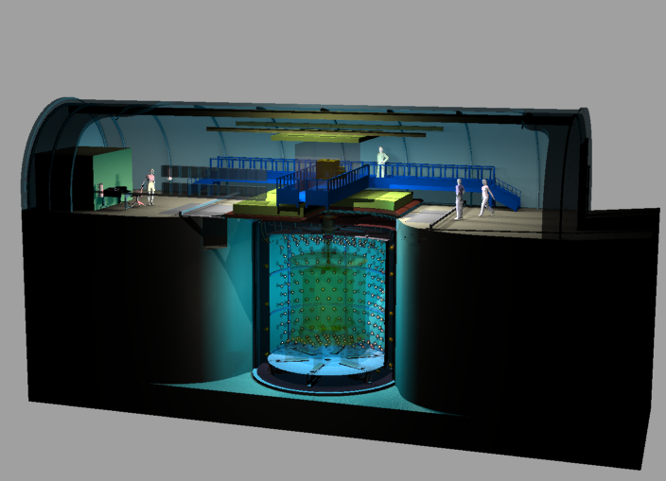
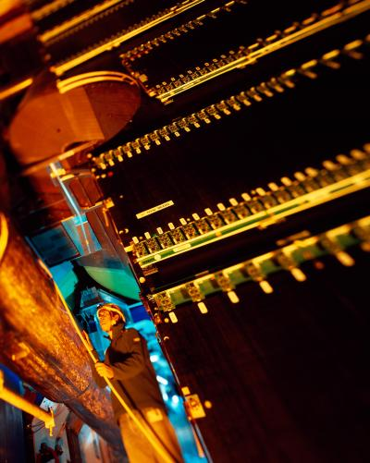
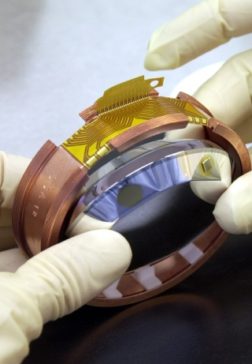
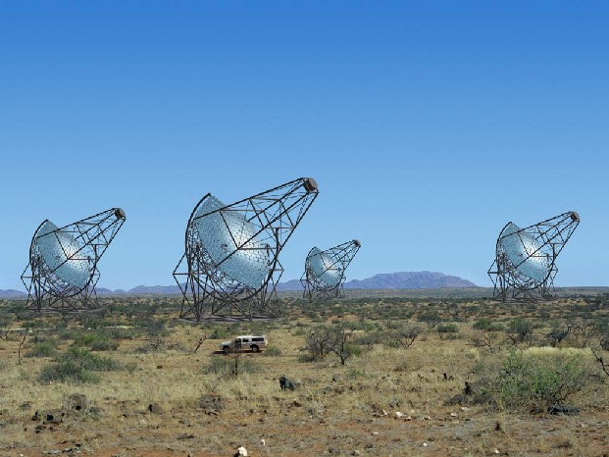
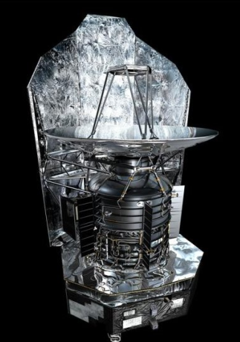
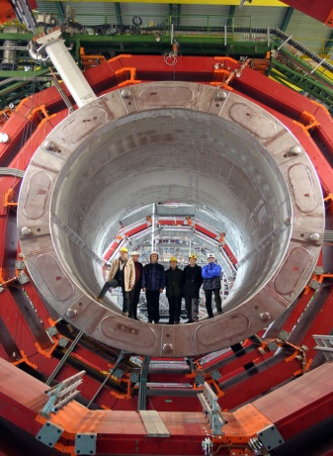
IRFU
Institute of research into the fundamental laws of Universe
Double Chooz
ALICE
Edelweiss
HESS
Herschel
CMS
Philippe CHOMAZ
Déchiffrer les rayons de l’Univers
Irfu Director

Slide 2
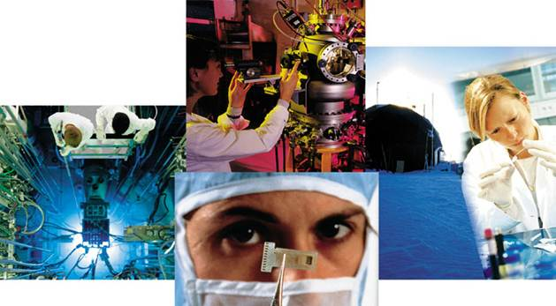
Irfu: Large CEA Institute created in 1993
Research and Technology
CEA
Alternative Energies & Atomic Energy Commission
Energies
Technologies
Defense
Basic Research
16 000 Employees, 3 900 M€

Slide 3

Irfu: Large CEA Institute created in 1993
Research and Technology

Slide 4
Irfu: Large CEA Institute created in 1993
Research and Technology
  Fusion in 1993 (DAPNIA)
      Physics: Infinitely large & small
      Technology: Radiations
  Institute in 2008
Irfu
814 Employees, 84 M€

Slide 5
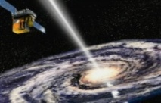
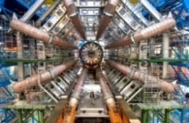
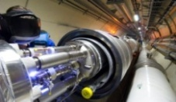
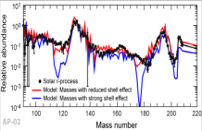
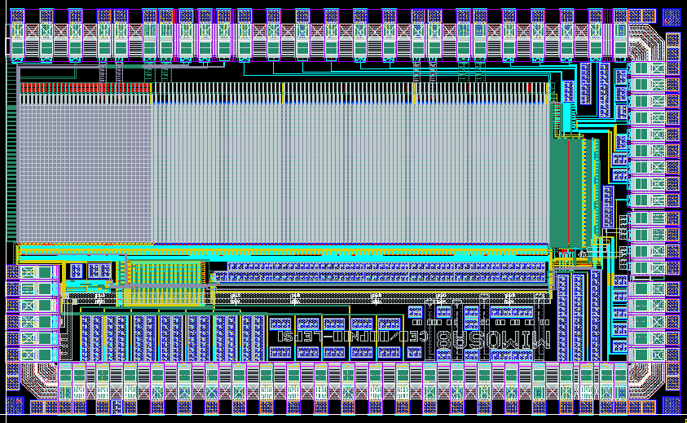
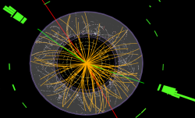
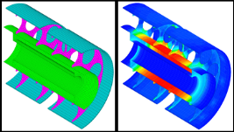
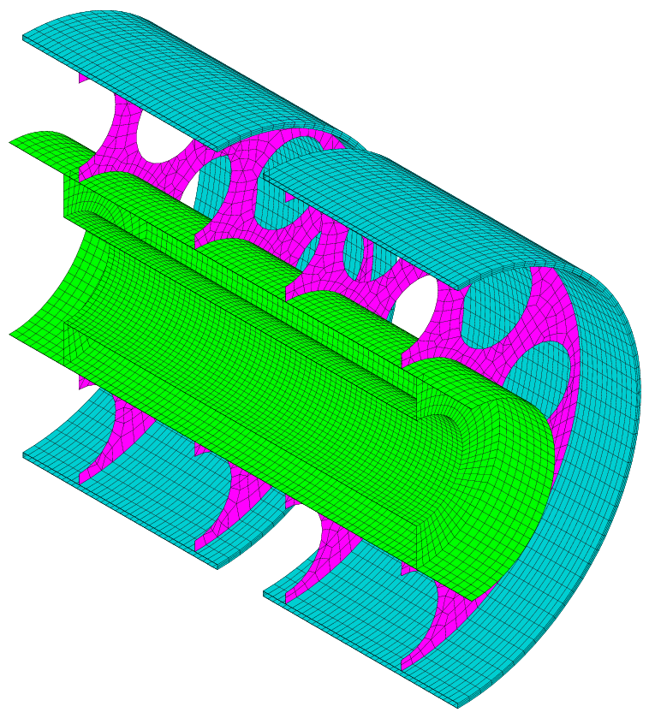
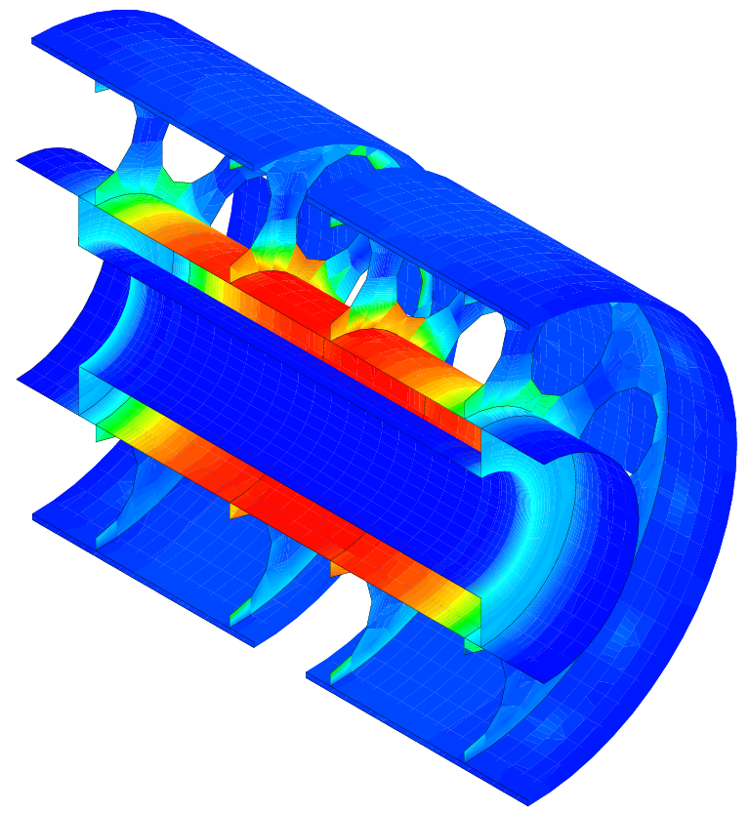
Irfu: Large CEA Institute created in 1993
Research and Technology
  Research & Technology
      Physics: Infinitely large & small
      Technology: Radiations
Irfu
Institute of Research into the Fundamental laws of Universe
Institute of Research into the Fundamental laws of Universe
Astrophysics
Space technologies
Astrophysics
Space technologies
SAp: Astrophysics
Space technologies
Accelerators,
Supra. Magnets
Accelerators,
Supra. Magnets
SACM: Accelerators,
Supra. Magnets
Nuclear Physics
Nuclear Physics
Detectors, electronic,
computing
SPhN: Nuclear Physics
Detectors, electronic,
computing
SEDI: Detectors,
electronic, computing
Particle Physics
Particle Physics
SPP: Particle Physics
Systems engineering
Systems engineering
SIS: Systems engineering

Slide 6
Irfu: Large CEA Institute created in 1993
Research and Technology
  Research & Technology
      Physics: Infinitely large & small
      Technology: Radiations
814 FTE
632/615 CDI/CDI-CEA
814
FTE
Institute of Research into the Fundamental laws of Universe
Institute of Research into the Fundamental laws of Universe
Astrophysics
Space technologies
116 CDI
94 CDD
Astrophysics
Space technologies
SAp: Astrophysics
Space technologies
Accelerators,
Supra. Magnets
Accelerators,
Supra. Magnets
SACM: Accelerators,
Supra. Magnets
121 CDI
10 CDD
Nuclear Physics
Nuclear Physics
Detectors, electronic,
computing
SPhN: Nuclear Physics
Detectors, electronic,
computing
56 CDI
29 CDD
SEDI: Detectors,
electronic, computing
125 CDI
11 CDD
Particle Physics
Particle Physics
SPP: Particle Physics
Systems engineering
72 CDI
45 CDD
Systems engineering
SIS: Systems engineering
97 CDI
8 CDD

Slide 7
Irfu: Large CEA Institute created in 1993
Research and Technology (see chapter 4)
814 FTE
632/615 CDI/CDI-CEA
84 M€ (2012)
54 M€ Gov. Subsidies
814
FTE
84
M€
Institute of Research into the Fundamental laws of Universe
Institute of Research into the Fundamental laws of Universe
Astrophysics
Space technologies
116 CDI
94 CDD
Astrophysics
Space technologies
SAp: Astrophysics
Space technologies
Accelerators,
Supra. Magnets
Accelerators,
Supra. Magnets
SACM: Accelerators,
Supra. Magnets
121 CDI
10 CDD
Nuclear Physics
Nuclear Physics
Detectors, electronic,
computing
SPhN: Nuclear Physics
Detectors, electronic,
computing
56 CDI
29 CDD
SEDI: Detectors,
electronic, computing
125 CDI
11 CDD
Particle Physics
Particle Physics
SPP: Particle Physics
Systems engineering
72 CDI
45 CDD
Systems engineering
SIS: Systems engineering
97 CDI
8 CDD

Slide 8

IRFU: Organized for large projects
Concentration of human Resources
Heavy equipment
Advanced technologies
Project oriented organization,
inside CEA, a technology
dominated institution
ATLAS Toroïdal Magnet

Slide 9




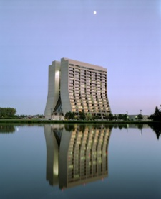
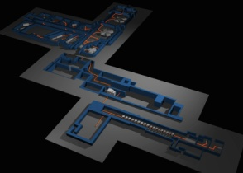
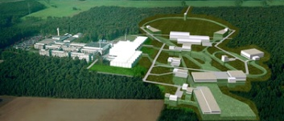

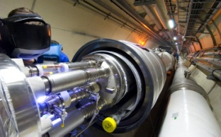
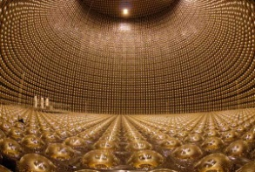
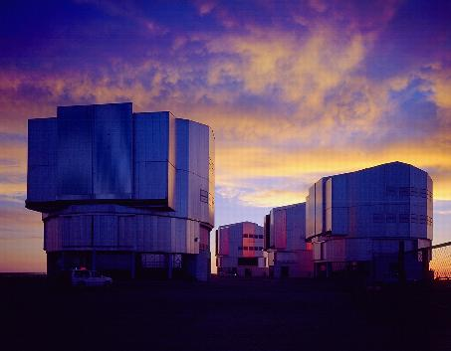
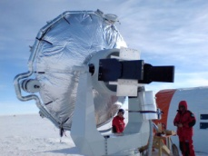
Think global …
Research projects inside large international programs
implying a collaboration with other French and foreign institutions
US-DOE
CNRS/In2p3
GANIL
GSI-FAIR
DESY
CERN
KeK
JAEA
ESO

Slide 10
Level of international relations
  International attractiveness
      Origin of PhD of the 25 physicists hired on a permanent contract

Slide 11
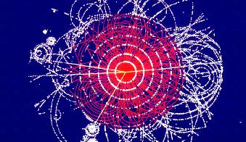
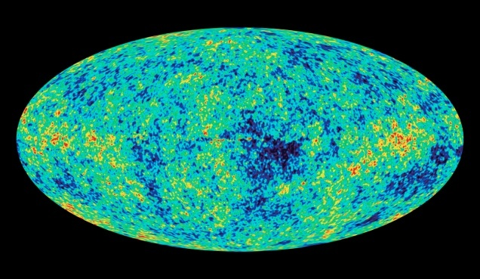
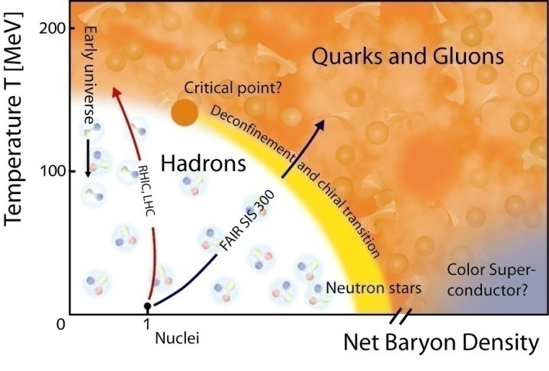
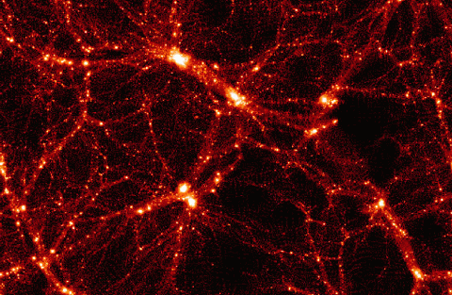
Exploring the fundamental laws of Universe
What are the ultimate constituents of matter ?
What is the energy content of the Universe ?
Infinitely small
Infinitely large
Elementary
Complexe
What are the origins of particles and nuclei ?
What are the origin and structure of Universe ?

Slide 12

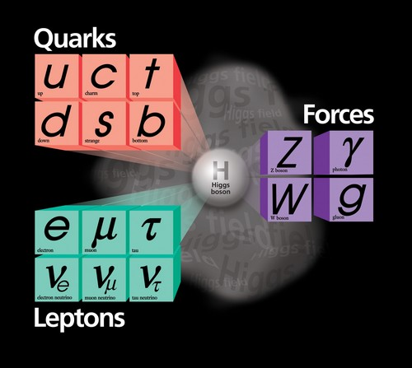

Ultimate constituents
47 (45 CEA)
Permanent physicists

Slide 13


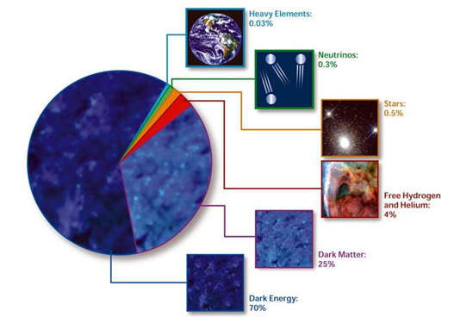
Energy content of the universe
27 (24 CEA)
Permanent physicists

Slide 14


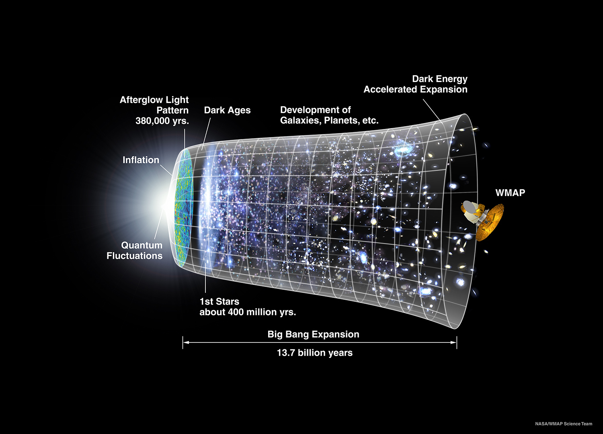
Formation of structures IN the universe
39 (28 CEA)
Permanent physicists

Slide 15


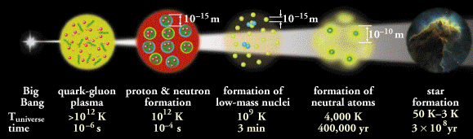
structures of Nuclear Matter
36 (35 CEA)
Permanent physicists

Slide 16
Exploring the fundamental laws of Universe
What are the ultimate constituents of matter ?
What is the energy content of the Universe ?
Infinitely small
Infinitely large
Elementary
Complexe
What are the origins of particles and nuclei ?
What are the origin and structure of Universe ?

Slide 17
3) Comment l’Univers est-il structuré ?
Exploring Universe history
  Etoiles et galaxies
  Univers violent et trous noirs
  Rayons cosmiques

Slide 18
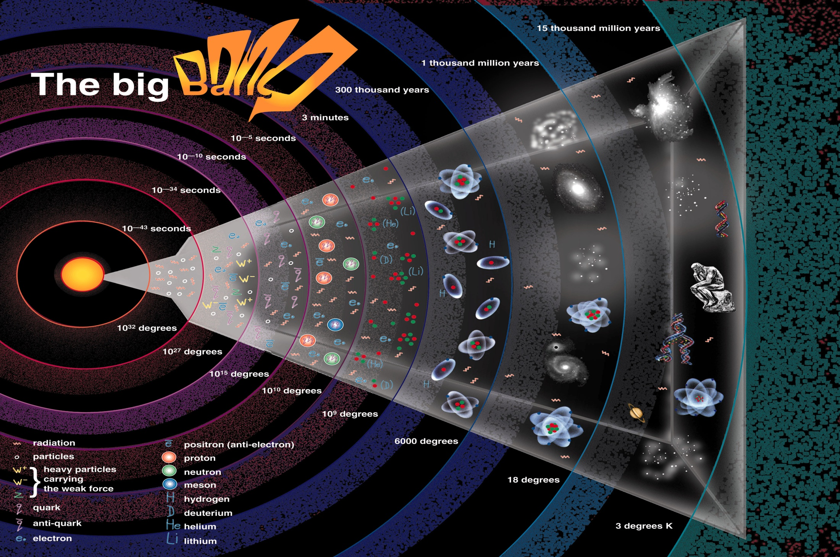
4) Comment les noyaux et particules sont-ils créés ?
Exploring Universe history
  Plasma de quarks et de gluons
  Noyaux exotiques

Slide 19
4) Comment les noyaux et particules sont-ils créés ?
Exploring Universe history
  Plasma de quarks et de gluons
  Noyaux exotiques

Slide 20
Positionnement par segment lois fondamentales de l’Univers
Explorer l’ histoire de l’ Univers
4) Comment les noyaux et particules sont-ils créés ?
Quels sont les constituants ultime de la matière ?
Quel est le contenu énergétique de l’Univers ?
Infiniment petit
Infiniment grand
élémentaire
Complexe
  Plasma de quarks et de gluons
  Noyaux exotiques
Comment s’organise la matière nucléaire ?
Comment l’Univers s’est-il structuré ?

Slide 21
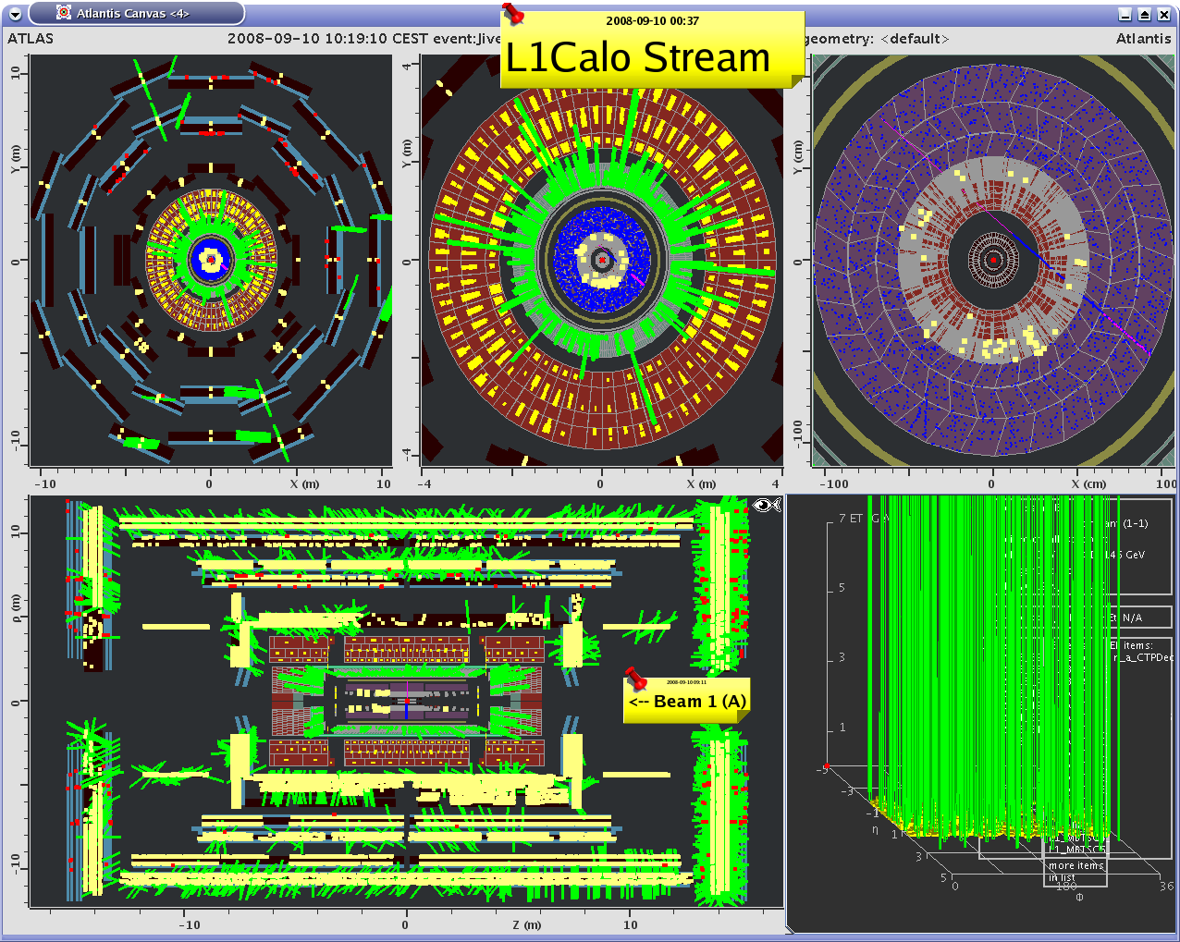
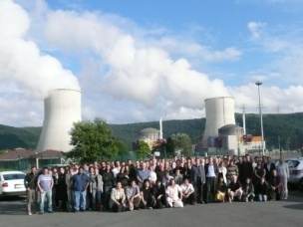

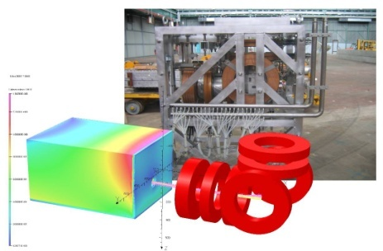
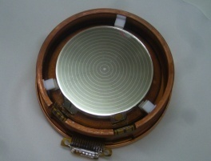

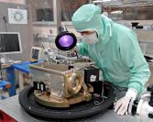

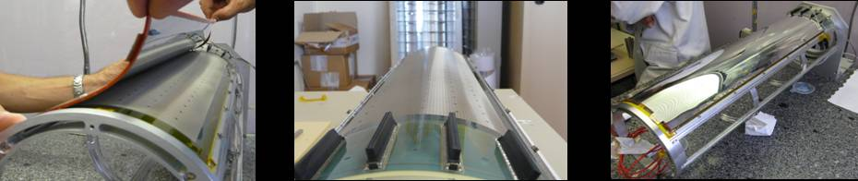
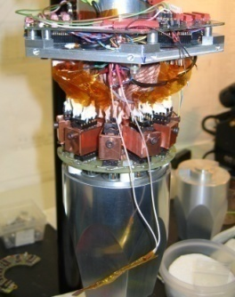

Exploring the fundamental laws of Universe
Elementary constituents?
  Standard Model, Higgs boson (ATLAS,CMS)
  Neutrinos oscillations (T2K, Db-Chooz, Cesox, Stereo)
Energy content?
  Dark Universe (Edelweiss, BAO, Desi, Euclid …)
  Antimatter (Gbar)
Structures in the Universe?
  Cosmology (Planck)
  Formation of galaxies and stars (Hershel, JWST …)
  Violent Universe (Fermi, Svom, Hess, CTA, Atena)
Origin of particles and nuclei?
  Plasma of quarks and gluons (ALICE)
  Structure of Hadrons (COMPASS, JLAB)
  Exotic nuclei (GANIL/SPIRAL2, FAIR)

Slide 22

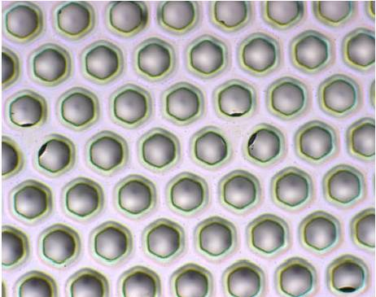
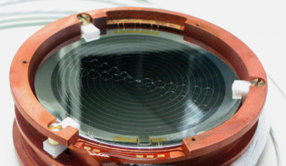
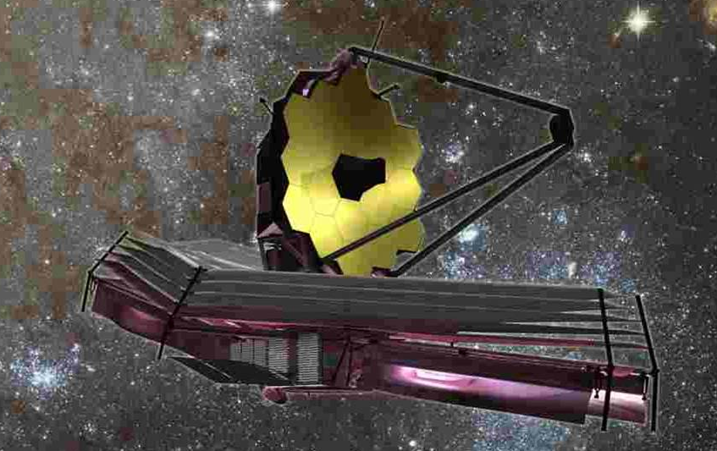
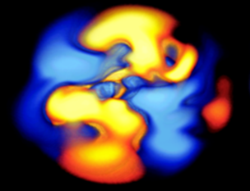
Inventing and constructing new devices
What are the ultimate constituents of matter ?
What is the energy content of the Universe ?
Manipulating
Detecting
What are the properties of matter under extreme conditions ?
What are the origin and structure of Universe ?
Observing
Simulating

Slide 23
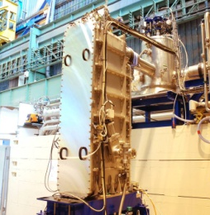
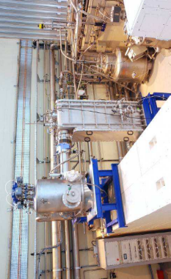
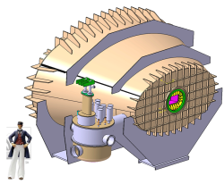
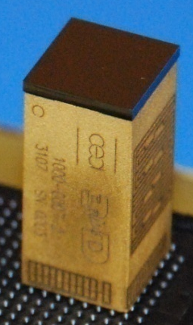
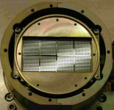
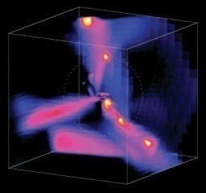
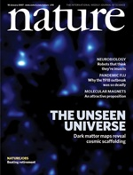
Inventing and constructing new devices
Production and manipulation of radiations
  Accelerators (Spiral2, XFeL, FAIR, CERN, IFMIF, ESS)
  Magnets & Superconductivity (R3B, ISEULT, JT60SA)
Detecting radiation
  Microstructured detectors (RD51, CLAS12)
  Imaging device (ELT-METIS, APEX, CALIST)
  ASIC
Space technology
  Camera (PACS, MIRI, Éclair)
  Data center (Fermi, SWOM)
Simulation and data treatment
  Massively parallel calculations
  Grid
  Data processing

Slide 24






Applying research and technologies
What are the ultimate constituents of matter ?
What is the energy content of the Universe ?
knowledge
Know-How
Energy
TGIR
Large Research infrastructures

Slide 25




Irfu

Slide 26
Direction des Sciences de la matière
Institut de Recherche sur les lois Fondamentales de l’Univers
Direction
Double Chooz
ALICE
Edelweiss
HESS
Herschel
CMS
Interpreting radiations from the Universe.
Commissariat à l’énergie atomique et aux énergies alternatives
Centre de Saclay | 91191 Gif-sur-Yvette Cedex
  Etablissement public à caractère industriel et commercial | RCS Paris B 775 685 019

