Slide 1
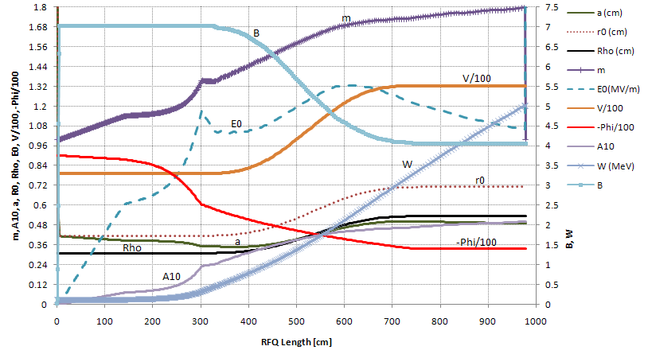
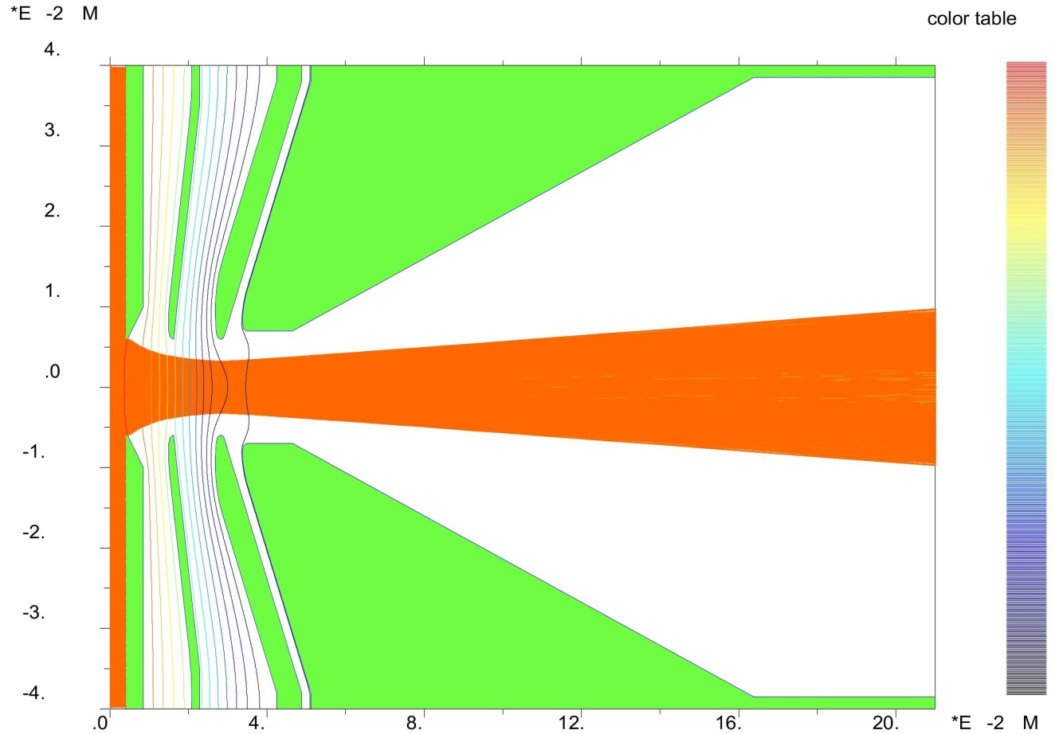
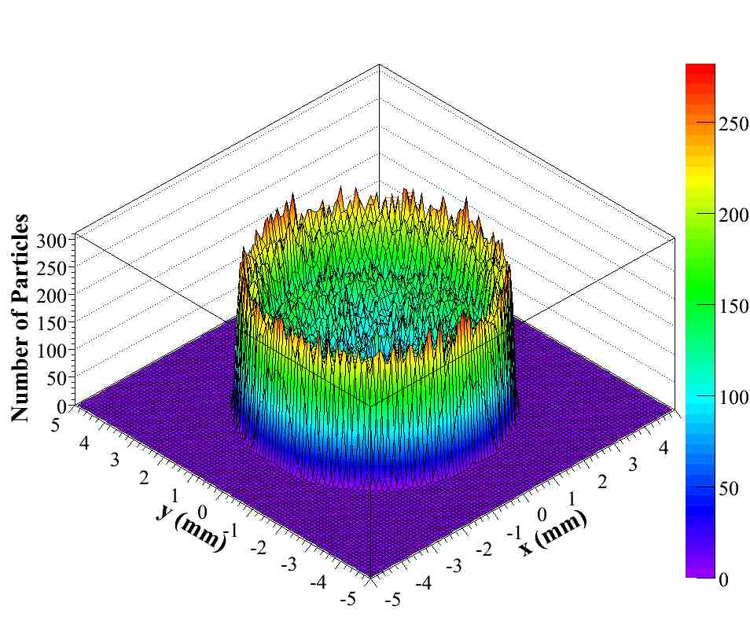
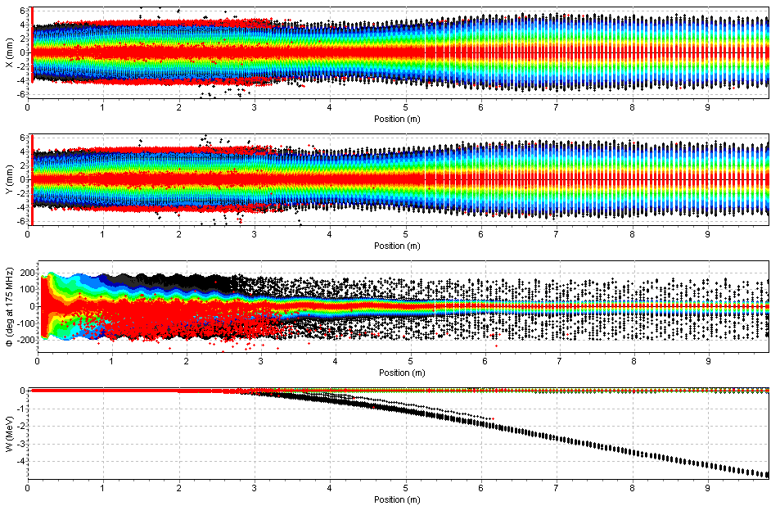
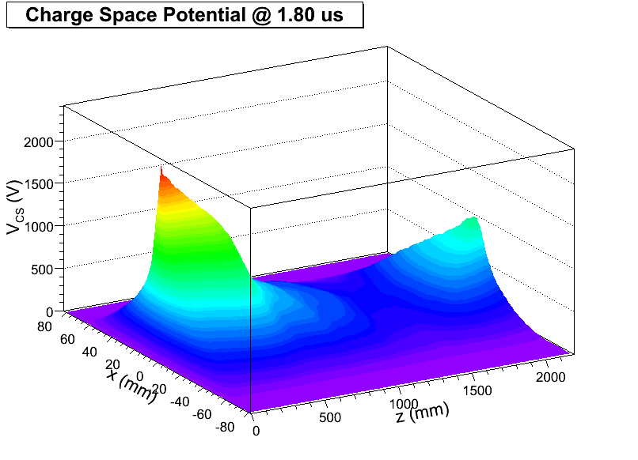
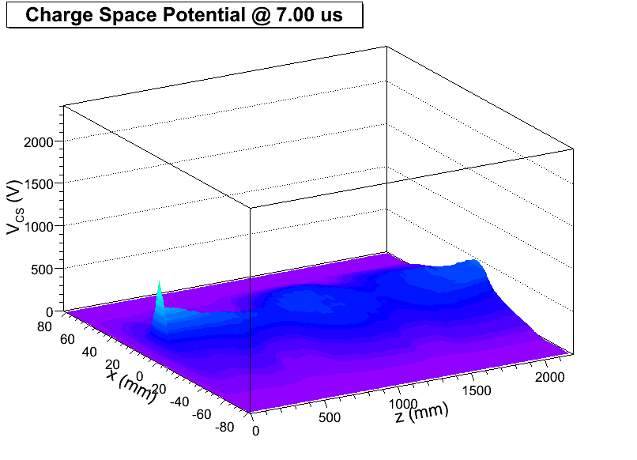
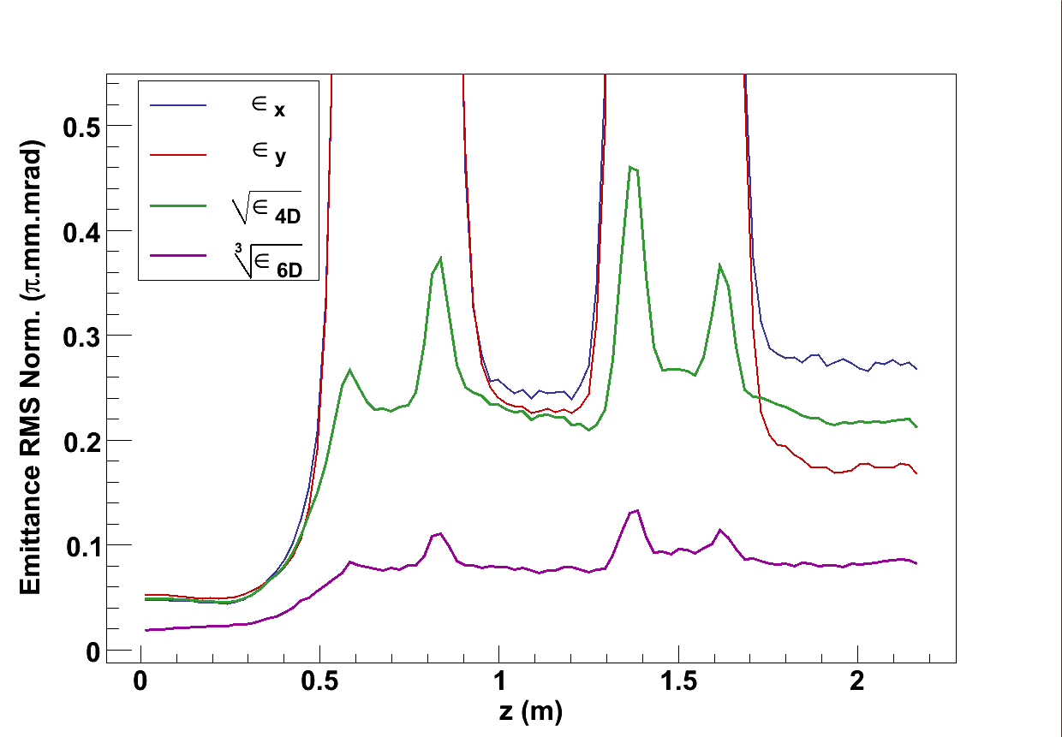
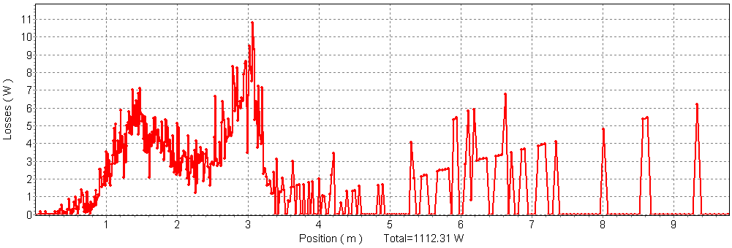
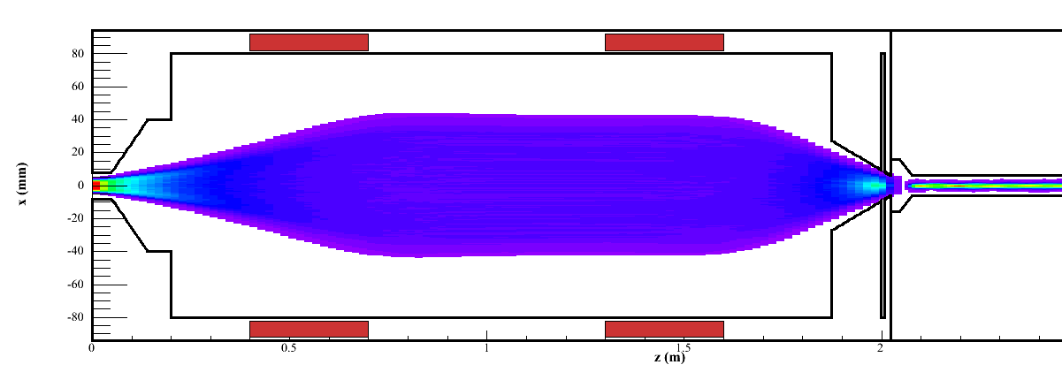
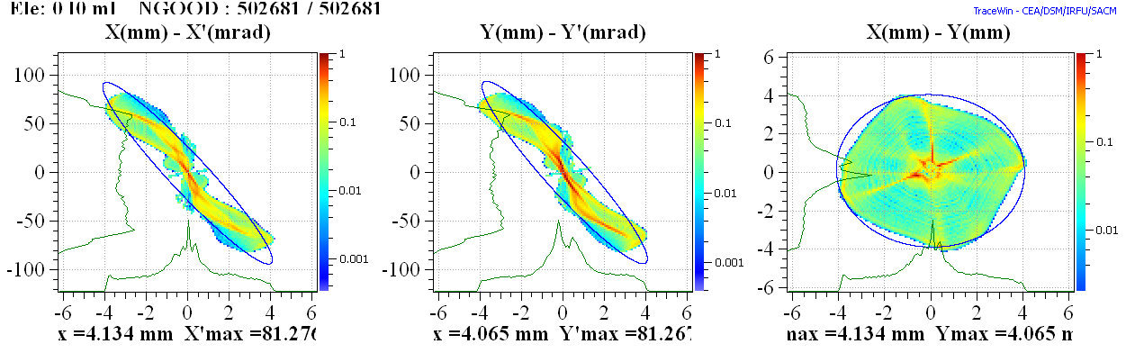
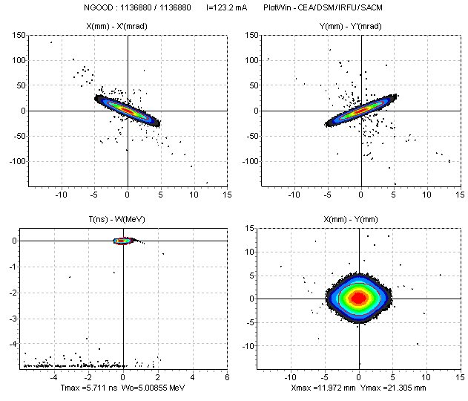
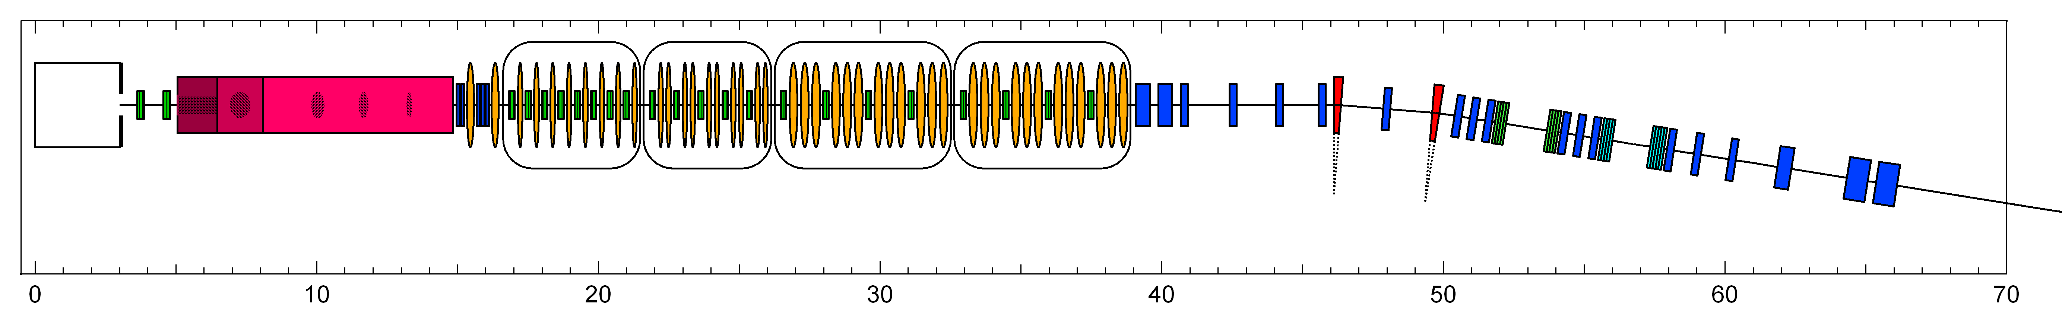
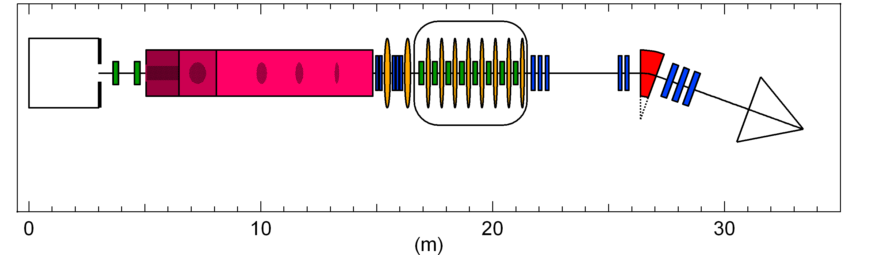
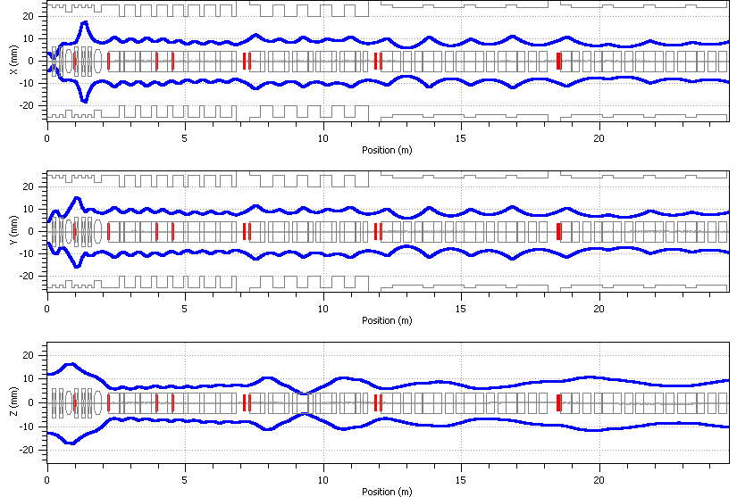
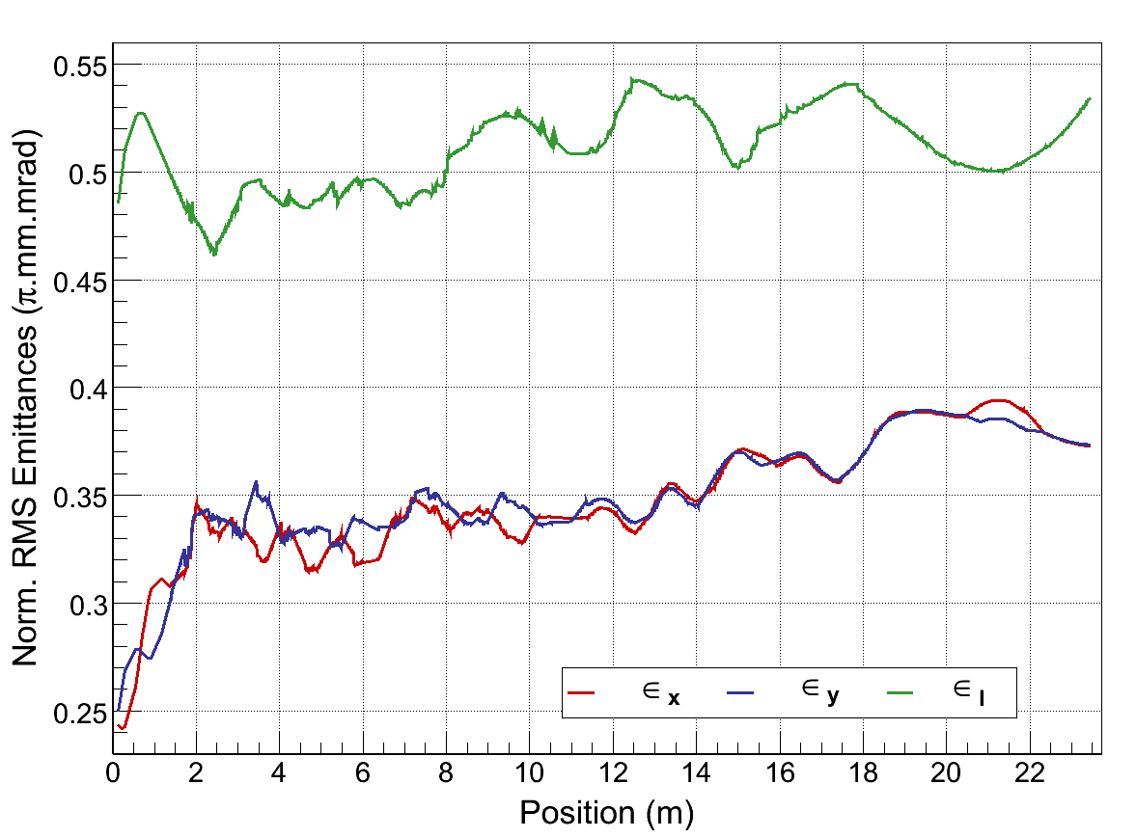
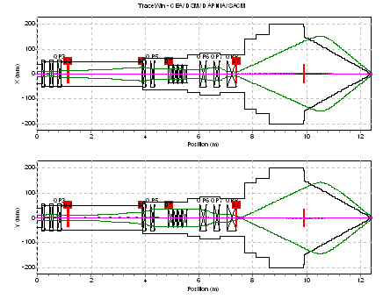
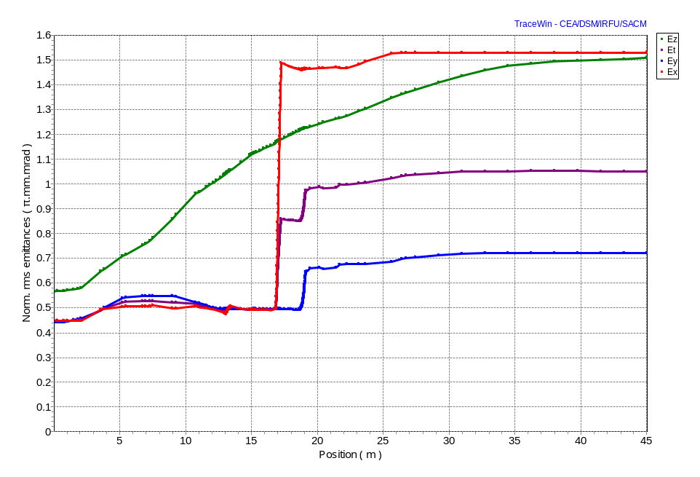
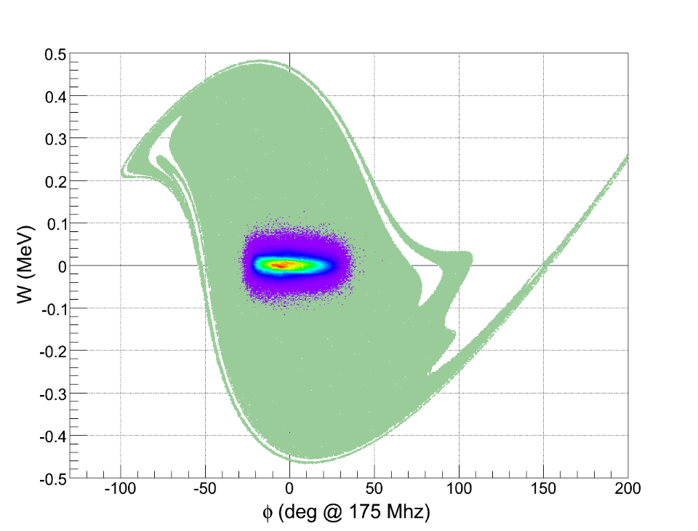
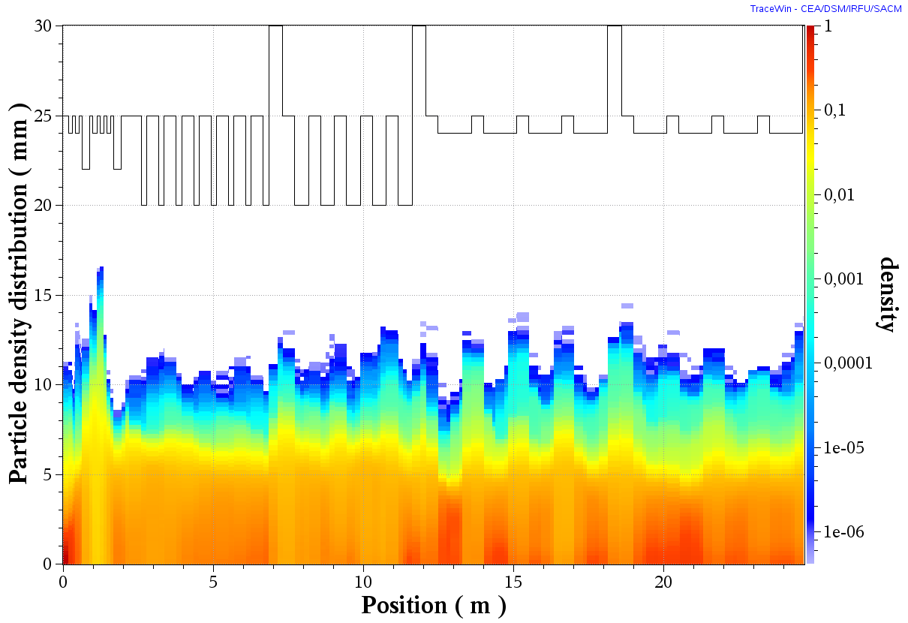

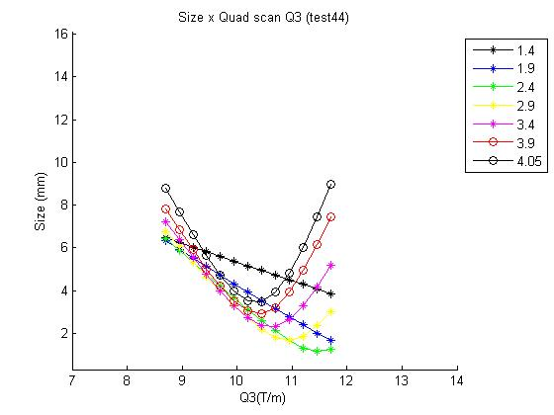
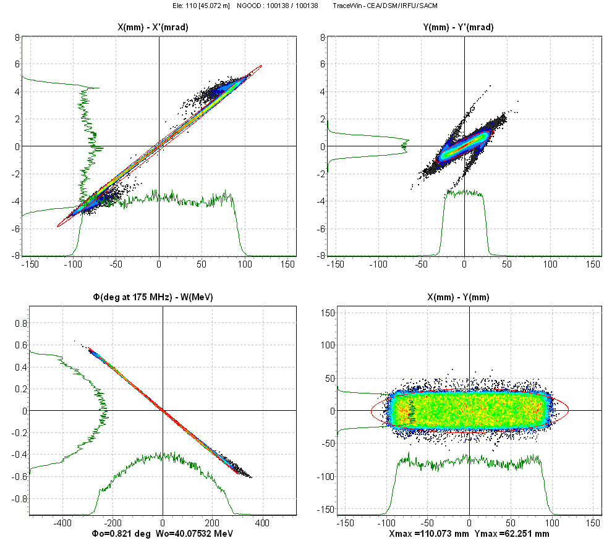

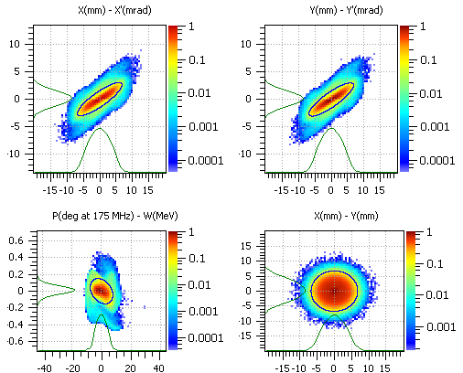
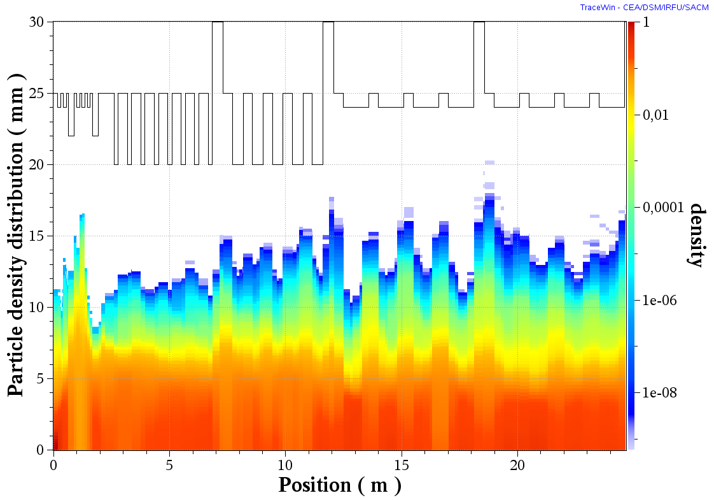
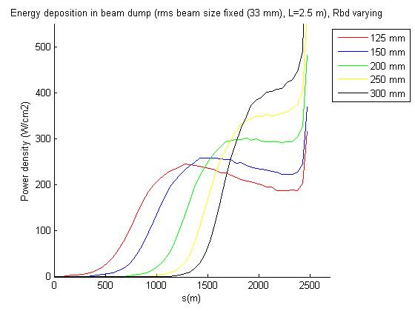
Un pas vers l'énergie des étoiles
BEAM DYNAMICS STUDIES for IFMIF-EVEDA ACCELERATORS
STATUS in Dec 2009 CEA(France), INFN(Italy), CIEMAT(Spain)
Nicolas Chauvin, Michele Comunian, Olivier Delferrière, Romuald Duperrier, Alban Mosnier, Phu Anh Phi Nghiem, Concepcion Oliver, Didier Uriot
BEAM EXTRACTION
4-ELECTRODE CONFIGURATION
175 mA total (140 mA D⁺, 26 mA D₂⁺, 9mA D₃⁺) @100 keV
BEAM OUTPUT DISTRIBUTION
RFQ
Φ12 mm
Plasma
electrode
ε_{rms norm.} ≈ 0.120 π.mm.mrad
r_{max}=10 mm
r’_{max}=45 mrad
MAIN PARAMETERS
E_{max}
98 kV.cm⁻¹
LEBT
BEAM DENSITY and SIZE
1.8 μs
7.0 μs
COMPENSATION of SPACE CHARGE POTENTIAL
EMITTANCE GROWTH (whith Kr gas added)
LOSSES MAINLY at 100 keV
BEAM OUTPUT
BEAM DENSITY and SIZE in CASE of WEAK FOCUSING
BEAM OUTPUT
GOAL
100 keV
0.6 MW
1.1 MW
1.8 MW
3.3 MW
5 MW
ION
5 MeV
9 MeV
14.5 MeV
26 MeV
40 MeV
DIPOLE
DODECAPOLE
OCTUPOLE
SOURCE
QUADRUPOLE
BEAM
LEBT
RFQ
MEBT
SOLENOID
RF CAVITY(175 MHz)
EXTRACTION
SRF-LINAC
HEBT
Li TARGET
IFMIF: 2 ACCELERATORS, EACH ACCELERATING 125 mA CW DEUTERON BEAM
TO 40 MeV
Most powerful
neutron source
in the world
ION
100 keV
5 MeV
9 MeV
BEAM DUMP
GOAL: Study materials for future FUSION reactors
SOURCE
UNPRECEDENTED PARAMETERS:
- VERY HIGH INTENSITY 2 x 125 mA (CW)
- VERY HIGH POWER 2 x 5 MW
BEAM
LEBT
RFQ
MEBT
SRF-LINAC
HEBT
EXTRACTION
EVEDA: 1 ACCELERATOR ACCELERATING 125 mA CW DEUTERON BEAM TO 9 M
eV
MEBT and SRF-LINAC
UNPRECEDENTED ISSUES:
- VERY STRONG SPACE CHARGE REGIME
- EVEN MICRO-LOSSES ARE HARMFUL
HEBT-EVEDA
HEBT-IFMIF
EMITTANCE GROWTH
ε_{x}
ε_{z}
ε_{y}
3 RMS TRANSVERSE and LONGITUDINAL SIZES
3 RMS TRANSVERSE SIZES
EMITTANCE GROWTH
without error
1 particle over 10⁶
LONGITUDINAL ACCEPTANCE
SIZE VARIATIONS for
EMITTANCE MEASUREMENT
500 machines with errors
BEAM OUTPUT at Li TARGET
Beam density and Beam size along the structure
BEAM OUTPUT
ENERGY DEPOSITION at BEAM DUMP
for different BEAM DUMP RADIUS

