Slide 1



Le programme de physique à venir du Hall A au Jefferson Laboratory
Alexandre Camsonne
Séminaires du SPhN
Vendredi 30 Juillet 2010

Slide 2
Plan
Introduction
  Jefferson Laboratory
  Hall A
Le programme à 6 GeV
  Expérience restantes
Le programme à 12 GeV
  Facteurs de forme ( Bogdan Wojstekowski)
  Violation de parité ( Robert Michaels, Krishna Kumar )
    Expérience Moller a 12 GeV
    PVDIS avec SoLID
  SIDIS avec SoLID (JP Chen)
  DVCS

Slide 3
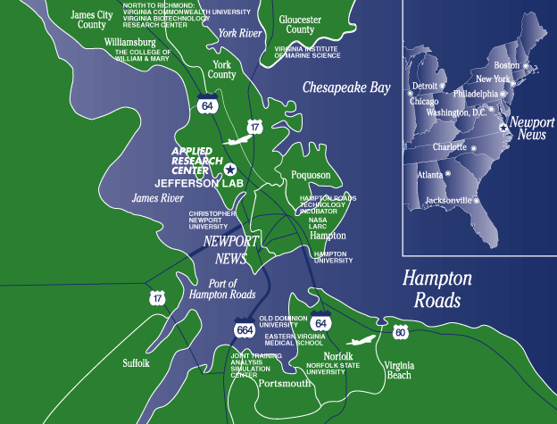
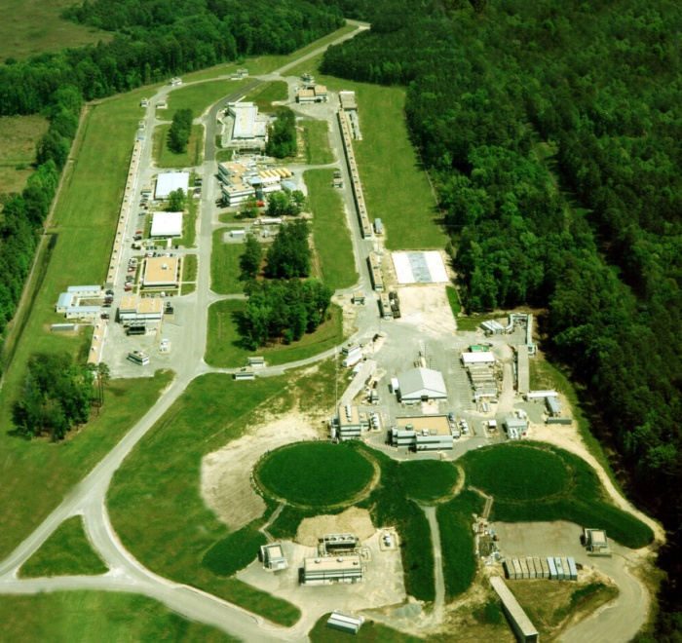
Jefferson Laboratory

Slide 4
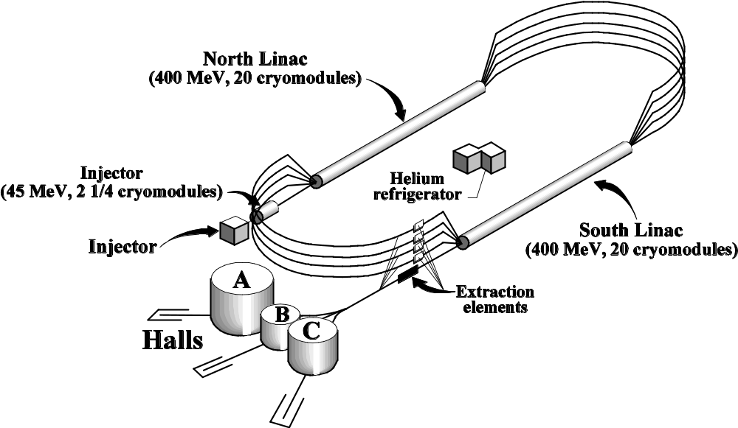
Jefferson Laboratory
Polarized electron beam
Current up to 200 uA at injector
Up to 5 pass for an energy up to 6 GeV
Continuous beam
( 2ns beam structure)

Slide 5
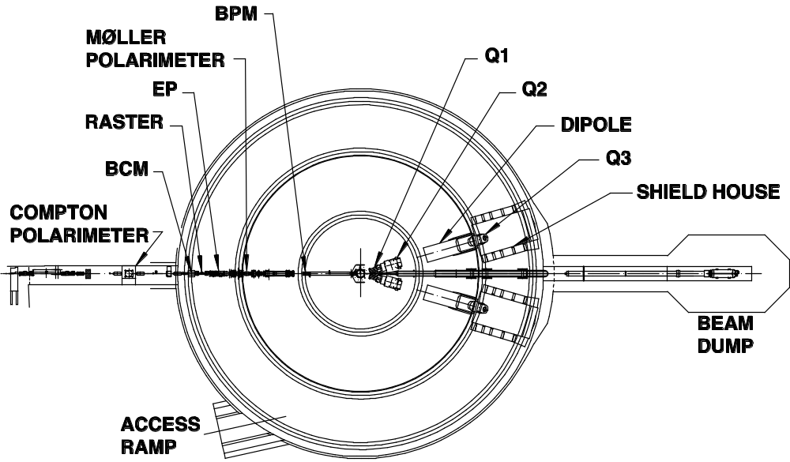
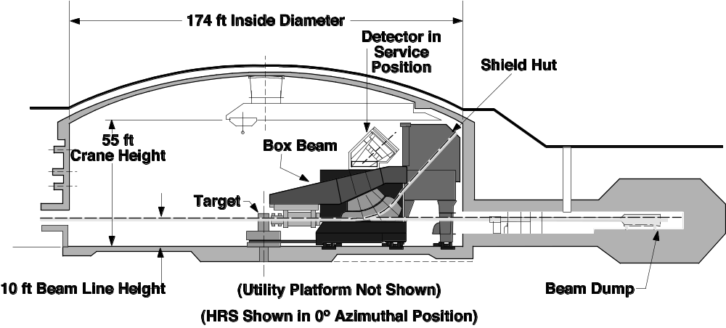
Hall A

Slide 6
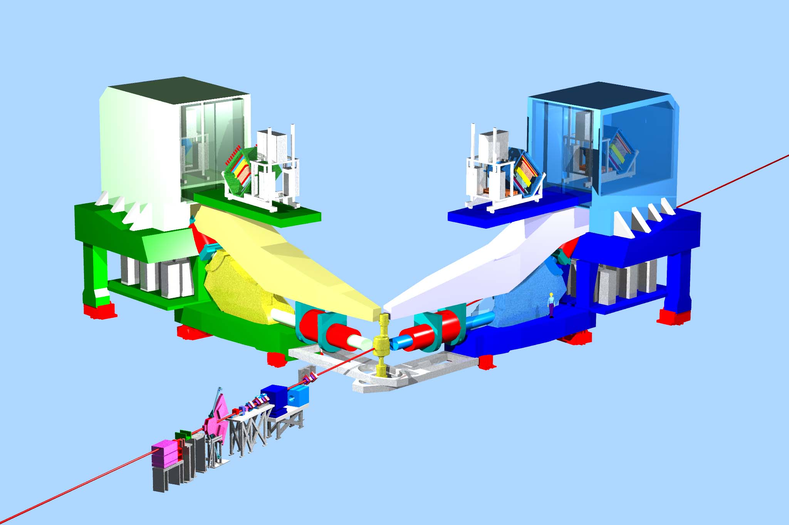
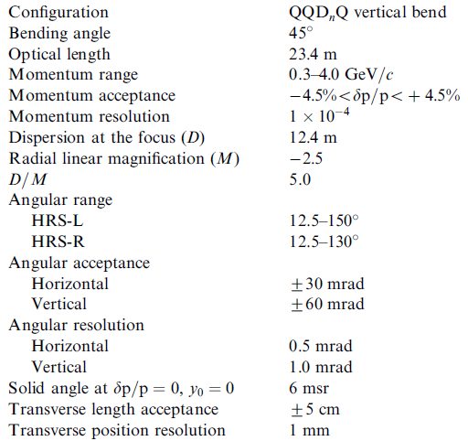
Hall A
High resolution spectrometers

Slide 7
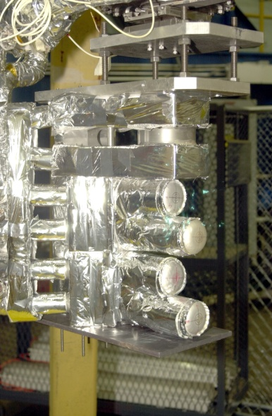
Hall A targets
Cibles solides : C, B, Li, Fe, Pb
Cibles cryogéniques liquides: H₂,D₂,He³,He⁴

Slide 8
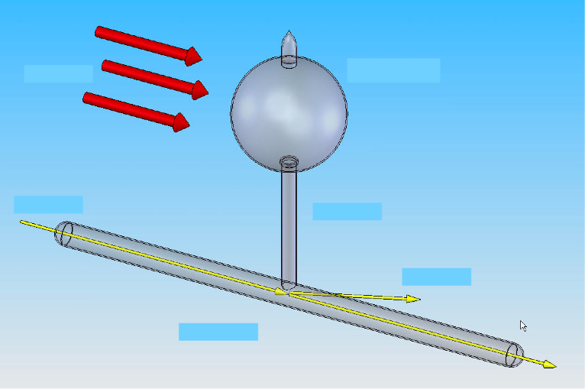
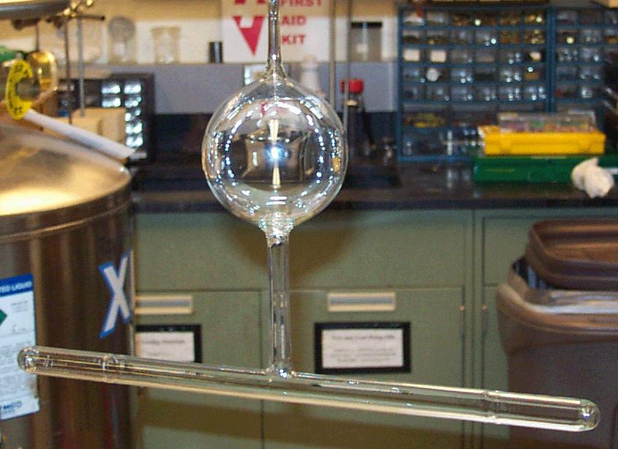
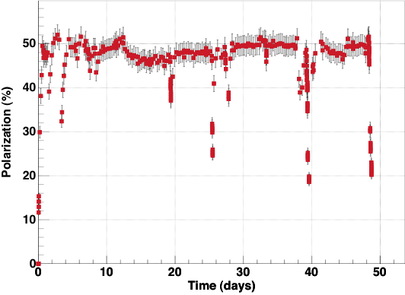
Polarized He-3 Target
Electron arm
Laser light
Pumping chamber
Polarization pumping
J_{polarized nuclei.}x P²_{nuclei}
Target
Neutron arm
Rb + K
Neutron arm
Polarized beam
G_{E}^{n}
Scattered electron
Target chamber
Recoiled neutron

Slide 9
Le programme a 6 Gev

Slide 10
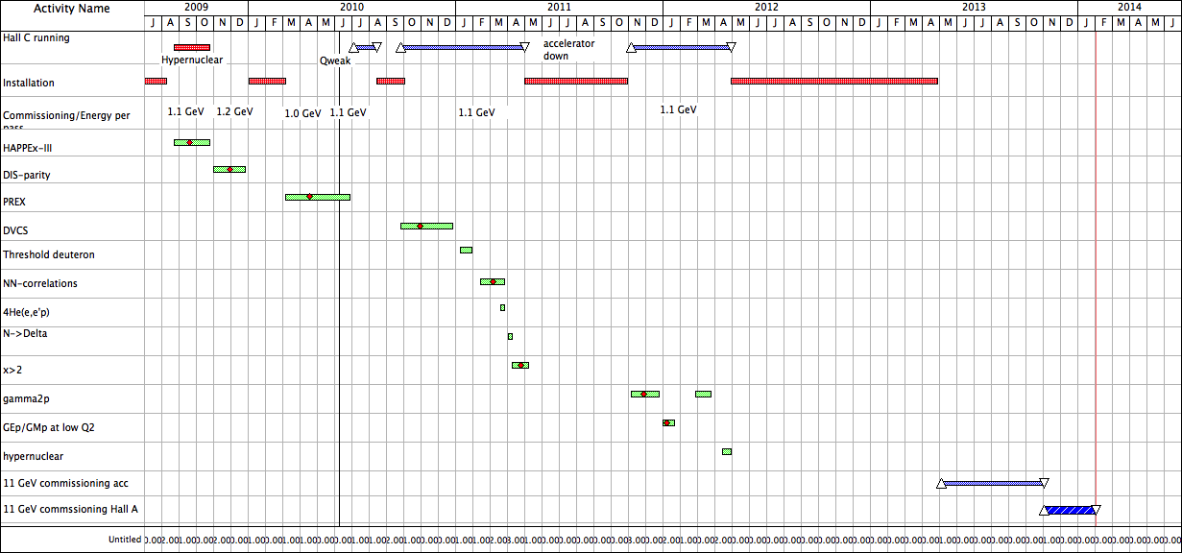
Completed
experiments
12 GeV Upgrade
Shutdown

Slide 11
Mesure à 1 spectromètre
Mesure simple bras :
  Deep Inelastic Scattering : mesure inclusive de la fonctions de structure g_{2p} à bas Q² : faisceau d’électrons longitudinalement poliarisés avec la cible NH₃ polarisée transversalement
  Facteurs de formes elastique : G_{Ep}/G_{Mp} à bas Q²

Slide 12
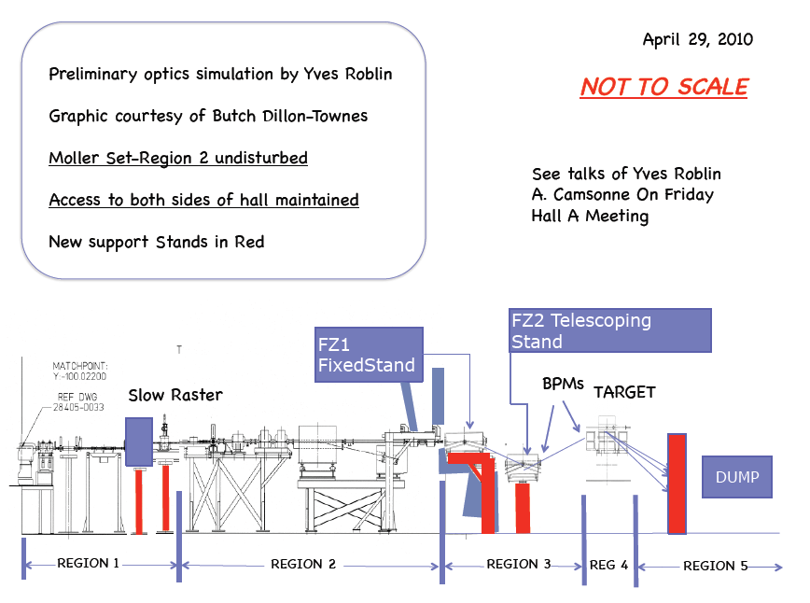
G_{2p} experiment
G2p experiment
  Low Q2 measurement
  Polarized ammonia target

Slide 13
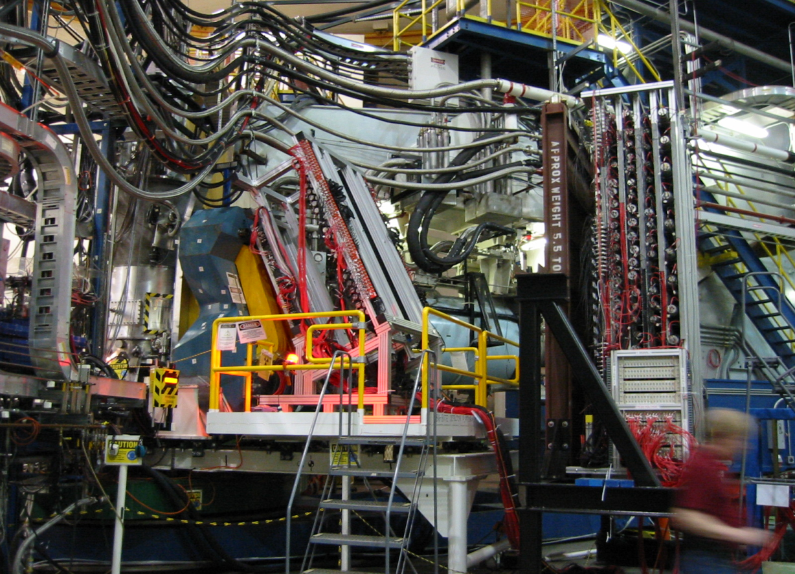
Détecteurs additionnels
Short range correlation
HRS + BigBite + Neutron detector

Slide 14
Le programME a 12 GEV

Slide 15
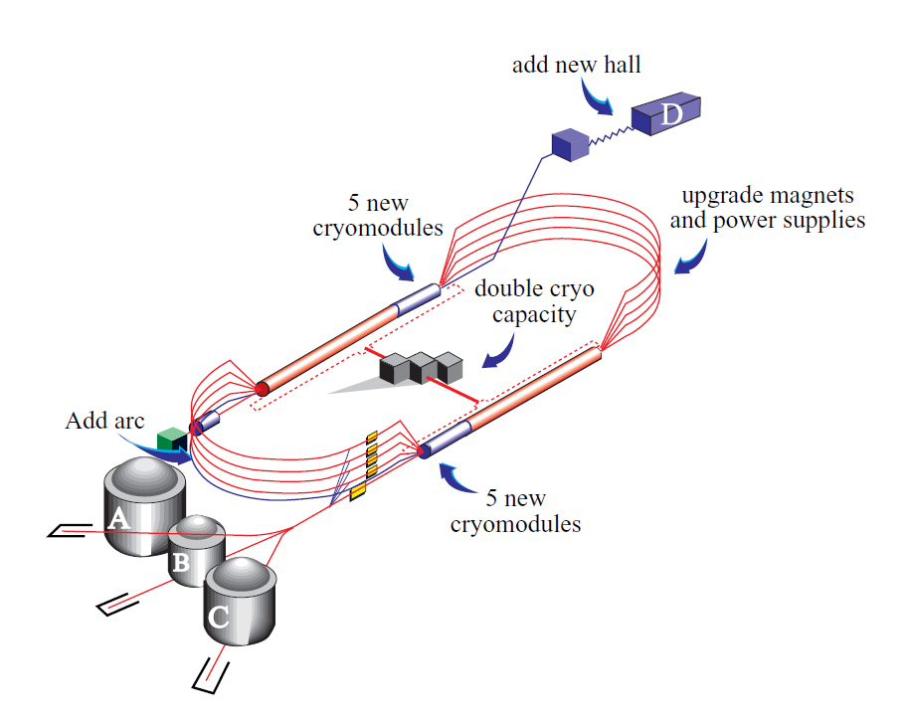
The 12 GeV upgrade

Slide 16
CEBAF electron beam in 2014
Beam energy 11/12 GeV
Beam power 1 MW
Beam current (Hall A/D) 85/5 µA
Beam polarization 85%
Emittance @ 12 GeV 10 nm-rad
Energy spread @ 12 GeV 0.02%
Beam spot ~ 0.1mm
Simultaneous beam delivery Up to 3 halls
Hall A will be the first hall which will get the beam

Slide 17
Le programme à 12 GeV
Programme à 6 GeV étendu profitant d’une couverture cinématique plus large
  Structure du nucléon
    Facteurs de formes
    Réactions semi-inclusives pour la transversité
    Réactions exclusives : DVCS
  Programme de Parité
    Parity Violation in Deep Inelastic Scattering
    Moller experiment

Slide 18
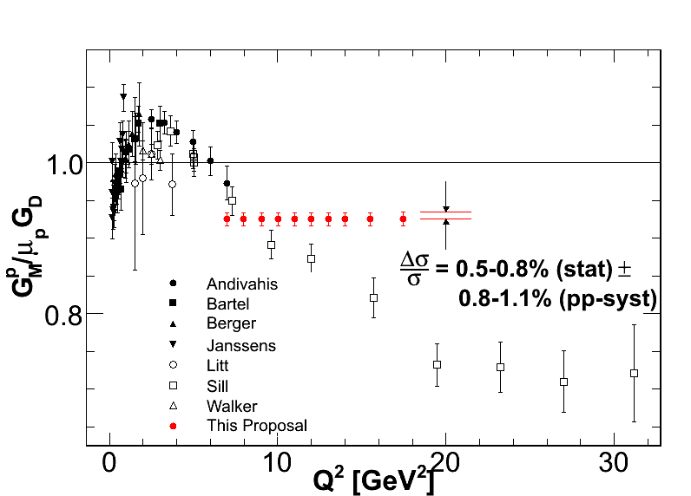
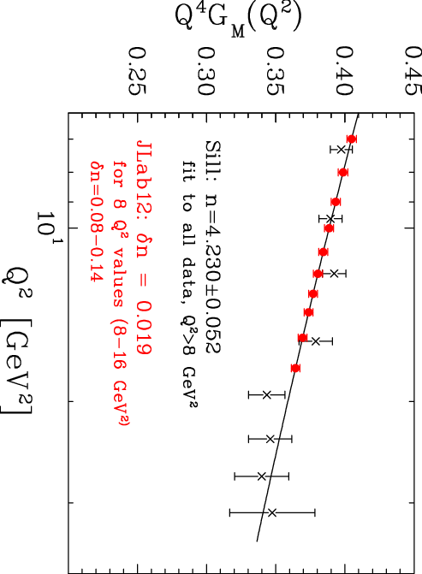
HRS 12 GeV experiment Gmp
Moffit, Gilad, Arrington, BW
The cross section of H(e,e’)p.
By using two existing Hall A
High Resolution Spectrometers
with several new ideas for improved control of systematic.
With 11 GeV beam in 31-day run.
approved by PAC32
for 12 GeV program
Notes:
This experiment will measure cross section and by using GEN extract GMP with 1% accuracy

Slide 19
3 projets de nouveaux détecteurs
SuperBigBite
  Spectromètre a large acceptance utilisant un dipôle pour des mesures simples et en coïncidences
SoLID
  Détecteur solénoïdal detector a haute luminosité
Moller
  Détecteur toroïdal

Slide 20
Spectrometre SUPER BIG BITE

Slide 21
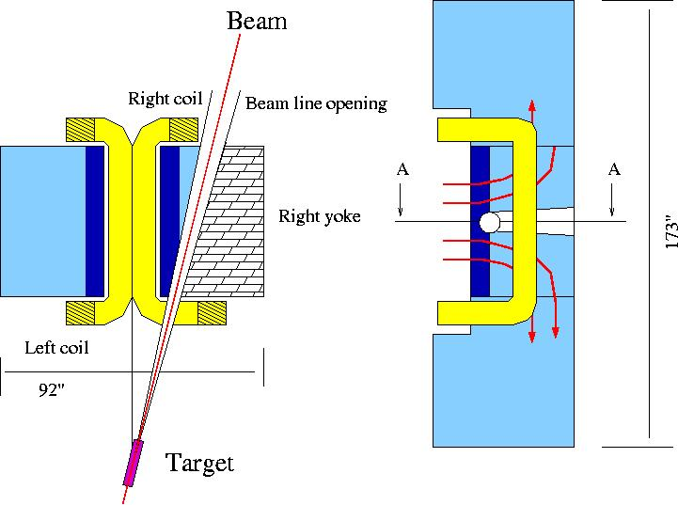
Super Bigbite Spectrometer in GEp(5)
48D48 – 46 cm gap, 2.5 Tesla*m
Solid angle is 70 msr at angle 15º
GEM chambers with 70 μm resolution
momentum resolution is 0.5% for 5 GeV/c
angular resolution is 0.3 mr
Notes:
As part of main stream interest of community SIDIS should be considered.
Several members of collaboration are considering full scale study - it will be
Very effective with 30^37 luminosity and large solid angle for both electron
and for pion/kaon.

Slide 22
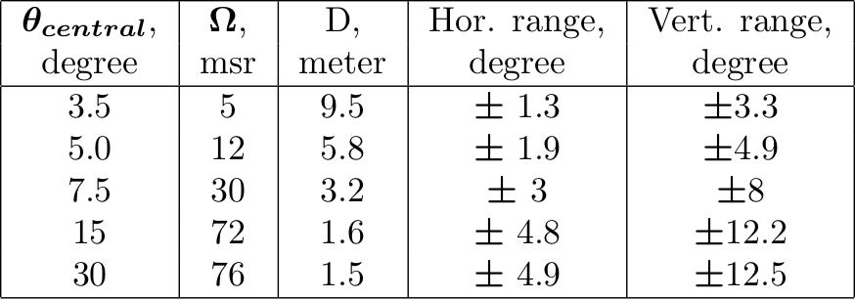
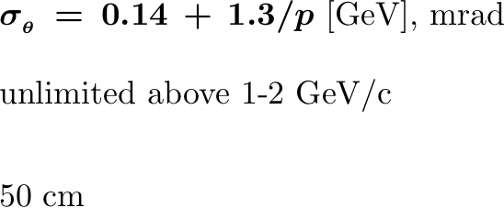
Parameters of SBS
Solid angle =>
Resolution:
Momentum =>
Angular =>
Momentum acceptance =>
Target length (y)
Notes:
As part of main stream interest of community SIDIS should be considered.
Several members of collaboration are considering full scale study - it will be
Very effective with 30^37 luminosity and large solid angle for both electron
and for pion/kaon.

Slide 23
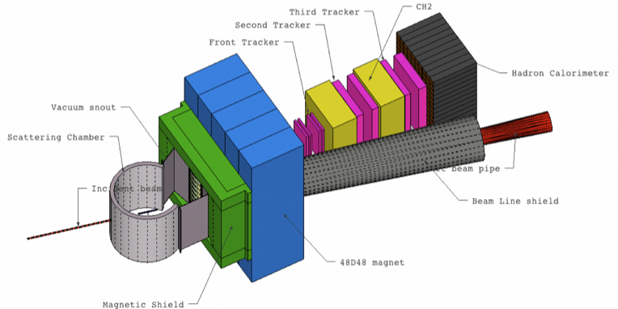
Super Bigbite Spectrometer in GEp(5)
Notes:
As part of main stream interest of community SIDIS should be considered.
Several members of collaboration are considering full scale study - it will be
Very effective with 30^37 luminosity and large solid angle for both electron
and for pion/kaon.

Slide 24
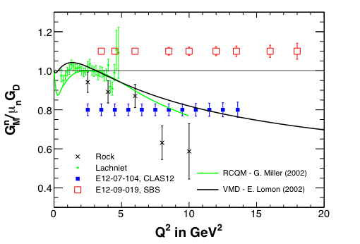
12 GeV approved GMn experiments
CLAS 12
BigBite + SBS
FoM ~ 30 CLAS 12

Slide 25
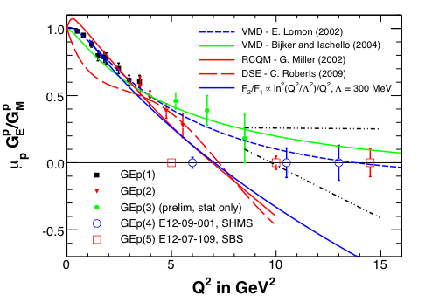
12 GeV approved GEp experiments
Recoil polarimeter in SHMS
GEp(5): Polarimeter in SBS
FoM ~ 10 SHMS

Slide 26
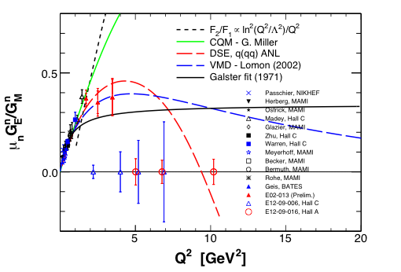
12 GeV approved GEn experiments
Recoil polarimeter + SHMS
Polarized target + SBS
FoM ~ 50 SHMS

Slide 27
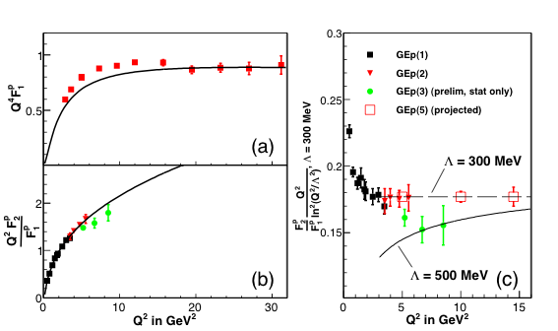
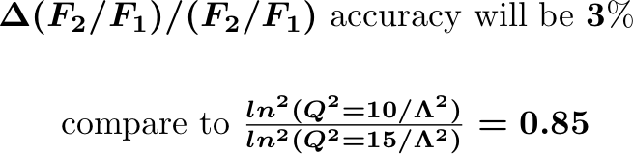
GEp(5): GEp/GMp for max Q²
Cisbani, Khandaker, Pentchev, Perdrisat, Punjabi, & BW
Up to max Q² = 14.5 GeV²
Study the spin flip part of the hadron current
Constrain GPDs at high t
Provide critical test of the FF models and reaction dynamics
Notes:
Measurement will significantly increase range of Q2, close to double it
Compare to GEP-III
Separation F1 and F2 allows to study these form factors
Reaction dynamics is very important, should see log²(Q²) effect

Slide 28

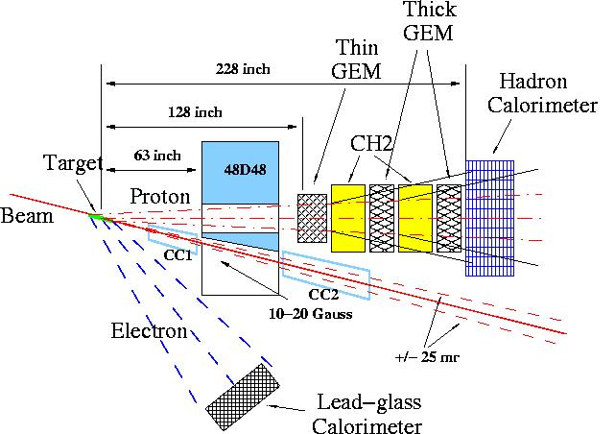
Experiment: Layout and Parameters
Beam: 75 μA, 85% polarization
Target: 40 cm liquid H₂
Electron arm at 39º, covers Q² range from 13.5 to 15.5 GeV²
Proton arm at angle 13º,
 Ω = 35 msr ,
Spin precession angle is ~ 90º
(it is optimum)
Event rate is 10 times higher
than with SHMS spectrometer
From 58 days of production time
resulting accuracy :
Notes:
Layout and Parameters of the proposed experiment ====== Beam line with +/- 25 milli radian opening to beam dump
40 cm long liquid hydrogen target. Beam of 75 micro Ampere. Scattered electron detected in Lead-glass calorimeter resolution of 3.5%
at 3.5 GeV energy of final electron, position resolution of 5 mm. Proton arm consists of a Magnet, Tracking devices and Trigger calorimeter

Slide 29
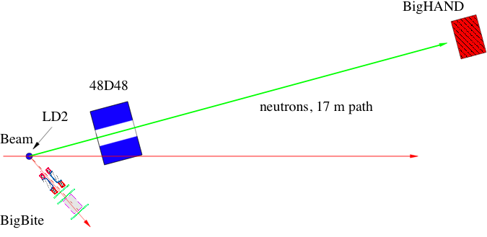

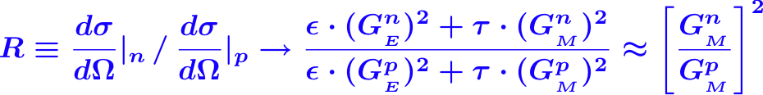
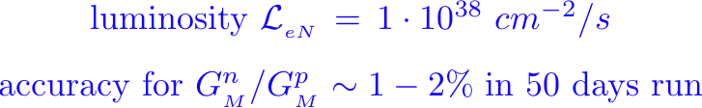
GMn concept for max Q²
R.Gilman, B.Quinn & BW
Expected to reach Q² of 18 GeV²
Notes:
Large size of the Hall A and luminosity close to 10^38

Slide 30
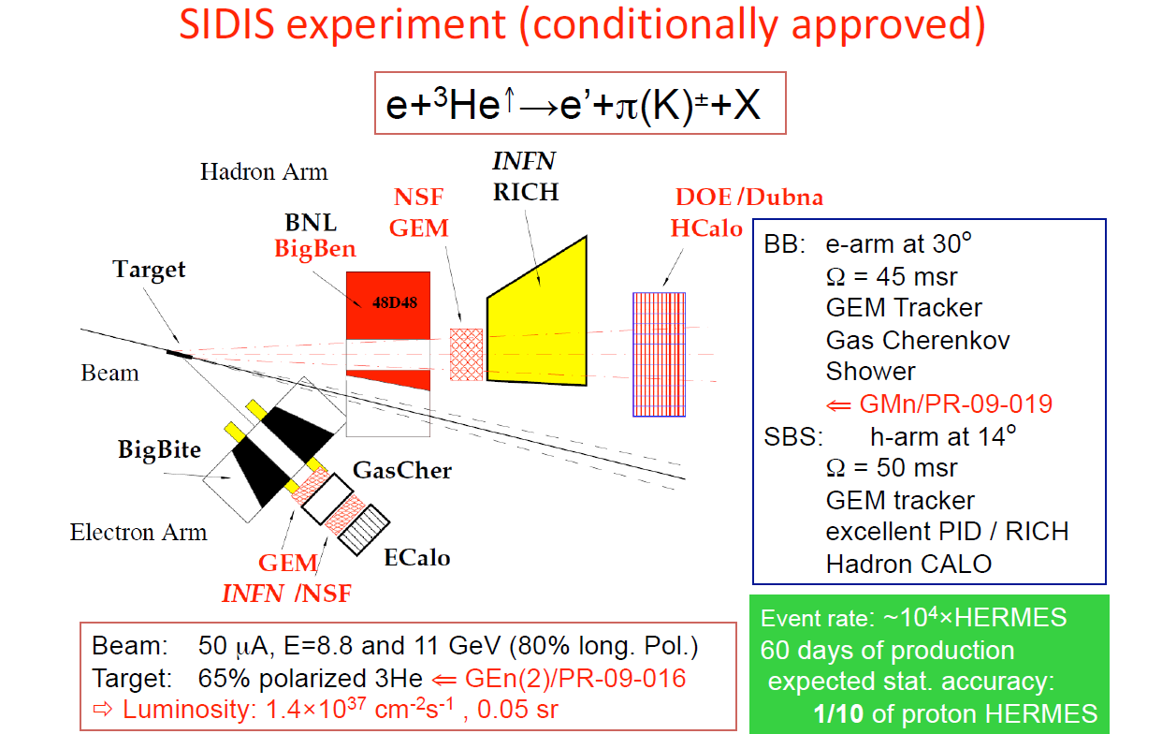

Slide 31
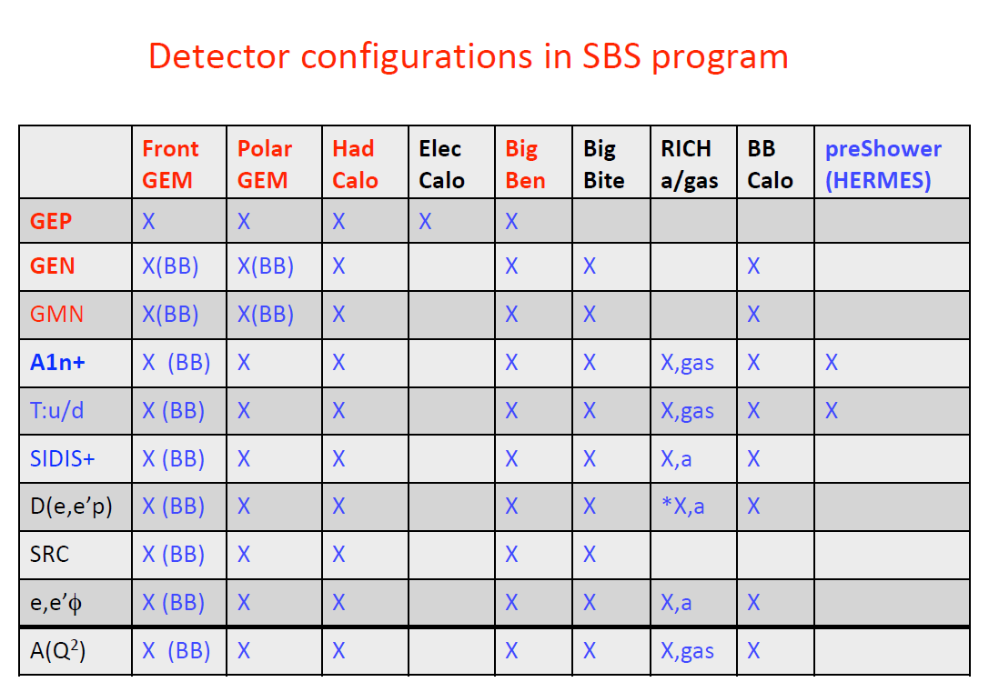

Slide 32
Experience moller A 12 GEV

Slide 33
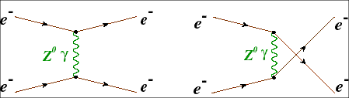

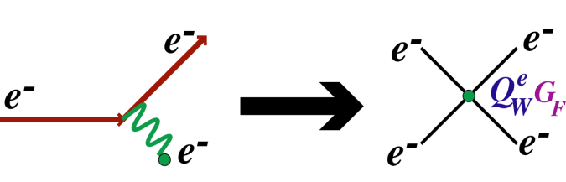

Møller Goal
Bob Michaels (DAQ)
Javier Gomez (project manager)
Jian-ping Chen (target coordinator)
Derman and Marciano (1978)
E_{beam}= 11 GeV
75 μA
80% polarized
(~ 2.5 yrs)
δ(A_{PV}) = 0.73 ppb
A_{PV} = 35.6 ppb
δ(Qe_{W}) = ± 2.1 (stat.) ± 1.0 (syst.) %
δ(sin2θ_{W}) = ± 0.00026 (stat.) ± 0.00012 (syst.)
~ 0.1%
not just “another measurement” of sin2θ_{W}
Compelling opportunity with the Jefferson Lab 12 GeV Upgrade:
Comparable to the two best measurements at colliders (that disagree at ≥ 4σ !)
Unmatched by any other project in the foreseeable future
At this level, one-loop effects from “heavy” physics

Slide 34
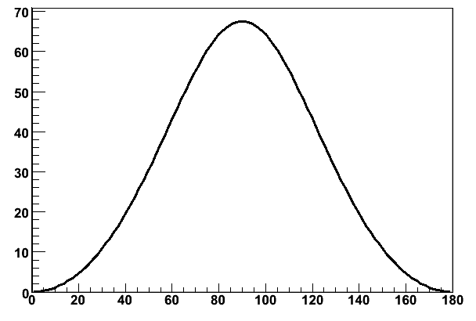
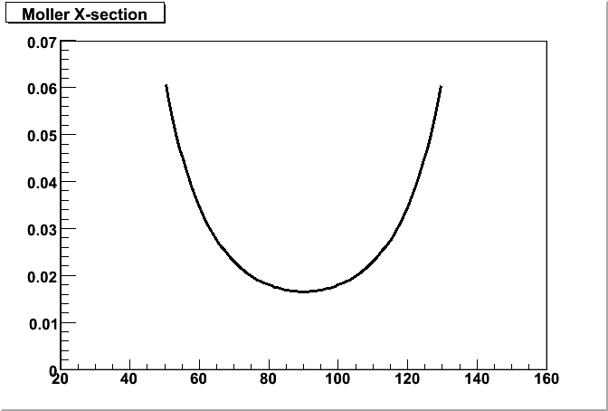
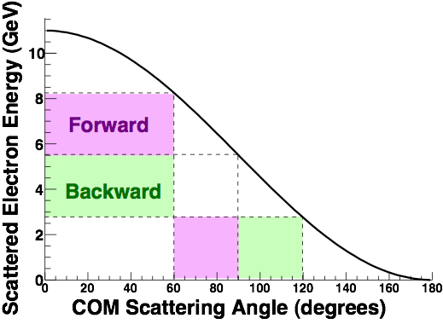
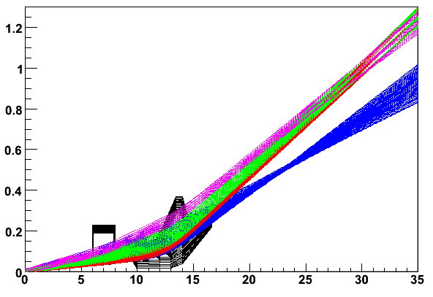
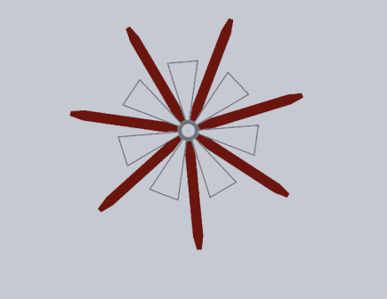
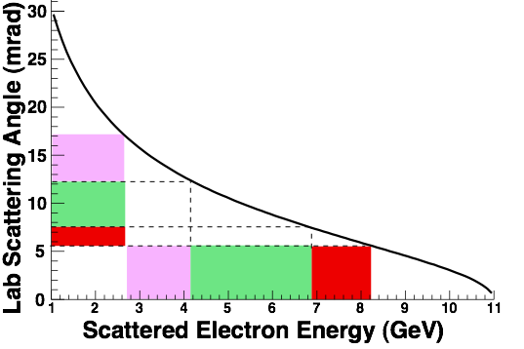
Møller Magnet and Detector Lay-out
E_{COM} = 53 MeV
Highest figure of merit at θCM = 90o
cross-section (mb)
Asymmetry (ppb)
identical particles!
Center of Mass Angle
Center of Mass Angle
Avoid superconductors
    ~150 kW of photons from target
    Collimation extremely challenging
Successfully passed a Director’s Review in Dec 2009
Quadrupoles a la E158
    High-field dipole chicane
    poor separation from background
    ~ 20-30% azimuthal acceptance loss
meters
Two Warm Toroids
    Odd number of coils: both forward & backward Møllers in same phi-bite
    100% azimuthal acceptance
    better separation from background
first toroid
hybrid
toroid
5 kW cryogenic target required!
meters

Slide 35
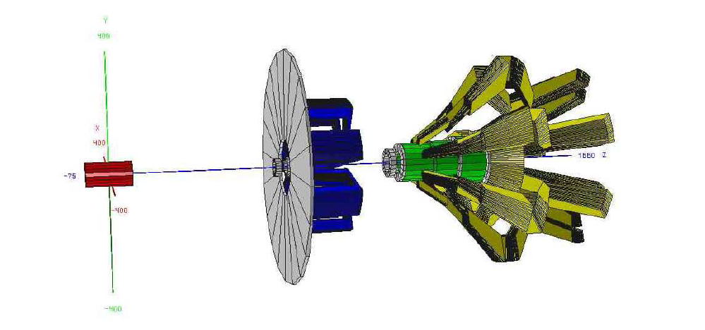
Double toroid magnet design

Slide 36
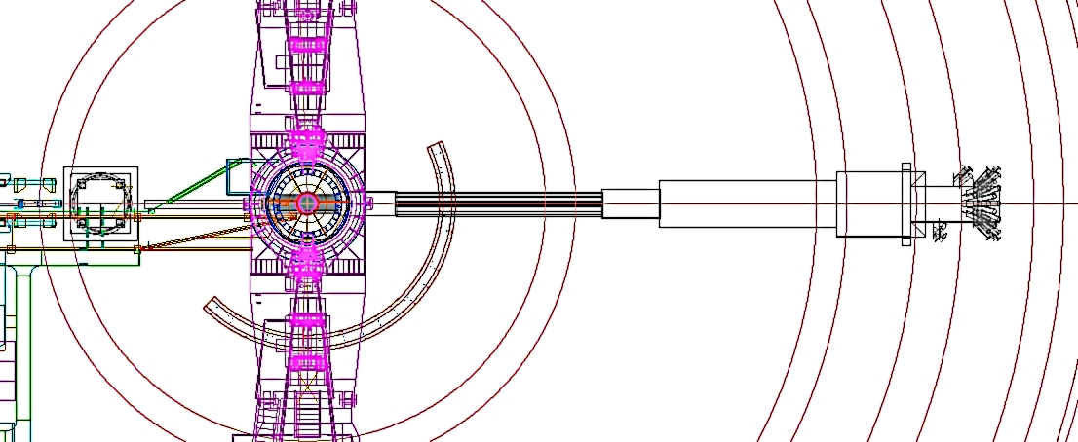
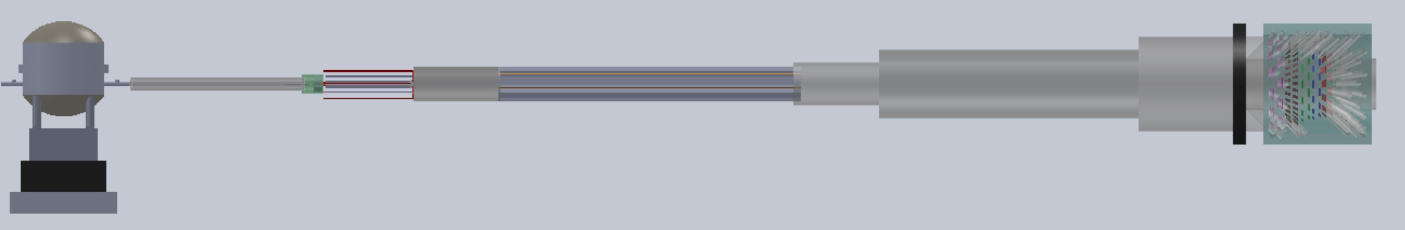
MOLLER Hall Layout
Left HRS
Beam Direction
First
Toroid
Hybrid
Toroid
Drift
Region
Detector
Region
Target
Chamber
contains primary beam & Mollers
Right HRS
Mollers exit vacuum
10 ft
28 m

Slide 37
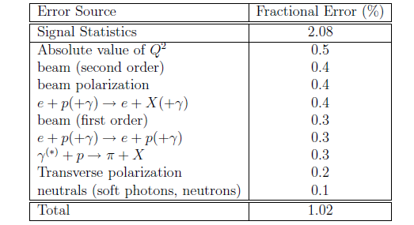
Moller experiment error budget
A_{PV} = 35.6 ppb
δ(A_{PV}) = 0.73 ppb
δ(Qe_{W}) = ± 2.1 (stat.) ± 1.0 (syst.) %
δ(sin2θ_{W}) = ± 0.00026 (stat.) ± 0.00012 (syst.)

Slide 38
Solenoidal Large intensity device a 12 GEV pour PVDIS

Slide 39
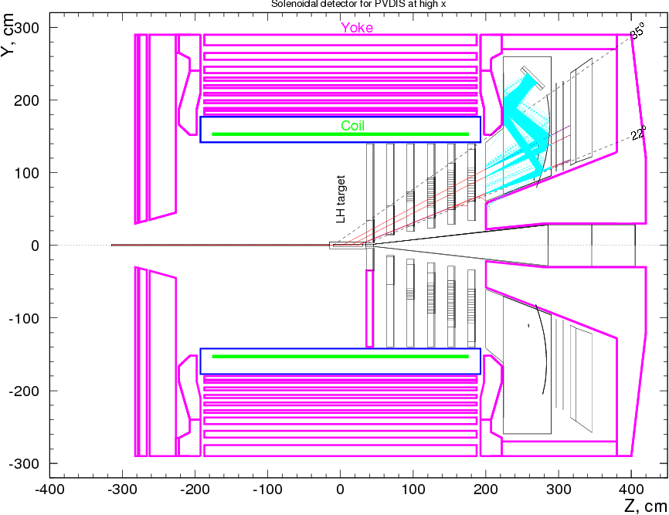
A New Design for Precision PV DIS Physics Over a Broad Kinematic Range
High Luminosity on LH₂ & LD₂
Better than 1% errors for small bins
x-range 0.25-0.75
W² > 4 GeV²
Q² range a factor of 2 for each x
  (Except x~0.75)
Moderate running times
Solenoid (from BaBar, CDF or CLEOII )
contains low energy backgrounds (Moller, pions, etc)
trajectories measured after baffles
Fast tracking, particle ID, calorimetry, and pipeline electronics
Precision polarimetry (0.4%)

Slide 40
SoLID Spectrometer for PVDIS
Gas Cerenkov
Shashlyk
Baffles
GEM’s

Slide 41
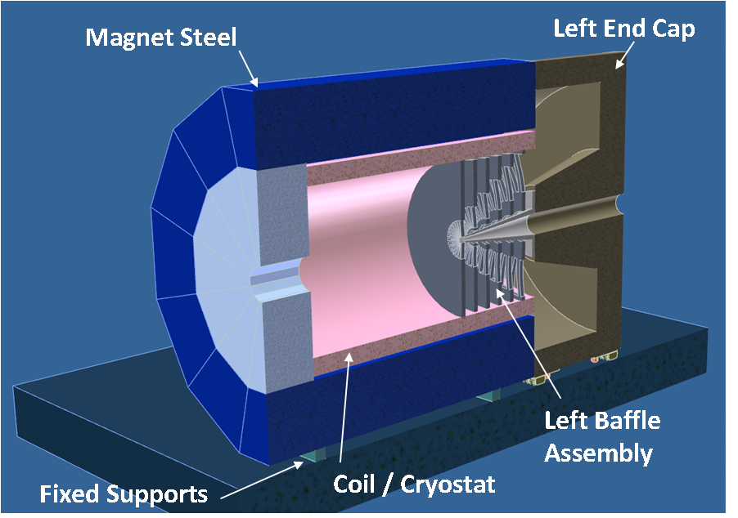
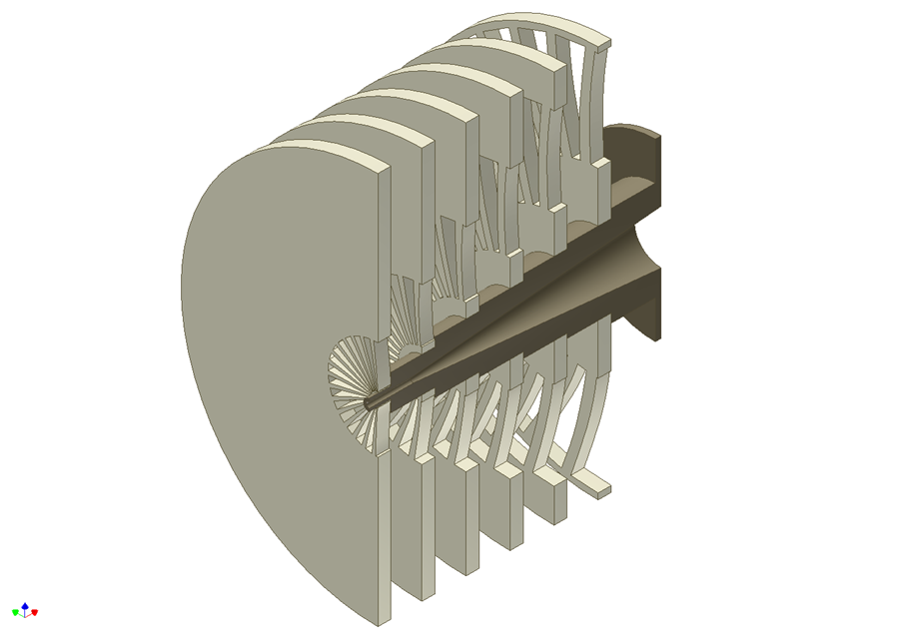
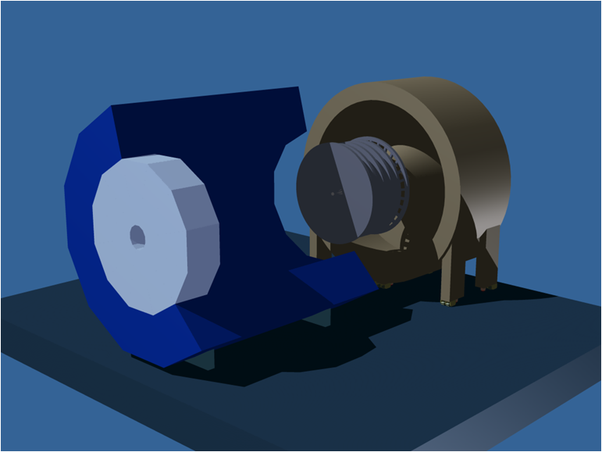
SOLID Spectrometer
using CDF coil
Lead Baffles

Slide 42
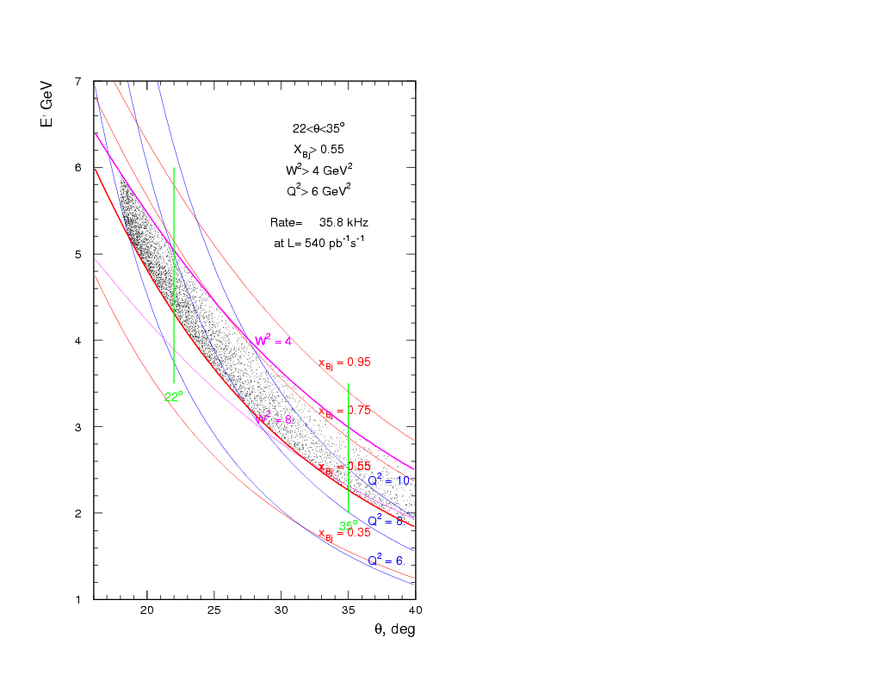
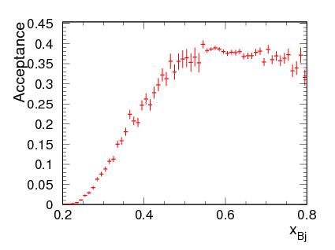
Kinematics at large x
E/ GeV

Slide 43

Simulation by Eugene Chudakov
Errors (%) for A_{PV} for bins in Q² and X. Total 120 days at 11 GeV and 60 days at 6.6 GeV for 50 uA and p_{e} = 0.85.

Slide 44


11 GeV PVDIS
6 GeV PVDIS
Qweak

Slide 45


Slide 46
Solenoidal Large intensity device a 12 GEV pour SIDIS

Slide 47

Solenoid Detector for 11 GeV SIDIS
GEMs
This study done with CDF magnet. Earlier study with BaBar Magnet

Slide 48
Transversity and TMDs
Three twist-2 quark distributions:
  Momentum distributions: q(x,Q²) = q↑(x) + q↓(x)
  Longitudinal spin distributions: Δq(x,Q²) = q↑(x) - q↓(x)
  Transversity distributions: δq(x,Q²) = q┴(x) - q┬(x)
It takes two chiral-odd objects to measure transversity
  Semi-inclusive DIS
    Chiral-odd distributions function (transversity)
    Chiral-odd fragmentation function (Collins function)
TMDs: (without integrating over P_{T})
  Distribution functions depends on x, k┴ and Q² : δq, f_{1T}┴ (x,k┴ ,Q²), …
  Fragmentation functions depends on z, p┴ and Q² : D, H₁(x,p┴ ,Q²)
  Measured asymmetries depends on x, z, P┴ and Q² : Collins, Sivers, …
    (k┴, p┴ and P┴ are related)

Slide 49

“Leading-Twist” TMD Quark Distributions
Nucleon
Unpol.
Long.
Trans.
Quark
Unpol.
Long.
Trans.
Notes:
49
49

Slide 50

Separation of Collins, Sivers and pretzelocity effects through angular dependence in SIDIS

Slide 51

Polarized ³He Target
High luminosity: L(n) = 10³⁶ cm⁻² s⁻¹
Record high 65% polarization (preliminary) in beam with automatic spin flip / 20min (-> <10 min).

Slide 52

Kinematic Coverage
Precision 4-D (x, Q², p_{T} and z) mapping of Collins, Sivers and pretzelosity.
Coverage with 11 GeV beam shown here
  Black: forward angle
  Green: large angle
x_{B}: 0.1 ~ 0.6
P_{T}: 0 ~ 1.5 GeV/c
W: 2.3 ~ 4 GeV
z: 0.3 ~ 0.7
M_{m}: 1.6~ 3.3 GeV

Slide 53
Particle Identification
Large angle side: 14.5º – 22º (Electron only)
  Momentum: 3.5 – 6.0 GeV/c
  π/e < 1.5
  Shashlyk calorimeter: (Pre-shower/Shower)
Forward angle side: 6.6º – 12º (Electron and Pion)
  Momentum: 0.9 – 7.0 GeV/c
  Calorimeter: Pre-shower/Shower splitting
  Light Gas Cherenkov for electron identification
  Heavy Gas Cherenkov and TOF detectors for hadron identification

Slide 54
Single Spin Asymmetry
With full azimuzhal coverage,
Simultaneously measured
Better control of systematic error
Simultaneously measured

Slide 55
Systematic Uncertainties
Sources
Type
Size
Raw Asymmetry
absolute
1.0 E-3
Background Subtraction
relative
1.0%
Nuclear Effects
relative
Few%?
Diffractive Vector Meson
relative
2-3%
Radiative Correction
relative
2%
³He Polarization
relative
2-3%
Total
N/A
4%(relative)+1.0E-3(absolute)‏+?(model)
Average Stat: 3.7e-3

Slide 56

Projected Data
Total 1400 bins in x, Pt and z for 11/8.8 GeV beam.
z ranges from 0.3 ~ 0.7, only a sub-range of 11/8.8 GeV shown here.

Slide 57

Power of SOLID

Slide 58
DVCS in HALL A

Slide 59
DVCS
Calorimètre associe au Left HRS
Réutilisation du setup expérimental de l’expérience a 6 GeV
Extension naturelle à 12 GeV
  Plus grande couverture en x et Q²

Slide 60

DVCS dans le Hall A

Slide 61

Calorimetre DVCS

Slide 62

DVCS dans le Hall A

Slide 63
Conclusions
Programme de physiques diversifié
3 larges nouveaux détecteurs approuvés et en cours de développement
Le Hall A devient le Hall dédié aux équipements spécialises en particulier les expériences à large acceptance à haute luminosité

