Slide 1


Dynamique de mémoire de chemin: des propriétés « quantiques » d'un objet classique
Arezki Boudaoud, Yves Couder, Antonin Eddi,
Emmanuel Fort, Charles Henri Gautier, Frédéric Moisy,
Julien Moukhtar, Suzie Protière
- Enseignement de Licence, Initiation à la Physique Expérimentale (Paris 7 Denis Diderot)
Laboratoire de Physique Statistique (ENS)
FAST (Orsay)
Matières et Systèmes Complexes (CNRS / Paris Diderot)
Institut Langevin, ESPCI ParisTech

Slide 2
Outline
Part I : Our tool: the bouncing droplets and their coupling to the surface wave they generate
(a) The “walkers”
(b) Their non-local interaction
Part II : The wave-particle problem
(a) The structure of the wave: path memory dynamics
(b) Single particle diffraction and interferences
(c) Tunnel effect
Part III: Can path-memory dynamics lead to a kind of quantization?
The walkers orbits in a rotating system

Slide 3
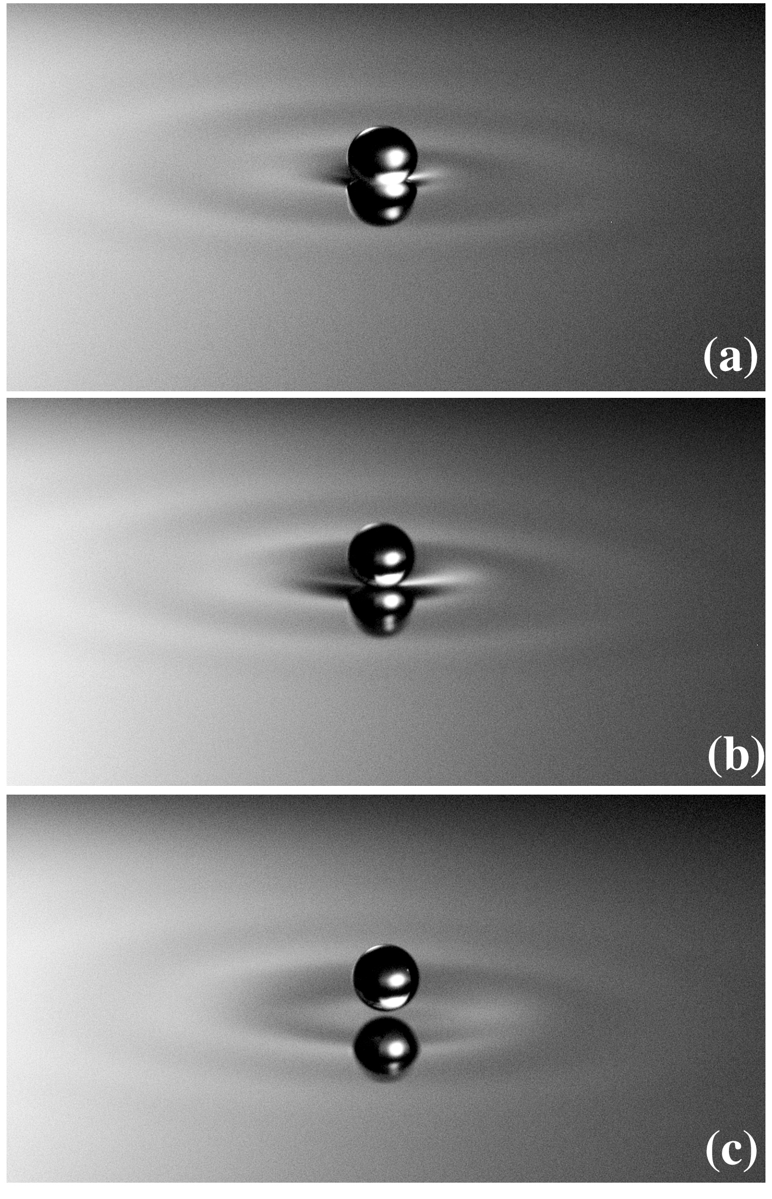
Part I
The bouncing droplets and their coupling to the surface waves they emit
    Couder Y., Fort E., Gautier C.H. & Boudaoud A., Phys. Rev. Lett. 94, 177801, (2005)

Slide 4
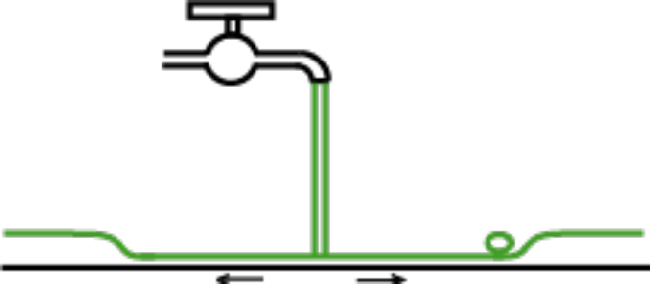
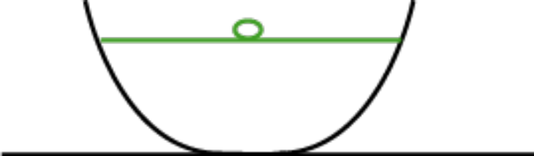
Coalescence or non-coalescence of a drop deposited on the surface of the same fluid
Near a hydraulic jump
(Sreenivas et al, J. Fluid Mech. 380, 297-307, (1999).
Lasts approximately
τ=1/10s

Slide 5
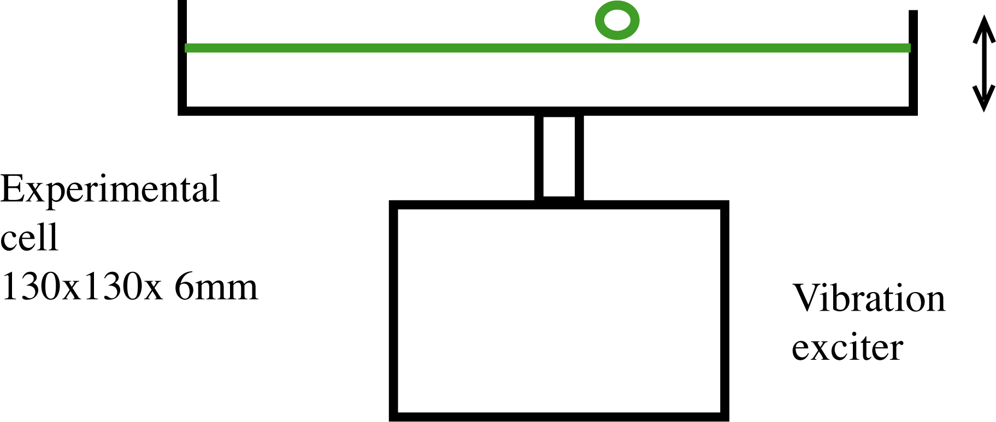
The basic experimental set-up
Vertical acceleration γ = γ_{m}cos(ωt)
with γ_{m} ranging from to 0 to 5 g
Forcing frequency range:
10 < ω/2π < 300 Hz
Fluids:
Silicon oils with viscosities
5 10⁻³ Pa.s < μ < 500 10⁻³ Pa.s

Slide 6
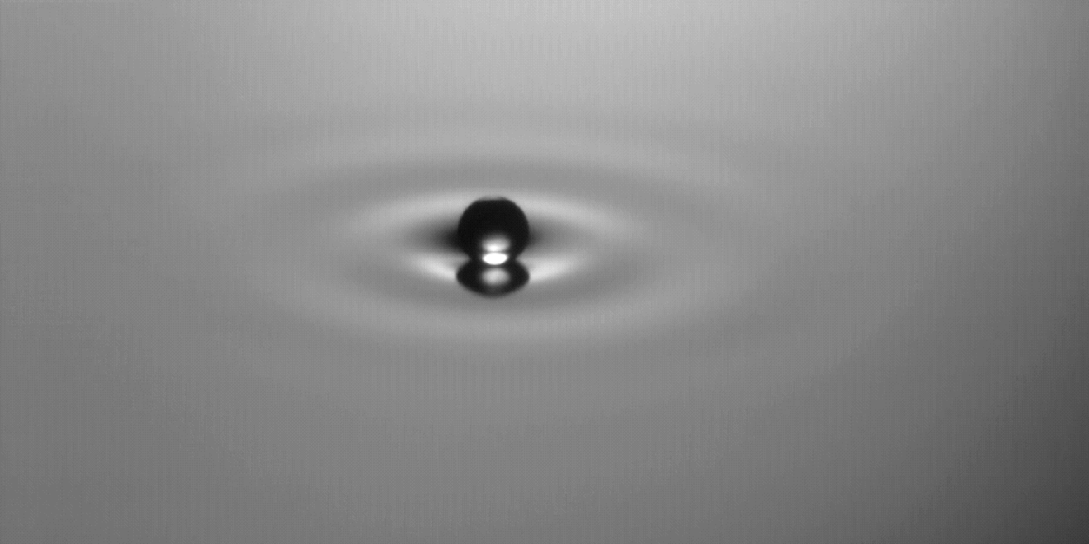
Can bounce for days!

Slide 7
Part I (a)
The walkers
    Couder Y., Fort E., Gautier C.H. & Boudaoud A., Phys. Rev. Lett. 94, 177801, (2005) Couder Y., Protière S., Fort E. & Boudaoud A., Nature 437, 208. (2005)
    Protière S., Boudaoud A. & Couder Y., J. Fluid Mech. 554, 85-108, (2006)
Notes:
7

Slide 8
The various types of bouncing
The relevant parameters
μ_{g} viscosity of the gas
μ_{L} viscosity of the fluid
ω/2π frequency of forcing
γ_{m} amplitude of forcing
D diameter of the drop
Three are fixed :
- The gas is air
- We use silicon oil with μ_{L}= 50 10⁻³ Pa s
- The forcing frequency ; ω/2π =50 Hz

Slide 9
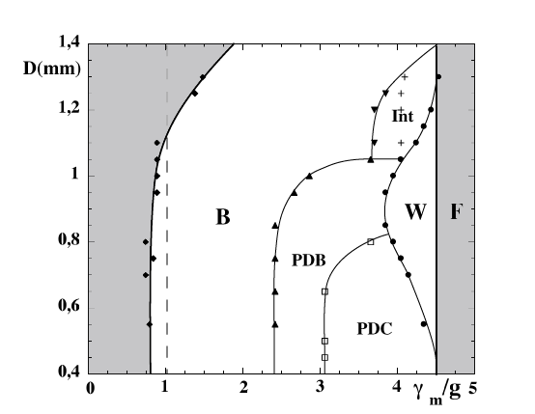
Phase diagram of the different types of bouncing
(as a function of the droplet size and the amplitude of the forcing)
B : simple bouncing at the forcing frequency
PDB : Period doubling
PDC: Chaos through a
sequence of period doubling
W : “walkers”
Int : Intermittent behavior
F : Faraday instability
Bouncing threshold
Faraday Instability
threshold

Slide 10
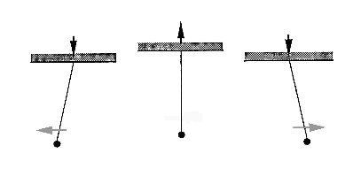
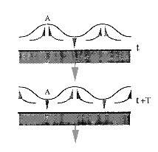
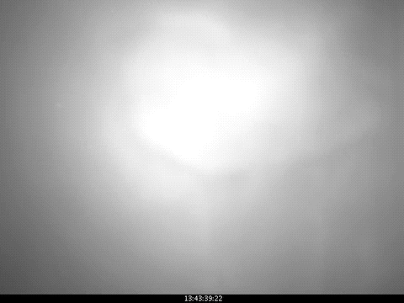
Parenthesis on the Faraday instability
(parametric forcing of surface waves)
From Stéphane Douady, Thesis (1989)
Occurs in a fluid submitted to a vertical acceleration
γ=γ_{m}cos(ωt)
Over a threshold value γ_{m}^{F} of the excitation, there is formation of standing surface waves with half the frequency of forcing
Analogous to the parametric forcing of a rigid pendulum

Slide 11
Phase diagram of the different types of bouncing
(as a function of the droplet size and the amplitude of the forcing)
B : simple bouncing at the forcing frequency
PDB : Period doubling
PDC: Chaos through a
sequence of period doubling
W : “walkers“
Int : Intermittent behavior
F : Faraday instability
Bouncing threshold
Faraday Instability
threshold

Slide 12
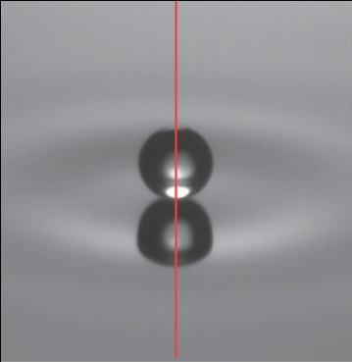
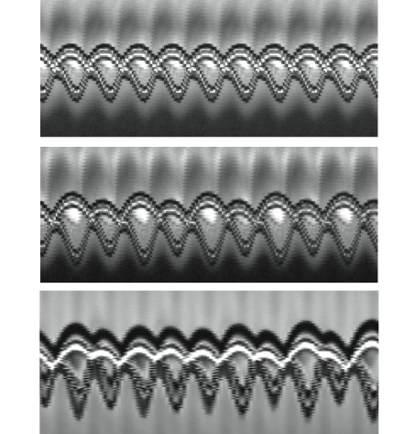
The drop’s bouncing:
Spatio-temporal diagrams of the vertical motion of a small drop (D < 0.6 mm)
γ_{m}=1.5g
Bouncing at the forcing frequency
γ_{m}= 3g
Period doubling
γ_{m}= 3.2 g
Temporal Chaos
Time

Slide 13
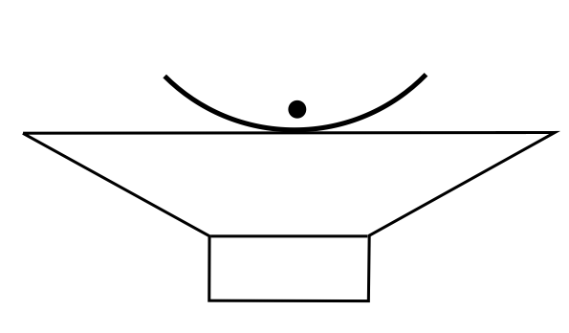
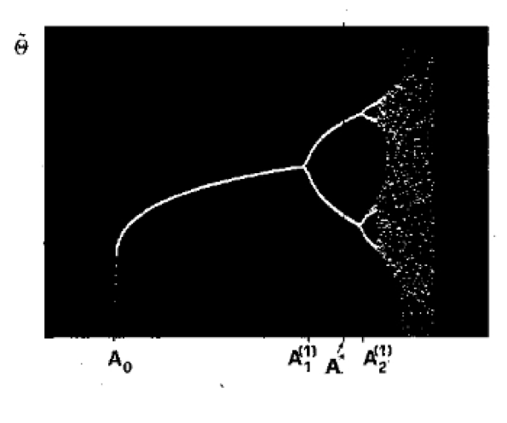
Small drops (D < 0,7mm) behave as solid balls bouncing on a solid substrate
(Piotr Pieranski’s experiment)
Transition to chaotic bouncing by the period doubling scenario
a steel ball of diameter around 4 mm
a glass or plastic concave lens
a loudspeaker
4. an audio frequency generator
P. Pieranski, Z. Kowalik and M. Franaszek, J. Phys. (Paris), 46, 681 (1985).

Slide 14
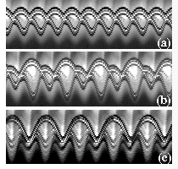
The drop’s bouncing: (for 0.6 < D < 1.1mm)
Spatio-temporal diagrams of the vertical motion
γ_{m}=1.5g
Bouncing at the forcing frequency
γ_{m}= 3g
Period doubling
γ_{m}= 4g
no chaos and complete period doubling
Time

Slide 15
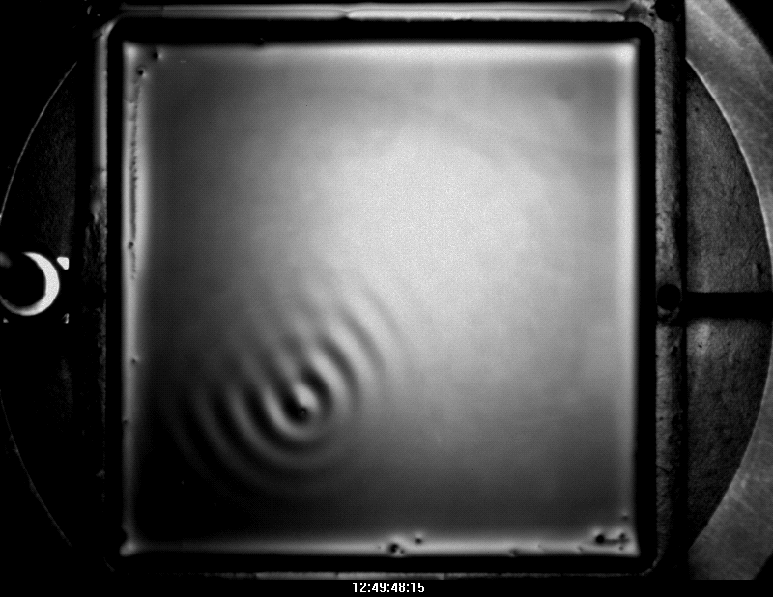

Slide 16
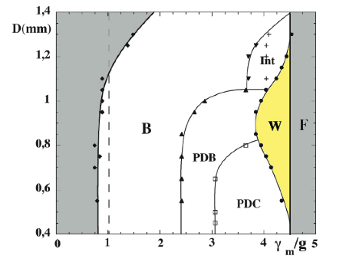
Near the Faraday instability onset, the droplets with 0.7 < D < 1.2 mm, become local emitters of Faraday waves.
(because their bouncing period has doubled),
Correlatively they become “walkers”
Onset of bouncing
Faraday Instability
threshold

Slide 17
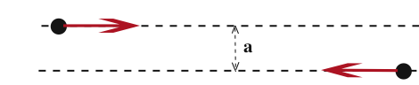
Part I (b)
The non-local interaction of walkers
We organize collisions of identical walkers with a parameter of impact a

Slide 18
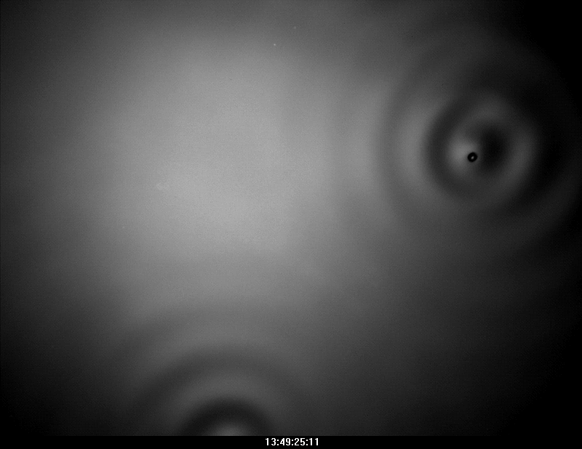
Collision of walkers

Slide 19
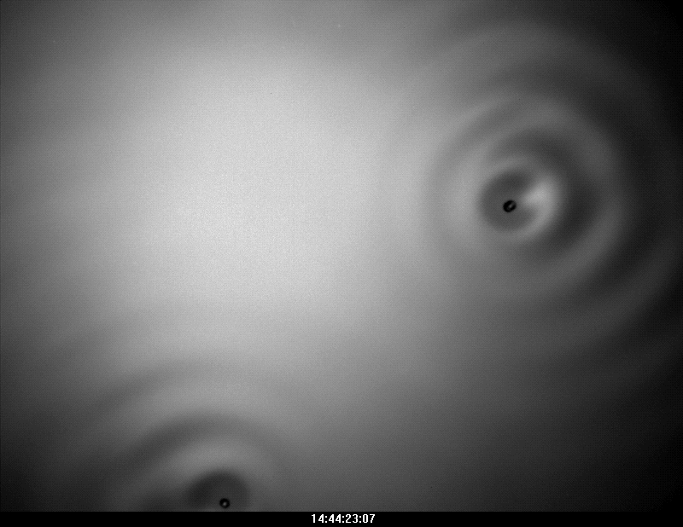
Collision of walkers

Slide 20
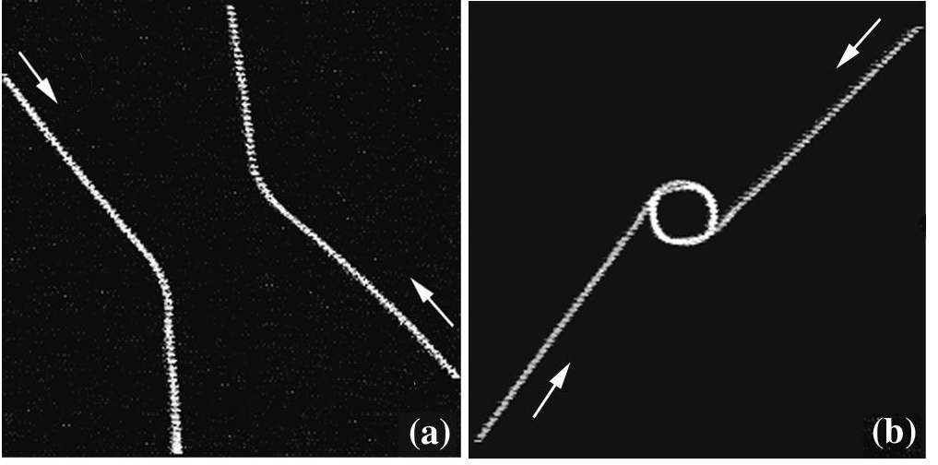
The output of organized collisions
Walkers have a non local interaction due to the overlap of their waves.
Depending on the value of a it can be either repulsive or attractive

Slide 21
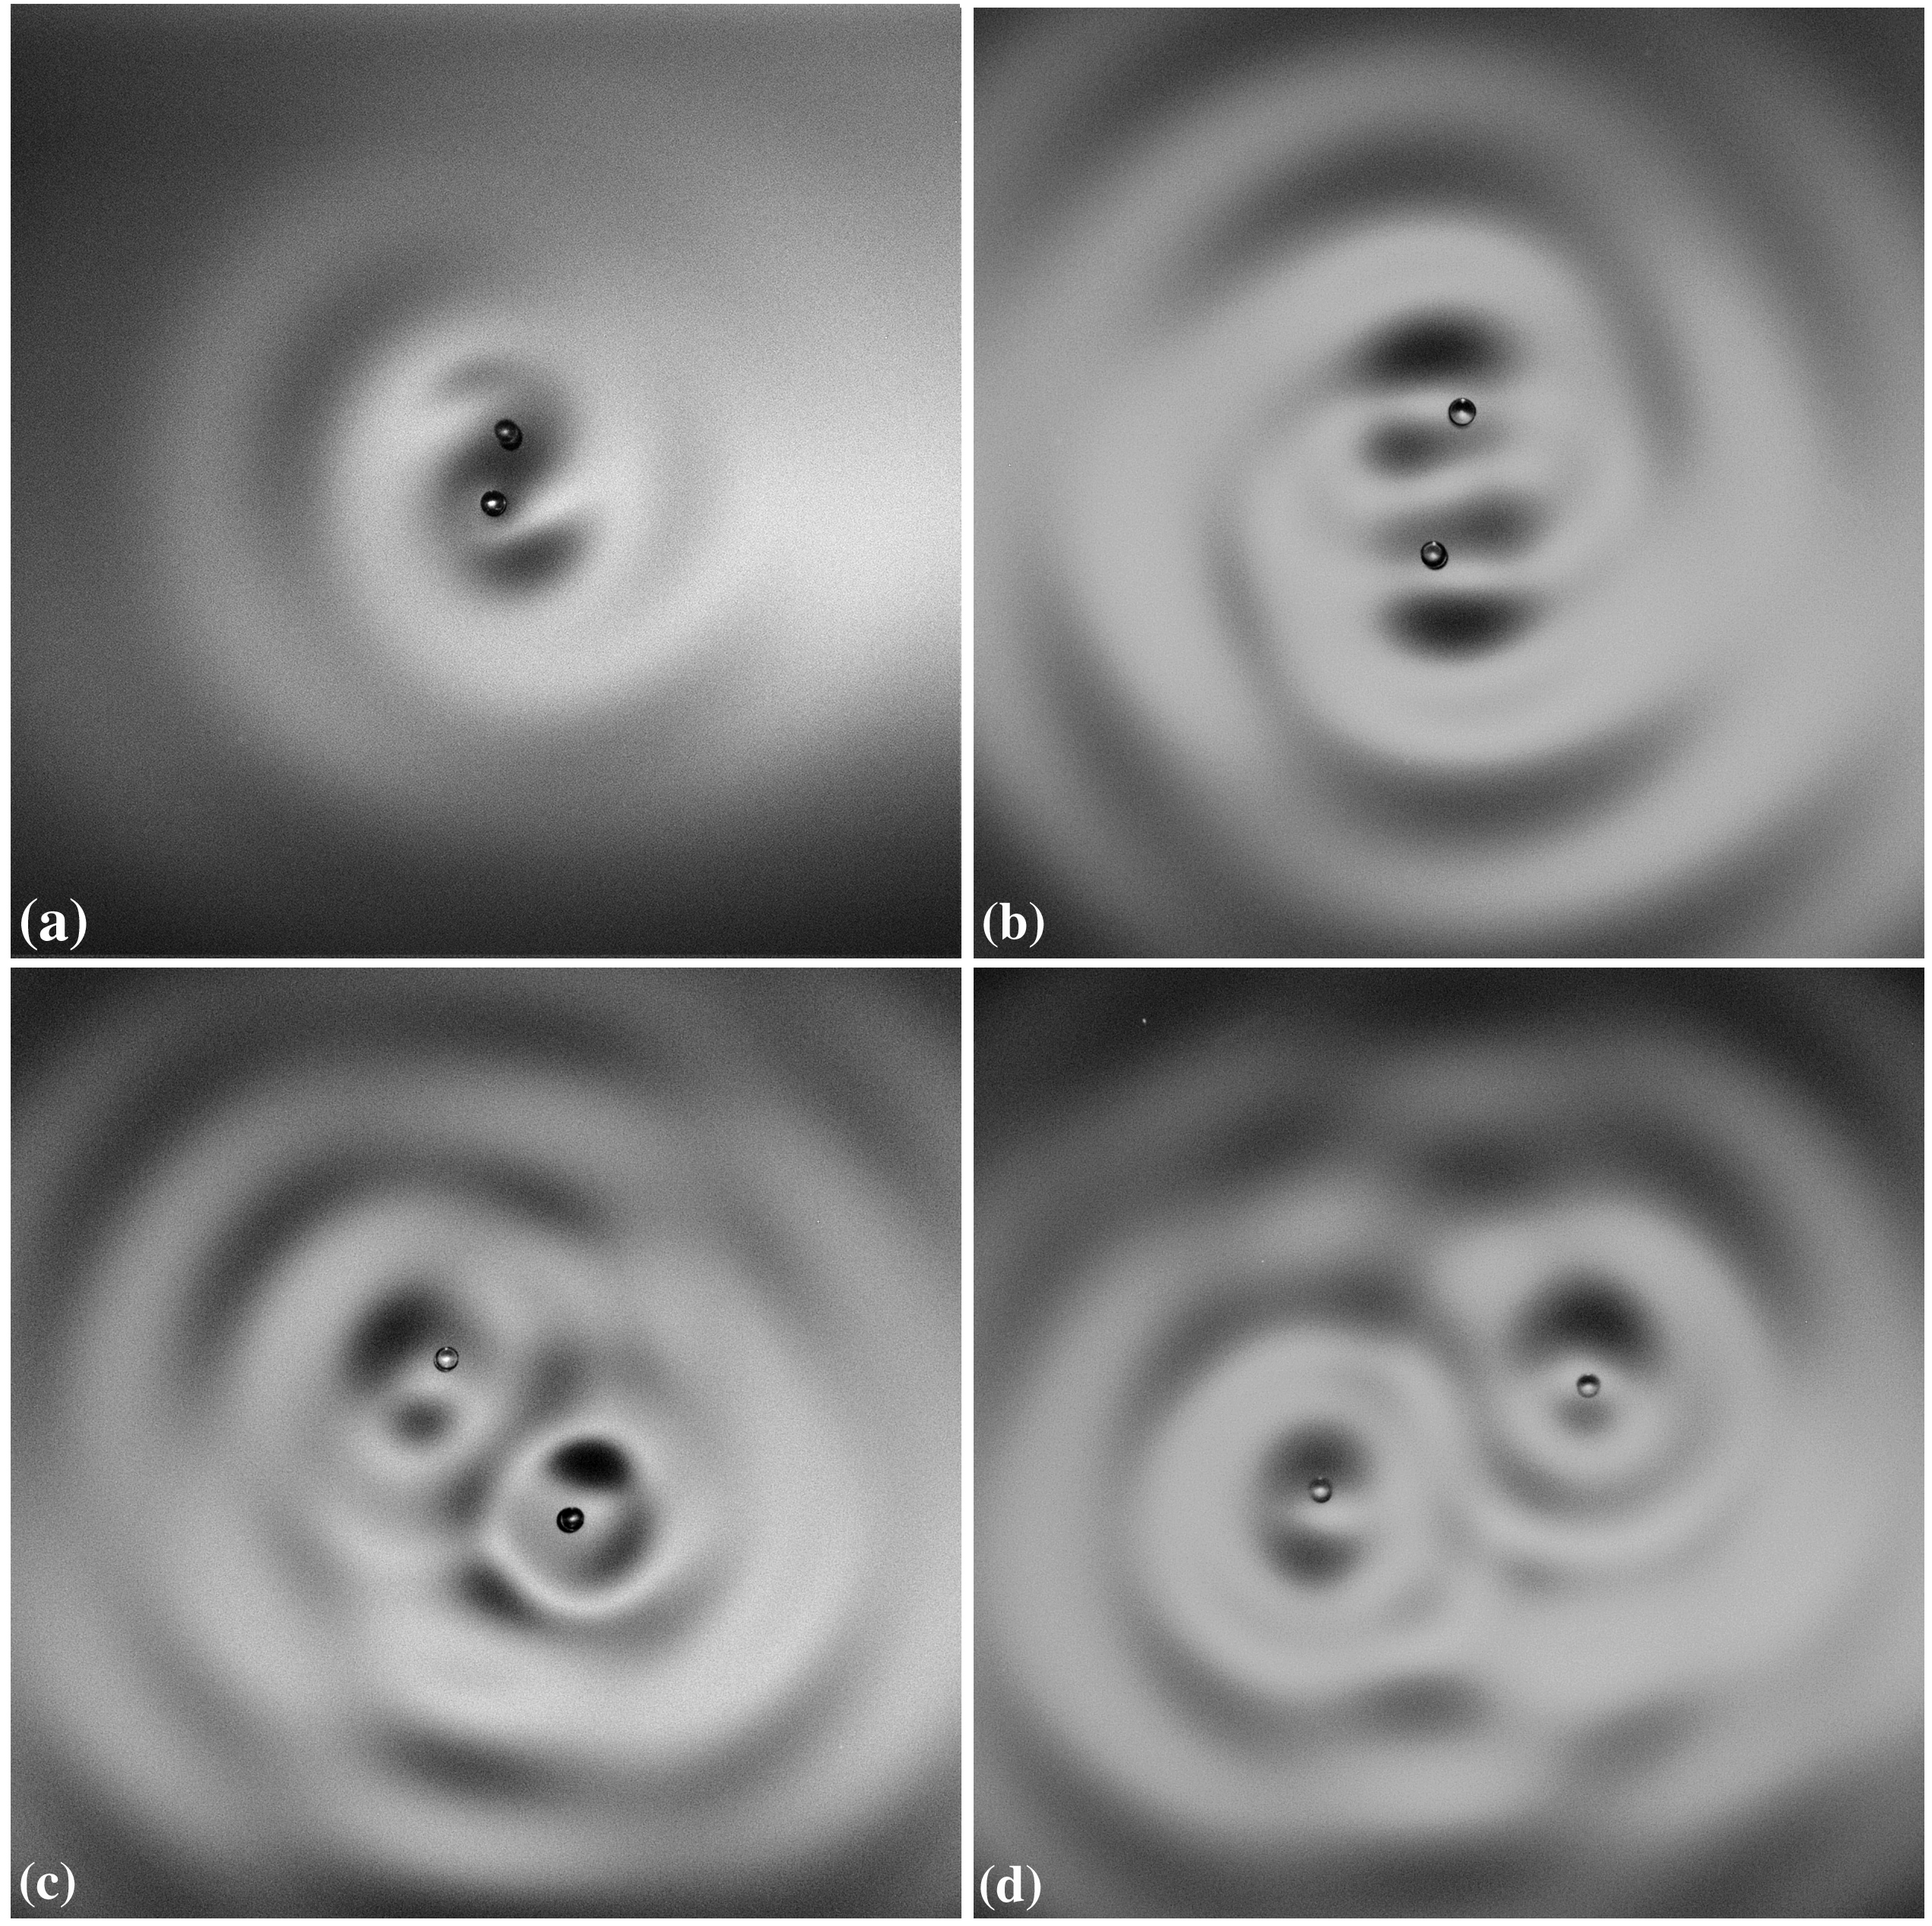
The first four orbits:
In (a) and (c) the drops bounce with opposite phases, (n=1/2 and 3/2)
In (b) and (d) they are in phase (n=1 and 2)

Slide 22
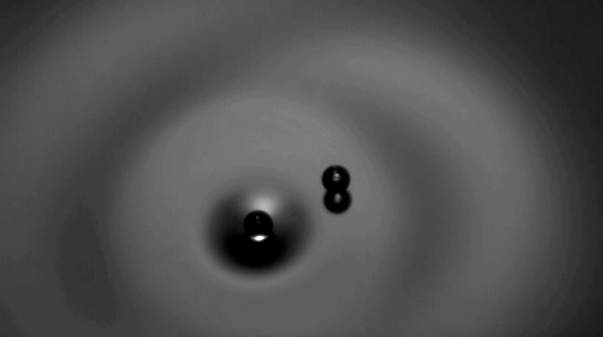
First orbit (n=1/2)

Slide 23
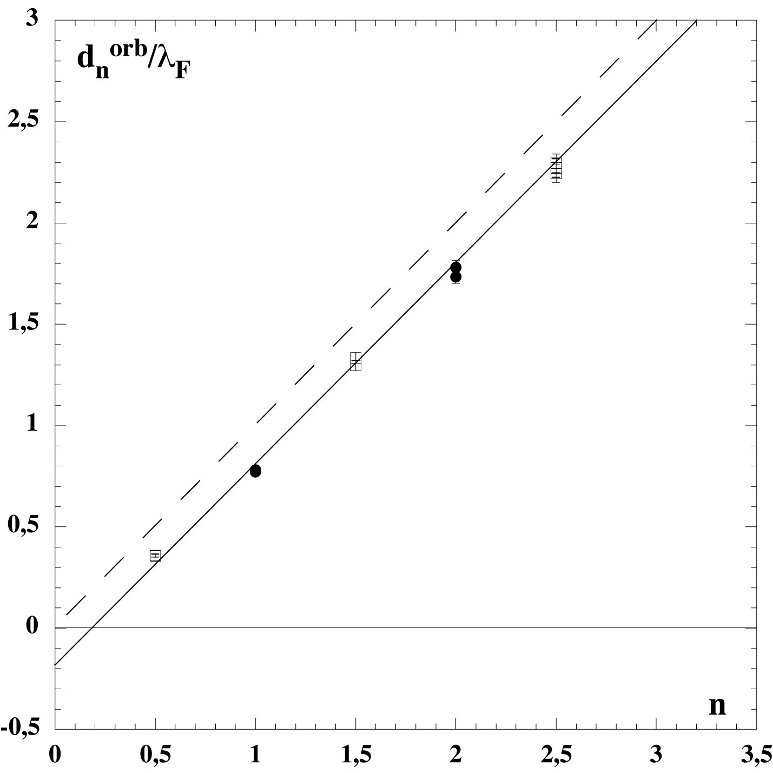
The discrete values of the possible orbits diameters
• Drops bouncing in phase:
d_{n}^{orb}= (n-ε) λ_{F}
• Drops bouncing
with opposite phases
d'_{n}^{orb}= (n+1/2-ε) λ_{F}
The Faraday wavelength λ_{F}
can be computed from the dispersion relation
ω² = (gk + σ/ρ k³)
λ_{F}= 4.75 mm for ω/2π =40 Hz
The offset ε is the same for all orbits.

Slide 24
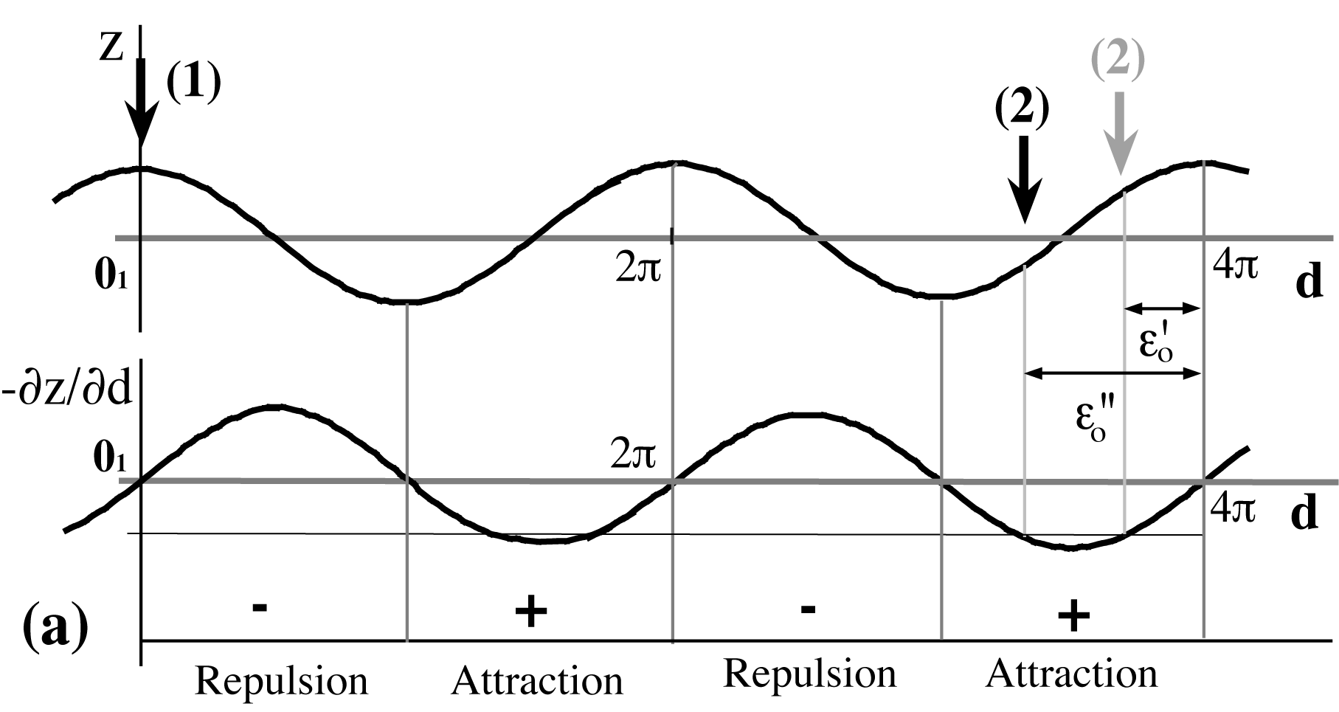
Principle of the interaction
For two drops bouncing in phase we have
- repulsive collisions when :
nλ_{F} < d_{min} < (n+1/2) λ_{F}
- attractive collisions when :
(n-1/2) λ_{F} < d_{min} < n λ_{F}
The latter lead to capture when the velocity is not too large

Slide 25
Part II
The wave-particle problem:
(a) the structure of the wave: path memory
Notes:
25

Slide 26
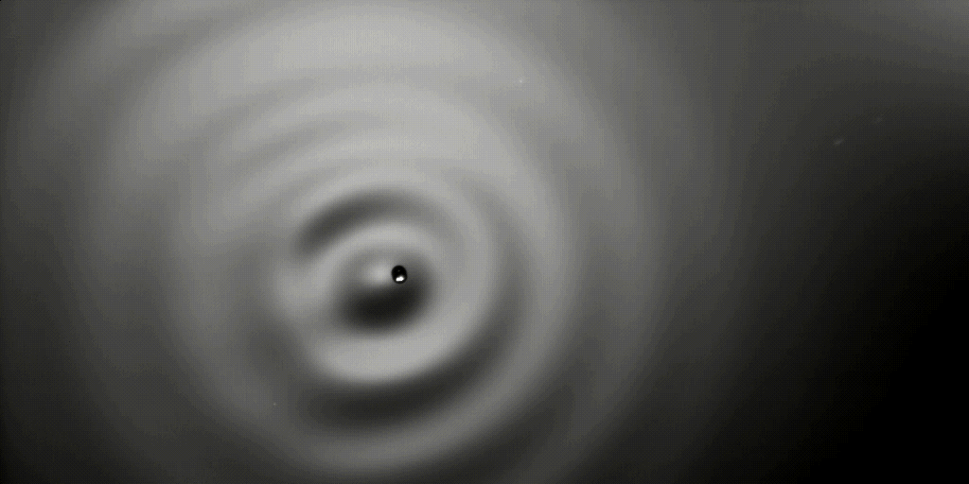
A walker

Slide 27
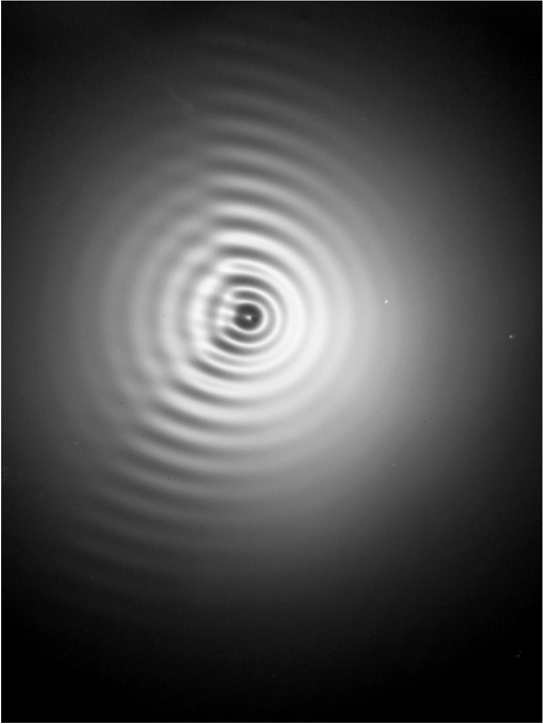
A walker is a “symbiotic" association of a particle with a wave:
If the particle vanishes, so does the wave,
If the wave is damped, the droplet stops
What is the structure of the wave field?
- Its characterisation
- The need for a second model
Notes:
27

Slide 28

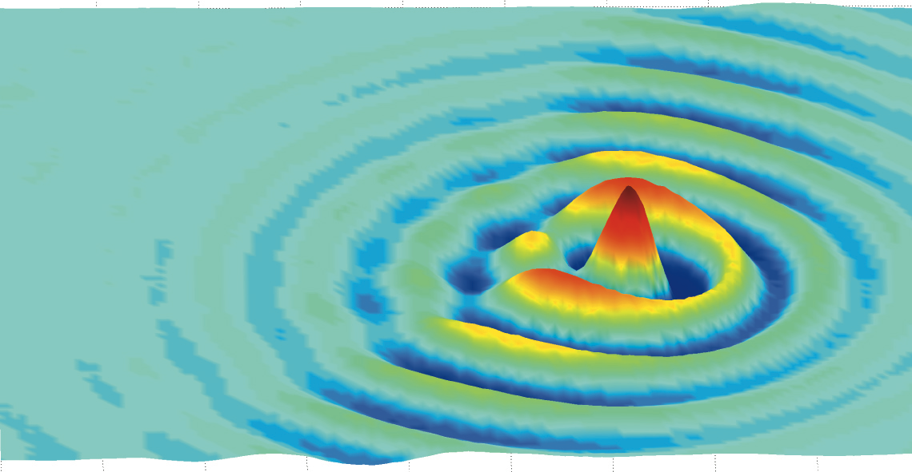
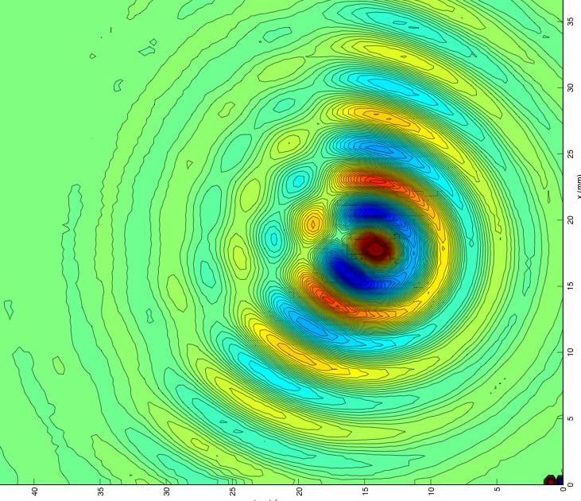
The measured wave field
Obtained by an adaptation of a particle image velocimetry technique (PIV) to measure the shape of the interface, a technique due to
Frédéric Moisy and Marc Rabaud (FAST Orsay)
Notes:
28

Slide 29
The path memory model
    Simplifying approximations:
    Decoupled vertical and horizontal motions. Take-off and landing times are determined only by the forcing oscillations.
    (2) The elementary displacement δr_{n} of the droplet results from three processes.
      - After take-off: free parabolic motion with constant horizontal velocity.
      At each bounce, the droplet is given a momentum increment by its inelastic shock on the surface. The direction of this kick depends on the local surface slope.
      During the contact time, viscous damping of the horizontal velocity due to the shearing of the air layer between the drop and the bath.
    The local slope of the interface results from the accumulation of the waves emitted by the points recently visited, with a tunable damping
Notes:
29

Slide 30
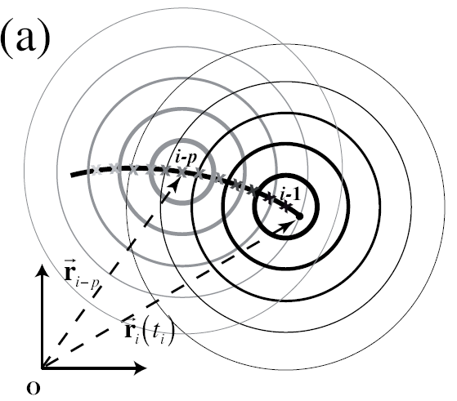

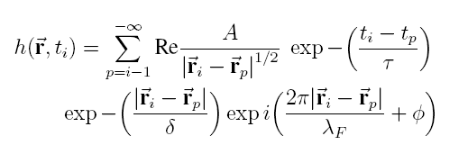
The path memory model
The relative surface height
at position and time is given by:
The spatial damping, δ : of travelling waves is fixed and related to the fluid viscosity.
The damping time, τ : the path memory parameter, is tunable, being determined by the distance to the Faraday instability threshold.

Slide 31
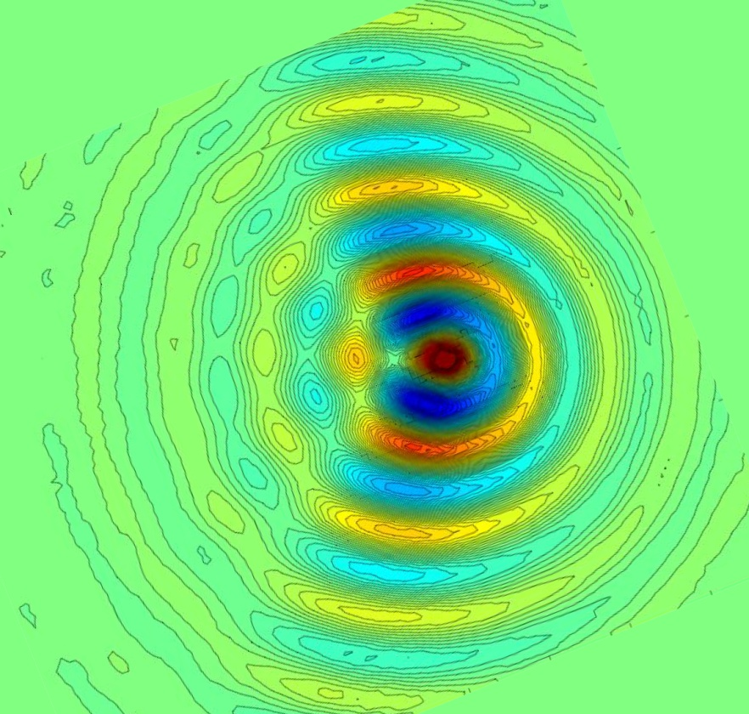
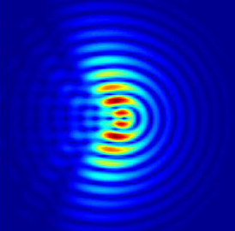
A wave field structure dominated by a “path memory” effect
- At each bounce, a circular wave packet is emitted
- The points of the surface recently visited by the droplet keep emitting waves (2D)
The wave field results from the superposition of the waves emitted by these points, hence the Fresnel interferences
The measured field
Its simulation
Notes:
31

Slide 32
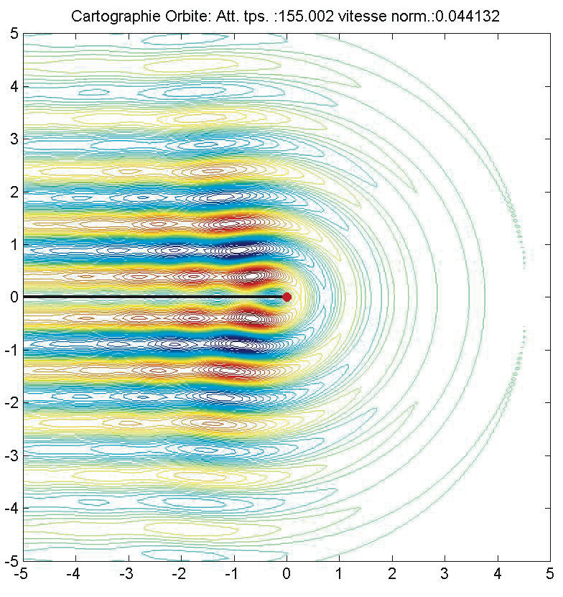
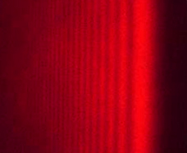
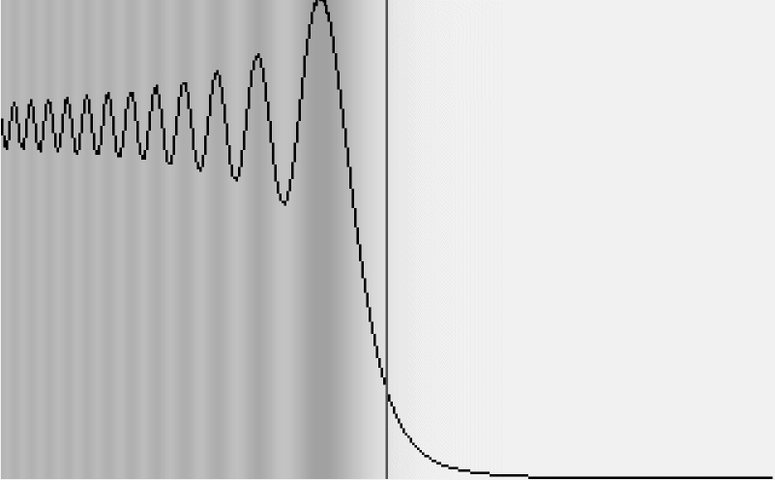
Path memory model and Huygens-Fresnel theory of diffraction
Fresnel diffraction behind an edge
(simulation John Talbot 1997)
Notes:
32

Slide 33
The wave-particle problem
A walker is formed of:
- A spread-out and continuous wave
- A discrete and localized droplet
How can they have a common dynamics?
1/ What happens if the wave passes through a diaphragm?
2/ What happens if the wave is partly reflected?
Notes:
33

Slide 34
Part II (b)
Single particles diffraction and interference
    Couder Y. & Fort E.
    Single-particle diffraction and interference at a macroscopic scale
    Phys. Rev. Lett. 97, 15101, (2006)
Notes:
34

Slide 35
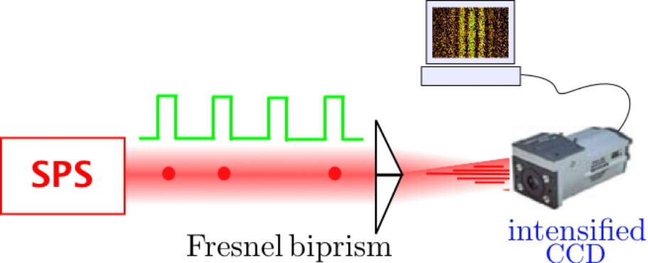
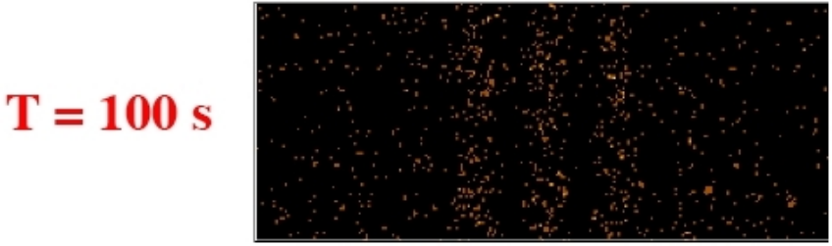
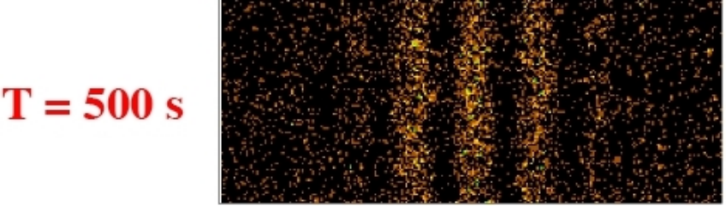
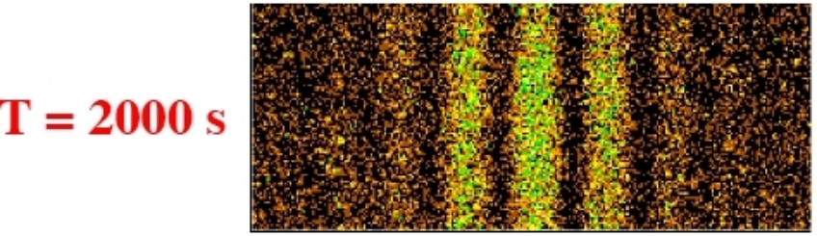
A modern version: single photon interference with a Fresnel biprism
Jean François Roch
François Treussard
Philippe Grangier

Slide 36
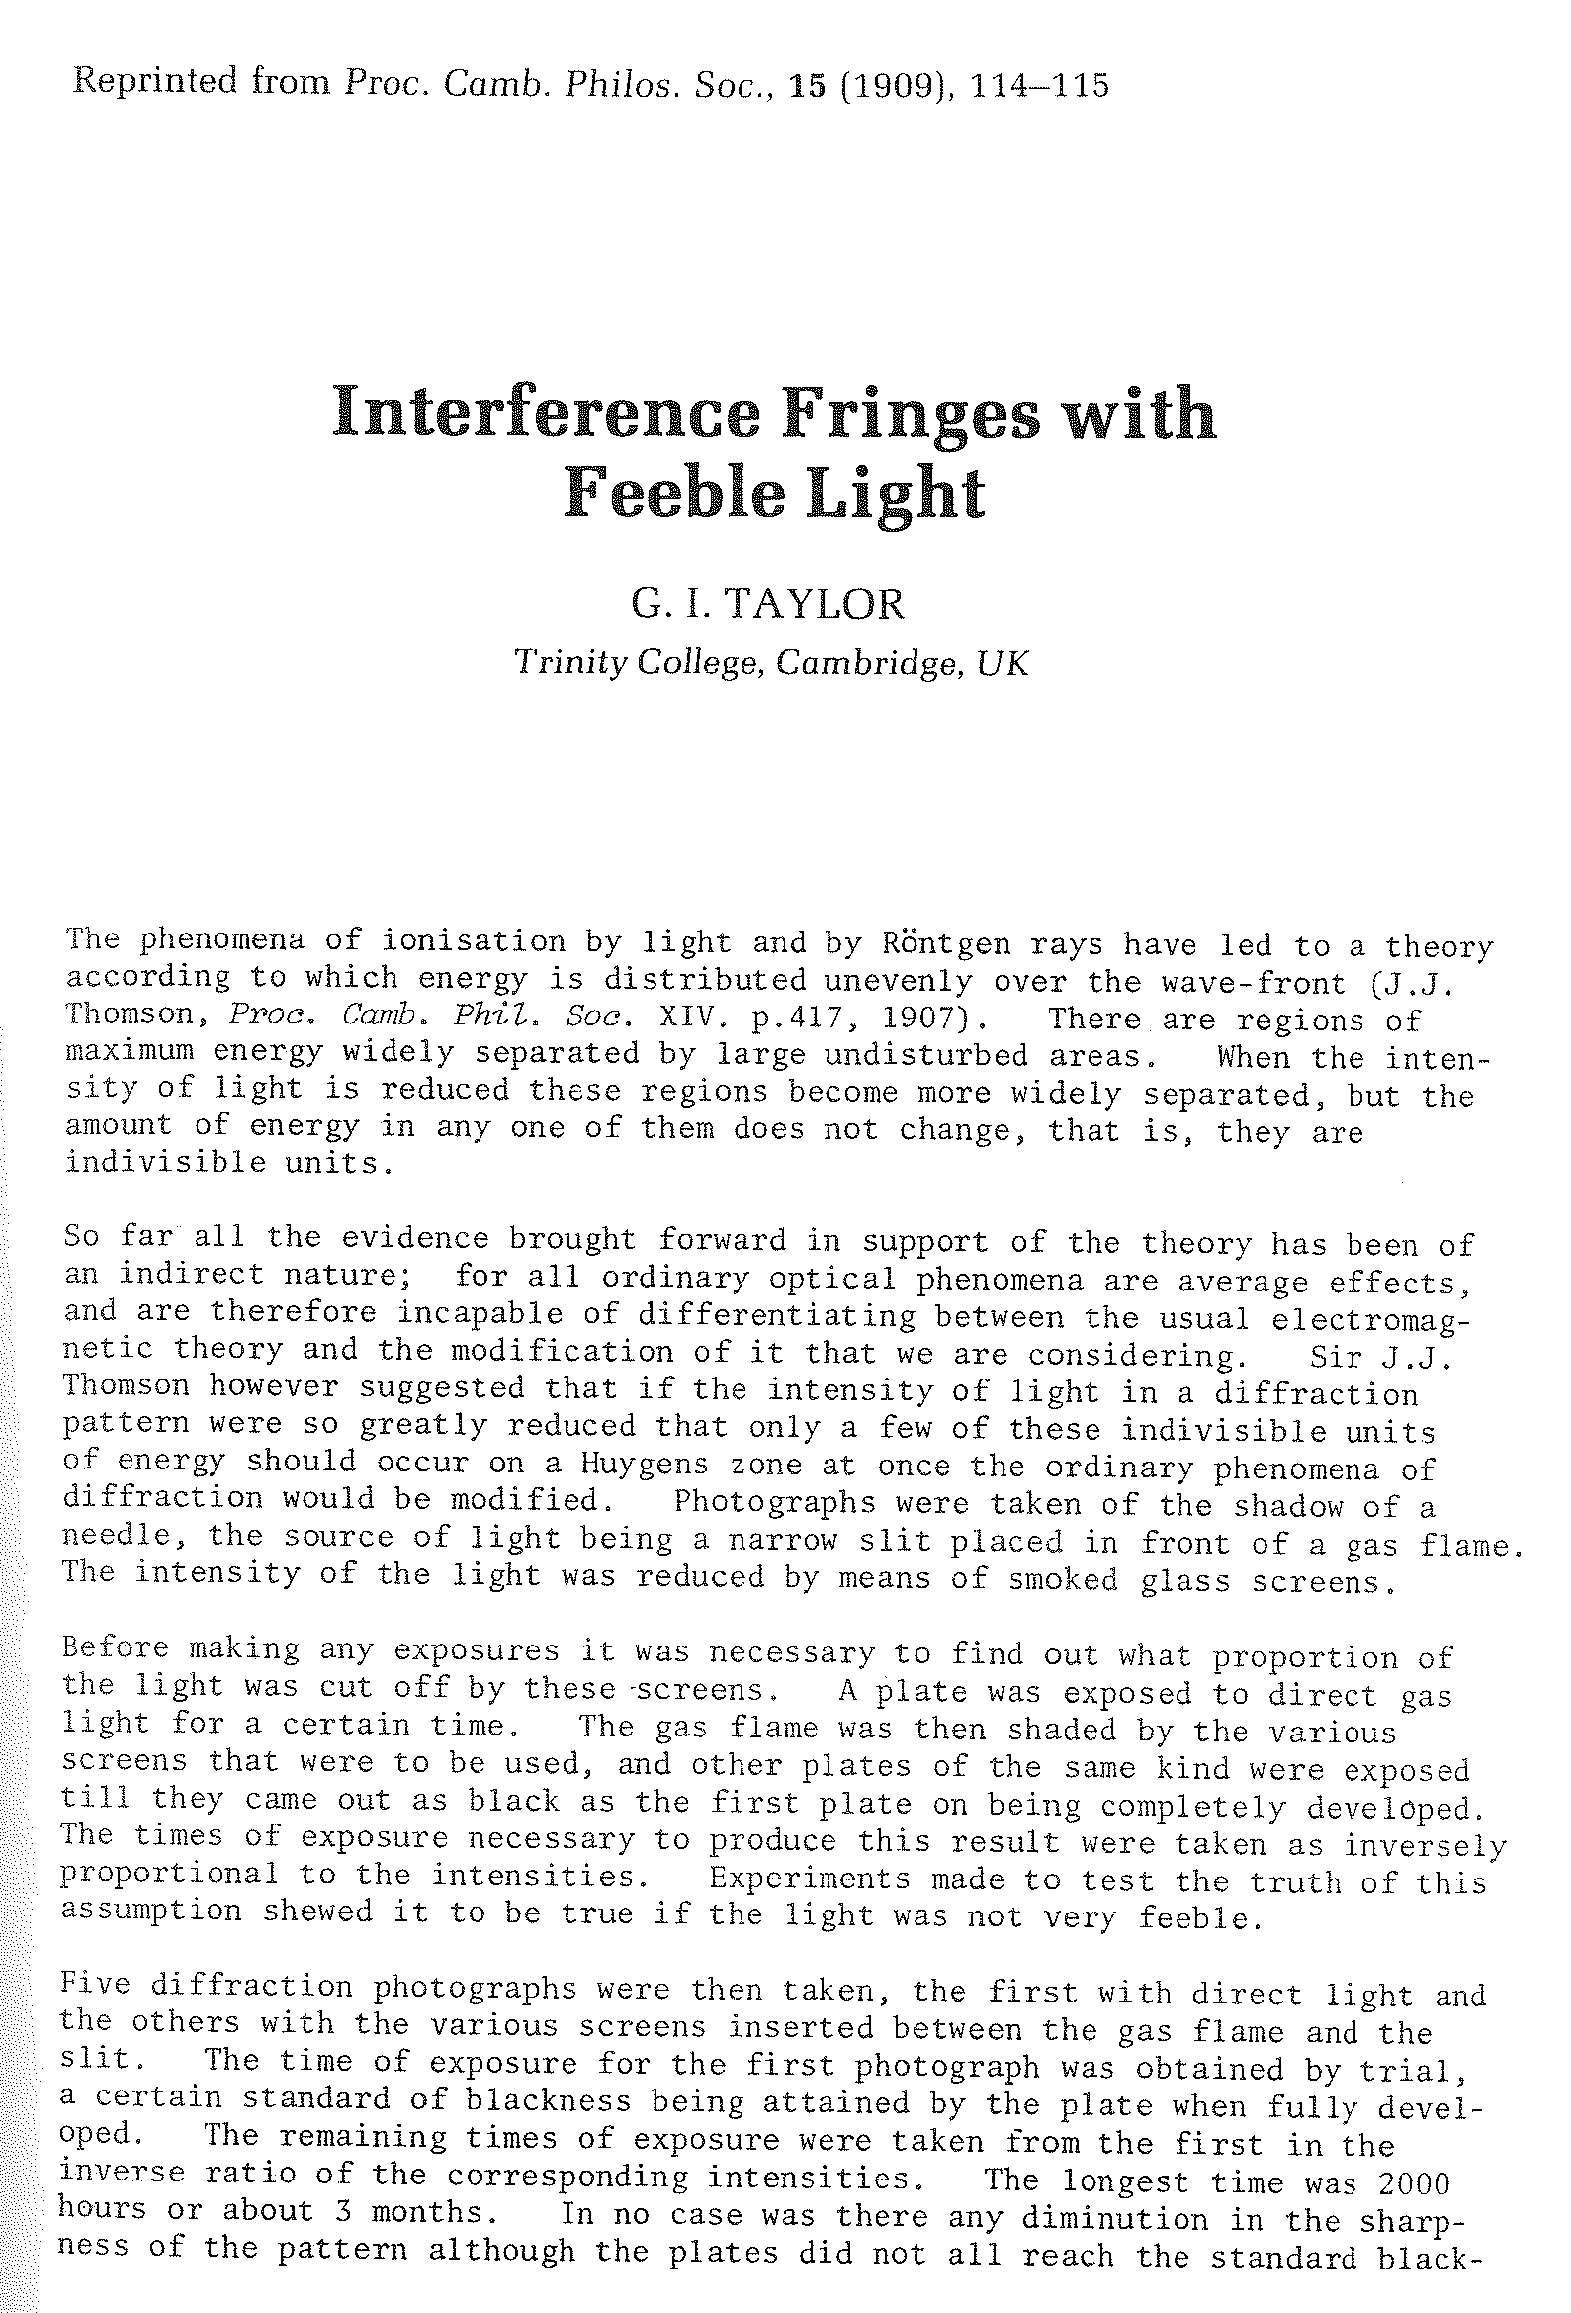
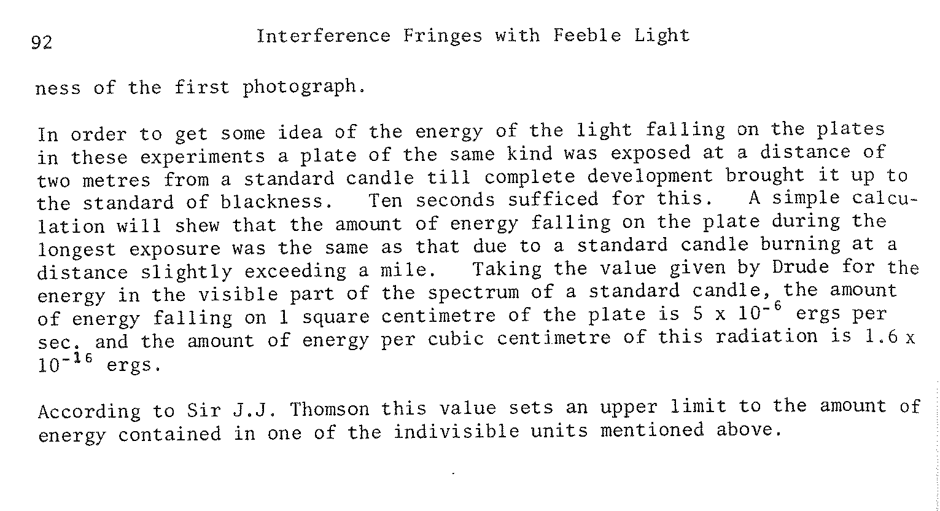
Single photon interference (a concise article!)
G.I. Taylor, Proc. Camb. Phil. Soc., 15, 114-115, (1909)
Notes:
36

Slide 37
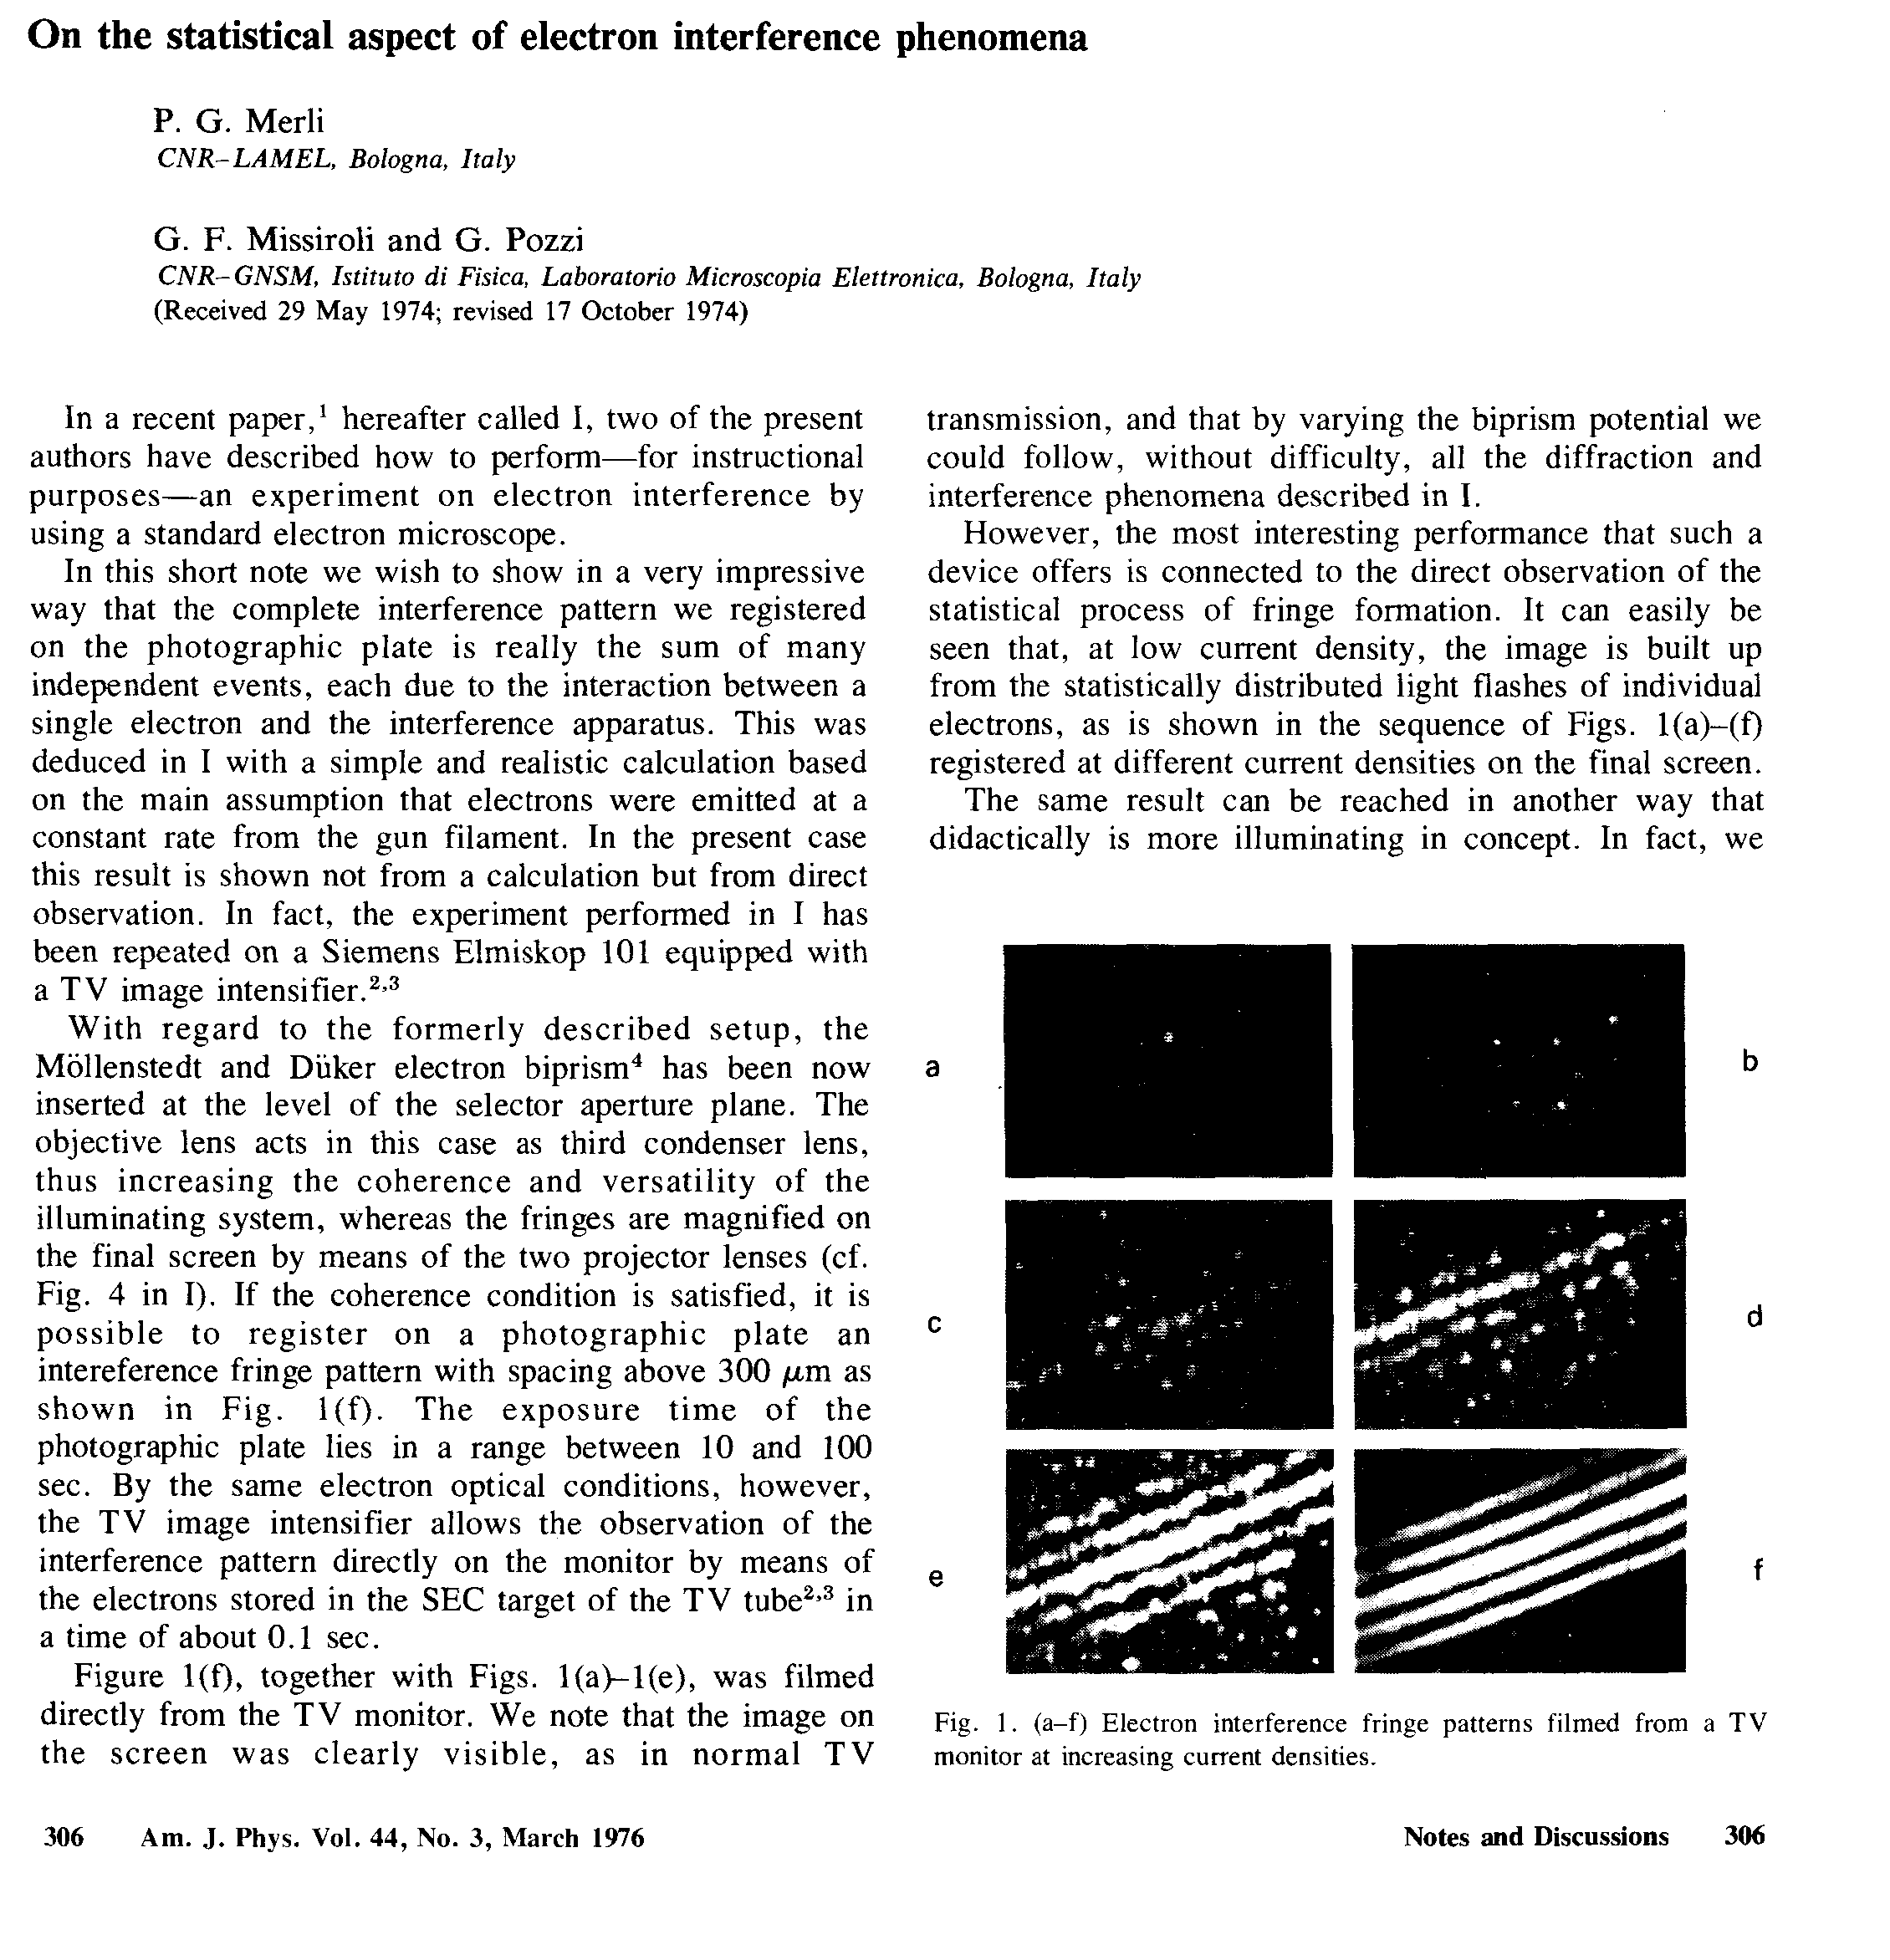
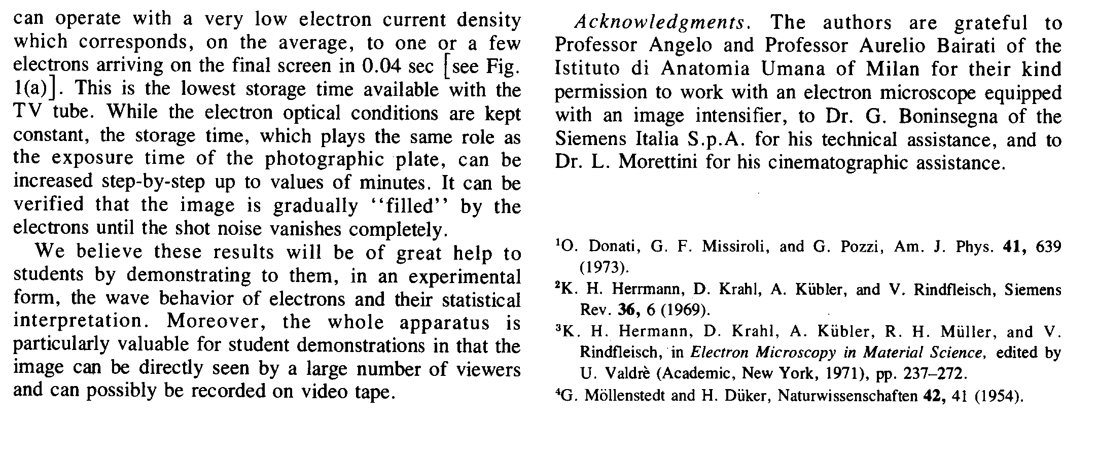
Single electron interference (another concise article!)
P.G. Merli, G.F. Missiroli and G. Pozzi, Am. J. Phys. 44, 306-307, 1976.

Slide 38
The build-up of the interference pattern with single particle
R. Feynman’s, Lectures on Physics, vol. 3, Quantum Mechanics, (First chapter)
« … In this chapter we shall tackle immediately the basic element of the mysterious behavior in its most strange form. We choose to examin a phenomenon which is impossible, absolutely impossible, to explain in any classical way and which is at the heart of quantum mechanics. In reality it contains the only mystery. We cannot make the mystery go away by explaining how it works . We will just tell you how it works.… »
Notes:
38

Slide 39
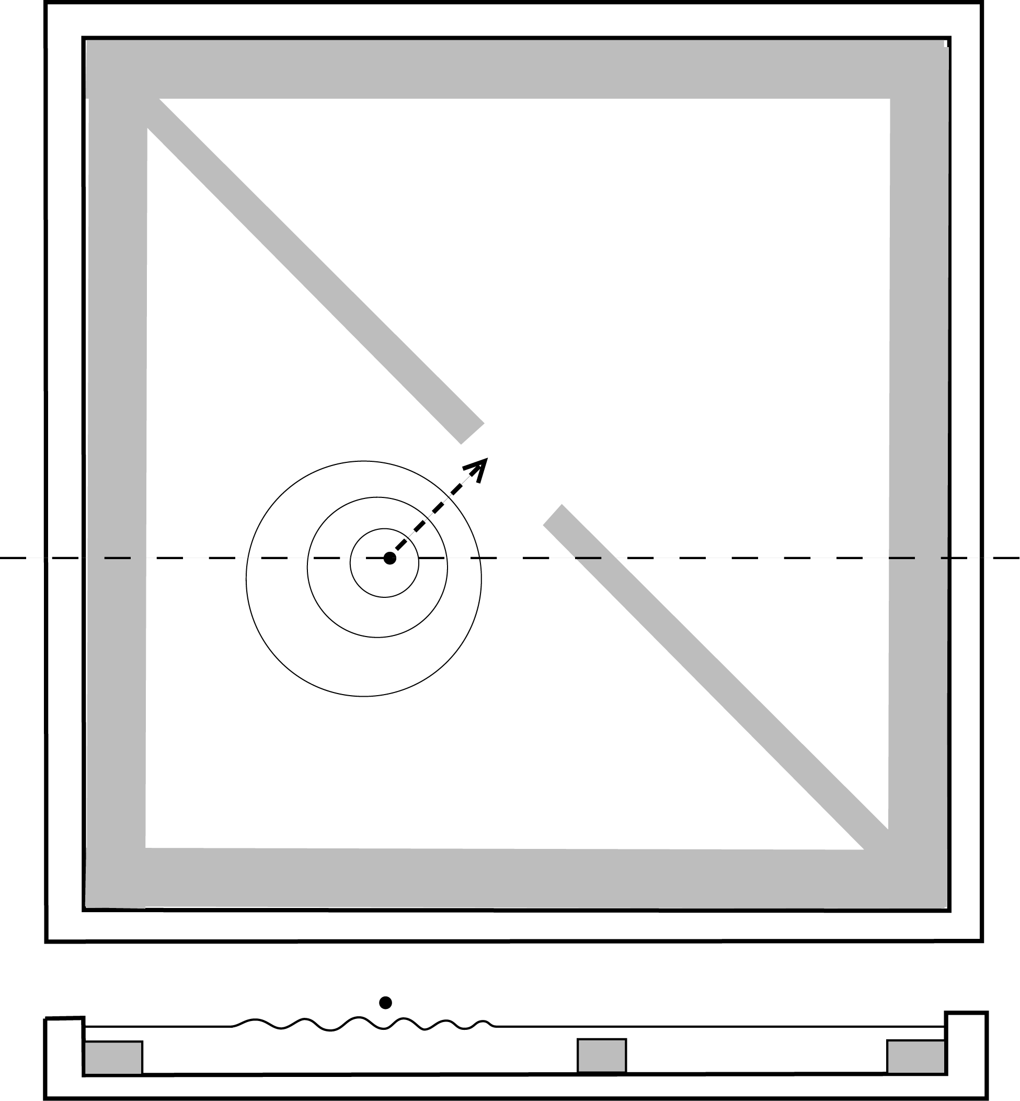
The experimental set up for diffraction and interference experiments
In the grey regions the fluid layer thickness is reduced to h₁=1mm
(h₀=4mm elsewhere)
In these regions the Faraday threshold being shifted, the walkers do not propagate
Cross section
Notes:
39

Slide 40
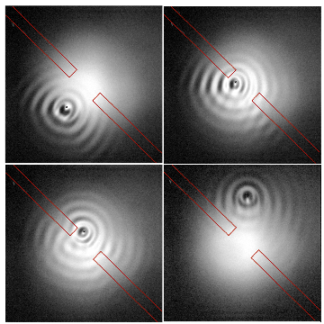
Four photographs of the wave pattern during the diffraction of a walker
Notes:
40

Slide 41
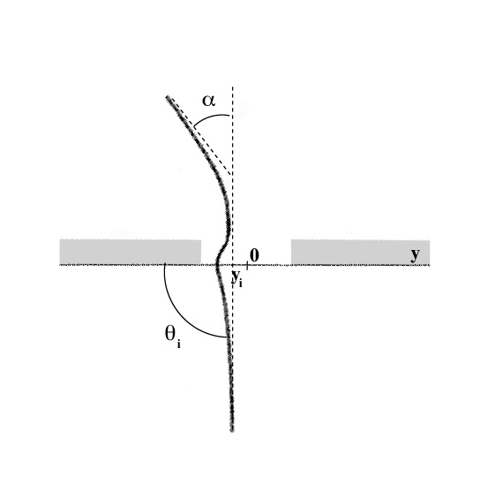
Measurements on the droplet’s trajectory
The relevant parameters:
L : the width of the slit,
θ_{i} : angle of incidence (chosen θ_{i}= π/2),
α : the angle of deviation
Y_{i} = y_{i}/L : the impact parameter
(With -0.5 < Y_{i} < 0.5)
Notes:
41

Slide 42
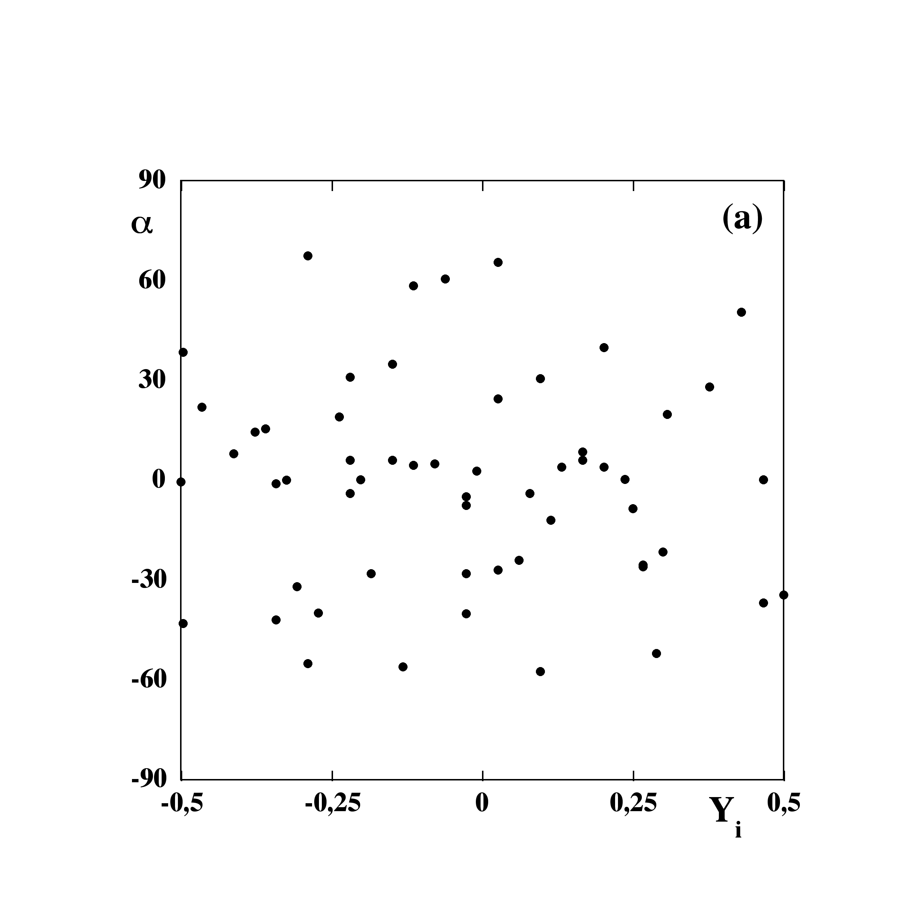
Is there a link between the far field deviation α and the impact parameter Y_{i} ?
The measured deviation in experiments performed with the same walker,
the same angle of incidence, but various impact parameters
L/λ_{F}=3.1 (L=14.7mm and λ_{F}= 4.75 mm).
Notes:
42

Slide 43
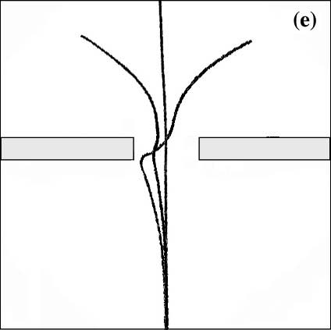
Is there a link between the far field deviation α and the impact parameter Y_{i} ?
The measured deviation in experiments performed with the same walker,
the same angle of incidence, but various impact parameters
L/λ_{F}=3.1 (L=14.7mm and λ_{F}= 4.75 mm).
Three independent trajectories with the same initial conditions (within experimental accuracy)
What about statistical properties?
Notes:
43

Slide 44
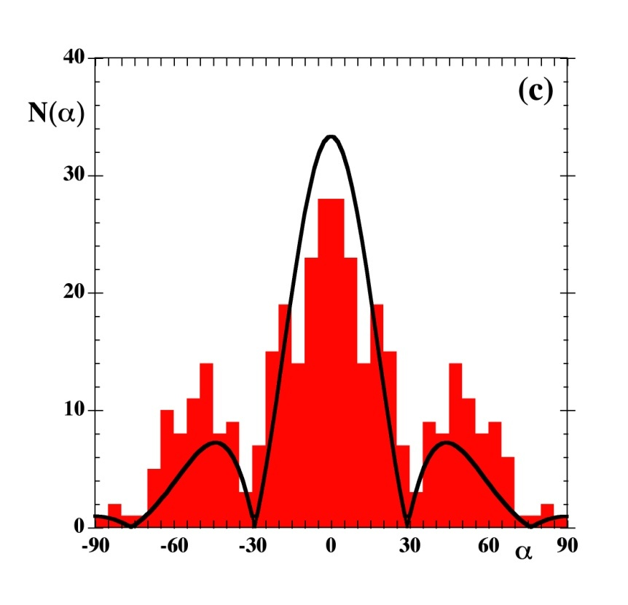
Cumulative histograms of the observed deviations in N independent crossings
ω/2π= 50Hz,
L/λ_{F}=2.11 (L=14.7mm and λ_{F}= 6.95 mm).
The curve is the modulus of the amplitude of diffraction of a plane wave with
L/λ_{F} =1.96.
Notes:
44

Slide 45
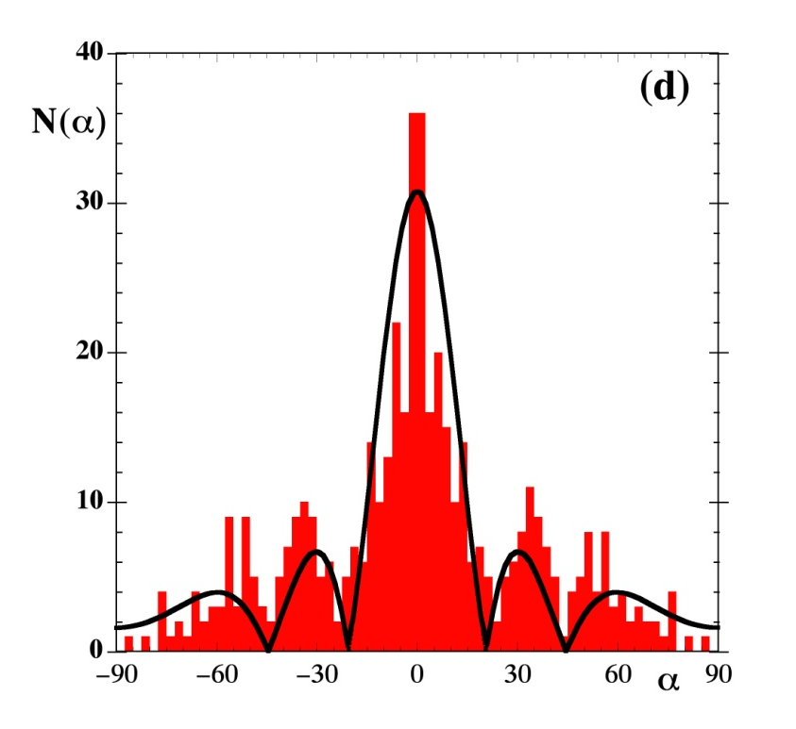
Cumulative histograms of the observed deviations in N independent crossings
ω/2π= 50Hz,
L/λ_{F}=2.11 (L=14.7mm and λ_{F}= 6.95 mm).
The curve is the modulus of the amplitude of diffraction of a plane wave with
L/λ_{F} =1.96.
Same with ω/2π= 80Hz ,
L/λ_{F}=3.1 (L=14.7mm and λ_{F}= 4.75 mm).
Notes:
45

Slide 46

Young’s two slits experiment
Notes:
46

Slide 47

Interference: histogram for 75 realizations
The curve is the modulus of the amplitude of the interference of a plane wave through two slits with
L/λ_{F}= 0.9 and d/λ_{F}=1.7.
Notes:
47

Slide 48
The simulation of the diffraction using path-memory model
    - Iterative computation of the trajectory: each displacement δr_{n} is determined by the local slope of the interface. This slope results of the interfering waves due both to previous bounces and to the scattering by the walls
    - The walls are modelled by secondary sources emitting waves with a phase opposite to the waves they receive.
    - The computation takes into account the retardation effects due to the finite wave and droplet velocities.
Notes:
48

Slide 49


The results of the numerical simulation of the diffraction through a slit with L/λ_{F}=3
Notes:
49

Slide 50
Diffraction of waves…
It is not a surprise that a wave passing through a slit is diffracted. This is the standard result from Fourier transform. The wave truncation results in its spreading in the transverse direction.
… or diffraction of particules?
Here, however, we do not measure the wave field but the trajectories of successive particles. Their individual deviations are unpredictable, exhibiting an uncertainty linked with the spreading of the wave
The Fourier spreading of the wave generates an uncertainty for
the direction of the velocity of the particle.
Notes:
50

Slide 51
Part II (b)
Tunneling through a barrier
(with Antonin Eddi)
    A.Eddi, F. Moisy, E. Fort & Y.Couder
    " Unpredictable tunneling of a classical wave-particle association”
    Phys. Rev. Lett. 102, 240401, (2009)
Notes:
51

Slide 52


Principle
Above a submerged barrier, the Faraday instability threshold is shifted, the wave is damped and the walking behaviour is evanescent.
If its horizontal thickness is large, an impinging walker is reflected away.
What happens if the barrier has a small horizontal thickness?
Notes:
52

Slide 53

The measured wave field of a walker impinging on a barrier of finite thickness
Obtained by an adaptation of a particle image velocimetry technique (PIV) to measure the shape of the interface
Frédéric Moisy and Marc Rabaud (FAST Orsay)
A wave of weak amplitude is transmitted on the other side of the barrier
Notes:
53

Slide 54

First experimental set-up
Escape out of a closed cavity
Notes:
54

Slide 55

A walker confined in a square cavity with thin walls
Notes:
55

Slide 56

The origin of the probabilistic behaviour: the trajectories inside the frame
For thick walls the walker reaches a stable limit cycle
With thin walls the reflections are imperfect, leading to different types of collisions with the wall and to a probability of escape
Notes:
56

Slide 57

Second experimental set-up
The particle is guided by the divergent walls so that it impiges perpendicularly on the barrier of thickness e.
Notes:
57

Slide 58

Accumulation of events
Notes:
58

Slide 59


Probability of crossing with normal incidence
Semi-log plot of the probability of crossing as a function
of the barrier’s tickness
Linear plot of the probability of crossing as a function walker’s velocity
Notes:
59

Slide 60

The relation to the incident trajectory
Far from the barriers, all walkers have a normal incidence.
They deviate because of the reflected waves
Only those walkers which have had a weak deviation have a probability of crossing
The walker deviates have a weaker probability of being deviated when the reflected waves are weaker (thin barriers), hence a larger probability of crossing
Notes:
60

Slide 61
The wave-particle problem
A walker is formed of:
- A spread-out and continuous wave
- A discrete and localized droplet
How can they have a common dynamics?
1/ What happens if the wave passes through a diaphragm?
2/ What happens if the wave is partly reflected?
In both cases the truncation of the wave leads, in the presence of path memory, to a form of chaos generating probabilistic behaviours for the particle.
Notes:
61

Slide 62
Part III
Can path-memory lead to a kind of quantization?
Experiments on the orbits of a walker in a rotating tank
A classical analogue to Landau quantization?
Fort E., Eddi A., Boudaoud A., Moukhtar J. & Couder Y.
Path-memory induced quantization of classical orbits
to appear in PNAS

Slide 63
What can be done?
In our system the frequency and thus the "energy" of the walker is fixed
We cannot seek a quantization of the energy…
but we could seek a quantization of the orbital motion
The first idea which comes to mind is to use magnetic forces

Slide 64
Classical orbiting motion in a magnetic field
In a magnetic field B Orbital motion
Larmor angular velocity
Orbit radius
Notes:
64

Slide 65
Classical orbiting motion in a magnetic field and in a rotating system
In a magnetic field B Orbital motion | On a surface rotating with angular velocity Ω Orbital motion in the rotating frame
Larmor angular velocity | Orbital motion angular velocity
Orbit radius | Orbit radius
Notes:
65

Slide 66
Landau levels: the Bohr-Sommerfeld quantization in a magnetic field
In 2D the energy of the particle is quantized into discrete Landau levels of energy :
where ω_{c}=qB/m.
Bohr Sommerfeld imposes:
Where γ = 1/2 in the semi-classical approach.
It results into a quantization of the orbits area Σ_{n}:
The Larmor radius can only take discrete values
Notes:
66

Slide 67


The analogy of the effect of rotation with that of a magnetic field used by Michael Berry
C. Coste, F. Lund, M. Umeki, Phys Rev. E, 60, 4908, 1999
Notes:
67

Slide 68

The rotating Faraday experiment
Notes:
68

Slide 69

A walker in a rotating frame

Slide 70


Measured trajectories
Trajectory in the laboratory
frame of reference
Trajectory in the rotating
frame of reference
Notes:
70

Slide 71

Classical radius of the orbits
The “classical“ radius of the orbit observed in the rotating frame and due to Coriolis effect should be:
R=V/2Ω
Notes:
71

Slide 72

Measured radius of the orbits for walkers without path memory
(far from the Faraday threshold)
The radius of the orbit observed in the rotating frame has a “classical“ dependance, but slightly shifted
R=a (V/2Ω)
with
Notes:
72

Slide 73

Measured radius of the orbits for walkers with path memory (near the Faraday threshold)
Near the Faraday instability threshold, the radius of the orbit evolves by discrete jumps when Ω is increased
Notes:
73

Slide 74

A transition from the orbit n=2 to n=1 when Ω is increased
Trajectory in the rotating
frame of reference
Notes:
74

Slide 75




Photographs of the walker in a rotating Faraday cell for increasing rotation frequency
d_{n}^{orb}=7 λ_{F}
d_{n}^{orb}=3 λ_{F}
d_{n}^{orb}=2 λ_{F}
d_{n}^{orb}=λ_{F}
Notes:
75

Slide 76
The experiments done to obtain a scaling law
Four different oils were used for which walkers were obtained for different forcing frequencies
Silicon oil | μ=10 10⁻³ Pa s | μ=20 10⁻³ Pa s | μ=50 10⁻³ Pa s | μ=100 10⁻³ Pa s
Faraday Frequency | f_{F} = 55 Hz | f_{F} = 40 Hz | f _{F}= 25 Hz | f_{F} = 19 Hz
Wavelength | λ_{F} = 3.74mm | λ_{F} = 4.75mm | λ_{F} = 6.97 mm | λ_{F} = 8.99mm
In each case, walkers of various velocities were obtained with droplets of different diameters
e.g. for μ= 20 10⁻³ Pa s, we investigated drops having velocities ranging
5 mm/s < V_{w}< 15 mm/s
Notes:
76

Slide 77

Dimensionless radius of the orbits
The radii of the orbits obtained at various
frequencies and for walkers of various
velocities are all rescaled by expressing:
Notes:
77

Slide 78
Returning to 2D Landau orbits in a magnetic field
The quantized Larmor radius is usually given by:
It can be expressed as a function of de Broglie wavelength
So that:
Notes:
78

Slide 79
Classical orbiting motion in a magnetic field and in a rotating system
In a magnetic field B Orbital motion | On a surface rotating with angular velocity Ω Orbital motion in the rotating frame
Larmor angular velocity | Orbital motion angular velocity
Orbit radius | Orbit radius
Notes:
79

Slide 80

Dimensionless radius of the orbits
The analogy suggests:
We find
Notes:
80

Slide 81

Evolution of orbit diameters using the path-memory model
The first two modes experiment and simulations
d_{n}^{orb}=2 λ_{F}
d_{n}^{orb}=λ_{F}

Slide 82

Evolution of orbit diameters using the path-memory model

Slide 83


Evolution of orbit diameters using the path-memory model
Radial Force due to the waves

Slide 84


Evolution of orbit diameters using the path-memory model:
a virtual memory droplet
Fund. Rel. of Dynamics : radial component

Slide 85
Remarks and conclusions
The echo-location of the droplets, by the waves they emit, is reminiscent of the guiding wave proposed by de Broglie in an early model of quantum mechanics.
L. de Broglie, Ondes et mouvements, (Gautier Villars Paris) (1926).
The de Broglie model was revisited by D. Bohm who demonstrated the possibility of an interpretation of quantum mechanics with a coexistence of a wave and a particle.
L. de Broglie, Ondes et mouvements, (Gautier Villars Paris) (1926).
    D. Bohm, Phys. Rev. 85: 166-179, and 180-193, (1952),
    Phys. Rev. 89: 458-466 (1953),
Our system is not an implementation of a guiding wave of this type.
It has a new ingredient, its “path memory’’ which is responsible :
- for the chaotic trajectories leading to probability distributions in the diffraction and tunneling effect
for the quantization of the orbits in a rotating system

Slide 86


Outlook...

Slide 87
References
    Couder Y., Fort E., Gautier C.H. & Boudaoud A.,
    From bouncing to floating drops: non-coalescence of drops on a fluid bath,
    Phys. Rev. Lett. 94, 177801, (2005)
    Couder Y., Protière S., Fort E. & Boudaoud A., ,
    Dynamical phenomena: Walking and orbiting droplets,
    Nature 437, 208. (2005)
    Protière S., Couder Y., Fort E., & Boudaoud A., ,
    The self-organization of capillary waves sources,
    J. Phys.: Condens. Matter. 17, S3529-S3535. (2005)
    Protière S., Boudaoud A. & Couder Y.
    A particle-wave association on a fluid interface,
    J. Fluid Mech. 554, 85-108, (2006)
    Couder Y. & Fort E.
    Single-particle diffraction and interference at a macroscopic scale
    Phys. Rev. Lett. 97, 15101, (2006)
    Eddi A., Fort E., Moisy F., & Couder Y.
    Unpredictable tunneling of a classical wave-particle association
    Phys. Rev. Lett. 102, 240401, (2009)
Fort E., Eddi A., Boudaoud A., Moukhtar J. & Couder Y.
Path-memory induced quantization of classical orbits
To appear in PNAS

