Slide 1




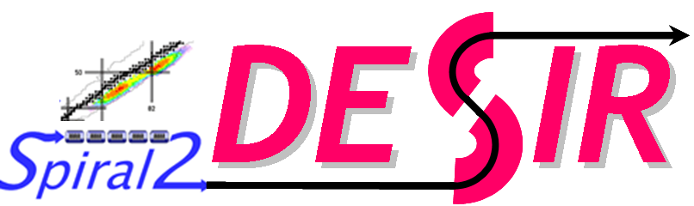
Collinear laser spectroscopy:
A powerful tool to study the structure of exotic nuclei
Gerda Neyens
IKS, KU Leuven, Belgium
Belgian Research Initiative
on Exotic nulcei

Slide 2
Collinear laser spectroscopy:
A powerful tool to study the structure of exotic nuclei
Introduction: goal of our research
Hyperfine structure – link to observables
Detect the hyperfine structure
  Optical detection ➔ COLLAPS, ISOLDE-CERN
  Resonantly excited ion detection ➔ CRIS, ISOLDE-CERN
Some results
Outlook

Slide 3
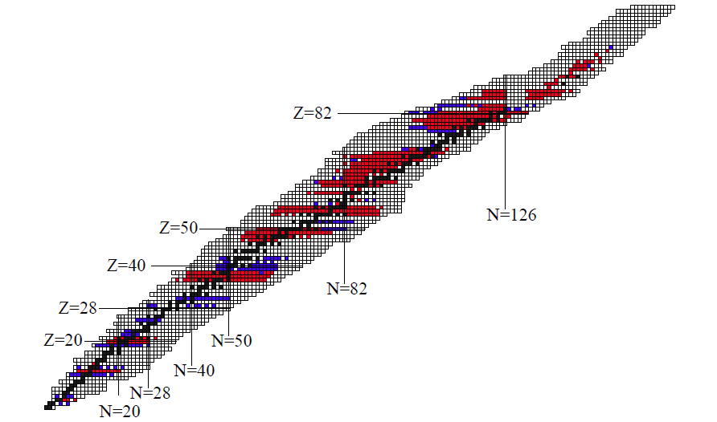
PURPOSE of exotic nuclei research:
Study fundamental properties of exotic nuclei in order to investigate the nucleon-nucleon interaction at the extremes of isospin
OBSERVABLES measured with collinear laser spectroscopy:
SPIN Ι
MAGNETIC MOMENT, g-factor μ = g.Ι
STATIC QUADRUPOLE MOMENT Q
MEAN SQUARE CHARGE RADIUS <r²>
isotopes studied < 1995
isotopes studied since 1995
Cheal and Flanagan, topical review in
J. Phys. G: Nucl. Part. Phys. 37 (2010) 113101

Slide 4
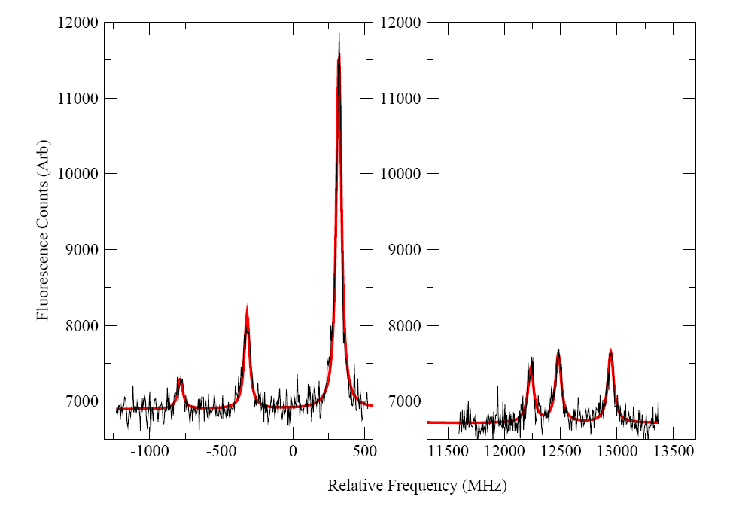
laser spectroscopy:
measure the hyperfine structure (HFS) in a free atom/ion
Fine structure:
electron levels
with spin J
F
Example: atomic levels and HFS of ⁶⁷Cu
(nuclear g.s. spin I=3/2)
|I-J| < F < |I+J|
Hyperfine structure
3
μeV
3²P_{3/2}
2
ΔE ~ B
B = e Q V_{zz}
measure Q
1
0
λ_{L}= 324.8 nm
(3.82 eV)
2
3²S_{1/2}
μB_{J}
= g B_{J}/J
ΔE ~ A
A=
measure g
IJ
1
Relative distances: spin dependent
Need to resolve all HFS levels to
measure the spin
Fluorescence photon counts
High resolution needed
ion velocity should be very well defined to reduce Doppler broadening of the levels
-1000 -500 0 500 12000 13000
relative frequency (MHz)

Slide 5
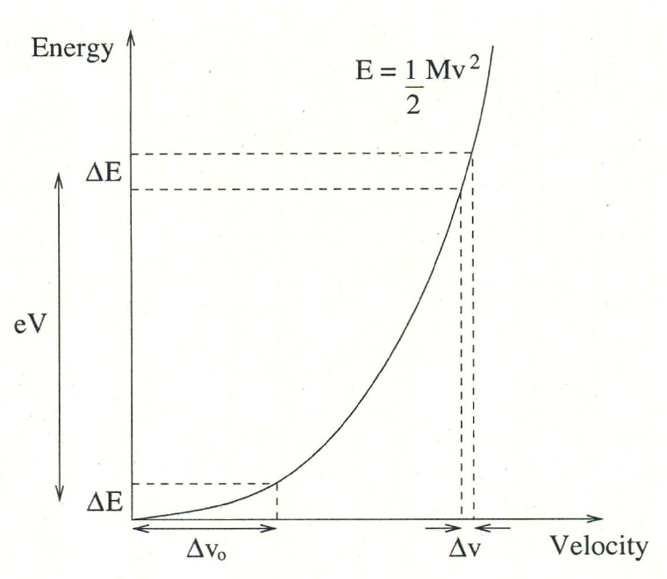
Collinear Laser Spectroscopy (CLS):
resonant interaction between accelerated ion beam and a parallel laser beam
ion beam from ISOL-target/gas cell : energy spread due to temperature, gas pressure, …
BUT: uncertainty on energy remains constant during acceleration
error on beam velocity decreases with increasing beam velocity:
δE=const=δ(¹/₂mv²)≈mvδv
Using an ion cooler (e.g. at Jyvaskyla)
Nieminen et al., PRL 88, 094801 (2002)
➔ energy uncertainty = few eV
Narrow Doppler line width
  ~ 30 MHz can be achieved
  with beam of 60 keV (+/- 2 eV)

Slide 6
Laser Spectroscopy: resonant excitation with laser light
atomic excited state
Hyperfine splitting (μeV – 100 MHz)
⁶⁸Cu (I=1)
Cu fine structure:
²P_{3/2}
J=3/2
~Q,μ
laser photon (eV – 10⁸ MHz)
F’_{i}
atomic ground state
²S_{1/2}
J=1/2
F₂
∼μ,Ι
F₁
high resolution:
use CW laser light
(very narrow bandwidth laser – 1 MHz)
use accelerated ion beam
(to reduce Doppler broadening < 50 MHz)
Scan the hyperfine structure
by scanning the laser frequency
or by scanning the acceleration voltage U
Parallel laser and ion/atom beam ➔ COLLINEAR laser spectroscopy

Slide 7
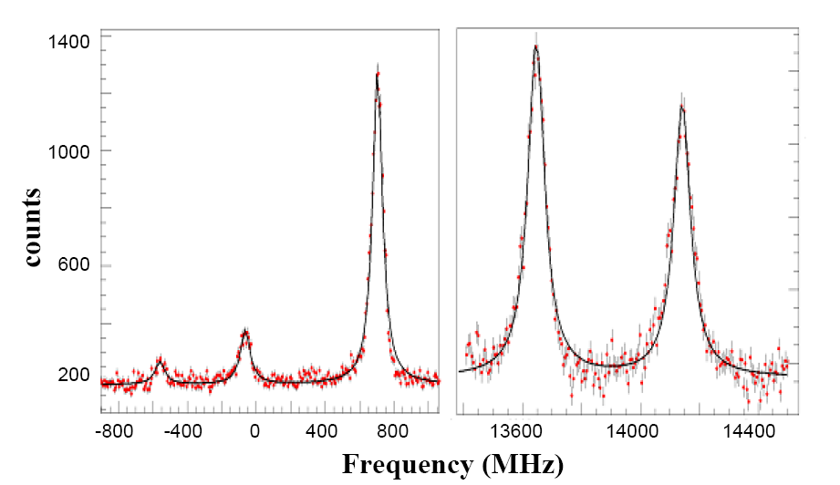
Signal observed via fluorescent photon detection (= optical detection)
hyperfine structure:
atomic excited state
Hyperfine splitting (100 MHz)
⁶⁸Cu (I=1)
Cu fine structure:
²P_{3/2}
J=3/2
~Q,μ
laser photon (eV – 10⁸ MHz)
F’_{i}
detect fluorescence photons
atomic ground state
²S_{1/2}
J=1/2
F₂
∼μ,Ι
F₁
Used in the COLLAPS set-up
at ISOLDE-CERN
Photon counts

Slide 8
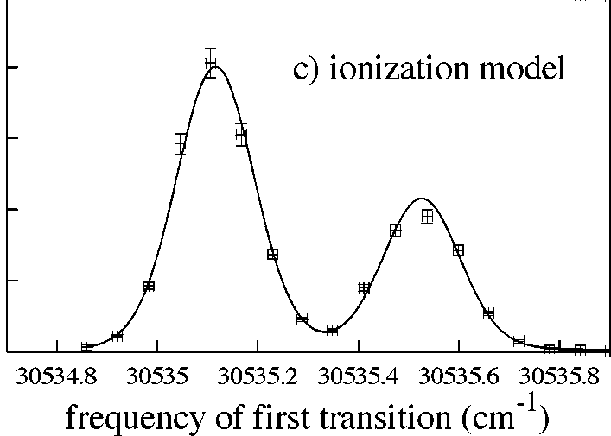
Signal observed via resonantly excited ion detection
= principle of resonance ionisation spectroscopy
using laser ion sources !
hyperfine structure:
⁶⁸Cu (I=1)
Cu fine structure:
Resonantly excited ion
continuum
²P_{3/2}
J=3/2
F’_{i}
~Q,μ
ionization potential
λ₂
²S_{1/2}
J=1/2
F₂
second step laser photon
∼μ,Ι
Hyperfine splitting
F₁
excited state
laser photon
λ₁
Ion counts
Atomic ground state
Improve resolution: apply to accelerated beam
= principle of CRIS
(Collinear Resonance Ionisation Spectroscopy)

Slide 9
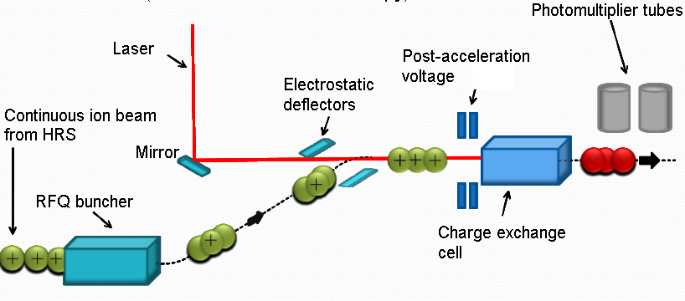
Comparing collinear laser spectroscopy set-ups at ISOLDE
Optical detection of decay photons
β-asymmetry detection
Resonance Ionisation
Detection (CRIS)
Signal detection requirements set-up
β-decay asymmetry detection 10³-10⁴ ions/s COLLAPS
from optically polarized nuclei (I>0)
optical detection (fluorescence photons) 10⁶-10⁷ → 10³-10⁴ ions/s COLLAPS/CRIS
(bunched beam)
ion detection after resonant excitation and 1-10 ions/s (bunched+UHV) CRIS
subsequent re-ionization of atoms

Slide 10
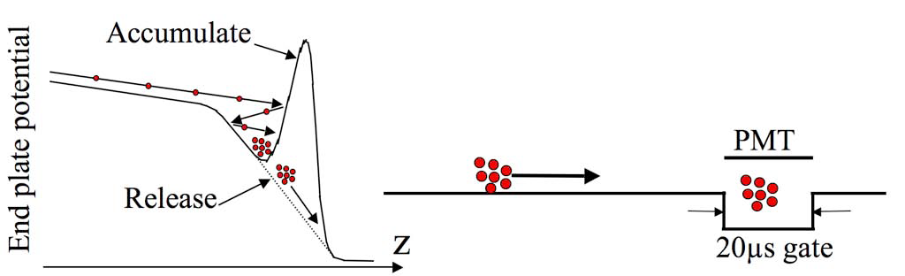
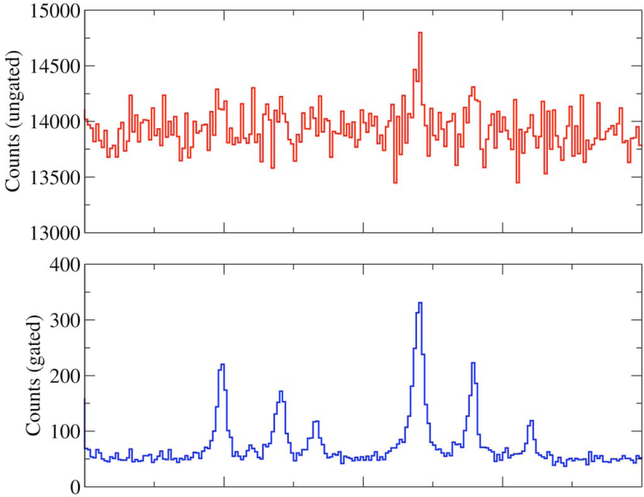
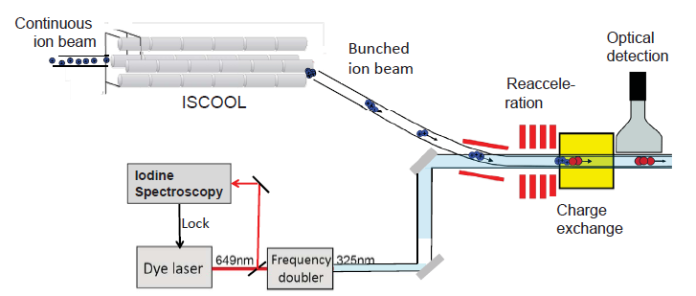
Advantage of using a bunched ion beam for optical detection
Continuous photon detection
15000
14500
14000
13500
13000
Counts(ungated)
⁷⁵Ga
400
300
200
100
0
⁷⁵Ga
Counts(gated)
HRS
(installed nov. 2007)
photon detection with
20 μs time gate
→ background reduced
by factor 300
(reduction factor up to 10000 in most cases)

Slide 11
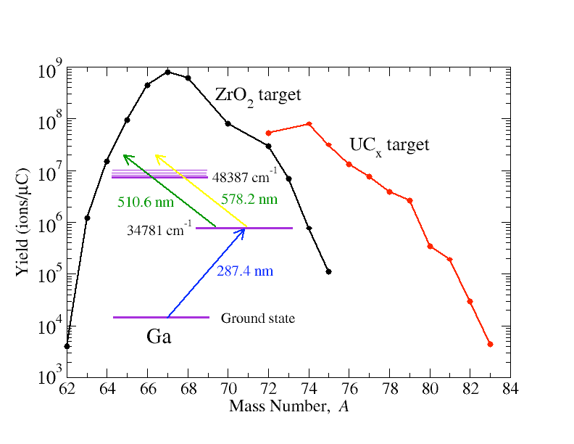
Recent results thanks to use of bunched beams at COLLAPS
from 2.10⁶ ions/μC → 5.10³ ions/μC
Ga isotopes ⁶³Ga - ⁸¹Ga
Extended measurements to
more exotic isotopes
Limit with continuous beam
18 isotopes
Extended region with bunched beam
2008,
2009,
2011
Cu isotopes ⁵⁸Cu – ⁷⁵Cu
K isotopes ³⁸K - ⁵¹K
17 isotopes
12 isotopes
2010-2011

Slide 12
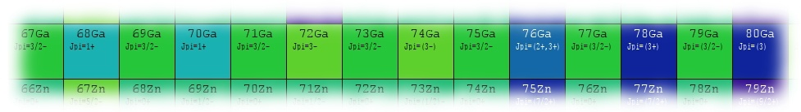
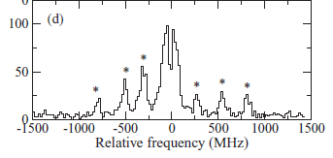
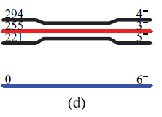
Selected results from study of Ga isotopes (Z=31)
N=40
N=50
(1) Discovery of an isomeric state in ⁸⁰Ga (N=49):
B. Cheal et al., PRC82, 051302R, 2010
Two structures in the hyperfine spectrum (HFS)
Isomer properties: T_{1/2} > 200 ms
E_{x} < 50 keV
(not observed in penning trap)
80 Ga
*
*
* 3⁻
* 6⁻
*
*
*
*
*
*
Jj44b effective interaction (Listesky and Brown)
56Ni core + f_{5/2}pg_{9/2} space

Slide 13
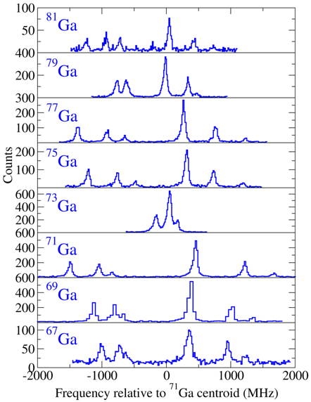
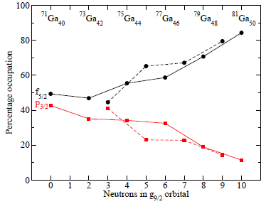
Selected results from study of Ga isotopes
(2) Established ground state spins and structure from ⁶³Ga to ⁸¹Ga:
Odd-Ga
Odd-odd Ga
B. Cheal et al.,
Phys. Rev. Let. 104, 252502, 2010
E. Mané et al.,
Phys. Rev. C 84, 024303 (2011)
3 protons in π(p_{3/2}f_{5/2}) orbits
Gradual increase of the πf_{5/2} occupation
^{76,78,79,80,81}Ga: dominated by π(f_{5/2})³
5/2
3/2
3/2
3/2
1/2
½ g.s.
E_{x}(3/2) < 1 keV !!
f_{5/2}
3/2
Occupation probability
3/2
p_{3/2}
3/2
Number of neutrons in g9/2

Slide 14
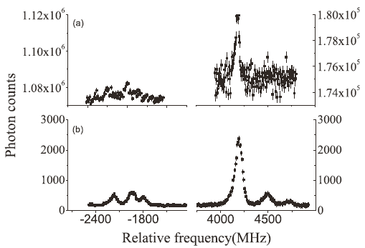
Selected results from study of Cu isotopes (Z=29)
(1) Spins, magnetic moments and parity of ^{72,74}Cu using bunched-beam CLS
P. Vingerhoets et al.,
Phys. Rev. C82, 061311 (2011)
⁷²Cu, I=2
I (^{72,74}Cu) = 2 measured
No bunching
(reduction of background with factor 10⁴ !)
With bunching
1/2
3²P_{3/2}
3/2
Can we assign parity
based on measured
magnetic moment ?
μ = -1.3451(6) μ_{N}
5/2
7/2
μ < 0
3/2
3²S_{1/2}
most intense line
5/2

Slide 15
Ground state parity and structure of ⁷²Cu: I^{π} = 2⁻
➔ Coupling of πf_{5/2} to νg_{9/2}
Use additivity rules for proton-neutron configurations:
Main negative parity configuration: μ(πf_{5/2} νg_{9/2}³; 2⁻) μ_{emp} (2⁻) = -1.94 μ_{N}
Main positive parity configuration: μ(πp_{3/2} νp_{1/2}⁻¹g_{9/2}⁴; 2⁺) μ_{emp} (2⁺) = +1.44 μ_{N}
Conclusion: the measured SIGN of the moment, μ = -1.3451(6) μ_{N}, is crucial to decide on the parity !
→ in absolute value it is in agreement with 2+ magnetic moment
however, a negative sign is only compatible with 2⁻, thus a proton in f_{5/2} orbital
(1+)
376
2+
431
1+
418
(6-)
t_{1/2}=1.76μs
270
2-
387
(4-)
219
5-
235
(3-)
137
4-
140
6-
16
2-
0
3-
0
Experiment
Realistic interaction
K.T. Flanagan et al.,
Phys. Rev. C82, 041302(R) (2010)
J.C. Thomas et al., PRC74, 054309, 2006

Slide 16
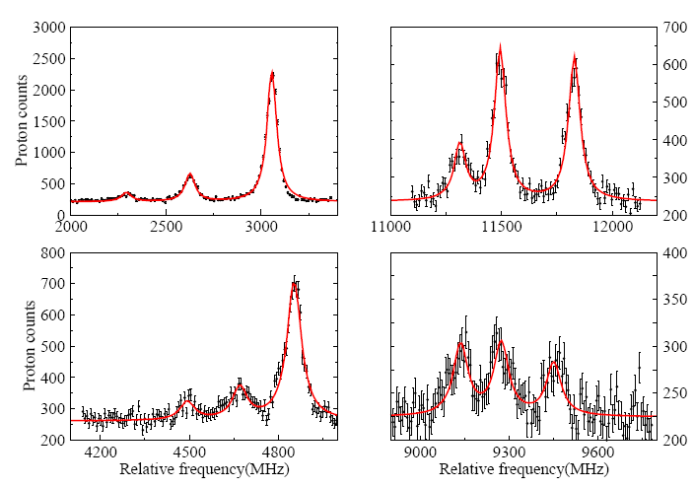
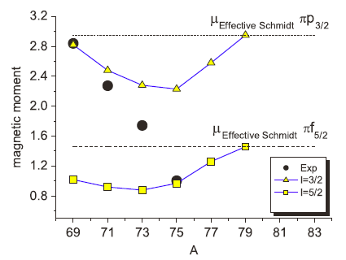
Selected results from study of Cu isotopes (Z=29)
(2) Spins and magnetic moments of ^{71,73,75}Cu using bunched-beam
  collinear laser spectroscopy (reduction of optical background with factor 10⁴)
K.T. Flanagan et al.,
Phys. Rev. Lett. 103, 142501 (2009)
⁷³Cu, I=3/2
  → inversion of πp_{3/2} and πf_{5/2} levels at N=46 confirmed from measured magnetic moment
⁷⁵Cu, I=5/2
Calculation: 56Ni core, jj44b interaction

Slide 17
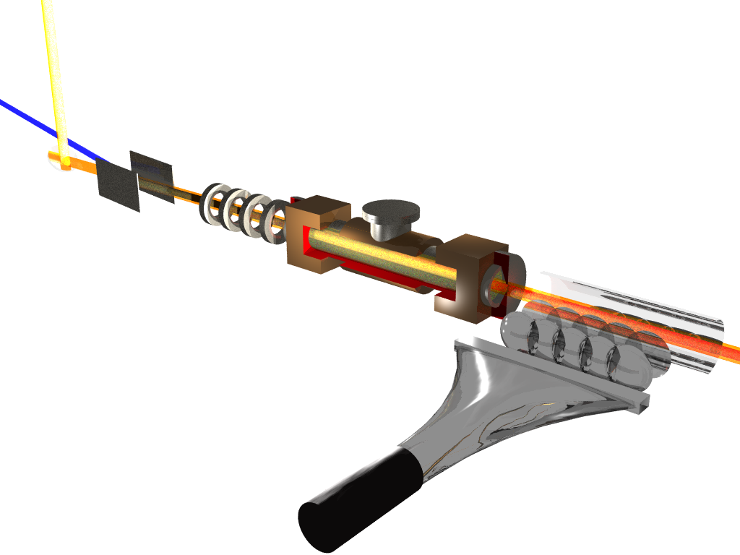
Collinear Laser Spectroscopy
with ion detection or β/α-decay detection after resonant re-ionization (CRIS)
Need 1-100 ion/s
Charge exchange cell:
neutralize the ion beam → atom beam
Re-ionization
region
Pure ion beam:
only resonantly
Ionized ions
ion detection
No background !
Higher efficiency !
AIS
D_{3/2}
CONDITION:
Ulta High Vacuum
Deflection of ions
towards ion detector
287.9 nm
Neutral
background
P_{1/2}
resonant re-ionisation of atom beam:
apply two lasers at same time:
- step one: resonant excitation (narrow band laser)
(to scan hyperfine structure)
- step two: ionization (broad band)
327.4nm
S_{1/2}
Cu atomic levels

Slide 18
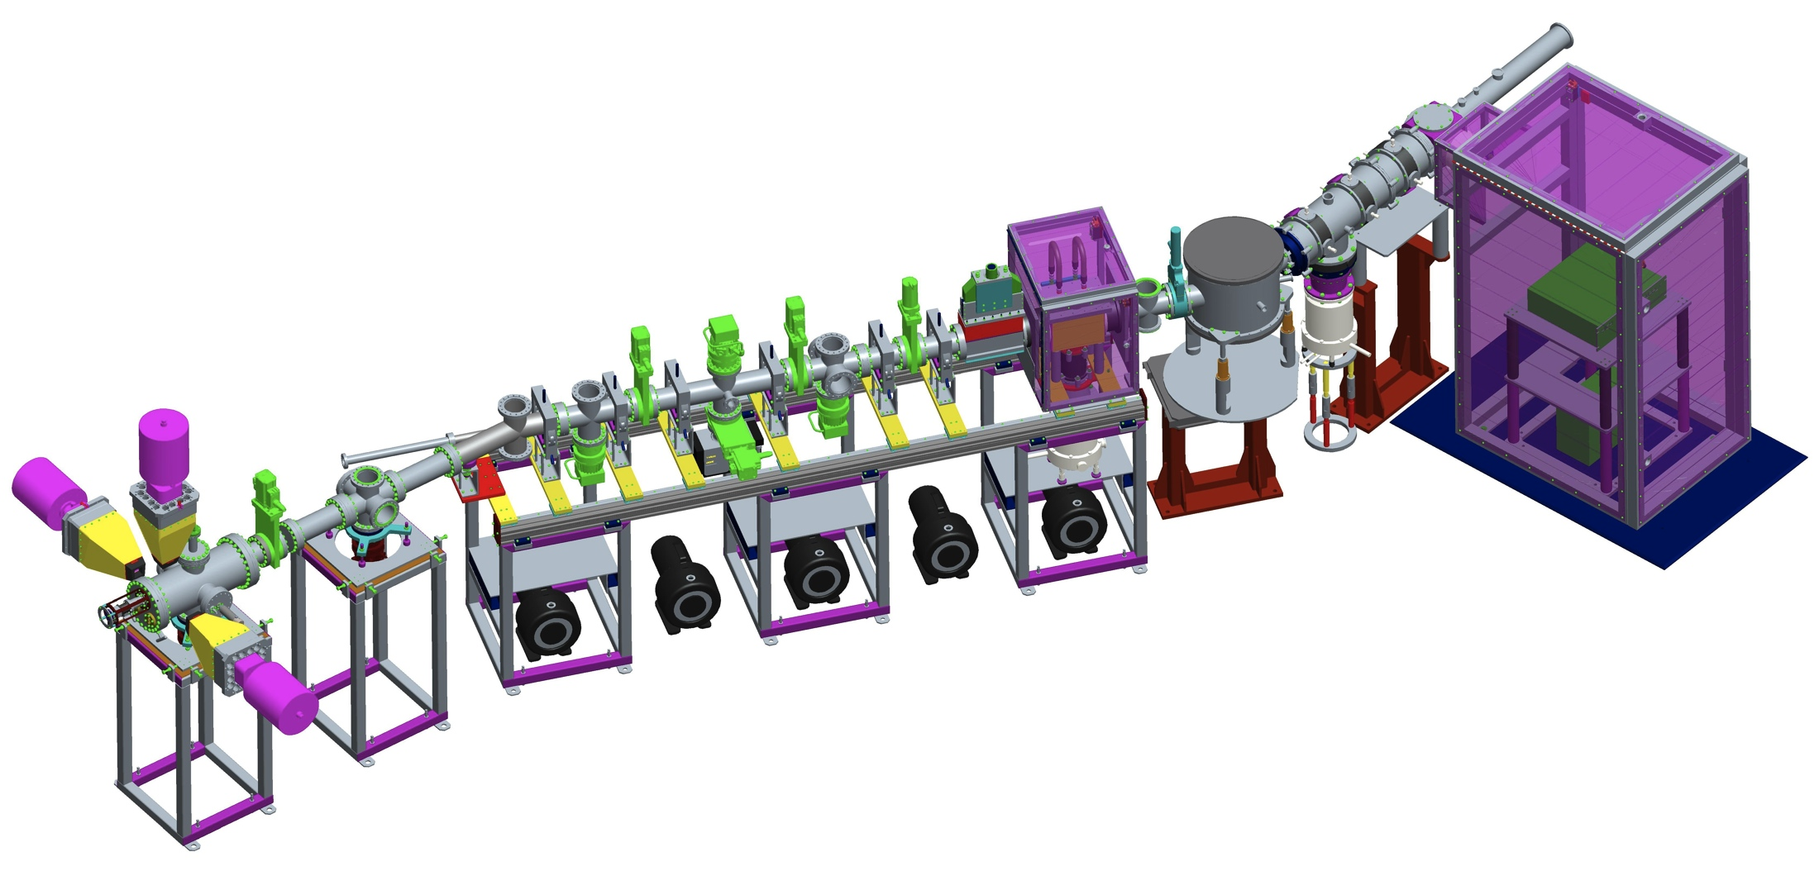
Status of the CRIS project at ISOLDE
Collinear Resonance Ionisation Spectroscopy
Radioactive bunched ion beam from ISOLDE
Doppler tuning voltage applied
Charge exchange cell
Differential pumping region
Stable beam from off line ion source
MCP: ion detection
UHV
interaction
region
Laser beam
Ge detectors
Si detectors
PMT: fluorescence detection
Laser Assisted
Decay Spectroscopy station: decay measurements

Slide 19
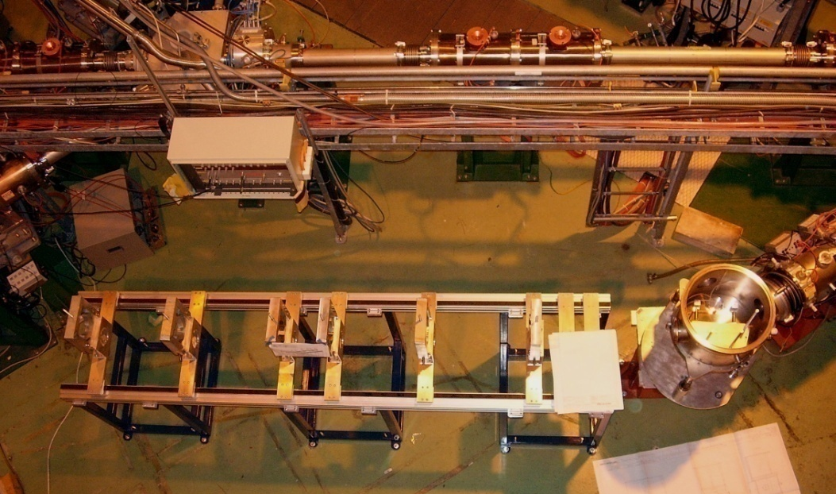
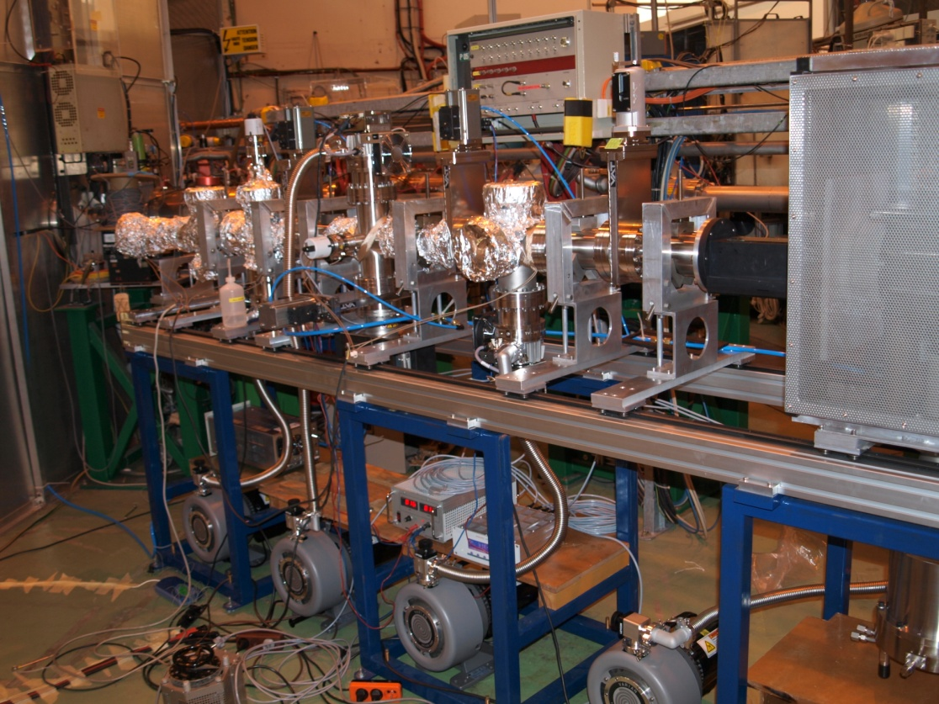
Status of the CRIS project
2008: design and construction of the beam line elements at Manchester
Nov. 2008: installation of the ‘railway’ track system at ISOLDE
→ one person can open and move chambers
April 2009: delivery of vacuum chambers, Faraday cage, charge exchange cell and installation of pumps.
July 2009: Vacuum testing:
initial bake-out of UHV section reached < 5 10⁻⁹ mbar (limit of the gauge) in the interaction region.
Thanks to Andy Smith, Manchester

Slide 20
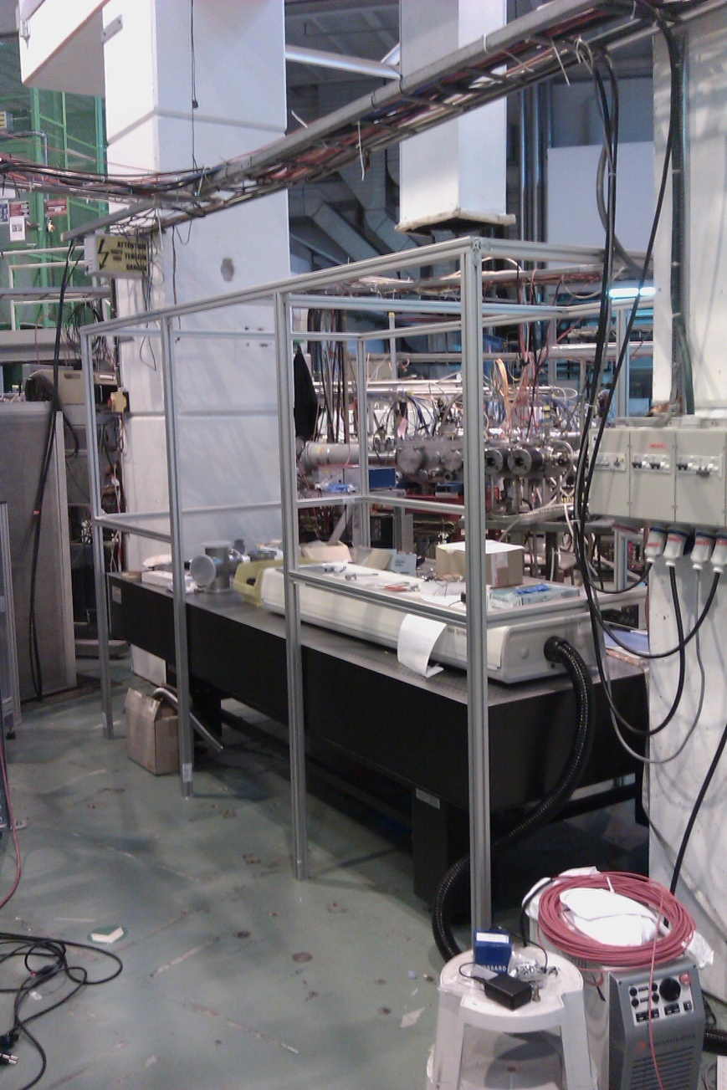
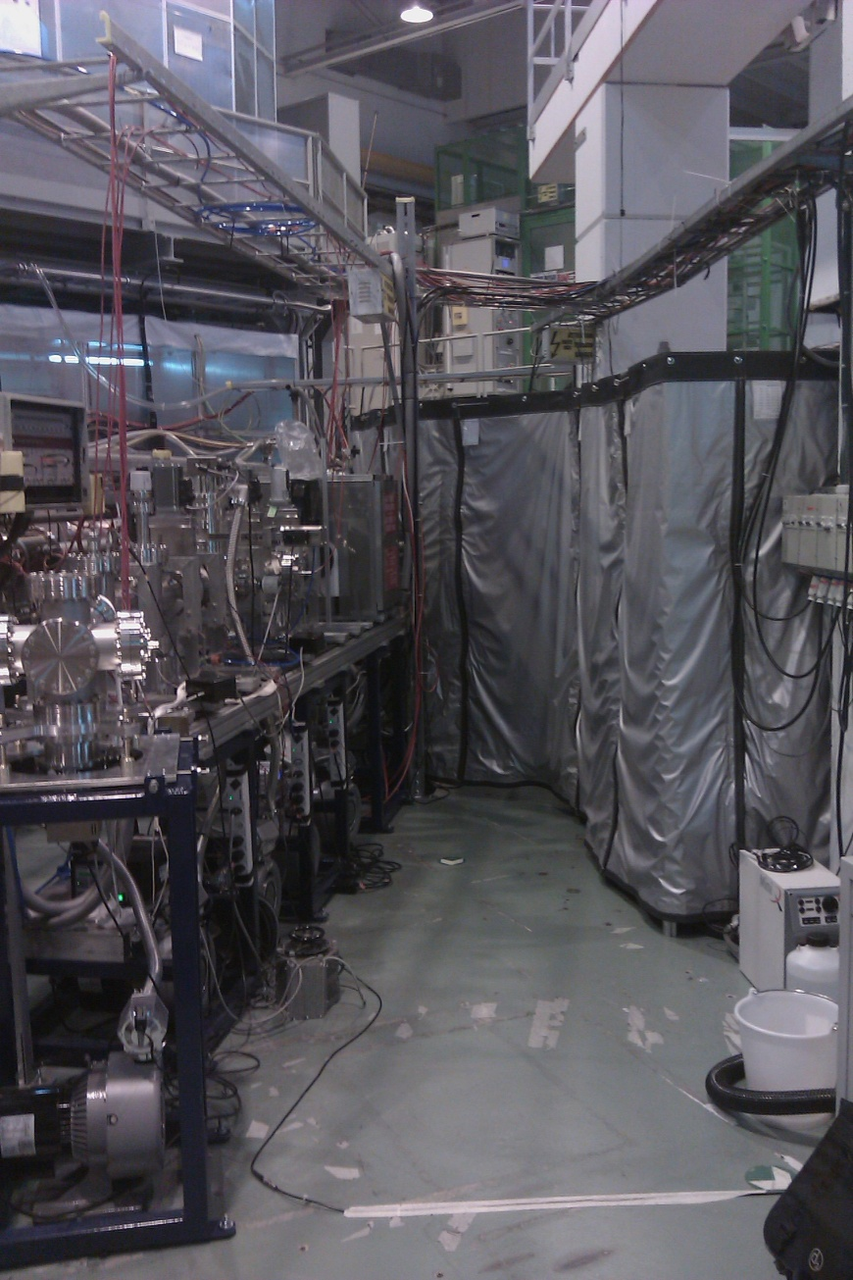
Status of the CRIS project
2010: beam optics simulations and transmission tests (master thesis, Leuven)
➔ add quadrupoles to optimize transmission (spring 2010)
installation of laser tables and enclosure
installation of first laser systems
fibre coupling between laser lab and pulsed laser area
development of data acquisition and control system (K. Lynch, CERN-Manchester)
LASER TABLE shielding
LASER TABLE near beam line
CRIS beamline
From K. Flanagan, collaboration meeting, jan. 2011

Slide 21
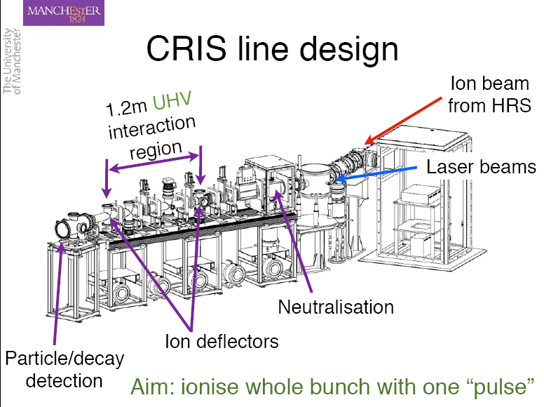
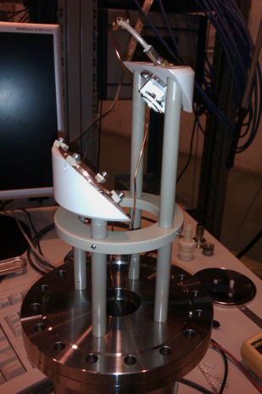
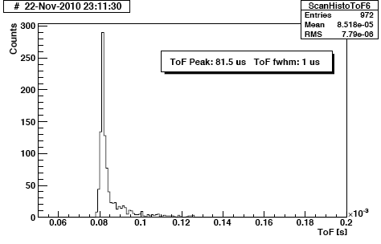
Status of the CRIS project
K. Lynch, T. Procter, K. Flanagan
Nov 2010: first on-line run
many laser problems
transmission ion/atom beam 80%
up to the interaction region
charge exchange > 75 %
differential pumping works well:
UHV reached (< 5 10⁻⁹ mbar)
in combination with charge exchange
mcp-detector
Aim: ionize the whole bunch with one “laser pulse”
observed timing of the atom pulse in
mcp detector ➔ 1 μs FWHM
electrons
( 26 cm bunch length)
ions
Fraction of ions produced by collisions in the UHV rest gas < 1/50.000
( will be our background in HFS measurement)

Slide 22
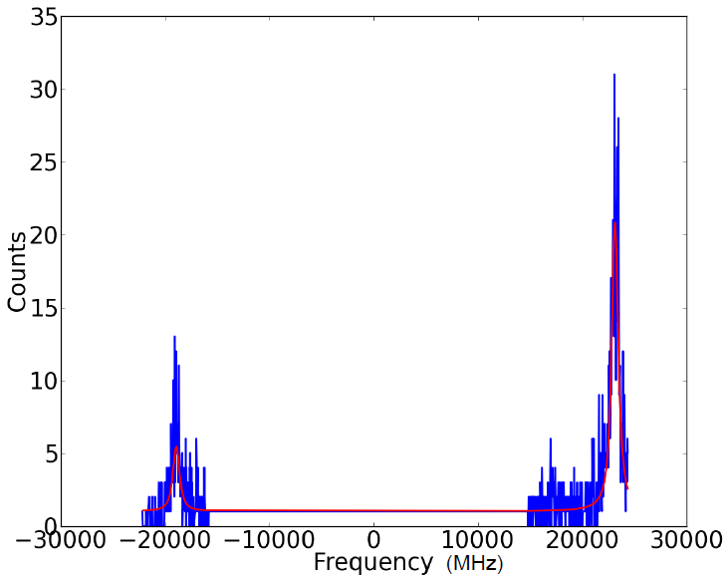
Status of the CRIS project
Nov 2011: first resonance ionization spectroscopy results
²⁰⁷Fr
continuum
Laser power in step 2 too low
➔ low ionization efficiency
1064 nm
3-4 mJ/cm²
8²P_{3/2}
422 nm
100 μJ/cm²
Laser power in step 1 too high
➔finestructure lines not resolved
7²S_{1/2}

Slide 23
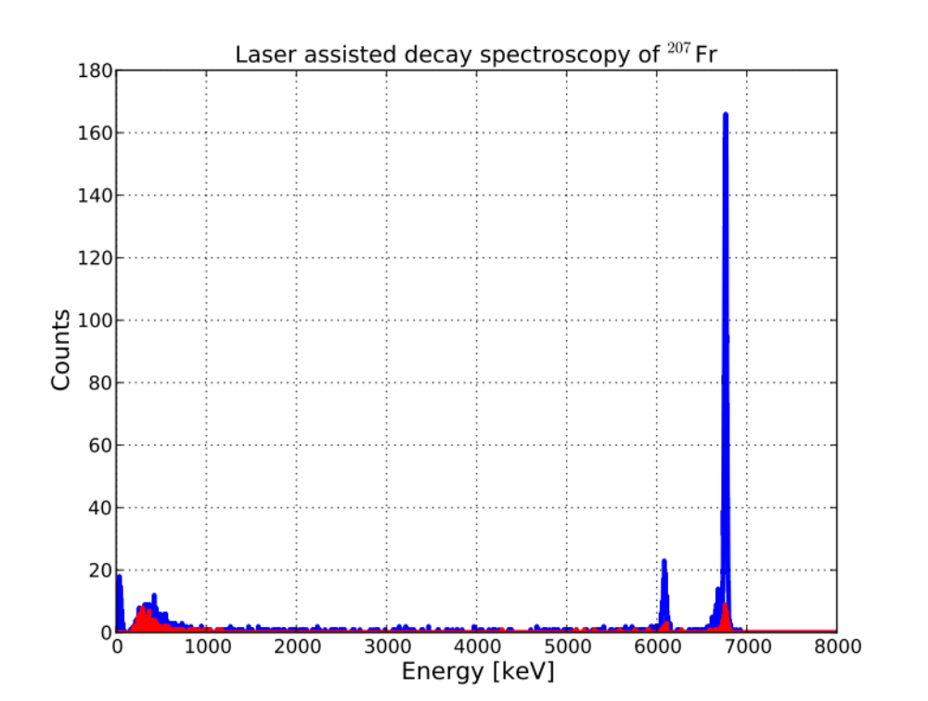
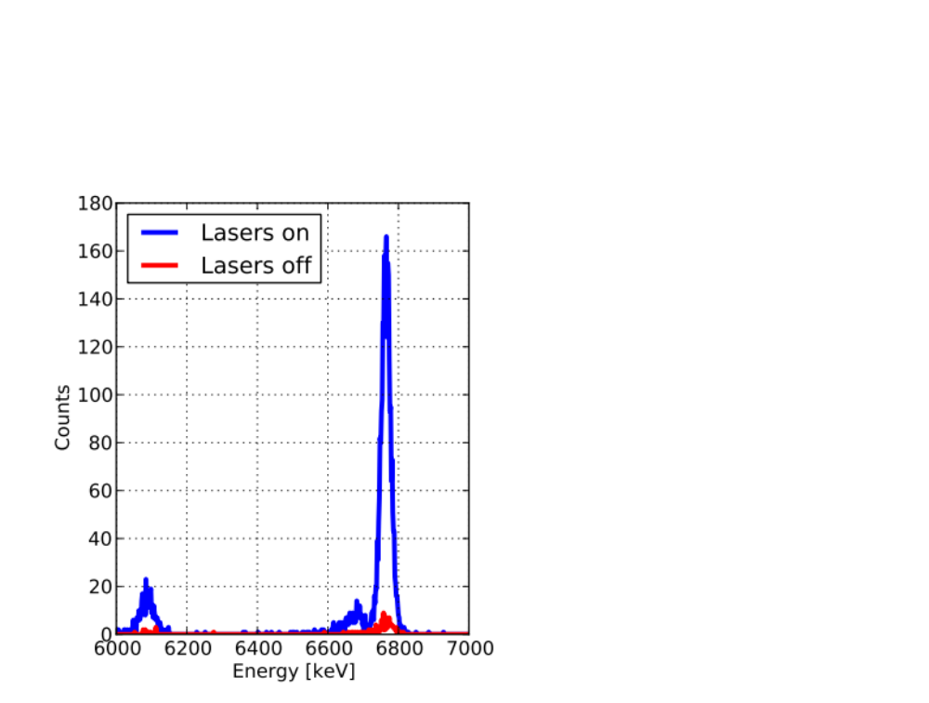
Status of the CRIS project
Nov 2011: first laser assisted decay spectroscopy results
Factor of 20 increase in detected alphas when lasers are on
15 mins data collection time
Data in red (lasers off) is due to collisional re-ionization in the interaction region (no UHV, beam line was not backed, pressure = 2.10⁻⁸ mbar) ➔ improve back ground rejection if UHV

Slide 24
SUMMARY
ISOLDE remains a pioneering facility for on-line collinear laser spectroscopy on exotic isotopes
COLLAPS ➔specializing in high-resolution and high-precision measurements using dedicated detection methods (rates > 5000/s)
(optical detection on bunched beams, β-asymmetry, photon-ion coincidences, …)
CRIS ➔ specializing in high-sensitivity studies on very exotic isotopes (rates 1-10⁴/s) using ultra-low background resonance ionisation spectroscopy with ion or
radioactive decay detection.
Pumping in ISCOOL (B. Cheal, Manchester University)
➔ extend studies to nearly all isotopes, can be used at COLLAPS or CRIS

Slide 25
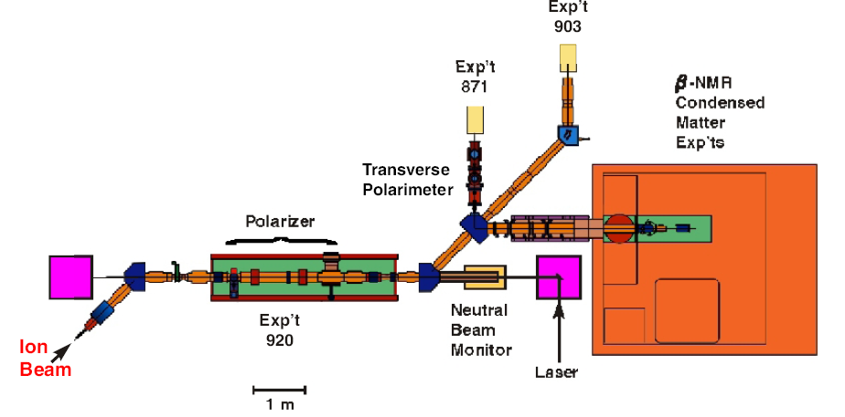
Outlook
Possible layout for collinear spectroscopy at DESIR:
➔ a normal-vacuum line with 2 (or 3) end stations
for optical detection, polarized beam experiments, …
➔ a UHV beam with differential pumping for CRIS
β-γ asymmetry set-up
β-NMR set-up
Polarization axis
Polarization axis
CRIS beam line
Multi-purpose station
(e.g. photon-ion coincidence detection)
Polarization axis
based on collinear laser beam line at TRIUMF
C.D.P. Levy et al. / Nuclear Physics A 746 (2004) 206c–209c

Slide 26
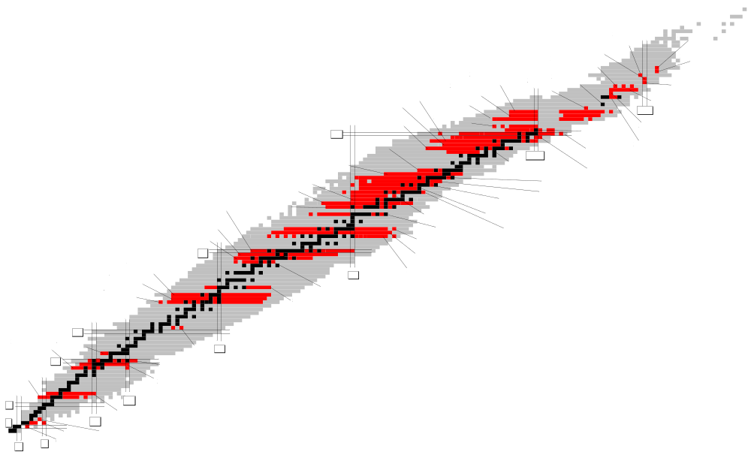
Day-1 experiments at DESIR: shell structure far from stability (⁷⁸Ni, ¹³²Sn, ¹⁰⁰Sn)
Extend existing laser spectroscopy studies beyond doubly-magic nuclei far from stability
➔ study the evolution of shell structure via spins, moments, radii, isomers, …
With S3 beams from gas cell or laser ion source:
neutron-deficient Sn, In, Cd
nuclear structure around ¹⁰⁰Sn
⁶²⁻⁸¹Ga
With U-target + n-converter
more neutron rich Sn, In, Cd…
nuclear structure below ¹³²Sn
more neutron-rich in Cu, Ga, …
nuclear structure at ⁷⁸Ni
and beyond N=50
⁵⁸⁻⁷⁵Cu

Slide 27
Collaborators
COLLAPS since early 1980ies
Heidelberg, Germany Max-Planck-Institut für Kernphysik Klaus Blaum (coordinator), Kim Kreim (at CERN)
K.U. Leuven, Belgium Instituut voor Kern- en Stralingsfysica Gerda Neyens, Mark Bissell (at CERN), Jasna Papuga
Marieke De Rydt, Mustafa Rajabali, Ivan Budincevic, Ronald Garcia
University of Mainz, Germany Institut für Kernchemie Wilfried Nörtershäuser, Rainer Neugart,
Christopher Geppert, Michael Hammen, Andreas Krieger,
Rodolfo Sanchez, Nadja Frömmgen
CERN, Switzerland Physics Department Magdalena Kowalska, Deyan Yordanov
CRIS since 2008
University of Manchester, UK Kieran Flanagan (at CERN) (coordinator), Tom Procter,
Kara Lynch (at CERN), Bradley Cheal, Jon Billowes, Andy Smith
K.U. Leuven, Belgium Instituut voor Kern- en Stralingsfysica Gerda Neyens, Mark Bissell (at CERN), Ivan Budincevic
Mustafa Rajabali, Jasna Papuga, Ronald Garcia
University of Tokyo, Japan Ryugo Hayano, Takumi, Kobayashi,
Garching, Germany Max Planck Institute of Quantum Optics Masaki Hori, Anna Soter
University of Mainz, Germany Institut für Physik Klaus Wendt, Sebastian Rothe (at CERN)
I.P.N Orsay, France Francois Le Blanc, David Verney, Iolanda Matea
New York University Henry H. Stroke
CERN, Switzerland Kara Lynch, Thomas Cocolios
COLLAPS/ISCOOL (not a formal collaboration)
University of Manchester, UK Jon Billowes, Bradley Cheal, Kieran Flanagan (at CERN), Kara Lynch (at CERN), Tom Procter
K.U. Leuven, Belgium Gerda Neyens, Mark Bissell (at CERN), Mustafa Rajabali, Jasna Papuga, Pieter Vingerhoets
University of Jyvskyla, Finland Ari Jokinen, Iain Moore, Juha Aysto
University of Birmingham, UK Garry Tungate, David Forest
Heidelberg, Germany Klaus Blaum, Kim Kreim (at CERN)
University Mainz, Germany Wilfried Nörtershäuser, Rainer Neugart, Christopher Geppert, Jörg Krämer, Andreas Krieger,
New York University, USA Henry H. Stroke
CERN, Switzerland Magdalena Kowalska, Deyan Yordanov

Slide 28
Collinear Laser Spectroscopy
with optical detection of the fluorescent decay
Laser beam,
Laser on fixed frequency
Laser beam, fixed frequency
Mass separated ion beam
E= 60 keV
Mass separated ion beam
E= 60 keV
Retardation zone:
electrostatic lenses
-10 kV → +10 kV
Electrostatic lenses
to scan ion beam energy
-10 kV → +10 kV
Excitation / Observation region
Resonant excitation
of atoms
Electrostatic
deflection
Electrostatic
deflection
Detect fluorescent decay
Alkaline vapor
Produce atom beam
by charge exchange
Charge exchange cell,
heated
ΔE=const=δ(¹/₂mv²)≈mvδv
ΔE=const=δ(¹/₂mv²)≈mvδv
Light guide
with phototube
Photo multiplier
Photo multiplier

