Slide 1



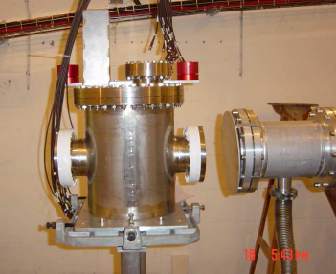
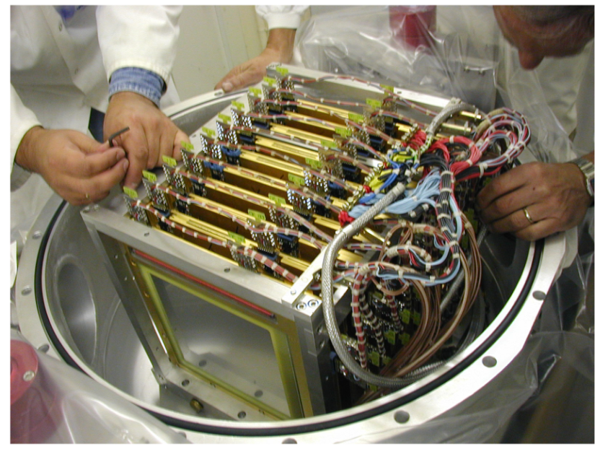
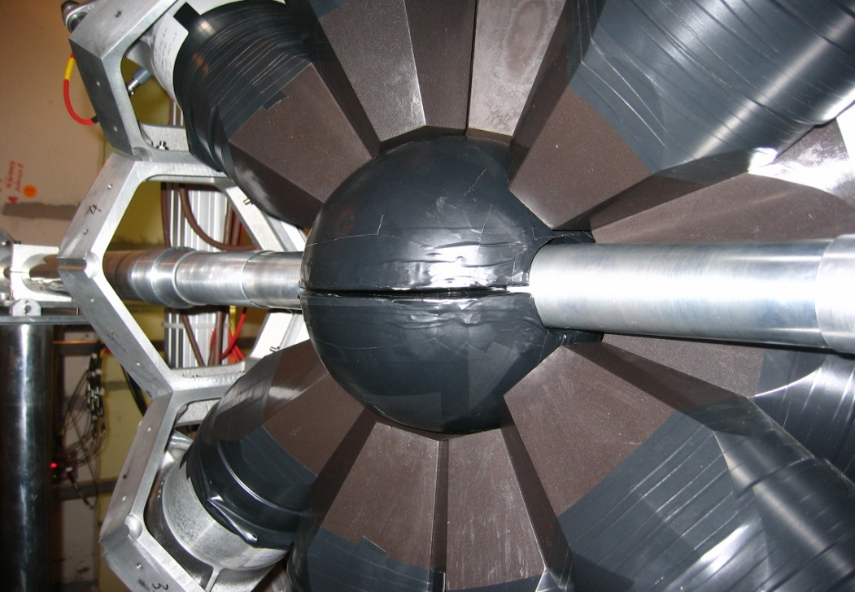
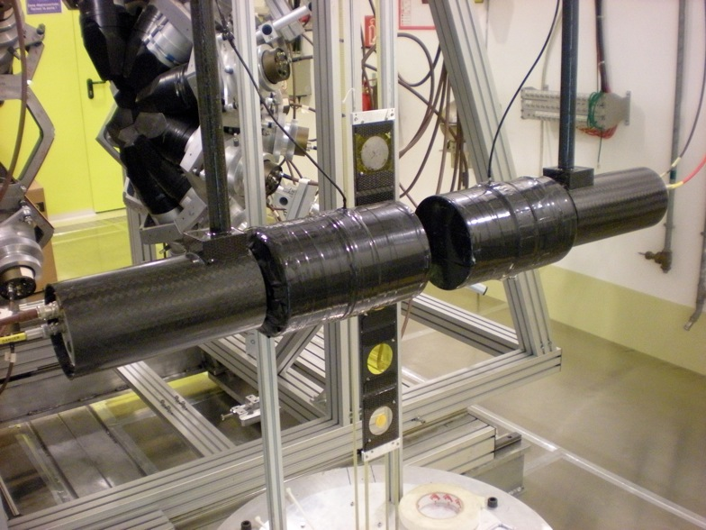
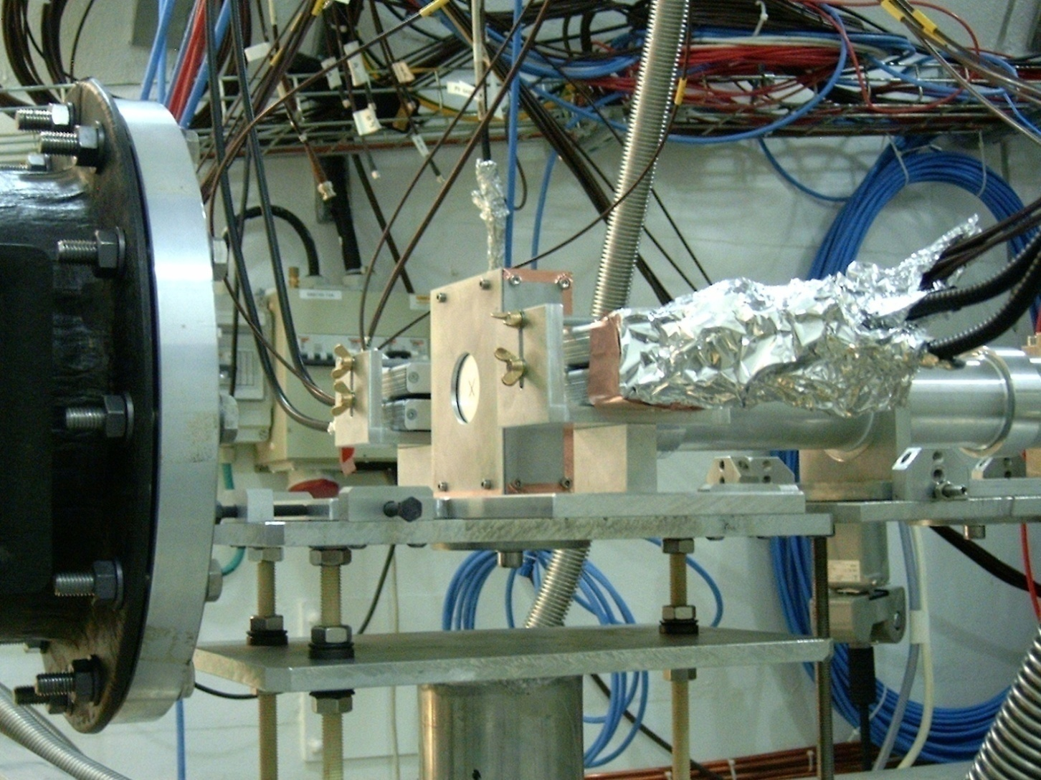
The n_TOF Collaboration, www.cern.ch/nTOF
The n_TOF facility at CERN: a bright future for neutrons
Enrico Chiaveri
Spokesperson of n_TOF Collaboration
Notes:
Thanks for the invitation

Slide 2
Outline of the talk
Scientific motivations
The n_TOF facility and experimental setup
Status, upgrades and future perspectives
Selected experimental results
n_TOF Experimental Area 2 Project

Slide 3
Outline of the talk
Scientific motivations
The n_TOF facility and experimental setup
Status, upgrades and future perspectives
Experimental results and 2012 experimental program
n_TOF Experimental Area 2 Project

Slide 4
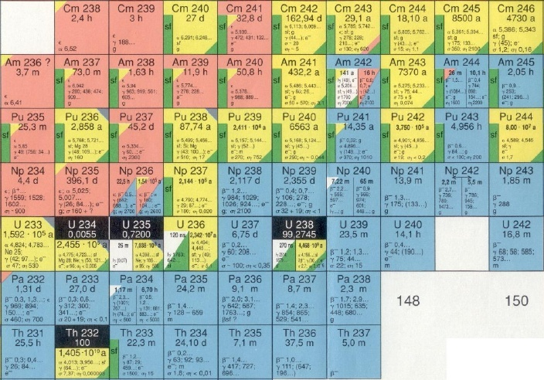
The nuclear waste problem
^{244, 245}Cm
1.5 Kg/yr
Figura Nucleosintesi (frecce che si muovono)
Foto FIC
²⁴¹Am:11.6 Kg/yr
²⁴³Am: 4.8 Kg/yr
²³⁹Pu: 125 Kg/yr
²³⁷Np: 16 Kg/yr
LLFP
76.2 Kg/yr
LLFP
Quantities refer to yearly production in 1 GW_{e} LW reactor

Slide 5
Main waste problem of current nuclear reactors
Existing reactors have a relatively low burn-up efficiency and produce large amount of radioactive waste
3% ²³⁵U
4% Fission products
Current reactors use only few % of U resources
Availability of U resources at current price may become a problem in the medium term (~100 y)
1% Pu and Minor Actinides
97%
²³⁸U
94%
²³⁸U
96%
potential
fuel
1% ²³⁵U
Fuel (LWR)
Spent fuel
A closed cycle would make uranium resources sufficient for thousand of years

Slide 6
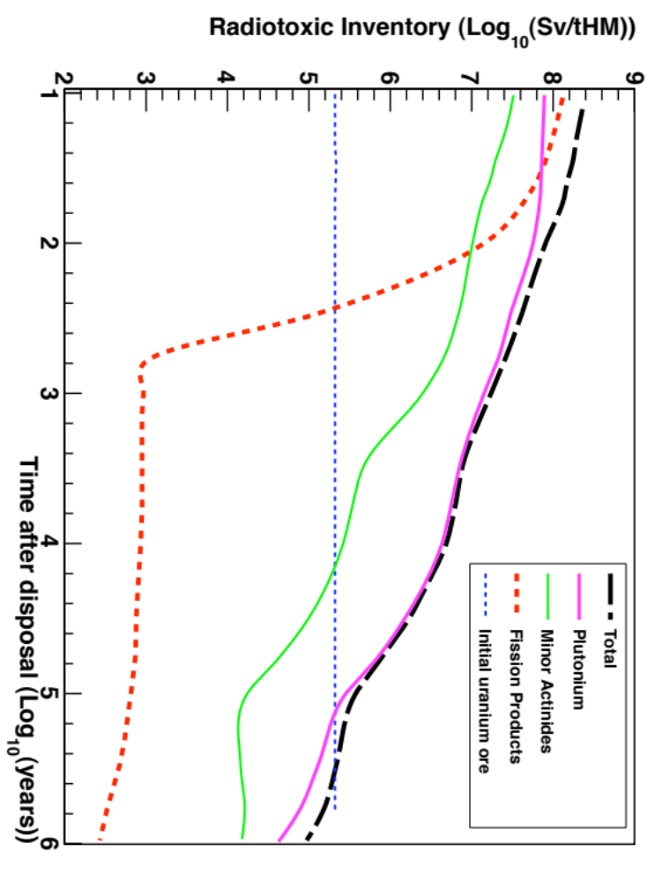
Nuclear waste composition
The long term radiotoxicity of nuclear waste is governed by actinides such as Pu, ²³⁷Np, ^{241,243}Am and ²⁴⁵Cm
FF decay after some hundreds of years (with some exceptions)
Actinides last for millions of years
Constitute the main problem in the nuclear waste management
Source: CEA – Clefs N. 46, Spring 2002

Slide 7
Data needs for nuclear energy
Nuclear fuel (U/Pu and Th/U)
  Th, U, Pu, Np, Am, Cm →(n,f) + (n,γ)
Long-lived fission products
  ⁹⁹Tc, ¹⁰³Rh, ¹³⁵Xe, ¹³⁵Cs, ¹⁴⁹Sm → (n,γ)
Structural and cooling material
  Fe, Cr, Ni, Zr, Pb, Na, … → (n,*)
Data on a large number of isotopes are needed for design of advanced systems and for improving safety of current reactors
The overall list if relatively long:
  Capture cross section of ^{235,238}U, ²³⁷Np, ²³⁸⁻²⁴²Pu, ²⁴¹⁻²⁴³Am, ²⁴⁴Cm
  Fission cross-section of ²³⁴U, ²³⁷Np, ^{238,240,242}Pu, ²⁴¹⁻²⁴³Am, ²⁴²⁻²⁴⁶Cm
NEA/WPEC-26 (ISBN 978-92-64-99053-1)

Slide 8
 |  | Energy Range | Current Accuracy (%) | Target Accuracy (%)
U238 | inel | 0.5 ÷ 6.1 MeV | 10 ÷ 20 | 2 ÷ 3
 | capt | 2.04 ÷ 24.8 keV | 3 ÷ 9 | 1.5 ÷ 2
Pu241 | fiss | 454 eV ÷ 1.35 MeV | 8 ÷ 20 | 2 ÷ 5
Pu239 | capt | 2.04 ÷ 498 keV | 7 ÷ 15 | 4 ÷ 7
Pu240 | fiss | 0.498 ÷ 1.35 MeV | 6 | 1 ÷ 3
Pu242 | fiss | 0.498 ÷ 2.23 MeV | 19 ÷ 21 | 3 ÷ 5
Pu238 | fiss | 0.183 ÷ 1.35 MeV | 17 | 3 ÷ 5
Am242m | fiss | 67.4 keV ÷ 1.35 MeV | 17 | 3 ÷ 4
Am241 | fiss | 2.23 ÷ 6.07 MeV | 9 | 2
Am243 | fiss | 0.498 ÷ 6.07 MeV | 12 | 3
Cm244 | fiss | 0.498 ÷ 1.35 MeV | 50 | 5
Cm245 | Fiss | 67.4 ÷ 183 keV | 47 | 7
Fe56 | Inel | 0.498 ÷ 2.23 MeV | 16 ÷ 25 | 3 ÷ 6
Na23 | inel | 0.498 ÷ 1.35 MeV | 28 | 4 ÷ 10
Pb206 | inel | 1.35 ÷ 2.23 MeV | 14 | 3
Pb207 | Inel | 0.498 ÷ 1.35 MeV | 11 | 3
Si28 | inel | 1.35 ÷ 6.07 MeV | 14 ÷ 50 | 3 ÷ 6
 | capt | 6.07 ÷ 19.6 MeV | 53 | 6
Uncertainty reduction requirements for Gen IV fast reactors
(in order to meet integral parameters target accuracies)
An accuracy better than 3-4% is required for most Pu isotopes and Minor Actinides, from few keV to several MeV
Aliberti, Palmiotti, Salvatores – Validation of simulation codes for future systems, NEMEA-4 Workshop, October 2007
Notes:
Quantitativamente gli studi di senbilitita’ forniscono le incertezze che I dati nucleari per certe reazioni, isotopi e intervalli energetici devono raggiungere per ottenere una accuratezza predeterminata su parametri integrali di un reattore come ad esempio il coefficiente di moltiplicazione. E’ evidente che nel caso della maggior parte degli isotopi e attinidi minori e’ richiesta una accuratezza dell’ordine del 3-4%

Slide 9

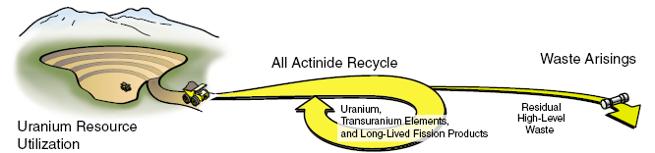
New generation reactors
Recycling and reuse!
Generation IV (especially fast) reactors would be in principle able to recycle part of spent fuel
Other options considered:
  Accelerator Driven Systems (nuclear waste incineration)
  Use Th/U fuel cycle (current being developed, e.g. India)
The development of Gen-IV fast breeder reactor requires accurate neutron data to minimize design uncertainties and optimize safety parameters (reduced β-delayed fraction compensation)

Slide 10
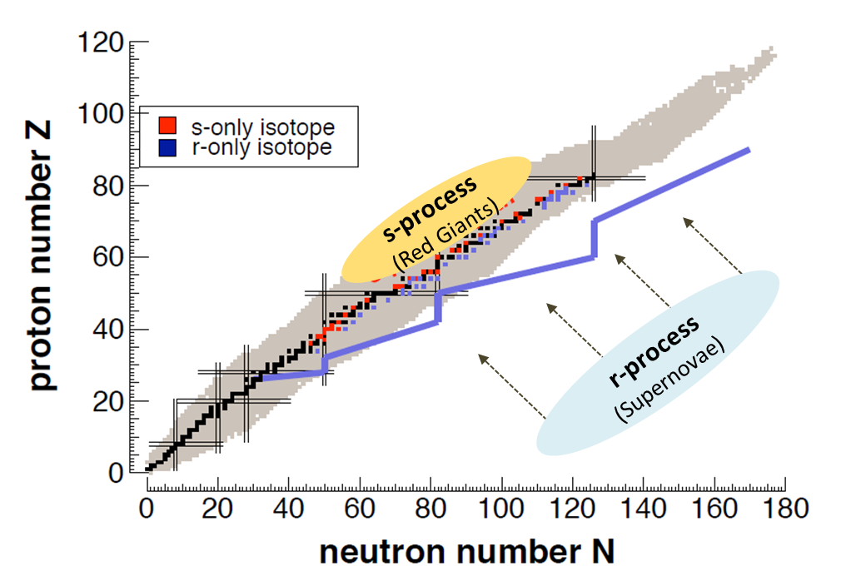
Stellar Nucleosynthesis
Neutron beams
Radioactive beam facilities
s-process (slow process)
  Capture times long relative to decay time
  Involves mostly stable isotopes
  N_{n}=10⁸ n/cm³, kT=0.3-300 keV
r-process (rapid process)
  Capture times short relative to decay time
  Produces unstable isotopes (neutron –rich)
  N_{n}=10²⁰⁻³⁰ n/cm³

Slide 11
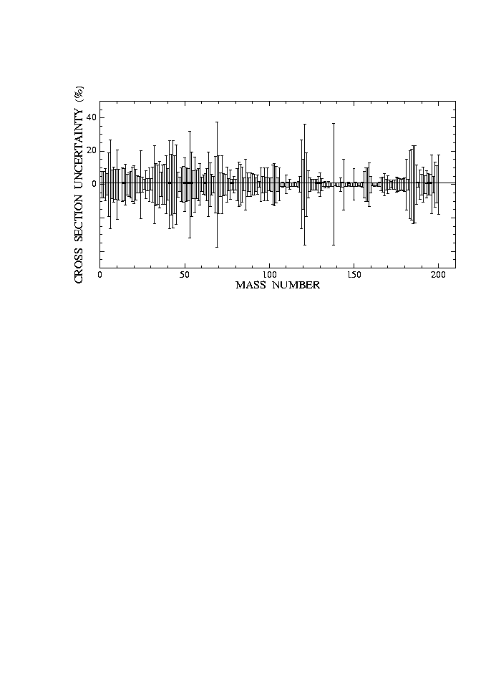
Status of neutron capture cross-section for astrophysics
Huge amount of data collected on many isotopes, mostly stable
Cross-section uncertainties remain high, in particular compared with progresses in:
  Observation of abundances
  Models of stellar evolution
Bao et al., ADNDT 76 (2000)
For three classes of nuclei data are lacking or need improvements:
  Nuclei with low cross-section, i.e. neutron magic nuclei (s-process bottlenecks) (N=50,82, e.g. ⁸⁸Sr, ⁹⁰Zr, ¹³⁹La, etc.)
  Isotopes unavailable in large amount (rare or expensive, ^{186,187}Os, ¹⁸⁰W)
  Radioactive branching isotopes (“stellar thermometers”)
    ⁷⁹Se, ⁸⁵Kr, ¹⁵¹Sm, ²⁰⁴Tl, ²⁰⁵Pb, etc.

Slide 12
Outline of the talk
Scientific motivations
The n_TOF Collaboration, facility and experimental setup
Status, upgrades and future perspectives
Experimental results and 2012 experimental program
n_TOF Experimental Area 2 Project

Slide 13
n_TOF Collaboration Institutions
n_TOF Collaboration is an International endeavour since 2001
Members as of 2012 (not necessarily CERN member states):
  30 Institutions (EU, USA, India) + collaboration with JP and RUS
  100 scientists
  16 PhD students
Newcomers since 2009:
  Joint Research Center IRMM (Belgium)
  University of Zagreb (Croatia)
  University of Manchester (United Kingdom)
  University of York (United Kingdom)
  University of Frankfurt (Germany)
  PSI – Paul Scherrer Institute (Switzerland)
  University of Thessaloniki (Greece)

Slide 14
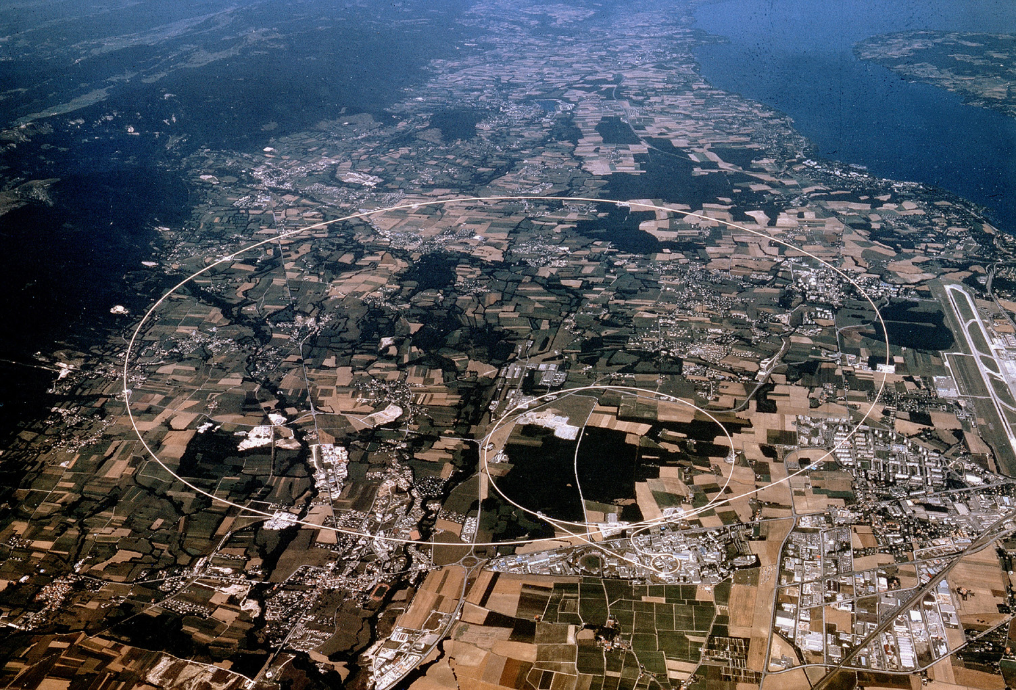
n_TOF facility at CERN
n_TOF (*) is a spallation neutron source based on 20 GeV/c protons from the PS of CERN
(*) C Rubbia et al., A High Resolution Spallation Driven Facility at the CERN-PS to measure Neutron Cross Sections in the Interval from 1 eV to 250 MeV, CERN/LHC/98-02(EET) 1998.

Slide 15
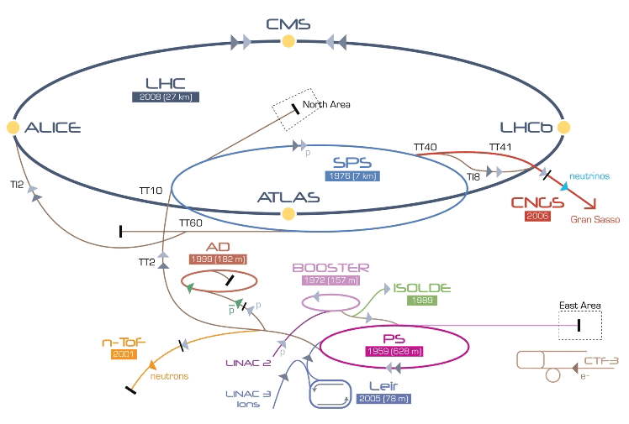
CERN Accelerator complex (2012)

Slide 16
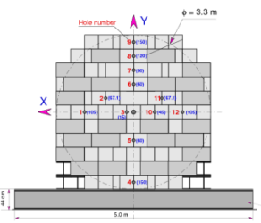
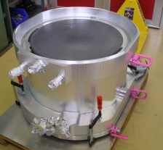
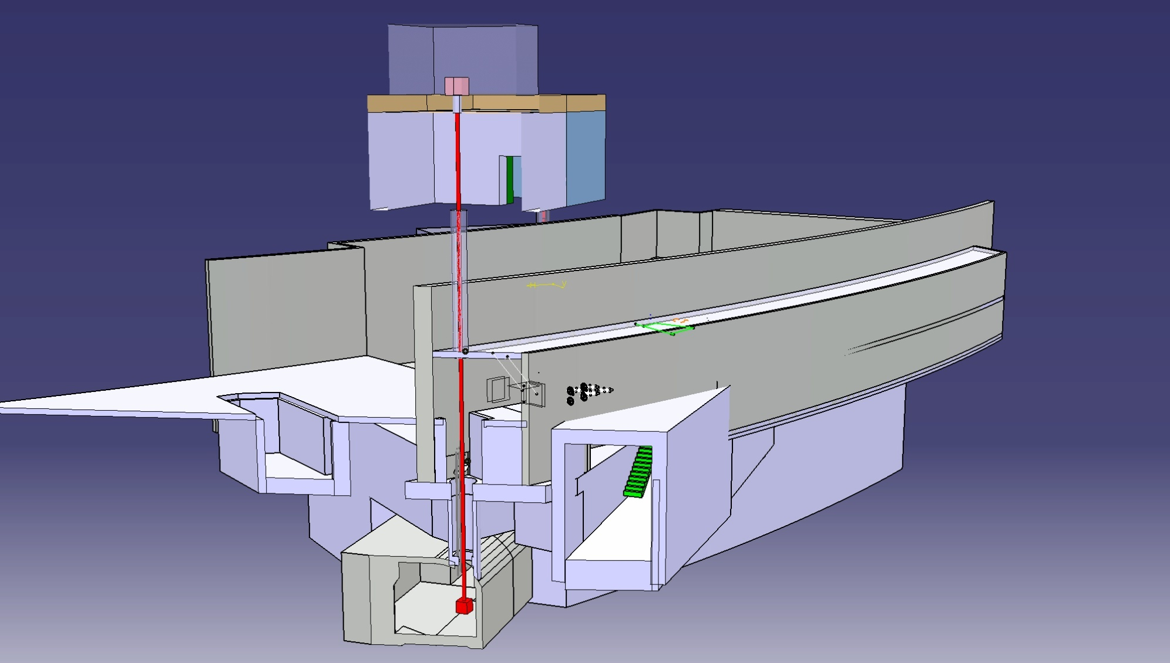
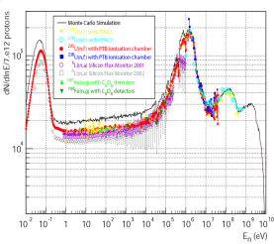
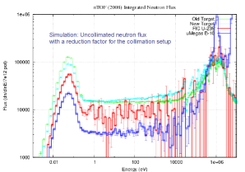
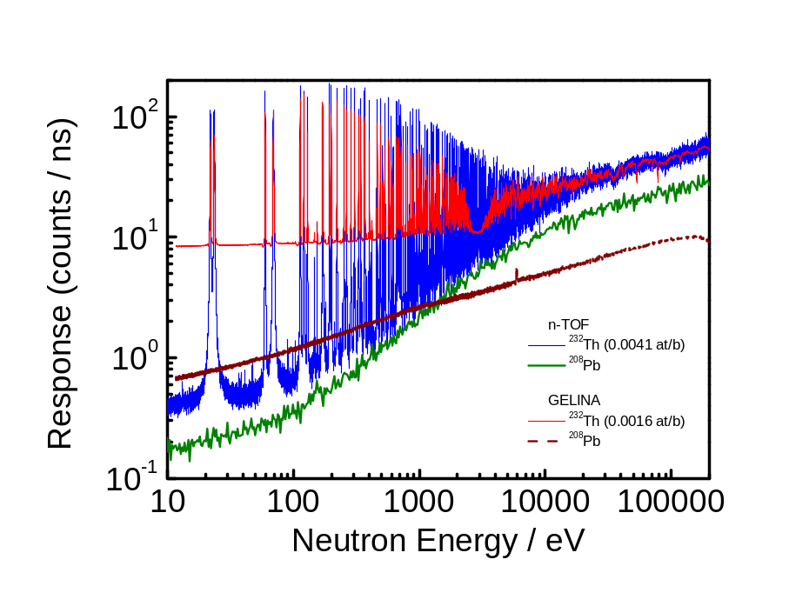
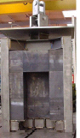
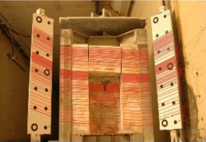
n_TOF Facility Timeline
2000
Commissioning
TARC experiment
New Target
construction
EAR2
design
2008
2011
1995-1997
Commissioning
Feasibility
CERN/LHC/98-02+Add
May 2009
Commissioning
EAR2
May 1998
2014
1996
2012
V. Vlachoudis
Construction
started
1999
2004-2007
Problem
Investigation
Phase I
Isotopes
Capture: 25
Fission: 11
Papers: 21
Proc.: 51
Doc: 150
2009
Phase II
Aug 1998
Proposal
submitted
Concept
by C.Rubbia
CERN/ET/Int. Note 97-19
Upgrades:
Borated-H₂O
Second Line
Class-A
2001-2004
1997
2010

Slide 17
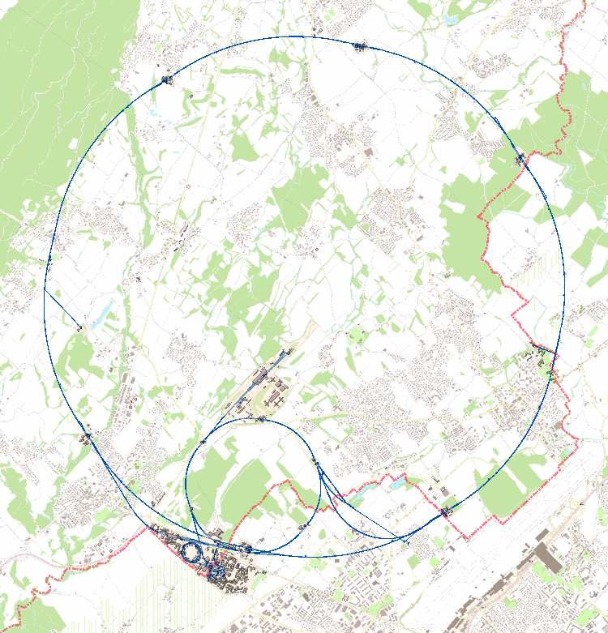
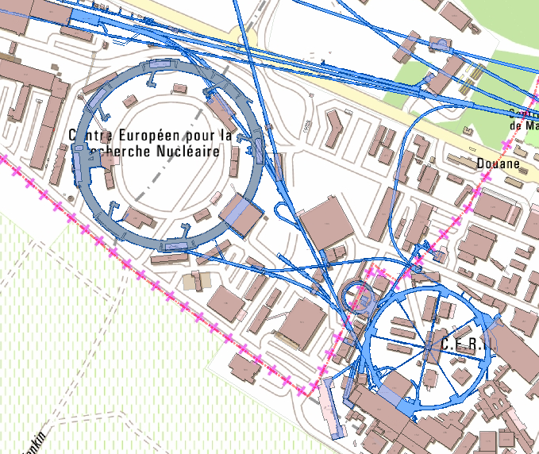
Accelerator complex for the n_TOF facility
n_TOF 185m flight path
n_TOF target
PSB 1.4 GeV/c
PS 20 GeV/c

Slide 18
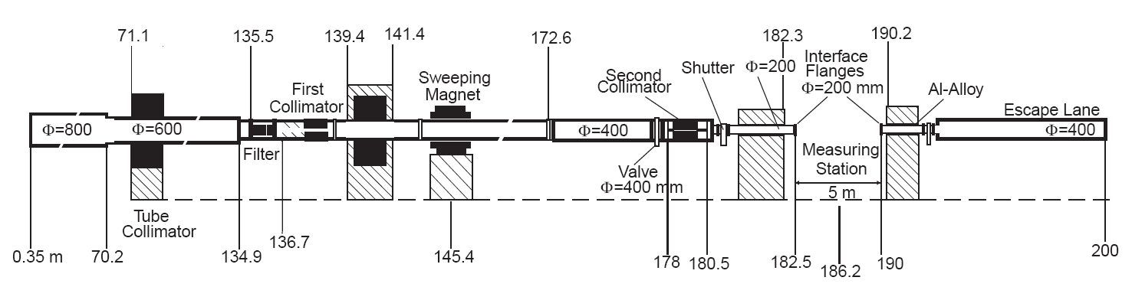
n_TOF experimental setup
Spallation target → neutrons
1st collimator (Ø=11 cm)
  Halo cleaning, first shaping of the beam + filter station
Sweeping magnet
2nd collimator (Ø=1.8/8 cm) – beam shaping for EAR
Experimental Area 1
  186 m from spallation target, location of samples and detector

Slide 19
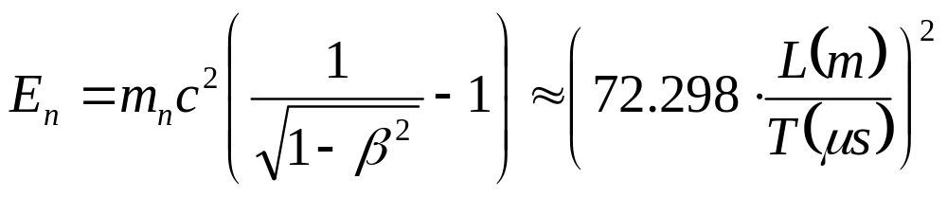
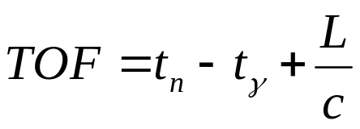
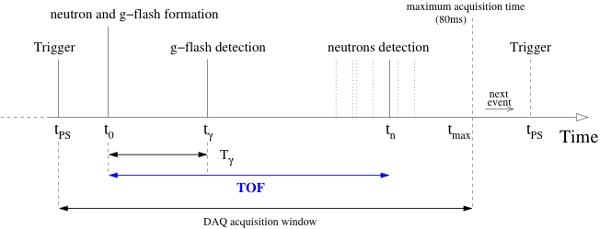
Time-of-flight method at n_TOF
Determination of the neutron kinetic energy via the time difference between neutron production and the detection of reaction products (γ or FFs)

Slide 20
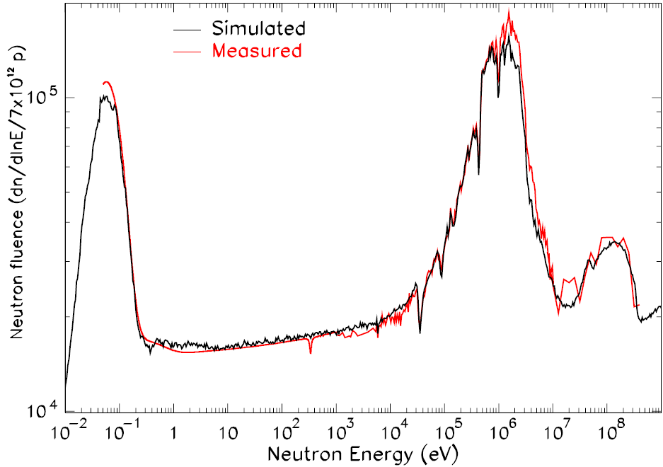
The n_TOF facility
Main feature of n_TOF is the extremely high instantaneous neutron flux (10⁵ n/cm²/pulse)
Unique facility for measurements of radioactive isotopes (maximize S/N)
  Branch point isotopes (astrophysics)
  Actinides (nuclear technology)
Other features of the neutron beam:
  High resolution in energy (ΔE/E=10⁻⁴) → study resonances
  Large energy range (25 meV<E_{n}<1 GeV) → measure fission up to 1 GeV
  Low repetition rate (<0.8 Hz) → no wrap-around

Slide 21
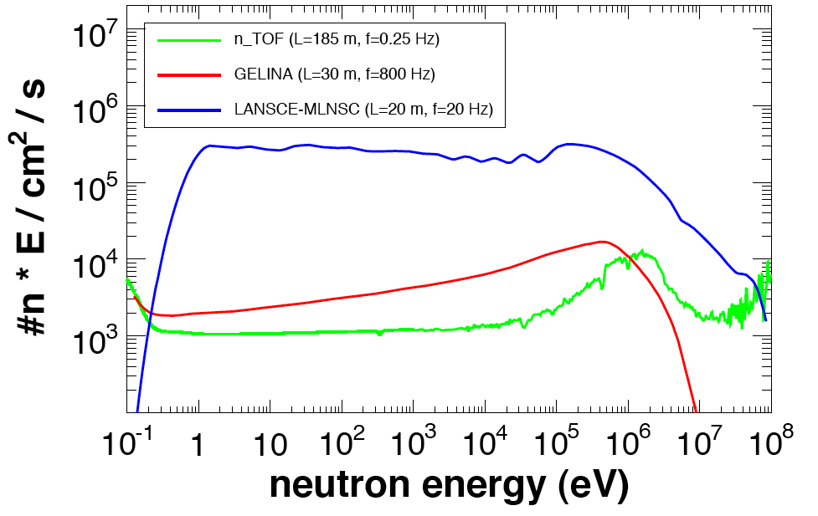
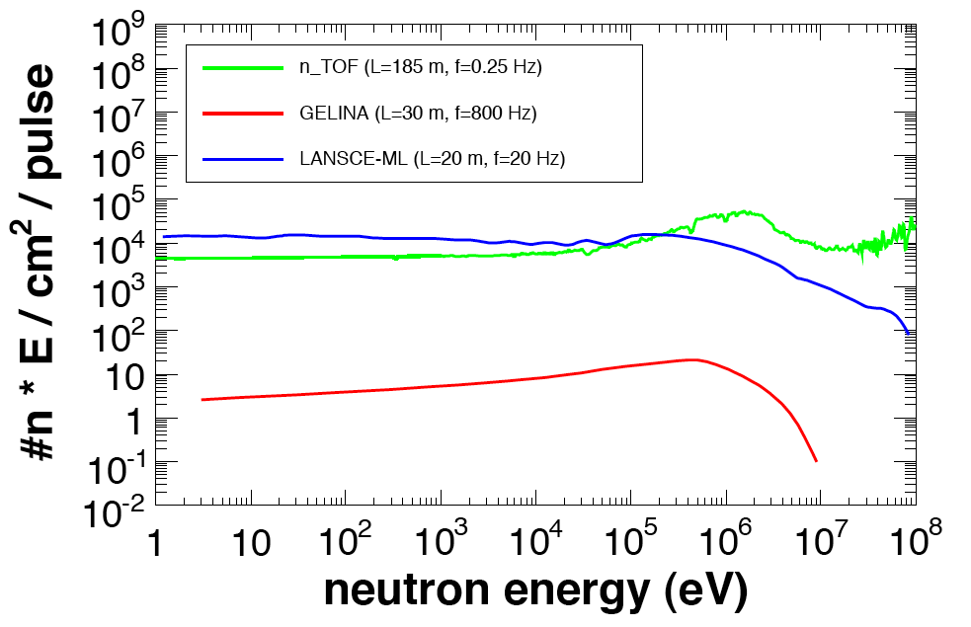
n_TOF basic characteristics
Average flux (n/sec)
Instantaneous flux (n/pulse)
3 orders of magnitude!
n_TOF average flux comparable to GELINA (with 30 m flight path)
Very high instantaneous neutron flux
  High proton intensity per pulse
  Spallation process
Great advantage in measuring radioactive samples (improved S/N ratio)

Slide 22
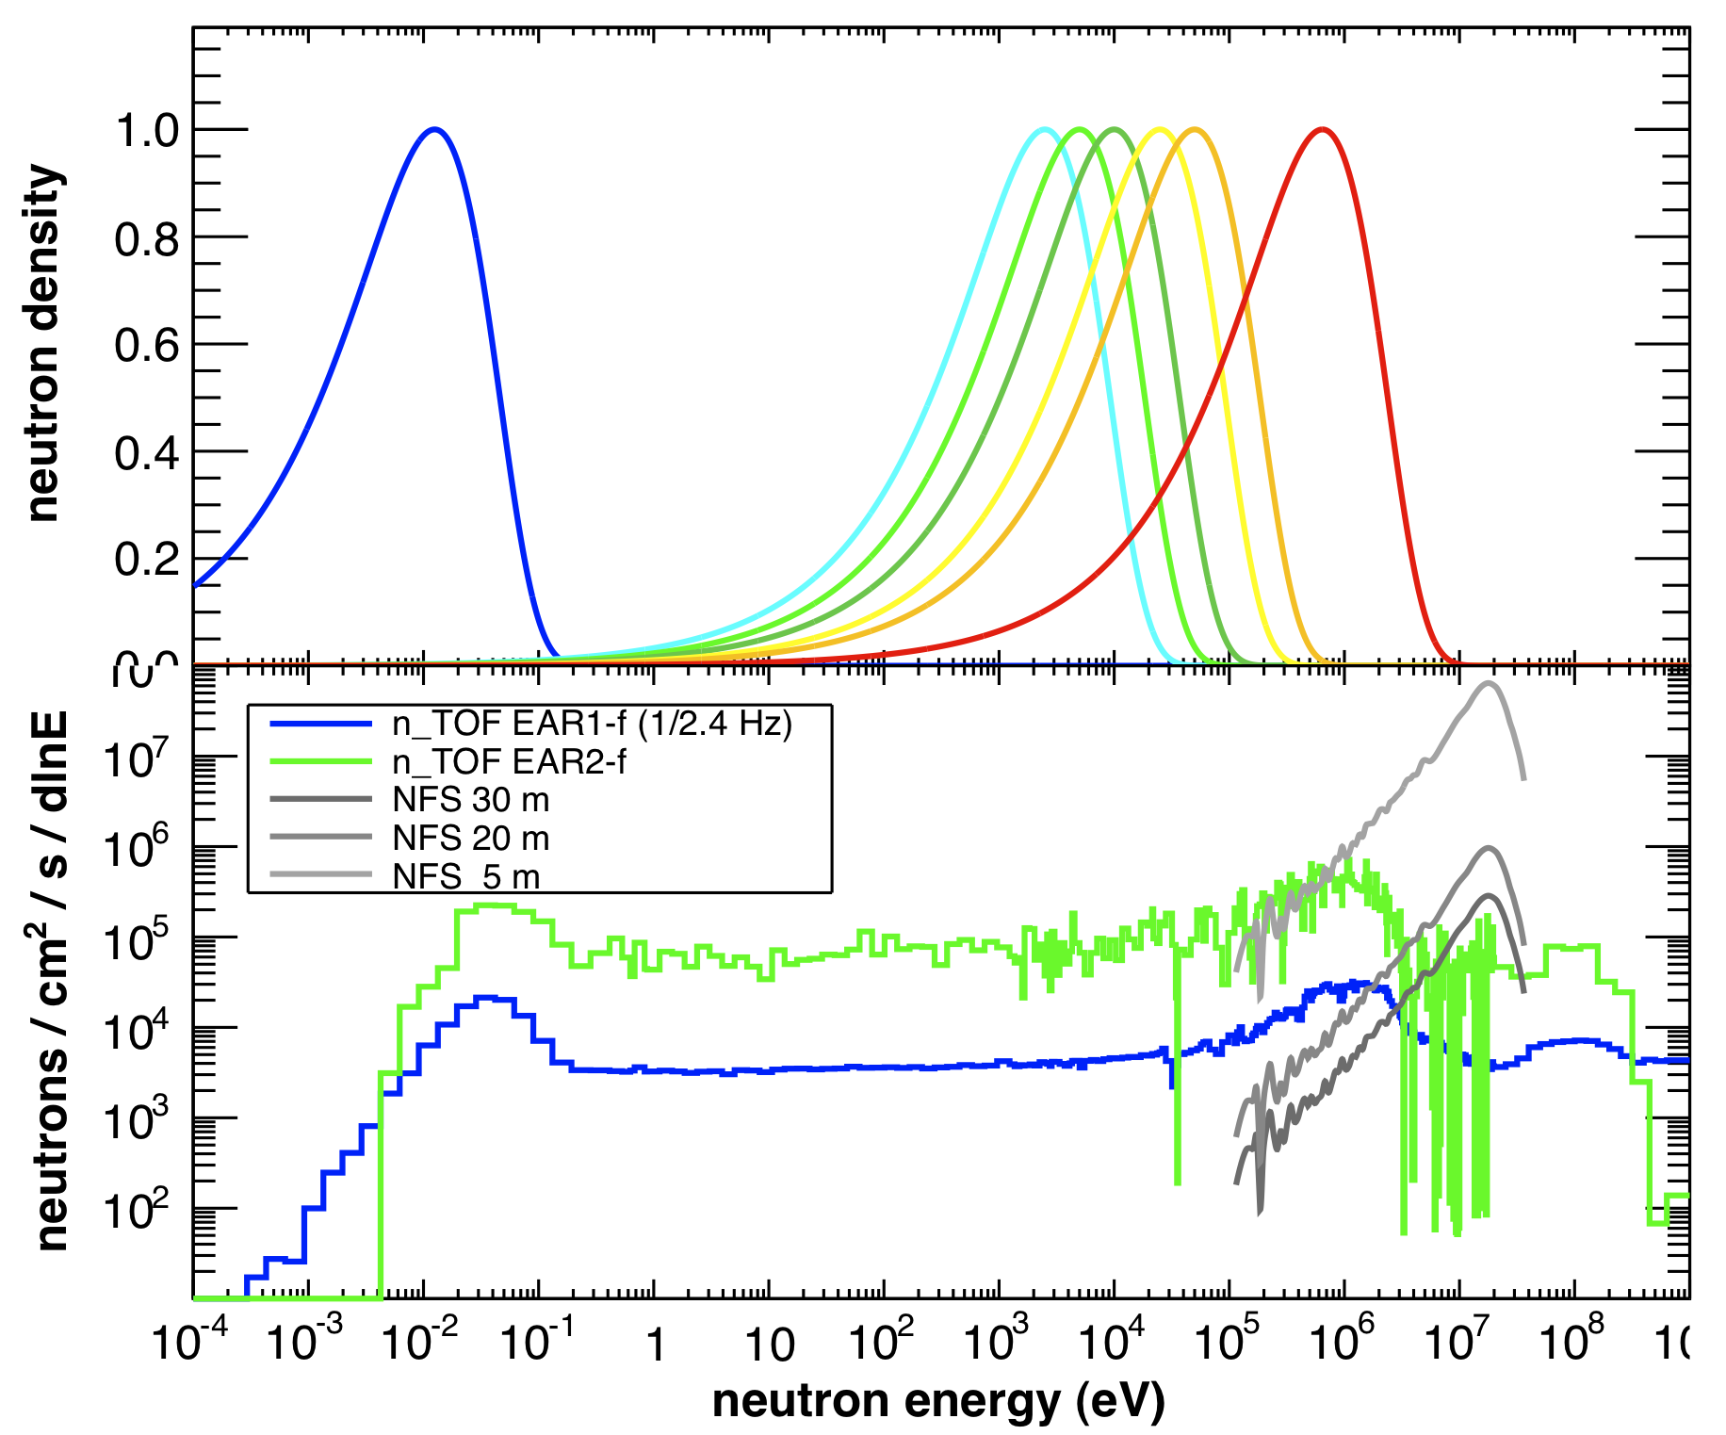
Complementarity with NFS (Neutron for Science)
Average flux (n/sec)
Instantaneous flux (n/pulse)
water-moderated
neutrons
neutrons in stellar
environments
kT = 5-100 keV
neutrons from
thermal fission
water-moderated
neutrons
neutrons in stellar
environments
kT = 5-100 keV
neutrons from
thermal fission

Slide 23
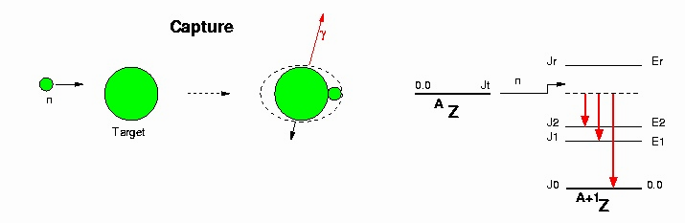
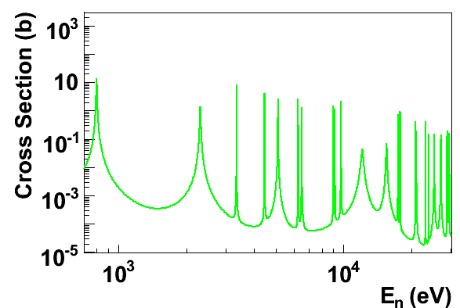
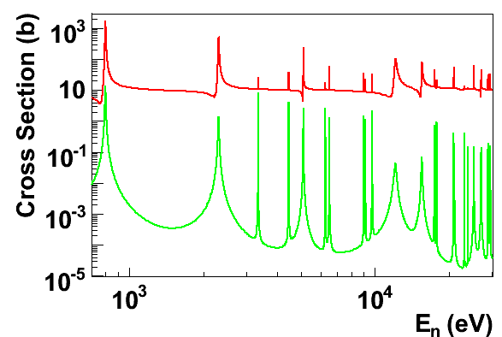
Detectors for capture (n,γ) reactions
Neutron capture reaction are studied by detecting γ-rays emitted in the de-excitation of the CN
Two types of background (source of systematic errors)
  γ-rays from neutron scattered by the sample and captured in the setup (“neutron sensitivity”)
  γ-rays from background, radioactivity of the sample or competing reactions
Neutron sensitivity: big problem for isotopes with low capture cross-section (e.g. astrophysics)
(n,n)
(n,γ)
A unique solution does not exists. At n_TOF two different detectors built to minimize the two background types

Slide 24
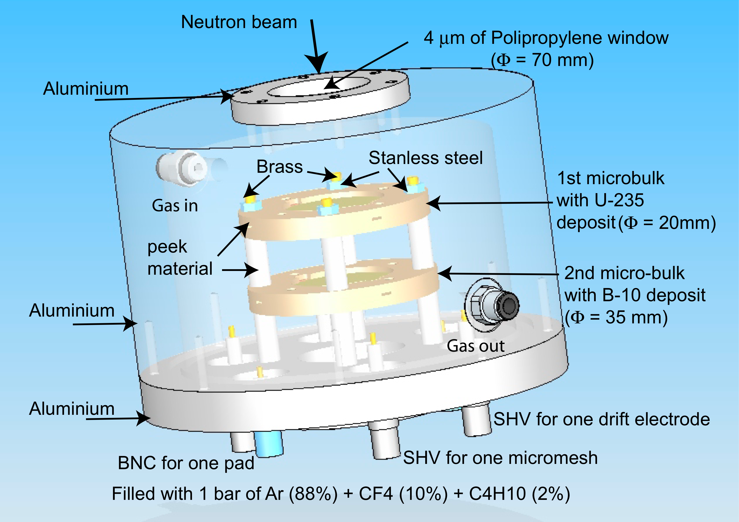

n_TOF Detectors
(n,chp) reactions
Parallel Plate Avalanche Counter
(PPAC)
MicroMegas (MGAS)
sCVD diamond (3x3 array)
(n,xnγ) reactions
BaF₂ Total Absorption Calorimeter (TAC)
Low neutron sensitivity C₆D₆

Slide 25
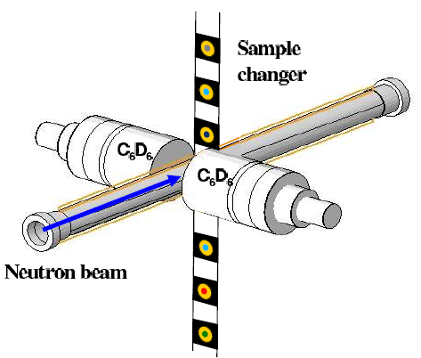
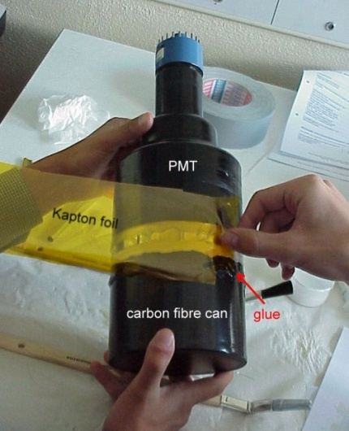
Detectors with low neutron sensitivity
At n_TOF neutron sensitivity enormously reduced relative to past detectors
Very small amount of material and extensive used of carbon fibers
However: low efficiency and selectivity

Slide 26
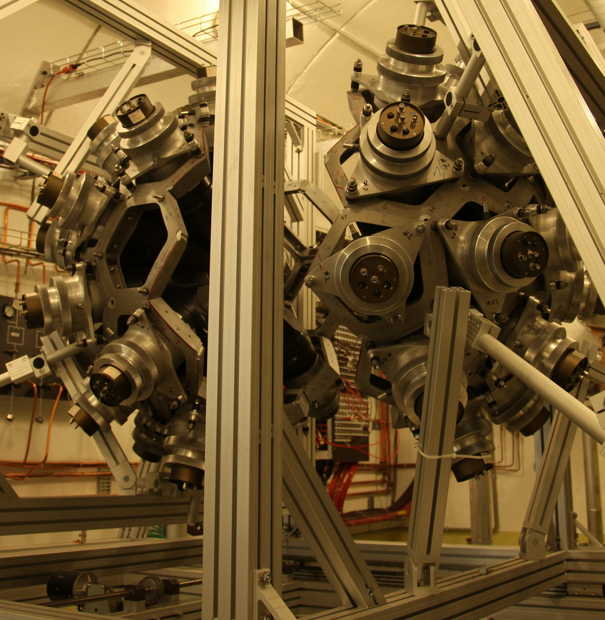
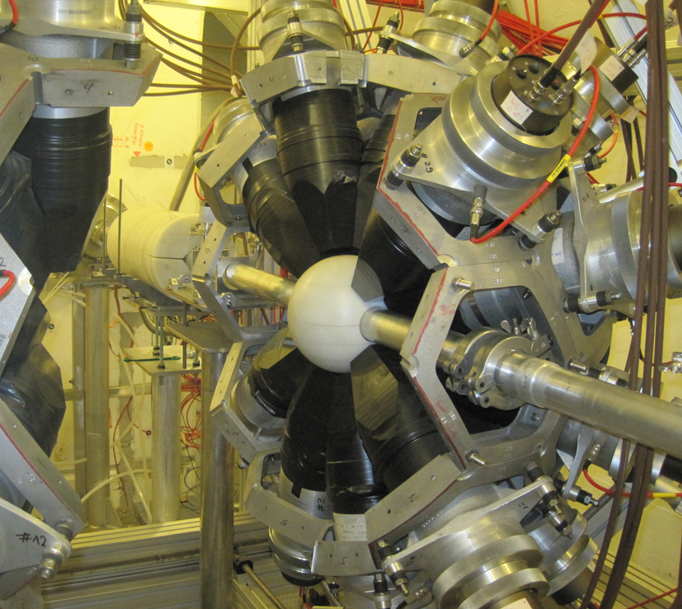
The n_TOF calorimeter
n_TOF TAC:
  4π array of 40 BaF₂ scintillators (15 cm thick)
  High efficiency allows to reconstruct the entire de-excitation cascade
High neutron sensitivity (detectors and heavy support structure)
  Minimize neutron sensitivity with inner sphere of absorbing material and capsules in carbon fibre with ¹⁰B

Slide 27
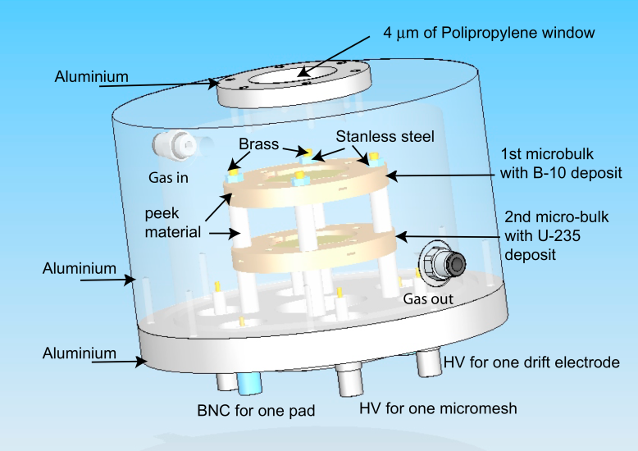
The fission setups
The main problem in fission measurements is the background due to α-decay
At n_TOF minimized by the very high instantaneous neutron flux
Three different detectors employed:
  Fission Ionization Chamber (FIC) [2002-2005]
    Standard detector, with fast gas (Ar+CF₄) and electronics
  Parallel Plate Avalanche Counters (PPAC) [2001-20xx]
    Fission fragments detected in coincidence
    Very good rejection of α-background
  MicroMegas detector (MGAS) [2010-20xx]
    Innovative detector based on the micro-mesh concept
    In beam monitoring, no sensitivity to γ-rays, fast response, compact device

Slide 28
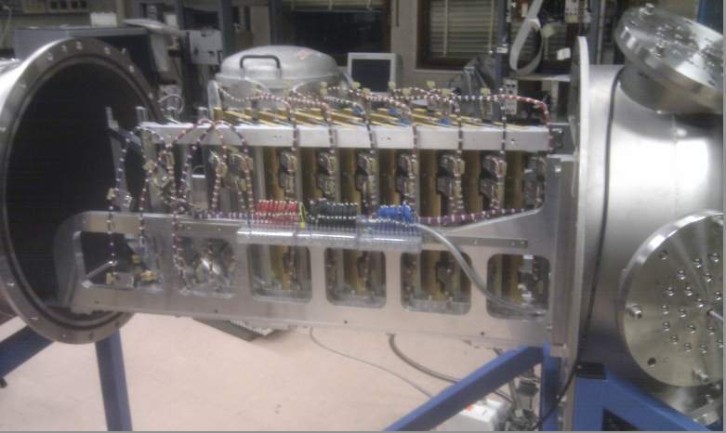
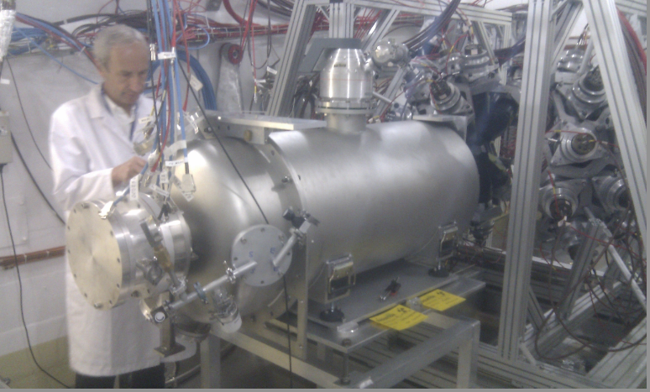
Parallel Plate Avalanche Counter PPAC
n_TOF Ph-2 set-up:
Samples tilted 45degrees wrt. neutron beam
10 PPAC detectors with 9 targets in between (²³⁵U, ²³⁸U, ²³⁷Np, 6x²³²Th)
Segmented cathodes to study the ang. distributions of FF, in addition to σ_{n,f}(E_{n}).

Slide 29
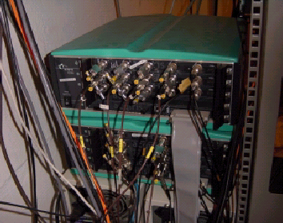
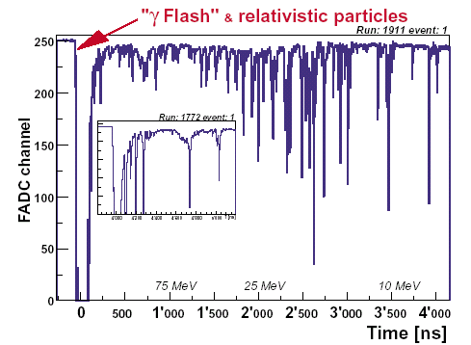
n_TOF Data Acquisition System
High instantaneous neutron flux
  Several events for each neutron pulse expected + pile-up between
Standard DAQ methods are largely inadequate
n_TOF DAQ based on flash-ADC:
  ~56 fADC channels, up to 1 GS/s
  Full history of every detector digitized during time window of up to 80 ms
  Nearly zero dead time
Offline signal reconstruction for time and charge
  Pulse-shape fitting analysis (pile-up)

Slide 30
Outline of the talk
Scientific motivations
The n_TOF Collaboration, facility and experimental setup
Status, upgrades and future perspectives
Experimental results and 2012 experimental program
n_TOF Experimental Area 2 Project

Slide 31
n_TOF facility improvements 2009/2014
New lead spallation target [2008/9]
  Extended operation of n_TOF
Improved cooling and ventilation system [2009]
  Optimization of heat dissipation and water chemistry
Separated moderator system: ¹⁰B water as moderator [2010]
  Reduction of the in-beam γ-rays by factor of 10x
Transformation of the EAR1 in a type-A laboratory [2010]
  No need for certified sealing for radioactive samples
Extended memory of flash-ADC digitizers [2011]
  n,γ measurement with C₆D₆ down to thermal energies (25.3 meV)
Experimental Area 2 Project [2012-2014]

Slide 32
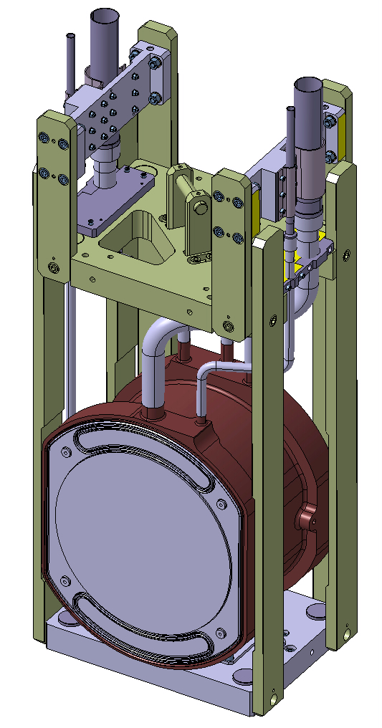
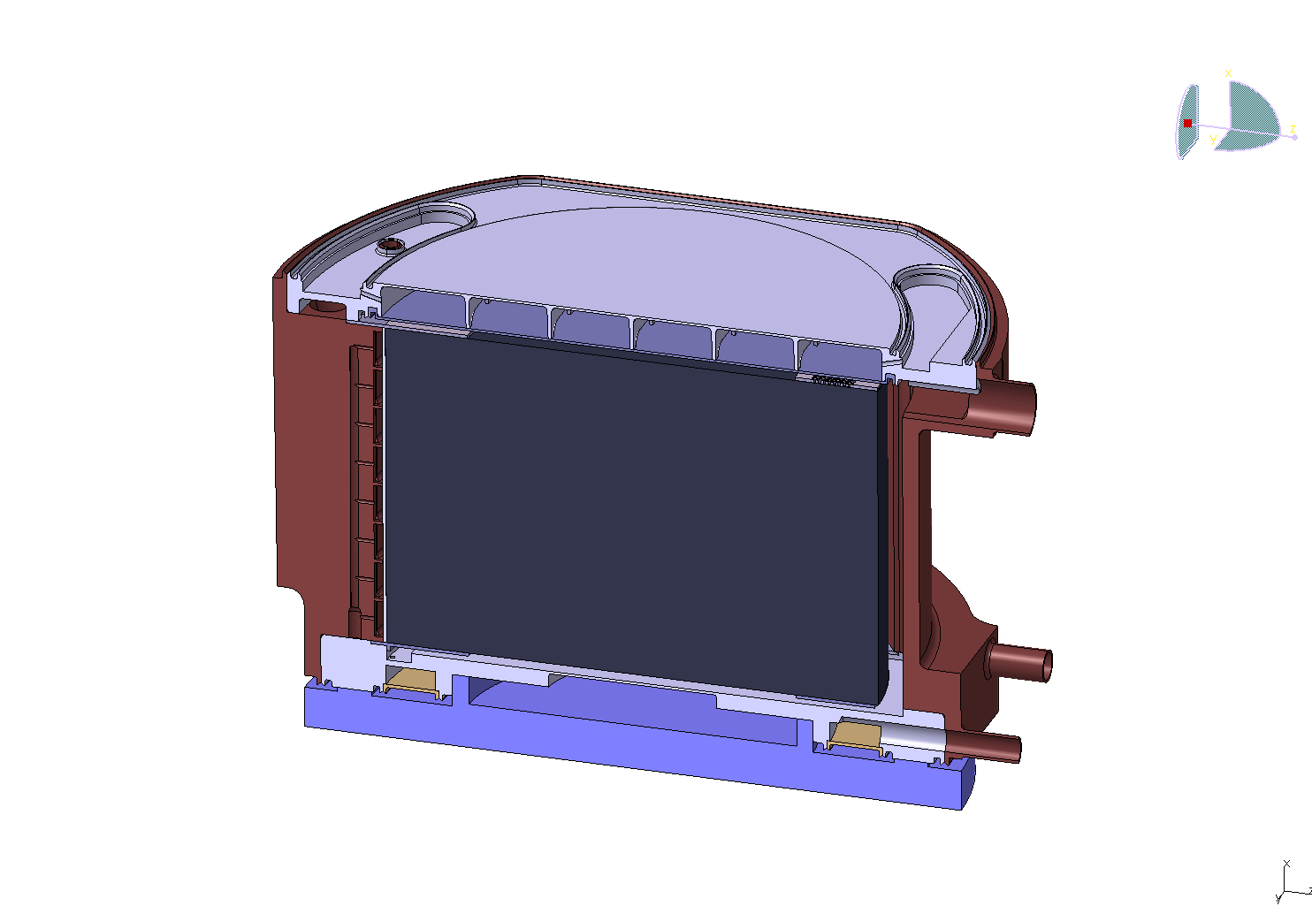
n_TOF new spallation target
Spallation target is now enclosed in a new pressurized vessel
Pure lead 99.99% monolithic
Support and anti-creep structure in AW5083 H111
Uncladded design
Water chemistry continuously monitored
Water jet flow on the proton entrance surface to maintain local temperature less than boiling point
Neutron window, Ø= 600 mm
Proton window, Ø= 200 mm

Slide 33
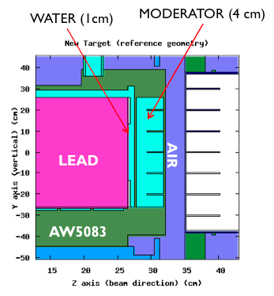
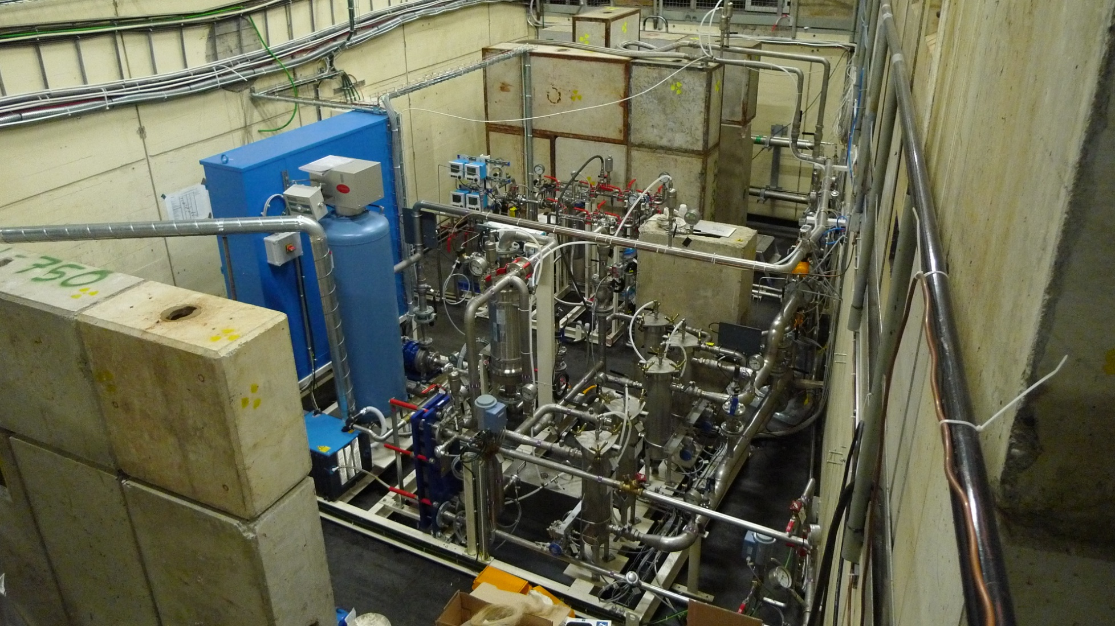
Borated water system moderator
Main goal is to reduce the in-beam γ-ray background from ¹H(n,γ) → 2.2 MeV
Increased capture in ¹⁰B rather than ¹H, by operating in saturated conditions (1.3% in H₃BO₃)
  Improvement of neutron-induced capture reaction with C₆D₆ liquid scintillator

Slide 34
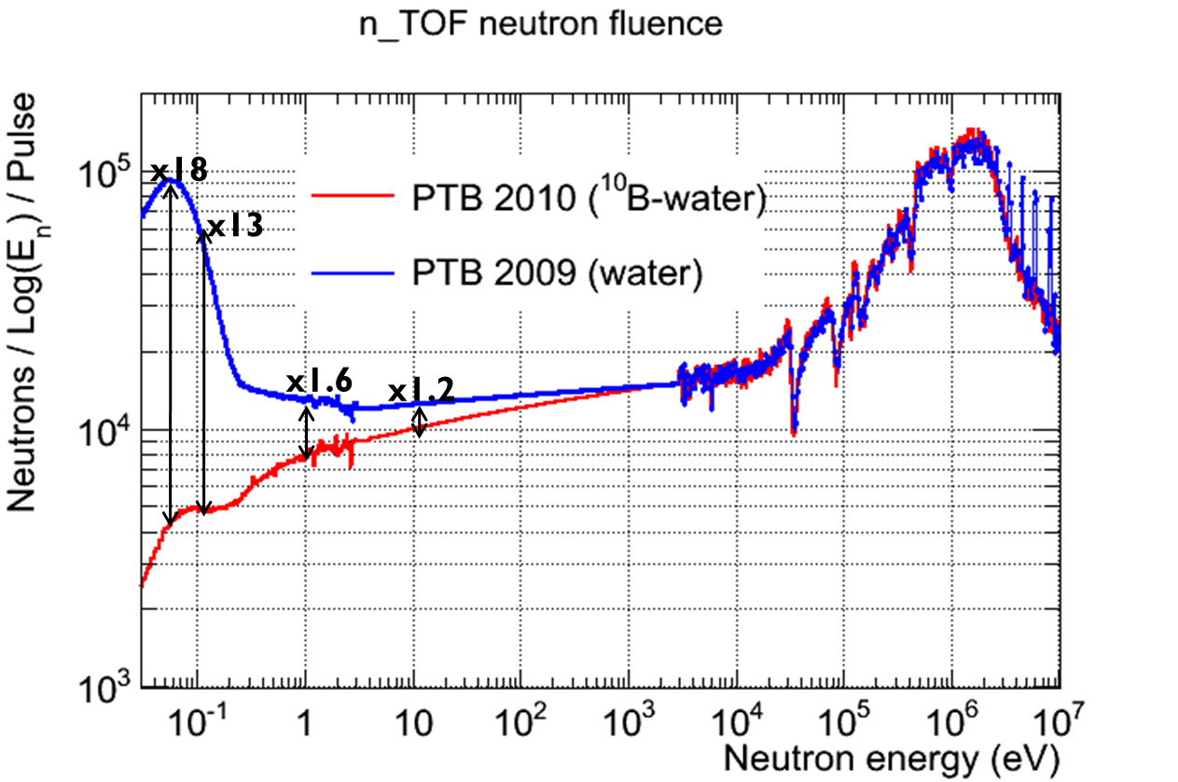
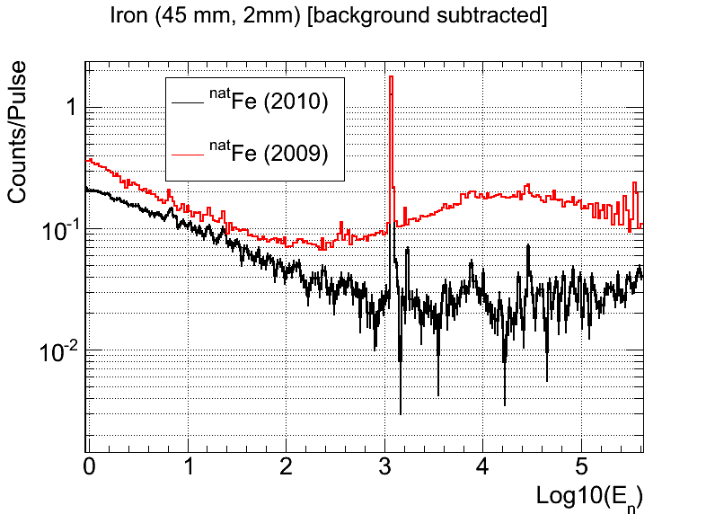
Performances with the borated water circuit
Expected reduction of the neutron fluence <1 keV
Reduction of the 2.2 MeV γ-ray (~10x)

Slide 35
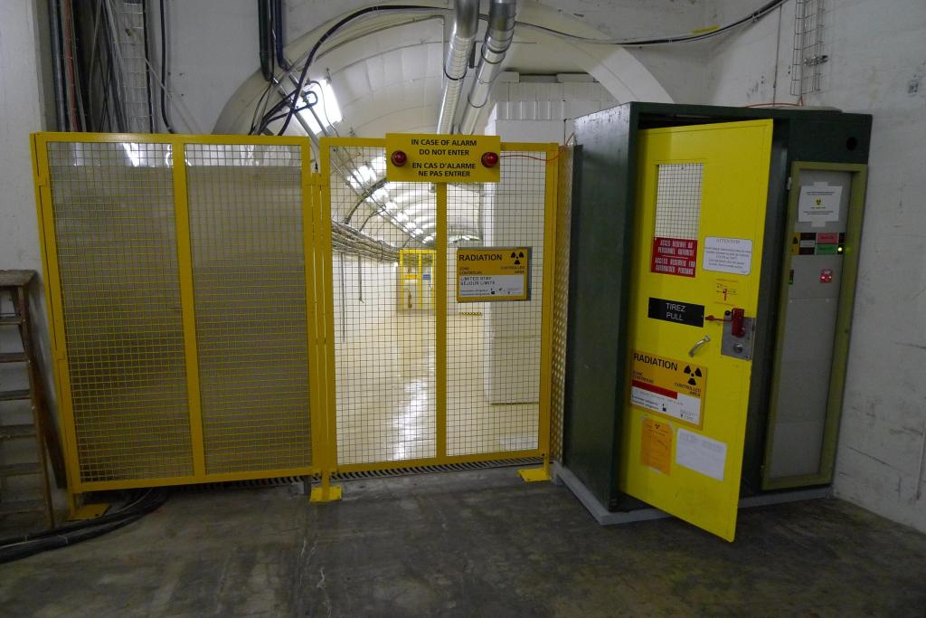



N_TOF Beam Line
Entrance of n_TOF beam line
EAR-1
Escape line

Slide 36
Outline of the talk
Scientific motivations
The n_TOF Collaboration, facility and experimental setup
Status, upgrades and future perspectives
Selected experimental results
n_TOF Experimental Area 2 Project

Slide 37
The n_TOF activity
Capture
¹⁵¹Sm
^{204,206,207,208}Pb, ²⁰⁹Bi
^{24,25,26}Mg
^{90,91,92,94,96}Zr, ⁹³Zr
^{186,187,188}Os, ¹³⁹La
²³²Th, ^{233,234}U
²³⁷Np,²⁴⁰Pu,²⁴³Am
Fission
^{233,234,235,236}U
²³²Th, ²⁰⁹Bi
²³⁷Np
^{241,243}Am, ²⁴⁵Cm
n_TOF Phase 1 (2001-2004)
  Misurements of capture reactions:
    25 Isotopes (8 of which radioactive)
    Astrophysics and Nuclear Technology (transmutation)
  Measurements of fission cross-sections:
      11 isotopes (10 radioactive)
      Mainly for Nuclear Technology (ADS, Gen IV, Th/U cycle)
      strong interest by International Nuclear Agencies
Papers: >50
Other pubblications: >150
Data are becoming available on EXFOR
Notes:
Motivazioni Zr, Mg / Misure precedenti Os (orela ’80) / Proprietà nucleari (average level spacing, average radiative width, average neutron strength) / ISO 2919

Slide 38
The n_TOF activity
n_TOF Phase 2 (2008-2012)
Capture
²⁵Mg, ^{54, 56,57}Fe
^{58,60,62}Ni, ⁶³Ni,⁸⁸Sr
^{236,238}U
²⁴¹Am
Fission
^{240,242}Pu
²³⁵U(n,γ/f)
²³²Th , ²³⁴U, ²³⁷Np ang. distr.
(n,α)
³³S, ⁵⁹Ni
  Measurements of capture reactions:
    12 Isotopes (4 of which radioactive)
    Astrophysics and Nuclear Technology (transmutation)
  Measurements of fission cross-sections:
      6 isotopes (5 radioactive)
      Mainly for Nuclear Technology (ADS, Gen IV, Th/U cycle)
  Other measurements:
      Simultaneous capture and fission
      (n,a) reactions (using diamond detectors)
Notes:
Motivazioni Zr, Mg / Misure precedenti Os (orela ’80) / Proprietà nucleari (average level spacing, average radiative width, average neutron strength) / ISO 2919

Slide 39



Data for the Th/U fuel cycle
At n_TOF we have measured the two main reactions of the cycle: the ²³²Th(n,γ) and ²³³U(n,F).
Results with high resolution, high accuracy (3 - 5 %) and wide energy range (from thermal to several MeV).
²³²Th(n,γ)
Important data for the development of the Th/U fuel cycle

Slide 40


Results from ²⁴⁵Cm(n,f) reaction (FIC)
Significant α-particle contribution due to t_{1/2}=8500 y and of ²⁴⁴Cm contamination (t_{1/2}=18 y)
High amplitude threshold + spontaneous fission subtraction
Data normalized at thermal energies with a weighted average of two recent measurement
From thermal up to 1 eV n_TOF data intermediate between Browne et al. and White et al.
M. Calviani et al. (n_TOF Coll.), accepted for publication in Phys. Rev. C (2012)

Slide 41


²⁴⁵Cm(n,f)
The 245Cm(n,f) cross section in the un- resolved resonance region from 1 keV to 1 MeV neutron energy, compared with the data and with the evaluated data sets of ENDF/B-VII.0 and JENDL/AC-2008.
The 245 Cm(n,f) cross section between 10 and 17 eV neutron energy, compared with two previous data sets and with evaluations.
M. Calviani et al., Phys. Rev. C 85, 034616 (2012)

Slide 42


²⁴¹Am(n,γ)
The sample (disk-shaped with 12.2 mm diameter) consists on 32.2 mg of ²⁴¹Am oxide embedded in a 305 mg Al₂O₃ matrix and encapsulated in a 0.5 mm thick aluminum canning.
(3.8 GBq)
PRELIMINARY
First time that complete region is covered from thermal to MeV in a single measurement
Combined C₆D₆/TAC measurement for improved accuracy
Unprecedented resolution and statistics, to extend RRR beyond 150 eV

Slide 43

⁶³Ni(n,γ)
⁶³Ni (t_{1/2}=100 y) represents the first branching point in the s-process reaction path:
  Highest uncertainty in ^{63,65}Cu abundances comes from the ⁶³Ni(n,γ) unknown cross section
⁶²Ni sample irradiated in thermal reactor (in 1984 and 1992)
total mass of 1002 mg
enrichment in ⁶³Ni: ~13 % (131.8 mg)
contaminants: ~15.4 mg ⁶³Cu
PRELIMINARY
⁶³Ni-sample
⁶²Ni-contam.
After chemical separation at PSI:
NiO powder, (919 mg Ni)
<0.01 mg ⁶³Cu
First high-resolution measurement of ⁶³Ni(n,γ) in the astrophysical energy range
First experimental observation of resonances in the keV region.
C.Lederer et al Neutron capture cross section of unstable 63Ni: implications for stellar nucleosynthesis to be published in Phys.Rev.

Slide 44
Outline of the talk
Scientific motivations
The n_TOF Collaboration, facility and experimental setup
Status, upgrades and future perspectives
Experimental results and 2012 experimental program
n_TOF Experimental Area 2 Project

Slide 45

n_TOF Experimental Area 2 Project
2nd Experimental Area:
  Flight path located at ~19 m at 90˚ vertically with respect to the proton beam
  Experimental area at ground level
  INTC-O-015
Operative by mid-2014

Slide 46
n_TOF EAR2 advantages
Main advantages of Experimental Area 2:
  Neutron fluence is on average increased by a factor of 25
  Very small mass samples (<1 mg) could be measured
  Very small cross-section
  Much shorter time scale measurement
  Running in parallel with Experimental Area 1
Example of EAR2 possible measurements:
  Measurement of the ²⁵Mg(n,α)²²Ne cross section
  Measurement of ⁷Be(n,p)⁷Li and ⁷Be(n,α)⁴He cross sections
  Capture (and fission) cross sections of the fissile ²⁴⁵Cm
  Cross section and angular distribution of fragments from ²³²U(n,f)

Slide 47


The main features of EAR 2
Higher fluence, by a factor of 25, relative to EAR1.
The shorter flight path implies a factor of 10 smaller time-of-flight.
Global gain by a factor of 250 in the signal/background ratio for radioactive isotopes!
Maximum neutron fluence gain: x27 (keV region)
ISR
The huge gain in signal-to-background ratio in EAR2 allows to measure radioactive isotopes with half lives as low as a few years.
n_TOF target pit

Slide 48


EAR-2 for Neutron Irradiation
Basket for material irradiation
Neutron Tube has 32 cm diameter
at 1.5 m from the target center
Total: 6.22e10¹⁵ n / cm^2 / 7e12 ppp

Slide 49

Overview of n_TOF target area
EAR2 (@20 m from pit, above ground)
To be built
ISR
Technical gallery (@10 m from pit)
Existing hole
n_TOF target pit

Slide 50

Experimental Hall
Dump
Detector Support

Slide 51

The future: n_TOF vertical flight path at 20 m
Beam Dump
EAR-2 Exp. Hall
Collimator
New area
Magnet
Existing area
Pit shielding
Target

Slide 52

Experimental Hall

Slide 53
The experimental program in EAR2
The EAR2 will allow to:
  measure samples of very small mass (<1 mg)
  measure short-lived radioisotopes (down to a few years)
  collect data on a much shorter time scale
  measure (n,charged particle) reactions with thin samples
Letter of intent for measurements in EAR2:
  (n,p) and (n,α) cross sections on ⁷Be, ²⁵Mg, ²⁶Al
  Fission cross sections of the short lived actinides ²³²U, ^{238,241}Pu and ²⁴⁴Cm
  Capture cross section of ⁷⁹Se, ²⁴⁵Cm
  Cross section and angular distribution of fragments from ²³²U(n,f)
ISR
Status of the EAR2:
Approved by CERN, final design phase
Start construction in 2013
Beam ready in mid-2014
Physics start after commissioning in 2015
n_TOF target pit

Slide 54
Conclusions
There is need of accurate new data on neutron cross-section both for astrophysics and nuclear technology
Since 2001, n_TOF is contributing to the world efforts aimed at collecting high quality data, mostly on capture and fission
Main advantage of n_TOF is the high instantaneous neutron flux and high performance detectors
Improved background conditions in EAR1 with the borated water system
Radioprotection issues solved by transformation of EAR1 in a Work Sector Type A
The 2nd experimental area (EAR2) will open new perspectives for measurement with lower masses (ready by 2014)

Slide 55

Thanks a lot for you attention!

