Slide 1
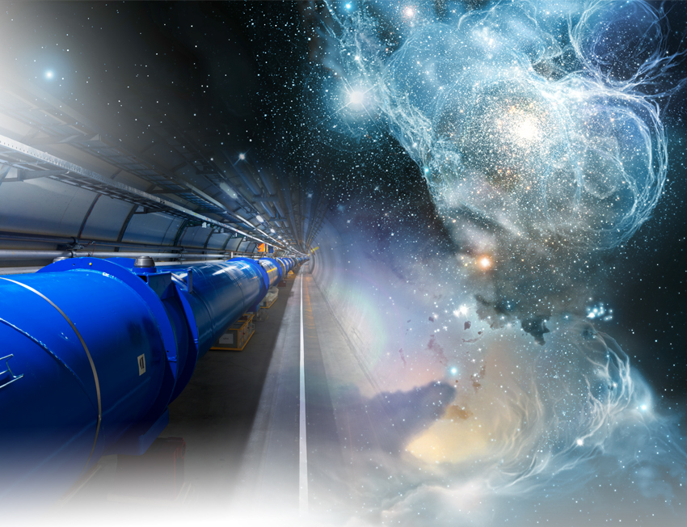
The LHC Upgrades in Luminosity and Energy: Options and Plan
Lucio Rossi
CERN
High Lumi LHC Coordinator
CEA Saclay – IRFU/SPP 17 September2012

Slide 2
Highlights
LHC today : performance
Luminosity : which goal, parameters and hardware changes
High Luminosity LHC
  Magnets
  SC Crab Cavities
  SC Links
LHC: a long history, a longer future?
High Energy: towards a farther energy frontier

Slide 3
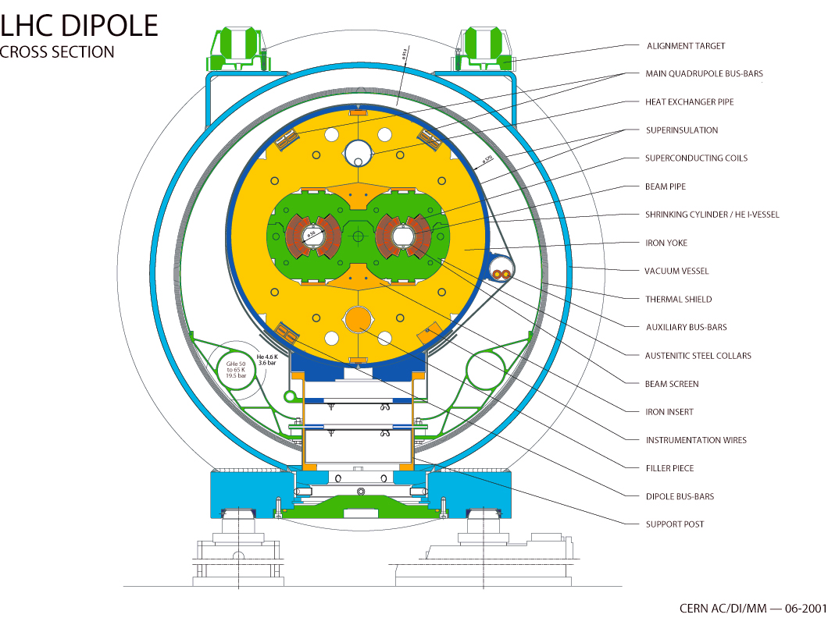
LHC: the numbers
27 km, p-p at 7+7 TeV
3.5+3.5 start, 4+4 in 2012
1232 x 15 m Twin Dipoles
Operational field 8.3 T @11.85 kA (9 T design)
HEII cooling, 1.9 K with 3 km circuits (130 tonnes He inventory).
Field homogeneity of 10⁻⁴ at 1 cm from the coils, bending strength uniformity better then 10⁻³. Field quality control (geometric and SC effects) at 10⁻⁵.

Slide 4
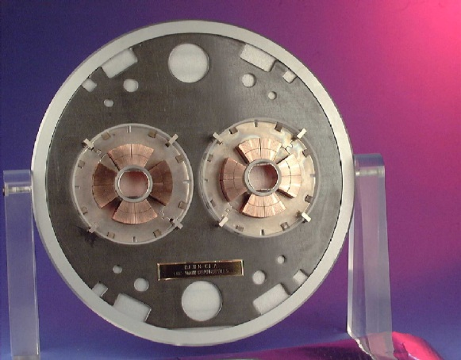

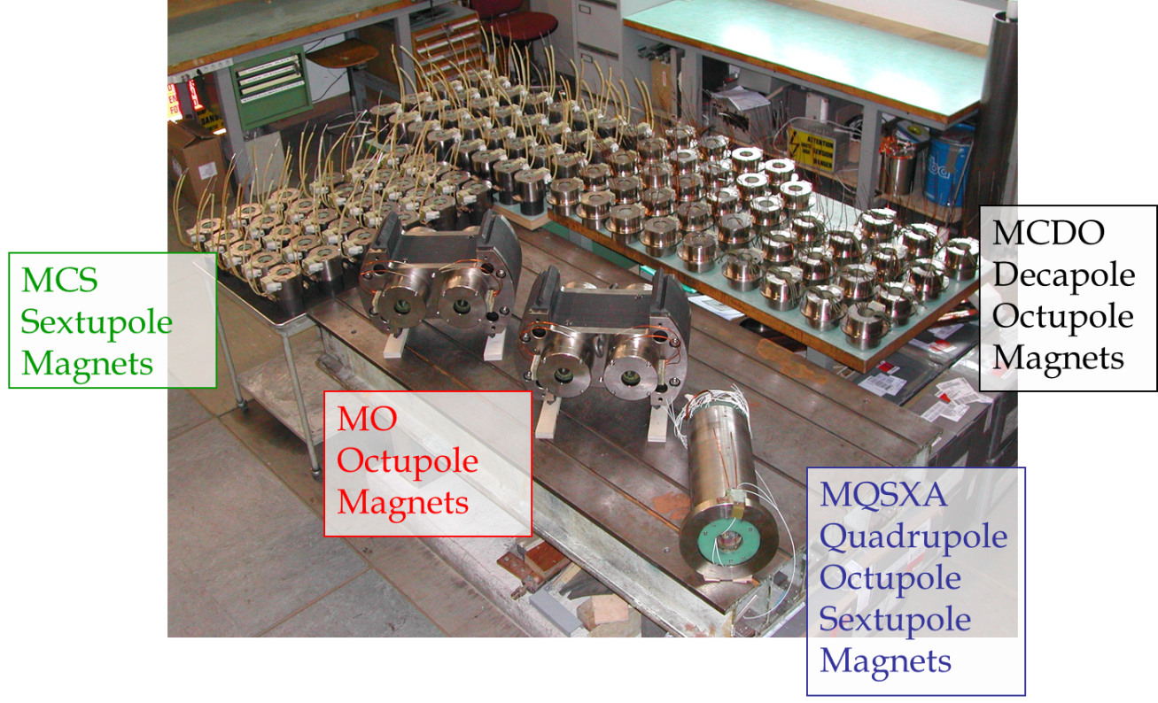
LHC: the numbers (cont.)
392 Main Quads Two-In-One rated for a peak field of 7 T.
About 100 other Two-in-One MQs
32 MQX (low-β) single bore for luminosity (design L=1⋅10³⁴ cm⁻²s⁻¹), 70 mm apertures, about 8 T peak field, high quality
A «zoo» of 7600 «small» Sc magnets (correctors and higher order magnets, till dodecapoles: so far only 6th and 8-th pole used)
Total: 9 MJ stored energy (at nominal)
Large detector magnets
  ATLAS toroid – 25 m long 1.2 MJ
  CMS solenois – 12 m long 2.5 MJ

Slide 5
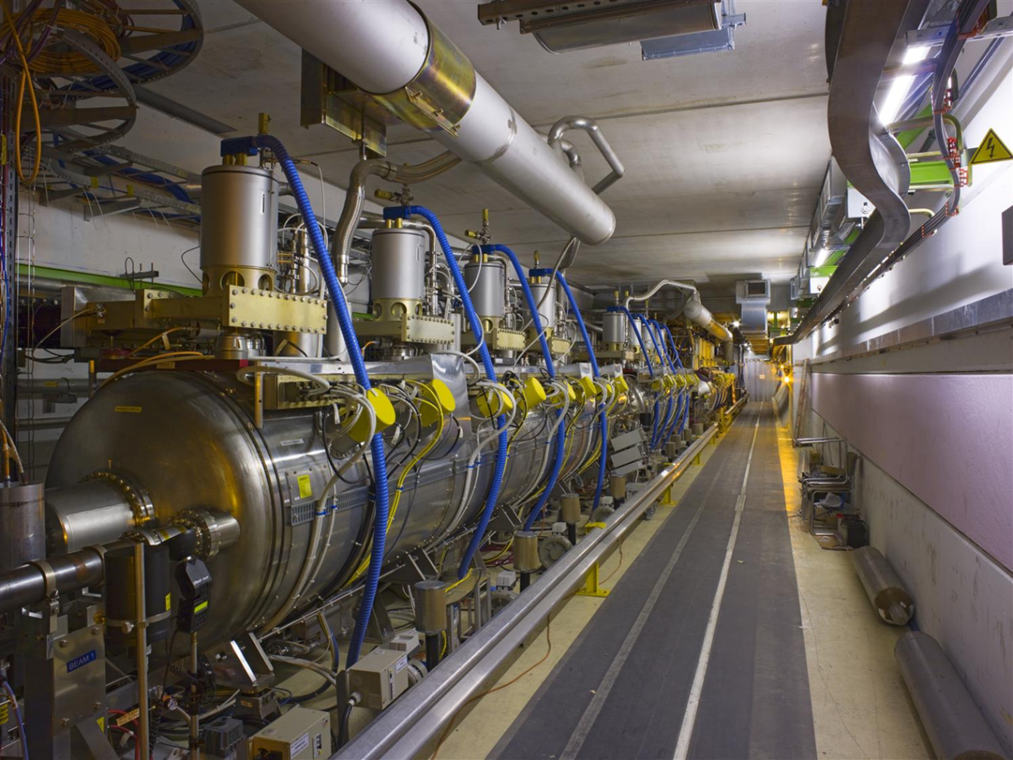
LHC: the numbers (cont.)
400 MHz Standing wave RF
4 single cell cavities in cryomodule, 2 crym per beam. Total 16 cavities.
Sputtered niobium design (as LEP)
Gradient 5.5 MV/m nominal (8 MV/m available)
Nominal 2MV, up to 3 MV at 8 MV/m
Center frequency mechanically tunable in a range of 100kHz by a stepper motor
Located in P4 (es LEP experiment) share cryo with the magnets

Slide 6
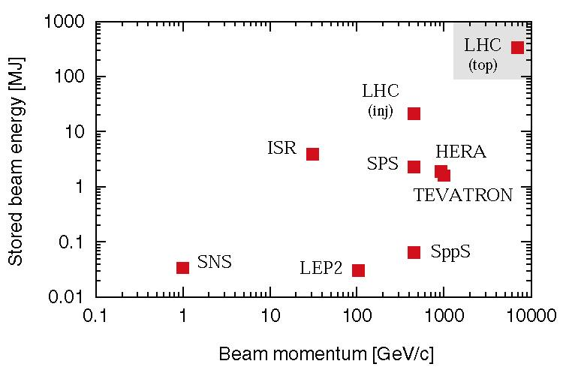
The power of LHC beams
Nominal LHC design: 3 × 10¹⁴ protons accelerated to 7 TeV/c
circulating at 11 kHz in a SC ring
LHC today
At less than 1% of nominal intensity LHC enters new territory. Collimators must survive expected beam loss…

Slide 7
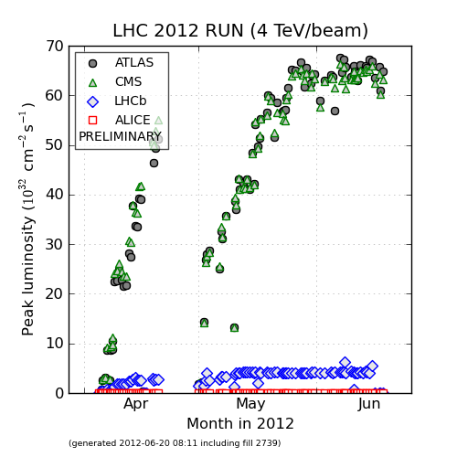
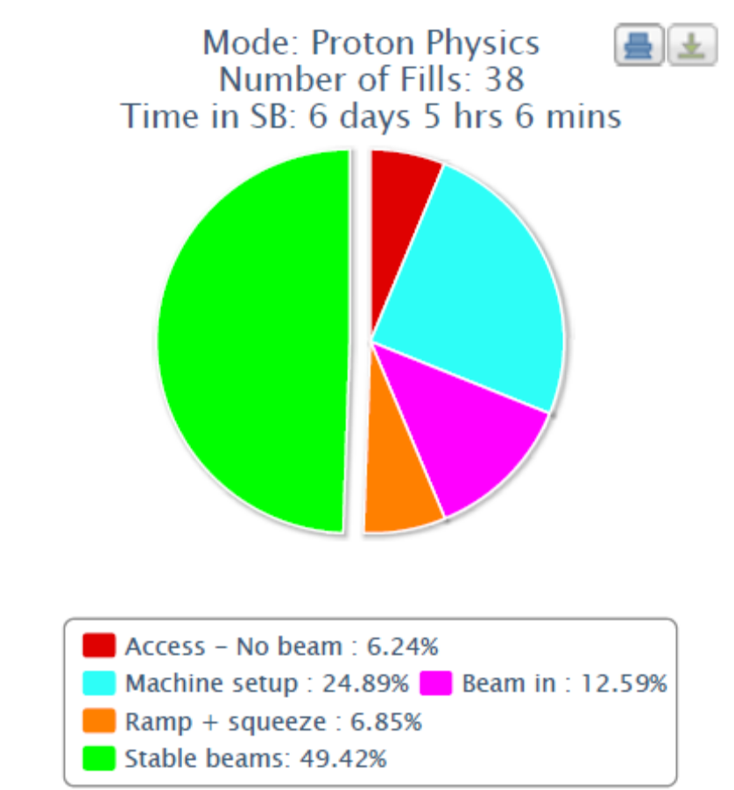
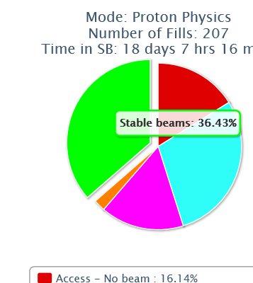
Performance
Luminosity: ∝ rate of collisions
77: New record Aug
Equiv 7 TeV
Typical 2012.
Best period 3 weeks in June !!

Slide 8
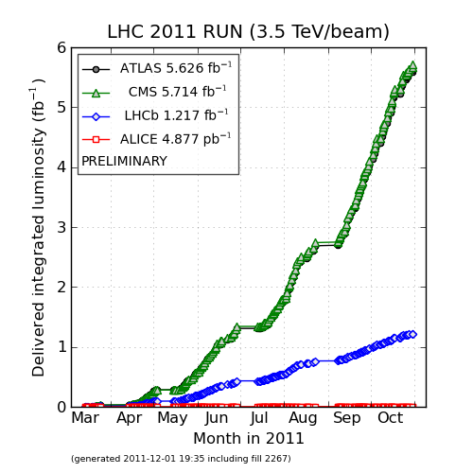
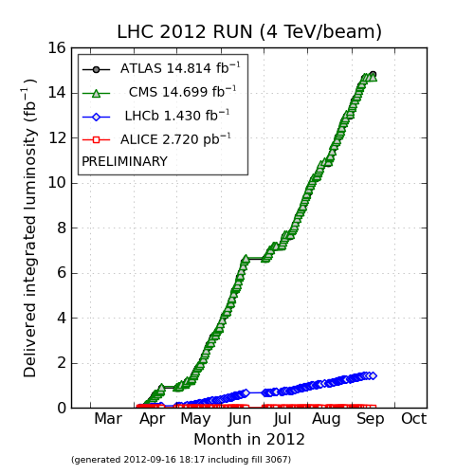
Performance (cont.)
Integrated lumi: ∝ # of collisions
Higgs got!
Promised minimum 2011 : 1 fb⁻¹
Promised 2012 (after extension) : 25 fb⁻¹

Slide 9
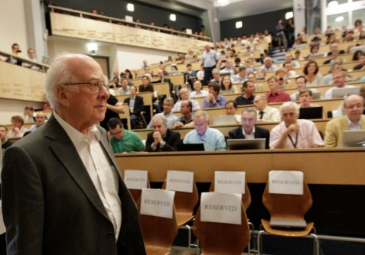
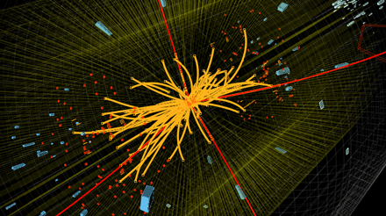
Higgs found

Slide 10
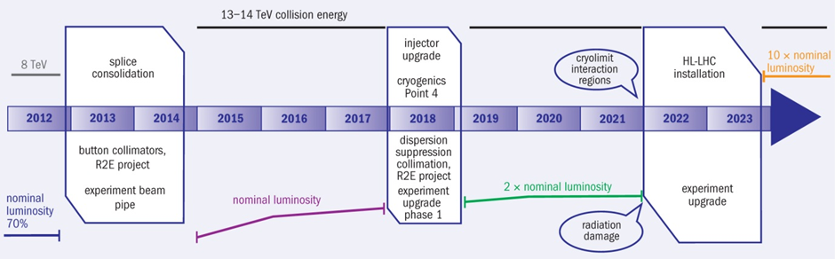
From here: where to go?
The CERN 10 y plan

Slide 11
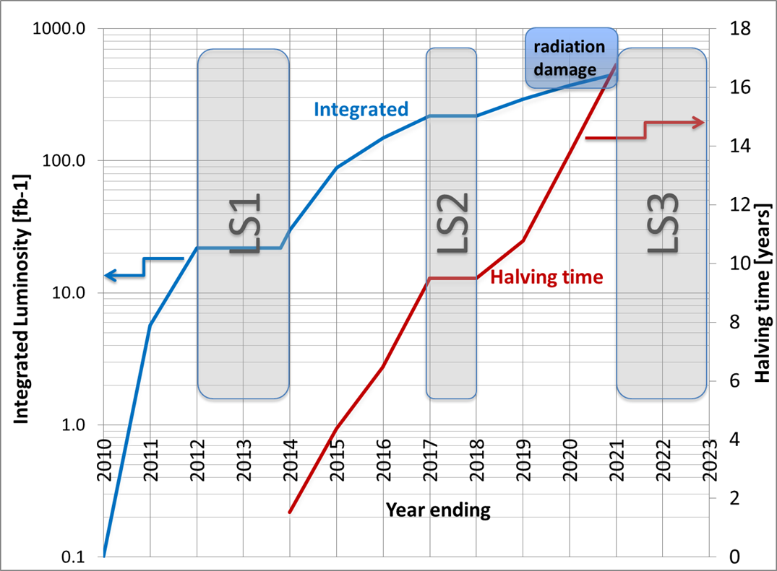
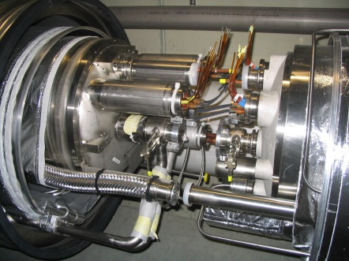
Next ten year plan for LHC
Shut down to fix interconnects and overcome energy limitation (LHC incident of Sept 2008)
Shut down to overcome beam intensity limitation (Injectors, collimation)

Slide 12

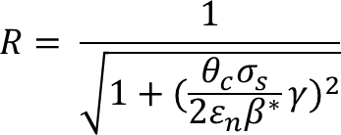
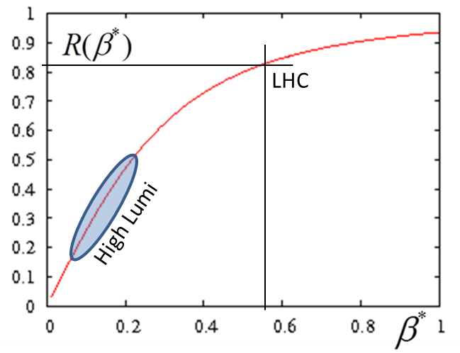

Luminosity: main ingredients
Beam current
energy
Beam size
Beam current and emittance: involve Inj chain and whole ring
β∗ involve «only» 2 IRs, 600 m.
Unit of lumi through the talk
LHC has been designed for L₀
All systems have singularly designed tentatively for ultimate 2L₀ (to be verified…)

Slide 13
High Luminosity LHC project
To push the performance above the ultimate, to 5 10³⁴ or more
  If pile up allows it. Today we have 30-35, experiments design upgrade for 140 evt/crossing average with a max of 200/crossing)
  If energy deposition by collision debris in the nearest SC magnets (low.β triplet quads) allows it
Use of lumi levelling to maximize integrated luminosity for a given max lumi.
Final goal is : 3000 fb⁻¹ by 10-12 years

Slide 14
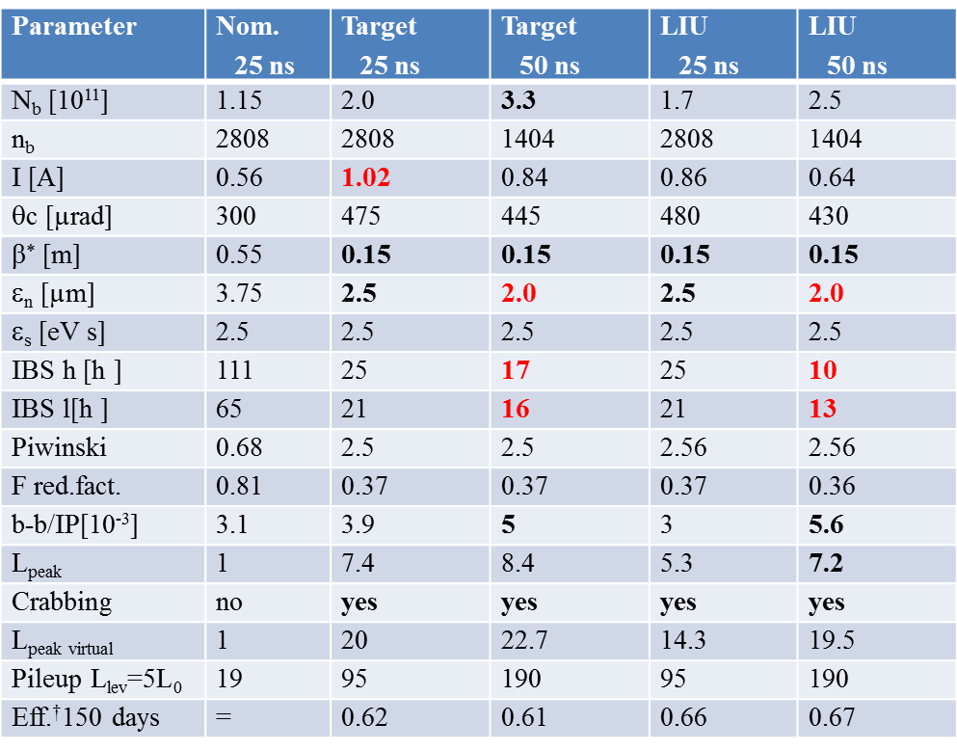
Target parameters for
HL-LHC run
Efficiency is defined as the ratio between the annual luminosity target of 250 fb⁻¹ over the potential luminosity that can be reached with an ideal cycle run time with no stop for 150 days: t_{run}= t_{lev}+t_{dec}+t_{turn}. The turnaround time after a beam dump is taken as 5 hours, t_{decay} is 3 h while t_{lev} depends on the total beam current
baseline

Slide 15
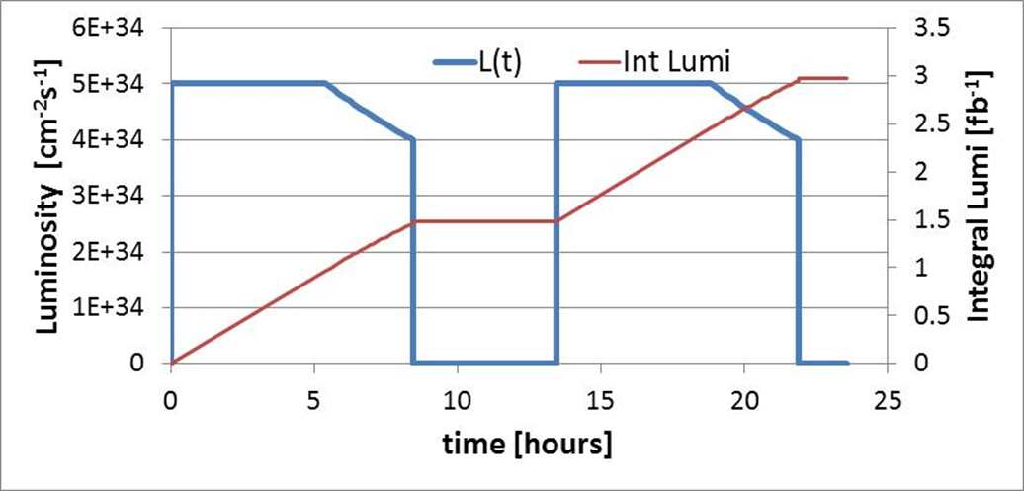
Cycle in the HL-LHC run
20E+34
pile up
heat deposition in IR and DS
other?
Levelling

Slide 16
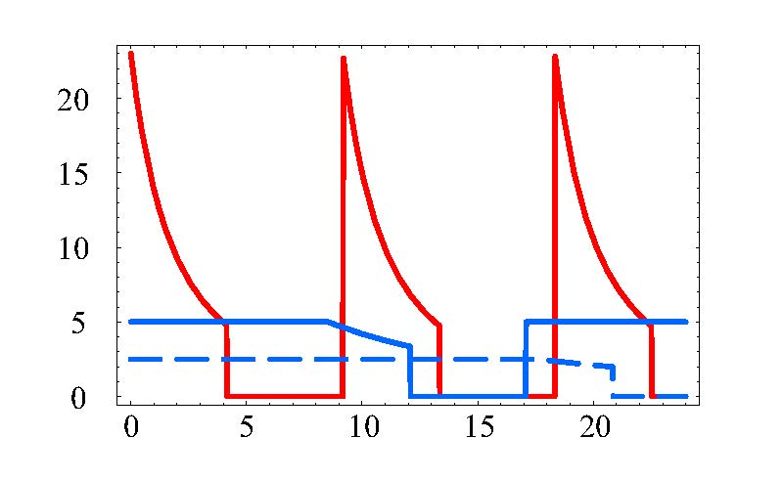
Pushing virtual lumi up to make longer run
L [10³⁴ cm⁻²s⁻¹]
virtual
peak
luminosity
25 ns
w/o
leveling
t_{lev}
t_{dec}
25 ns
leveled
t_{ta}
50 ns leveled
t [h]

Slide 17
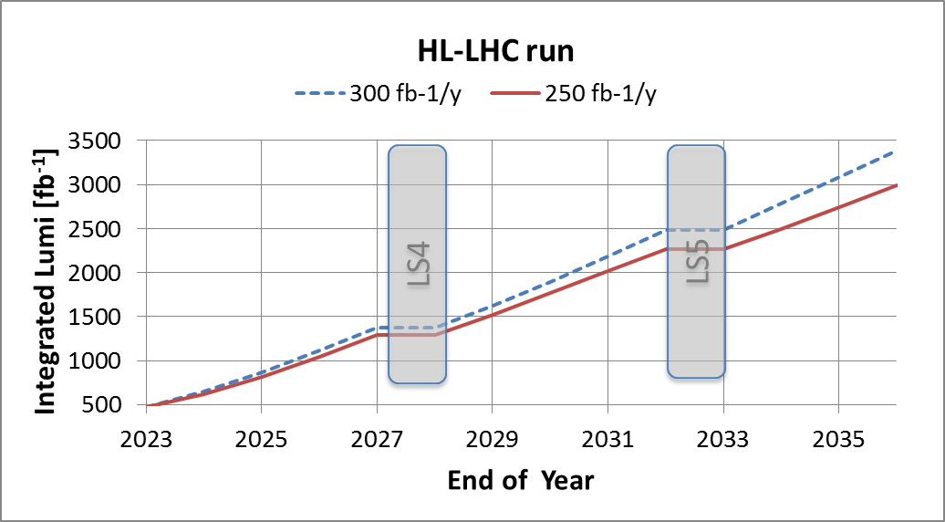
The goal
3000 fb⁻¹ in 10-12 years

Slide 18
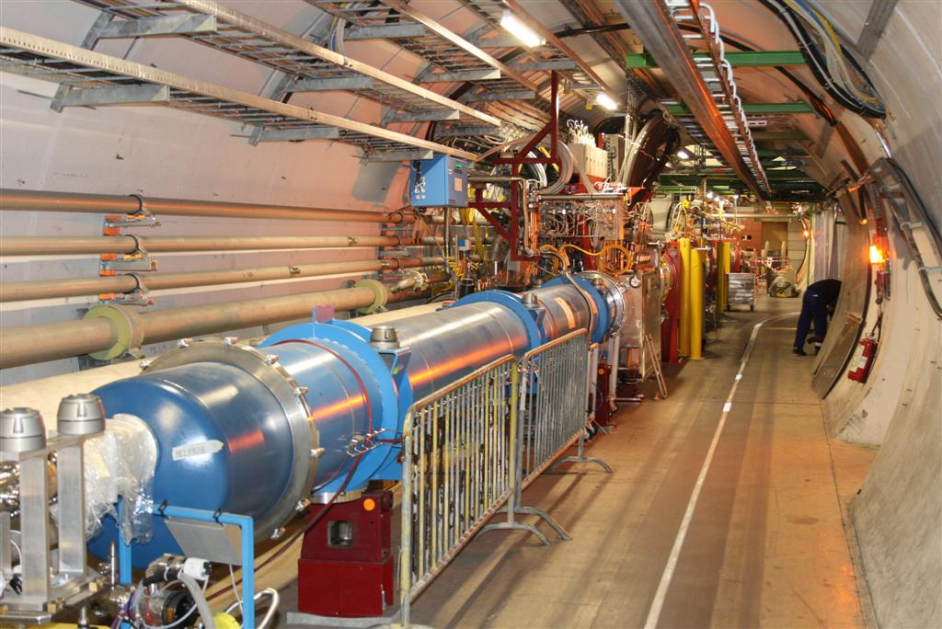
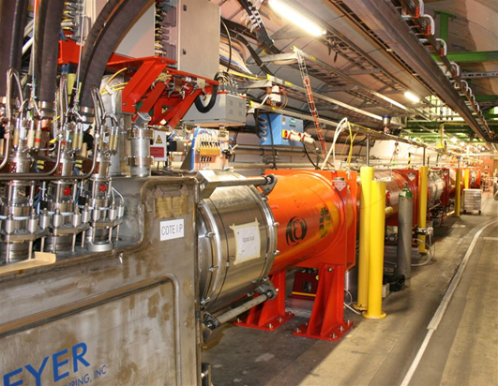
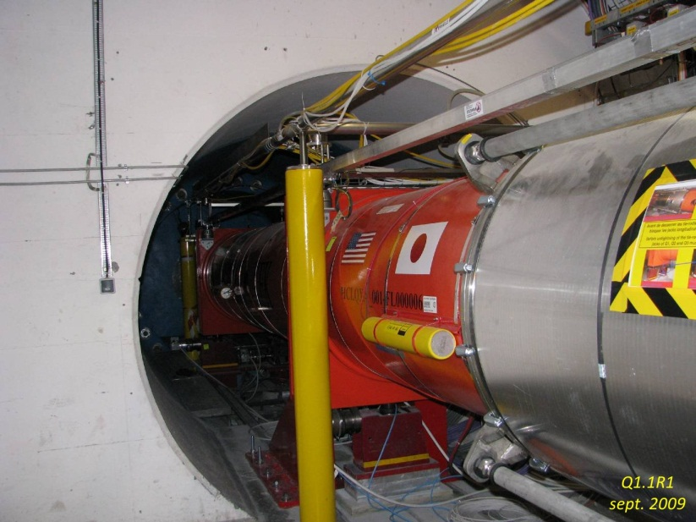
Here the magnets for the low β in present LHC

Slide 19
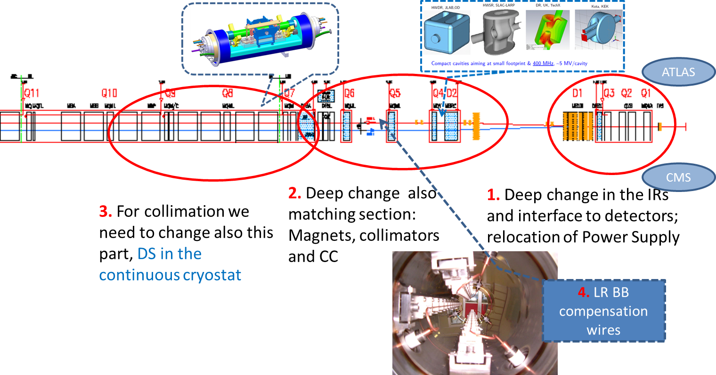
Changing 300x2 m both ATLAS & CMS (+LHC-b & Alice …)
1.2 km of LHC !!

Slide 20
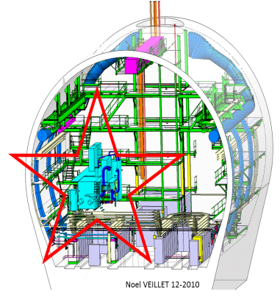
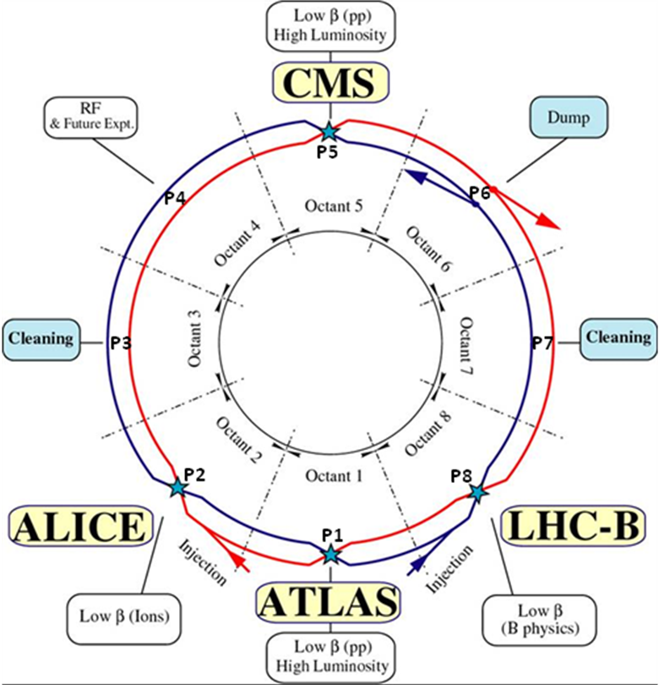
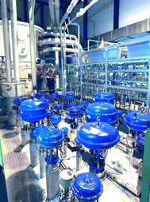

HL-LHC installation all around the ring…
6.5 kW@4.5K cryoplant
2 x 18 kW @4.5K cryoplants for IRs

Slide 21

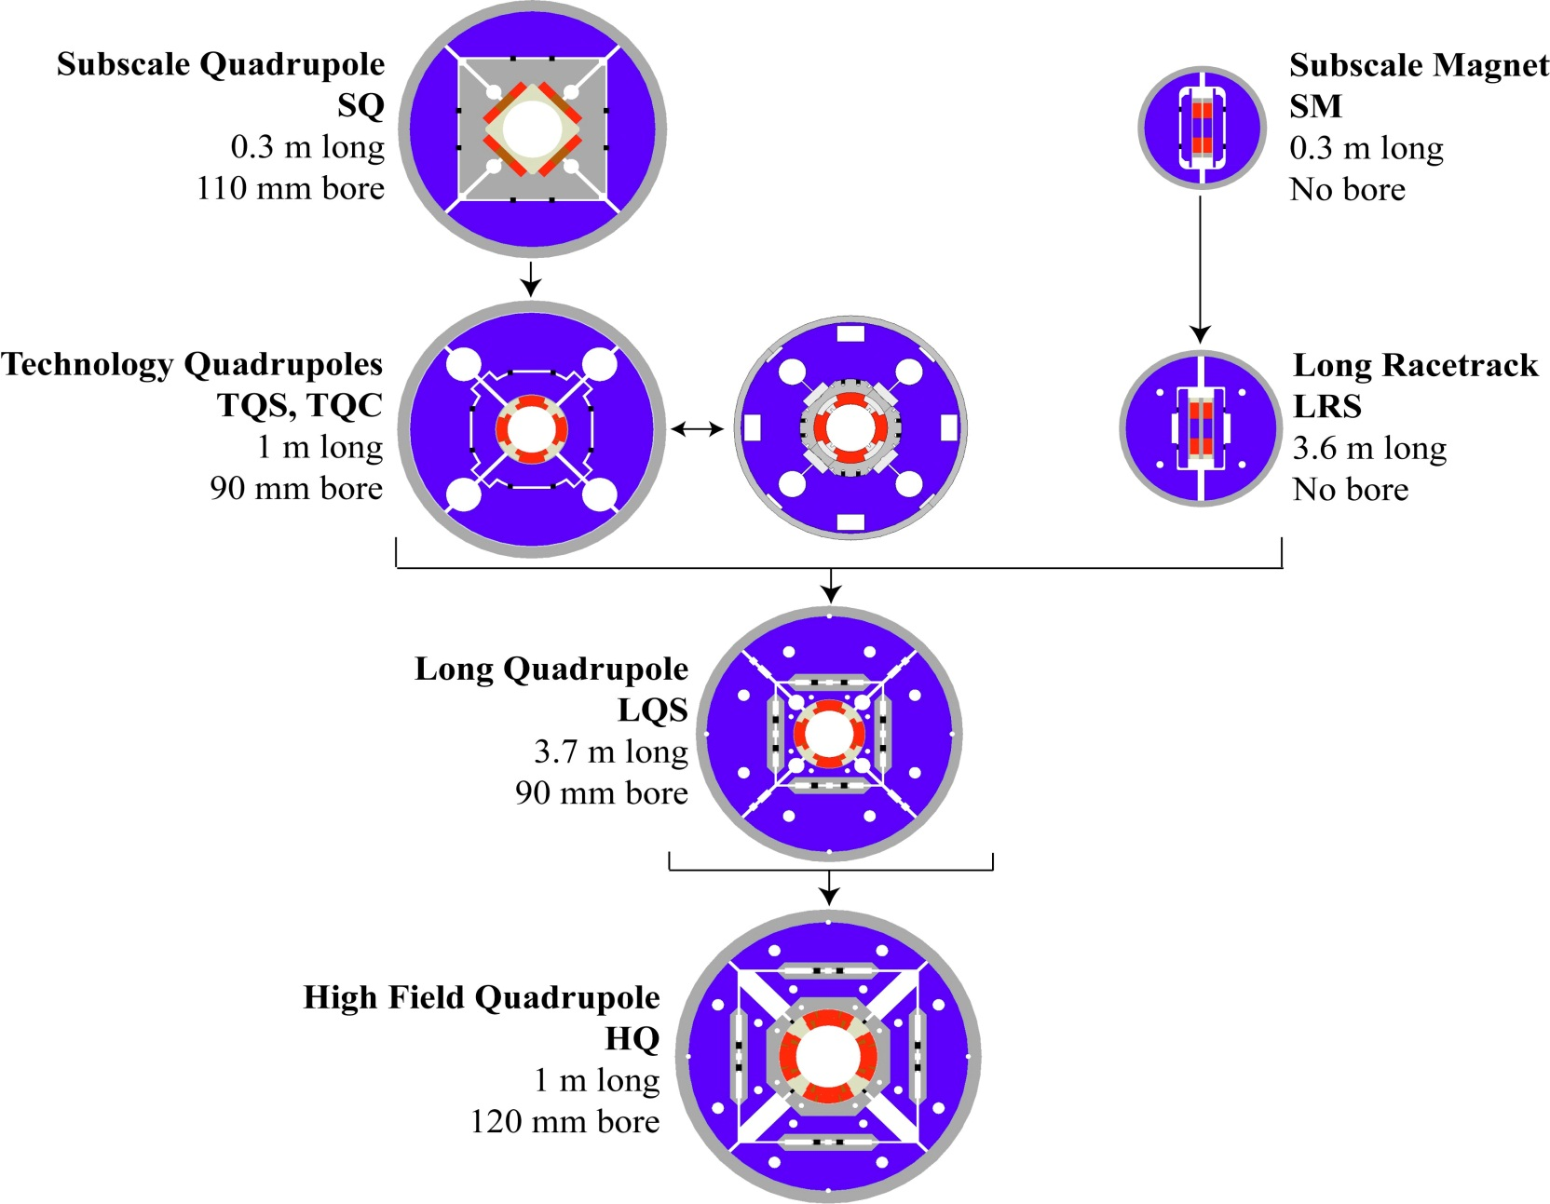
US LARP: Magnet Develop. Chart
G.L. Sabbi , LBNL

Slide 22
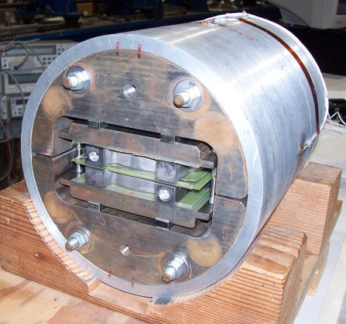
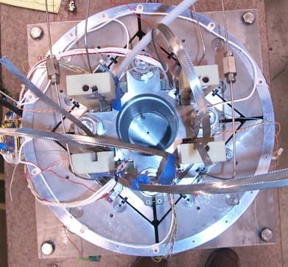
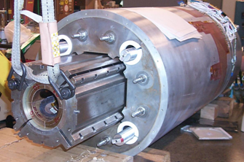
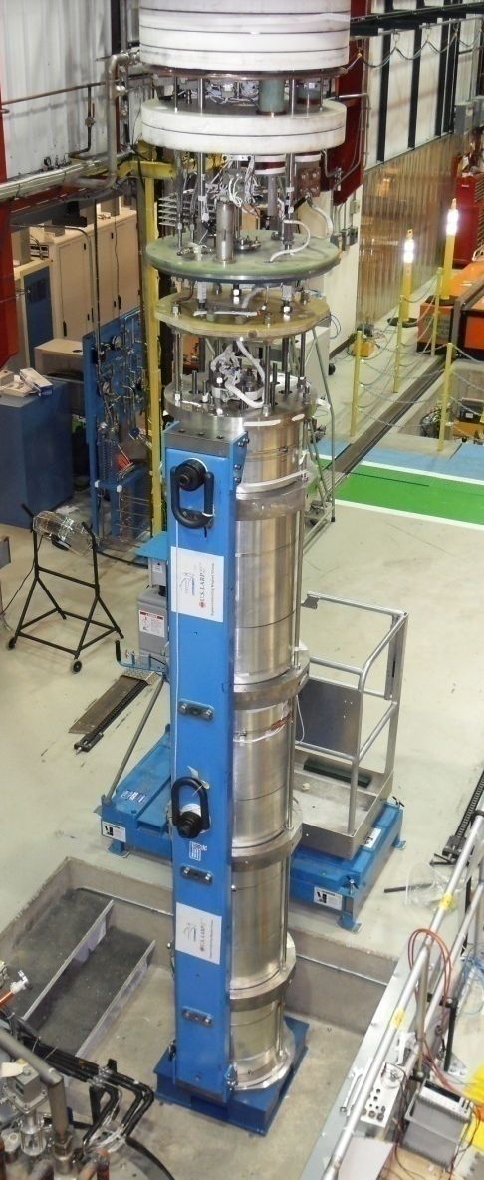
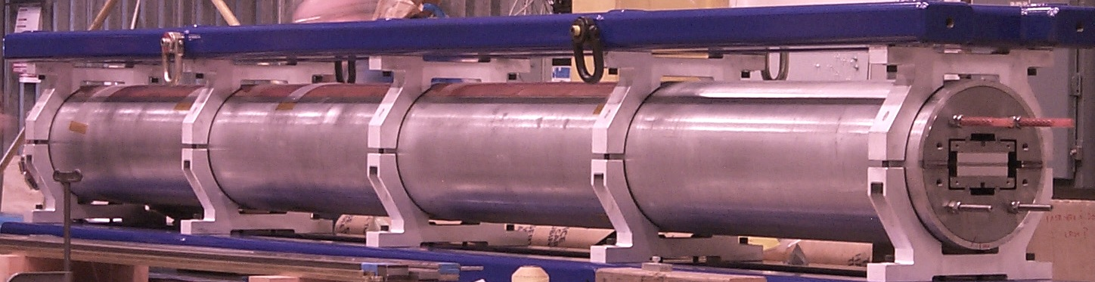
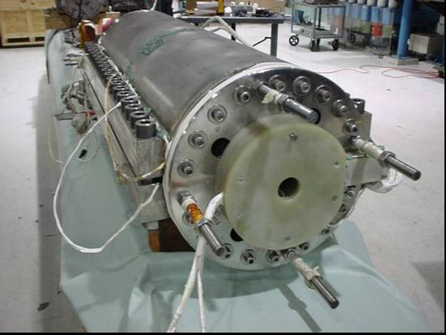
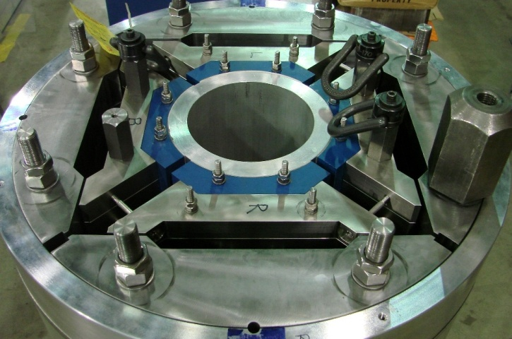
LARP (US LHC program) Magnets
SM
SQ
TQS
LQS-4m
LR
TQC
HQ

Slide 23

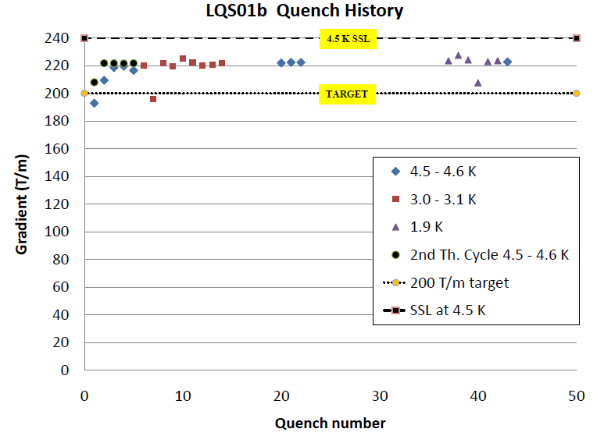
Results LARP LQ
(90 mm vs 70 mm LHC)
LHC equivalent today
G. Ambrosio, FNAL

Slide 24
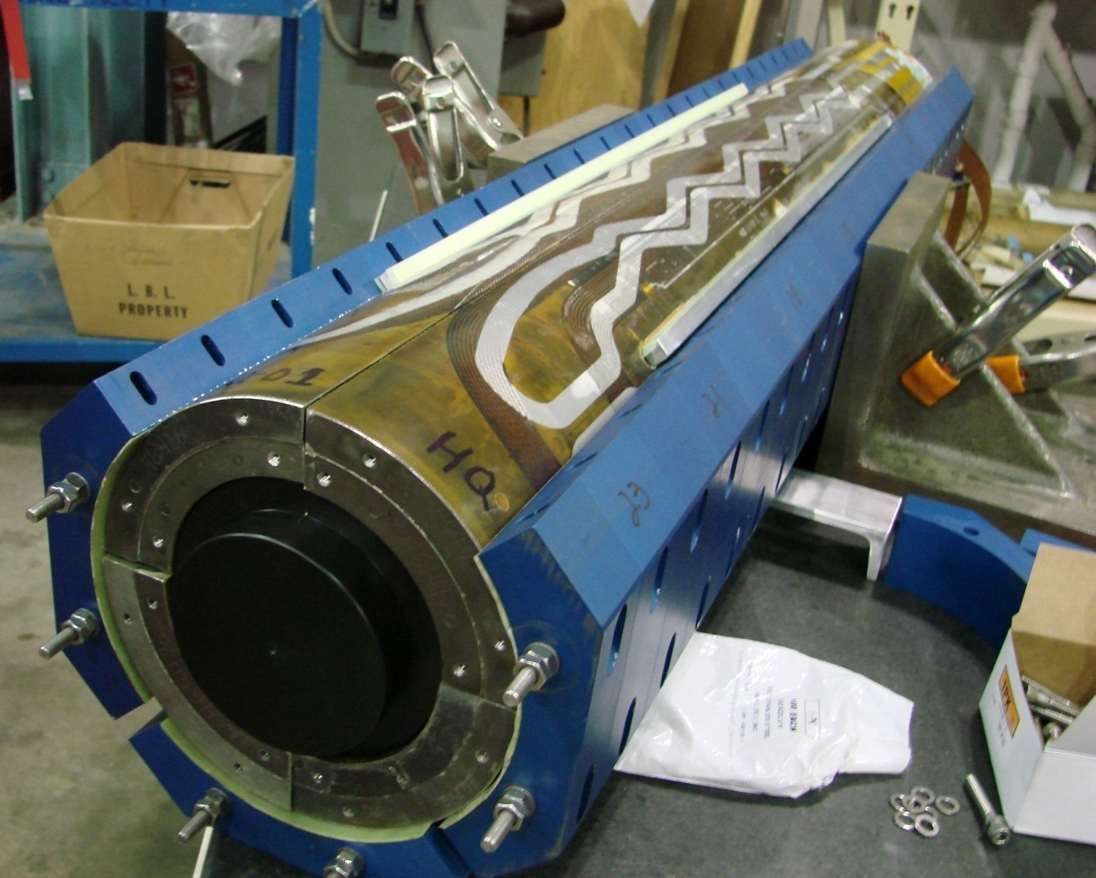
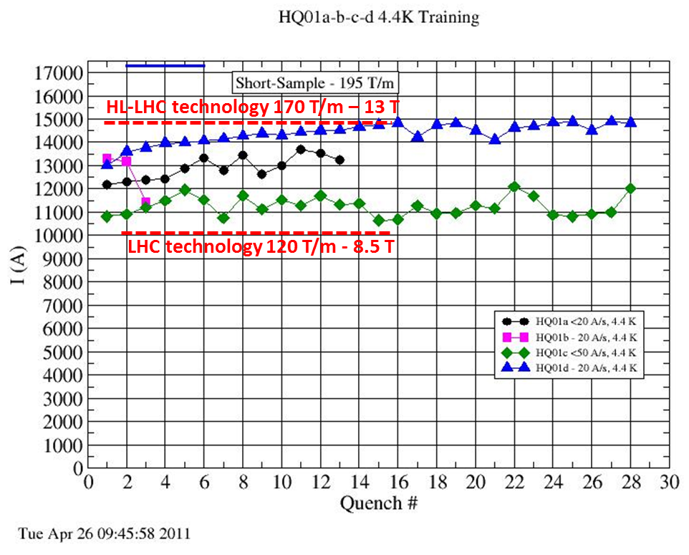
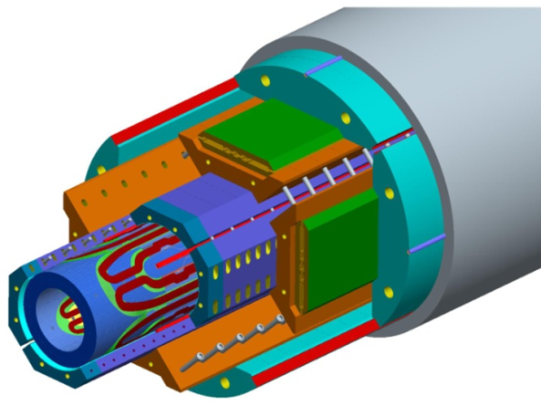
LARP HQ
(120 mm- 13 T)
S. Caspi , LBNL

Slide 25
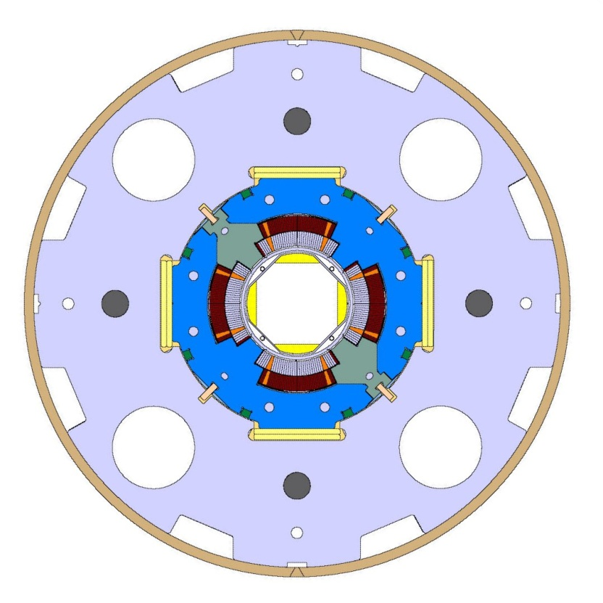
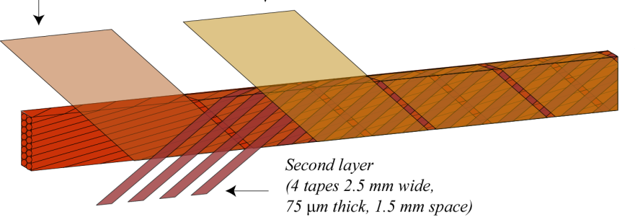
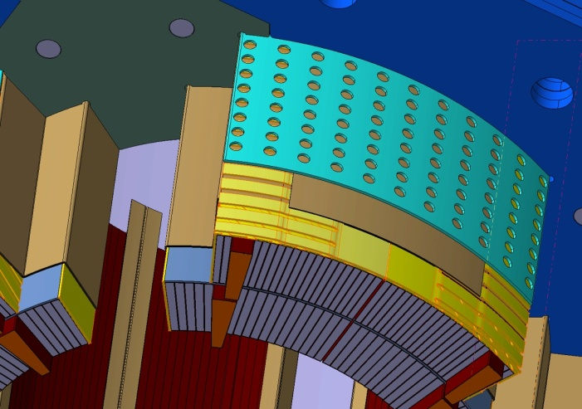
Improved Nb-Ti technology Low-β quads and MS magnets
new insulation scheme, more porous in the coils and in the structure
Higher heat removal (matching the gap to NbSn ?)

Slide 26

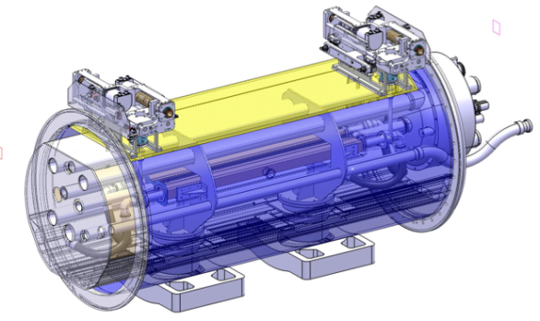
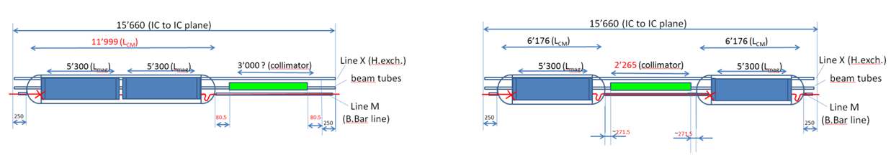
Avoid off-momentum protons on SC dipoles (diffractive)
5.5 m Nb₃Sn
3.5 m Collim
5.5 m Nb₃Sn
5.5 m Nb₃Sn
3.5 m Collim.
5.5 m Nb₃Sn

Slide 27
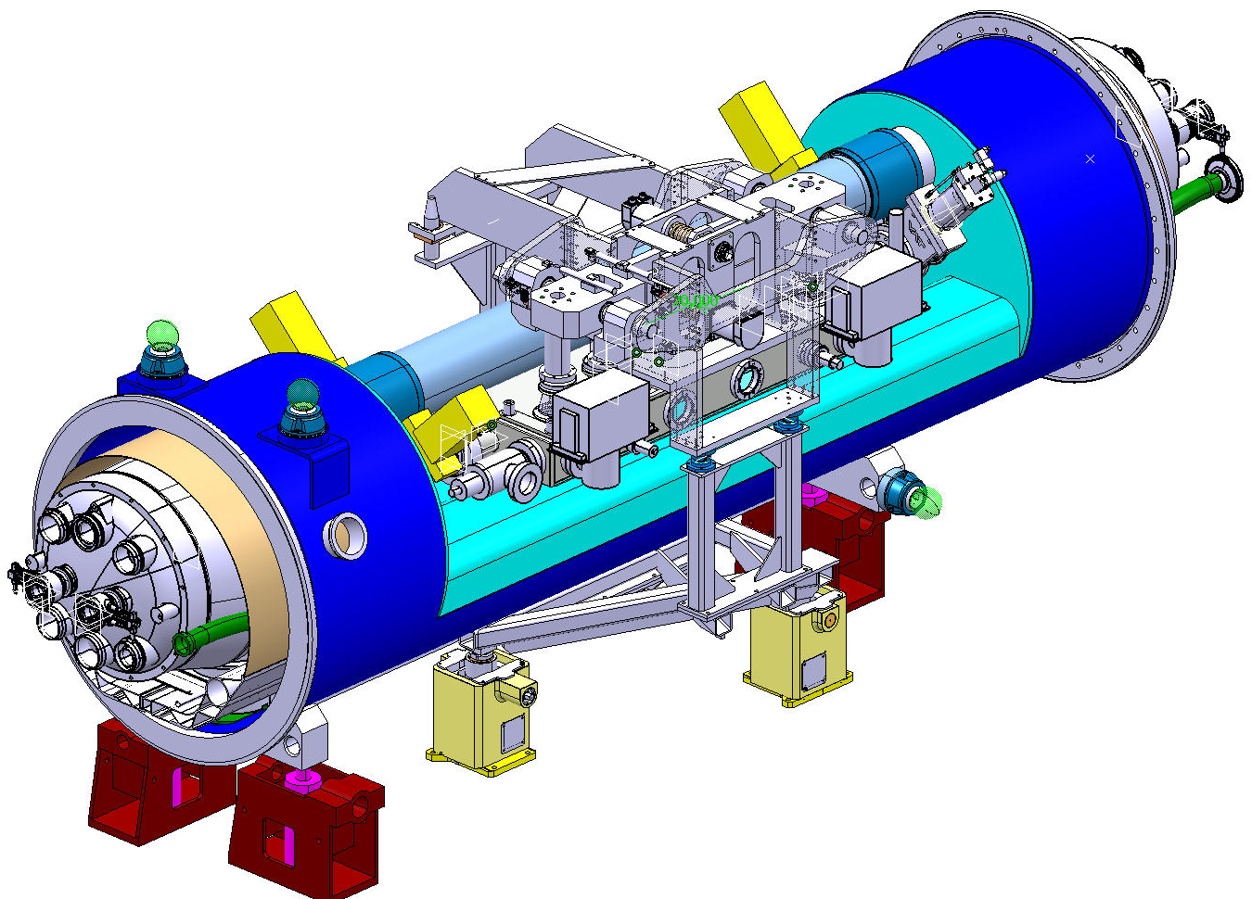
Warm collimators in the cold region
A. Bertarelli of the EN-MME team

Slide 28
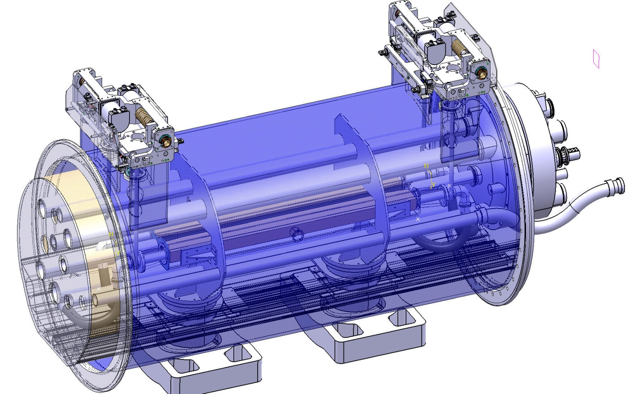
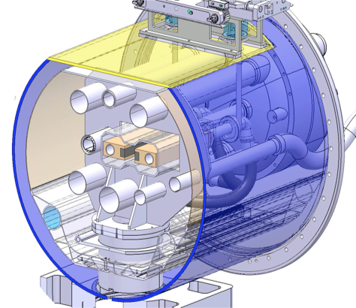
Cold collimator design
Cold mass
External actuation system
He heater (from 55K to >80K)
Cu/W Collimator jaws with embedded cooling pipe
D. Duarte Ramos
Ch. Mucher
Jaw cooling hose (from E-line)

Slide 29

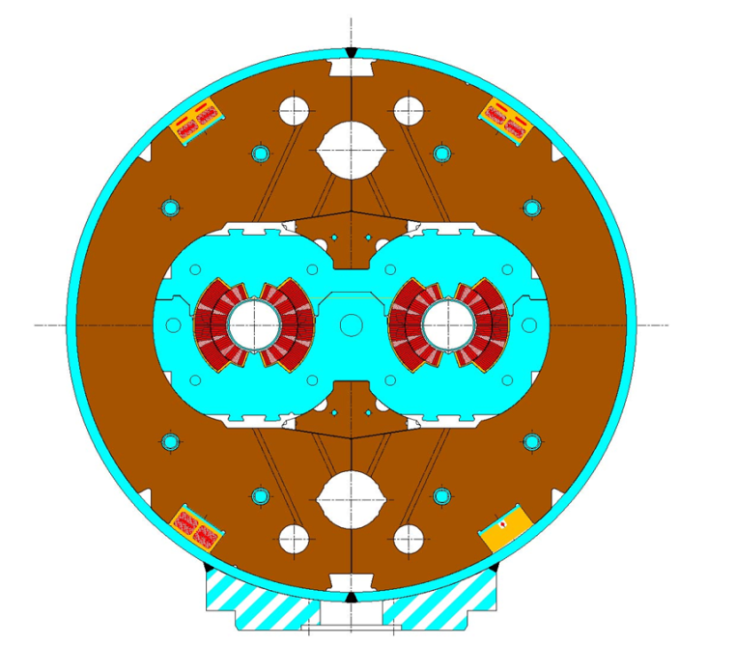

11 T-11 m dipole
CERN-FNAL collaborations
Series to LHC dipoles: BL/I =120Tm/11.85kA
  Cable, strand constrained
  Nested power supply ±300 A
Field quality
  Fe saturation 6.5→0.5
  Pers. Current (40 μm fil. Size): 44 →20→10? Enough (few magnet)
Forces, energy 70% higher in same envelope
Demo (single, 2 m) by 2012; Proto by 2013-14
1 unit = 2x5.5m⇒straight
First NbSn in operation?
LHC
11 T

Slide 30


11 T
Demo 2 m single bore
Project launched September 2010
Fermilab/CERN collaboration
Collared coil Dec 2011
Cold mass finished in May 2012
Test: very good to 10.4 T
Limited by a single spot
Next model by beginning of 2013

Slide 31
Performance targets for Nb₃Sn
Performance
Peak field
Cost
J_{C} (kA/mm²)
1
1.5
Target performance:
Jc > 3 kA/mm²
D_{fil} < 20 μm
RRR > 100
2
2.5
PIT
3
3.5
target
Magnetization Field Quality
Stability
4
10
200
20
150
50
100
100
50
RRP
RRR (-)
D_{fil} (μm)
Stability Protection

Slide 32


Procured strands
0.7 mm, 108/127 stack RRP from Oxford OST
1 mm, 192 tubes PIT from Bruker EAS
Work is on-going on a new strand architecture (169 stack) to reduce the filament diameter to 52 μm at 1 mm strand diameter, and 35 μm at 0.7 mm strand diameter
R&D started for an alternative architecture with filaments of 30 μm at 0.7 mm strand diameter

Slide 33




Material R&D (basic science)
Strand center
Fine grains
Coarse grains
By courtesy of I. Pong and L. Oberli

Slide 34

The successful SMC-3 cable
1.25 mm PIT strand, 14 strands
Conductor: done? Not at all: instability and FQ issues will continue to play a major role
Strand, cabling and cable behavior need to be modelized more deeply.

Slide 35


Crab Cavity, for p-beam rotation at fs level!

Slide 36


Effect of the crab cavity
RF crab cavity deflects head and tail in opposite direction so that collision is effectively “head on” and then luminosity is maximized
Crab cavity maximzes the lumi and can be used also for lumimosity levelling: if the lumi is too high, initially you don’t use it, so lumi is reduced by the geometrical factor. Then they are slowly turned on to compensate the proton burning

Slide 37

Crab Cavity:
Effort going on at SLAC-ODO and in BNL, USA
Effort going on in Daresbury (Cockcroft Institute and STCF) with CERN.

Slide 38






Progress in SC Crab Cavities
UK - Cockcroft
Finished cavity at Niowave
Jan 2012
May 2012
USA (ODU)

Slide 39


Crab cavity ; cryomodule and cavity
L. Xiao et al.
Y. Yakovlev et al.
~250 mm outer radius

Slide 40

SC Links
Layout at Point 1
∼3.6 m
DFBL
I
I
4.5 K
4.5 K
1.9 K
DFBA
Q6
Q5
Q4,D2
D1
DFBX
Q3,Q2,Q1
Q11, Q10…Q7
TAN
TAS
IP1
IP 8
∼12 m
∼3 m
RR 13
UJ 13
A. Ballarino, 18 Nov. 2011

Slide 41

DFB in the tunnel at P1 L
A. Ballarino, 18 Nov. 2011

Slide 42



Room temperature
Cryogenic environment
(4.5 K LHe in the DFBs)
Cold powering system:
1) Current leads in a distribution cryostat (near the power converters);
2) Vertical electrical transfer (link);
3)Horizontal electrical transfer (link);
4) Cryogenic fluid supply and control;
5) Interconnection to the magnets bus system;
6) Protection of link and current leads.
Tunnel

Slide 43



2×100 kA
A. Ballarino, 18 Nov. 2011

Slide 44





Conductors in Superconducting Links
MgB₂
MgB₂ Tape : 3.64×0.65 mm²
MgB₂ : 12 %
Cu : 15 %
YBCO
YBCO Tape : 4 ×0.1 mm²
YBCO: 1-3 μm
Cu : 2×20 μm
Bi-2223
Bi-2223 Tape : 4.5 ×0.4 mm²
BSCCO: 23 %
Cu : 2×50 μm
A. Ballarino, 18 Nov. 2011

Slide 45



Minimum quench energy of superconductors
Φ∼6 mm
Nb-Ti cables
used in LHC
6 kA at 6 K
MgB₂ cable
6 kA at 20 K
(> 12 kA at 4.5 K)
Nb-Ti, Top = 5 K
Tc= 6 K → MQE = 2.63 mJ/cm³
Tc = 7 K → MQE = 5.26 mJ/cm³
Tc = critical temperature
Top = operating temperature
MQE= Minimum Quench Energy
A. Ballarino, 18 Nov. 2011

Slide 46



PLAN
First installation SC link 2017?
Horizontal SC link in P7: RR with many 600 A EPCs in RR just downstream betatron cleaning
Nexan Cryoflex® line
(20 m long cryostat of link) procured and
installed in the CERN
SM-18 laboratory
20 kA – 4 to 80 K test

Slide 47

Beam Diagnostic
& Instrumentation
BPM capable to withstand more intense beam
Cryo BLM
Long range beam wire for LRBB compensation
Experiments in SPS and RHIC demonstrated ability to affect the beam (destroy it) but not yet to cure it
(we can only do i LHC)
It is a collimator like device: 10 σ or less form beam

Slide 48




E-lens? From FNAL?

Slide 49


LS2 - 2018
Cryogenics P4 ⇒ separation between SC Magnets and RF Cavities cooling circuit
5-6 kW plant
crab cavity test P4
Anticipated 2017:
  Sc link in P7
  Test crab cavities in SPS

Slide 50
LS2 - 2018
DS Cryo-collimation with 11 T in 1 IP: priority NOT yet decided: IP1,IP5 or IP2 ?
Review of collimation needs in Spring 2013
Vertical SC links in RRs of P1, P5 (stand-alone)
Improve triplet cooling
Some Beam diagnostics
Some Collimators
INJECTORS!

Slide 51
LS3
Triplets + D1-D2 (disinstallation)
TAS + Exp-interfaces
New cryo in IP1-IP5 with separation Arc-IR
New MS magnets (Q4-Q5) and correctors
CC cavities with its local cryo
Vertical links for all new magnets IP1-IP5
New collimators
Diagnostics & wigglers

Slide 52

FP7 HiLumi Design Study application 25 Nov 2010

Slide 53

HiLumi is the focal point of 20 years of converging International collaboration
The collaboration wiht US on LHC upgrade started during the construction of LHC
EU programs have been instrumental in federating all EU efforts
With Hi-Lumi the coordination makes a step further: from coordinated R&D to a common project
CERN is not anymore the unique owner, rather is the motor and cathalizer of a wider effort.
Managed like a large detector collaboration (with CERN in special position as operator of LHC)

Slide 54




Budget FP7 HiLumi
CERN waives all technical works:
LHC is core program.
Only kept the CERN cost for managem.
Only EU research area
Perfect score 15/15, 100% budget
Waiving effect
50%
85% of CERN gen. mngt

Slide 55

HL-LHC management

Slide 56

HL-LHC composition
5 M€ grant from EC FP7
Matching section and correctors
Collimation
Project
High Field Magnets R&D
Beam Diagnostics
HE-LHC Studies
Hardware Commissioning

Slide 57
Budget of HiLumi DS and HL-LHC
HiLumi covers 6 WPs
Manag and Tech. Coord. (6%)
Acc. Physics and beam
Magnets for IR
Crab Cavities
Collimators
Sc links
Table 2. Summary of the cost of HL-LHC with split between Performance Improving-Consolidation and Full performance i.e. all HL-LHC)
 | Improving Consolidation | Full performance | Total HL-LHC
Mat. (MCHF) | 476 | 360 | 836
Pers. (MCHF) | 182 | 31 | 213
Pers. (FTE-y) | 910 | 160 | 1070
TOT (MCHF) | 658 | 391 | 1,049

Slide 58

Lumi reach in the two cases

Slide 59

And after?
Can we run LHC forever?
NO: history demonstrates that at certain point, to get resources for new projects, previous accelerators are closed (despite last minute claims of new discovery…)
High Energy LHC may be the answer

Slide 60






Slide 61

Possible list of parameters

Slide 62
List parameters - cont.

Slide 63

Main dipoles: is it possible ?
Looking at performance offered by practical SC, considering tunnel size and basic engineering (forces, stresses, energy) the practical limits is around 20 T. Such a challenge is similar to a 40 T solenoid (μ-C)
Nb-Ti operating dipoles;
Nb3Sn cosϑ test dipoles
Nb3Sn block test dipoles

Slide 64
The Superconductor « space »
Nb-Ti
Nb₃Sn
HTS

Slide 65



The « new » materials: HTS
Bi-2212
Round wire, isotropous and suitable to cabling!
HEP only users (good < 20K and for compact cable)
Big issue: very low strain resistance, brittle
Production ~ 0,
cost ~ 2-5 times Nb3Sn
(Ag stabilized)
DOE program 2009-11 in USA let to a factor 2 gain. We need another 50% and more uniformity, eliminating porosity and leakage

Slide 66



The « new » materials: HTS
YBCO
Tape of 0.1-0.2 mm x 4-10 mm : difficult for compact (>85%) cables
Current is EXCELENT but serious issue is the anisotropy;
>90% of world effort on HTS are on YBCO! Great synergy with all community
Cost : today is 10 times Nb₃Sn, target is same price: components not expensive, process difficult to be industrialize at low cost
FP7 Eucard is developing EU Ybco

Slide 67



New (old) approach to cabling suitable for tapes
An old type of cabling (Roebel) suitable for tapes has been recently rivisited (Karlsruhe, New Research Industry NZ)
Here a first 2 m long test cable done at CERN

Slide 68




Magnet shapes (field optimization & structure)
Cosϑ Coil
Canted Solenoid Coil
S. Caspi
Block Coil
Hybrid Cosϑ Block Coil
P. McIntyre

Slide 69




First consistent cross section, 2010 WG and Malta (fits our tunnel)
L. Rossi and E. Todesco
Magnet design: 40 mm bore (depends on injection energy: > 1 Tev)
Very challenging but feasable: 300 mm inter-beam; anticoils to reduce flux
Approximately 2.5 times more SC than LHC: 3000 tonnes!
Multiple powering in the same magnet for FQ (and more sectioning for energy)
Certainly only a first attempt: cosϑ and other shapes will be also investigated

Slide 70


The EU program
The chance for HTS
Last FP7 call in Nov2011: EuCARD2 (2013-16)
Approved; under negotiation for signature
WP-10Future Magnets
  Assessment of YBCO and Bi-2212 for HE-LHC
  Development of 10 kA class HTS compact cable
  Prototype of a 5 T real accelerator quality magnet
  Test the coil in a 13-15 T background field to proof 18-20 T principle with 10 kA HTS conductor.

Slide 71
What is the possibile for HE-LHC?
Full profit of the HiLumi program
US basic programs and LARP R&D
EU FP6-CARE-NED
EuCARD 13 T large dipole+ 18 T small insert
US 13 T Quads FP7-HiLumi
US NbSn-HTS development
US 16 T small dipole
LARP 11 T long quad
EuCARD R&D
15-20 T R&D dipole models and prototypes
15-20 T dip final proto & Industrialization
Final delivery Magnets HE-LHC
2005 2010 2015 2020 2025 2030 2035
EuCARD2 full bore dipole HTS
HE-LHC preliminary study
HTS for HE-LHC: yes.or.no
Industry contracts, start constrution
HE-LHC start-up

Slide 72
Other important issues (among many …)
Synchrotron radiation
15 to 30 times!
The best is to use a window given by vacuum stability at around 50-60 K (gain a factor 15 in cryopower removal!)
First study on beam impedance seems positive but to be verified carefully
Use of HTS coating on beam screen?
Beam in & out
Both injection and beam dump region are constraints.
Ideally one would need twice stronger kickers
Beam dumps seems feasable by increasing rise time from 3 to 5μs
Injection would strongly benefit form stronger kickers otherwise a new lay-out is needed (different with or wihtout experiments)

Slide 73


Injector chain
Various reason to renew
Age! PS 80 years old by 2039
SPS will have seen an amount of radiation well beyond its design
Chance to redesign the chain in synergy with other programs
  Low energy physics
  Neutrino
SPS+ (1-1.2 TeV) R&D is progressing thanks to FAIR SIS300 design.
Discorap INFN magnet, 4.5 T pulsed at 1-2 T/s, test in July : success

Slide 74

Between Linac4 and SPS+
HE-LHC
SPS+
New injectors optimization
Linac4

Slide 75


Alternate scenarios for
Injectors
Avoid touching the SPS (and its transfer lines: 6 km!)
Install a Low Energy Ring in the LHC tunnel using superferric Pipetron magnets (W. Foster). Possible with adequate logistic and change in the experiment (workshop 2006 FP6-CARE-HHH network, revisited for LHeC ring-ring option).
Work done in collaboration with Fermilab (H. Piekartz)

Slide 76


The big leap forward: a 80 km tunnel for a VLHC
John Osborne (CERN), Caroline Waaijer (CERN)
For a LEP300?, then for HE-LHC
Optimitation could be at 16 T field level: collision energy 80 TeV c.o.m.
Much better new infrastructure.
However many costs go linearly, or more, with length. Magnet stored energy, beam energy also a concern
Option 1 (preferred)
Whatever solution, a vigorous Magnet R&D will enable to go beyond LHC energy
Option 2

