Slide 1




Université de Caen Basse-Normandie
Laboratoire de Physique Corpusculaire
A Constrained-Path Quantum Monte-Carlo Approach for the Nuclear Shell Model
Jérémy Bonnard
March 1, 2013

Slide 2
Overview
Introduction
Challenges of the nuclear structure; Theoretical approaches; The Shell Model; Motivations
Quantum Monte-Carlo methods: generalities
Stochastic reformulation of a quantum state; Validity & efficiency; Imaginary-time propagation
A constrained-paths Quantum Monte-Carlo approach
Importance sampling; The phase problem & the phaseless approximation; Choice of the trial state: the SEMF method; Results
Toward strongly-correlated electron systems
The Cuprates & the Hubbard model; QMC methods; Systematic errors; A way to detect them;
Conclusions & perspectives

Slide 3
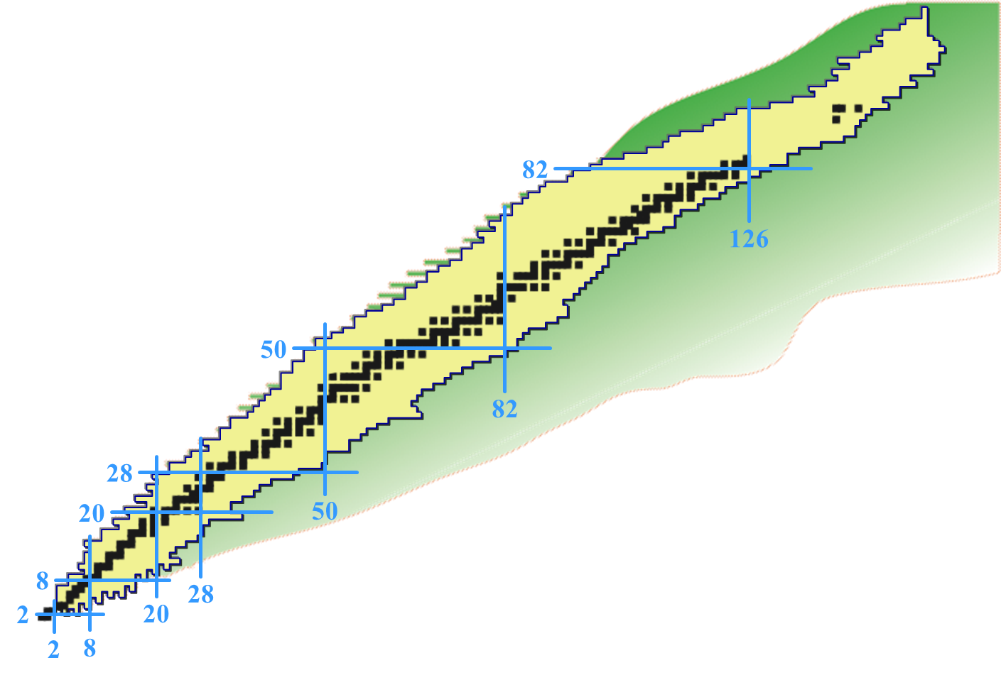



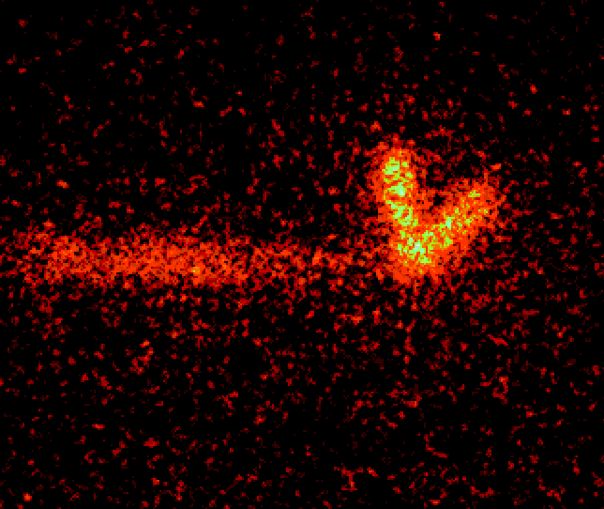
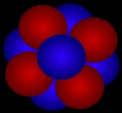
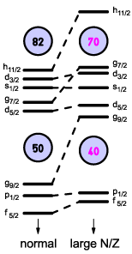

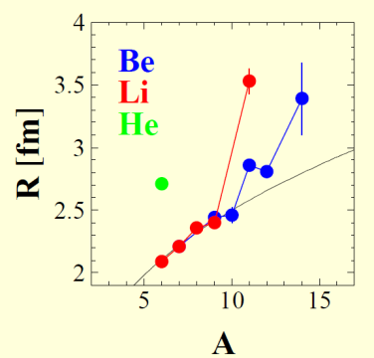

Nuclear Structure: Exotic Phenomena
Spin-singlet pairing
2-p radioactivity
^{p}
^{p}
New magic numbers
⁴⁵Fe
Halo nuclei
Proton number
¹¹Li
²⁰⁸Pb
Neutron number

Slide 4

Nuclear Structure: Theoretical Approaches
Self-consistent mean-field theories
Global parametrization of the interaction (EDF)
HF, HFB
Shell Model with configuration mixing
Proton number
Ab initio methods
‘‘Bare’’ interactions (2-body and / or 3-body potential)
Faddeev/Yakubovsky, GFMC/DMC, NCSM
Neutron number

Slide 5
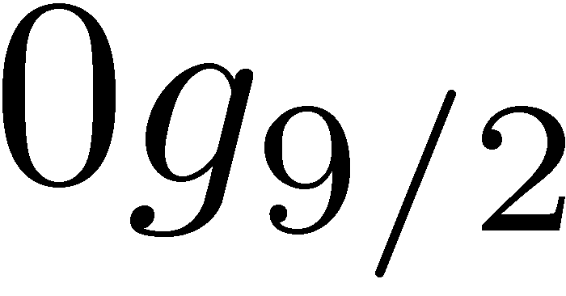
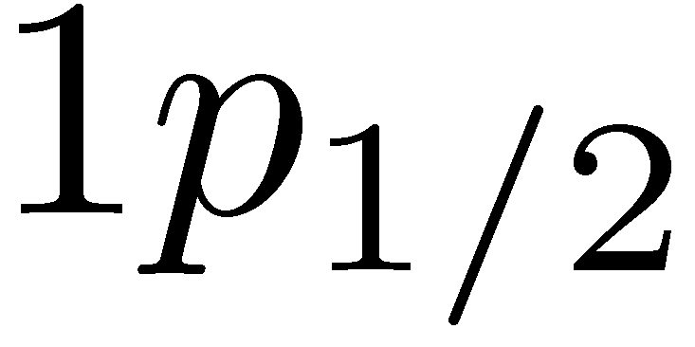
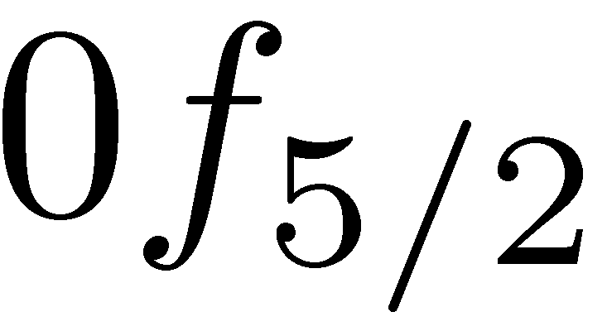
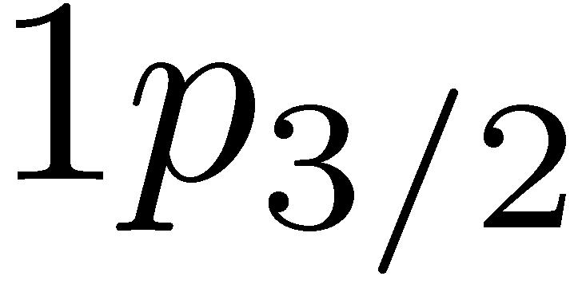
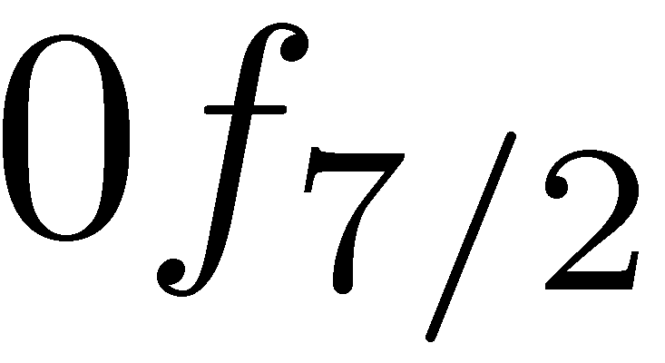
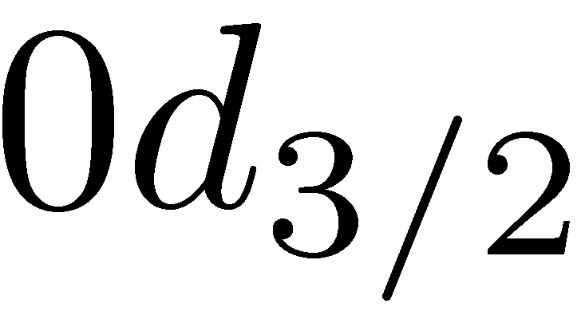
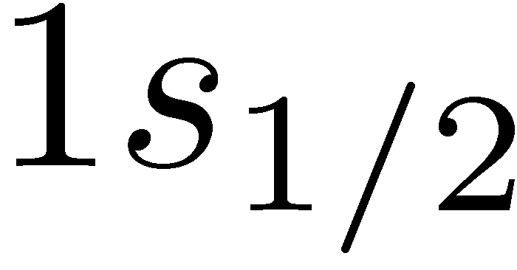
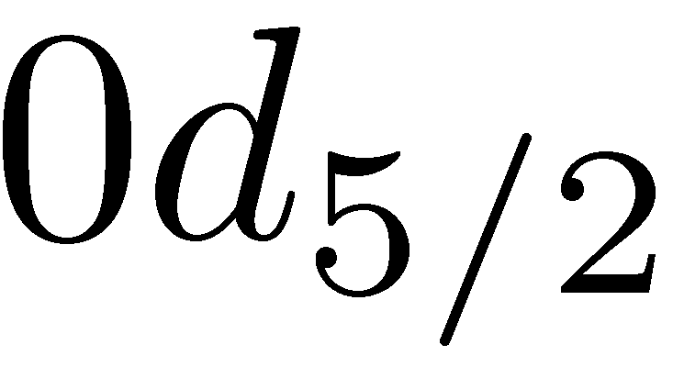
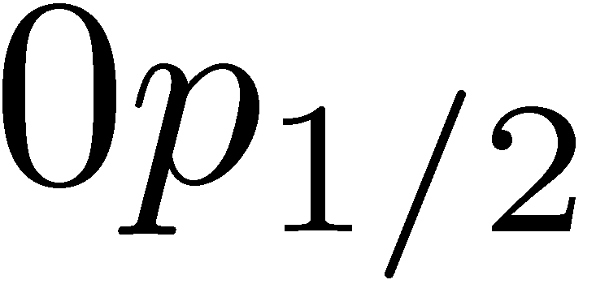
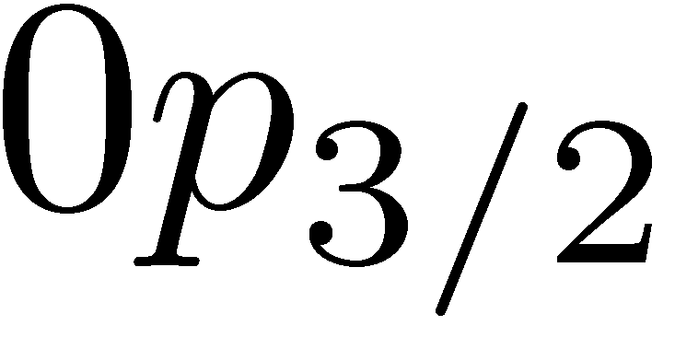
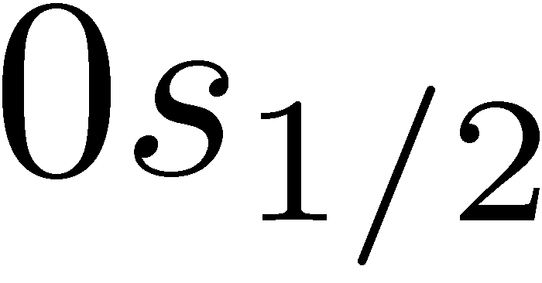
The Nuclear Shell Model
Independent nucleons
Interacting nucleons
Choice of a 2-body
effective residual interaction
(e.g. G matrix, fit)
Choice of a 2-body
residual interaction
fp
Configuration mixing
sd
Diagonalization of the Hamiltonian in the basis of all the accessible configurations
Active major shell
p
Inert magic core
Physical observables: spectroscopy, electromagnetic transition and decay probability, deformation
s
!
The dimension of the Hilbert space exponentially grows with the number of valence nucleons as well as the number of active shells

Slide 6
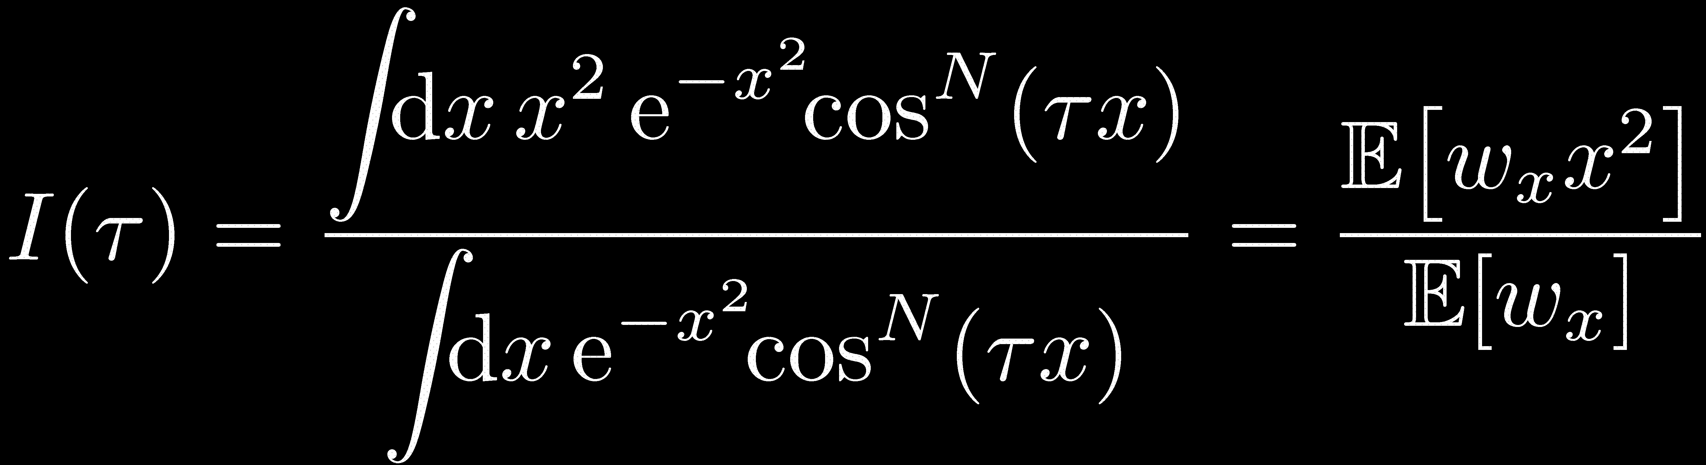
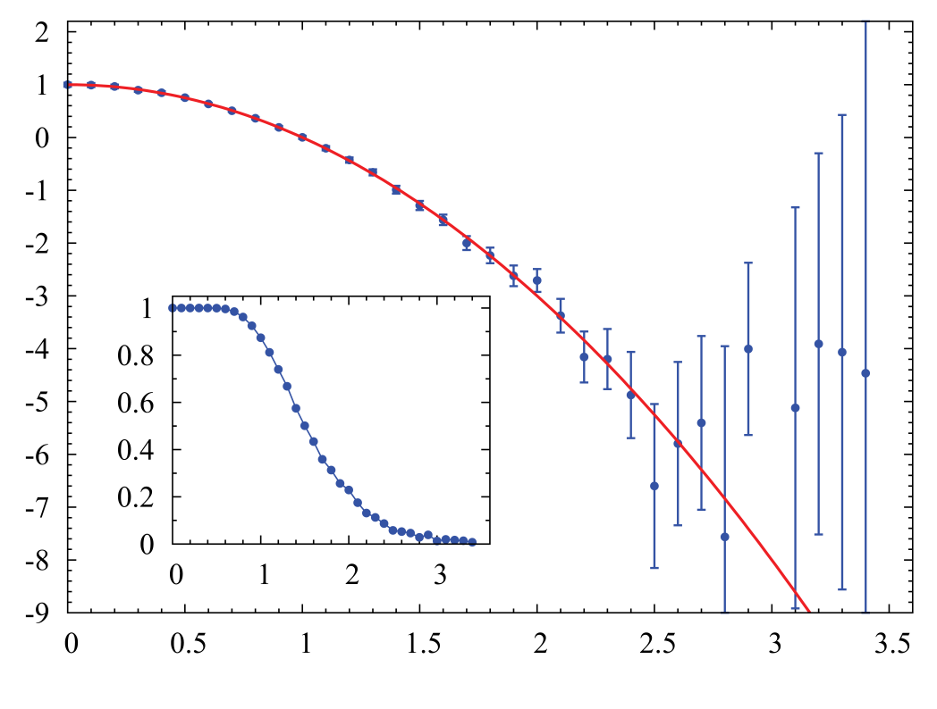
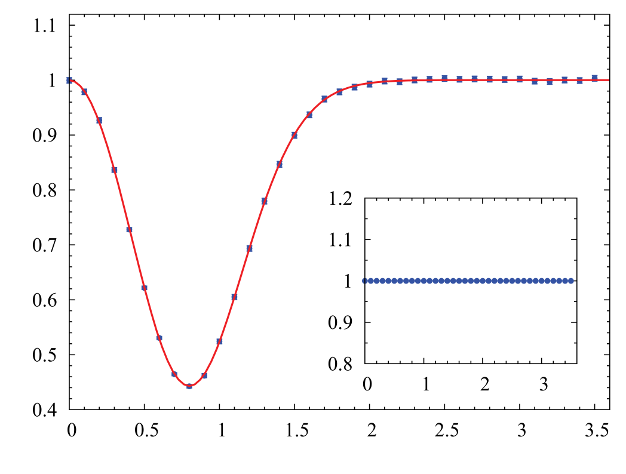



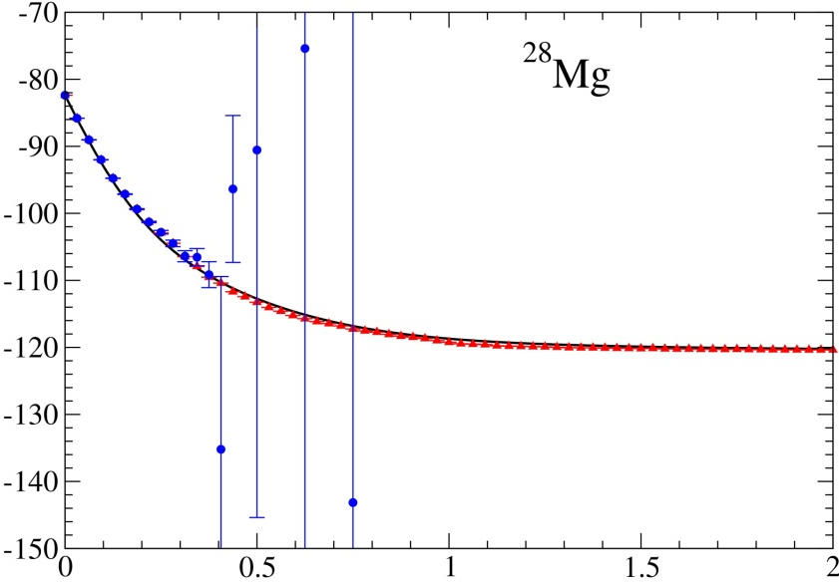


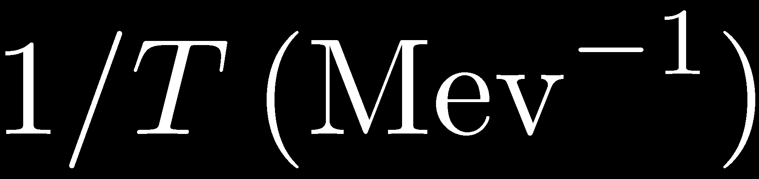

Motivations
Quantum Monte-Carlo (QMC) methods provide an attractive alternative to the direct diagonalization of the Hamiltonian
Shell Model Monte Carlo
Koonin, Dean, & Langanke
Phys. Rept. 278,1 (1997)
Illustration
Ground-state properties
Finite-temperature properties
Spectroscopy
Sign/phase problem
(Except for specific cases)
²⁸Mg
SMMC
Exact
Effective interaction: USD
Stoitcheva et al., nucl-th/0708,2945 (2007)

Slide 7
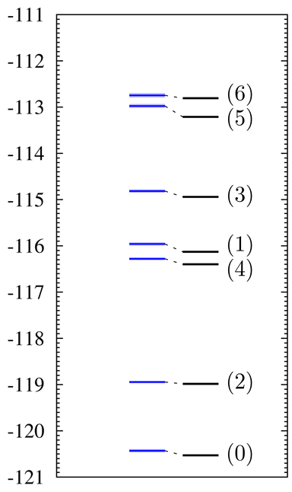
Motivations
Quantum Monte-Carlo (QMC) methods provide an attractive alternative to the direct diagonalization of the Hamiltonian
Goal
Shell Model Monte Carlo
Koonin, Dean, & Langanke
Phys. Rept. 278,1 (1997)
A QMC method allowing to reach the spectroscopy of nuclei with a well-controlled sign/phase problem
Ground-state properties
Finite-temperature properties
Spectroscopy
Sign/phase problem
²⁸Mg
(Except for specific cases)
²⁸Mg
SMMC
Exact
QMC
Exact
Effective interaction: USD
Stoitcheva et al., nucl-th/0708,2945 (2007)

Slide 8











Fundamentals of the QMC Methods
Standard approach (configuration interaction)
!
Impossible
Quantum Monte-Carlo approaches
Reconstruction as an average over all the states describing independent particles that evolve in fluctuating external fields

Slide 9
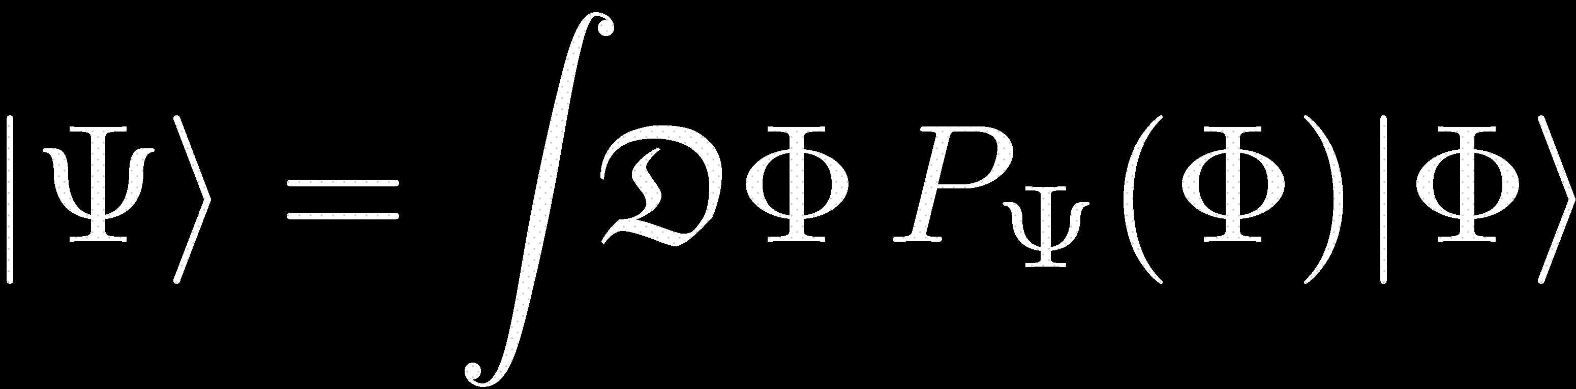

Fundamentals of the QMC Methods
Quantum Monte-Carlo approaches
with any
Real &Positif

Slide 10

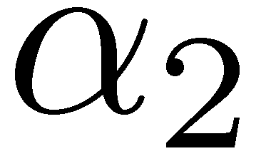
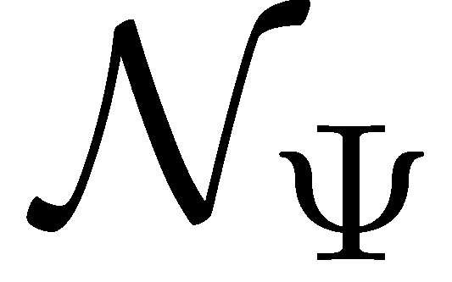

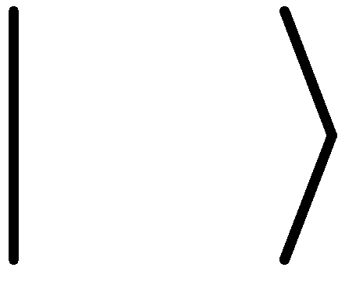
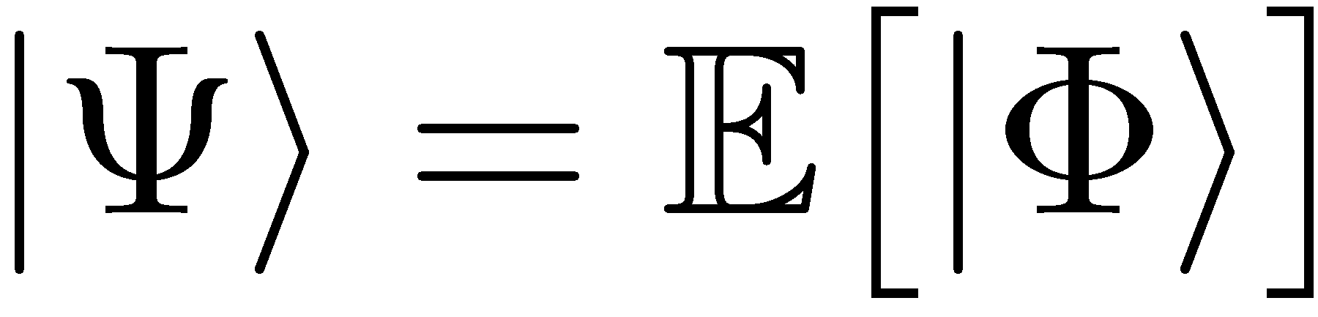
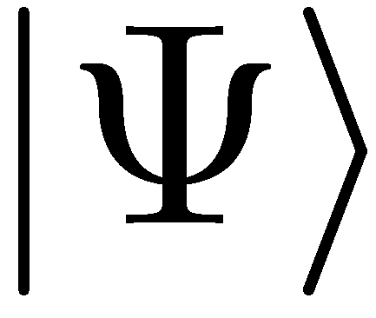
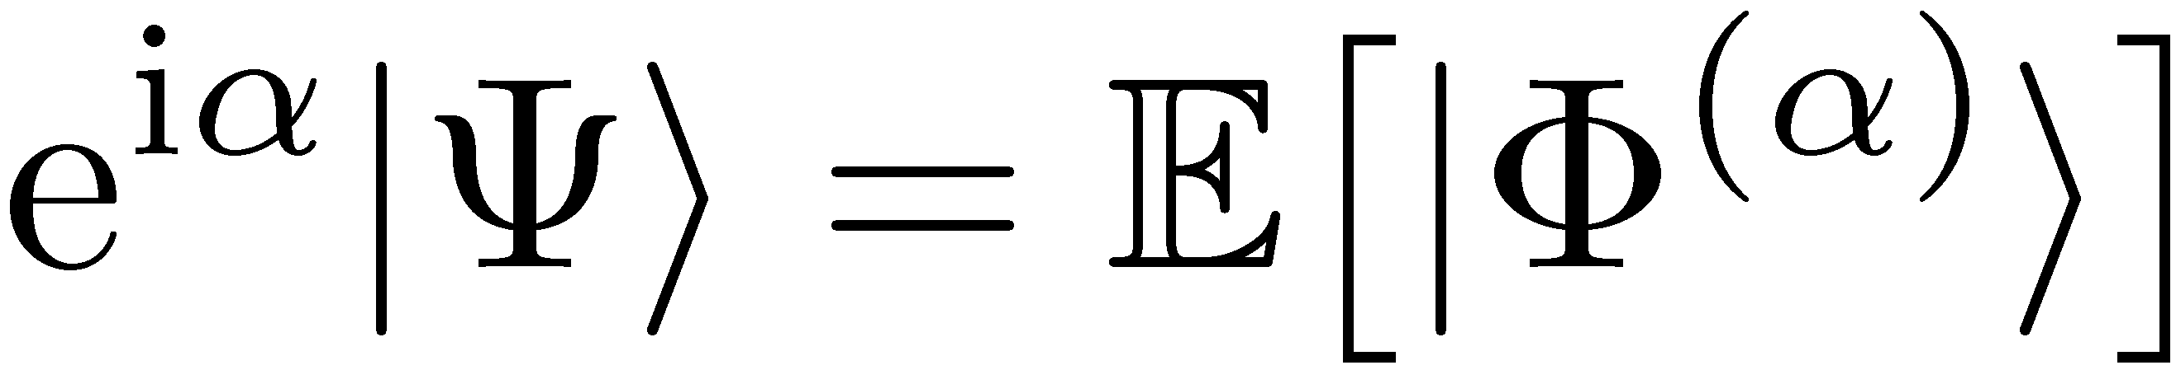
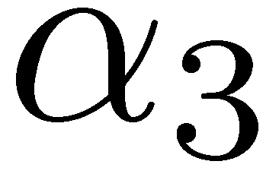
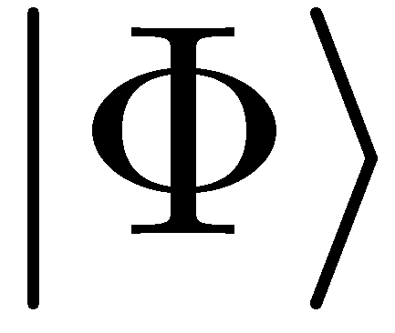
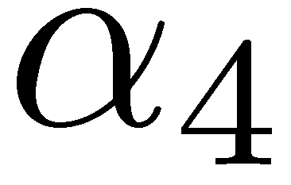


Fundamentals of the QMC Methods
Quantum Monte-Carlo approaches
Many-Body Hilbert Space
Real &Positif
Reformulation in terms of an ensemble average of Slater determinants :
But, with the same distribution
Physically equivalent to .

Slide 11


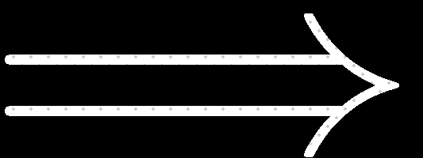


Validity Conditions
In order that the sampling of be as efficient as possible concretely, the underlying stochastic process must obey 2 conditions:
Many-Body Hilbert Space
1. Distinct domains for the phase of the overlap must not be populated
if
Sign/phase problem
2. The variance for the error on the exact state must be finite
if not
Risk of a biased reconstruction

Slide 12
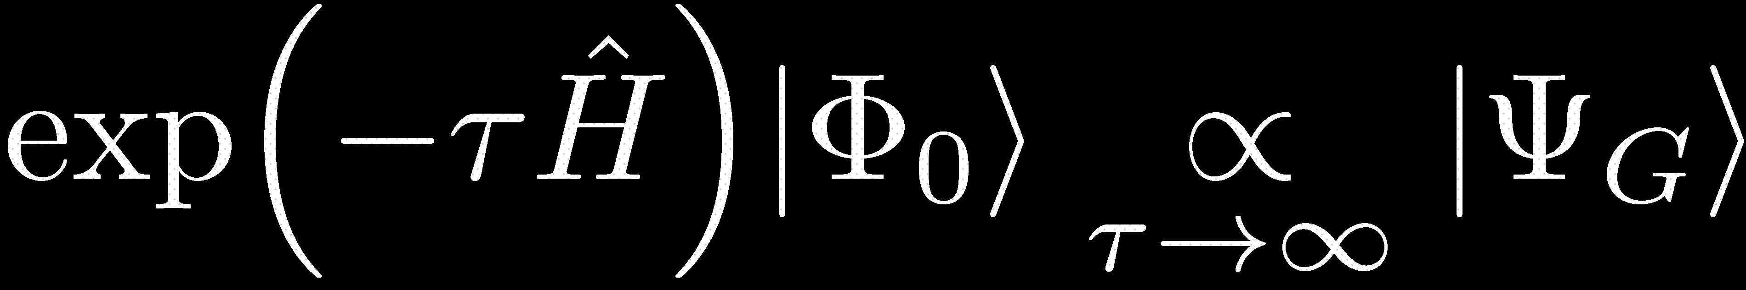
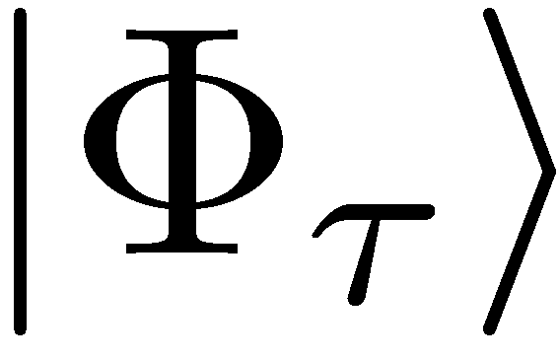
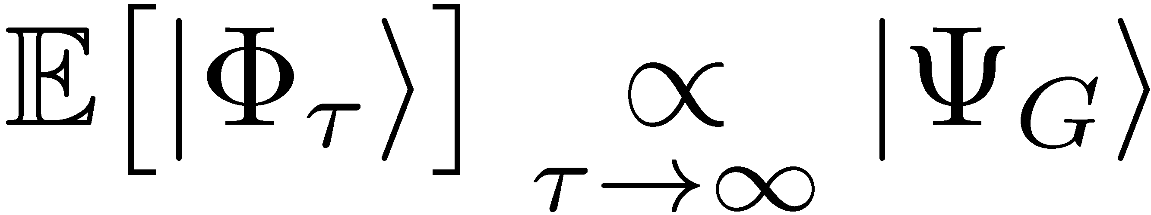
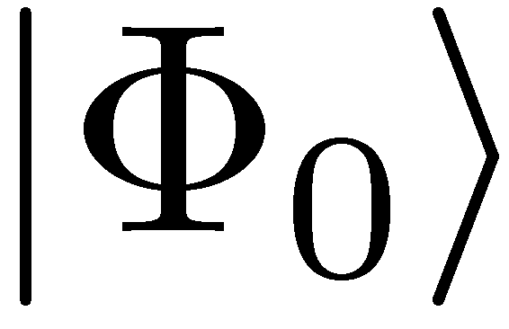
Imaginary-Time Propagation
The initial wave-function is projected onto the ground-state having the same symmetries (yrast spectroscopy)
Many-Body Hilbert Space
Walkers randomly
exploring the overcomplete basis
The orbitals undergo a Brownian motion to reproduce in average the exact propagation

Slide 13
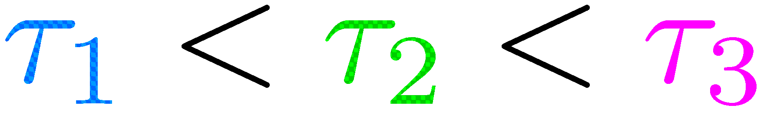
Importance of the initial state
Many-Body Hilbert Space
The statistical errors are reduced if the Brownian motion is initialized by a good approximation of the ground state

Slide 14
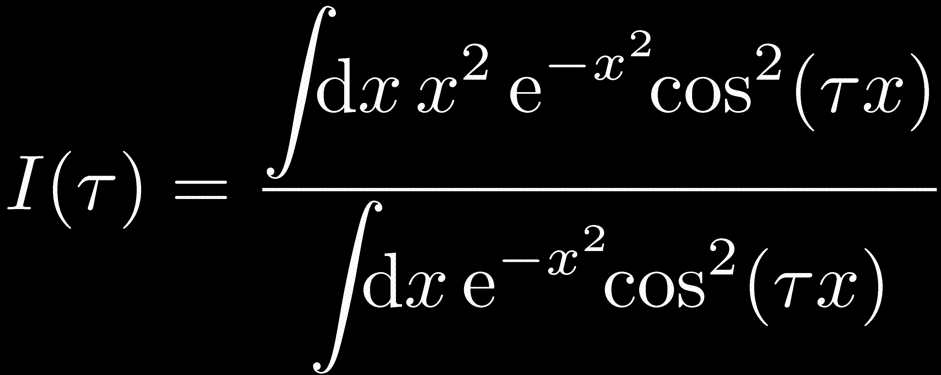
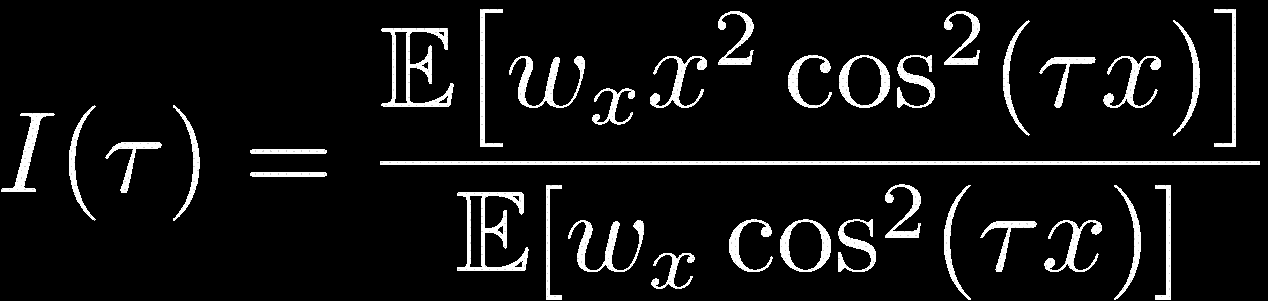
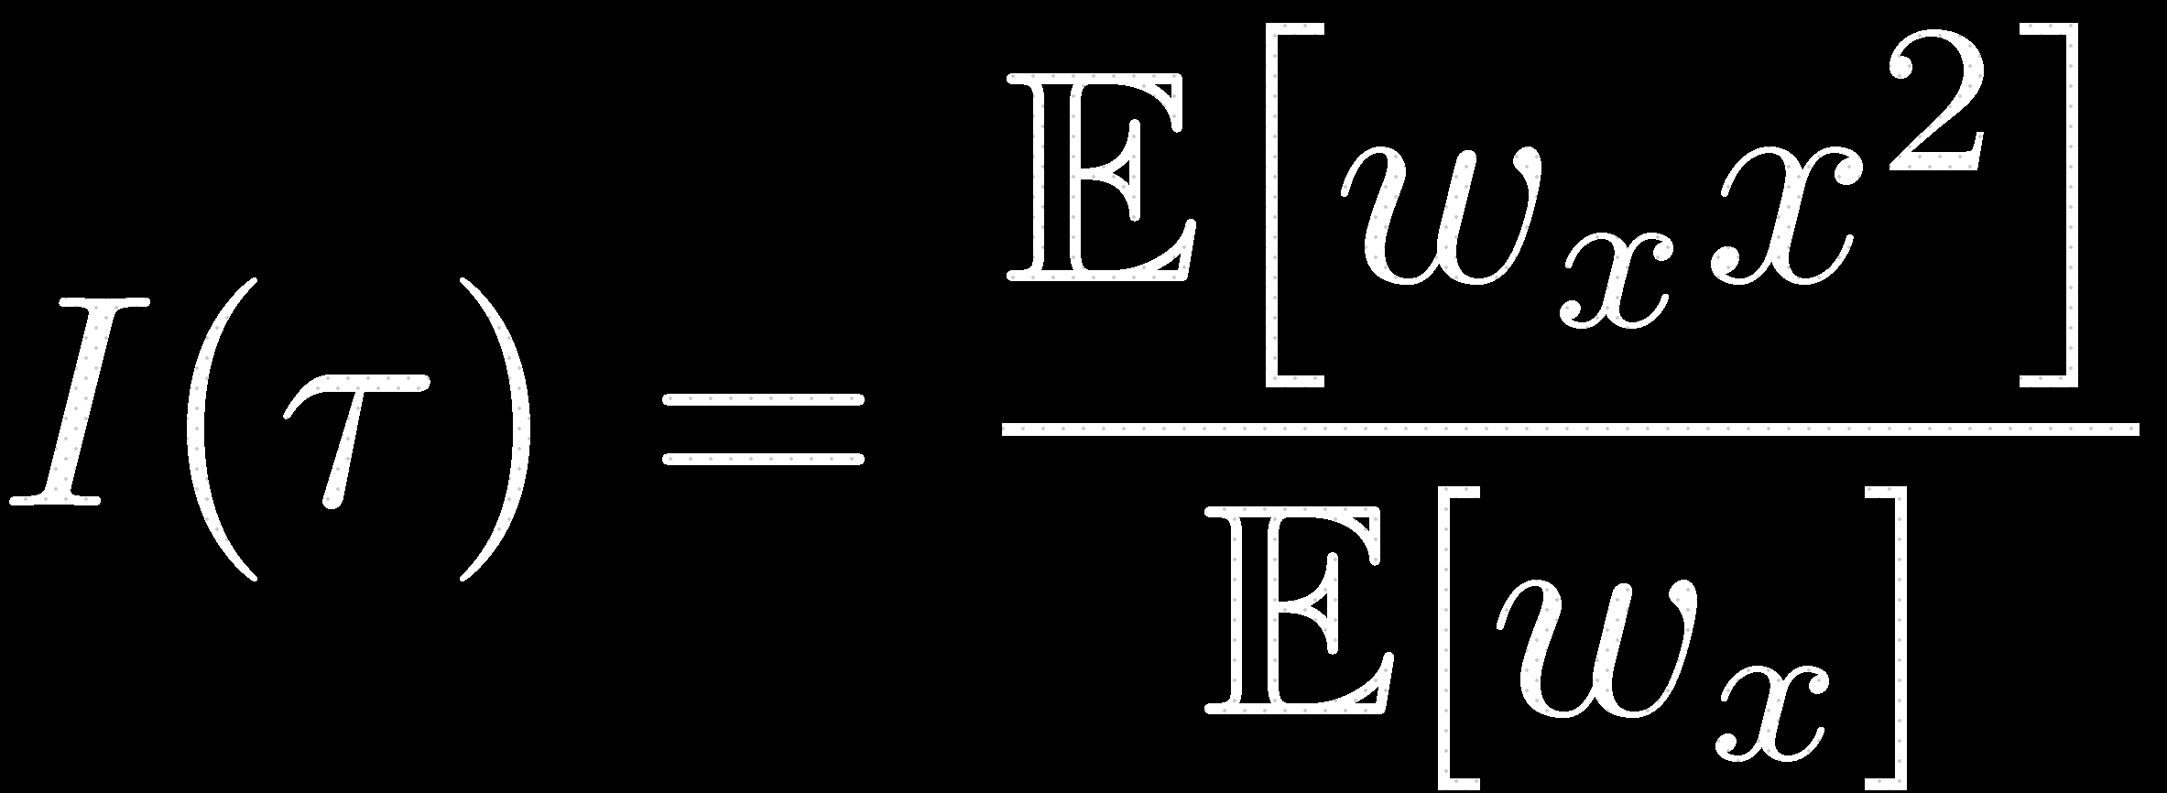
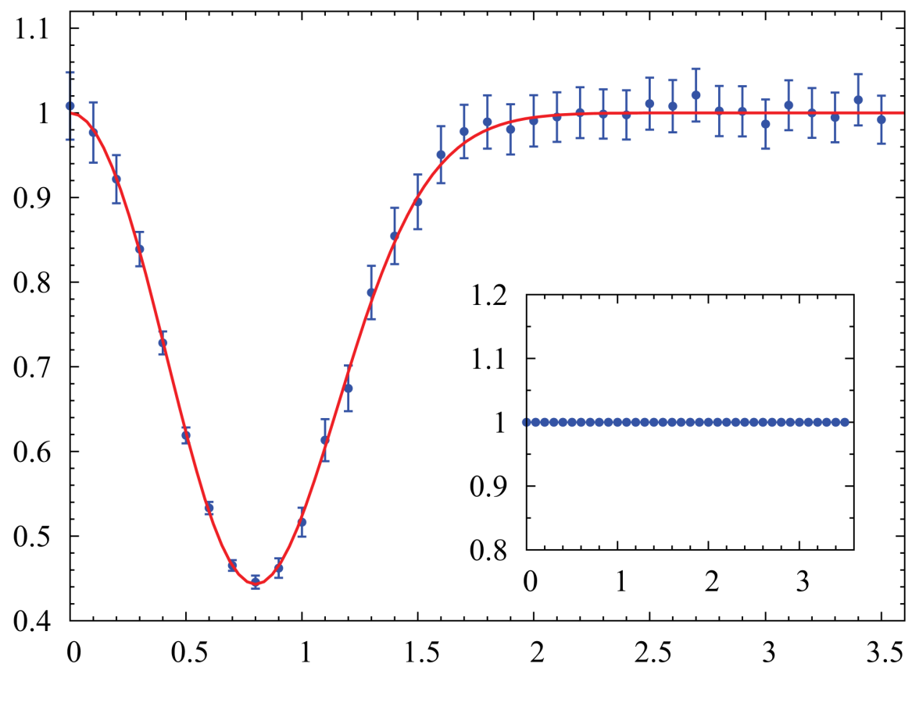


Principle of the Importance-Sampling Technique
Standard sampling
Importance sampling
Gaussian distribution
Probability distribution dedicated to the function
Efficiency improved by the choice of the distribution

Slide 15
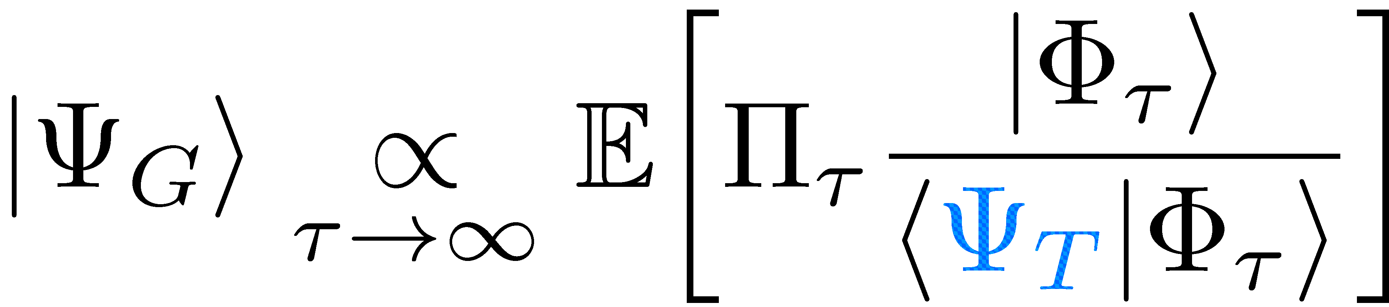
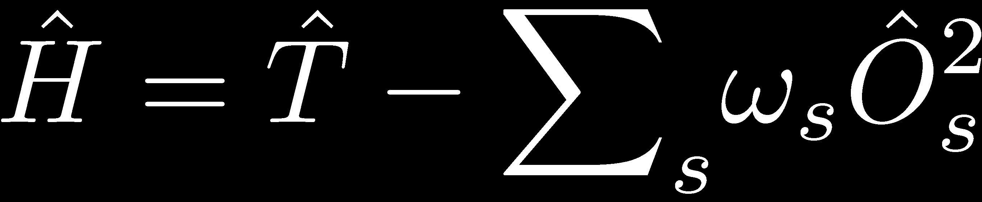
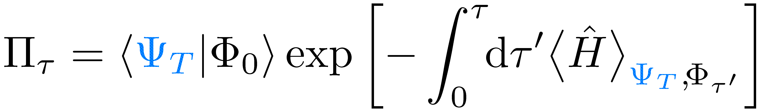
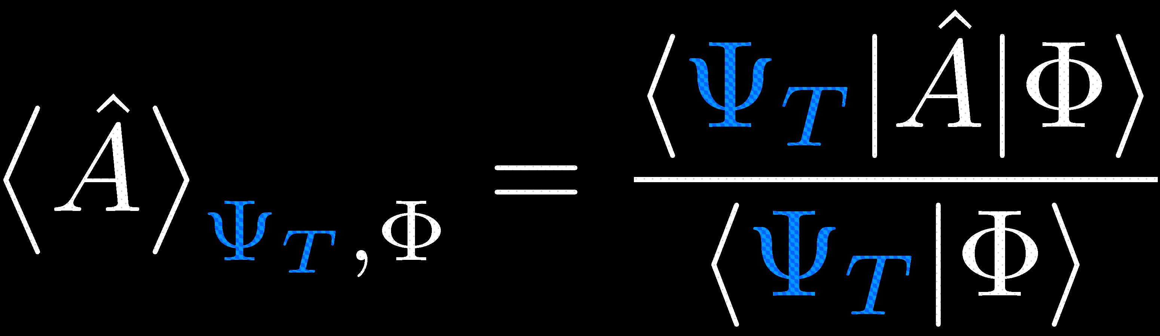



The Stochastic Scheme with Guided Dynamic
Idea:
Importance sampling incorporated within the Brownian motion
S. Zhang, H. Krakauer, PRL 90,1336401 (2003)
Quadratic form of one-body operators:
Drift guided by the trial state
Diffusion

Slide 16
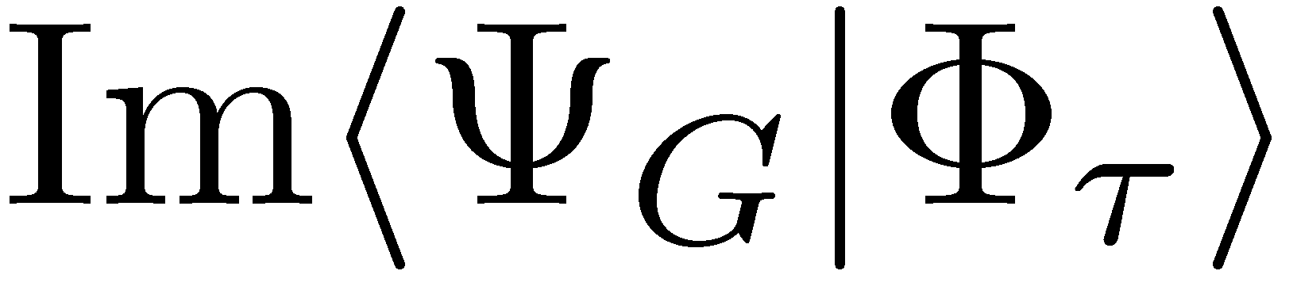
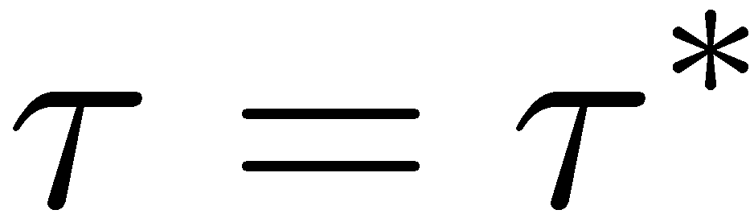
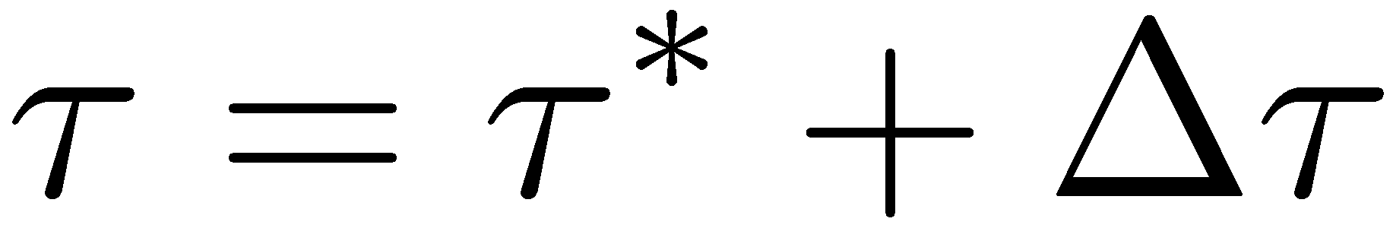


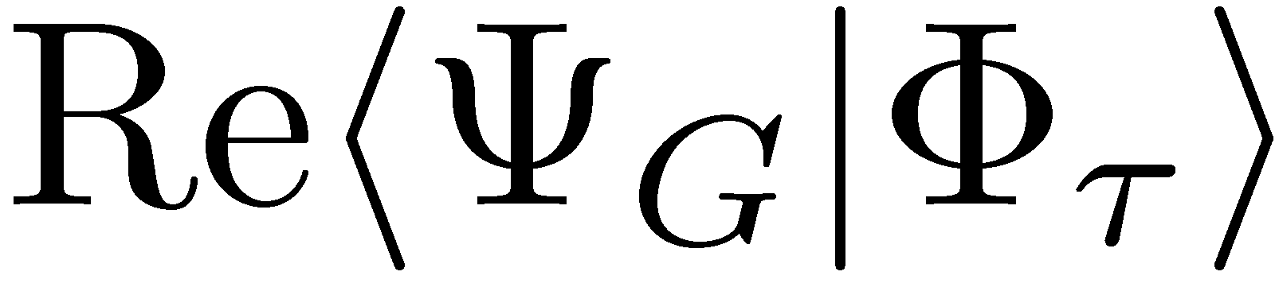












The Phase Problem
Populating distinct domains:
!
signal
Exponential destruction of the signal-to-noise ratio
noise
Control of the Phase Problem
Constraint on

Slide 17


The Stochastic Scheme with Guided Dynamic
and Constrained Paths
Idea:
Importance sampling incorporated within the Brownian motion
The Phaseless Approximation
S. Zhang & H. Krakauer, PRL 90,1336401 (2003)
Weights biased by the trial state
The trial state guides and constrains the Brownian trajectories

Slide 18


The SEMF method: principle
What trial state to guide, constrain, and initialize the Brownian motion?
Goal
Quantum numbers
Spectroscopy of nuclei
The SEMF Method
Minimization of the energy after restoration of the quantum numbers
SEMF
Combination of states transformed by rotation
Entanglement of the mean-field by the symmetry of the Hamiltonian
‘‘Symmetry-Entangled Mean-Field’’
O. Juillet & R. Frésard, cond-mat/1208.6277 (2012)
Similar to the VAMPIR approach without direct consideration of the pairing
‘‘Variation After Mean-field Projection In Realistic model space’’
K. W. Schmid et al., PRC 29,291 (1984), PRB 72,085116 (2005)

Slide 19





The SEMF method: formalism
Variational parameters: &
Generalized eigenvalue equation
Optimization:
Hartree-Fock-like equation
SEMF effective Hamiltonian

Slide 20


SEMF Results: sd Shell
²⁸Mg
²⁶Al
SEMF
Exact
Effective interaction: USD
Exact results from the code ANTOINE
E. Caurier et al., Acta Pol. 30,705 (1999), Rev. Mod. Phys. 77,2 (2005)

Slide 21


SEMF Results: sd Shell
²⁷Na
SEMF
Exact
Effective interaction: USD
Exact results from the code ANTOINE
E. Caurier et al., Acta Pol. 30,705 (1999), Rev. Mod. Phys. 77,2 (2005)

Slide 22

SEMF Results: sd Shell
²⁷Na
SEMF
Exact
Effective interaction: USD
Exact results from the code ANTOINE
E. Caurier et al., Acta Pol. 30,705 (1999), Rev. Mod. Phys. 77,2 (2005)

Slide 23


SEMF Results: fp Shell
⁵¹Fe
⁵²Fe
SEMF
Exact
Effective interaction: GXPF1A

Slide 24












SEMF Results: application to ⁶³Co
SEMF
4p-4h
5p-5h
A. Dijon et al., PRC 83,064321 (2011)

Slide 25


SEMF Results: sd Shell
²⁸Mg
²⁶Al
SEMF
QMC
Exact
Effective interaction: USD
Exact results from the code ANTOINE
E. Caurier et al., Acta Pol. 30,705 (1999), Rev. Mod. Phys. 77,2 (2005)

Slide 26


First QMC Results
J. Bonnard & O. Juillet
In preparation
²⁷Na
SEMF
QMC
Exact
Effective interaction: USD
Exact results from the code ANTOINE
E. Caurier et al., Acta Pol. 30,705 (1999), Rev. Mod. Phys. 77,2 (2005)

Slide 27


First QMC Results
J. Bonnard & O. Juillet
In preparation
⁵⁶Ni
SEMF
QMC
Exact
Effective interaction: GXPF1A
Too huge dimension → Exact energies from:
S. Pittel & B. Thakur, Rev. Mex. Fís. 55,108 (2009)

Slide 28








Toward Strongly-Correlatad Electron Systems
The« Cuprates »
The Hubbard Model
Hopping between nearest neighbor sites
On-site Coulomb repulsion

Slide 29


QMC Approaches for the Hubbard Model
Traditional Schemes
Serious sign problem in general
Many-Body Hilbert Space
Stochastic Scheme with Guided Dynamic
Since we choose
real:
Positive weights for the Brownian trajectories are guaranteed: a priori exact reconstruction of the ground state
Sign-Free Stochastic Hartree-Fock Scheme
O. Juillet, New. J. Phys 9,163 (2007)
Dynamic guided by a single Slater determinant
Gaussian QMC scheme
J. F. Corney & P. D. Drummond, PRL 93,260404 (2004)
Finite-temperature extension

Slide 30





Stochastic Scheme with Guided Dynamic: Results
!
QMC
Exact
Dynamic guided by a Slater determinant

Slide 31












Origin of the Systematic Errors
Many-Body Hilbert Space
1. Constant phase for
2. Finite variance of the error on
Error:
Possibly biased results
If the probability distribution of the norm exhibits a power-law asymptotic behavior of the form , then a QMC sampling requires .
Fréchet Distribution
Infinite moments of the error can be detected through an extreme values analysis of the norm
O. Juillet, en préparation

Slide 32







Analysis of the Validity Conditions
!
QMC
Exact

Slide 33




Conclusions
Many-Body Hilbert Space
²⁸Mg
Constant phase for
Phase Problem
Systematic errors
SMMC
Exact
Constrained-Paths QMC
²⁸Mg
QMC
Exact
SEMF
QMC
Exact

Slide 34

Perspectives
Nuclear Shell Model
Reconstruction of the complete spectroscopy of nuclei by determining SEMF solutions orthogonal to those already obtained ( );
The pairing correlation are contained within the Brownian motion of Slater determinants:
Take them into account directly in the ansatz by propagating Bogoliubov quasiparticle vacua.
Hubbard Model
Investigating the influence of the choice for the trial state on the systematic errors: SEMF ?

Slide 35
Thank you for your attention
March 1, 2013
CEA/SPhN, Orme des Merisiers, Gif-sur-Yvette
Jérémy Bonnard

