Slide 1
Improvement of Nuclear Reaction model in combination of Intra-Nuclear Cascade and DWBA
Shintaro Hashimoto¹,
Yosuke Iwamoto ¹, Tatsuhiko Sato ¹, Koji Niita²,
Alain Boudard³, Joseph Cugnon⁴,
Jean-Christophe David³, Sylvie Leray³
and Davide Mancusi ³
(JAEA¹, RIST², CEA³, Univ. of Liège⁴)
CEA/Saclay, France,
June 14th, 2013.

Slide 2
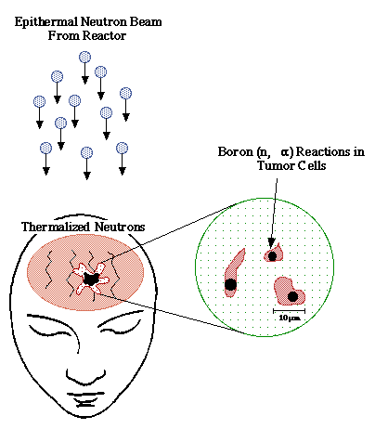
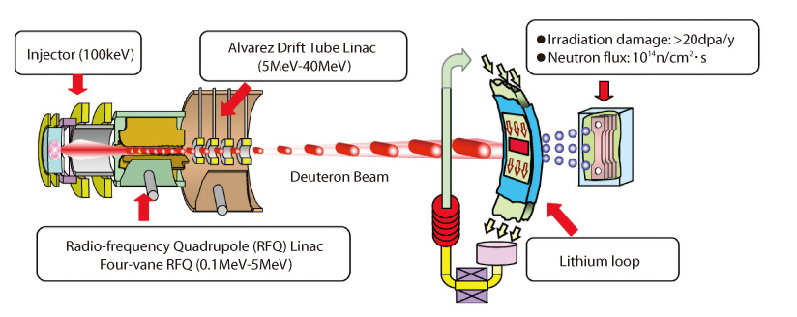
Introduction
Recently, reliable simulations in low energy region(< 50 MeV) come to be desired.
Accelerator-based neutron sources are used for scientific and medical applications.
  ■International Fusion Materials Irradiation Facility (IFMIF)
  ■Boron Neutron Capture Therapy (BNCT).
For these applications, about 10 MeV neutrons are required.
In order to obtain high intensity neutron beam, proton- and deuteron-induced reactions below 50 MeV on Li, Be, and C are focused on.
BNCT
IFMIF project
2
http://web.mit.edu/nrl/www/bnct/info/description/description.html
http://jolisfukyu.tokai-sc.jaea.go.jp/fukyu/mirai-en/2006/3_14f3_30.html

Slide 3
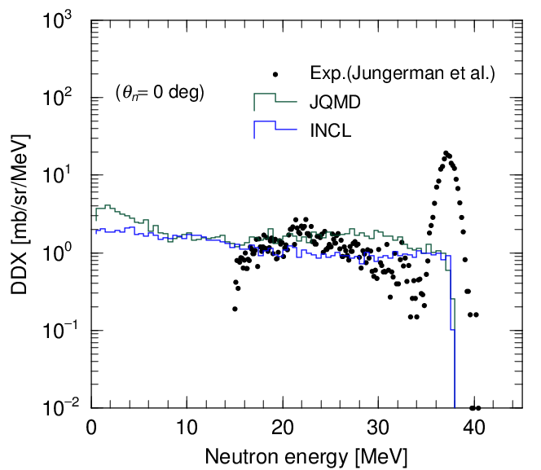
Motivation of study
However, accuracy of nuclear reaction models in PHITS, JQMD and INCL, is not enough to reproduce experimental data of double-differential cross section (DDX) for (p,xn) and (d,xn) reactions.
This peak is a sum of discrete spectra corresponding to transitions to discrete states of ⁷Be.
The transitions between discrete states are not considered in JQMD and INCL.
DDX of ⁷Li(p,xn) at 39 MeV
3

Slide 4
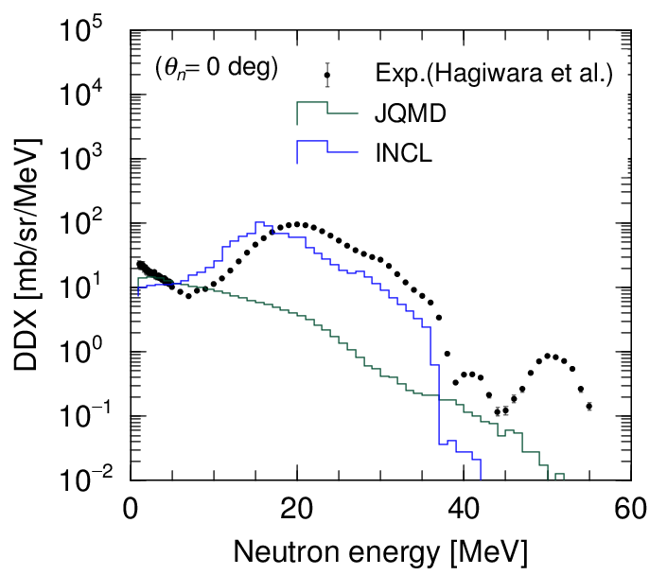
Motivation of study
However, accuracy of nuclear reaction models in PHITS, JQMD and INCL, is not enough to reproduce experimental data of double-differential cross section (DDX) for (p,xn) and (d,xn) reactions.
These peaks are sums of discrete spectra corresponding to transitions to discrete states of ⁷Be and ⁸Be.
The transitions between discrete states are not considered in JQMD and INCL.
To include these transitions, we used DWBA (Distorted Wave Born Approximation). Then, we combined INC type model (JQMD or INCL) + DWBA.
DDX of ^{nat}Li(d,xn) at 40 MeV

Slide 5

DWBA
Distorted Wave Born Approximation (DWBA) is a quantum mechanical method to calculate cross sections of transitions between nuclear discrete states.
The nuclear reaction dynamics is described using wave functions, and the shell structure of nuclei is included.
TWOFNR [http://www.tac.tsukuba.ac.jp/~yaoki/] was used.
As input parameters, optical potentials for p, n, and d are required. We adjusted those parameters and normalization factors so that the result reproduces experimental data.
Some reactions and final states are included.
(Information on energies and spins of states are taken from ENSDF)
Reactions | Final states (E_{ex} [MeV])
⁷Li(p,n)⁷Be | g.s.(0), 1st ex.(0.4)
⁹Be(p,n)⁹B | g.s.(0), 1st ex.(2.3)
⁶Li(d,n)⁷Be | g.s.(0), 1st ex.(0.4)
⁷Li(d,n)⁸Be | g.s.(0), 1st ex.(3.0)
⁹Be(d,n)¹⁰B | g.s.(0) and 10 excited states.
neutron
proton
⁷Li
⁷Be

Slide 6
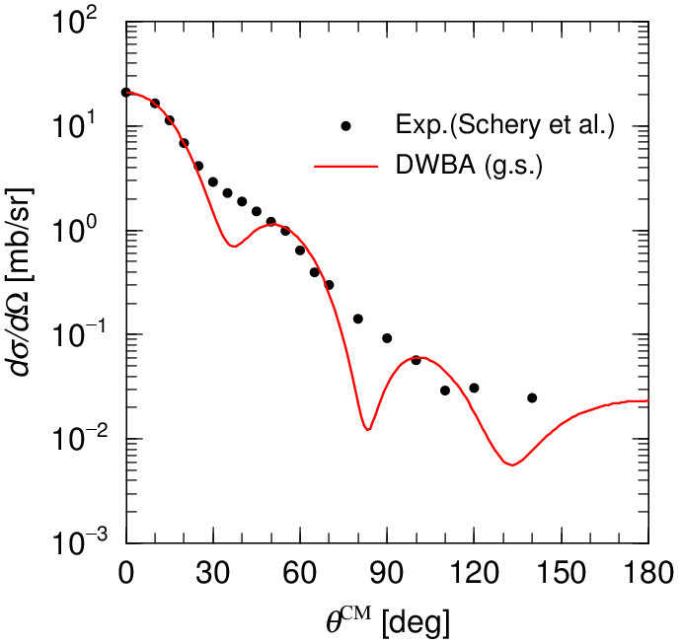
Result of DWBA for (p,n)
DWBA reproduces the experimental data very well.
Angular distribution has an interference pattern due to the quantum mechanical effect.
In this case, the interference pattern is very strong. Optical potentials may not be appropriate.
[Schery et al., Nucl. Instr. and Meth. 147, 399 (1977).]
⁷Li(p,n)⁷Be(g.s.) at 45 MeV
neutron
proton
⁷Li
⁷Be

Slide 7
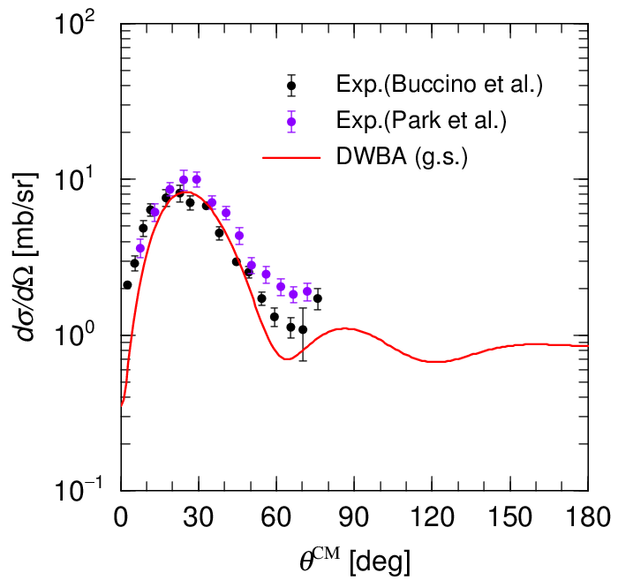
Result of DWBA for (d,n)
DWBA reproduces the experimental data very well.
Angular distribution has an interference pattern due to the quantum mechanical effect.
[Buccino and Smith, Phys. Lett. 19, 234 (1965);
Park et al., Phys. Rev. C8, 1557 (1973)]
⁹Be(d,n)¹⁰B(g.s.) at 7 MeV
deuteron
neutron
proton
⁹Be
¹⁰B

Slide 8

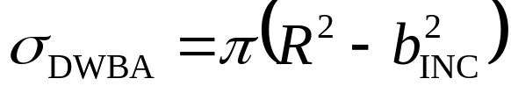
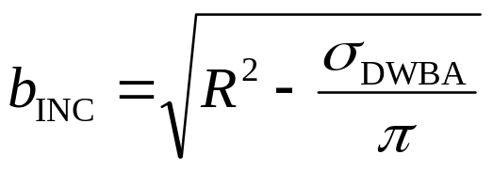
INC + DWBA
INC type models (INCL and JQMD) are used as a major part of this combination.
DWBA supplementary gives some discrete peaks.
Important factor of the combination is the impact factor.
  The transition processes calculated by DWBA correspond to the so-called ‘direct process’, which takes place at the surface of the target nucleus.
  Reaction cross sections of the INC type models should reduce by reducing the impact parameter for the models.
We made data tables of results of the DWBA calculation with changing incident energies or target nuclei to generate one nuclear reaction event.
Area of surface region
projectile
Target nucleus

Slide 9
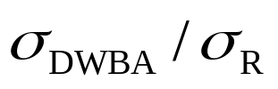
INC + DWBA
Flow chart of the generation of nuclear reaction events
start
Generation of DWBA events
No
Yes
Determination of energies and momenta of particles in final channel using the DWBA data table
Determination of energies and momenta of particles in final channel by the INCL or JQMD calculation
end

Slide 10
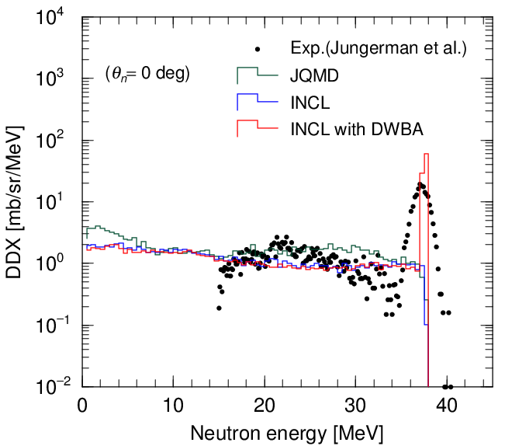
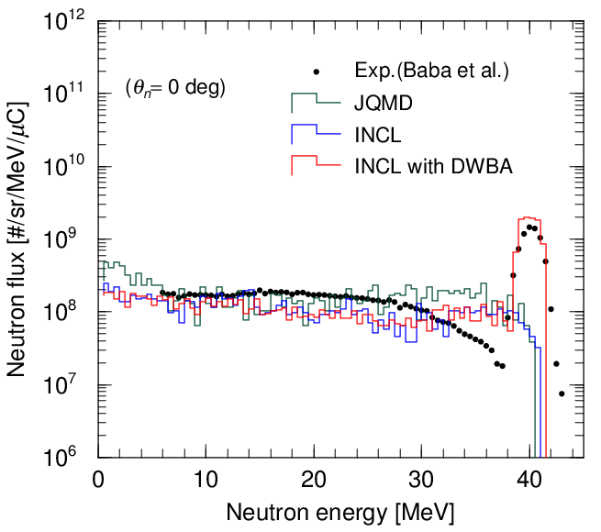
⁷Li(p,xn) spectra
Double differential cross section (DDX)
Neutron yields on the 3.6mm thick target
⁷Li(p,xn) at 39 MeV
⁷Li(p,xn) at 43 MeV
The sharp peak of calculated DDX consists of two discrete spectra obtained by DWBA.
The combination (INCL with DWBA) can reproduce the experimental data of neutron yields very well.
[Jungerman et al., NIM94, 421 (1971)]
[Baba et al., NIMA428, 454 (1999)]

Slide 11
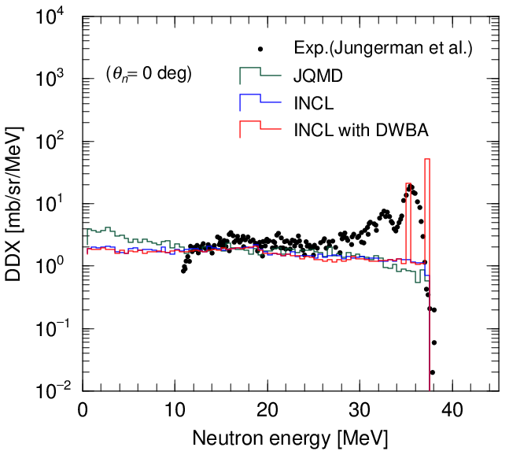
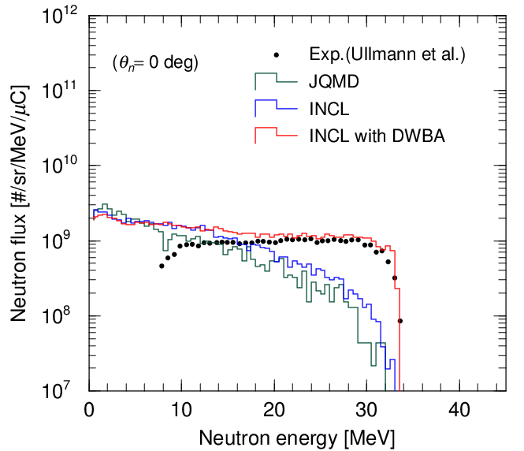
⁹Be(p,xn) spectra
Double differential cross section (DDX)
Neutron yields on the 11.6mm thick target
⁹Be(p,xn) at 39 MeV
⁹Be(p,xn) at 35 MeV
[Ullmann et al., J., Med., 8, 396 (1981)]
The largest peak of the DDX data consists of two discrete spectra obtained by DWBA. The second one is not reproduced.
The neutron yields on the thick target obtained by the combination are in excellent agreement with the data.
[Jungerman et al., NIM94, 421 (1971)]

Slide 12
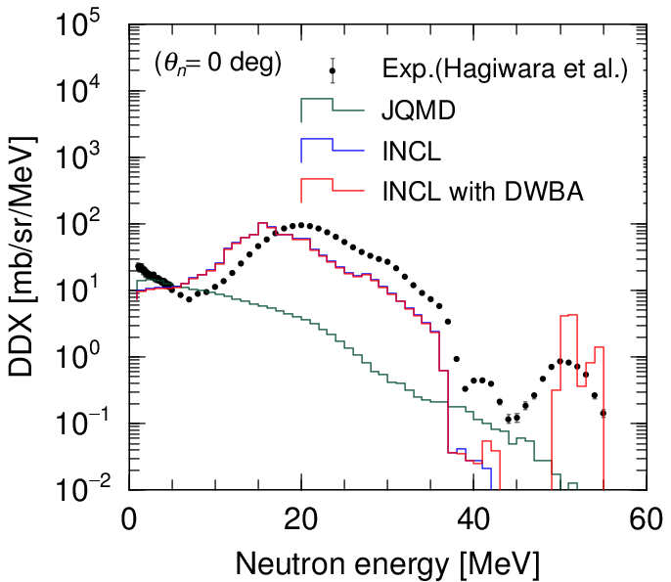
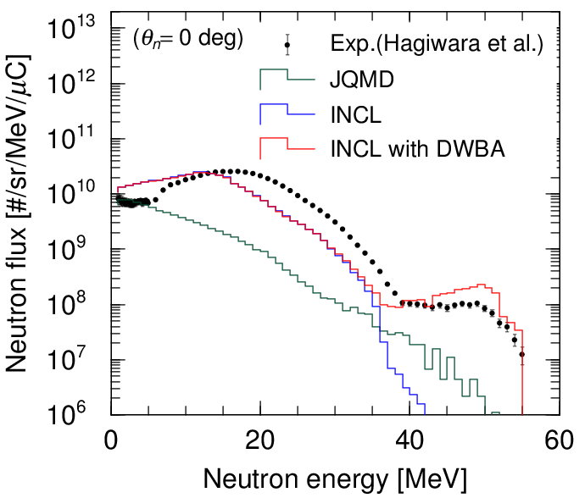
^{nat}Li(d,xn) spectra
Double differential cross section (DDX)
Neutron yields on the 2.1cm thick target
^{nat}Li(d,xn) at 40 MeV
Two peaks of the DDX data are produced by DWBA.
For the broad peak around 50 MeV in neutron yields, the data and the calculated result agree with each other.
[Hagiwara et al., Fusion Sci, Technol. 48, 1320 (2005).]

Slide 13
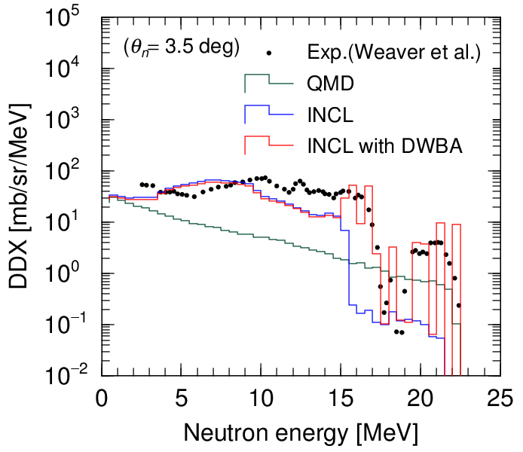
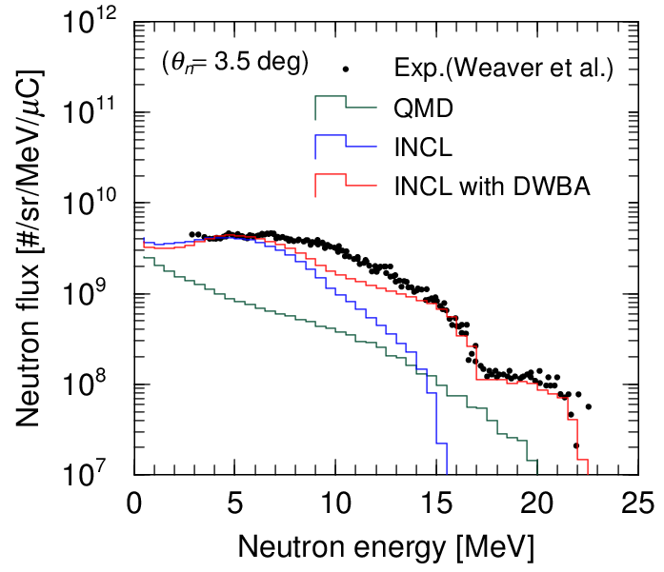
⁹Be(d,xn) spectra
Double differential cross section (DDX)
Neutron yields on the 2.5mm thick target
⁹Be(d,xn) at 18 MeV
[Weaver et al., Phys. Med. Biol., 18, 64 (1973).]
The 11 states of ¹⁰B are considered.
The effect of the improvement of the reaction model is the same as in the other reactions.

Slide 14
Summary
We improved the nuclear reaction model in combination of Intra-Nuclear Cascade type models, INCL or JQMD, and the DWBA calculation, and incorporated it into the PHITS code.
The combination was applied to estimate the neutron spectra in the proton- and deuteron-induced reactions on Li and Be targets at incident energies below 50 MeV.
Agreement of the calculated results with experimental data on double-differential cross sections (DDXs) and neutron yields on thick targets is improved very well.
14

