Slide 1
H→ττ in CMS,
A Particle Flow Analysis
Colin Bernet (CERN, CRNS/LLR)
Notes:
Need to find a nice picture

Slide 2
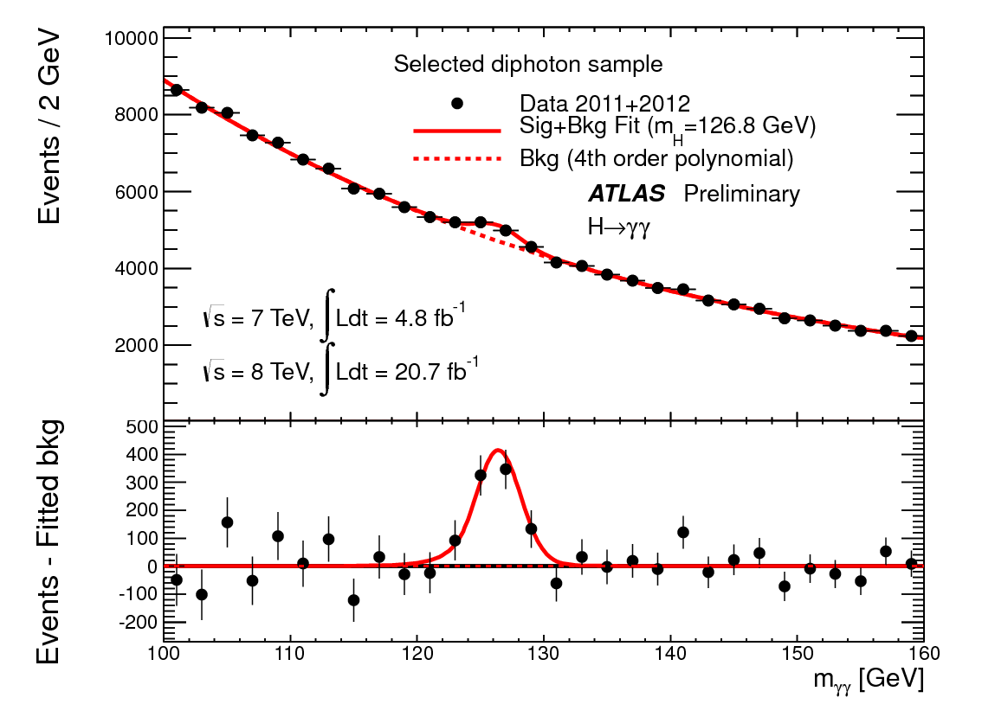
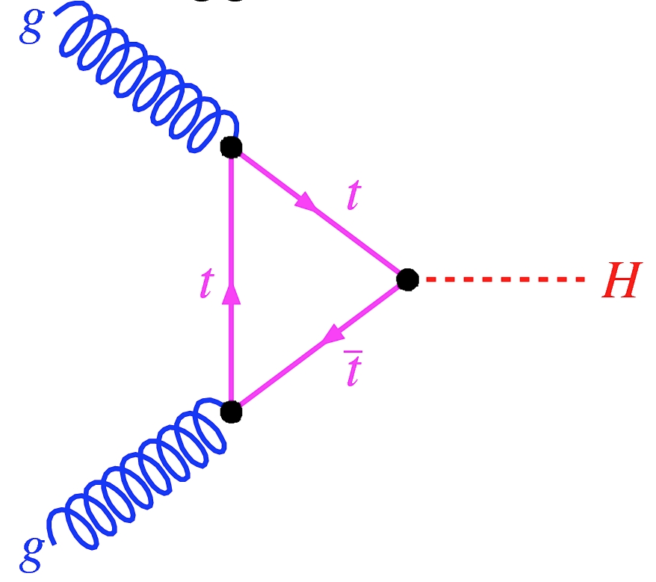
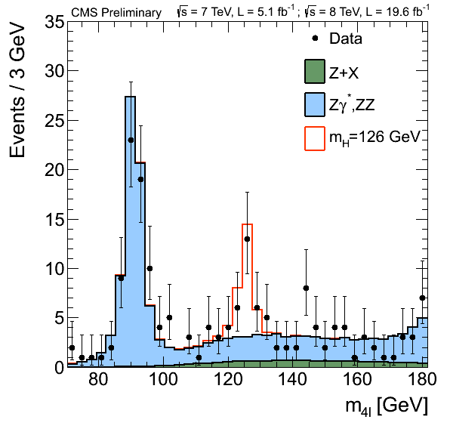
Discovery of a Higgs boson
gluon-gluon fusion
Dominant Higgs production mechanism
H→γγ
H→ZZ→4 leptons
mass ~ 125.6 ± 0.5 GeV
σ x BR compatible with SM
  couples to Z and W
  couples to top quark (probably)
does it couple to leptons?
ATLAS-CONF-2013-012, CMS-PAS-HIG-13-002

Slide 3
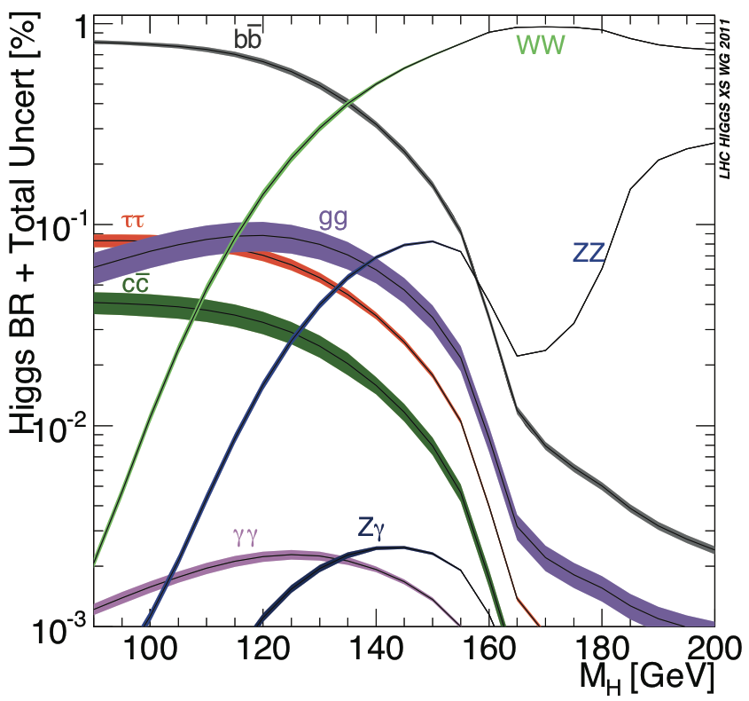


Probe lepton coupling: H→ττ
Yukawa coupling to fermions proportional to fermion mass m_{f}
~1/300
LHC Higgs σ Working Group
Notes:
BR to mu mu ~ 1e-4

Slide 4
Part I
Principles of the H→ττ search
  fighting the main background sources
  need for high-performance physics objects
Particle flow reconstruction
  What and why?
  The algorithm
  Physics object performance
The CMS H→ττ analysis
  specific techniques
  results

Slide 5
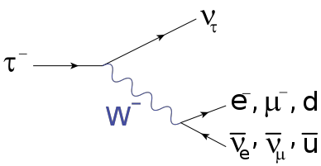
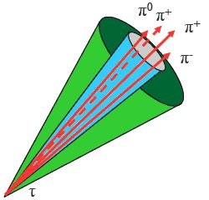
The τ, a massive (and challenging) lepton
m = 1.78 GeV
cτ = 90 μm
Branching ratios:
  65% τ±→τ_{had}± ν_{τ}
    75% , τ±→1π± + [π⁰(‘s)] + ν_{τ} (1 prong)
    23% , τ±→3π± + [π⁰(‘s)] + ν_{τ} (3 prongs)
  35% τ±→l±ν_{l}ν_{τ}
Decays into 1 or 2 neutrinos
→ MET in the event
Narrow “jet”
with only a few particle
→ high jet to τ fake rate (few %)
3 prong tau decay

Slide 6
H→ττ channels
m = 1.78 GeV
cτ = 90 μm
Branching ratios:
  65% τ±→τ_{had}± ν_{τ}
    75% , τ±→1π± + [π⁰(‘s)] + ν_{τ} (1 prong)
    23% , τ±→3π± + [π⁰(‘s)] + ν_{τ} (3 prongs)
  35% τ±→l±ν_{l}ν_{τ}
Decays into 1 or 2 neutrinos
→ MET in the event
Narrow “jet”
with only a few particle
→ high jet to τ fake rate (few %)

Slide 7
H→ττ channels
low BR and large background
Z→ττ + Z→ll
Low BR but very clean
Z→ττ + ttbar
The most powerful channels
Z→ττ, W+jets, QCD
Large BR but large background
Z→ττ, QCD
(jet→τ fake rate ~ few%)

Slide 8
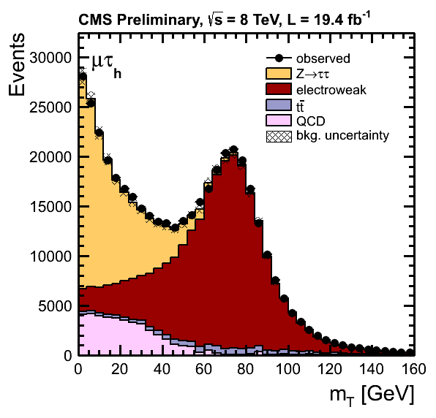

The H→ττ→μτ channel
H→ττ is
here (small!)
Inclusive selection:
  identified and isolated
  μ & τ, with pT > 20 GeV
  rejects QCD & W+jets
    This background yield is proportional to the
    jet→τ fake rate
mT < 20 GeV
  rejects W+jets & ttbar
    H→τ τ at low mT like Z→ττ
  separation performance depends on E_{T}^{miss} resolution
Transverse mass
mass of the μ + E_{T}^{miss} system in the transverse plane
CMS-PAS-HIG-13-004
Notes:
isolation and tau isolation undefined,
shape of this distribution not explained

Slide 9
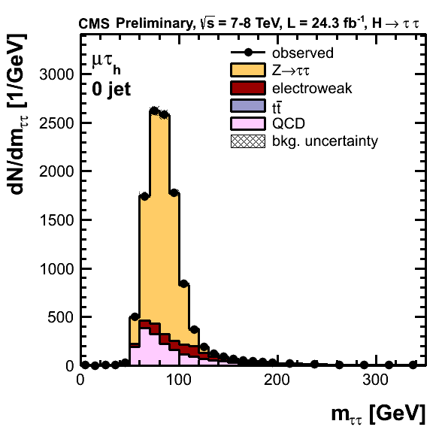
The H→ττ→μτ channel
Inclusive selection:
  identified and isolated
  μ & τ, with pT > 20 GeV
  rejects QCD & W+jets
    This background yield is proportional to the
    jet→τ fake rate
mT < 20 GeV
  rejects W+jets & ttbar
    H→τ τ at low mT like Z→ττ
  separation performance depends on E_{T}^{miss} resolution
Full ττ mass
includes neutrinos;
reconstructed from μ, τ, E_{T}^{miss} (more later)
CMS-PAS-HIG-13-004
Notes:
small remaining amount of W+jets spread out in mass
signal still invisible.

Slide 10
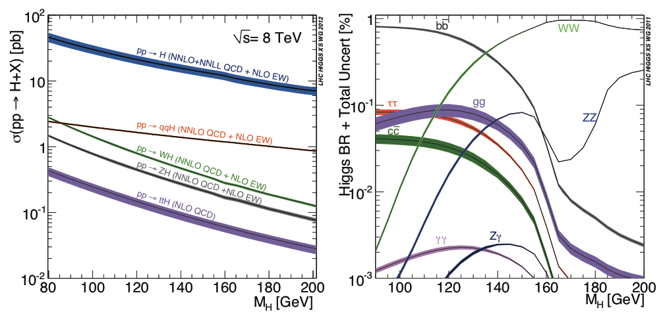
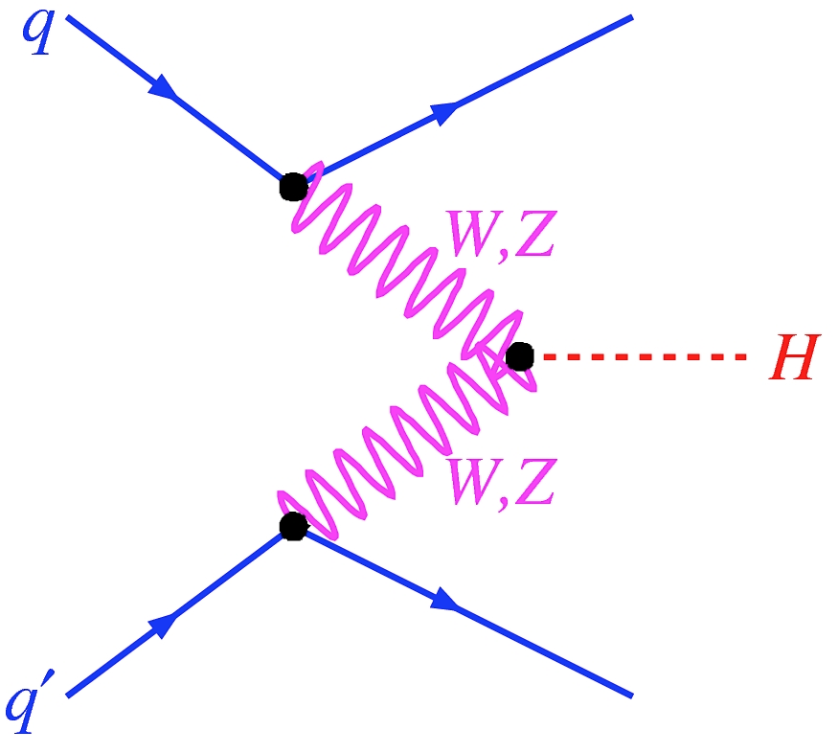
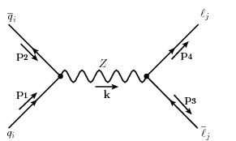
Vector Boson Fusion (VBF)
2 forward jets
No colour flow in between
→ rapidity gap
LHC Higgs σ Working Group

Slide 11
The H→ττ→μτ channel: VBF cuts
before VBF selection
VBF selection:
  2 jets pT > 30 GeV
  |Δη| > 3.5
  m_{jj} > 500 GeV
  no jet in between
Rejects Z→ττ
Uncertainty in
jet energy scale
→ 5% uncertainty in signal yield
Full ττ mass
includes neutrinos;
reconstructed from μ, τ, E_{T}^{miss} (more later)
CMS-PAS-HIG-13-004
Notes:
small remaining amount of W+jets spread out in mass
signal still invisible.

Slide 12
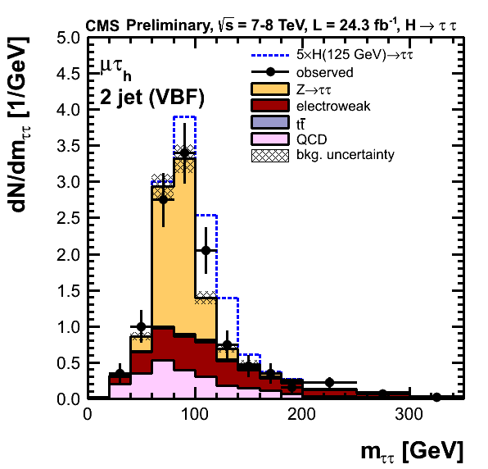
The H→ττ→μτ channel: VBF cuts
after VBF selection
VBF selection:
  2 jets pT > 30 GeV
  |Δη| > 3.5
  m_{jj} > 500 GeV
  no jet in between
Rejects Z→ττ
Uncertainty in
jet energy scale
→ 5% uncertainty in signal yield
showing
5x SM Higgs
Full ττ mass
includes neutrinos;
reconstructed from μ, τ, E_{T}^{miss} (more later)
CMS-PAS-HIG-13-004
Notes:
Of course, theoretical and lumi uncertainties on signal yield also important
here, focusing on experimental uncertainties related to the CMS detector
what are the theoretical uncertainties on VBF / ggH in VBF category? in 1-jet category?
get the reduction factors

Slide 13
The H→ττ→μτ channel: VBF cuts
after VBF selection
H→ττ separated from Z→ττ using m_{ττ}
  τ energy scale uncertainty
    error results in shifted peak
  E_{T}^{miss} resolution
    drives the peak width
showing
5x SM Higgs
Full ττ mass
includes neutrinos;
reconstructed from μ, τ, E_{T}^{miss} (more later)
CMS-PAS-HIG-13-004
Notes:
Of course, theoretical and lumi uncertainties on signal yield also important
here, focusing on experimental uncertainties related to the CMS detector
what are the theoretical uncertainties on VBF / ggH in VBF category? in 1-jet category?
get the reduction factors

Slide 14
Part II
Principles of the H→ττ search
  fighting the main background sources
  need for high-performance physics objects
Particle flow reconstruction
  What and why?
  The algorithm
  Physics object performance
The CMS H→ττ analysis
  background estimation & main uncertainties
  statistical procedure
  results
τ ID efficiency and fake rate
τ energy scale syst. uncertainty
E_{T}^{miss} resolution
jet energy scale syst. uncertainty
and much more!

Slide 15
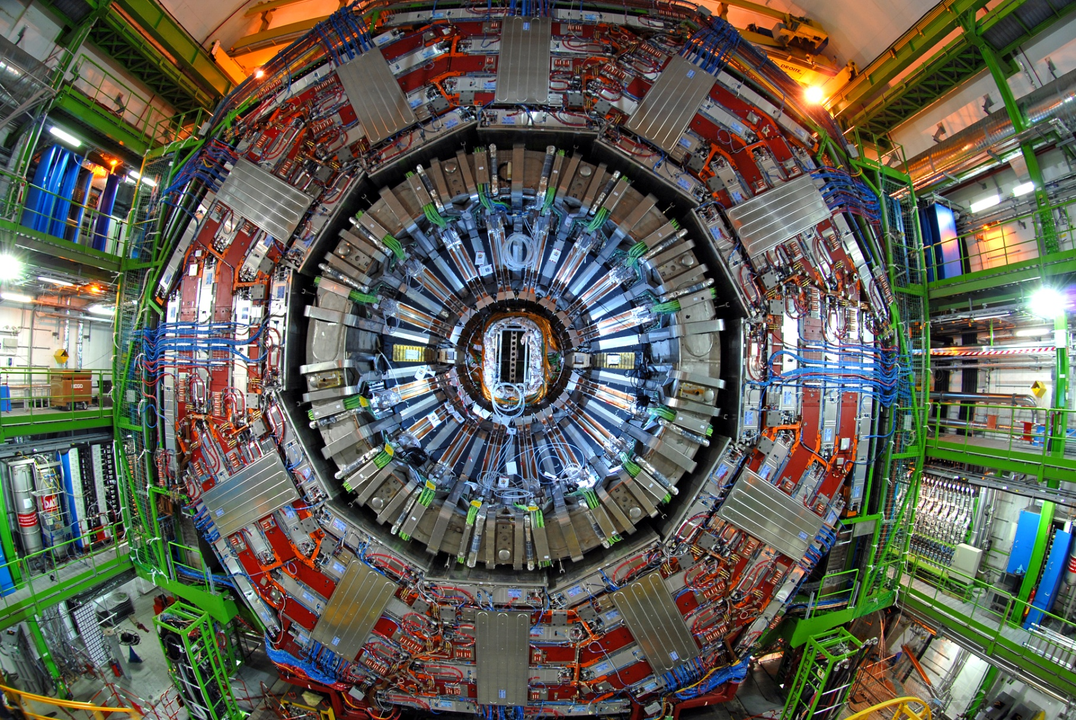
Make use of the whole CMS system
  tracker
  ECAL
  HCAL
  Solenoid
  Muon chambers
Particle flow
  a.k.a energy flow
  reconstruct & identify all stable particles in the event.

Slide 16
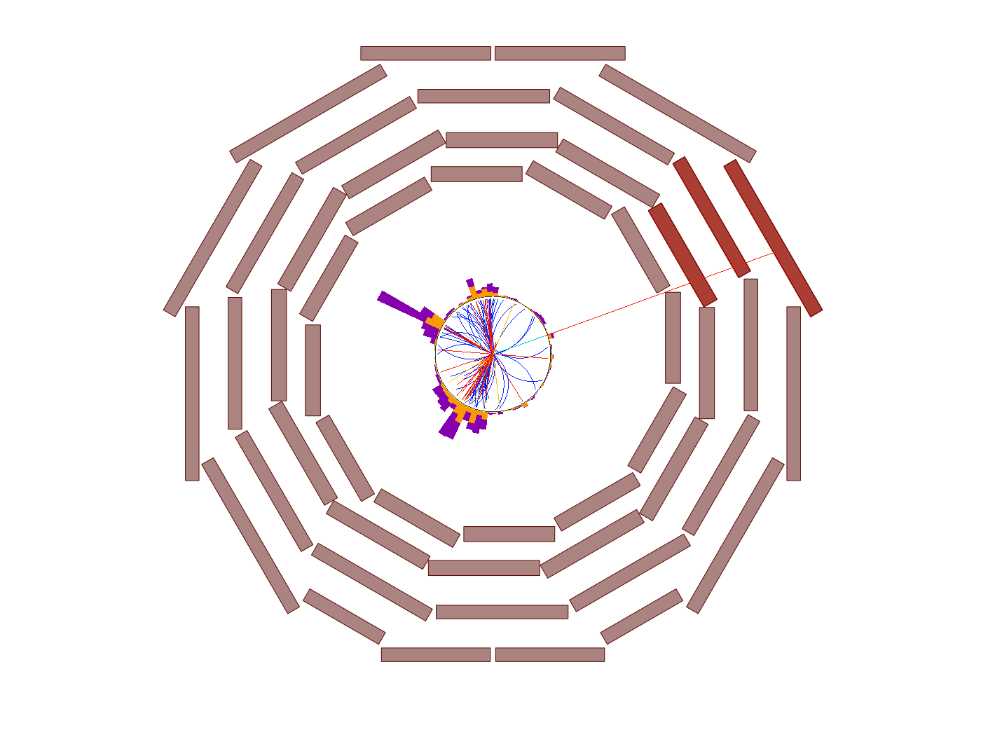
Muon

Slide 17
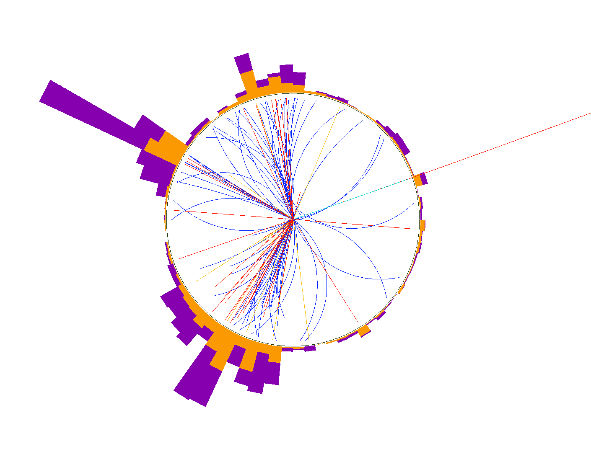
Zoom
Charged hadron
HCAL
deposit
Muon
ECAL deposit
Photon
Single list of reconstructed particles:
all calibrated
used to build high-level objects in a consistent way
(global event description)
Neutral hadron

Slide 18
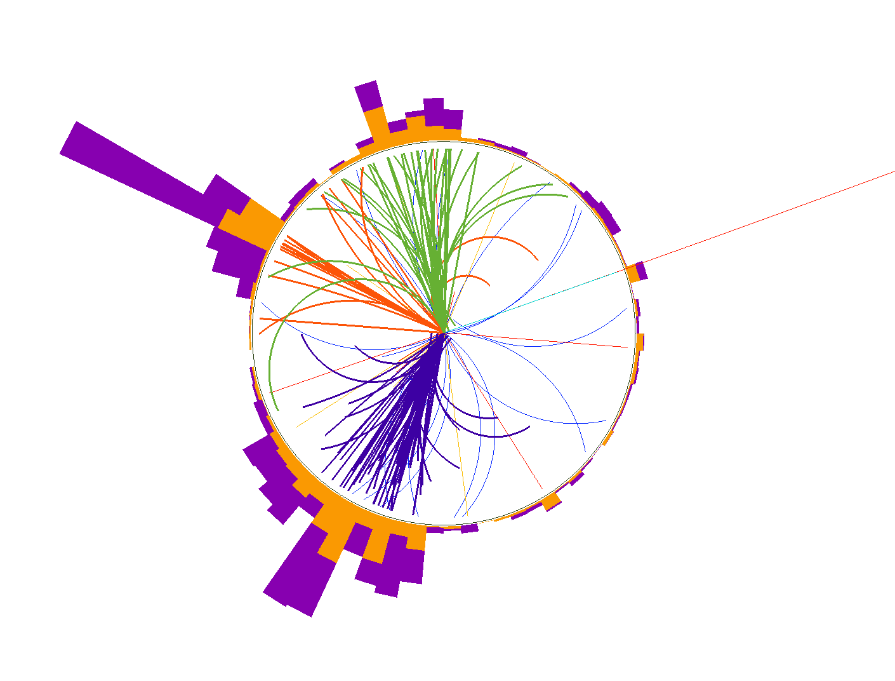
Particle Jets
For the first time in a hadron collider experiment

Slide 19

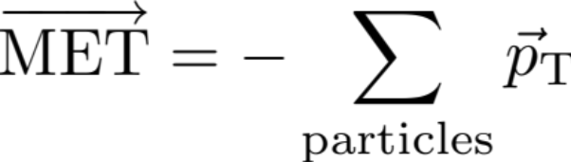
Missing Transverse Energy
Momentum
For the first time in a hadron collider experiment

Slide 20
Why Particle Flow?
Calorimeter jet:
  E = E_{HCAL} + E_{ECAL}
  σ(E) ~ calo resolution
  to hadron energy:
  120 % / √E
  direction biased (B = 3.8 T)
Particle flow jet:
  65% charged hadrons
    σ(pT)/pT ~ 1%
    direction measured at vertex
  25% photons
    σ(E)/E ~ 1% / √E
    good direction resolution
  10% neutral hadrons
    σ(E)/E ~ 120 % / √E
  Need to resolve the energy deposits from the neutral particles…
neutral hadron
photon
charged
hadron

Slide 21
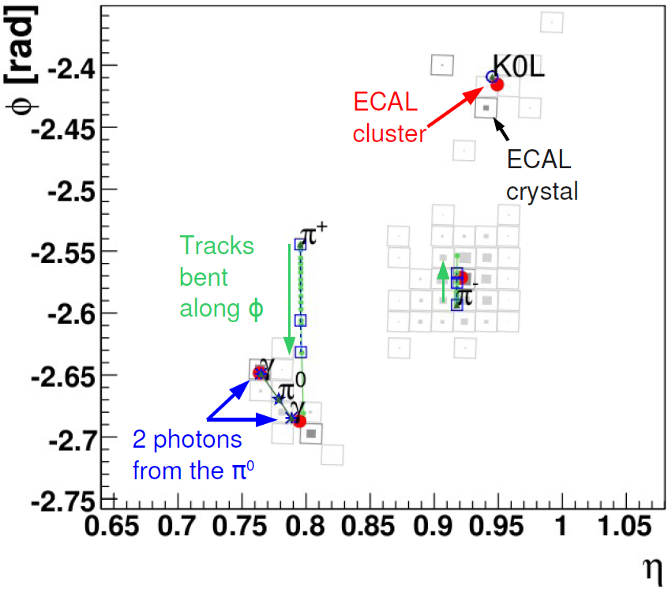
ECAL Surface
A typical jet
  pT = 50 GeV/c
Cell size:
  0.017x0.017
CMS-PAS-PFT-09-001

Slide 22
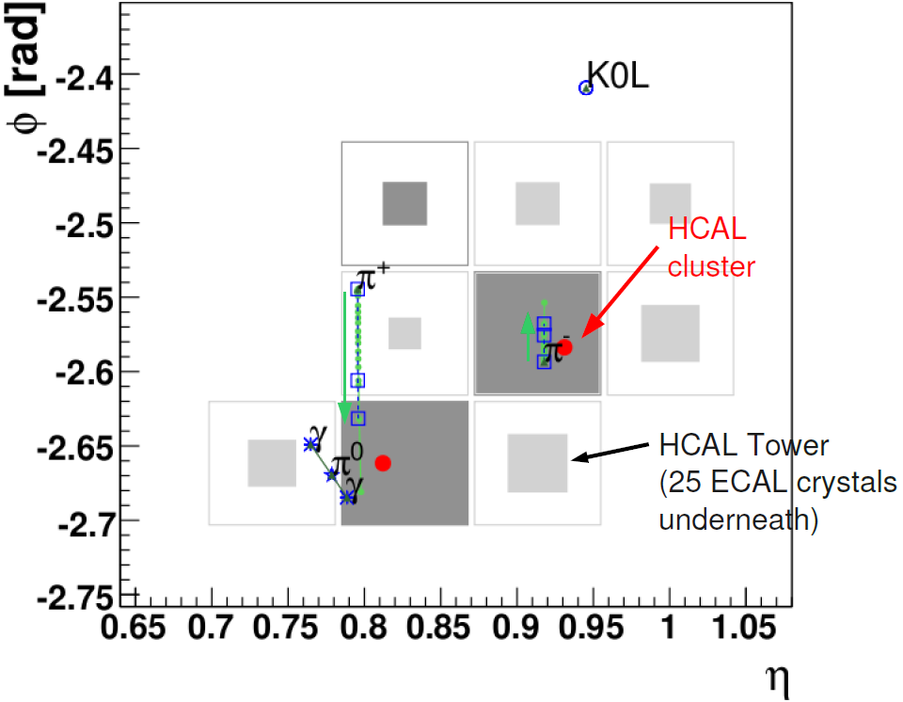
HCAL Surface
A typical jet
  pT = 50 GeV/c
Cell size:
  0.085x0.085
  5 ECAL crystals
CMS-PAS-PFT-09-001

Slide 23
2 charged hadrons, 3 photons
from tracks
from ECAL clusters
CMS-PAS-PFT-09-001, + instructive backup slides

Slide 24
Effects of particle flow in CMS
Jets
  energy resolution / 2
  angular resolution / 3
  Flavour dependence of response / 3
  Systematic error on JES / 2
  « electron in jet » b tagging
  quark-gluon jet tagging
MET:
  resolution / 2
  pile-up control
  smallest tails
τ
  jet fake rate / 3 @ same eff.
  energy resolution / 4
Electrons
  down to pT = 3 GeV
  in jets
μ
  4% more efficient ID @ same bgd rate
  better momentum assignment at high pT
e, μ, τ, γ isolation
  pile-up control
Physics analyses
  Better trigger for jets, MET, taus (PF@HLT)
  e.g:
    FSR photon recovery in H→ZZ
    embedding in H→ττ
    jet substructure

Slide 25
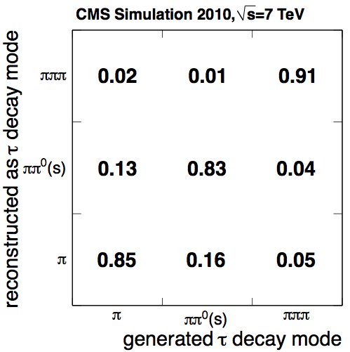
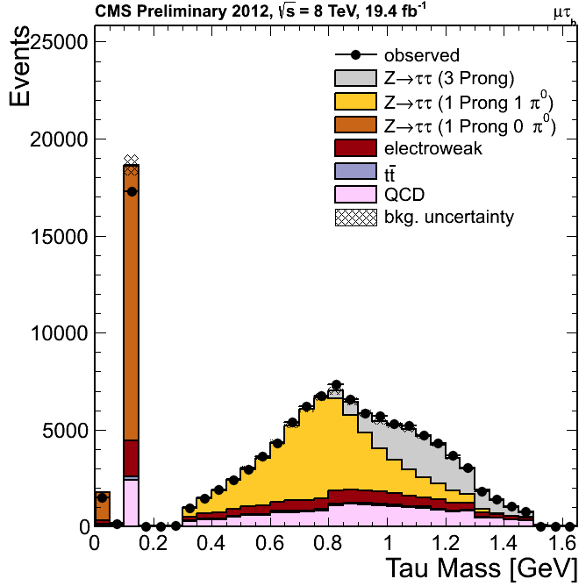
τ Reco & ID in CMS
Select decay particles according to decay mode
Isolation w/r to other particles
CMS-PAS-TAU-11-001
Notes:
- Need to have something about the tau decay modes not to far before.
- Need to highlight the differences with a traditional reconstruction technique.
can say it.

Slide 26
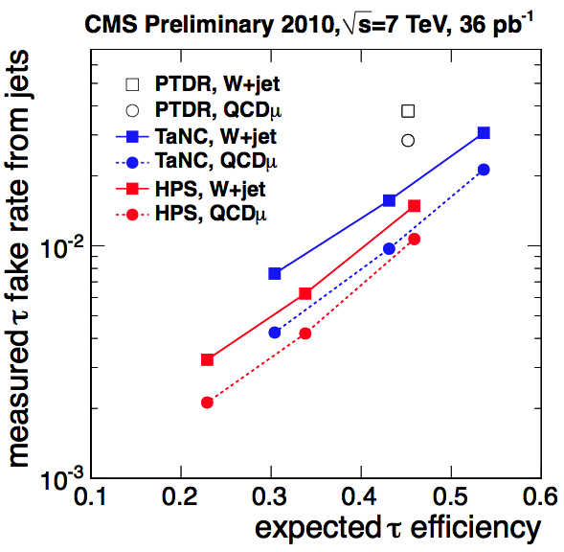
τ ID performance
3 times less jet→τ fake rate at same efficiency
  → 3 times less W+jets and QCD background
Showing
5x SM Higgs
CMS-PAS-TAU-11-001
Notes:
Fake rate divided by 3 with PF
remove atlas stuff

Slide 27
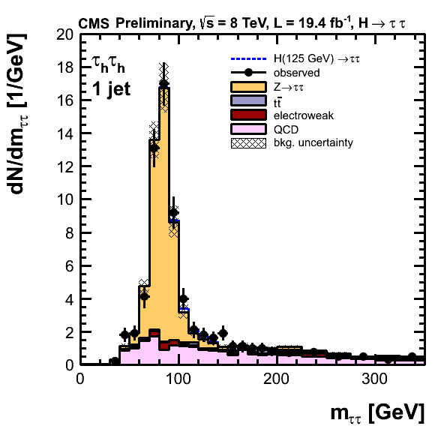
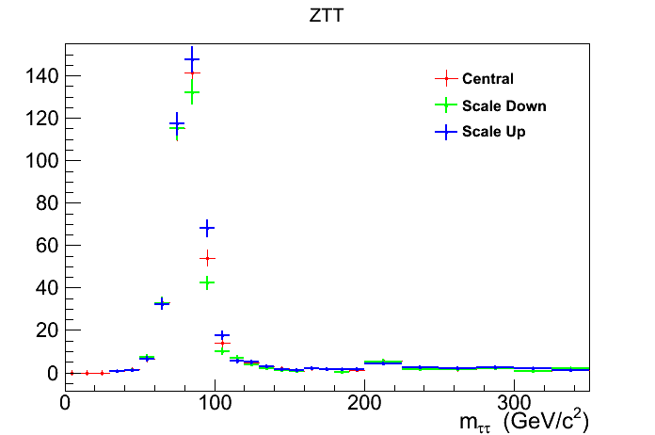
τ Energy Scale
CMS PAS HIG-13-004
unofficial plot
shift of the τ E scale
+3%
-3%
fully hadronic (ττ) channel
  3% shift of τ E scale = 1-2 x signal expectation
Important to calibrate τ energy
  done using the τ mass

Slide 28
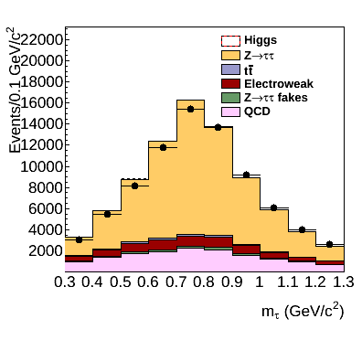
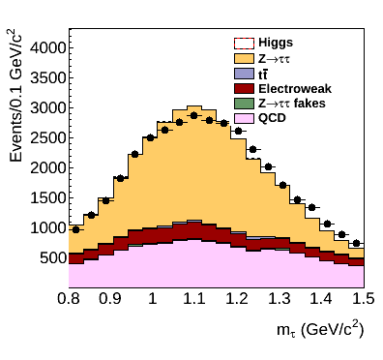
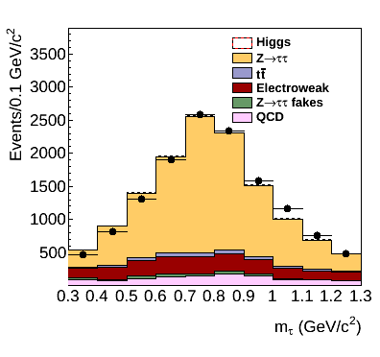
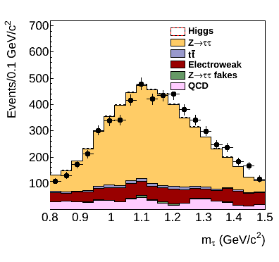
τ mass before calibration
Unofficial plots
plots and fit done using μτ events.
pT<40
1 prong + π0
3 prongs
pT>40

Slide 29
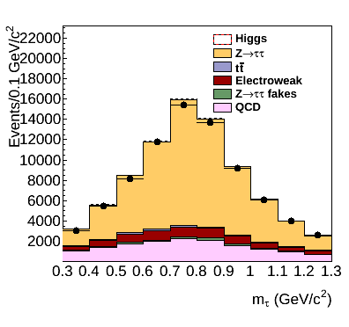
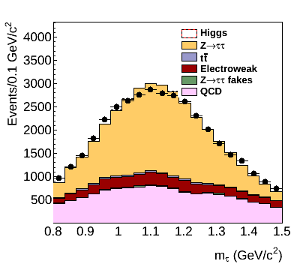
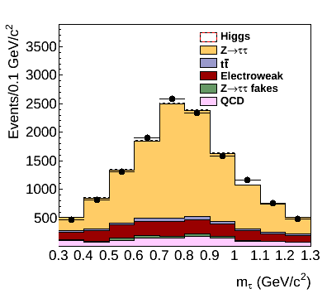
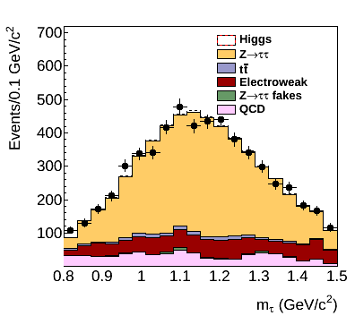
τ mass after calibration
Unofficial plots
plots and fit done using μτ events.
pT<40
1 prong + π0
3 prongs
pT>40

Slide 30
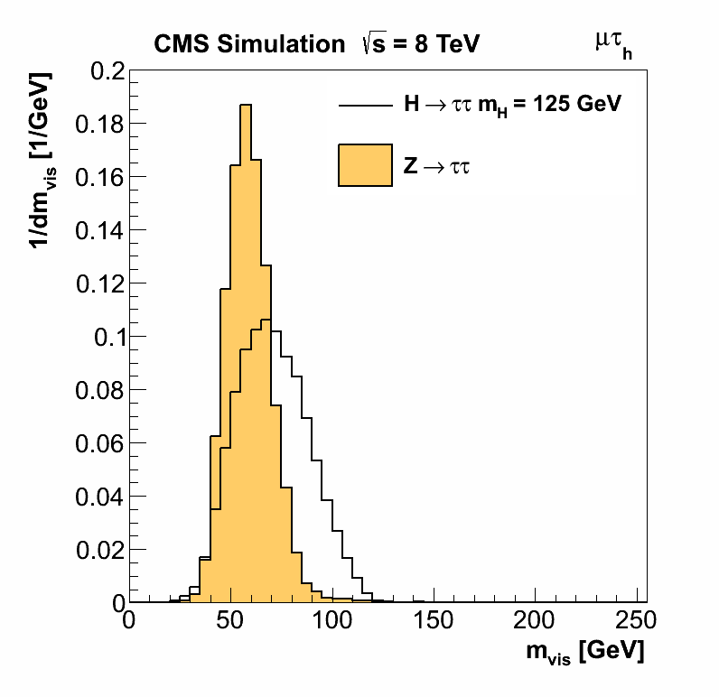
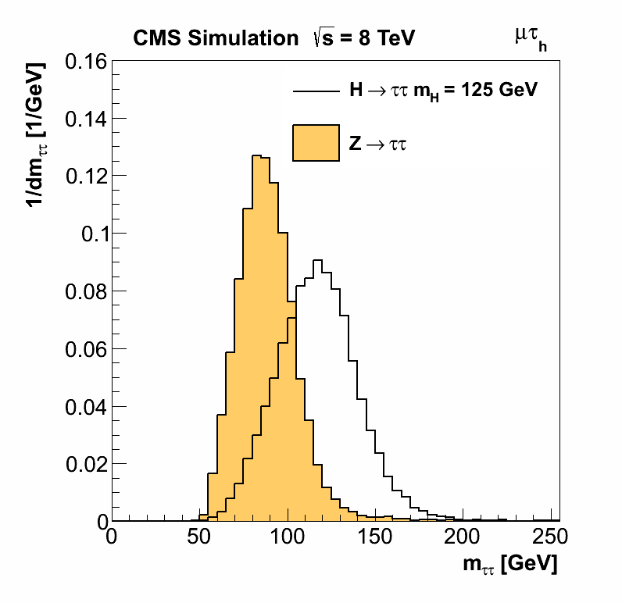


E_{T}^{miss} resolution: m_{ττ}
CMS PAS HIG-13-004
H→ττ better separated from Z→ττ (main, irreducible background)
Resolution on m_{ττ} ~ 20% (resolution on E_{T}^{miss} important)

Slide 31
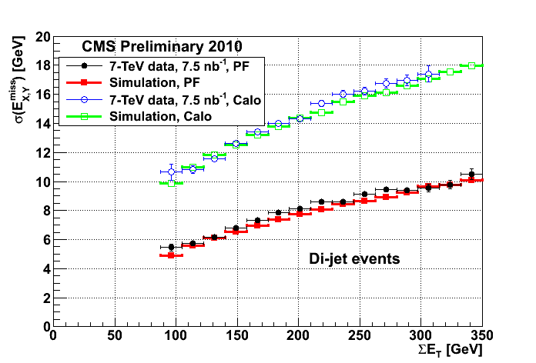
PF vs Calorimeter E_{T}^{miss}
Resolution twice better
CMS PAS PFT-10-002
Notes:
Explain that regression is a function of inputs
training and data / MC validation using Z->mu mu events.

Slide 32
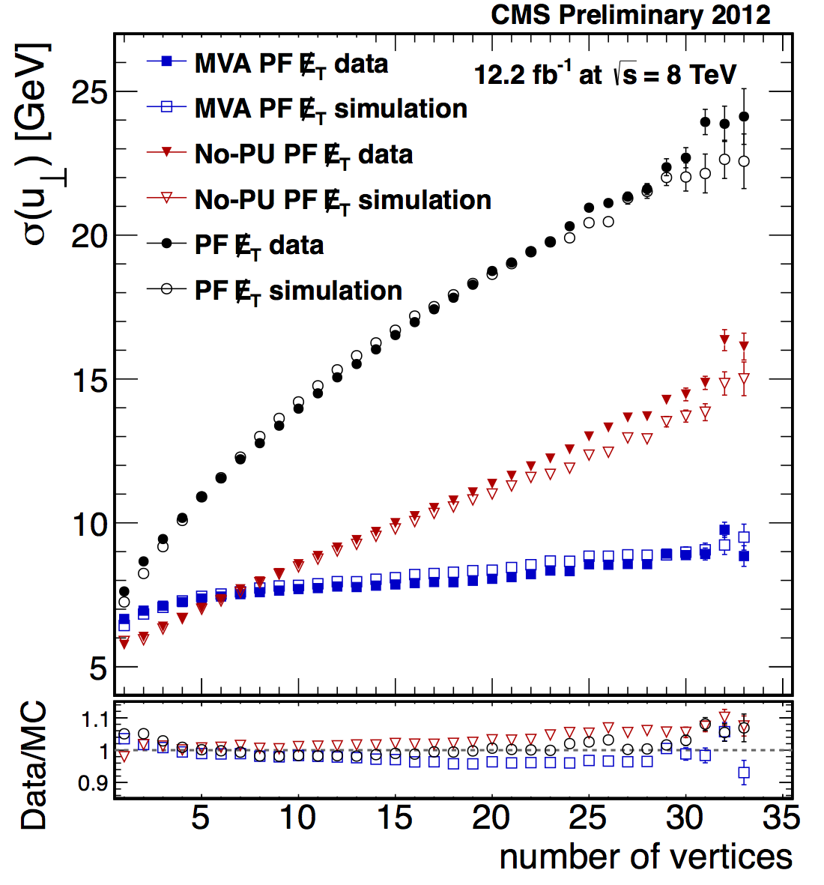
Multivariate PF E_{T}^{miss}
several kinds of particle-flow E_{T}^{miss}:
E_{T}^{miss}
from all
particles
(PF E_{T}^{miss})
E_{T}^{miss}
from
pileup
particles
E_{T}^{miss}
from primary vertex
particles
etc.
Multivariate PF E_{T}^{miss} estimation
Additional factor 2 improvement @ 20 pile-up vertices
MVA PF MET Almost insensitive to pileup
CMS-PAS-JME-12-002
Notes:
Explain that regression is a function of inputs
training and data / MC validation using Z->mu mu events.

Slide 33
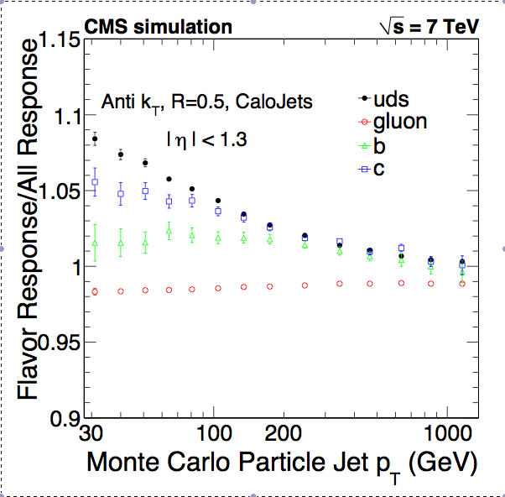
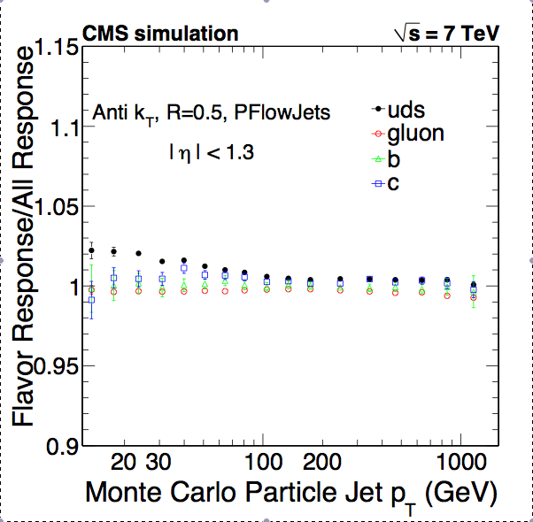
Jet Response: Flavour Sensitivity
Calo Jets
PF Jets
PF jet response almost independent
from the flavour of the jet-initiating parton
CMS PAS PFT-10-002

Slide 34
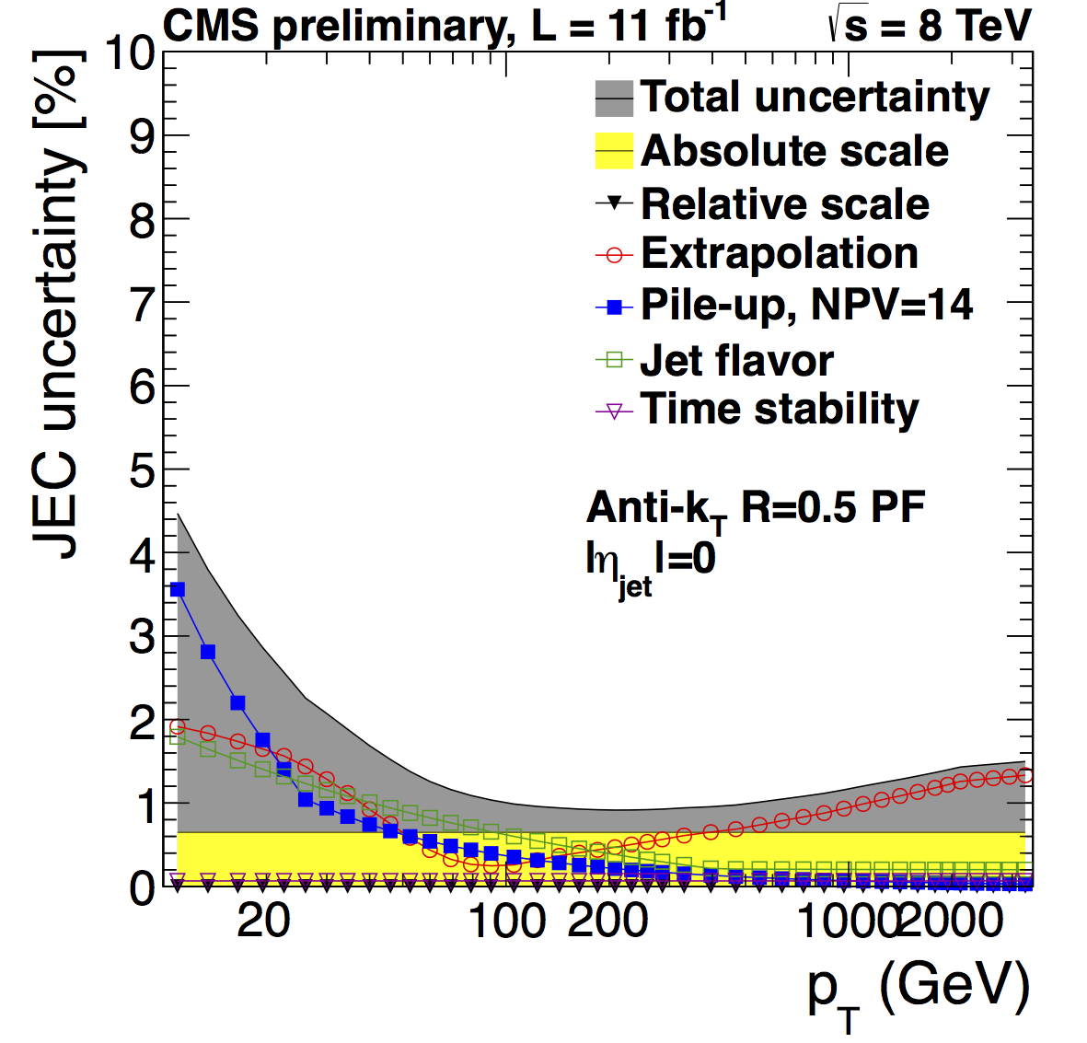
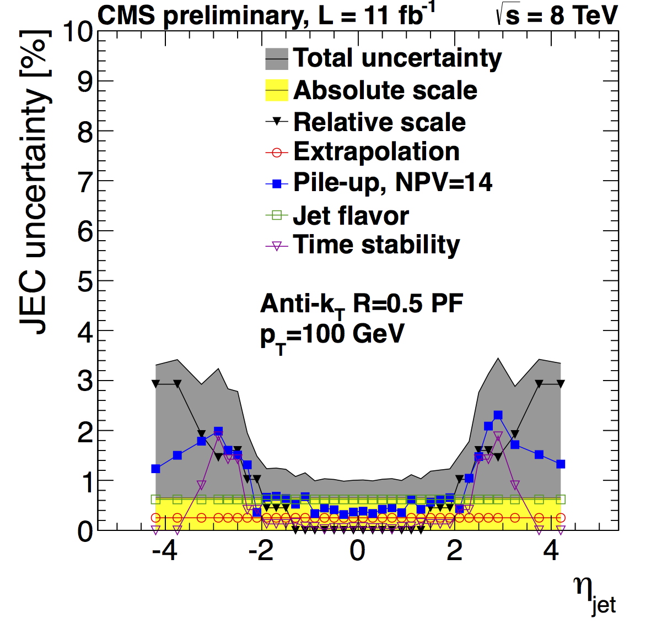
Jet Energy Scale Uncertainty
1-3 % Jet Energy Scale Systematic uncertainty
https://twiki.cern.ch/twiki/bin/view/CMSPublic/PhysicsResultsJME2013JEC

Slide 35
Part III
Principles of the H→ττ search
  fighting the main background sources
  need for high-performance physics objects
Particle flow reconstruction
  What and why?
  The algorithm
  Physics object performance
The CMS H→ττ analysis
  background estimation & main uncertainties
  statistical procedure
  results
τ ID efficiency and fake rate
τ energy scale syst. uncertainty
E_{T}^{miss} resolution
jet energy scale syst. uncertainty
and much more!

Slide 36
Background : Z→ττ
CMS PAS HIG-13-004
μ
μ
Select data Z→μμ events
Replace muons by particles reconstructed from simulated Z→ττ decay, and apply selection
Jets and E_{T}^{miss} from data. Main remaining uncertainties:
  τ ID efficiency uncertainty (8%)→ affects the yield
  τ energy scale uncertainty (3%)→ affects the shape
Notes:
need to define categories before? people know about the VBF though.
make a drawing for the embedding

Slide 37
Background : Z→ττ
CMS PAS HIG-13-004
e.g. π⁺, γ
from τ
μ from τ
Select data Z→μμ events
Replace muons by particles reconstructed from simulated Z→ττ decay, and apply selection
Jets and E_{T}^{miss} from data. Main remaining uncertainties:
  τ ID efficiency uncertainty (8%)→ affects the yield
  τ energy scale uncertainty (3%)→ affects the shape
Notes:
need to define categories before? people know about the VBF though.
make a drawing for the embedding

Slide 38
Background : W+Jets
CMS PAS HIG-13-004
normalization region
signal region
normalization to data in high mT region
assume simulated shape → yield in signal region
  yield syst. uncertainty = 20%
Notes:
W+jets is electroweak, write that on the slides

Slide 39
Background : QCD
CMS PAS HIG-13-004
Select same-sign (SS)
μτ events
QCD_{SS} = data - Bgd_{SS}
QCD_{OS} = f_{SS→OS} QCD_{SS}
10% uncertainty
1.06 ± 0.11
from data
VBF category: not enough events in SS region
  yield QCD_{VBF} = f_{inclusive→VBF}QCD_{inclusive}
    20 % uncertainty
  shape from control region with non-isolated μ
Notes:
need to talk about isolation before. maybe only about the tau?
animation VBF : plot + text

Slide 40
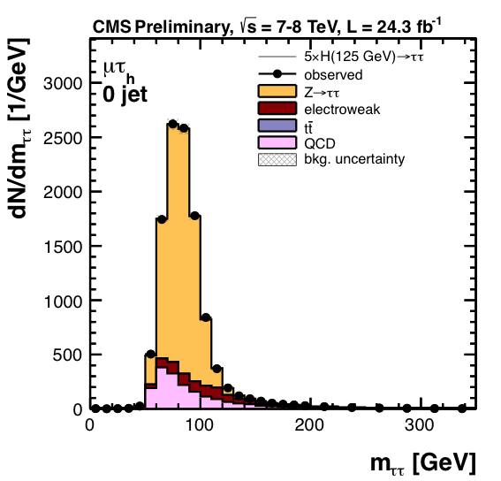
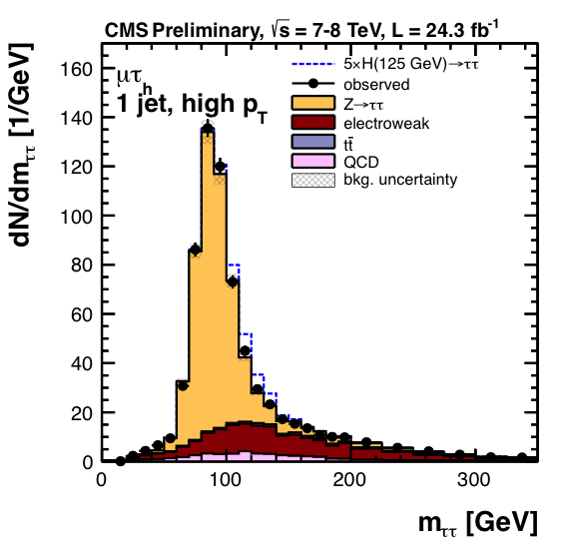
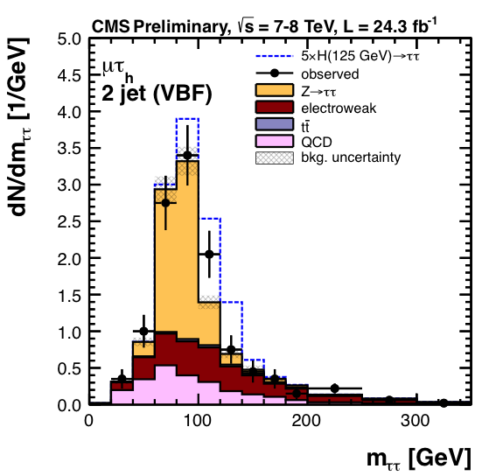
Event categories
CMS PAS HIG-13-004
constrains systematic errors
for sensitive categories
5 channels:
μτ_{h}, eτ_{h}, eμ, τ_{h}τ_{h}, μμ
Showing
5x SM Higgs
Notes:
5 channels, showing only mu tau, which is the most powerful.
all categories
main background H->tautau
point at VBF category. essential to control the yield and shape of this background
systematic errors
constrained in 0 jet category
expectation for SM Higgs at 125 x 5
difficult to see anything apart from an excess
to get a better view, combine with a weight = signal over background ratio in the signal region

Slide 41
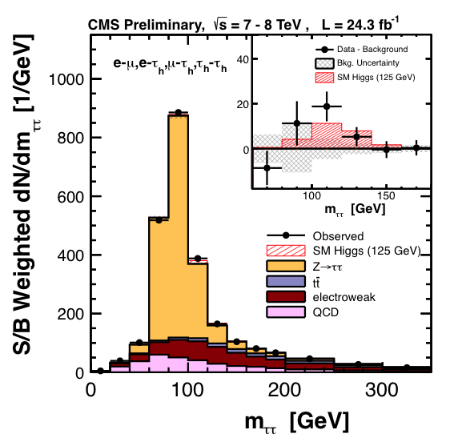
Combined mass distribution
CMS PAS HIG-13-004
Combination of all categories of all major channels
Each is weighted by the expected S/B in the signal region
Notes:
S/B gives more weight to the VBF
S/sqrt(B) would have been better.

Slide 42
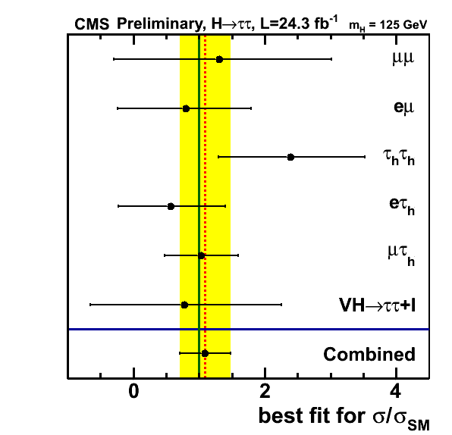
H → ττ significance
CMS PAS HIG-13-004
All channels compatible
μ = 1.1 ± 0.4

Slide 43
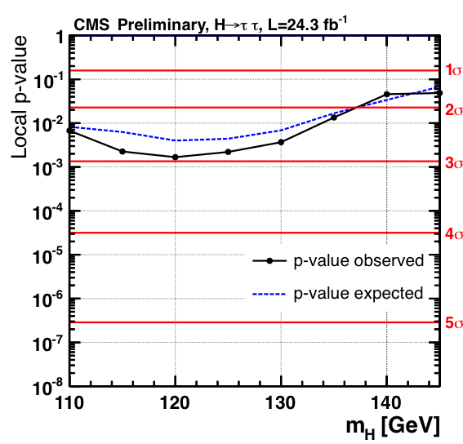
H → ττ significance
CMS PAS HIG-13-004
All channels compatible
Maximum significance:
2.93 σ @ mH = 120 GeV (2.65 exp.)
μ = 1.1 ± 0.4
First Strong indication that the new boson couples to τ as the SM Higgs

Slide 44
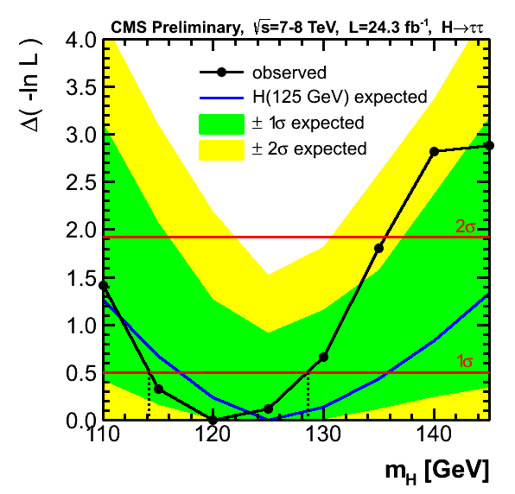
H→ττ mass measurement
CMS PAS HIG-13-004
Due to low mττ resolution, compatible with:
- expectation for m_{H} = 125 GeV
- H→ZZ→4 lepton mass measurement

Slide 45
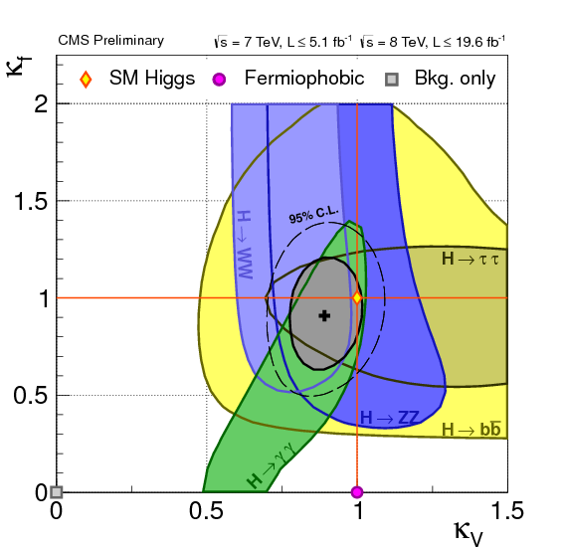
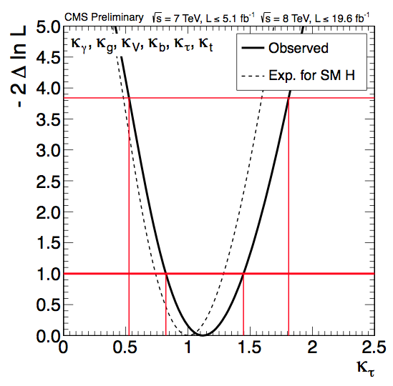
Summary
CMS PAS HIG-13-005
particle flow dramatically improves the performance of CMS
  used in almost all analyses
    e.g. only 2 jet-based analyses don’t use PF jets
First strong hint for H→ττ (2.94σ)
main constraint on the coupling to fermions
Coupling to fermions VS coupling to bosons, w/r to Standard Model
Coupling to τ, w/r to SM

Slide 46
Back-up

Slide 47

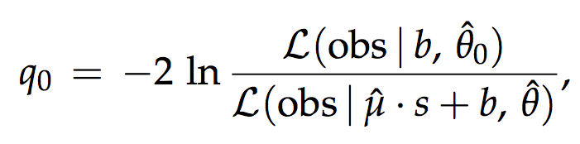


Statistics

Slide 48

Recipe for a good particle flow
Separate neutrals
from charged hadrons
  Field integral (BxR)
  Calorimeter granularity
Efficient tracking
Minimize material before calorimeters
Clever algorithm to compensate for detector imperfections
PF Jet,
pT = 140 GeV/c
Data

Slide 49
Neutral/charged separation (1)
Field Integral
Strong magnetic field:
3.8 T
ECAL radius 1.29 m
BxR = 4.9 T.m
  ALEPH: 1.5x1.8 = 2.7 T.m
  ATLAS: 2.0x1.2 = 2.4 T.m
  CDF: 1.5x1.5 = 2.25 T.m
  DO: 2.0x0.8 = 1.6 T.m
PF Jet,
pT = 140 GeV/c
Data

Slide 50
PF Clustering, HCAL
Used in:
  ECAL, HCAL, preshower
Iterative,
energy sharing
  Gaussian shower profile with fixed σ
Seed thresholds
  ECAL : E > 0.23 GeV
  HCAL : E > 0.8 GeV

Slide 51
PF Clustering, HCAL
Used in:
  ECAL, HCAL, preshower
Iterative,
energy sharing
  Gaussian shower profile with fixed σ
Seed thresholds
  ECAL : E > 0.23 GeV
  HCAL : E > 0.8 GeV

Slide 52

PF Clustering, ECAL - Validation
Right π⁰ mass

Slide 53

Iterative Tracking (1/2)
Developed for PF,
now standard
At each iteration:
  Reconstruct a set of tracks
  Remove track hits
  Relax constraints
Fast (~10 s / event)
Iterative tracking:
  1-2 % fake rate
Old “CTF” tracking:
  20 % fake rate
Pixel layers
Beam tube

Slide 54

Iterative Tracking (2/2)
Efficient also for secondary tracks
Secondary tracks
used in PF:
  Charged hadrons from nuclear interactions
    No double-counting of the primary track momentum
  Conversion electrons
    Converted brems
    from electrons
    (cf electron slide later)
Nuclear interaction vertices
Displaced beam pipe!

Slide 55
Linking – ECAL view
Track impact within cluster boundaries
→ track & cluster linked
http://cdsweb.cern.ch/record/1194487?ln=en

Slide 56
Linking – HCAL view
Track impact within cluster boundaries
→ track & cluster
linked
Clusters overlapping
→ clusters linked
http://cdsweb.cern.ch/record/1194487?ln=en

Slide 57


Link Validation
Distance between:
the track impact and
the closest HCAL cluster

Slide 58
Links and blocks
Links:
  Track-ECAL
  Track-HCAL
  ECAL-HCAL
  Track-track
  ECAL-preshower
The block building rule:
  2 linked PF elements are put in the same blocks
HCAL
ECAL
ECAL
3 typical blocks
Track
Track

Slide 59

Result: 2 PF “Blocks”
→ 1 photon
http://cdsweb.cern.ch/record/1194487?ln=en

Slide 60

Photons
http://cdsweb.cern.ch/record/1194487?ln=en

Slide 61

Photons
http://cdsweb.cern.ch/record/1194487?ln=en

Slide 62

Block simplification
http://cdsweb.cern.ch/record/1194487?ln=en

Slide 63

Block simplification
http://cdsweb.cern.ch/record/1194487?ln=en

Slide 64

Charged hadrons, overlapping neutrals
For each HCAL cluster, compare:
  Sum of track momenta p
  Calorimeter energy E
    Linked to the tracks
    Calibrated for hadrons
E and p compatible
  Charged hadrons
E > p + 120% √p
  Charged hadrons +
  Photon / neutral hadron
E<<p
  Need attention …
  Rare: muon, fake track
http://cdsweb.cern.ch/record/1194487?ln=en

Slide 65
Charged+neutrals: E ≈ p
Charged hadron energy from a fit of p_{i} and E
  i = 1, .. , Ntracks
  Calorimeter and track resolution accounted for
Makes the best use of the tracker and calorimeters
  Tracker measurement
  at low pT
  Converges to calorimeter measurement at high E
http://cdsweb.cern.ch/record/1194487?ln=en

Slide 66
Charged+neutrals: E > p
Significant excess of energy in the calorimeters:
E > p + 120% √E
Charged hadrons [ p_{i} ]
Neutrals:
  E from ECAL or HCAL only:
    HCAL → h⁰ [ E – p ]
    ECAL → γ [ E_{ECAL} – p/b ]
  E from ECAL and HCAL:
    E-p > E_{ECAL} ?
      γ [ E_{ECAL} ]
      h⁰ with the rest
    Else:
      γ [ (E – p) / b ]
Always give precedence to photons
http://cdsweb.cern.ch/record/1194487?ln=en

Slide 67

Validation of the calibration
Ratio of the calorimeter response between data and Monte-Carlo

Slide 68
2 charged hadrons, 3 photons
→ 1 photon
http://cdsweb.cern.ch/record/1194487?ln=en

