Slide 1


UN NEUTRINO S’TERRE-T-IL?
D. Lhuillier
Séminaire SPhN

Slide 2

Outline
Intro on (reactor) ν
The 4th ν hypothesis:
  Status of the reactor anomaly
  General context of other results
Testing new ν_{e} disappearance at short distance from compact sources:
  Reactor experiments
  Source experiments

Slide 3
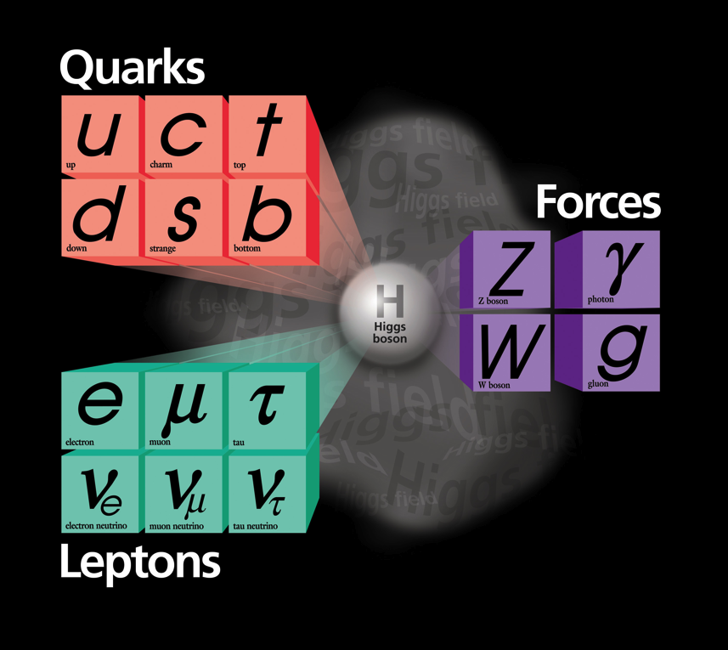
Neutrino Status
3 active neutrinos.
Neutral partner of charged leptons in weak isospin doublets.
(anti)neutrinos are (rigth) left handed.
  Flavor eigenstates ≠ mass eigenstates + different masses.
  → Neutrinos can oscillate

Slide 4
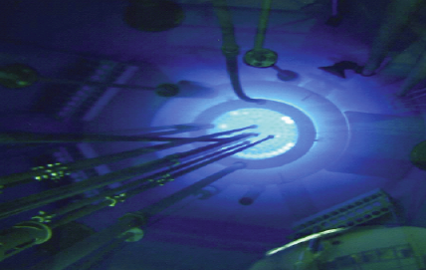
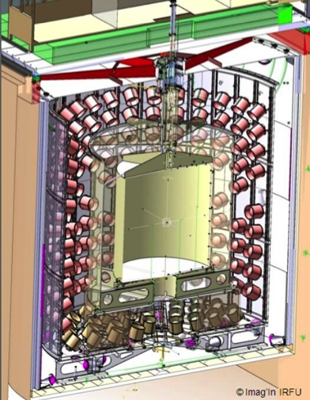
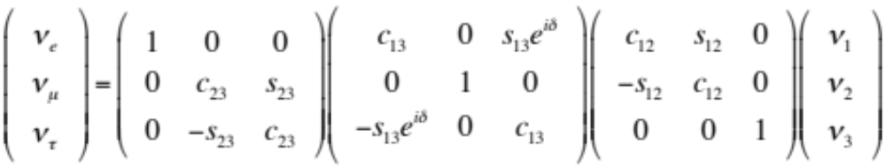
Neutrino Oscillations
ν₁, ν₂, ν₃
Interaction / flavor
Propagation / mass
Interaction / flavor
ν₁
ν₂
ν₃
-1
ν_{e}
ν_{μ}
ν_{τ}
ν_{e}
ν_{μ}
ν_{τ}
θ
ν₁
ν₂
ν₃
θ
=
. . . .
=
Δm²
θ₁₂ = 33.5 ± 1.5°
θ₂₃ = 40.4 ± 5°
θ₁₃ = 8.7 ± 0.5°
Δm²₂₁ = 7.6 ± 0.2 10⁻⁵ eV²
|Δm² ₃₁| = 2.5 ± 0.1 10⁻³ eV²
δ=?

Slide 5
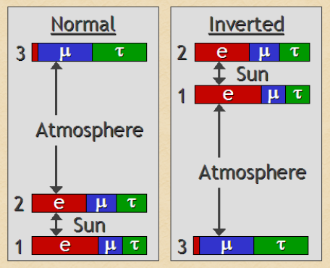
Open questions
Neutrino masses
Absolute masses
Hierarchy
Dirac or Majorana
β decay, ββ0ν decay, cosmo
Matter effects, ββ0ν decay
ββ0ν decay
CP violation
Impact on the matter-antimatter asymmetry?
Additional neutrino states?
Oscillation experiments

Slide 6
Reactor ν

Slide 7
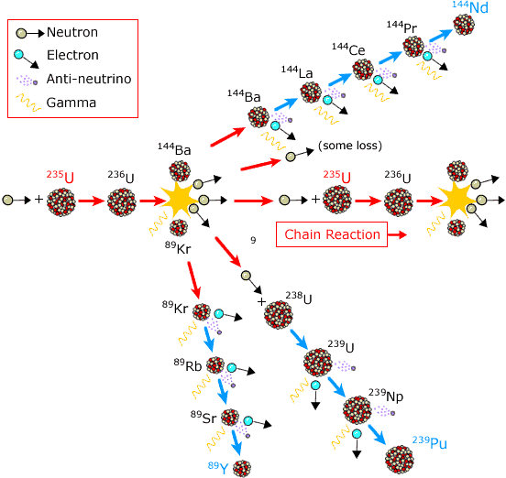
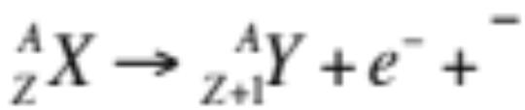
Reactor Antineutrinos
Reactor are intense and pure sources of electron antineutrinos from β⁻ decay of fission products
ν_{e}
Few MeV energy range
2.10²⁰ ν_{e} /s/GW_{th}
Compensate for tiny interaction probability

Slide 8
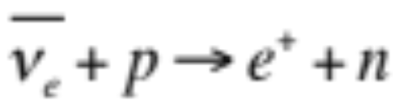
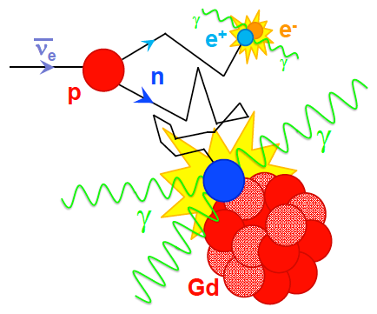
Golden Detection Process
Inverse Beta Decay
Selective signal sequence:
e⁺ prompt signal
+
n-capture few 10 μs later
Backgrounds
Accidental: [γ-n_{th}] coinc
Correlated: fast n
Not sensitive to solar ν_{e}.

Slide 9
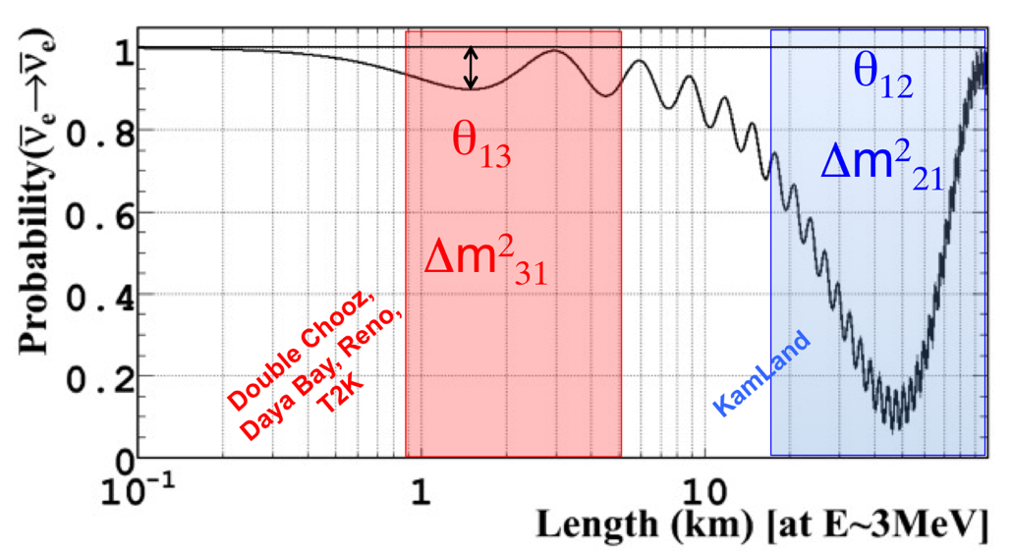
Oscillations of Reactor ν
ν₁, ν₂, ν₃
ν_{e}
ν_{e}
Interaction / flavor
Propagation / mass
Interaction / flavor
Periodic disappearance of the detected ν_{e} rate with a L/E dependence
P(ν_{e}→ ν_{e}) = 1 - sin²(2θ_{ij}) sin²(Δm²_{ij}L/4E)

Slide 10
Reactor ν Spectra

Slide 11

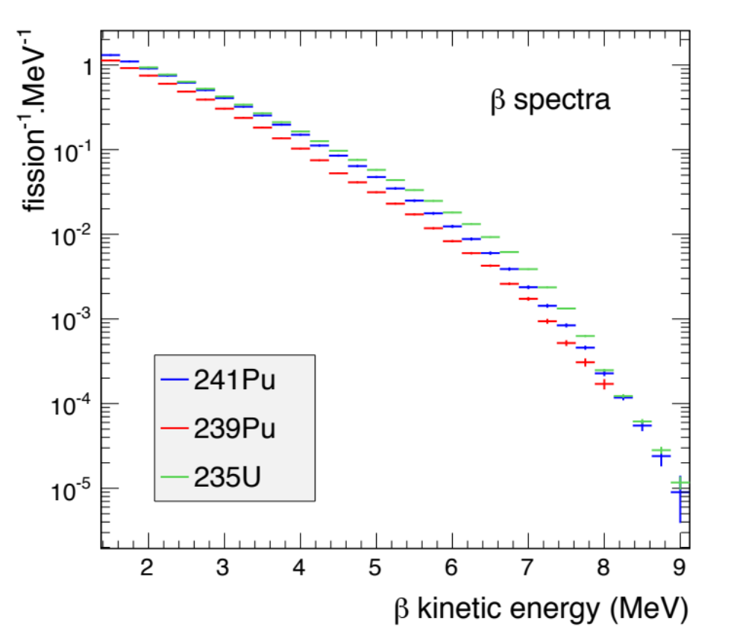
Prediction of Reactor ν Spectra
Reference fission β spectra of 3 isotopes measured at the ILL reactor
K. Schreckenbach et al.,
Phys. Lett. 99B, 251 (1981)
Accurate reference of total fission β-spectra
Key input for searches of oscillations at reactors

Slide 12
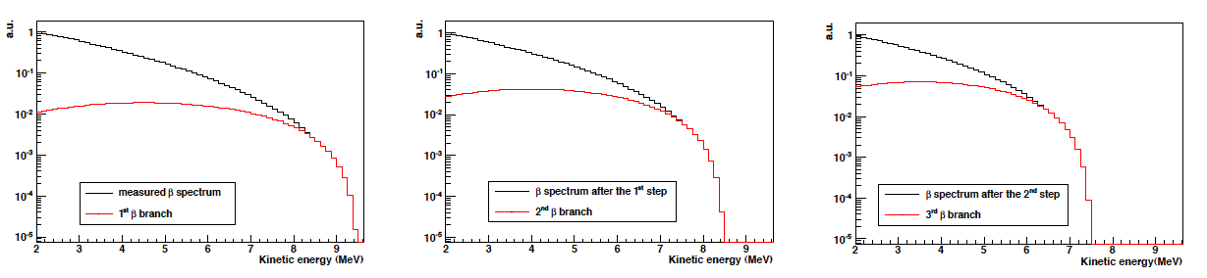
Conversion of reference e⁻ spectra
1- Fit total e⁻ spectrum with a sum of 30 effective β branches determined by iterative method (instead of ~10,000 real branches)
2- Convert each effective e⁻ branches to ν branches
3- Sum all converted ν branches to get total ν spectrum
Reference neutrino spectra to be coupled to a reactor simulation.
Dramatic improvement with respect to ab-initio calculation, limited by the knowledge of nuclear data.

Slide 13
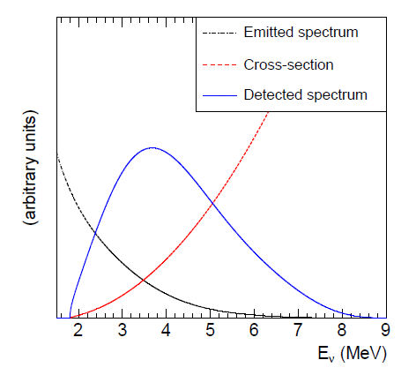
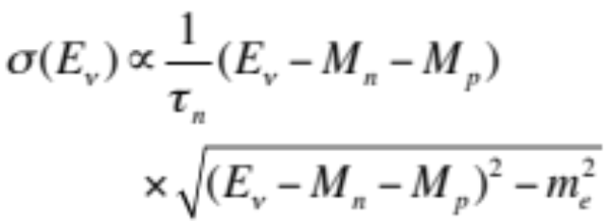
Detected Spectrum
E_{ν} ∊ [2-8] MeV
σ_{interacion} ~ qq 10⁻⁴³ cm²

Slide 14
The Reactor Anomaly

Slide 15
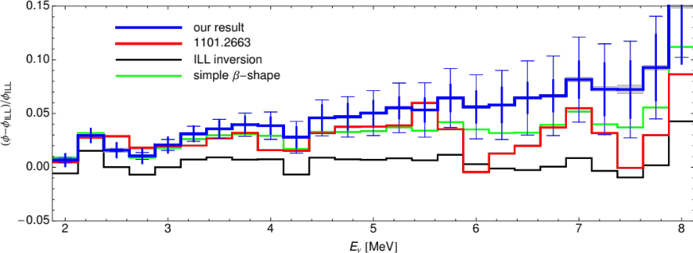
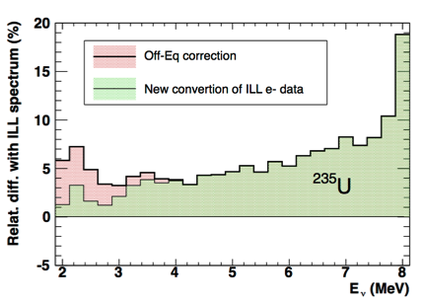
Re-evaluation of Reactor ν Spectra
Work triggered at CEA-Irfu by the need of accurate predictions for the Double Chooz experiment
Improved conversion of ILL beta spectra
Th. Mueller et al, Phys. Rev. C83,054615 (2011)
P. Huber, Phys. Rev. C84, 024617(2011)
New
Conversion
→ +3.5%
Accumulation of long lived isotopes
→ +1%

Slide 16

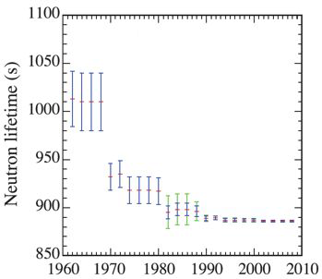
Re-evaluation of Detected Spectra
Increased prediction of detected flux
New
Conv.
→ + 1.5%
New τ_{n}
PRD 83, 073006 (2011)

Slide 17
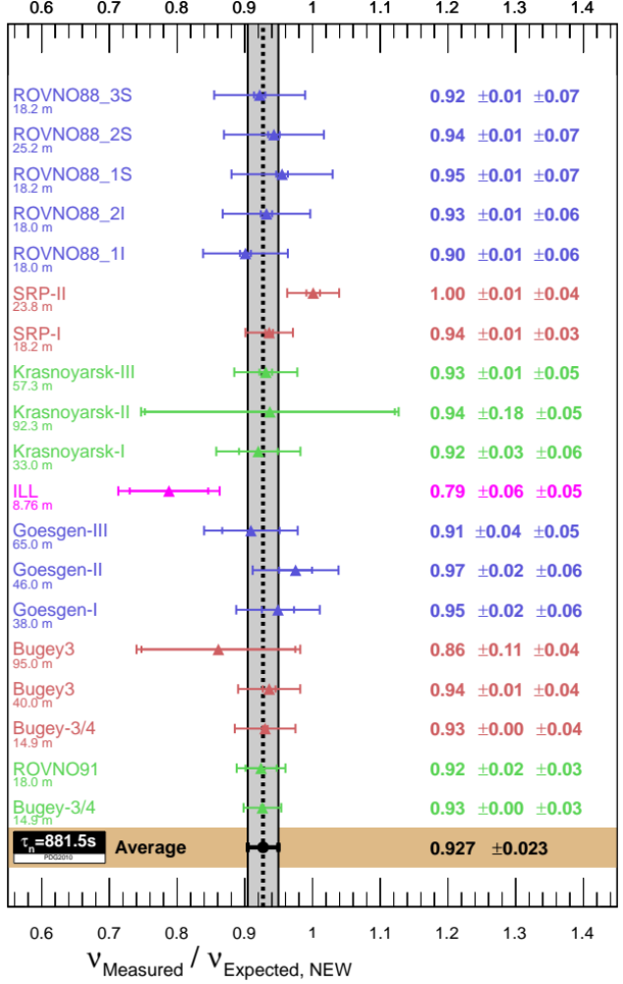
The Reactor ν_{e} Anomaly
Re-analysis of 19 Short Baseline Experiments (L<100m)
Observables: ratios of observed event rate to predicted rate of events
  2011 results Phys. Rev. D83, 073006 (2011)
  Average: μ = 0.943 ± 0.023
  98.6 % C.L. deviation from μ = 1

Slide 18
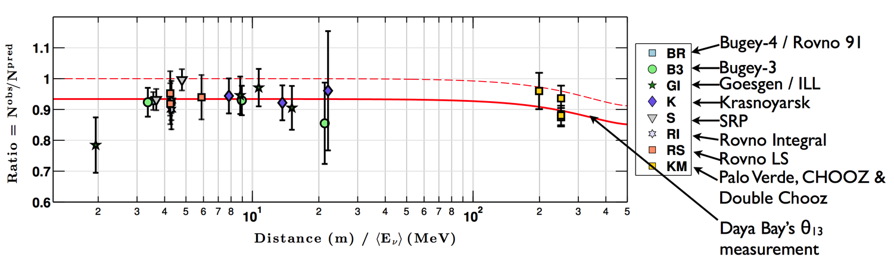
Including km-scale Experiments
Refined treatment of experimental correlations
Latest updated neutron mean life (τ_{n} = 881.5 s).
Corrects for a statistical bias (1% shift)
km-scale baselines (Chooz, Double Chooz, Palo Verde)
  θ₁₃ deficit corrected from Daya Bay’s independent measurement
μ = 0.936 ± 0.024, 2.7σ deviation from unity

Slide 19
The Sterile Neutrino Hypothesis

Slide 20
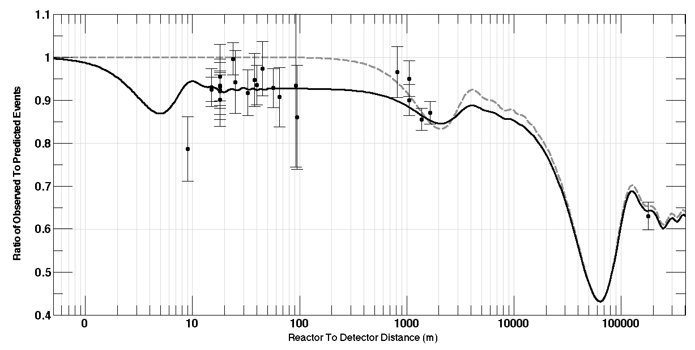
A 4th neutrino ?
New prediction for no oscillation
Old prediction
θ₁₂
New Oscillation to sterile ν?
Atmospheric Oscillation
Solar
Oscillation
θ_{new}?
Reactor anomaly
θ₁₃

Slide 21
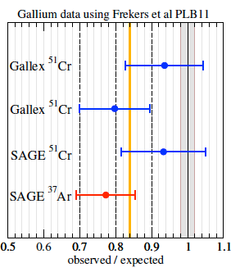
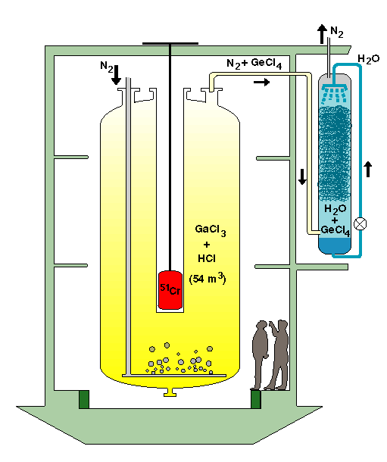
The Gallium Neutrino Anomaly
Calibration of solar neutrino detectors with MCi e-capture ν_{e} emitters
  ⁷¹Ga/³⁷Ar + ν_{e} → ⁷¹Ge/³⁷Cl + e⁻
    Gallex, <L>=1.9 m
      ⁵¹Cr, 750 keV
    Sage, <L>=0.6 m
      ⁵¹Cr & ³⁷Ar (810 keV)
  Deficit observed
    2.8 - 3 σ anomaly
    Supported by new ⁷¹Ga(³He,³H)⁷¹Ge cross section meas.
Gallex

Slide 22
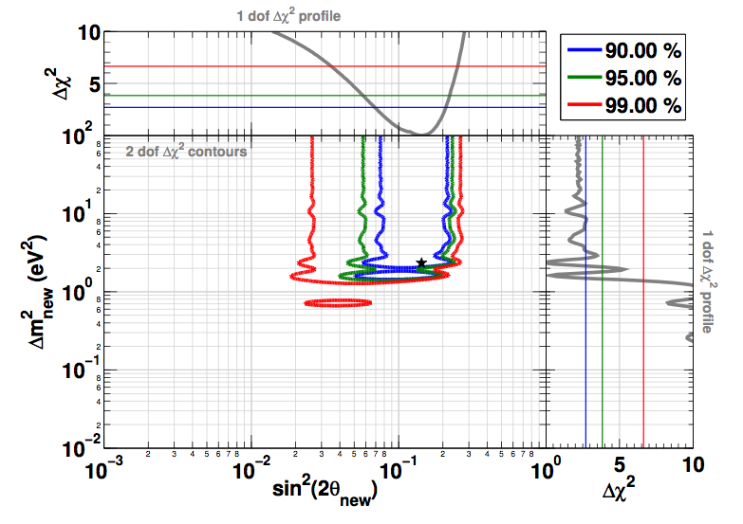
Contours

Slide 23
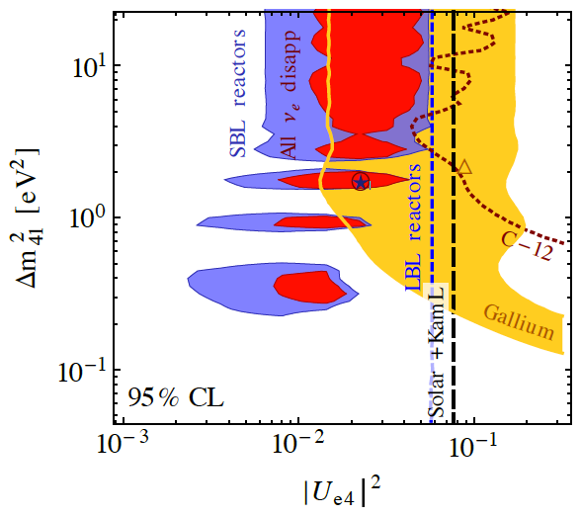
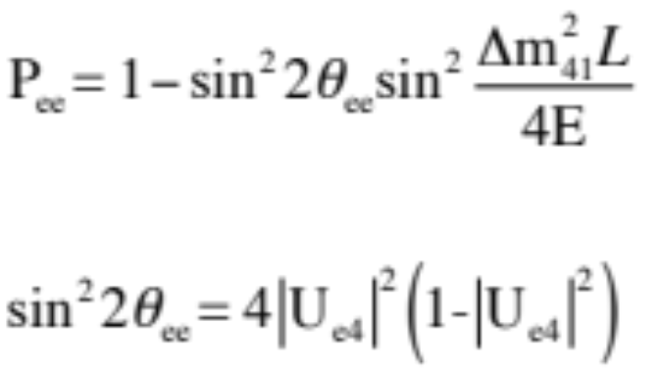
Contours
₍₋₎
Data consistent with ν_{e} disappearance with L/E≈1 m/MeV
J. Kopp et al., arXiv:1303.3011

Slide 24
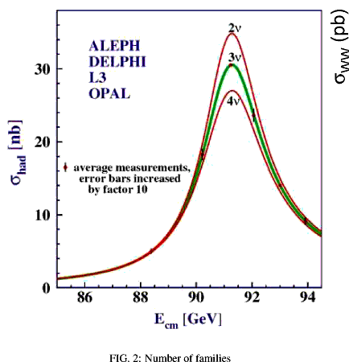
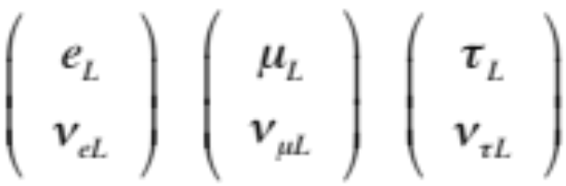


Theoretical Aperçu
New neutrino id
Mass of the order 1 eV
Sterile
Mixing with the active flavor(s)
L state because of Lorentz invariance
3 sterile ν candidates?
No
Could only mix L ν state with sterile L state of anti-ν →
ΔN_{lepton}= 2
Not compatible with independent L,R states of Dirac formalism
Requires new ν_{s} state(s), with Dirac or Majorana masses
Little theoretical constraints on mass range and number of ν_{s}

Slide 25
Anomalous & Regular Results
Anomalous | Source | Type | Signal | Channel | Significance
Gallium | Electron Capture | ν_{e} dis. | Total Rate | CC | 2.7-3.0 σ
Reactor | Beta-decay | ν_{e} dis. | Total Rate, Energy | CC | 2.7 σ
LSND | Meson Decay-at-Rest | ν_{μ} → ν_{e} | Total Rate, Energy | CC | 3.8 σ
MiniBooNE | Meson Decay-in-Flight | ν_{μ} → ν_{e} | Total Rate, Energy | CC | 3.8 σ
Regular | Source | Type | Signal | Channel
KARMEN Icarus/Opera | Meson Decay -at-Rest & Flight | ν_{μ} → ν_{e} | Total Rate, Energy | CC
CDHS/MiniBooNE | Meson Decay-in-Flight | ν_{μ} → ν_{μ} | Total Rate, Energy | CC
Minos | Meson Decay-in-Flight | ν_{μ} → ν_{s} | Total Rate | CC
−
−
−
−
−
−

Slide 26
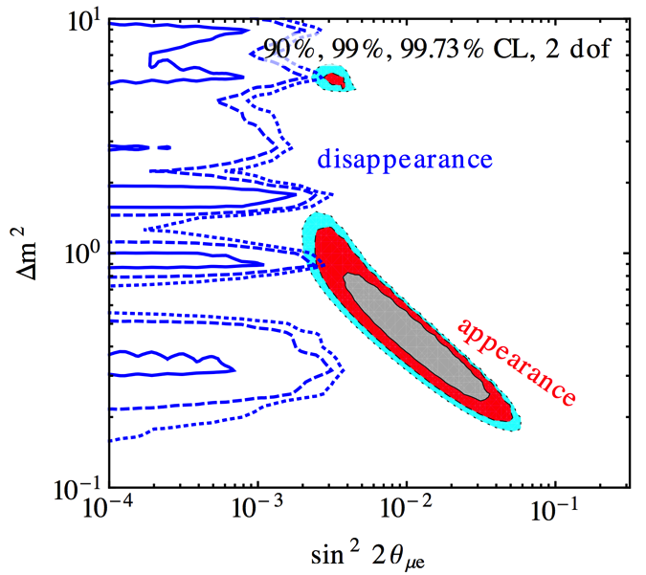
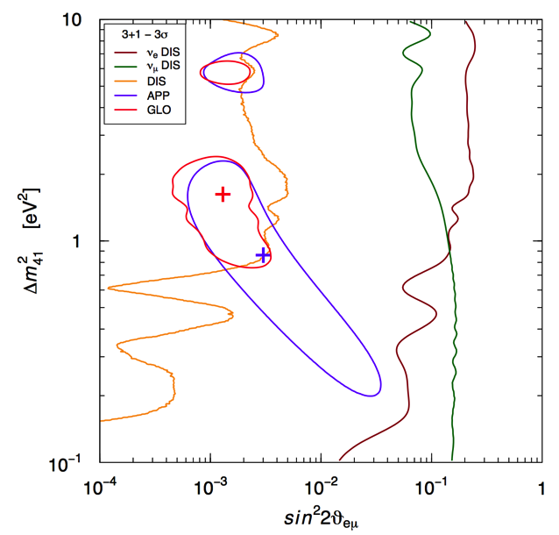
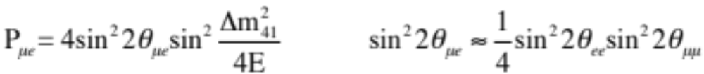
Appearance VS Disappearance
J. Kopp et al., arXiv:1303.3011
C. Giunti et al., arXiv:1302.6720
AP
DIS
Hard to reconcileν_{e}/ν_{e} appearance/disappearance withν_{μ}/ν_{μ} disappearance (3+1 & 3+2 models)

Slide 27
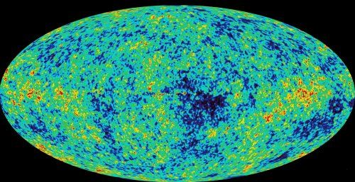
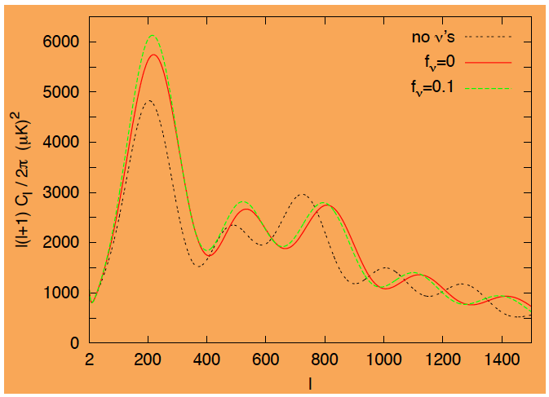
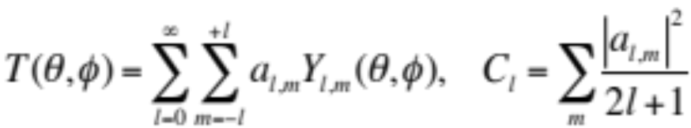
CMB
The recombination of e⁻ and p ~380000 y after the big-bang provides a quasi infinite propagation to the photons
Distribution of anisotropies is frozen and observable today in the CMB
Spherical harmonics expansion of the signal
Position and amplitude of the acoustic peaks are sensitive to the cosmological parameters:
H₀, Ω_{b}h², Ω_{c}h², Ω_{Λ}, …., N_{eff}, Σm_{ν}
http://www.apc.univ-paris7.fr/blog/content/le-fond-diffus-cosmologique-cmb

Slide 28
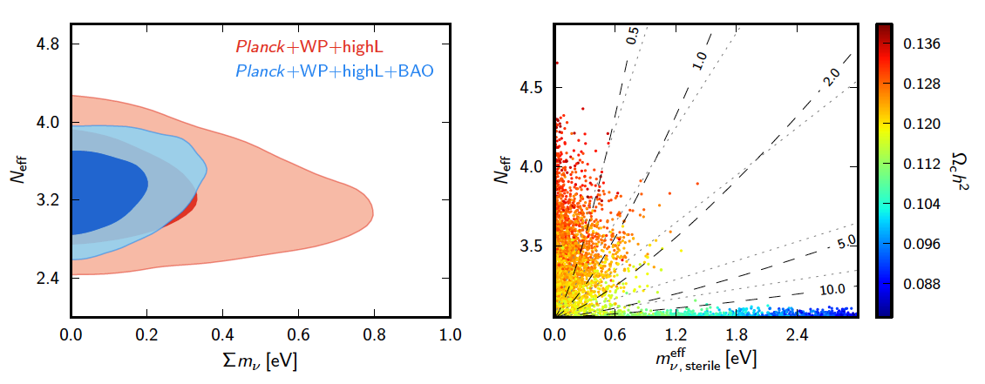
Constraints from cosmology
Planck results, astro-ph:1303.5076
Combination of Planck results and BAO data:
N_{eff}<3.9
m^{eff}_{s}<0.6 eV
95% C.L.
Requires non-standard mechanism to depart from ΔN_{eff} = +1

Slide 29
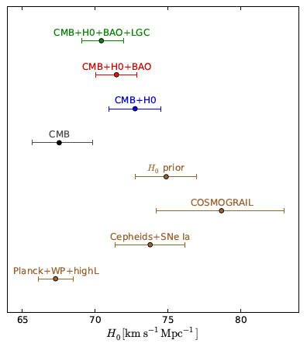
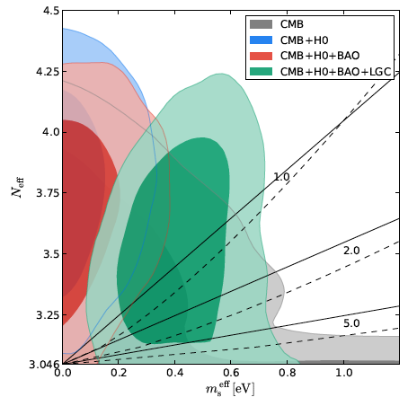
Constraints from cosmology
See next SPP seminar by J. Lesgourges
Several tensions between data sets would require fine study of systematic errors
Overlap with reactor anomaly sensitive to choice of data sets
arXiv,hep-ph:1309.3192
Need complementary approach of direct measurements of sterile neutrino

Slide 30
Testing new ν_{e} disappearance at short distance from compact sources

Slide 31
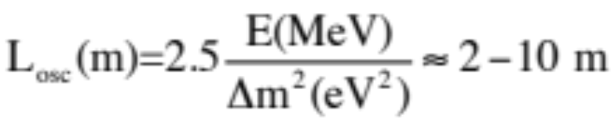
Experimental Strategy
Need direct test, beyond the current mean deviation from predicted rate
Input from sterile neutrino fits
  Δm² ≈ 0.1-10 eV² →
  sin²(2θ_{ee}) ≈ 0.01-0.15
Experimental specifications:
  Compact source
  Good vertex and energy resolutions
  High statistics, few % stat. uncertainty
  Few % syst measurements to cover the anomaly contour
Search for a new oscillation pattern in E & L
Measurement of relative shape distortion, completed by norm information.

Slide 32
Reactor Experiments

Slide 33
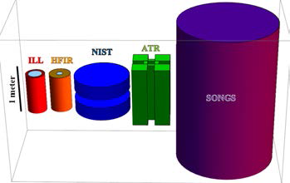
Research Reactors
Typical reactor core sizes
Compact sources
  No oscill. smearing.
High statistics, typically few 100 evts/day/t
  Intense source
  Very short baselines available (5-50 m)
Alternation of reactor ON/OFF periods
  moderate overburden compensated by accurate measurement of the cosmogenic component.
Highly enriched fuel
  Well known ²³⁵U fisison spectrum.
But challenging reactor-induced backgrounds (γ and n)
→ Requires comprehensive site characterization.

Slide 34
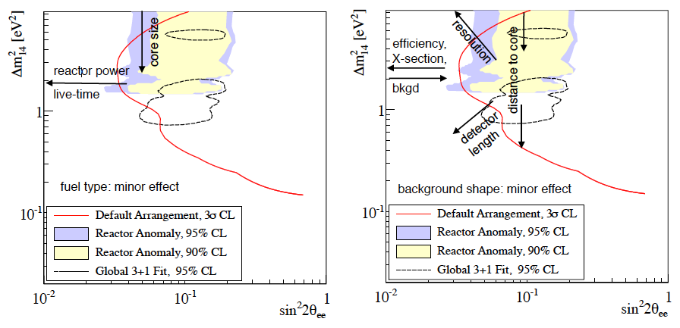
Main Experimental Parameters
All current projects have the sensitivity to test the reactor anomaly space of parameters, Δm²>0.1, sin²2θ>0.05
Source
Detector
K.M. Heeger et al., arXiv:1212.2182v1
Year scale stability
K.M. Heeger et al., arXiv:1212.2182v1

Slide 35
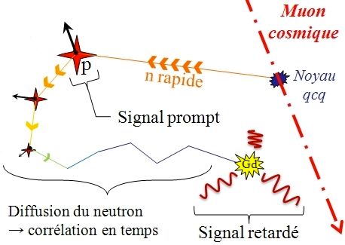
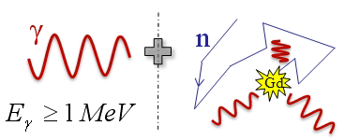

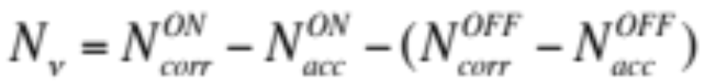
Backgrounds
Accidental
Correlated
High E γ
Random coinc of independent evts
Accurately measured online using duplicated off-time windows
→ Statistical limitation only
Online reduction: overburden, μ-veto, PSD of recoiling proton
Measured reactor OFF and subtracted

Slide 36

Worldwide Experimental Program
Nucifer @ Osiris Saclay
SOLID @ BR2, Belgium
DANSS @ KNPP Udolmya
Neutrino4 @ SM-3 Dimitrovgrad
Stereo @ ILL Grenoble
CARR site Beijing
US Short Baseline Interest Group
Hanaro,
Corea

Slide 37

Detection of Reactor ν
Experiment Type | Experimental Strategy
Mature Gd-doped LS detector Technology | - High E signature of n-capture (8 MeV γ-cascade) - High light yield → fast n background rejection by PSD - But sensitive to high-E γ’s → need large passive shielding
Highly segmented detector for background reduction | - Vertex correlation between prompt and delayed - Topology of E depositions: e+ → compact track + annihilation γ’s γ → longer interaction length
Enhanced neutron Tagging | - Unique signature of neutron capture with Li-doped LS/PS
2 detector complex or Moving detector | - Better sensitivity to lower Δm² - But Need larger volume and/or longer running time

Slide 38
Reactor ν Proposals
Experiment Type | Projects | P_{th} | M_{det} | L | Depth
Mature Gd-doped LS detector Technology | Nucifer (FRA) | 70 MW | 0.7 tons | 7 m | 13 mwe
 | Stéréo (FRA) | 50 MW | 2 tons | [8-11] m | 18 mwe
 | Neutrino 4 (RU) | 100 MW | 2 tons | [6-12] m | Few mwe
Highly segmented detector for background reduction | DANSS (RU) | 3 GW | 1 ton | [9.7-12.2] m | 50 mwe
 | SoLid (UK) | 45-80 MW | 3 tons | 8 m | 10 mwe
Enhanced neutron Tagging
 | Hanaro (KO) | 30 MW | 0.5 t | 6 m | Few mwe
2 detector complex or Moving detector | US project | 20-120 MW | - | 4m & 15m | ~ Surf.
 | CARR project (China) | -
 | DANSS/Neutrino 4 | Movable detector

Slide 39
Gd-Loaded Liquid Scintillators

Slide 40
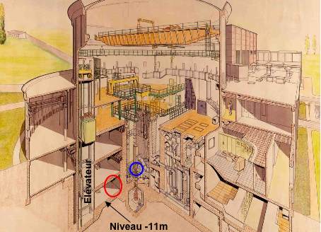
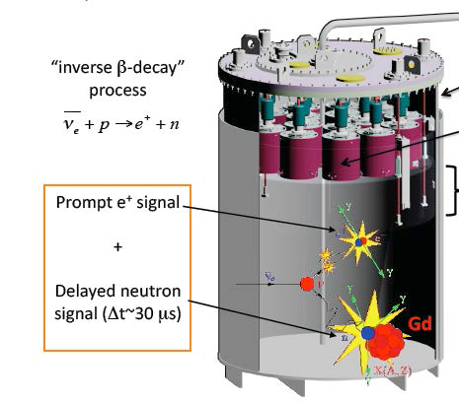
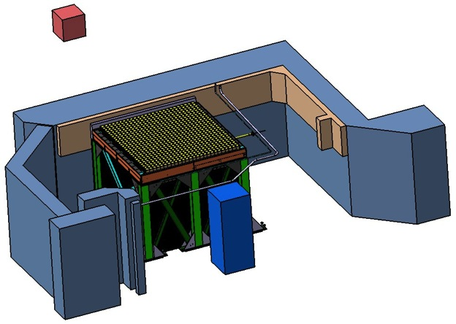
Nucifer @ Osiris
Detector designed for reactor monitoring studies
  850 kg Gd-loaded LS
  ~1000 int. expected / day
  Shallow depth (few mwe)
Osiris reactor
Saclay, France
70 MW
7m

Slide 41
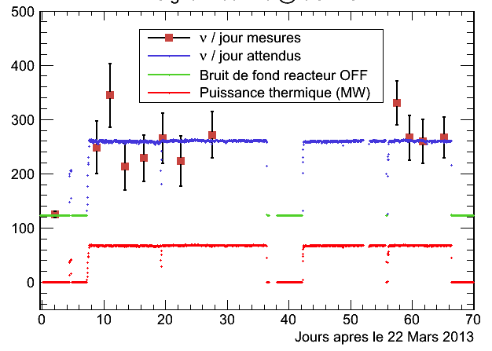
Nucifer: First Neutrinos
Detection efficiency and statistical accuracy limited by excessive accidental background
P_{th} (MW)
Shallow depth but cosmic bkg is kept below the ν signal.

Slide 42
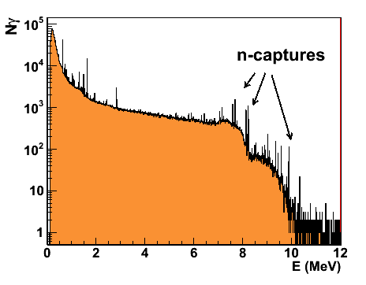
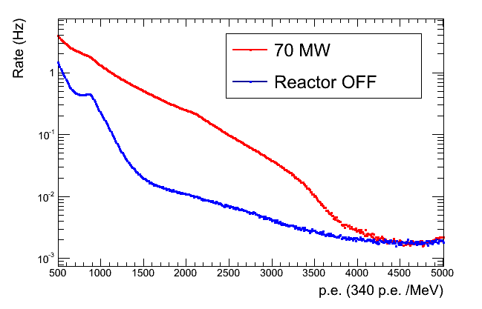
Nucifer: Accidentals
External γ background: high E rays from n-capture on Fe, Al, Ni, …
Nucifer singles
prompt
delayed
Total rate above 2 MeV = 200 Hz, on specification
But high energy tail, spoiling the n-capture signal around 8 MeV
→ Need 4cm extra lead shielding, to be installed soon.

Slide 43
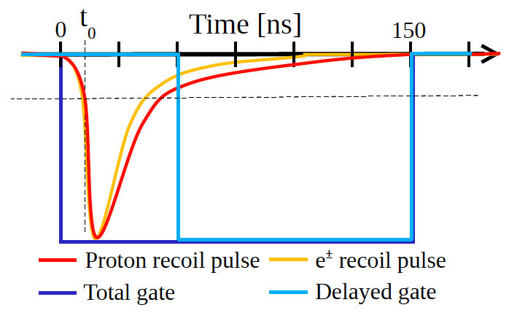
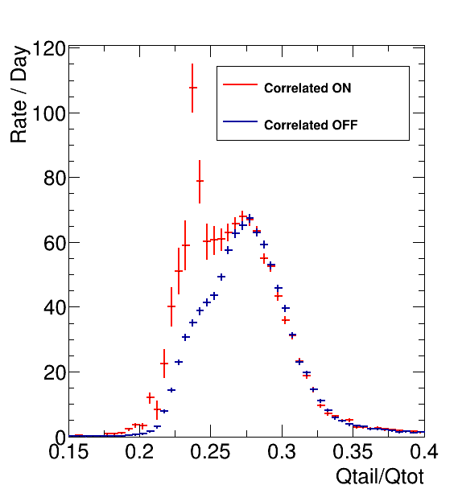

Nucifer: Fast n Background
Pulse Shape Discrimination
PSD plot of Osiris data taking
Q_{tail}
Q_{tot}
ν
Nucifer liquid : 50% PXE, 50% dodecane
²⁵²Cf source
γ
p recoils
Perfect match of p recoils after acc subtraction
→ No fast neutrons from reactor

Slide 44

Nucifer: Sensitivity to Sterile ν
Modest sensitivity to Sterile-ν:
  Compact core: 60x60x60 cm³
  Short baseline: only 7 m
  Simple design
  One single baseline
  Challenging Reactor bkg
1 year data taking starting spring 2014 after final shielding upgrade
1 year
S/B=0.5

Slide 45





Stereo @ ILL
Outer crown for improved ε_{det} and veto of external background
Good overburden from water channel, factor 4 attenuation of vertical flux
μ veto
γ and n shielding
Relative measurement in 6 cells
50 MW core
h=80cm, Φ=40cm
Detector based on Double Chooz and Nucifer developments.
[8.5-11] m baseline range

Slide 46





Stereo: Background Rejection
Core
Reduction of accidentals
Comprehensive on site measurements of muon, thermal n, fast n and γ backgrounds.
Massive deployment of shielding during the upcoming long reactor shutdown. 30 cm of lead in front hot γ spots + hermetic B4C coating.
Dedicated plug of the neutron line.
Stereo
Shadow of water channel
B4C
Lead

Slide 47


Stereo: Background Rejection
Rejection of fast neutrons
100 ml test sample
FoM>1
Overburden
μ-veto and top passive shielding
Active outer-crown
Kinematics and liquid quenching factor → E_{n} > 5 MeV
Liquid R&D for optimal light yield and PSD

Slide 48

Stereo Sensitivity
6 ILL cycles (1.5 year running)
L₀ = 9.8 m
S/B = 1.5
E_{vis}>2 MeV, Neutron cut = 5 MeV
Complete det response
δL=20 cm, δE/E~10%@ 1MeV
δEscale = 2%
All syst. of ²³⁵U spectrum
3.5% total norm error
480 ν/day expected
Funded by ANR grant
Time schedule:
  2013-2014: design and construction
  Prototype testing
  2015-2016: data taking

Slide 49



Neutrino-4 @ SM3
Courtesy of A. Serebrov
2.5 m³ LS target, 5 section movable detector [6-12] m
100 MW compact core
Detector at Surface
E_{prompt}>2.2 MeV, No background
95%

Slide 50



Neutrino-4 Prototype
Validation of a prototype detector at the WWR-M 17 MW reactor (Gatchina)
Raw
Raw + veto
coinc
Coinc + veto
Neutrino detection currently limited by cosmic rays induced fast neutrons.
Lead + CH2 detector shielding integrated at the SM-3 site.
Data taking in 2015
arXiv:1310.5521

Slide 51
Highly Segmented Detectors

Slide 52



DANSS @ KNPP
1 GW extended core
Good overburden
Vertical motion of the detector (9.7-12.2 m)
Highly segmented detector
→ background rejection
Plastic strips with Gd-loaded interlayer, WLS fibers readout, δE/E~20%
Start in 2014/15
10⁴ evt/day
VVER-1000

Slide 53



DANSSINO Prototype
Tested for ~20 days @ KNPP
1/25th of DANSS
10 cm Cu-Lead + 10 cm CH₂ shelding
Accidentals well suppressed
S/B~1, limited by cosmic fast neutrons.
arXiv:1304.3696v2

Slide 54
Highly Segmented
&
Enhanced Neutron Discrimination

Slide 55



SoLi∂ Antineutrino detection
Assembly of 5cm cubic cells
⁶Li
⁶Li
-
⁶Li
ν_{e}
e⁺
γ
γ
⁶Li
n
Very discriminant neutron signal in ⁶LiF:ZnS. High neutron-γ rejection factor
3D reconstruction close to interaction point : high background rejection capability using topological information of IBD.
δE/E ~ 17% at 1 MeV
Courtesy of A. Vacheret

Slide 56

SoLi∂
Search for Oscillations with ⁶Li Detector
BR2 REACTOR, Mol, Belgium
Core: 45-80 MW, ~ 50cm diameter
DETECTOR
2.88t fiducial volume
Novel type of composite solid scintillator detector (PVT + 6LiF:ZnS)
2x 20 planes 1.2m x 1.2m x 1m with 576 5cm x 5cm x 5cm cubes
Read out by WLS fibres and Geiger-mode APDs (MPPC), 1920 channels total
HDPE shielding
Lead Wall
SoLid detector
BR2 core
5.5m
HIGH SIGNAL TO BACKGROUND RATIO : S/B ~ 6
Soft Gamma-rays (< 3 MeV)
No reactor neutrons
Overburden ~10 m.w.e

Slide 57





SoLi∂ Sensitivity & status
NEMENIX prototype under test at BR2
Rate + shape
8kg Fiducial mass
5σ
95% CL
99% CL
Analysis in progress
<Baseline>=6.8m, 2.88t fiducial mass
300 days (~ two years running)
45% IBD efficiency, 1200 n/day expected
L binning of 20 cm
Systematics : norm 4.1%, total ~5%
Physics run scheduled for start of 2016

Slide 58
2 Detector Concept

Slide 59


US Effort
reactor core
Segmented, LS target based technology
3 reactor sites
  NIST – 20 MW
  ATR – 85 MW
  HFIR – 120 MW
Surface location
2-detector concept
Status:
  Site characterization ongoing
  Start 2016?
detector 1
~4m
detector 2
~15m
x10 det1 vol.

Slide 60

2 Detector Sensitivity
Extends sensitvity to lower Δm²
Possible discrimination between 3+1 and 3+2 scenarios

Slide 61
Source Experiments

Slide 62
Worldwide Experimental Program
Katrin
Sage, Baksan
CeLAND,
KamLAND
LENS,
Kimbelton
SOX@ LNGS
Ce - Daya Bay

Slide 63
ν Generator Proposals
Type | Detection | Background | Isotope | Production | Activity | Projects
ν_{e} | ν_{e} e →ν_{e} e 5% E_{res} 15cm R_{res} or Radio-chemical | Detector Radioactivity Solarν (irreducible) ν generator impurities | ⁵¹Cr 0.75 MeV t_{1/2}=26d | n_{th} irradiation in Reactor | >3 MCi | Sage LENS
 |  |  |  |  | >10 MCi | SOX (SNO+)
 |  |  | ³⁷Ar 0.8 MeV t_{1/2}=35d | n_{fast} irradiation in Reactor (breeder) | >1 MCi | -
 |  |  |  |  | 5 MCi | Ricochet
ν_{e} | ν_{e} p → e⁺ n E_{th}=1.8 MeV (e⁺,n) 5% E_{res} 15cm R_{res} | reactorν, geo ν, ν generator impurities | ¹⁴⁴Ce E<3MeV t_{1/2}=285d | spent nuclear fuel reprocessing + REE extraction | 75 kCi | CeLAND SOX
 |  |  |  |  | 500 kCi | Daya-Bay
 |  |  | ⁹⁰Sr ¹⁰⁶Rh |  | - | -
 | ³H→He e⁻ ν_{e} EC/β-decay | Kink search | ³H E<18 keV | Irradiation in reactors | 3 Ci | KATRIN (Mare/Echo)
−
−
−

Slide 64

¹⁴⁴Ce-¹⁴⁴Pr ν generator
−
−
1st Trick: ν_{e} source detected via ν_{e} + p → e⁺ + n (Thr=1.8 MeV)
  High IBD cross section → ~100 kCi activity
  (e⁺,n) detected in coincidence → Strong background reduction
2nd Trick: ¹⁴⁴Ce-¹⁴⁴Pr
  Abundant fission product (5%)
  ¹⁴⁴Ce: long-lived & low-Q_{β} Enough time to produce, transport, use
  ¹⁴⁴Pr: short-lived & high-Q_{β} ν_{e}-emitter above threshold
−
Phys.Rev.Lett. 107 (2011) 201801

Slide 65


CeSOX
100 kCi ¹⁴⁴Ce deployed next to Borexino (8.2 meters)
Cerium Antineutrino Generator (CeANG) produced in Russia in 2014/15.
Transportation from Russia to LNGS middle of 2015
Deployment at LNGS middle of 2015
1.5 y data taking – 10 000 neutrino interactions expected
Collaboration: France – Italy – Germany - USA

Slide 66

CeSOX: detector

Slide 67

CeSOX: signal
High quality of the Borexino detector
E_{resol} 6% @ 1 MeV
Vertex resol ~ 15 cm
Very low background
Large lever arm in L
L/E (m MeV⁻¹)

Slide 68

Activity: Calorimeter
Source power ~750 W @ 100 kCi
% level measurement of total activity using calorimeter
→ complementary normalization information
(multi layer insulation not represented)

Slide 69

CeSOX: sensitivity

Slide 70
Conclusion
Anomalies calling for clarification
  Compatible Reactor and Gallium anomalies (ν_{e} disappearance)
  Tension in global fit
  Δm²≈eV² Sterile Neutrino? Or Experimental Artifacts?
Establishing the existence of sterile neutrinos would be a major result for physics . Many proposals with capabilities to unambiguously test
L/E≈1 m/MeV oscillatory behavior within short time scale (5 years) and modest cost.
Reactor experiments: combination of mature technologies and R&D. Background mitigation is challenging.
Source experiments: low background and state of the art detector. Challenging source production and transportation.

