Slide 1
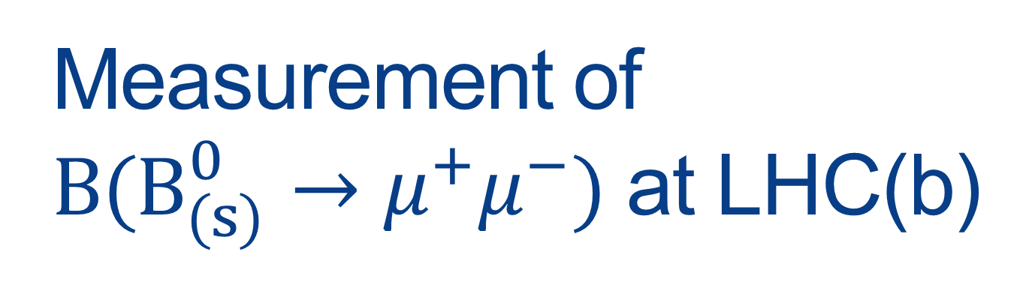
Measurement of $B(B_{(s)}^{0}→μ^{+}μ^{−})$ at LHC(b)
Mathieu Perrin-Terrin*
Seminar at CEA Saclay
Monday, January 6th 2014
*CERN

Slide 2
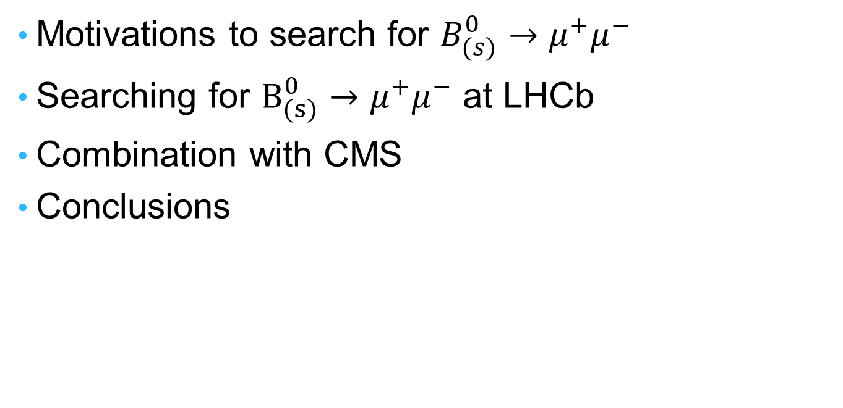
Outlines
Motivations to search for $B_{(s)}^{0}→μ^{+}μ^{−}$
Searching for $B_{(s)}^{0}→μ^{+}μ^{−}$ at LHCb
Combination with CMS
Conclusions

Slide 3
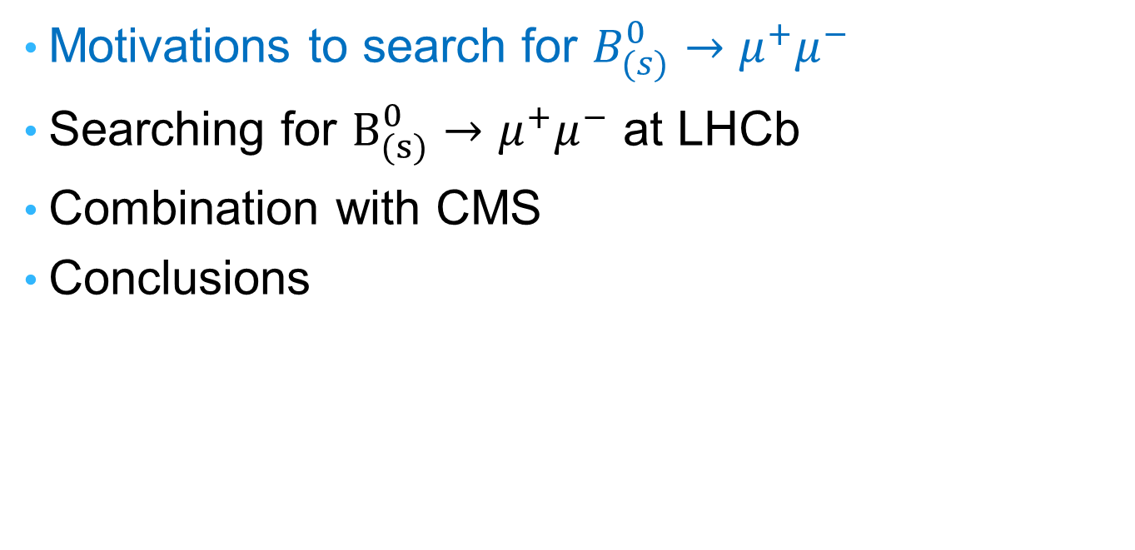
Outlines
Motivations to search for $B_{(s)}^{0}→μ^{+}μ^{−}$
Searching for $B_{(s)}^{0}→μ^{+}μ^{−}$ at LHCb
Combination with CMS
Conclusions

Slide 4
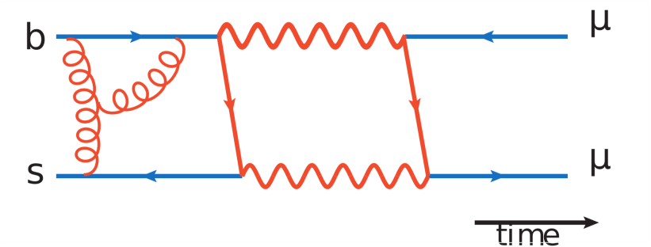
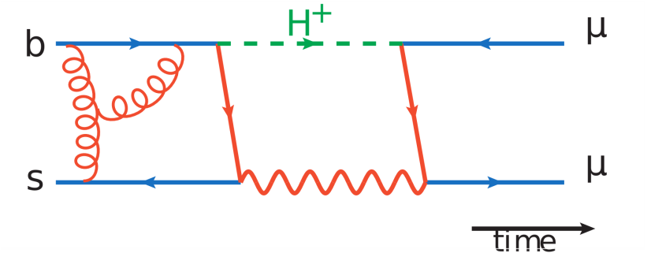



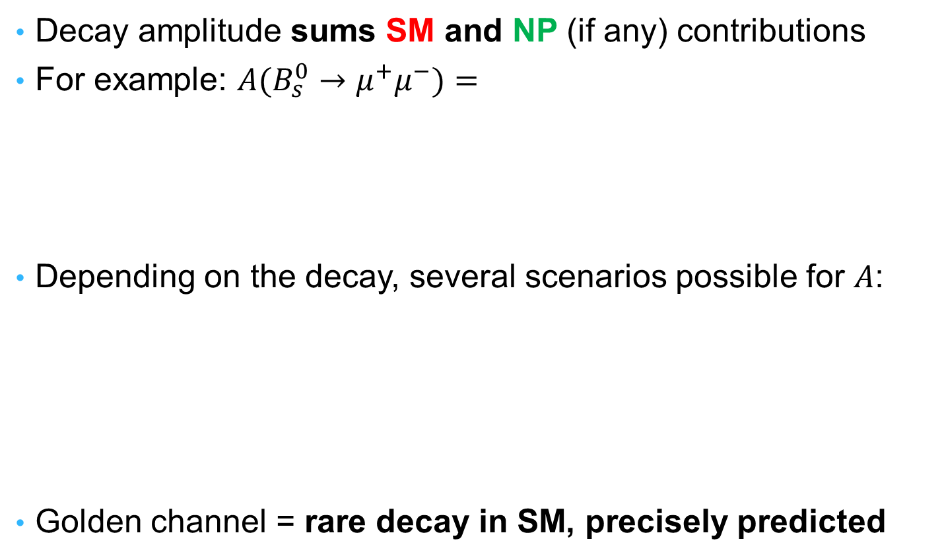


Searching for NP with Flavour Physics
Decay amplitude sums SM and NP (if any) contributions
For example: ${A(B}_{s}^{0}→μ^{+}μ^{−})=$
Depending on the decay, several scenarios possible for $A$:
Golden channel = rare decay in SM, precisely predicted
$$+$$
$+$ etc…
$$A$$
$$A$$
$$A$$
SM dominates
NP can dominate but large theo. uncert.
NP can dominate and small theo. uncert.

Slide 5
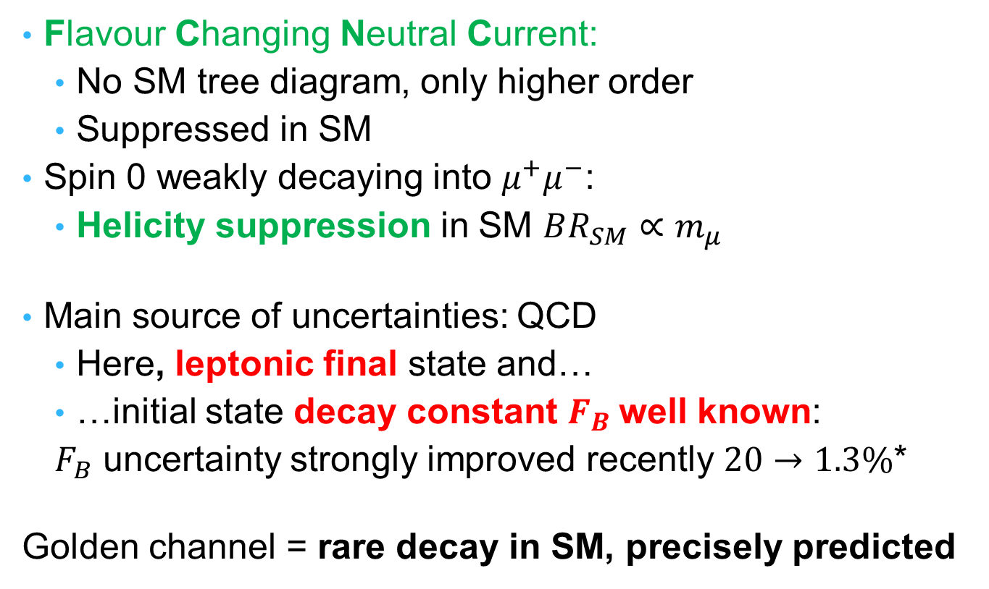




The $B_{(s)}^{0}→μ^{+}μ^{−}$Case: Rare & Precise
Flavour Changing Neutral Current:
  No SM tree diagram, only higher order
  Suppressed in SM
Spin 0 weakly decaying into $μ^{+}μ^{−}$:
  Helicity suppression in SM $BR_{SM}∝m_{μ}$
Main source of uncertainties: QCD
  Here, leptonic final state and…
  …initial state decay constant $F_{B}$well known:
  $F_{B}$ uncertainty strongly improved recently $20→1.3\%$*
Golden channel = rare decay in SM, precisely predicted
  Helicity Suppressed
$$μ^{+}$$
$$μ^{−}$$
$$B_{s}$$
*HPQCD, PRL 110, 222003, 2013

Slide 6
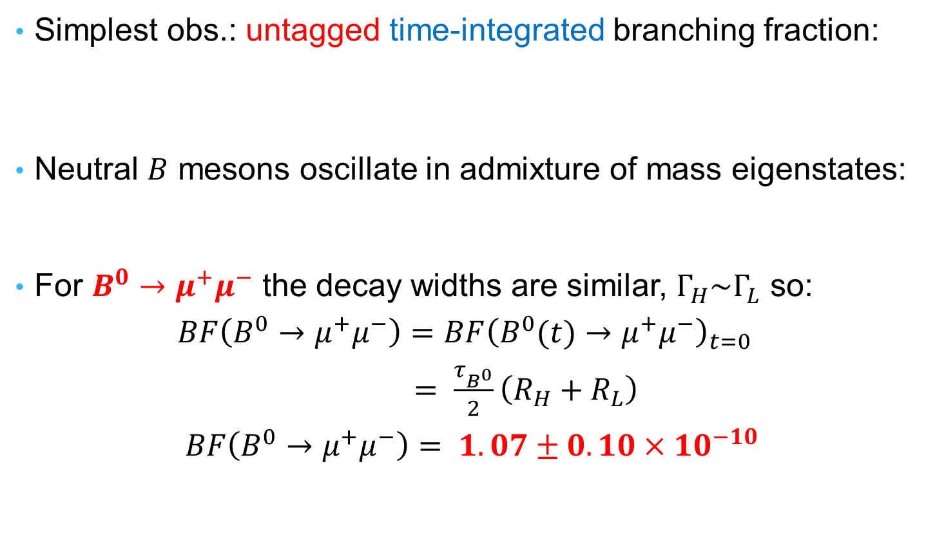

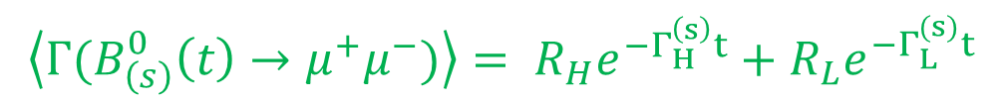
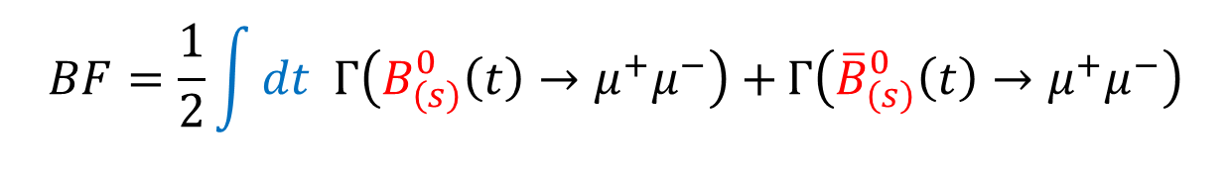
The $B_{(s)}^{0}→μ^{+}μ^{−}$ Observables
Simplest obs.: untagged time-integrated branching fraction:
Neutral $B$ mesons oscillate in admixture of mass eigenstates:
For $B_{}^{0}→μ^{+}μ^{−}$ the decay widths are similar, $Γ_{H}^{}\sim Γ_{L}^{}$ so:
$BF\left(B_{}^{0}→μ^{+}μ^{−}\right)=BF{\left(B_{}^{0}(t)→μ^{+}μ^{−}\right)}_{t=0}$
$= \frac{τ_{B^{0}}}{2}\left(R_{H}+R_{L}\right)$
$BF\left(B_{}^{0}→μ^{+}μ^{−}\right)= 1.07±0.10×{10}^{−10}$
$$BF=\frac{1}{2}\int{dt Γ\left(B_{\left(s\right)}^{0}\left(t\right)→μ^{+}μ^{−}\right)+}Γ\left({\overline{B}}_{\left(s\right)}^{0}\left(t\right)→μ^{+}μ^{−}\right)$$
$${\left\langle Γ(B_{\left(s\right)}^{0}\left(t\right)→μ^{+}μ^{−})\right\rangle = R}_{H}e^{−Γ_{H}^{\left(s\right)}t}+R_{L}e^{−Γ_{L}^{(s)}t}$$
SM
Updated from Buras et al. EPJ 2012

Slide 7
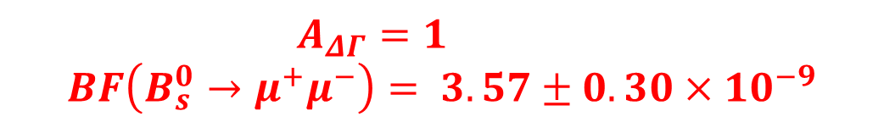

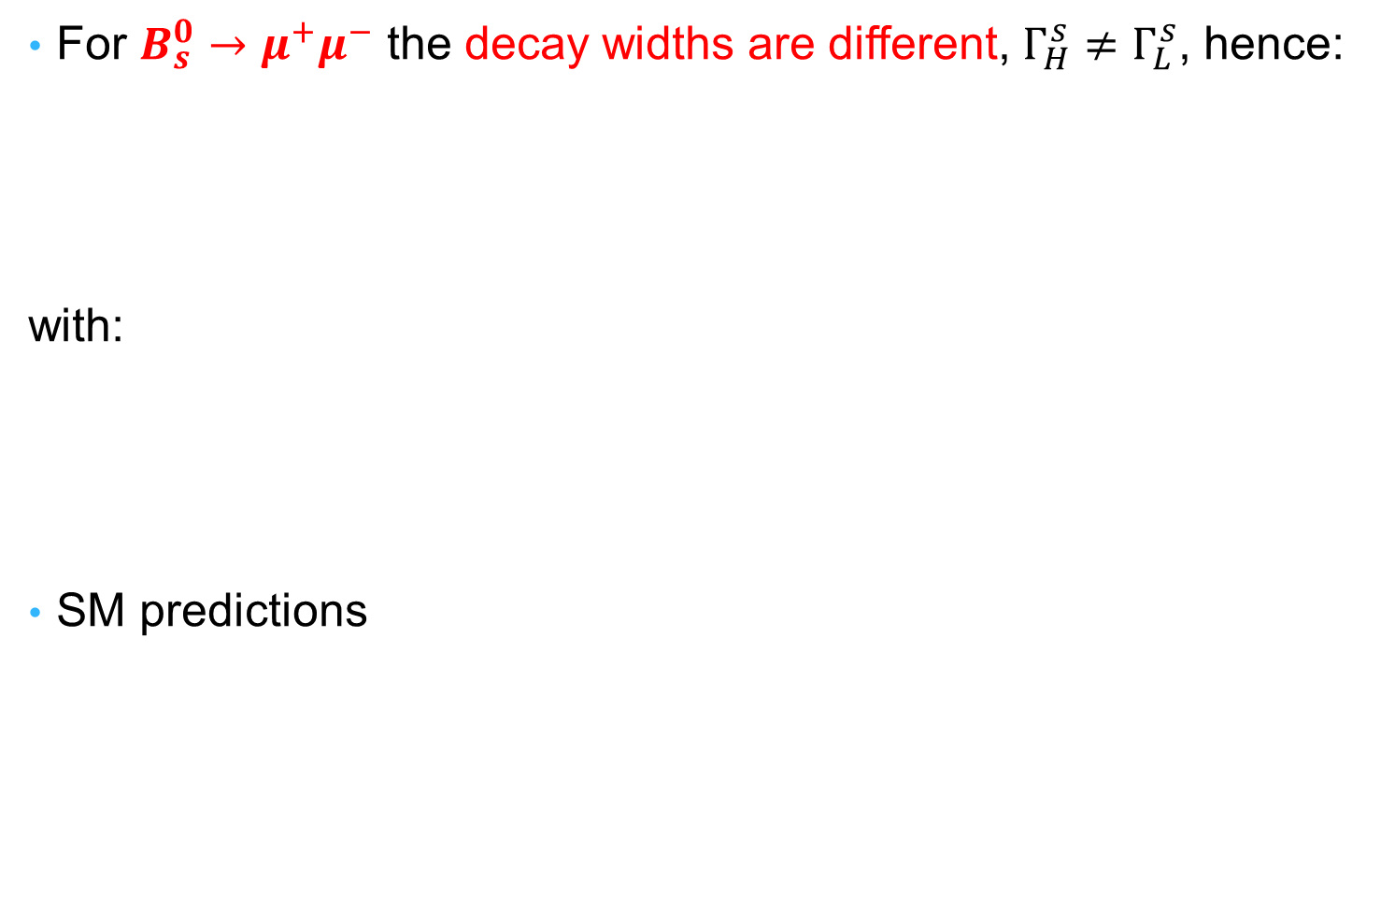
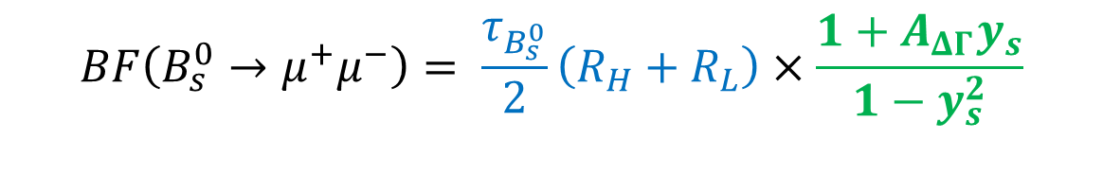
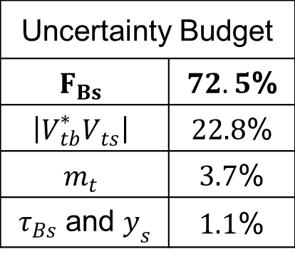
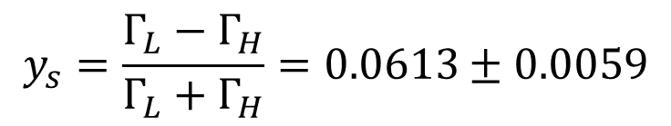
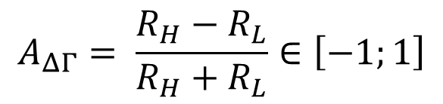
For $B_{s}^{0}→μ^{+}μ^{−}$ the decay widths are different, $Γ_{H}^{s}≠Γ_{L}^{s}$, hence:
with:
SM predictions
$$BF\left(B_{s}^{0}→μ^{+}μ^{−}\right)= \frac{τ_{B_{s}^{0}}}{2}\left(R_{H}+R_{L}\right)×\frac{1+A_{ΔΓ}y_{s}}{1−y_{s}^{2}}$$
$$BF{\left(B_{s}^{0}\left(t\right)→μ^{+}μ^{−}\right)}_{t=0}$$
meas.
$$A_{ΔΓ}= \frac{R_{H}−R_{L}}{R_{H}+R_{L}}∈\left[−1;1\right]$$
$$y_{s}=\frac{Γ_{L}−Γ_{H}}{Γ_{L}+Γ_{H}}=0.0613±0.0059$$
Uncertainty Budget
$$F_{Bs}$$ | $72.5$%
$$\left|V_{tb}^{∗}V_{ts}\right|$$ | $22.8$%
$$m_{t}$$ | $3.7$%
$τ_{Bs}$ and $y_{s}$ | $1.1$%
SM
$A_{ΔΓ}=1$
$BF\left(B_{s}^{0}→μ^{+}μ^{−}\right)$ $= 3.57±0.30×{10}^{−9}$
SM
Updated from Buras et al. EPJ 2012

Slide 8
What About New Physics?

Slide 9

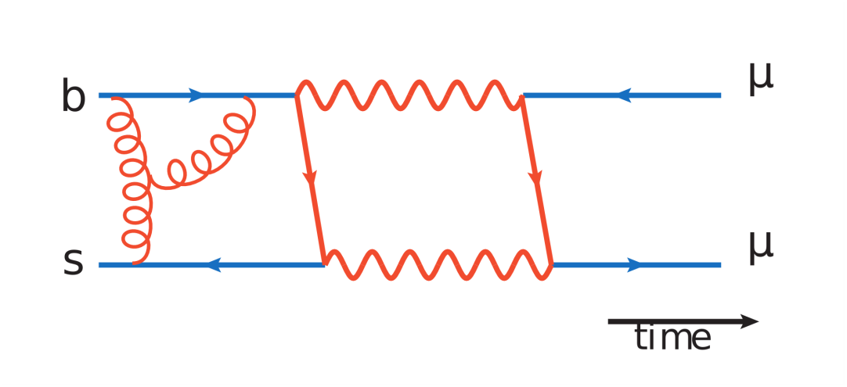
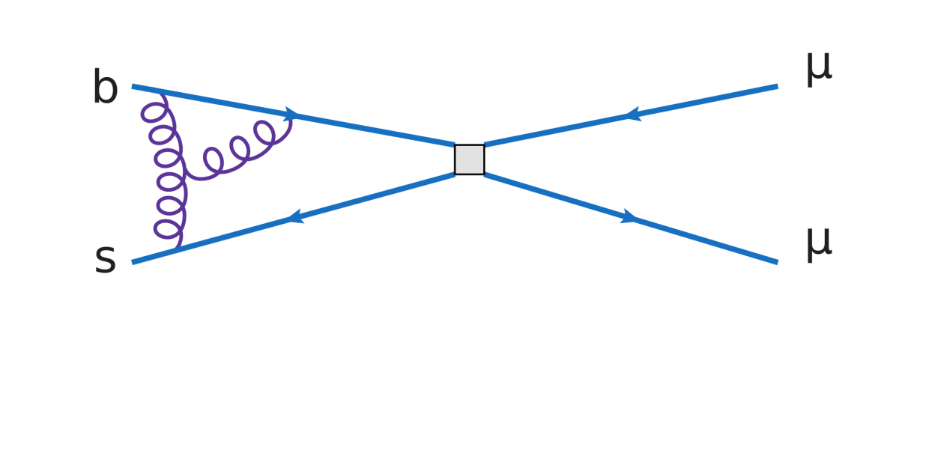

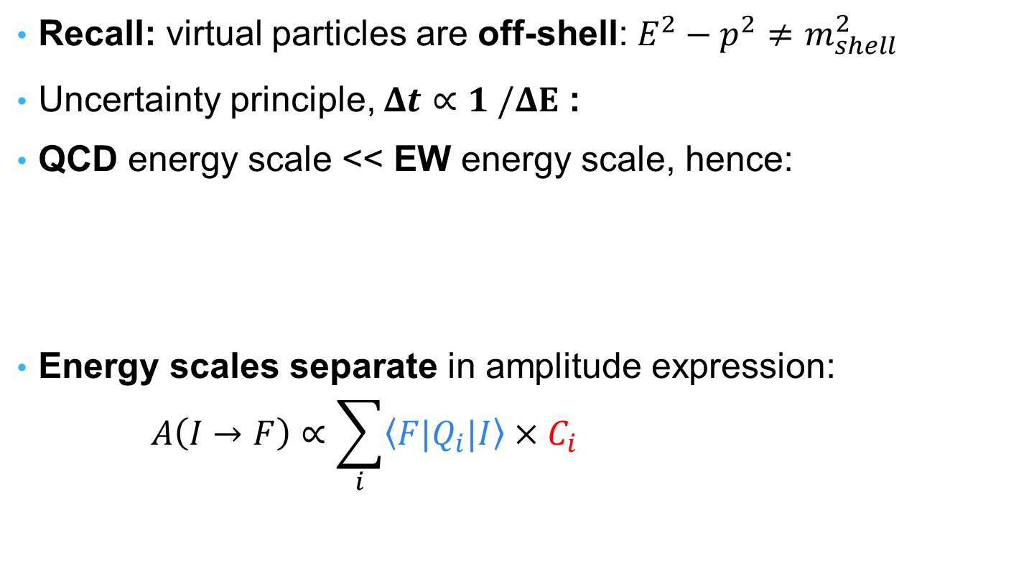
Model Independent Approach
Recall: virtual particles are off-shell: $E^{2}−p^{2}≠m_{shell}^{2}$
Uncertainty principle, $Δt∝1 /ΔE$ :
QCD energy scale << EW energy scale, hence:
Energy scales separate in amplitude expression:
$$A\left(I→F\right)∝\sum_{i}{\left\langle F|Q_{i}|I\right\rangle }{×C}_{i}$$
$$Δt$$
Matrix elements:
encode low energy
Main source of uncertainty
Wilson coefficents:
10 universal coefficients
Encode high energy

Slide 10
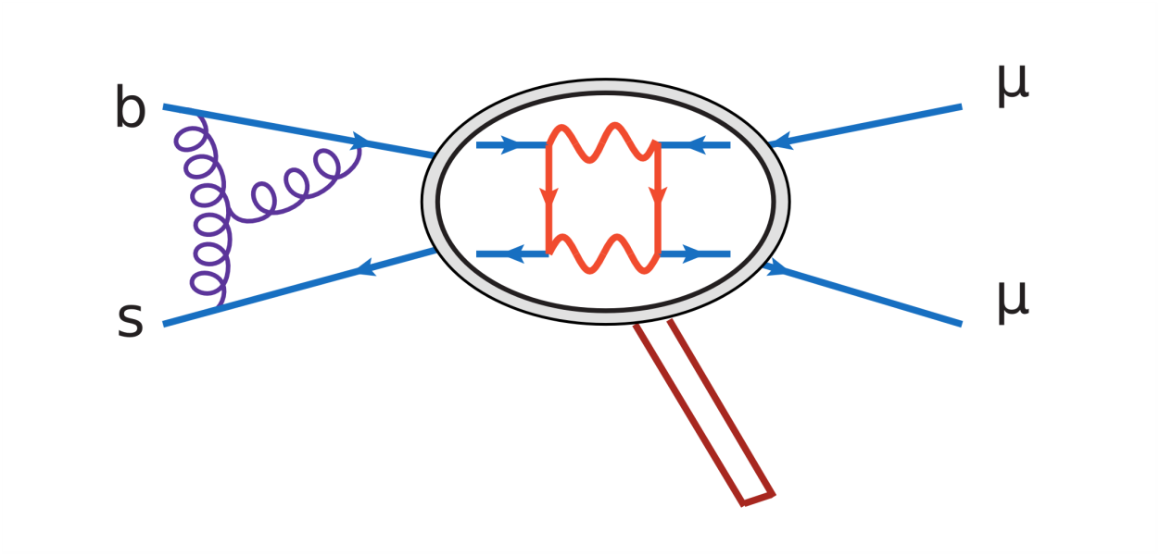
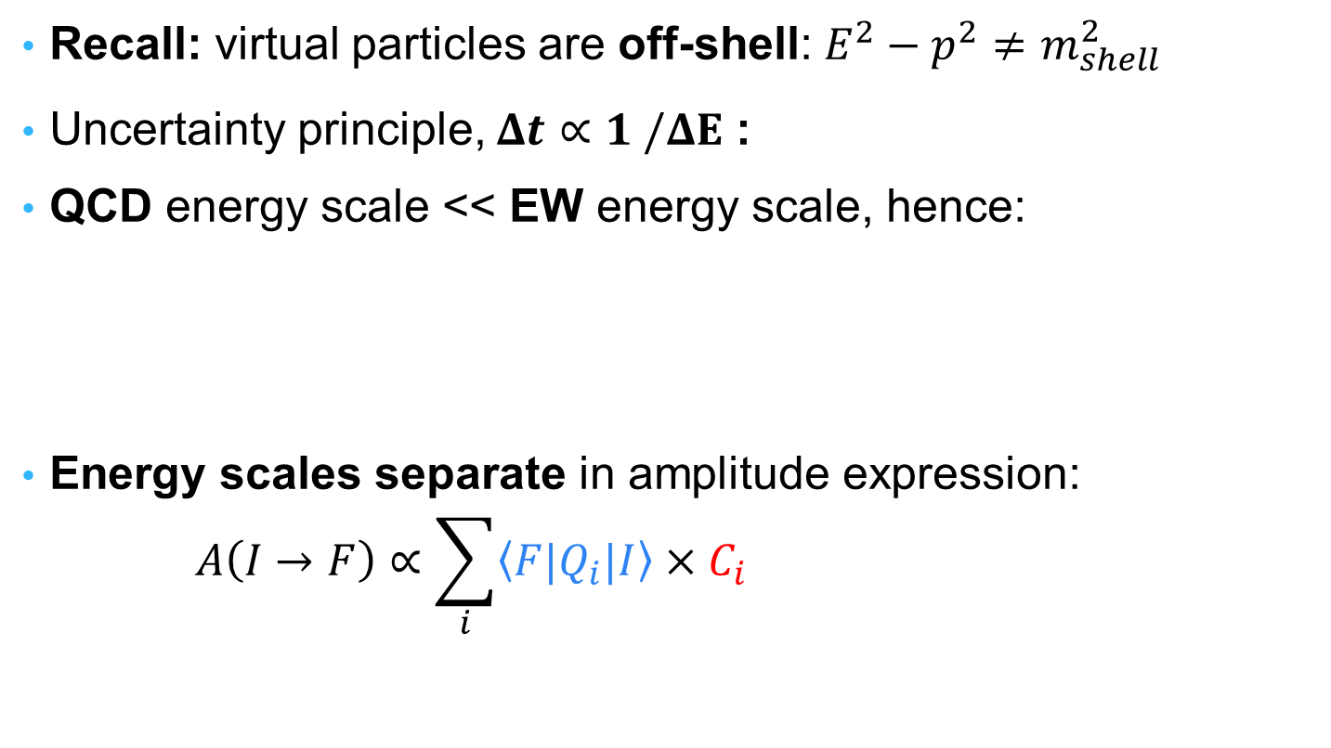
Model Independent Approach
Recall: virtual particles are off-shell: $E^{2}−p^{2}≠m_{shell}^{2}$
Uncertainty principle, $Δt∝1 /ΔE$ :
QCD energy scale << EW energy scale, hence:
Energy scales separate in amplitude expression:
$$A\left(I→F\right)∝\sum_{i}{\left\langle F|Q_{i}|I\right\rangle }{×C}_{i}$$
$$Δt$$
Matrix elements:
encode low energy
Main source of uncertainty
Wilson coefficents:
10 universal coefficients
Encode high energy

Slide 11
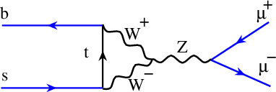
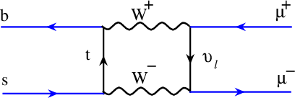
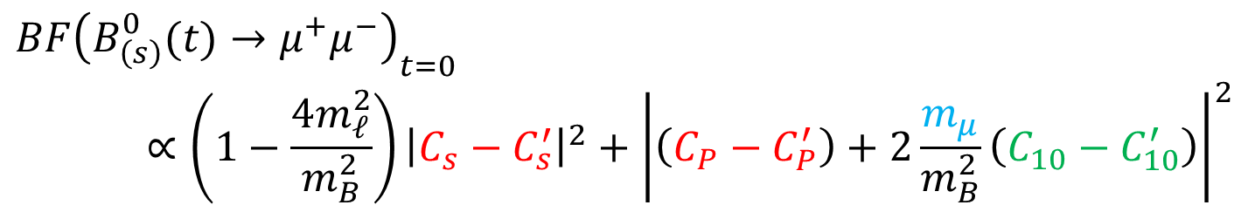


New Physics in ${{BF(B}_{(s)}^{0}→μ^{+}μ^{−})}_{t=0}$
Helicity Supp.
$$BF{\left(B_{\left(s\right)}^{0}(t)→μ^{+}μ^{−}\right)}_{t=0}∝\left(1−\frac{4m_{ℓ}^{2}}{m_{B}^{2}}\right){\left|C_{s}−C_{s}^{′}\right|}^{2}+{\left|\left(C_{P}−C_{P}^{′}\right)+2\frac{m_{μ}}{m_{B}^{2}}\left(C_{10}−C_{10}^{′}\right)\right|}^{2}$$
*
Sensitive to (Pseudo-)Scalar NP
Not affected by helicity supp.
Scalar adds up with SM
Pseudo-scalar can interfere destructively with SM
SM contributions:
75%
24%
*$A_{ΔΓ}$ phenomenology not accounted for

Slide 12
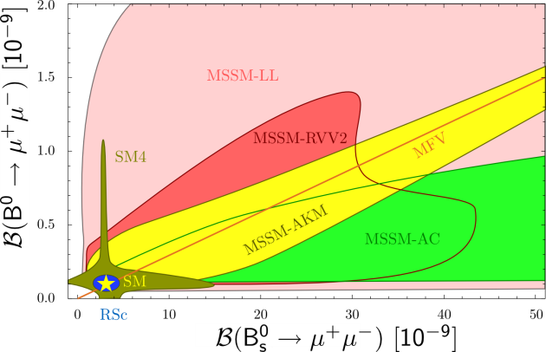
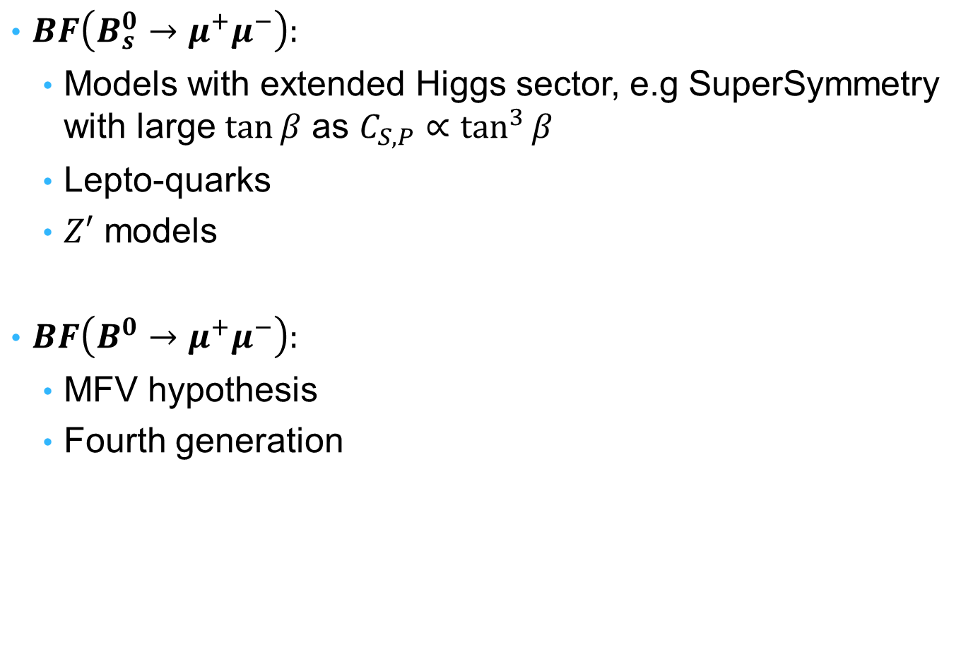
Which Models are Probed?
$BF\left(B_{s}^{0}→μ^{+}μ^{−}\right):$
  Models with extended Higgs sector, e.g SuperSymmetry with large $\tan{β}$ as $C_{S,P}∝\tan^{3}{β}$
  Lepto-quarks
  $Z′$ models
$BF\left(B^{0}→μ^{+}μ^{−}\right):$
  MFV hypothesis
  Fourth generation
Straub, arXiv:1205.6094

Slide 13
Experimental Picture

Slide 14
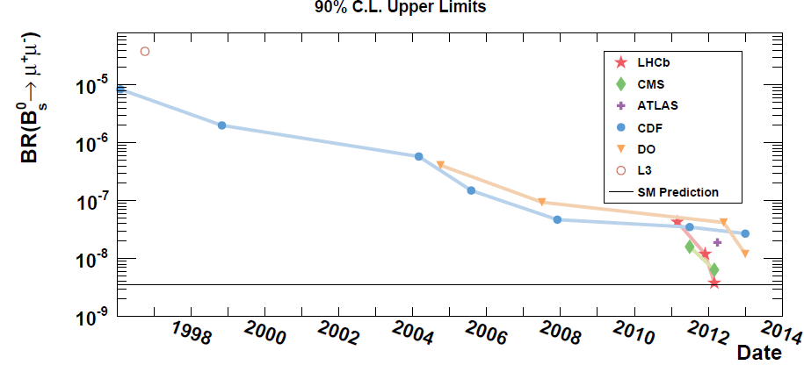
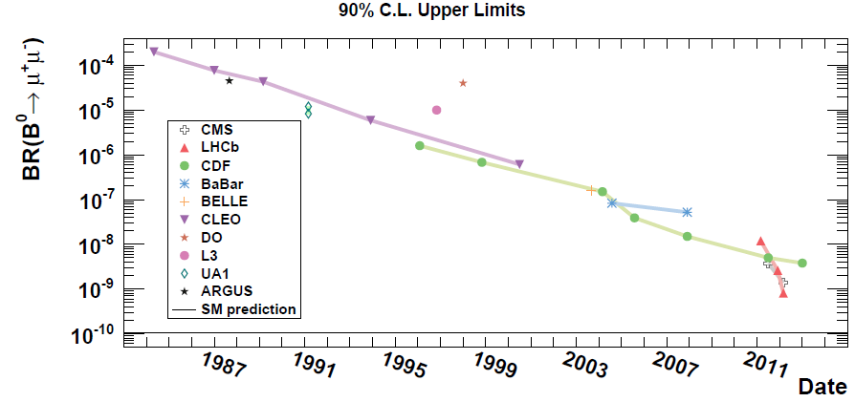
A long hunting…
1984 CLEO

Slide 15
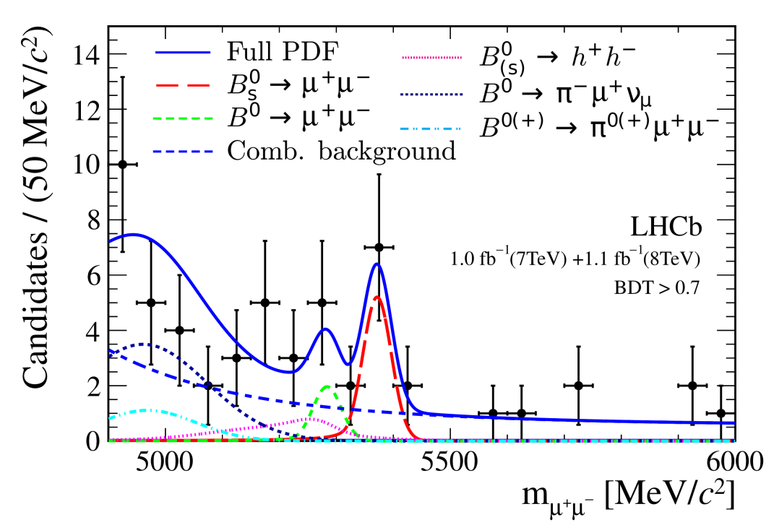
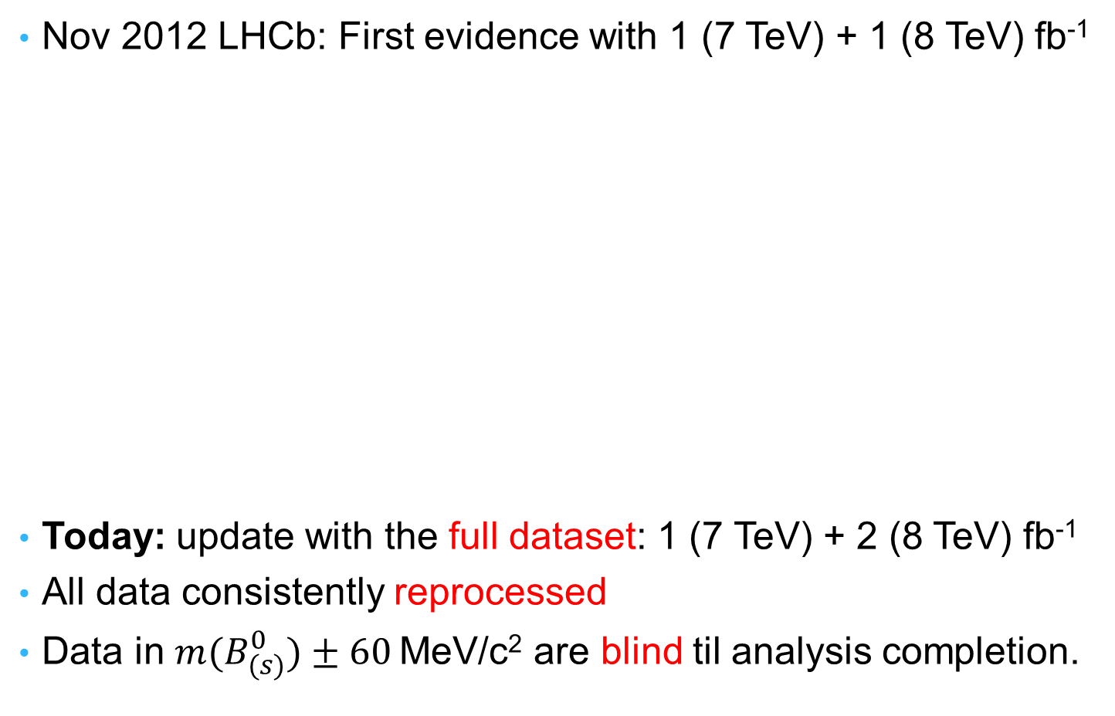
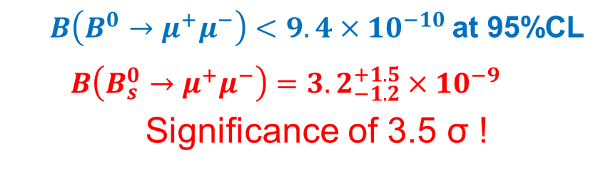
…before the first evidence!
Nov 2012 LHCb: First evidence with 1 (7 TeV) + 1 (8 TeV) fb⁻¹
Today: update with the full dataset: 1 (7 TeV) + 2 (8 TeV) fb⁻¹
All data consistently reprocessed
Data in $m(B_{(s)}^{0})±60$MeV/c² are blind til analysis completion.
PRL 110, 021801, 2013
  $B\left(B^{0}→μ^{+}μ^{−}\right)<9.4×{10}^{−10}$ at 95%CL
  $$B\left(B_{s}^{0}→μ^{+}μ^{−}\right)={3.2}_{−1.2}^{+1.5}×10^{−9}$$
  Significance of 3.5 σ !

Slide 16
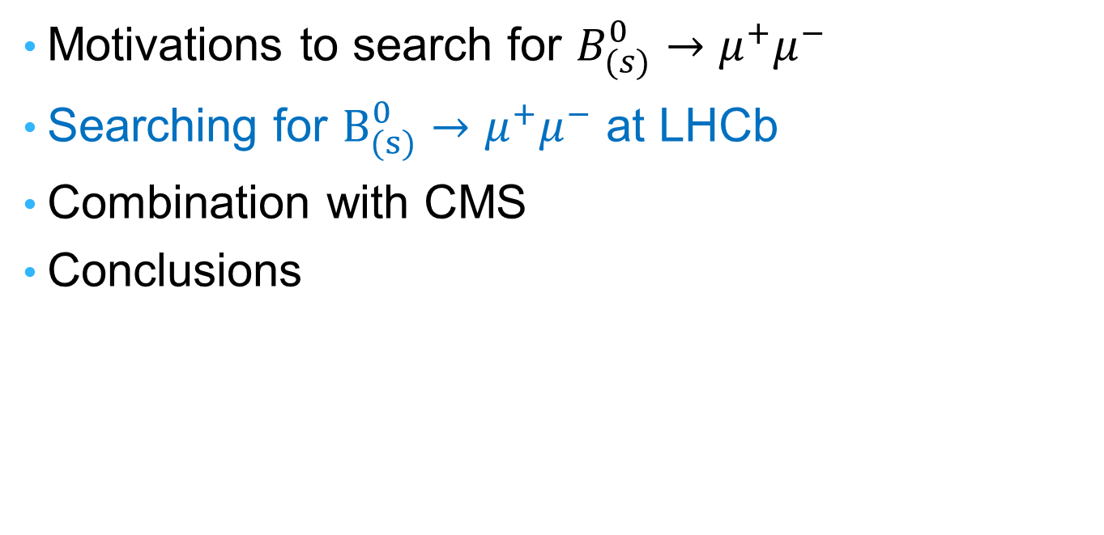
Outlines
Motivations to search for $B_{(s)}^{0}→μ^{+}μ^{−}$
Searching for $B_{(s)}^{0}→μ^{+}μ^{−}$ at LHCb
Combination with CMS
Conclusions

Slide 17
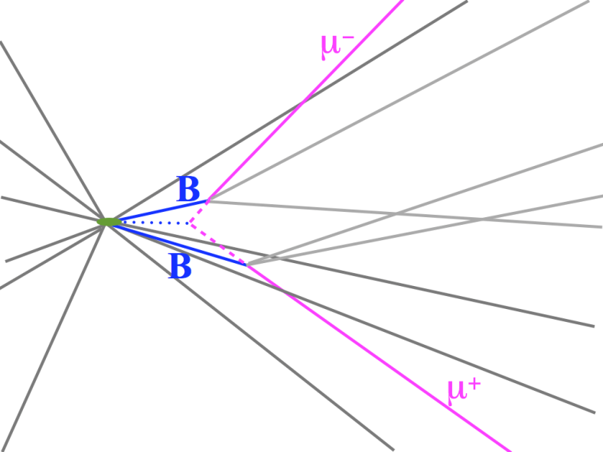
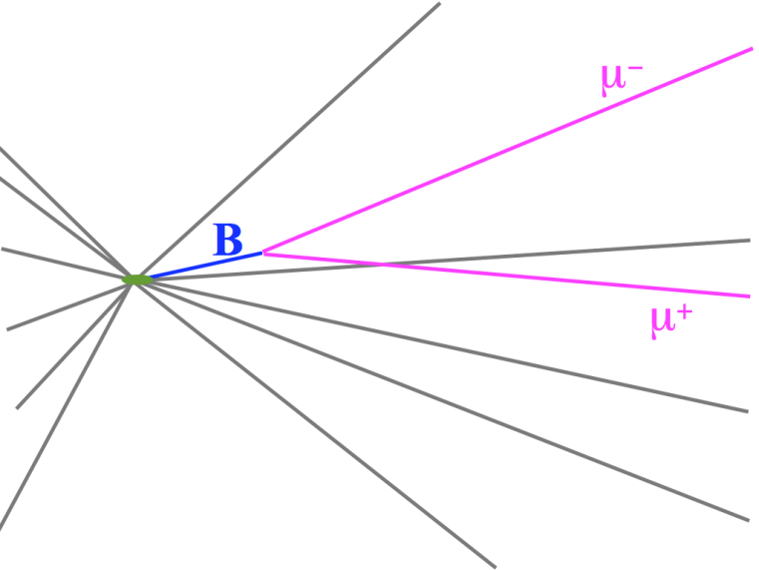
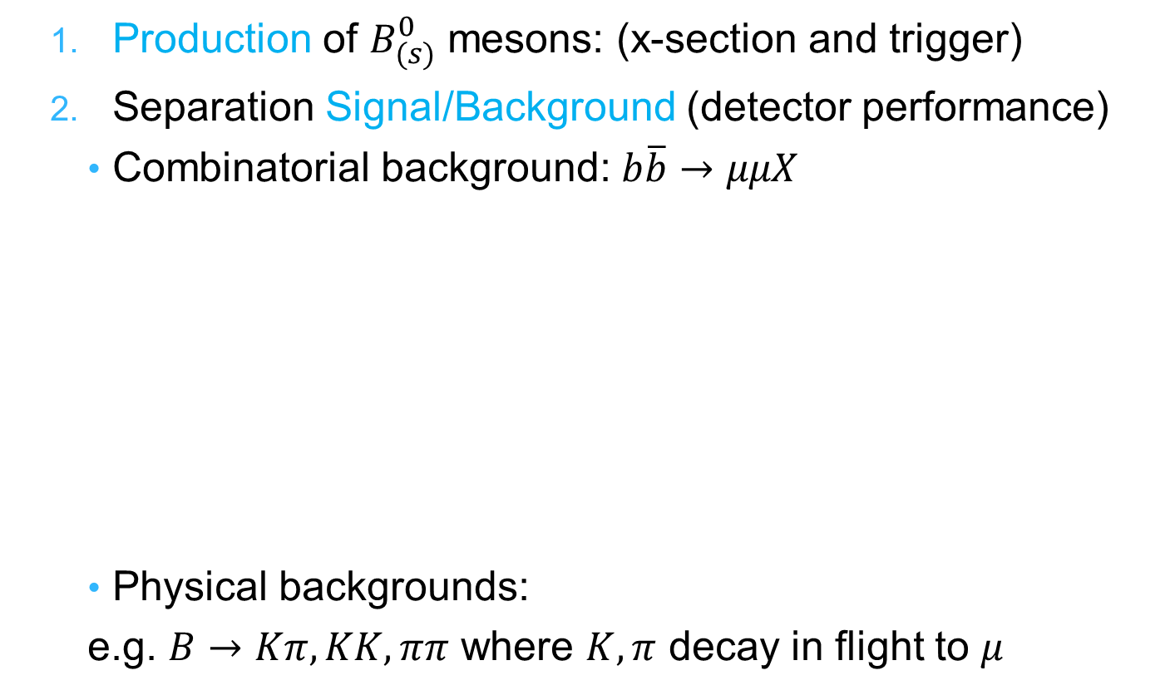

2 Key Points for${ B}_{(s)}^{ 0}→μ^{+}μ^{−}$ with LHCb
  Production of $B_{(s)}^{0}$ mesons: (x-section and trigger)
  Separation Signal/Background (detector performance)
    Combinatorial background: $b\overline{b}→μμX$
    Physical backgrounds:
    e.g. $B→Kπ, KK, ππ$ where $K,π$ decay in flight to $μ$
Background
Signal

Slide 18
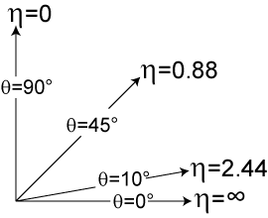
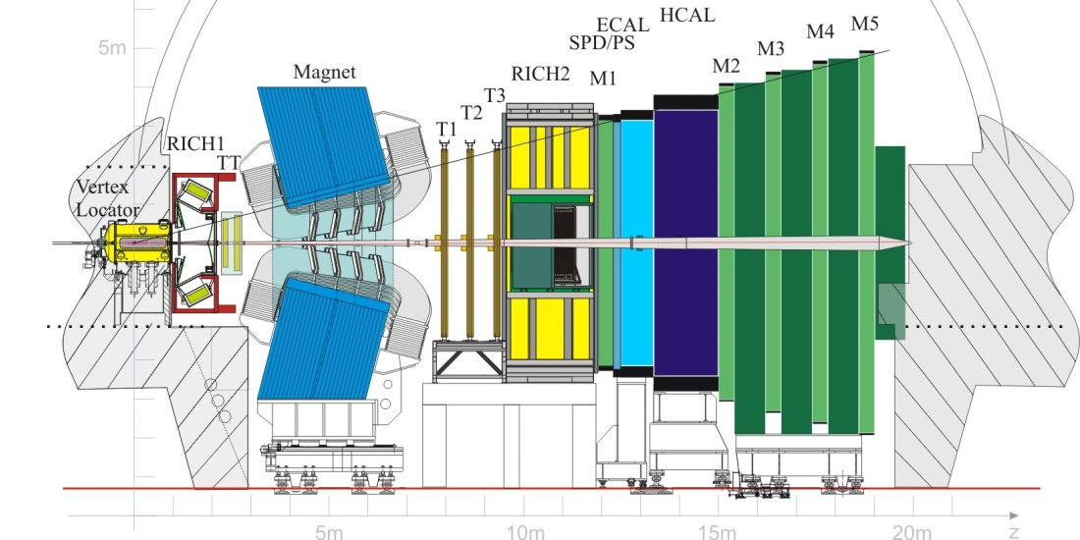
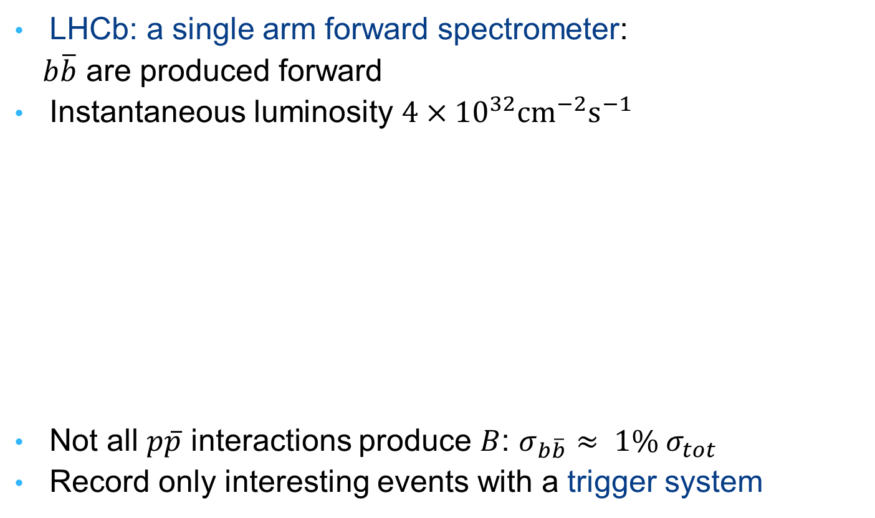

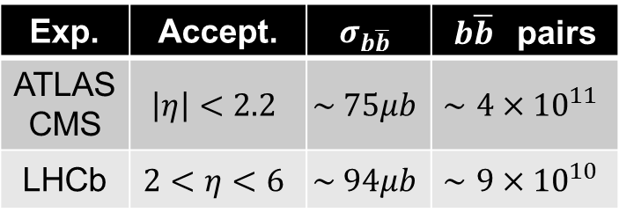
Key Point 1: $B_{(s)}^{0}$ production
LHCb: a single arm forward spectrometer:
  $b\overline{b}$ are produced forward
Instantaneous luminosity $4×{10}^{32}cm^{−2}s^{−1}$
Not all $p\overline{p}$ interactions produce $B$: $σ_{b\overline{b}}≈ 1\% σ_{tot}$
Record only interesting events with a trigger system
Exp. | Accept. | $$σ_{b\overline{b}}$$ | $b\overline{b}$ pairs
ATLAS CMS | $$\left|η\right|<2.2$$ | $$\sim 75μb$$ | $$∼4×{10}^{11}$$
LHCb | $$2<η<6$$ | $$\sim 94μb$$ | $$∼9×{10}^{10}$$
Albrecht, arXiv:1207.4287

Slide 19
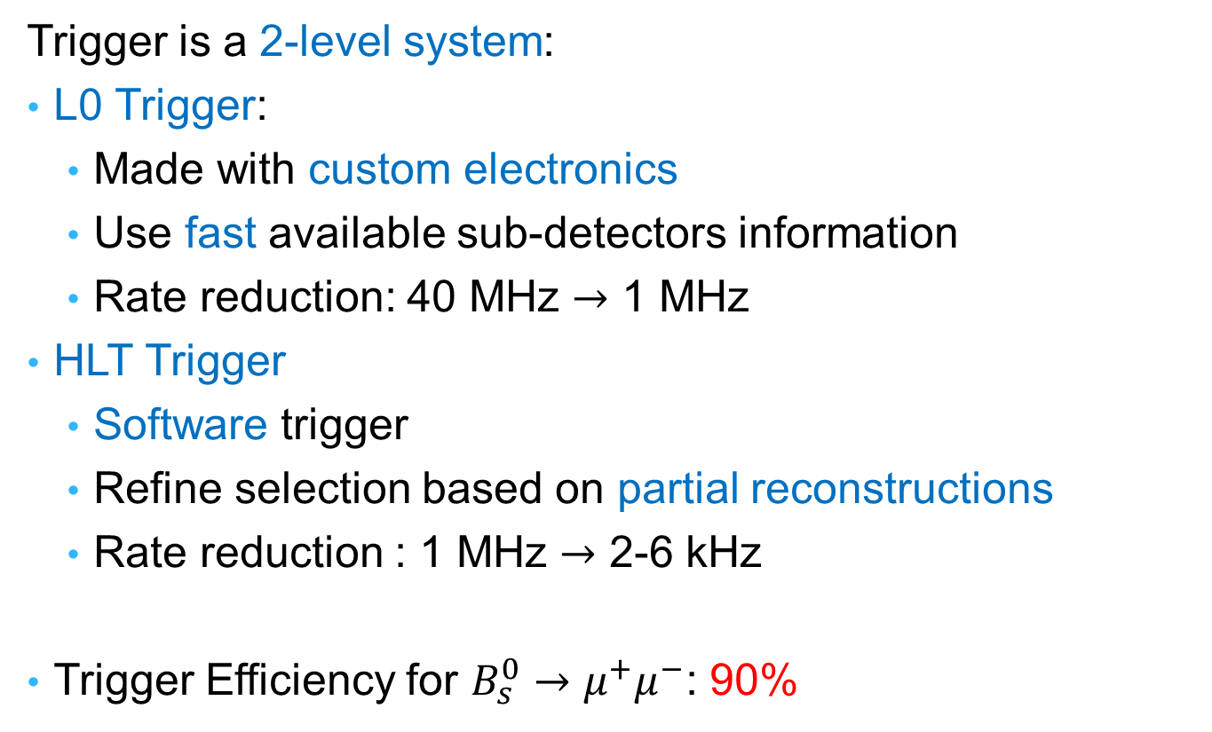
Trigger
Trigger is a 2-level system:
L0 Trigger:
  Made with custom electronics
  Use fast available sub-detectors information
  Rate reduction: 40 MHz $→$ 1 MHz
HLT Trigger
  Software trigger
  Refine selection based on partial reconstructions
  Rate reduction : 1 MHz $→$ 2-6 kHz
Trigger Efficiency for $B_{s}^{0}→μ^{+}μ^{−}$: 90%

Slide 20
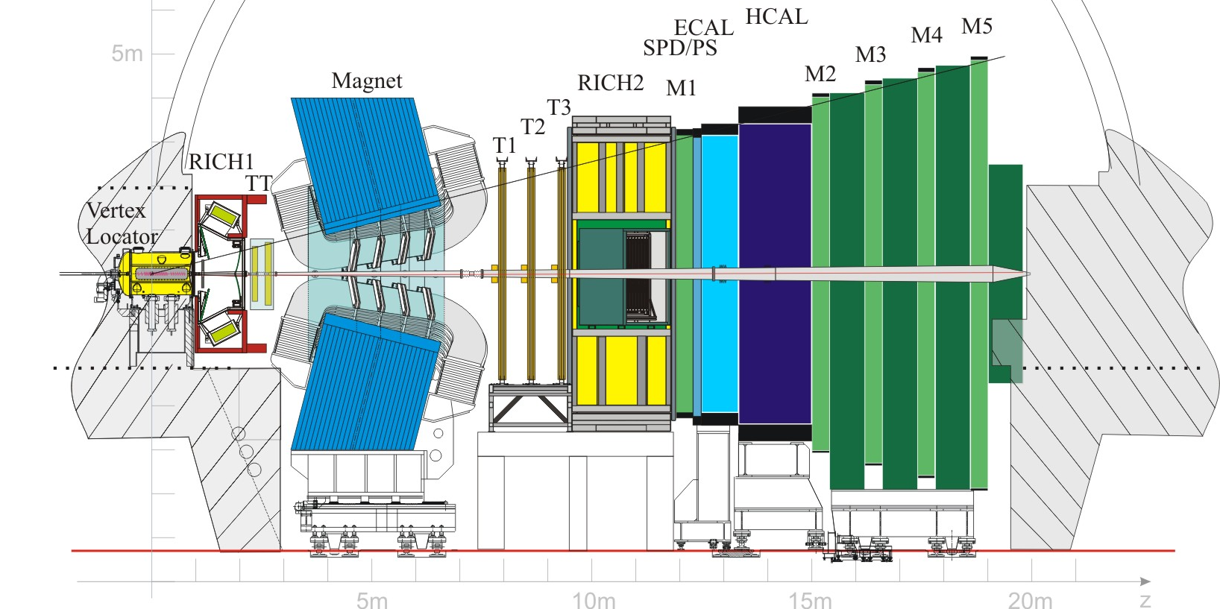
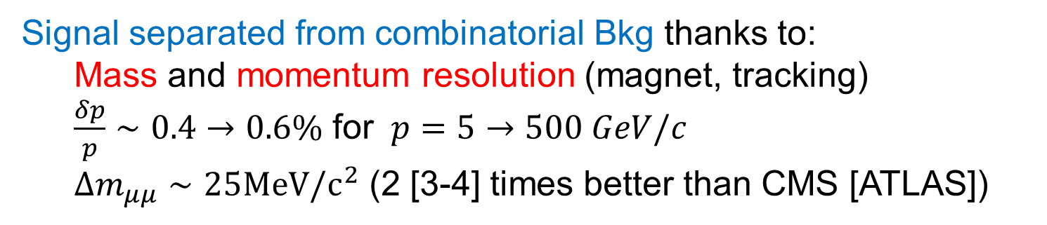
Key Point 2: Separation Sig/Bkg
Signal separated from combinatorial Bkg thanks to:
  Mass and momentum resolution (magnet, tracking)
  $\frac{δp}{p}∼0.4→0.6\%$ for $p=5→500 GeV/c$
  $Δm_{μμ}∼25MeV/c^{2}$ (2 [3-4] times better than CMS [ATLAS])

Slide 21
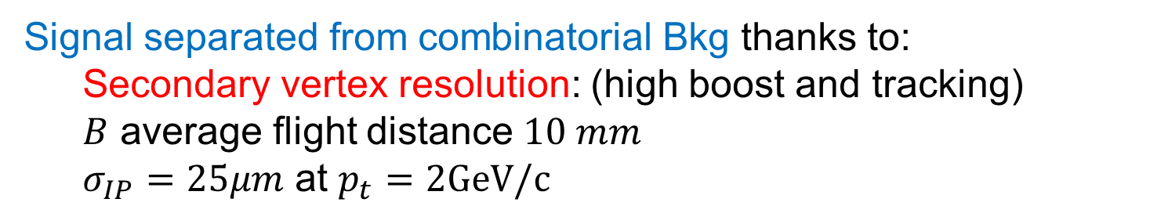
Key Point 2: Separation Sig/Bkg
Signal separated from combinatorial Bkg thanks to:
  Secondary vertex resolution: (high boost and tracking)
  $B$ average flight distance $10 mm$
  $σ_{IP}=25μm$ at $p_{t}=2GeV/c$

Slide 22
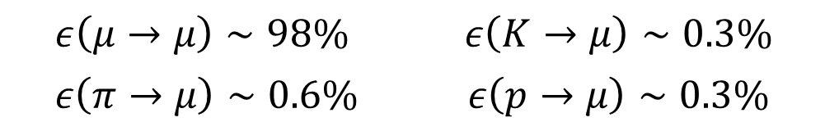
Key Point 2: Separation Sig/Bkg
Signal separated from physical Bkg thanks to:
  Particle identification info (RICH – muons chambers)
$$ε\left(μ→μ\right)∼98\%$$ | $$ε\left(K→μ\right)∼0.3\%$$
$$ε\left(π→μ\right)∼0.6\%$$ | $$ε\left(p→μ\right)∼0.3\%$$

Slide 23
LHCb Analysis

Slide 24
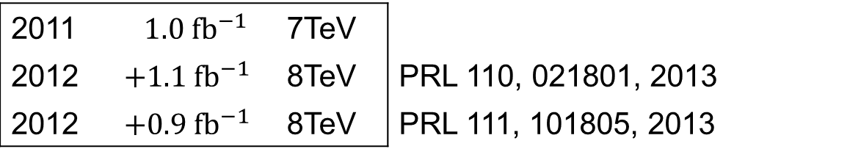
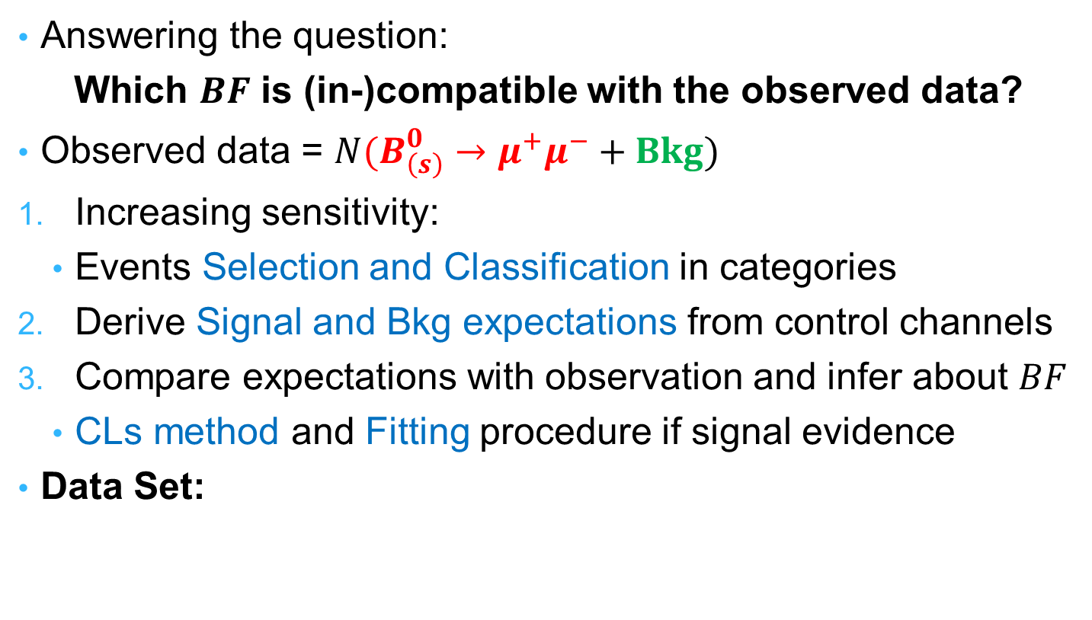
Analysis Overview
Answering the question:
Which $BF$ is (in-)compatible with the observed data?
Observed data = $N(B_{\left(s\right)}^{0}→μ^{+}μ^{−}+Bkg)$
Increasing sensitivity:
  Events Selection and Classification in categories
Derive Signal and Bkg expectations from control channels
Compare expectations with observation and infer about $BF$
  CLs method and Fitting procedure if signal evidence
Data Set:
2011 | $$1.0 fb^{−1}$$ | 7TeV
2012 | $$+1.1 fb^{−1}$$ | 8TeV | PRL 110, 021801, 2013
2012 | $$+0.9 fb^{−1}$$ | 8TeV | PRL 111, 101805, 2013

Slide 25
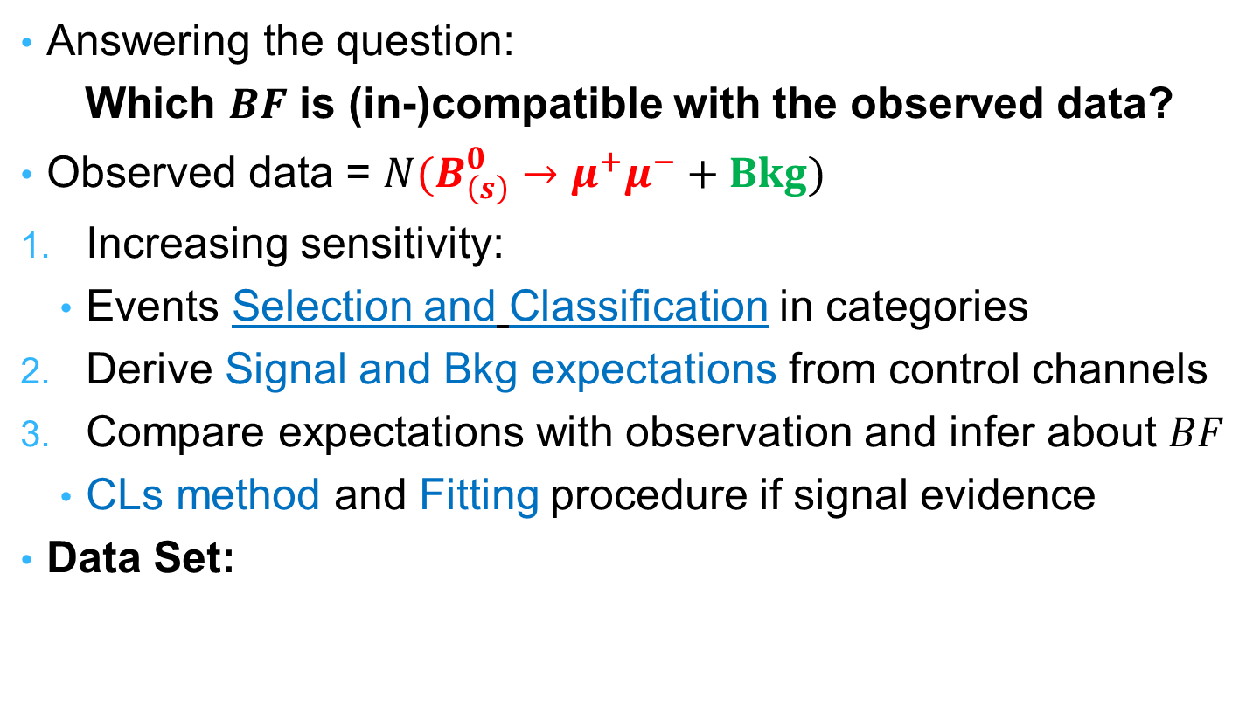
Analysis Overview
Answering the question:
Which $BF$ is (in-)compatible with the observed data?
Observed data = $N(B_{\left(s\right)}^{0}→μ^{+}μ^{−}+Bkg)$
Increasing sensitivity:
  Events Selection and Classification in categories
Derive Signal and Bkg expectations from control channels
Compare expectations with observation and infer about $BF$
  CLs method and Fitting procedure if signal evidence
Data Set:
2011 | $$1.0 fb^{−1}$$ | 7TeV
2012 | $$+1.1 fb^{−1}$$ | 8TeV | PRL 110, 021801, 2013
2012 | $$+0.9 fb^{−1}$$ | 8TeV | PRL 111, 101805, 2013

Slide 26
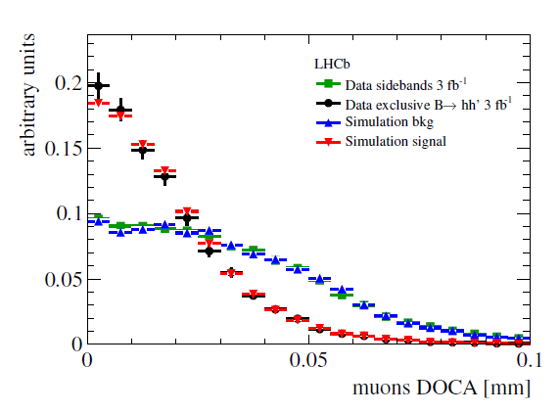
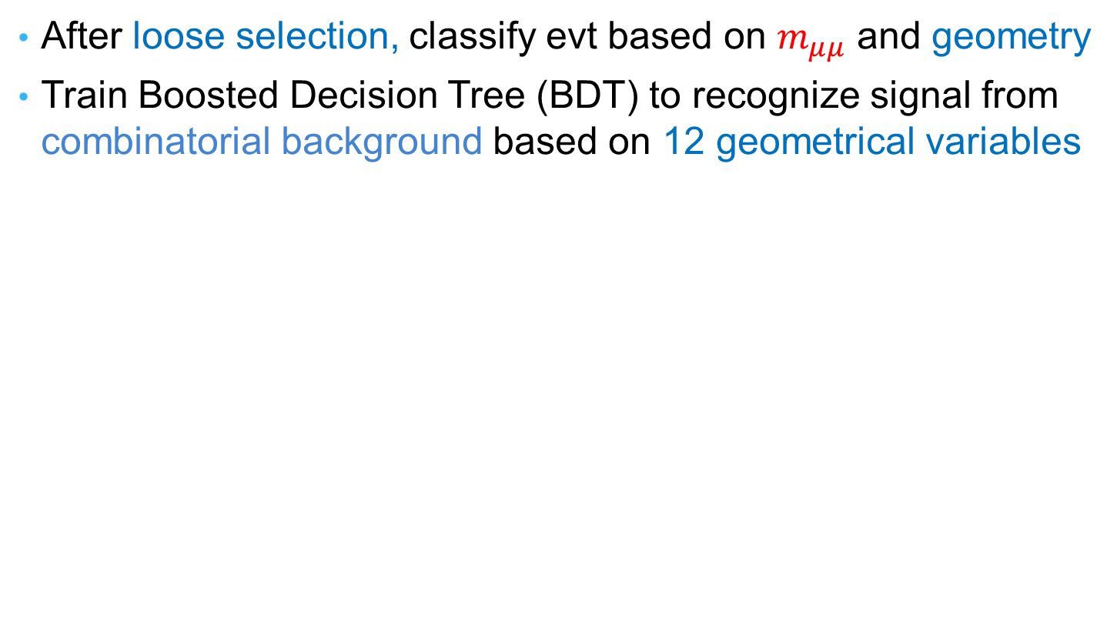
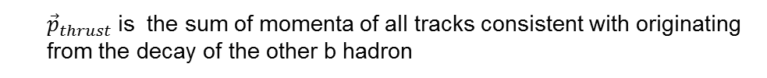

Selection and Classification
After loose selection, classify evt based on $m_{μμ}$ and geometry
Train Boosted Decision Tree (BDT) to recognize signal from combinatorial background based on 12 geometrical variables
B candidate:
- proper time
- impact parameter
- transverse momentum
- B isolation
- Angle between ${\vec{p}}_{B}$ and ${\vec{p}}_{thrust}$
- Angle in $B$ rest frame between $p_{μ^{+}}$ and ${\vec{p}}_{thrust}$
Muons:
- min IP significance
- distance of closest approach
- muon isolation
- polarisation angle
- |η(µ₁)-η(µ₂)|
- |φ(µ₁)- φ(µ₂)|
  ${\vec{p}}_{thrust}$is the sum of momenta of all tracks consistent with originating from the decay of the other b hadron

Slide 27


Selection and Classification
After loose selection, classify evt based on $m_{μμ}$ and geometry
Train Boosted Decision Tree (BDT) to recognize signal from combinatorial background based on 12 geometrical variables
Bkg Region
Sig Region
Log Scale

Slide 28

2-D Binned Classification
Blind Analysis: Signal Mass Region Hidden during analysis development

Slide 29
2-D Binned Classification

Slide 30

Analysis Overview
Answering the question:
Which $BF$ is (in-)compatible with the observed data?
Observed data = $N(B_{\left(s\right)}^{0}→μ^{+}μ^{−}+Bkg)$
Increasing sensitivity:
  Events Selection and Classification in categories
Derive Signal and Bkg expectations from control channels
Compare expectations with observation and infer about $BF$
  CLs method and Fitting procedure if signal evidence
Data Set:
2011 | $$1.0 fb^{−1}$$ | 7TeV
2012 | $$+1.1 fb^{−1}$$ | 8TeV | PRL 110, 021801, 2013
2012 | $$+0.9 fb^{−1}$$ | 8TeV | PRL 111, 101805, 2013

Slide 31


Bkg Expectations
Extrapolate Bkg from
side-bands
Fit components:
  Combinatorial
  MisId
  $B_{s}^{0}→h^{+}h^{′−}$
  $B^{0}→{π,K}^{+}μ^{−}{\overline{ν}}_{μ}$
  Partially Reco
  $B^{0,+}→π^{0,+}μ^{+}μ^{−}$
  $Λ_{b}^{0}→pμ^{−}{\overline{ν}}_{μ}$
  Total

Slide 32

Bkg Expectations
Extrapolate Bkg from
side-bands
Fit components:
  Combinatorial
  MisId
  $B_{s}^{0}→h^{+}h^{′−}$
  $B^{0}→{π,K}^{+}μ^{−}{\overline{ν}}_{μ}$
  Partially Reco
  $B^{0,+}→π^{0,+}μ^{+}μ^{−}$
  $Λ_{b}^{0}→pμ^{−}{\overline{ν}}_{μ}$
  Total

Slide 33


Bkg Expectations
Extrapolate Bkg from
side-bands
Fit components:
  Combinatorial
  MisId
  $B_{s}^{0}→h^{+}h^{′−}$
  $B^{0}→{π,K}^{+}μ^{−}{\overline{ν}}_{μ}$
  Partially Reco
  $B^{0,+}→π^{0,+}μ^{+}μ^{−}$
  $Λ_{b}^{0}→pμ^{−}{\overline{ν}}_{μ}$
  Total

Slide 34

Bkg Expectations
Extrapolate Bkg from
side-bands
Fit components:
  Combinatorial
  MisId
  $B_{s}^{0}→h^{+}h^{′−}$
  $B^{0}→{π,K}^{+}μ^{−}{\overline{ν}}_{μ}$
  Partially Reco
  $B^{0,+}→π^{0,+}μ^{+}μ^{−}$
  $Λ_{b}^{0}→pμ^{−}{\overline{ν}}_{μ}$
  Total

Slide 35

Bkg Expectations
Extrapolate Bkg from
side-bands
Fit components:
  Combinatorial
  MisId
  $B_{s}^{0}→h^{+}h^{′−}$
  $B^{0}→{π,K}^{+}μ^{−}{\overline{ν}}_{μ}$
  Partially Reco
  $B^{0,+}→π^{0,+}μ^{+}μ^{−}$
  $Λ_{b}^{0}→pμ^{−}{\overline{ν}}_{μ}$
  Total

Slide 36

Bkg Expectations
Extrapolate Bkg from
side-bands
Fit components:
  Combinatorial
  MisId
  $B_{s}^{0}→h^{+}h^{′−}$
  $B^{0}→{π,K}^{+}μ^{−}{\overline{ν}}_{μ}$
  Partially Reco
  $B^{0,+}→π^{0,+}μ^{+}μ^{−}$
  $Λ_{b}^{0}→pμ^{−}{\overline{ν}}_{μ}$
  Total

Slide 37

Bkg Expectations
Extrapolate Bkg from
side-bands
Fit components:
  Combinatorial
  MisId
  $B_{s}^{0}→h^{+}h^{′−}$
  $B^{0}→{π,K}^{+}μ^{−}{\overline{ν}}_{μ}$
  Partially Reco
  $B^{0,+}→π^{0,+}μ^{+}μ^{−}$
  $Λ_{b}^{0}→pμ^{−}{\overline{ν}}_{μ}$
  Total

Slide 38

Bkg Expectations
Extrapolate Bkg from
side-bands
Fit components:
  Combinatorial
  MisId
  $B_{s}^{0}→h^{+}h^{′−}$
  $B^{0}→{π,K}^{+}μ^{−}{\overline{ν}}_{μ}$
  Partially Reco
  $B^{0,+}→π^{0,+}μ^{+}μ^{−}$
  $Λ_{b}^{0}→pμ^{−}{\overline{ν}}_{μ}$
  Total

Slide 39

Bkg Expectations
Extrapolate Bkg from
side-bands
Fit components:
  Combinatorial
  MisId
  $B_{s}^{0}→h^{+}h^{′−}$
  $B^{0}→{π,K}^{+}μ^{−}{\overline{ν}}_{μ}$
  Partially Reco
  $B^{0,+}→π^{0,+}μ^{+}μ^{−}$
  $Λ_{b}^{0}→pμ^{−}{\overline{ν}}_{μ}$
  Total

Slide 40


Misidentified Backgrounds - $B_{(s)}^{0}→h^{+}h^{′−}$
MisID probabilities measured on data in bins of $p$ and $p_{T}$
  $π→μ$ and $K→μ$ measured with $D^{0}→K^{+}π^{−}$ from $D^{∗+}→D^{0}π^{+}$,
  $p→μ$ measured with $Λ→p π^{−}$
Probabilities then convoluted with $B_{(s)}^{0}→h^{+}h^{′−}$MC spectra to get the average double misID efficiency ε_{µµ →hh} (~10⁻⁵)
Rate obtained applying ε_{µµ →hh} to the $B_{(s)}^{0}→h^{+}h^{′−}$yield
Mass shape is evaluated from MC
$B_{(s}^{0}→h^{+}h^{′−}$included as fit component with rate constrained to expected yield

Slide 41


Other exclusive backgrounds
Yields obtained by normalising to $B^{+}→J/{ψ{ K}^{+}}$
$B^{0}→{π,K}^{+}μ^{−}{\overline{ν}}_{μ}$, $B^{0,+}→π^{0,+}μ^{+}μ^{−}$: included in fit
  Mass PDF in each BDT bin determined from MC
  normalization fixed to expected yield
$Λ_{b}^{0}→pμ^{−}{\overline{ν}}_{μ}$: treated as a systematic
Expected background yield in [4.9-6] GeV/c²

Slide 42





Signal Expectations - PDF
BDT PDF:
$B_{(s)}^{0}→h^{+}h^{′−}$ same
geometry as signal
PDF by extracting yields
with a $m_{μμ}$ fit in each bin
Mass PDF, Crystal Ball
Mean $B_{(s)}^{0}$ mass, from $B_{(s)}^{0}→h^{+}h^{′−}$
Mass resolution, from $J/ψ$, $ψ\left(2S\right)$, $Υ(1,2,3S)$ and $B_{(s)}^{0}→h^{+}h^{′−}$
Radiative tail from MC
$$Υ(1,2,3S)$$
$$J/ψ, ψ\left(2S\right)$$
$$σ_{B^{0}}=22.8±0.4 MeV$$
$$m_{B_{s}}−m_{B_{d}}∼3.5σ_{B^{0}}$$

Slide 43


Signal Expectations - Yields
Number of signal events corresponding to a $BF$:
$N_{{ B}_{(s)}^{ 0}→μ^{+}μ^{−}}∝BF(B_{\left(s\right)}^{ 0}→μ^{+}μ^{−})×N_{B_{s}}$
$N_{B_{s}}$obtained by normalising to channels of known $BF$:
  $B^{+}→J/ψK^{+}$ and $B^{0}→Kπ$
Correcting for efficiencies and hadronisation probability:
$N_{{ B}_{(s)}^{ 0}→μ^{+}μ^{−}}=$ $BF\left(B_{\left(s\right)}^{ 0}→μ^{+}μ^{−}\right)×\frac{N_{norm}}{{BF}_{norm}}$
$$×\frac{f_{{ B}_{(s)}^{ 0}}}{f_{norm}}$$
$$×\frac{ε_{sig}^{ }}{ε_{norm}^{ }}$$
Ratio of probability for a b quark to hadronise into a${ B}_{(s)}^{ 0}$ or into the normalisation initial state

Slide 44


Normalisation Ingredients
$N_{{ B}_{(s)}^{ 0}→μ^{+}μ^{−}}=$ $BF\left(B_{\left(s\right)}^{ 0}→μ^{+}μ^{−}\right)$
$$×\frac{N_{norm}}{{BF}_{norm}}$$
$$×\frac{f_{{ B}_{(s)}^{ 0}}}{f_{norm}}$$
$$×\frac{ε_{sig}^{ }}{ε_{norm}^{ }}$$
Averaging the results from the two control channels:
Obtained by fitting control
channels invariant mass
Measured in LHCb*
Measured with simulations
SM expectations in signal mass windows:
$\text{4}\text{0}±4 B_{s}^{0}→μ^{+}μ^{−}$ and $4.5±0.4 B^{0}→μ^{+}μ^{−}$
*LHCb-CONF-2013-011

Slide 45

Time Acceptance Correction - 1
Recall, decay rate depends on $A_{ΔΓ}$:
${\left\langle Γ(B_{\left(s\right)}^{0}\left(t\right)→ℓ^{+}ℓ^{−})\right\rangle = R}_{H}e^{−Γ_{H}^{\left(s\right)}t}+R_{L}e^{−Γ_{L}^{(s)}t}$ and $A_{ΔΓ}=\frac{R_{H}−R_{L}}{R_{H}+R_{L}}$
So $B_{s}^{0}→μ^{+}μ^{−}$ signal efficiency $ε_{sig}$ depend on $A_{ΔΓ}$:
$$ε_{sig}(A_{ΔΓ})= \frac{∫Γ\left(A_{ΔΓ},t\right)×ε\left(t\right) dt }{∫Γ\left(A_{ΔΓ},t\right)dt}$$
Signal efficiency used in normalisation…
  $$BF_{sig}=BF_{norm}×\frac{N_{sig}}{N_{norm}}×\frac{f_{sig}}{f_{norm}}×\frac{ε_{sig}(A_{ΔΓ})}{ε_{norm}}$$
  …is obtained form MC and must be corrected to match latest $y_{s}$ and $τ_{B_{s}^{0}}$ values:
  $${ε_{B_{s}^{0}→μμ}^{SM}}/{ε^{MC}}=1.0457{ ε_{B_{}^{0}→μμ}^{SM}}/{ε^{MC}}=1.015$$

Slide 46


Time Acceptance Correction - 2
BDT uses decay-time as input variable
BDT PDF obtained with mainly $B_{}^{0}→h^{+}h^{′−}$
$B_{}^{0}→h^{+}h^{′−}$ and $B_{s}^{0}→μ^{+}μ^{−}$ have different lifetime distributions
Need corrections:
$${PDF_{corr}^{i}}/{PDF_{raw}^{i}}=δ_{PDF}^{i}$$
Nota: all these corrections depend on the
value assumed for $A_{Δ_{Γ}}$

Slide 47

Analysis Overview
Answering the question:
Which $BF$ is (in-)compatible with the observed data?
Observed data = $N(B_{\left(s\right)}^{0}→μ^{+}μ^{−}+Bkg)$
Increasing sensitivity:
  Events Selection and Classification in categories
Derive Signal and Bkg expectations from control channels
Compare expectations with observation and infer about $BF$
  CLs method and Fitting procedure if signal evidence
Data Set:
2011 | $$1.0 fb^{−1}$$ | 7TeV
2012 | $$+1.1 fb^{−1}$$ | 8TeV | PRL 110, 021801, 2013
2012 | $$+0.9 fb^{−1}$$ | 8TeV | PRL 111, 101805, 2013

Slide 48



Sensitivity Expectations (CLs method)
Expected significance for a $B_{s}^{0}→μ^{+}μ^{−}$ SM signal : $5.0 σ$
No significant $B_{}^{0}→μ^{+}μ^{−}$ SM signal expected:
$B(B^{0}→μ^{+}μ^{−})<5$.4 x 10⁻¹⁰ at 95% CL

Slide 49
Open the box
B_{s} window
B⁰ window

Slide 50



Fit Projection
$B_{s}^{0}→μ^{+}μ^{−}$
$B_{}^{0}→μ^{+}μ^{−}$
$B^{0}→{π,K}^{+}μ^{−}{\overline{ν}}_{μ}$
$B^{0,+}→π^{0,+}μ^{+}μ^{−}$
${ B}_{(s)}^{0}→h^{+}h^{′−}$
Total

Slide 51

Fit Projection
$B_{s}^{0}→μ^{+}μ^{−}$
$B_{}^{0}→μ^{+}μ^{−}$
$B^{0}→{π,K}^{+}μ^{−}{\overline{ν}}_{μ}$
$B^{0,+}→π^{0,+}μ^{+}μ^{−}$
${ B}_{(s)}^{0}→h^{+}h^{′−}$
Total

Slide 52

Fit Projection
$B_{s}^{0}→μ^{+}μ^{−}$
$B_{}^{0}→μ^{+}μ^{−}$
$B^{0}→{π,K}^{+}μ^{−}{\overline{ν}}_{μ}$
$B^{0,+}→π^{0,+}μ^{+}μ^{−}$
${ B}_{(s)}^{0}→h^{+}h^{′−}$
Total

Slide 53

Fit Projection
$B_{s}^{0}→μ^{+}μ^{−}$
$B_{}^{0}→μ^{+}μ^{−}$
$B^{0}→{π,K}^{+}μ^{−}{\overline{ν}}_{μ}$
$B^{0,+}→π^{0,+}μ^{+}μ^{−}$
${ B}_{(s)}^{0}→h^{+}h^{′−}$
Total

Slide 54

Fit Projection
$B_{s}^{0}→μ^{+}μ^{−}$
$B_{}^{0}→μ^{+}μ^{−}$
$B^{0}→{π,K}^{+}μ^{−}{\overline{ν}}_{μ}$
$B^{0,+}→π^{0,+}μ^{+}μ^{−}$
${ B}_{(s)}^{0}→h^{+}h^{′−}$
Total

Slide 55

Fit Projection
$B_{s}^{0}→μ^{+}μ^{−}$
$B_{}^{0}→μ^{+}μ^{−}$
$B^{0}→{π,K}^{+}μ^{−}{\overline{ν}}_{μ}$
$B^{0,+}→π^{0,+}μ^{+}μ^{−}$
${ B}_{(s)}^{0}→h^{+}h^{′−}$
Total

Slide 56


Fit Projection
$B_{s}^{0}→μ^{+}μ^{−}$
$B_{}^{0}→μ^{+}μ^{−}$
$B^{0}→{π,K}^{+}μ^{−}{\overline{ν}}_{μ}$
$B^{0,+}→π^{0,+}μ^{+}μ^{−}$
${ B}_{(s)}^{0}→h^{+}h^{′−}$
Total

Slide 57

Fit Projection
$B_{s}^{0}→μ^{+}μ^{−}$
$B_{}^{0}→μ^{+}μ^{−}$
$B^{0}→{π,K}^{+}μ^{−}{\overline{ν}}_{μ}$
$B^{0,+}→π^{0,+}μ^{+}μ^{−}$
${ B}_{(s)}^{0}→h^{+}h^{′−}$
Total

Slide 58


Fit Result
arXiv:1307.5024, Phys.Rev. Lett.111(2013) 101805
Significance: 4.0 σ
expected 5.0 σ (median)
Significance: 2.0 σ
Correlation between BR(B⁰→μ⁺μ⁻) and BR(B_{s}→μ⁺μ⁻) : 3.3%
Profile Likelihood:
All parameters except ${B(B}_{s}^{0}→μ^{+}μ^{−})$ are floated within their errors.

Slide 59




$B^{0}→μ^{+}μ^{−}$ upper limit
Obtained with the CLs method
Observed
Observed
Expected
Bkg+SM
Expected Bkg only
 | Limit at 95%CL
Expected bkg only | $4.4$ x 10⁻¹⁰
Expected bkg + SM | $5.4$ x 10⁻¹⁰
observed | $$7.4×{10}^{−10}$$

Slide 60

Outlines
Motivations to search for $B_{(s)}^{0}→μ^{+}μ^{−}$
Searching for $B_{(s)}^{0}→μ^{+}μ^{−}$ at LHCb
Combination with CMS
Conclusions

Slide 61

CMS Analysis in Brief
Dataset: 5 (7 TeV) + 20 (8 TeV) fb⁻¹
Trigger requirement :
  (sub-)leading muon pT> 3 (4) GeV, dimuon pT>4.9 GeV for |η_{µµ}|<1.8
  (sub-)leading muon pT> 4 (4) GeV, dimuon pT>7 GeV for |η_{µµ}|>1.8
  4.8<m_{µµ}<6 GeV
  Vertex fit p(χ²) >0.5%
Discriminant variables: $m_{μμ}$ and BDT
Two categories and 2011 and 2012 data kept separated:
  Both muons in barrel : $σ_{μμ}\sim 40$ MeV
  At least one muon in endcap: more events but $σ_{μμ}\sim 60$ MeV

Slide 62
BDT
Training on MC signal and data sidebands:
  To avoid biases, use 3 separate samples:
  train on 1st, test on 2nd and apply on 3rd ⇒ 3 BDT per categories
12 variables used, independent of pile-up conditions
Signal BDT distribution taken from MC, systematics evaluated using control sample
Then, 2 possible methods:
  Simple cut on BDT output, optimised for each sample:
  limit computation
  Analysis in 3 bins of BDT vs mass (higher expected sensitivity):
  simultaneous maximum likelihood fit

Slide 63

Most Sensitive Bin
2nd Most Sensitive Bin
Barrel
8 TeV data
End Cap

Slide 64


Results
arXiv:1307.5025, Phys.Rev. Lett.111(2013) 101804
Significance: 4.3 σ (exp. 4.8)
Significance: 2.0 σ
CCLs Method | Limit at 95%CL
Expected bkg + SM | $6.3×{10}^{−10}$
observed | $$11×{10}^{−10}$$

Slide 65

Combination CMS LHCb
Simple average technique (arXiv:physics/0406120)
Treat correlated systematic uncertainty: ${f_{s}}/{f_{d}}$
Update CMS results with latest ${f_{s}}/{f_{d}}$ *
$B\left(B_{s}^{0}→μ^{+}μ^{−}\right)={2.96}_{−0.85}^{+0.97}±{0.17}_{{f_{s}}/{f_{d}}}$ CMS
$B\left(B_{s}^{0}→μ^{+}μ^{−}\right)={2.87}_{−0.95}^{+1.09}±{0.17}_{{f_{s}}/{f_{d}}}$ LHCb
Combined result:
$B\left(B_{s}^{0}→μ^{+}μ^{−}\right)=\left(2.9±0.7\right)×{10}^{−9}$ Signifiance $>5σ$
$B\left(B_{}^{0}→μ^{+}μ^{−}\right)={(3.6}_{−1.4}^{+1.6} )×{10}^{−10}$ Signifiance $<3σ$
*LHCb-CONF-2013-011

Slide 66

Outlines
Motivations to search for $B_{(s)}^{0}→μ^{+}μ^{−}$
Searching for $B_{(s)}^{0}→μ^{+}μ^{−}$ at LHCb
Combination with CMS
Conclusions

Slide 67

From 1984 to now…

Slide 68








Summary
LHCb 3 fb⁻¹
CMS 25 fb⁻¹
4.3 σ
4.0 σ
2.0 σ
2.0 σ
CMS + LHCb :
First observation of BR(B_{s}→μ⁺μ⁻) !!
1 σ

Slide 69
Spares

Slide 70

Some projections
From LHCB-TDR-012:
Obs. | End 2018 | LHCb upgrade $50fb^{−1}$
$${B(B}_{s}^{0}→μ^{+}μ^{−})$$ | $$0.5×{10}^{−9}$$ | $$0.15×{10}^{−9}$$
$$\frac{B(B_{s}^{0}→μ^{+}μ^{−})}{B(B_{}^{0}→μ^{+}μ^{−})}$$ | 100% | 35%

Slide 71



$A_{ΔΓ}$ Dependency
BR results valid only if $A_{ΔΓ}=1$
In NP $A_{ΔΓ}$ can take any value between -1 and +1
Results depend on $A_{ΔΓ}$:

Slide 72




Exploiting $A_{ΔΓ}$ Dependency
New Physics can enter both $BF_{t=0}$ and $A_{ΔΓ}$
The experi. $BF$ dependency on $A_{ΔΓ}$ must be accounted for
The constraints are more accurate and more stringent
*
Different NP scenarios feature different non-trivial $A_{ΔΓ}−BF$ correlations
* Modified from De Bruyn et al. PRL 109, 041801, 2012

Slide 73




Exploiting $A_{ΔΓ}$ Dependency
New Physics can enter both $BF_{t=0}$ and $A_{ΔΓ}$
The experi. $BF$ dependency on $A_{ΔΓ}$ must be accounted for
The constraints are more accurate and more stringent
*
**
$${\tilde{C}}_{S,P}^{(′)}={C_{S,P}^{(′)}}/{m_{B}}$$
* Modified from De Bruyn et al. PRL 109, 041801, 2012
** Altmannshofer, arXiv:1306.0022

Slide 74




Exploiting $A_{ΔΓ}$ Dependency
New Physics can enter both $BF_{t=0}$ and $A_{ΔΓ}$
The expe. $BF$ dependency on $A_{ΔΓ}$ must be accounted for
The constraints are more accurate and more stringent
Constraints on scalar are 30% more stringent
With(-out) $A_{ΔΓ}$ dep.

Slide 75



Sensitivity Projection on $A_{ΔΓ}$
$A_{ΔΓ}$ can be obtained from effective lifetime,
$$τ_{eff} = \frac{∫\left\langle Γ\left(B_{s}^{0}\left(t\right)→μ^{+}μ^{−}\right)\right\rangle ×t dt }{∫\left\langle Γ\left(B_{s}^{0}\left(t\right)→μ^{+}μ^{−}\right)\right\rangle dt} = \frac{τ_{B_{s}}}{1−y_{s}^{2}}×\frac{1+2A_{ΔΓ}{ y}_{s}+y_{s}^{2}}{1+A_{ΔΓ} y_{s}}$$
LHCb measured $τ_{eff}(B_{s}^{0}→K^{+}K^{−}$) at 7% precision with 552 signal events which give an uncertainty on $A_{ΔΓ}$ of $100\%$
Assuming the same
sensitivity (S/B =10 ) for
$B_{s}^{0}→μ^{+}μ^{−}$, with 50$fb^{−1}$:
${A_{ΔΓ}^{μμ}}/{δA_{ΔΓ}^{μμ}}=75\%$

Slide 76




Uncertainty with new lattice $F_{B}$
Recent works in Lattice QCD claims uncertainties at $1.3\%$
Results still discussed
‘Conservative’ approach:
Central value from weighted average + uncertainty of 8 MeV
If results confirmed:
$$BF\left(B_{s}^{0}→μ^{+}μ^{−}\right)=3.57±0.18×{10}^{−9}$$
Dominant uncertainty $\left|V_{tb}^{∗}V_{ts}\right|$
Uncertainty Budget
$$F_{Bs}$$ | $72.5$% | 27.0%
$$\left|V_{tb}^{∗}V_{ts}\right|$$ | $22.8$% | 60.0%
$$m_{t}$$ | $3.7$% | 9.8%
$τ_{Bs}$ and $y_{s}$ | $1.1$% | 2.8%

Slide 77




Hadronisation Probablility $f_{s}/f_{d}$
$f_{s}/f_{d}$ is measured at LHCb by comparing abundances of:
  $B_{s}^{0}→D_{s}^{−}π^{+}$, $B^{0}→D^{−}K^{+}$ and $B^{0}→D^{−}π^{+}$ arXiv:111.2357 aka PRD85 032008 (2012)
  $B_{s}^{0}→D_{s}^{−}μ^{+}X$ and $B^{0}→D^{−}μ^{+}X$ LHCb-paper-2012-037 in preparation
Use $B(D_{s}^{−}→K^{+}K^{−}π^{−})$ and $τ_{B}$
at 7 TeV: ${f_{s}}/{f_{d}}=0.259±0.015$
$p_{T}$ dependency small enough to be negligible
$\sqrt{s}$ dependency checked with $B^{+}→J/{ψK^{+}}$ and $B_{s}^{0}→J/{ψφ}$: stable within $1σ$

Slide 78


Exclusive Backgrounds :
$B_{s}^{0}→K^{+} μ^{−} {\overline{ν}}_{μ}$ and $B^{0}→π^{+} μ^{−} {ν ̅}_{μ}$
Lower contribution from $B_{s}^{0}→K^{+} μ^{−} {\overline{ν}}_{μ}$ explained by:
  ${f_{s}}/{f_{d}}=0.26$
  ${B(B_{s}^{0}→K^{+} μ^{−} {\overline{ν}}_{μ})}/{{B(B}^{0}→π^{+} μ^{−} {ν ̅}_{μ}\text{) }}=0.88$
  ${ε_{K→μ}}/{ε_{π→μ}}=0.28$ (RICH efficiency and ${B(K^{−}→ μ^{−} {\overline{ν}}_{μ})}/{B(π^{−}→μ^{−} {ν ̅}_{μ}\text{) }}$)

Slide 79






BDT Variables
Muon isolation: number of other tracks with which the muon can make a good vertex
Other tracks requierement:
Long track
Impact Param Significance with PV > 3
Vertex requirement:
Angle track-muon<0.27rad
Distance of Closest Approach < 130 µm
Distance to PV: 0.5cm<d<4cm
Distance to SV: -0.15cm<d<30cm
$\frac{\left|\vec{p_{μ}}+\vec{p_{track}}\right|\sin{α}}{\left|\vec{p_{μ}}+\vec{p_{track}}\right|\sin{α}+p_{T,μ}+p_{T,track}}<0.6$
$${p_{μ}+p}_{track}$$
$$p_{μ}$$
$$α$$
$$p_{track}$$
$$PV$$

Slide 80

BDT Variables
Polarisation Angle:
angle between the muon momentum in the $B$ rest frame and the vector perpendicular to the $B$ momentum and the beam axis
B Isolation:
$$I= \frac{p_{T,B}}{p_{T,B}+\sum_{tracks}{p_{T,track}}}$$
sum running on the tracks such that $δη^{2}+δφ^{2}<1.0$

Slide 81

MVA Selection Variables
B Candidate
  impact parameter*
  impact parameter $χ^{2}$
  $χ^{2}$ of the vertex
  pointing angle
  distance of closest approach*
Muons
  min IP
*common with BDT

