Slide 1
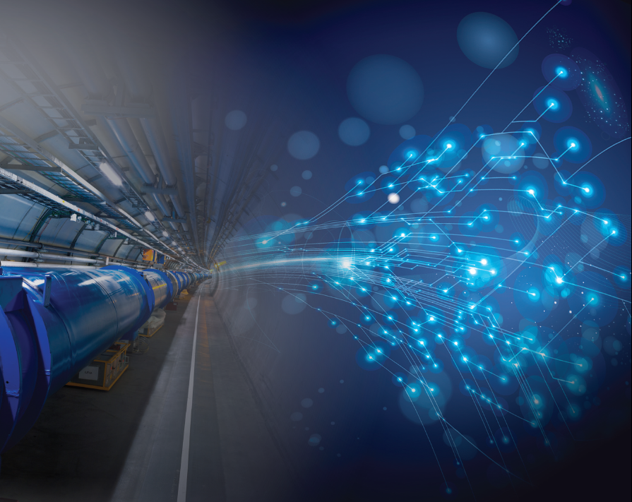
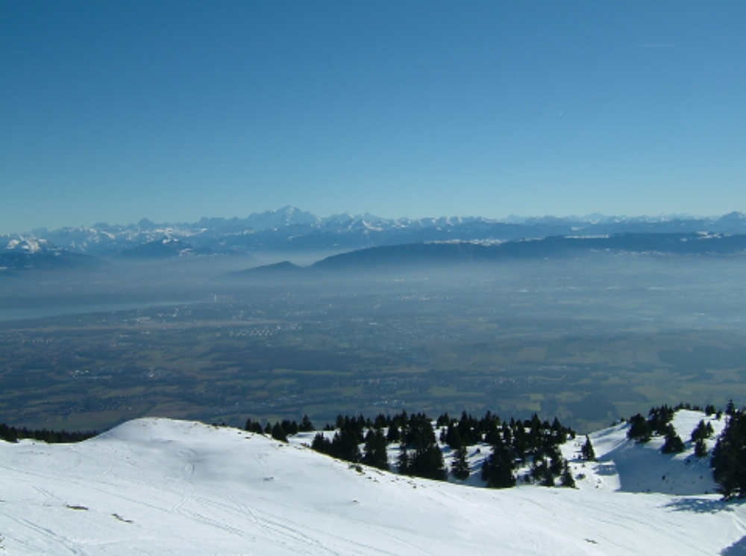
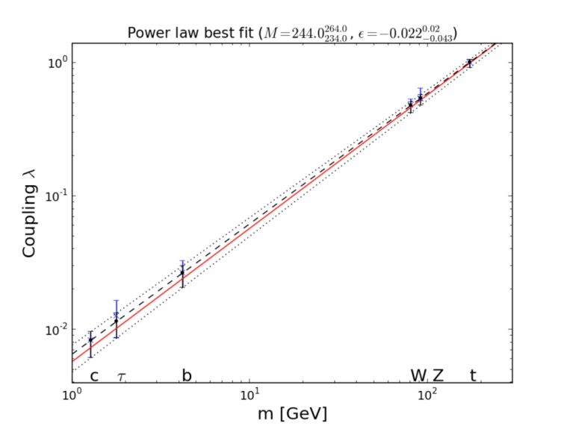
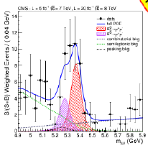
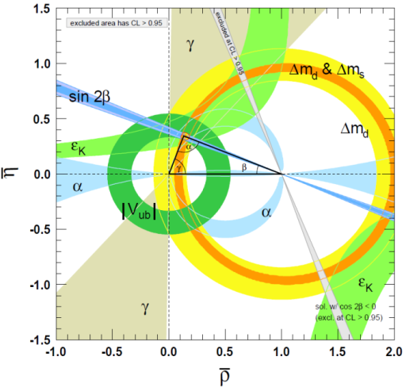


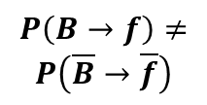
The Higgs Boson, the SM… and now what? aFCC (ee,pp,ep)
CSTS
June 6, 2014
SPP : R. A., H. Bachacou, M. Besançon, F. Couderc, F. Deliot, S. Ganjour, P.-F. Giraud, C. Guyot, G. Hamel de Monchenault, E. Lançon, J.-F. Laporte, E. Locci, J. Malcles, C. Royon, P. Schune, P. Schwemling, M. Spiro, J. Zinn-Justin
SACM : A. Chancé, B. Dalena, J. Payet, J.-M. Rifflet
SEDI : en discussion
Introduction
FCC: The Frontiers for Particle Physics
FCC: Organization
SACLAY involvements
Conclusion
LHC
PS
SPS
FCC
$$P\left(B→f\right)≠$$
$$P\left(\overline{B}→\overline{f}\right)$$
J. Ellis et al.

Slide 2
With the discovery of the Higgs Boson
Self-consistent model (SM) accounting for all Particle Physics phenomena at presently accessible energy
but does not explain major issues
Mass of neutrino (in the most general way)
Baryon Asymmetry of Universe
Dark Matter, Dark Energy
Unification of all interactions
New Physics must exist … but at which energy scale?
Direct Exploration of Higher Energy Scales
Precision measurements rare process studies

Slide 3
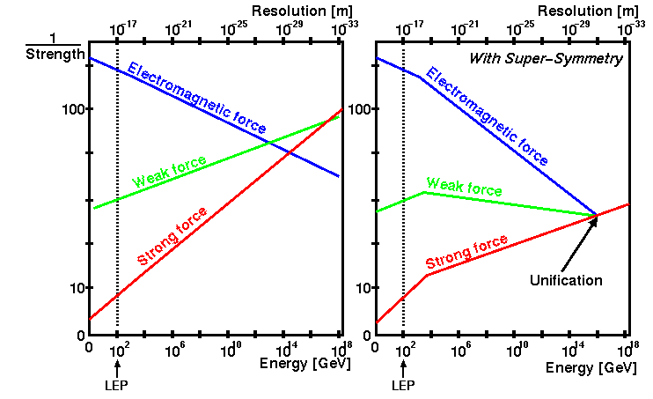



Grand unification of Interactions (Strong, Weak, Electromagnetic)
Interaction strength varies with energy scale depending on available quantum numbers and particle species
e.g. supersymmetric particles at TeV’s energy scales affect the running of the coupling constants
$$\frac{1}{α_{1}}$$
$$\frac{1}{α_{2}}$$
BICEP2
points to 10¹⁶ GeV unification scale
$$\frac{1}{α_{3}}$$
Need to explore higher energy regions (up to ~10 TeV)

Slide 4
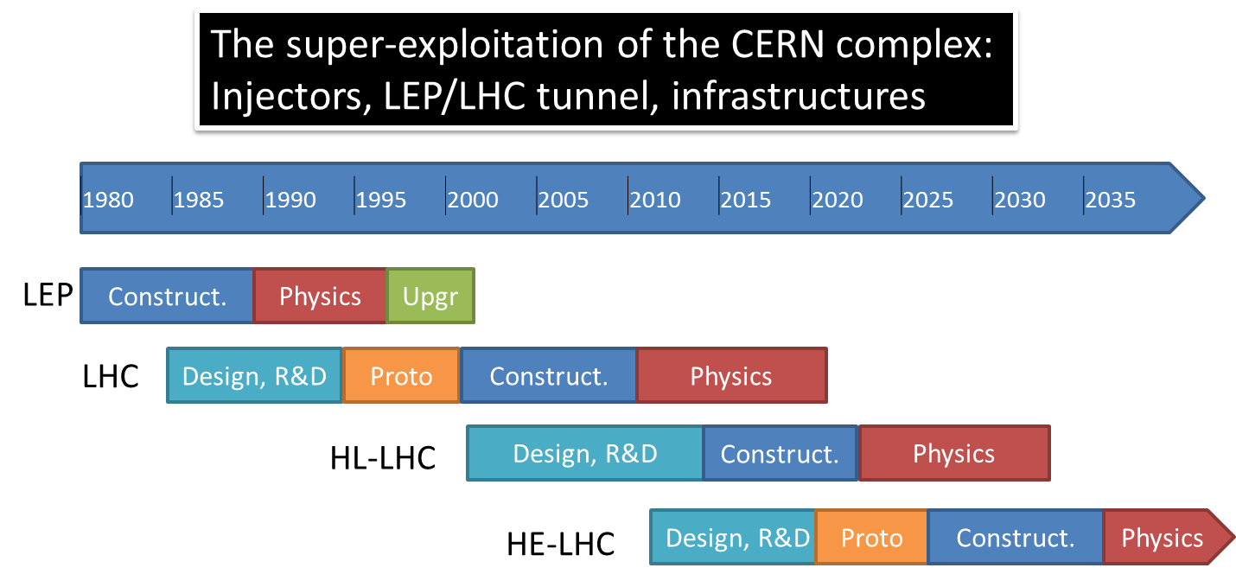
Either using existing
LEP/LHC tunnel to reach 26-32 TeV collisions
VHE
VHE-LHC
Or build (or reuse) a 80km tunnel to reach 80-100 TeV collisions FCC-hh
a more detailed study of such a tunnel needed
Paramètres | Valeurs
Energie c.m. (TeV) | 100
Circonférence (km) | ~100
Champ des dipôles (T) | 16 (Nb₃SN) [20 option HTS]
Luminosité (cm⁻²s⁻¹) | 5 10³⁴
Energie stockée/faisceau (GJ) | 8.2
Puissance dissipée (W/m) | 26
Espacement bunch (ns) | 25 [ 5 option]
Pile up | 171 [34]
Population bunch | 1 [0.2] x 10¹¹
Nombre bunch | 10500 [53000]
In both cases, SC challenge to develop 16-20 Tesla magnets!
Magnets for HL_LHC is an indispensable first step

Slide 5
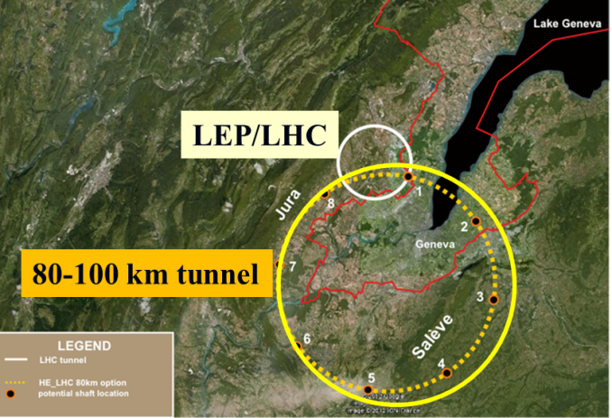
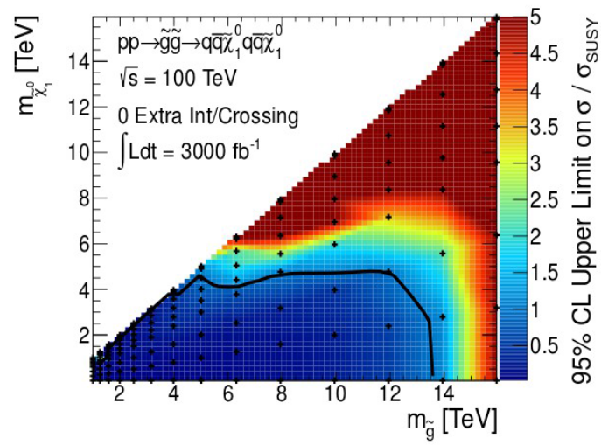
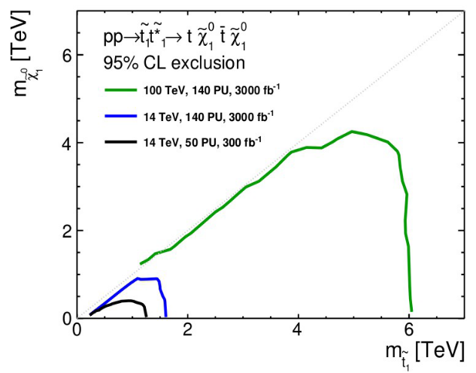
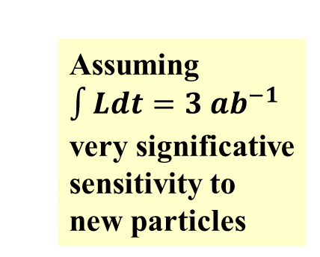
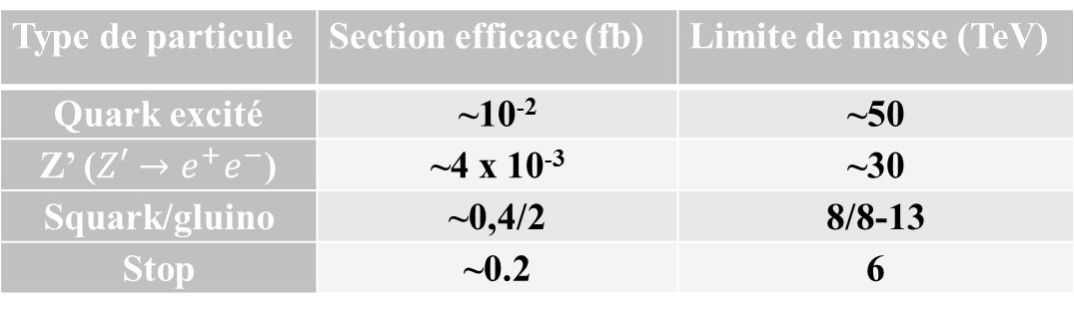
Today’s most promising manner to explore directly the energy scale up to 10 TeV and higher for some specific new particle is a 100 TeV p-p collider
FCC
Assuming $\int{Ldt}=3 {ab}^{−1}$ very significative sensitivity to new particles
Examples
A more complete study of the physics reach for the search of new particles needs to be carried out
Type de particule | Section efficace (fb) | Limite de masse (TeV)
Quark excité | ~10⁻² | ~50
Z’ ($Z′→e^{+}e^{−}$) | ~4 x 10⁻³ | ~30
Squark/gluino | ~0,4/2 | 8/8-13
Stop | ~0.2 | 6

Slide 6
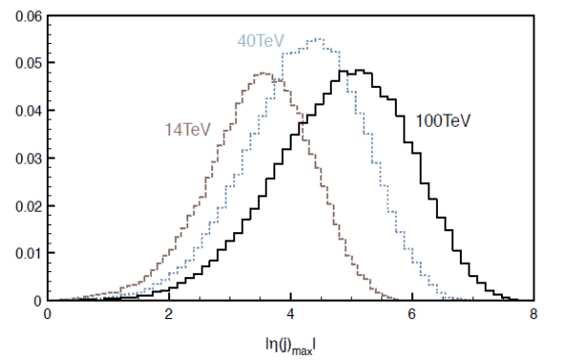
FCC-pp permits to study “conventional” physics, thanks to the large production cross sections
Outstanding example is Higgs production
x 60
x 40
Particular examples are the H to tt and self couplings
Parameter | uncertainty
δg_{Htt}/g_{Htt} | ~1%
δλ_{ΗΗΗ}/λ_{ΗΗΗ} | ~10%
Detector with high η (∼6) acceptance!
A more complete study of the sensitvity reach for the Higgs couplings is needed with a dedicated detector

Slide 7
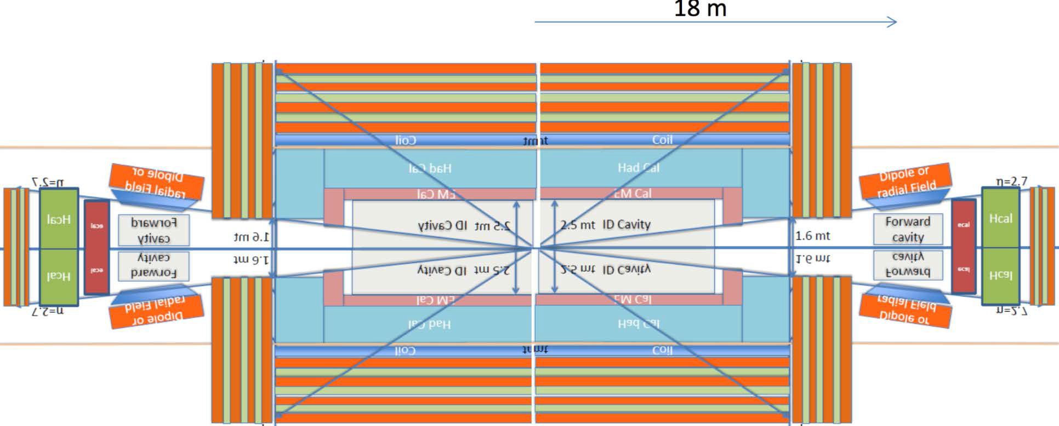
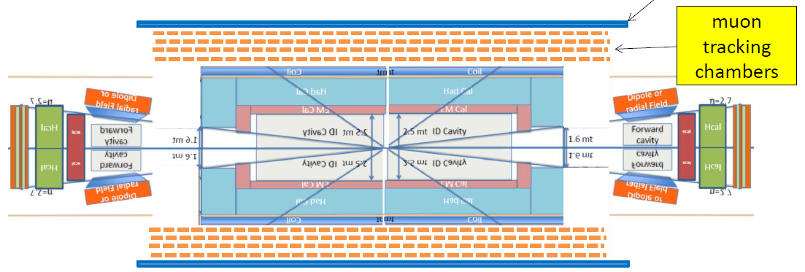
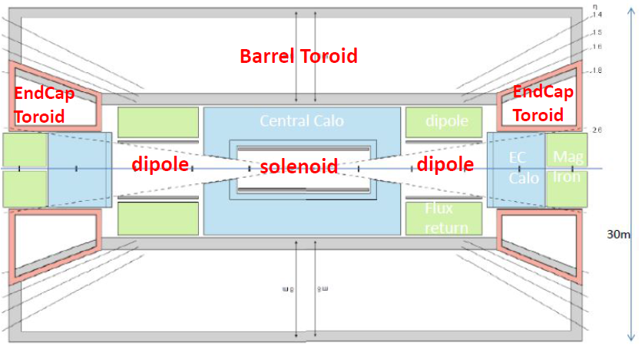
$14TeV→100TeV ⇒{(1}/{σ_{p}})BL^{2}\left(FCC\right)≅7 × LHC$
Detector concept studies have started
Shield coil
Stored energy 65 GJ
B_{out} ~-2.3 T B_{in} ~8.3 T
B ~6.0 T
120 kt yoke
52m
Stored energy 54 GJ
B_{tor.}~2 T
B_{ID}~3.5 T/3m(2T/4m)
Optimization of overall detector design is needed!!!

Slide 8
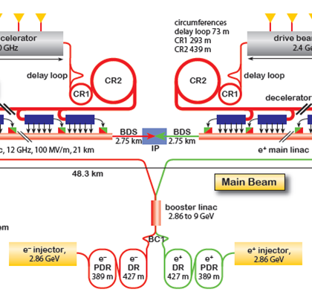
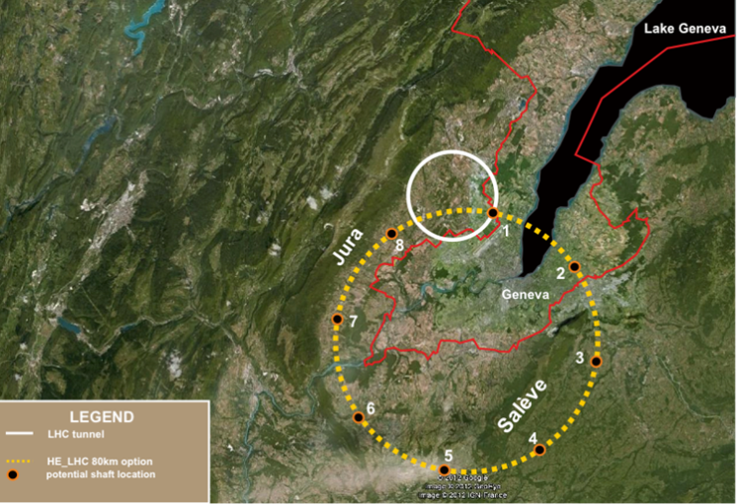
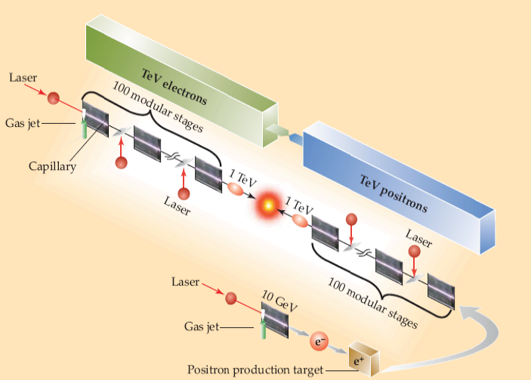
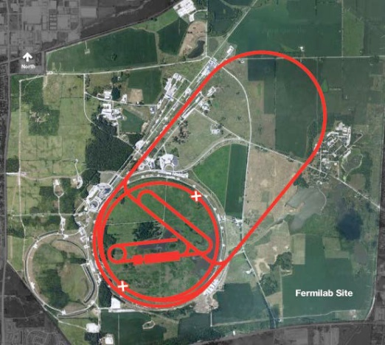
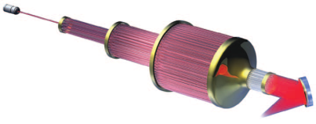
Future large scale accelerators
…for HE-physics and -Frontier exploration
pp Colliders
(HE-LHC, VHE-LHC,…)
Muti-TeV e⁺e⁻ Linear Colliders
(CLIC)
LEP/LHC
p-p collider FFC-hh (VHE-LHC) in
80-100 km tunnel
HE-Frontier Colliders
up to 3 TeV
up to 100 TeV
> 5 TeV
up to 10 TeV
Muon Colliders
(ν-Fact. as possible 1st step
Plasma Colliders

Slide 9

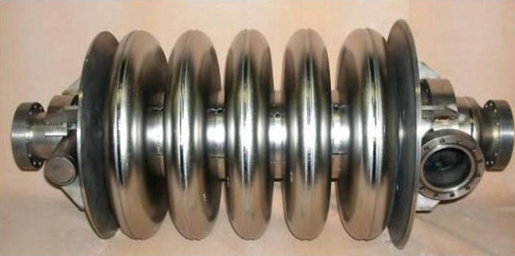
TLEP Ring e⁺e⁻ collider: Primary Cost Driver is the tunnel
If e⁺e⁻ needed, it is likely to come first
Building on existing technologies and experience (LEP, KEKB, PEPII…)
LEP/LHC
80 km tunnel
Using SC cavities
Energy CM (GeV) | 90 | 160 | 240 | 350
Luminosity (x10³⁴cm⁻²s⁻¹)/IP | 28-56 | 12-16 | ~6 | ~1.8
Cavity Gradient (MV/m) | 20 | 20 | 20 | 20
#5-cell SC cavities | 600 | 600 | 600 | 600
Beam lifetime (mn) | 200 | 50 | 21 | 15
Total AC power (MW) | 250 | 250 | 260 | 300
Could cover a wide range of energy up to 400 GeV collision energy.
Most parameters have been achieved or are planned at SuperKEKB

Slide 10
Main features:
Very High luminosity
Multi Interaction Regions
Low beamstrahlung
Excellent beam energy knowledge
To know more about FCC-ee/TLEP see
arXiv:1308.6176v1 [hep-ex] 28 Aug 2013

Slide 11
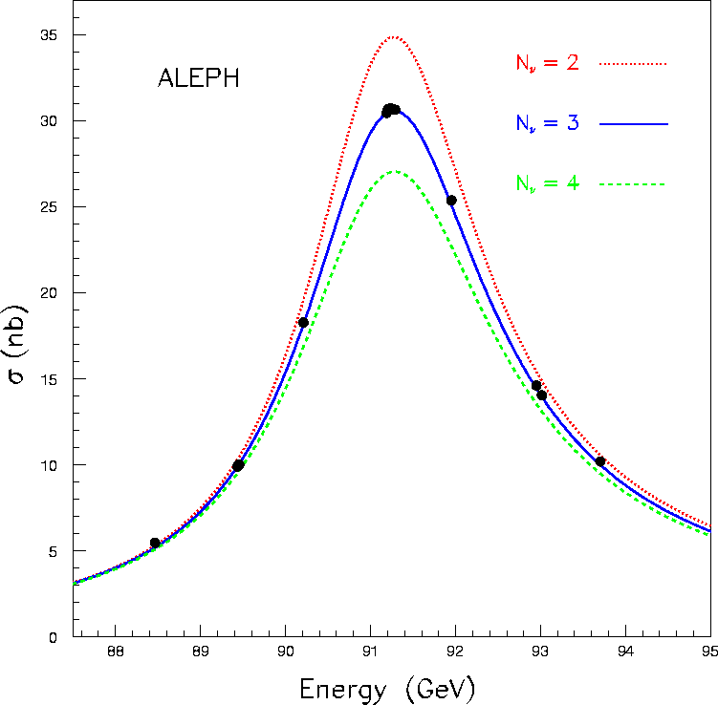
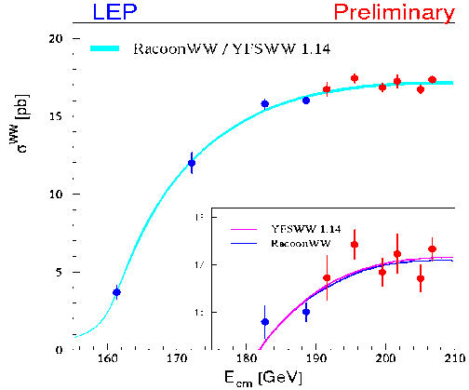
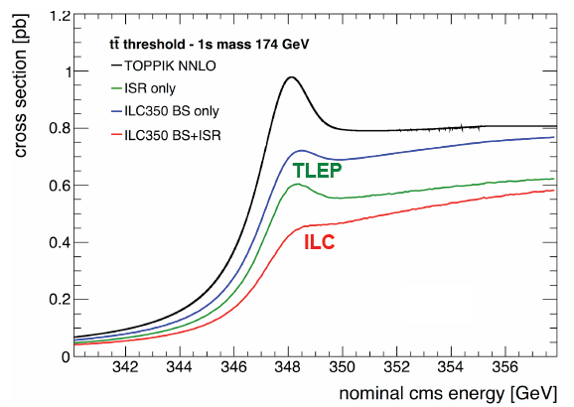
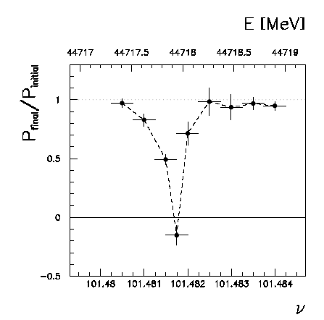
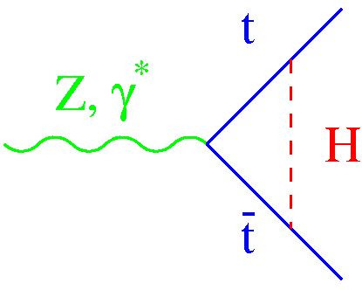
Unique to FCC-ee
FCC-ee instant. Luminosity (cm⁻²s⁻¹) | 5.6 10³⁵ @Z-pole | 1.6 10³⁵ @161 GeV | 5 10³⁴ @240 GeV | 1.3 10³⁴ @~350 GeV
FCC-ee Programme | #Z in 1 year @Z-pole | #W in 1 year @161 GeV | #H in 5 years @240 GeV | #top in 5 years @~350 GeV
# events@FCC-ee with 4 detectors | ~ 10¹² | ~ 5 10⁷ | >2 10⁶ | > 10⁶
Beam E cal. with
reson. depolar.
 | LHC(300) | LHC (3000) | ILC programme | FCC-ee programme | Comment/caveat
Δm_{W} (MeV) | ~10 | ~10 | ~7 | <0.5 | Theor. limited
Δm_{t} (MeV) | 800-1000 | 500-800 | 34 | 10 | ~100 from theo.
Δm_{H} (GeV) indirect | -25 | ~20 | ~5 | ~1.4 | Theor. errors should match!
Δm_{H} (MeV) direct | ~100 | ~50 | ~35 | ~7 | Overkill for now

Slide 12
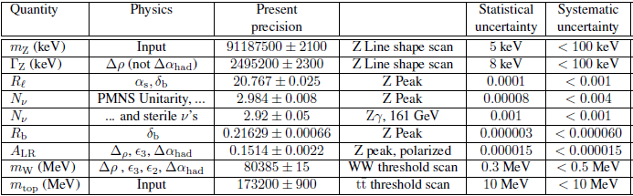
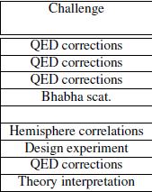
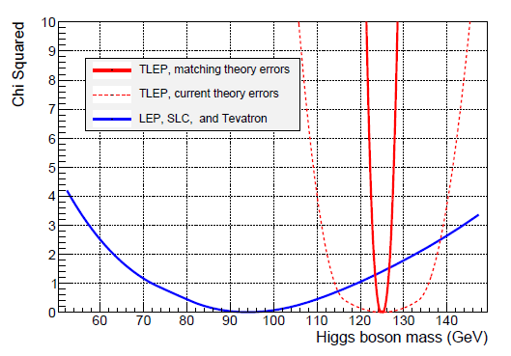
High precisions at Z pole and WW and top thresholds
Indirect m_{H} measurement error
TLEP + matching theory a δm_{H} ± 1.4 GeV
TLEP + present theory a δm_{H} ± 11 GeV
E_{beam} calibration with resonant depolarization unique to circular collider
a δE_{beam} < 0.1 MeV should be possible @TLEP

Slide 13
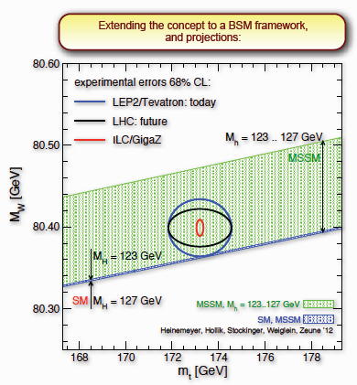
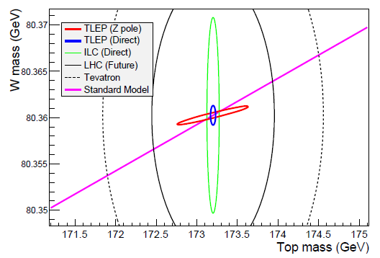
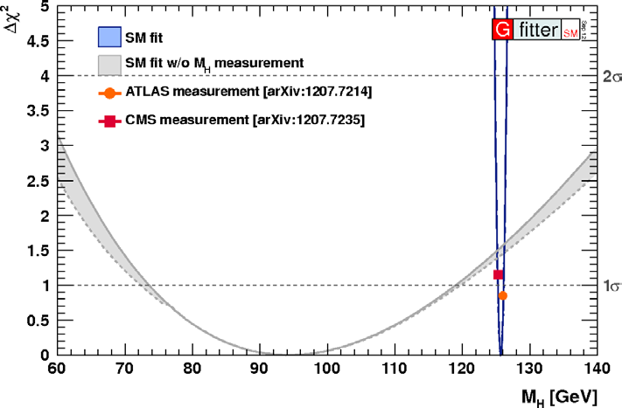
High precisions at Z pole and WW and top thresholds
(HL-LHC)
TLEP
Indirect:M_{H}=94.0 ± 1.4
Direct: M_{H}=125.500 ±0.007
.
Actual M_{H}

Slide 14
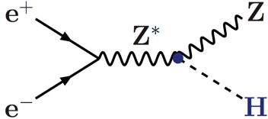
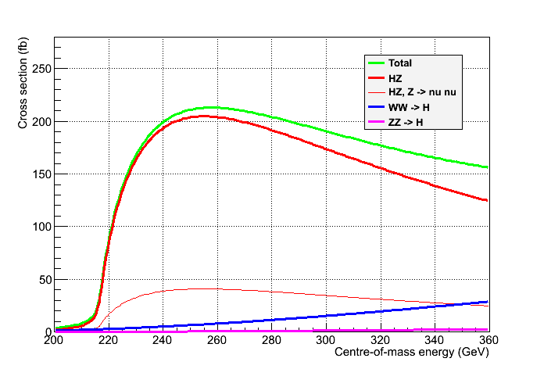
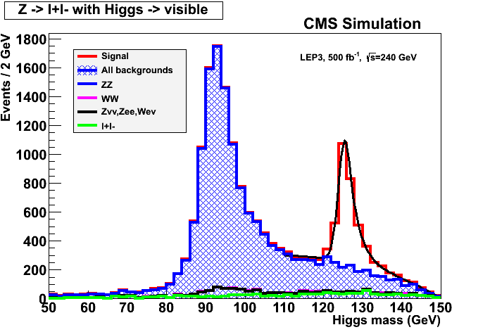

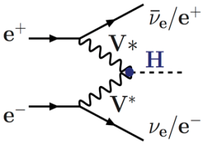

High precisions Higgs couplings at 240 GeV and 350 GeV
Great e⁺e⁻ asset: Tagged Higgs sample
  Total Higgs decay width
  Individual branching ratios to sub %
  Invisible and exotic decays
Reconstruct Z
Determine recoil mass
(thanks to be beam-energy constraint)
But …
Cross section modest a very large luminosity
Unpolarized cross sections
P Janot and G. Ganis
σ_{Hνν,} BRs,
width
Spin,
mass
σ_{HZ,} BRs,
width
δ(σ_{HZ}) = 0.4%
Z → All
Z → νν
Model independent way to measure Γ_{Η}

Slide 15

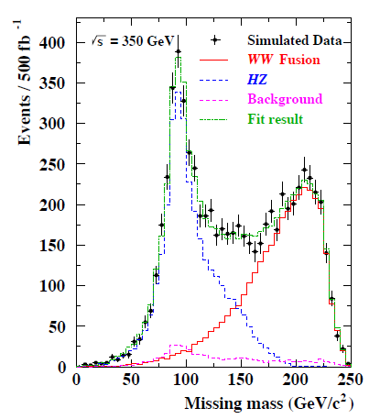
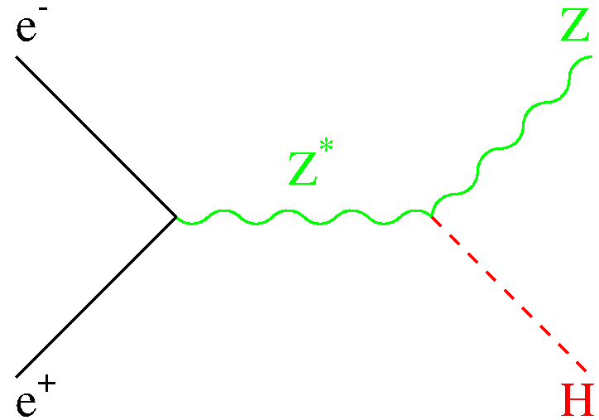
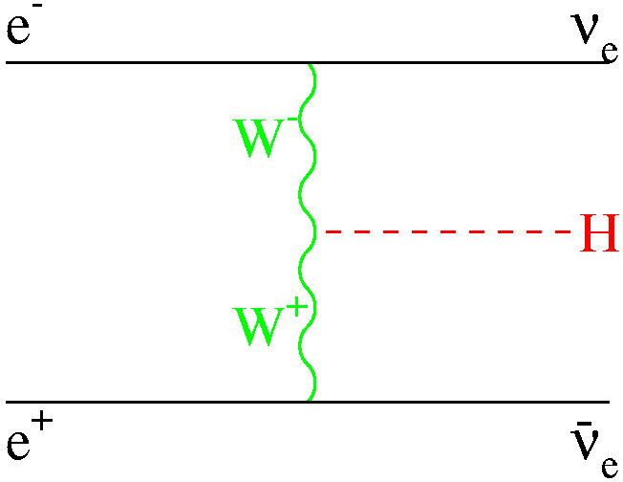
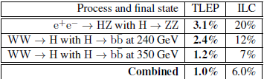
Total Higgs decay width can also be extracted from W-fusion
ν
ν
ν
δ(σ_{WWgHgbb} )
= 0.6%
ΔΓ_{H} /Γ_{H}

Slide 16
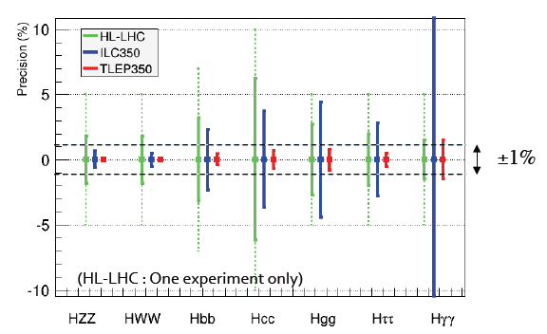
Accelerator → Physical quantity ↓ | HL-LHC 3000fb⁻¹ /exp | ILC (250+350) | TLEP 240 +350 4 IP
ΔΓ_{H/}Γ_{H} | -- | 6.0% | 1.0%
ΔΓ_{inv/}Γ_{H} | ~7% | 2.9% | 0.45%
Δg_{Hγγ}/g_{Hγγ} | 2.0% | 14.5% | 1.5%
Δg_{Hgg}/g_{Hgg} | 3.0% | 4.4% | 0.8%
Δg_{Hww}/g_{Hww} | 2.0% | 0.5% | 0.19%
Δg_{HZZ}/g_{HZZ} | 2.0% | 0.9% | 0.15%
Δg_{Hμμ}/g_{Hμμ} | <10% | 45% | 6.2%
Δg_{Hττ}/g_{Hττ} | 2.0% | 2.9% | 0.54%
Δg_{Hcc}/g_{Hcc} | ~7% | 3.8% | 0.71%
Δg_{Hbb}/g_{Hbb} | 4.0% | 2.4% | 0.42%
Sensitivity to Higgs couplings at FCC-ee/TLEP using data at 240 and 350 GeV (5 years at each energy)
Comparison with of TLEP sensitivities with HL-LHC and ILC
Sub-percent (permille) level measurements are needed

Slide 17

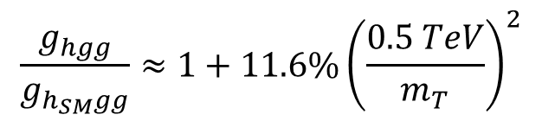
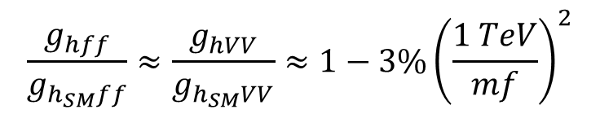
ElectroWeak Symmetry Breaking precision measurements
Example : Precision for Higgs couplings
SUSY modifies tree-level couplings
e.g. Pseudo-scalar A is difficult to find for moderate tanβ=5
H. Baer, M. Peskin et al.
Largest effet expected for bb, ττ
$$\frac{g_{hbb}}{g_{h_{SM}bb}}=\frac{g_{hττ}}{g_{h_{SM}ττ}}≈1+1.7\%{\left(\frac{1 TeV}{m_{A}}\right)}^{2}$$
e.g. light stop is an important search (hierarchy problem)
$$\frac{g_{hgg}}{g_{h_{SM}gg}}≈1+11.6\%{\left(\frac{0.5 TeV}{m_{T}}\right)}^{2}$$
$$\frac{g_{hγγ}}{g_{h_{SM}γγ}}≈1−3.2\%{\left(\frac{0.5 TeV}{m_{T}}\right)}^{2}$$
Compositness
All couplings reduced according to compositness scale
$$\frac{g_{hff}}{g_{h_{SM}ff}}≈\frac{g_{hVV}}{g_{h_{SM}VV}}≈1−3\%{\left(\frac{1 TeV}{mf}\right)}^{2}$$
Higgs couplings should be measured as precisely as possible!

Slide 18
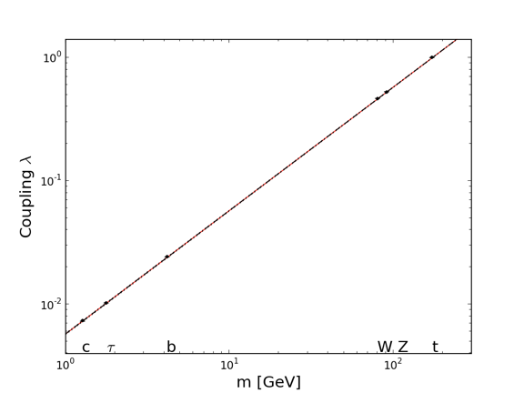


Measuring precisely the particle coupling to H⁰
$$g_{HVV}∝ m_{V}{}_{}^{2}{}$$
$$g_{Hff}∝ m_{f}$$
f ⁺
H
f ⁻
e
u
d
s
μ
c
τ
b
W
Z
t
M = 246.0 ± 0.8 GeV, ε = 0.0000^{+0.0015}_{-0.0010}

Slide 19
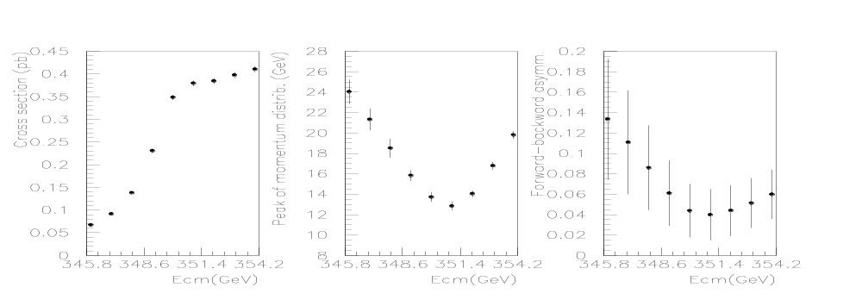
High precisions at ttbar threshold
Scan of the tt threshold
  Observables σ_{tt}, A_{FB} and <p^{@max}> sensitive to m_{top} , Γ_{top} , and λ_{top} (ttH Yukawa coupling)
    Experimental precision for ILC with 100,000 tt events
      No beamstrahlung and 500,000 tt events at TLEP
    Expected sensitivity for TLEP (full study to be done) and ILC
-
-
Study made for TESLA
m_{top} = 175 GeV
σ_{tt}
p^{@max}
A_{FB}
M. Martinez and R. Miquel, 2003
 | Δm_{top} | ΔΓ_{top} | Δλ_{top}/λ_{top}
TLEP | 10 MeV | 11 MeV | 13%
ILC | 31 MeV | 34 MeV | 40%

Slide 20
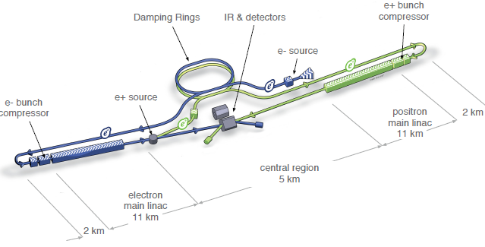
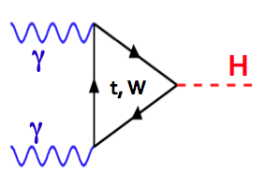

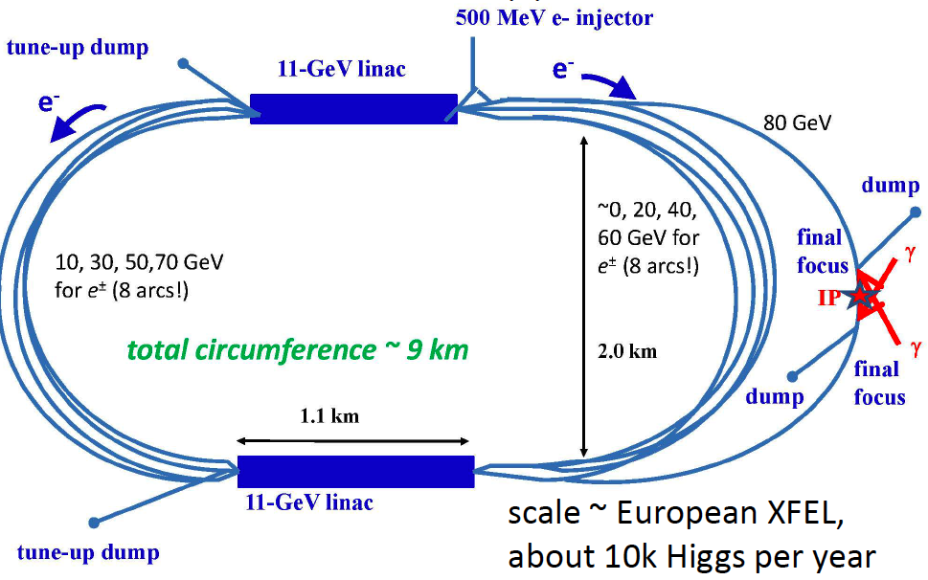
Possible future large scale accelerators to address PP frontiers
From electroweak high precision tests to Higgs studies
Linear e⁺e⁻ Colliders
(ILC, CLIC)
Circular e⁺e⁻ Colliders
(TLEP, super TRISTAN, CEPC…)
LEP/LHC
up to 400 GeV
FCC-ee (TLEP) in
80-100 km tunnel
<1 TeV
~14kH/year
Higgs Factories
~400kH/year (4 det.)
~10kH/year
~10kH/year (2det.)
μ ⁺
laser~5J,
~100kHz
H
μ ⁻
~126 GeV
γγ Colliders
(SAPPHIRE, SILC, CLICHE, HFiTT )
~160 GeV
Muon Colliders
(ν-Fact. as possible 1st step

Slide 21
Recommendations from European Strategy Group (cont’d)
High-priority large-scale scientific activities (2)
Recommendation #2
d) To stay at the forefront of particle physics, Europe needs to be in a position to propose an ambitious post-LHC accelerator project at CERN by the time of the next Strategy update, when physics results from the LHC running at 14 TeV will be available.
CERN should undertake design studies for accelerator projects in a global context, with emphasis on proton-proton and electron-positron high-energy frontier machines. These design studies should be coupled to a vigorous accelerator R&D programme, including high-field magnets and high-gradient accelerating structures, in collaboration with national institutes, laboratories and universities worldwide.

Slide 22

CEPC+SppC
« The FCC in China »
A 50-70 km tunnel is very affordable in China NOW
CPEC
  Pre-study, R&D and preparation work
    Pre-study: 2013-15
      Pre-CDR by the end of 2014 for R&D funding request
    R&D: 2016-2020
    Engineering Design: 2015-2020
  Construction: 2021-2027
  Data taking: 2028-2035
SppC
  Pre-study, R&D and preparation work
    Pre-study: 2013-2020
    R&D: 2020-2030
    Engineering Design: 2030-2035
  Construction: 2035-2042
  Data taking: 2042 -
Contact with IHEP/Tsinghua has been established. Agreement to joint effort on specific physics and TPC studies
Slides from Yifang Wang (IHEP director)

Slide 23

FCC Design Study : 100km Circular (pp, ee, ep) collider
Kick-off meeting of the FCC was held on February 12-14, 2014
FCC DS is huge a WP with EC funding and WP without EC funding
a number of partners for H2020 part will be limited
For these topics, Working Groups are being set up, each WG being divided in sub-groups

Slide 24
Example of breakdown of the working group on lepton collider
Overall coordination: A. Blondel, P. Janot
  Discovery through precision measurements, rare, or invisible processes.
  Develop the necessary tools Understand the experimental conditions
  Set constraints on the possible detector designs to match statistical precision
Electroweak Physics at the Z pole
R. Tenchini
Di-boson Physics m_{W} measurement
R. Tenchini
H(126) Properties
M. Klute
K. Peters
Top Quark Physics
P. Azzi
QCD and gg Physics
D. d’Enterria
P. Skands
Flavour Physics
S. Monteil
New Physics
M. Pierini
C. Rogan
Offline Software
P. Janot, F. Gianotti
B. Hegner (PH-sft)
Online Software
C. Leonidopoulos
Experimental Environment
N. Bacchetta
Synergy with FCC-hh
Coordination with accelerator team
(Wenninger, Burkhardt, etc)
Detector Designs
A. Cattai
G. Rolandi
Synergy with linear collider detectors
Periodic Workshops and vidyo meetings are organized

Slide 25


Example of breakdown of the working group on hadron collider
F. Gianotti, M. Mangano
Performance requirements
and experimental challenges
Main physics goals
Detectors layout, R&D and technologies
important to maintain flexibility at
this stage
synergies with FCC-ee, ILC and
CLIC being established
High-precision studies,
may require dedicated
experiments
FCC-hh, a very versatile facility?
ideas for experiments of different types (collider, fixed target),
maintain flexibility in e.g. injector system
Detector-machine
interface issues

Slide 26




Study timeline
2014 |  |  |  | 2015 |  |  |  | 2016 |  |  |  | 2017 |  |  |  | 2018
Q1 | Q2 | Q3 | Q4 | Q1 | Q2 | Q3 | Q4 | Q1 | Q2 | Q3 | Q4 | Q1 | Q2 | Q3 | Q4 | Q1 | Q2 | Q3 | Q4
Study plan, scope definition
Explore options
“weak interaction”
Workshop & Review: identification of baseline
conceptual study of baseline “strong interact.”
H2020-DS submission
Workshop & Review, cost model, LHC results → study re-scoping?
Elaboration,
consolidation
Workshop & Review
→ contents of CDR
Report
Release CDR

Slide 27

FCC EU DS Status – DRAFT
Implication de l’IRFU à l’étude
WP1: Management, Coordination, Implementation & Costing
Coordination & Outreach
Realization aspects
WP4: High-field Accelerator Magnet Design FCC-hh
Magnet design
Field quality evaluation and comparison
Field optimisation for DA maximum
WP2: Interaction region design FCC-hh
IR and final focus design
MDI
Shielding and FF quad protection
Beam parameters
Collimation requirements
Beam-beam
WP5: Beam pipe design FCC-hh
Vacuum design
Beam screen optimisation
Beam screen coating
Cryogenics integration
Prototype production
Performance measurements
WP3: Arc design FCC-hh
Arc lattice design
Dynamic aperture evaluation
Impedance calculations and instabilities
SR: photo-electrons and e-cloud effect
Aperture and field quality specifications
WP6?: IR&beam-beam FCC-ee
Implication de l’IRFU à l’étude

Slide 28


Involvement of IRFU in FCC
Both for FCC-hh and FCC-ee , the areas of interest cover
Physics Studies , Detector Studies, Accelerator Studies
FCC-hh
Physics Studies
FCC-ee
Measured parameter | Method | Energy (GeV)
$$Γ_{H}$$ | $$σ_{HZ}$$ | 240
 | $σ_{HZ} ×Br(H→ZZ$)
$$Γ_{H→inv}$$ | $σ_{HZ} ×Br(H→inv$) | 240
$$g_{Hcc}$$ | $σ_{HZ} ×Br(H→c\overline{c}$) | 240
$$N_{ν}$$ | $σ_{HZ} ×Br(Z→inv$) | 240
 | $σ_{ZZ} ×Br(Z→inv$)
 | $σ_{γZ} ×Br(Z→inv$)
$$N_{ν}$$ | $σ_{γZ} ×Br(Z→inv$) | 126
$$Br(H→ee)$$ | $$σ_{e^{+}e^{−}→H}$$ | 126
m_{t} , Γ_{t} , $g_{Htt}$ | $σ_{e^{+}e^{−}→t\overline{t}}$ , $\frac{dp_{peak}}{dE_{cm}}$ , $A_{FB}$ | Scan 350
The physicists are mainly interested to study the mass reach at FCC-hh for BSM particles : SUSY and heavy resonances in di-lepton, $t\overline{t}$ or multi-boson final states.

Slide 29





Involvement of IRFU in FCC
N_{ν} at FCC-ee (240 GeV)
LEP measurement : $Nν= 2.984 ±0.008$
$$→inv.$$
ν
ν
ν
ν
ν
ν
Combined (ZZ, ZH) precision potentially lead to δN_{ν}= 0.006
γZ events potentially lead to δN_{ν}= 0.001

Slide 30
Involvement of IRFU in FCC
Detector study
FCC-hh
FCC-ee
Capitalizing on IRFU’s experience in LHC, we propose to participe to the studies for the magnetic configuration and magnet layout of the FCC-hh detectors.
Comparative studies of the solenoid options with passive and active shielding.
Study of the a large toroid option.
This may be useful for the FCC-ee detectors
Study of the operability of a TPC for a FCC-ee detector
Two important issues have to be studied
1) Ions
Primary ions
Back flow of ions
2) Low power electronic
Minimization of material in the end plates
A contact at SACM is needed to define the possible studies

Slide 31

Involvement of IRFU in FCC
TPC for FCC-ee
There is a believe that TPC is the ideal detector for e⁺e⁻. Certainly TPC have been used with success at LEP and LHC (ALICE)
Minimum of material
For excellent tracking capability (large number of measured points)
Some PID with de/dx (5% resolution)
Capitalization of studies done at IRFU (T2K/ILC) using micromegas
Possible synergies with linear collider studies (ILD)
But cannot be used in all environments!
R_{in} : 229 mm
R_{out} : 1808 mm
L_{z} : 2×2350 mm
B=4 T
σ_{R-φ} ~100 μm
σ_{R-Ζ} ~500 μm
dp/p² = 8 x 10⁻⁵ (full tracking : 2 x 10⁻⁵)
Most demanding conditions @ Z-pole
~33 kHz Bhabhas
~17 kHz of hadronic events with <mult.> ~20 (~1 evt / 60 μs avg)
Total drift time ~50μs
On average < 1 evt drifting in TPC
2-hit r-z resolution is 8 mm (160 ns drift time) a evt mixing is negligible

Slide 32






Involvement of IRFU in FCC
TPC for FCC-ee : ions are the main issue
Primary ions
Secondary ions
With high evt rate TPC is filled with primary ions
Preliminary calculations for Z-pole operation
0.70*10⁹ Ions (B=3.5 T)
(0.66*10⁹ @ ILC dominated by beamstrahlung γ−γ events; non-issue @ FCC-ee)
Secondary ions are a serious issue. May in principle be gated but one needs
Study gating feasibility in FCC-ee conditions
Calculate the impact on resol.
Verify with test
FCC-ee
Maximum distorsion
8.5 mm (negligible)!
0.4 1.8
r(m)
We need
To improve simulations for FCC-ee environment
To carry out an R&D programme for measuring these effects
Support from SEDI needed (~0.2 FTE/y)

Slide 33
Involvement of IRFU in FCC
TPC: Electronic power consumption
Typically, the present power per channel for high rate operation is 30-40mW. With 1 x 4mm² pads one gets 7-10kW/m²
This is manageable but requires but significant (excessive?) material will be needed to evacuate such a heat load. ILC solves the issue with power pulsing, not possible @ FCC-ee.
Conceptual architecture study to reduce consumption by factor 10
We would need the help of an electronicien (0,2 FTE/year)
Other possible studies
Comparative study of options for calorimetry and optimization for FCC-ee requirements of resolution/operability/cost
Investigation of wireless powering and data transmission

Slide 34
Involvement of IRFU in FCC
Accelerator study
FCC-hh
FCC-ee
Design of the arc lattice , e.g.
  Dynamic aperture evaluation
  Aperture and field quality specifications
High-field Accelerator Magnet Design e.g.
  Magnet design
  Field quality evaluation, comparison and optimization
IRFU has expertise on Beam Dynamics and SRF system
However, no commitments can be taken at this point. We propose to follow-up the developments for a possible contribution at a later stage.
We propose to play a leading role in these areas.

Slide 35
Funding
Many studies require simulation/calculation studies i.e. physicists / engineer time
It also requires travels for discussions/meetings/workshops
2014 request: 20 K€ +(2k€ for co-organizing a workshop in Paris)
The R&D for TPC related issues requires material cost
  Cosmic telescope for test bench
  Modification of cylindrical TPC end plate
  Development of an ion generation system based on UV flashes
  Test with magnetic field (cost not included) probably in 2015
2014 request: 30 K€ (12+8+10)
2015 estimation: 50 K€ (30 for travels + 20 for R&D)
2016 – 2017 : will depend on studies in 2014-15 and new studies/R&D ideas

Slide 36
Conclusions
High precision and High energy frontiers have to be overcome to explore and understand further the fundamental law of the universe
FCC (hh, ee) is a very exciting project and addresses these frontiers in a very efficient way
FCC (hh, ee) design study is in line with the highest priority of the European Strategy after the LHC
There is a strong interest to FCC from IRFU’s physicists.
We have periodic FCC-Saclay meeting with many contributions (see http://tlep-saclay.extra.cea.fr/ )
We propose to participate in this project an IRFU group to
  Physics Studies
  Detector Studies
  Accelerator Studies
We are already actively contributing to the project in several ways :
- Workshops/vidyo-meeting
  TLEP workshops (3rd, 5th, 6th ) : R. A.
  Kickoff meeting: Ph. Schwenling
  Vidyo meetings : R. A., S. Ganjour, E. Locci, Ph. Schwemling
  Publications (see http://arxiv.org/abs/arXiv:1308.6176 )
  Development of the H2020-DS proposal

Slide 37
Backup

Slide 38
13-14 TeV
L= 5 10³⁴ cm⁻² s⁻¹
Increase beam current a protect SC dipole (diffracted protons)
8T-15m (20 magnets) a 11T-2x5.5 m dipoles
All this work is essential for precision measurements and is a first step toward higher energy
Reduce beam size at IP a Larger aperture quads near IP
Change Quadrupole Triplets a 140T/m, 150mm (13T, 8m)
Protect Electrical Distribution Feedbox’s (DFBX)
a 2×100 kA ~500m HTS links
Improve and adjust the luminosity with beam overlap control
a SC RF «Crab» Cavity, for p-beam rotation at fs level!

Slide 39



The « revolution » of circular e⁺e⁻ colliders
The Top up scheme
Continuous High luminosity
K; Oide
8x10³⁵@superKEKB

Slide 40





…Why e⁺e⁻…
Improve further the consistency tests of the Standard Model
Moriond EW ’12
Z pole measurements
Standard Model
∝ M_{t}²
∝ ln(M_{H})
Direct m_{W}, m_{top}
measurements
M_{W}= 80.385 ± 0.015 GeV
Affects Z lineshape, Asymmetries, Cross section, Decay Rates…
M_{t}= 173.5 ± 1.0 GeV
M_{H}= 93 ± ²⁶ ₂₀ GeV
Need to improve
Measurement @Z-pole
M_{w} and M_{t} ( @threshold)
M_{H}

Slide 41

Polarization at circular colliders
e⁻(e⁺) spin naturally align along dipole magnetic field
Transverse polarization builds up by synchrotron radiation emission (or if needed using wigglers)
Transverse to longitudinal polarization is achieved with Spin Rotators
RF-m
B⊥
Resonant depolarization is achieved with small field (perpendicular to dipole field) RF-magnet with frequency in phase with precession frequency. (Precession period is proportional to beam energy)
Depolarizing RF-magnet frequency measures beam energy with <0.1 MeV

Slide 42




High precisions at Z-pole
Many other measurements would benefit from Tera-Z production
Channels | Production/year | Physics
τ⁺τ⁻ | 3 10¹⁰ pairs | Rare decays, conservation laws…
c or b quarks | > 2 10¹¹ | CP violation, rare decays…
 | e.g. > 3 10¹⁰ B_{s} | Large B_{s} sample with clean environment within SM, > 1000 B_{s} g τ⁺τ⁻ detected
Complement to B_{s} g μ⁺μ⁻ for NP search
SM
Example of non-SM
… or any NP loop process favoring 3rd generation

Slide 43

High precisions at H threshold
Sub % sensitivities on couplings to Higgs are highly desirable to probe new physics at and above the TeV scale

Slide 44
Do we have the technology to carry out these measurements?
 | LHC(300) | LHC (3000) | ILC (250+350) | TLEP (240+350) | Comment
Δm_{H} (MeV) | ~100 | ~50 | ~30 | ~7 | Overkill for now
ΔΓ_{Η}/Γ_{Η} (ΔΓ_{inv}) | --(14) | --(7) | 6(2.9)% | 1.0(0.45)%
H spin | P | P | P | P
Δm_{W} (MeV) | ~10 | ~10 | ~7 | <0.5 | Theo. limits
Δm_{t} (MeV) | 800-1000 | 500-800 | 31 | 10 | ~100 from theo.
Δg_{HVV}/g_{HVV} | 4-7%* | 2%* | 0.5-14.5% | 0.15-1.5%
Δg_{Hff}/g_{Hff} | 6-13%* | 2- 7%* | 2-2.5% | 0.2-0.7%
Δg_{Htt}/g_{Htt} | 14%* | 7%* | ~40% | ~13%
Δg_{HHH}/g_{HHH} | -- | ~30% | 44%** | -- | Insufficient ?
Could be significantly improved at VHE-LHC
*Assuming systematic errors scales as statistical and theoretical errors are divided by 2 compared to now
**Sensibility with 2ab⁻¹ at 500 GeV

Slide 45


Sensitivity to Higgs Coupling at TLEP using data at 240 GeV (5 years, 4 detectors)

Slide 46

Selected Future Projects
RF system needs
Project | Beam Type | RF freq. (MHz) | Beam Power (MW) | Pulse length (μs) | # cavity | Gradient (MV/m)
ILC 250 | elect. | 1300 | ~8 | 727 | 8000 | 31,5
CLIC 3000 | elect. | 12000 | 14 | 0,155 | 30000 | 100
TLEP | elect. | 700-800 | 100 | CW | 600 | 20
VHELHC | prot. | 400 | 2 | CW | 16 | 2
We do have the technologies for Higgs factories and Energy frontier up to TeV scale with e⁺e⁻ and 60 (100) TeV with pp colliders
We do not have the technology for multi TeV (>5) lepton colliders
μ collider or « plasma acceleration » colliders may be the solution but many issues to be solved

Slide 47






Possible future large scale accelerators to address PP frontiers
… and Flavor physics …
ν super Beams (T2HK, LBNE, LNBO…)
superB e⁺e⁻ Factory
ESS based 5MW p-beam
SuperKEKB
ν
accumulator
target/horn station
L=8 10³⁵ cm⁻² s⁻¹
>10¹⁰ B/year
Flavor Factories
1.6x10¹⁶ pot/s
Fast
5-10 GeV
ν,μ
$$τ_{μ}=2.2μs$$
Multi-MW
SC cavities
Goal: >10²¹ μ/y stored

Slide 48
FCC-ee tentative timelines (personal) | 2013 | 2014 | 2015 | 2016 | 2017 | 2018 | 2019 | 2020 | 2021 | 2022 | 2023 | 2024 | 2025 | 2026 | 2027 | 2028 | 2029 | 2030 | 2031 | 2032 | 2033 | 2034 | 2035 | 2036 | 2037 | 2038 | 2039 | 2040 | 2041 | 2042 | 2043
CDR
TDR +R&D
R&D + Construction
Physics
Delivery of CDR and European Strategy update
FCC-pp tentative timelines (personal) | 2013 | 2014 | 2015 | 2016 | 2017 | 2018 | 2019 | 2020 | 2021 | 2022 | 2023 | 2024 | 2025 | 2026 | 2027 | 2028 | 2029 | 2030 | 2031 | 2032 | 2033 | 2034 | 2035 | 2036 | 2037 | 2038 | 2039 | 2040 | 2041 | 2042 | 2043
CDR
TDR +R&D
R&D + Construction
Physics

