Slide 1
High Intensity lasers: probing quantum vacuum, dark matter, gamma beams, electron or proton accelerators, colliders
Michel Spiro

Slide 2
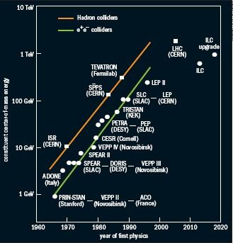

Slide 3
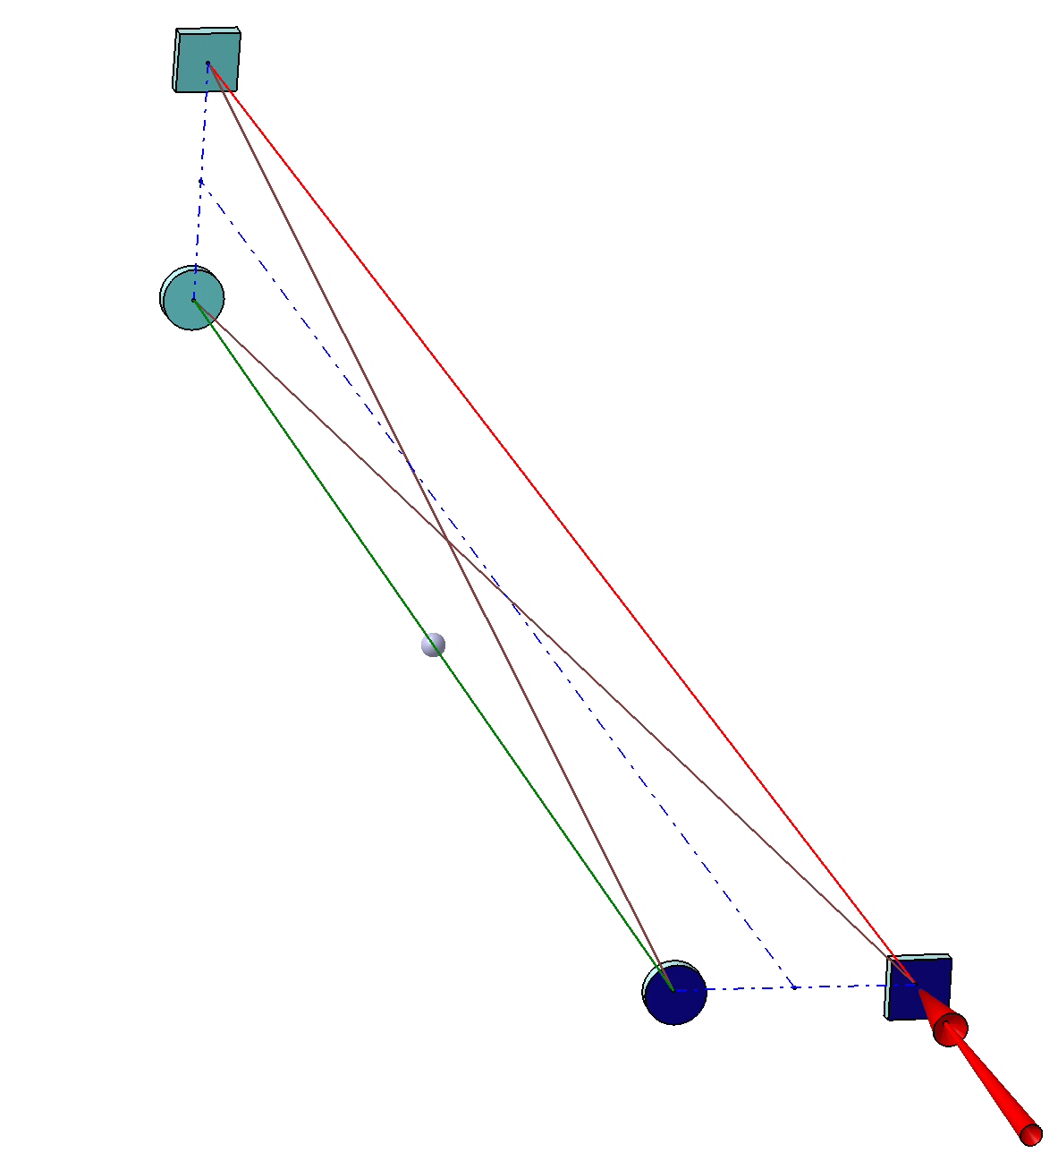
Toward small laser spot size: ThomX
Small laser spot size &2 mirrors cavity ➔ unstable resonator (concentric resonator)
Stable solution: 4 mirror cavity
as in Femto lasers
Laser input
BUT➔ astigmatic & linearly
polarised eigen-modes
e⁻ beam
Non-planar 4 mirrors cavity
➔Astigmatism reduced &
~circularly polarised eigenmodes

Slide 4

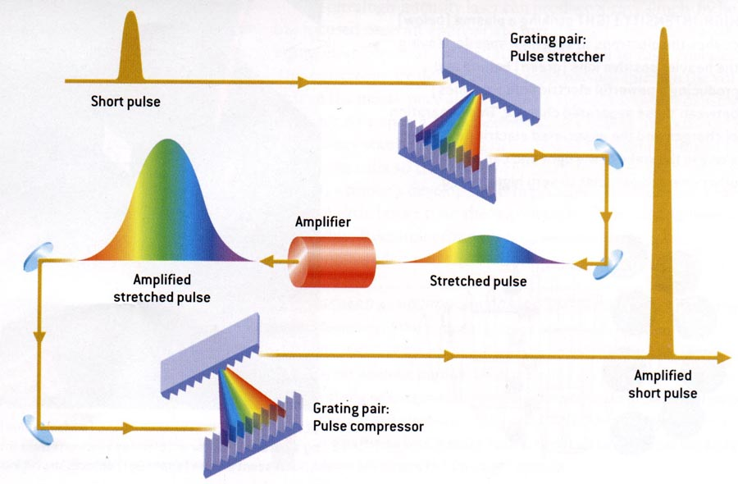
^{Chirped Pulse Amplification}
D. Strickland and G. Mourou 1985
100fs
⁴
Notes:
Chirped Pulse Amplification concept.
The pulse is stretched a thousand times, lowering the intensity accordingly without changing the input fluence. Once it has been amplified, it is recompressed to its initial value. Let’s stress the amount of manipulation. Stretching 10⁴ times, Amplification ~10¹⁰, and compression 10⁴ times.

Slide 5




ILE – APOLLON 10P : A collaborative project between
Several laboratories on the « Plateau de Saclay »
ELI Nuclear Physics meeting, Bucarest Feb1-2, 2010
ILE APOLLON Single beamline 10PW laser
KHz Ti:Sa
30 fs @ 800 nm
500 µJ
Spectral broadening
< 10 fs @ 800 nm
100 µJ, kHz
Ampli 0
2J /1Hz
Ampli 1
« LASERIX »
50J /0.1Hz
Ampli 2
600J -1shot/mn
OPCPA
Amplification stages
LBO/BBO
10 fs
@ 800 nm
100 mJ, 1Hz
synchronized
Front End
Compression
and SHG
1 à 100 ps
1 J @ 515 nm
1 Hz
Nd YAG
6J/1Hz
Nd Glass
100J/0.1Hz
Nd Glass
1.5KJ – 1tr/mn
Yb:KGW
Diode pumped
300 fs, 200 µJ
@ 1030 nm
Amplis Yb:KGW
Yb:YAG
Diode pumped
2 J @ 1030 nm
1Hz
Amplifiers
150J / 15 fs @1shot/mn
10 PW
DM2
DM1
ϕ 200 mm
ϕ 180 mm
ϕ 520 mm
G4
G1
ϕ 520 mm
SF
G3b
G2
G3
G2b
Vacuum compression / spatial beam control

Slide 6

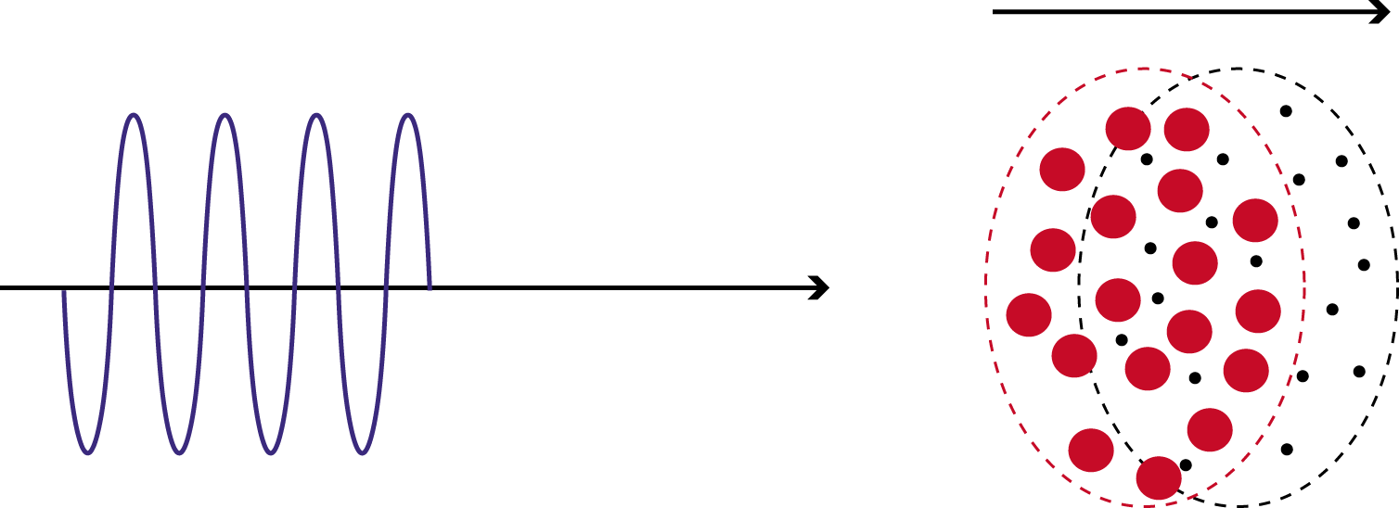
Relativistic Rectification
(Wake-Field Tajima, Dawson)
+
-
(laser, e, p induced) pushes the electrons.
The charge separation in plasma or crystals generates an electrostatic longitudinal field. (Tajima and Dawson: Wake Fields or Snow Plough)
The electrostatic field

Slide 7
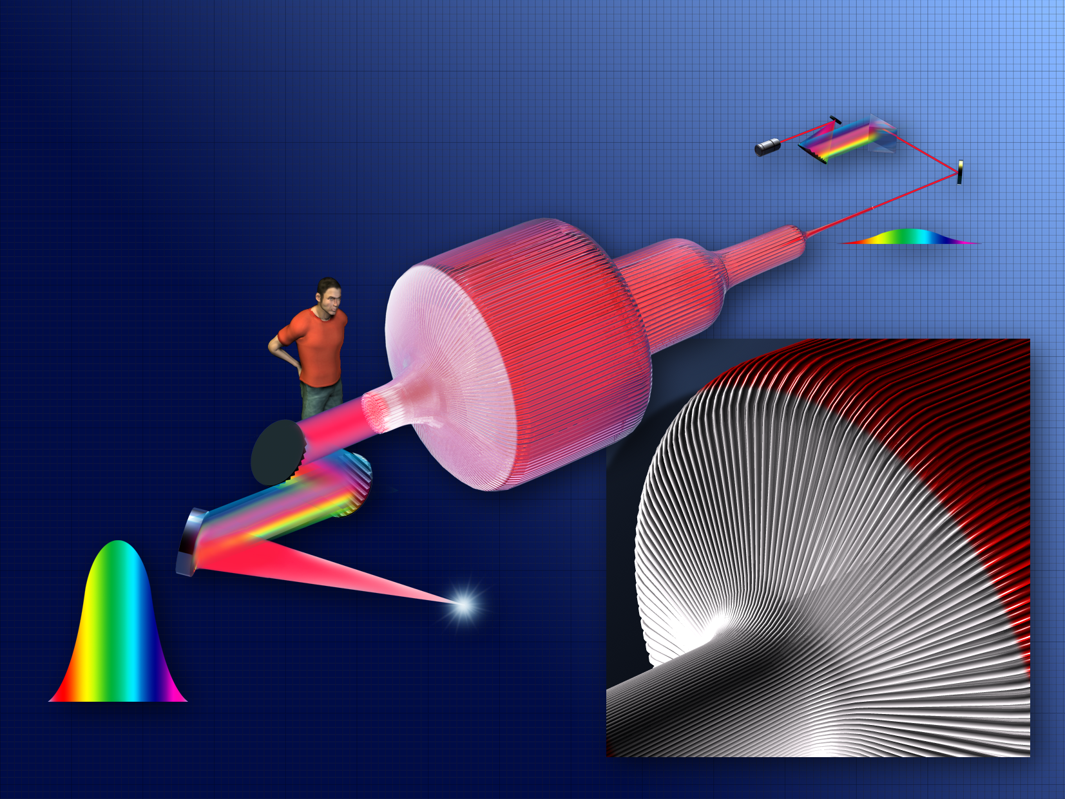
ICAN (European Project)
CAN Coherent Amplification Network
G. Mourou, W. Brocklesby, J. Limpert, T. Tajima, Nature Photonics April 2013
« The future of Acceletaor is Fiber »

Slide 8
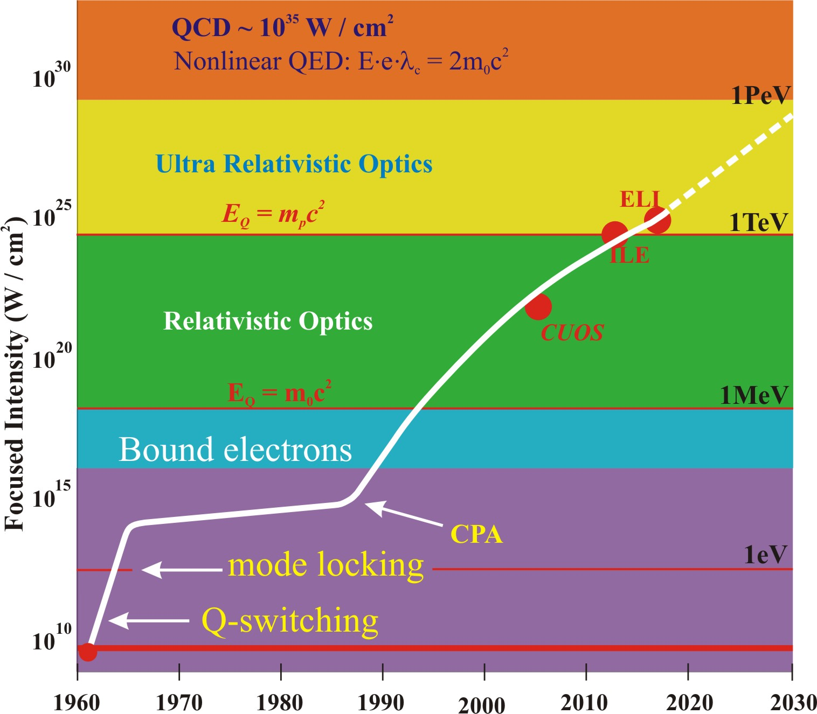
LMJ/NIF, 2MJ, 3B€
MJ
TeV
Vacuum Polarization
IZEST C³
XCELS
ELI, kJ .3 B€
E_{p}=m_{p}c²
kJ
GeV
E_{e}=m₀c²
MeV
J
MeV
mJ
eV

Slide 9
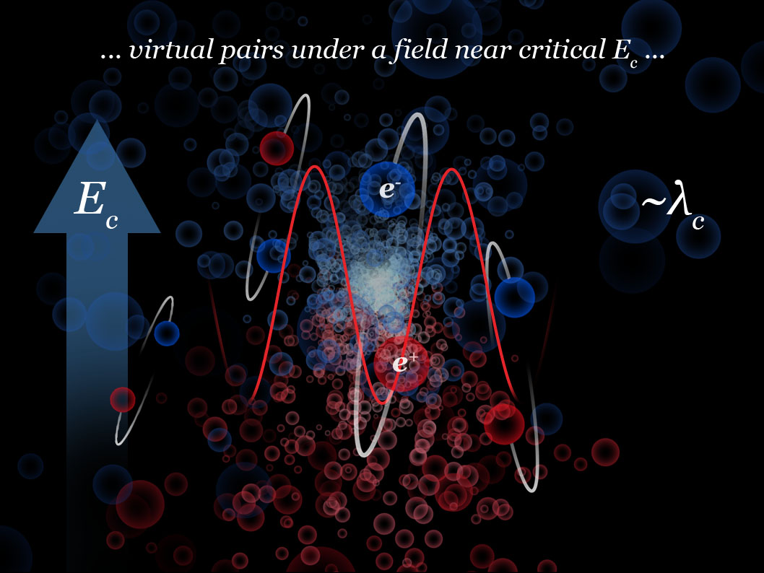
1.
Probing the quantum vacuum with high intensity lasers, a step towards understanding dark energy?

Slide 10
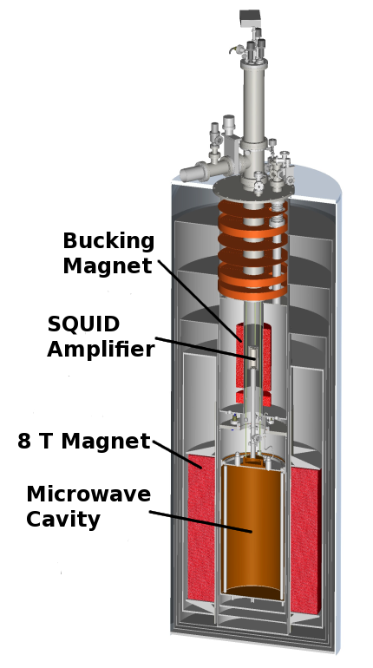
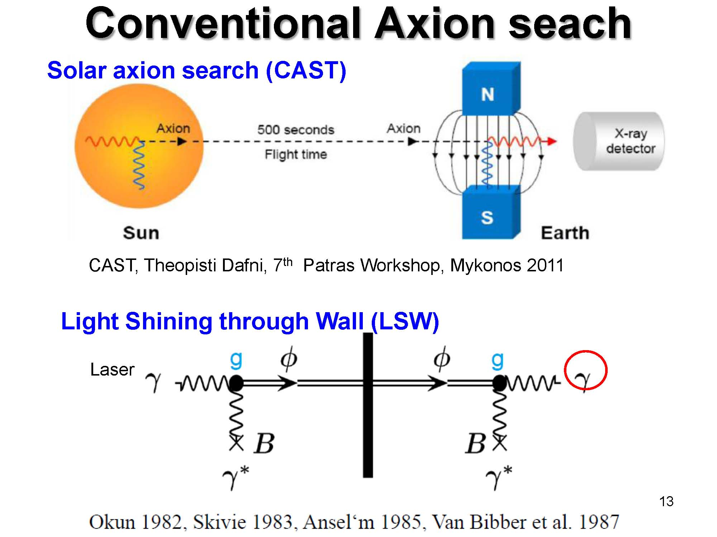
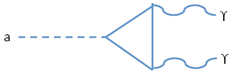
2. AXIONS: very light particles
Strongly motivated by the strong CP problem
Motivates introduction of the axion (sub eV), which couples to two photons
4m

Slide 11
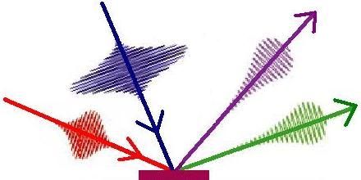

Degenerate Four-Wave Mixing (DFWM)
Laser-induced nonlinear optics in vacuum (cf. Nonlinear optics in crystal)
Decay into (4-x)ω can be induced by frequency-mixing
2ω,
xω
K.Homma, D.Habs, T.Tajima
Appl. Phys. B (2012)
xω,
2ω
+z
w₀
(4-x)ω=2ω+2ω-xω
resonance
(signal) ~ N₁ N₂ N₃ / τ
.
2ω,
xω
Sweep by arbitrary
frequency xω
Wirth et al. (Science 2011: synthesized light transients)

Slide 12
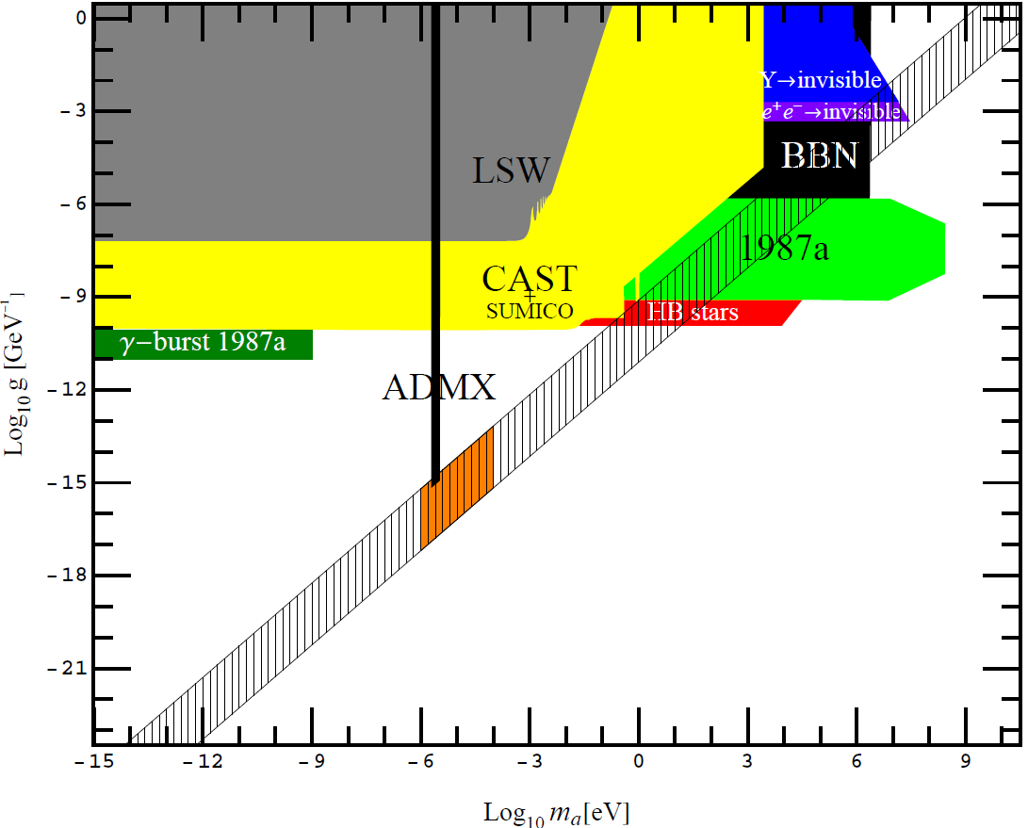

Photon mixer to new fields:
Dark Matter and Dark Energy in a single shot (with rep-rate such as ICAN/IZEST, far lower detection limit possible)
SHG
200J
15fs
DFWM
200J 1.5ns
Strength of coupling [1/GeV]
QCD axion (Dark matter)
DFWM
200J
15fs.
IZEST
⬇
Gravitational
Coupling（Dark Energy)
K.Homma, D.Habs, T.Tajima (2012)
mass of coupling [eV]

Slide 13
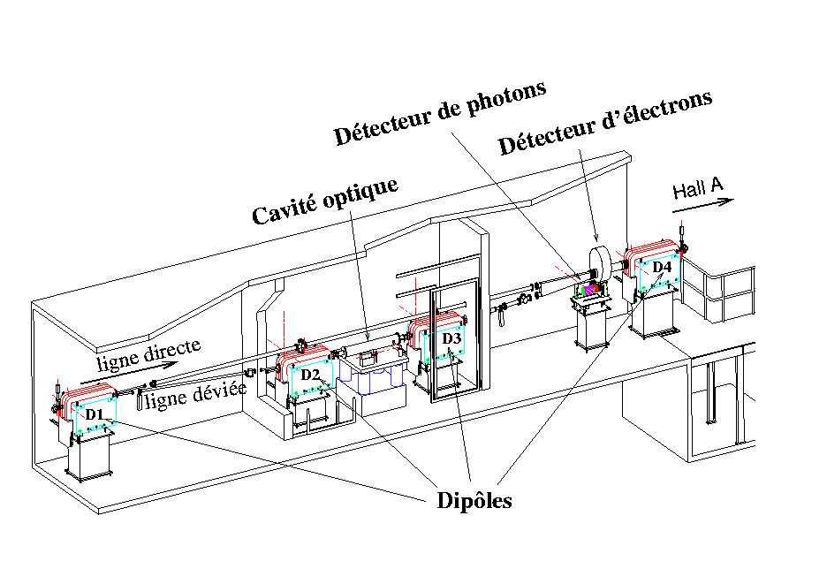
3. APPLICATIONS of THOMX concept:
Compton polarimeter uses high gain Fabry-Perot cavity to create ~ 1 kW of laser power in IR (1064 nm). Detects both scattered electron and backscattered gamma → 2 independent measurements, coincidences used to calibrate γ detector
X-ray sources
Gamma ray sources: ELI-NP nuclear photo excitation
Photon detector
Electron detector
Optical cavity
Dipoles

Slide 14
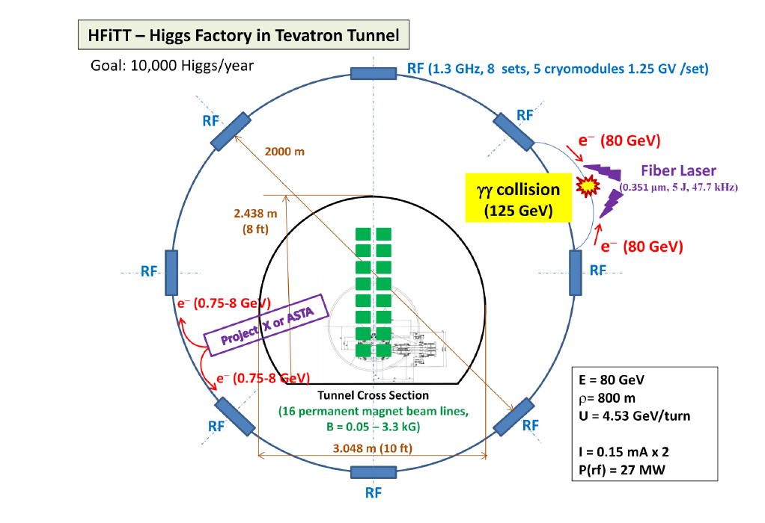

Slide 15
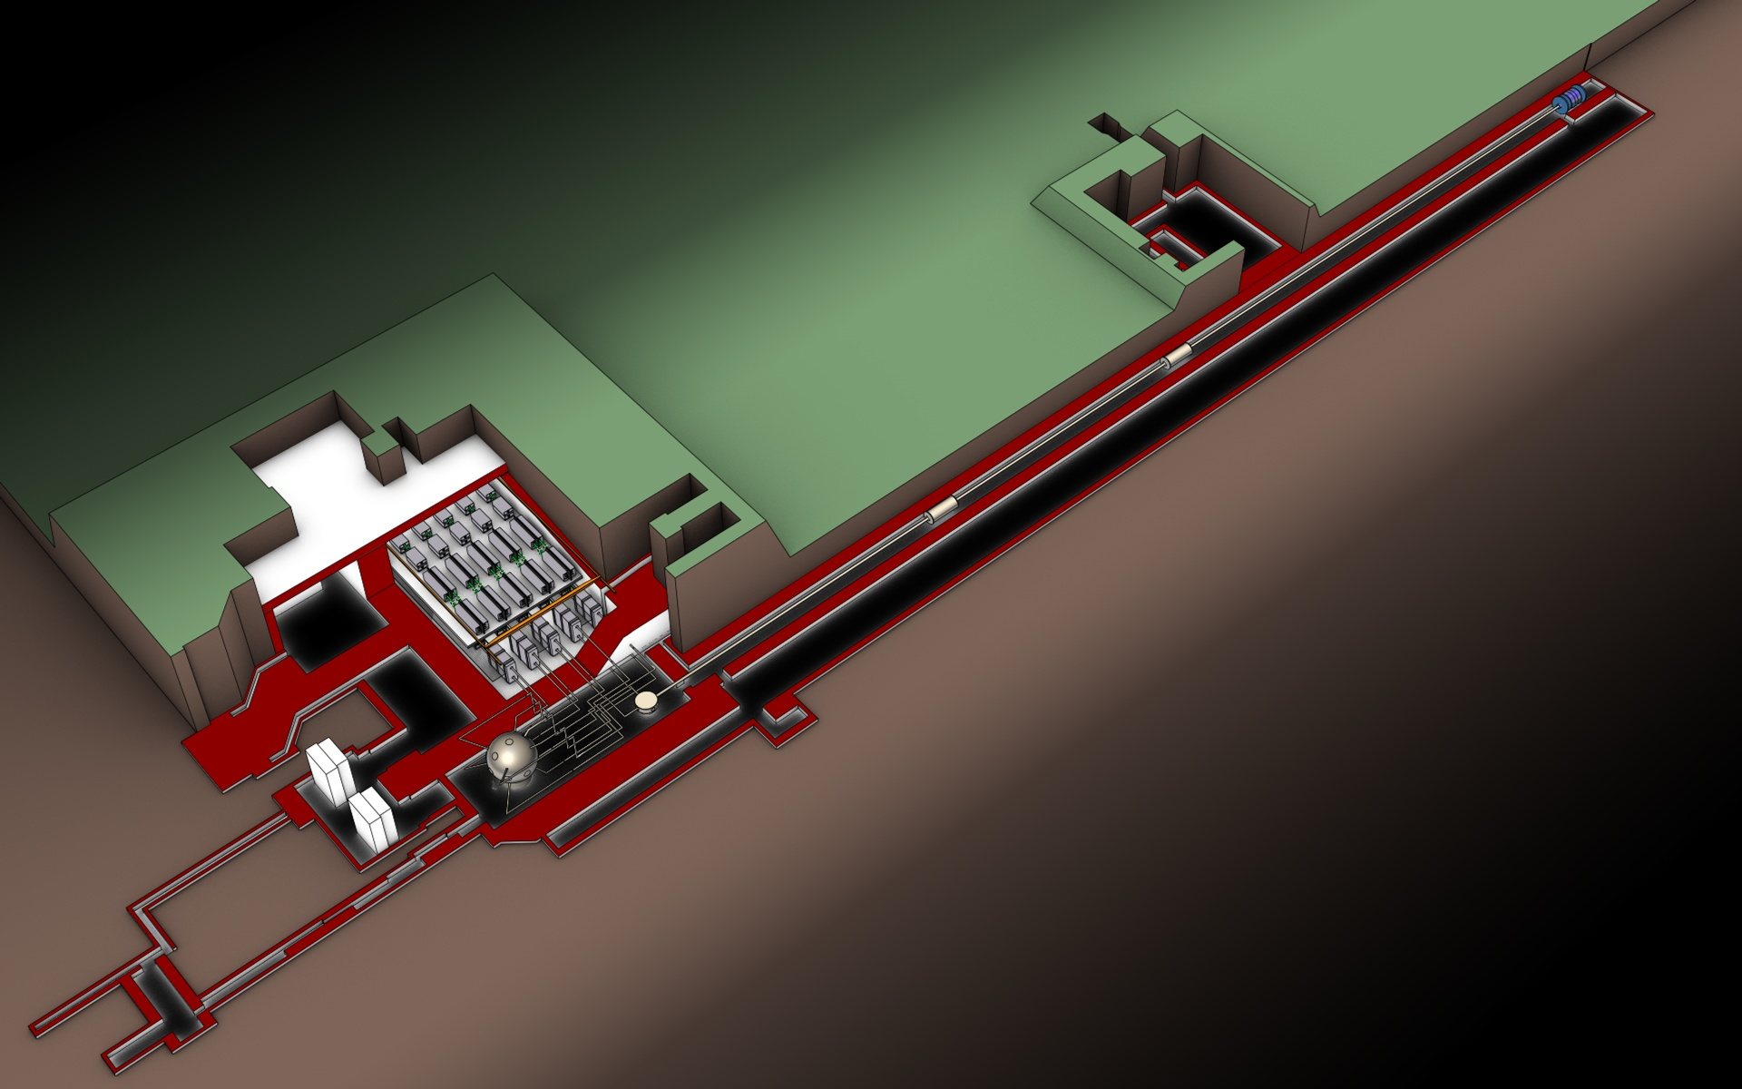
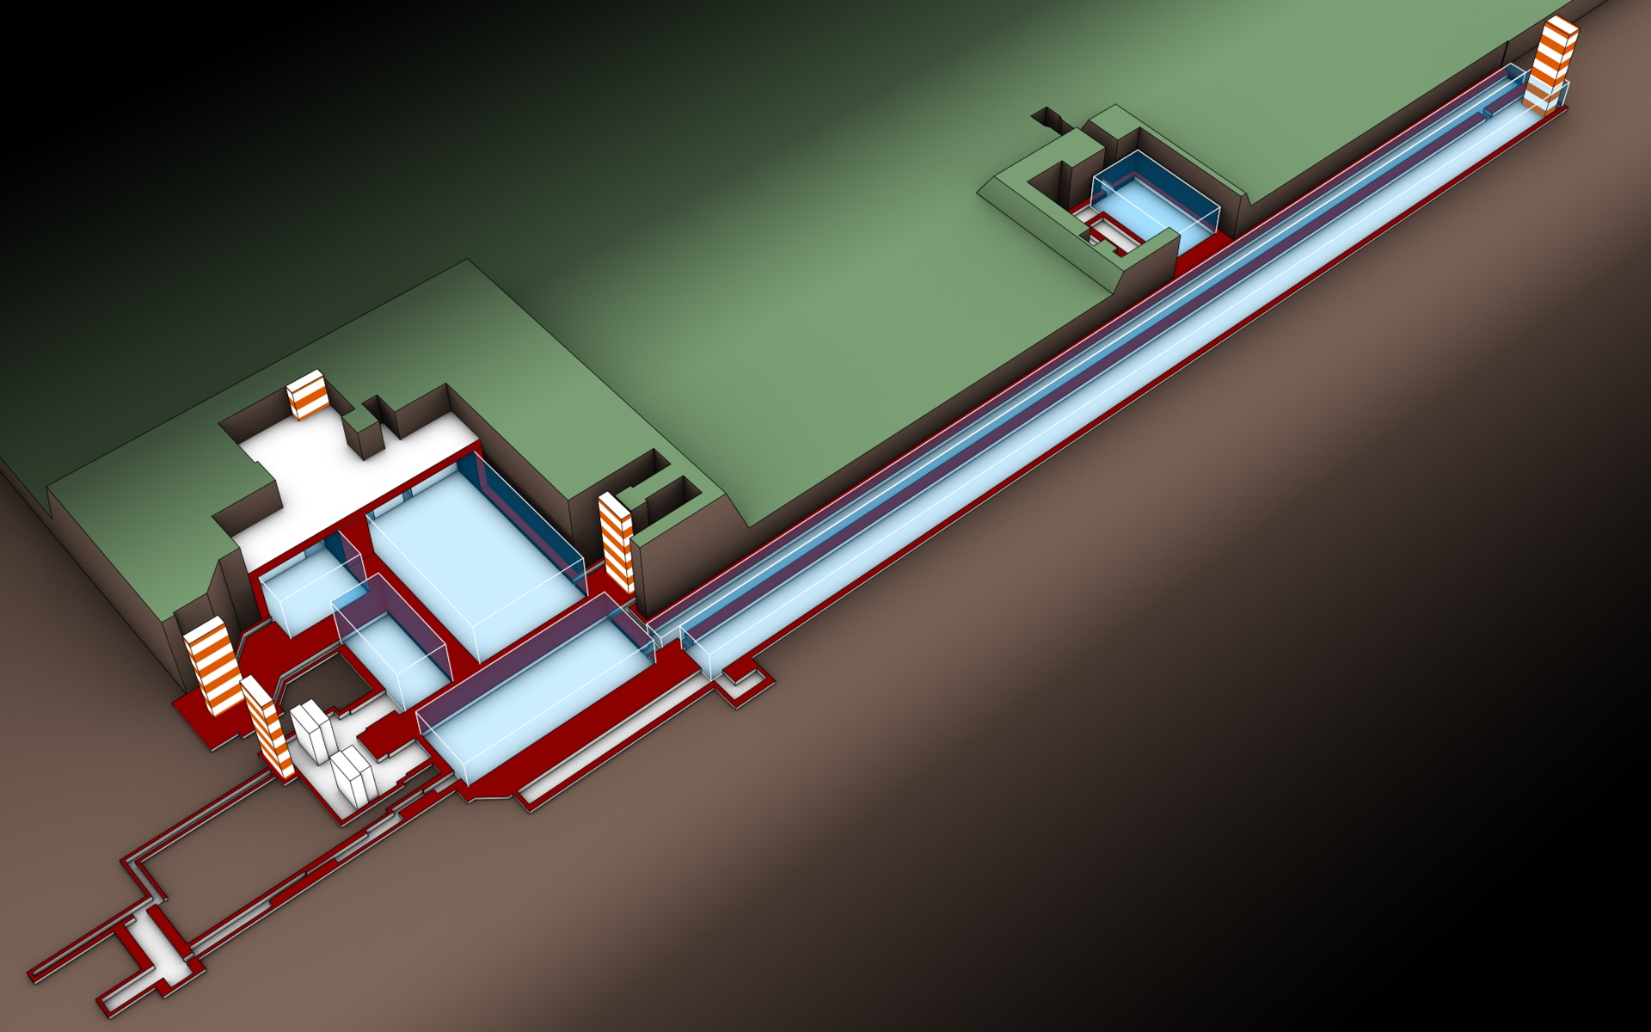
4. APOLLON ILE CILEX Orme des merisiers electron or protonaccelerator
and ELI High Intensity Laser possible location
ELI Nuclear Physics meeting, Bucarest Feb1-2, 2010
Laser 10 PW 30 fs dans hydrogène donne électrons
ou protons relativistes faible émittance
Dans un capillaire un laser donne
champ de sillage dans plasma
et le faisceau d’électrons ou
de protons est accéleré (GeV/m)
dans le sillage→ étages

Slide 16
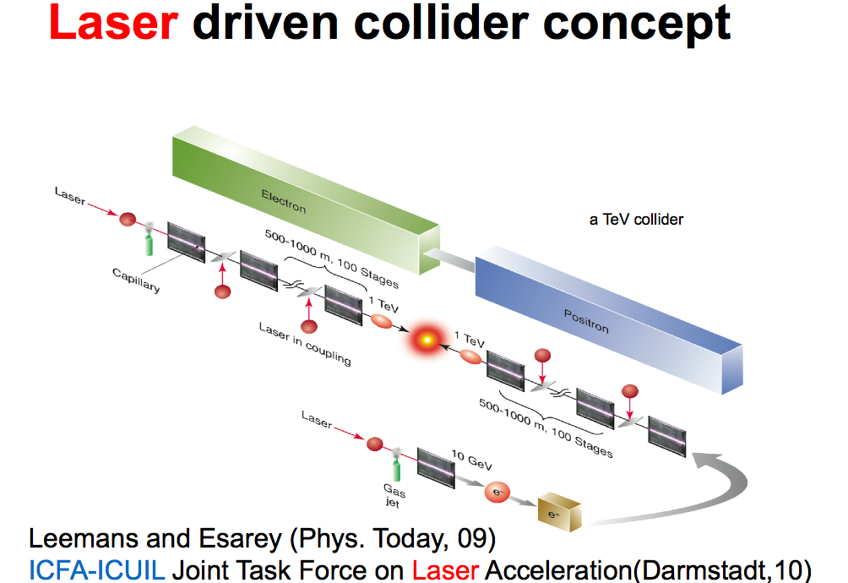
5.

Slide 17
CONCLUSIONS
Lasers de puissance très porteurs pour la physique du particule: champs de sillage dans plasmas ou cristaux par des lasers, des électrons ou des protons, pression de radiation, CPA, Multifibres (le domaine va de l’avant)
Propriétés du vide quantique
Axions
Diffusions compton inverse
Accélération d’électrons ou de protons (injecteurs de protons relativistes, première application?)
Collisionneurs linéaires?

