Slide 1
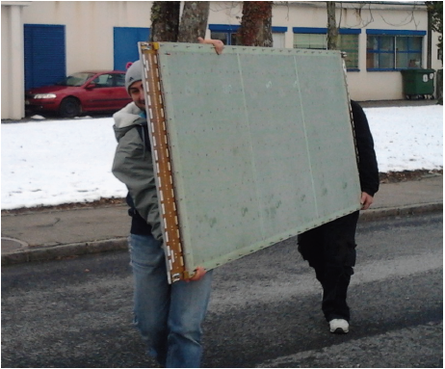
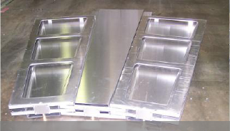

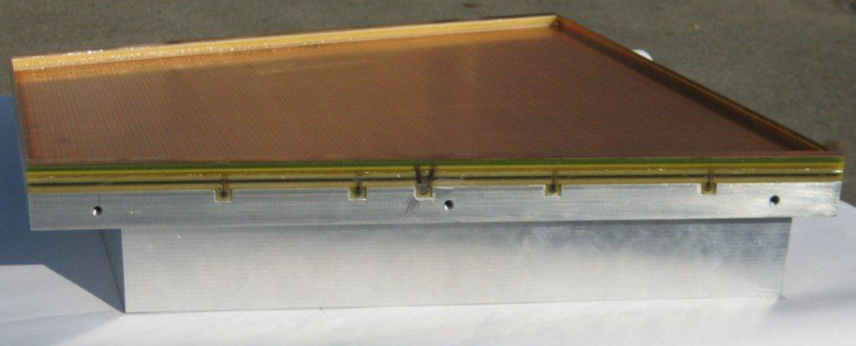
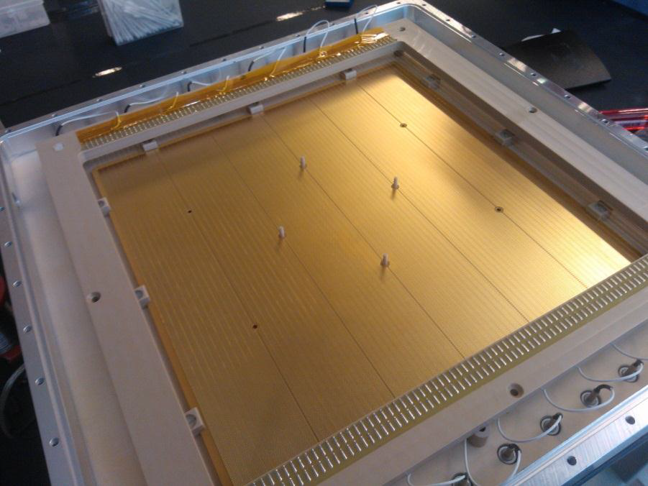
The RD51 Collaboration:
« Development of Micro-Pattern
Gaseous Detector Technologies »
MM for ATLAS upgrade
Leszek Ropelewski, CERN, Switzerland
Maxim Titov, CEA Saclay, France
GEM for CMS upgrade
OUTLINE of the TALK:
RD51 Motivation and Main Objectives (2008-2013)
Future RD51 Activities (beyond 2013)
Summary of the RD51 Highlights (2013-2014)
(Large area MPGDs - Support of HL- HLC Upgrades, R&D (quality control, long-term tests), Academia-Industry Matching Event, Software & Simulation, SRS Electronics, CERN MPGD Production Facility & Industrialization, RD51 Test Beam Facility, Training)
GEM for ALICE TPC
upgrade
THGEM for COMPASS
upgrade
CEA Saclay, SPP CSTS, June 6, 2014

Slide 2
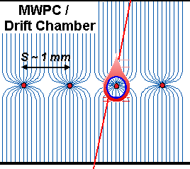
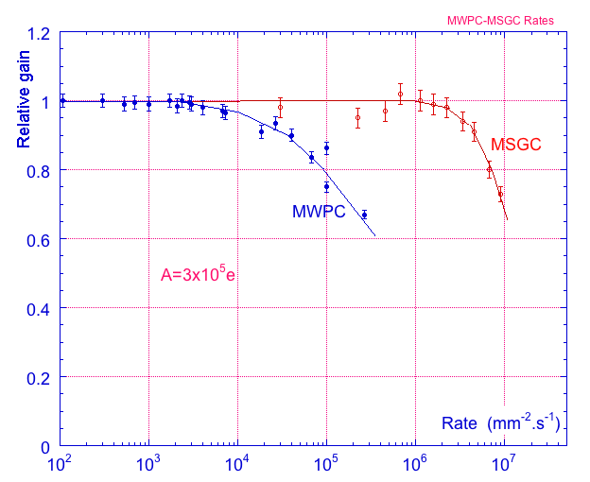
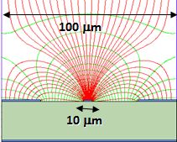
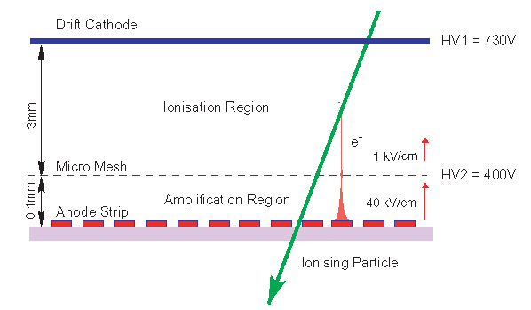
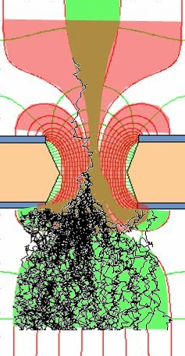
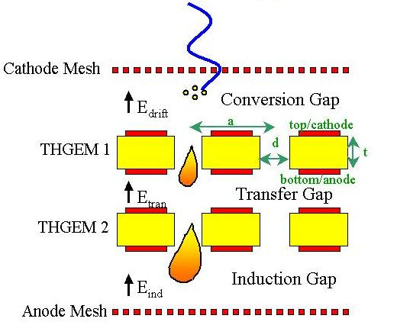
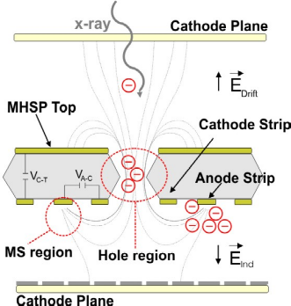
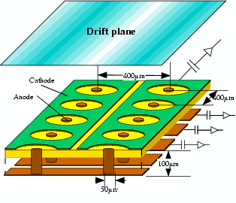
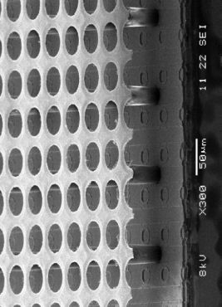
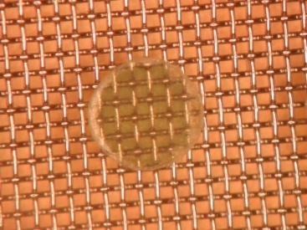
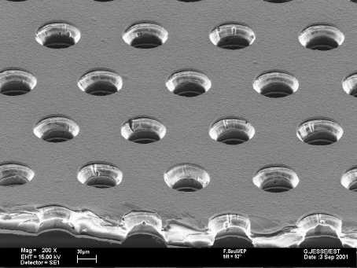
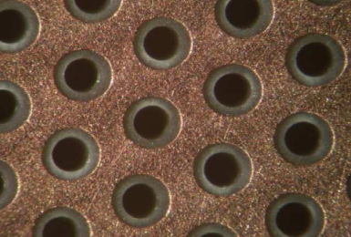
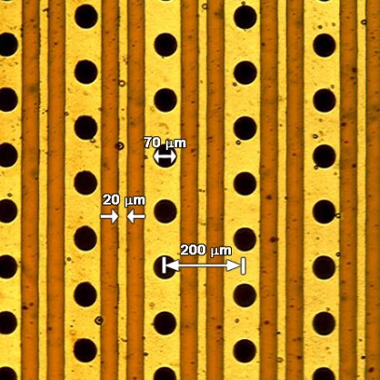
Micro-Pattern Gaseous Detector Technologies for Future Physics Projects
Micromegas
GEM
Thick-GEM, Hole-Type and RETGEM
MPDG with CMOS pixel ASICs (“InGrid”)
Micro-Pixel Chamber (μPIC)
Rate Capability:
MWPC vs MSGC
Micromegas
GEM
THGEM
MHSP
μPIC
Ions
40 %
60 %
Electrons
InGrid

Slide 3
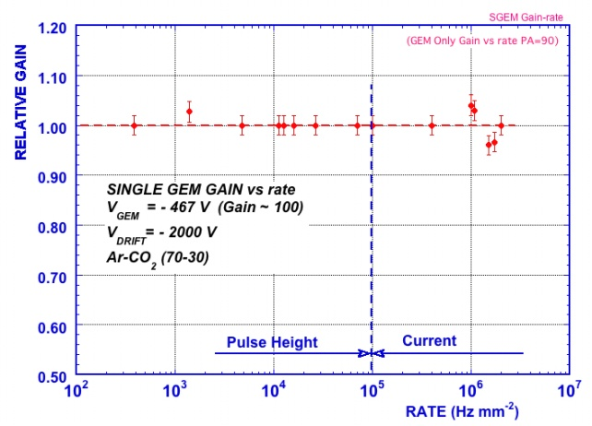
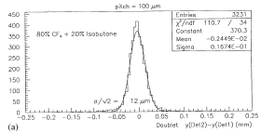
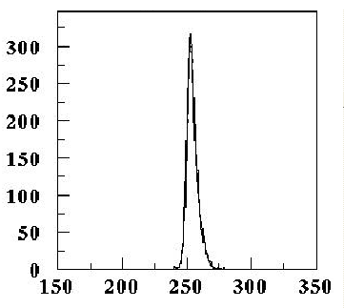
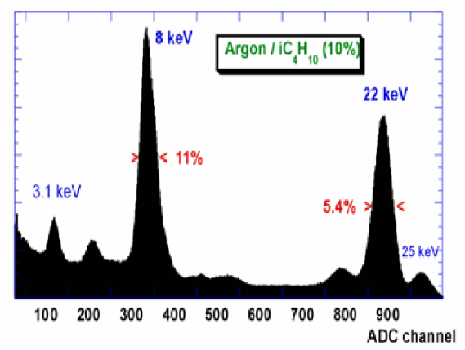
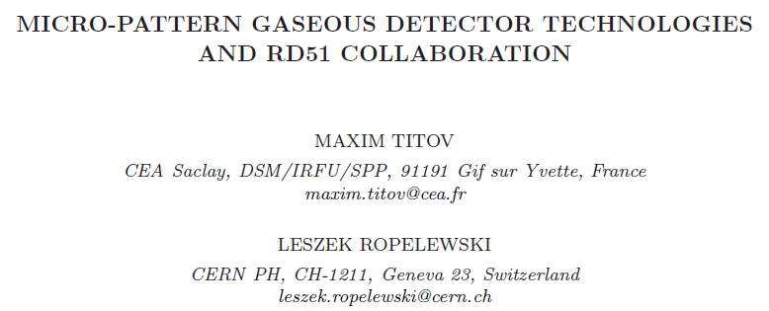
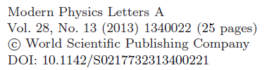

Why Micro-Pattern Gaseous Detectors are so attractive …
High Rate Capability
High Gain
High Space Resolution
Good Time Resolution
Good Energy Resolution
Excellent Radiation
Hardness
Ion Backflow Reduction
Photon Feedback
Reduction
GEM
2x10⁶ Hz/mm²
GEM
Micromegas
σ_{space} ~ 15-40 μm
GEM
σ _{time} ~ few ns
Micromegas
One of the recent reviews describing
the progress of the RD51 collaboration:

Slide 4
Historical Roadmap of the MPGD Technologies and RD51 Collaboration
MicroMEGAS (CEA Saclay, Y. Giomataris)
RD51
collaboration
MSGC (ILL, A. Oed)
GEM (CERN, F. Sauli)
RD28
1988
1996
1992
1997
2003
LEM (Periale)
THGEM(Chechik)
2008
1996
2000
2005
InGrid
μ-PIC (A. Ochi, T. Tanimori)
Capillary plate (Yamagata U., H. Sakurai)
Many of the Micro-Pattern Gaseous Detector Technologies were introduced before
the RD51 Collaboration was founded
With more techniques becoming available (or affordable), new detection concepts
are being introduced and the existing ones are substantially improved

Slide 5
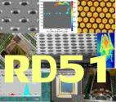
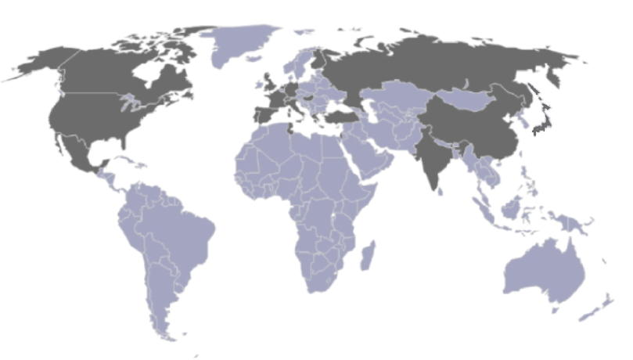
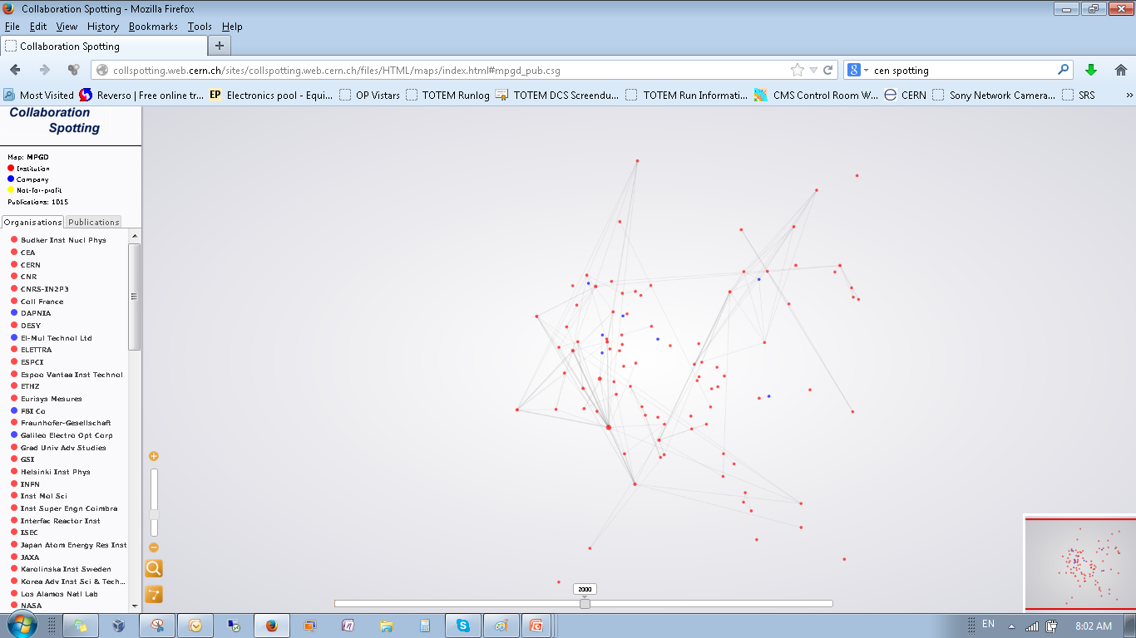
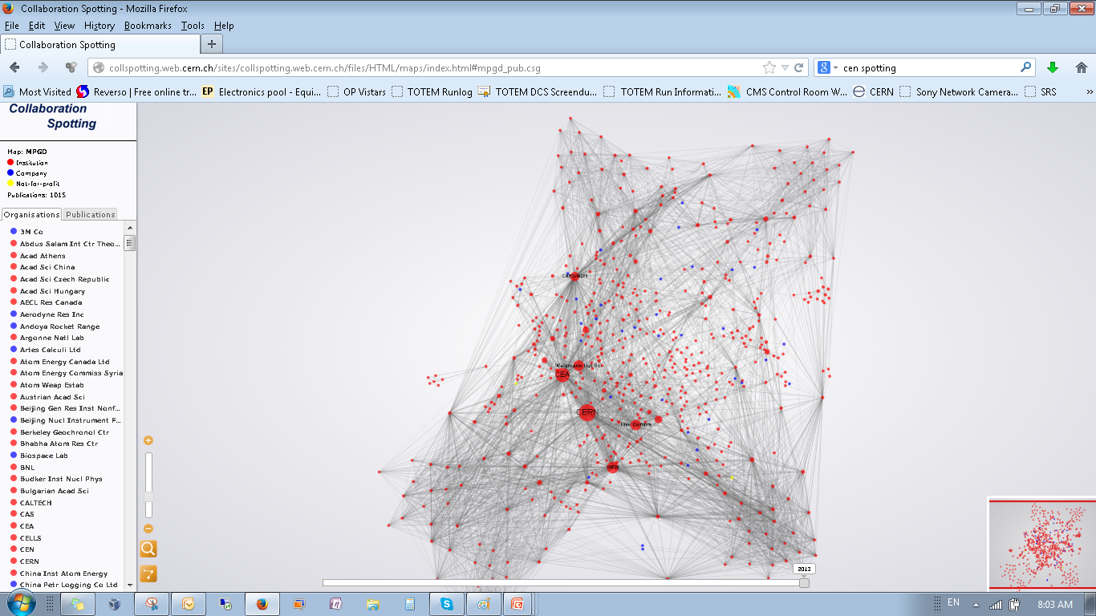
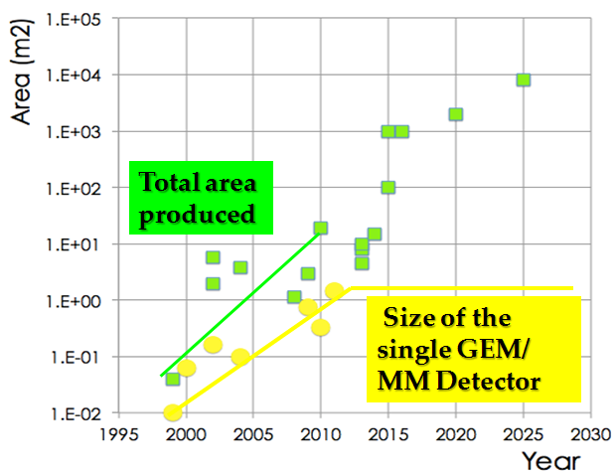
RD51 – Development of Micro-Pattern Gaseous Detector Technologies
The main objective is to advance MPGD technological development and associated electronic-readout systems, for applications in basic and applied research”
A fundamental boost is offered by RD51: from
isolate MPGD developers to a world-wide net
1998
2014
http://rd51-public.web.cern.ch/rd51-public
World-wide Collaboration for the
MPGD Developments →
RD51 (91 institute, > 500 people):
Large Scale R&D program to advance MPGD Technologies
Access to the MPGD “know- how”
Foster Industrial Production
Advances in photolithography →
Large Area MPGDs (~ m² unit size)

Slide 6
Summary of the RD51 Achievements (2008 – 2013)
Consolidation of the Collaboration and MPGD Community Integration (> 80 institutes, 450 members);
Major progress in MPGD Technologies: Large area GEM (single mask), Micromegas (resistive) and THGEM; picked up by experiments, including LHC upgrades;
Secured future of the MPGD Technologies development through the TE MPE workshop upgrade and FP7 AIDA contribution
Contacts with industry for large volume production; MPGD industrialization and first industrial runs
Major improvement to the MPGD simulation software framework for small-scale structures for applications;
Development of common, scalable readout electronics (SRS); many developers and > 50 user groups; Production (PRISMA company and availability through CERN store); Industrialization (re-design of SRS in ATCA in EISYS)
Infrastructure for common RD51 test beam and facilities (> 20 user groups);

Slide 7
RD51 Prolongation for the 5-Years Term (2014-2018)
LHCC Minutes (June 12-13, 2013):
In summary, RD51 is a successful R&D Collaboration with well-defined and important future
plans. In view of the above and given the modest request for resources for further work, the
referees recommend that the RD51 R&D project be continued for five years beyond 2013
and for CERN to continue to provide the limited requested support to the Collaboration. A
status report is expected to be submitted to the LHCC in one year’s time. The Committee
agrees to the continuation of the project on this basis.
CERN Research Board Minutes (August 28, 2013):
Existing R&D projects RD39, RD42, RD50 and RD51 were reviewed. RD39 studies 3D-trenched,
cryogenic charge injection devices (CID) and CVD diamond detectors, with applications for beam monitoring at the LHC. The LHCC recommends emphasis on the BLM development, and R&D on the CID sensors should be progressively integrated into RD42 and RD50. RD42 is comparing scCVD and pCVD detectors, with applications in specialized detectors such as the PLT for CMS and BCM for ATLAS, and with potential for pixel detectors. RD50 is a productive and diversified R&D collaboration for radiation-hard semiconductor development. RD51 is a large collaboration studying advanced gas-avalanche micro-pattern gas detectors (MPGD) of various types and readout technologies. The Research Board approved the continuation of these projects for the coming year; for RD39 further continuation would be subject to new results being produced during that time; for RD51 the approval is for five years.

Slide 8
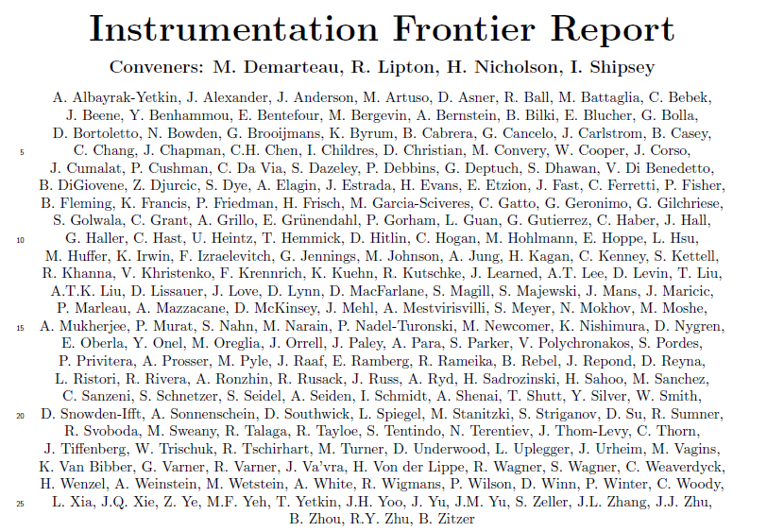
2013: USA Snowmass Instrumentation Frontier Report
Contribution to “Large Area Arrays”:
(special thanks to
M. Hohlmann, R. Rusack, A. White):
http://www.snowmass2013.org/
tiki-index.php?page=Instrumentation%20Frontier
“Micro-pattern gas detectors (MPGDs) for charged particle tracking and muon detection are an alternative to pixelated silicon vertex and tracking detectors [85]. These low-mass detectors have the potential of economically covering large areas and provide high tolerance against radiation damage, high spatial resolution (of order 10μm), and good time resolution (of order 1ns). Future work is needed to reduce the readout cost by developing highly integrated, radiation-hardened front-end readout electronics with at least 4000 channels/chip and high density detector electronics interconnects and integrating ex-circuit readout electronics directly into the MPGD structure. Work is also required to develop innovative signal induction structures to reduce cost, improve performance, and provide stability against electric breakdown. It is important to develop materials with resistance to aging and radiation damage, as well as cost-effective MPGD construction techniques for high-volume production.”

Slide 9
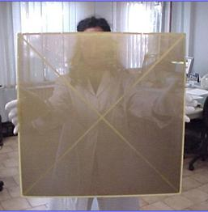
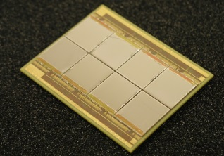
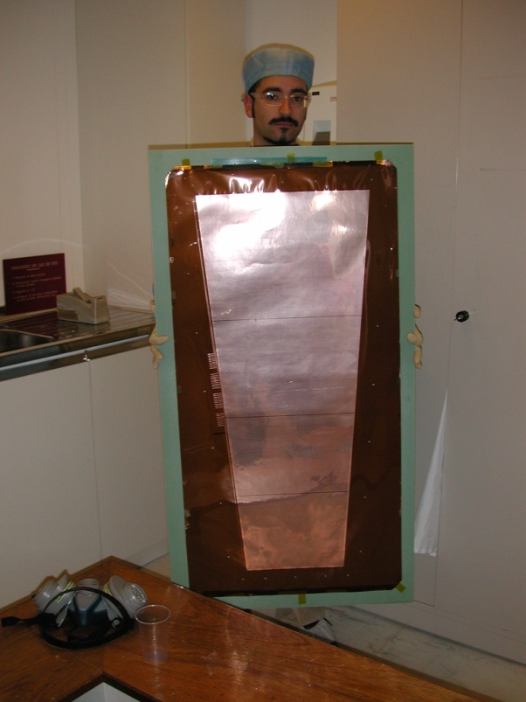
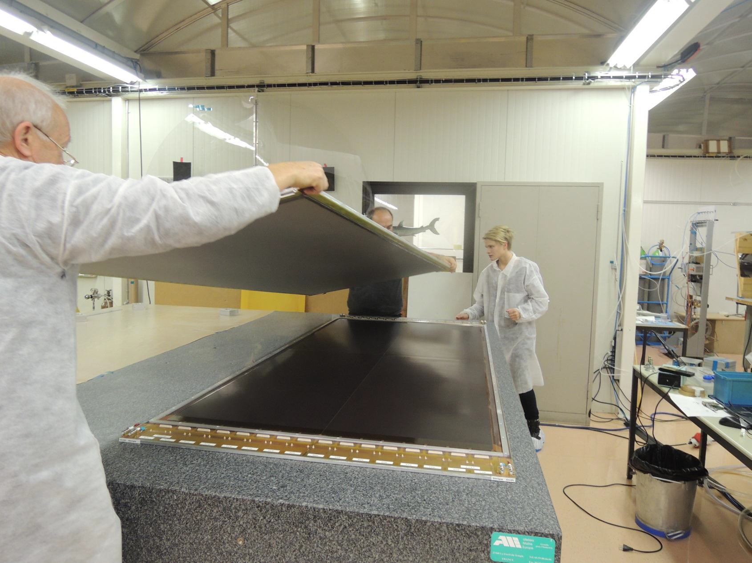
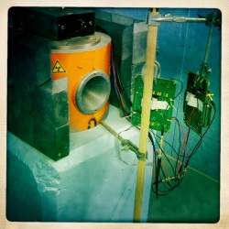
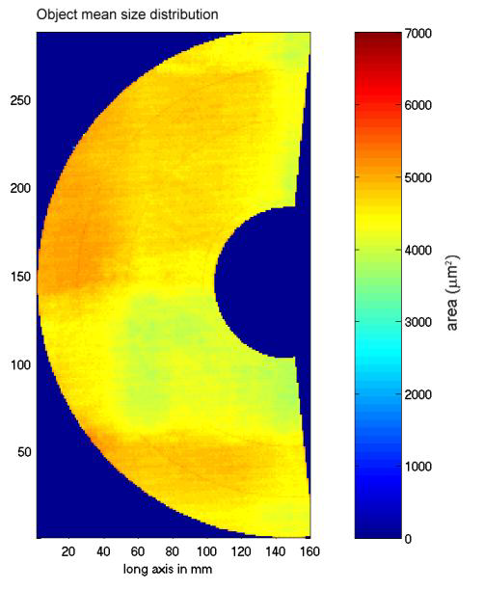
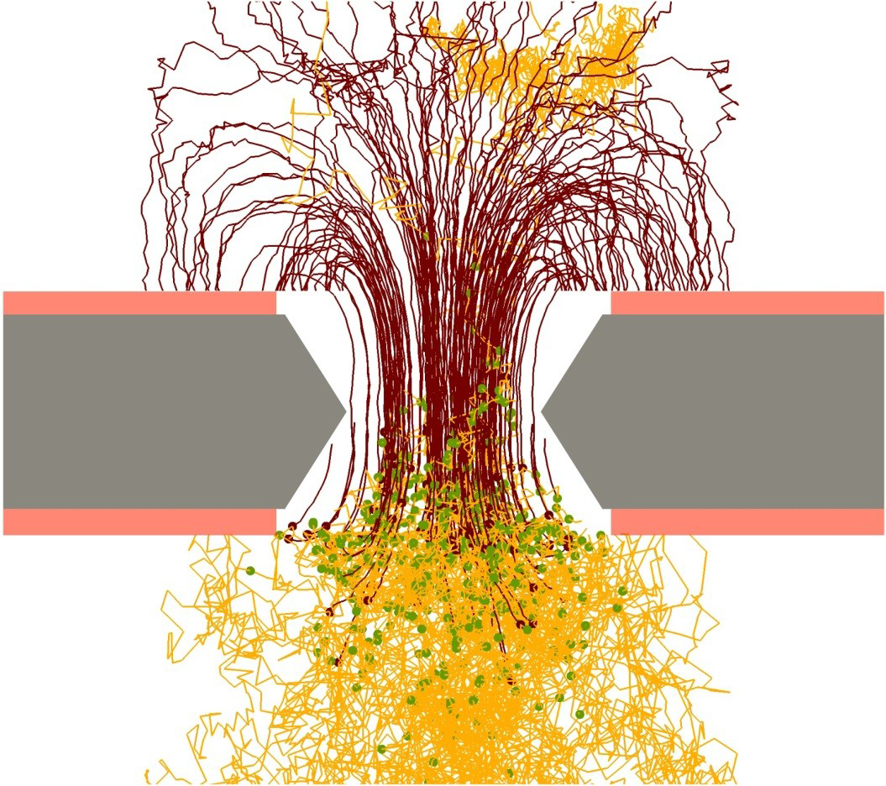
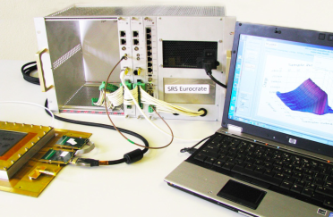
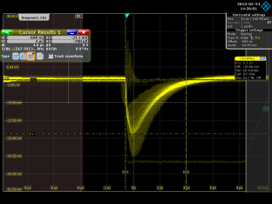
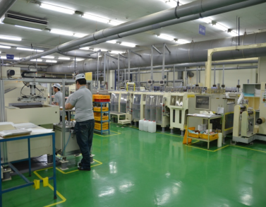
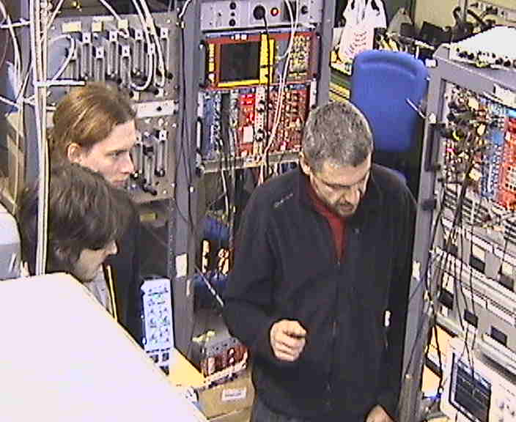
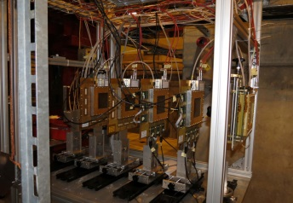
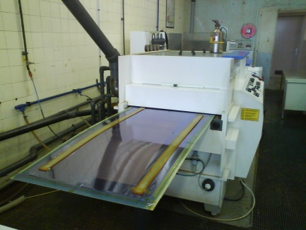
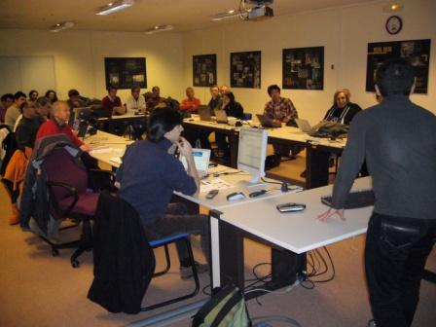
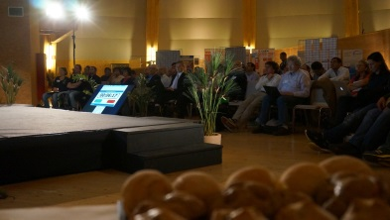
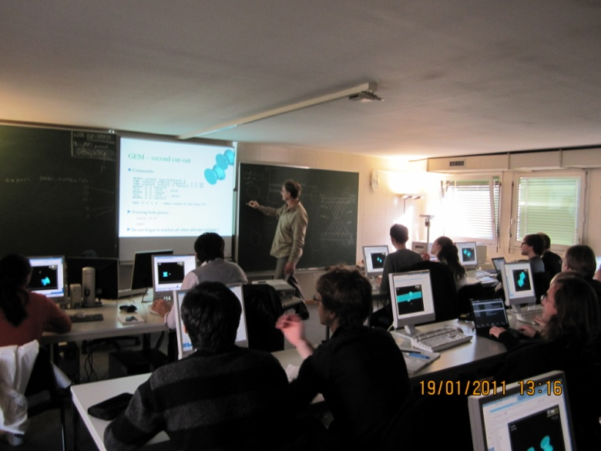
Future RD51 Collaboration Activities (beyond 2013)
Large Area Detectors
Assembly Optimization
RD51 Common Projects
Generic R&D, QA
Long Term Stability
WG2:
WG1:
Co-spokesperson – MT
Management Board Members – Paul, Colas, Yannis Giomataris, MT
Conveners – Paul Colas (WG1), Fabien Jeanneau (WG6)
WG5:
Software Tools and
Simulations
MPGD Electronics
RD51
WG4:
WG3/NEW WG:
WG7:
WG6:
Conferences / Schools
Academia-Industry
Matching Events
CERN MPGD
Workshop,
Quality Control
and Industrialization
RD51 Common
Test Beam and Lab Facilities

Slide 10
RD51 Highlights (2013-2014)
… as a part of the RD51 Collaboration Working Plan beyond 2013 …
WG1: Continuation of the R&D support for the experiments and LHC upgrades
WG2: Generic R&D (long-term stability, quality control); RD51 Common Projects Development of new structures and consolidation of the existing structures
WG3 (NEW): Applications - organization of series of specialized workshops disseminating MPGD applications beyond fundamental physics – RD51, potential users and industry (e.g. dosimetry, neutron detection, medical physics, …)
WG4: Development and Maintenance of Software & Simulation Tools; basic studies & software support for the RD51 community
WG5: Development and Maintenance of the SRS Electronics; An extended support for the SRS including new developments and implementations of additional features
WG6: MPGD Production and QA Control - GEM, MicroMegas, Thick GEM; completion of the industrialization of main technologies
WG7: Maintenance and extension of the RD51 Lab and Test-Beam Infrastructure
WG (NEW): MPGD Education and Training : organization of schools for students and newcomers & academic training
Participation in the funding requests / funding contributions: Marie-Curie/GASNET, AIDA2

Slide 11
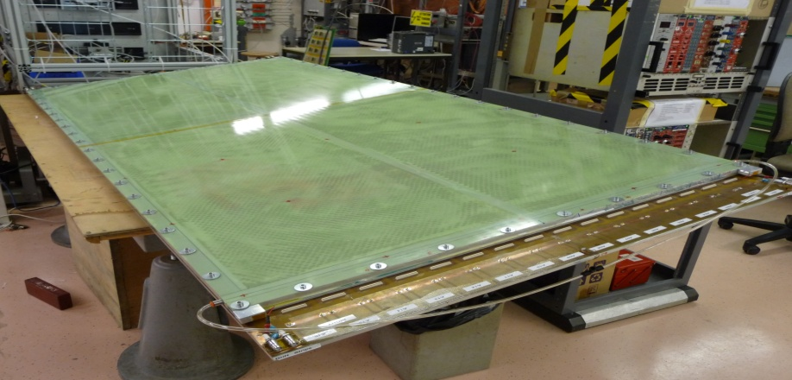
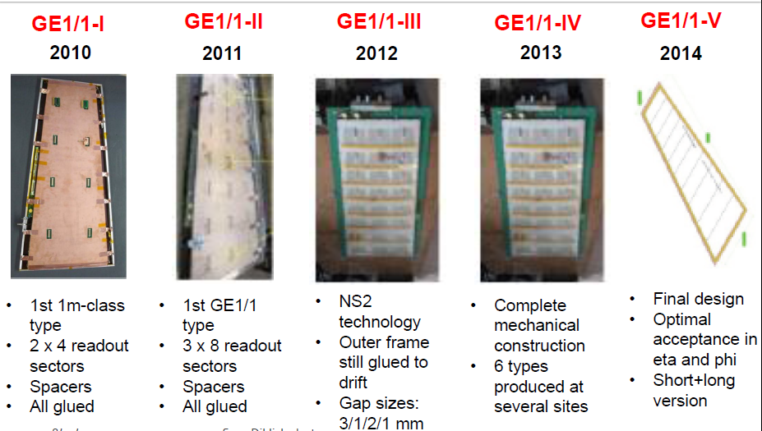
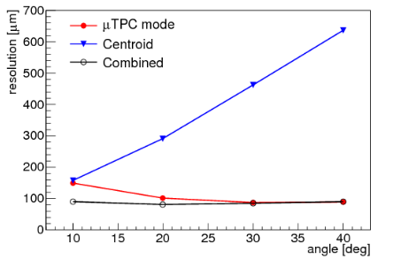
WG1: Continuation of the R&D Support for the LHC Upgrades
MM for the ATLAS Muon System Upgrade:
GEMs for the CMS Muon System Upgrade:
R&D Started in 2007 within the RD51 collaboration:
Standard Bulk MM suffers from limited efficiency at
high rates due to discharges induced dead time
Solution: Resistive Micromegas concept
R&D Started in 2009 within the RD51 collaboration:
Single-mask GEM technology (instead of double-mask)
→ Reduces cost /allows production of large-area GEM
Self-stretching technique: assembly time reduction
from 3 days → 2 hours
2.4 x 1m²
MM resistive chamber constructed and characterized at CERN RD51 lab
Resolution for inclined
tracks (μTPC method)
better than 80 µm
MM can operate in
magnetic field
NSW Technical Design Report (TDR) approved
by LHCC (October 2013) →
~ 1280 m2 of resistive MM will be installed (LS2) in
ATLAS → the largest MM system, ever built
→ FOSTER INDUSTRIAL PRODUCTION NEEDS
Future work will focus on stability and uniformity
of GEMs, and development of electronics, …
During the LHC End-Year stop of 2016/2017, two GEM super-chamber demonstrators will be installed

Slide 12
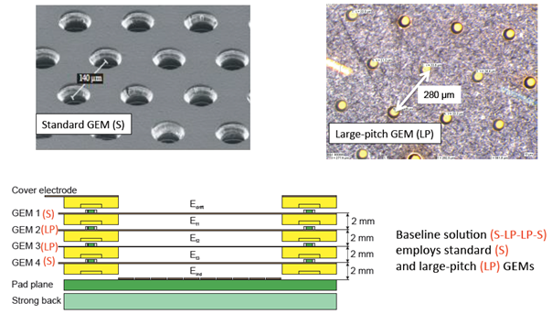
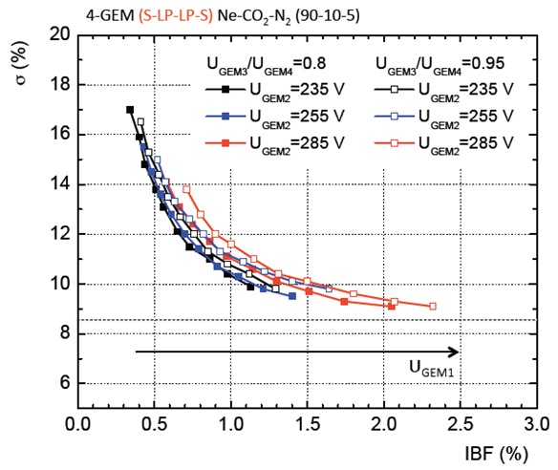

WG1: Continuation of the R&D Support for the LHC Upgrades
ALICE TPC Upgrade
→ replace MWPC with GEM
Continuous TPC readout at 50 kHz
Physics requirement: IBF < 1%, energy:
σ(E)E < 12% achieved
TDR Baseline Solution: 4-GEM Stack
Also option under study: Micromegas + 2 GEM
4 GEM Stack Configuration
(to minimize IBF)
Energy resolution vs IBF (4-GEM detector):
4 GEM Stack
engineering design
Special ALICE TPC / RD51 workshop
will be organized on June 18th, 2014
(during the RD51 Collaboration Week)

Slide 13







WG2: R&D Continuation - Quality Control
Electrical rigidity
Hole diameter uniformity in GEM
Gap uniformity in MicroMegas
THGEM thickness uniformity
Final detector calibration and characterization protocols and infrastructure

Slide 14



WG2: R&D Continuation - Long Term Stability
Portable gas monitoring
system for detector stability
studies
→ to be used by LHCb and
CMS upgrade for the
muon system
Classical gas detectors ageing detector
Radiation hardness and activation of detector components
Sustainability to neutrons and heavily ionizing particles induced discharges
Exposure to X-Ray, Gamma, Neutron and Alpha Sources
Monitoring infrastructure
Discharge studies of the triple GEM detector exposed to the low energy neutron flux
Resistive MicroMegas
stability performance
under X-Ray irradiation

Slide 15



WG3: 14-15 October 2013: 1st RD51 Academia – Industry Matching Event
“Special Workshop on Neutron Detection with MPGDs”
Research + industry + potential users focused on dedicated applications
91 participants: https://indico.cern.ch/conferenceDisplay.py?confId=265187

Slide 16



WG3: 14-15 October 2013: 1st RD51 Academia – Industry Matching Event
“Special Workshop on Neutron Detection with MPGDs”
Summaries based on workshop contributions and follow-up “Neutron Session”(end of 2014):
Richard Hall-Wilton: “The importance of defining proper methods to characterize the detectors; detector needs for ESS”
Bruno Guerard: “Status of MPGDs already used in NSS; fabrication and physical constraints of neutron gas detectors”
Fabrizio Murtas: “Performance of MPGDs, and development status in HEP”
Robert McKeag: “Lesson learned from a technology transfert from NSS to the industry”
2nd RD51 Academia-Industry Matching Event (topic to be defined) is planned for December 2014

Slide 17

WG4: MPGD Simulation Tools
Focus on providing techniques for calculating electron transport in small-scale structures
The main difference with traditional gas-based detectors is that the electrode scale
(~ 10 μm) is comparable to the collision mean free path
Development and Maintenance of Garfield++:
Garfield++ is a collection of classes for the detailed simulation of small-scale detectors.
Garfield++ contains:
- electron and photon transport using cross sections provided by Magboltz
- ionisation processes in gases, provided by Heed and MIP
- ionisation and electron transport in semi-conductors
- field calculations from finite elements, boundary elements, analytic methods
Simulation Improvements:
→ Transport:
- ion mobility and diffusion, measurement and modelling
- Magboltz cross sections (Ar, Xe, He, Ne; GeH₄, SiH₄, C₂H₂F₄ ) are frequently
updated in collaboration with LXCAT (http://www.lxcat.laplace.univ-tlse.fr)
- e-ion recombination process in Xe
- thermal motion
→ Photons:
- update in UV emission
- inclusion of IR production
- photon trapping and resulting excitation transport
- photon absorption in the gas (gas feedback)
- photon absorption in and electron emission from walls (feedback)
- photo cathodes

Slide 18



WG4: MPGD Simulation Tools
Applications:
GEM: multiplication process and polyimide properties; charging up effects
MicroMegas: timing and effects of resistive layers
TPC GEM: ion backflow
→ ALICE TPC end-cap upgrade studies: rate dependence of the Ion Back Flow in GEM
Simulation
Measurement
Summary of simulation improvements in 2013:
Systematic calculations of GEM charging-up as function of hole shape; these reproduce the trends observed in experimental data
Measurements in Krakow for numerous gas mixtures of energy transfer rates which permit much more accurate avalanche gain calculations
Start of a collaboration with Coimbra on ion transport measurements in mixtures and start of an effort to model ion transport microscopically, which will help to predict charging-up and ion feedback
Measurement in Orsay at particularly low gain and low noise of the avalanche fluctuations in He/iso, Ne/iso and Ar/isobutane (these fluctuations are reproduced by MC run)

Slide 19







WG5: Development of Scalable Readout System (SRS) for MPGD
RD51 Development / Industrialization: portable multi-channel readout system (2009-2012)
Scalable readout architecture: from ~ 100 channels up to very large LHC systems (> 100 k ch.)
Project specific part (ASIC) + common acquisition hardware and software
Physical Overview of SRS:
Scalability from small to large system
Common interface for replacing the chip
frontend
Integration of proven and commercial
solutions for a minimum of development
Default availability of a very robust and
supported DAQ software package
Cheap! < 2 € / ch + FE
ADC frontend adapter
for APV and Beetle chips
ADC plugs into FEC to
make a 6U readout unit for
up to 2048 channels
FEC cards (common):
Virtex-5 FPGA, Gb-Ethernet, DDR buffer, NIM and LVDS pulse I/O, High speed Interface connectors to frontend adapter cards
Frontend hybrids:
based on
APV25, VFAT, Beetle, VMMx and Timepix
chips

Slide 20




WG5: Development of Scalable Readout System (SRS) for MPGD
“SRS Classic” (developed by RD51):
→ Produced by PRISMA (Greece),
sold via CERN store
EicSys Germany reworked “SRS classic”
into ATCA → functionally equivalent
“SRS Classic” with triple channel density
SRS IP and licence
has been finalized
(KN2288/KT/PH/203A, SRS ;
CERN + IFIN HH Bucharest + UPV Valencia)
1st license taker (EicSys GmbH, Hamburg)
royalties to CERN/RD51
if sold outside RD51 and/or
research domain
SRS Progress (May 2013- May 2014):
Major SRS experiments and plans for 2014/15
SRS is Very successful → to be used outside MPGD fields (e.g SiPM, …)
Number of SRS APV channels sold: 2010- 2012- 25k; 2012-2013 – 50k; 2013-2014 – 60k; 2014-2015 – 130k

Slide 21






WG5: Development of Scalable Readout System (SRS) for MPGD
Synergy between RD51 & ATLAS NSW:
Design of 128 –channel hybrid plug-
compatible with 128 channel APV hybrid
→ VMM is the new, 64 channel, digital readoutchip with Z-suppression (RD51 baseline RD51)
AVD active Voltage Divider for GEMs
Trigger pickup box for MPGD meshes
Several prototypes built: tested OK with triple GEM incl. readout of GEM foil voltages via SRS
New version: continued operation withshort circuit on one GEM foil sector
5 TP boxes built and are used. Integrate HV filter and charge sensitive preamplifiers
RD51: Towards
complete SRS-
Lab equipment
for MPGDs
QUAD MPGD signal amplifier 2 GHz, 25dB
Femto-ampere measuring box
One prototypes built: tested on MicroMega
1 channel works OK
3 channels have
ringing problem . New version: Improvement of shielding, new 50 OHM PCB
Several FEMTO built: sensitivity from 10 fA – to 1 uA. Tested Ok with MPGD detector pickup. New version: larger analogue display, triax input connect
Oscilloscope 50 Ohm output

Slide 22


WG6: RD51 – MPGD Production at CERN
Currently CERN-MPGD workshop is the UNIQUE MPGD production facility (generic R&D,
detector components production, quality control)
Upgrade of the workshop equipment approved by CERN management (Nov. 2009) →
installation of the new infrastructure (to fabricate 2x1m² Bulk MM & 2x0.5m² GEM) COMPLETED
  MPGD Projects using new equipment (detector size):
SBS tracker GEM - 600 x 500 mm²
ALICE TPC upgrade GEM - 600 x 400 mm²
CMS muon GEM - 1.2m x 450mm
ATLAS NSW muon MM - 2m x 1m
COMPASS Micromegas GEM/MM - 500x 500mm²
BESIII GEM - 600 x 400 mm²
KLOE GEM - 700 x 400 mm²
SOLID GEM - 1.1m x 400mm
CLAS 12 MM - 500 x 500 mm²
LSBB (geoscience) MM - 1m x 500 mm
Most of them are still at R&D phase, but a few are close to full production :
  SBS Tracker 100 GEMs
  ALICE TPC upgrade 250 GEMs
  COMPASS pixel MM 20 GEM + MM
  BESIII 15 GEM
  CLAS 12 30 MM
  CMS 450 GEM
  ATLAS NSW ~2000 MM-PCB; 1280 m² area
Construction of the new workshop’s building:
Start : beginning 2012
Completion: mid of 2015

Slide 23






WG6: MPGD Technology Industrialization
Technology Industrialization → transfer “know-how” from CERN workshop to industrial partners
GEM Technology (contacts):
Mecharonix (Korea, Seoul)
New Flex (Korea, Seoul)
Tech-ETCH (USA, Boston)
Scienergy (Japan, Tokyo)
TECHTRA (Poland, Wroclaw
THGEM Technology (contacts):
ELTOS S.p.A. (Italy),
PRINT ELECTRONICS
GEM Licenses signed by:
Mecharonics, 21/05/2013
TECH-Etch, 06/03/2013
China IAE, 10/01/2012
SciEnergy, 06/04/2009
Techtra, 09/02/2009
CDT, 25/08/2008
PGE, 09/07/2007
MicroMegas Technology(contacts):
ELTOS S.p.A. (Italy)
TRIANGLE LABS(USA, Nevada)
SOMACIS (Italy, Castelfidarco)
ELVIA (France, CHOLET)
GEM Industrialization Status (May 2014):
Micromegas Industrialization Status (May 2014):
Waiting for an offer for production of ~ 2000 MM-PCB/
1280 m² of MM-resistive for ATLAS NSW from ELVIA/ELTOS

Slide 24



WG7: Common Test Beam Facility at H4 SPS and DT GDD Lab Infrastructure
Common RD51 Test-Beam Infrastructure: 3 beam telescopes (1 Bulk MM, 1 resistive MM & 1 triple-GEM with SRS readout), HV, gas & power lines …
→ Fall 2014: Resume RD51 test-beam activities (e.g. interested groups are ALICE, CMS, …)
Extension and improvement of the RD51 DT-GDD Lab Infrastructure
RD51 Common Test Beam Facility @ H4 SPS:
RD51 Lab Facility @ CERN:

Slide 25



RD51 Event – 3rd MPGD Conference / Collaboration Meeting in Zaragosa (July 2013):
Article in CERN Courier:
http://gifna.unizar.es/mpgd13
2014: International Workshop on Advanced Detectors and 14th RD51
Collaboration meeting will take place in Kolkata, India, 27-31 October:
http://indico.vecc.gov.in/indico/internalPage.py?pageId=1&confId=31

Slide 26



RD51 Event - SRS Electronics School (February, 2014)
3 days school for students from 27 RD51 institutes; 10 teachers → Lectures/Training sessions
https://indico.cern.ch/conferenceDisplay.py?confId=283113
Earlier RD51 schools:
2009: MPGD Design and Assembly Training; 2011: MPGD Simulation School
http://rd51-public.web.cern.ch/rd51-public/Meetings/TrainingSessions.html

Slide 27





RD51 Event - SRS Electronics School (February, 2014)
Article published at the CERN website: under “Students and Educators”
http://home.web.cern.ch/students-educators/updates/2014/02/students-get-charged-rd51-electronics-school
Tutorial:
Training:
RD51 SRS Electronics School Pictures: http://cds.cern.ch/record/1646429?ln=en

