Slide 1

Recent Progress in Understanding the Nucleon Sea
Séminaires du SPhN
Oct. 10th 2014, 11:00-12:00
Wen-Chen Chang
Institute of Physics, Academia Sinica, Taiwan
in collaboration with
Jen-Chieh Peng
University of Illinois at Urbana-Champaign

Slide 2
Outline
Introduction:
  Flavor Asymmetry of light sea quarks
  Structure of strange quarks
  Intrinsic charm in BHPS light-front 5q model
Intrinsic light sea
Connected and disconnected sea
Summary

Slide 3
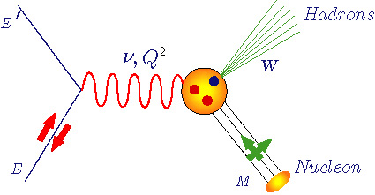
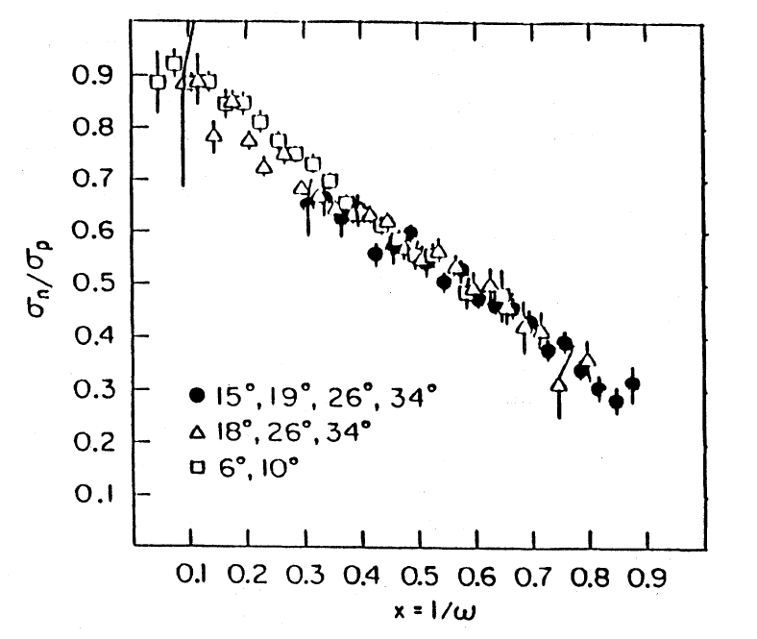
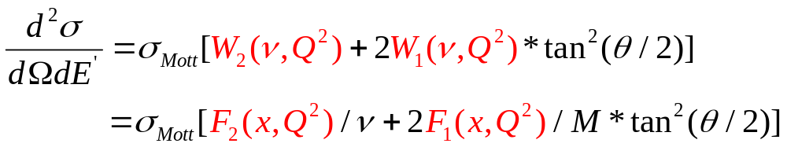
Deep Inelastic Scattering
Q² :Four-momentum transfer
x : Bjorken variable (=Q²/2Mν)
ν : Energy transfer
M : Nucleon mass
W : Final state hadronic mass
Scaling
Valence quarks
Quark-antiquark pairs
Notes:
It is well known that the most clear experimental evidence of substructure of nucleon comes from the deep inelastic scattering. The scaling property and ratio of sigma_n/sigma_p go to 1/3 supports the picture of parton model. As x->0, there is a common structure for both n an p which can be interpreted as q-qbar pair.

Slide 4
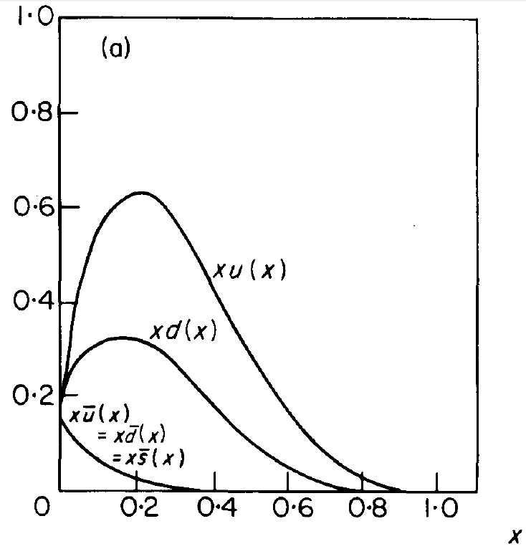
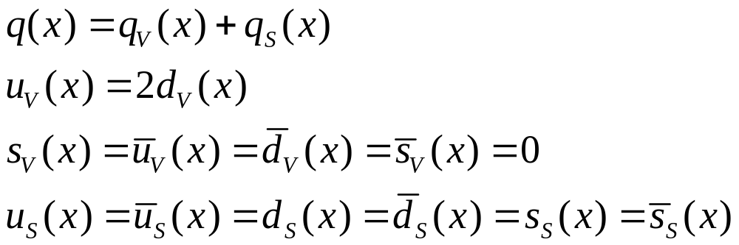
Naïve Expectation of Quark Sea: SU(3) Symmetric
F.E. Close, “An Introduction to Quarks and Partons”

Slide 5
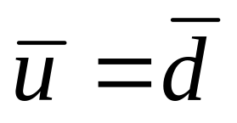
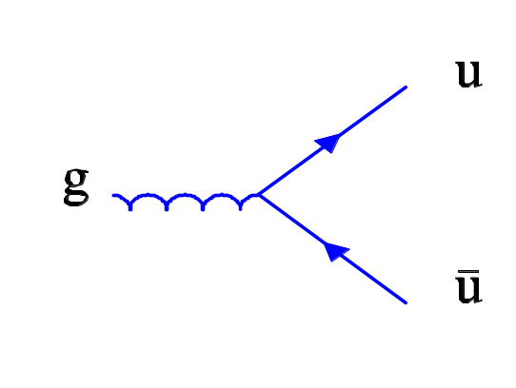

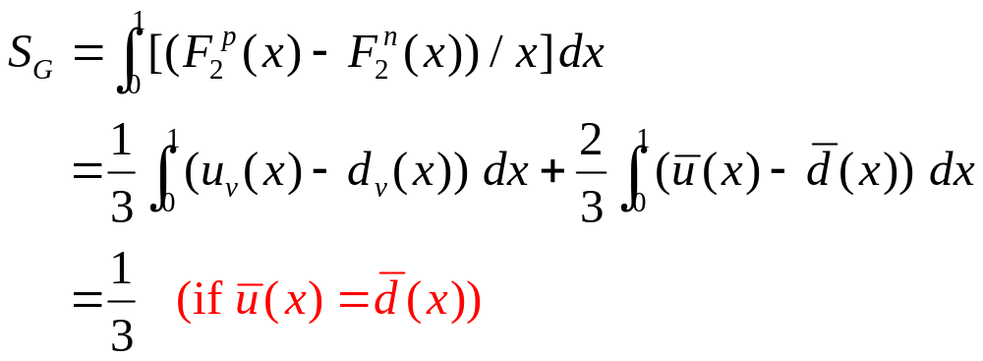
Is in the Proton?
=
Gottfried Sum Rule
Notes:
Gluon splitting. GSR, =1/3 if ubar(x)=dbar(x)

Slide 6
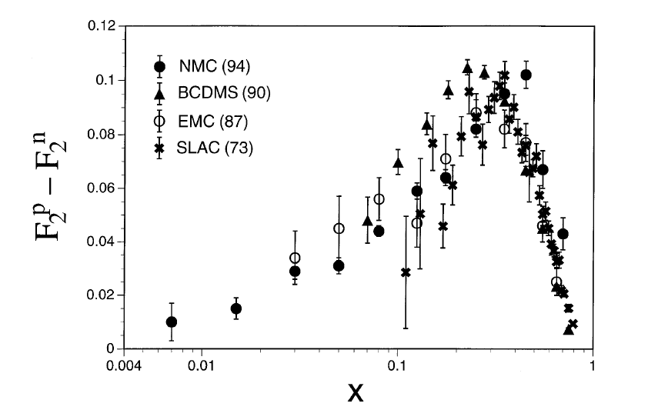
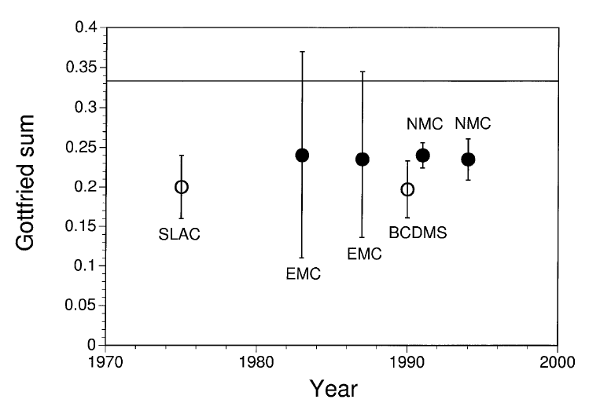
Measurement of Gottfried Sum
S. Kumano, Physics Reports, 303 (1998) 183
New Muon Collaboration (NMC), Phys. Rev. D50 (1994) R1
S_{G} = 0.235 ± 0.026
( Significantly lower than 1/3 ! )
Notes:
Experimental test of this sum rule using DIS exp deviates from 1/3

Slide 7
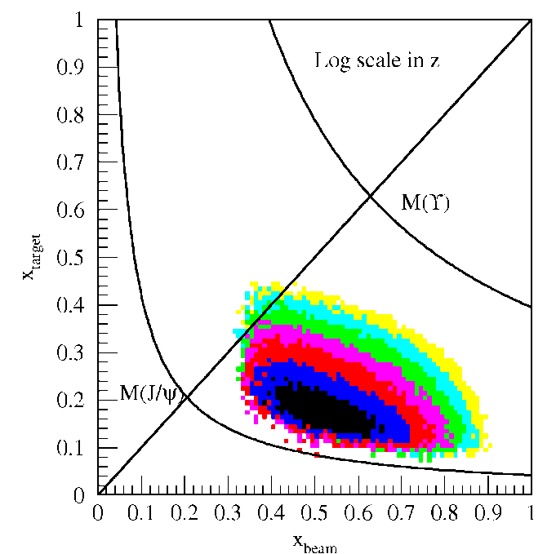
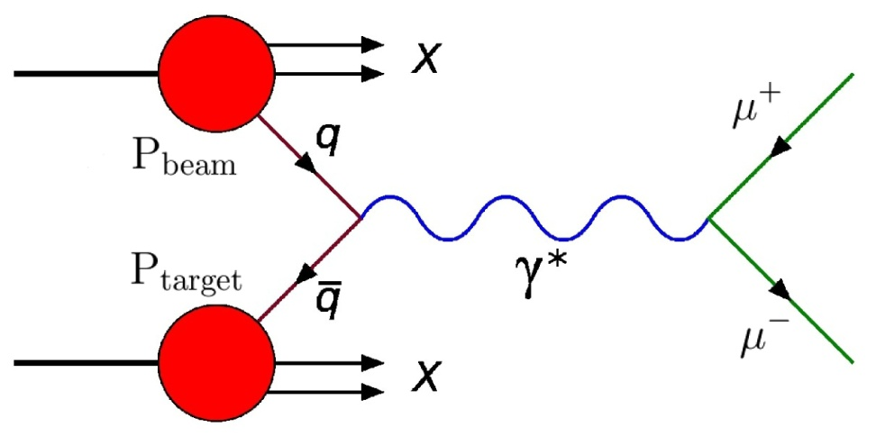
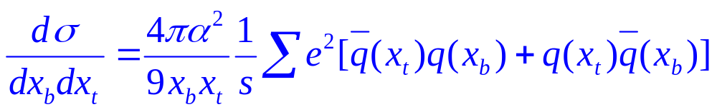
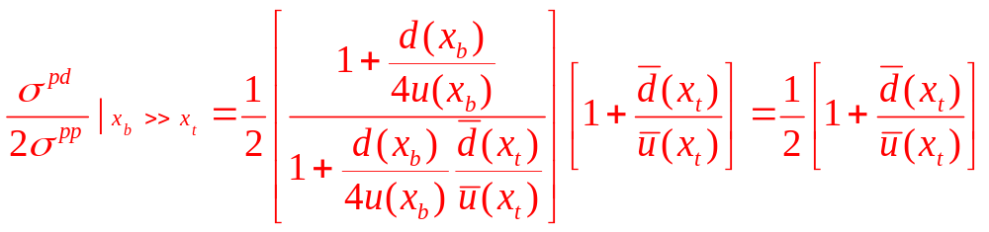
Drell-Yan Process:
Map out x-dependence of Sea Quarks
Acceptance for fixed-target experiment: x_{beam} >> x_{target}
Notes:
Ratio of proton-induced Drell-Yan production with deuteron and proton at the forward direction will provide the dbar/ubar ratio as a function of x.

Slide 8
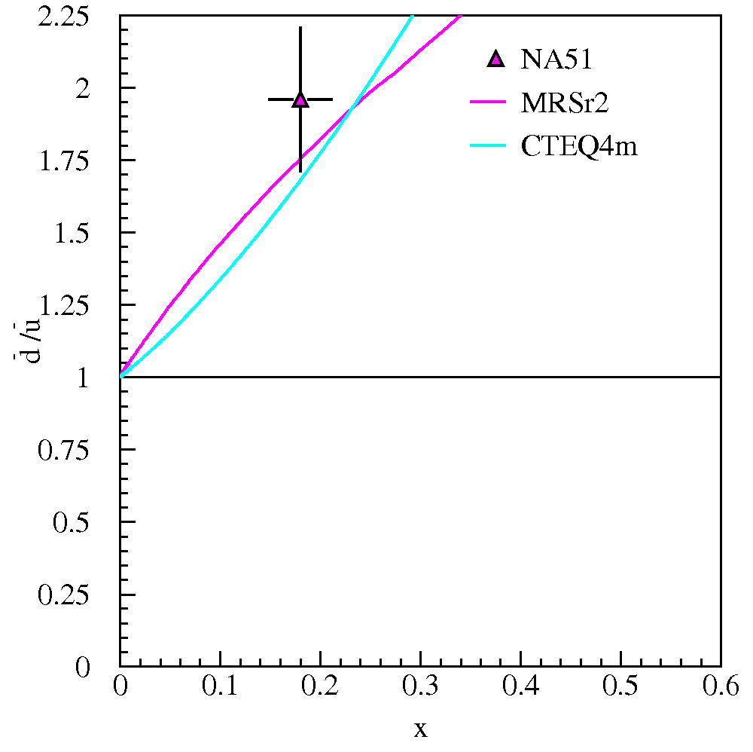
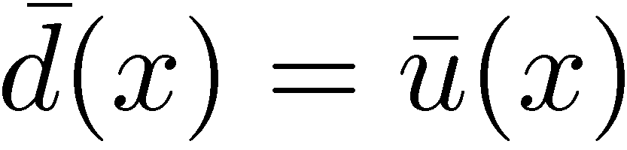
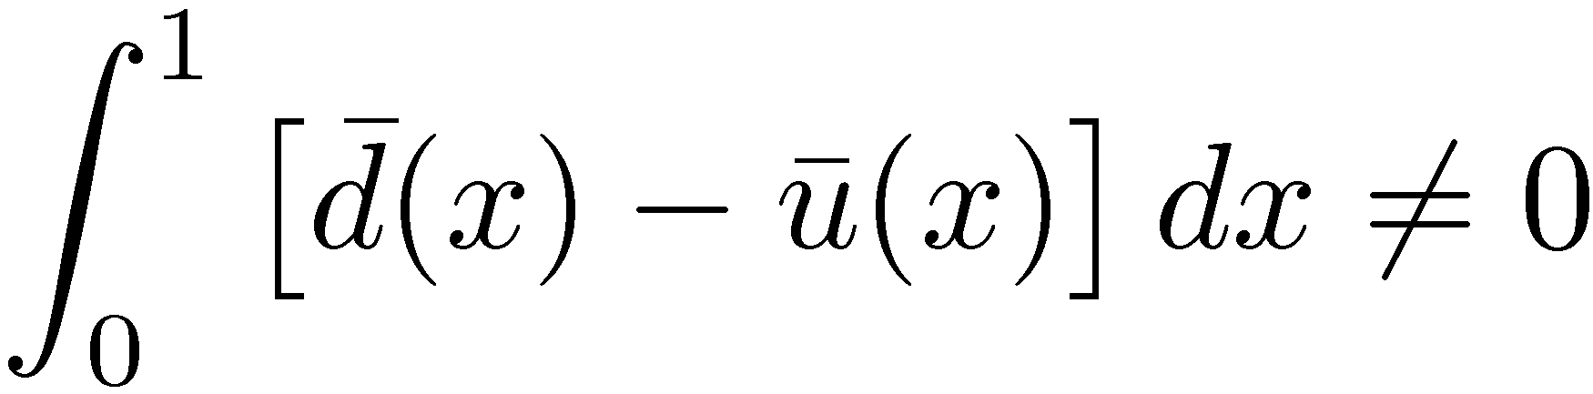
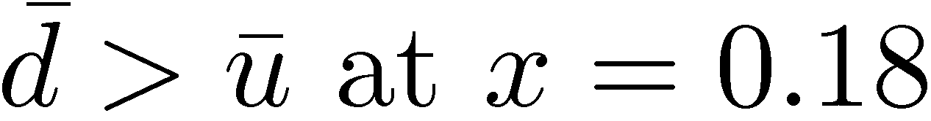
Light Anti-quark Flavor Asymmetry
Naïve Assumption:
NMC (Gottfried Sum Rule)
NA51 (Drell-Yan, 1994)
NA 51 Drell-Yan confirms
d(x) > u(x)
−
−
Notes:
CERN NA51 provided the first measurement and dbar>ubar at one fixed point of x.

Slide 9
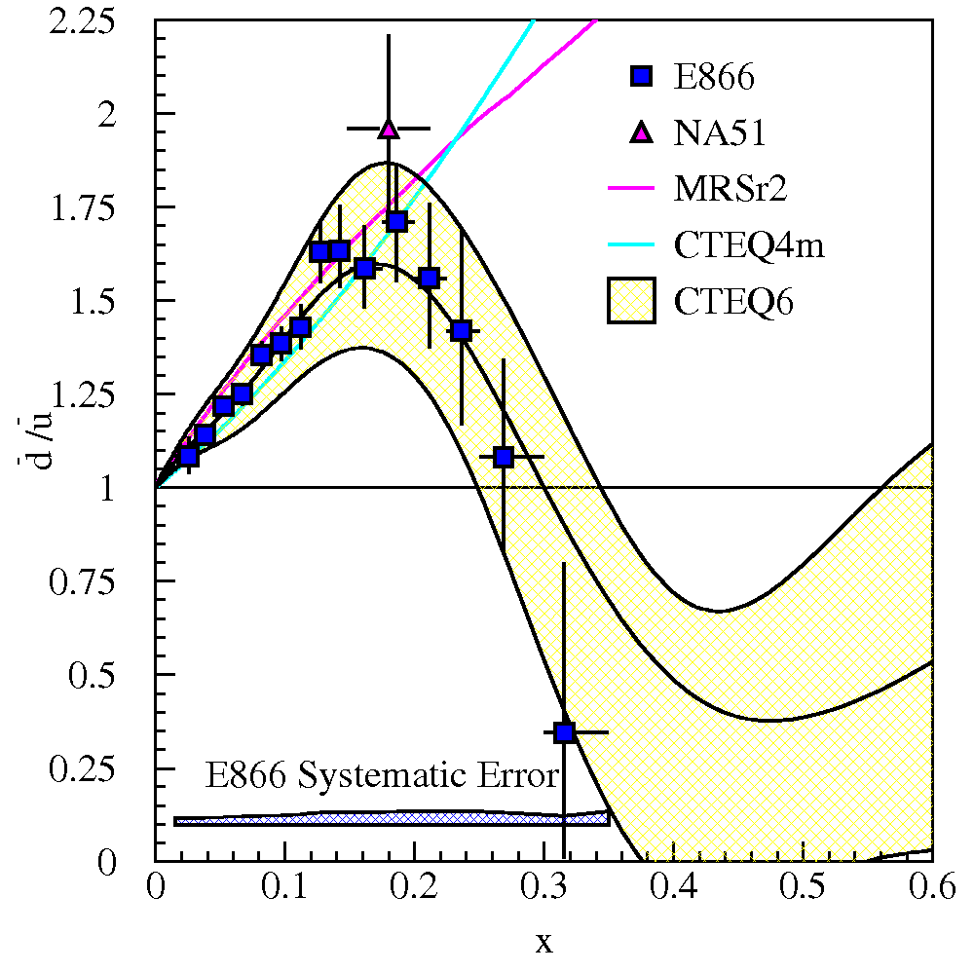
Light Anti-quark Flavor Asymmetry
Naïve Assumption:
NMC (Gottfried Sum Rule)
NA51 (Drell-Yan, 1994)
E866/NuSea (Drell-Yan, 1998)
Notes:
E866 provides a clear x-dependence of d/u between 0-0.3

Slide 10


Origin of u(x)≠d(x):
Perturbative QCD effect?
−
−
$$q$$
G
$$\overline{q}$$
Pauli blocking
  g→uu is more suppressed than g→dd in the proton since |p>=|uud> (Field and Feynman 1977)
  pQCD calculation (Ross, Sachrajda 1979)
  Bag model calculation (Signal, Thomas, Schreiber 1991)
Chiral quark-soliton model (Pobylitsa et al. 1999)
Instanton model (Dorokhov, Kochelev 1993)
Statistical model (Bourrely et al. 1995; Bhalerao 1996)
Balance model (Zhang, Ma 2001)
−
−
The valance-quark configuration affects the gluon splitting.
Notes:
pQCD is less than 1% effect.

Slide 11
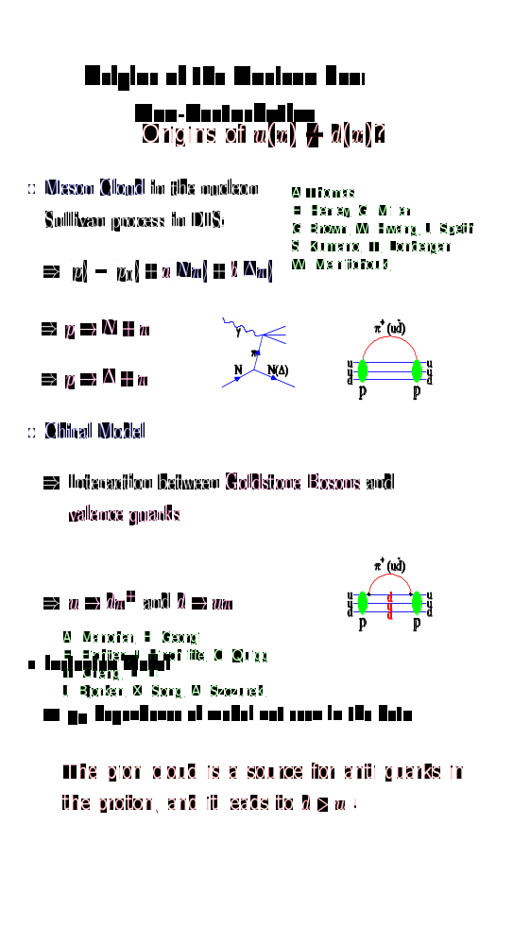


Origin of u(x)≠d(x):
Non-perturbative QCD effect?
−
−
Meson cloud in the nucleons (Thomas 1983, Kumano 1991):
Sullivan process in DIS.
Chiral quark model (Eichten et al. 1992; Wakamatsu 1992): Goldstone bosons couple to valence quarks.
n
Pion cloud is a source of antiquarks in the protons
and it lead to d>u.
−
−

Slide 12
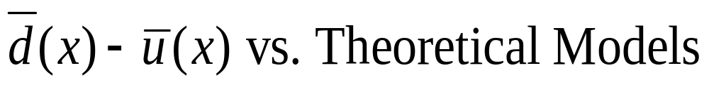
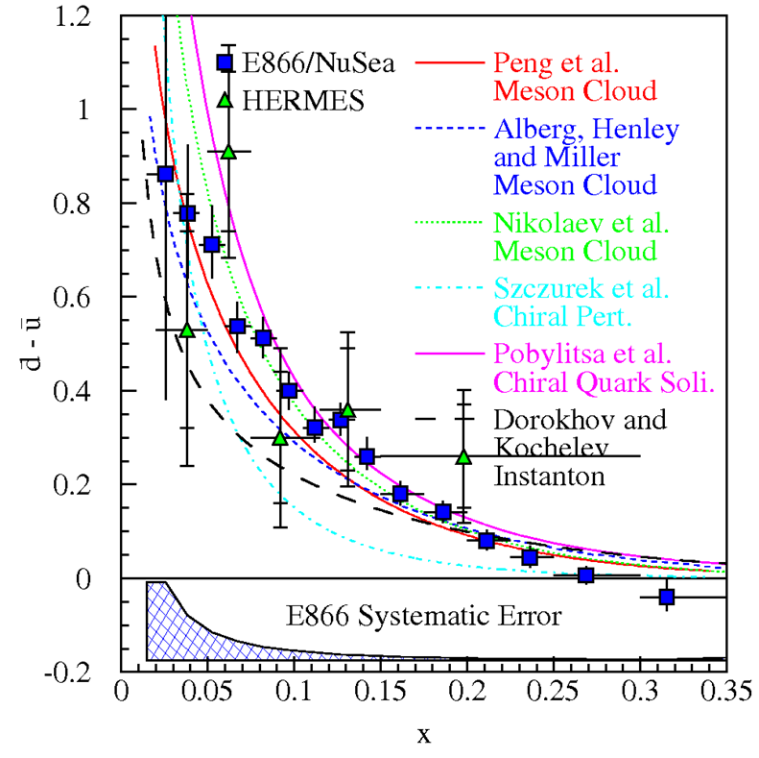
Notes:
No model predicts ubar>dbar.

Slide 13
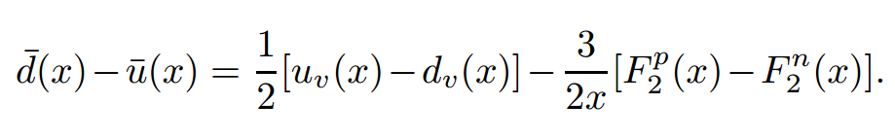
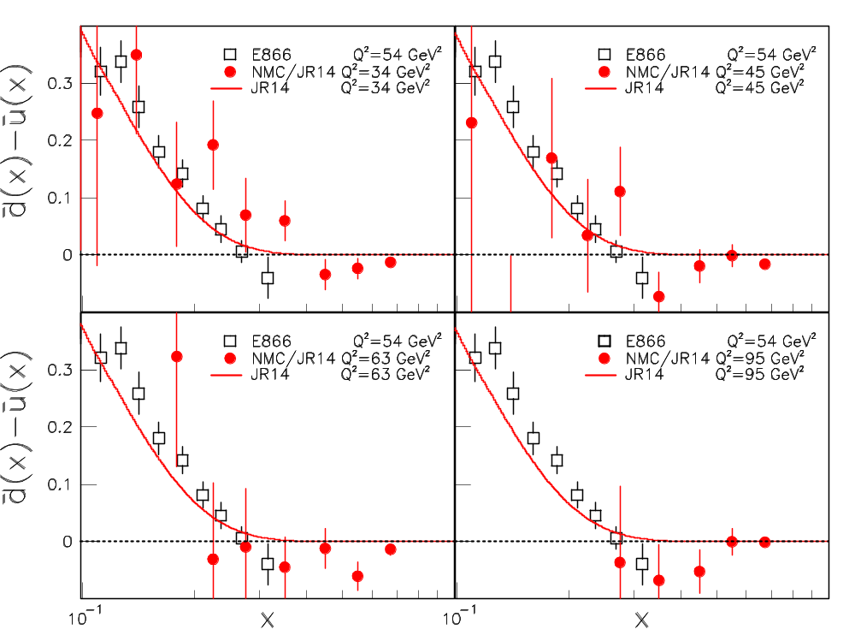
Momentum Dependence of the Flavor Structure of the Nucleon Sea: NMC vs E866
JR14
NMC
J.-C. Peng, W.-C. Chang, H.-Y. Cheng, T.-J. Hou, K.-F. Liu, J.-W. Qiu,
Phys. Lett. B736 (2014) 411

Slide 14
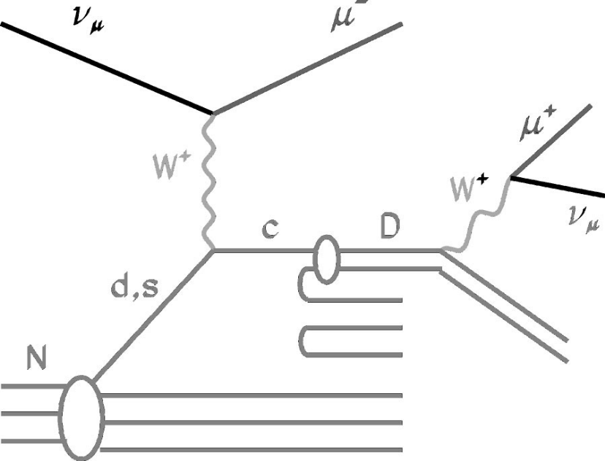
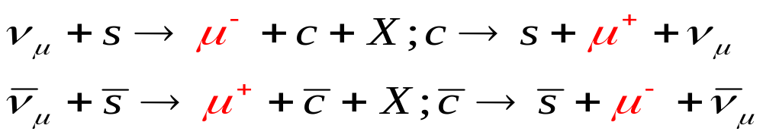
Strange Quark in the Nucleon:
Deep-Inelastic Neutrino Scattering
Notes:
The information of s quark is mostly coming from neutrino scattering. The strange and antistrange seas are directly accessible through the measurement and study of dimuon events in neutrino and antineutrino deep inelastic scattering (DIS)[15]. These events occur in charm production from charged current (CC) interactions with strange (or through Cabibbo suppressed, down) quarks in the nucleon. Neutrino (antineutrino) interactions generate charmed (anticharmed) hadrons from the strange (antistrange) sea. Approximately 10% of the time, the charmed hadrons decay semimuonically, resulting in a ﬁnal state with two oppositely charged muons and a hadronic shower from the nucleon breakup and charm decay. The second muon provides a clear signal by which to distinguish these events from other CC interactions.

Slide 15
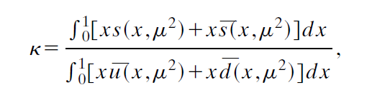
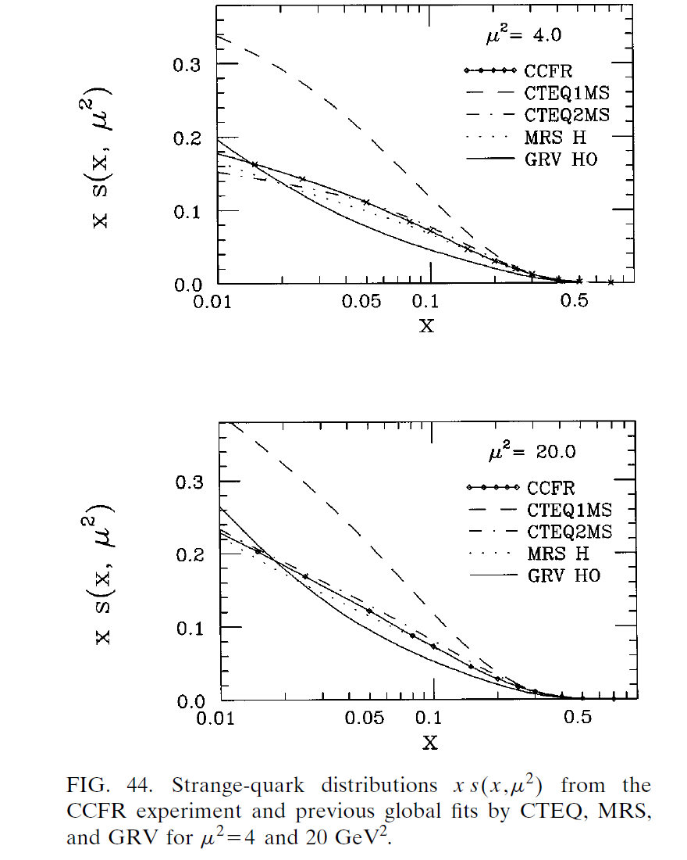
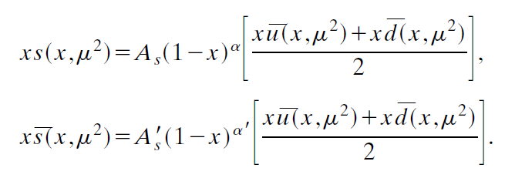
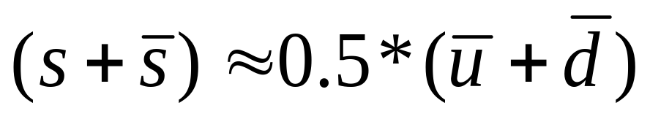
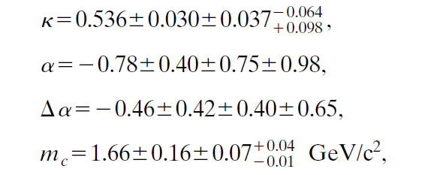
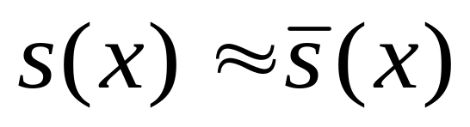
Strange Quark in the Nucleon
CCFR, Z. Phys. C 65, 189 (1995)
Notes:
The asymmetry between s(x) and ¯s(x) was measured in the neutrino dimuons production in DIS [32]. The
first muon is created in the charm production from neutrino charged current (CC) interactions with strange
quarks in the nucleon. The second muon comes from the decay of the charm hadron which provides a clear
signal to distinguish these events from other CC interactions.

Slide 16
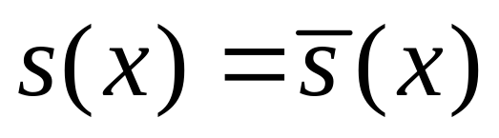
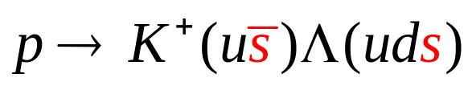
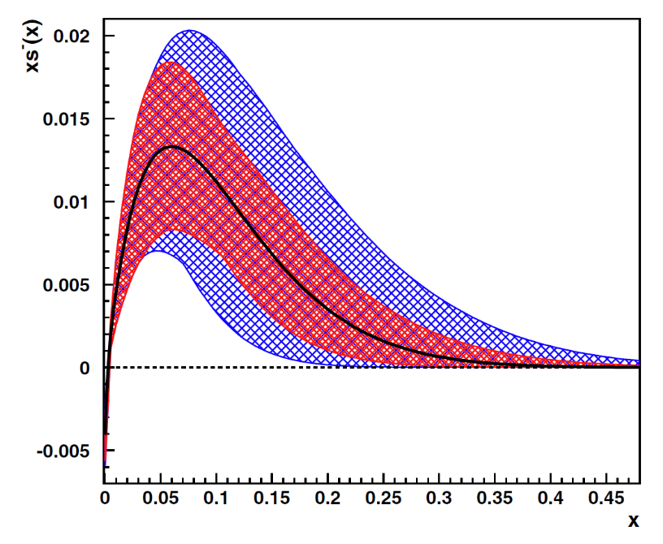
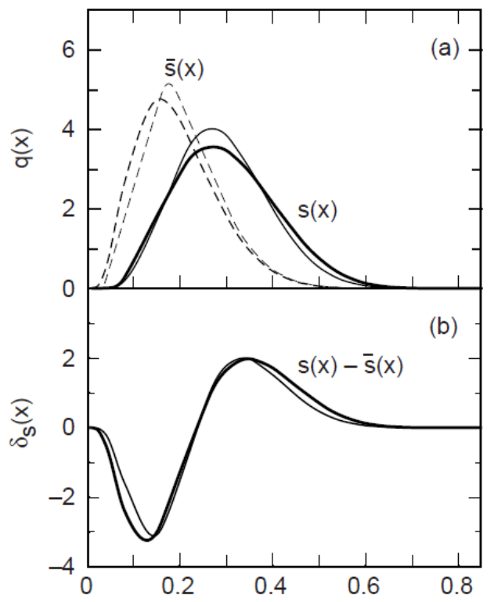

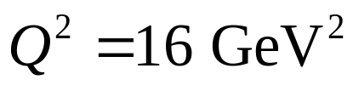
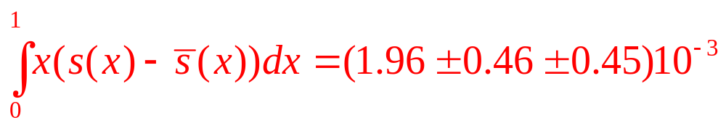
Is in the Proton?
Meson cloud model
NuTeV, PRL 99, 192001 (2007)

Slide 17
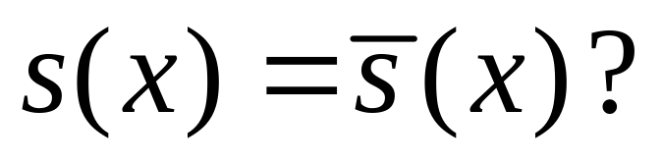
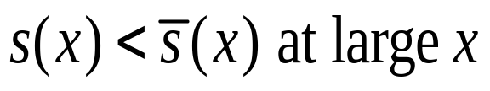
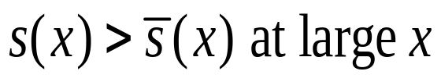
Meson Cloud Model (Signal and Thomas, 1987)
Chiral Field (Burkardt and Warr , 1992)
Baryon-Meson Fluctuation (Brodsky and Ma , 1996)
Perturbative evolution (Catani et al., 2004)
Notes:
The theoretical predictions of asymmetry of s and sbar vary a lot.

Slide 18
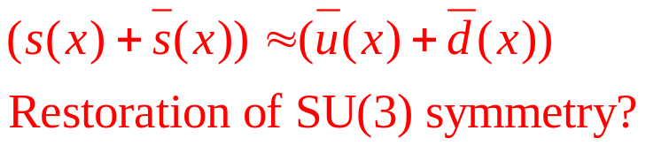
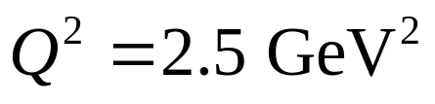
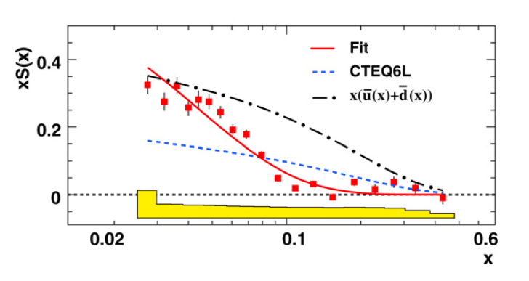

Strange Content from Semi-Inclusive Charged-Kaon DIS Production
HERMES, PLB 666, 446 (2008)
Notes:
At small x, s+sbar + ubar+dbar, restoration of SU(3) asymmetry
A peculiar structure lies at large-x region beyond the small-x sea quark.

Slide 19
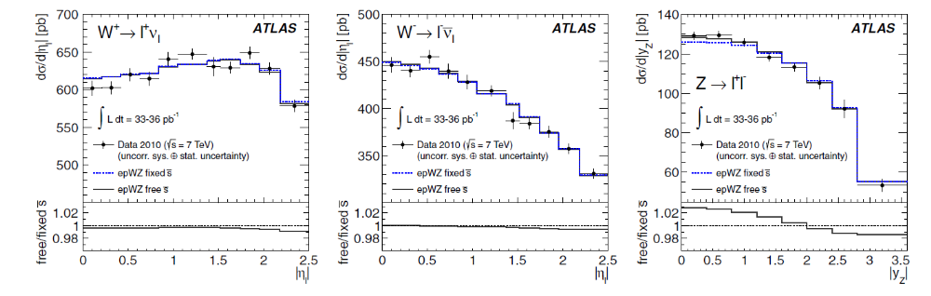
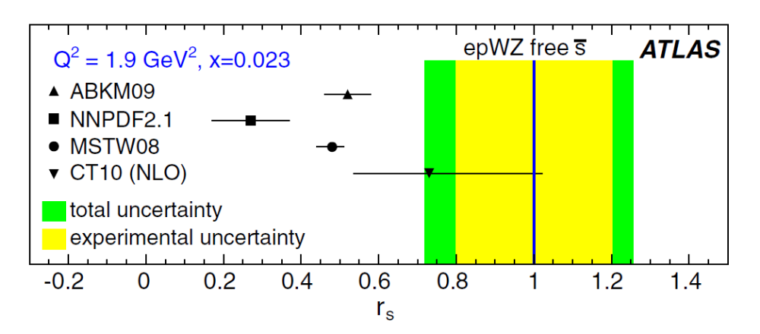
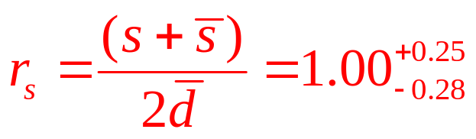
W and Z production at LHC
ATLAS, PRL 109, 012001 (2012)

Slide 20
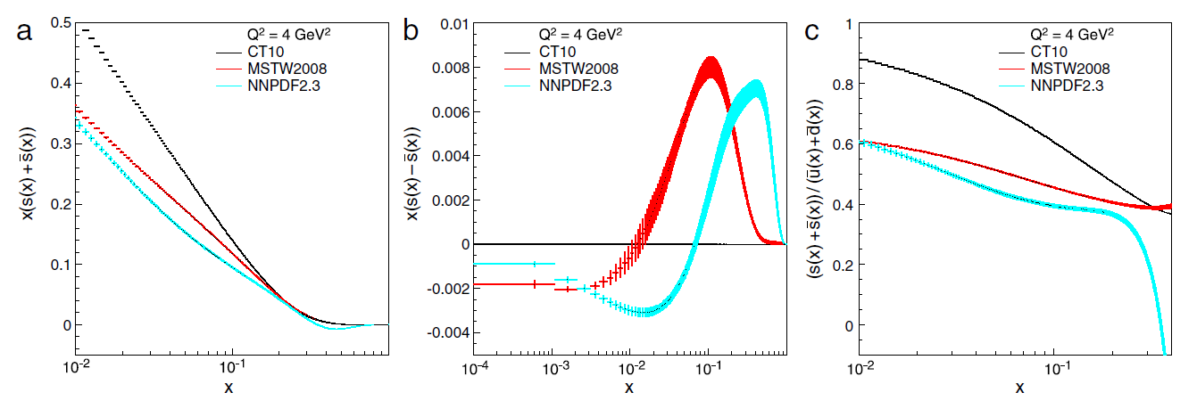
Strange Quarks of Proton in the Global Analysis
No converging pictures: more experimental data are required!
W.-C. Chang and J.-C. Peng,
Progress in Particle and Nuclear Physics 79 (2014) 95; arXiv:1406.1260

Slide 21
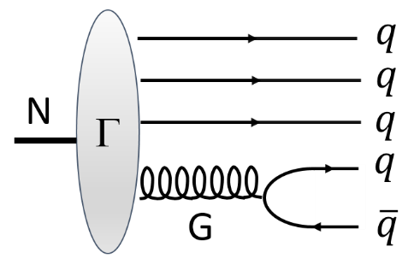
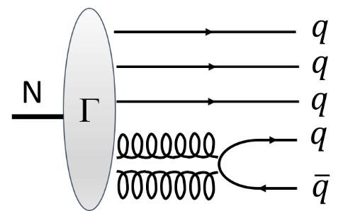

Short-Range Structure of Hadron
Extrinsic Sea | Intrinsic Sea
Gluon splitting | Gluon fusion & light quark scattering
Perturbative radiation | Spatial overlapping of partons
CP invariant | Possible CP non-invariant
Fast fluctuation | With a longer lifetime
Of small x | Of large x (valence-like)
Strong Q² dependent | Small Q² dependent
Hoyer and Brodsky, AIP Conf. Proc. 221, 238 (1990)
Notes:
For further understanding of sea quarks, it might be helpful to classify them into two types depending on their origin.

Slide 22



Intrinsic Sea Quarks in Light-Front 5q Fock States
Brodsky, Hoyer, Peterson, Sakai (BHPS) PLB 93,451 (1980); PRD 23, 2745 (1981)
“extrinsic”
“intrinsic”
Notes:
Dominant Fock state configurations have the minimal invariant mass, i.e. the ones with equal-rapidity constituents.
The large charm mass gives the c quark a larger x than the other comoving light partons, more valence-like.
The existence of IC will lead to large contribution to charm production at large x.

Slide 23


Experimental Evidences of Intrinsic Charm
Gunion and Vogt, hep-ph/9706252
Notes:
There are some experimental evidence of IC.

Slide 24

Global Fit by CTEQ
Pumplin, Lai, Tung, PRD 75, 054029 (2007)
No Conclusive Evidence…..

Slide 25




Search for the “intrinsic” sea of lighter quarks
No conclusive experimental evidence for intrinsic-charm so far
The 5-quark states for lighter quarks have larger probabilities!

Slide 26
How to separate the “intrinsic sea” from the “extrinsic sea”?
Select experimental observables which have no contributions from the “extrinsic sea”
“Intrinsic sea” and “extrinsic sea” are expected to have different x-distributions.
  Intrinsic sea is “valence-like” and is more abundant at larger x.
  Extrinsic sea is more abundant at smaller x.

Slide 27



How to separate the “intrinsic sea” from the “extrinsic sea”?
Select experimental observables which have no contributions from the “extrinsic sea”
Investigate the x distribution of flavor non-singlet quantities: , .
=

Slide 28


Data of d(x)-u(x) vs. Light-Front 5q Fock States
−
−
The data are in good agreement with the 5q model after evolution from the initial scale μ to Q²=54 GeV²
The difference of these two 5-quark components could be determined.
Chang and Peng, PRL 106, 252002 (2011)
Notes:
Assuming there existing a difference of probability intrinsic uudddbar state and uuduubar, we construct the x distribution from light-front 5q model in a numerical way at certain initial scale. Then we evolve the x distribution to the experimental scale at Q2=54 GeV2. The difference of these two 5-quark components could be determined.

Slide 29
How to separate the “intrinsic sea” from the “extrinsic sea”?
“Intrinsic sea” and “extrinsic sea” are expected to have different x-distributions
  Intrinsic sea is “valence-like” and is more abundant at larger x
  Extrinsic sea is more abundant at smaller x

Slide 30


Data of x(s(x)+s(x)) vs. Light-Front 5q Fock States
−
−
The x(s(x)+s(x)) are from HERMES kaon SIDIS data at <Q²>=2.5 GeV².
The data seem to consist of two components.
Assume data at x>0.1 are originated from the intrinsic |uudss> 5-quark state.
−
Chang and Peng, PLB 704, 197 (2011)

Slide 31

How to separate the “intrinsic sea” from the “extrinsic sea”?
Select experimental observables which have no contributions from the “extrinsic sea”
Investigate the x distribution of flavor non-singlet quantities: , .

Slide 32



Data of x(d(x)+u(x)-s(x)-s(x)) vs. Light-Front 5q Fock States
−
−
−
−
−
The d(x)+u(x) from CTEQ 6.6.
The s(x)+s(x) from HERMES kaon SIDIS data at <Q²>=2.5 GeV².
−
Chang and Peng, PLB 704, 197 (2011)

Slide 33






Extraction of various 5q-components for light quarks

Slide 34
Comparison of 5q Probabilities
−
−
−
−
P(uu) | P(dd) | P(ss) | P(cc) | References
0.198 | 0.148 | 0.093 | 0.011 | Bag model; Donoghue and Golowich, PRD15, 3421 (1977)
 |  |  | 0.003 | Light-cone 5q model; Hoffmann and Moore, ZPC 20, 71 (1983)
0.250 | 0.250 | 0.050 | 0.009 | Meson cloud model; Navarra et al., PRD 54, 842 (1996)
 |  | 0.10 -0.15 |  | Constituent 5q model; Riska and Zou, PLB 636, 265 (2006)
0.122 | 0.240 | 0.024 |  | Light-front 5q model; Chang and Peng, this work (2011)
 |  | 0.00025 -0.00058 |  | Constituent 5q model; Kiswandhi, Lee, Yang, PLB 704, 373 (2011)
0.098 | 0.216 | 0.057 |  | Extended chiral constituent quark model; An and Saghai, PRC 85, 055203 (2012)

Slide 35





Diagrams of Nucleon Hadronic Tensor in Path-Integral Formalism
Connected Diagram
Disconnected Diagram

Slide 36
Connected and Disconnected Sea
Liu and Dong, PRL 72, 1790 (1994)
−
−
q^{ds}(x)=q^{ds}(x), where q=u, d, s; s(x)=s(x)
u^{ds}(x)=d^{ds}(x)
q^{cs}(x)=q^{cs}(x), where q=u, d
Origin of u(x) ≠ d(x): u^{cs}(x) ≠ d^{cs}(x)
Small-x behaviors:
  q^{valence}(x) , q^{cs}(x) ∼ x^{-1/2}
  q^{ds}(x) ∼ x⁻¹
−
−
−
−
−
−
−
How do we separate these two components?
Notes:
Reggeon and Pomeron Exchange.

Slide 37




Ratio of Momentum Fraction between s and u in DI by Lattice QCD
Connected Insertion (CI)
Doi, et al. PoS LATTICE2008:163, 2008
Disconnected Insertion (DI)

Slide 38





Connected Sea:
Liu, Chang, Cheng and Peng, PRL 109, 252002 (2012)

Slide 39

Small-x Behaviors of CS and DS
Small-x behavior:
Valence and CS∼x^{-1/2}
DS∼x⁻¹
Liu, Chang, Cheng and Peng, PRL 109, 252002 (2012)

Slide 40



Moments of Nucleon Sea
Liu, Chang, Cheng and Peng, PRL 109, 252002 (2012)

Slide 41
Future Prospect (Experimental)
Light sea quarks:
  E906/SeaQuest at FNAL: flavor asymmetry of d-bar/u-bar at large x region.
  MINERνA at FNAL: x-dependence of nuclear effects for sea quarks.
  JLAB-12 GeV: transverse spatial distribution of sea quarks.
  Kaon-induced DY experiment at COMPASS & J-PARC with beam PID detector: s and s-bar.
  Electron-Ion Collider (EIC): sea quark distributions and their spin structure.
Heavy sea quarks:
  Open-charm production at forward rapidity, e.g. fixed-target experiment at LHC (AFTER).
  Higgs production at large x_{F} at LHC.

Slide 42



d/u measured by E906/SeaQuest
−
−
Fermilab E906
Physics data taking started at Feb, 2014
¹H, ²H, and nuclear targets
Unpolarized Drell-Yan using 120 GeV proton beam
Fixed Target Beam lines
Tevatron 800 GeV
Main Injector 120 GeV

Slide 43


s(x) of Nucleon by COMPASS-DY with Kaon Beam
−
CEDAR
(CErenkov Differential counter with Achromatic Ring focus)
50 m
(Unpolarized) Nuclear Target(s)
30 m
h⁺ beam: p (75%) / π⁺ (24%)
h⁻ beam: π⁻ (97%) / K⁻ (2.4%)
Beam
Beam Particle Identification
NH₃ target
(polarized)
Nuclear Target(s)
Tungsten Plug
In parallel with the “normal” DY exp.
Flavor dependency of EMC effect
Parton structure of π and K
Strange quark in nucleon

Slide 44
Summary
Using DIS, Drell-Yan and SIDIS processes, the structure of sea quarks in the nucleon are explored and interesting flavor structures are found.
The measured x distributions of (d-u), (s+s) and (u+d-s-s) could be reasonably described by the light-front 5q Fock states. The probabilities of the intrinsic 5q states of light sea quarks are extracted.
More data of sea quarks will be available in the coming experiments at FNAL, CERN, JLAB, J-PARC and EIC.
−
−
−
−
−
−
“Flavor Structure of the Nucleon Sea”
W.-C. Chang and J.-C. Peng, Progress in Particle and Nuclear Physics 79 (2014) 95; arXiv:1406.1260

Slide 45


New HERMES Results of $s\left(x\right)+\overline{s}\left(x\right)$
PRD 89, 097101 (2014)

Slide 46


New HERMES Results of $s\left(x\right)+\overline{s}(x)$
PRD 89, 097101 (2014)

Slide 47




New HERMES Results of $s\left(x\right)+\overline{s}(x)$
PRD 89, 097101 (2014)

