Slide 1
Muon cooling
for a Higgs Factory at CERN ?
Carlo Rubbia
Gran Sasso Science Institute, L’Aquila, Italy
IASS, Institute for Advanced Sustainability Studies Potsdam, Germany
Senator for life of the Italian Republic

Slide 2
The LHC observation of the Higgs at 125 GeV
CMS and Atlas have observed a narrow line of high significance at about 125 GeV mass. compatible with the Standard Model Higgs boson.
  ATLAS: m_{H} = 125.5 ± 0.2 (stat) ± 0.6 (sys) GeV
  CMS: m_{H} = 125.8 ± 0.4 (stat) ± 0.4 (sys) GeV
Their data are consistent with fermionic and bosonic coupling expected from a SM Higgs particle.
Searches have been performed in several decay modes, however in the presence of very substantial backgrounds.
Experimental energy resolutions have been so far much wider of any conceivable intrinsic Higgs width.
Results of both experiments also exclude other SM Higgs bosons up to approximately 600 GeV.

Slide 3
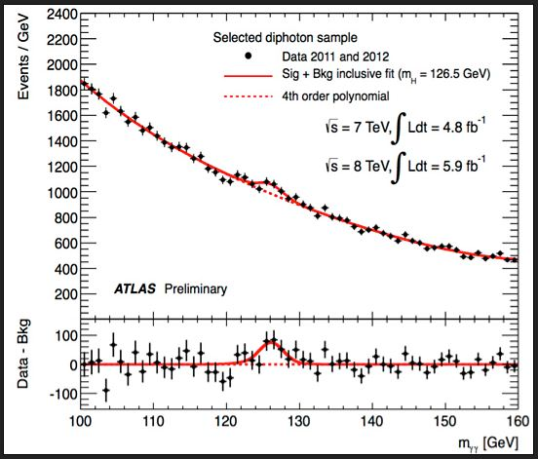
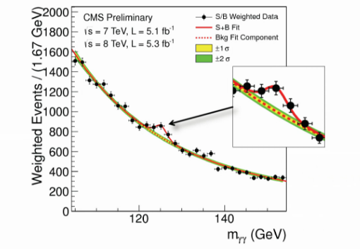
The early dscovery story

Slide 4
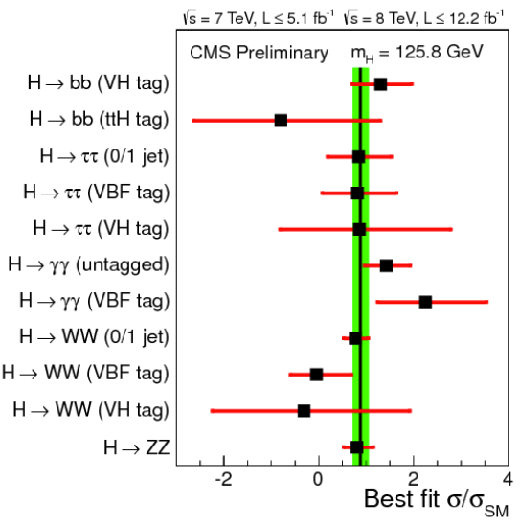
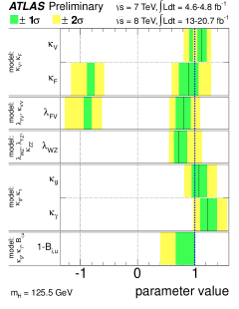
Experimental results

Slide 5
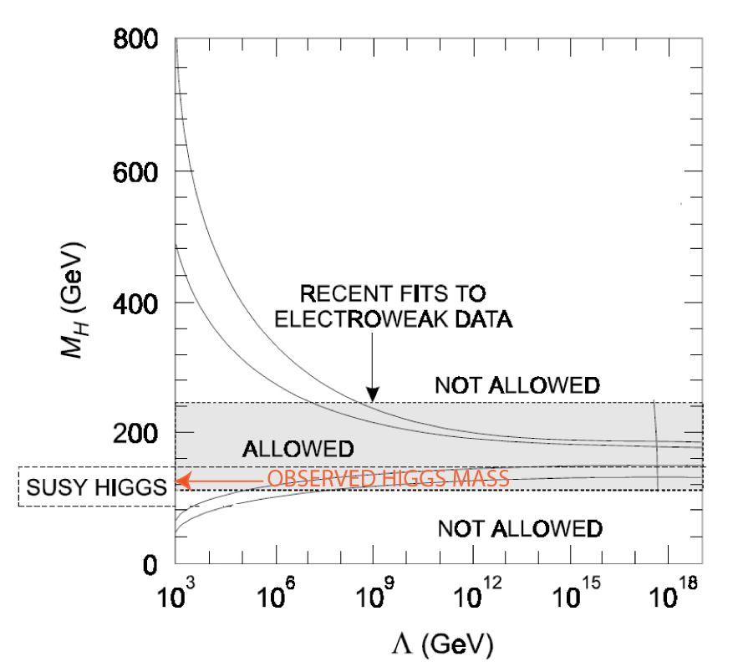
The myth of symmetry breaking at TeV scale
It had been widely argued by many very influential theorists that “new physics” must also necessarily appear at the TeV scale, one of the the main reasons for arguing for the necessity of a nearby SUSY.
This was based on the argument that the otherwise divergent self-interaction of the Higgs sector does require a cutoff at the TeV scale.
However, this does not hold for the recently observed Higgs mass of 126 GeV, since stability conditions may allow without novelties a legitimate cutoff even up to the Planck Mass

Slide 6
Present situation
For these values, the electroweak vacuum is claimed metastable, but with a lifetime longer than the age of the Universe.
The Standard Model can be valid without new physics all the way up to the Planck scale.Thus, there may be only one standard model (SM) Higgs and no need for the “no fail theorem”.
arXiv:1310.0763v3 [hep-ph] 30 Dec 2013

Slide 7
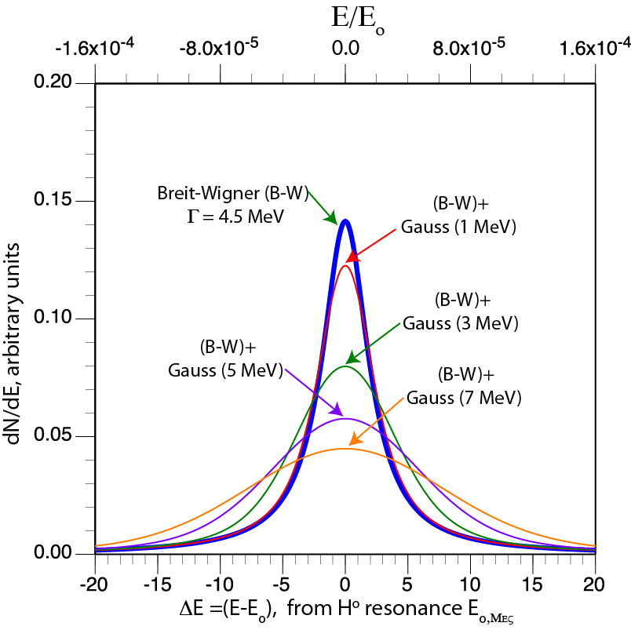
The Higgs width and the Standard Model
In particular, like in the case of the Zo, the determination of the H_{o} width will be crucial in the determination of the nature of the particle and the underlying theory: the SM prediction is only ≈4 MeV, a formidable task!
Cross section is shown here, convoluted with a Gaussian beam distribution.
Signal is not affected only if the rms beam energy width is ≤ a few MeV.
A very demanding resolution R ≈ 0.003% is required

Slide 8
The future of LHC/Higgs
During the next twenty years (!) CERN plans to pursue the hadronic production of the Higgs related sector and of the possible existence of SUSY. The existence of additional Higgs particles is assumed as unlikely within the LHC energy range.
Therefore studies will concentrate on the properties of the already discovered mass. The High Luminosity-LHC will already be a sort of “Higgs factory”, able to perform relatively accurate (typically ± 10%) measurements.
There are plenty of opportunities to check the couplings since a 125 GeV SM Higgs boson has several substantive branching fractions : B (bb) 60%, B (WW) 20%, B (gg) 9%, B (ττ) 6%, B (ZZ) 3%, B (cc) 3%, etc.
B (γγ) with 0.2% is also substantive due to the high mass resolution and relatively low background.

Slide 9
The future of the LHC
The estimates reflect 1 LHC detector accumulating 300 fb−1 of data, dominated at this level by systematic errors of the ATLAS and CMS collaborations and their best understanding.
ATLAS and CMS have estimated errors also for 3000 fb−1 from the High-L LHC.
However such estimates can hardly be a straightforward extrapolation of the current performances.
arXiv:1207.2516v3 [hep-ph] 1 Apr 2013
LHC 300fb⁻¹
1 σ uncertainty
Unambiguous discovery requires 5 σ

Slide 10
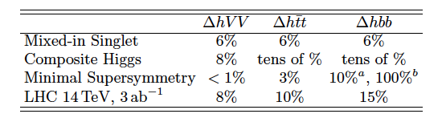
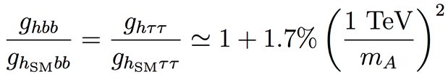
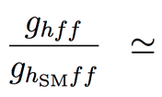
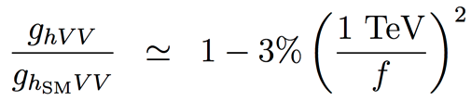
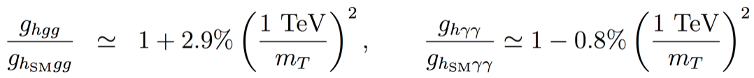
The need of a better precision
What precision is needed in order to search for possible additional deviations from the SM, even under the assumption that there is no other additional “Higgs” state at the LHC ?
Predicted ultimate LHC accuracies for “exotic” alternatives
R.S. Gupta et al.
Ultimate at LHC
1 ab= 10⁻⁴² cm²
SUSY tan(β)>5
  Composite Higgs
  Top partners
Sensitivity to “TeV” new physics for “5 sigma” discoveries may need 1 per-cent to sub 1-per-cent accuracies on rates.
arXiv:1206.3560v3 [hep-ph] 27 Sep 2012

Slide 11
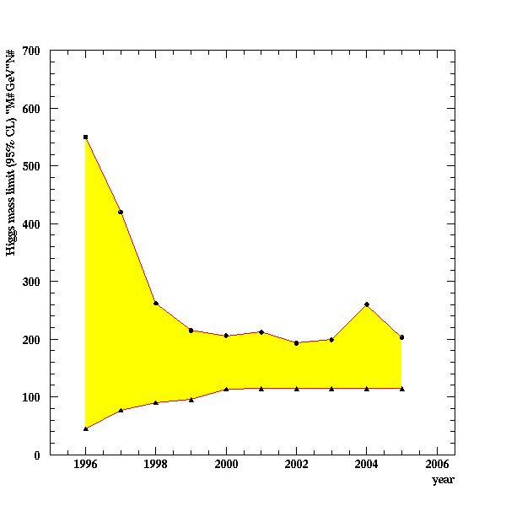
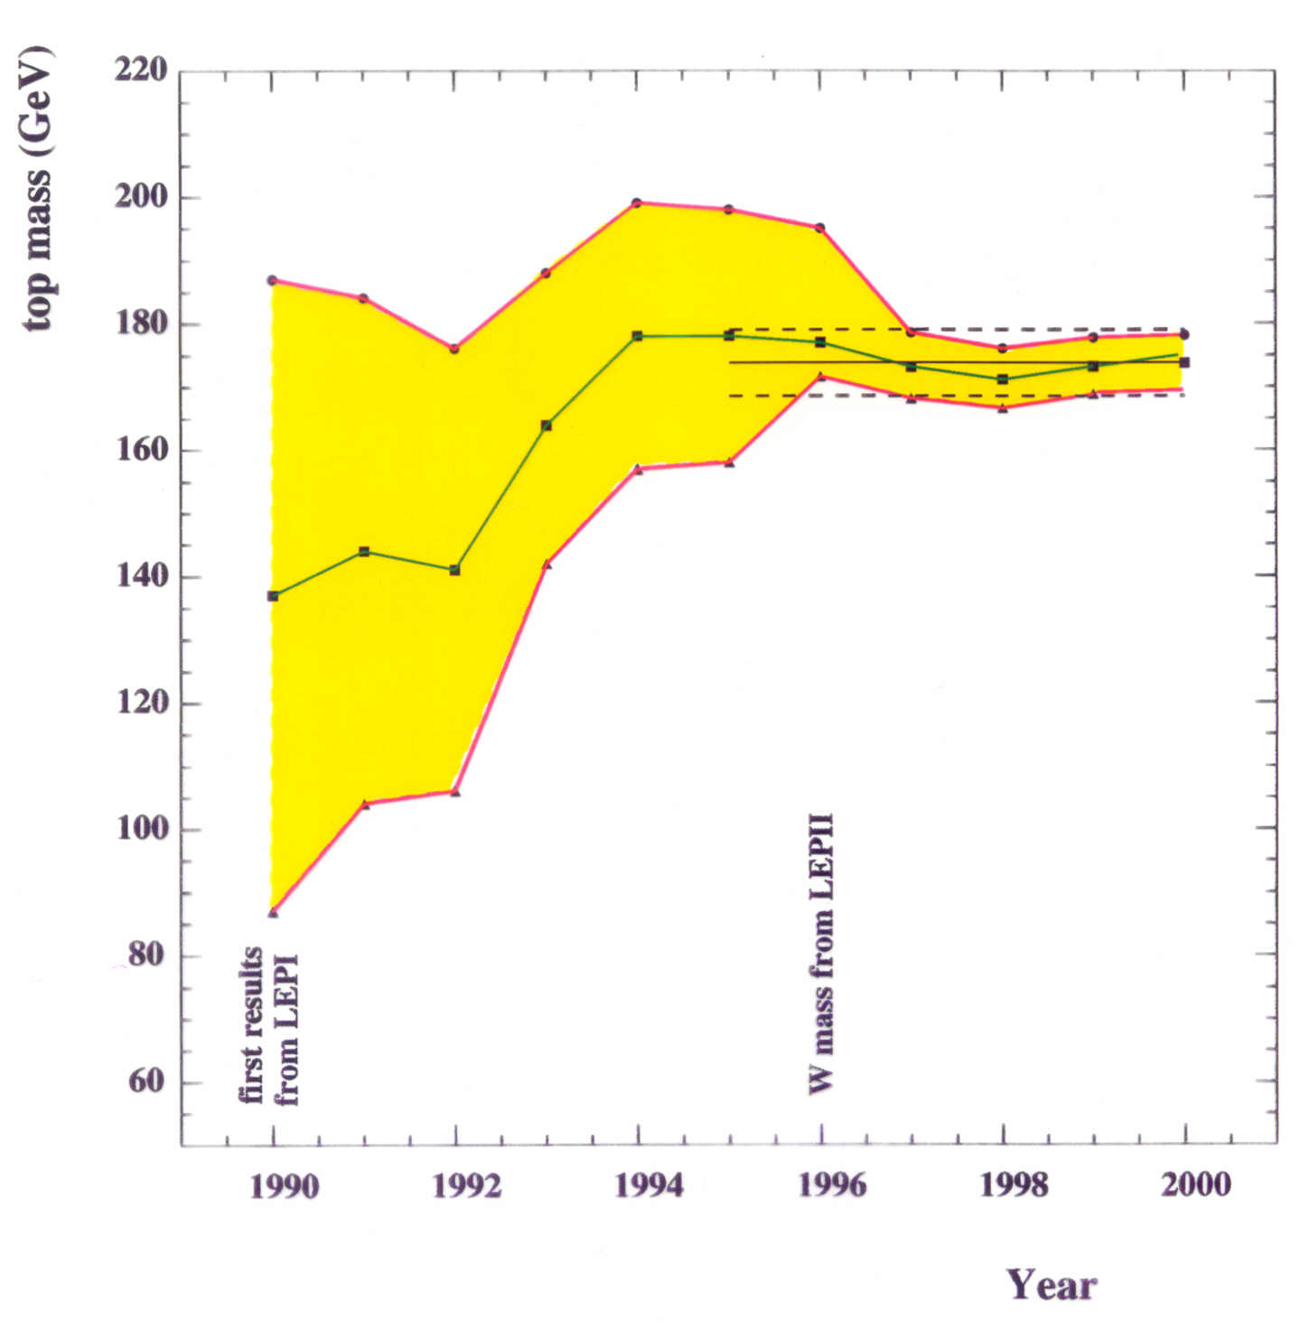
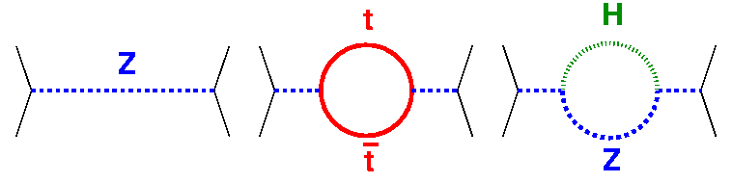
Predictive power of theory: The previous Z case
mtop
mH
LEP1
LEP2
MH between 114 and ~200 GeV
Experimental discovery
MH = 125 - 127 GeV
LEP2
Experimental discovery
2012
Higher order, renormalizable experimental corrections are used to predict existence beyond data (virtual graphs).

Slide 12
Studying the Higgs beyond LHC ?
The scalar sector is definitely one of the keys to the future understanding of elementary particle physics.
After the p-pbar discovery of the Zº , its detailed studies at LEP and SLAC in very clean conditions have been an essential second phase. Higher order corrections have anticipated the masses of both the top quark and of the Higgs scalar.
A similar second phase may be also necessary for the H_{o} and the presence of structure beyond the SM may manifest itself as tiny corrections in the observation of large number of events/year in very clean experimental conditions.
Two future alternatives are hereby compared:
  A e⁺e⁻ collider at L > 10³⁴ and a Z+H_{o} signal of ≈ 200 fb. The circumference of a new, LEP-like ring is of about≈ 80 km or a Linear Collider of 33 km.
  A μ⁺μ⁻ collider at L > 10³² and a H_{o} signal of ≈ 20’000 fb in the s-state. The collider radius is much smaller, only ≈ 50 m, but the novel “muon cooling” facility is necessary.
1 femtobarn (fb)
=10⁻³⁹ cm²

Slide 13
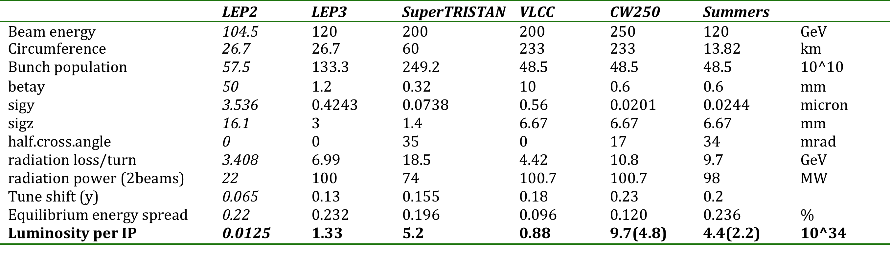
An adequate e⁺e⁻ collider ?
The LEP2 parameters were L = 1.25x10³² cm⁻²s⁻¹, a beam lifetime of 6.0 h, a current of 4 mA and β* = 1.5, 0.05 m.
The extension to the e⁺e⁻ -≥ H_{o}+Z requires E_{cm} ≥ 300 GeV and >500 x its luminosity.
Some recent possibilities for E_{cm} > 200 GeV.
1 fb= 10⁻³⁹ cm²

Slide 14
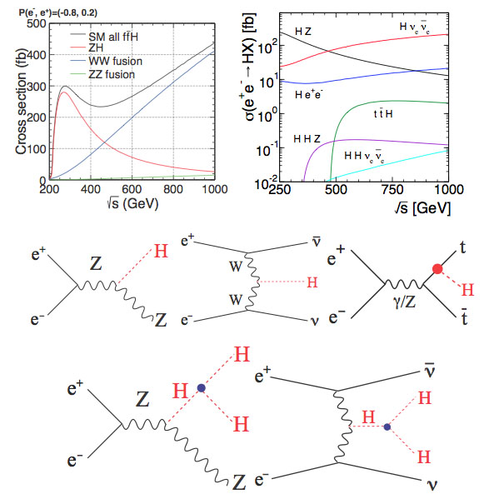
Production cross sections at the e+ e- collider
The production cross sections of the Higgs boson with the mass of 125 GeV for e+-e- as a function of the energy √s.
The cross sections of the production processes as a function of the √s collision energy.
The Higgs-strahlung diagram (Left), the W-boson fusion process (Middle) and the top-quark association (Right).
Double Higgs boson diagrams via off-shell Higgs-strahlung (Left) and W-boson fusion (Right) processes

Slide 15

The first option: a huge e⁺ e⁻ LEP like ring.
UNK Higgs
Factory, 2012
FNAL site filler, 2012
LEP3 2011
West Coast
design, 2012
LEP3 on LI, 2012
Chinese Higgs
Factory, 2012
SuperTristan 2012
LEP3 in Texas, 2012
Options for circular e⁺e⁻
Higgs factories are becoming
popular around the world
F. Zimmerman

Slide 16

Super Tristan
80 km ring in KEK area
12.7 km
KEK

Slide 17
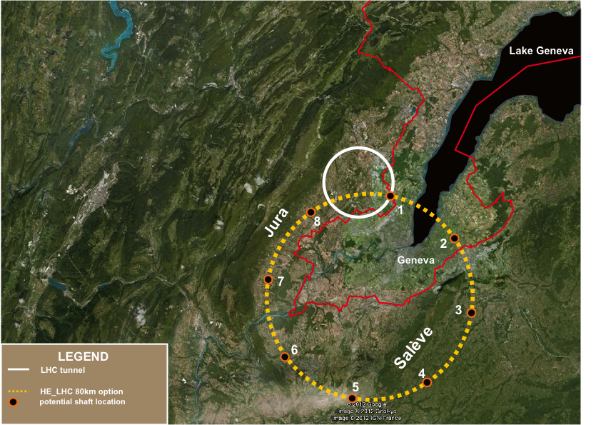
TLEP tunnel in the Geneva area
«Pre-Feasibility Study for an 80-km tunnel at CERN»
John Osborne and Caroline Waaijer,
CERN, ARUP & GADZ, submitted to ESPG

Slide 18
Requirements for the Higgs with a e⁺e⁻ collider
The luminosity is pushed to the beam-strahlung limit.
Collisions are at an angle, but with fewer bunches than for a B-Factory: a nano-beam scheme
σ_{x}/φ
2φ
σ_{z}
Luminosity (several x 10³⁴ cm⁻² s⁻¹), costs and power consumption (≈100 MW) are comparable to those of a linear collider ILC.
In order to reach luminosity (factor ≈ 1000 x LEP2) and power consumptions ( factor 5 x LEP2) the main cures are
  Huge ring (80 km for SuperTristan or for T-LEP)
  Extremely small vertical emittance, with a beam crossing size the order of 0.01 µ (it has been 3 µ for LEP2)
The performance is at the border of feasibility (E_{cm}≈ 250 GeV).
However the Ho width of ≈4.0 MeV cannot be detected.
18

Slide 19
The ILC option
The International Linear Collider (ILC) is a high-luminosity linear electron-positron collider based on 1.3 GHz superconducting radio-frequency (SCRF) accelerating technology.
Its energy √s is 200–500 GeV (extendable to 1 TeV).

Slide 20
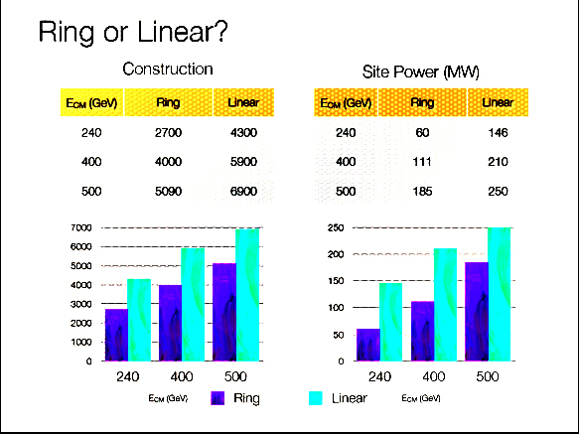
Super-Tristan vs ILC
Linear collider and circular ring have comparable costs and power consumptions
The more conservative ring alternative is preferred.

Slide 21
Comparing LHC and e+-e- colliders
Any deviations from Standard Model behaviour, if they exist, are likely to be small. Precision measurements of scalar state will be critical for establishing and testing the theory.
LHC 300 fb-1
Ring or ILC1 250 GeV
250 fb-1
ILC 500 GeV
500 fb-1
ILCTeV 1.0 TeV
1000 fb-1
Unambiguous discovery requires 5 σ
1 σ uncertainty
arXiv:1207.2516v3 [hep-ph] 1 Apr 2013

Slide 22
The second option: a μ⁺μ⁻ collider ?
The direct Hº cross section is greatly enhanced in a μ⁺μ⁻ collider when compared to an e⁺e⁻ collider, since the s-channel coupling to a scalar is proportional to the lepton mass.
Like in the well known case of the Z⁰ production, the Hº scalar production in the s-state offers conditions of unique cleanliness .
An unique feature of such process — if of an appropriate luminosity — is that its actual mass, its very narrow width and most decay channels may be directly measured with accuracy.
Therefore the properties of the Higgs boson can be detailed over a larger fraction of model parameter space than at any other proposed accelerator method.
A particularly important conclusion is that it will have greater potentials for distinguishing between a standard SM and the SM-like H_{o} of SUSY or of other than any other collider.

Slide 23
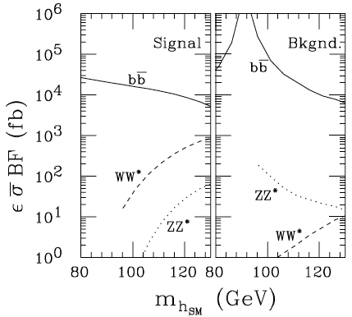
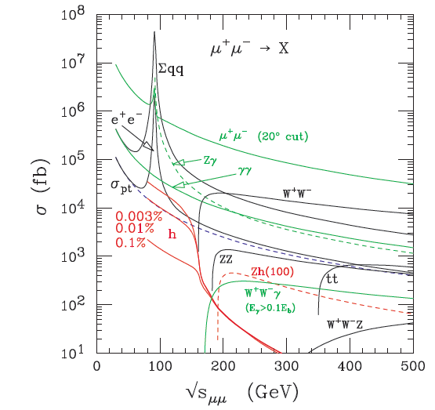
A muon collider after the discovery of the Higgs
A μ± collider with adequate muon cooling and L > 10³² cm⁻² s⁻¹ .
Decay electron backgrounds are important: : 2 x 10¹² μ± decays produce 6.5 x 10⁶ collimated e± decays/meter with E_{ave}≈ 20 GeV.
The very narrow resonant signal (4.12 MeV ,Γ/M_{H} =3.6 x 10⁻⁵ for the SM) will dominate over most non resonant backgrounds.

Slide 24
Leading Higgs processes
Signal and background for H → bb, WW∗ at a energy resolution R = 0.003%. folded with a Gaussian energy spread ∆ = 3.75 MeV and 0.05 fb⁻¹/step and with detection efficiencies included.
Effective pb at the √s resonance for two resolutions R and with the SM branching fractions = H → bb 56% and WW∗= 23%
arXiv:1210.7803 [hep-ph].

Slide 25
Future accelerators for CERN-HL-LHC
A new LHC injector complex to increase the collider luminosity 10x with the High Luminosity LHC (HL-LHC)).
Two accelerators (the LP-SPL and a new 50 GeV synchrotron, PS2) would replace the three existing ones (Linac2, the PSB, and the PS), with the injection of the SPS at 50 GeV,

Slide 26
CERN-SPL parameters
Layout of superconducting SPL with intermediate extractions.
SPL design is very flexible and it can be adapted to the needs of many high-power proton beam applications.
50 Hz
4 MWatt
CERN 14-07

Slide 27
A muon based Higgs factory for CERN
A muon cooled Higgs factory can be easily housed within the present CERN.
The new 5 GeV Linac will provide at 50 c/s a multi MWatt H⁻ beam with enough pions/muons to supply also the factory.
The basic additional accelerator structure will be the following:
Two additional small storage rings with R ≈ 50 m will strip H- to a tight p bunch and compress the LP-SPL beam to a few ns.
Muons of both signs are focused in a axially symmetric B = 20 T field, reducing progressively pt with a horn and B = 2 T
A buncher and a rotator compresses muons to ≈ 250 MeV/c
Muon Cooling in 3D compresses emittances by a factor 10⁶.
Bunches of about 10¹² μ± are accelerated to 62.5 GeV
Muons are colliding in a SC storage ring of R ≈ 60 m where about 10⁴ Higgs events/y are recorded for each experiment.

Slide 28
1.- CERN accumulator and compressor
A tight p bunch may be realized with a pair of rings with R≈50 m (Accumulator and Compressor).
The H⁻ beam produced by the SPS LINAC at 5 GeV is stripped to p produce a number of short pulses , condensed into a few, shorter (2ns) bunches
“A Feasibility study of accumulator and compressor for SPL”.
CERN-AB-2008-060 (2008)

Slide 29

2.-Target and solenoidal capture
Liquid metal target is immersed in high field solenoid (20 T)
  Proton beam is oriented with about 20° with respect to axis
  Particles with p_{t} < 0.25 GeV/c are trapped (about ½ of all)
  Pions decay into muons
  Focussing both signs of particles
The MERIT/CERN experiment has successfully injected a Hg-jet into a 15-T solenoid
Pions/muons drifting as a function of c τ
Z = 1 m
GeV/c ->
c τ
Z = 58 m
GeV/c ->
.
c τ

Slide 30
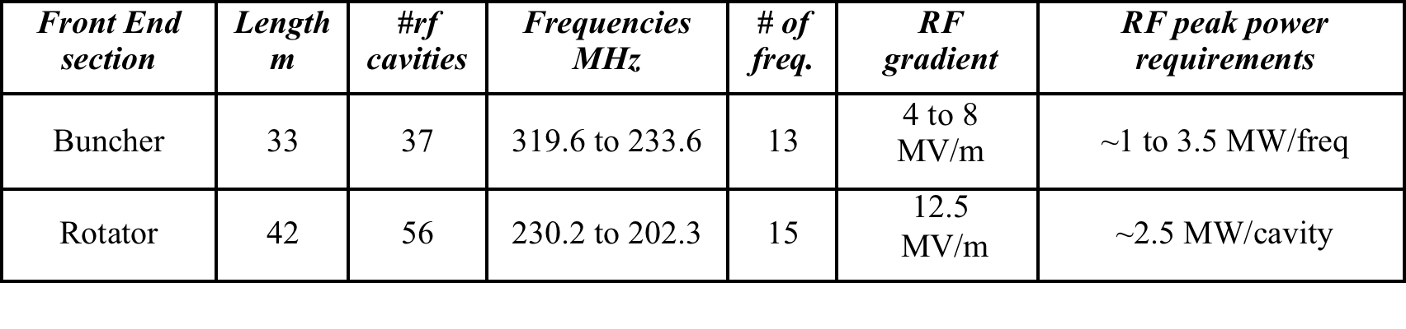
3.- Buncher and rotator
p
εT = 20 mm rad
εL = 30 mm rad
Drift
Buncher
Rotator
π→μ
FE Target
Solenoid
Drift
Buncher
Rotator
Cooler
10 m
~50 m
~30m
36m
~80 m
≈250 MeV/c
4 MW of protons at 5 GeV
50 pulses/s and 1.0 x 10¹⁴ ppp
Muons of both signs are collected
A very efficient capture : 1.2 x 10¹³ muons/pp within the 12 best bunches.
Train of many muon bunches, requires recombination and signs
Solenoidal coils at about 2 T

Slide 31
4.-Ionization cooling of muons
This method, called “dE/dx cooling" closely resembles to the synchrotron compression of relativistic electrons — with the multiple energy losses in a thin, low Z absorber substituting the synchrotron radiated light.
The main feature of this method is that it produces an extremely fast cooling, compared to other traditional methods. This is a necessity for the muon case.
Transverse betatron oscillations are “cooled” by a target “foil” typically a fraction of g/cm² thick. An accelerating cavity is continuously replacing the lost momentum.
Unfortunately for slow muons the specific dE/dx loss is increasing with decreasing momentum. In order to “cool” also longitudinally, chromaticity has to be introduced with a wedge shaped “dE/dx foil”, in order to reverse (increase) the ionisation losses for faster particles.
T. Neuffer Particle Accelerators 1983 Vol. 14 pp. 75-90

Slide 32
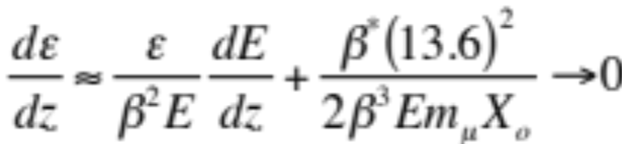
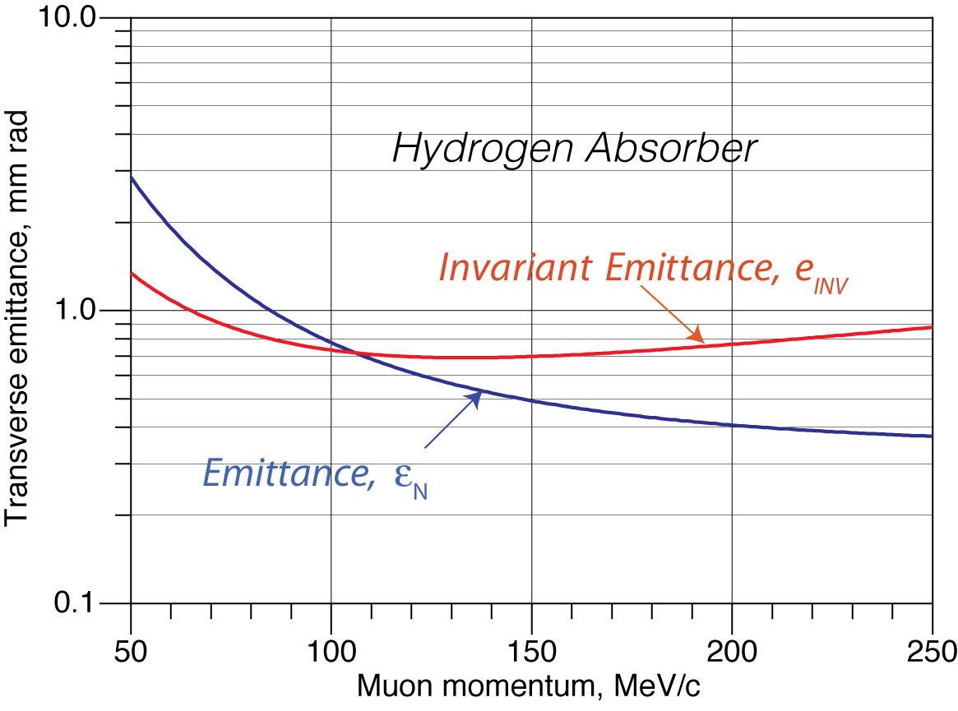
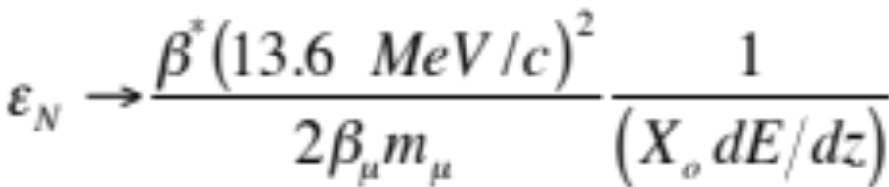
Muon cooling ring: transverse emittance
The emittance ε_{Ν} evolves whereby dE/dx losses are balanced by multiple scattering (Neuffer and McDonald):
Cooling
Scattering
β* = beta at cross
mμ,βμ = mu values
Xo = Rad. Length
dE/dz = ioniz. Loss
The cooling process will continue until an equilibrium transverse emittance has been reached:
The equilibrium emittance εΝ and its invariant εΝ/βγ are shown as a function of the muon momentum.
For H2 and β*= 10 cm, εΝ/βγ ≤ 700 mm mr from 80 to 300 MeV/c
For a 125 GeV collider and β*= 5 cm
bunch equil. transverse size is ≈ 240 µ

Slide 33
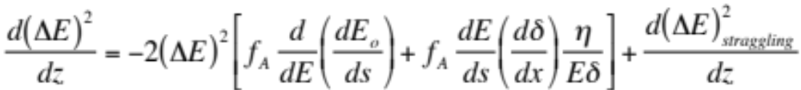



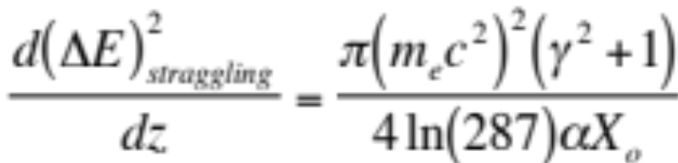
Muon cooling ring: longitudinal emittance
  Longitudinal balance is due to heat producing straggling balancing dE/dx cooling. A dE/dx radial wedge is needed in order to exchange longitudinal and transverse phase-spaces.
  Balancing heating and cooling for a Gaussian distribution limit:
Intrinsic Energy loss
Wedge shaped absorber
Straggling
, where f_{A} is the fraction of the transport length occupied by the absorber, which has an energy absorption coefficient
η is the chromatic dispersion at the absorber and δ and are the thickness and radial tilt of the absorber
the straggling (H2) is given by

Slide 34
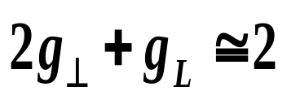
Longitudinal balance (cont.)
The thickness of the absorber must vary with the transverse position, producing the appropriate the energy dependence of energy loss, resulting in a decrease of the energy spread
Energy cooling will also reduce somewhat the transverse cooling, according to the Robinson’s law on sum of damping decrements.
At moderate B, E_{RF}, λ_{RF,} equilibrium 6-D “naïve” cooling is for H₂:
From D. V. Neuffer/NIM A 350 (1994) 27-35

Slide 35
Examples of muon cooling arrangements
Some practical but still conceptual descriptions of muon coolers
The average muon momentum is 220 MeV/c and the approximate diameter ≈ 10 m.
Acceptance increased to ≈ ± 20 % with solenoids

Slide 36
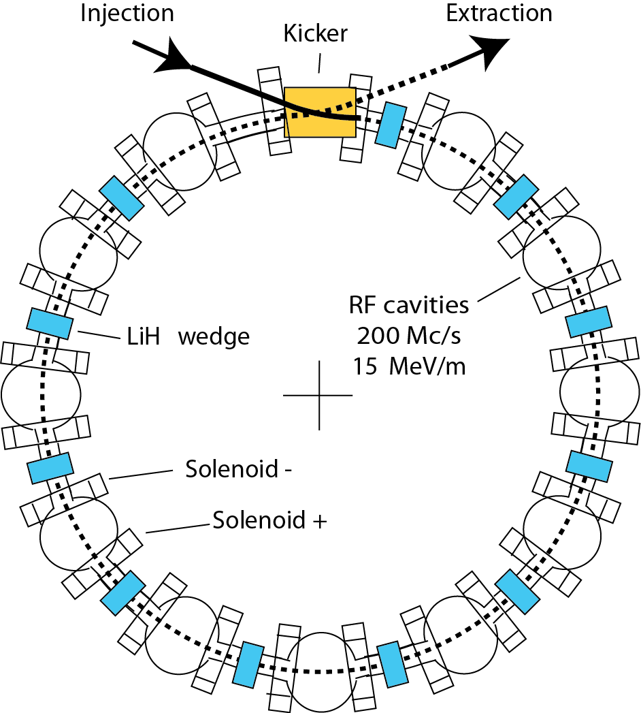
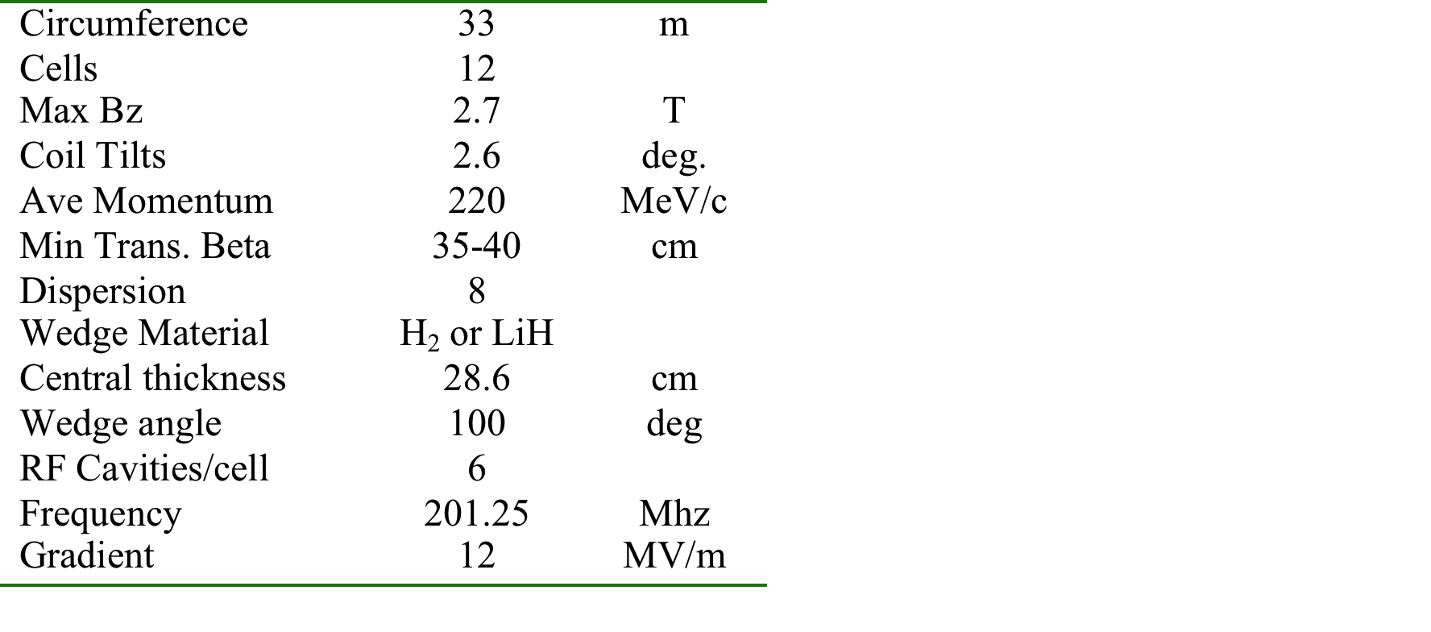
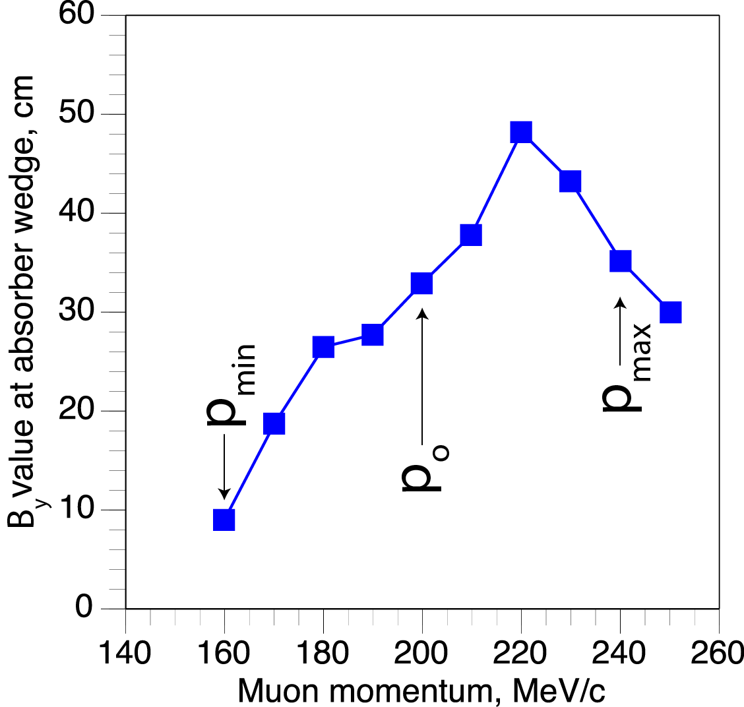
Simulation of the cooling ring (Balbekov, Palmer)
An idealized muon cooling process has been numerically evaluated in 6D by Balbekov and by Palmer et al. in a small ring and for p_{μ} ≈ 200 MeV.
In order to increase the incoming muon acceptance, strong focussing is performed with solenoids in alternate directions, rather than with q-poles (RFOFO).

Slide 37
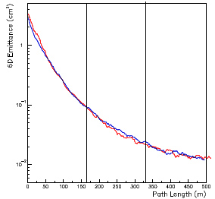
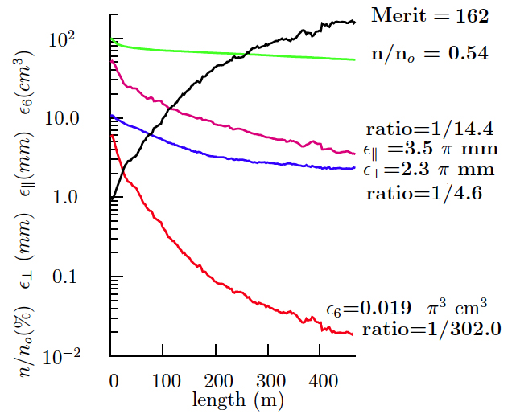
Performance of Palmer et al. design
A first estimate of the expected cooling process is given. This is not an engineering design: for instance injection, extraction, etc. have still to be evaluated.
The so called ”merit factor” in the 6D takes into account the fractional loss of muons in the process and due to decays.
GEANT (red line) and ICOOL (blue)

Slide 38
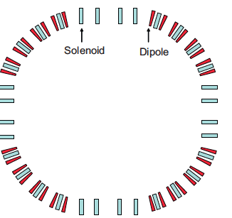
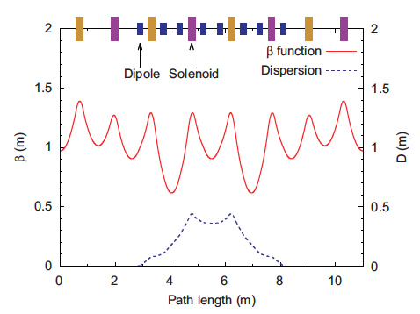
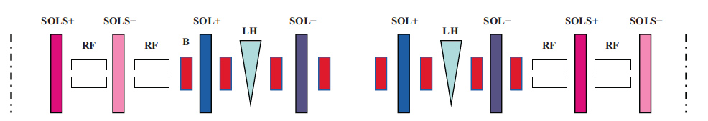
A straightforward design for the achromatic cooling ring
A realistic study is the one of Garren et al. (NIM, 2011).
The four-sided ring has four 90° arcs with 8 dipoles separated by solenoids.
Arcs are achromatic both horizontally and vertically. The dispersion is zero in the straight sections between the arcs.
Injection/extraction kickers are used in a straight section; a superconducting flux pipe is used for the injected beam.

Slide 39
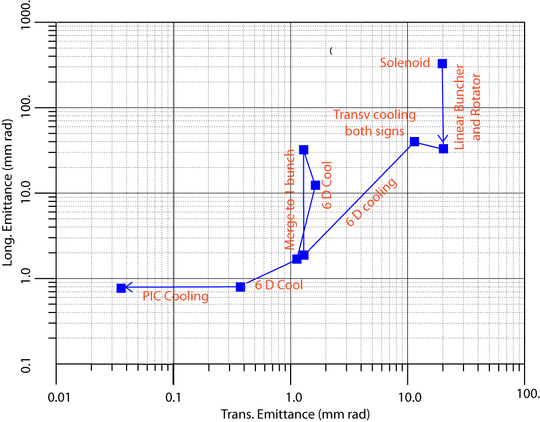
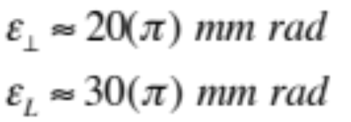
Describing the full cooling procedure
A number of successive steps is required in order to bring the cooling process at very low energies (initially at ≈250 MeV/c and later at≈ 100 MeV/c), after capture and bunching + rotation.
Particle of both signs are transvers. cooled with small Δp increase.
Cooling in 6D with a B field brings the μ+ and μ- to a reasonable size
Merging and further cooling of 1+1 bunches
PIC cooling at ≈100 MeV/c where the normal elliptical motion in x-x' phase space has become hyperbolic.
(

Slide 40
PIC, the Parametric Resonance Cooling of muons
Combining ionization cooling with parametric resonances is expected to lead to muon with much smaller transv. sizes.
A linear magnetic transport channel has been designed by Ya.S. Derbenev et al where a half integer resonance is induced such that the normal elliptical motion of particles in x-x' phase space becomes hyperbolic, with particles moving to smaller x and larger x' at the channel focal points.
Thin absorbers placed at the focal points of the channel then cool the angular divergence by the usual ionization cooling.
LEFT ordinary oscillations
RIGHT hyperbolic motion
induced by perturbations near an (one half integer) resonance of the betatron frequency.
x x’ = const
V. S. Morozov et al, AIP 1507, 843 (2012);

Slide 41
Details of PIC
Without damping, the beam dynamics is not stable because the beam envelope grows with every period. Energy absorbers at the focal points stabilizes the beam through the ionization cooling.
The longitudinal emittance is maintained constant tapering the absorbers and placing them at points of appropriate dispersion, vertical β and two horizontal β.
. Comparison of cooling factors (ratio of initial to final 6D emittance) with and without the PIC condition vs number of cells:

Slide 42
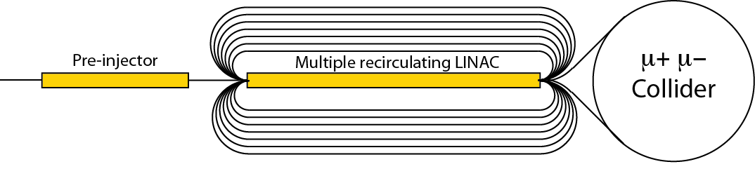
5.- Bunch acceleration to 62.5 GeV
  In order to realize a Higgs Factory at the known energy of 126 GeV, an acceleration system is progressively rising the energy of captured muons to m_{Ho}/2, with the help of a series of several re-circulating RLAs.
  Adiabatic longitudinal Liouvillian damping from p_{i} = 0.22 GeV/c to p_{f}= 62.5 GeV/c.
  Recirculating energy gain/pass = 62.5/8 = 7.75 GeV
μ+
p = 220 MeV/c
μ−
P = 62.5 GeV/c

Slide 43
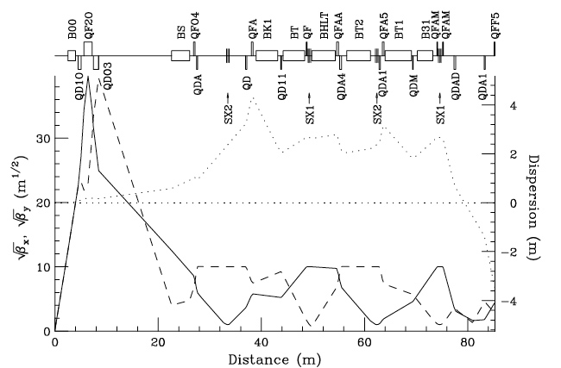
6.-Muons collide in a storage ring of R ≈ 60 m
Lattice structure at the crossing point, including local chromaticity corrections with β_{x} = β_{y} = β* = 5 cm.
Ankenbrandt et al. (1999)

Slide 44
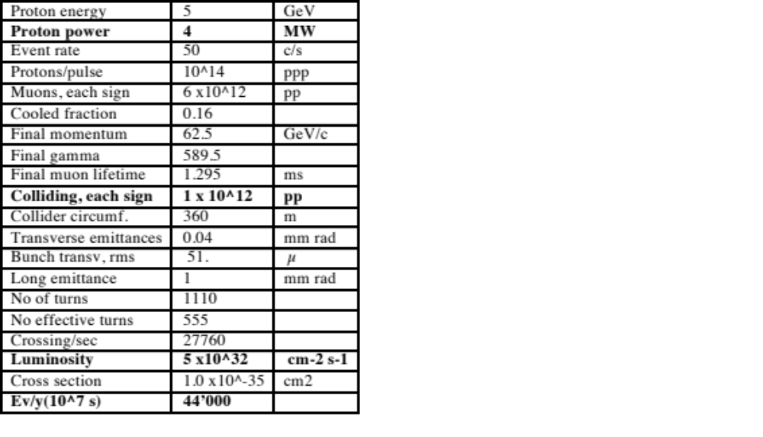
Eatimated performance of the Hº-factory
Two asymptotically cooled μ bunches of opposite signs collide in two low-beta interaction points with β*= 5 cm and a free length of about 10 m, where the two detectors are located.
The bunch transverse rms size is 0.05 mm and the μ−μ tune shift is 0.086.
A luminosity of 5 x 10³² cm⁻² s⁻¹ is achieved with 1 x10¹² μ/bunch.
The SM Higgs rate is ≈ 44’000 ev/year in each detector.

Slide 45
Finding the location of the Higgs
Presently the Higgs mass is known to some 600 MeV. It will be known to ≈ 100 MeV from the LHC with 300 fb-1 . But at a muon collider we need to find M_{H} to ~4 MeV and then select the resonance location.
Finding the Higgs requires a few months running at 1.7 x 10³¹ luminosity.

Slide 46
Preparatory work on the Zº and search for rare decays
Running of the Zo peak is an excellent tuning up of the μμ collider.
  Measurements of the luminosity, suppression of backgrounds, spin precession at manageable parameters
  The cross section is very large, σ = ~30000 pb. Therfore one expects 30’000 Z/day with L = 10³¹ cm-2 s-1.
Useful Physics at Z ?
  E, ΔE to ~0.1 MeV or less
  μ⁺μ⁻ → Z₀
Then move to 126 GeV and study the Higgs

Slide 47
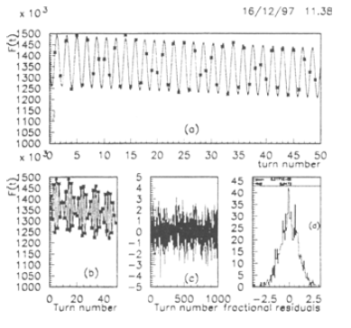



Polarization & Energy measurement
The effects of polarization are visible in the single electron decay angular distributions.
Measure ω from fluctuations in electron decay energies
    The e-rate is of 10⁶ decays/m
    Since frequencies can be very precisely measured, energy E, and δE can be measured to a few hundred keV or even better
Raja and Tollestrup (1998) Phys. Rev. D 58 013005

Slide 48
The muon Higgs collider:
Advantages
  Large cross section σ (μ⁺μ⁻ → h) = 41 pb in s-channel resonance, compared to e⁺e⁻ → ZH and 0.2 pb.
  Small size footprint: it may fit in the CERN site
  Cost so far unknown but far smaller than the ILC.
  No synchrotron radiation and beamstrahlung problems
  Precise measurements of line shape and total decay width Γ
  Exquisite measurements of all channels and tests of SM.
  A low cost demonstration of muon cooling can be done first.
Challenges
  Muon 4D and 6D cooling needs to be demonstrated
  Need ulimately very small c.o.m energy spread (0.003%)
  Backgrounds from constant muon decay
  Significant R&D required towards end-to-end design

Slide 49
The next step: the realization of the Initial Cooling Experiment
Physics requirements and the studies already undertaken with muon cooling suggest that the next step, prior to but adequate for a specific physics programme could be the practical realization of a full scale cooling demonstrator.
Indicatively this corresponds to the realization of a cascade of unconventional but very small rings of few meters radius, in order to achieve the theoretically expected longitudinal and transverse emittances of asymptotically cooled muons.
The injection of muons from pion decays could be extracted from some existing accelerator at low intensity.
The goal is of experimentally demonstrate the full 6D cooling
The other facilities, namely (1) the pion/muon production, (2) the final, high intensity cooling system (3) the subsequent muon acceleration and (4) the accumulation in a storage ring could be constructed later and only after the success of the initial cooling experiment has been confirmed.

Slide 50
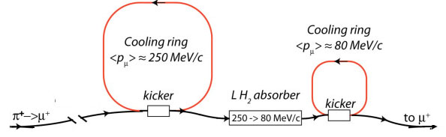
The initial cooling experiment
A single sign muon cooling arrangement with two rings , either μ+ or μ- is required and with few particles
A low intensity pion-> muon beam is produced from an appropriate accelerator in the form of a very short pulse
PIC resonant Cooling ring
at <p> ≈100 MeV/c
Decay channel
Low β channel
To 6D analysis of decay muons

Slide 51
The proposed initial cooling experiment
A first “wide band” cooling ring must collect the widest muon spectrum peaked around 250 MeV/c and to introduce a first major reduction in the transverse and longitudinal emittances, namely:
  solenoids instead of quadrupoles have a wider acceptance
  with a few turns, only integer resonances are harmful
  As a first cooler, the ionization absorber does not have to be made with LH₂: other solid materials (LiH) may be used.
An intermediate LH₂ absorber ≈3 m long inside a low β∗ channel reduces the vector muon momenta by range.
The resulting beam must then be extracted and its momentum substantially reduced to about 100 MeV/c.
A second “deep freezer” cooling PIC ring must ensure an required asymptotic beam emittances

Slide 52
Conclusions
The recent discovery of the Higgs particle of 125 GeV at CERN has highlighted the unique features of the direct production of a Hº scalar in the s-state, in analogy with the two steps of the Z with the PbarP and LEP programmes and where the mass, total and partial widths of the Hº can be directly measured with a remarkable accuracy and a very large number of events.
A high energy μ⁺μ⁻-collider is the only possible circular high energy lepton Higgs collider that can be easily situated within the existing CERN (or FNAL) sites.
A first step to could be the practical and experimental realization of a full scale cooling demonstrator, a relatively modest and low cost system but capable to conclusively demonstrate “ionization cooling” at the level required for a Higgs factory and eventually as premise for a subsequent multi-TeV collider and/or a long distance ν factory.

Slide 53
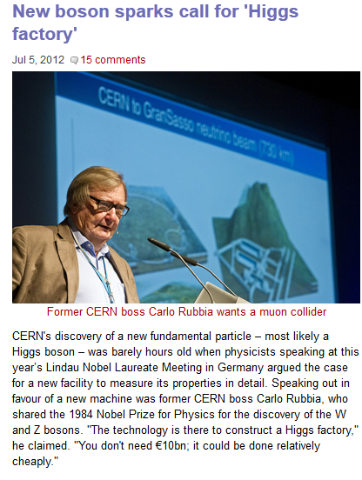

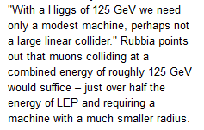
Professional endorsement

