Slide 1





MYRTE
le projet H2020 en soutien à MYRRHA
Jean-Luc BIARROTTE
CNRS-IN2P3 / IPN Orsay, France

Slide 2
The P&T strategy
The MYRRHA project
The MYRRHA linac concept
Main R&D achievements (MAX project)
On-going activities (MYRTE project)

Slide 3
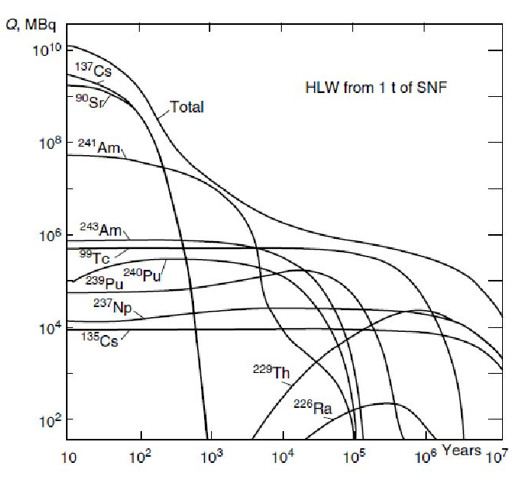

Nuclear wastes
About 2500 tons of Spent Nuclear Fuel are produced every year by the 145 reactors of EU
High Level Wastes represent 0.2% in volume & 95% in radiotoxicity and are long-term dominated by Minor Actinides (MA, especially ²⁴¹Am)
Reference solution for HLW management = long-term geological disposals
Initial Uranium ore
The Yucca Mountain Nuclear Waste Repository (USA)
project de-funded in 2011
Activity of High Level Waste remaining after processing of 1 ton of Spent Nuclear Fuel in dependence of time

Slide 4
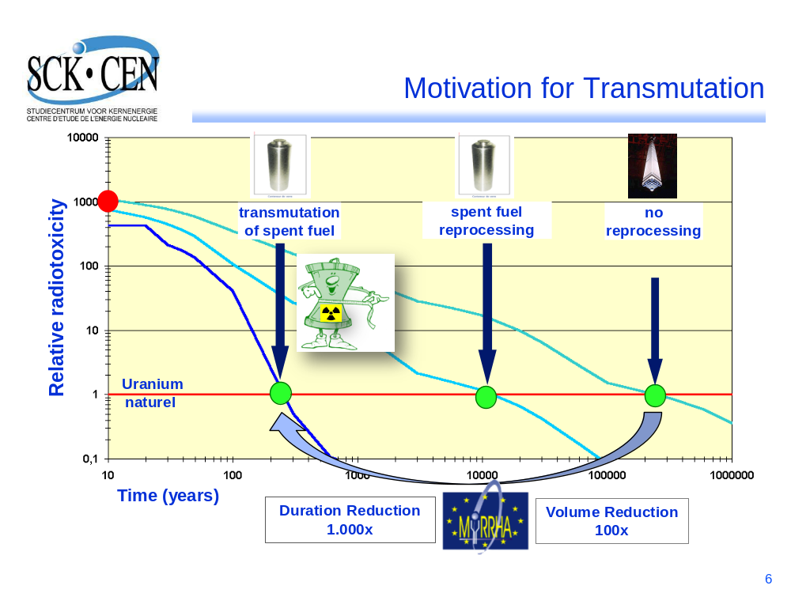
Motivation for Partitioning & Transmutation
Partitioning & Transmutation (P&T) strategy: reduce radiotoxicity, volume and heat loads of long-lived nuclear wastes (MA) before geological storage
H. Aït Abderrahim (SCK•CEN)

Slide 5
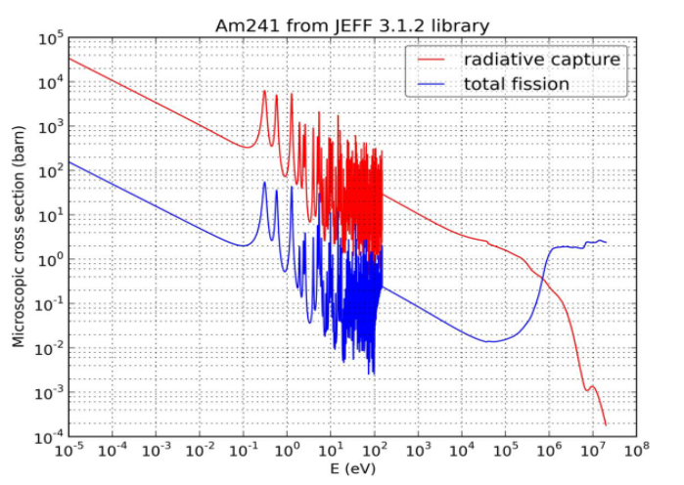
Present options for MA transmutation
Transmutation of MA into fission products is efficient only if:
  Fission to capture cross section ratio is high enough
  Enough neutrons are available to feed the transmutation process
  => Need for a fast neutron spectrum
In which type of fast reactor could we transmute ?
  In the next generation GEN-IV nuclear power plants (critical Fast Reactors)
    homogeneous mode with low AM content in fuel (< 3%) for safety reasons
    heterogeneous mode (MA blankets)
  In a few dedicated MA burners (subcritical Accelerator Driven Systems), highly loaded with MA
  => sensitive compromise btwn safety / economics / proliferation / politics...

Slide 6
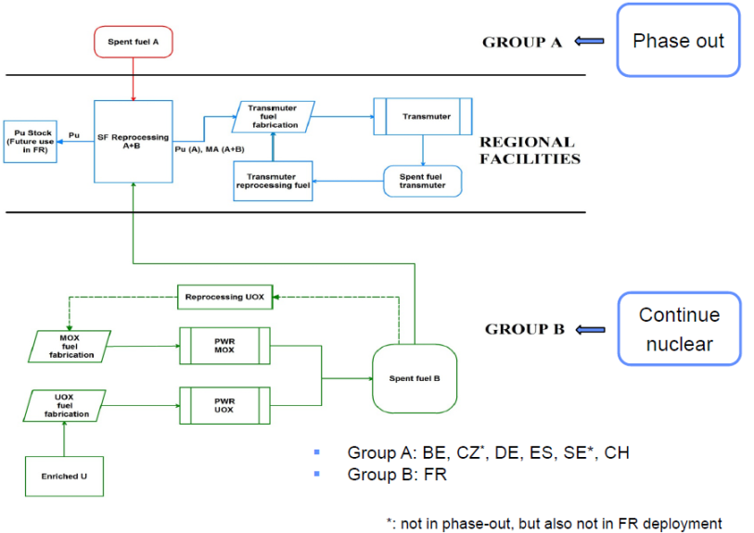

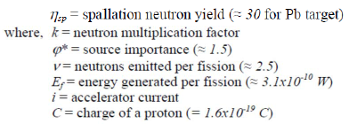
ADS (Accelerator Driven System)
ADS sub-critical systems = present reference solution for dedicated “transmuter” facilities
Suited for various strategies on nuclear energy
One “small” 400 MWth industrial ADS could burn about 100kg of MA / year (→ 10 to 20 units for EU)
G. Van den Eynde (SCK•CEN)
ADS reactor specificities
Neutron multiplication factor keff<1 (typically between 0.93 & 0.97)
Driven by external neutron source
(proton beam + spallation target)
No control rods, no safety rods
Some very fast neutrons (> 20 MeV) in the core

Slide 7
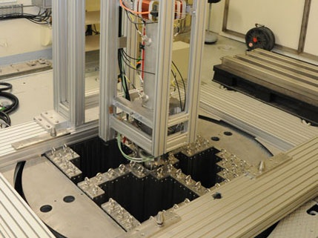
On the path of ADS demonstration
Design & low-power experiments
Several ADS design activities since the 90’s (US, Europe, Japan, China, India…)
Several low-power coupling experiments:
  FEAT, MUSE, GUINEVERE in Europe
  KART in Japan, etc.
High-power ADS demonstration is on-going…
C-ADS project in China
  10 MW_{th} ADS by 2022+ (stage 1)
  500 MW_{th} ADS by 2030+ (stage 2)
The Guinevere experiment in SCK*CEN (Belgium), operated since 2011
MYRRHA project in EU/Belgium
  100 MW_{th} ADS by 2025+

Slide 8
The P&T strategy
The MYRRHA project
The MYRRHA linac concept
Main R&D achievements (MAX project)
On-going activities (MYRTE project)

Slide 9
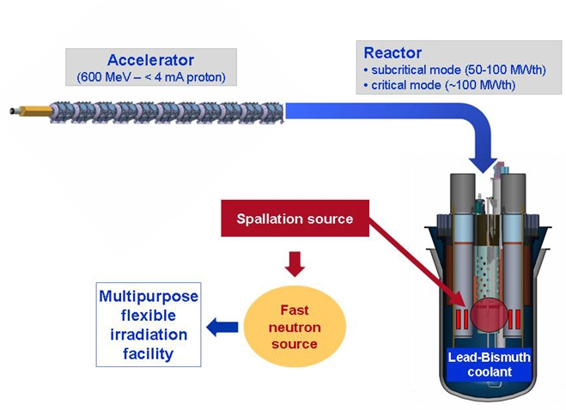
MYRRHA as an ADS demonstrator
Demonstrate the physics and technology of an Accelerator Driven System (ADS) for transmuting long-lived radioactive waste
Demonstrate the ADS concept
(coupling accelerator + spallation source + power reactor)
Demonstrate the transmutation
(experimental assemblies)
Main features of the ADS demo
50-100 MWth power
Highly-enriched MOX fuel
Pb-Bi Eutectic coolant & target
k_{eff} around 0.95 in subcritical mode
600 MeV, 2.5 - 4 mA proton beam

Slide 10
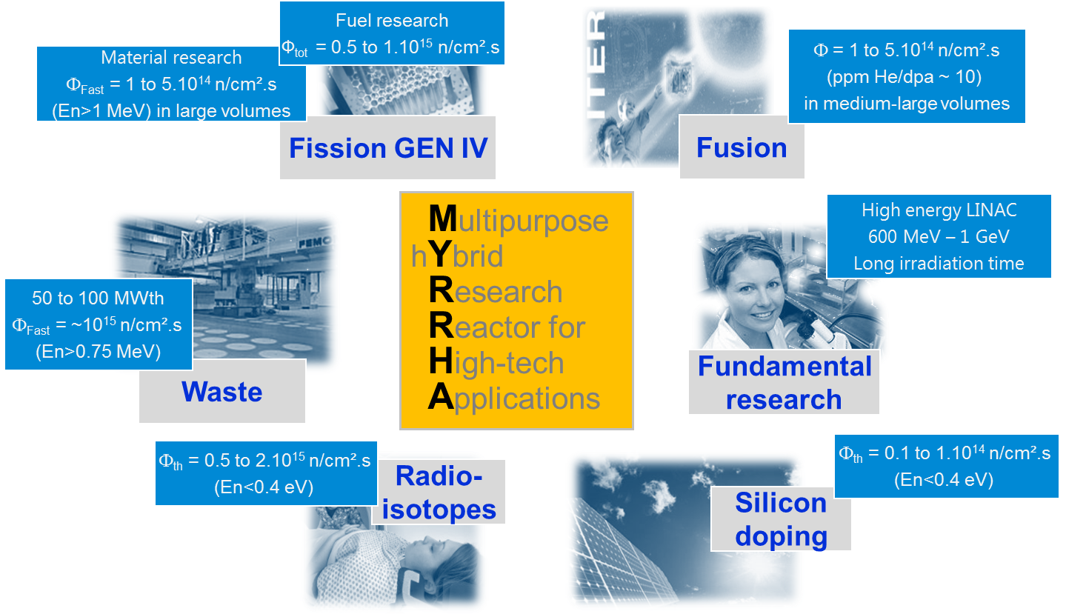

The MYRRHA project

Slide 11
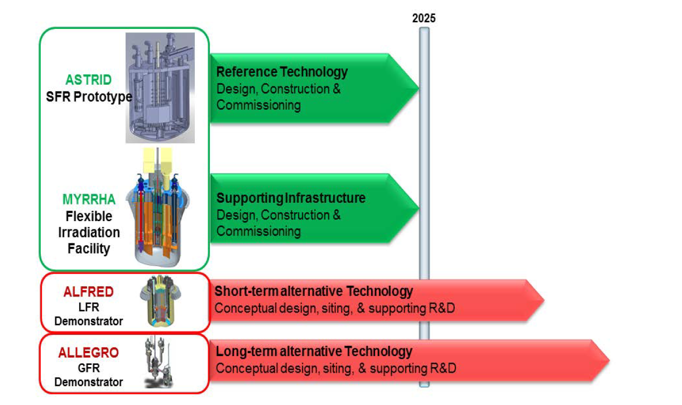

MYRRHA as a flexible irradiation facility
Serve as:
A supporting infrastructure for Gen. IV liquid-metal based reactor concepts
A European fast spectrum irradiation facility

Slide 12
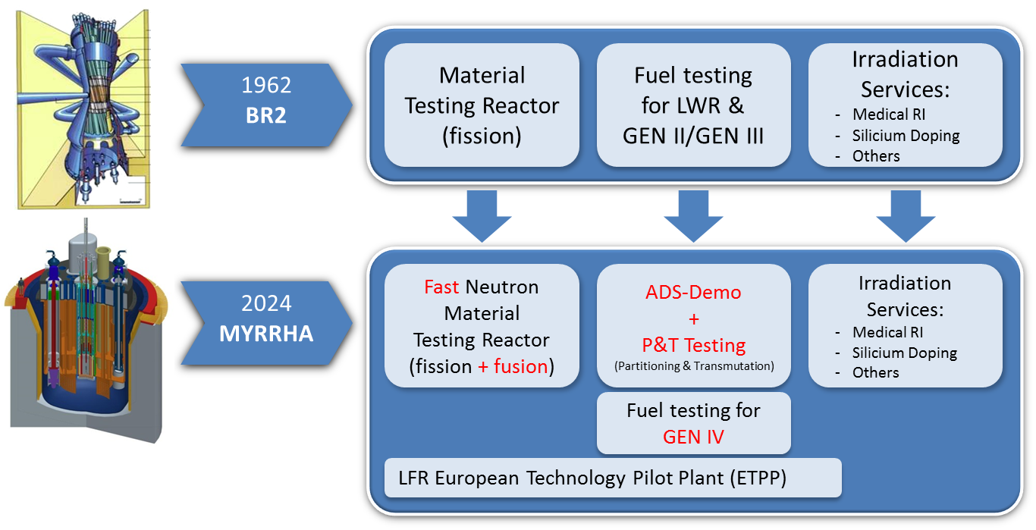
MYRRHA as a replacement for BR2
MYRRHA: a multipurpose irradiation facility at

Slide 13
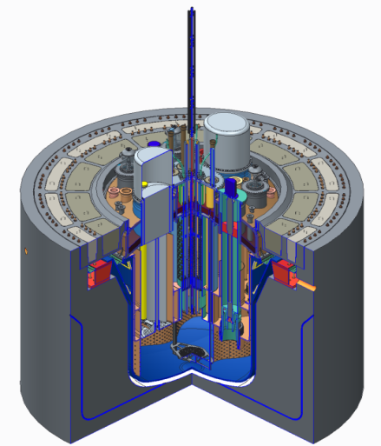
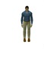

MYRRHA reactor layout (V1.6)
Beam tube
Heat exchangers (×4)
Reactor cover
Primary pumps (×2)
Fuel manipulators (×2)
Core
You :)
Diaphragm
Main vessel

Slide 14
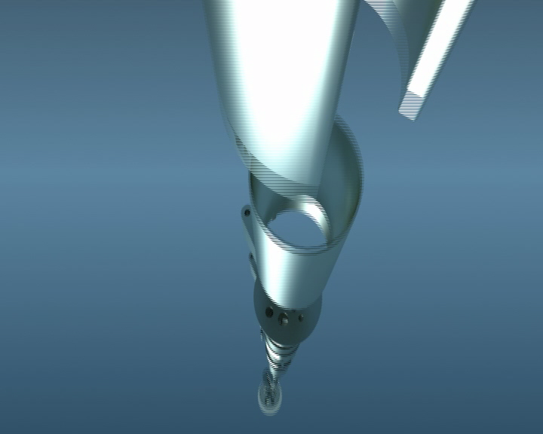
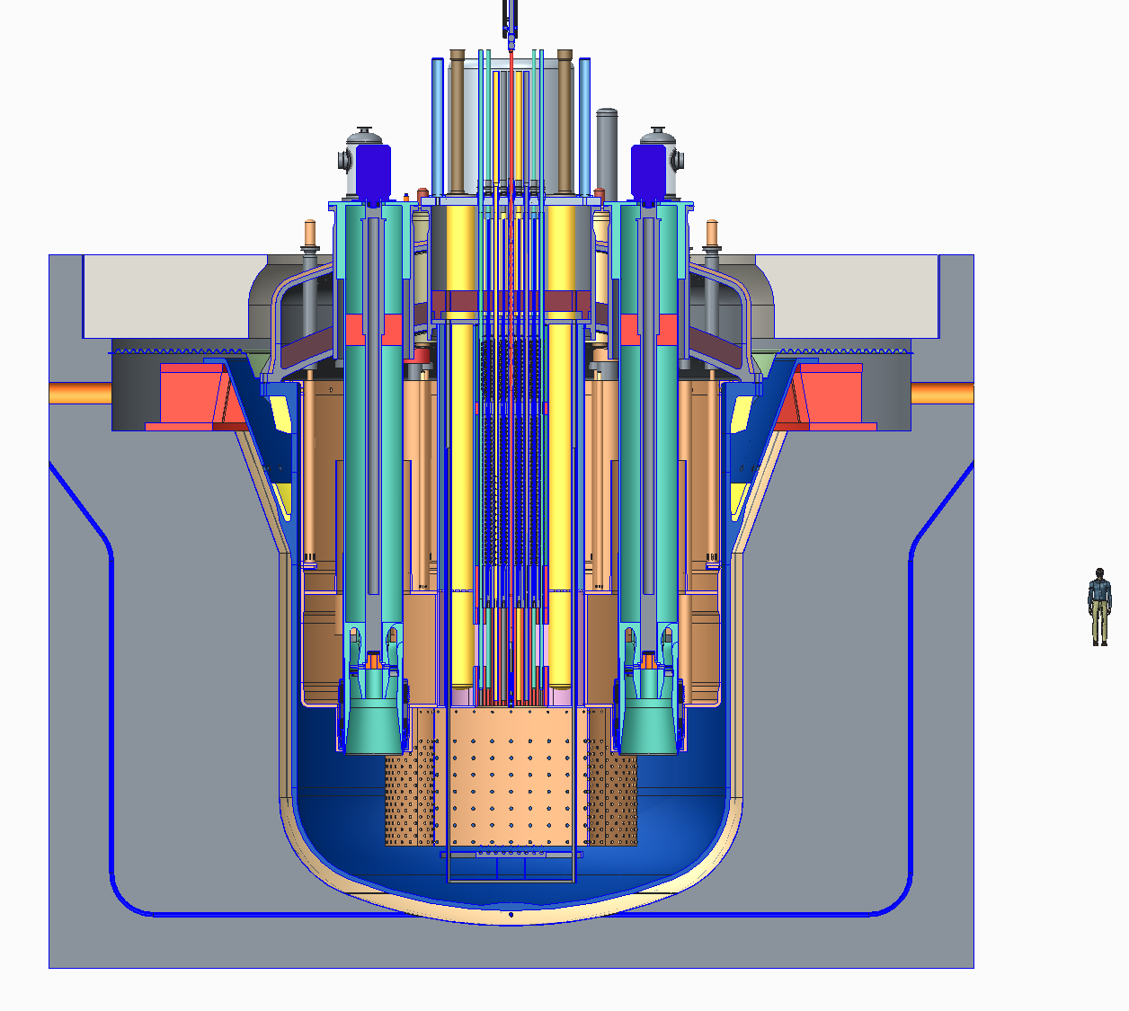
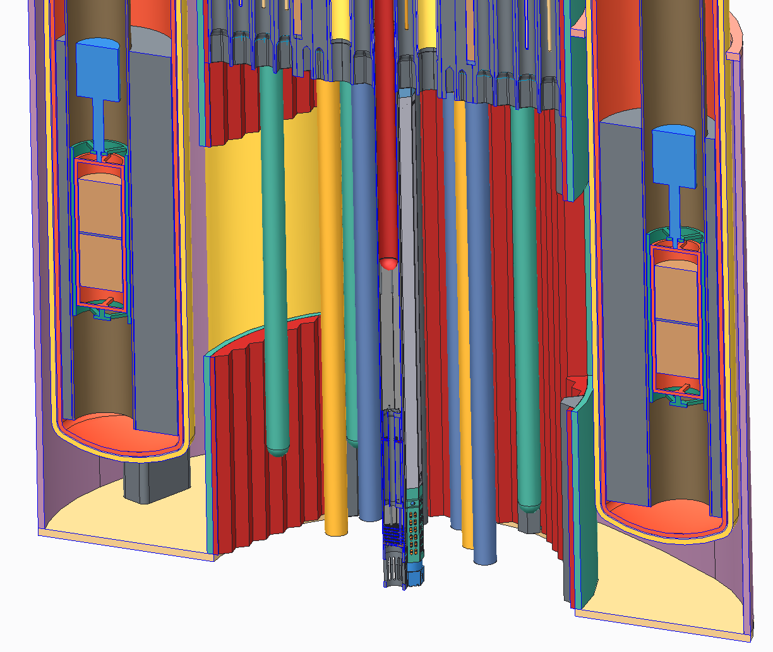
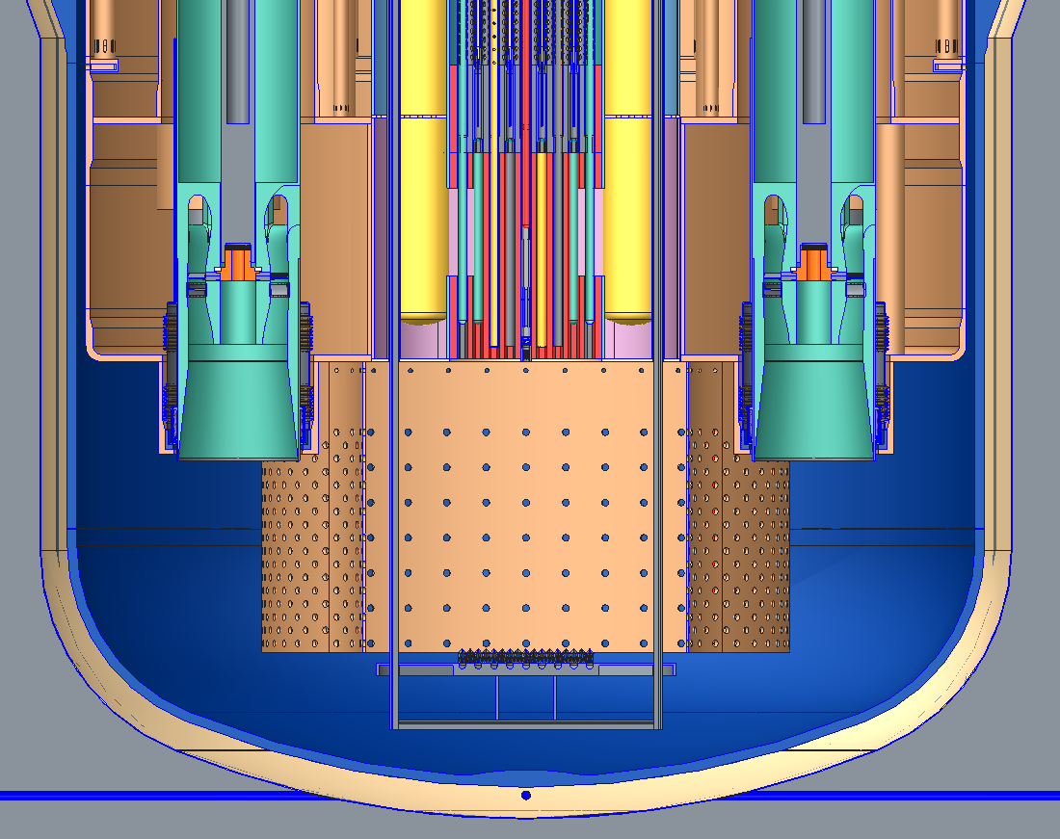
MYRRHA reactor layout (V1.6)

Slide 15
MYRRHA key dates
1998: first studies
2002: pre-design “Myrrha Draft 1” (cyclotron 350 MeV)
2002-2004: studied as one of the 3 reactor designs within the PDS-XADS FP5 project (cyclotron turns into linac, fault-tolerance concept is introduced)
2005: updated design “Myrrha Draft 2” (350 MeV linac)
2005-2010: studied as the XT-ADS demo within the IP-EUROTRANS FP6 project
(600 MeV linac conceptual design, R&D activities w/ focus on reliability)
2010: MYRRHA is on the ESFRI list, and is officially supported by the Belgium government at a 40% level
2010-2015: engineering design, licensing process, assessments on a possible international consortium, w/ support from the CDT, FREYA & MAX FP7 projects
Present situation:
  Engineering design is going on, w/ support from the MYRTE H2020 project
  Phased approach strategy is considered (w/ 100 MeV linac as a 1st step!)

Slide 16
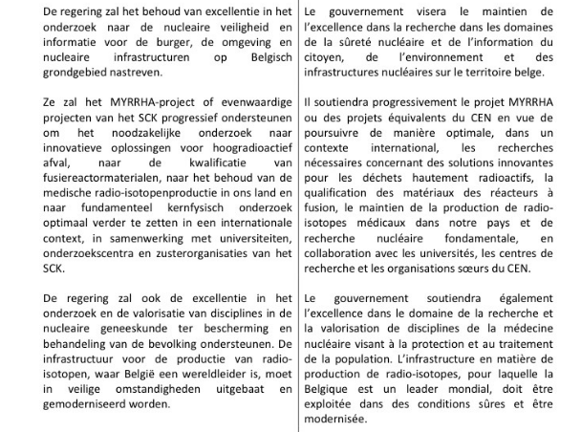
MYRRHA in the 2014 BE Government Declaration
The Belgian Government will support in a progressive way the MYRRHA project or any equivalent project at SCK•CEN aiming to continue the needed research for innovative solutions for High level waste, qualification of materials for fusion, the production of radioisotopes for medical applications in our country and fundamental nuclear research in collaboration with the universities and sister organisation of SCK•CEN

Slide 17
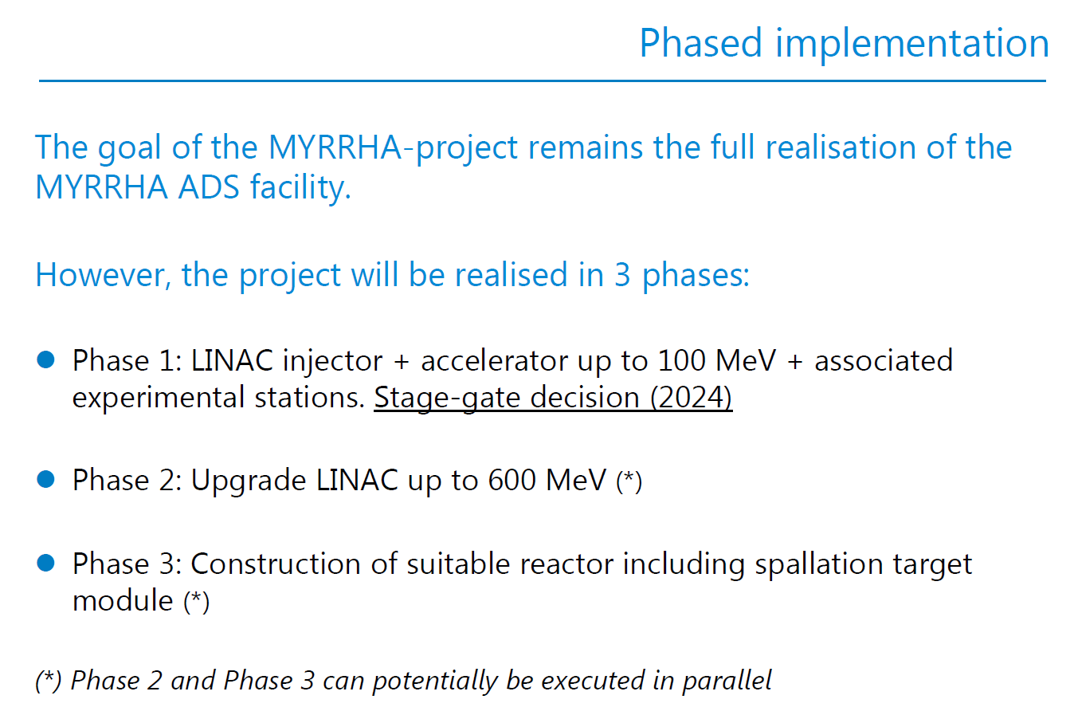
“MYRRHA phased approach” (decision 09/12/15, SCK*CEN)

Slide 18
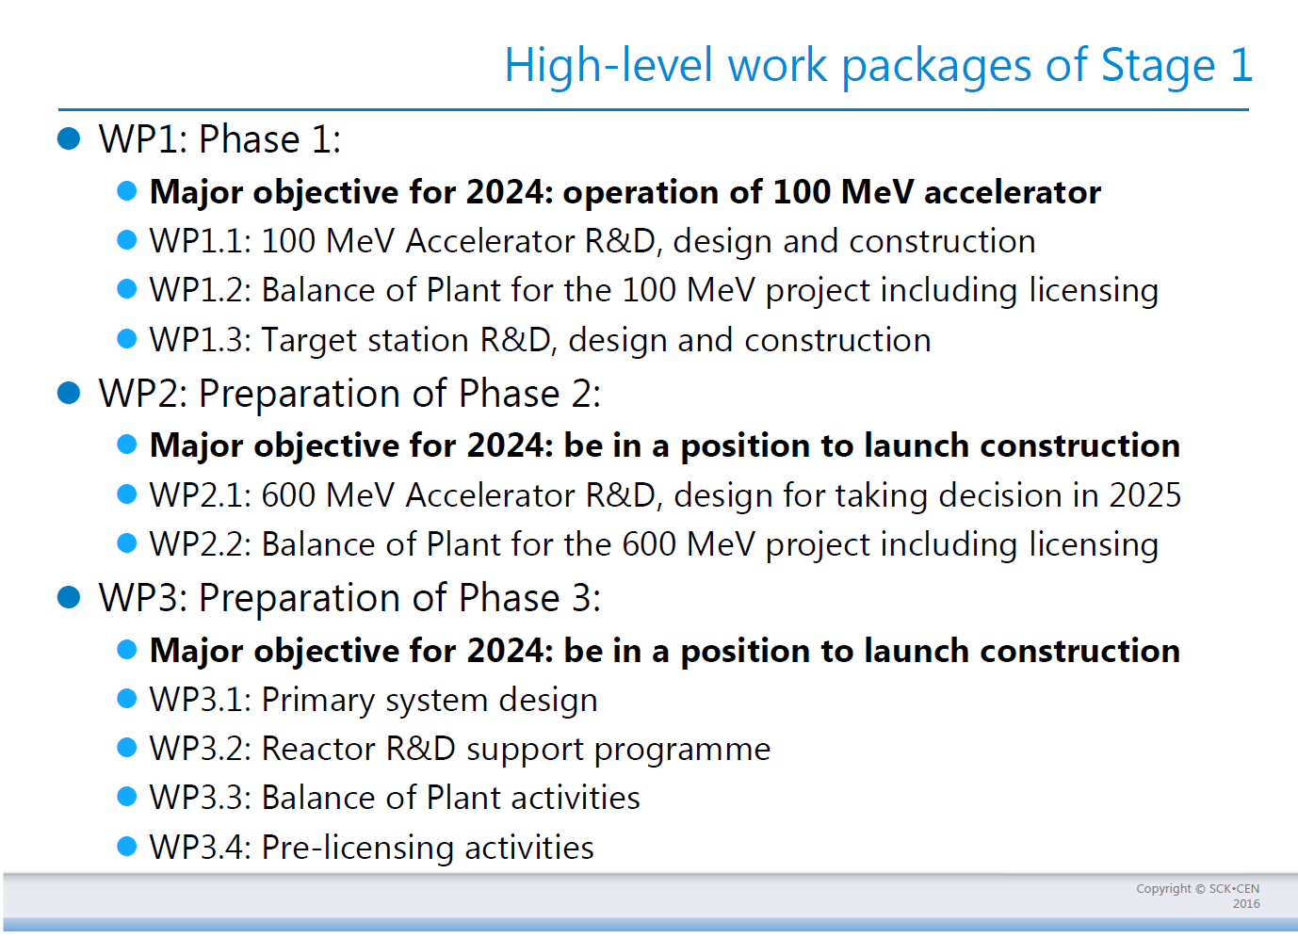
“MYRRHA phased approach” (decision 09/12/15, SCK*CEN)

Slide 19
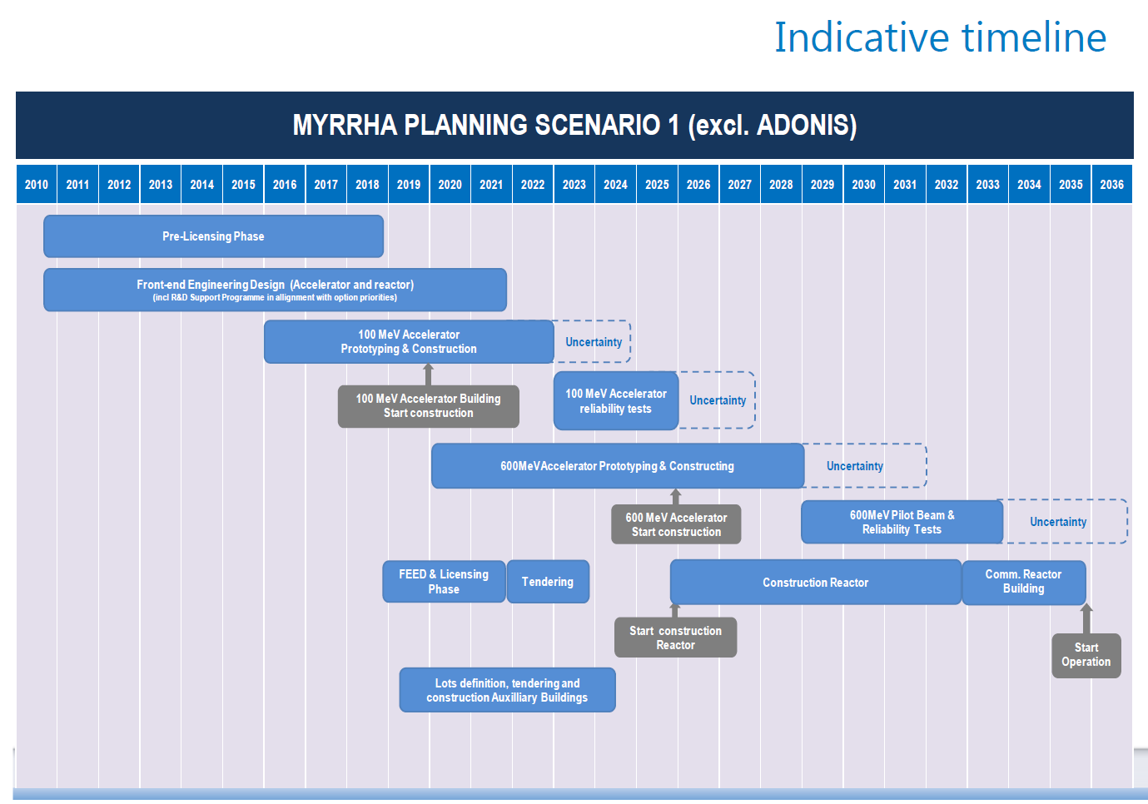
Very indicative roadmap

Slide 20
The P&T strategy
The MYRRHA project
The MYRRHA linac concept
Main R&D achievements (MAX project)
On-going activities (MYRTE project)

Slide 21
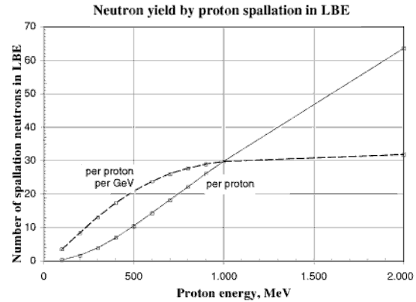
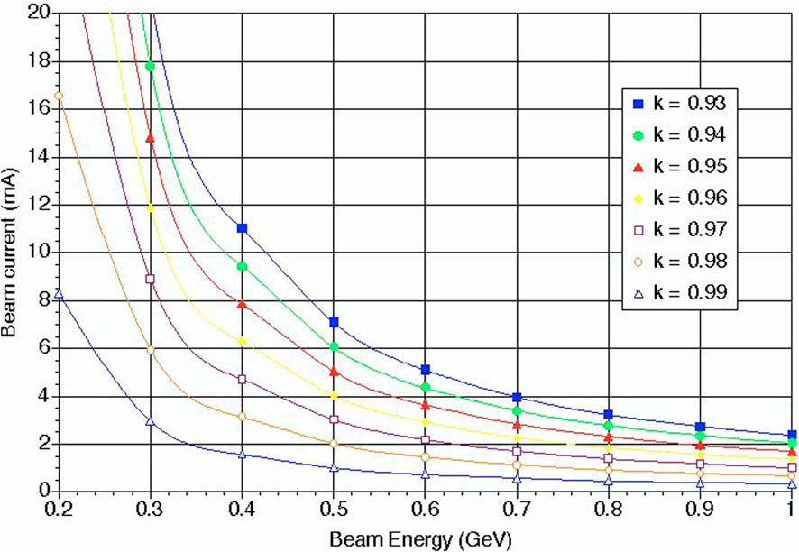
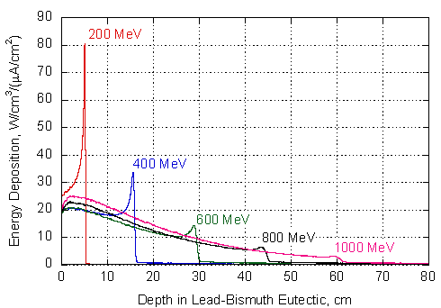
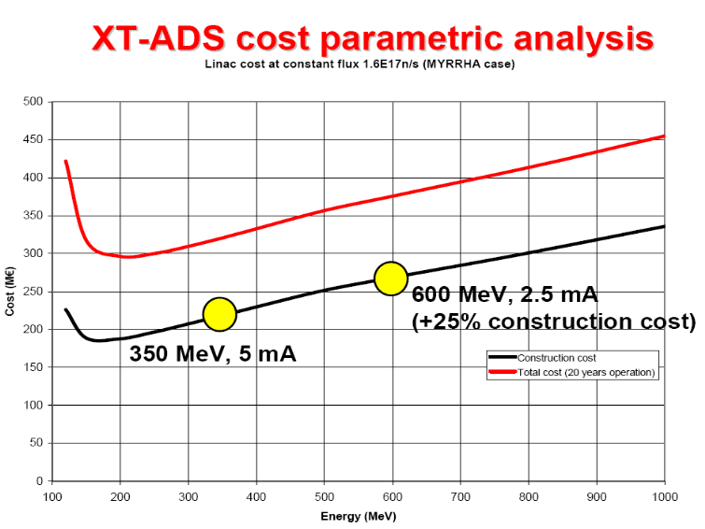
ADS proton beam requirements
Current / Energy / Sub-Criticity
for a 80 MW_{therm} ADS demo
(simulation by ANSALDO)
❶
❷
3
10
Power density deposited in LBE
Accelerator cost
❸
❹

Slide 22
MYRRHA proton beam requirements
High power proton beam (up to 2.4 MW)
Proton energy | 600 MeV
Peak beam current | 0.1 to 4.0 mA
Repetition rate | 1 to 250 Hz
Beam duty cycle | 10⁻⁴ to 1
Beam power stability | < ± 2% on a time scale of 100ms
Beam footprint on reactor window | Circular ∅85mm
Beam footprint stability | < ± 10% on a time scale of 1s
# of allowed beam trips on reactor longer than 3 sec | 10 maximum per 3-month operation period
# of allowed beam trips on reactor longer than 0.1 sec | 100 maximum per day
# of allowed beam trips on reactor shorter than 0.1 sec | unlimited

Slide 23
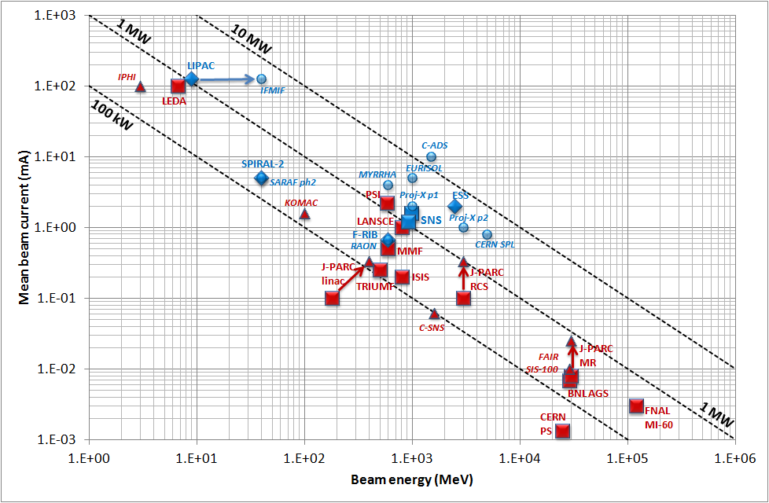
Panorama of high-power hadron accelerators
Existing NC machines
Under construction NC machines
Existing SC machines
Under construction SC machines
Planned SC machines
Only 2 accelerators are presently above the MW level: PSI & SNS
J-L. Biarrotte, Proc. SRF 2013

Slide 24
MYRRHA proton beam requirements
High power proton beam (up to 2.4 MW)
Proton energy | 600 MeV
Peak beam current | 0.1 to 4.0 mA
Repetition rate | 1 to 250 Hz
Beam duty cycle | 10⁻⁴ to 1
Beam power stability | < ± 2% on a time scale of 100ms
Beam footprint on reactor window | Circular ∅85mm
Beam footprint stability | < ± 10% on a time scale of 1s
# of allowed beam trips on reactor longer than 3 sec | 10 maximum per 3-month operation period
# of allowed beam trips on reactor longer than 0.1 sec | 100 maximum per day
# of allowed beam trips on reactor shorter than 0.1 sec | unlimited
Extreme reliability level

Slide 25
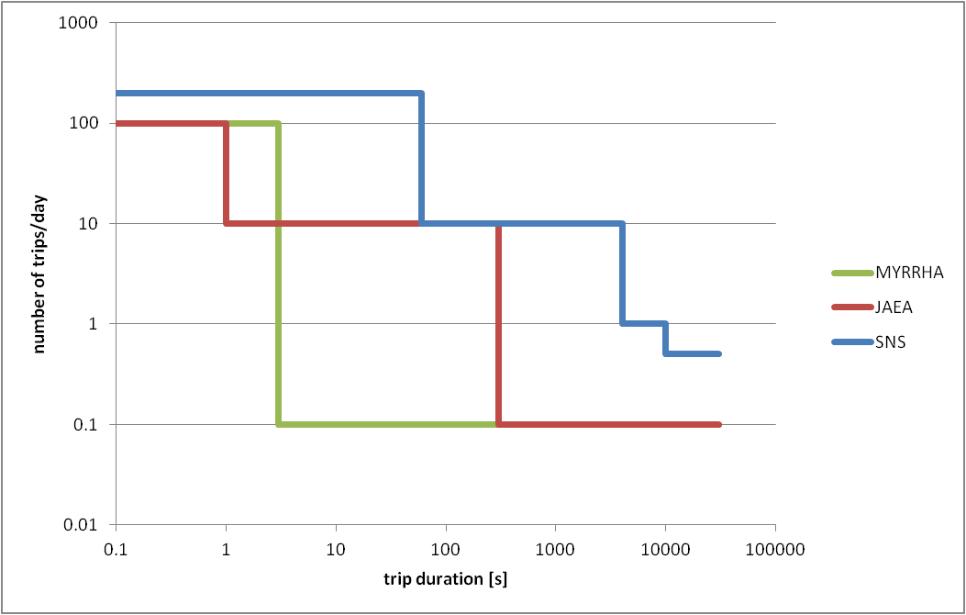
The ADS reliability requirement
Beam trips longer than 3 sec must be very rare:
To limit thermal stress & fatigue on the target window, reactor structures & fuel assemblies
To ensure a 80% availability – given the foreseen reactor start-up procedures
Present MYRRHA spécifications: <10 beam trips per 3-month operation period (i.e. MTBF > 250h) – derived from the PHENIX reactor operation analysis
Far above present HPPA accelerator performance – MTBF is a few hours at PSI or SNS
Far above present ADS specifications in US or Japan – based on simulations
D. Vandeplassche, Proc. IPAC 2012

Slide 26
The ADS reliability requirement
Beam trips longer than 3 sec must be very rare:
To limit thermal stress & fatigue on the target window, reactor structures & fuel assemblies
To ensure a 80% availability – given the foreseen reactor start-up procedures
Present MYRRHA spécifications: <10 beam trips per 3-month operation period (i.e. MTBF > 250h) – derived from the PHENIX reactor operation analysis
Far above present HPPA accelerator performance – MTBF is a few hours at PSI or SNS
Far above present ADS specifications in US or Japan – based on simulations
In any case, reliability guidelines are needed for the ADS accelerator design:
Strong design i.e. robust optics, simplicity, low thermal stress, operation margins…
Redundancy (serial where possible, or parallel) to be able to tolerate failures
Repairability (on-line where possible) and efficient maintenance schemes

Slide 27
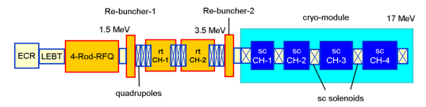
Strategy for a fault in the injector = parallel redundancy
❶ Initial configuration
❸ The failure is localized in injector
Operational injector 1: RF + PS + beam ON
The switching magnet polarity is changed (~1s)
+
-
Warm stand-by injector 2: RF+ PS ON, beam OFF (on FC)
Need for an efficient fault diagnostic system !
❷ A failure is detected anywhere
❹ Beam is resumed
Beam is stopped in injector 1 by the Machine Protection System @t₀
Failed injector 1, to be repaired on-line if possible
+
-
Injector 2 operational (@t₁ < t₀ +3sec)

Slide 28
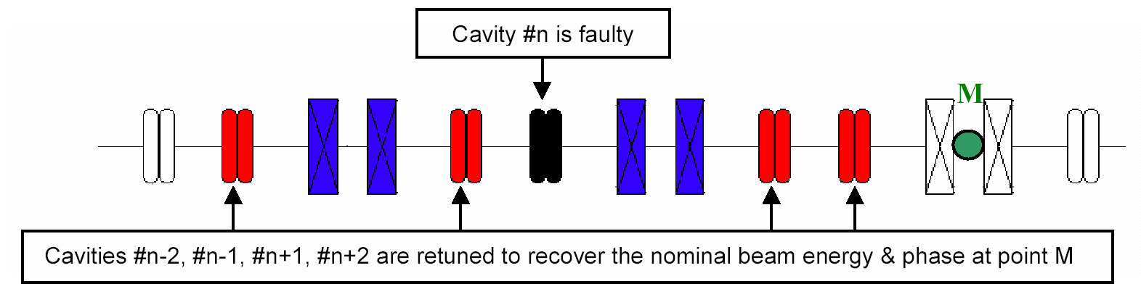
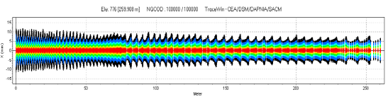
Strategy for a fault in the main linac = serial redundancy
❶ A failure is detected anywhere
→ Beam is stopped by the MPS in injector at t₀
❷ The fault is localized in a SC cavity RF loop
→ Need for an efficient fault diagnostic system
❸ New V/φ set-points are updated in cavities adjacent to the failed one
→ Set-points determined via virtual accelerator application and/or at the commissioning phase
❹ The failed cavity is detuned (to avoid the beam loading effect)
→ Using the Cold Tuning System
❺ Once steady state is reached,
beam is resumed at t₁ < t₀ + 3sec
→ Failed RF cavity system to be repaired on-line if possible

Slide 29
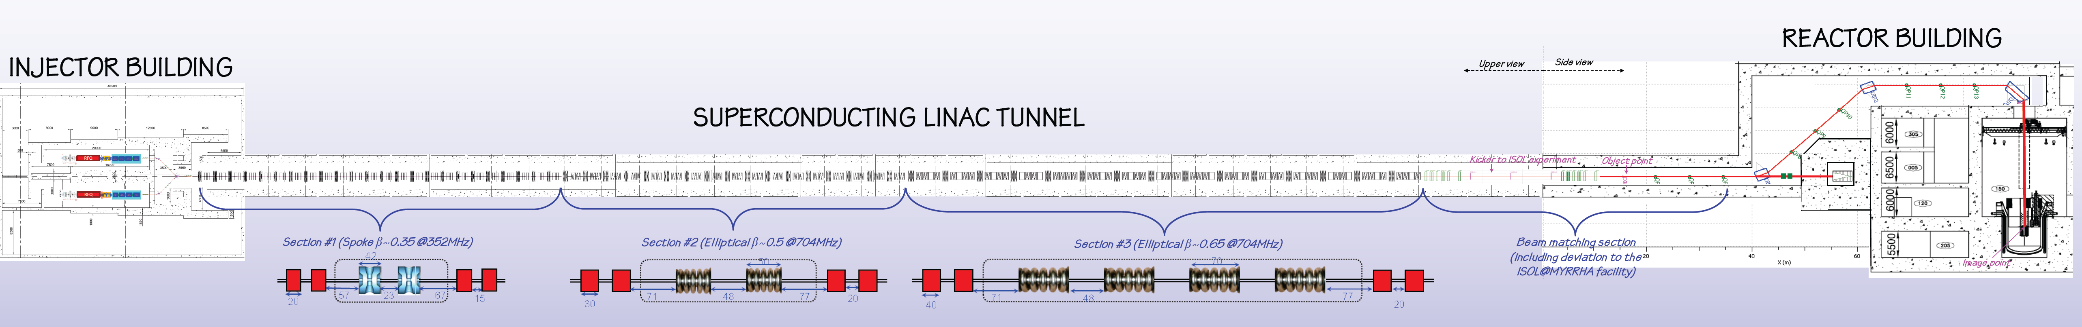
Layout of the MYRRHA linac

Slide 30
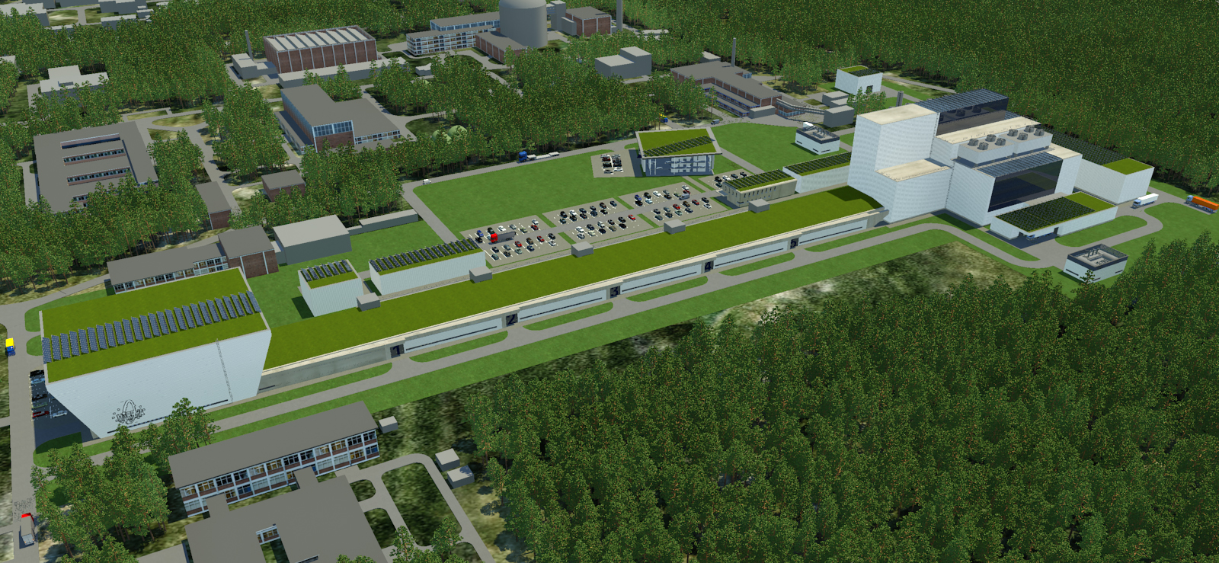
Layout of the MYRRHA linac

Slide 31
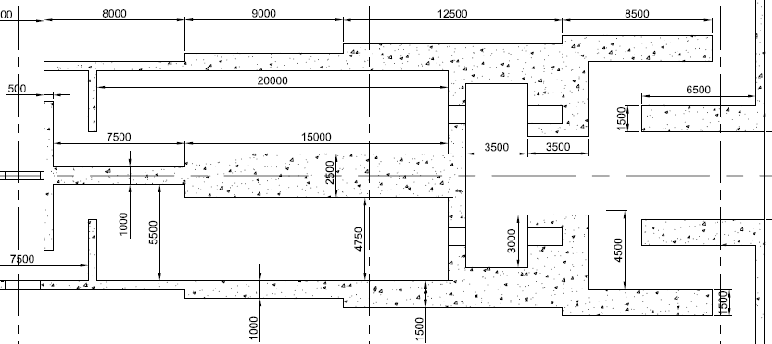
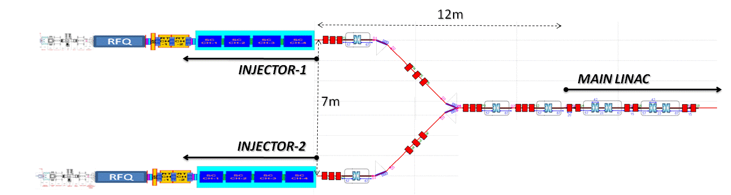
Injector beam reconfiguration (1/4)
Injector 1 in nominal operation mode : beam sent to main linac
  All elements operating (source, RF, power supplies…) at nominal parameters
  Chopper: nominal mode (i.e. pseudo CW with short holes)
  Switching magnet: power supply polarized PLUS
ON
PLUS
OFF
Injector 2 in stand-by mode: beam sent to dump #2
  All elements operating at nominal parameters except dipole magnet
  Chopper: tuning mode (i.e. low duty cycle tbd)
  Survey of output beam properties (TOF energy, current monitor)

Slide 32
Injector beam reconfiguration (2/4)
A failure is detected in Injector #1
  E.g. anormal beam losses in MEBT (or source voltage breakdown, PS failure, cavity quench…)
  Fault information is sent to Machine Protection System (MPS) / Control System
  If failure is serious (i.e. reproducible after 1 or 2 tries), MPS stops the beams
ON
Anormal beam losses
PLUS
OFF
MPS stops the beam in both injectors asap (typically less than 0.1ms)
  Using the LEBT chopper only in Injector #2
  Definitively in injector #1 using (TBD) the LEBT chopper as a fast mean and then the LEBT Faraday cup for example as a slow & permanent mean

Slide 33
Injector beam reconfiguration (3/4)
The polarity of dipole magnets is changed (time budget = less than 1sec tbc)
  Dipole of injector #1 is switched OFF
  Dipole of injector #2 is switched ON
  Common dipole polarity is changed to MINUS
OFF
MINUS
ON
Once steady-state is reached in the PS, beam is resumed in Injector #2
  First, a few very short pulses are sent to check everything is ok (« fast commisionning mode »)
  If all is ok, then duty cycle is ramped quickly (within 1 or 2 sec) to recover nominal operation

Slide 34


Injector beam reconfiguration (4/4)
Maintenance is started on Injector #1
  Injector #1 casemate needs to be accessible during Injector #2 operation
  Beam might probably need to be completely stopped on Injector #1
OFF
MINUS
ON
Once failed component is fixed, Injector #1 is put back to operation
  Injector #1 is re-tuned & commissionned localy
  Once ok, injector #1 stays in « stand-by mode », low dc beam sent to beam dump #1

Slide 35
Main linac beam reconfiguration (1/6)
Nominal main linac operation
  All elements (cavities, RF amps, power supplies…) operating at nominal (derated) parameters
  Reference scheme: local compensation scheme for RF & magnets faults
  about 30% margins available on all cavities, 40% on amplifiers & 10% on magnets PS
  Alternative scheme for RF faults (under evaluation): global compensation scheme
  no margin on cavities & amp but a few hot spare cryomodules at the linac end at full voltage but with bunching/debunching synchronous phase

Slide 36
Main linac beam reconfiguration (2/6)
Anormal beam losses
A fault is detected in the main linac
  E.g. anormal beam losses at high energy (or RF failure, PS failure…)
  Fault information is sent to Machine Protection System (MPS) / Control System
  If failure is serious (i.e. reproducible after 1 or 2 tries), MPS stops the beams
MPS stops the beam in the operating injector asap
  Using the LEBT chopper + possibly an additional redundant mean (tbd)

Slide 37
Main linac beam reconfiguration (3/6)
Compensation forbidden
The origin of the fault is analysed & fault recovery procedure is launched if possible
  If the origin of the fault is not diagnosed, the beam needs to be stopped permanently
  If it is diagnosed AND can be compensated, fault recovery procedure can be started
  Conditions to fullfil to make compensation possible (proposed basic preliminary rules):
    fault implying a cavity: the 4 nearest neighbouring cavities operating derated (i.e. not already used for compensation) are used; max allowed # of consecutive failed cavities = 2 (sections #1&2) or 4 (section #3)
    fault implying a Qpole: the whole doublet is switched off & the 4 neighbouring doublets are used;
    max allowed # of consecutive failed doublets = 1

Slide 38
Main linac beam reconfiguration (4/6)
Fast retuning procedure (e.g. case of a RF cavity failure)
  The failed cavity RF loop is disabled
  The failed cavity is detuned of more than 100 bandwidth (time budget = less than 2 seconds)
  New (Voltage / Phase) setpoint values for compensating cavities are picked in the Control System database (from past beam experience or from a predictive calculation )
  New setpoints are applied in the corresponding LLRF (w/ typically a ramp of about 150ms)
    The capability of SC cavities to raise reliabily its operating voltage has to be checked at each maintenance period !

Slide 39
Main linac beam reconfiguration (5/6)
  Once steady-state is reached on the retuned elements, back to beam operation
  First, a few very short pulses are sent to check everything is ok (« fast commisionning mode »)
  If all is ok, then duty cycle is ramped quickly (within 1 or 2 sec) to recover nominal operation
  Maintenance is done if possible
  If the needed maintenance is inside the tunnel -> wait for next shut-down period
  If the needed maintenance is outside the tunnel -> repair during beam operation

Slide 40
Main linac beam reconfiguration (6/6)
If maintenance is successful, back to nominal operation using opposite procedure (? TBC)
  Beam is stopped
  The repaired cavity is retuned (time budget = less than 2 seconds)
  Initial (Voltage / Phase) setpoint values for repaired & compensating cavities are set back
  Beam is resumed (short pulse) and duty cycle is ramped up to nominal operation

Slide 41
The P&T strategy
The MYRRHA project
The MYRRHA linac concept
Main R&D achievements (MAX project)
On-going activities (MYRTE project)

Slide 42
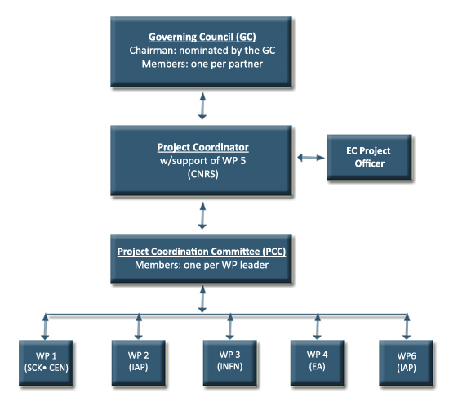











The MAX project (2011-2014)
Goal: deliver a consolidated reference layout of the MYRRHA linac
with sufficient detail and adequate level of confidence in order to initiate
in 2015 its engineering design and subsequent construction phase
WP1: Global accelerator design
WP2: Injector developments
WP3: Main linac developments
WP4: System optimisation
http://ipnweb.in2p3.fr/MAX/
11 partners
~ 5 M€ total cost
~ 10 people FTE

Slide 43
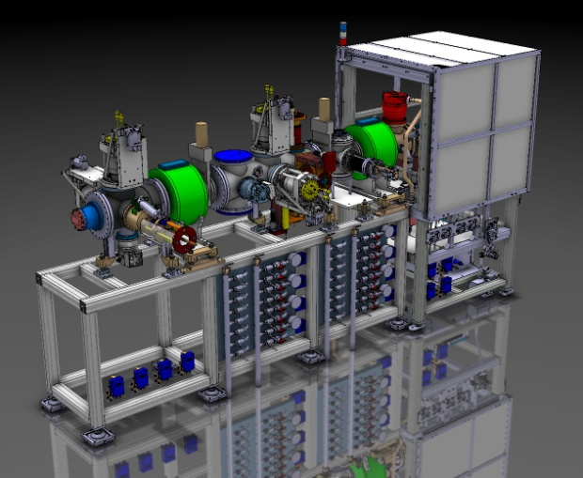
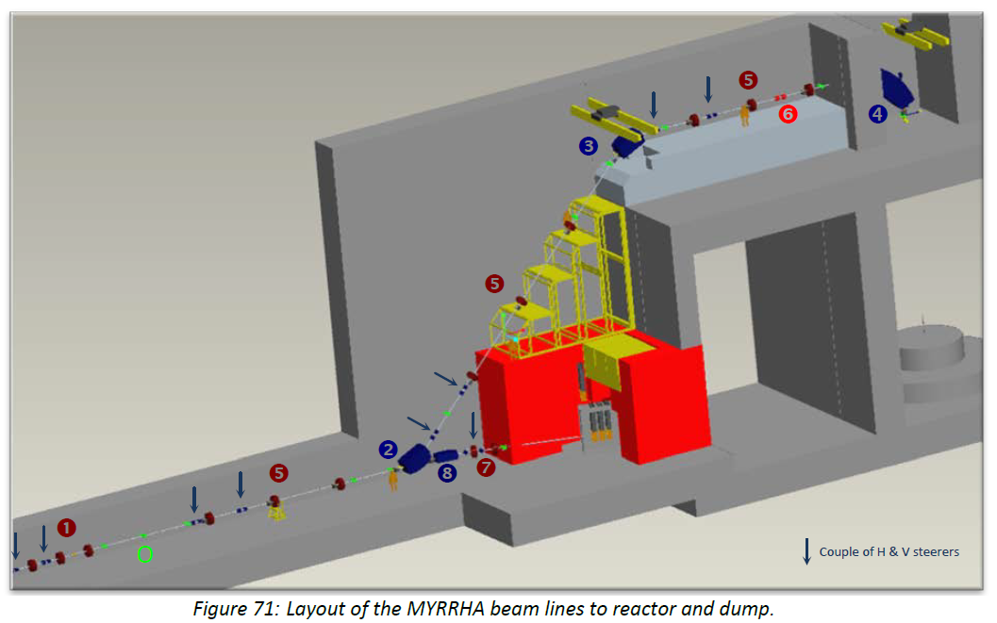
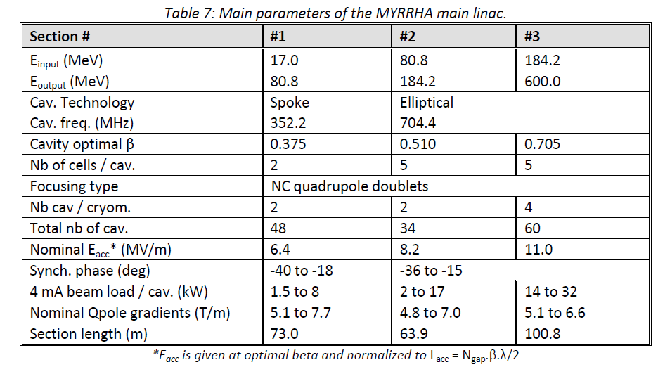
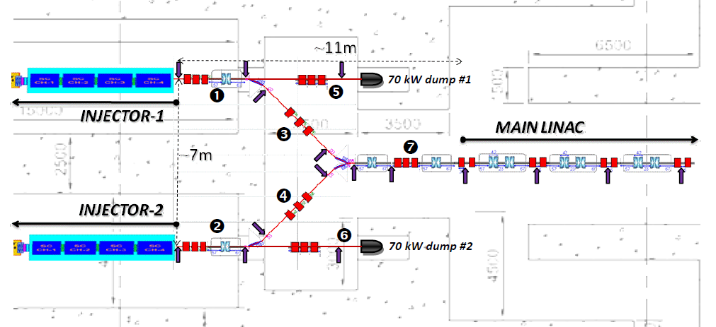
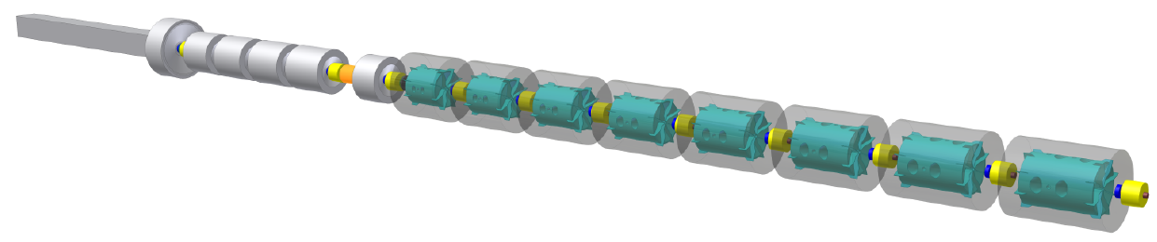
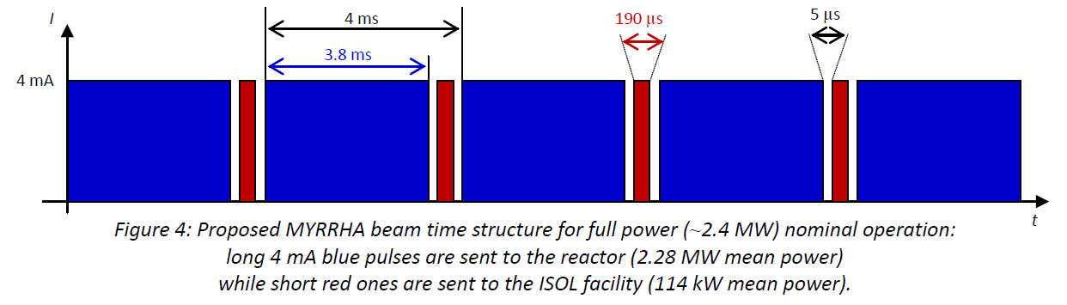

WP1 – Global accelerator design
Production of a reference design for the whole MYRRHA accelerator
  LEBT, together w/ MARISA
  (presently under construction by SCK+LPSC)
  RFQ + CH booster
  (incl. several improved versions)
  MEBT
  (conceptual design)
  Main SRF linac
  (incl. fault-tolerance capabilities)
  HEBT, from CDT inputs
  (ISOL deviation + reactor interface)
  Definition of beam time structure & power control strategy

Slide 44
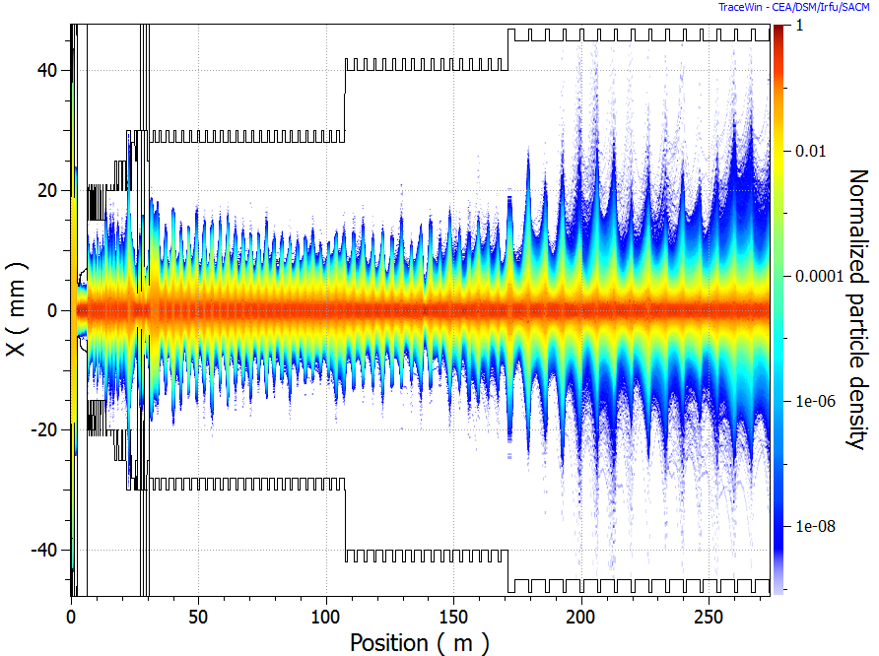
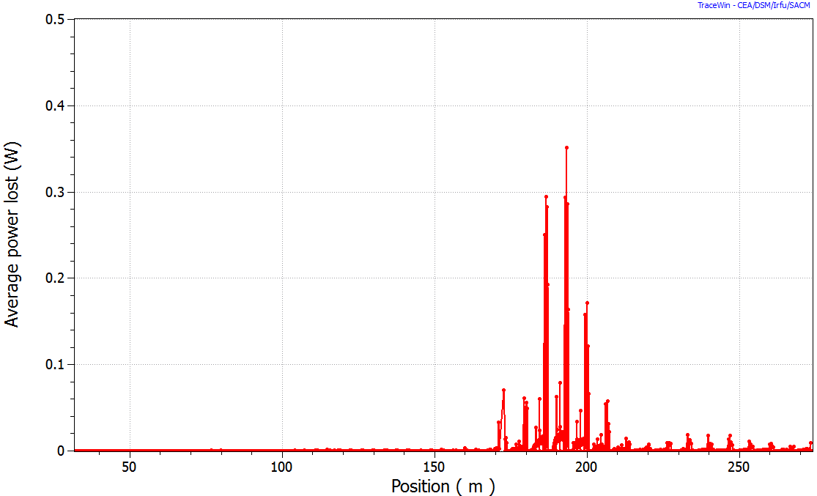
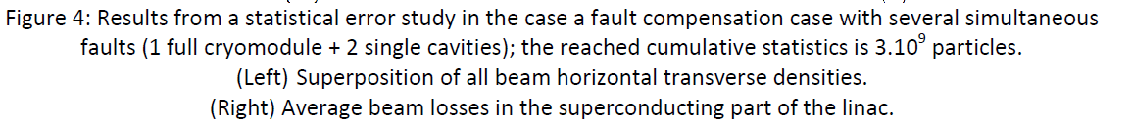
WP1 – Global accelerator design
MYRRHA linac international design review (Brussels, Nov. 2012)
  Very encouraging feedback, list of very valuable recommendations
Consolidation of the reference design
  Beam dynamics benchmarking activities
  Beam simulations from source to target
  Monte Carlo error studies (incl. fault compensation cases)
    Longitudinal acceptance is the key point for beam loss control
    Compensation schemes should be slightly less aggressive (i.e. involving more cavities)
Assessments of the MYRRHA buildings layout

Slide 45
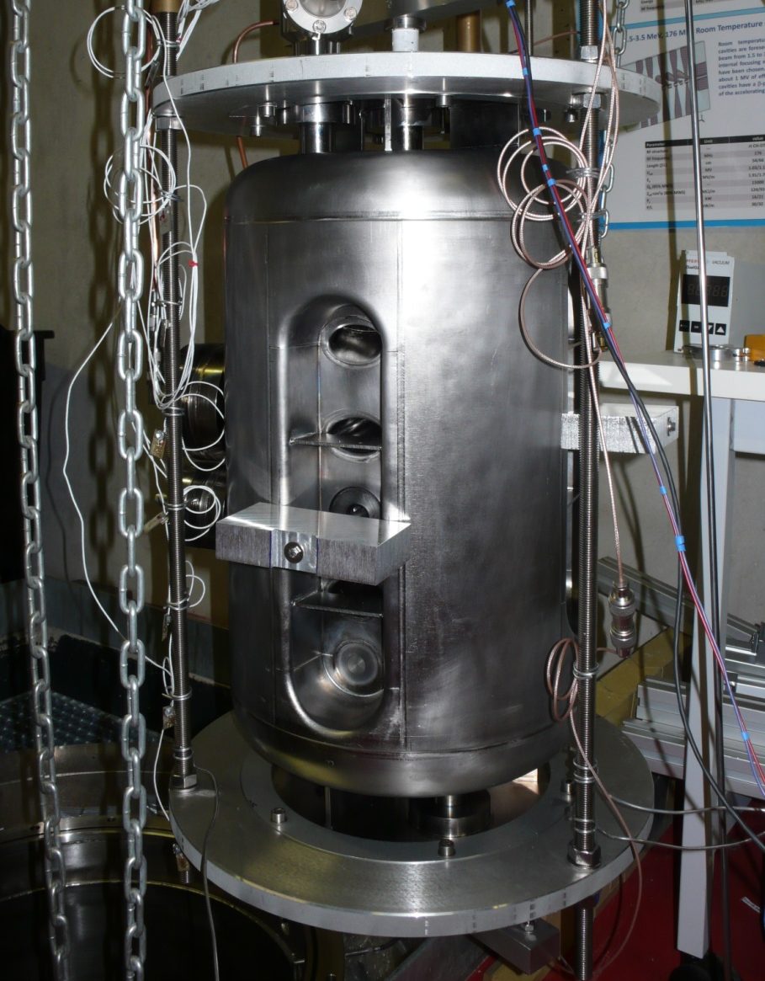
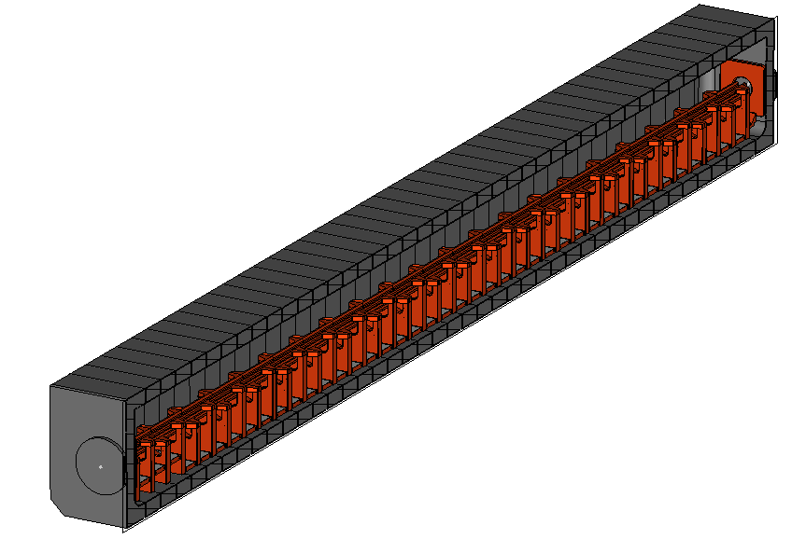
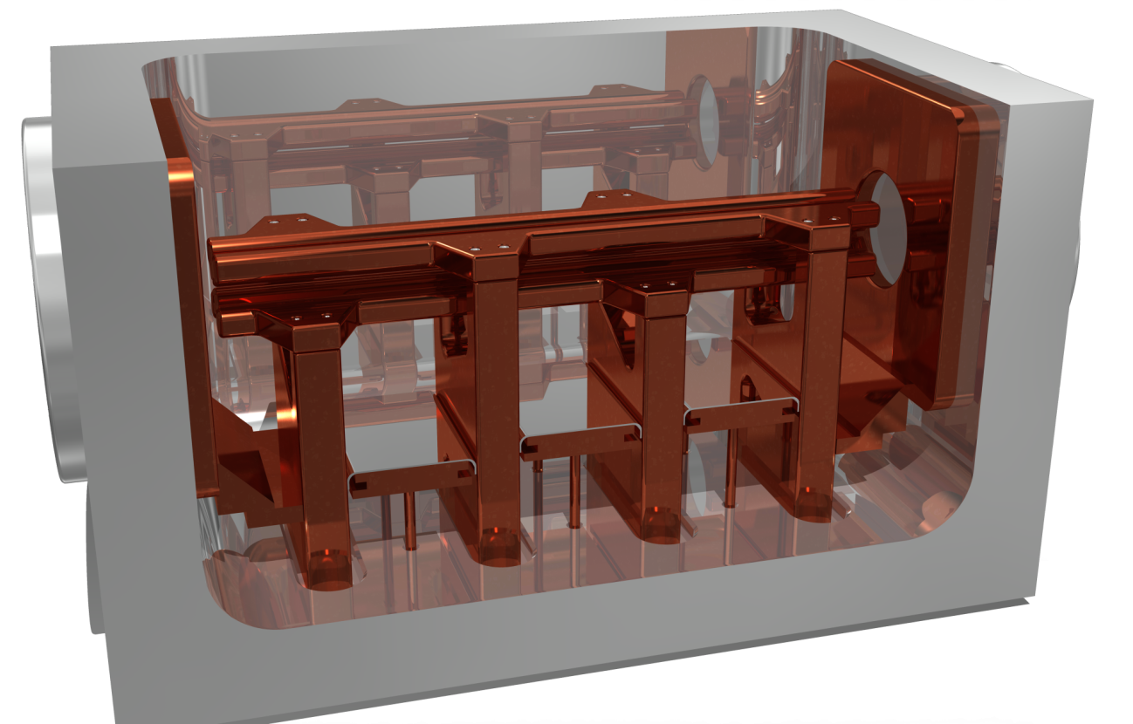
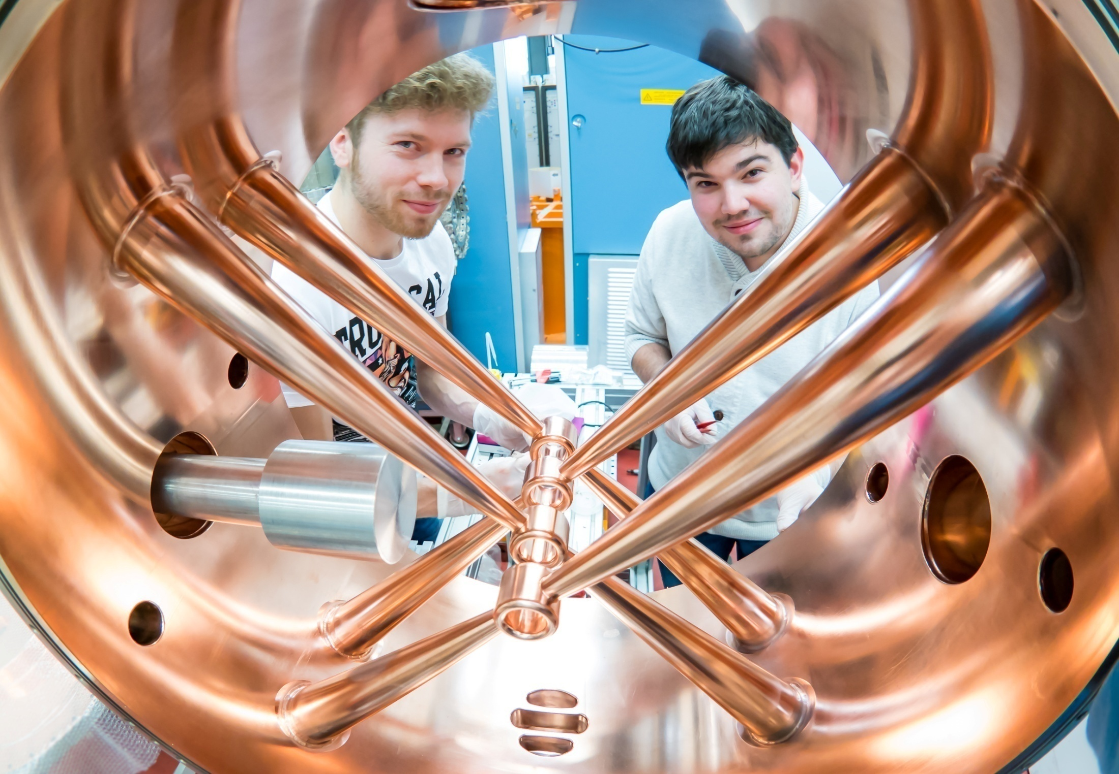
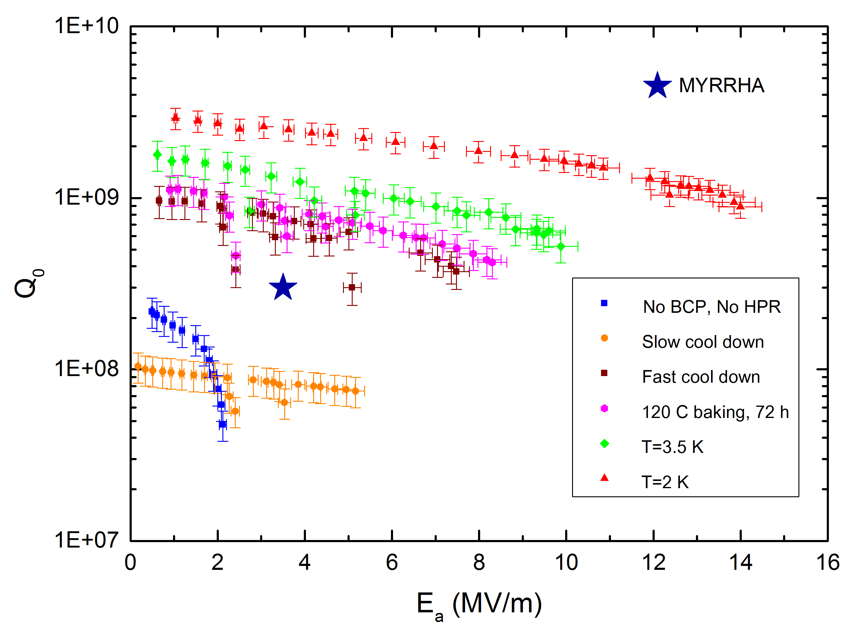
WP2 – Injector developments
R&D on the MYRRHA 176 MHz RFQ
  4-rod w/ technology choices optimized for reliable CW operation
  Fabrication and successful high-power RF test of a short
  prototype → 116 kW/m
  Design of the 4m-long MYRRHA RFQ
R&D on the MYRRHA CH cavities
  NC and SC CH cavity design incl. ancillaries
  Fabrication of a NC 5-gap CH-prototype
  Fabrication and successful tests of a SC 7-gap
  CH-prototype → 14 MV/m

Slide 46
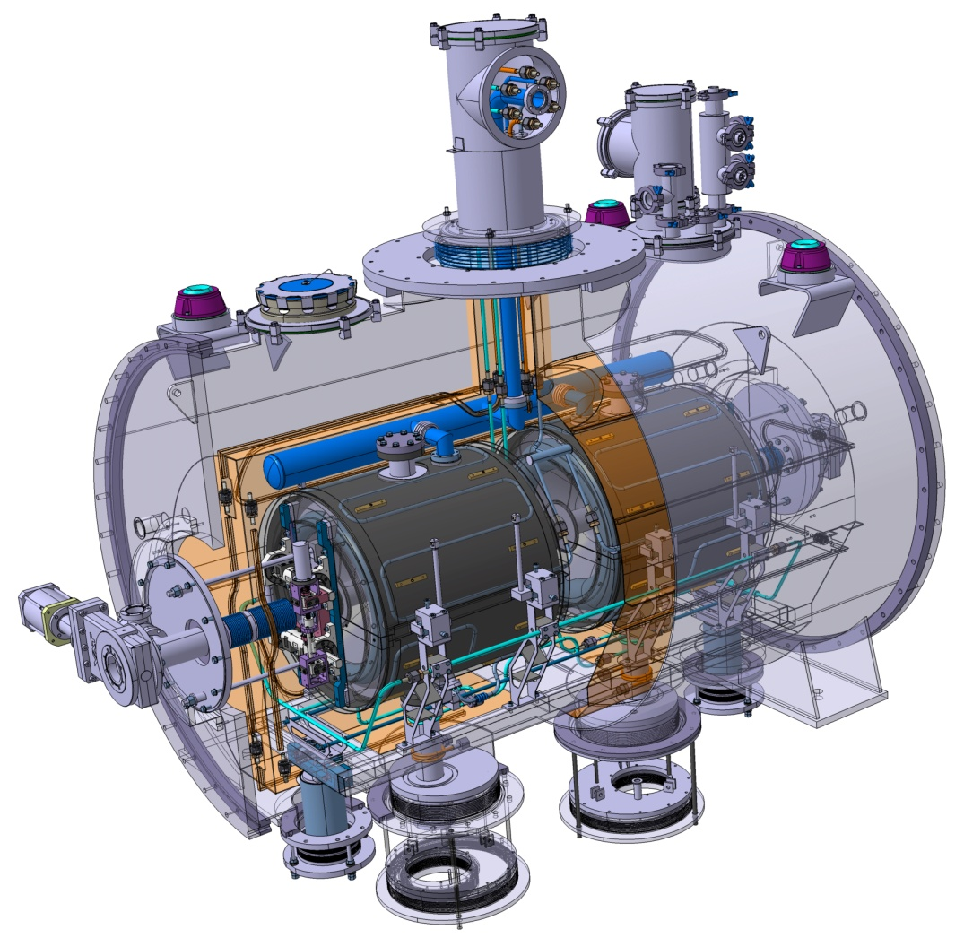
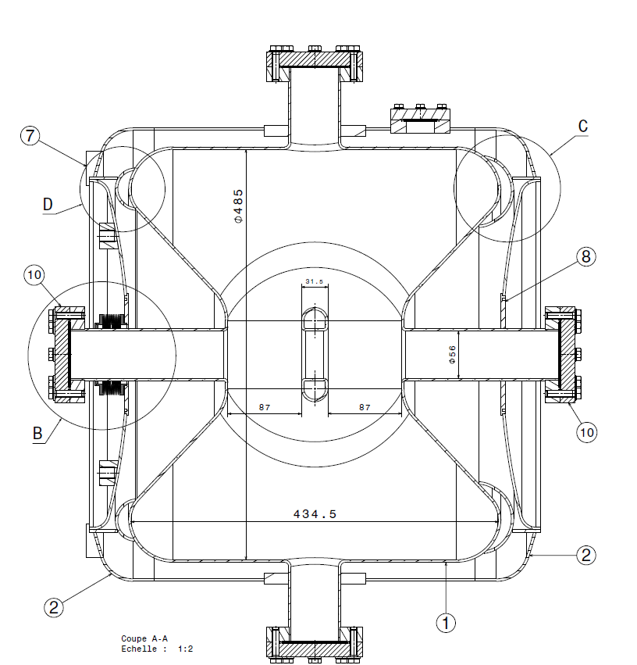




WP3 – Main linac developments
R&D on the MYRRHA 352 MHz Spoke cryomodule
  Design of the MYRRHA spoke 2-gap cavity
  incl. call for tender for 2 prototypes (presently in fabrication)
  Detailed design of the MYRRHA spoke cryomodule
  incl. engineering drawings
R&D on 704 MHz elliptical cavities
  High-power commissioning of the test cryomodule
  w/ β=0.5 5-cell cavity, 80kW IOT, @2K
  Development and test of an innovative control system
    Main sequences of the fault recovery scenario tested, incl. LLRF + pizo-based CTS + ADEX smart control
    Low-beta elliptical cavities are too soft mechanically -> might be replaced by ESS-type spoke cavities
  Assessments on multipacting

Slide 47


WP4 – System optimisation
Reliability analysis
  Development of a reliability model of the SNS accelerator
  & benchmark w/ SNS logbook data
  Development of the MYRRHA linac reliability model
    Diagnostics and C&C must be designed with increased reliability
    We expect 13 compensation events per 3-month cycle -> the 30% margin on RF power could be lowered
R&D on 700 MHz solid-state amplifiers
  Design of a 32kW SSPA for MYRRHA
  Development & test of a 800W elementary module
Conceptual design of the MYRRHA cryogenic plant & choice of 2K operation
Main lessons learned from the GUINEVERE ADS operation analysis

Slide 48

MAX final report is available on http://ipnwww.in2p3.fr/MAX

Slide 49
The P&T strategy
The MYRRHA project
The MYRRHA linac concept
Main R&D achievements (MAX project)
On-going activities (MYRTE project)

Slide 50

The MYRTE project

Slide 51

MYRTE overview

Slide 52







MYRTE WP2 overview
13 partners
  4 research institutes (CNRS, SCK*CEN, CERN, CEA) for a total of 206 pm
  2 universities (IAP, U. Darmstadt) for a total of 39 pm
  7 SME & industries (ACS, ADEX, EA, IBA, COSYLAB, TED, NTG) for a total of 104 pm
Overall budget: 5.3 M€
  349 pm over 4 years (about 8 FTE)
  1760 k€ for consumables and travels
EC contribution: 4.0 M€

Slide 53





WP2 objectives
Pursue the research, design and development of the MYRRHA accelerator
W/ special focus on the first section of the INJECTOR part (building from previous work)
MYRRHA injector #1
MEBT
Main LINAC
Source
RFQ
NC CH cavities
SC CH cavities
SC Spoke cavities
Existing Source + LEBT
installed at CNRS/LPSC Grenoble
MAX RFQ short prototype
MYRRHA RFQ design

Slide 54
WP2 objectives – Injector demonstration
  Realisation of a full-size MYRRHA-type RFQ demonstrator (Task 2.1)
    IAP, NTG, U. Darmstadt, SCK•CEN, CEA, CNRS
    April 2015 → Oct. 2017

Slide 55
Parameter MYRRHA RFQ
Parameter | MHYRRA | Unit
RF Structure | 4.Rod | ---
Frequency | 176.1 | MHz
Beam current | 5 | mA
Duty factor | 100 | %
E_{out} | 1.5 | MeV
R_{p} | 77 | kΩm
RF Power | 108 | kW
Specific power | 25 | kW/m
Voltage | 44 | kV
Length | 4 | m

Slide 56

















4-rod RFQ for CW Operation
50 kW/m in 2009
Pure Silver Solution
Problem at 100 A/cm with copper plated INCONEL contacts
75 A/cm @ 176 MHz
Experimental Investigation
⇒
High Power TP
of NTG
Improved Cooling
Plungers: Induced eddy currents lead to power losses on the surface in the order of 20 W/cm².
⇒
Improved RF-Contacts
RF penetration can cause problems in some hidden areas of the structure.
⇒

Slide 57



Cooling System on Main Parts of the RFQ
copper electro forming
brazed silver plates

Slide 58




NEXT GEN HIGH POWER CW-RFQ
4-stem Model
keeps cool at even 130 kW/m
(limit not yet reached)

Slide 59





FRANZ Accelerator
CW RFQ
CW IH-Middle-Frame
CW CH-Rebuncher
Notes:
Another RFQ/IH combination currently under construction at NTG for cw operation for FRANZ project at IAP.
This one is an R&N project trying to push further the limits at cw.

Slide 60


Mechanical MYRRHA RFQ Design
No. of stems: 40
Distance of Stems: 100 mm
No. of electrode sections: 3
Pumping ports: 2 + 1 DN100CF
Height of beam axis: 150 cm
No. of tuner ports: 1 + 1
Adjustable three-point-support

Slide 61




Some recent impressions from the work shop
tank body and lid
raw material for stems
Electrode cooling channels
cooling connections

Slide 62

WP2 objectives – Injector demonstration
  Realisation of a full-size MYRRHA-type RFQ demonstrator (Task 2.1)
    IAP, NTG, U. Darmstadt, SCK•CEN, CEA, CNRS
    April 2015 → Oct. 2017
  Construction of a prototype Solid State RF power amplifier (Task 2.2)
    IBA, SCK•CEN, CNRS, Cosylab, IAP
    April 2015 → Oct. 2017
  Digital Low Level RF development (Task 2.3)
    CNRS, SCK•CEN, Cosylab
    April 2015 → Oct. 2017
  Injector commissioning (Task 2.7)
    SCK•CEN, CNRS, ADEX, CEA, Cosylab, IAP
    April 2017 → April 2019

Slide 63

WP2 objectives – Beam characterization & control
  Space-charge experiments (Task 2.8)
    CNRS, CEA, IAP, SCK•CEN
    April 2015 → Oct. 2017

Slide 64


April 2015
On Tuesday 7 April

Slide 65


Summer 2015: Continuation of the assembly and cabling
The LEBT on
29 September 2015
Chopper box mounted for vacuum test.
Leak in the water cooling circuit of the dump.

Slide 66


March 2015 Tests : Einzel Lens & Space Charge Compensation
(Possible) Influence of the einzel lens voltage on the space charge compensation
I_{source} ≈ 15.4 mA
I_{solenoid} = 68 A
P_{@Faraday Cup} ≈ 2.2 10⁻⁵ mbar (Ar injection)
V_{Einzel}= 0 kV
V_{Einzel}= 2.0 kV
Emit [rms] = 0.3874 Pi.mm.mrad [ Norm. ]
Emit [30.47%] = 0.3874 Pi.mm.mrad [ Norm. ]
Beta = 6.7224 mm/Pi.mrad
Alpha = 0.9466
file: emit_2015_03_25_17-27.dat
file: emit_2015_03_25_17-41.dat

Slide 67
WP2 objectives – Beam characterization & control
  Space-charge experiments (Task 2.8)
    CNRS, CEA, IAP, SCK•CEN
    April 2015 → Oct. 2017
  Beam diagnostics development (Task 2.4)
    CEA, CNRS, SCK•CEN, Cosylab
    April 2015 → April 2019

Slide 68
TASK 2.4 Diagnostics - Summary
  5 diagnostics devices for tuning and/or monitoring the MYRRHA injector beam on-line
  BCM (CEA-lead): 1 ACCT and 1 CF -> design + construction
  BPM (IPNO-lead): 3 -> design + construction
  4D emittance-meter (CEA-lead): detailed design @ 1.5 MeV, prototype test @ 30/100keV,
  3D Wire scanner (LPSC-lead): detailed design @ 1.5 MeV, prototype test @ 30 keV.
  1 transversal use : bunch length measurement (IPNO-lead)
  Bibliography, prospective, application to other diagnostics.
  Urgent request:
  design of the “commissioning diagnostic box” after the RFQ in order to clarify the mechanical interfaces for the ACCT and the BPM.
  Control system integration
MYRTE WP2 second meeting

Slide 69
WP2 objectives – Beam characterization & control
  Space-charge experiments (Task 2.8)
    CNRS, CEA, IAP, SCK•CEN
    April 2015 → Oct. 2017
  Beam diagnostics development (Task 2.4)
    CEA, CNRS, SCK•CEN, Cosylab
    April 2015 → April 2019
  Control system in a highly reliable accelerator context (Task 2.5)
    Cosylab, SCK•CEN, ADEX, ACS, CEA, CNRS, IAP
    April 2015 → April 2019
  Beam simulation code development, global coherence (Task 2.6)
    CEA, CNRS, SCK•CEN
    April 2015 → April 2019

Slide 70


simulation of the CAVITY imperfections
Static errors: Not defined
Reference set point (RF Phase and field amplitude
ε_{static}
Beam diagnostics
Tuning procedure
Cavity
ε_{diag}
+
-
ε_{LLRF}
Power supply
RF Output antenna
Example: Spiral2 tolerances
ε_{LLRF} = dynamics errors (0.05%, 0.05°)
ε_{diag} = TOF accuray: ΔW/W = 3.10⁻³
Example LLRF Spiral2 test performed on β=0,07 cryomodule on the cryogenic test stand at CEA/Saclay

Slide 71
WP2 objectives – Others
  LINAC4 reliability analysis (Task 2.9)
    CERN, EA, SCK•CEN, TED
    April 2015 → April 2019

Slide 72


CERN/MYRTE Reliability Workshop (CERN, 17-18 Nov.2015) – CERN Technical Note, 2016-01
LINAC4
Availability/Reliability activities at CERN
Fault tracking tools at CERN (AFT for LHC, L4)
MYRRHA-Myrte & Collaboration for Myrte reliability model

Slide 73





Commissioning stages
diagnostic line
diagnostic line
107 MeV
12 MeV
Commissioning in 5 stages of increasing energy
Phase | Energy | Duration (incl. HW test)
1 | 3 MeV | 11.2013 – 3.2014
2 | 12 MeV | 7.2014 – 12.2014
3 | 50 MeV | Summer 2015
4 | 107 MeV | End 2015
5 | 160 MeV | 1st half 2016
Measured and simulated beam profiles at 12 MeV in transverse and longitudinal planes

Slide 74
WP2 objectives – Others
  LINAC4 reliability analysis (Task 2.9)
    CERN, EA, SCK•CEN, TED
    April 2015 → April 2019
  MYRRHA SRF spoke R&D (Task 2.10)
    CNRS, ACS
    April 2015 → Oct. 2017

Slide 75

The MYRRHA spoke cryomodule
Conceptual design done

Slide 76


The MYRRHA spoke resonator : the delivery
AMELIA (ZA01)
VIRGINIA
(ZA02)

Slide 77
WP2 objectives – Others
  LINAC4 reliability analysis (Task 2.9)
    CERN, EA, SCK•CEN, TED
    April 2015 → April 2019
  MYRRHA SRF spoke R&D (Task 2.10)
    CNRS, ACS
    April 2015 → Oct. 2017
  SRF CH demonstration with beam (Task 2.11)
    IAP
    April 2015 → Oct. 2017

Slide 78

2.1. Verkupferung
Notes:
Tuner erwähnen

Slide 79

3. Design Kühlung
Notes:
(2) Tankwand <-> Zickzack
Tuner + Schleife
2x2 Stützen <-> 4xStützen
Tankdeckel

Slide 80

217 MHz SC CH-Prototype
Delivered 8. September 2015
First cryo-test end of November

Slide 81
WP2 objectives – Others
  LINAC4 reliability analysis (Task 2.9)
    CERN, EA, SCK•CEN, TED
    April 2015 → April 2019
  MYRRHA SRF spoke R&D (Task 2.10)
    CNRS, ACS
    April 2015 → Oct. 2017
  SRF CH demonstration with beam (Task 2.11)
    IAP
    April 2015 → Oct. 2017
  MYRRHA linac cost estimation (Task 2.12)
    SCK•CEN, ACS, TED, CNRS, IAP
    April 2015 → Oct. 2016

Slide 82
Conclusions

Slide 83
Conclusions & perspectives
Produire un faisceau de type ADS est un challenge très intéressant à relever
  Un faisceau de plusieurs MW n’est pas facile à produire et contrôler
  Le niveau de fiabilité requis par un ADS de type MYRRHA est extrêmement élevé
  La R&D sur MYRRHA aura un impact important sur la fiabilité des accélérateurs du futur
Les recherches et développements depuis 10 ans nous permettent d’envisager aujourd’hui une phase de construction pour l’accélérateur de MYRRHA.
  Nous avons acquis une certaine confiance sur la pertinence des solutions envisagées, mais le besoin en R&D reste important pour finaliser l’engineering design et préparer la phase de construction (et démontrer complètement la faisabilité du niveau de fiabilité)
  Une phase active d’ “APD et prototypage” a débuté (via le projet H2020 MYRTE d’une part, et via un certain nombre d’activités bilatérales en cours de définition d’autre part)
Objectif SCK*CEN = obtenir un feu vert des autorités belges fin 2017 pour démarrer la construction de Myrrha phase 1 (linac 100 MeV)

Slide 84
Merci pour votre attention !

