Slide 1




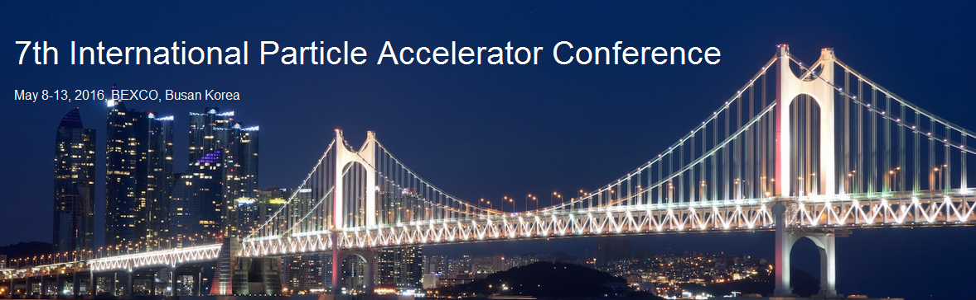

Advanced methods & concepts
for very high intensity beams
P. A. P. NGHIEM
N. CHAUVIN, M. COMUNIAN, L. DUCROT, C. OLIVER
W. SIMEONI Jr., M. VALETTE, D. URIOT

Slide 2
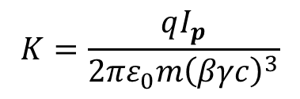
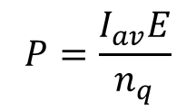
What is HIGH intensity ?
Only in the sense of comparison:
Beam A intensity is higher than Beam B intensity
Only makes sense if
higher intensity → higher issues to face
Issues to be analyzed are twofold:
High intensity
$$P=\frac{I_{av}E}{n_{q}}$$
$$K=\frac{qI_{p}}{{2πε}_{0}m{\left(βγc\right)}^{3}}$$
Strong
space charge
High power
- even tiny losses
are harmful
- ….
- strong nonlinear
repulsive forces
- …
Combination of the two issues → particularly critical situation

Slide 3
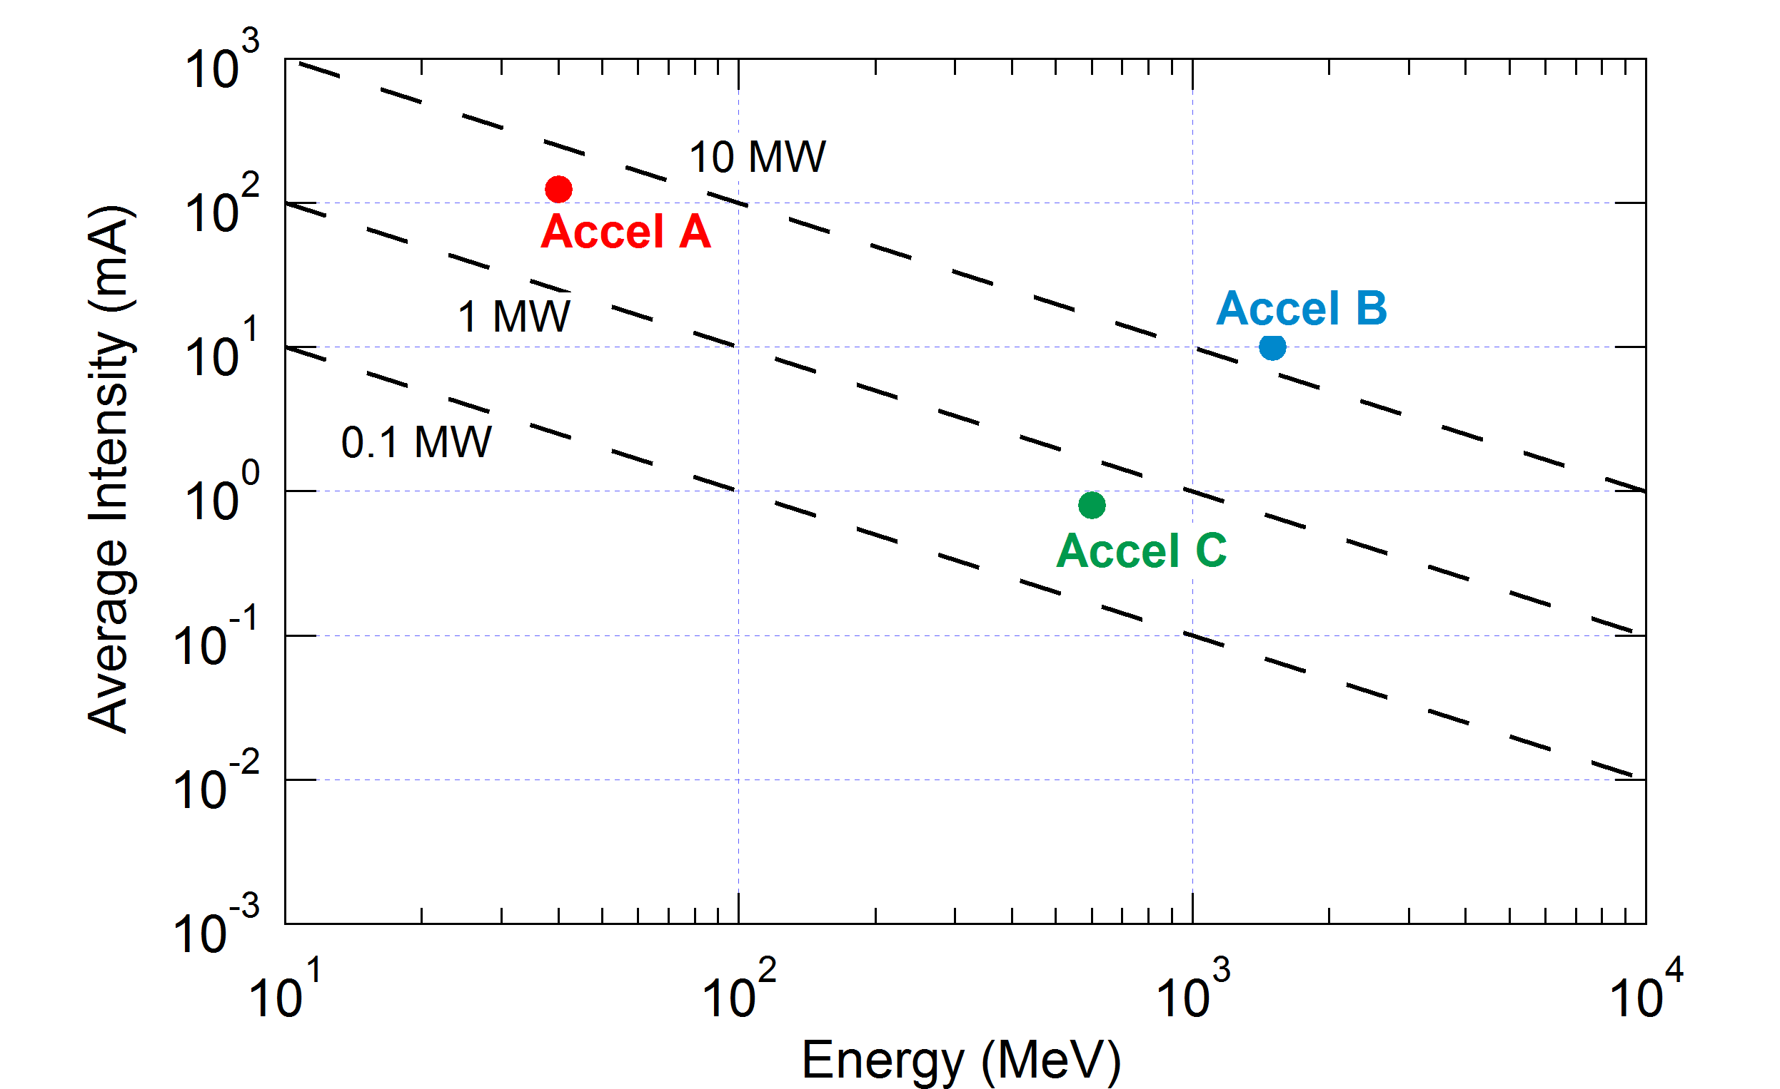
Beam analysis (1)
Classically: assimilation to high power
Final
Power
Example of three accelerators:
Average, peak intensity; starting→final energy
- Accel A: 125 mA, 125 mA; 0.1 → 40 MeV
- Accel B: 8 mA, 10 mA; 0.05 →1500 MeV
- Accel C: 40 mA, 0.8 mA; 0.03 → 600 MeV
The most challenging : Accel B, then A, then C ???
Final
This graph is highly reductive:
● Only last section, no upstream sections
● No space charge
- need of strong focusing
- non-linearities
- emittance growth
- halo creation
- sudden losses
- Each energy range ↔ specific acceleration-focussing technologies
Source, LEBT, RFQ, DTL, CCL, SC-HWR, Spoke cav, Elliptical cav
- Challenges are not comparable at very different energies
- Challenging last section doesn't mean challenging upstream sections

Slide 4
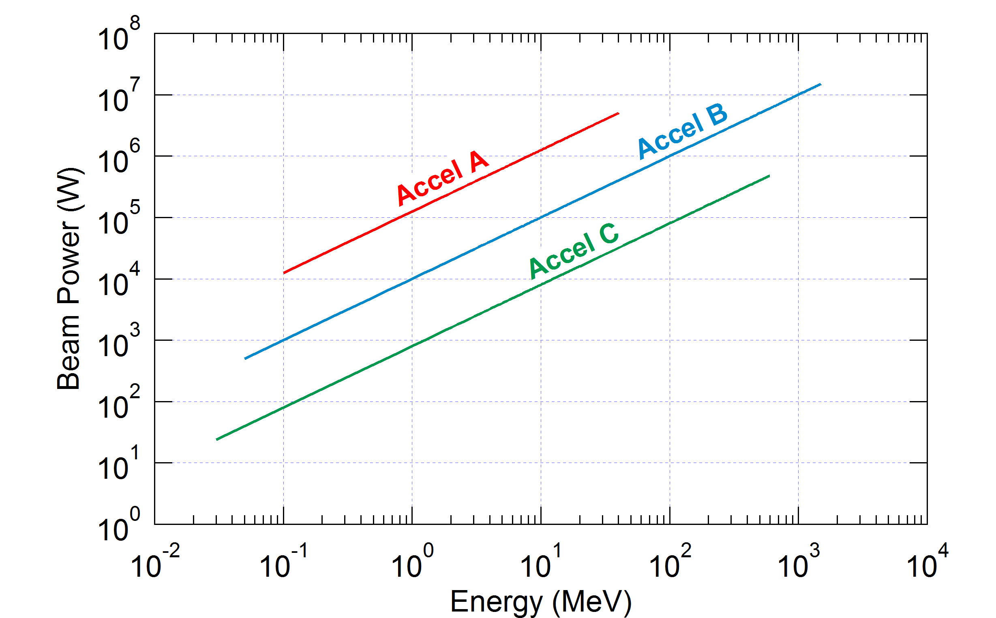
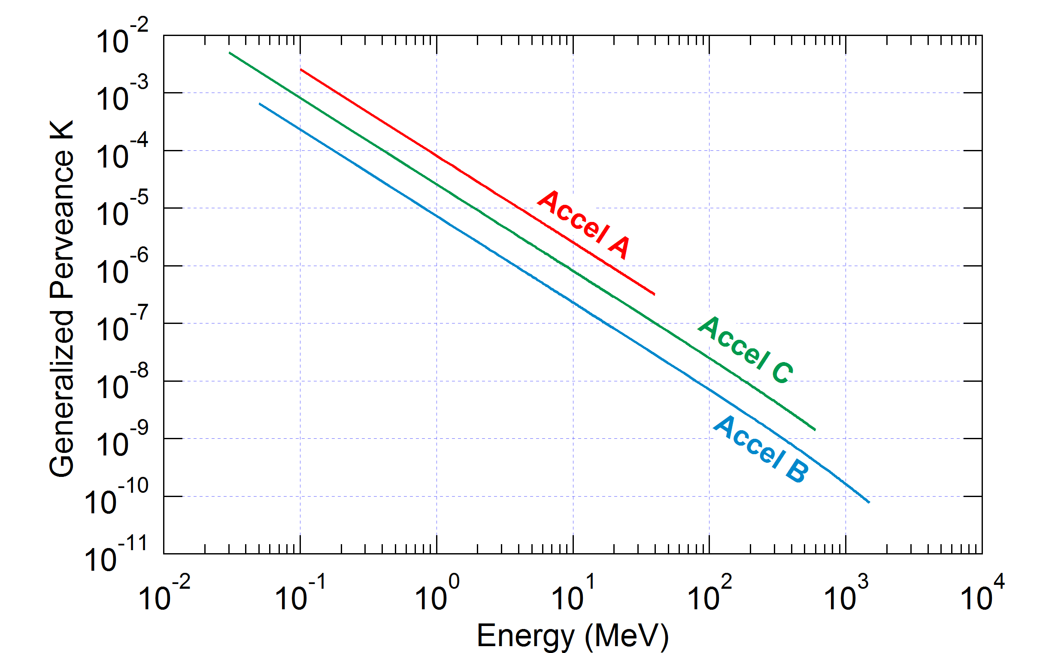
Beam analysis (2)
Advanced analysis:
Beam power & Space charge along the accelerator
(average & peak intensity, start & final energy)
Beam power issues
Only last section: B, A, C
For a given section: A, B, C
RFQ end
Space charge issues
Only first section: C, A, B
For a given section: A, C, B
Direct comparison between accelerators
for a same acceleration component
⇒ challenging or not
⇒ adjust section start/end could help
⇒ see effects of combination of
high power & space charge
RFQ end

Slide 5
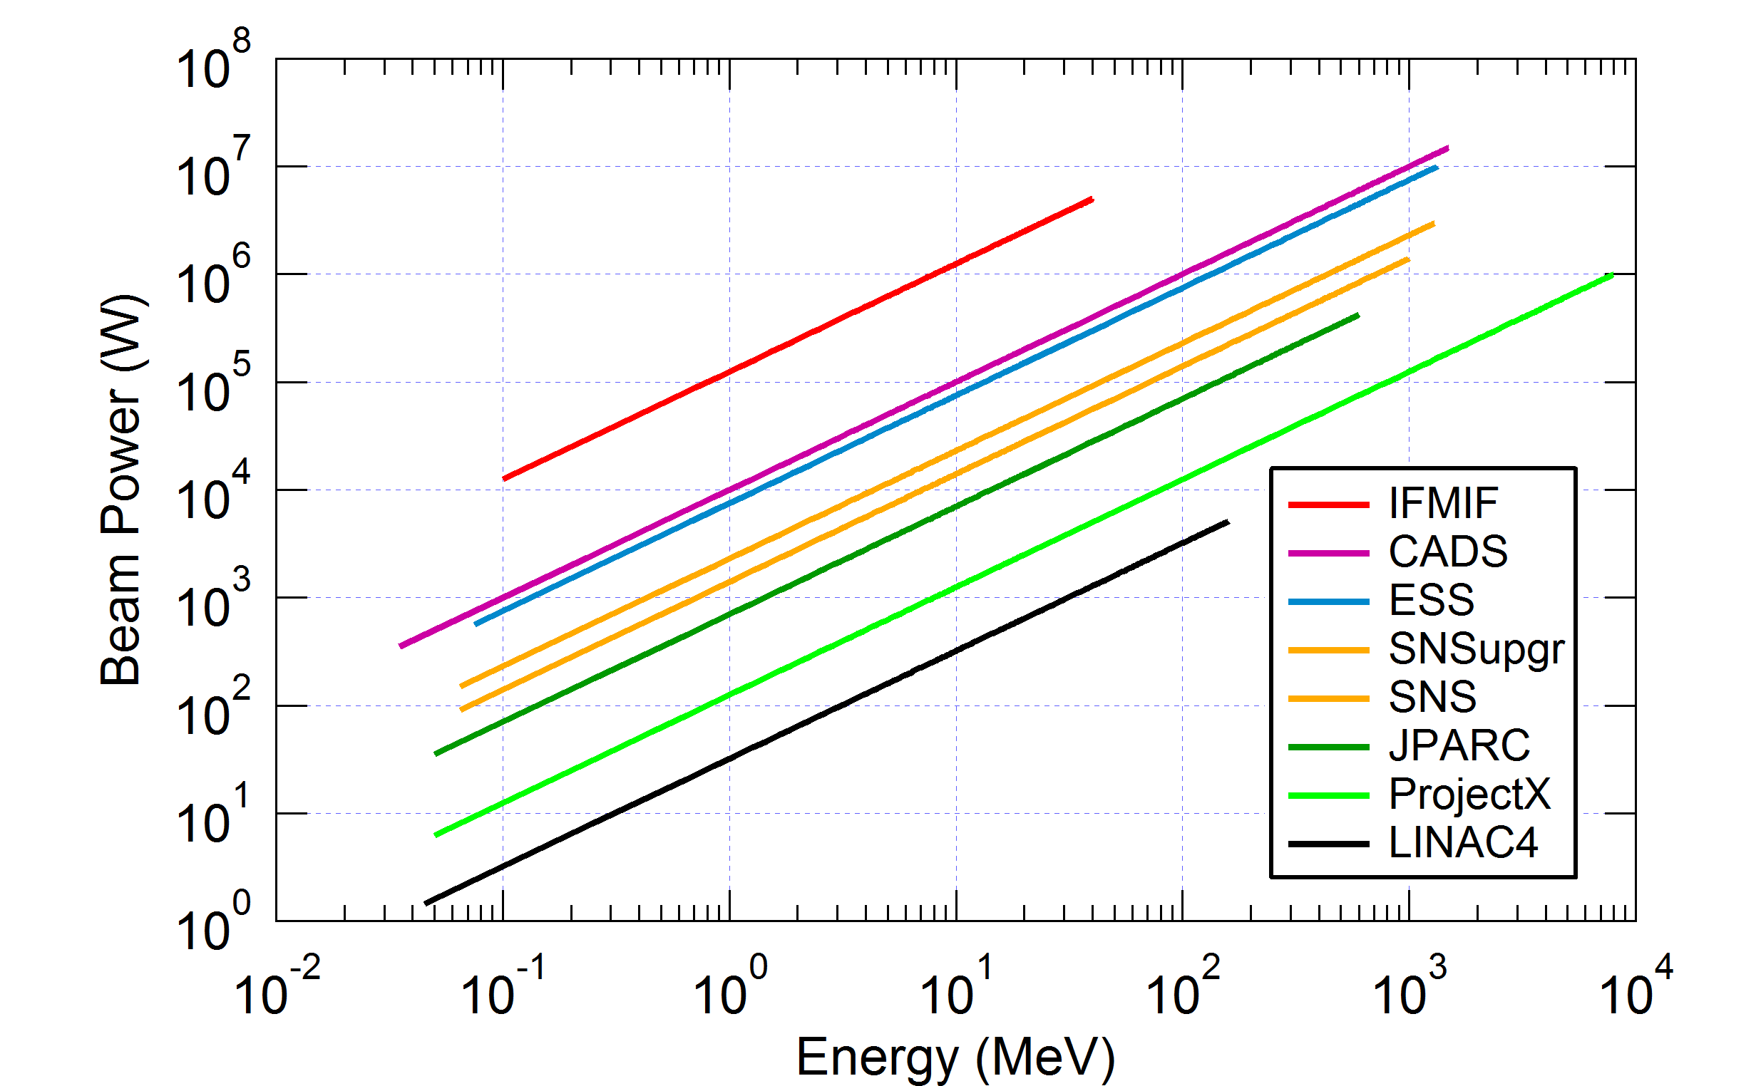
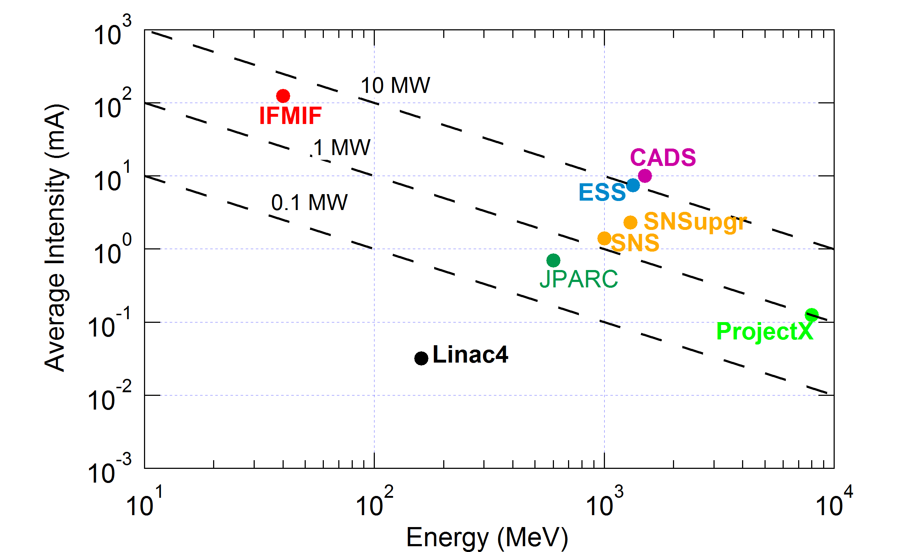
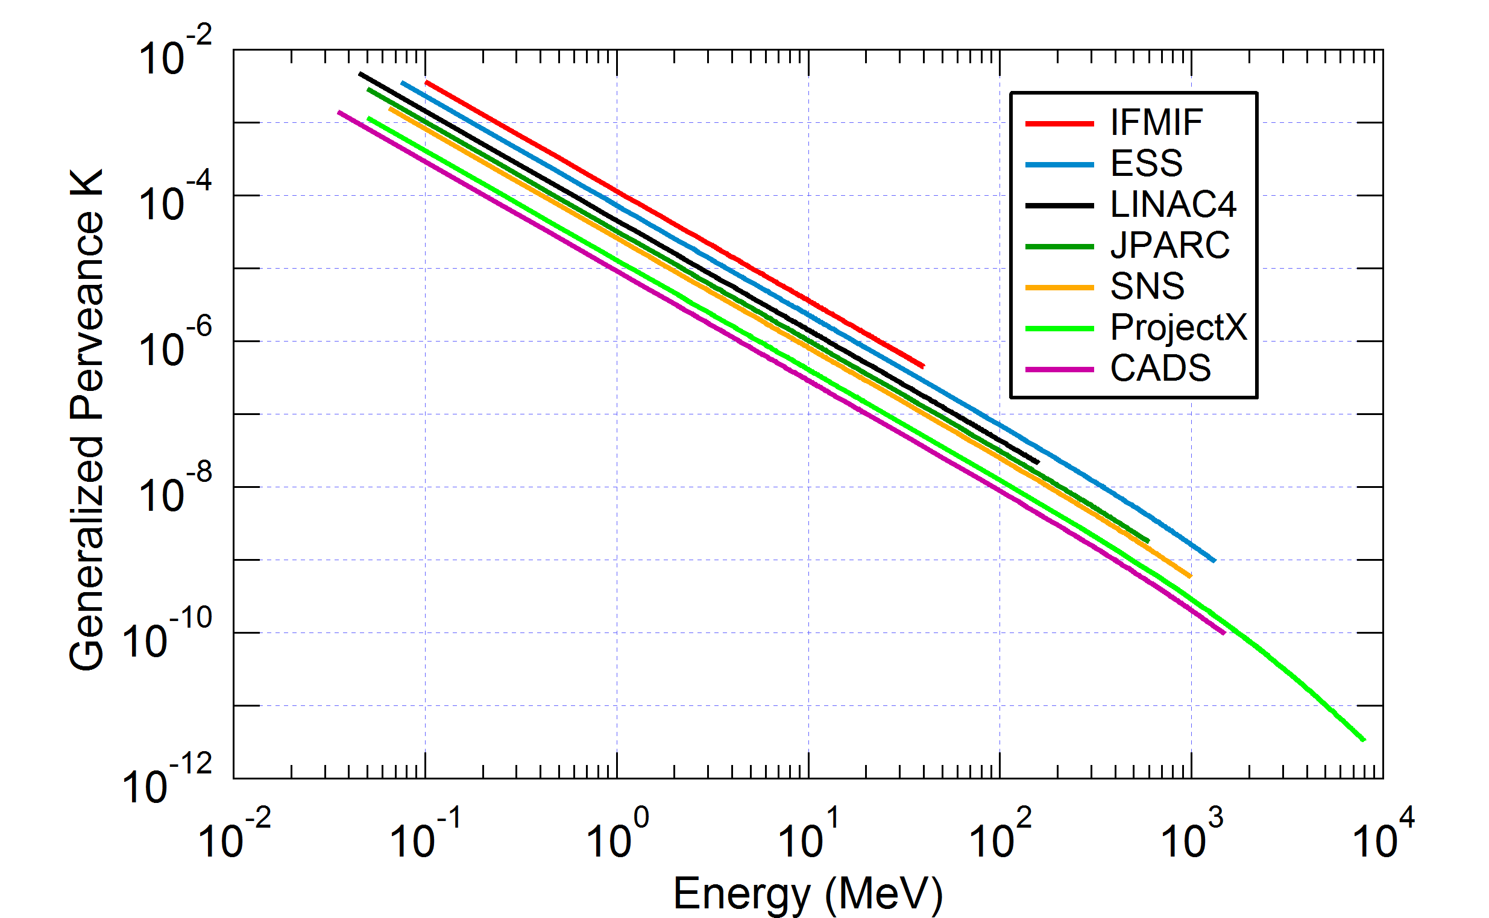
Beam analysis (3)
Examples of accelerators achieved or under construction or planned
Advanced
Classically
Nucl. Instru. Meth. Phys. Res. A 654, 63–71, 2011

Slide 6
Advanced methods and concepts
New idea for: Beam analysis
New protocol for: Beam loss prediction
New method for: Beam optimization
New strategy for: Beam measurement
New concept for: Beam characterization

Slide 7
Advanced methods and concepts
New idea for: Beam analysis
New protocol for: Beam loss prediction
New method for: Beam optimization
New strategy for: Beam measurement
New concept for: Beam characterization

Slide 8
Beam loss prediction (1)
High power → even a tiny part of the beam, when lost,
can take away a significant power
● Accidental loss → brutal heat deposition → damage equipment
● Permanent loss → activate materials → harmful radiations for personnel
→ cryogenic systems must be able to cool down
Hands-on maintenance requirement: Losses << 1W/m
MW beam → well less than 1 particle lost over 10⁶ is tolerated !!
→ microlosses
High intensity → High power on almost the whole accelerator
→ Carreful and exhaustive prediction of losses
all along the accelerator is needed

Slide 9
Beam loss prediction (2)
Double issue:
- Define exhaustively all the loss situations in the accelerator lifetime
- Define the protocols to simulate and estimate them
Loss situations and protocols: (Laser Part. Beams (2014), 32, 461-469)
A. Ideal machine: nominal theoretical conditions, without any error
B. Starting from scratch: errors as tolerances, not corrected, tunable param.±10%
C. Commissioning, tuning, exploration: same as above but errors corrected
D. Routine operation: errors corrected, tunable param. nominal
E. Sudden failure: individual or combination of sudden trips of tunable param.
from 100% up to 110%, or down to 0%.
→ CATALOGUE of LOSSES:
affects all the subsystems: hot points, beam stop system velocity,
limitations for control system, maximum beam power for operation,
dynamic range of diagnostics, etc.

Slide 10
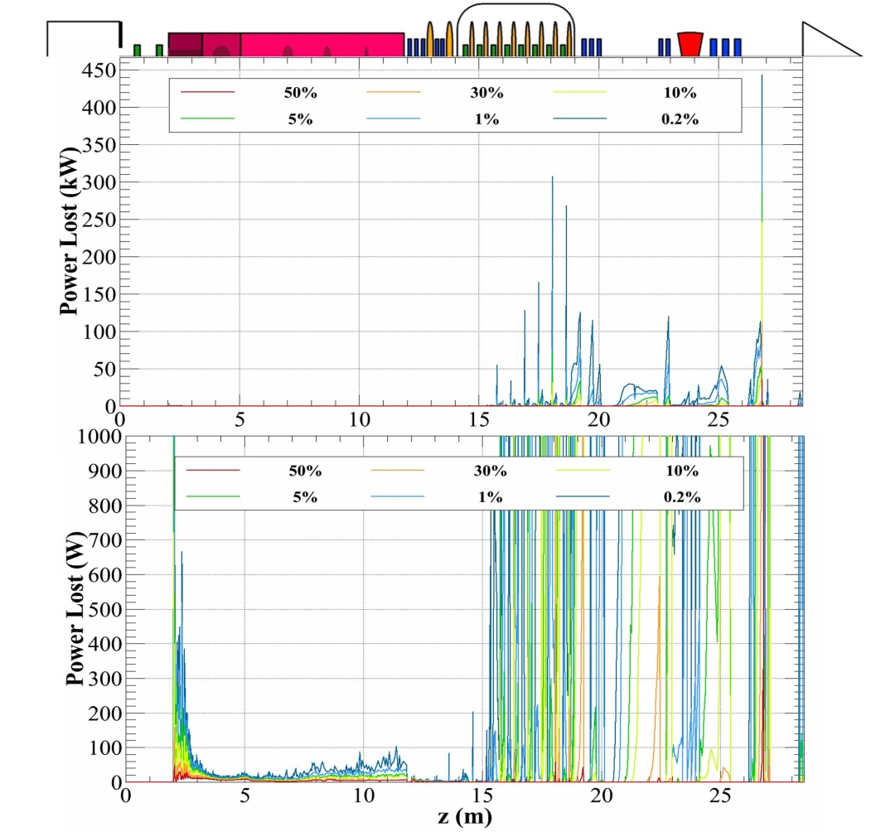
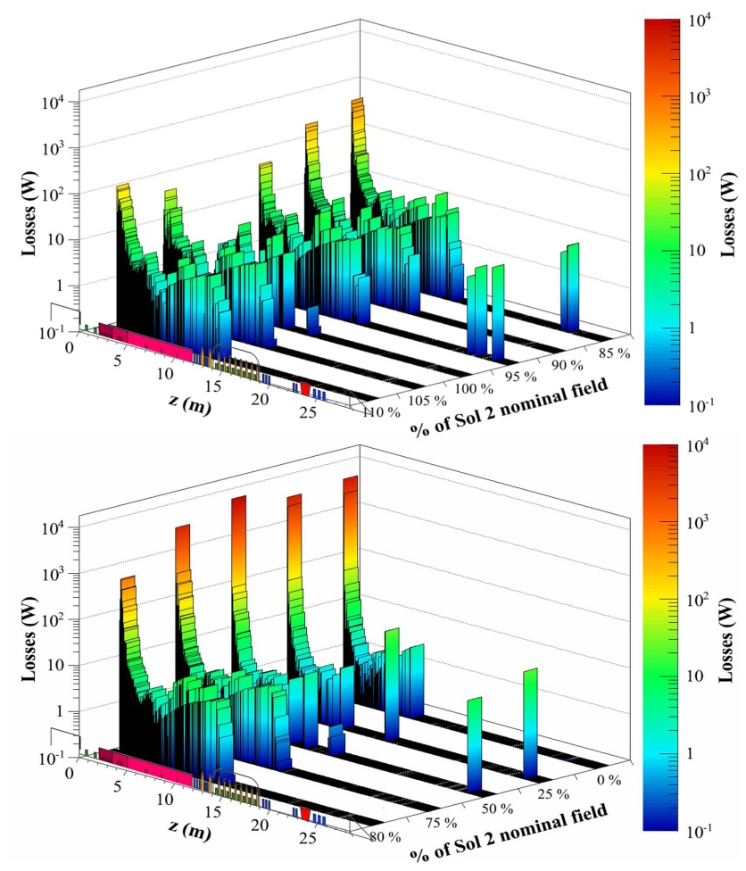
Beam loss prediction (3)
Example: CATALOGUE of LOSSES for the IFMIF Prototype accelerator
Laser Part. Beams (2014), 32, 461-469
Beam loss power probabilities when starting from scratch for a full power beam
Beam loss power in case of sudden failure of the second LEBT solenoid

Slide 11
Advanced methods and concepts
New idea for: Beam analysis
New protocol for: Beam loss prediction
New method for: Beam optimization
New strategy for: Beam measurement
New concept for: Beam characterization

Slide 12
Beam Optimization (1)
What are the parameters to be optimized ?
Classically:
Global parameter: rms Emittance
Minimize emittance growth
Emittance matching
Halo may be indirectly minimized
Advanced:
Extension of the outermost particles
Minimize directly the halo
Halo matching
Maximize margin between
beam border and pipe wall
Emittance : figure of merit
But: MW beam→ microlosses
10⁻⁶ of the beam must be avoided
→ very external part
→ halo
Halo: figure of merit
Results:
comfortable margin between
beam external border
and beam pipe wall

Slide 13
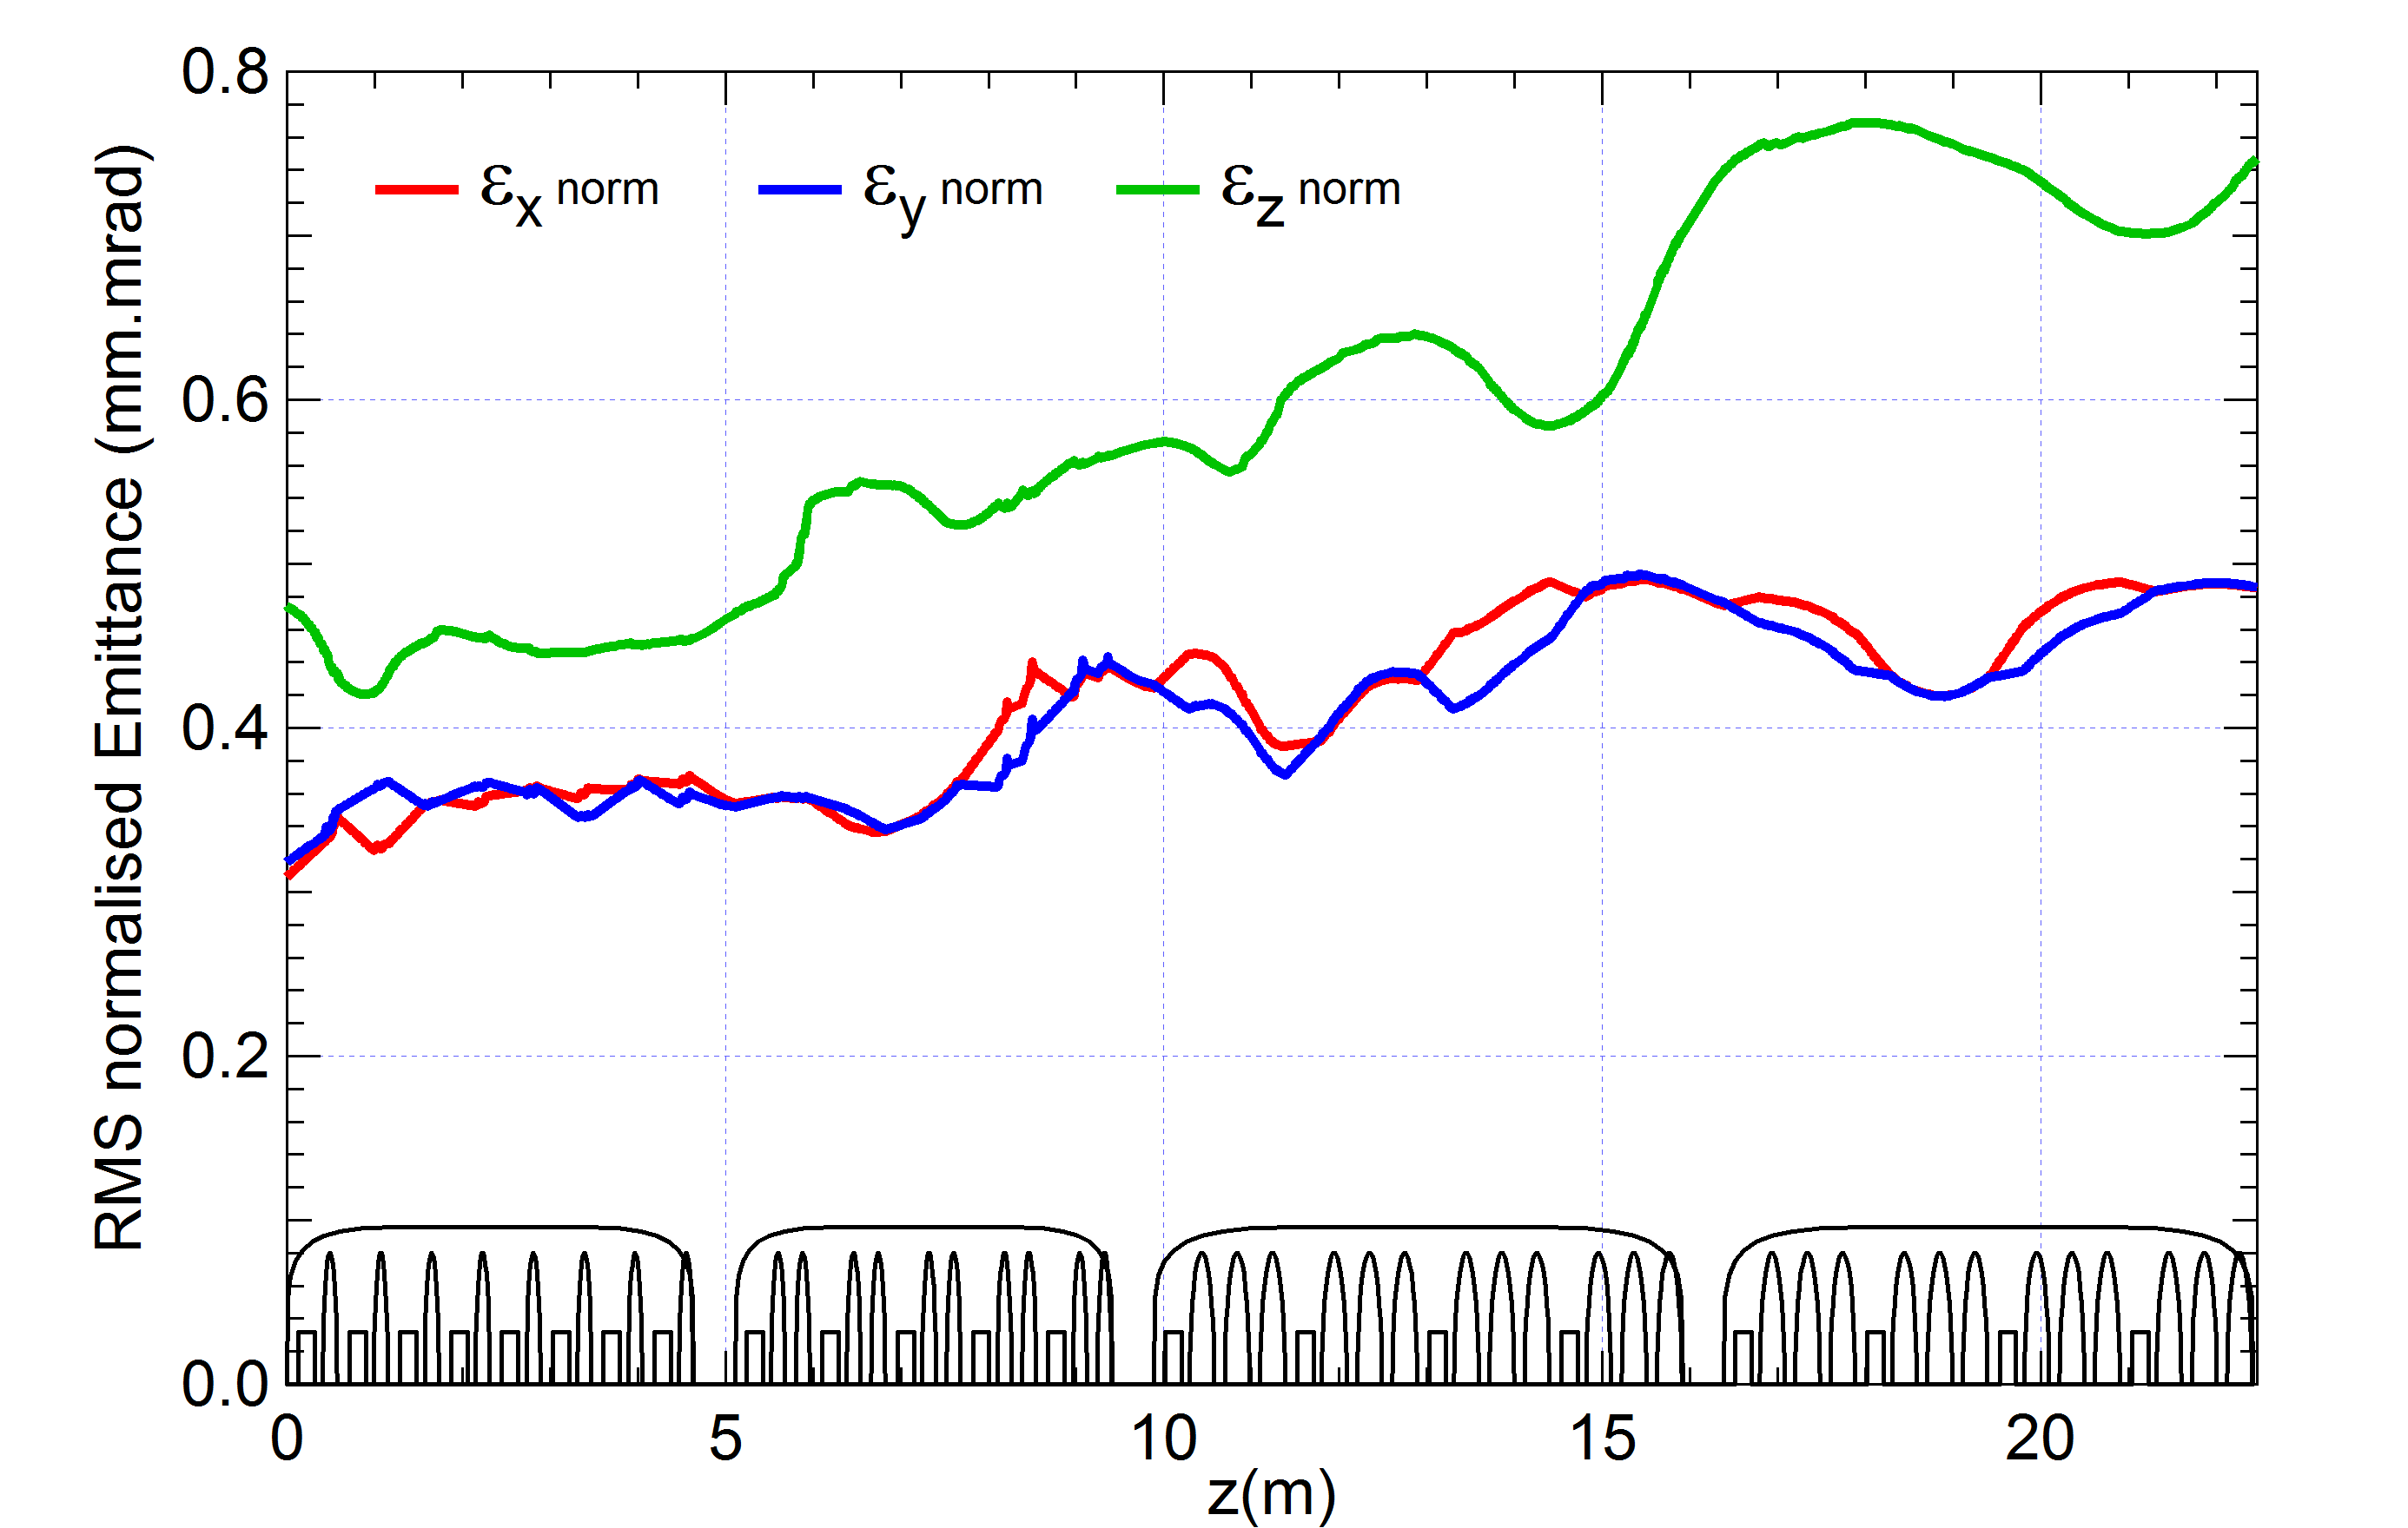
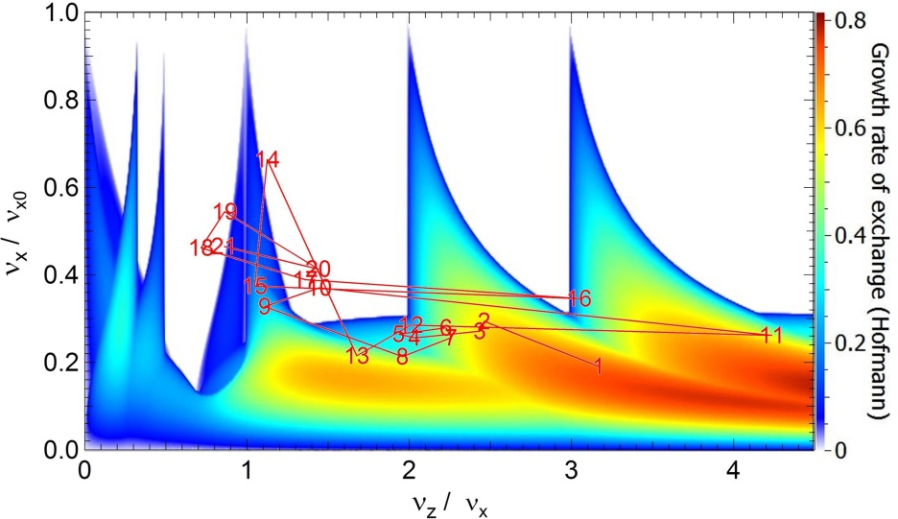
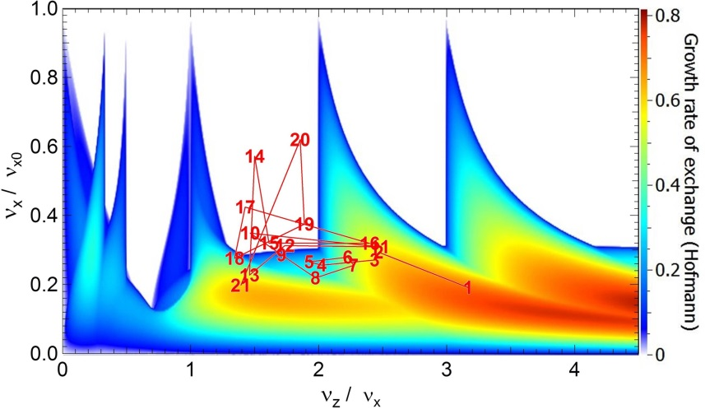
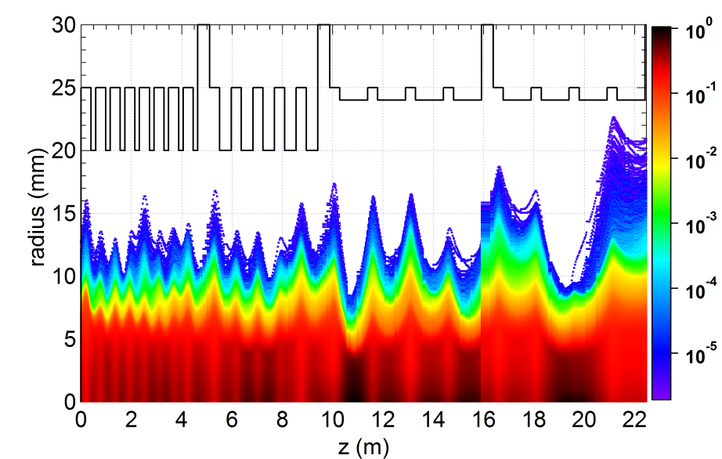
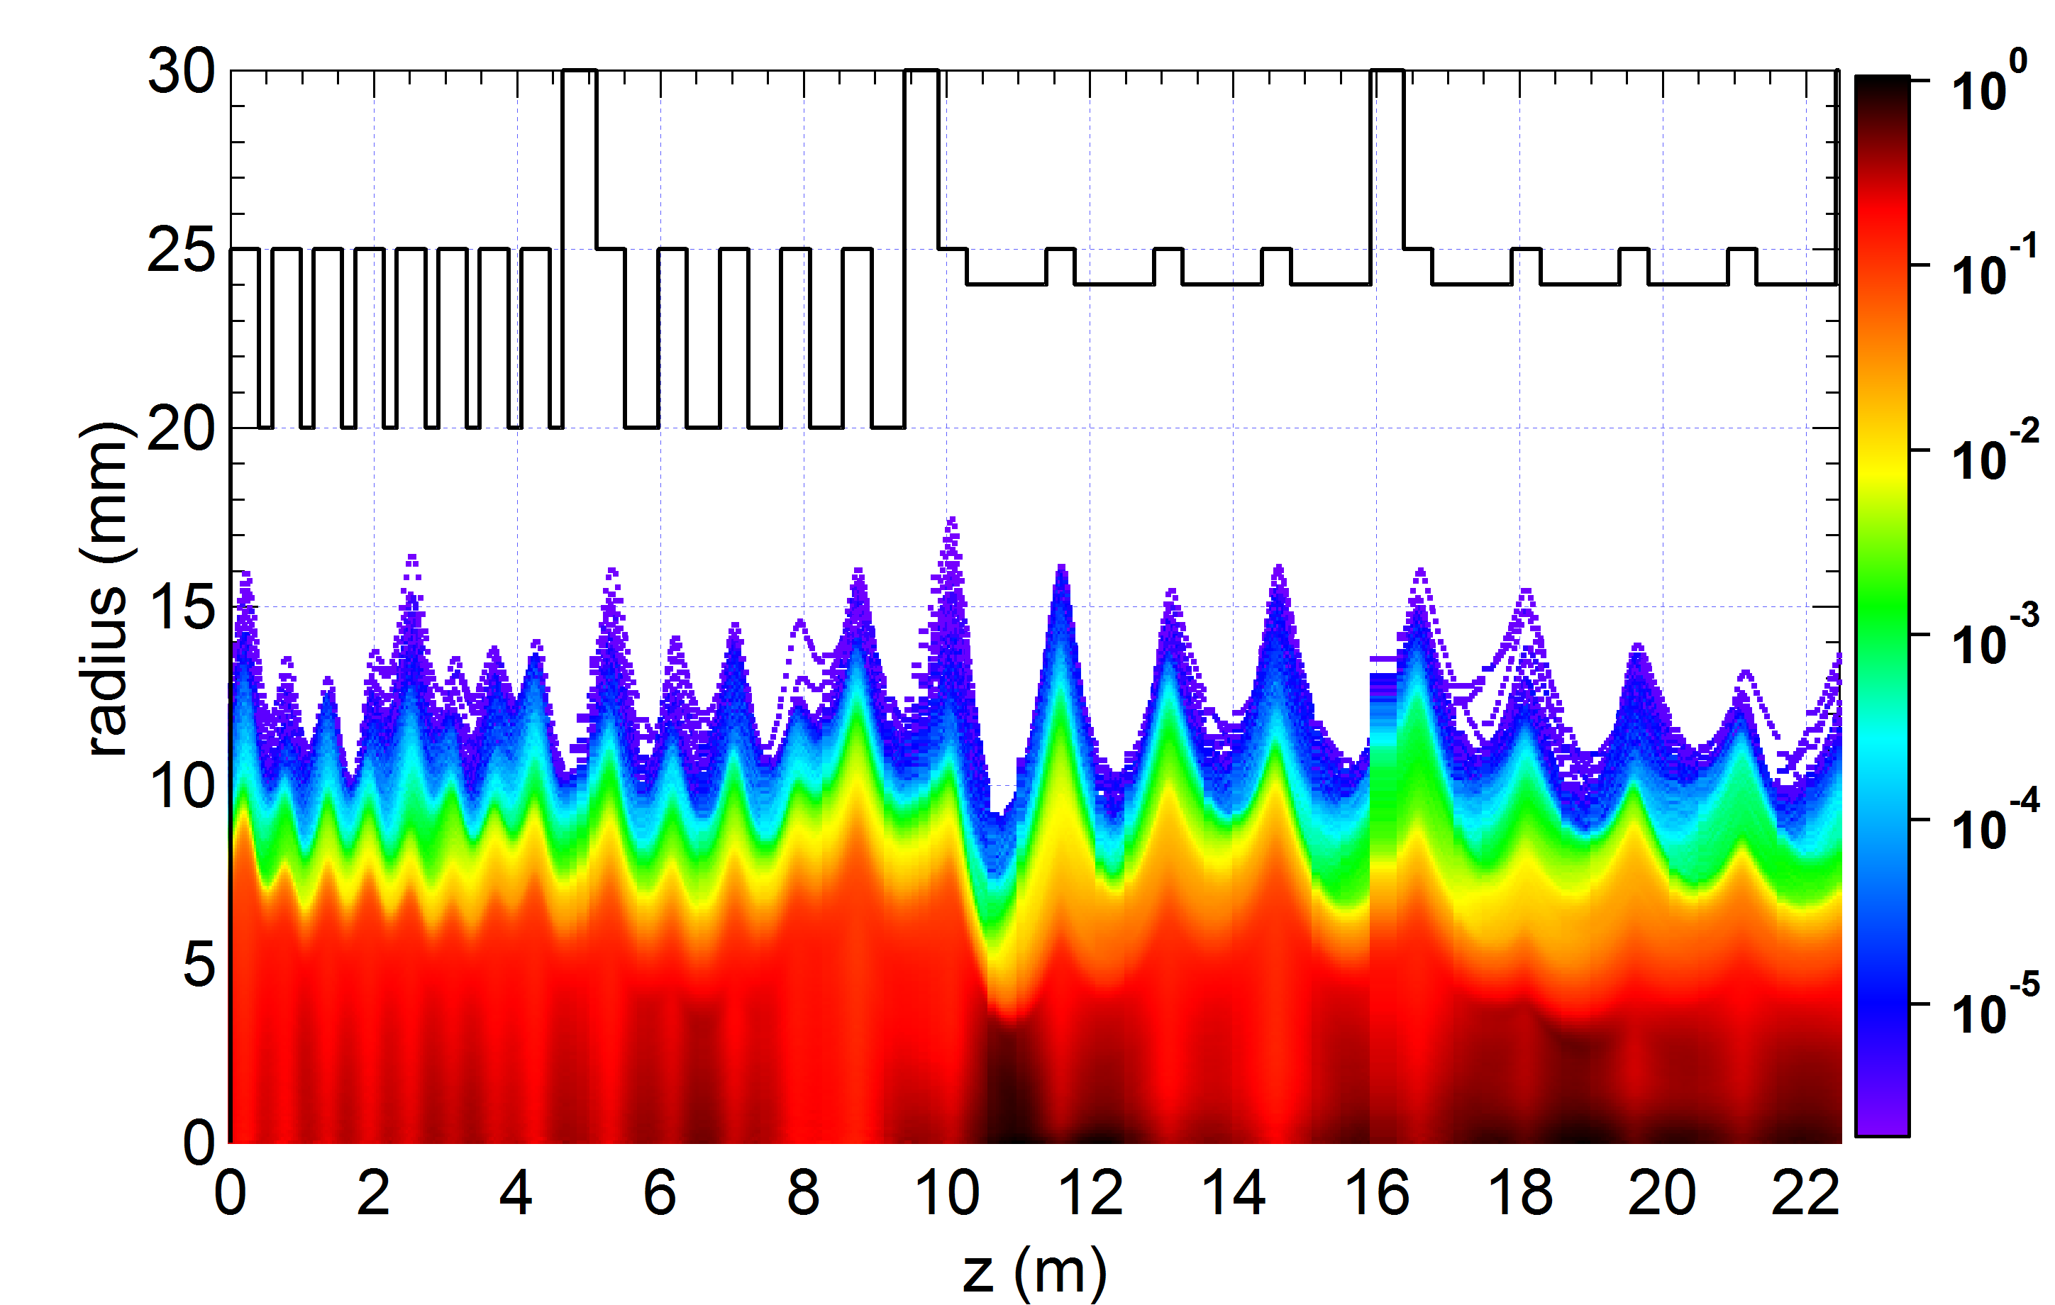
Beam Optimization (2)
Example: IFMIF SRF Linac (Laser Part. Beams 32, 10-118, 2014)
Classically: Emitt. matching
Advanced: Halo matching
1 particle over 10⁶

Slide 14
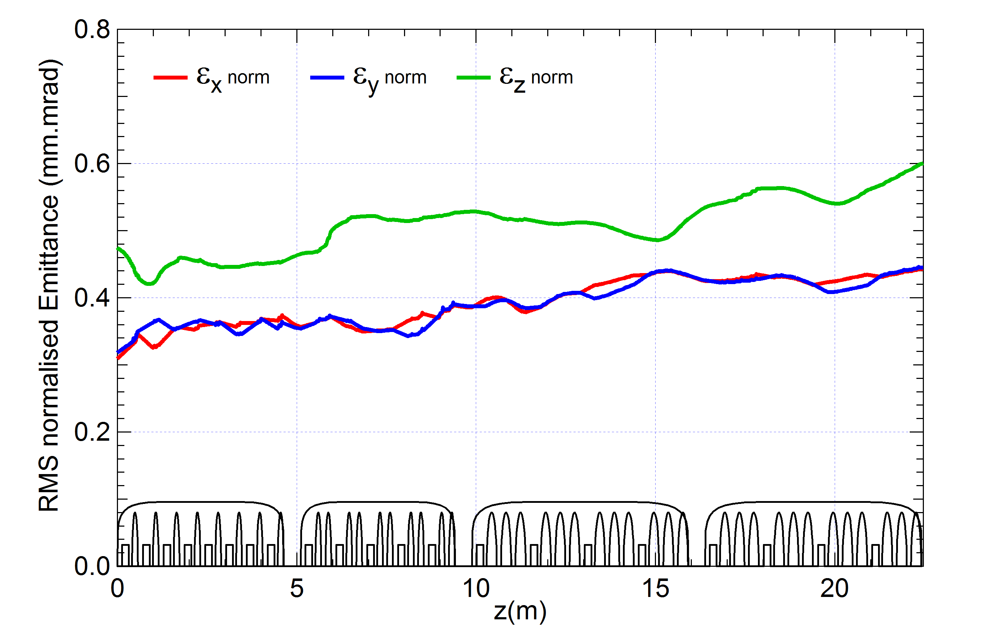
Beam Optimization (3)
Example: IFMIF SRF Linac (Laser Part. Beams 32, 10-118, 2014)
Classically: Emitt. matching
Advanced: Halo matching
1 particle over 10⁶

Slide 15
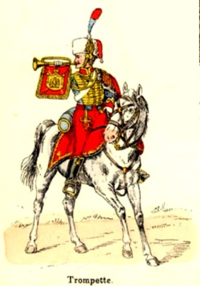

Beam Optimization (4)
Issue: The beam must be optimised to an accuracy of 10⁻⁶
But simulations are not reliable to that accuracy
components are not reproducible to that accuracy
→ Frequent in-situ fine tunings are mandatory
STRATEGY: SELF-RULE
Perform only Beam Dynamics optimizations
that could be reproduced in-situ on the real machine
with the appropriate Beam Diagnostics
in sufficient quantities
In other words:
Each BDyn tuning procedure MUST have its in-situ Avatar on the machine

Slide 16
Beam Optimization (5)
Examples of beam matching …
… to the RFQ
… to the SRF Linac
Optimization
Not to fulfill theor.Twiss param.
But to maximize RFQ transmission
Optimization
Not to minimize RMS envelope, emittance
But to minimize micro-losses
Diagnostic
Current measurements at
RFQ entrance and exit
Diagnostic
Micro-loss measurements
the closest to solenoid vacuum chamber
Rev. Sci. Instru. 83, 02B320, 2012 Proc. of PAC. Vancouver, BC, Canada, 2009
Enough independent diagnostics:
at least the same number as that of available tuneable parameters

Slide 17
Advanced methods and concepts
New idea for: Beam analysis
New protocol for: Beam loss prediction
New method for: Beam optimization
New strategy for: Beam measurement
New concept for: Beam characterization

Slide 18
Beam Measurement (1)
High Power
Losses << 10⁻⁶
HIGH INTENSITY
High intercepted Power
Strong Space Charge
B Dyn simulations are not precise at the level of 10⁻⁶ !
Strong non-linear effects
High sensitive settings
Delicate optimisations
Compact structure
to limit beam halo,
emittance growth
Deposited power on diagnostic devices ~ kW
Machine tuning based on beam diagnostics is mandatory
Lack of space for installing
diagnostic devices
Interceptive devices not possible
Diagnostics not only necessary for beam characterization
But also critical for achieving targeted performances
Conflicting
Issues !!
Installation of
diagnostic devices
difficult or not possible

Slide 19
Beam Measurement (2)
Classically: A lot of measurements, no need of sorting, classification
Advanced: clearly distinguish between
ESSENTIAL measurements
- for commissioning & tuning & operating the accelerator
- in order to meet required specifications of current and losses
- direct impact on the achievement of accelerator specifications
- available for everyday beam tuning at full power, non interceptive
- beam position, beam phase, current, losses, micro-losses
CHARACTERIZATION measurements
- for beam commissioning or beam study or beam dynamics understanding
- could be measurements during beam commissioning only, if lack of room
- could be interceptive devices for low duty cycle, if pb of power deposition
- transverse profile, emittance, halo, energy spread,
- mean energy, bunch length

Slide 20
Beam Measurement (3)
Errors
Essential:
Automatic
correction
algorithm
Measurement: with Bdiag
Correction: with corrector
Characterization: Knowledge, Understanding, Surveillance
Definition of the complete beam diagnostic system

Slide 21
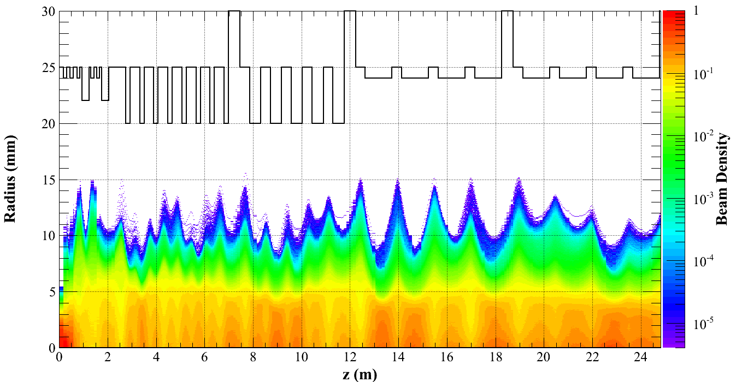
Beam Measurement (4)
Example of essential diag: Microloss monitors for IFMIF
Best μLM: CVD diamond
Best correction: PSO (Part. Swarm Opt.) algorithm
⇒ Ideally as many μLM as foc. elements upstream (one-to-one correspondence)
⇒ Located at foc.elements where loss probability is the highest,
and the closest to the beam to allow locating losses
(Proc. of DIPAC11, Hamburg, Germany)
(Proc. of PAC09, Vancouver, Canada)
1 macroparticle over 10⁶
Performances: resolution 1/10 of maximum allowed losses

Slide 23
Advanced methods and concepts
New idea for: Beam analysis
New protocol for: Beam loss prediction
New method for: Beam optimization
New strategy for: Beam measurement
New concept for: Beam characterization

Slide 24
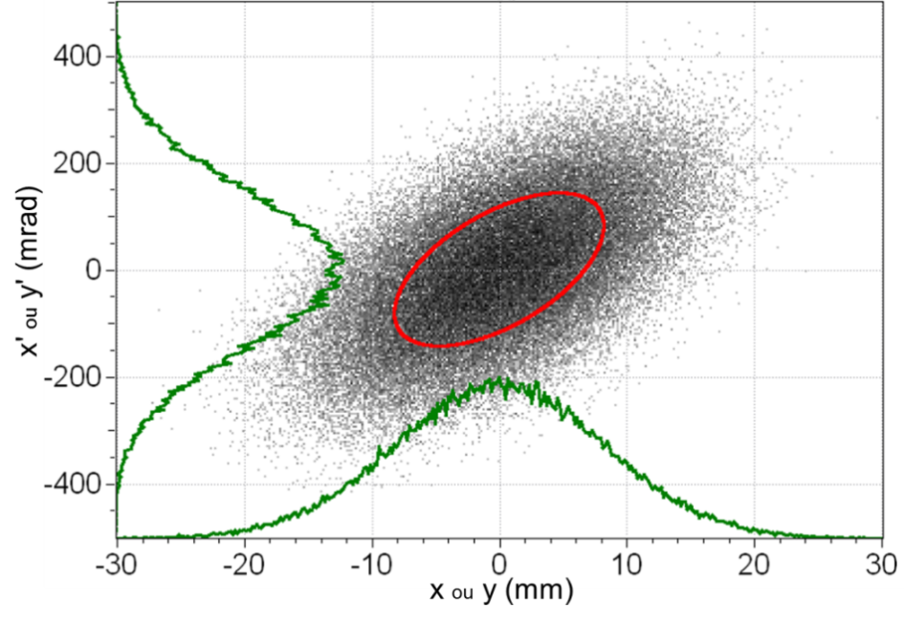
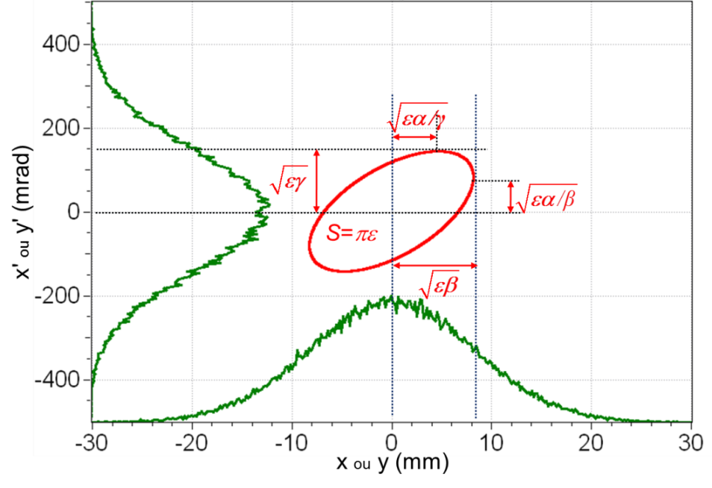
Beam Characterization (1)
Classically
10⁶ particles in 6D phase space
→ 6 10⁶ parameters
→ very big number → num. simulations
Concentration ellipse
RMS ε, α, β (,γ)
→ 3 global parameters
High intensity
10⁹ particles in 6D phase space
→ 6 10⁹ parameters
→ huge number
RMS ε, α, β (,γ)
Not enough !!

Slide 25
Beam Optimization (3)
Example: IFMIF SRF Linac (Laser Part. Beams 32, 10-118, 2014)
Smaller emittance: Bigger size
Bigger emittance: Smaller size

Slide 26
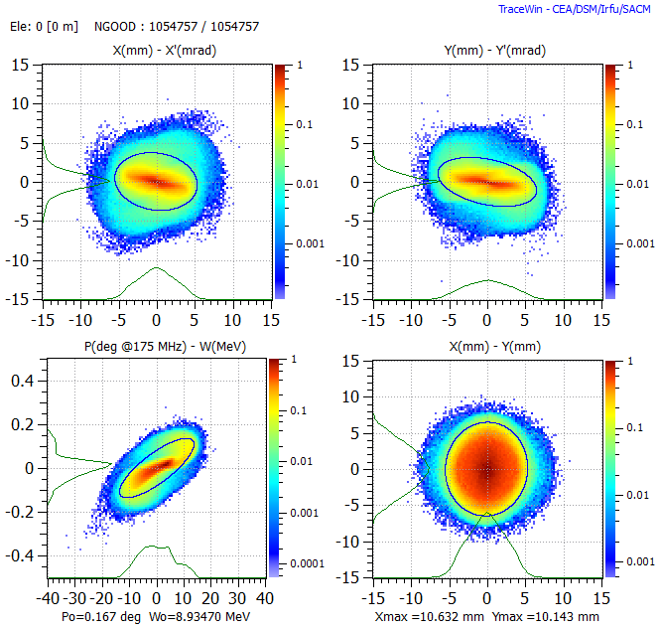
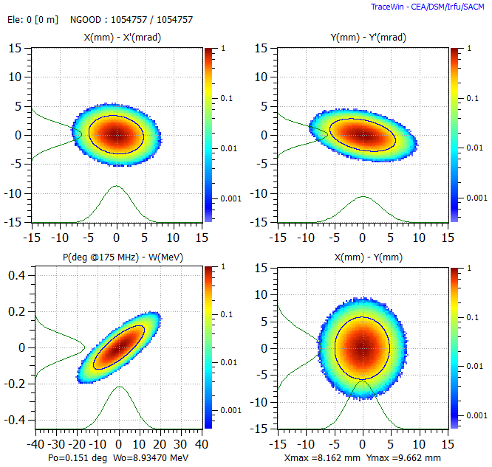
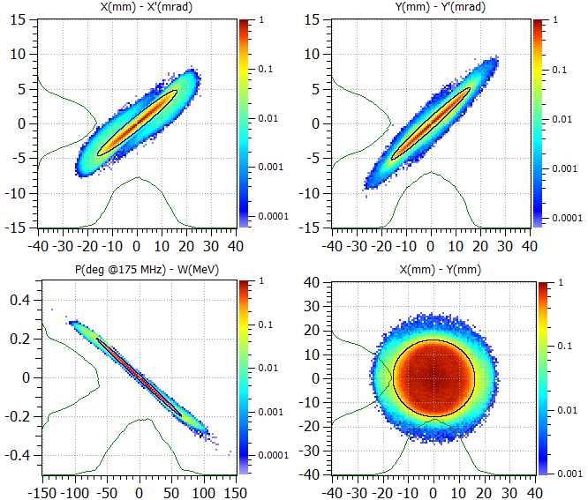
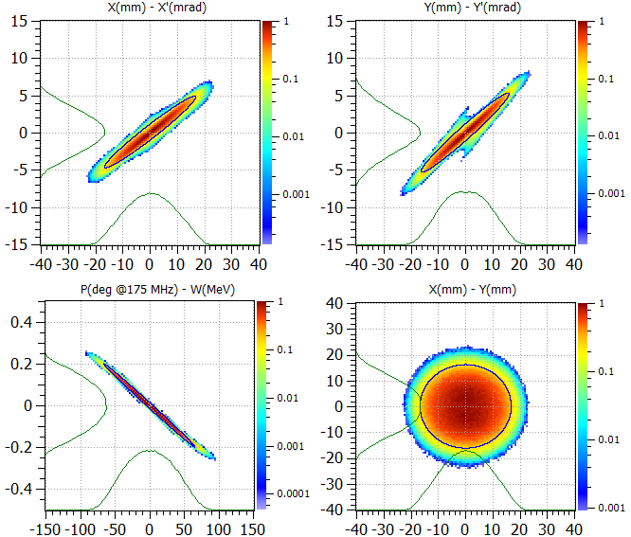
Beam Characterization (2)
HEBT entrance
exactly same α,β,γ,ε
"Nominal" distribution
Gaussian distribution
3.5 m downstream
through 3 quadrupoles:
significantly different beam outputs
α,β,γ,ε

Slide 27
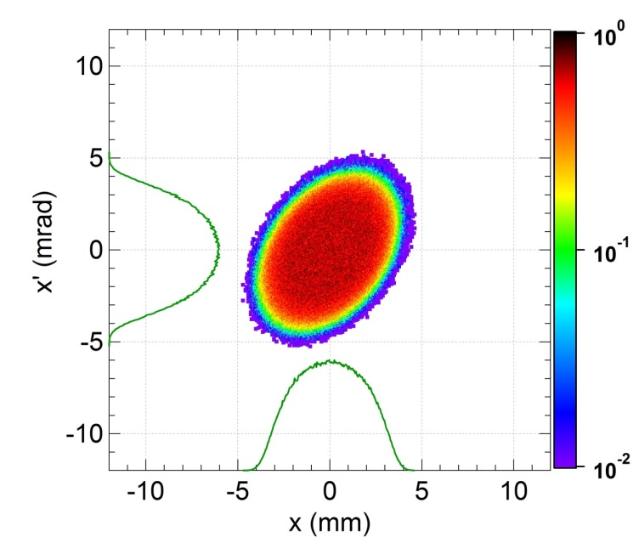
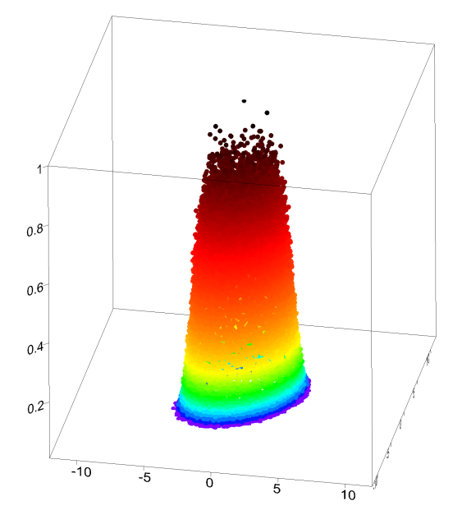
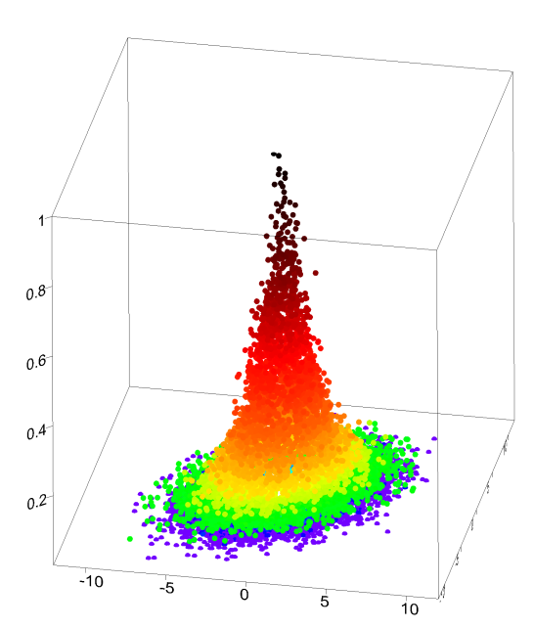
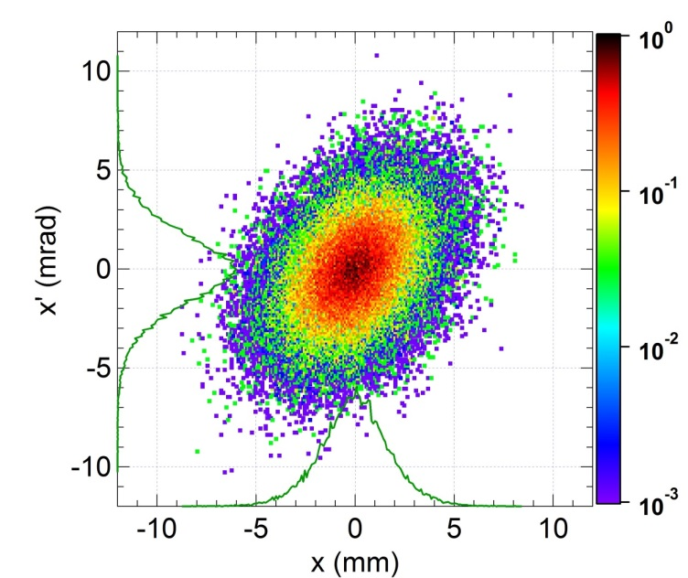
Two different beams...

Slide 28
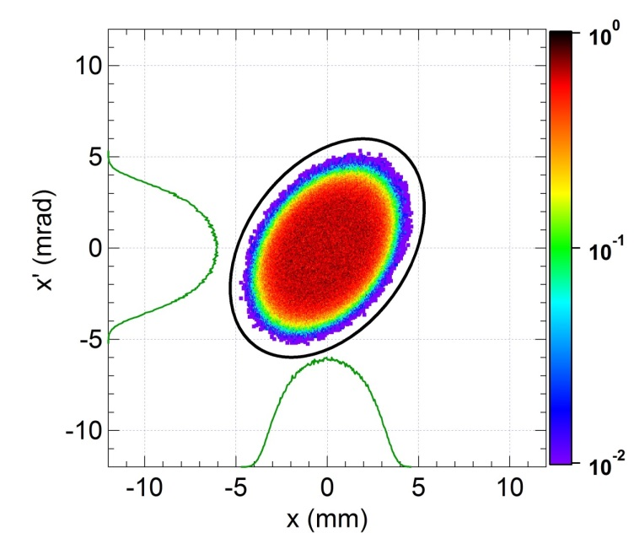
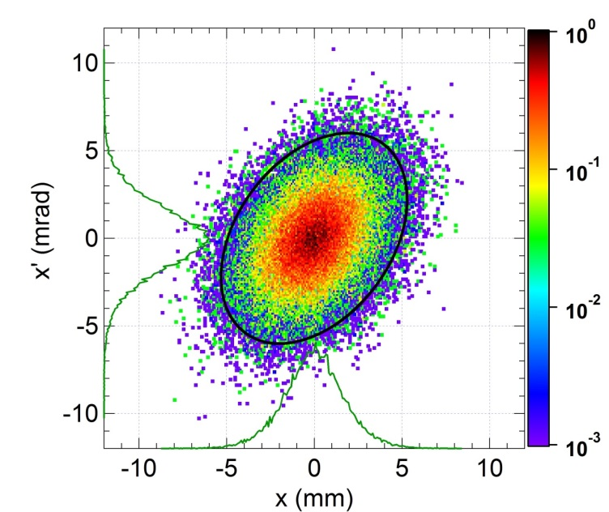
Same Emittance but different Halos
ε = 3.30, α = -0.40, β = 0.95
ε = 3.30, α = -0.40, β = 0.96

Slide 29
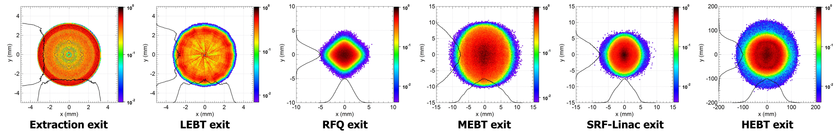
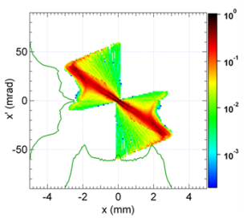
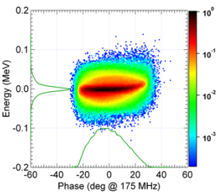
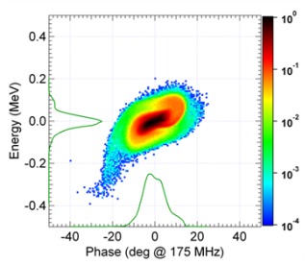
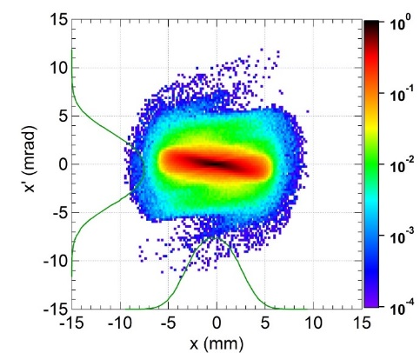
Example: Beam along the IFMIF prototype accelerator

Slide 30
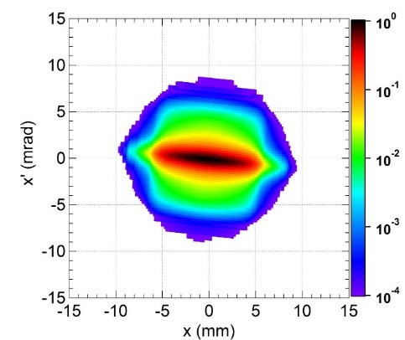
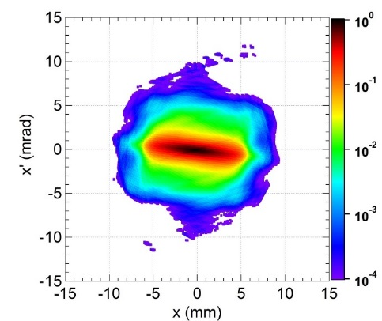
Beam Characterization (4)
Advanced:
1) Massive simulations with the actual number of particles
5 10⁹ particles (125 mA) for IFMIF-LIPAc (WEPOY032, IPAC'16)
→ 175 processors for 25 days
→ confirm losses < 10⁻⁷
→ representative statistics of microlosses
2) Characterize the beam by its projections onto a few axes
MENT method: reconstruct a distribution from its projections (MOPOR032, IPAC'16)
Projection axes correctly chosen
→ 2 projections for the core
→ 6 projections for the external parts
→ ~ 10 - 30 parameters for 2D
2 projections
6 projections
Actual distribution
3) Characterize the beam by its core and halo separately
Loose fine details but gain more insight into the physics of the beam

Slide 31
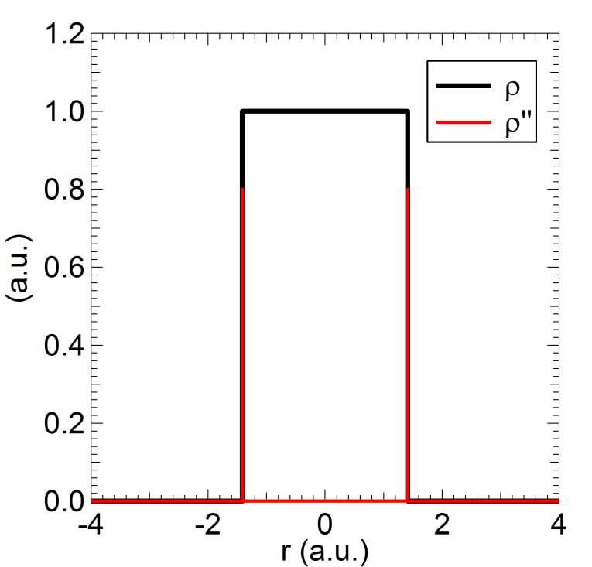
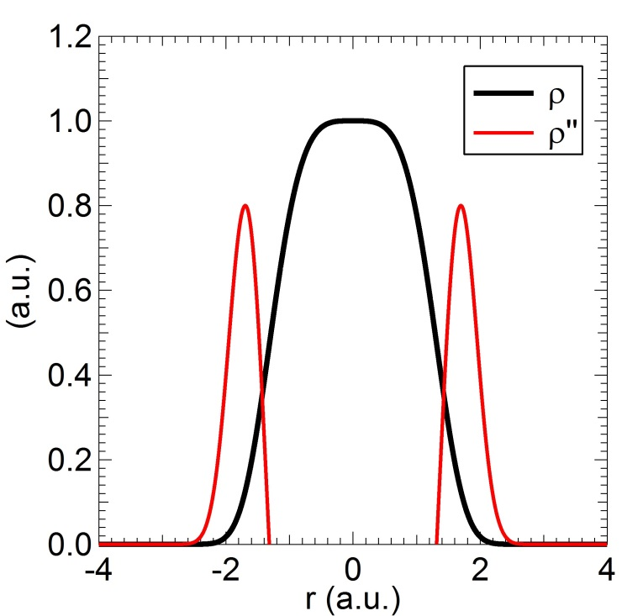
Beam Characterization (5)
We propose: Core-Halo limit based on the beam internal dynamics
Appl. Phys. Lett. 104, 074109, 2014
Extreme case:
Core: uniform, sc force strictly linear
Halo: tenuous, sc force nonlinear
→ core-halo limit: very steep (infinite)
variation of the slope
General case:
Continuously varying density
Core-Halo limit: steepest variation of
the slope → max of 2nd derivative
→ Core & Halo are submitted to two
different space charge force regimes
Phys. Plasmas 22, 083115, 2015: This core-halo limit ≡ good indicator of beam internal dynamics

Slide 32
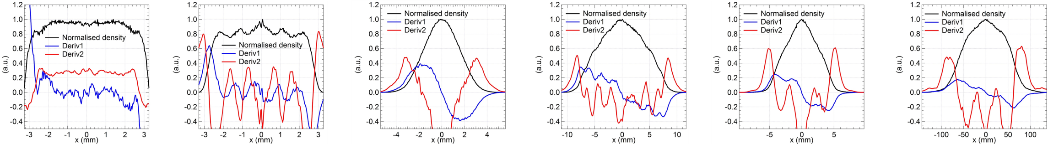
Beam Characterization (6)
Example: Beam along the IFMIF prototype accelerator

Slide 33
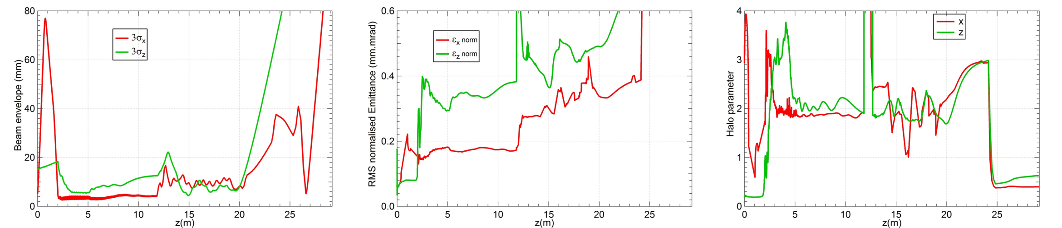
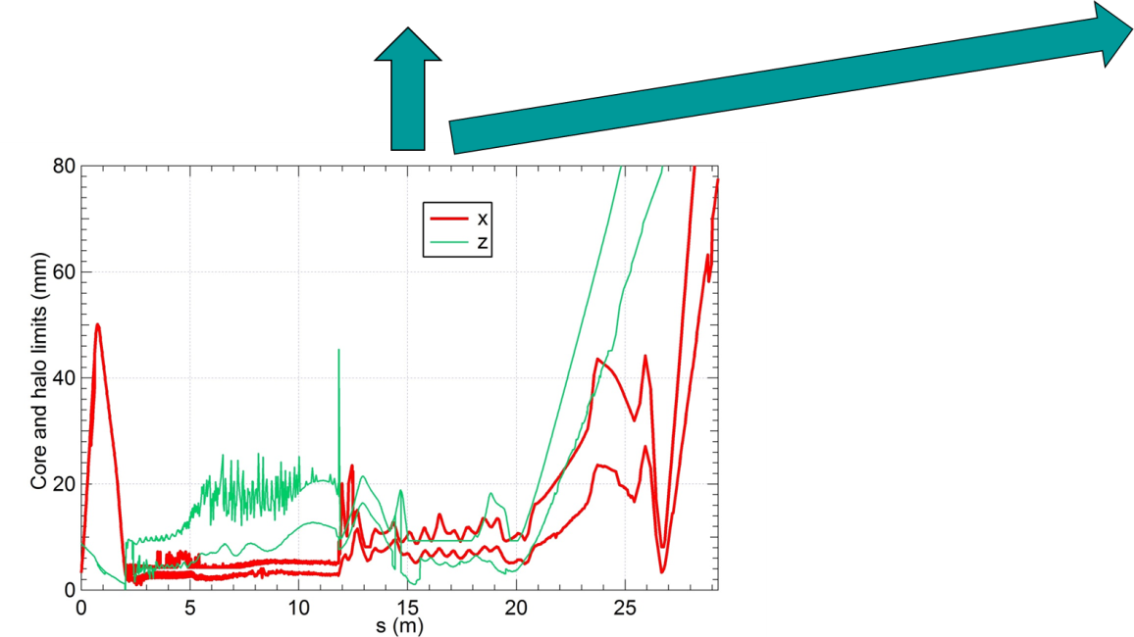
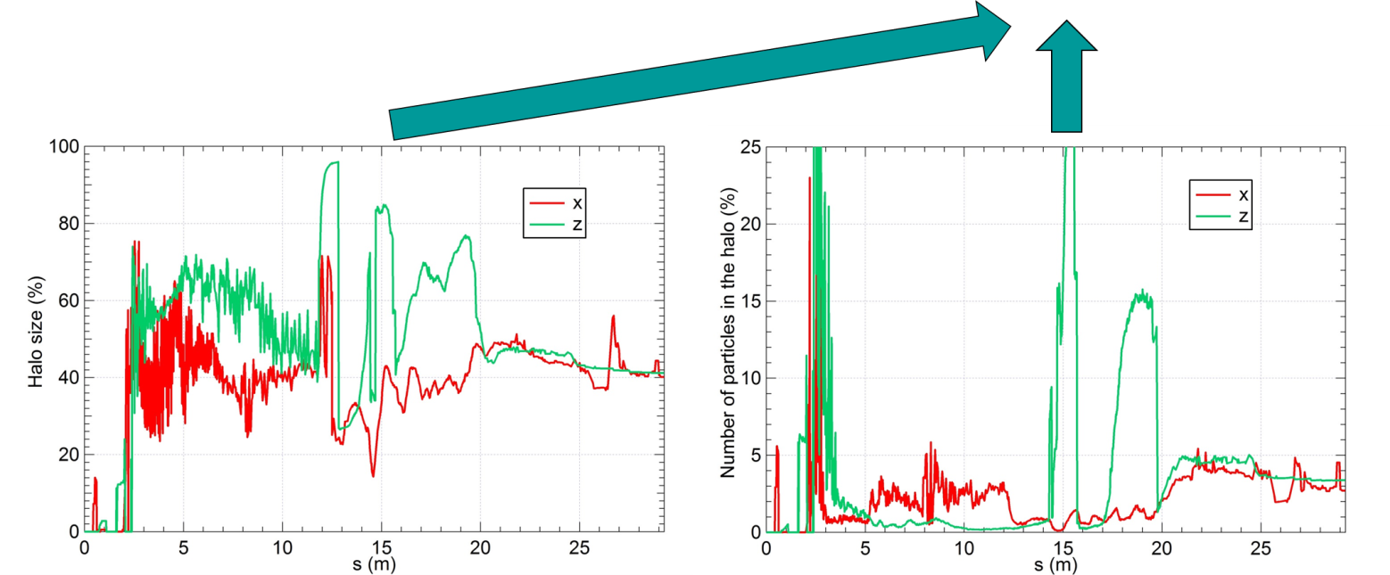
Beam Characterization (8)
Example: Beam along the IFMIF Prototype accelerator
Classically
PHS
PHP
Advanced

Slide 34
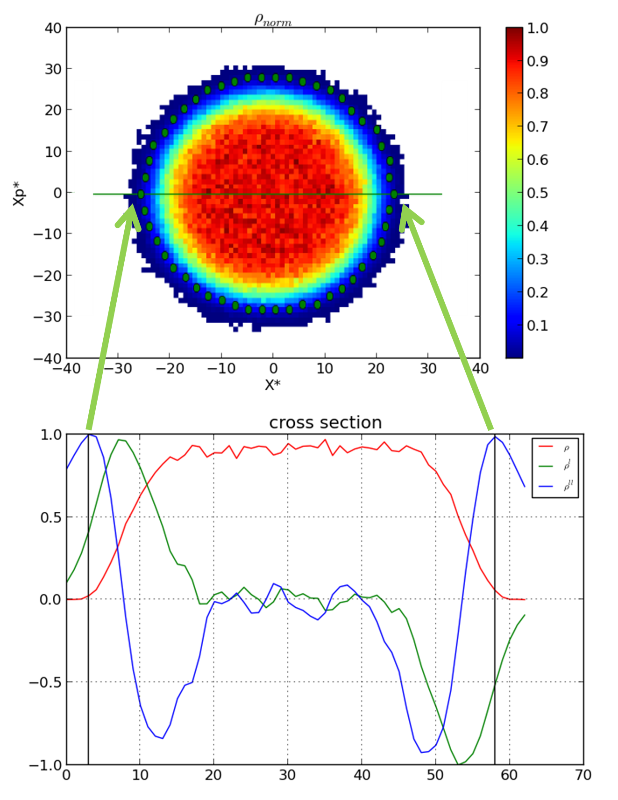
Beam Characterization (10)
MOPWA010, IPAC'15: Extension to 2D
"Wheel algorithm": Max of second derivative
along many sections
Core-Halo limit contour
PHS, PHP
Emittance ε and Twiss parameters α, β, γ
of the core and the halo separately
THPMR014, IPAC'16:
This Core-Halo limit contour is consistent
with the well-established halo formation dynamics

Slide 35
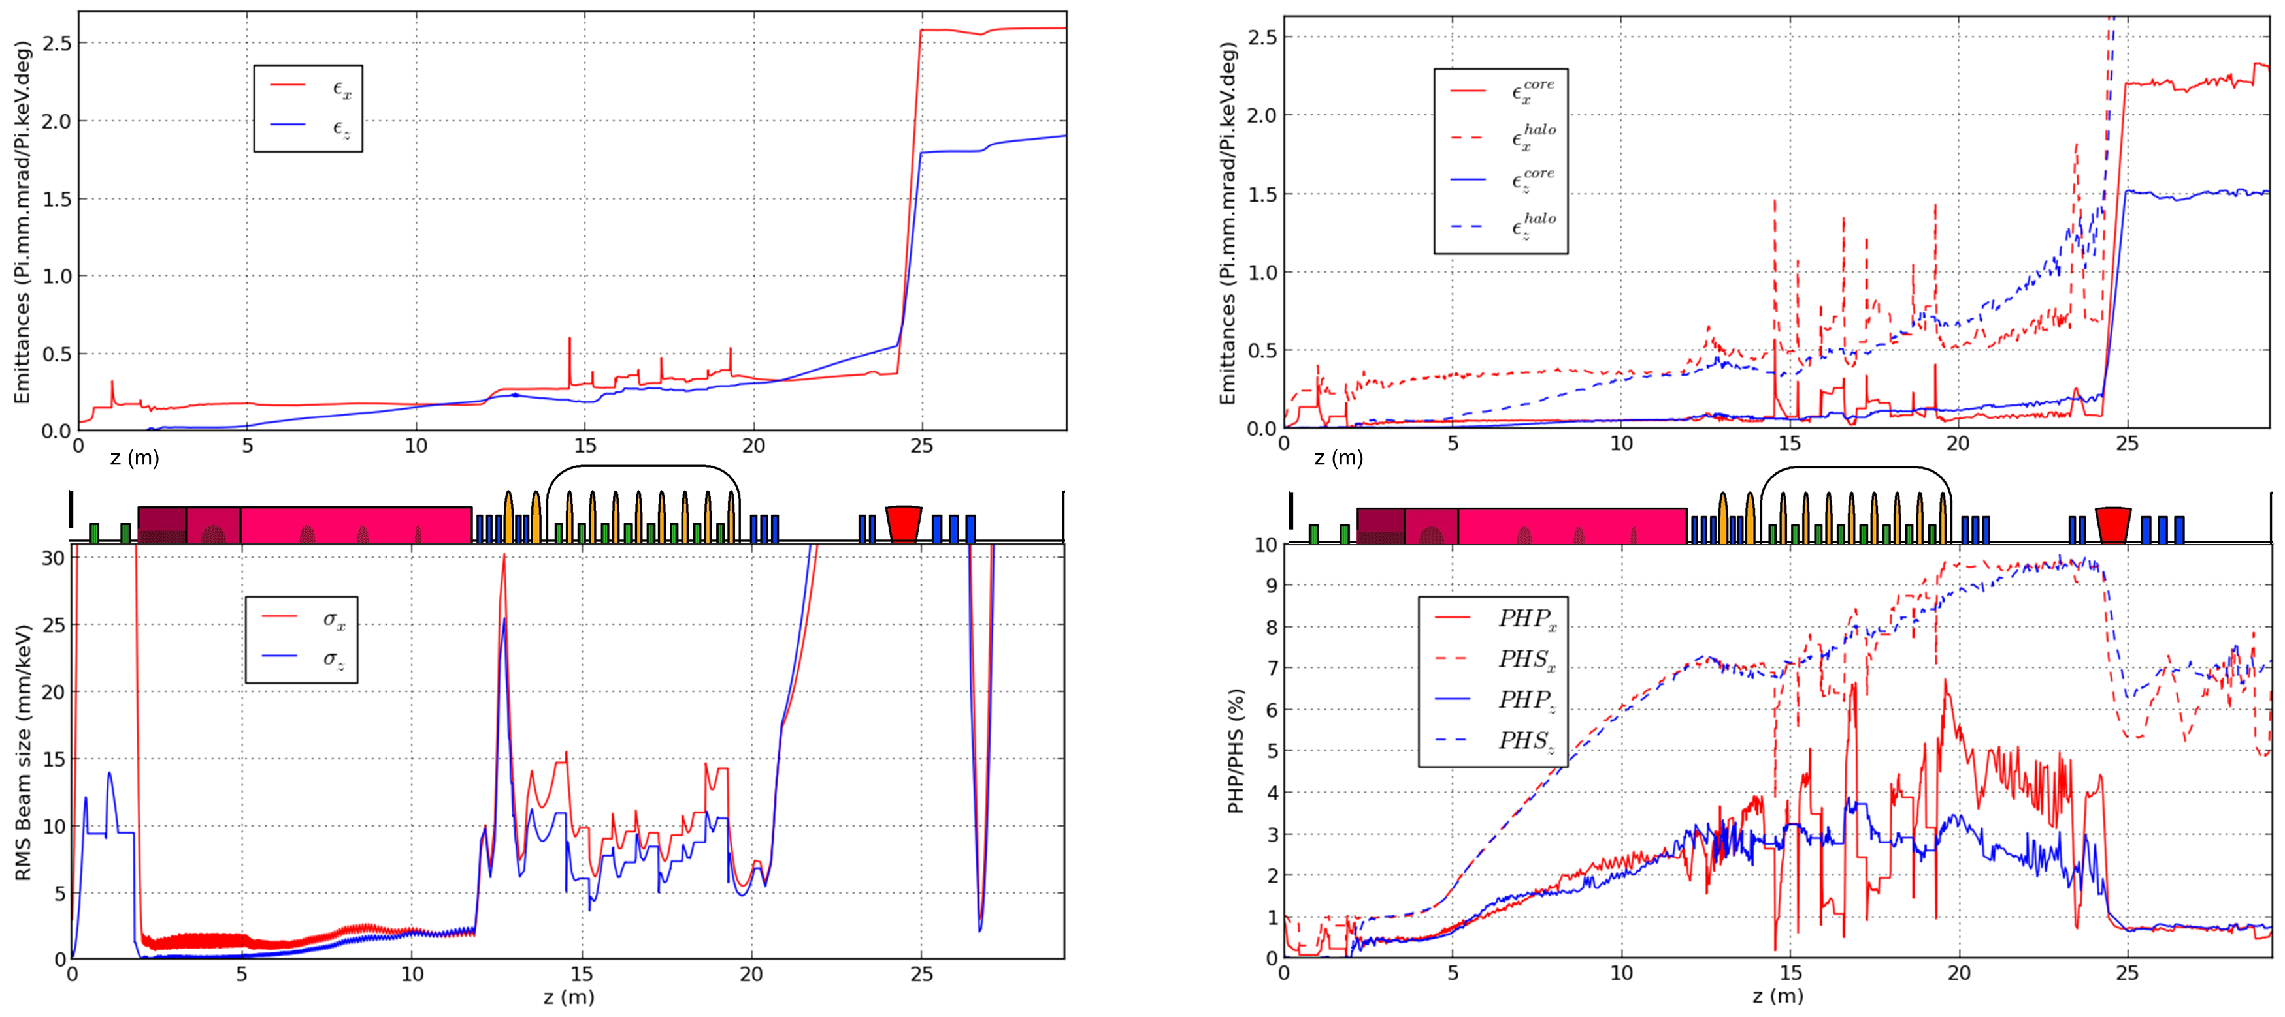
Beam Characterization (11)
Classically
Advanced

Slide 36
Summary
High intensity
High power
Strong space charge
Combination of the two aspects → new and serious issues
Advanced methods and concepts:
Catalogue of Losses, Halo matching, online Avatar of BD optimization,
Essential and Characterization diagnostics, Core-Halo limit, PHS, PHP
For the five purposes of:
Beam analysis, beam loss prediction, beam optimization
beam diagnostic and beam characterization
Laser Part. Beams 32, 639-649, 2014

Slide 37
Extra

Slide 38
Two different beams...

Slide 39
Same Emittance but different Halos
ε = 3.30, α = -0.40, β = 0.95
ε = 3.30, α = -0.40, β = 0.96

Slide 40
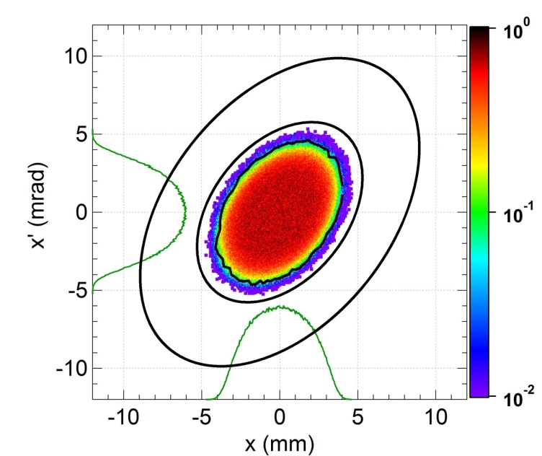
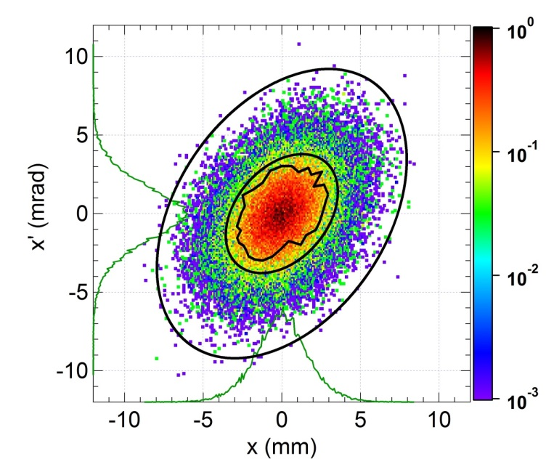
ε α β
Global 3.30 -0.40 0.96
Core 3.15 -0.41 1.00
Halo 8.95 -0.46 1.00
PHS=28.9% PHP=3.2%
ε α β
Global 3.31 -0.40 0.95
Core 1.40 -0.39 1.01
Halo 7.56 -0.40 0.93
PHS=90.1% PHP=30.9%

