Slide 1
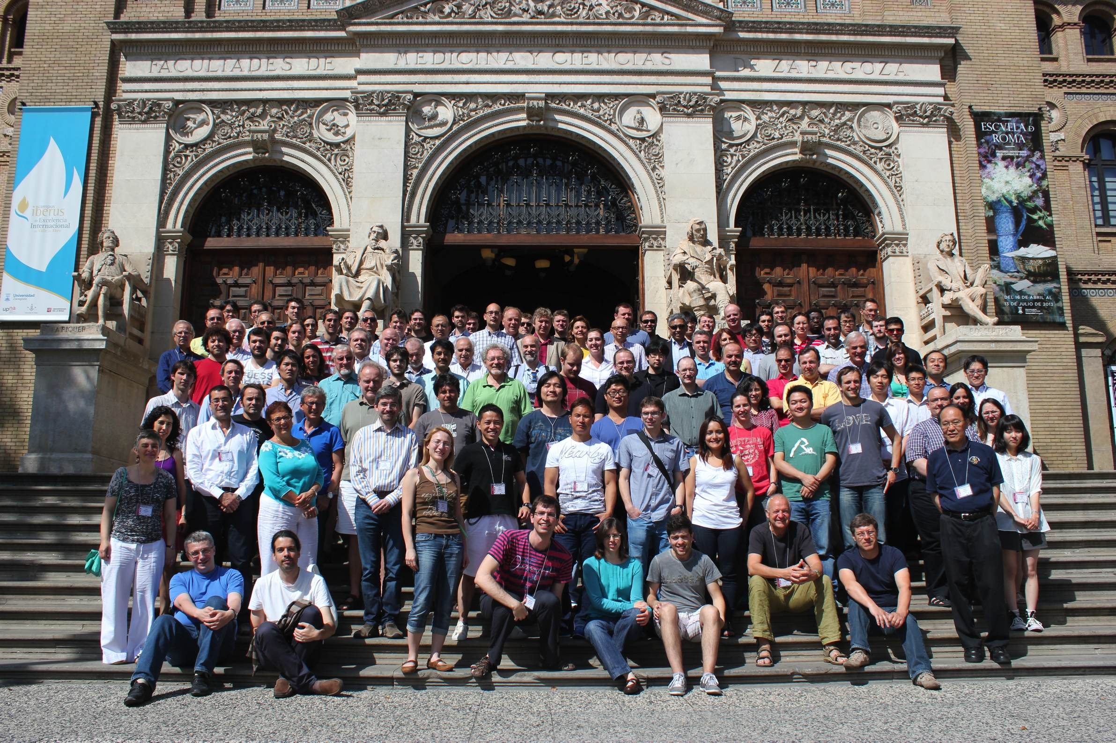
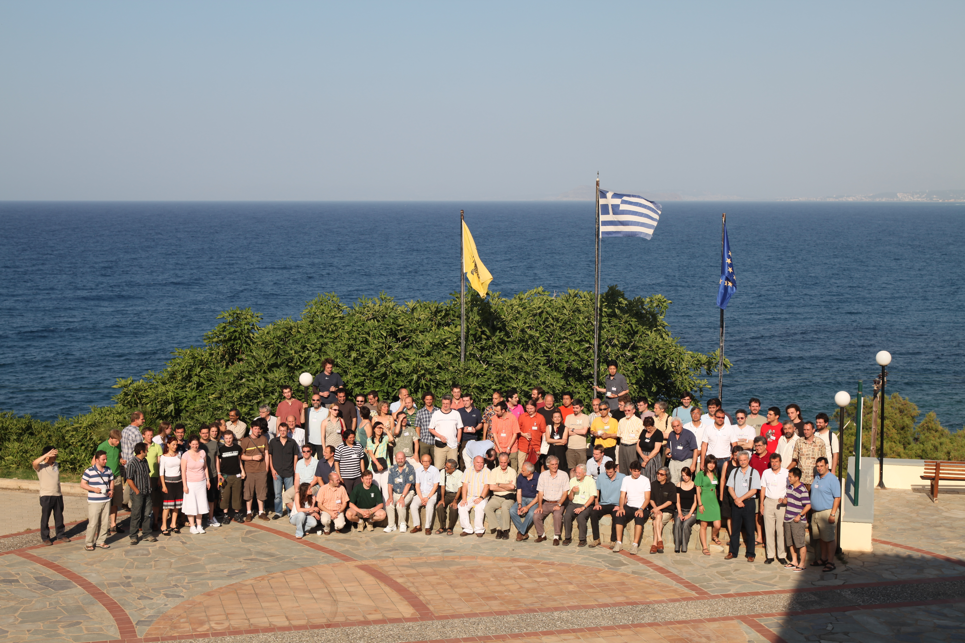
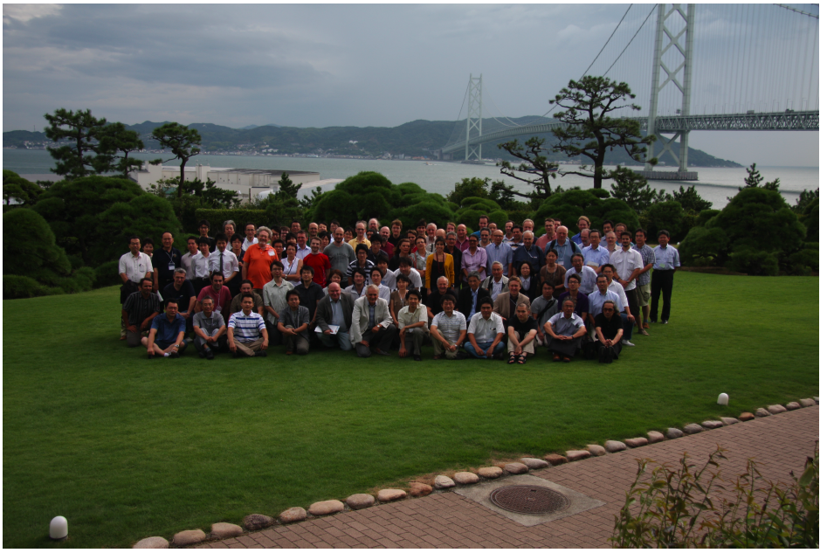
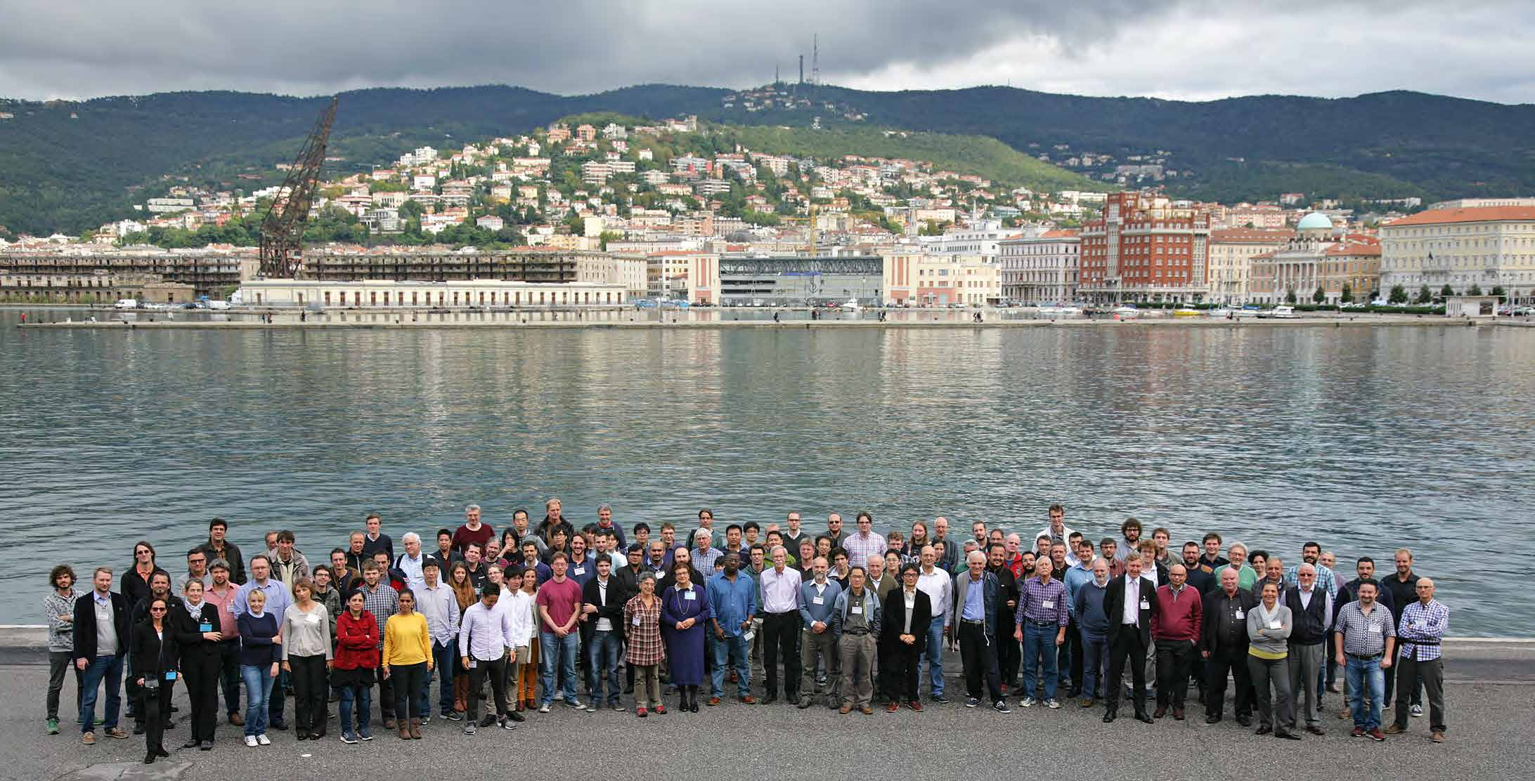
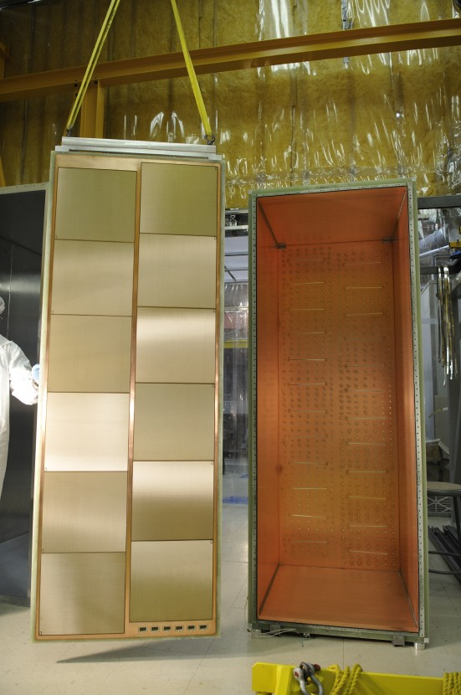
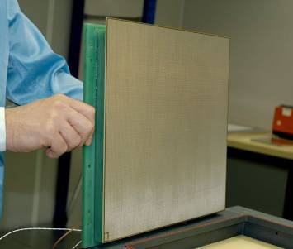
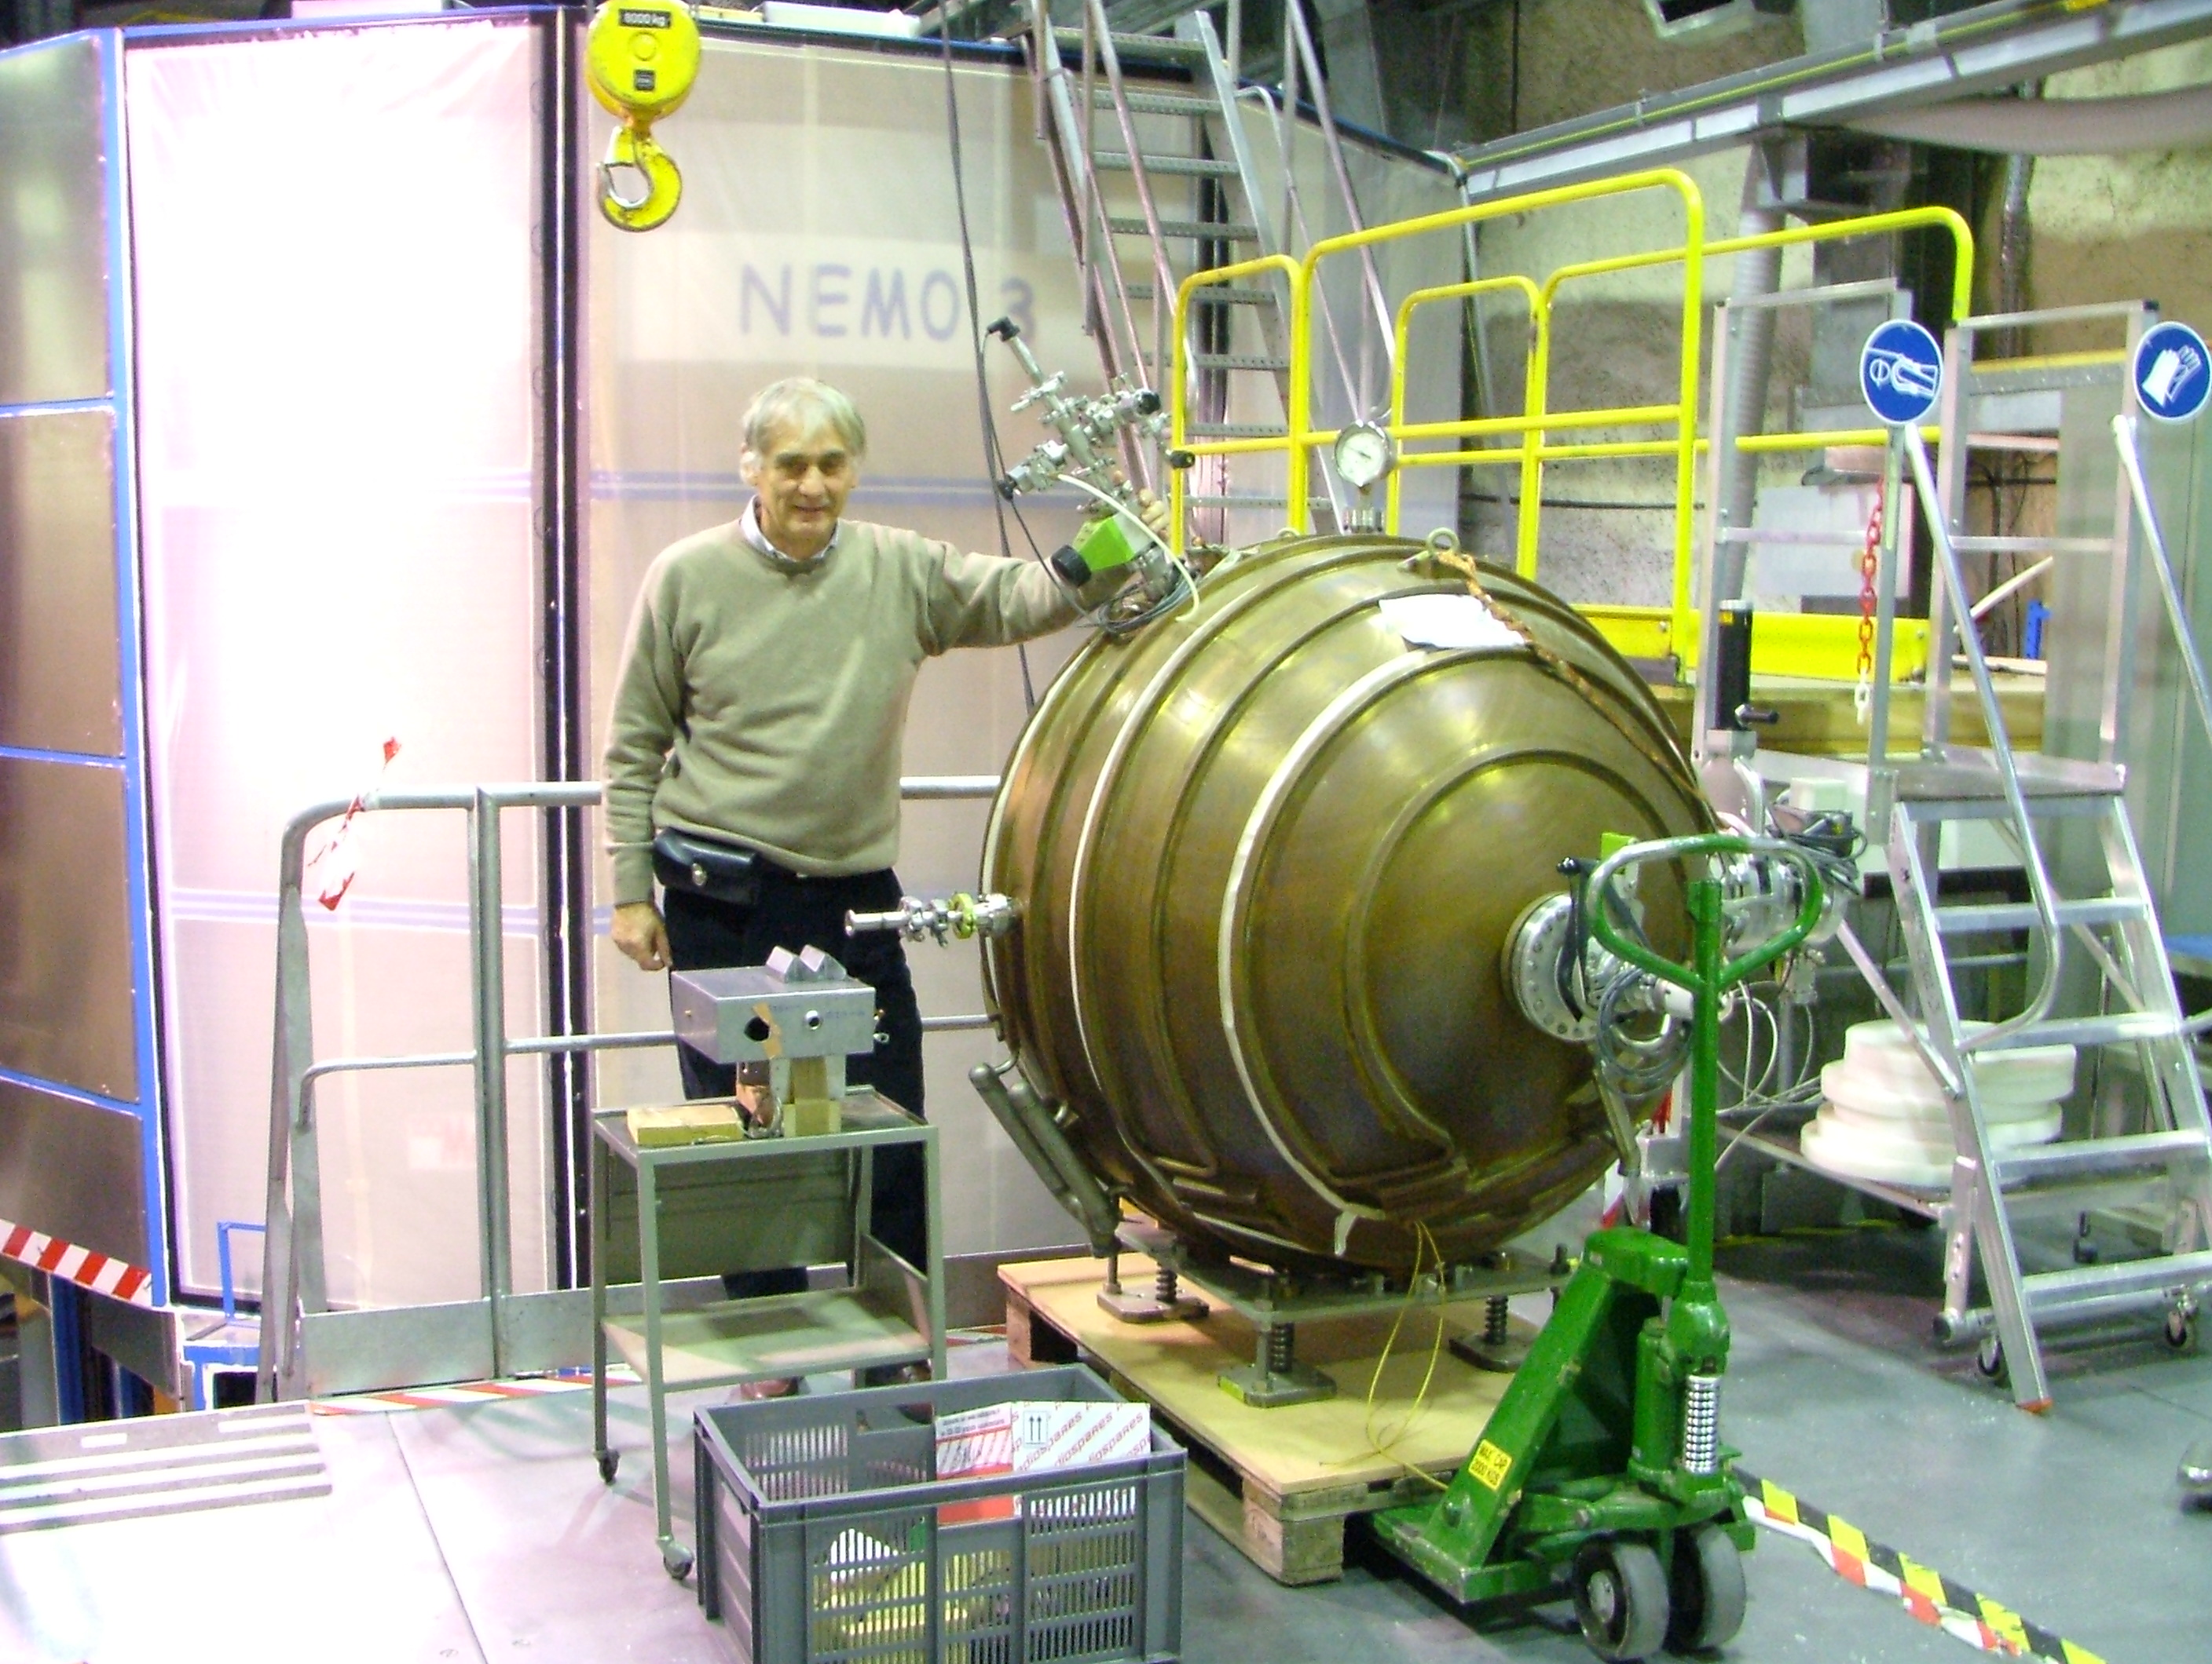
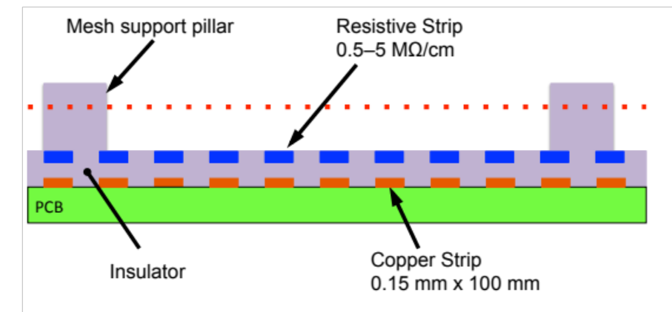
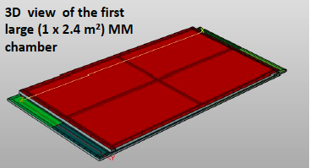
Gaseous detectors: current and future developments
I. Giomataris CEA-Saclay
MPGD2013, Saragoza, Spain
MPGD2009, Kolymbari, Crete, Greece
MPGD2011, Kobe, Japan,
MPGD2015, Trieste, Italy
Charged particle
T2K
Drift cathode
Grid
mms or cms
~ 1 kV/cm
Spherical detector
Anode
ATLAS
Notes:
1

Slide 2
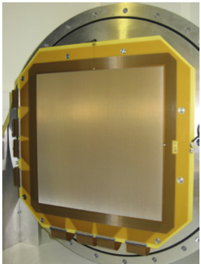
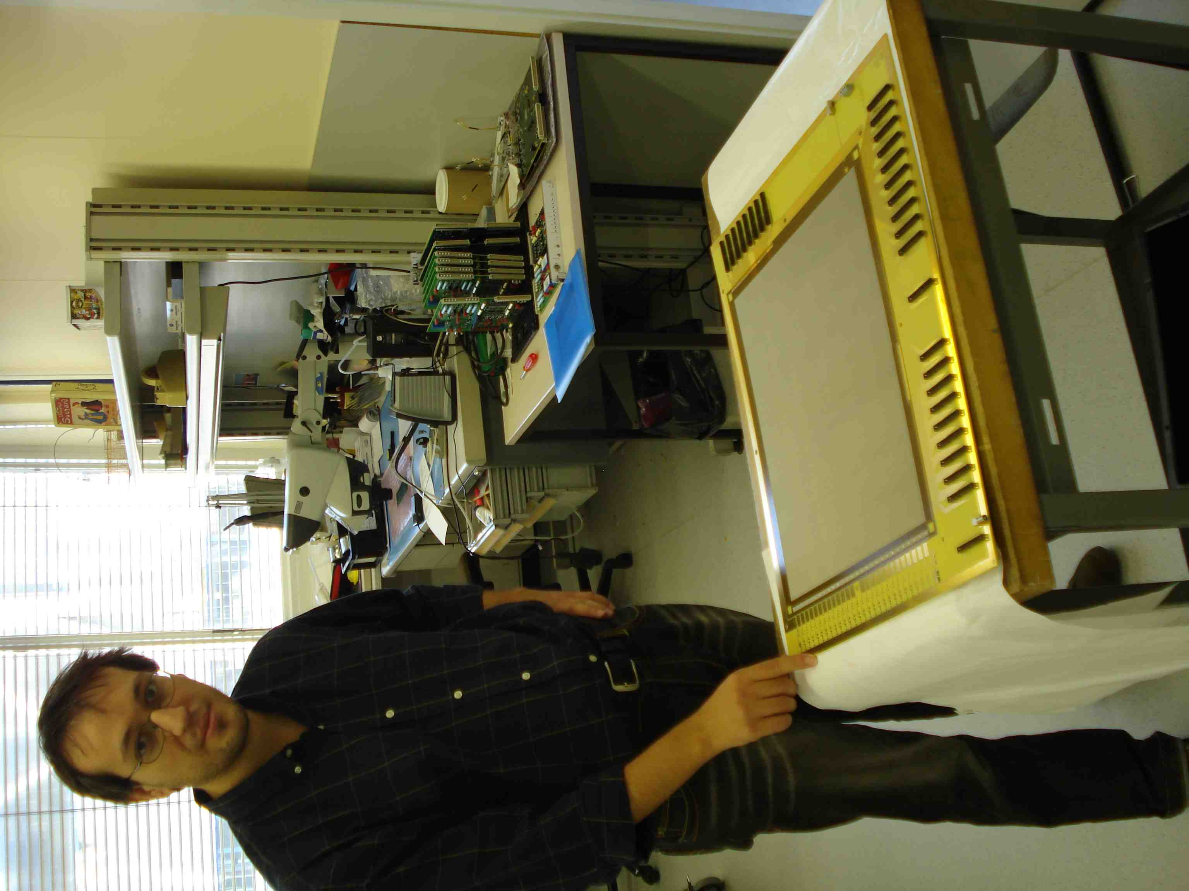
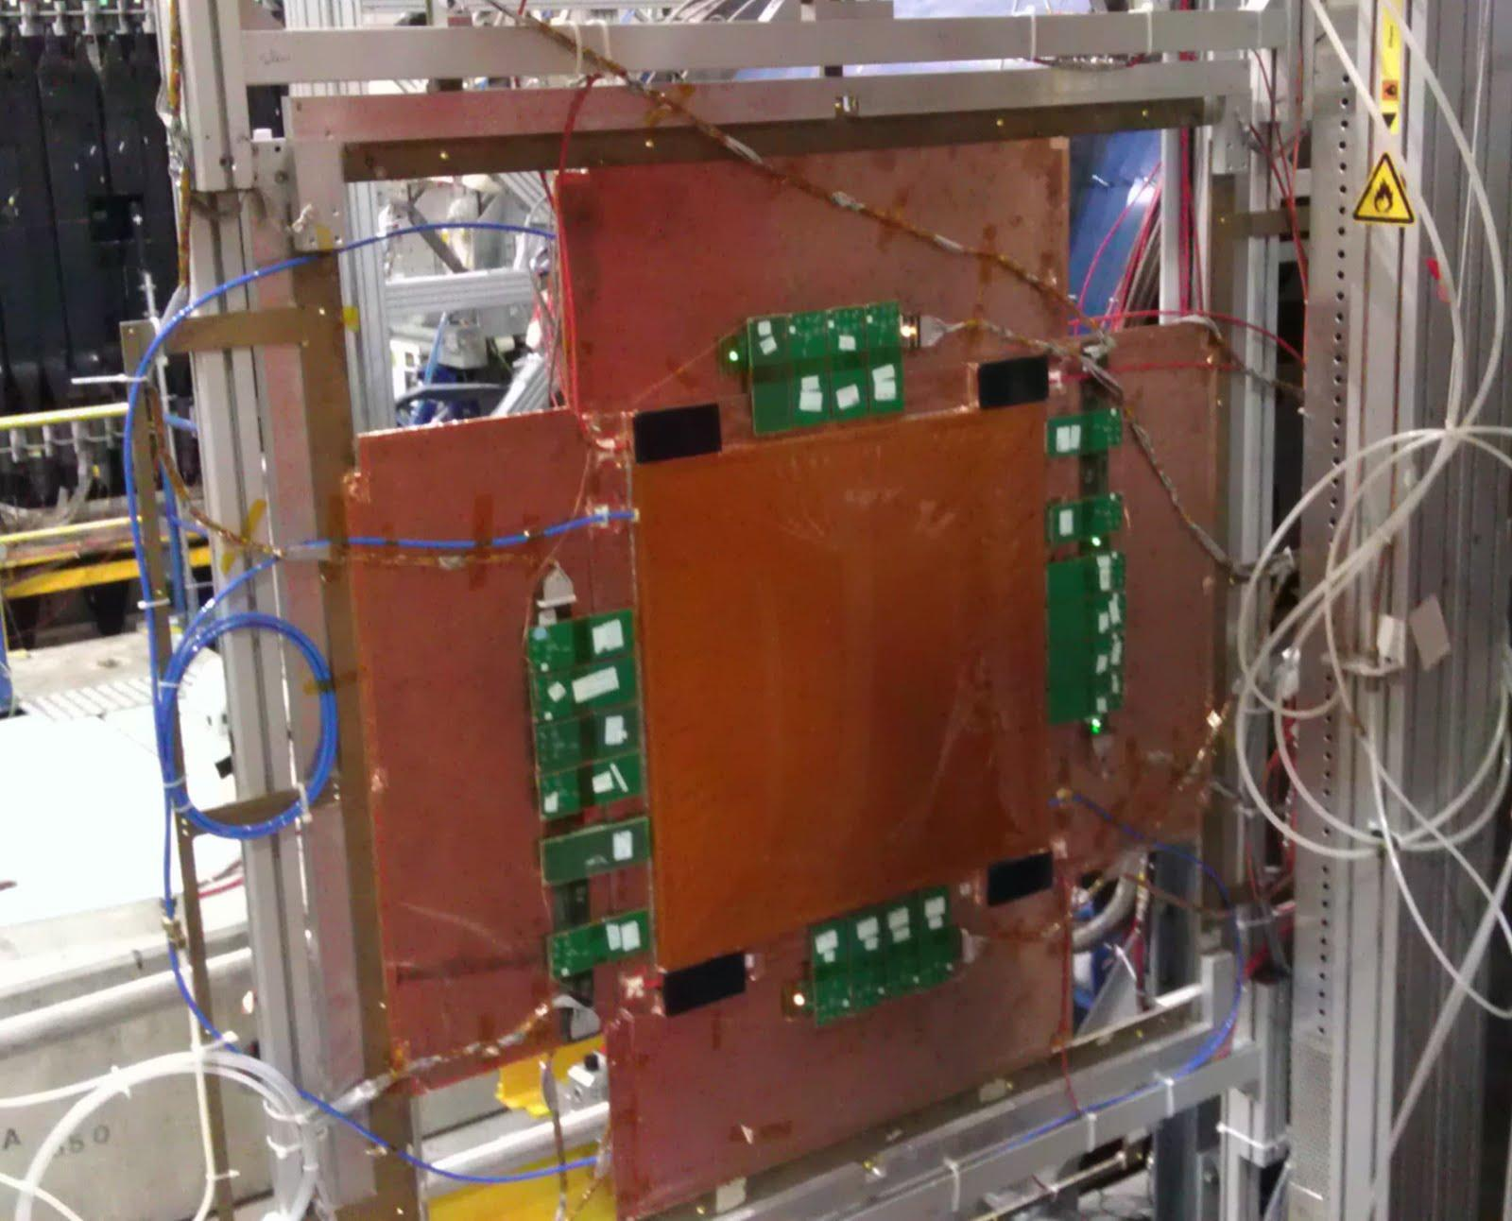
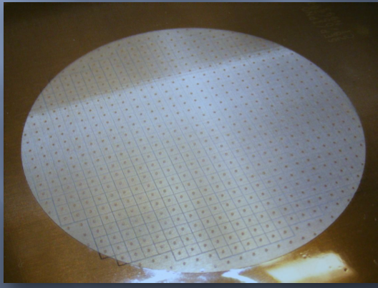
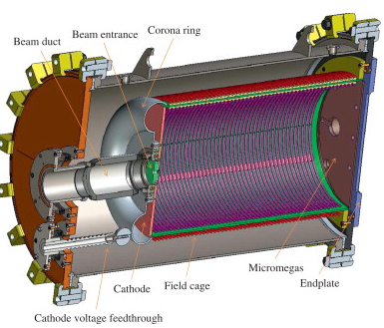
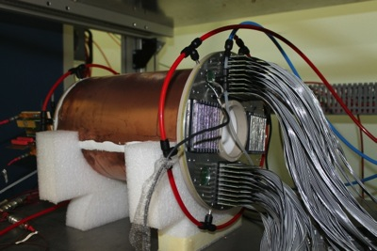
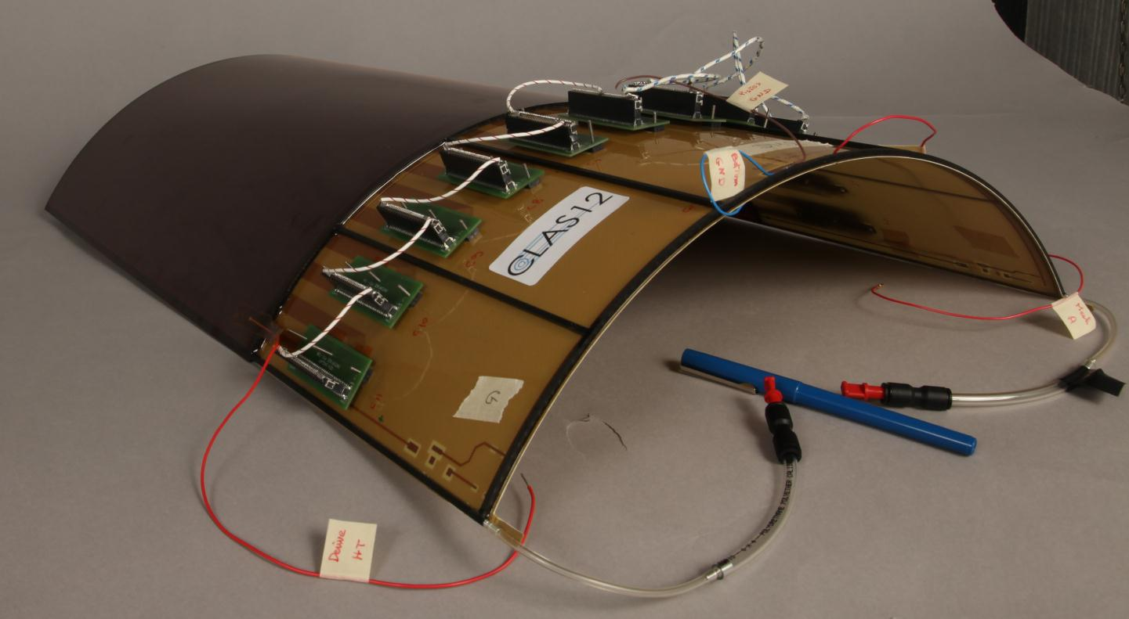
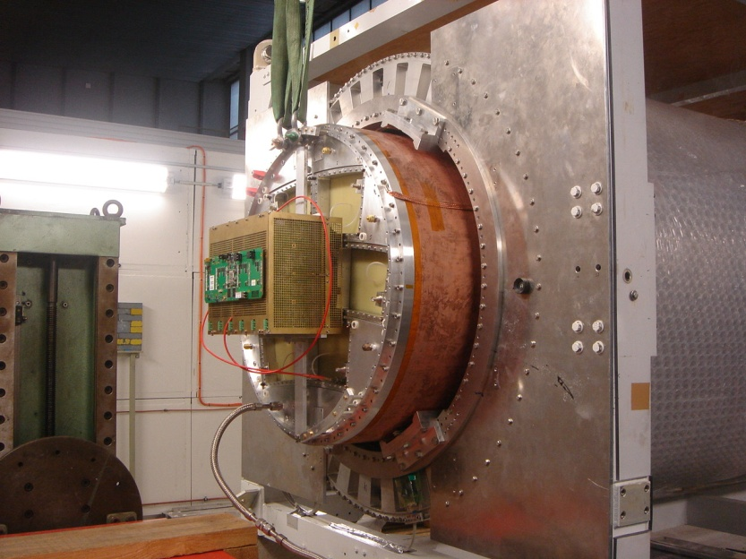
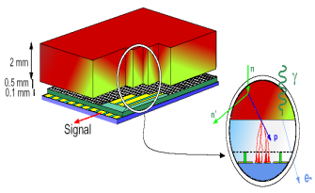
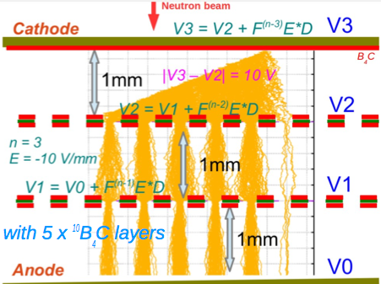
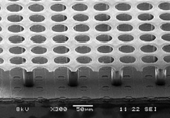
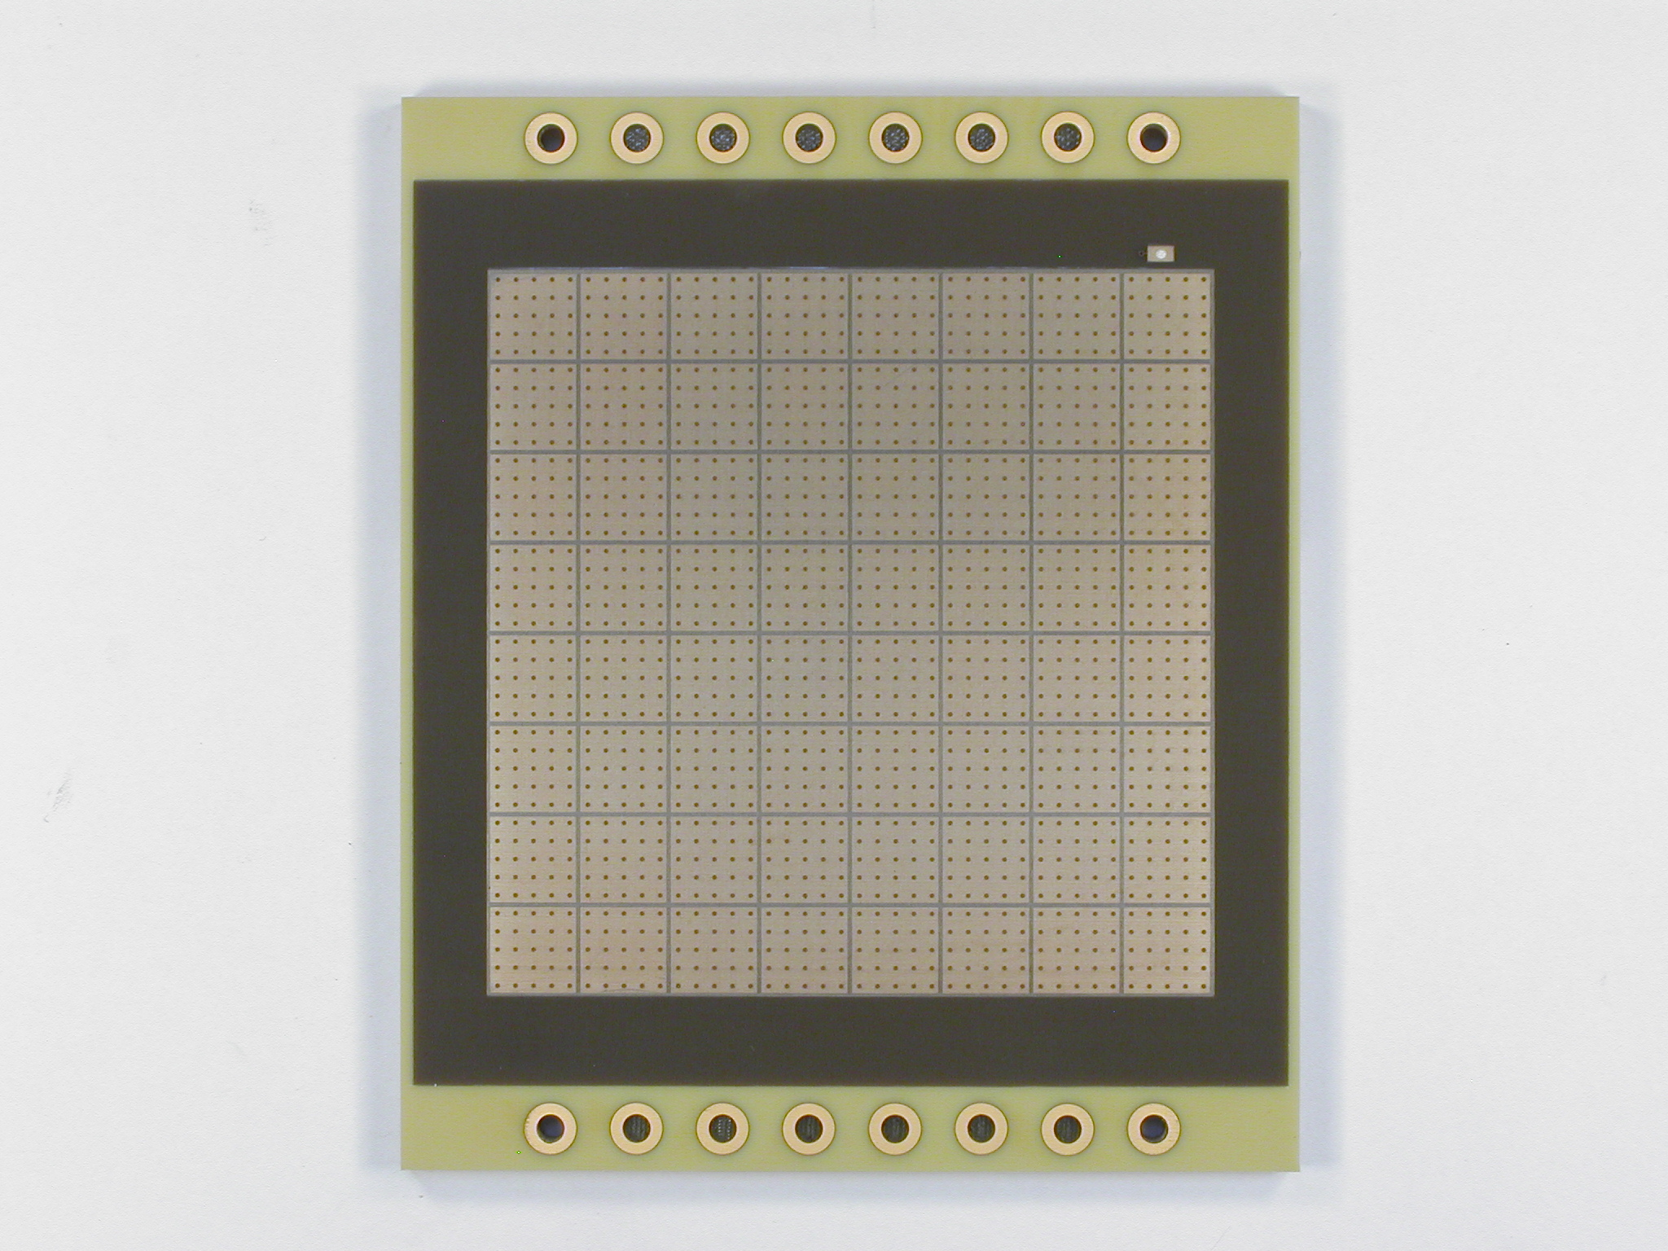
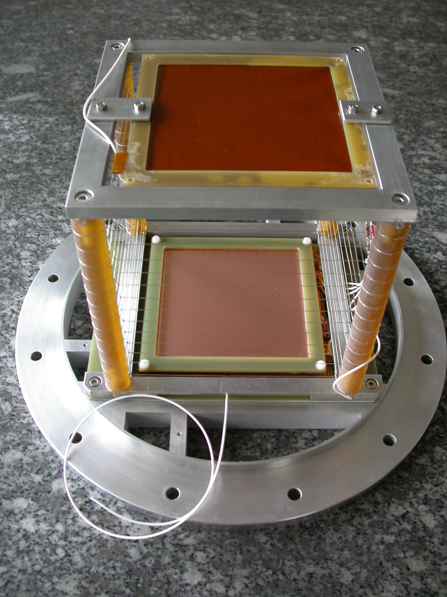
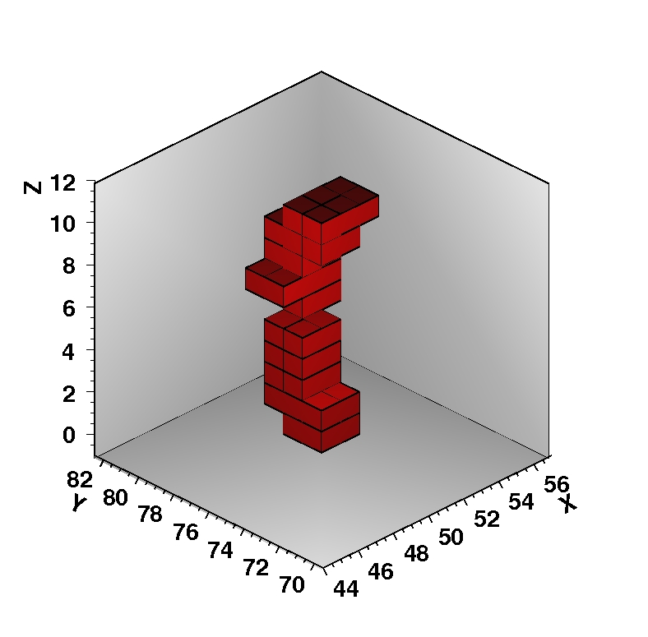
Some experiments using
Micromegas read-out
ATLAS-SLHC
COMPASS Hybrid MM
Astro-gamma
T2K
HARPO
ACTAR TPC
CLAS12G
MINOS
Michigan TPC
ILC/TPC
B₄C multi-layer detectors
Laser MJ (CESTA
Timepix Ingrid
HCAL
MiMaC

Slide 3
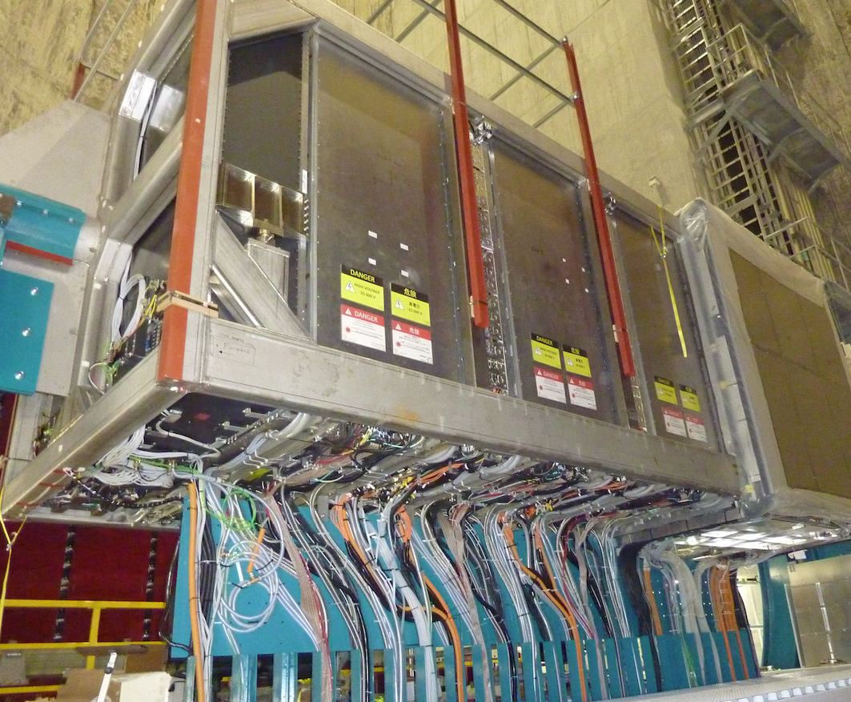
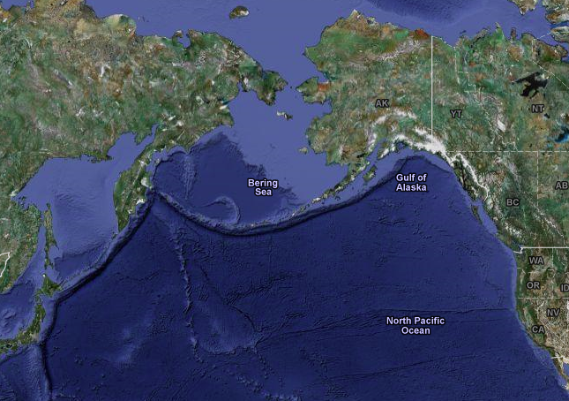
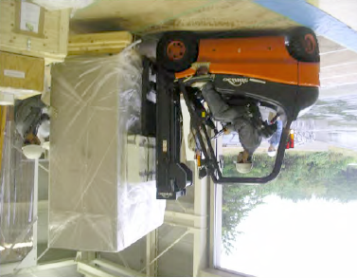
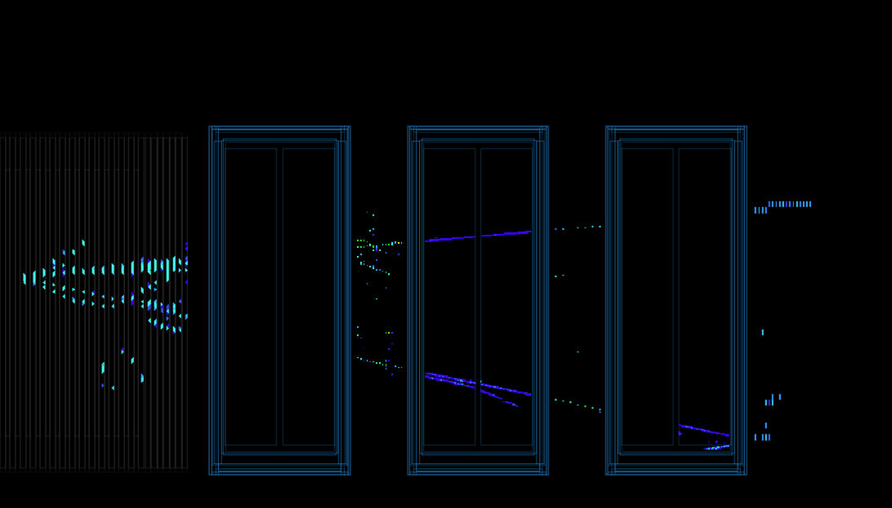
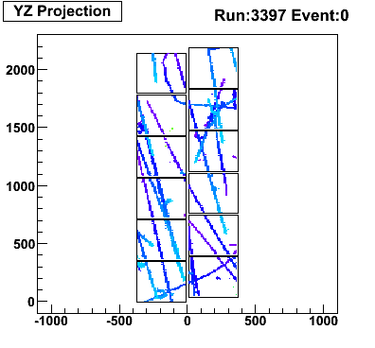
T2K Micromegas TPC – Bulk technology
3xTPCs, 6 end plates, 72 Micromegas
First neutrino event
Next upgrade under under study:
A high pressure TPC

Slide 4
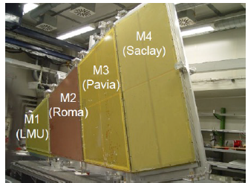
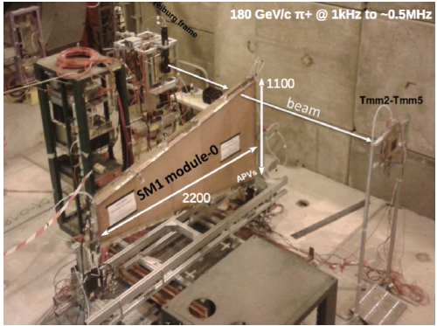
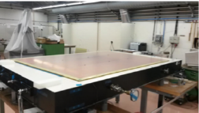
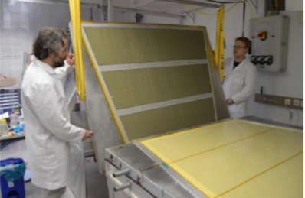
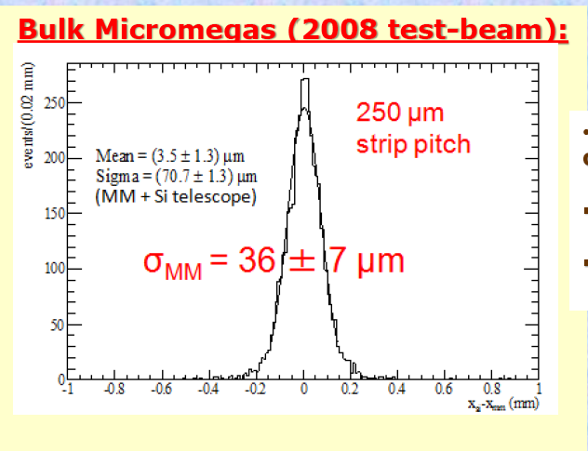
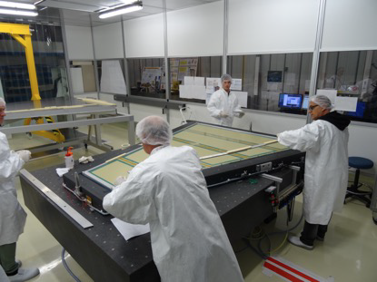
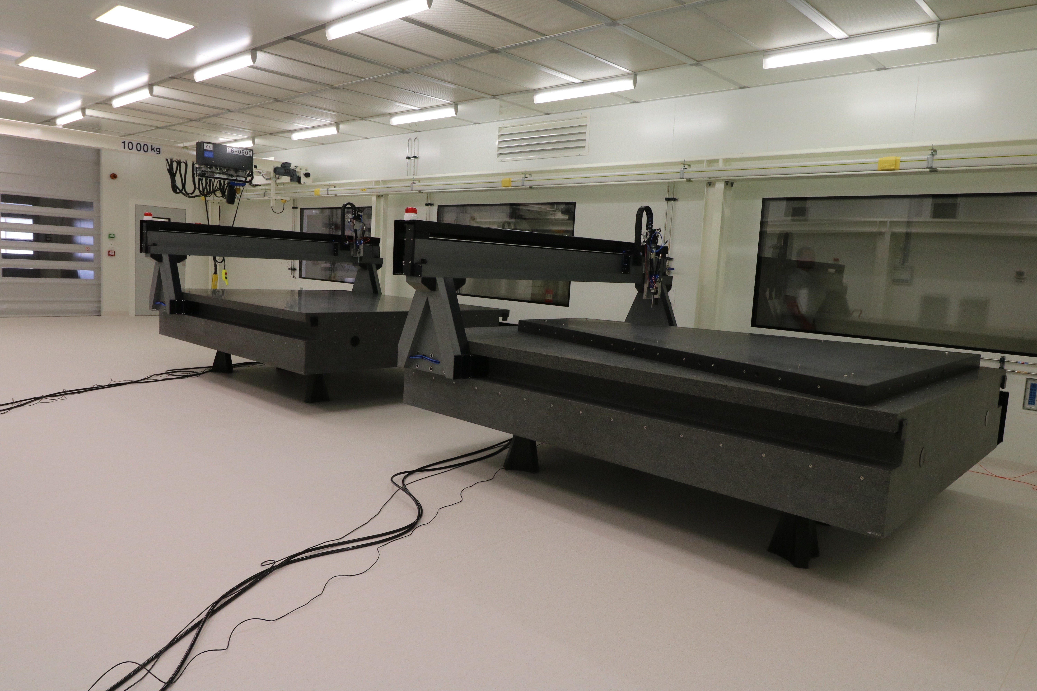
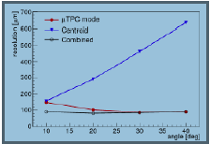
Construction of large chambers in ATLAS
Goal : 1200 m2 total detector surface
Industrialization is going on
through ELVIA, ELTOS
ATLAS Resistive strip technology
Joerg Wotschack, Mod.Phys.Lett. A28 (2013) 1340020
T. Alexopoulos, et al. Nucl. Instrum. Meth. A 640, 110-118, (2011).
SM1 module
LM2 – CERN / Dubna -Thessaloniki
SM2 – Germany
At Saclay the large clean room is ready and operational
First M0 module is under construction and soon will be tested

Slide 5
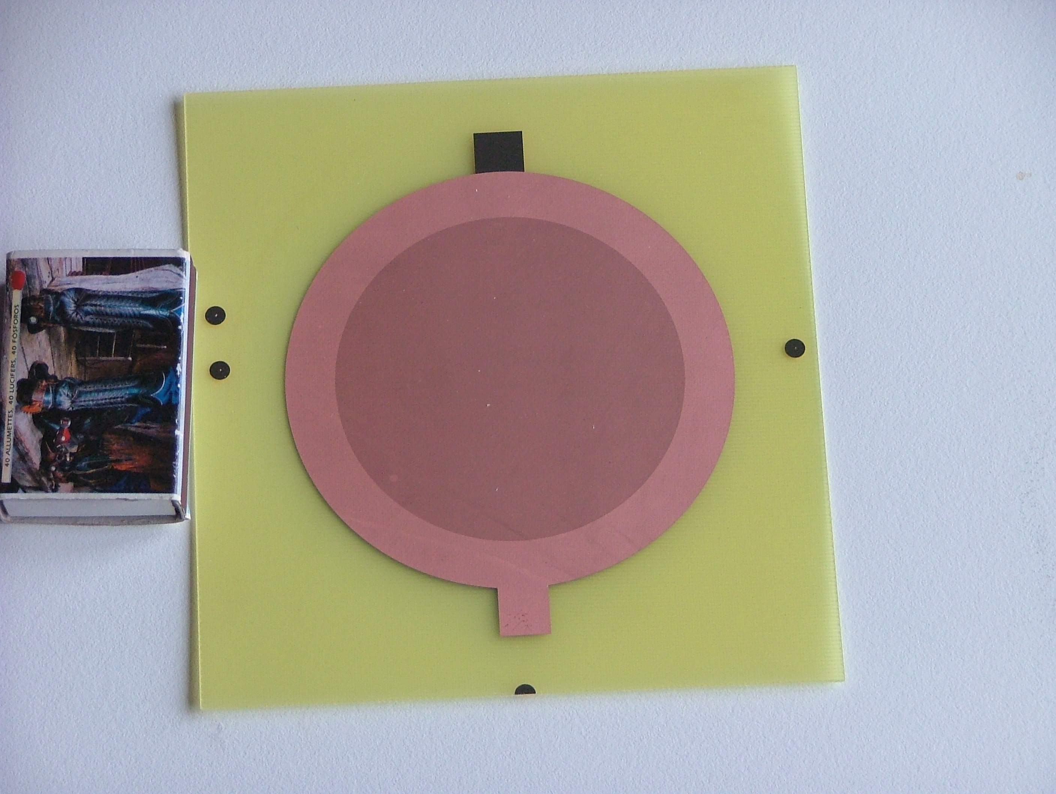
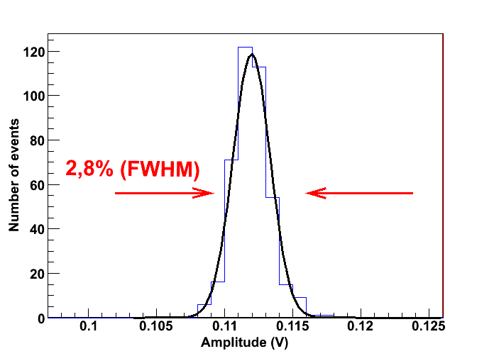
  2nd fabrication technology Micro-Bulk
Micromegas
inside
Type1
Type2
CEA-CERN patent
50 μm and 25 μm gaps fabricated
Very good energy resolution
11% at 5.9 keV
5.5% at 22 keV
< 1% with Am alpha source
Other advantages
Flexible structure (cylinder)
Good uniformity
Low material
Low radioactivity
Xe @ 2 bar
Neutrinoless Double Beta (0nbb) using ¹³⁶Xe
Under study by PANDA-X DBD project
Notes:
5

Slide 6
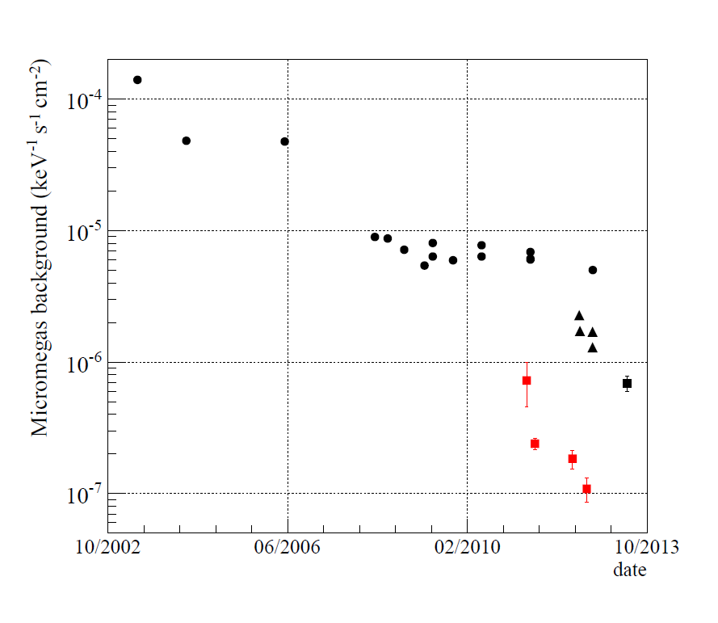
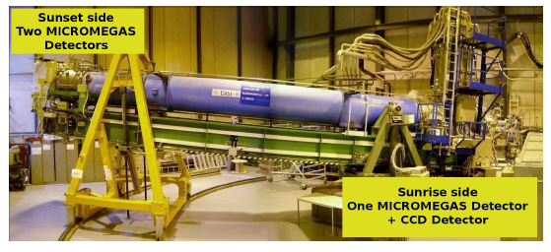
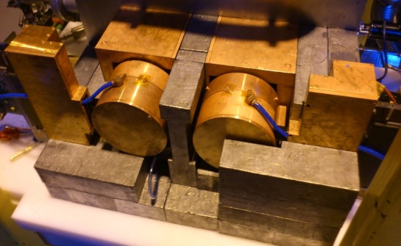
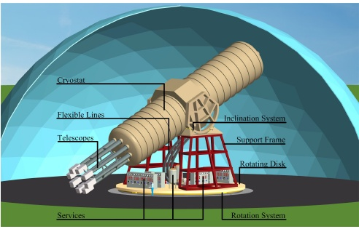
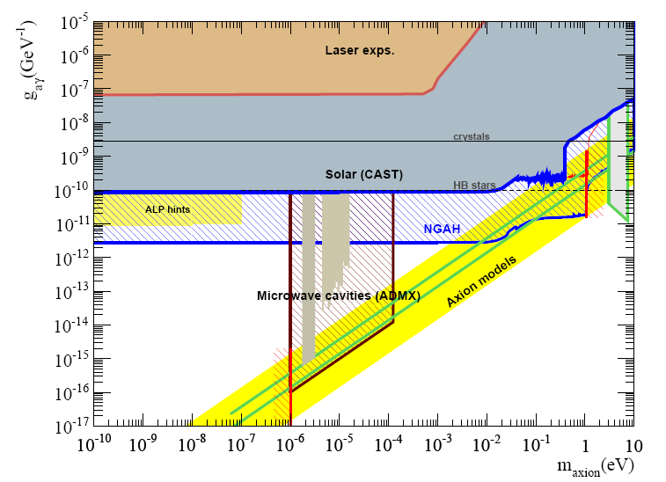
Micromegas micro-bulk in CAST
  Evolution of Micromegas
  CAST background
International Axion Observatory (IAXO)
Axion search exclusion plots
8 coil magnet L= 20 m
8 bores: 600 mm diameter each
8 X-rays optic + 8 detection systems
Rotating platform with services

Slide 7
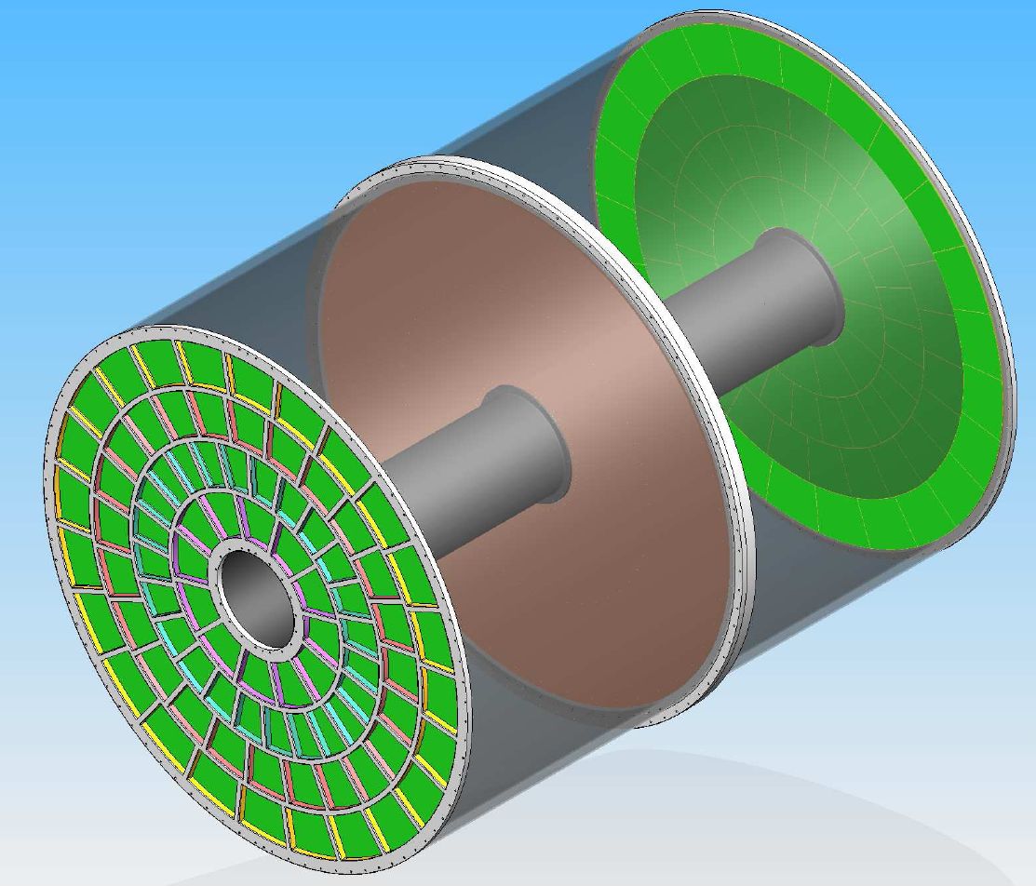
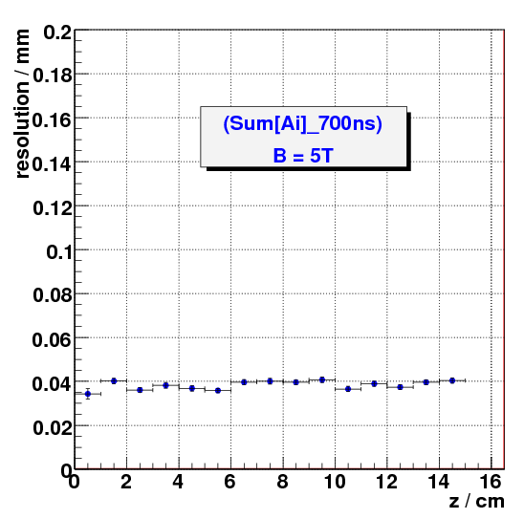
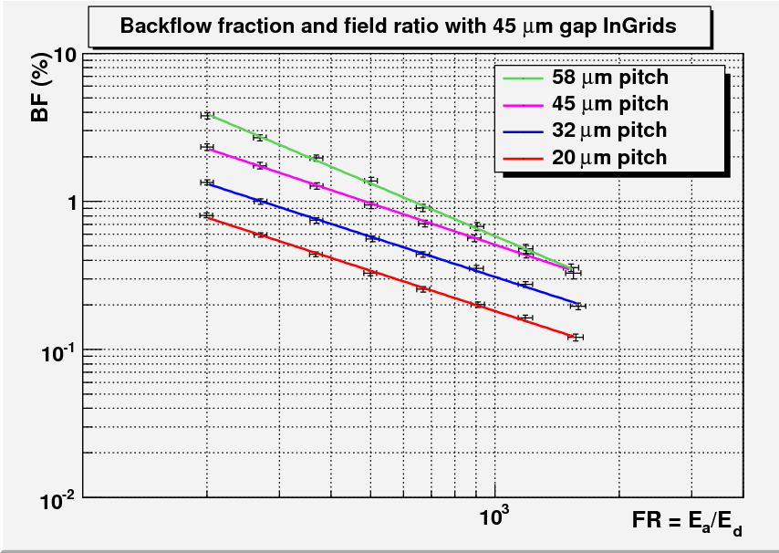
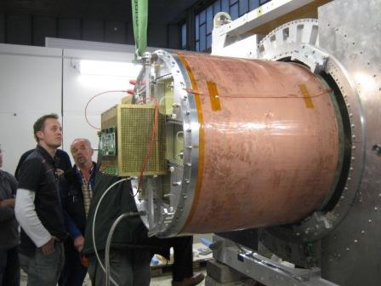
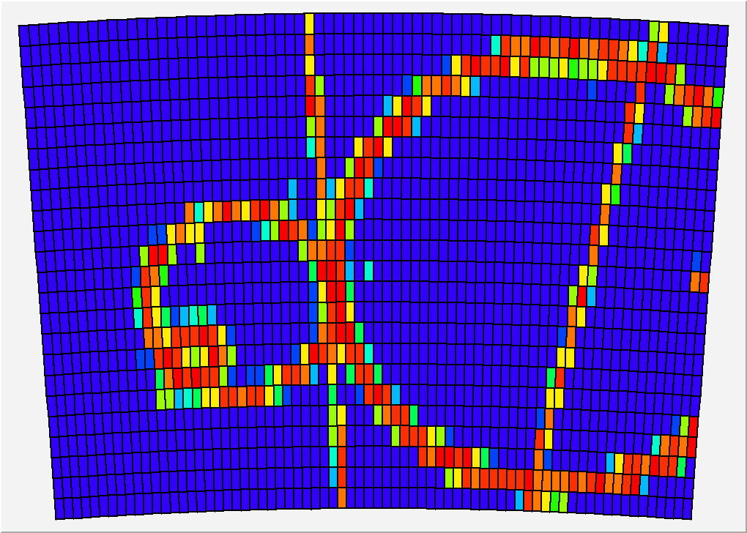
ILC TPC project - Large International collaboration
G. Aarons et al., arXiv:0709.1893, M. S. Dixit et al., NIMA 518 (2004) 521, M. Kobayashi et al.,NIMA581(2007)265,
ILC TPC with Micromegas,
L = 4.6 m, D = 3.4 m
Ion feed back supression
No ExB effect
~ 40 μm average!!
Pad size 2x6 mm
Momentum resolution=5x10⁻⁵
ILC TPC prototype
with Micromegas
Event in DESY test beam
TPC Micromegas advantages
Ion suppression .1%
No ExB effect
Great resolution ~ 40 μm
Good energy resolution

Slide 8
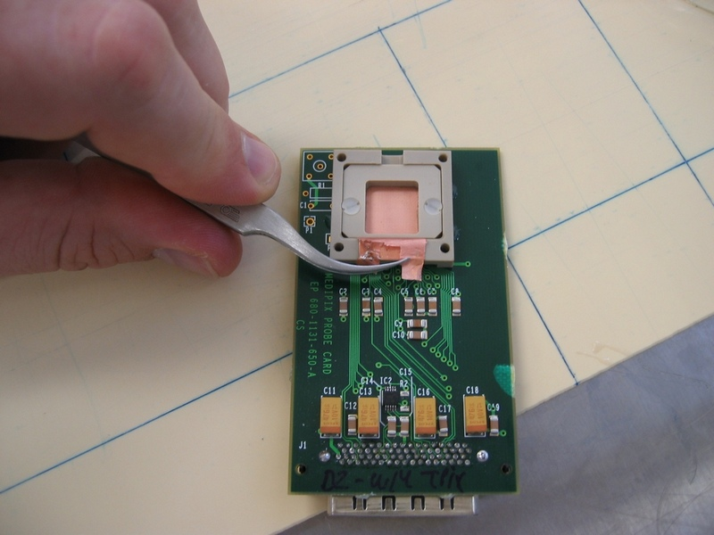
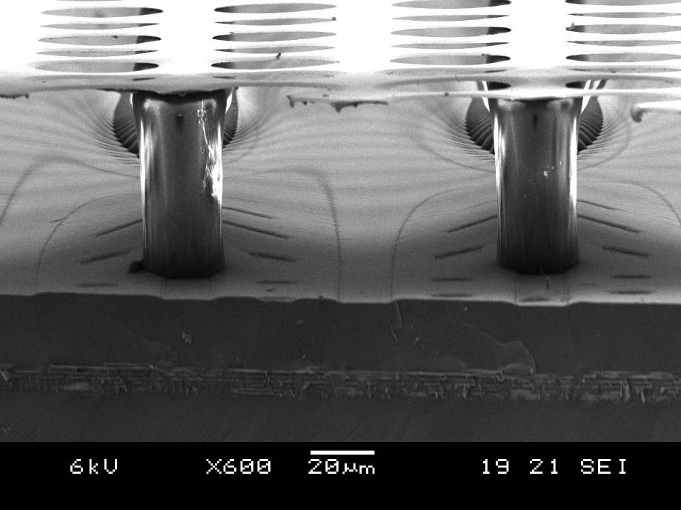



Micromegas + micro-pixels
Nikhef, Saclay, Bonn collaboration
Industrialization by Bonn is going on
P. Colas et al., NIMA535(2004)506
surface: 1.4 x 1.6 cm²
Matrix of 256 x 256
pixel size: 55 x 55 µm²
Medipix2
InGrid technology
M. Cambell et al, NIMA540(2005)295
M. Chefdeville et al., NIMA556(2006)490
Great resolution
Single electron counting!!
Gas On Slimmed SIlicon Pixels (GOSSIP)
Under study for ATLAS SLHC tracker
I. Giomataris

Slide 9






Muon tomography using Micromegas detector
D. Attie, S. Bouteille, S. Procureur et al.
Multiplexing
^{ScanPyramids Mission}
Mcube
‘Chateau d’eau’ at Saclay

Slide 10





X-ray polarimeter using MM ‘Piggyback’ and Caliste
P. Serrano, E. Ferrer, O. Limousin
Caliste
He+ 20% CO2 1 BAR
Φ
θ
Promising prospects to measure X-rays polarisation

Slide 11




MIMAC-He3 MIcro-tpc Matrix of Chambers of He3
WIMP directional TPC, Micromegas read-out,
Grenoble – Saclay, Cadarache collaboration
C. Grignon et al., JINST 4 (2009) P11003
Direct QF evaluation
D. Santos et al., [arXiv:0810.1137]
1.49 keV electron
Micromegas:µTPC chamber
Quenching factor measurement
1.5 keV ion
proton 8 keV, He + 5% iC₄H₁₀, 350 mbar
QF at various pressures in He-4
Recoil from 144 keV neutrons
40 keV ¹⁹F, 70 % CF₄ + 30% CHF_{3 ,} 55 mbar
6 keV electrons in He + 5% iC₄H₁₀ 350 mbar
26 septembre 2016
I. Giomataris
I. Giomataris

Slide 12










Applications in neutron detection
n-TOF MicroMegas-based neutron
transparent flux monitor and profiler
Micromégas Concept for Laser MégaJoule and ICF Facilities
M. Houry et al., NIM,557(2006)648
F. Belloni et al.,, Mod.Phys.Lett. A28 (2013) 1340023
DT SHOT, 31769; 4.10¹³ n_{14MeV}
Signal (mV)
Time (ns)
DD SHOT, 31777; 2.10¹¹ n_{2.45MeV}
{
T₀
Time (ns)
Piccolo Micromegas, Nuclear reactor in-core neutron measurement
J. Pancin et al., NIMA, 592(2008)104
neutron tomography
2D image

Slide 13









Fast timing Picosecond Micromegas
CEA-Saclay, CERN, Thessaloniki, Athens, Princeton
First tets in
IRAMIS facility @ CEA Saclay
(thanks to Thomas Gustavsson! )
UV laser with σ_{t} ~ 100 fs
λ = 275-285 nm after doubling
Cividec 2 GHz preamplifier
DAQ through Lecroy Osciloscope
Fist encouraging laser results
20 ps resolution
Single electron distribution

Slide 14





CERN-SPS recent measurements
Resolution 34 ps
Resolution 45 ps
Future plans and improvements
Improve analysis and include tracking information
Improve photocathode quality
Further improve detector, mesh and accuracy
Optimize gas mixture
Radiation hardness
High rate protection

Slide 15


Towards ultra-low capacitance MM
Spark protection
Preserves fast electron signal
Anode strip element
First protoype was fabricated using microbulk kapton etching
Results are encouraging: high gain, good energy resolution, Capacitance x3 lower
Future improvements
Combine with anode mesh
segmentation to reduce capacitance
Pad read-out
Move pad read-out back by 1-2 mm
To further reduce capacitance
Ultimate goal
Read-out pad or strip capacitance <1 pF
Charge released by spark < 10⁹ electrons
The idea has been successfully tested
Th. Geralis et al.,PoS TIPP2014 (2014) 055
To reach the goal we need new high-precision fabrication technology

Slide 16


E₁
High gas pressure detector deal
E₁> E₂
E₂
The gain variation exhibits a minimum for :
d = V/Bp
Ideal gap
Message
For high pressure operation up to 10 bar
We need a small 10-30 μm gap
Ref: Y. Giomataris, NIM A419, p239 (1998)
The idea of small gap MM was tested D. Attie et al., JINST 9 (2014) C04013
Gaps of 12.5, 25, 50 μm have been fabricated and successfully tested
From this study we concluded that the highest achievable gain was lower with smaller gaps
To improve gain we need to fabricate much smaller mesh holes, smaller than gap length
of the order of 5- 10 μm
To reach the goal we need new high-precision fabrication technology

Slide 17










High precision 3D printer technology
On our table
Ni shim
Wire bonds

Slide 18
Second part
Spherical detector, light-dark matter search
and neutrino physics

Slide 19


Radial TPC with spherical proportional counter read-out
Saclay-Thessaloniki-Saragoza
A Novel large-volume Spherical Detector with Proportional Amplification read-out, I. Giomataris et al., JINST 3:P09007,2008
5.9 keV ⁵⁵Fe signal
E=A/R²
20 μs
1-15 mm
Simple and cheap
Large volume
single read-out
Robustness
Good energy resolution
Low energy threshold
Efficient fiducial cut
Low background capability
C≈ R_{in}= 7.5 mm < 1pF

Slide 20

Rejection power
26/09/2016
I. Giomataris

Slide 21



Low-energy calibration source Argon-37
Home made Ar-37 source: irradiating Ca-40 powder with fast neutrons 7x10⁶neutrons/s
Irradiation time 14 days. Ar-37 emits K(2.6 keV) and L(260 eV) X-rays (35 d decay time)
Installation near the spherical detector
Argon 37
First measurement
with Ar-37 source
Total rate 40 hz
in 250 mbar gas, 8 mm ball
240 eV peak clearly seen
A key result for light dark matter search
5.9.keV
2.4 keV
260 eV

Slide 22






Low background detector d=60 cm p=10 bar
University of Saragoza detector
Basic R@D detector in Saclay
University of Thessaloniki detector
University of Tsinghua - HEP detector
Queens University test sphere
Bibliography
I Giomataris et al., JINST 3:P09007,2008.,
I Giomataris and J.D. Vergados, Nucl.Instrum.Meth.A530:330-358,2004, I. Giomataris and J.D. Vergados, Phys.Lett.B634:23-29,2006.
I. Giomataris et al. Nucl.Phys.Proc.Suppl.150:208-213,2006.,
S. Aune et al., AIP Conf.Proc.785:110-118,2005.
J. D. Vergados et al., Phys.Rev.D79:113001,2009.,
E Bougamont et al. arXiv:1010.4132 [physics.ins-det], 2010
G. Gerbier et al.,arXiv:1401.790v1

Slide 23


NEWS collaboration
Queen’s University Kingston, IRFU/Saclay , LSM, Thessaloniki University, LPSC Grenoble, TU Munich,PNNLTRIUM
Collaboration meeting at LSM april 2016

Slide 24




NEWS-LSM: Exploration of light dark matter search at LSM
Detector installed at LSM end 2012: 60 cm, Pressure = up to 10 bar
Gas targets: Ne, He, CH4
Polyethylene
30 cm
80
Effect of the cup
Rate [Hz]
Lead
10 cm
Copper
5 cm
Decrease of factor 20 for
Energy range 1 – 200 keV
4
Date [s]

Slide 25


Internal contamination cleaning
Goal: remove Po-210, Pb-210
1st chemical cleaning of sphere
Conditions :
Nitric acid (17 %)
Temperature 10° C
Cleaning by filling
the spherical cavity
Washing by pure water
Drying by hot nitrogen
2nd chemical cleaning of sphere
Conditions :
Nitric acid (30 %)
Temperature 30° C
Cleaning by spray
Washing by pure water
Drying by hot nitrogen

Slide 26
Backround evolution of the detector
Alpha rate evolution
β/γ rate evolution
1st chemical cleaning
α rate
1st chemical cleaning
β/γ rate
2nd chemical cleaning
Sensor cleaning
Reduction factor = 90
180 mHz => 2 mHz
2nd chemical cleaning
Reduction factor = 20
400 mHz => 20 mHz
Sensor cleaning
Copper shielding added
New development
Removal of about 10mm copper using a high pressure jet
is under study with a french compagny

Slide 27


Light WIMP search results
Fast on line analysis
Energy spectrum [eV] at low energy
30.5 days
3 bars Ne + CH₄ (0.7%)
300 – 1300 eV
18 Évén./jour/keV/kg
With additional shield
Reduction
Summary:
background level among the best experiments
Achieved with modest budget and manpower
Combined with the low energy threshold and low-Z targets:
Competitive sensitivity for very-light WIMPs
Publication under preparation

Slide 28




NEWS-SNO with compact shield : implementation at SNOLAB by fall 2017
140 cm Ø detector, 10 bars, Ne, He, CH₄
Copper 1 mBq/kg
Compact lead –ancient- & PE shield solution
Copper sphere
Lead shield
Miniclean
PE shield
DEAP
NEWS

Slide 29

NEWS-SNOLAB project:
Funded by Canadian grant of excellence
and ANR-France
CDMSLite1
CRESSTII
DAMIC
H
COGeNT
2017
He
CDMS_Si
CDMSLite2
DAMA
NEWS-SNOLAB
CRESST
Ne
DarkSide50-Ar
Edelweiss LE
CDMS-Edelweiss
CDMS reanalysis
Xenon
LUX

Slide 30



Quenching factor measurements
Goal: measure QF down to 500 eV ion energy using the Grenoble MIMAC facility
for H, He, Ne, CF4, Ar, Xe at various pressures
Earlier measurements
D. Santos et al., arXiv:0810.1137
Previous investigations with a 15 cm sphere
show the capability to measure 500 eV He-4 ions
with an estimated QF of about 25%
Saclay, Grenoble, Thessaloniki, Queen’s-Kingston
He-4 700 mbar

Slide 31



CUBIC: a new way of fabricating an ultra low-background spherical detector – under study
  I. Giomataris, CEA-Irfu-France
Aurubis pure copper
Tested in PNLL
μBq/kg : ²³²Th= 1, ²³⁸U= 1
Advantages
Auto-shield
Pressure up to 50 bar
Low cost
Faster process
milling
moulding
70 cm
10
50
50
10
10

Slide 32


Multi-ball ‘ACHINOS’ structure
Developed in Saclay in collaboration with University of Thessaloniki
Advantages
- Amplification tuned by the ball size:
1mm diameter for high pressure
-Volume electric field tuned by the size
of the ACHINOS structure
- Detector segmentation

Slide 33


Additional physics
Neutrino-nucleus coherent elastic scattering
ν + N --> ν +N σ ≈ N²E ², D. Z. Freedman, Phys. Rev.D,9(1389)1974
High cross section but very-low nuclear recoil
Illustration: using the present prototype at 10 m from the reactor, after 1 day run
A dedicated Supernova detector
Simple and cost effective - Life time >> 1 century
Through neutrino-nucleus coherent elastic scattering
Y. Giomataris, J. D. Vergados, Phys.Lett.B634:23-29,2006
Sensitivity for galactic explosion
For p=10 Atm, R=2m, D=10 kpc, U_{ν} =0.5x10⁵³ ergs
# Number of events (after quenching, E_{th} =0.25 keV)
He Ne Ar Kr Xe Xe (with Nuc. F.F)
0.08 1.5 6.7 23.8 68.1 51.8
Idea : A world wide network of several of such dedicated Supernova detectors
To be managed by an international scientific consortium and operated by students

Slide 34
Competitive double beta decay experiment with Xe-136 at 50bar
In collaboration with CNBG ( F. Piquemal et al.,), CPPM (J. Busto et al.,)
The goal is to reach a record low background level << 10⁻⁴/keV/Kg/y
and an energy resolution of .3%
Simulation model
By J. Galan
Sphere diameter: 2 m
Shield 30 cm copper
Xenon gas at 50 bar (1272 Kg)
Vessel Copper activity μBq/kg :
Aurubis commercial ²³²Th= 1, ²³⁸U= 1
PNNL ²³²Th=.034, ²³⁸U=.13
Results are very encouraging:
Expected background rate in the region of Q_{bb} (2.46 MeV)
8.x10⁻⁵/keV/Kg/ year Arubis copper
1.54x10⁻⁵/keV/Kg/ year PNNL copper
(compared to 2x10⁻³/keV/Kg/ year of running experiments)

Slide 35


If additional rejection is required: a new idea
Background free double beta decay experiment, I. Giomataris, J.Phys.Conf.Ser. 309 (2011) 012010
The idea is to detect Cherenkov light emitted by two electrons and then reject background
from single electrons (Compton scattering etc..)
Xenon-136 at high pressure of about 25-40 bar is ideal to keep high efficiency for double electrons,
Good enough electron path and reduce multiple scattering
A simple read-out is the standard spherical detector signal combined with
CsI photocathode layer deposited at the internal vessel surface, inducing a delayed signal
UV QE CsI
S₂ (S₁) is the charge signal collected and amplified
S₃ is the delayed Cherenkov light signal

Slide 36
THANK YOU
8th SYMPOSIUM ON LARGE TPCs FOR LOW-ENERGY RARE EVENT DETECTION
The eighth international symposium on “large TPCs for low-energy rare event detection”
will be held in Paris on the 5th-7th of December 2016.
The purpose of the meeting is an extensive discussion of present and future projects using
a large TPC for low energy, low background detection of rare events
(low-energy neutrinos, double beta decay, dark matter, solar axions).
In addition to the symposium, a half day workshop on neutrino from Supernova will complete
this three-day symposium and will be the closing session just before the summary talk.

