Slide 1








S³ : Super
Separator
Spectrometer
Some Physics at (or a bit above) Coulomb Energy
from the S³ Letters of Intent
S³ Collaboration (LoI signed by 28 laboratoires)
ANL (US), CENBG, CSNSM, JINR-FLNR, (Russia), GANIL, France, GSI (Germany), INFN Legnaro, (Italy), IPHC, France, IPNL, , Irfu CEA Saclay, IPNO, France, JYFL (Finland), K.U. Leuven (Belgium), Liverpool-U, (UK), LNS (Italy), LPSC, MSU (US), LMU, (Germany), Nanjing-U (China), Northern Illinois University (US), SAS Bratislava, (Slovaquia), IFJ PAN Cracow (Poland), Smoluchowski Institute (Poland), CEA-DAM; SUBATECH, TAMU (US), U. Mainz (Germany), York-U (UK), Vinca Institute (Serbia)
INP

Slide 2

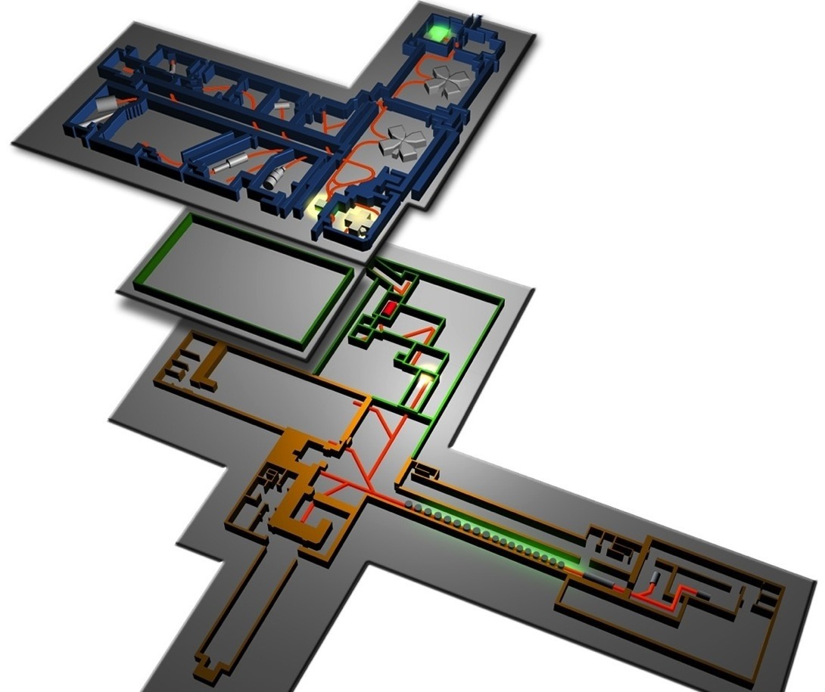
S³ in Spiral2@Ganil
Present Ganil
Fed by the very high intensity
stable heavy ion beams
of LINAG
- He to U nuclei
- From 2 to 14MeV/u
- beyond 1pµA (≈ 10¹⁴pps)
SPIRAL2
Phase 1
Neutron for Science
S³
Phase 1++
DESIR (low energy)
Accelerator Upgrade
Phase 2
- RIB
Desir
S³
NfS

Slide 3
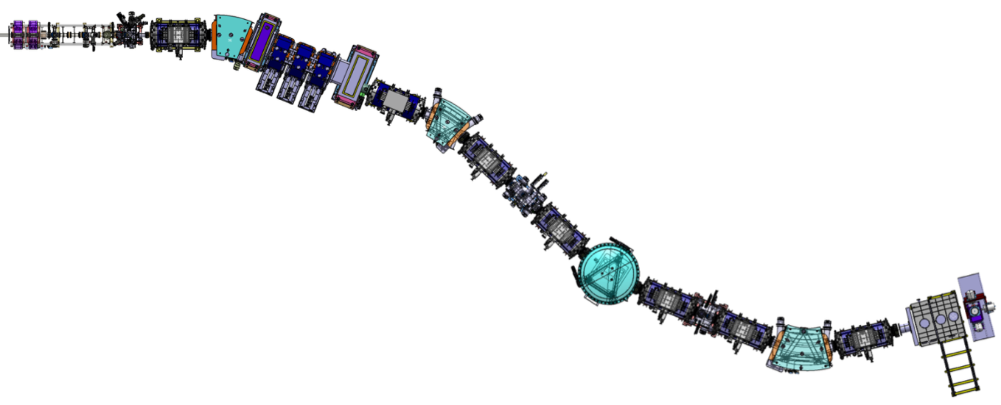
Cible
Arrêt faisceau primaire
Multipôles supraconducteurs
Faisceau
Spectromètre de masse
Achromate en moment
Grande acceptance
ΔΩ = 11msr
ΔE = ±14%
5 états de charge
Double sélection
Réjection du faisceau primaire, sélection en moment
Dipôles électrique & magnétique : sélection en masse
Détection

Slide 4

Physics objectives
Study of very rare events in nuclear and atomic physics
⁵⁸Ni+⁴⁶Ti→¹⁰⁰Sn +4n
(I=10pµA) ➔ 3evt/s @ σ_{th}=5nb
Nuclei produced by
Fusion-Evaporation
Proton Dripline & N=Z nuclei
Shelll correction effects
Study the role of π-ν correlations
Deformation – shape coxistence
Exotic decay
Astrophysics rp-process
Fundamental interaction
⁴⁸Ca+²³⁸U→⁻²⁸³112+3,4n
(I=10pµA) ➔20evt/week/pb
Heavy and Superheavy
Elements
Limit of the nuclear existence
Reaction mechanism
Shell correction effects
Atomic properties
Ion-Ion interactions
Atomic physics
FISIC project
➔ High Selectivity and High Transmission versatile separator-spectrometer

Slide 5
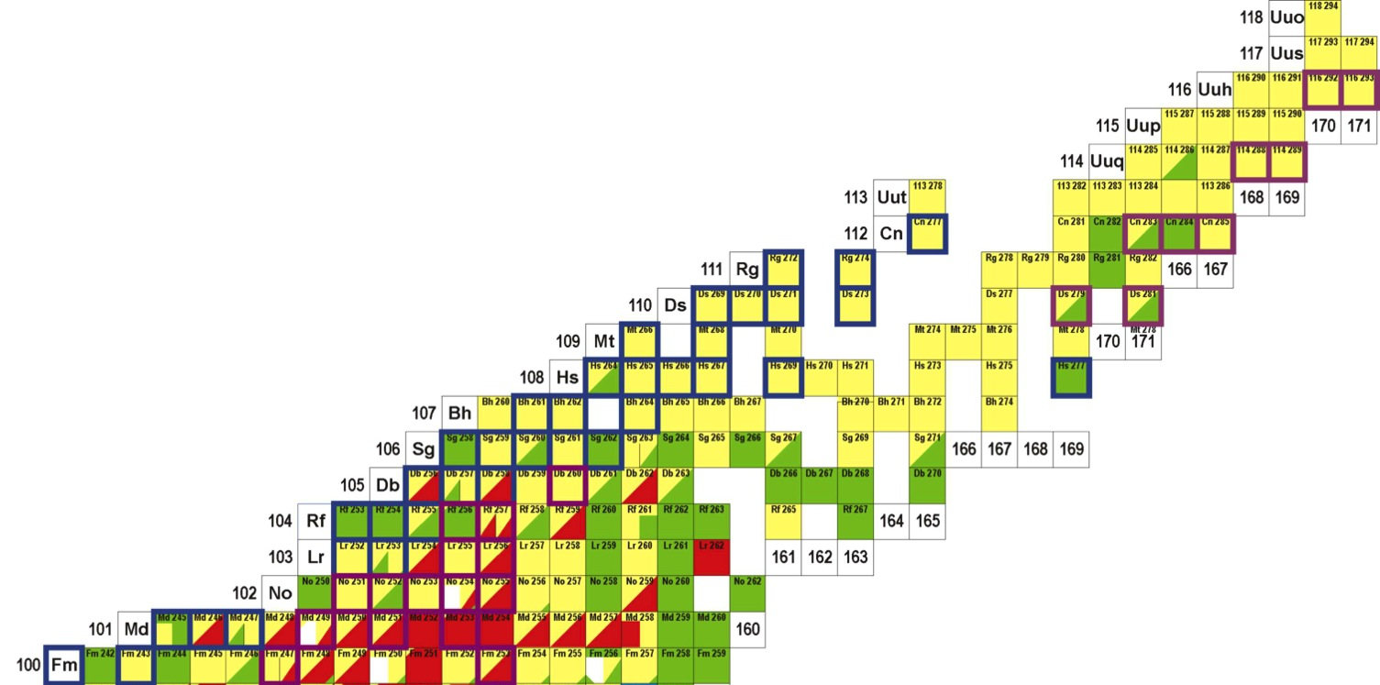
Very and Superheavy elements studies
nuclide | feature | X-section [pb] | rate [h⁻¹] | 21UT integral
 |  |  |  | day 1 | phase 1++
²⁵⁴No | ER | 2000 | 60.000 | 6×10⁷ | 1×10⁷
²⁵⁶Rf | ER | 17 | 550 | 90.000 | 5.4×10⁵
²⁶⁶Hs | ER | 15 (²⁷⁰Ds) | 0.34 | 57 | 285
^{266m}Hs | K-isomer | 15 (²⁷⁰Ds) | 0.01 | 2.5 | 12.5
²⁷⁰Ds | ER | 15 | 0.45 | 76 | 380
^{270m}Ds | K-isomer | 15 (²⁷⁰Ds) | 0.22 | 38 | 190
²⁶²Sg | α-decay | 15 (²⁷⁰Ds) | 0.02 | 5 | 25
²⁷⁶Cn | ER | 0.5 (²⁷⁷Cn) | 0.01 | 2.5 | 12.5
²⁸⁸115 | ER | 10 | 0.3 | 50 | 300
²⁸⁸115 | L X-rays | 10 | 1,8 | 300 | 1800
Nuclear structure
Quasi-particle excitations ➔ deformation/K-isomers
Alpha/gamma/electron spectroscopy
X ray spectroscopy
Reaction studies
Isospin dependent investigation
Z > 112 ➔ Actinide targets
⁴⁸Ca beam and heavier
Instrumentation
SIRIUS for Decay spectroscopy

Slide 6
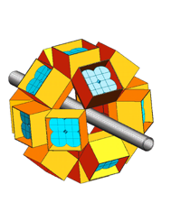
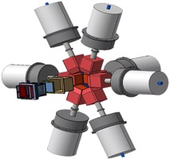
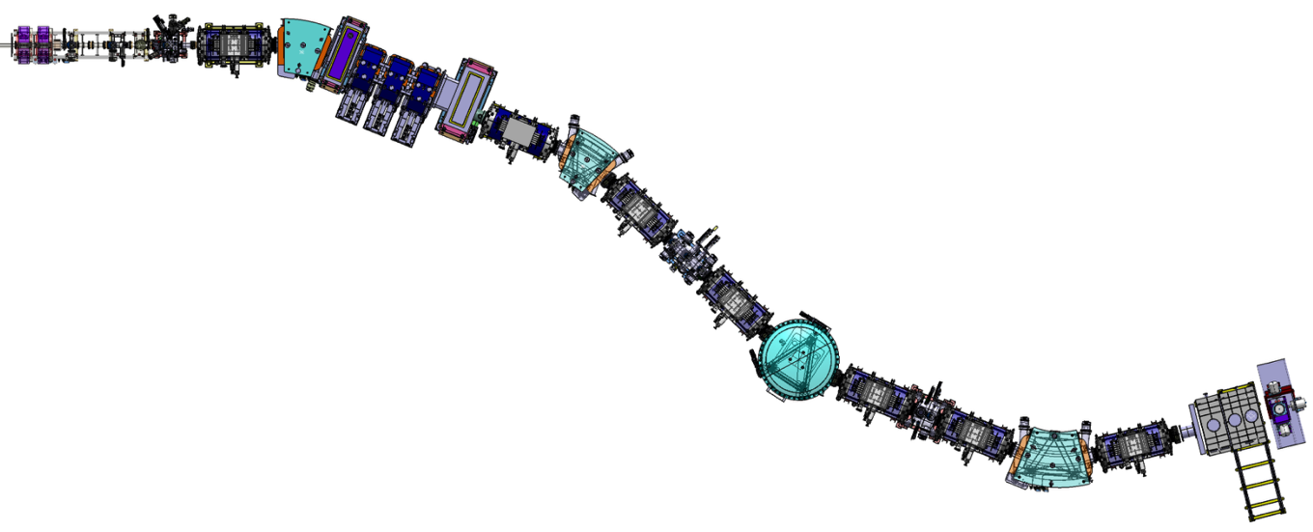
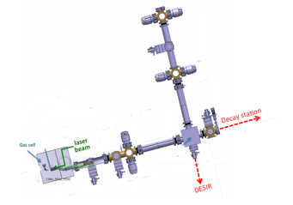
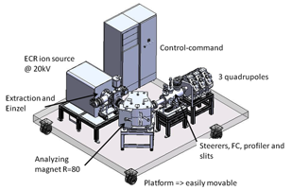
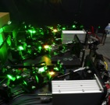
Experimental Techniques
In-beam spectroscopy
Two step reactions
EXOGAM2/AGATA
PARIS
MUST2/GASPARD
Phase 1.a : Decay spectroscopy
SIRIUS setup
Implantation-decay
station at the mass
dispersive plan
(α,e-,fission,γ)
Primary Beam dump
Achromatic point
Secondary
Beam dump
Mass
focal
point
Atomic physics
FISIC setup
Fast Ion Slow
Ion Collisions
Electron exchange
Phase 1b:
Ground state properties
(mass, size, moments, spins)
REGLIS³ setup
Low Energy
Branch
DESIR

Slide 7
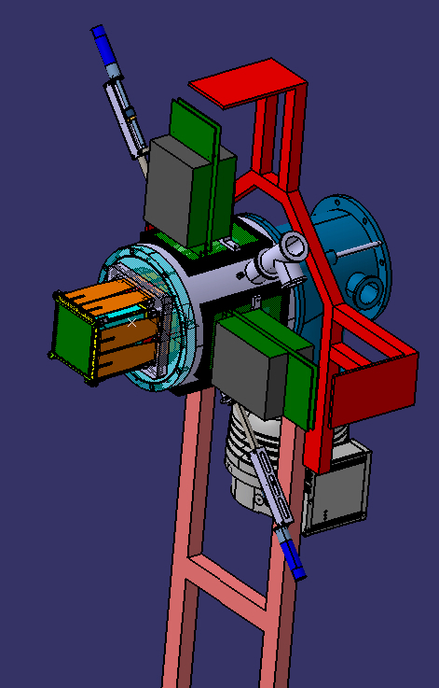
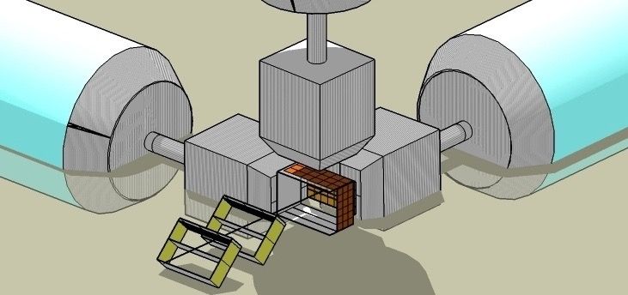
SIRIUS (Spectroscopy & Indentification of Rare Ions Using S³)
Germanium detector
e.x. Exogam2, CLODETTE
Time of flight + tracking detector
Implantation detector
(HI, α and e⁻ decay)
Tunnel detector for escaped e⁻ and α
Large size (200x150 mm²)
Time Resolution < 1ns
Position resolution = 1mm
Very low thickness
Large detector size 10x10cm²
High resolution FWHM
  Ability to detect large> 50MeV pulse
  Followed (≈ 10µs)
  by a weak (<15MeV) pulse.
No Dead time
Conversion electrons FWHM <5 keV
Escaped alpha FWHM 15 keV
R&D is ending ➔ Construction phase starts this year (CPIER funding)

Slide 8
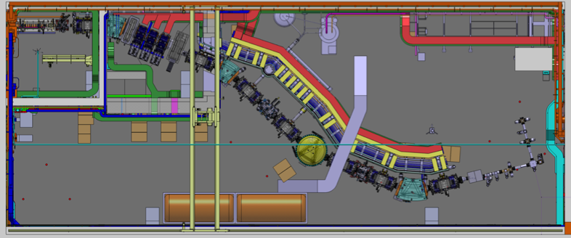
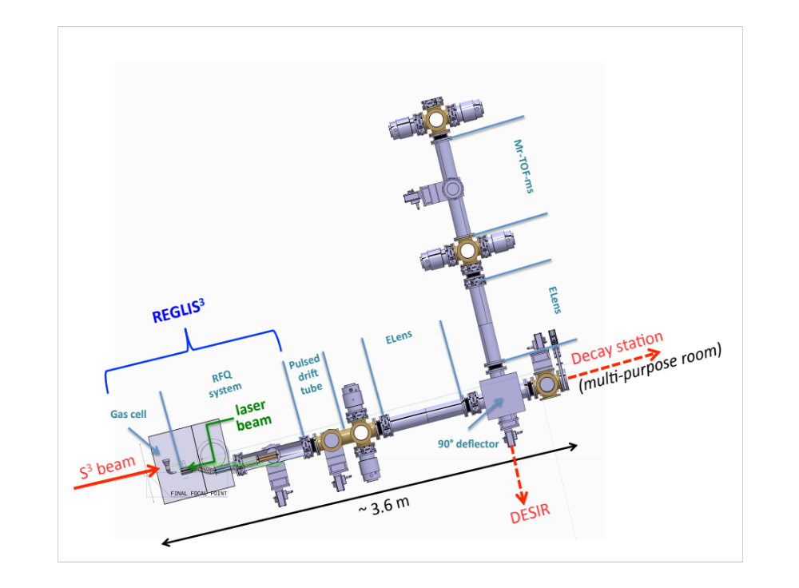

Expected performances of S³ LEB
efficiency ( 4 %): including S³ transmission - experiments possible with I to <1 pps
selectivity: suppression of unwanted isotopes in the order of 1/10 000 - extra cleaning necessary
fast: short lived isotopes (delay time 250 ms) - trade off between efficiency and delay time
spectral resolution: down to ~200 MHz: isotope/isomer shift, spins and moments.

Slide 9
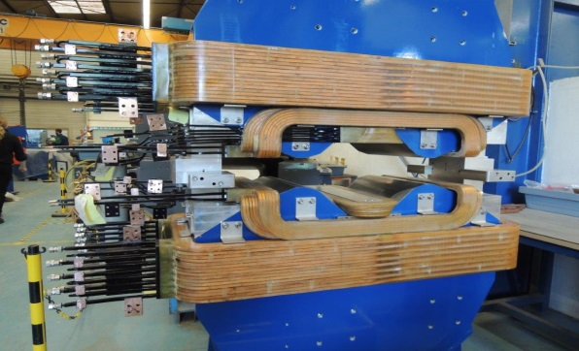
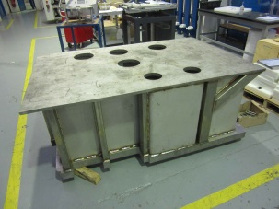

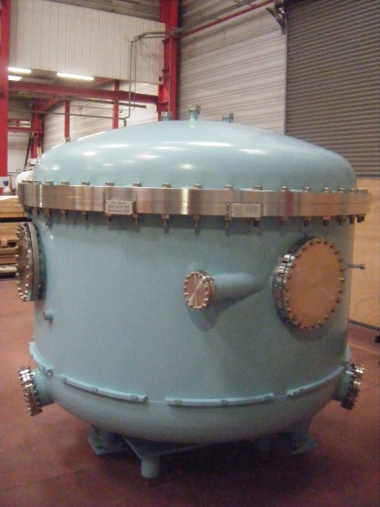
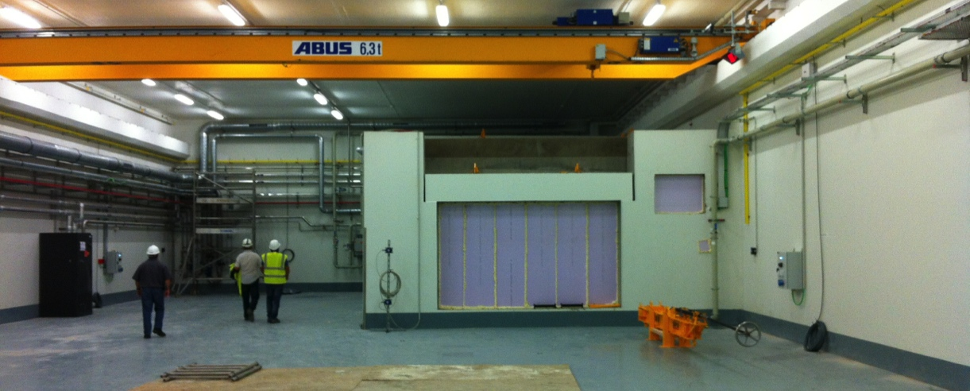
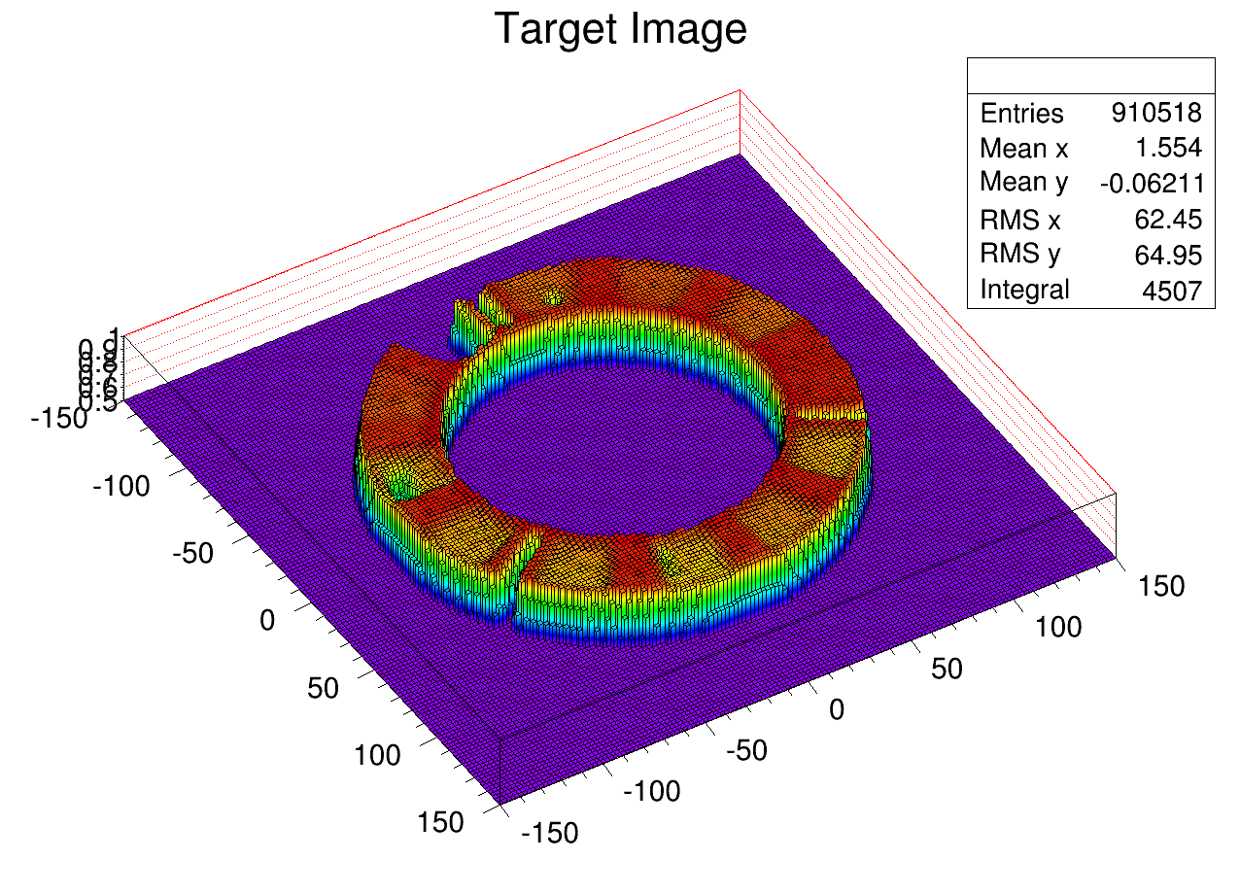
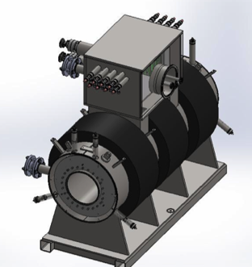
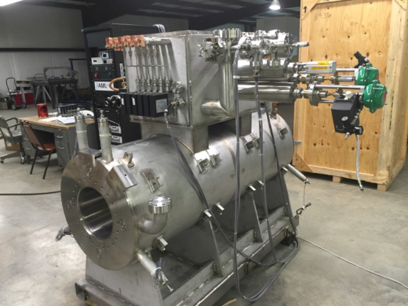
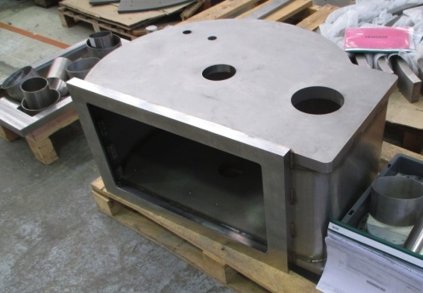
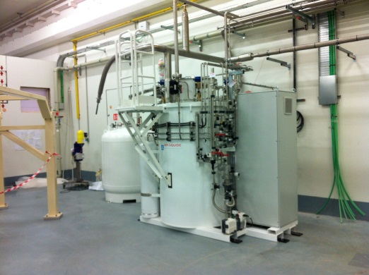
Equipements majeurs Phase "0" S³
Zone Dispersive
Beam Dump en cours de réalisation
Dipôle électrique
Électrodes au T4 de 2016
Triplet Ouvert :
Au Ganil,
À installer...
Station cibles
Profils de cibles avec canon à électrons
Boite froide
MES : fin 2016
SMT
Phase proto :
Fin au T2 2016
Série :
→ août 2017
Chambre station cibles stables

Slide 10
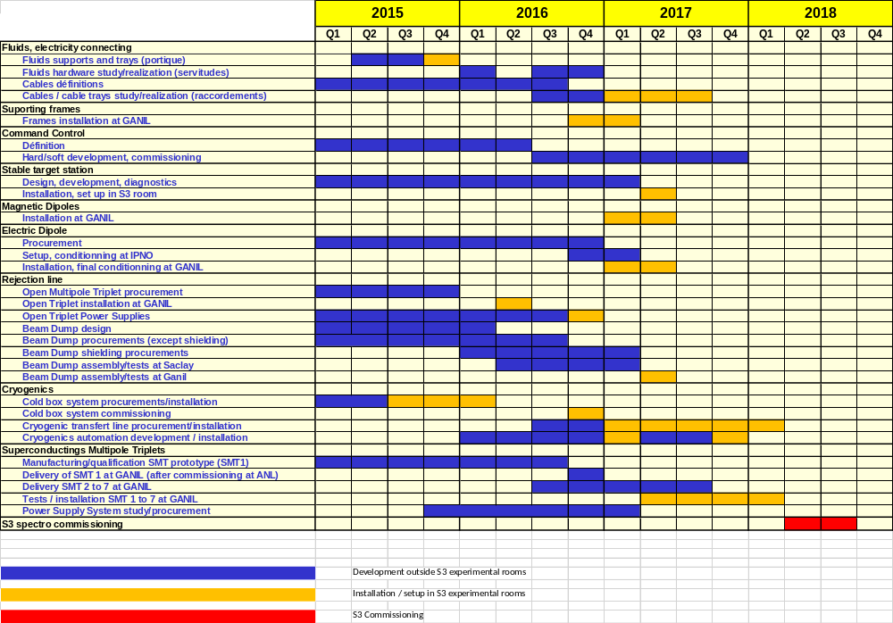
Planning S³

Slide 11
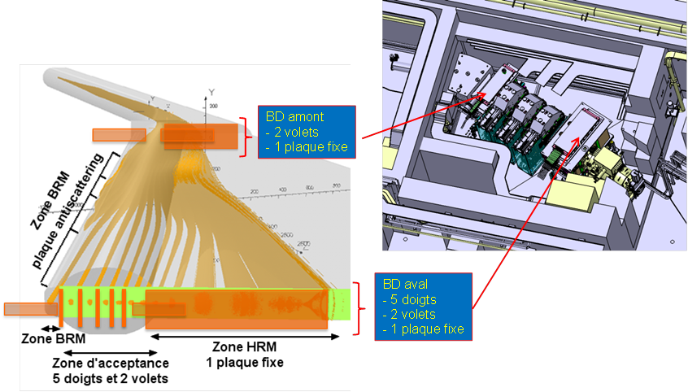


Beam-Dump : IRFU

Slide 12
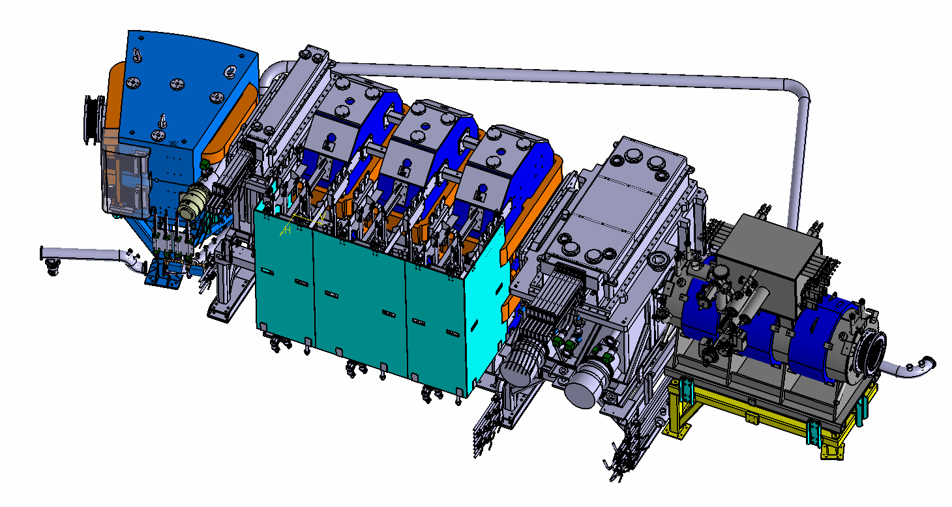
Section Beam Dump
Triplet chaud
Salle 169
D11 – Fin 2016
Plug Amont
SMT2
Plug Aval
½ culasse triplet – avant été 2016
Plugs + SMT2 – mars 2017

Slide 13
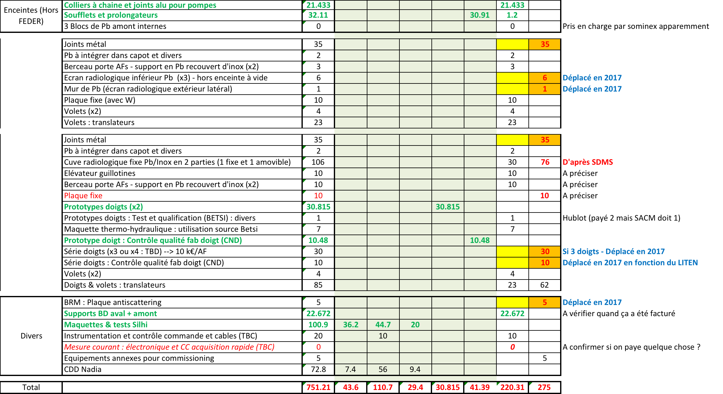
Budget Beam dump
Attention : coût des translateurs en cours d’estimation

Slide 14
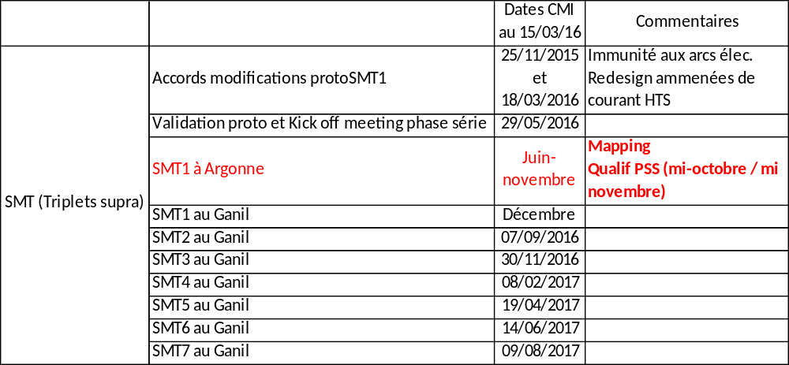
Planning SMTs
Chemin critique
Training GANIL (SDA/GAC, SDA/GVC,…)

Slide 15
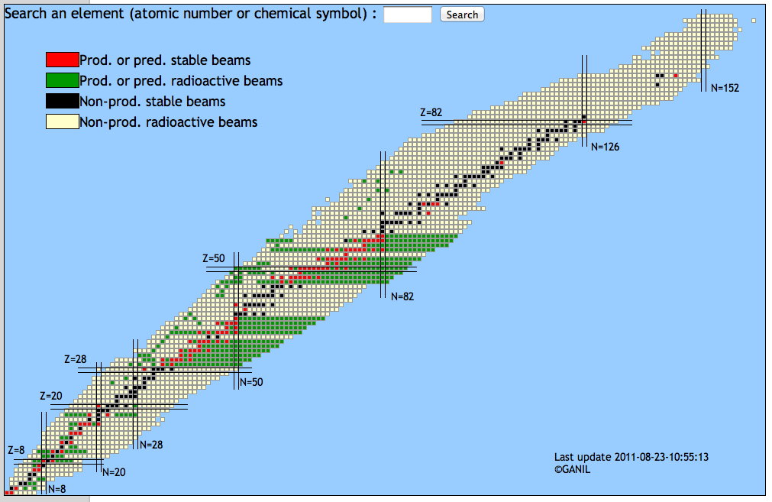
Projet Haute Intensité (SPIRAL2 Phase 1++)
Projet de référence ≤ 10¹⁵ pps, p-Ni, 0.75 MeV/n – 14.5 MeV/n
Phase 1++ ≤ 10¹⁵ pps, p-U, 0.75 MeV/n – 9 MeV/n
LINAC SPIRAL2 A/Q=6 (Phase 1 ++)
Ions | Intensity (pµA)) [A/Q=3] | High Intensity [A/Q=6-7]
¹⁸O | 216 | 375
¹⁹F | 28,6 | 50
³⁶Ar | 17.5 | 40
⁴⁰Ar | 2.9 | 30
³⁶S | 4.6 | 30
⁴⁰Ca | 3 | 20
⁴⁸Ca | 1.25 | 15
⁵⁸Ni | 1.1 | 10
⁸⁴Kr | 0 | 20
¹²⁴Sn | 0 | 10
¹³⁹Xe | 0 | 10
²³⁸U | 0 | 2.5
LINAC SPIRAL2 A/Q=3
✕5-10
Renforcer le programme scientifique phase 1+
Ouvre nouvelles perspectives scientifiques
(Faisceaux lourds Xe, Pb, U)
✕10^{x}
Notes:
RIB available GANIL will cover the following regions.
Very promising RIB will be available in the next future at GANIL, and if you want to get more precise beam intensity as well as the energy, please
Use the new interactive web interface has been put online
where any users can estimated the currently available and future beams at the GANIL/SPIRAL1/SPIRAL2 facility.
Regions produced with light beams (ISOL), HI beams ISOL and in-flight completed by nuclei produced with high intensity RIB of ff.

Slide 17

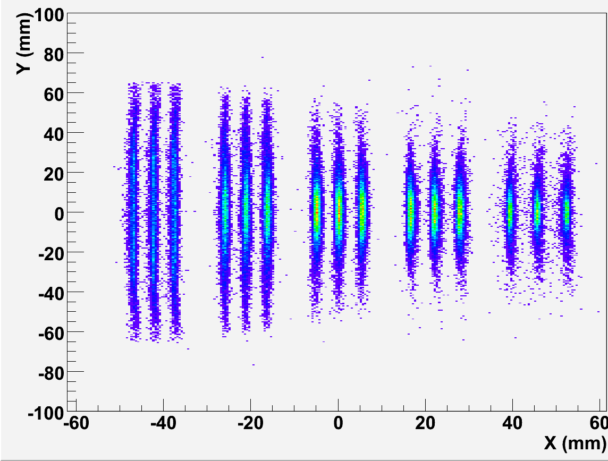
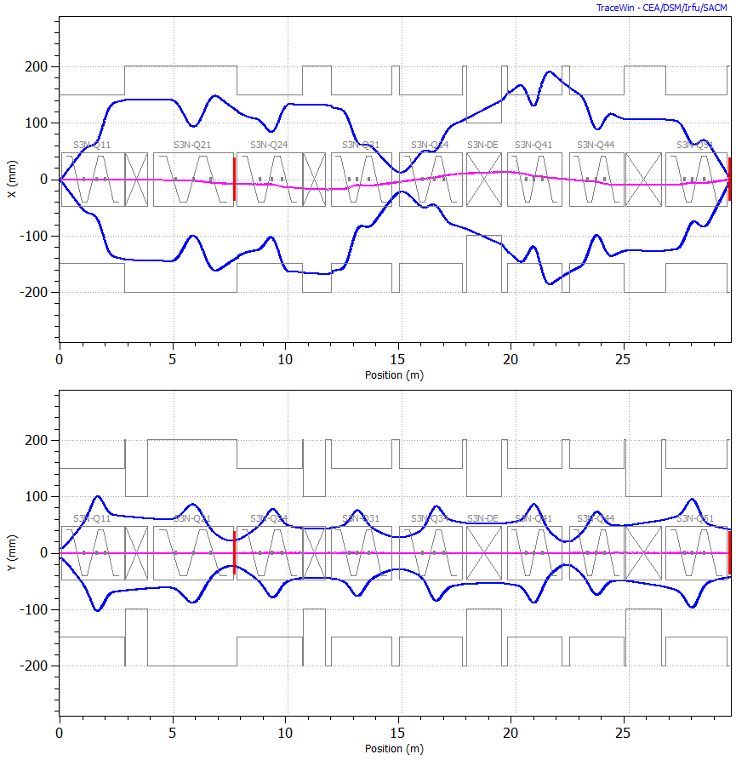
Principles
Target point
High power rotating target
Multistep selection
Large acceptance (11 msr, Δp=15%)
Mass resolution (ΔM/M ≈ 300)
Versatility (Bρ_{max}=1.6Tm; Eρ_{max} = 12MV)
Image 2
Achromat selection
Extended drift to place detector arrays
High
Intensity
Beams
Image 1
Momentum Selection
and beam rejection
Image 3
TKE selection
Image 4 : Mass selection
A=101,100,99
Image 4
Δ(M/Q) ≈ 460
300
mm
Horizontal
22+
23+
24+
25+
26+
Momentum Achromat
Mass spectrometer
300
mm
Tracewin simulation code:
Full raytracing in the multipole 3D
field maps
Automatic optimisation of 80 fields
Vertical
Notes:
The design we propose is a two-stage selection (Bρ & m/q) for very good rejection of both the beam and adjacent mass channels of reaction products
The optical design of such complex spectrometer is only possible with full raytracing sophisticated software and modern computer capabilities

Slide 18
Physics Programs for Day 1 experiments
VHE-SHE & N=Z decay studies
➔S³’s niche within an intense worldwide competition
(high beam intensity capabilities, mass resolution and high transmission)
D. Ackermann Talk
➔Well identified strategy for day 1 (day 2) experiments
Doubly magic ²¹⁸U; in depth spectroscopy of Fm isotopes; bridge the gap between cold and hot fusion ; Search for isomers beyond Z=110; X-ray identification of SHE; ¹¹²Ba-¹⁰⁸Xe -¹⁰⁴Te super-allowed α decay
Beams: Si, Ar, ⁴⁸Ca, ⁶⁴Ni
Targets: ²⁰⁸Pb
Instrumentation: SIRIUS
Crucial
Next steps
new RFQ and high power source = Phase 1++
Actinides targets
In beam spectroscopy detection for N=Z
GS properties @ REGLIS³
➔Unique characteristics
(nuclei not available elsewhere, REGLIS ANR, high selectivity, DESIR coupling in 2018)
P. van Duppen Talk
➔Well identified strategy for day 1 (day 2) experiments
⁹⁴Ag, ¹⁰⁰Sn, ⁸⁰Zr studies : mass, charge radius, decay characteristics for ground or isomeric states
then going to very heavy nuclei (²⁵⁴No)
Beams: Ne, ⁴⁰⁻⁴⁸Ca, ⁵⁸Ni
Targets: stable
Instrumentation: LEB
Crucial
Next steps
New RFQ and high power source = Phase 1++
New lasers @ Ganil
to the DESIR facility

Slide 19

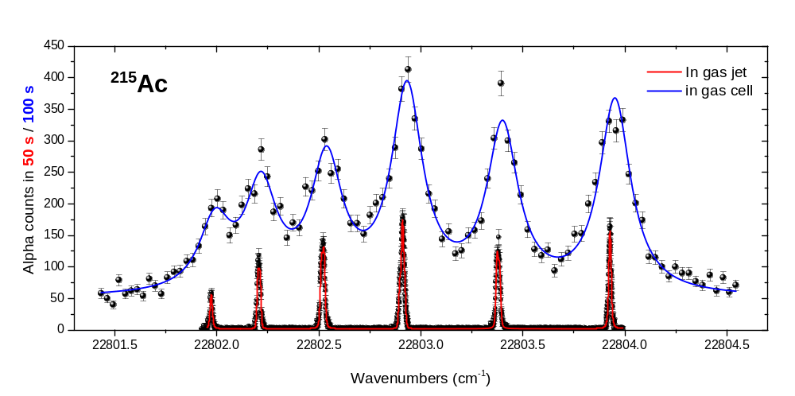
First test: In-Gas-Jet Spectroscopy of ^{214,215}Ac
Rep. rate 10 kHz
gas cell
detector station
Nd:YAG
collector
plates
Diode
λ-meter
de Laval
nozzle
target
SEM
SPIG
Ti:sa
SHG
CYCLONE 110
cyclotron beam
dipole
magnet
ionization
volume
accel.
optics
Ti:sa
SHG
Figures of merit:
Resolution ~ 5e-7
(FWHM= 400 MHz)
Selectivity ~ 200
Efficiency ~ 0.5%
R. Ferrer · LAP 2015, East Lansing, July 7-11, 2015

Slide 20
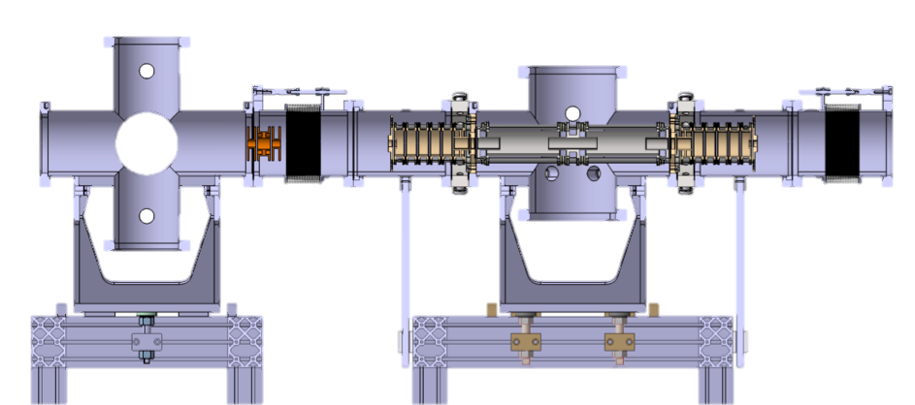
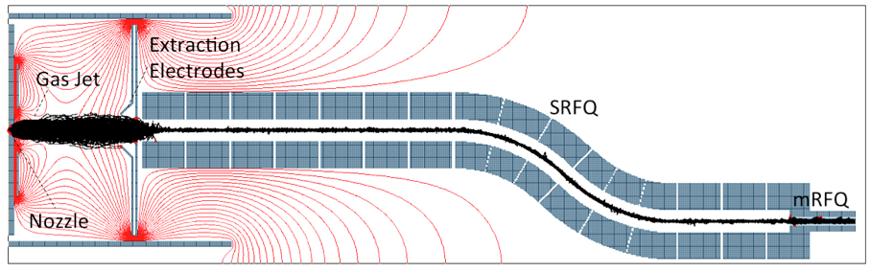
Low Energy Branch
PILGRIM Multi Reflection – Time of Fight –Mass Spectrometer
The RFQ system (LPC-Caen, KULeuven)
Tests experiment: Laser scans of ²¹²⁻²¹⁵Ac in-gas cell laser spectroscopy experiments at LISOL facility (Louvain-La-Neuve).

Slide 21
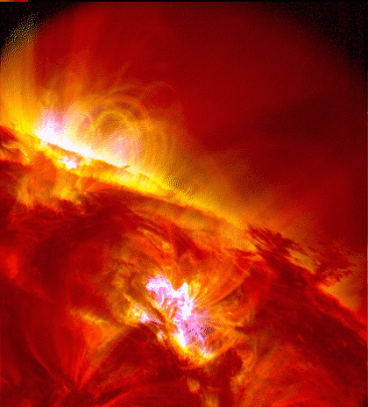
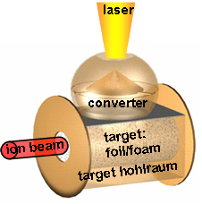
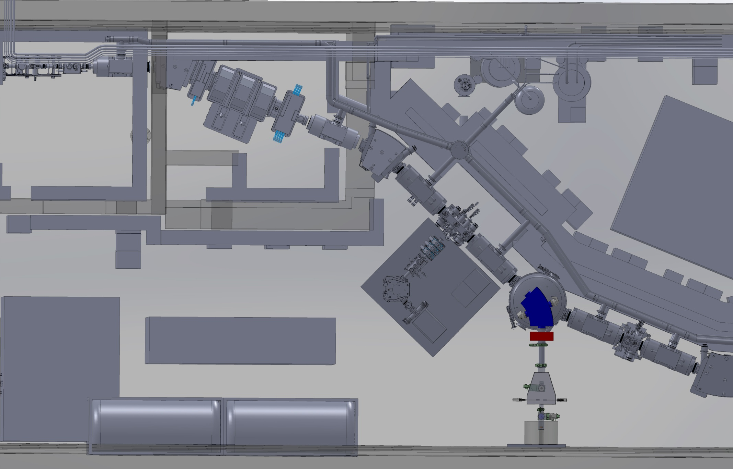
FISIC (Fast Ion — Slow Ion Collision)
[E. Lamour]
FISIC*: a collider project on SPIRAL2/GANIL for Atomic Physics of ion-ion collisions
From the study of elementary processes
ionization
to damage in materials and ion energy transfer in plasmas
excitation
stopping power and ion-plasmas interaction
capture
Stellar plasmas
inertial confinement plasmas
v_{p}
Z_{p}
Z_{t}
All the elementary processes have σ max and of the same order of magnitude
Primary beam
+Q
Detection
of q+/-1
Investigations of ion-ion collisions
“clean plasmas” with well known charge states
Ability to investigate a large variety of systems
Possibility to easily scan the charge state dependence
Low
Energy
Beam
+q
Detection
of Q-/+1
Notes:
Thoses processes are strongly correlated to damage in materials and to ion energy transfer at various plasma conditions such as…

