Slide 1
The clustering of galaxies in the completed SDSS-III Baryon Oscillation Spectroscopic Survey : cosmological analysis of the DR12 galaxy sample arXiv:1607.03155
E. Burtin, Cosmo-Club, Oct. 6, 2016

Slide 2
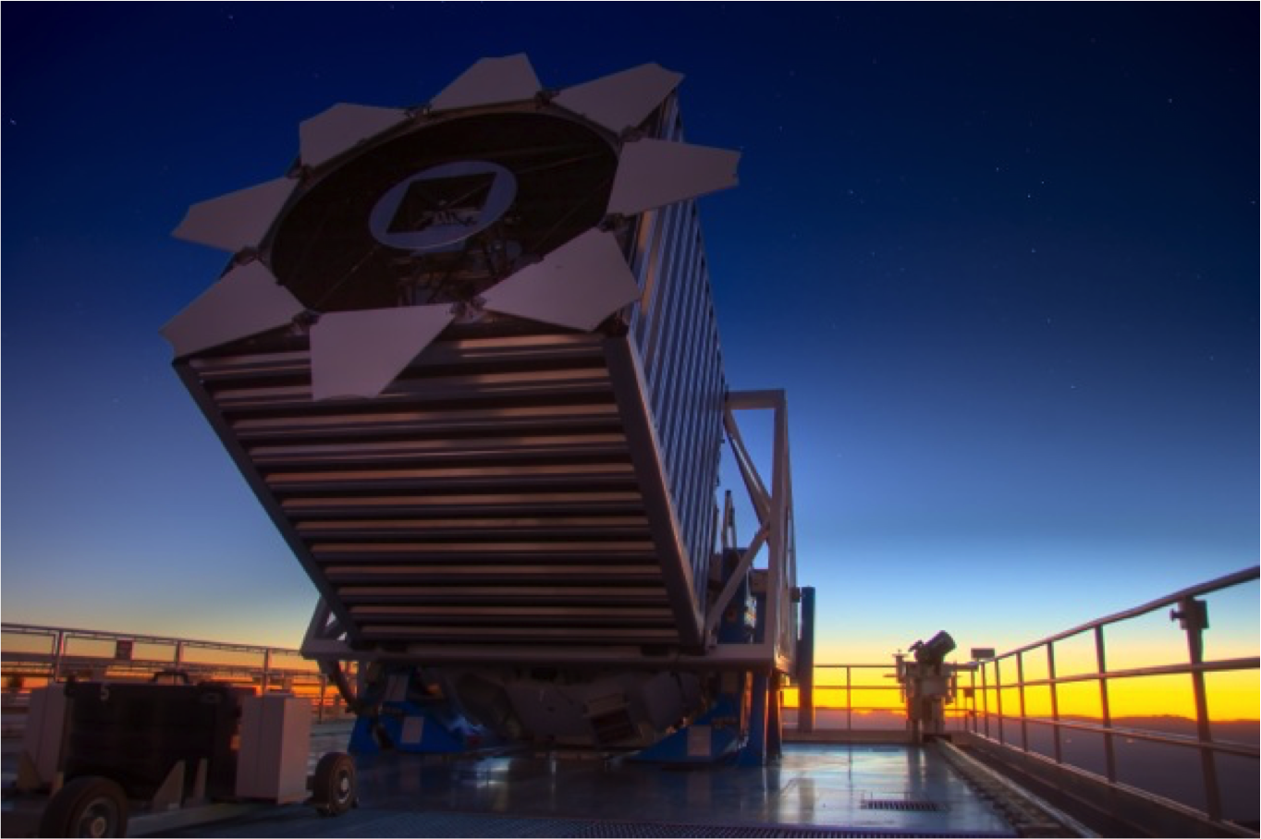
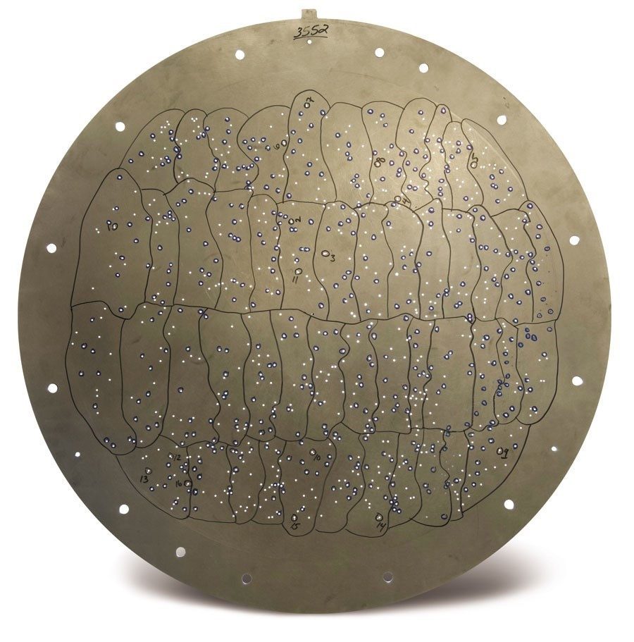
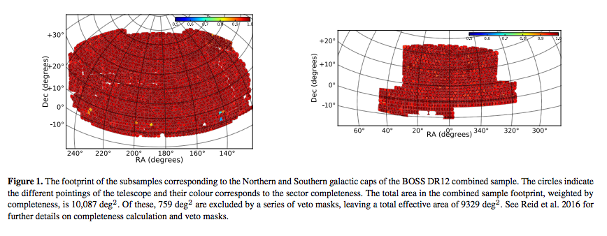
SDSS-BOSS
Multi-object spectrograph
on the 2.5m Sloan Telescope
3 deg. diameter plates
1000 fibers per plate
Run 2009 – 2014
paper on DR12 (full data set)

Slide 3
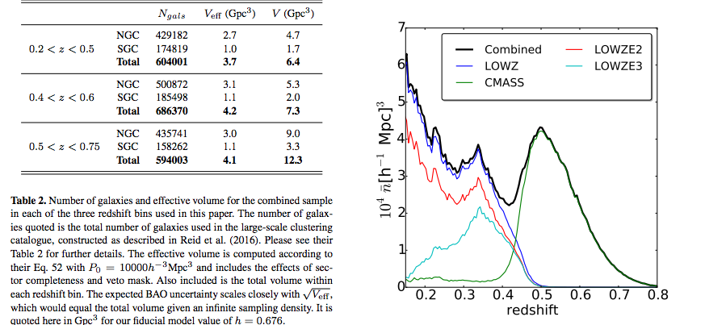
Redshift distribution
3 redshifts bins – marginal gain from overlapping bin…

Slide 4
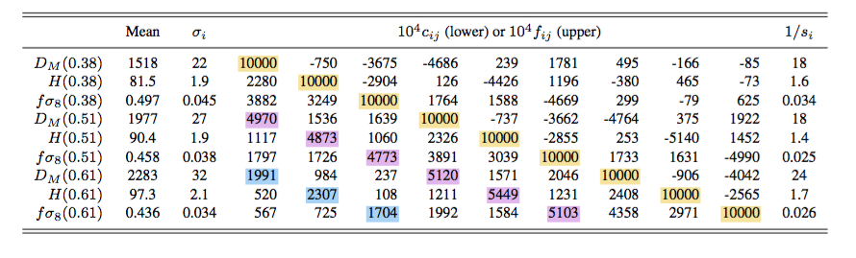
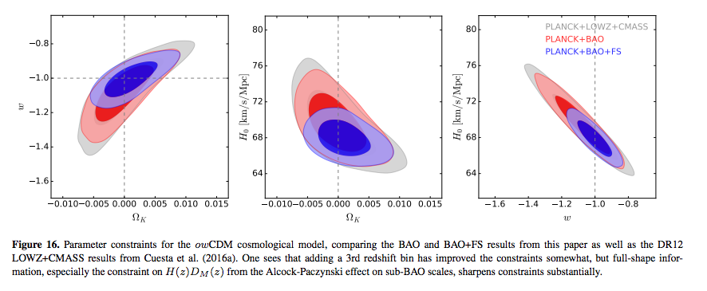
Redshift distribution
-> 2 bins
-> 3 bins

Slide 5

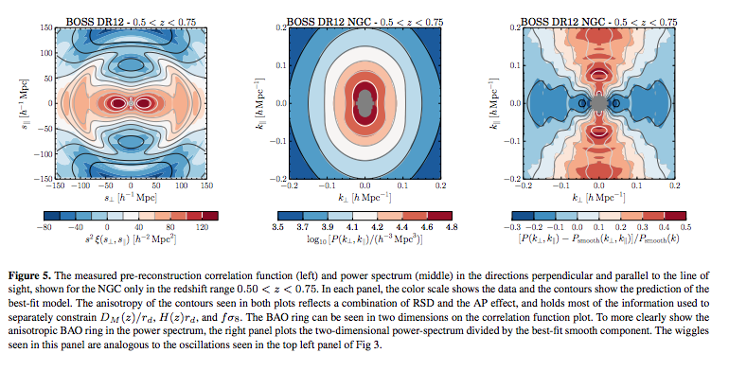

2D clustering pre-reconstruction: correlation function and power spectrum

Slide 6
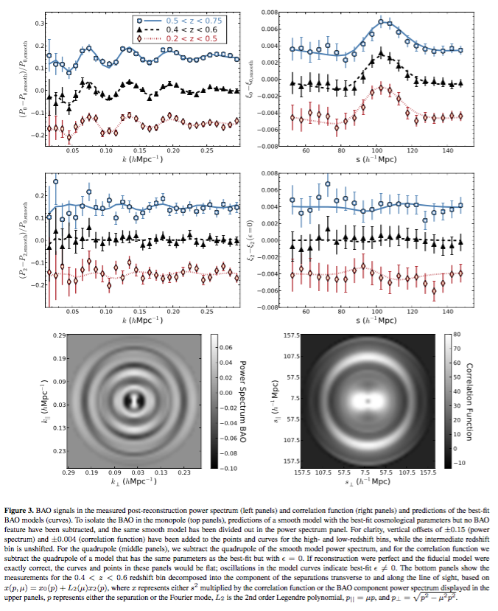
Anisotropic BAO - post reconstruction
Reconstruction :
Measure smoothed density field
with the galaxies
Move galaxies back to original
positions
Narrows BAO peak
Cancels RSD at large scales

Slide 7
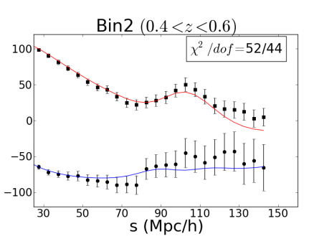
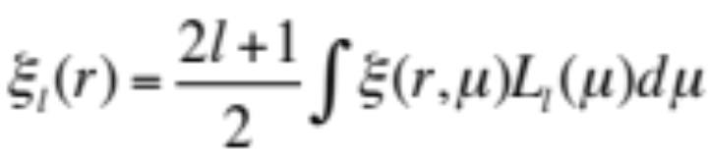


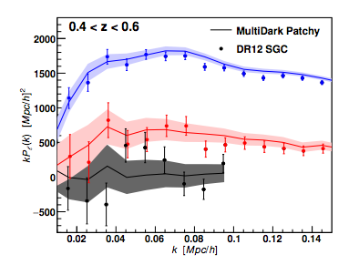


Legendre multipoles decomposition
Only l=0,2,4 are non zero in linear theory
Biased tracers of matter :
Satpathy et al. (2016)
Monopole (l=0):
Quadrupole (l=2):
Hexadecapole (l=4):
Beutler et al. (2016)

Slide 8
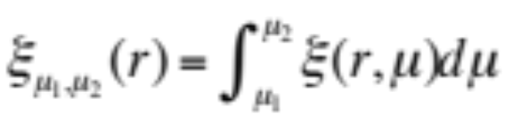
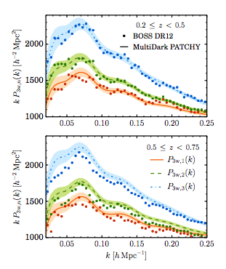
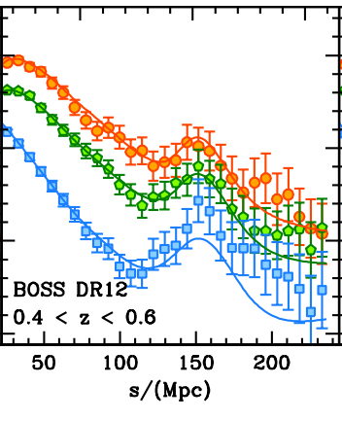
« wedges » analysis
Performed by a different group.
Filtering out l>4 multipoles
Configuration space : Sanchez et al. (2016)
Fourier space : Grieb et al. (2016)

Slide 9
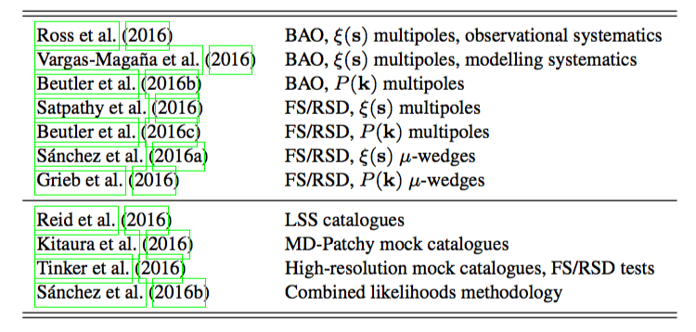
Companion papers :

Slide 10
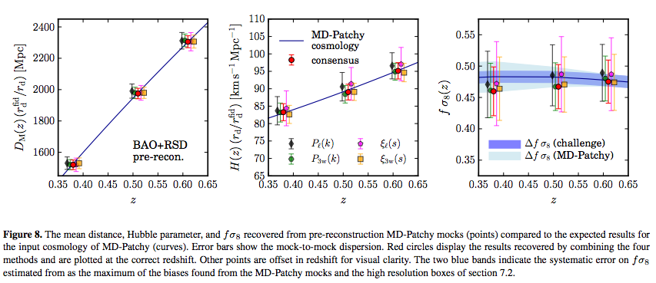
Performance of analysis methods on mocks
What the paper says about it :
« In all cases the µ-wedges analyses give significantly tighter
constraints than the multipole analyses, in both configuration
space and Fourier space »

Slide 11
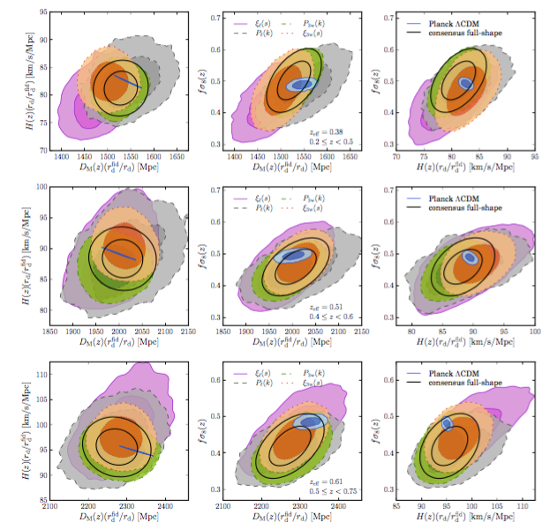
Comparison of analyses - consensus

Slide 12
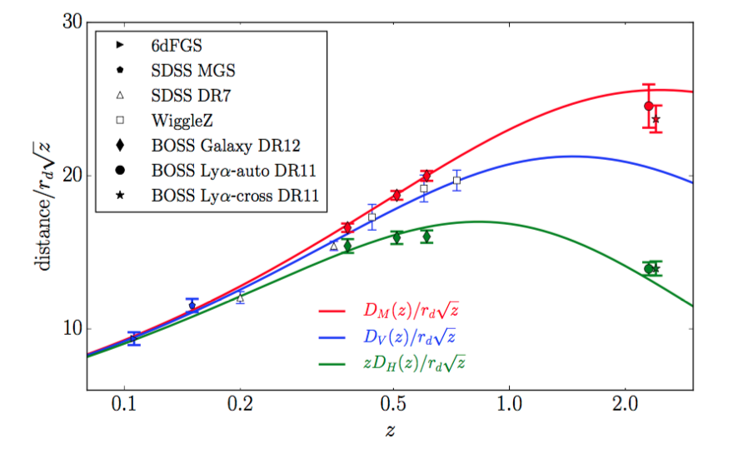
BAO « Hubble diagram »
Angular diameter distance : D_{A}(z)= (transverse BAO size)/angle
Comoving diameter distance : D_{M}(z) = (1+z)D_{A}(z)
Angle averaged BAO -> D_{V}(z) = [ czD_{M}²(z)/H(z) ]^{1/3}

Slide 13

Cosmological constraints :
Planck Results (June2016)
In Λ-CDM : DR12
H₀ = 67.6 +/- 0.5
Ω_{m} = 0.311 +/- 0.006
In o-CDM :
Ω_{K} = 0.000 ± 0.005 (95%, Planck TT,TE,EE+lowP+lensing+BAO)
Ω_{K} = +0.0004 ± 0.0020 (68%, Planck TT,TE,EE+lowP+DR12)
In w-CDM :
w = -1.006 ^{+0.085} _{-0.091} (95%, Planck TT,TE,EE+lowP+lensing+BAO)
w = -1.01 ± 0.05 (68%, Planck TT,TE,EE+lowP+DR12)

Slide 14
Cosmological constraints :
In ow-CDM :

Slide 15
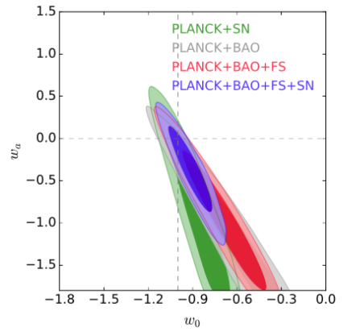
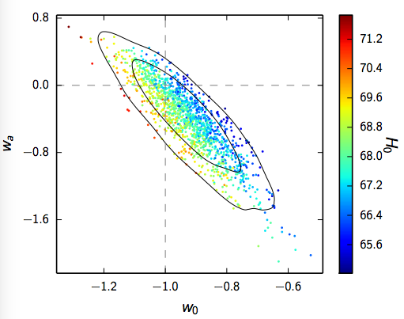
Cosmological constraints
Time varying Dark Energy eq of state : w = w₀ + ( 1 - a ) w_{a}

Slide 16

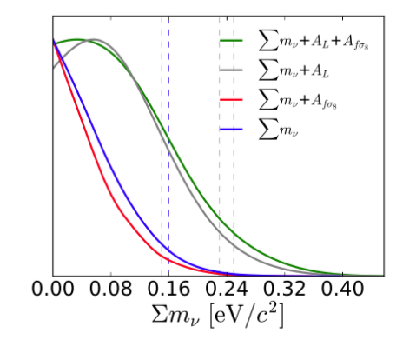
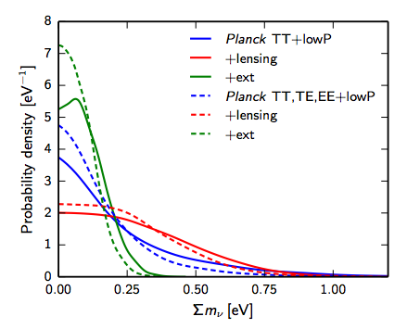
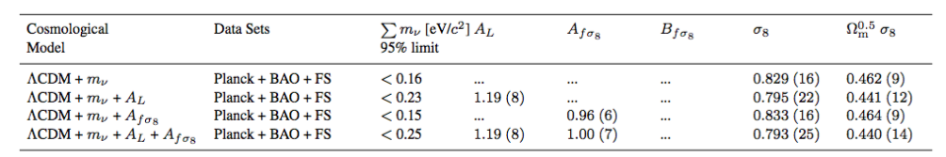
Constraint on neutrino mass
Planck Results (June2016)
BOSS – DR12
Power spectrum + CMB lensing

Slide 17
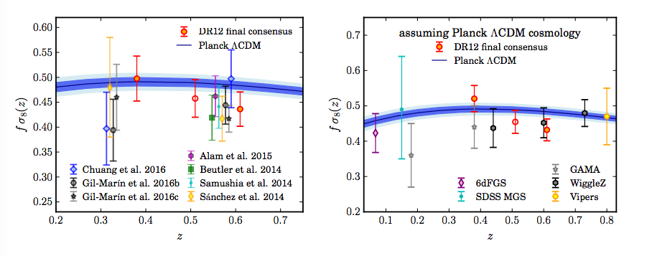
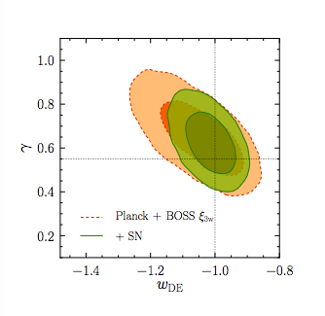
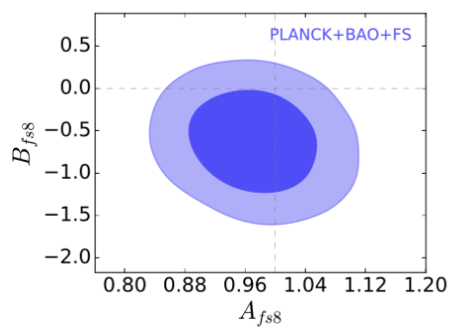
Growth of structures
BOSS z=0.5 point highly correlated with the other two.
Tension growth / ΛCDM ? They say no.
Time varying growth of structures :
fσ₈ -> fσ₈ [ A_{fσ8} + B_{fσ8} (z-0.51) ]
Sanchez et al. (2016)
f=Ω_{m}(z)^{γ}

Slide 18
Conclusions from the paper
7 data analyses consistent – statistically limited
Hubble parameter measured to 2.4%, angular diameter distance to 1.5%
growth of structures measured to 9.2%
vanilla spatially flat L-CDM is enough
H₀ = 67.6 +/- 0.5, Ω_{m} = 0.311 +/- 0.006
H₀ = 67.5 +/- 1.2, Ω_{m} = 0.311 +/- 0.007, Neff=3.03+/-0.18 (Planck+DR12)
tight limits on owCDM
w_{a} = -0.39+/-0.34 including SNe
Stable limits on H₀ – still in tension with distance ladder ( Riess et al. (2016) )
ΣM_{ν}<0.16 eV (95%) -> ΣM_{ν}<0.25 eV (95%) releasing growth of structure
growth consistent with GR. mild (1.5 σ) evolution possible.

Slide 19
Almost full set of companions papers
2016arXiv160703154W, Wang, Yuting et al.,
The clustering of galaxies in the completed SDSS-III Baryon Oscillation Spectroscopic Survey: tomographic BAO analysis of DR12 combined sample in configuration space
2016arXiv160703153Z, Zhao, Gong-Bo et al.,
The clustering of galaxies in the completed SDSS-III Baryon Oscillation Spectroscopic Survey: tomographic BAO analysis of DR12 combined sample in Fourier space
2016arXiv160703152P, Pellejero-Ibanez, Marcos et al.,
The clustering of galaxies in the completed SDSS-III Baryon Oscillation Spectroscopic Survey: double-probe measurements from BOSS galaxy clustering & Planck data -- towards an analysis without informative priors
2016arXiv160703150B, Beutler, Florian et al.,
The clustering of galaxies in the completed SDSS-III Baryon Oscillation Spectroscopic Survey: Anisotropic galaxy clustering in Fourier-space
2016arXiv160703149B, Beutler, Florian et al.,
The clustering of galaxies in the completed SDSS-III Baryon Oscillation Spectroscopic Survey: Baryon Acoustic Oscillations in Fourier-space
2016arXiv160703148S, Satpathy, Siddharth et al.,
The clustering of galaxies in the completed SDSS-III Baryon Oscillation Spectroscopic Survey: On the measurement of growth rate using galaxy correlation functions
2016arXiv160703147S, Sanchez, Ariel G. et al.,
The clustering of galaxies in the completed SDSS-III Baryon Oscillation Spectroscopic Survey: cosmological implications of the configuration-space clustering wedges
2016arXiv160703146S, Sanchez, Ariel G. et al.,
The clustering of galaxies in the completed SDSS-III Baryon Oscillation Spectroscopic Survey: combining correlated Gaussian posterior distributions
2016arXiv160703145R, Ross, Ashley J. et al.,
The clustering of galaxies in the completed SDSS-III Baryon Oscillation Spectroscopic Survey: Observational systematics and baryon acoustic oscillations in the correlation function
2016arXiv160509745A, Ata, Metin; et al.,
The Clustering of Galaxies in the Completed SDSS-III Baryon Oscillation Spectroscopic Survey: Cosmic Flows and Cosmic Web from Luminous Red Galaxies
2016arXiv160703144S, Salazar-Albornoz, Salvador et al.,
The clustering of galaxies in the completed SDSS-III Baryon Oscillation Spectroscopic Survey: Angular clustering tomography and its cosmological implications
2016arXiv160703143G, Grieb, Jan Niklas et al.,
The clustering of galaxies in the completed SDSS-III Baryon Oscillation Spectroscopic Survey: Cosmological implications of the Fourier space wedges of the final sample

Slide 20
Growth of structures

Slide 21
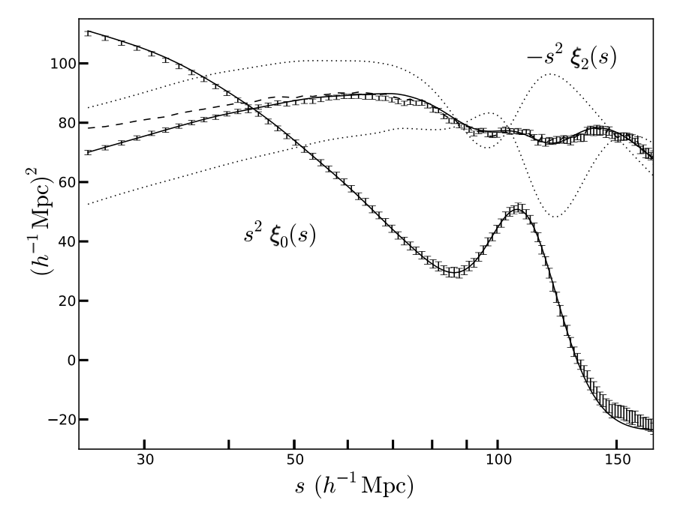
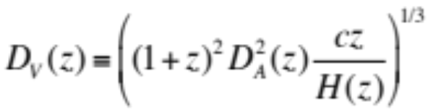

Other sources of distortions :
Alcock-Paczinski Effect
When the data is analyzed with a different cosmology than the real one
+/- 10% on F(z)
BAO peak sensitive to :
Quadrupole sensitive to :
f*σ₈(z)
Full RSD analysis :
Recognized as a key probe of cosmology

