Slide 1

Optical readout:
an intuitive readout
for MPGD detectors
Filippo Resnati (EP-DT-DD)
on behalf of the GDD team
Seminar at SPhN department - CEA/Saclay - Friday 3rd of February 2017

Slide 2
Overview
Relevant mechanisms for the operation of gaseous detectors
Imaging applications of MPGDs outside high energy physics
Developments of the optical readout for MPGDs at CERN
Possible other applications
Seminar at SPhN department - CEA/Saclay - Friday 3rd of February 2017

Slide 3
Overview
Relevant mechanisms for the operation of gaseous detectors
Imaging applications of MPGDs outside high energy physics
Developments of the optical readout for MPGDs at CERN
Possible other applications
Seminar at SPhN department - CEA/Saclay - Friday 3rd of February 2017

Slide 4
Why gaseous detectors
Large dimensions (several m²)
Not expensive (< 5 kCHF/m²)
Good position resolution (<100 um)
Excellent time resolution (<5 ns and even <100 ps)
Radiation hard (10s year of LHC)
Low material budget (<0.01 X0)
Compatible with magnetic field
Seminar at SPhN department - CEA/Saclay - Friday 3rd of February 2017

Slide 5
Gas as active medium
Gas at RTP is not dense
Small amount of energy released
Few primary electron-ion pairs
Amplification is needed
Two possibilities: charge and light
Seminar at SPhN department - CEA/Saclay - Friday 3rd of February 2017

Slide 6
Townsend mechanism
Externally applied electric field acts on electrons and ions (free to move) separating them.
On top of the random motion (diffusion) charges acquire energy and move following the field lines (drift).
If the field is high enough, the energy gained by the electrons is sufficient to further ionise the gas.
Seminar at SPhN department - CEA/Saclay - Friday 3rd of February 2017

Slide 7

Townsend avalanche
α: average number of electron ion pairs created by a single electron per unit path
Avalanche increases ~exponentially in time, field and space
Cathode
+
-
+
-
Anode
For a linear response of the detector,
the amplification must be confined in a small region.
Seminar at SPhN department - CEA/Saclay - Friday 3rd of February 2017

Slide 8
MWPC
Charpak, 1968
E
Cathode
+
-
avalanche
-
10s μm
Anode
-
drift
-
+
10s μm
r
The field is shaped by the curvature of the wire.
Several wires to allow the position resolution.
The field is sensitive to wire imperfections.
Slowly moving ions affect the rate capabilities.
Seminar at SPhN department - CEA/Saclay - Friday 3rd of February 2017

Slide 9
Change of paradigm (I)
In order to evacuate the ionic charge fast, the cathode electrodes are placed in the vicinity of the anode electrodes:
Micro Pattern Gaseous Detectors.
Seminar at SPhN department - CEA/Saclay - Friday 3rd of February 2017

Slide 10
MSGC
Oed, 1988
Cathode1
+
-
-
Anode
Cathode2
10s μm
Substrate
Ions are evacuated fast: better rate capability.
Finer anode pitch is possible: better position resolution.
The dielectric substrate charges up, changing the field.
Close anode and cathode occasionally result in sparks.
Seminar at SPhN department - CEA/Saclay - Friday 3rd of February 2017

Slide 11
Change of paradigm (II)
In order to reduce the effects of the discharges and the ageing, the electric field responsible for the amplification is shaped by extended electrodes.
Seminar at SPhN department - CEA/Saclay - Friday 3rd of February 2017

Slide 12
MPGDs: a rich variety
Non-exhaustive list
extended
Micro-bulk MM
MicroMeGas
CAT
Micro-RWell
TH-GEM
InGrid
MicroGroove
LEM
GridPix
MicroWell
GEMpix
RPWell
GEM
electrode
MHSP
MicroPic
MSGC
MicroDot
MicroWire
MicroPin
MicroGap
micro
mesh
type
hole
Seminar at SPhN department - CEA/Saclay - Friday 3rd of February 2017

Slide 13
MicroMeGas
Giomataris, 1996
Cathode
+
-
Metal mesh
-
~130 um
Pilar
Segmented anode
Anode can be made resistive to reduce the discharge effects
Seminar at SPhN department - CEA/Saclay - Friday 3rd of February 2017

Slide 14
GEM
Sauli, 1997
Cathode1
+
-
Cathode2
-
70 μm
50 μm
-
Anode2
-
-
Anode1
Amplified electrons available for further amplification
Seminar at SPhN department - CEA/Saclay - Friday 3rd of February 2017

Slide 15
GEMs
Sauli, 1997
+
-
-
-
-
-
-
-
-
-
-
-
-
-
-
-
-
-
-
-
-
-
-
-
-
-
Push further the discharge limit: larger gain
Seminar at SPhN department - CEA/Saclay - Friday 3rd of February 2017

Slide 16
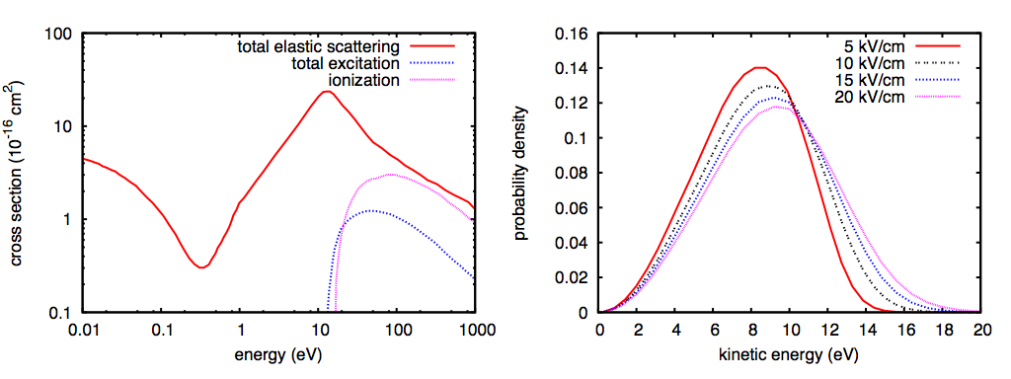
Scintillation
Electrons in pure argon
Electron argon cross sections
Electron energy distribution
total
Magboltz computation
Excitation
threshold
Ionisation
threshold
Excitation happens at lower fields. It results in scintillation.
Electron and ion recombination may result in scintillation too.
Seminar at SPhN department - CEA/Saclay - Friday 3rd of February 2017

Slide 17
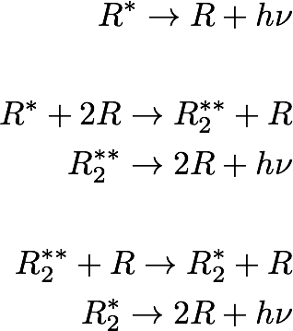
Scintillation
Valid for all the rare gases
Simplified, but effective picture
Unlikely because of what follows
Vibrationally
excited dimer
First continuum:
relevant at low pressures
Second continuum:
relevant at pressure >100 mbar
Gas now transparent
(no rare gas molecules around)
Seminar at SPhN department - CEA/Saclay - Friday 3rd of February 2017

Slide 18
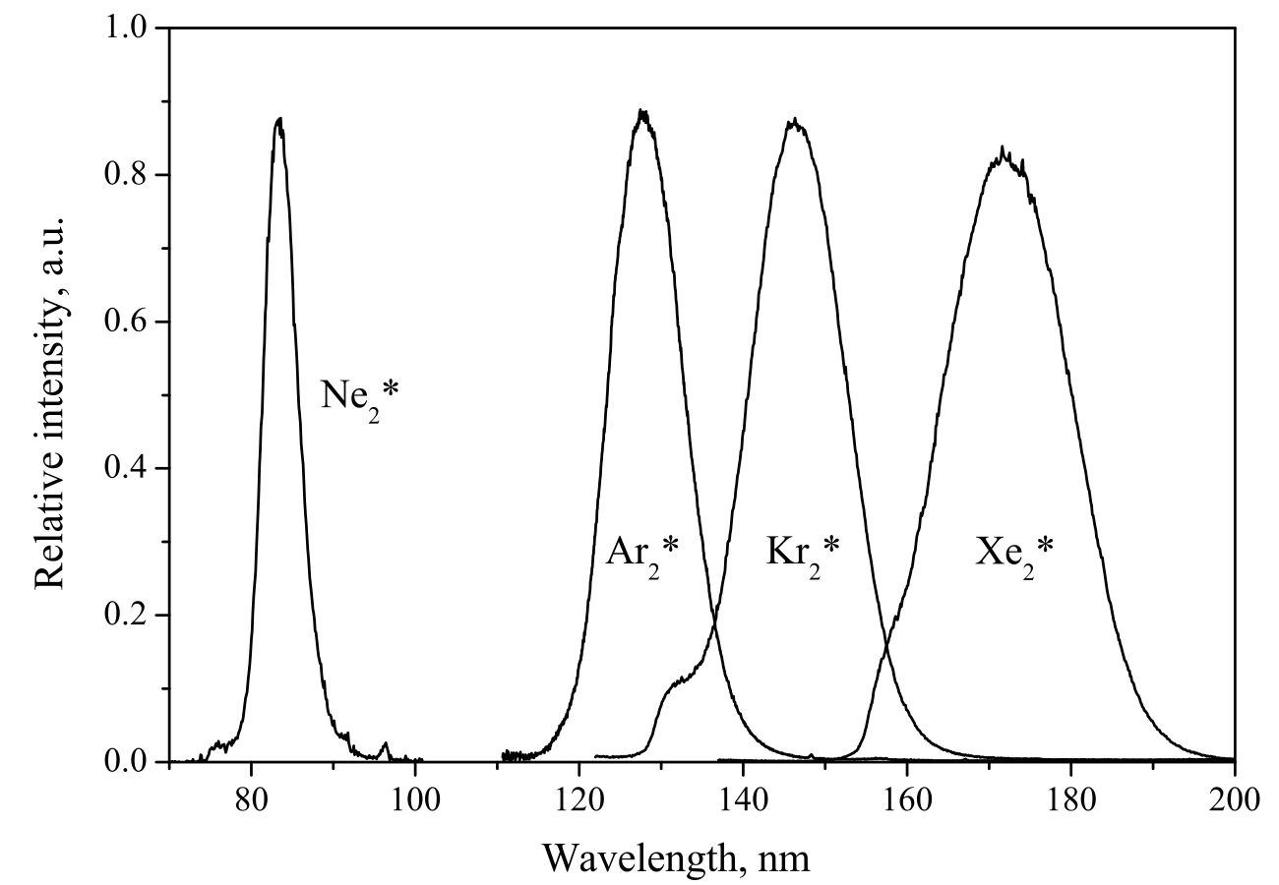
Scintillation
Valid for all the rare gases
Often wavelength shifter are needed solid and/or gaseous
M. Hofmann (2012) PhD dissertation,
Technical University of Munich (and references)
Seminar at SPhN department - CEA/Saclay - Friday 3rd of February 2017

Slide 19
Quencher and shifter
With the addition of molecules
Concurrent mechanism somewhere in the chain:
quencher without and shifter with radiative emission.
Quencher/shifter
E.g., adding a small amount of xenon into argon
results in xenon scintillation.
Energy transfer (favoured) from argon to xenon.
Then the xenon chain is followed.
Quencher/shifter
Another form of quenching:
absorption (not transparent admixtures).
Seminar at SPhN department - CEA/Saclay - Friday 3rd of February 2017

Slide 20
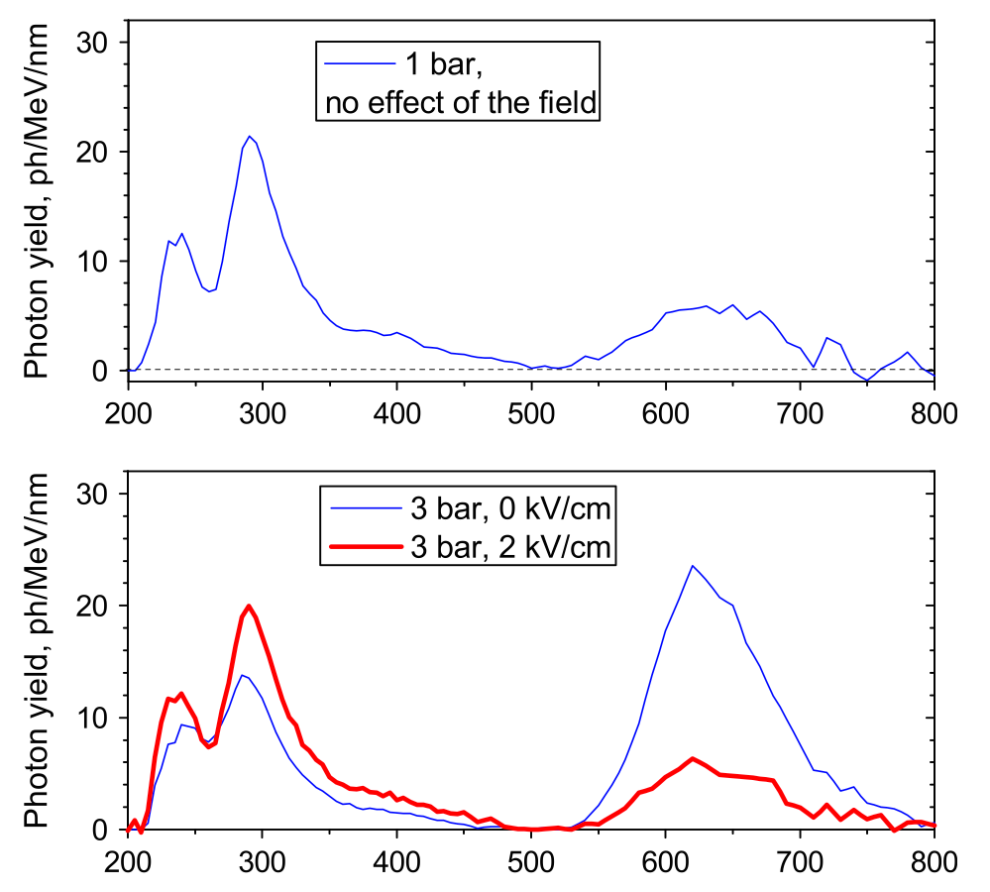
CF4
Admixtures which provide useful scintillation
(enough and near the visible range) are rare.
Pure CF4 primary scintillation
A. Morozov et al., NIM A 628 (2011) 360
CF4 is not transparent to the CF4 de-excitation to ground.
What scintillates must be something else: (CF3*), CF3^{+*} and CF4^{+*}
Seminar at SPhN department - CEA/Saclay - Friday 3rd of February 2017

Slide 21
Where to get the light from
Almost the same spectra
Primary
Excitation and ionisation
produced by the particle
interacting with the gas.
Some dependance
with the electric field.
Electroluminescence
Scintillation without charge
amplification.
Increase linearly with the field.
Easy in pure noble gases.
Avalanche
Exponential scaling with the field.
Proportional to the charge gain.
The extreme is the visible spark.
If only CF3^{+*} and CF4^{+*} are the responsible of the scintillation,
electroluminescence does not take place.
Certainly CF3^{+*} and CF4^{+*} are produced in avalanches,
in fact avalanche scintillation present in CF4 mixtures.
Seminar at SPhN department - CEA/Saclay - Friday 3rd of February 2017

Slide 22
Overview
Relevant mechanisms for the operation of gaseous detectors
Imaging applications of MPGDs outside high energy physics
Developments of the optical readout for MPGDs at CERN
Possible other applications
Seminar at SPhN department - CEA/Saclay - Friday 3rd of February 2017

Slide 23
Imaging
Visual representation of an object (often, but not necessarily in spatial coordinates) using any of a variety of techniques.
When using a camera it’s called photography.
Seminar at SPhN department - CEA/Saclay - Friday 3rd of February 2017

Slide 24
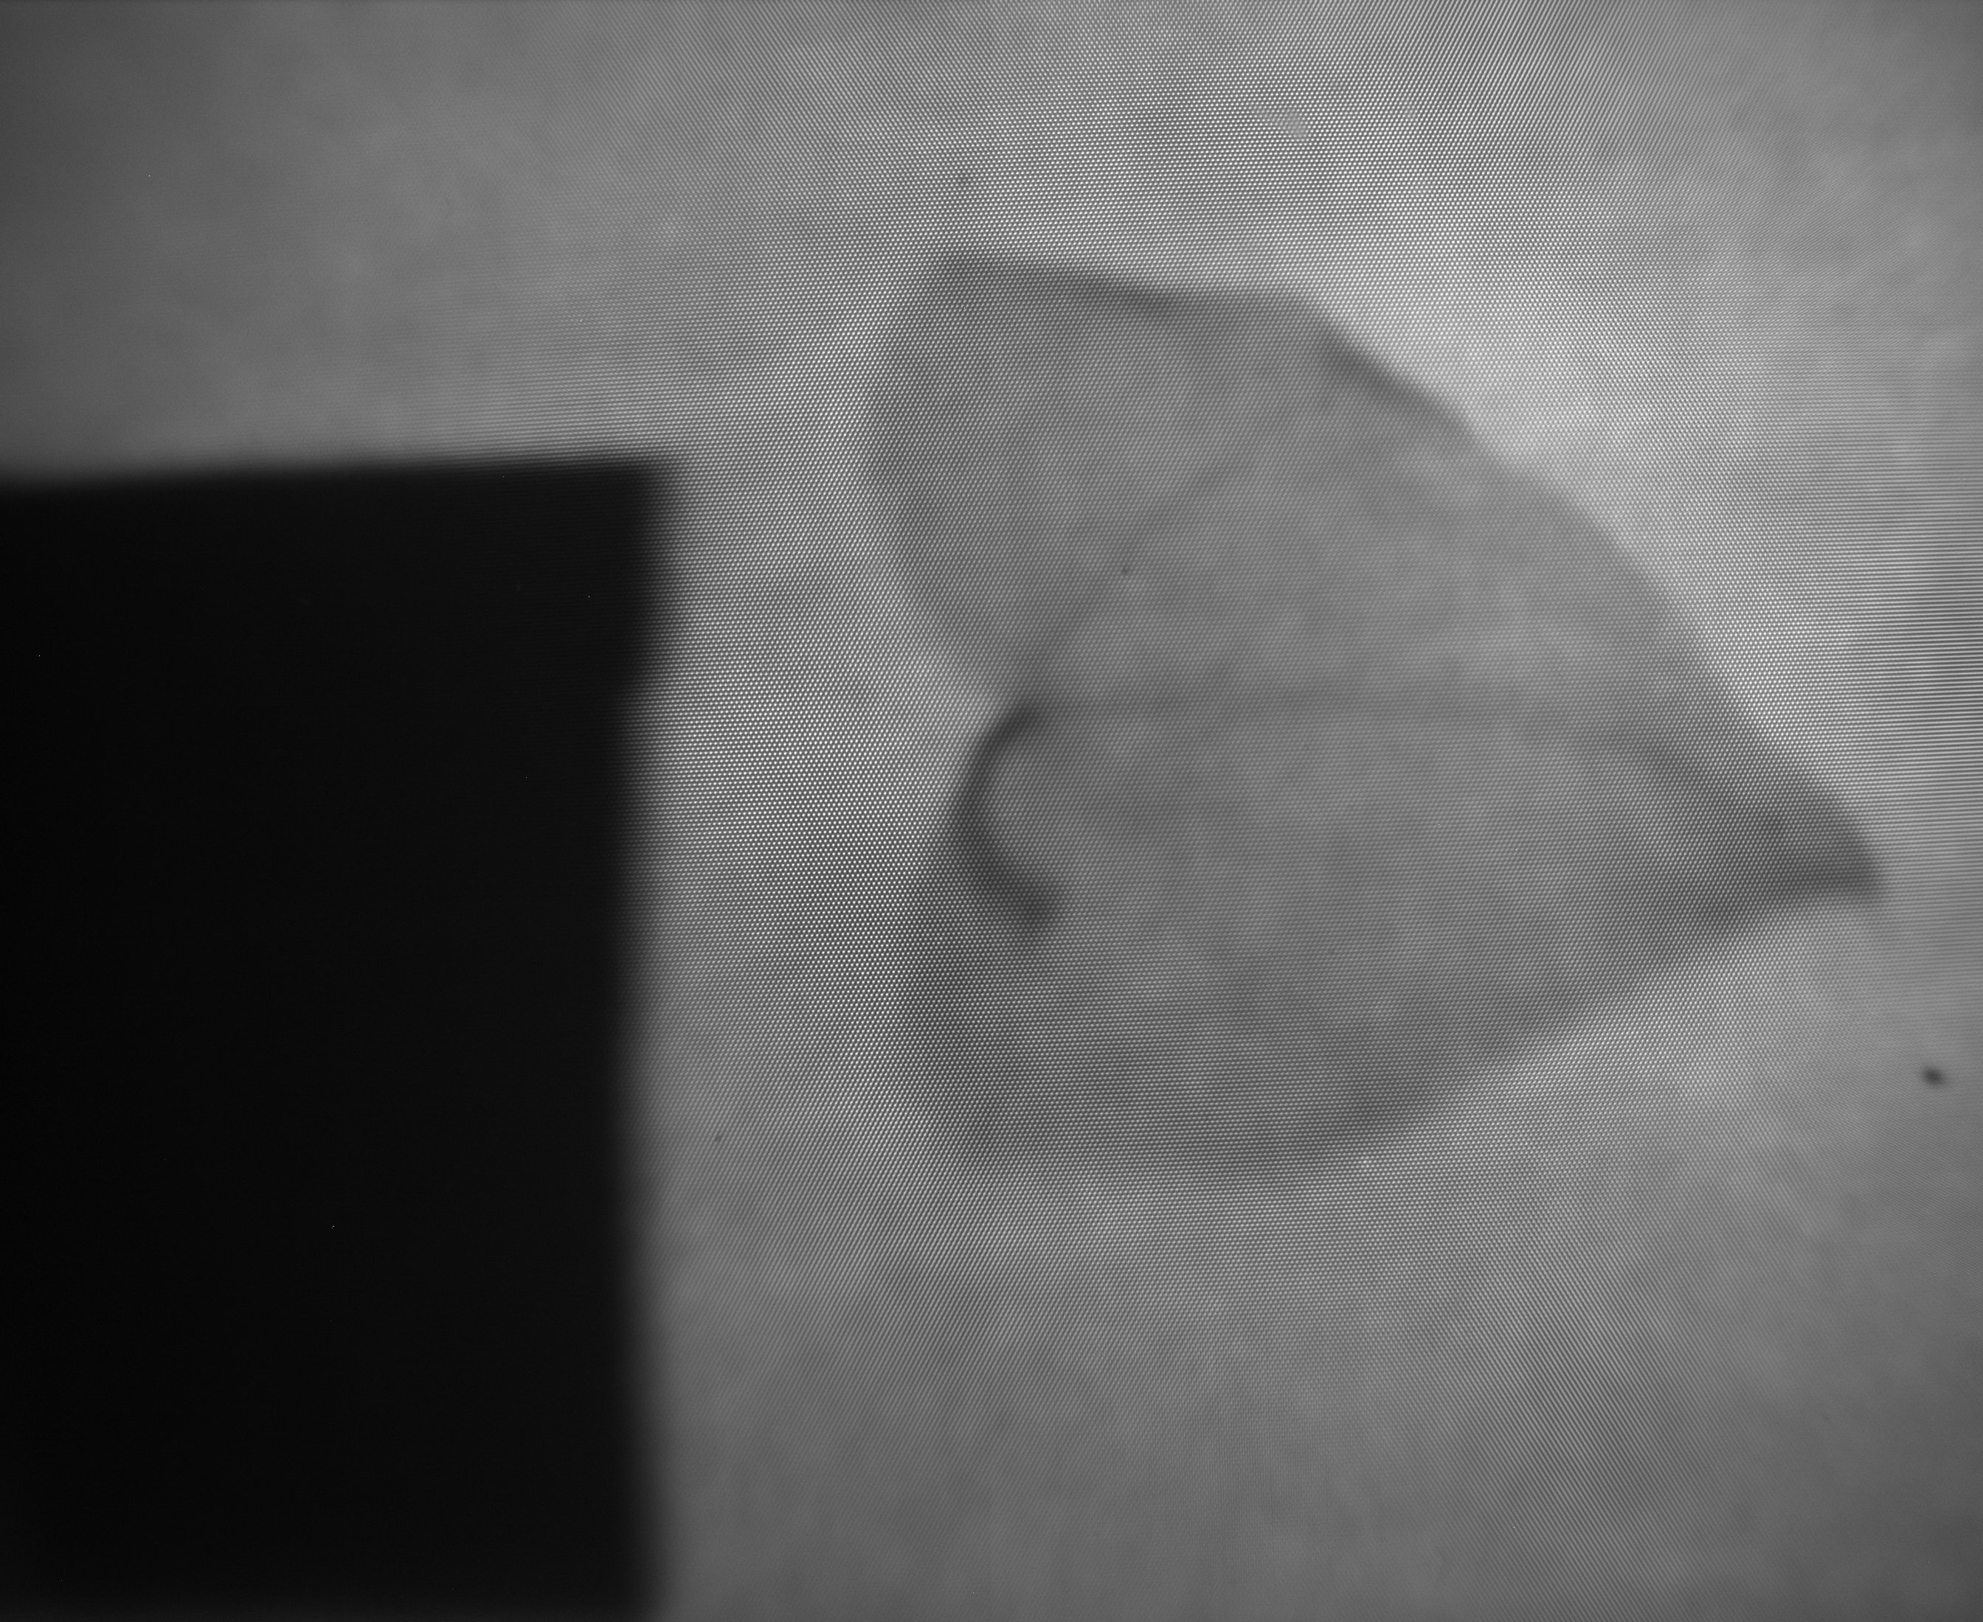
Why imaging?
Seminar at SPhN department - CEA/Saclay - Friday 3rd of February 2017

Slide 25
Sight
Our dominant sense:
- Intuitive handling of the data
- Immediately available information
- Visual learning fast and effective
Seminar at SPhN department - CEA/Saclay - Friday 3rd of February 2017

Slide 26
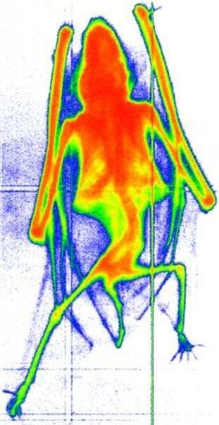
Radiography with GEMs
https://gdd.web.cern.ch/GDD/gemreadout.htm
Demonstration application:
first radiography with GEMs of a small mammal.
Cu X-ray and triple-GEM with X-Y readout.
6 cm
11 mm
Seminar at SPhN department - CEA/Saclay - Friday 3rd of February 2017

Slide 27
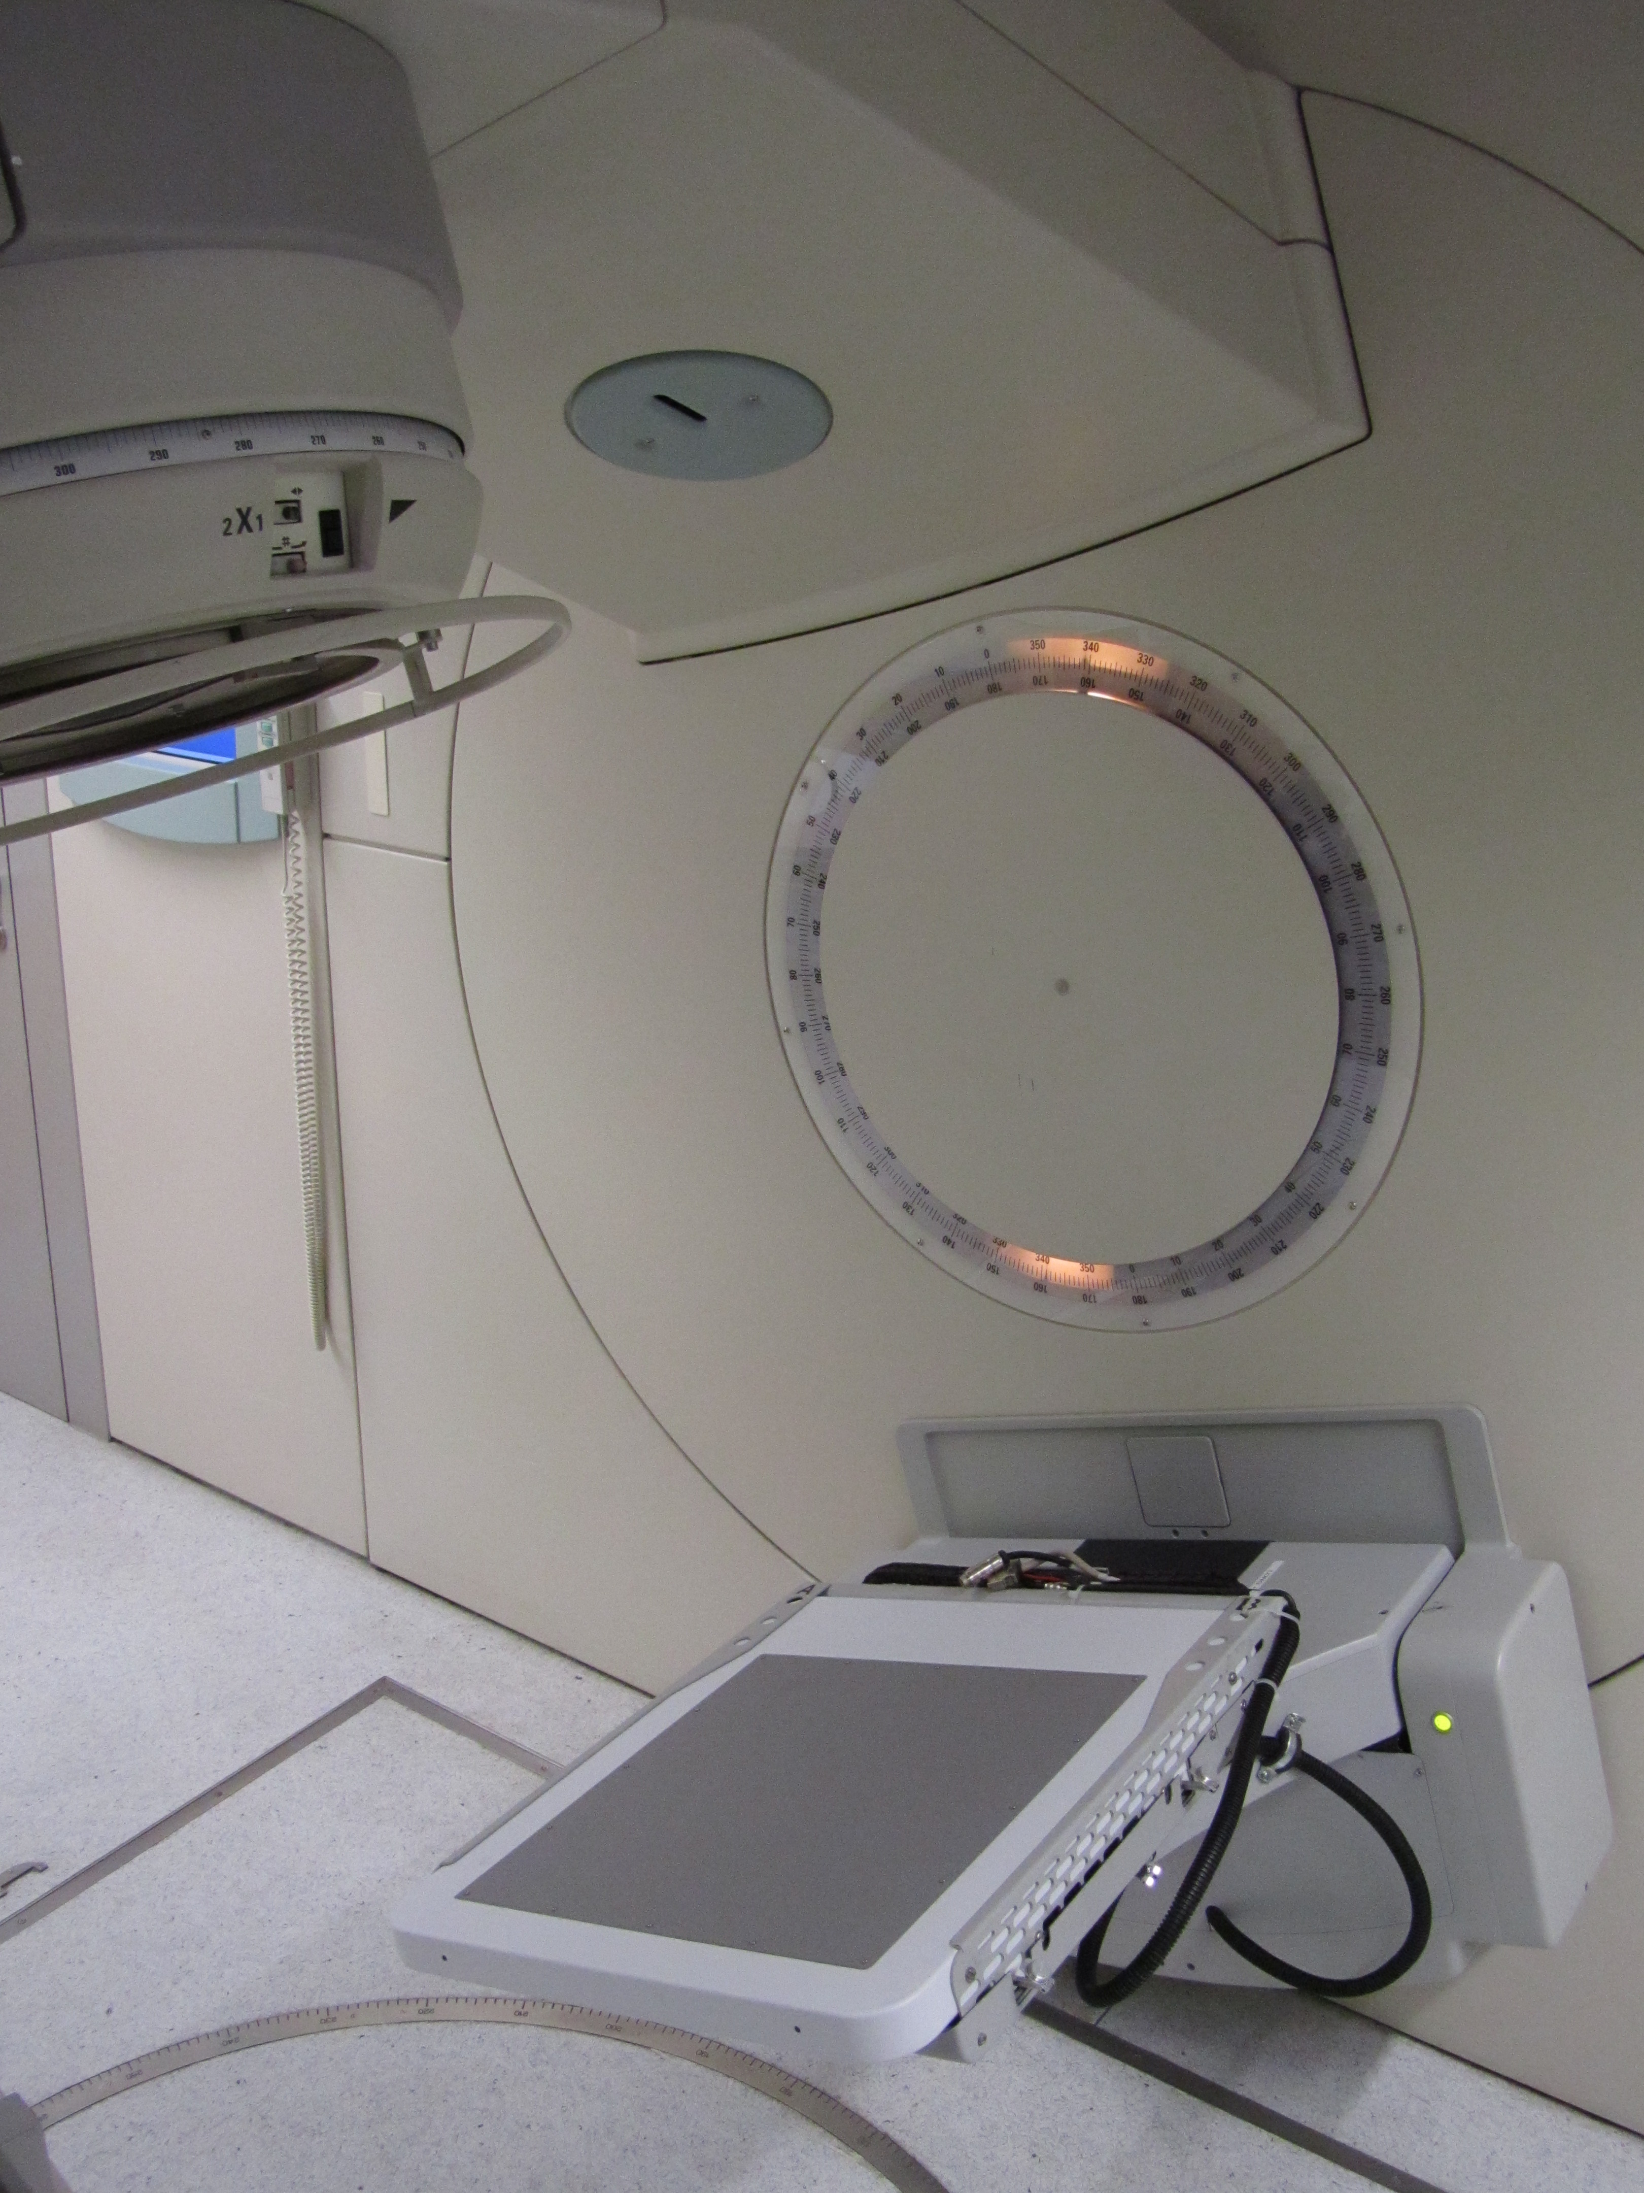
C-RAD GEMINI
Imaging applications in the radiotherapy treatment process
Increasing demand for better accuracy in monitoring the tumour position and movements.
Online verification of the actually delivered dose distribution.
Detectors exposed to high dose: radiation hard and ageing matters.
Clinical installation
gamma
from 6 MV linac
patient
converter
+
+
-
-
GEM
electron
pixelated readout
40x40 cm²
dedicated
electronics
Seminar at SPhN department - CEA/Saclay - Friday 3rd of February 2017

Slide 28
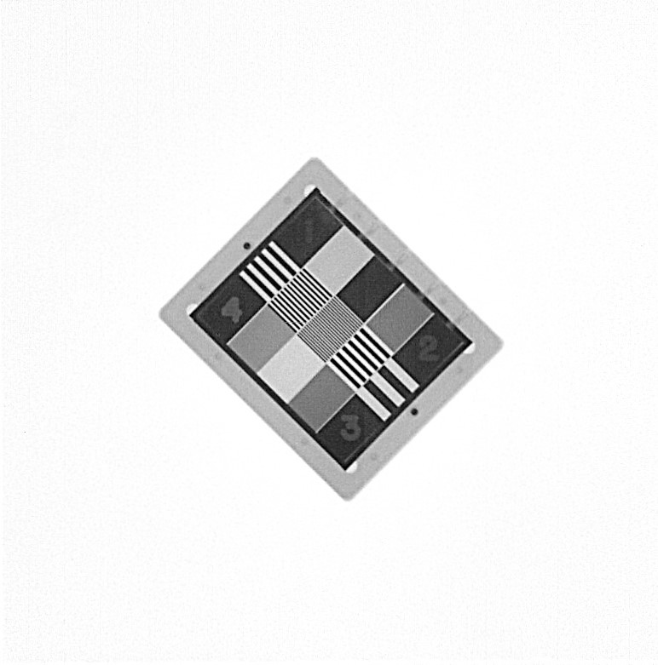
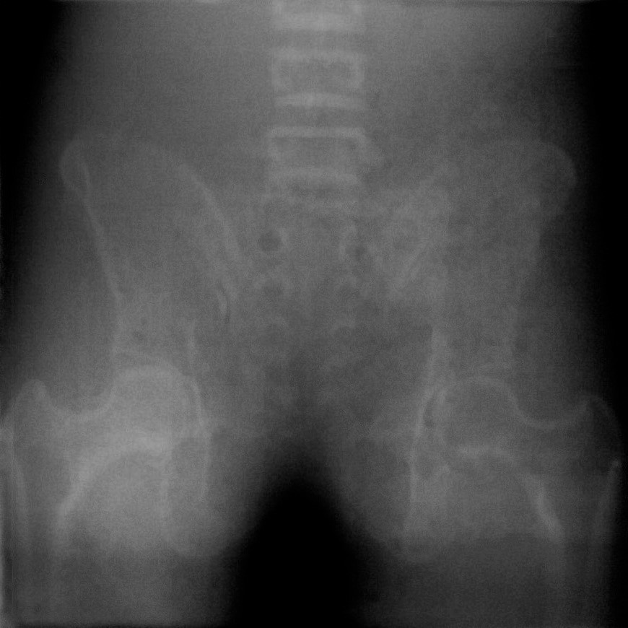
C-RAD GEMINI
6 MV linac, 1.5 MeV average gamma energy, 3 MU dose
QA object (resolution and contrast measure)
Pelvic phantom
40 cm
Seminar at SPhN department - CEA/Saclay - Friday 3rd of February 2017

Slide 29
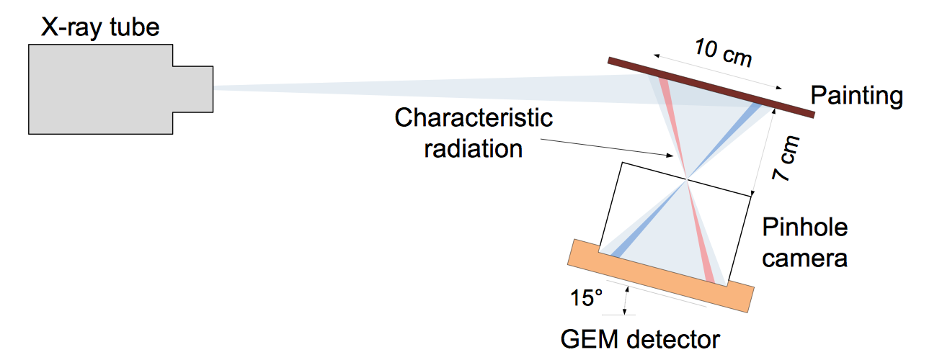
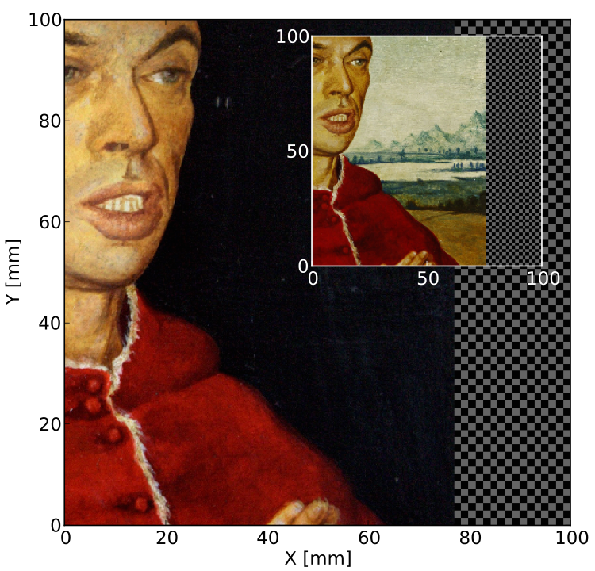
X-ray fluorescence
XRF imaging system for fast mapping of pigment distributions in cultural heritage paintings
Scanning XRF revealed a painting under Rembrandt’s “An old man in military costume”.
It took 19 days with an X-ray tube and 24 h with synchrotron radiation.
Scanning is detailed, but long and expensive.
A. Zielińska, 2013 JINST 8 P10011
Mock painting done
with Renaissance
techniques
Position and energy sensitive method
No position scan required
The system can be brought to the museum
Seminar at SPhN department - CEA/Saclay - Friday 3rd of February 2017

Slide 30
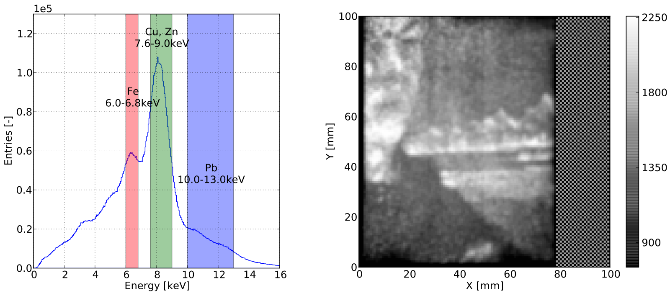
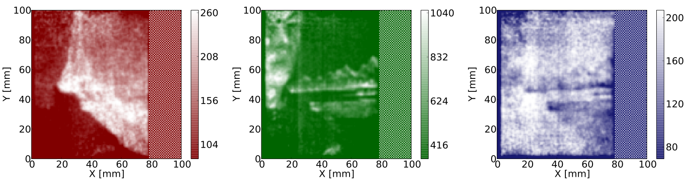
X-ray fluorescence
A. Zielińska, 2013 JINST 8 P10011
Seminar at SPhN department - CEA/Saclay - Friday 3rd of February 2017

Slide 31
Overview
Relevant mechanisms for the operation of gaseous detectors
Imaging applications of MPGDs outside high energy physics
Developments of the optical readout for MPGDs at CERN
Possible other applications
Seminar at SPhN department - CEA/Saclay - Friday 3rd of February 2017

Slide 32
Optical readout
Record the light emitted during the Townsend avalanche with a camera:
use the detector as a scintillating plate.
Seminar at SPhN department - CEA/Saclay - Friday 3rd of February 2017

Slide 33
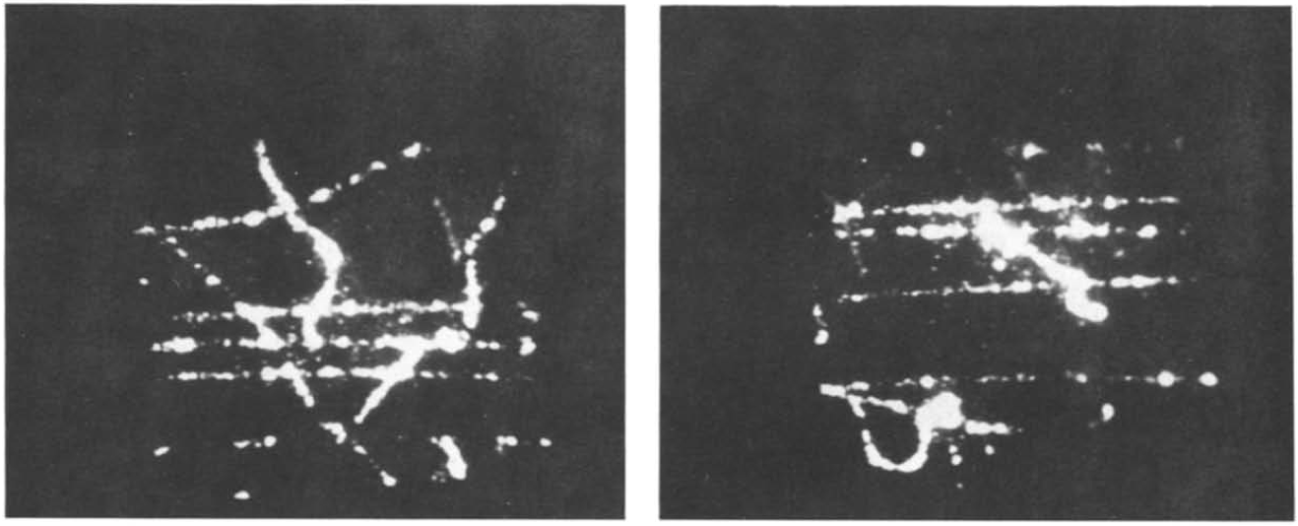
Only techniques are new
Parallel mesh chamber filled with Ar/CH4/TEA 80%/8%/2%
seen by an image intensifier and a camera
Muons and delta rays
G. Charpak et al., NIM A258 (1987) 177
Seminar at SPhN department - CEA/Saclay - Friday 3rd of February 2017

Slide 34
Advantages
Simplicity: like taking a picture
Robustness: as a device off-the-shelf
Versatility: several uses / environments
Seminar at SPhN department - CEA/Saclay - Friday 3rd of February 2017

Slide 35
CCD vs CMOS
CCD
low noise
~fast
sensitive
high power
many pixel
expensive
CMOS
higher noise
fast
less sensitive (not full frame)
low power
less pixel (partially true)
~cheaper
Traditionally and due to manufacturing processes
Anyway, sCMOS very attractive (expensive)
Seminar at SPhN department - CEA/Saclay - Friday 3rd of February 2017

Slide 36
CCD
ICCD
EMCCD
Full frame / Interline
Back-illuminated
Noise (cooled, etc…)
Colours, micro-lenses
Size, aspect ratio
ADC depth, …
From somewhere in internet
EMCCD
e- amplification in Si (impact ionisation)
Similar to avalanche photo-diode
Amplification after the CCD
Amplification before the digitisation
Reduce the importance of read-noise
Introduce the amplification noise
ICCD
Photocathode
MCP (typically)
Phosphor screen
Focus (maybe)
CCD
Seminar at SPhN department - CEA/Saclay - Friday 3rd of February 2017

Slide 37
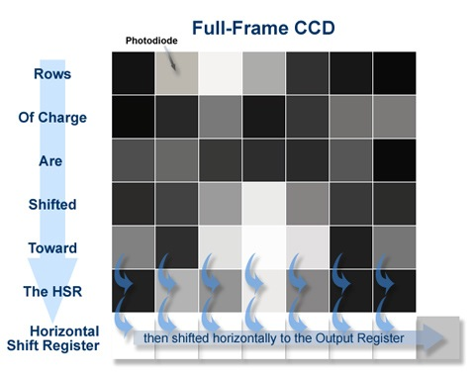
CCD
ICCD
EMCCD
Full frame / Interline
Back-illuminated
Noise (cooled, etc…)
Colours, micro-lenses
Size, aspect ratio
ADC depth, …
From somewhere in internet
Full-frame
sensitive (better red)
possible back-illuminated
slow
shutter needed
possible anti-blooming
expensive
Interine
~sensitive (better blue)
no back-illuminated
fast
no shutter needed
typically anti-blooming
cheaper
Back-illuminated
Increase the quantum efficiency
Extend sensitivity to UV (~>200nm)
Expensive
Seminar at SPhN department - CEA/Saclay - Friday 3rd of February 2017

Slide 38
Noise sources
Dark current: √(In te / qe) and T dependent
Hot pixels: anomalous large In
Pixel non-uniformity: noise and QE
Read noise: both random and coherent
Shot noise: photo-statistic
Seminar at SPhN department - CEA/Saclay - Friday 3rd of February 2017

Slide 39

Lens
Focal length and aperture
Minimum focussing distance
Field of view at MOD
Vignetting: sensor size
Lens resolution: pixel size and density
Magnification: M ~ f / (q - f)
Light collection:
Seminar at SPhN department - CEA/Saclay - Friday 3rd of February 2017

Slide 40
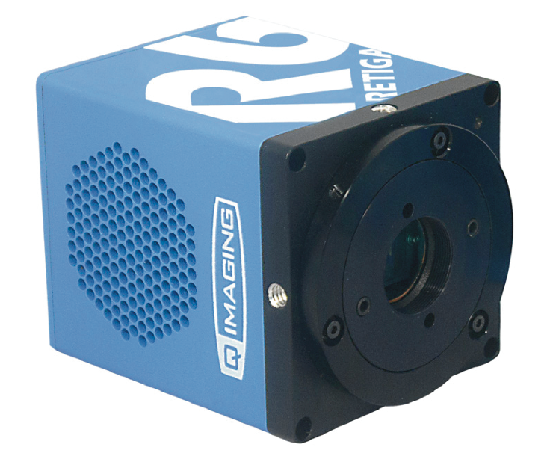
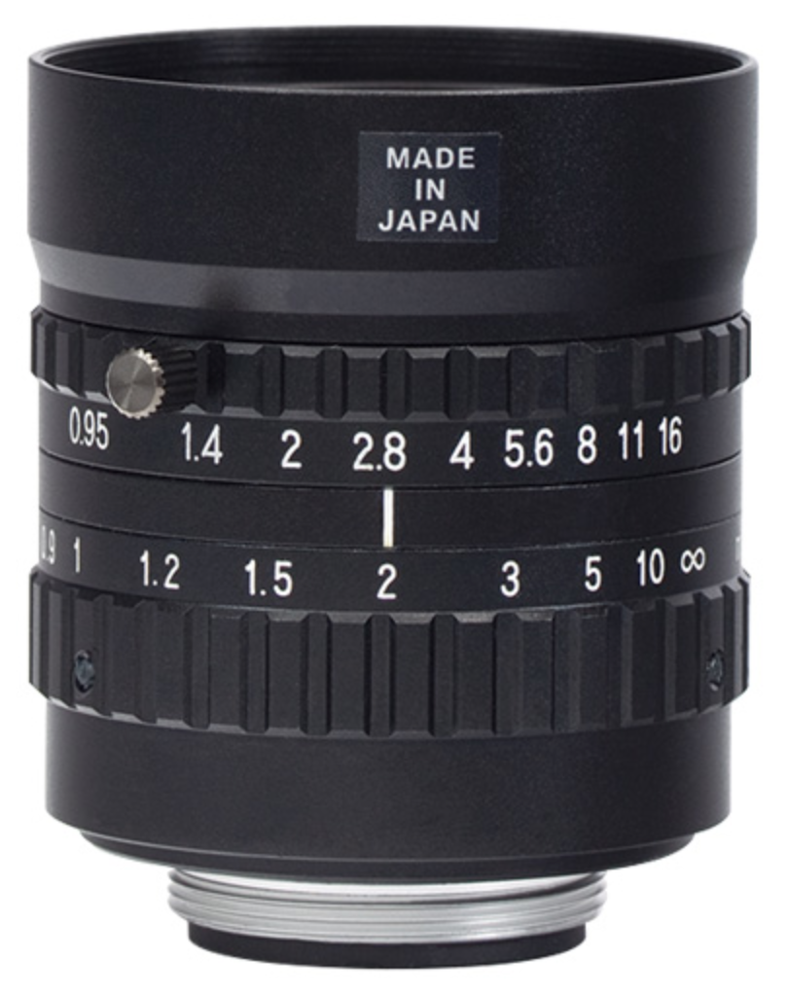
Our camera and lens
QImaging Retiga R6
CCD: 2688x2200 4.54x4.54 um² pixels
ADC: 14 bit
rate: 6.9 fps (20fps with binning)
read noise: 5.7 e⁻ RMS
dark current: 0.0002 e⁻/p/s @ -20º C
trigger: external bulb + others
Navitar
focal length: 25 mm
aperture: f/0.95
Mount: C-Mount
Sensor type: 1’’ format
Seminar at SPhN department - CEA/Saclay - Friday 3rd of February 2017

Slide 41
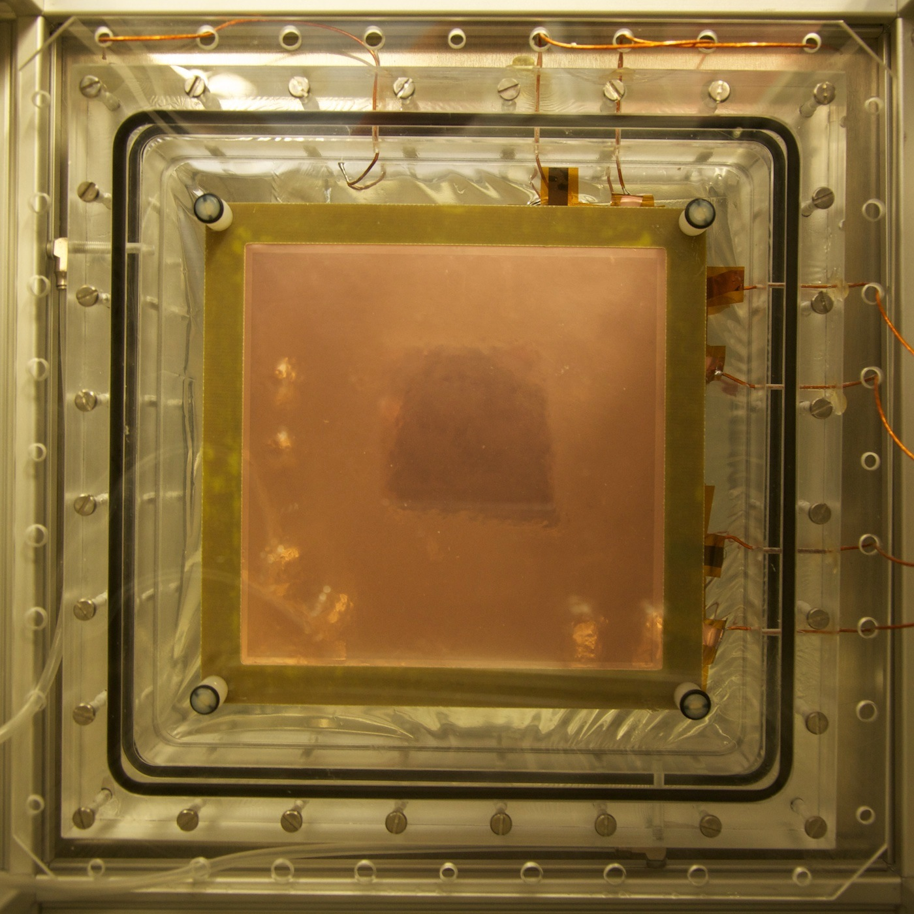
The setup
Ar/CF4 80/20
10 mm
10 cm
2 mm
2 mm
2 mm
Plexiglass
Geometrical acceptance
M = sensor size / image size
M ~ 0.1, Ω ~ 5x10⁻⁴
This implies:
- large sensor
- low noise
- fast lens
- a lot of light
+3 dioptre lens
25 mm f/0.95 lens
CCD camera
Seminar at SPhN department - CEA/Saclay - Friday 3rd of February 2017

Slide 42
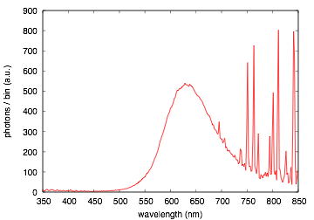
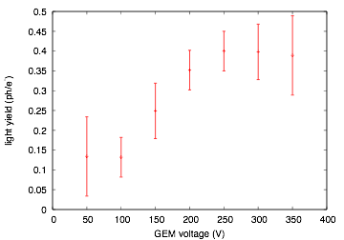
Ar/CF4 80/20 scintillation
Plexiglass cuts below 400 nm
About 0.4 ph/e⁻ in the visible
ArI 4p 4s lines
CF4
Preliminary
Nicely overlapping with CCD efficiency curve
High charge gain -> high light gain
Light yield comparison
NaI: ~40 ph/keV
GEM at a gain of 10⁵: ~10⁶ ph/keV
Seminar at SPhN department - CEA/Saclay - Friday 3rd of February 2017

Slide 43

⁵⁵Fe X-ray imaging
4.4 cm
One of the first images
20 min exposure
70 um hole, 140 um pitch

Slide 44
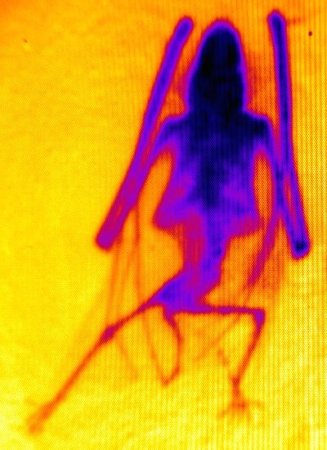
X-ray images
X-ray tube with W target at 20 kV - 40 kV at few mA
Charge acquisition (26/10/1998)
Light acquisition
~7 cm
Raw data:
fast (<1 s) acquisition
and no processing time
Seminar at SPhN department - CEA/Saclay - Friday 3rd of February 2017

Slide 45
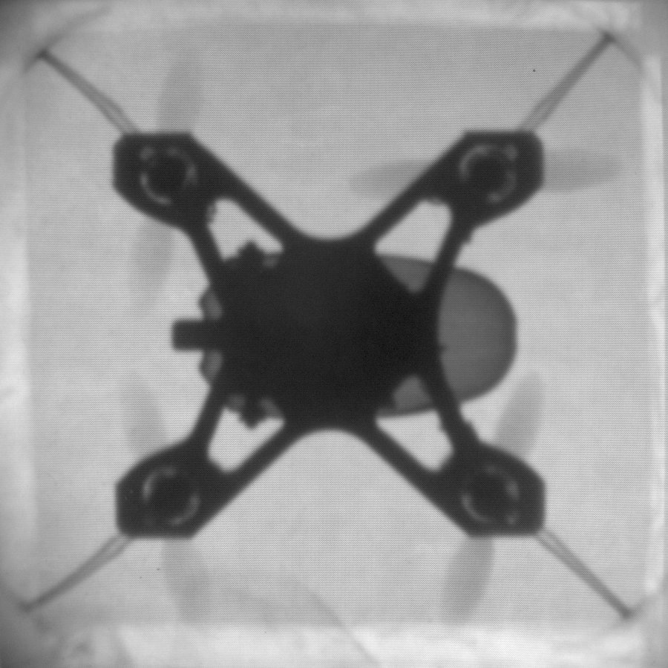
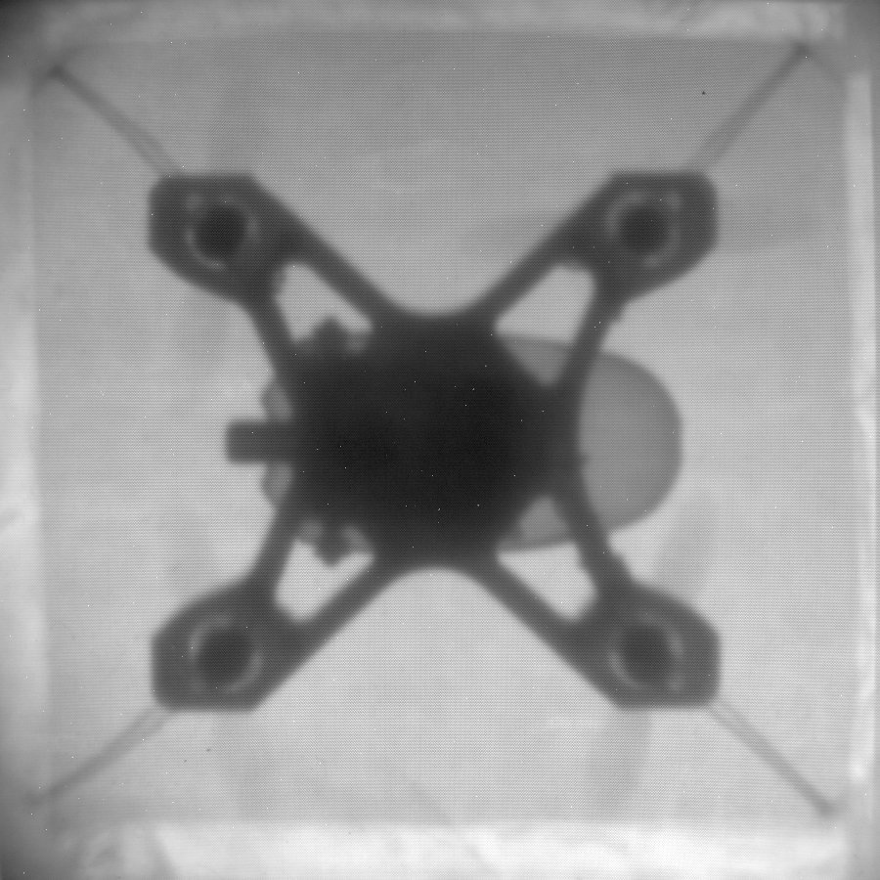
X-ray images
X-ray tube with W target
11 kV
40 kV
8 cm
Straight out from the camera, no even the flat field correction
Seminar at SPhN department - CEA/Saclay - Friday 3rd of February 2017

Slide 46
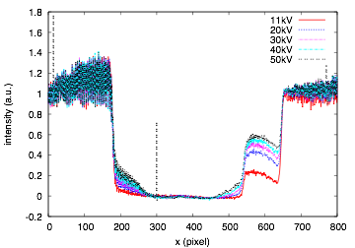
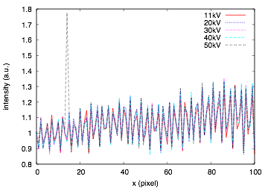
X-ray images
X-ray interacting
with the CCD
Increasing energy:
- X-ray more penetrating
- Worse position resolution (larger charge cloud)
Seminar at SPhN department - CEA/Saclay - Friday 3rd of February 2017

Slide 47
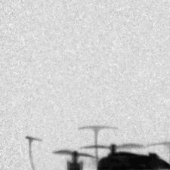
Fluoroscopy
50 ms exposure
10 Hz acquisition
Seminar at SPhN department - CEA/Saclay - Friday 3rd of February 2017

Slide 48
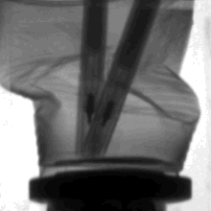
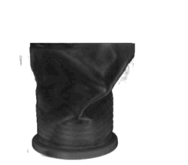
CT and 3D imaging
Image -> Sinograms -> Filtered Back Projection -> 3D image
Seminar at SPhN department - CEA/Saclay - Friday 3rd of February 2017

Slide 49
Fluorescence
17 cm
Contemporary
industrial painting
Pin-hole
X-ray tube
W target
40 kV, 1 mA
GEMs
Shielding
Camera and lens
Seminar at SPhN department - CEA/Saclay - Friday 3rd of February 2017

Slide 50
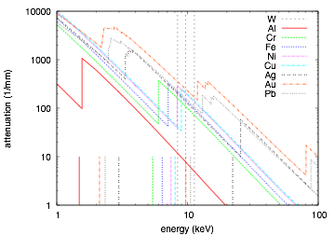
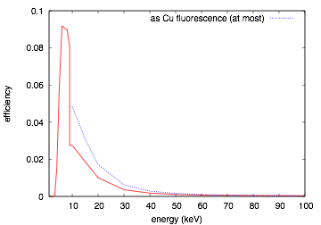
What should be expected
W target:
bremsstrahlung +
characteristic lines
Limiting factors (because not optimised):
- low energy -> window and cathode
- high energy -> gas
Lα Lβ Lγ
feasible:
Cr, Fe, Ni, Cu
difficult:
Au, Pb
more difficult:
Al, Ag
Seminar at SPhN department - CEA/Saclay - Friday 3rd of February 2017

Slide 51
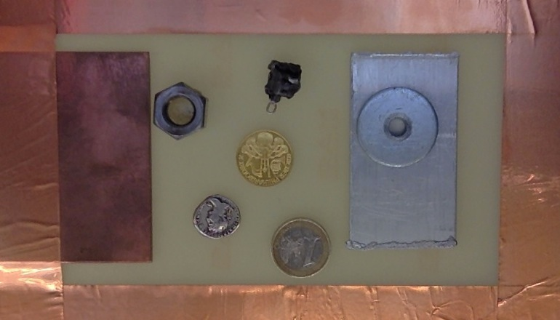
The painting (visible)
17 cm
Fe
SS
?
Cu
Cu
Au
Al
Ag
Seminar at SPhN department - CEA/Saclay - Friday 3rd of February 2017

Slide 52
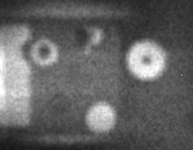
The painting (X-rays)
O(1 kHz) in 500 s exposure
Seminar at SPhN department - CEA/Saclay - Friday 3rd of February 2017

Slide 53
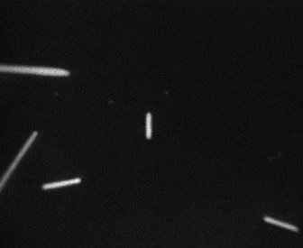
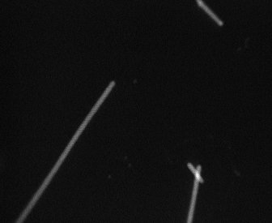
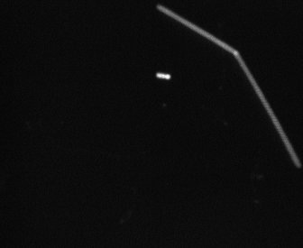
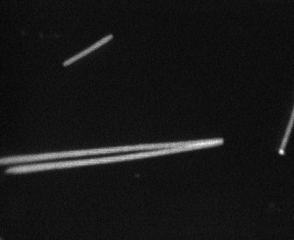
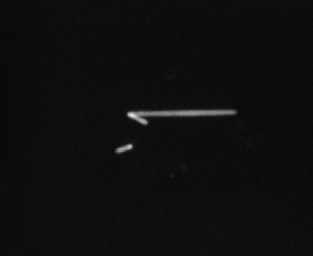
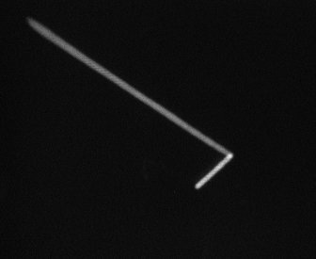
Event by event: alphas
Settable GEM gain: increasing it
²²⁰Rn & ²¹⁶Po
Seminar at SPhN department - CEA/Saclay - Friday 3rd of February 2017

Slide 54
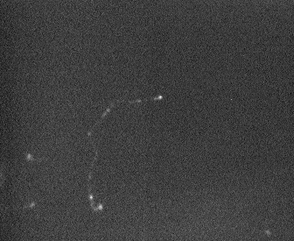
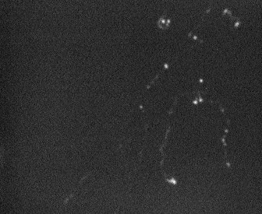
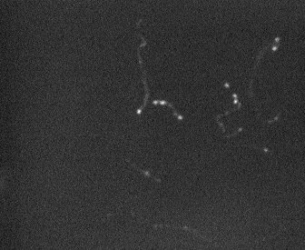
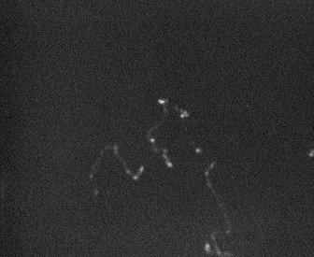
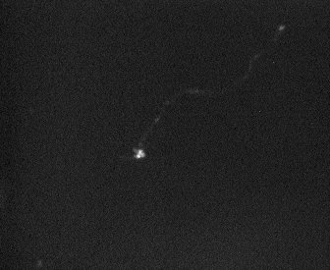
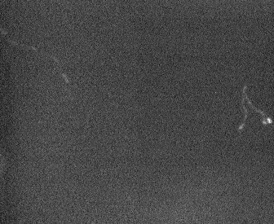
Event by event: electrons
Settable GEM gain: increasing it more
Electrons from 125 keV
γ-rays from ⁵⁵Fe source
Seminar at SPhN department - CEA/Saclay - Friday 3rd of February 2017

Slide 55
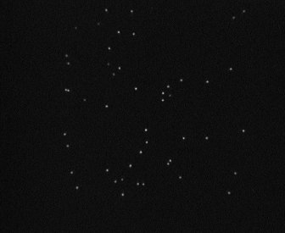
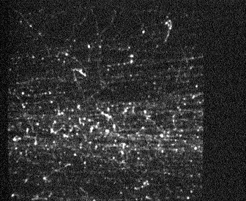
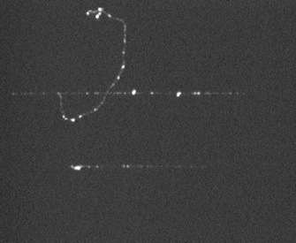
Other examples
α from 220Rn & 216Po
X-rays from 55Fe
For hours in sealed mode at test beam
shower from a charged pion
muon and δ-ray
Seminar at SPhN department - CEA/Saclay - Friday 3rd of February 2017

Slide 56
X-rays in details
Seminar at SPhN department - CEA/Saclay - Friday 3rd of February 2017

Slide 57
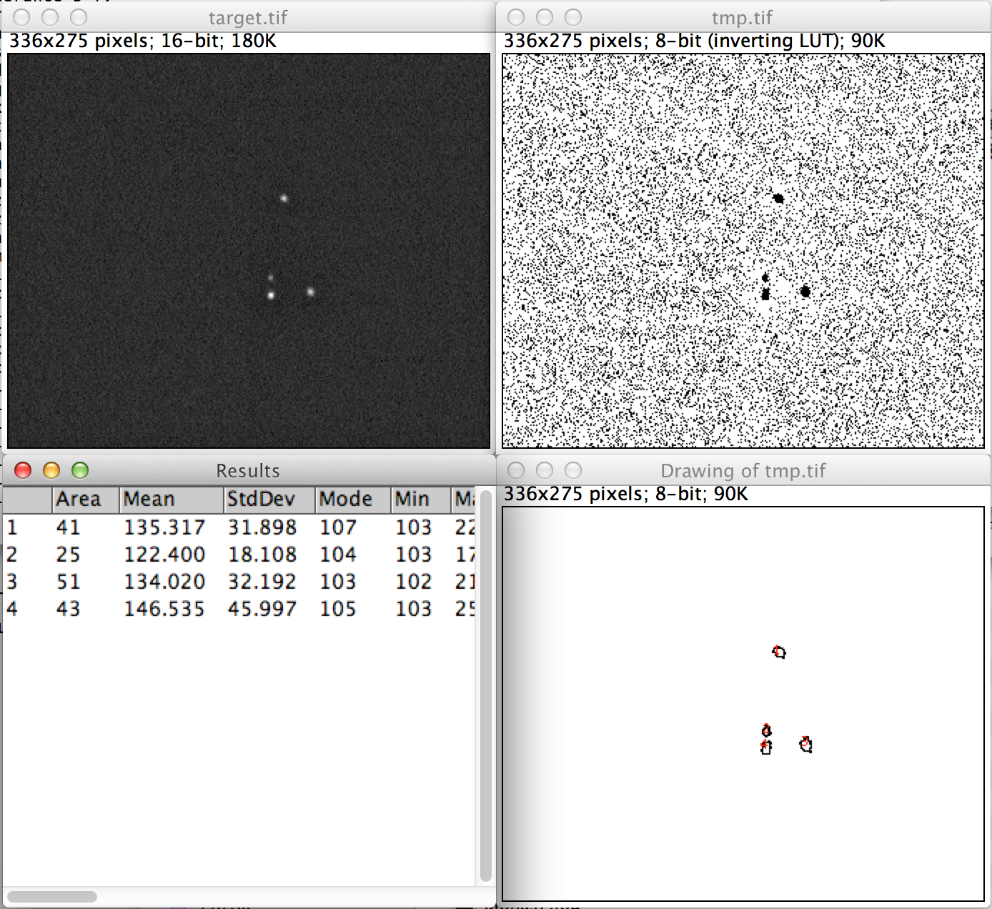
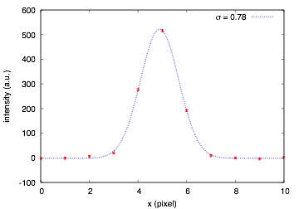
Analysis of single clusters
Average profile of 5.9 keV events
Spatial resolution in the limit of long exposure:
280 um for 1 cm drift and 5.9 keV X-rays.
Dominated by e⁻ diffusion and cluster size.
Resolution improves using the centre-of-mass of the cluster
Seminar at SPhN department - CEA/Saclay - Friday 3rd of February 2017

Slide 58
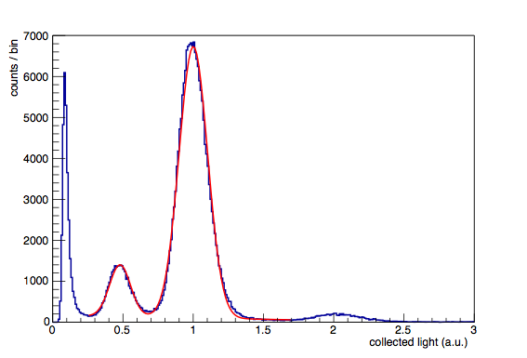

The spectrum
from CCD images
Gain uniformity, vignetting plays a role too
⁵⁵Fe source
Full energy
Escape
Pileup
FWHM at 5.9 keV over 8x8 cm²
~36% before gain uniformity correction
24.7% after gain uniformity correction
Seminar at SPhN department - CEA/Saclay - Friday 3rd of February 2017

Slide 59

Fluorescence event by event
Seminar at SPhN department - CEA/Saclay - Friday 3rd of February 2017

Slide 60



Fluorescence event by event
some color coding
Red
Green
Blue
Seminar at SPhN department - CEA/Saclay - Friday 3rd of February 2017

Slide 61

Fluorescence event by event
some color coding
Seminar at SPhN department - CEA/Saclay - Friday 3rd of February 2017

Slide 62

Fluorescence event by event
It’s Zinc
Seminar at SPhN department - CEA/Saclay - Friday 3rd of February 2017

Slide 63


Crystallography
Detection efficiency -> Thick conversion gap
Parallel field: parallax error
Parallax error mitigation with radial field
segmented cathode
drift
field shaper
It would improve the spatial resolution
of X-ray fluorescence setup too
radius
segmented GEM
Seminar at SPhN department - CEA/Saclay - Friday 3rd of February 2017

Slide 64

Flat exposure
Parallel field
Radial field
Seminar at SPhN department - CEA/Saclay - Friday 3rd of February 2017

Slide 65


Radial exposure
Parallel field
Radial field
Mask
Mask
10 cm
Seminar at SPhN department - CEA/Saclay - Friday 3rd of February 2017

Slide 66
Overview
Relevant mechanisms for the operation of gaseous detectors
Imaging applications of MPGDs outside high energy physics
Developments of the optical readout for MPGDs at CERN
Possible other applications
Seminar at SPhN department - CEA/Saclay - Friday 3rd of February 2017

Slide 67

Beam monitor
For instance for ion therapy beamlines
In principle very low material budget possible < 200 um H2O eq
Beam position and shape measurement (at 20 Hz or more)
beam
Though to cope with 10⁸ - 10⁹ particles/s/mm² -> Single GEM
More GEM are an option for weaker beams -> more material budget
Seminar at SPhN department - CEA/Saclay - Friday 3rd of February 2017

Slide 68









0 s
0.5 s
1 s
~10 cm
1.5 s
2 s
2.5 s
3 s
3.5 s
4 s
0.5 s exposure

Slide 69


Integrating
Intensity profile
Pion beam of about about 2 x 10⁶ pions per spill
(two orders of magnitude less than the expected conditions)
Detector operated in sealed mode though not though for this.
Seminar at SPhN department - CEA/Saclay - Friday 3rd of February 2017

Slide 70


Other kind of MPGDs?
Developments not limited to triple GEMs
Transparent MSGC based on LCD technology
Scintillating glass THGEM
H. Takahashi, “Development of a transparent Single-grid-type
MSGC based on LCD technology,” MPGD2015
T. Fujiwara, “Development and application of Scintillating Glass-GEM detector,” MPGD2015
See also other nice developments of optically readout triple GEM
M. Marafini et al., Nucl. Instrum. Methods A824 (2016) 562.
Seminar at SPhN department - CEA/Saclay - Friday 3rd of February 2017

Slide 71





TPC readout
Direction-Sensitive Dark Matter Searches with a low pressure CF4 detector with optical readout.
CERN/GDD development for studying scintillation
in controlled conditions targeted to TPC readout
with emphasis also on the primary scintillation.
DMTPC
Grids in 50 Torr CF4
C. Deaconu et al.,
Physics Procedia 61 (2015) 39
DRIFT
Triple GEM in 100 Torr CF4
N. S. Phan et al.,
arXiv:1510.02170
nuclear recoil
104 keVr (~66 keVee)
F. Brunbauer et al.,
Symposium on large TPCs (2016) Paris
Seminar at SPhN department - CEA/Saclay - Friday 3rd of February 2017

Slide 72
Possible other applications
UV imaging
Neutron imaging
Gamma imaging
Portable devices
Educational purposes
…
Seminar at SPhN department - CEA/Saclay - Friday 3rd of February 2017

Slide 73








Radiography of a bat
and closeup of the GEM holes
Freeze-frame of an X-ray
movie of a flying drone
Radiography of a
crushed cup with pens and
its 3D tomographic reconstruction
O (100 keV) electrons
~MIPs
Cu
Visible picture of a painting
and its X-ray fluorescence image.
Different colours refer to different
materials (energy resolved)
SS
Fe
Al
Alphas from ²²⁰Rn decay
and its daughter ²¹⁶Po
Zn
Au
Cu
Ag
1€
Single X-rays from ⁵⁵Fe
and the energy spectrum
extracted from the images

