Slide 1
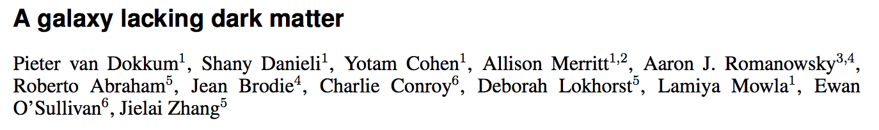
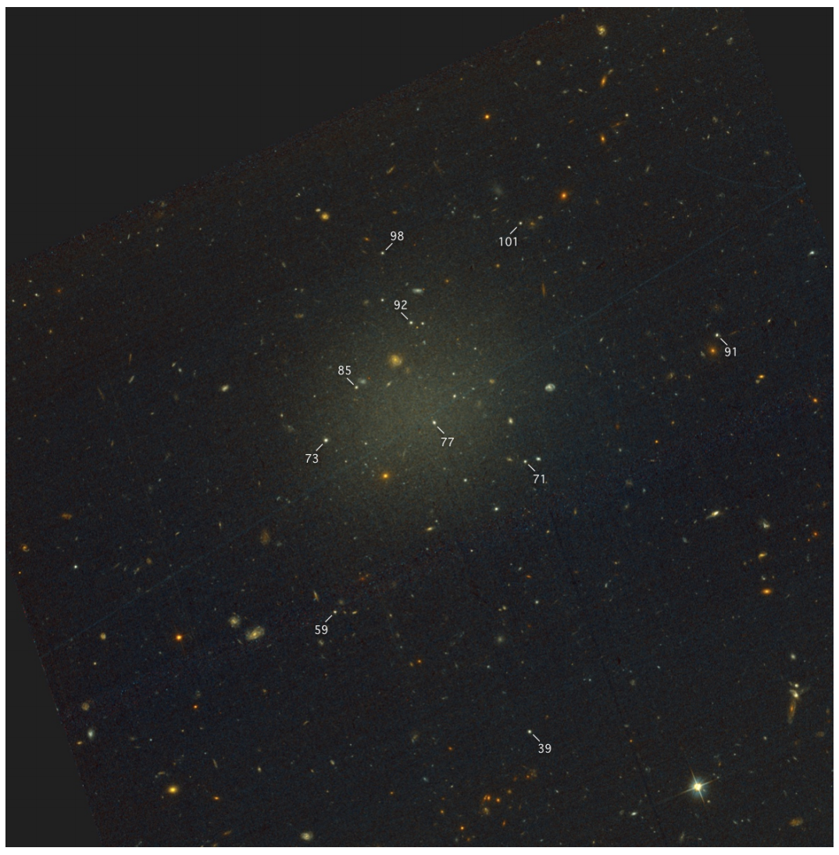
4 kpc
UDG Dwarf NGC1052-DF2
M_{stars} = 2 x 10⁸ solar masses
10 Globular clusters
(spectroscopically confirmed)

Slide 2
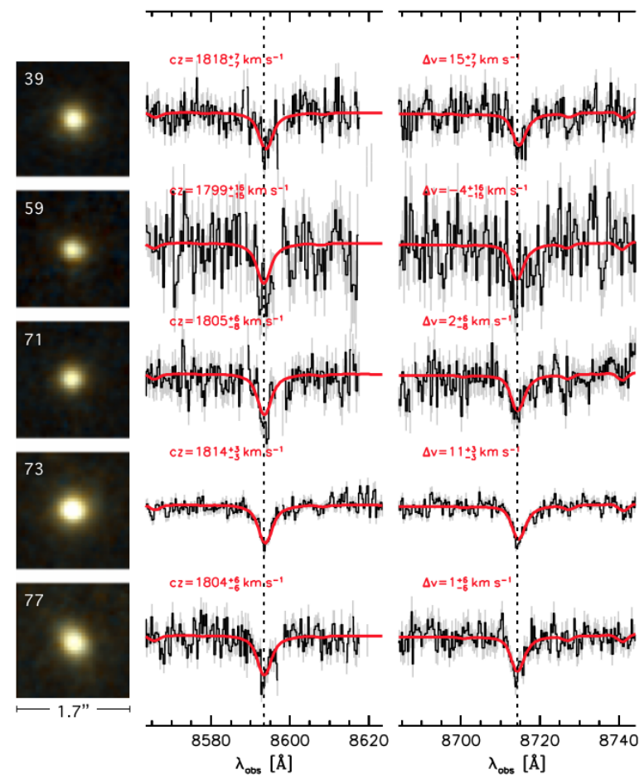
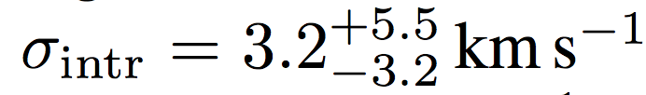


CaII lines of globular clusters
Velocity dispersion of the GC system
=> Dynamical mass (baryons+dark matter):
at
Dark/Visible mass ratio <1
  (dark/total <2)
  with 90% confidence
  Dark/Visible mass ratio is about 30 for the MW,
  and even higher for low-mass and high-mass galaxies

Slide 3
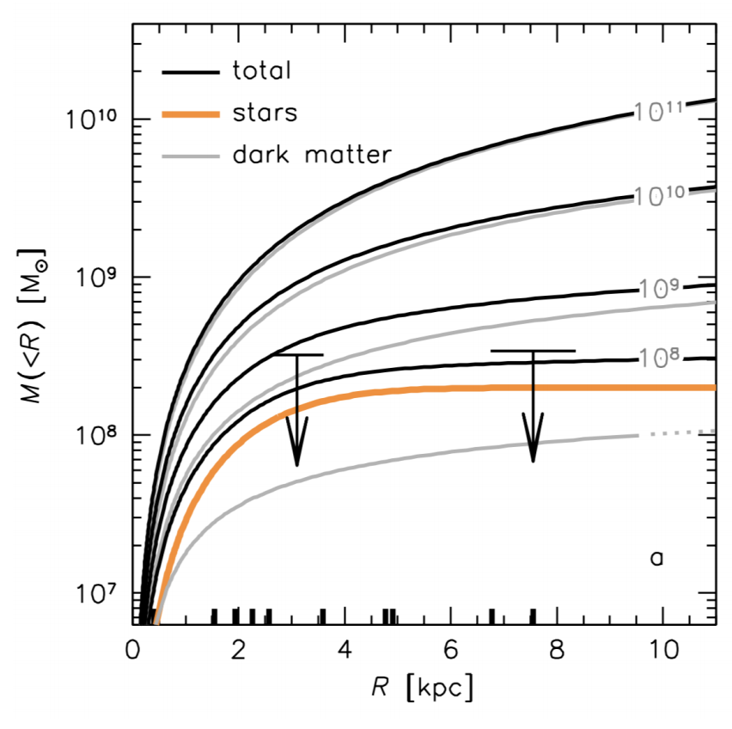
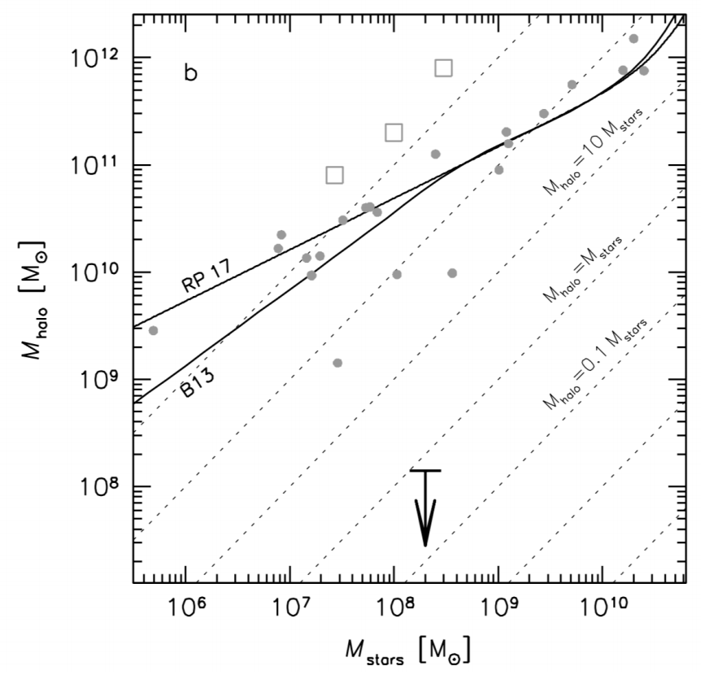
CaII lines of globular clusters (Keck)
Velocity dispersion of the GC system
=> Dynamical mass (baryons+dark matter):
at
Dark/Visible mass ratio <1
  (dark/total <2)
  with 90% confidence
  Dark/Visible mass ratio is about 30 for the MW,
  and even higher for low-mass and high-mass galaxies

Slide 4
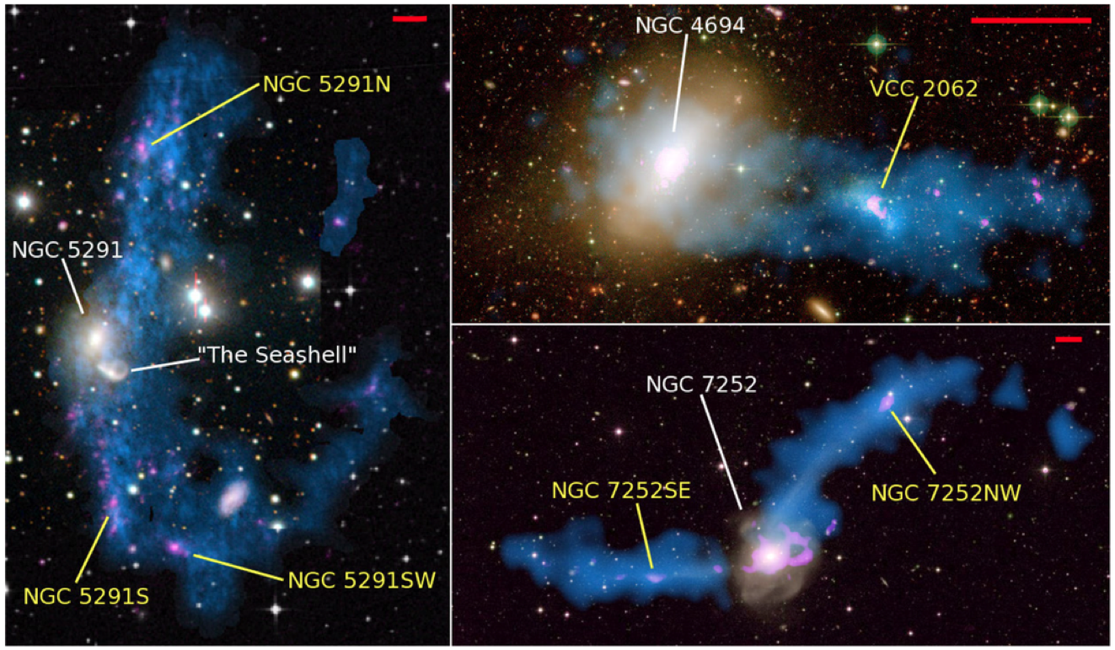
Possible origin of an (almost) dark-matter free dwarf galaxy ?
Tidal dwarf galaxy : gas expulsed in a tidal interaction/collision
Jet-induced shocks and fragmentation
Tidal dwarf galaxies.
Duc et al. 2000
Duc & Bournaud 2006
Lelli et al. 2015

Slide 5
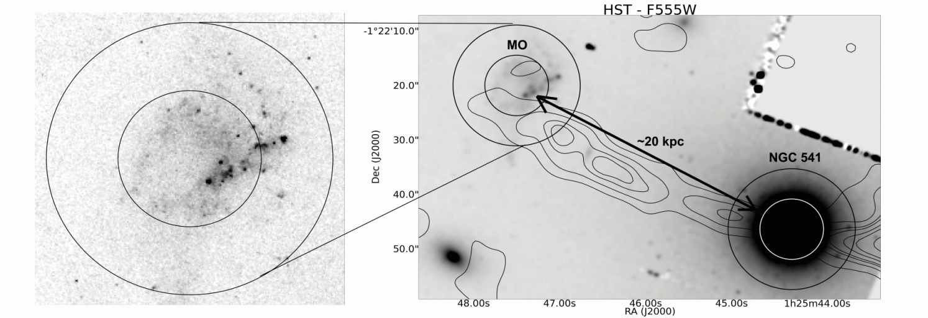
Possible origin of an (almost) dark-matter free dwarf galaxy ?
Tidal dwarf galaxy : gas expulsed in a tidal interaction/collision
Jet-induced shocks and fragmentation
Minkovski’s object
Salomé, Combes et al. 2015

Slide 6
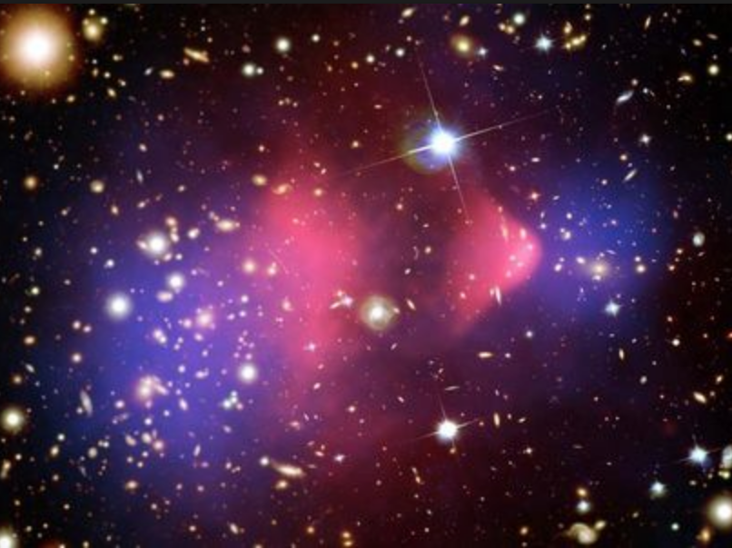
Possible origin of an (almost) dark-matter free dwarf galaxy ?
Tidal dwarf galaxy : gas expulsed in a tidal interaction/collision
Jet-induced shocks and fragmentation
Evidence for dark matter and against MOND ?
One can always « remove » dark matter
Formation of an exotic galaxy outside of any halo,
Offsets between baryons and dark matter (e.g. bullet cluster).
In a MOND-like scenario, one cannot remove the « apparent » dark
mass, and it should be centered on the baryonic mass center.

Slide 7
Possible origin of an (almost) dark-matter free dwarf galaxy ?
Tidal dwarf galaxy : gas expulsed in a tidal interaction/collision
Jet-induced shocks and fragmentation
Evidence for dark matter and against MOND ?
One can always « remove » dark matter
Formation of an exotic galaxy outside of any halo,
Offsets between baryons and dark matter (e.g. bullet cluster).
In a MOND-like scenario, one cannot remove the « apparent » dark
mass, and it should be centered on the baryonic mass center.

Slide 8
Uncertainties and Main Caveats
Noise, instrumental resolution and systematics…
All taken carefully into account
Note that the « low » spectral resolution of 30km/s is balanced by the high signal-to-noise ratio.
Small statistics.
I took five sub-samples of 6 GC each (out of 10). One has a dispersion σ=7.9km/s. One only 1.9km/s
This remains consistent with the 90% confidence limits claimed in the paper.
Globular System dynamics.
Is the globular system close to a spheroid with isotropic velocity dispersions ?
Remember the « lost and found dark matter in ellipticals » controversy ?

Slide 9
Milky Way’s GC system
Oblate spheroid,
1.8 < axis ratio <3.7
(depends on radius, selection)
V/s = 0.25-0.6
A dwarf could have a
different GC history.
NGC1502-DF2 does not seem
to have a rotation-dominated
GC system.

Slide 10
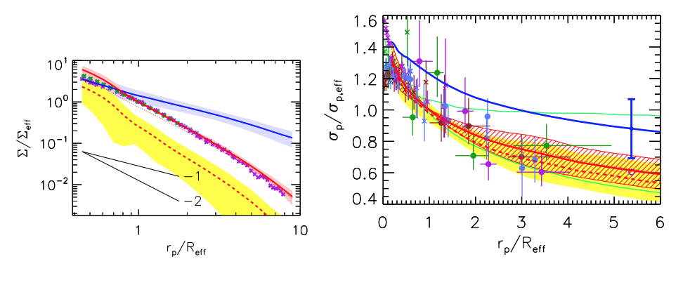
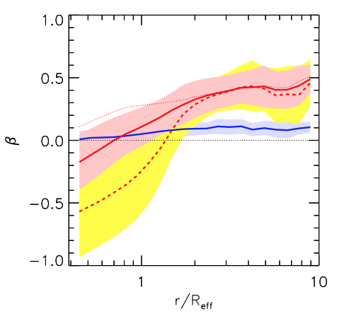
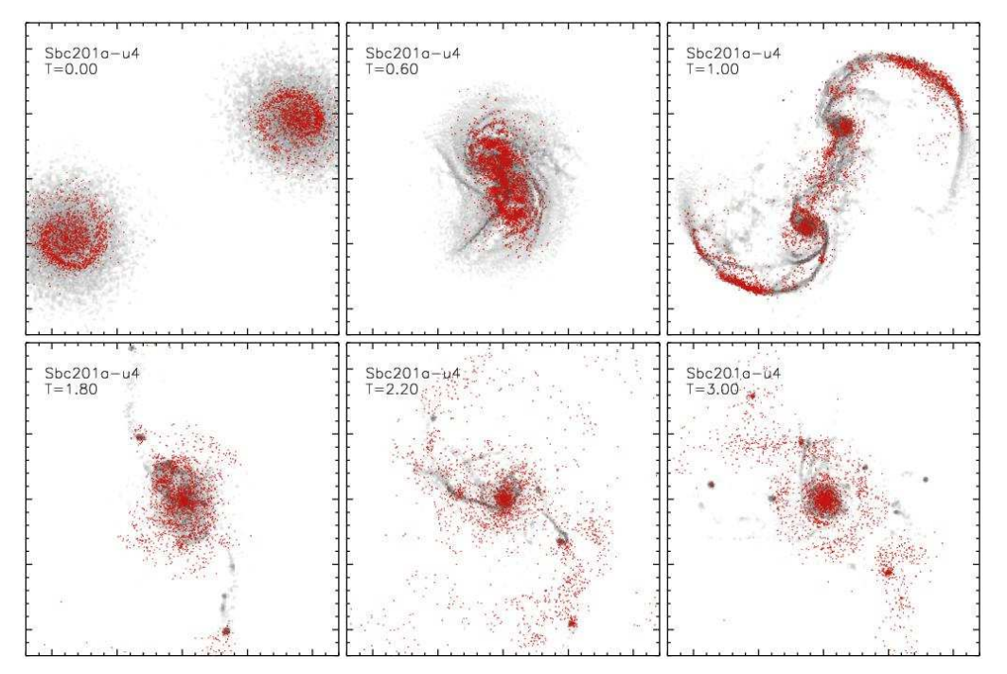
« Lost and found dark matter
in elliptical galaxies »
(Dekel et al. 2005)

Slide 11
Uncertainties and Main Caveats
Noise, instrumental resolution and systematics…
All taken carefully into account
Note that the « low » spectral resolution of 30km/s is balanced by the high signal-to-noise ratio.
Small statistics.
I took five sub-samples of 6 GC each (out of 10). One has a dispersion σ=7.9km/s. One only 1.9km/s
This remains consistent with the 90% confidence limits claimed in the paper.
Globular System dynamics.
Is the globular system close to a spheroid with isotropic velocity dispersions ?
Remember the « lost and found dark matter in ellipticals » controversy ?
Virial radius of the dark halo for a ultra-diffuse dwarf ?
The dark matter to visible mass ratio is about unity at about twice the optical (stellar) radius
Roughly similar to the Milky Way, after all…
BUT the dark matter to visible mass ratio is about unity at the estimated virial radius
=> at the virial radius is should be > 30...but what is the R₂₀₀-M_{stars} relation for a UDG ???

Slide 12
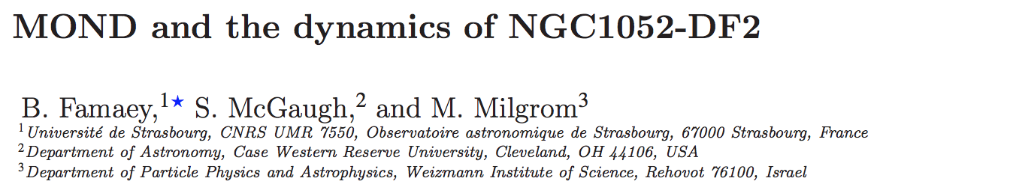



A MOND-compatible system ?
Add an external tidal field:
Virial radius of the dark halo for a ultra-diffuse dwarf ?
The dark matter to visible mass ratio is about unity at about twice the optical (stellar) radius
Roughly similar to the Milky Way, after all…
BUT the dark matter to visible mass ratio is about unity at the estimated virial radius
=> at the virial radius is should be > 30...but what is the R₂₀₀-M_{stars} relation for a UDG ???

