Slide 1
Elastic and Diffractive
Scattering at the LHC
… a review of the story so far and prospects for the future …
Paul Newman
(University of Birmingham)
Saclay seminar,
28 January 2019
Elastic and Total Cross Sections
Soft Diffractive Dissociation
Hard Diffractive Dissociation
[Ultra-peripheral Vector Mesons]
→ Prospects for Central Exclusive Production

Slide 2
LHC: Exploring the ultra-rare at the Energy Frontier

Slide 3
LHC: Exploring the ultra-rare at the Energy Frontier

Slide 4
But what usually happens when hadrons collide at large $√s$?

Slide 5
Understanding 10⁻¹ Processes is Hard!
“minimum bias”
pp event in
PYTHIA8
at √s=7 TeV,
visualised
using MCViz

Slide 6
Understanding 10⁻¹ Processes is Hard!
“minimum bias”
pp event in
PYTHIA8
at √s=7 TeV,
visualised
using MCViz
… the real revolution at the
energy frontier?
Eugène DELACROIX:
La Liberté guidant le peuple

Slide 7
Understanding 10⁻¹ Processes is Hard!
“minimum bias”
pp event in
PYTHIA8
at √s=7 TeV,
visualised
using MCViz
… the real revolution at the
energy frontier?
Théodore Géricault
Le Radeau de la Méduse

Slide 8
Why should we Care?
Everyday strong interaction processes intimately linked
to our basic understanding of physics:
Fundamental questions:
– Confinement
- Hadronic mass generation,
- Non-perturbative degrees of freedom
- Strong / weak coupling and super-gravity
- …
Practical concerns:
- Modelling pile-up at
the LHC
- Luminosity monitoring
- Modelling cosmic ray air
showers
- …

Slide 9
Methods for Diffraction and Elastics
… old slide from diffraction at HERA

Slide 10
Methods for Diffraction and Elastics
… old slide from diffraction at HERA
Partially still true for LHC (but proton tagging technology
got better and rapidity gaps got harder to identify)

Slide 11

First Generation LHC
Proton Spectrometers
(TOTEM & ATLAS-ALFA)
‘Roman pot’ vacuum-sealed insertions to beampipe,
well downstream of IP.
Usually deployed in
dedicated (high β*) runs
Can run independently
of ATLAS / CMS or with
common DAQ.

Slide 12
Second Generation LHC Proton Spectrometers
(CT-PPS at CMS and AFP at ALFA)
AFP @
ATLAS
Designed to
operate in
standard high
luminosity
runnning.

Slide 13
AFP Detectors
Tracking: four slim-edge 3D pixel
sensor planes per station (IBL)
- Pixel sizes 50x250 μm
- 14º tilt improves x resolution (hence ξ)
→ δx = 6 μm, δy = 30 μm
- Trigger capability
Timing: 4x4 quartz bars at Cerenkov
angle to beam. Light detected in PMTs
→ resolution 25ps demonstrated

Slide 14
[a nice illustration, from AFP, with thanks to Maciej Trzebinski]

Slide 16
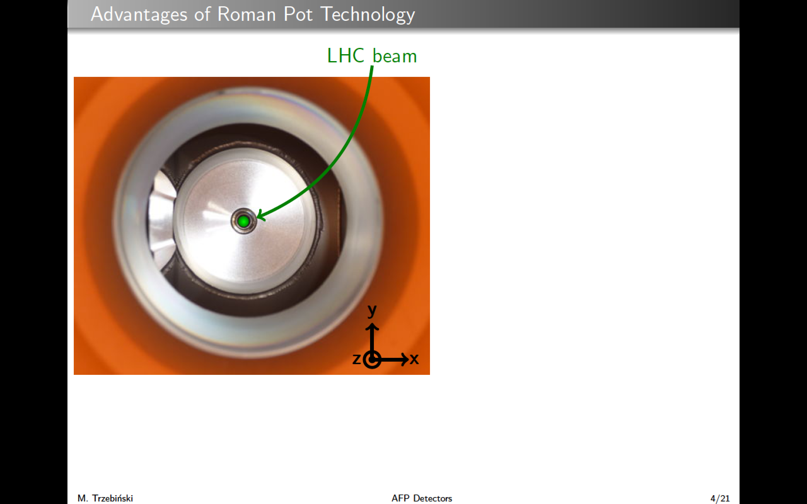

Slide 17


Slide 18
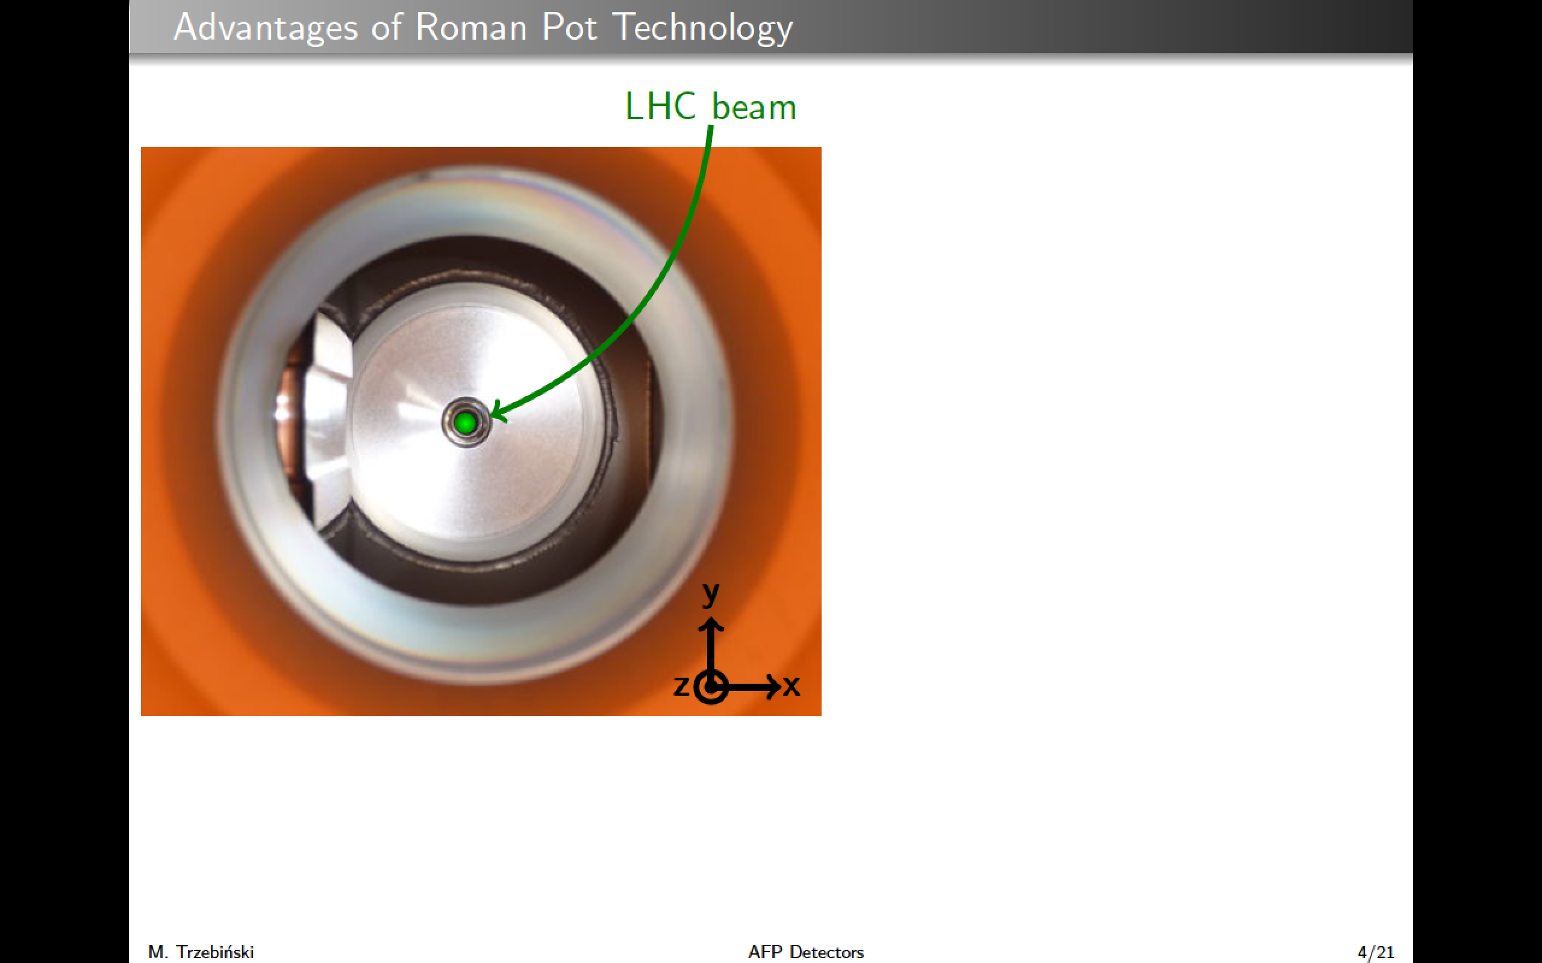

Slide 19
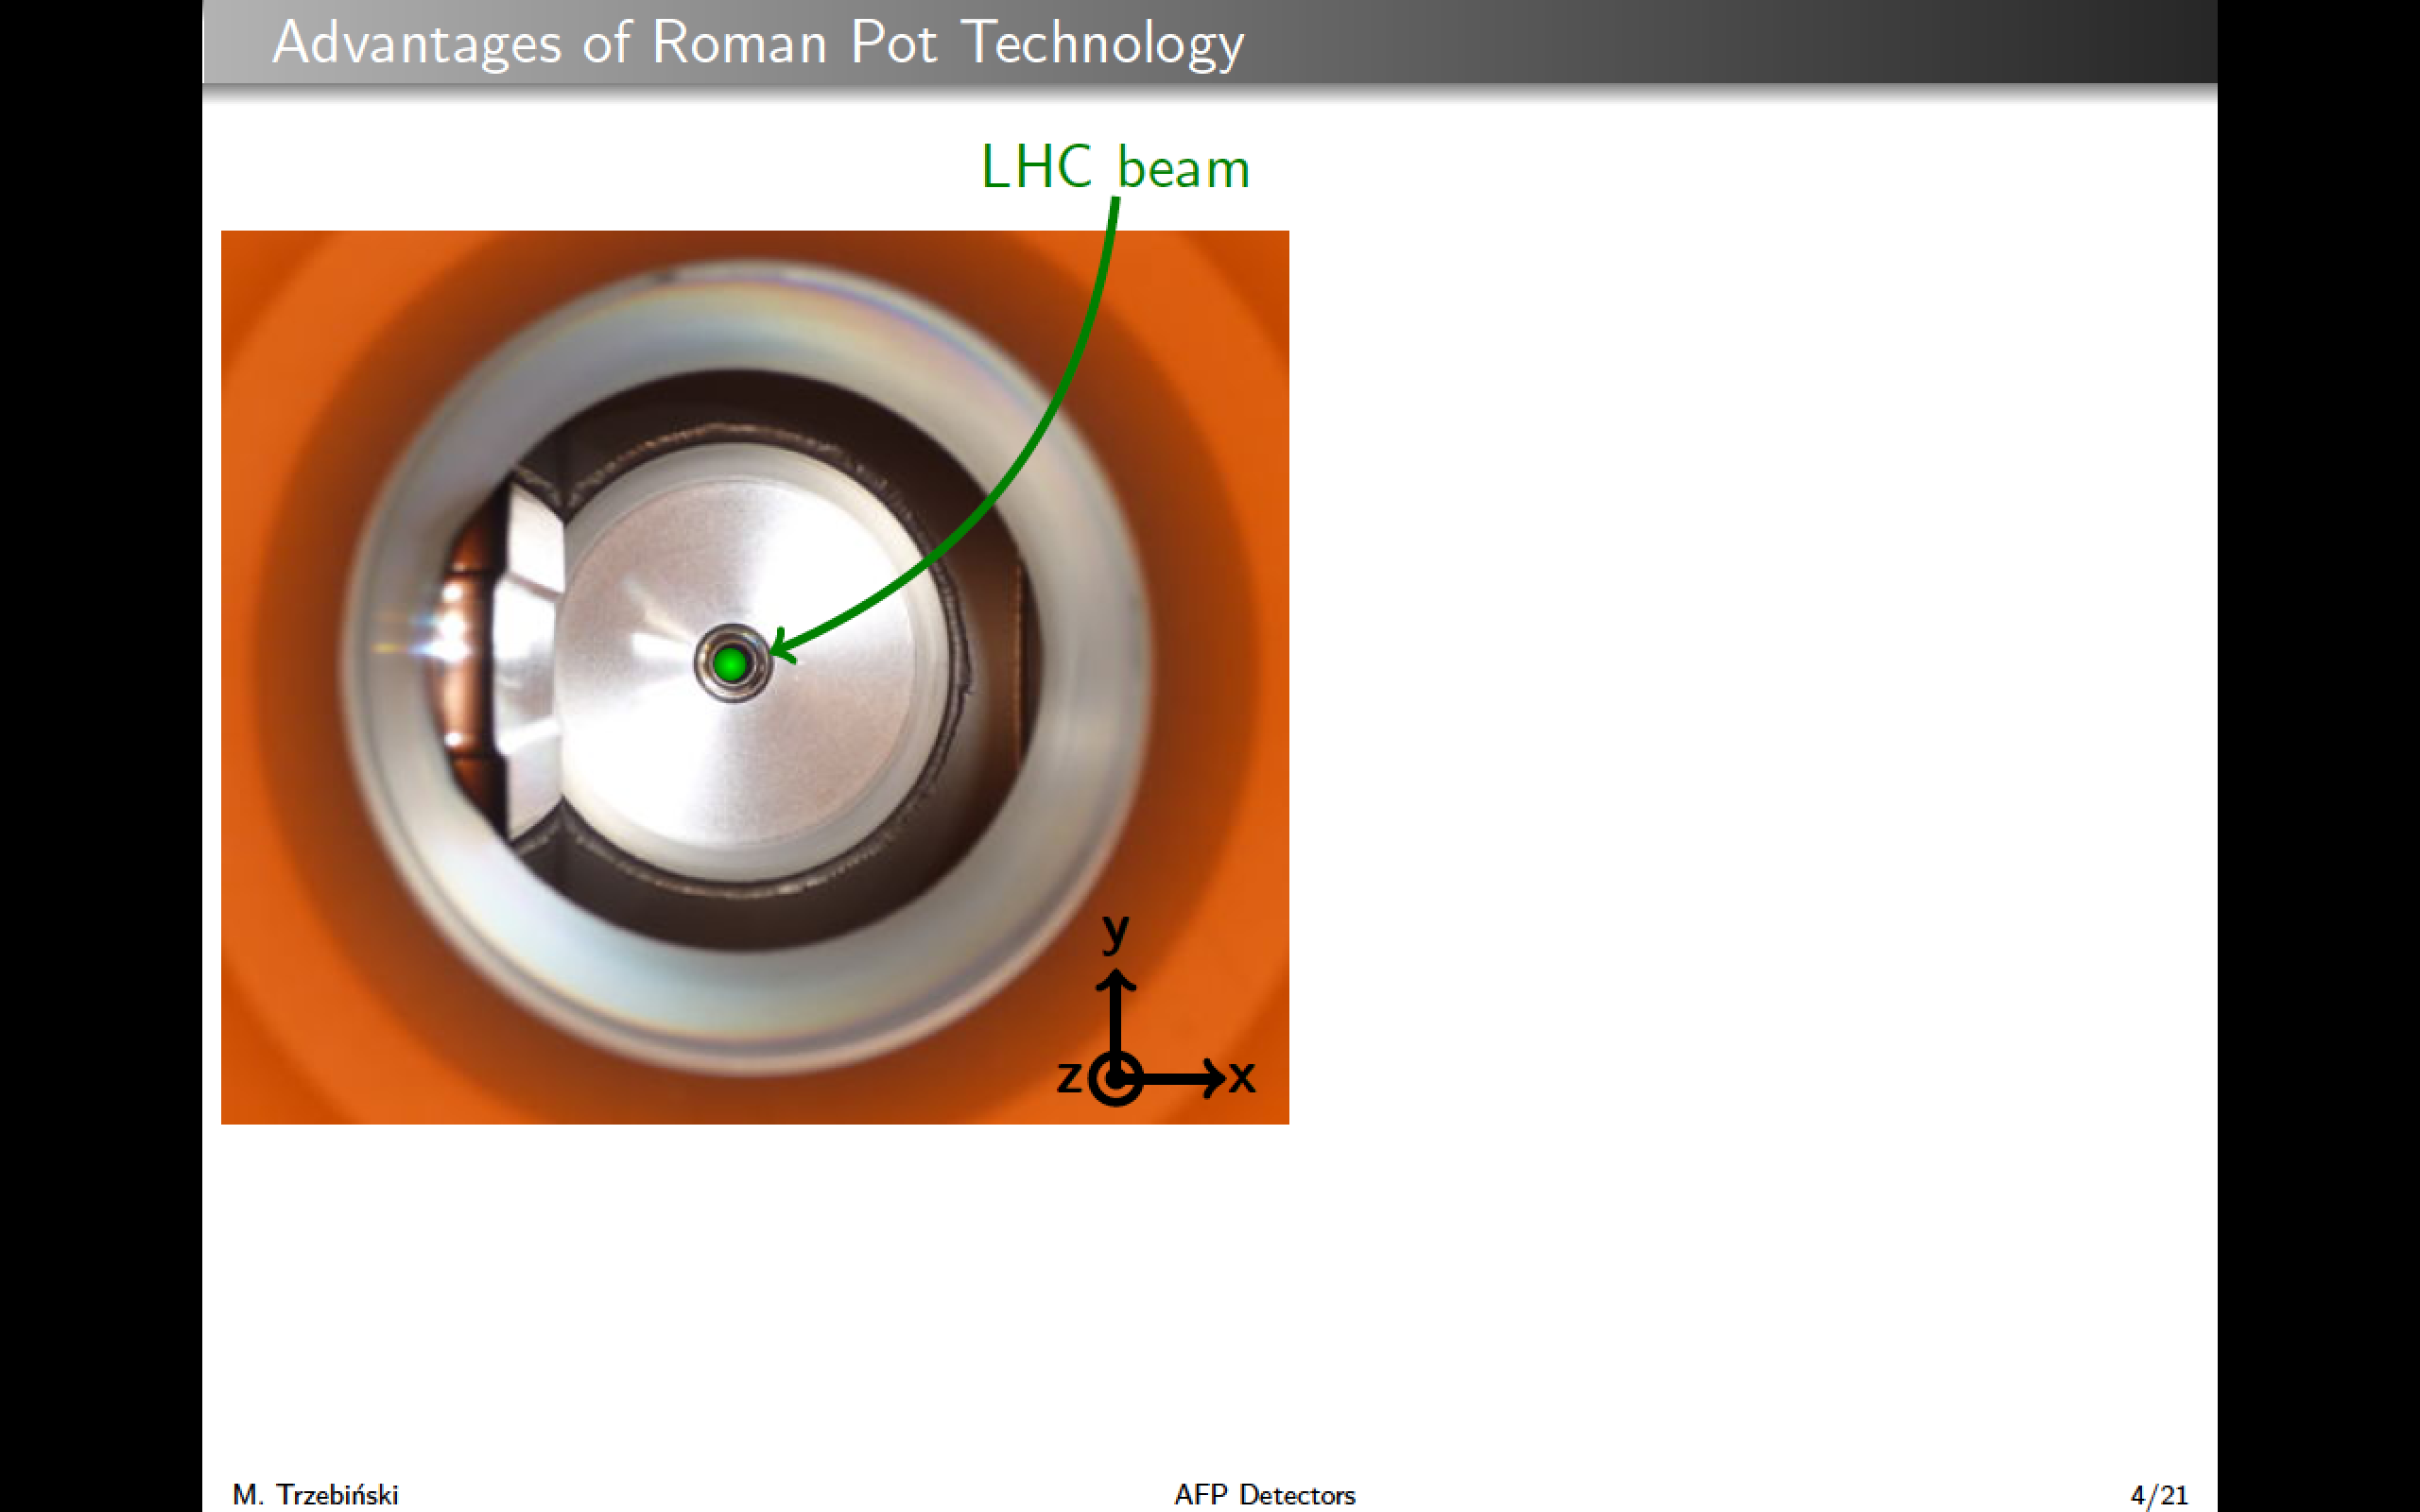

Slide 20


Slide 21
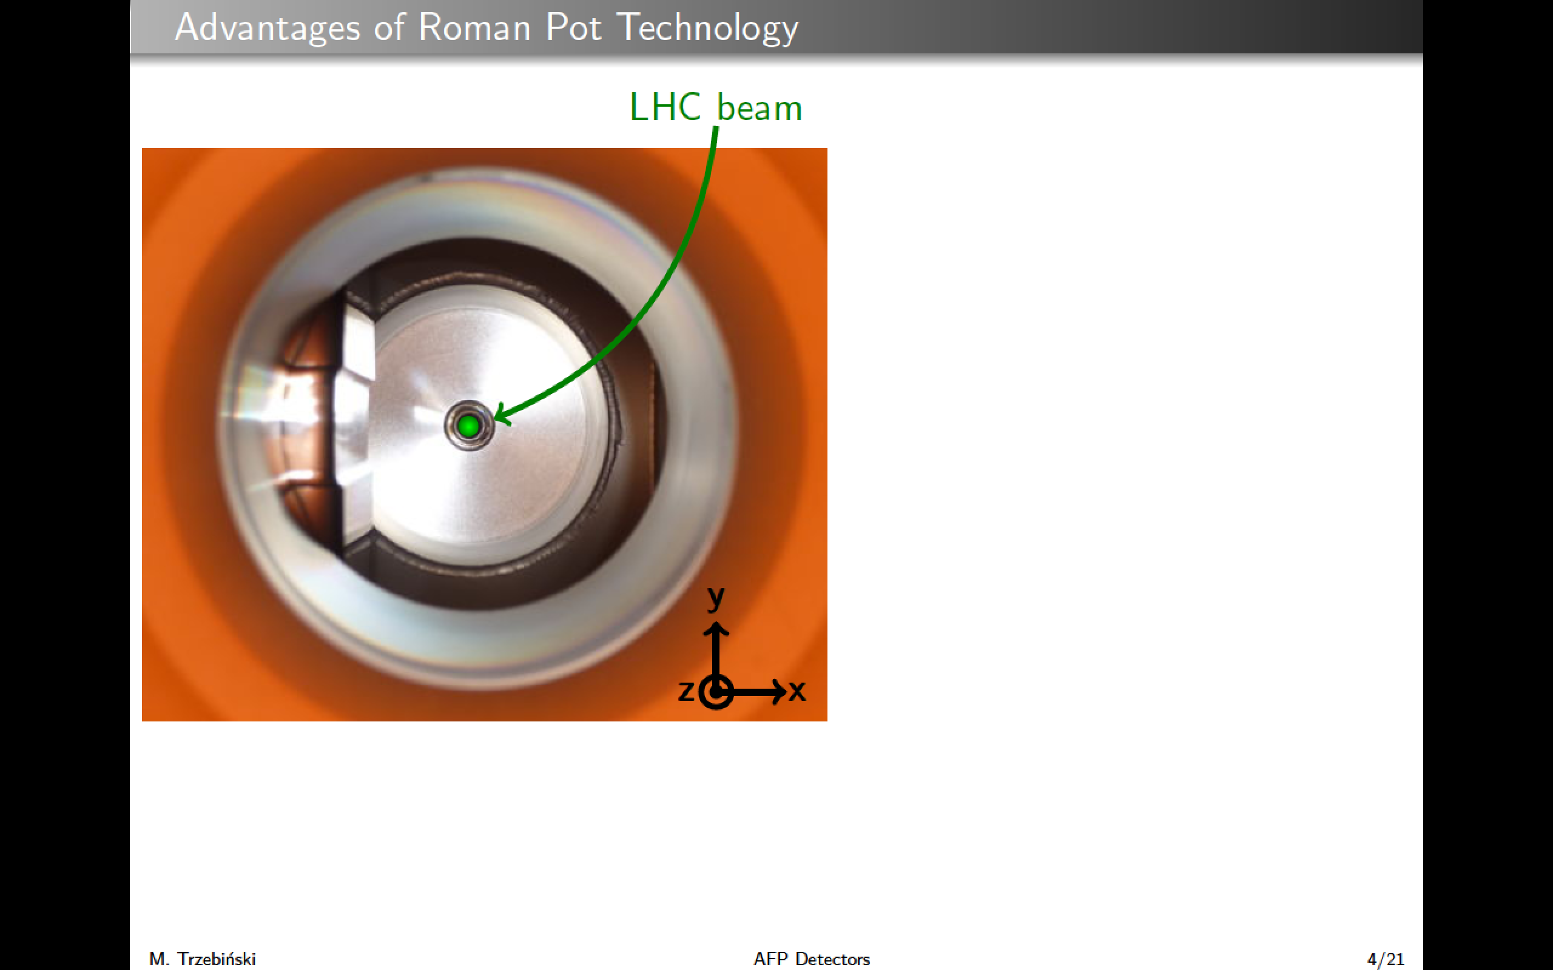

Slide 22
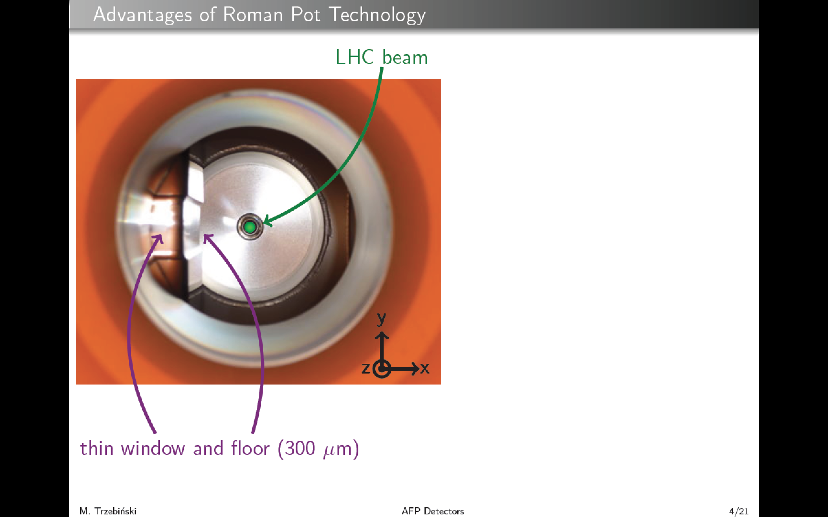

Slide 23
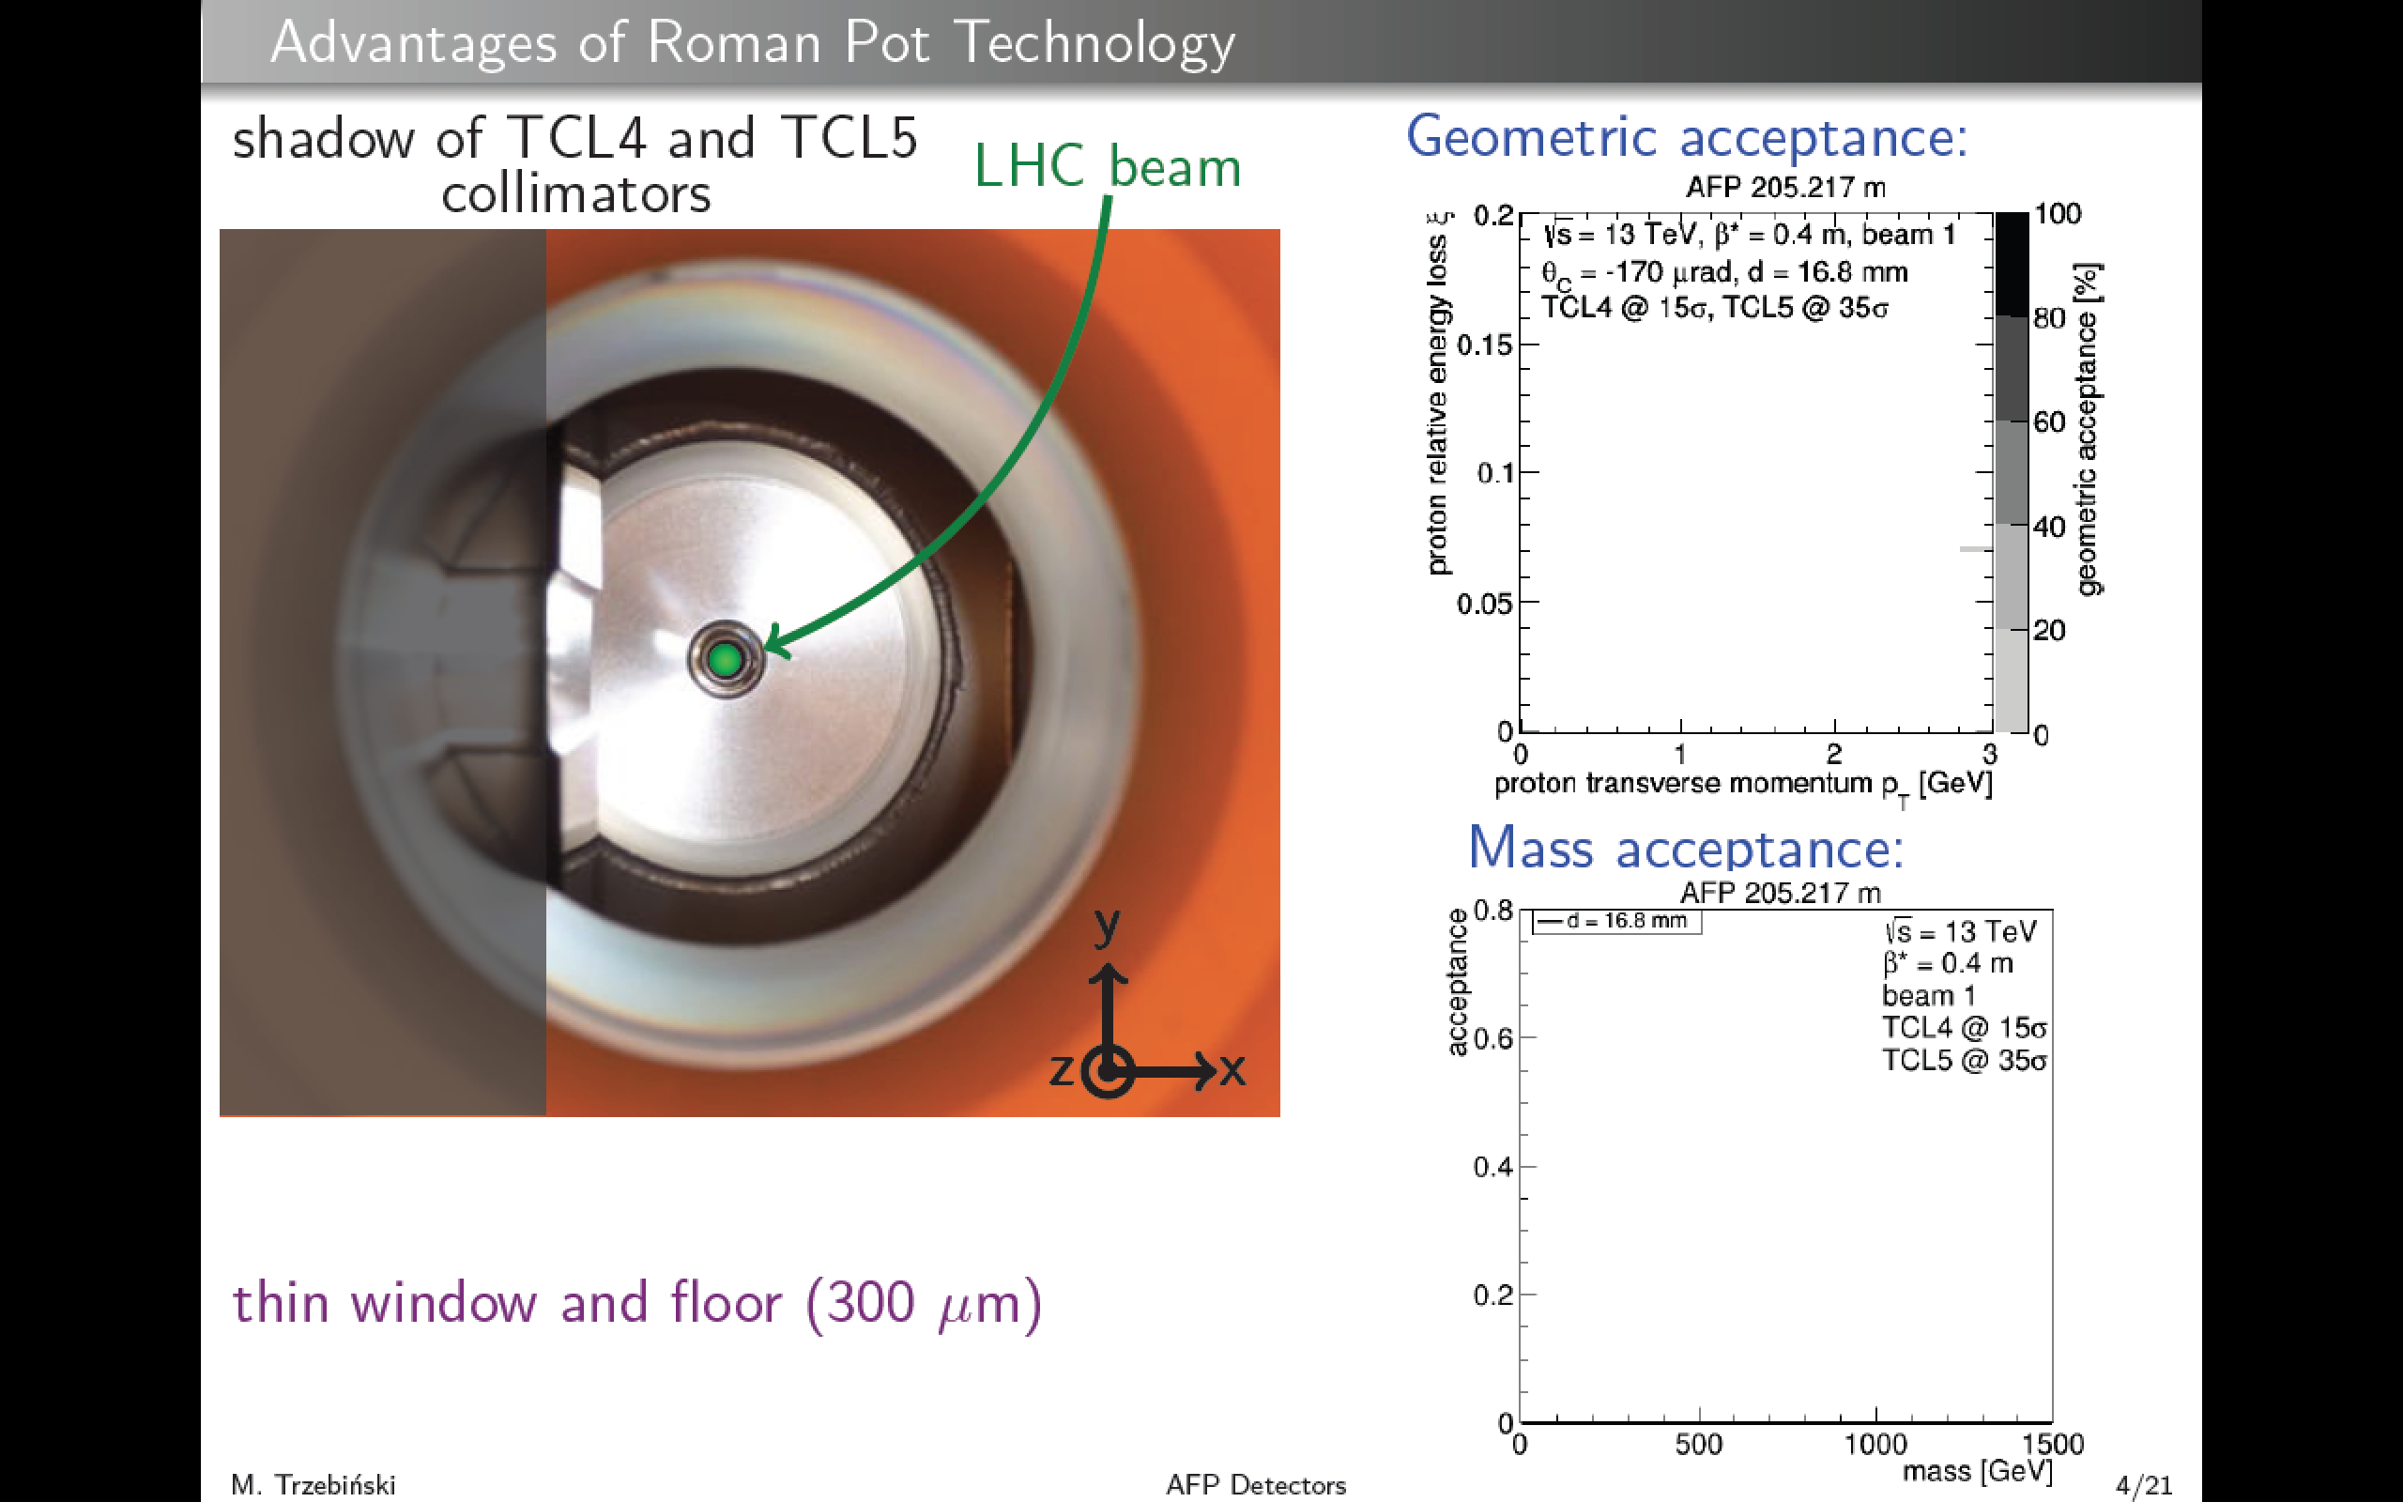
23

Slide 24
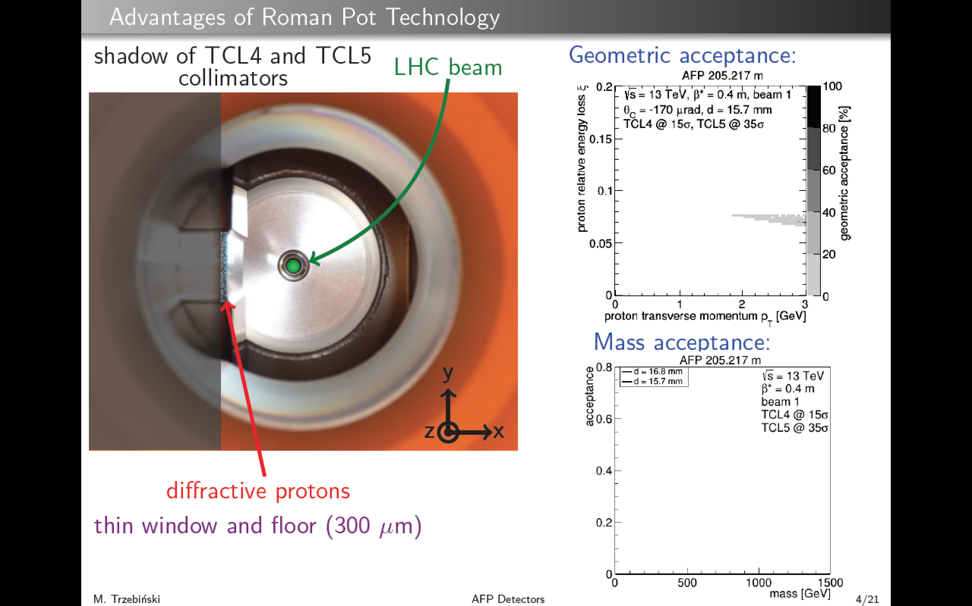

Slide 25
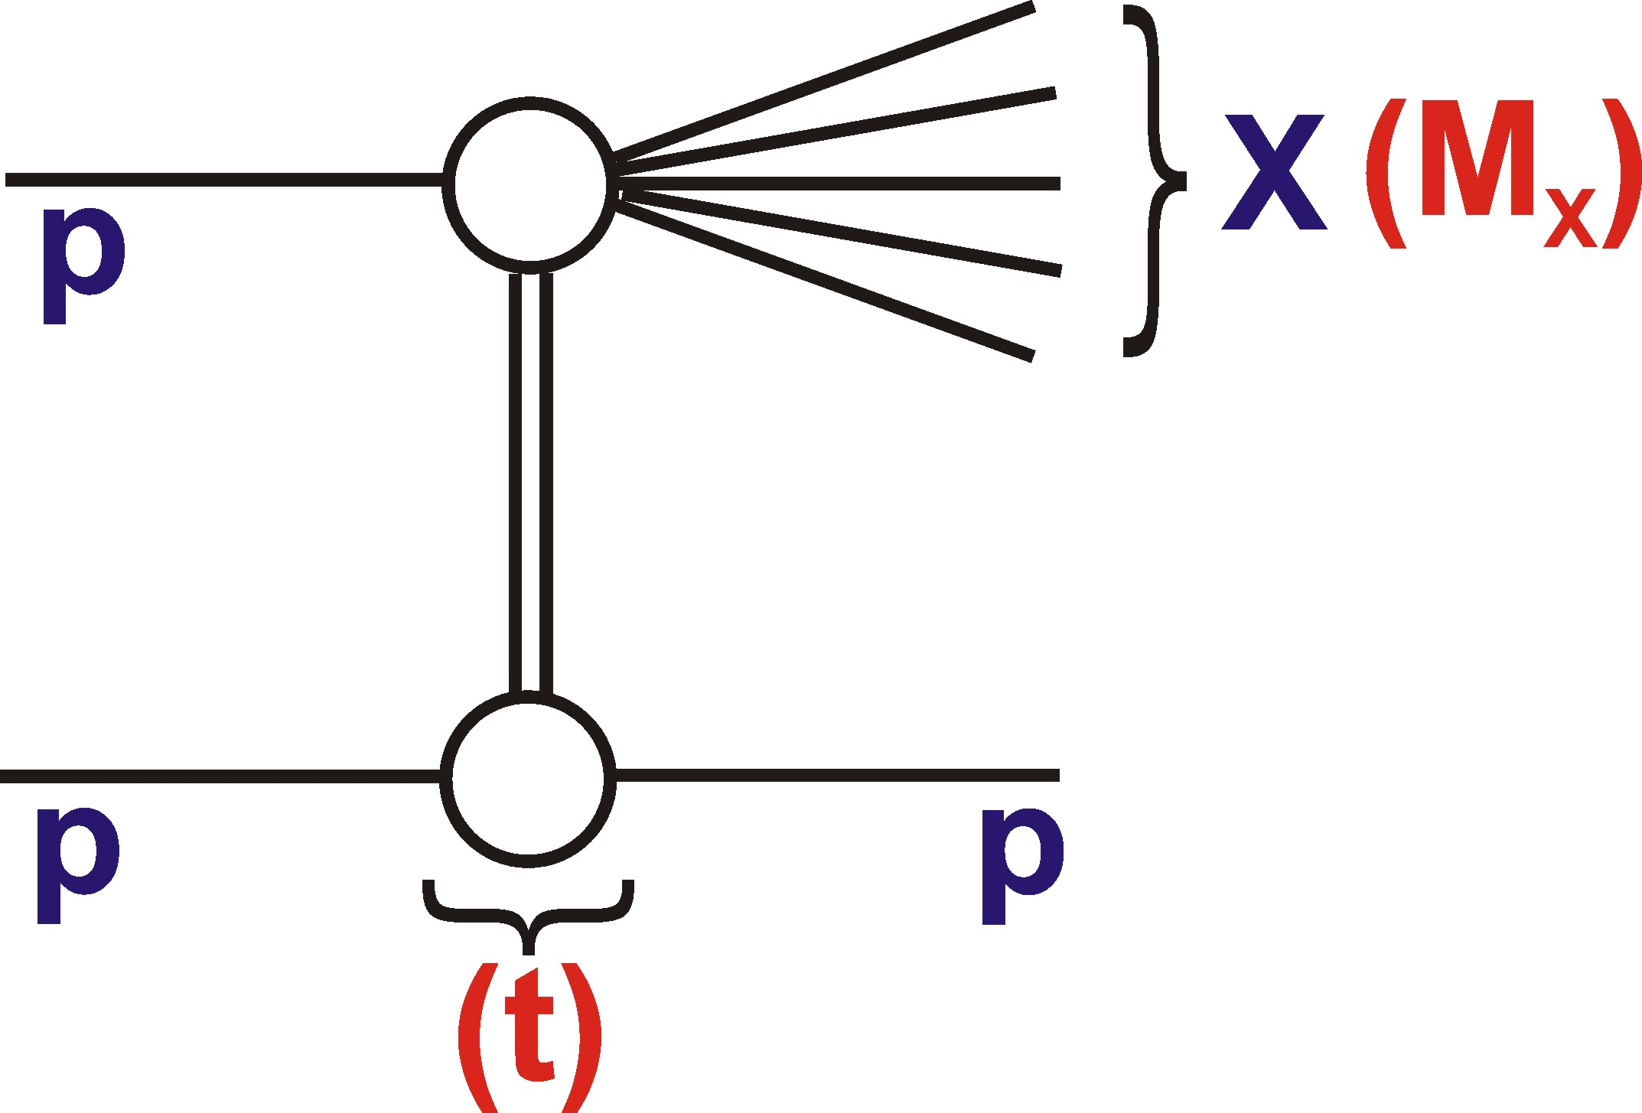
Described here in
terms of kinematics
of `Single Diffractive
Dissociation’ (SD)
(ξ)
ξ = fractional proton energy loss
t = -p_{T}² of outgoing proton
25

Slide 26
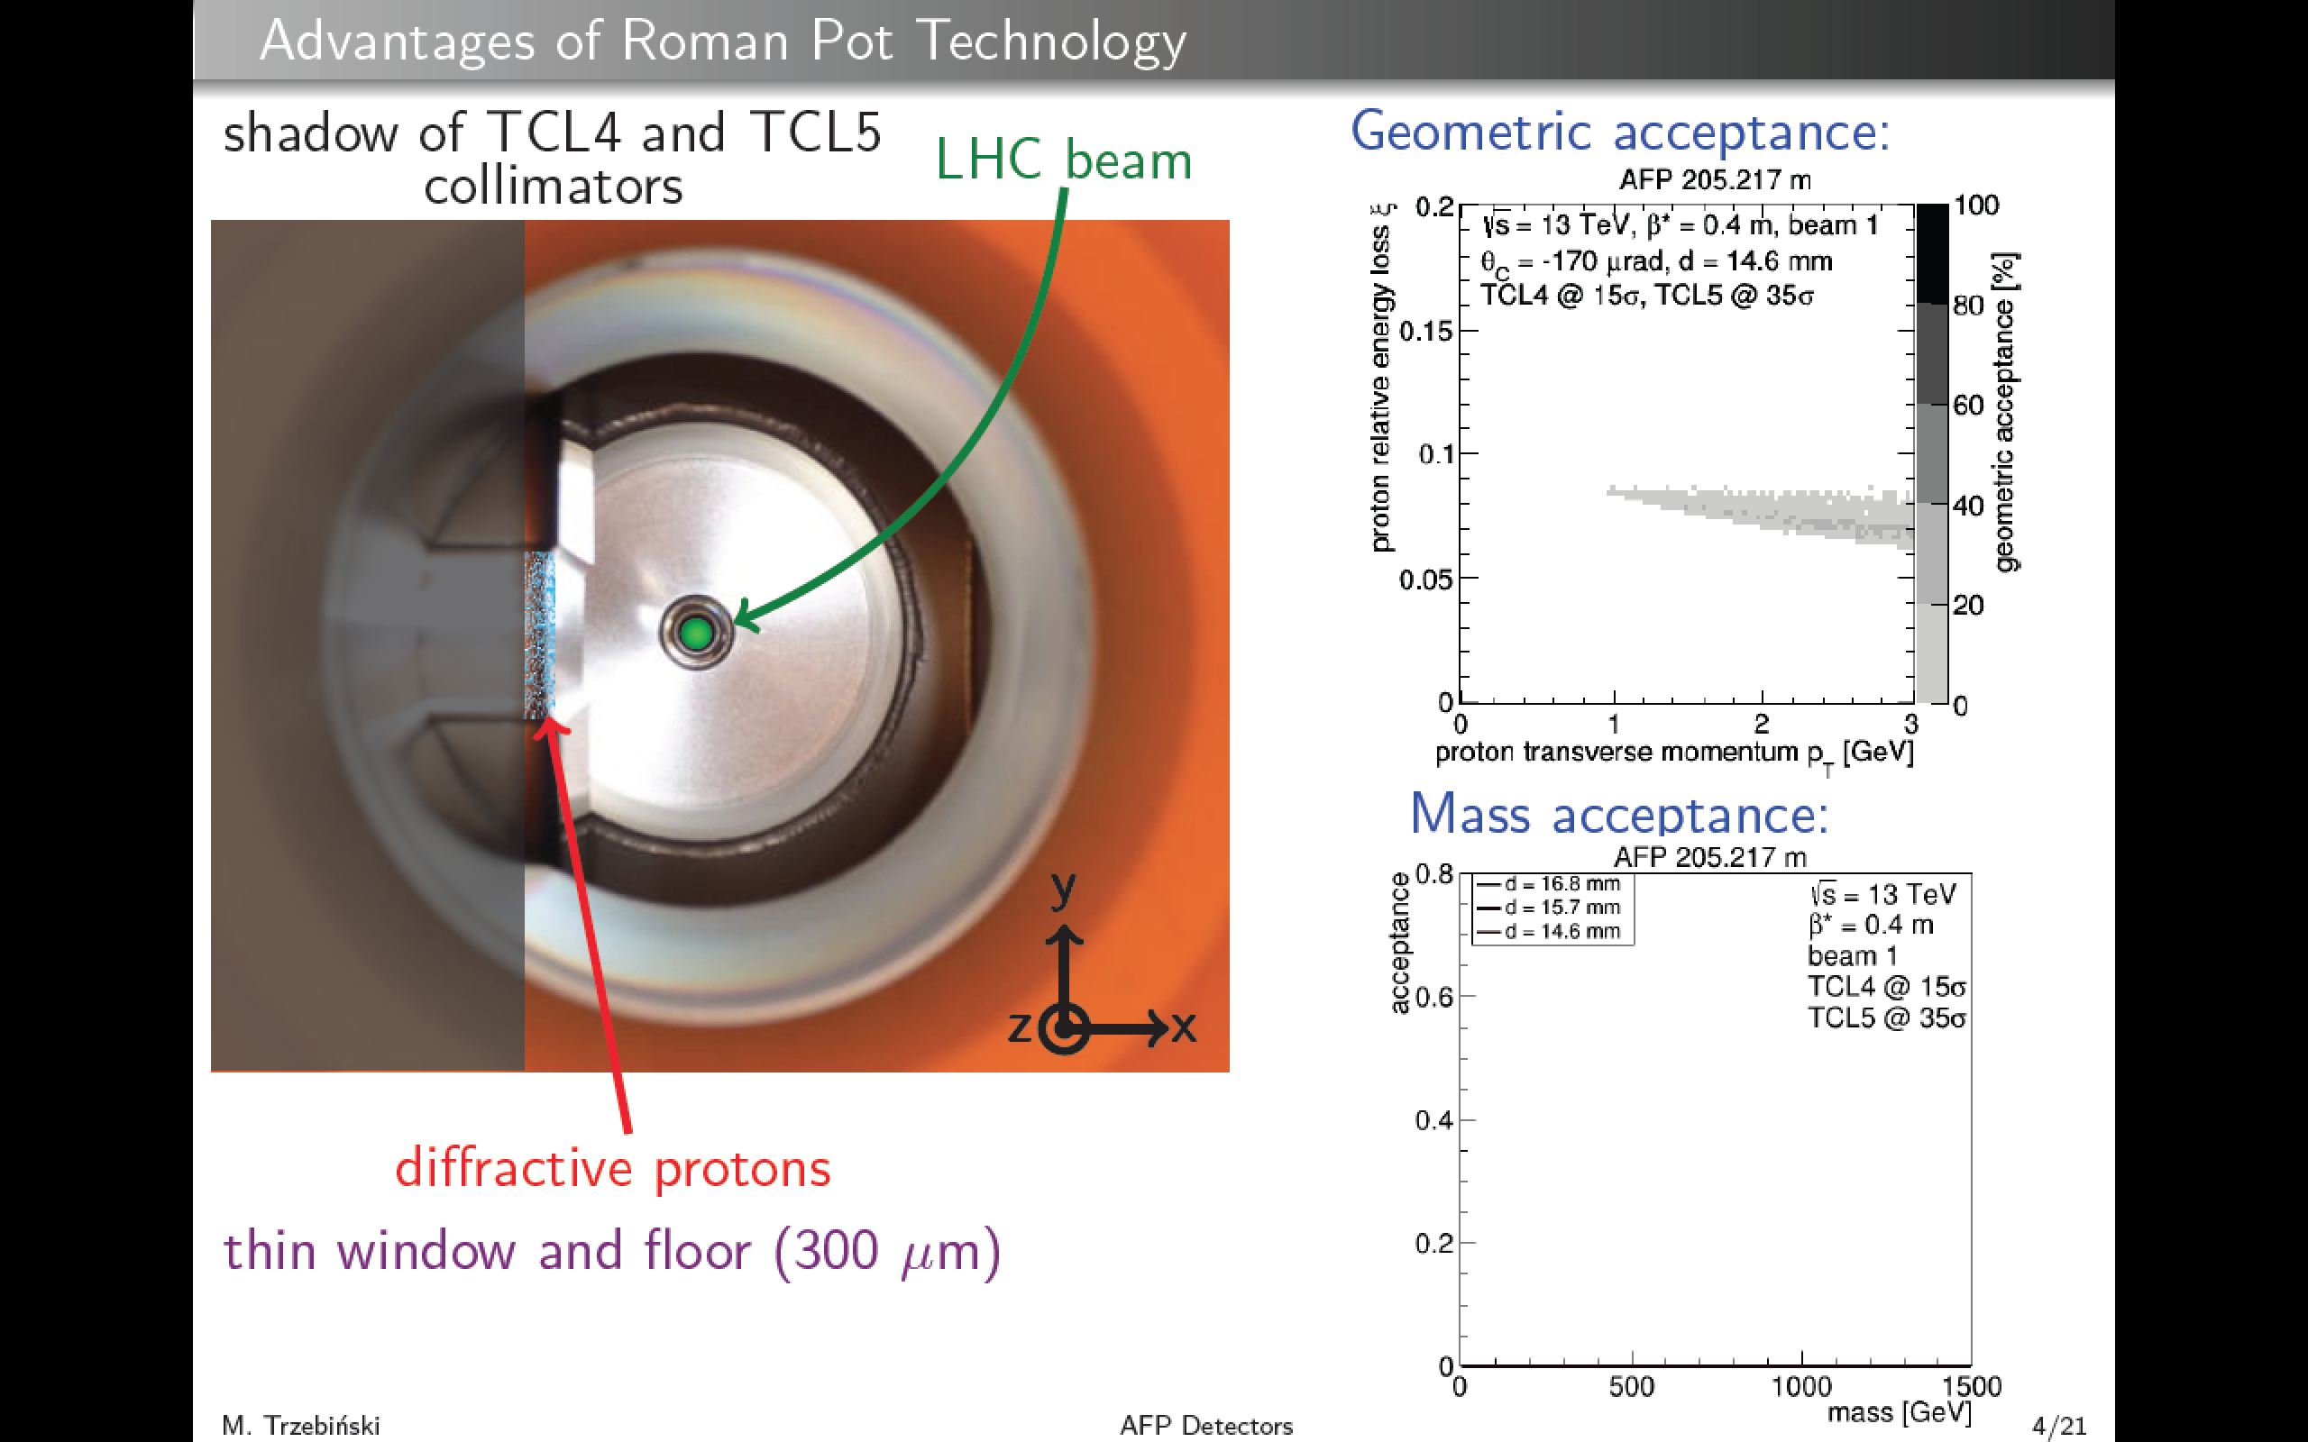
Described here in
terms of kinematics
of `Single Diffractive
Dissociation’ (SD)
(ξ)
ξ = fractional proton energy loss
t = -p_{T}² of outgoing proton
26

Slide 27
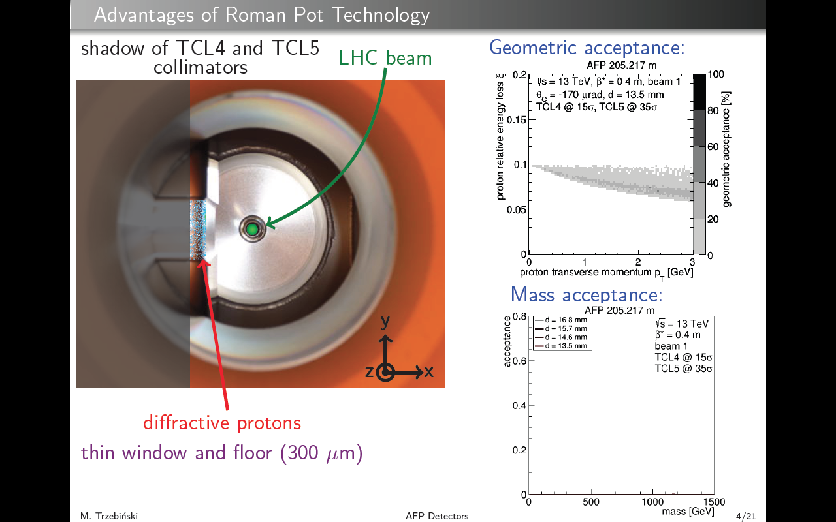
Described here in
terms of kinematics
of `Single Diffractive
Dissociation’ (SD)
(ξ)
ξ = fractional proton energy loss
t = -p_{T}² of outgoing proton
27

Slide 28

Described here in
terms of kinematics
of `Single Diffractive
Dissociation’ (SD)
(ξ)
ξ = fractional proton energy loss
t = -p_{T}² of outgoing proton
28

Slide 29
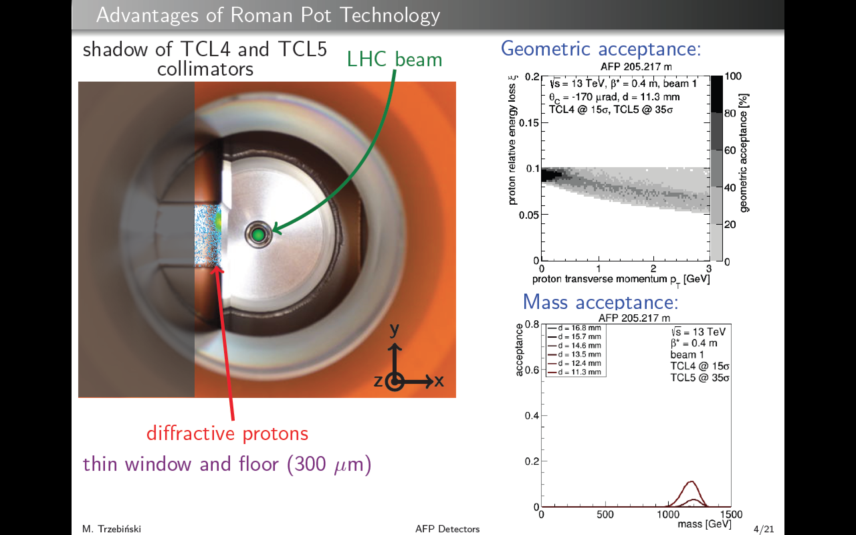
Described here in
terms of kinematics
of `Single Diffractive
Dissociation’ (SD)
(ξ)
ξ = fractional proton energy loss
t = -p_{T}² of outgoing proton
29

Slide 30

Described here in
terms of kinematics
of `Single Diffractive
Dissociation’ (SD)
(ξ)
ξ = fractional proton energy loss
t = -p_{T}² of outgoing proton
30

Slide 31
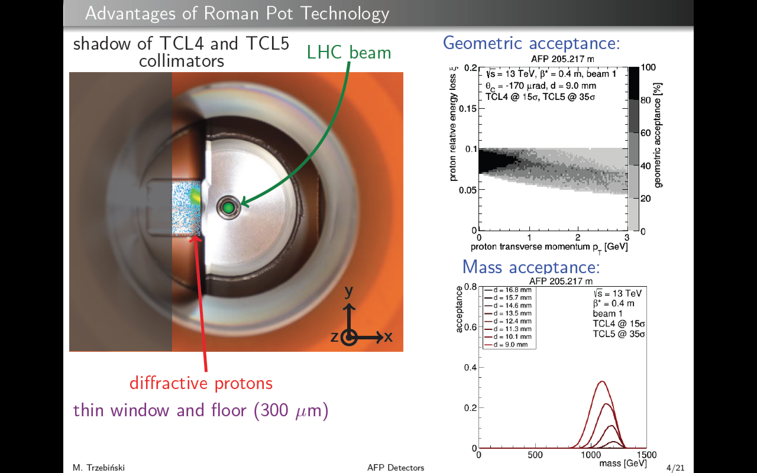
Described here in
terms of kinematics
of `Single Diffractive
Dissociation’ (SD)
(ξ)
ξ = fractional proton energy loss
t = -p_{T}² of outgoing proton
31

Slide 32
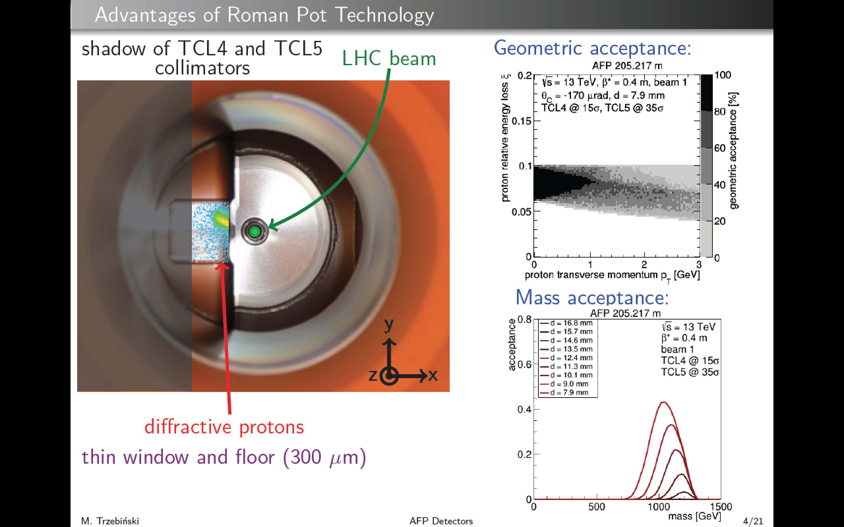
Described here in
terms of kinematics
of `Single Diffractive
Dissociation’ (SD)
(ξ)
ξ = fractional proton energy loss
t = -p_{T}² of outgoing proton
32

Slide 33
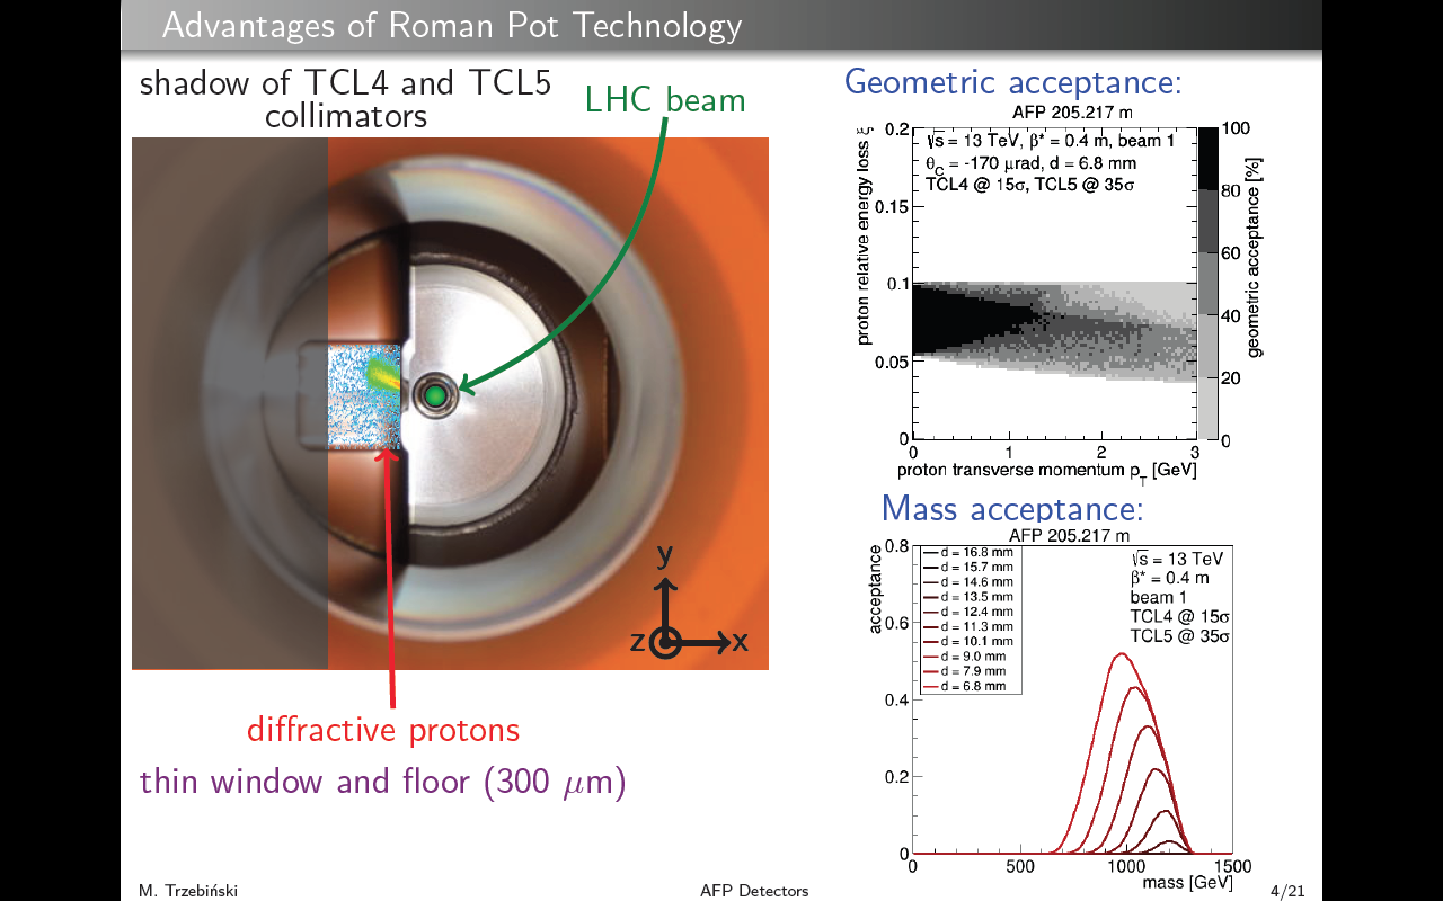
Described here in
terms of kinematics
of `Single Diffractive
Dissociation’ (SD)
(ξ)
ξ = fractional proton energy loss
t = -p_{T}² of outgoing proton
33

Slide 34
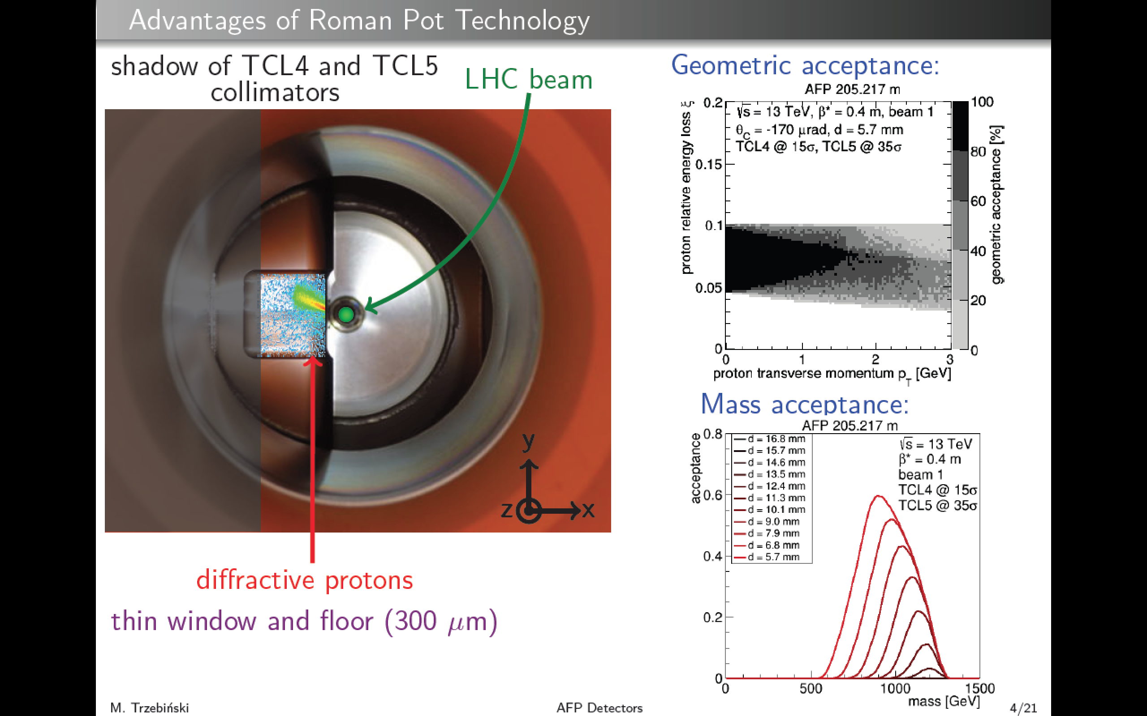
Described here in
terms of kinematics
of `Single Diffractive
Dissociation’ (SD)
(ξ)
ξ = fractional proton energy loss
t = -p_{T}² of outgoing proton
34

Slide 35
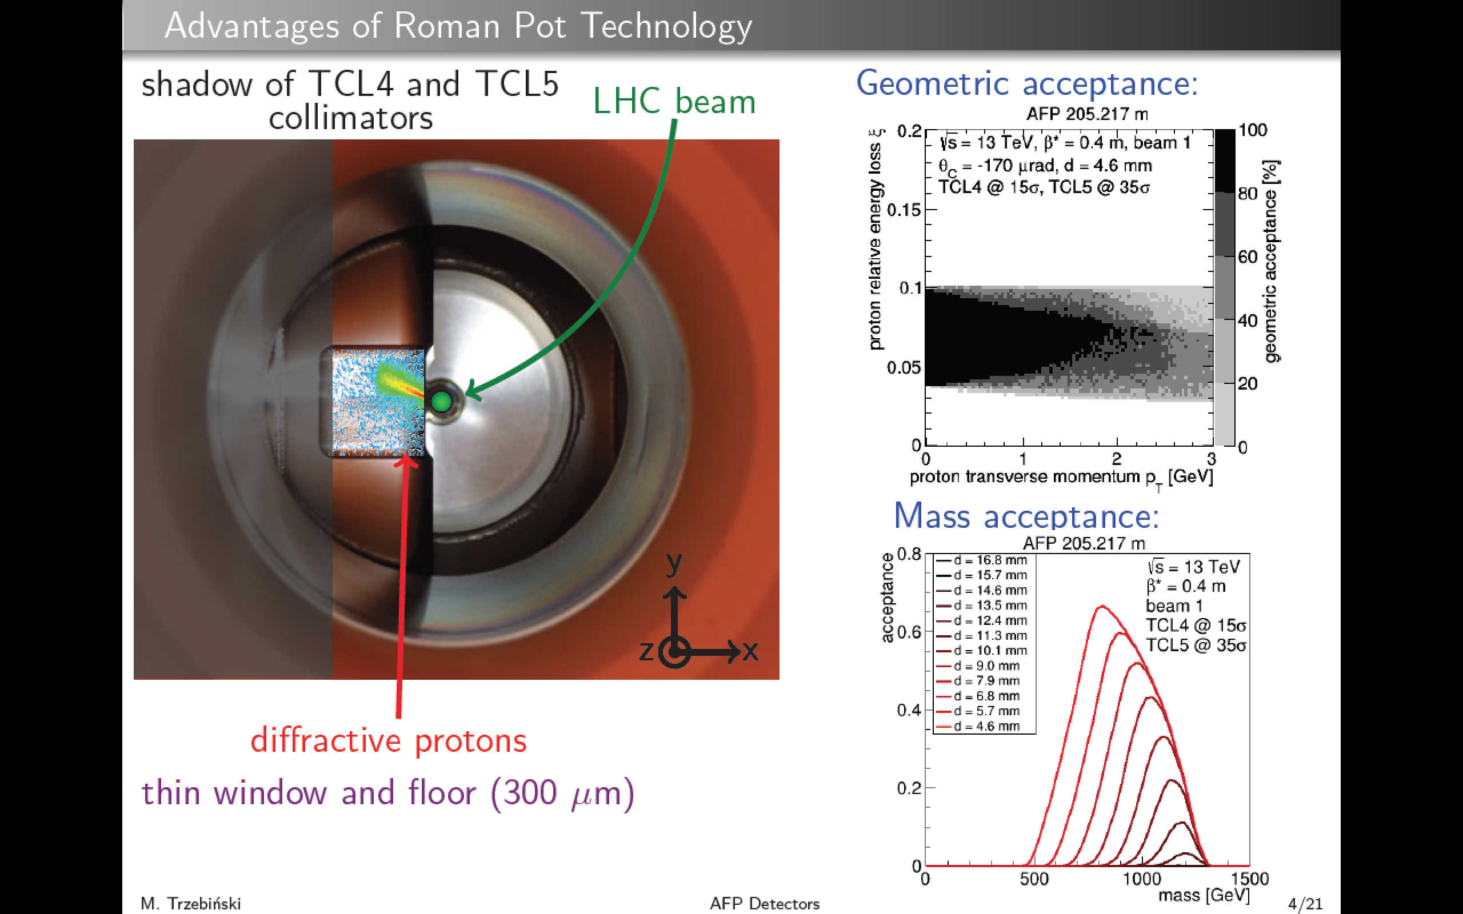
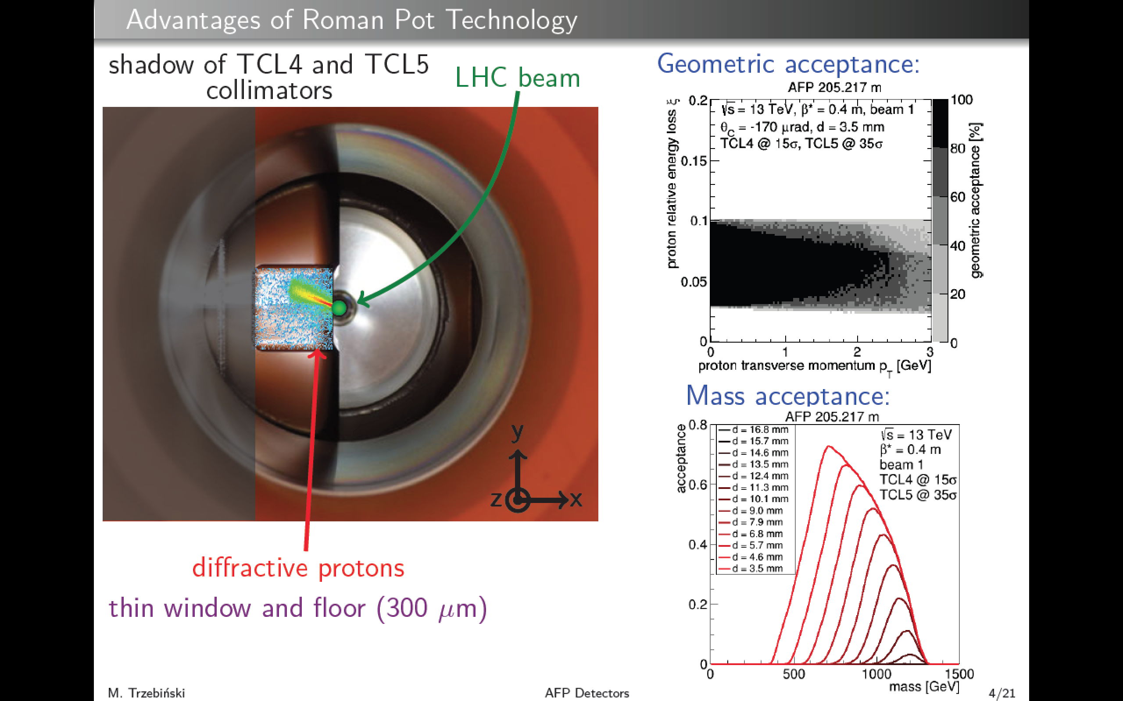
Described here in
terms of kinematics
of `Single Diffractive
Dissociation’ (SD)
(ξ)
ξ = fractional proton energy loss
t = -p_{T}² of outgoing proton
35

Slide 36
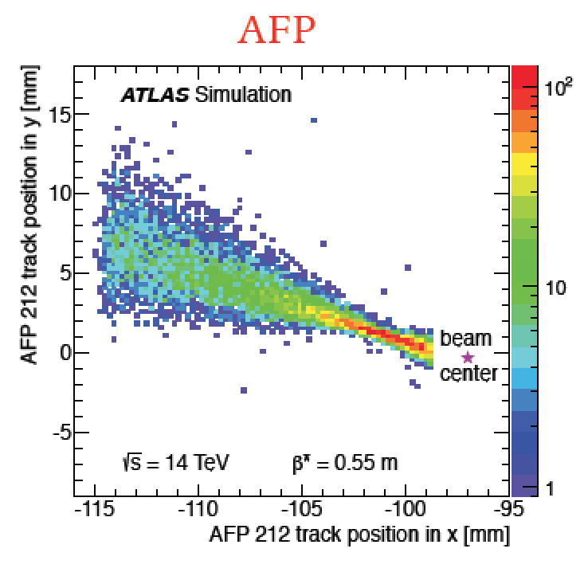
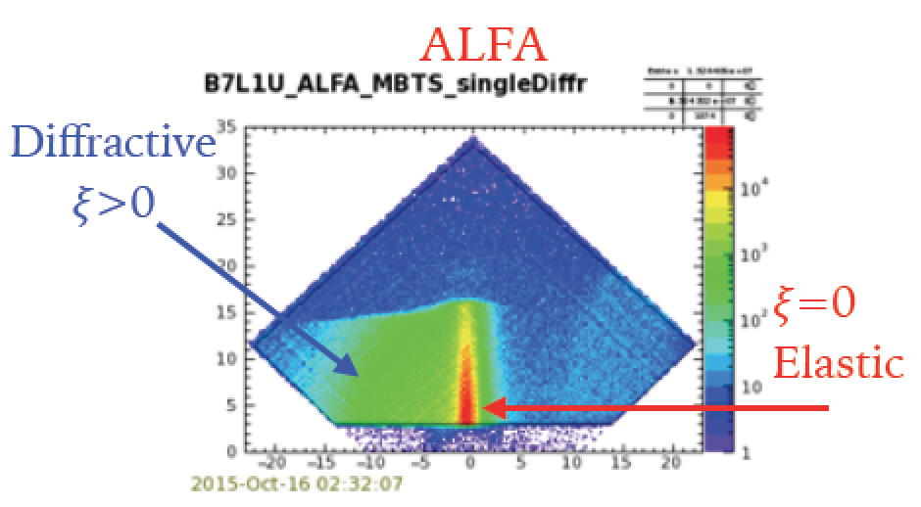
Acceptance Depends on Location and
Orientation of Pot (horizontal or vertical) and on beam optics
e.g. complementarity between ATLAS ALFA and AFP
ALFA is optimised for Elastic scattering
AFP acceptance for Inelastic diffraction with ξ >~ 0.02

Slide 37
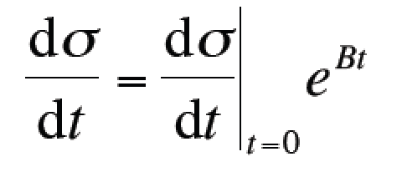
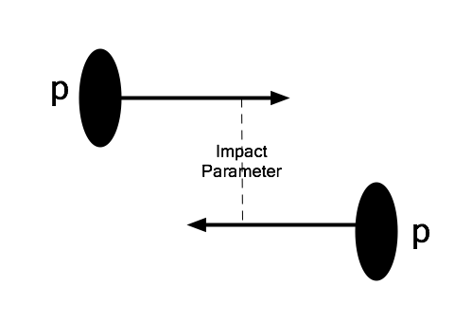
Start`Simple’:
Elastic Scattering
At fixed √s, 1 non –trivial variable
→ squared 4-momentum transfer, t
Typically |t| << 1 GeV²: non-perturbative
At fixed s:
Slope parameter B measures mean impact
parameter (~size of interaction region
~ range of strong force ~1-2fm).

Slide 38
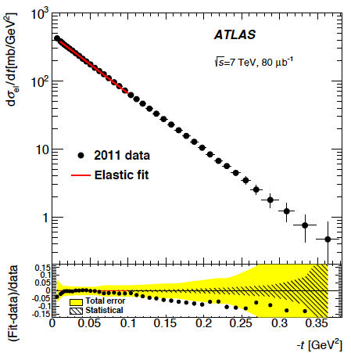
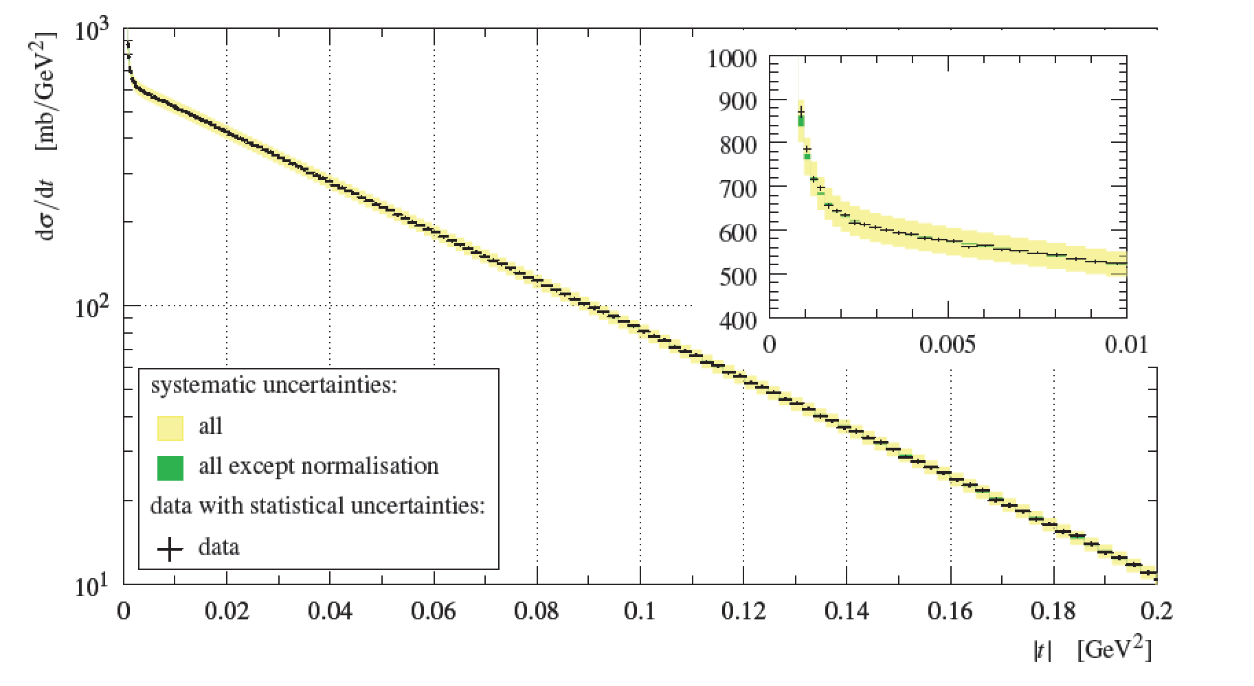
Example Elastic Scattering Data
Precise t dependence over ‘bulk’ range of |t|at LHC
TOTEM
13 TeV
ALFA
7 TeV
`Standard’ exponential fit, excluding lowest |t|
(influence of Coulomb, rather than hadronic,
scattering) and largest |t|(various pQCD effects)
e.g. at √s=7 TeV …
B=19.89±0.27 GeV⁻² (TOTEM)
B=19.73±0.24 GeV⁻² (ALFA)

Slide 39
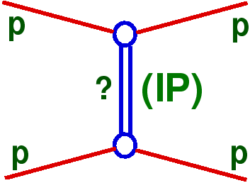
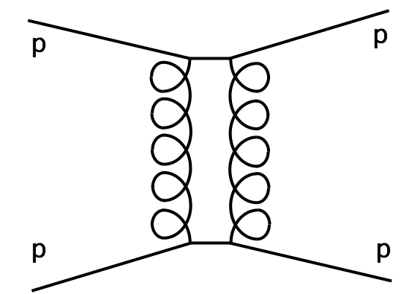
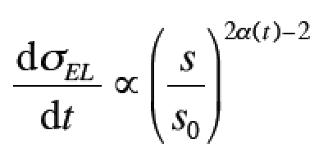
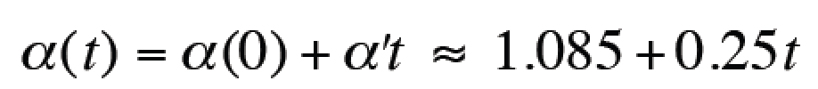
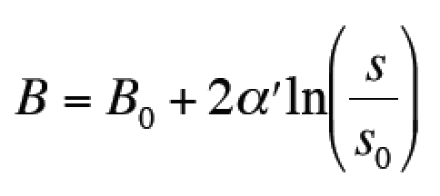
Universal Exchange Picture of Elastic and Diffractive Scattering
Historically, Regge phenomenology offers
unified picture in terms of trajectory exchanges
`Pomeron’ exchange dominates for
sufficiently large $√s$.
Loosely interpreted as exchange of two
gluons in net colour singlet state [but beware
partonic language in non-perturbative regime]
For elastic scattering at fixed t:
Pomeron trajectory:
… Leads to slope parameter
growing logarithmically with energy

Slide 40
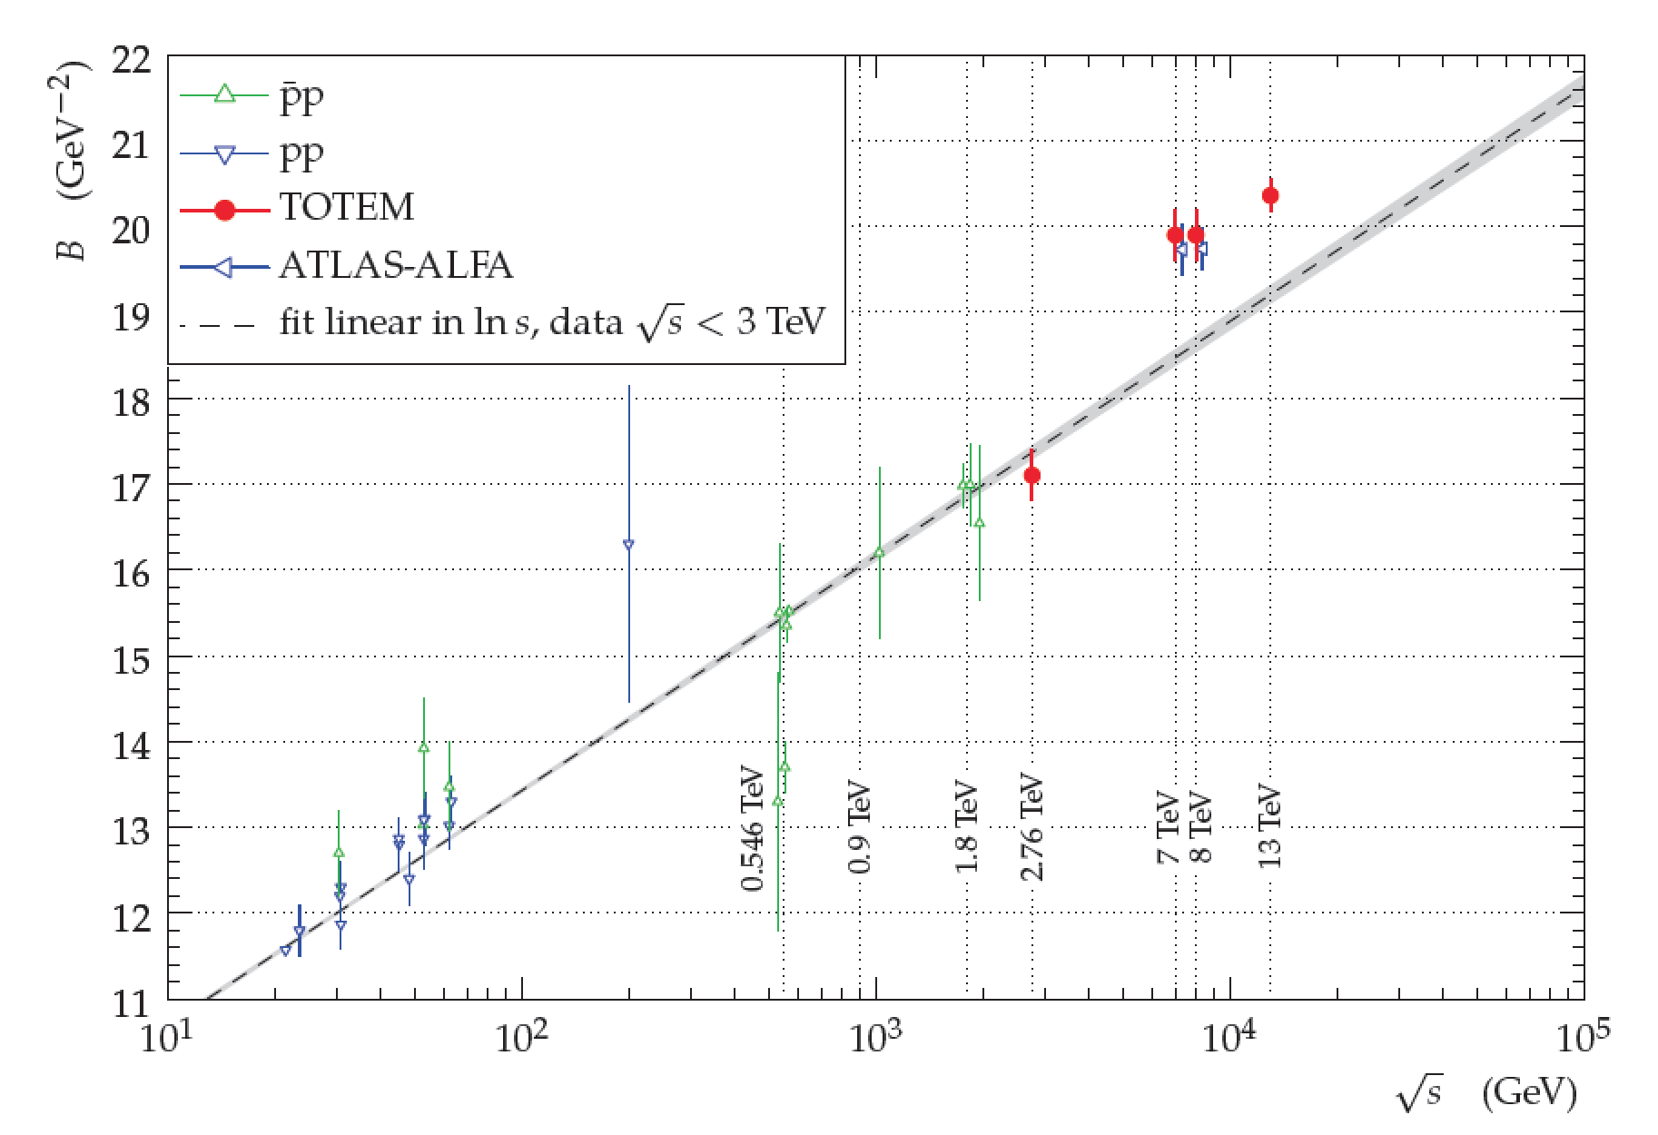
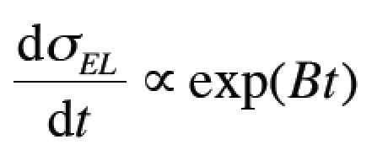
√s dependence of t Slopes
B increases with √s … ‘shrinkage’ of forward elastic peak →
Increase of mean impact parameter / effective proton size as
longer-lived fluctuations develop larger transverse size.
Growth seems faster than `standard’ α’ ~ 0.25 GeV⁻² →
Single pomeron exchange insufficient (absorptive corrections / different physics)
From fits at fixed s:
`Standard’ Pomeron
`pole’ Regge theory

Slide 41
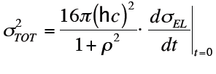
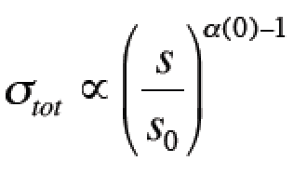
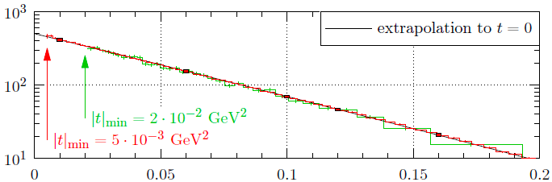
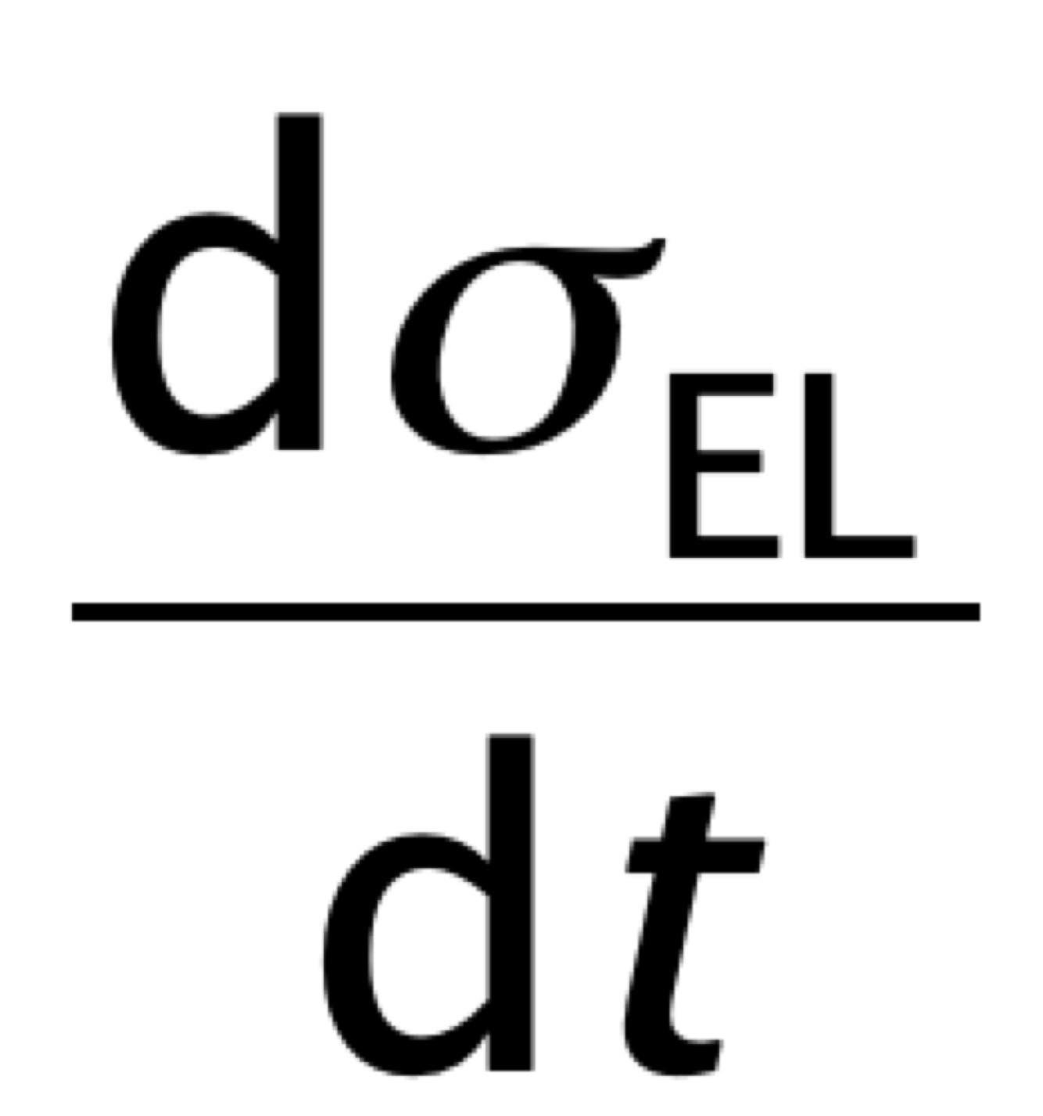
From Elastic to Total Cross Sections
Elastic amplitude closely related
to total x-sec via optical theorem …
e.g in Regge language, leads to
Asymptotically (Froissart bound) limited to $\ln^{2}s$ dependence
obtained through
extrapolation
of hadronic part of
elastic cross section
(~10% extrapolation)
~ 0.14 = Real / Imaginary part of hadronic amplitude at t=0
Most recent / sophisticated treatment exploits Coulomb-
Nuclear interference and fits to full t range and simultaneously
extracts σ_{tot} and ρ … see later

Slide 42
Total (& Elastic) Cross Section versus √s
Multiple TOTEM
Extractions at
$\sqrt{s}=13$ TeV
2.5% precision
Cosmic ray data
extend to 50 TeV!
Broadly consistent
with fits to low energy data (with either logarithmic or power law
behaviour)
[TOTEM
13 TeV]

Slide 43
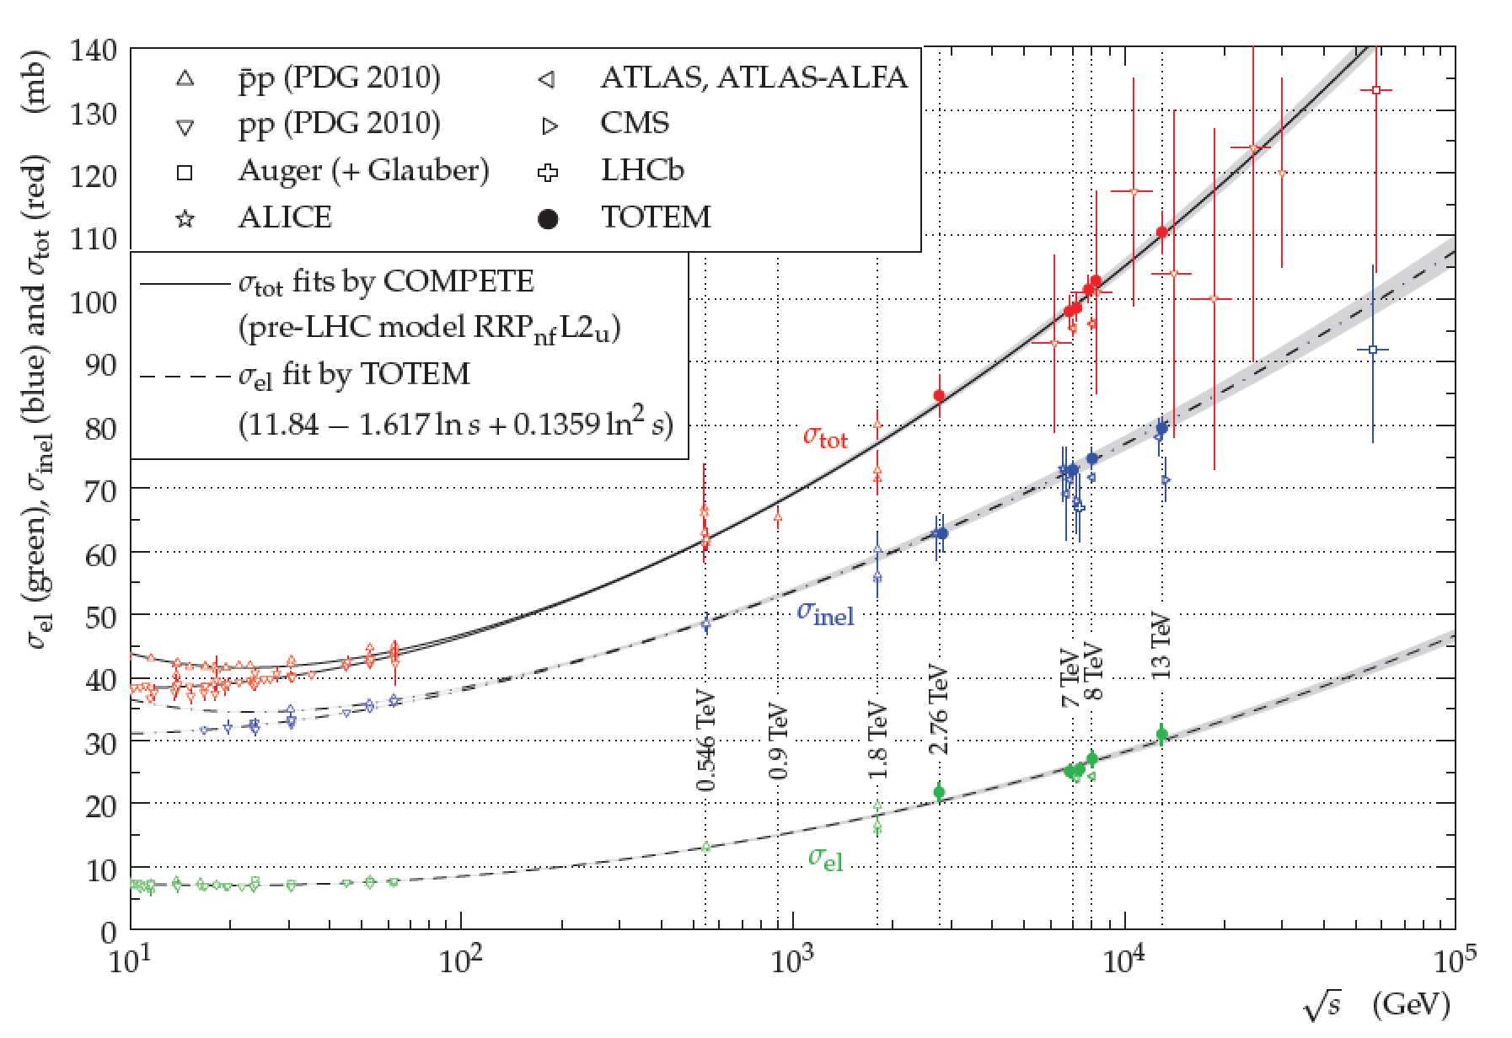
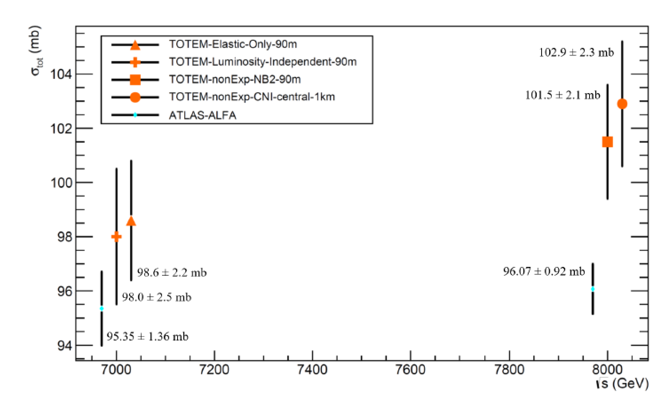
Total (& Elastic) Cross Section versus √s
ATLAS-ALFA:
1% measurement
at 8TeV
Small tension between
TOTEM & ALFA at 8 TeV
(traceable to normalisation
of elastic data)

Slide 44
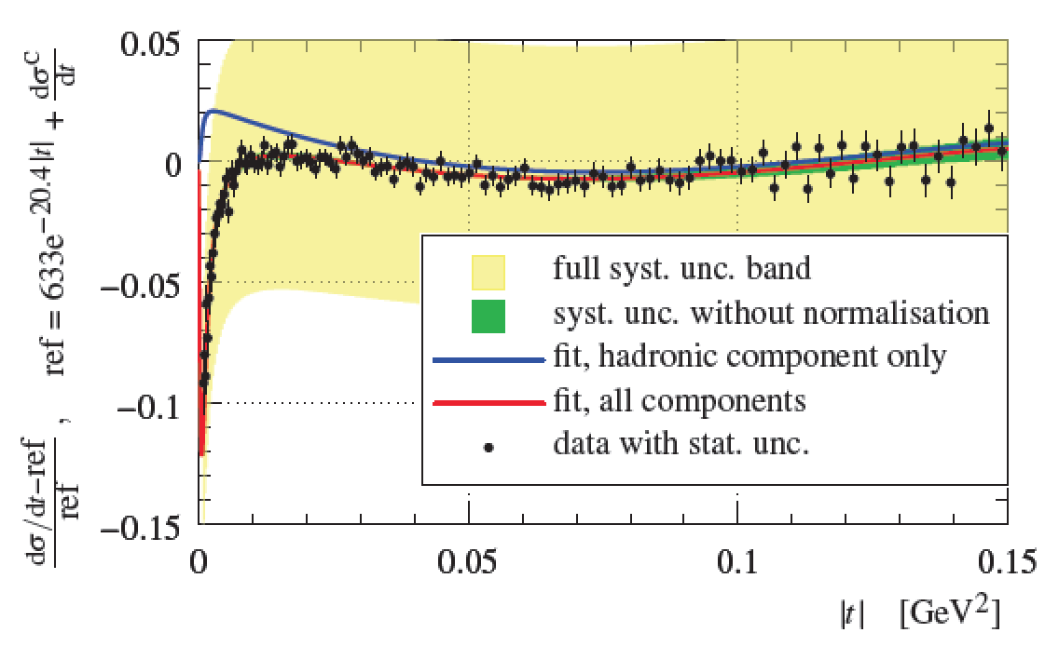
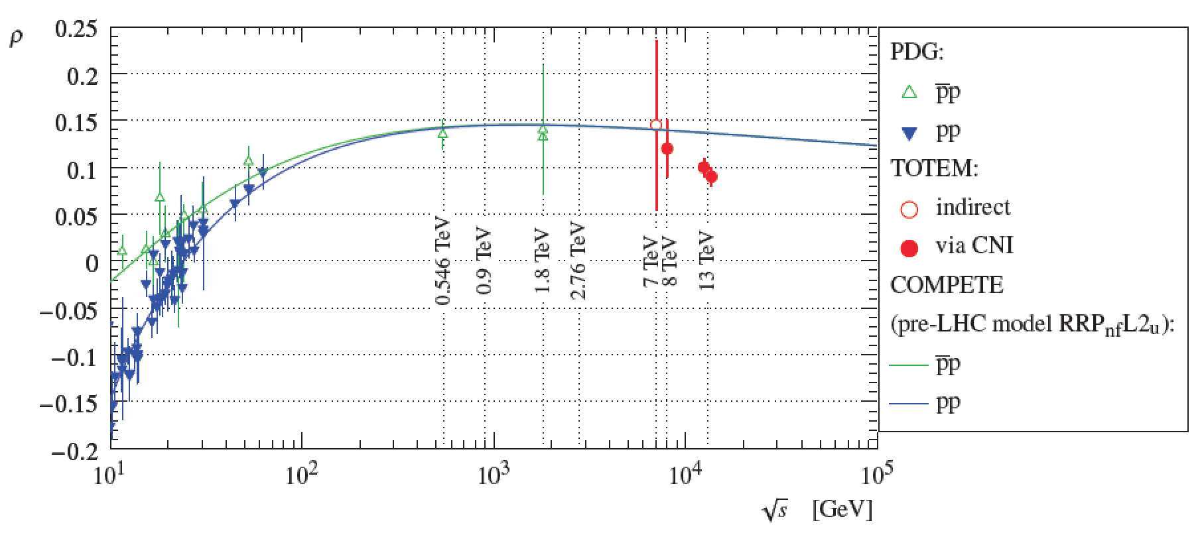
First LHC Extraction of ρ Parameter
Interference between
Coulomb and Nuclear parts
of elastic cross section is
sensitive to ρ parameter
Very high statistics TOTEM
sample at 13 TeV ...
→ First LHC measurements of ρ

Slide 45
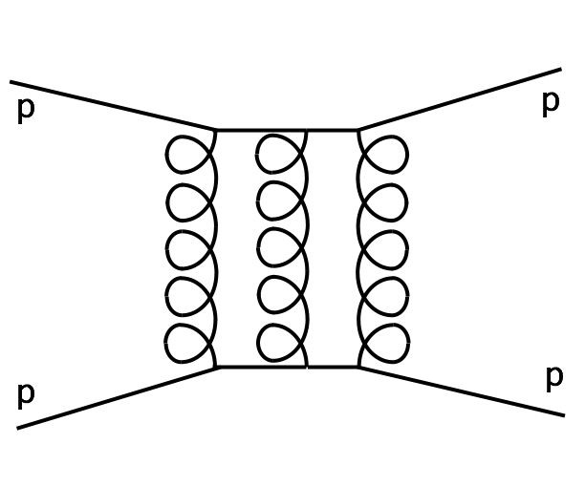
Interpretation as Evidence for Odderon
- No extrapolated
pre-LHC model
describes both
and σ_{tot} from 13 TeV TOTEM data (multiple
models studied
in `COMPETE’
framework).
Introducing a CP-odd contribution to the elastic
exchange (i.e. an `odderon’ – 3 gluon-based
state) is one way of reconciling data
Slow-down of growth of σ_{tot} beyond
LHC range (influencing ρ via dispersion
relations) is another
→ Detailed studies are ongoing …

Slide 46
Odderons and pp versus ppbar
CP-odd odderon exchange should contribute oppositely in
pp (eg LHC) and ppbar (eg Tevatron) cases.
LHC (TOTEM) data at 2.76 TeV v Tevatron (D0) at 1.96 TeV
Evidence for difference in behaviour around the ‘diffractive
dip’ … ‘smoking gun’ for odderon if conclusive …

Slide 47
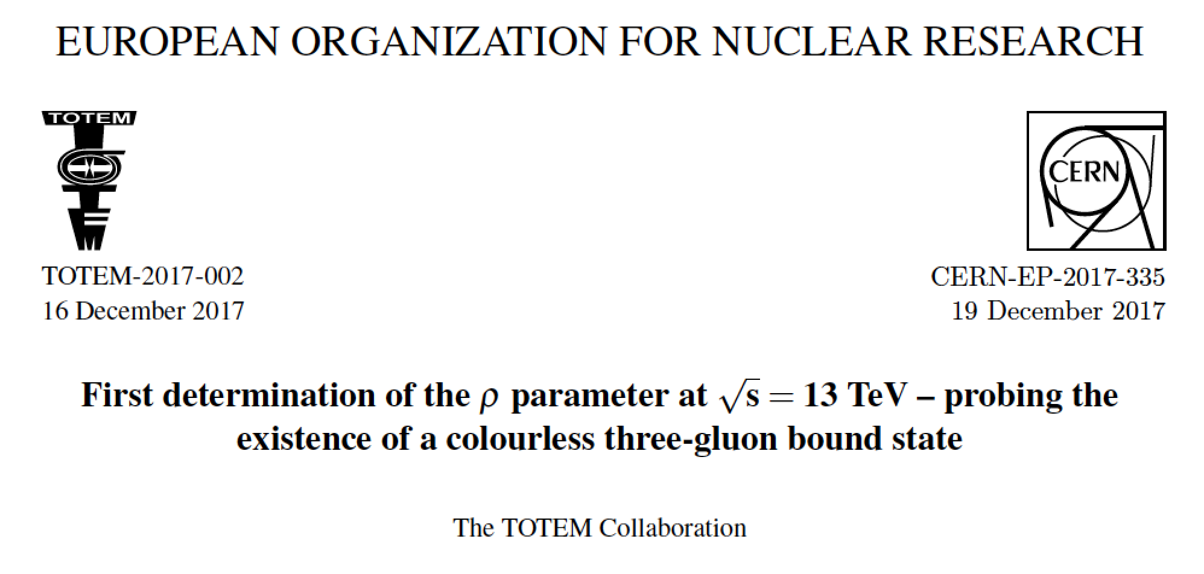
Did TOTEM
Discover the Odderon?

Slide 48
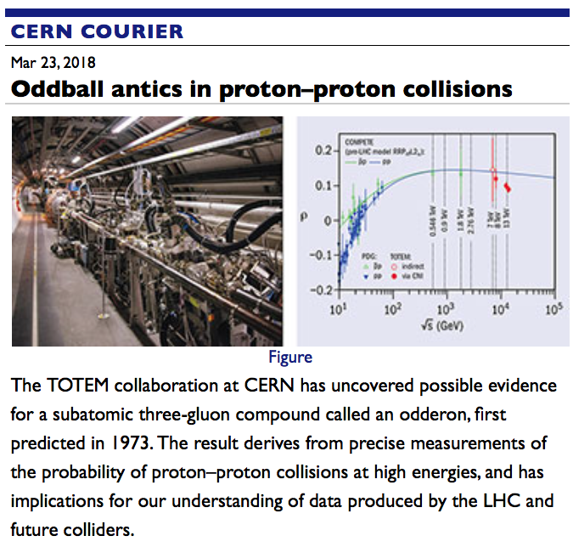
Did TOTEM
Discover the Odderon?

Slide 49
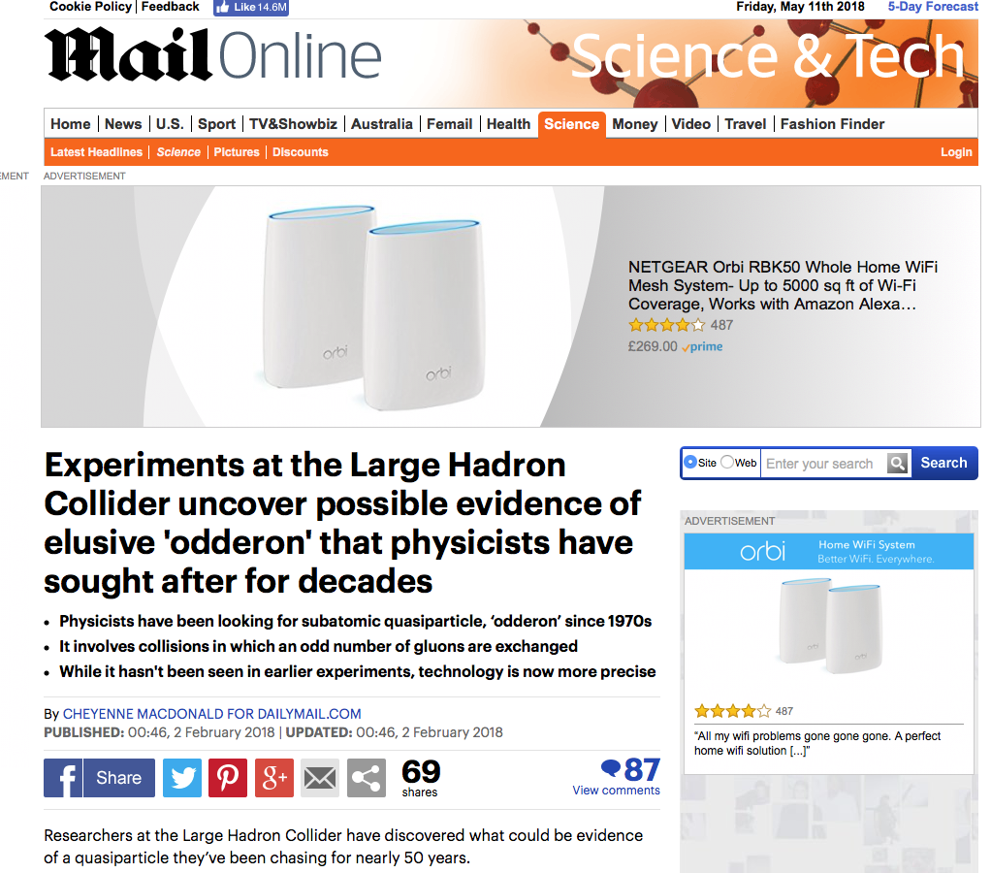
Did TOTEM
Discover the Odderon?

Slide 50

Did TOTEM
Discover the Odderon?
[Should you believe anything you read in the Daily Mail?]

Slide 51
Did TOTEM
Discover the Odderon?
… maybe …

Slide 52
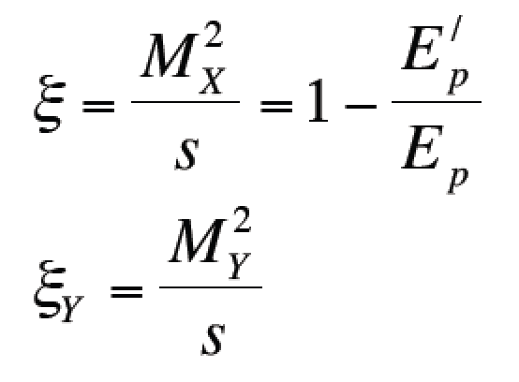
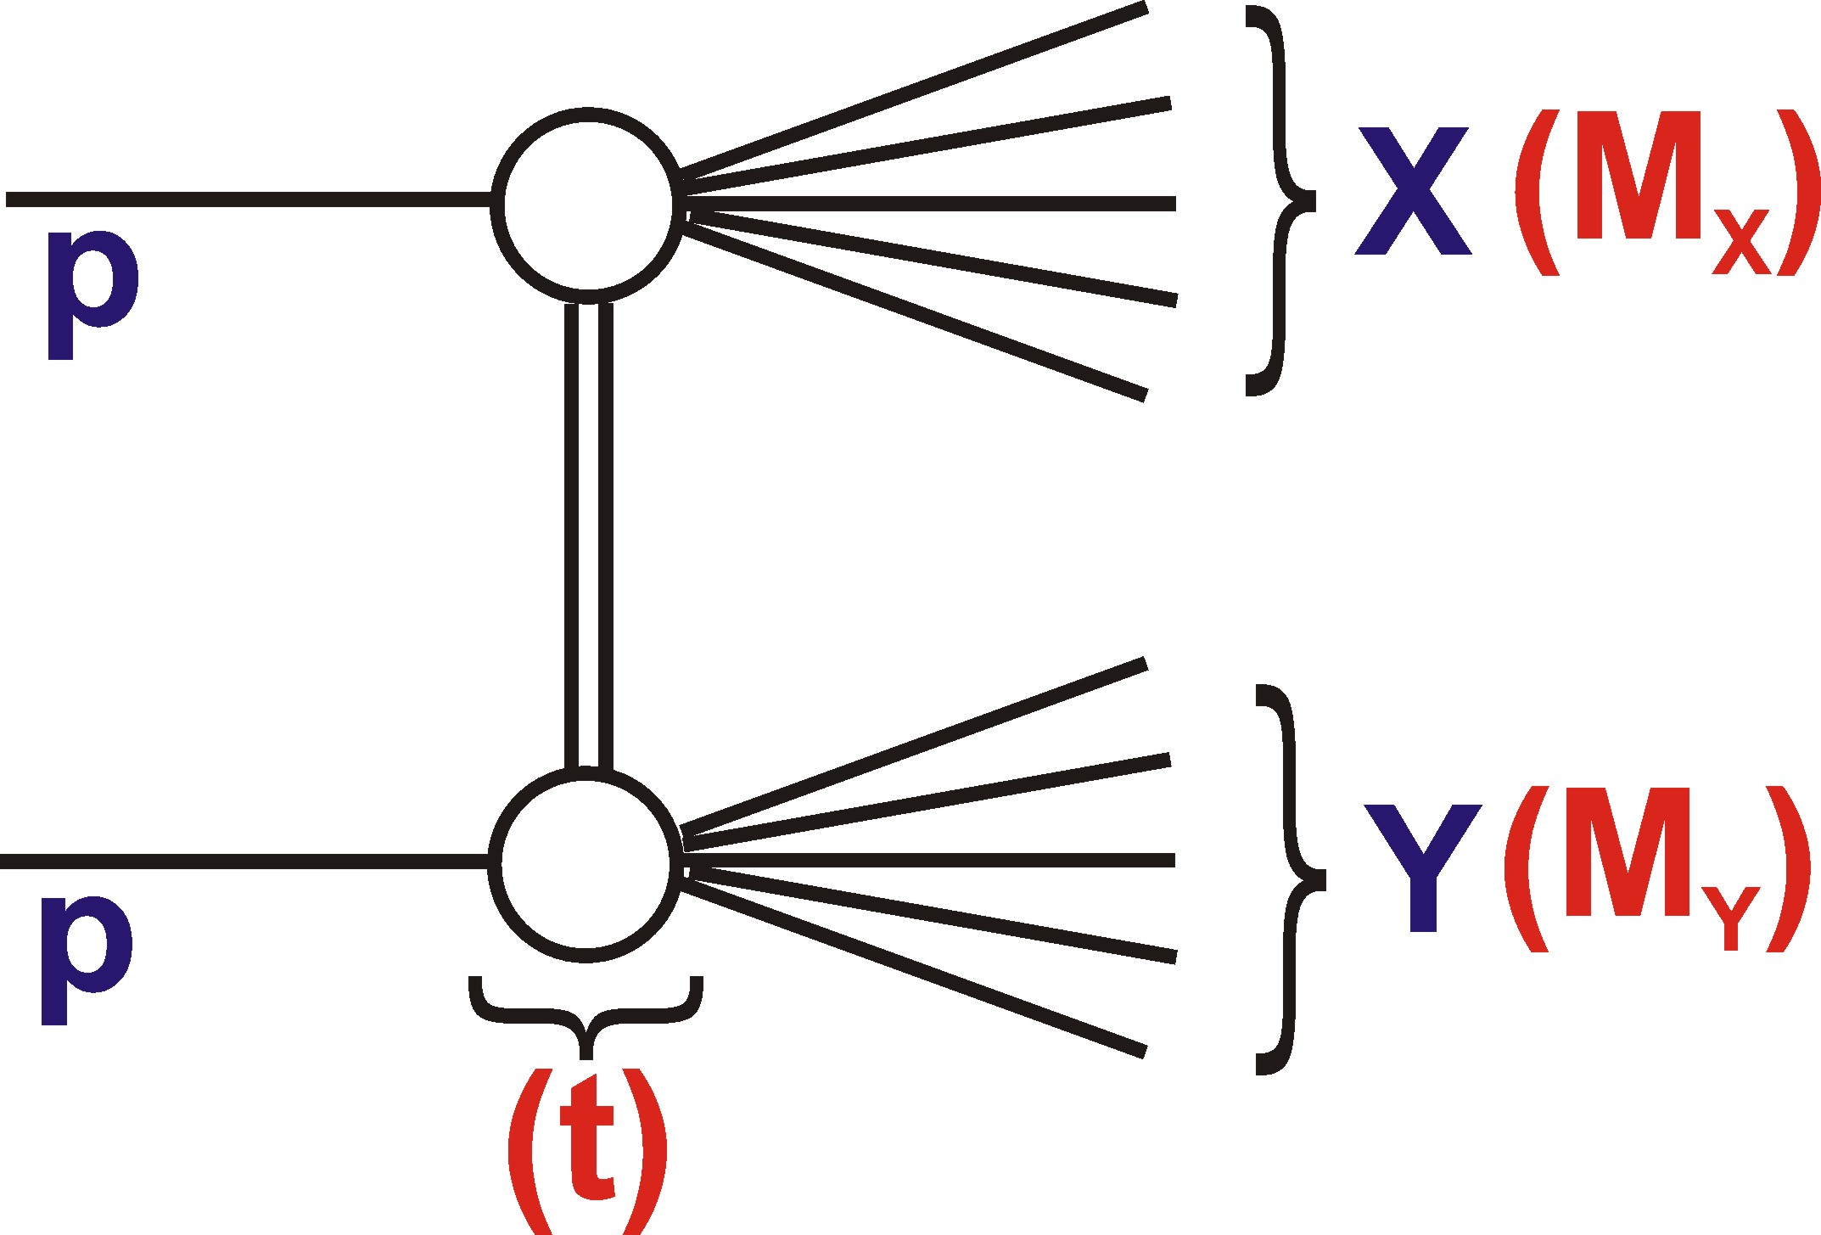
Inelastic Diffraction
Single diffractive dissociation
Additional kinematic variables:
‘
Double diffractive dissociation
At LHC, M_{X}, M_{Y} can be as large as
1 TeV in soft diffractive processes
… very poorly predicted pre-LHC

Slide 53
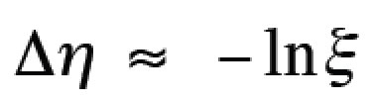
Diffractive Channels:
& Rapidity Gap Kinematics
ξ
- Protons not tagged directly
- $ξ={M_{X}^{2}}/s$ is strongly correlated with
empty rapidity regions
… exploited in all SD measurements to be shown
- Correlation limited by hadronisation fluctuations

Slide 54
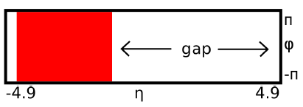
Rapidity gap cross-sections
Method developed by
ATLAS to measure hadron
Level cross section as a
function of Δη^{F}: forward
or backward rapidity gap
extending to limit of
instrumented range:
i.e. including η= ±4.9
… no statement on |η| > 4.9
… large Δη^{F} sensitive to
SD + low M_{Y} DD
Δη^{F}
Δη^{F} ~ 6 event in ATLAS
Implies ξ~10⁻⁴

Slide 55
CMS and ATLAS Rapidity Gap Data
Using very early LHC runs at 7 TeV (avoiding pile-up) …
ATLAS: Δη^{F} extends from η= ±4.9 to 1st particle with p_{t}>200 MeV
CMS: Δη^{F} extends from η= ±4.7 to 1st particle with p_{t}>200 MeV
Small gaps
dominated
by non-
diffractive
processes
… exponentially
suppressed and
sensitive to hadronisation
fluctuations / underlying event
Large gaps
dominated
by diffractive
processes …
characteristic
plateau
Roughly 1mb per
unit gap size

Slide 56
Large Gap Region compared with Models
ξ_{X} ~ 10⁻⁵
ξ_{X}~ 10^{-2.5}
- Most models take `triple Regge’ approach:
Large differences between models due to assumptions on total
diffractive cross sections, α(t) and fragmentation modelling.
- Fit to large Δη^{F} data: α_{IP}(0) = 1.058 ± 0.003 (stat) ± 0.036 (syst)

Slide 57
SD Cross Section with Direct ξ Measurement
- Directly reconstruct ξ using
particle flow algorithm and
cunning kinematics.
Compatible with α_{IP}(0) = 1.08
Precision limited by unfolding
SD and DD → Need proton tagging!

Slide 58
Inelastic Diffraction at the Parton Level
P (920 GeV)
e (27.5 GeV)
HERA,
(1992-
2007)
HERA ep Collider:
Virtual photon probes pomeron
partonic structure rather like
inclusive DIS …
>100 papers later …

Slide 59
Hard Diffraction: Structure of Vacuum Exchange
Quarks
Gluons
Diffractive DIS at HERA →
Diffractive parton densities
(DPDFs) dominated by gluon, which extends to large momentum fractions
… NLO predictions based
on HERA DPDFs give
impressive description of
all HERA ‘hard’ diffractive
data, eg jet production …
→ DPDFs used in many models in pp

Slide 60
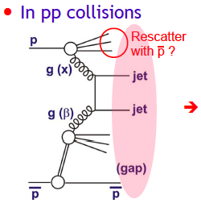
… but in pp(bar)
Spectacular failure in
comparison of Tevatron
proton-tagged diffractive dijets with
HERA DPDFs [PRL 84 (2000) 5043]
… rescattering (absorptive corrections / related to Multi Parton Interactions …) breaks factorisation …
`rapidity gap survival probability’ ~ 0.1
Gap survival probability needs to be
understood to interpret all LHC hard diffraction data.
Here: First results from LHC:
… dijets with large rapidity gaps …
(ξ)

Slide 61
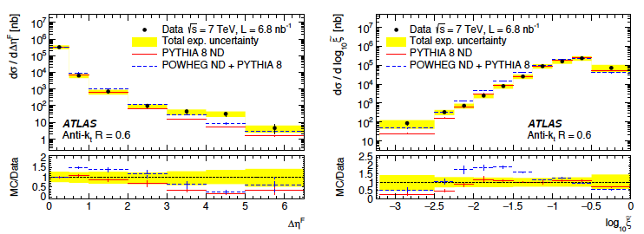
Diffractive
Dijets (p_{T}>20 GeV) from ATLAS
Δη^{F}
- Kinematic suppression of large gaps → no
clear diffractive plateau (unlike minimum bias case)
- ND models matched to small gap sizes give
contributions compatible with data up to
largest Δη_{F} and smallest ξ … no clear diff signal …

Slide 62
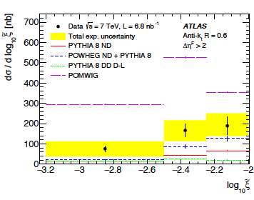

Evidence for Diffractive Contribution
Focusing on small ξ, whist simultaneously requiring large gap size (Δη_{F} > 2) gives best sensitivity to diffractive component
Models with no diffractive jets are below data by factor >~3
Comparison of smallest
ξ with DPDF-based model
(POMWIG) leads to rapidity
gap survival probability
estimate …
Model dependence not
investigated in detail
- In context of POMWIG,
using anti-k_{T} with R=0.6:
Gap
Survival
Factor

Slide 63
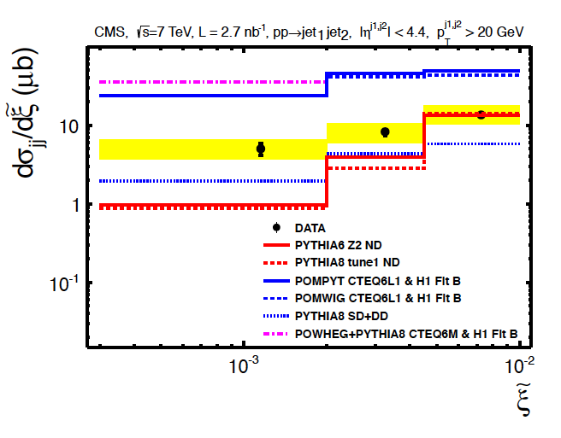
Similar CMS Analysis
Comparison of 1st bin v
diffractive DPDF models
Gap survival probability
estimate S² = 0.08 ± 0.04
(based on NLO POWHEG)
… LHC results for S²
comparable to Tevatron,
but different x range
… larger than expected?
Gap
Survival
Factor
ND
Models
Proton tagged data required for substantial further progress
→ removing complications from double dissociation and
non-diffractive events with large gap fluctuations

Slide 64


New Generation of Roman Pots
Future LHC diffractive
Physics based on CT-PPS
(CMS/TOTEM) & AFP (ATLAS)
Operated in Run 2 and will
remain in Run 3 (and possibly be upgraded for HL-LHC)
- Precision (fairly) radiation hard silicon pixel spatial detectors
Time of Flight detectors with ~ 25ps timing precision from Cerenkov light in diamond (CT-PPS) and quartz (AFP)
Operate in normal LHC runnning conditions
Optimised for double proton-tagged
processes, where vertex can be located
to ~1mm from proton ToF, suppressing pile-up

Slide 65


Newly Accessed Physics with Double Tags
Inclusive central production
pomeron-pomeron hard scattering with jets,
heavy flavour, W, Z signatures
Central Exclusive QCD Production
of dijets, γ-jet and other strongly
produced high mass systems
Two photon physics → exclusive
dileptons, dibosons & anomalous
multiple gauge couplings, exclusive
t-tbar?...
Searches for new heavy particles
heavy Higgs recurrencies, pair produced BSM states, axions, vector-like fermions …)

Slide 66

e.g. Exclusive γγ Production
In general …
- QCD production
dominates at low
central system
masses
QED production
(light-by-light)
takes over at larger
central system
masses
- ZZ, WW, γγ final states … Competitive sensitivity to
anomalous quartic gauge couplings in large mass region

Slide 67


Data Collected to Date
CT-PPS fully installed from 2016, AFP from 2017
- Total of 110 fb⁻¹ accumulated by CT-PPS, 81 fb⁻¹ by AFP.
→ Transformational lumi compared with previous Roman potS
→ Commissioning and data understanding ongoing
→ First results obtained (with single tags so far)

Slide 68



AFP Observation of Single
Diffractive Dijet Signal
- Single proton
tagged sample
with ξ measured
in main ATLAS calorimeter
- Strong enhancement in low ξ_{Cal}
diffractive region for AFP-triggered data over MBTS data
+ common pile-up contribution
Low ξ data exhibit expected x-y correlation in AFP pixels and correlation between pixel x position and ξ_{Cal}
→ Clear diffractive signature

Slide 69


First High Lumi Study @ CT-PPS (9.4 fb⁻¹)
γγ → ee or μμ
Single proton tagged (so far)
Dileptons required to be back to back
- Study correlation between ξ from proton
and from l⁺l⁻ pair …
12 μμ events match in ξ (1.5±0.5 background)
8 ee events match in ξ (2.4±0.5 background)
5.1σ
signal
[arXiv:
1803.04496]

Slide 70

Kinematics of Candidate Events
Potential region
for double tagging:
350GeV <~ m(ll) <~ 2TeV
2 electron events were in double tag acceptance, but only
one proton seen due to inefficiencies
- Highest mass events: m(ee) = 917 GeV and m(μμ) = 342 GeV

Slide 71
Summary
Precise elastic & total cross section data
Surprises in energy dependences
Multi-exchanges / absorption play a role
Evidence for odderon under discussion
Diffractive dissociation data
Soft pomeron with intercept as
expected works well
Limited by control over ND gap fluctuations and low M_{Y} DD
Rapidity gap survival probability larger than expected?
Rapidity gap method: further progress requires proton tagging
Undergoing revolution based on high lumi Roman pots
First results from single tagged samples and <10% of run2 lumi
Uncharted QCD territory in exclusive central production
Rare / exotic EW physics and searches with tagged protons

Slide 72
Back-ups Follow

Slide 73
SD Cross Sections with Direct ξ Measurement
ξ
- Use forward calorimeter (CASTOR) tag to help distinguish
SD from DD (sensitive to much lower M_{Y} than central detector).
- Directly reconstruct ξ using
particle flow algorithm and
cunning kinematics.
- Larger uncertainties, but more directly related to dynamics.

Slide 74
CMS Direct ξ Measurement
‘DD’
‘SD’
SD data (small DD admixture M_{Y} <~ 3 GeV) compatible with
PYTHIA8 with α_{IP}(0) = 1.08 or 1.104
Precise DD data (3.2 < M_{Y} < 12 GeV) prefer α_{IP}(0) = 1.08
… precision still limited by SD / DD unfolding → need p tags!

Slide 75

Direct Measurement of Total
(Inelastic) Cross Section
Extraction of total cross section only via elastic measurement
and optical theorem requires a more `direct’ consistency check
Total inelastic cross section can be measured either from σ_{tot} – σ_{el}
or directly by counting (almost) “all” events with a minimum bias
trigger
… eg collect events using ATLAS
Minimum Bias Trigger Scintillators
(MBTS) z = ± 3.6m, 2.1 < |η| < 3.8
see 90-95% of all inelastic events
[similar techniques in all main
LHC experiments]
MBTS

Slide 76


Inelastic Cross Section Measurements
13 TeV result:
Direct and indirect results compatible and
indirect result in agreement with indicative
selection of models
Comparisons limited by extrapolation to low
mass diffractive dissociation (unseen by MBTS for ξ <~ 10⁻⁶)
ξ

Slide 77

Perturbative Odderon in Elastic Scattering at large|t| ?
?
Larger |t| perturbative region consistent with power law ~t⁻⁸
No evidence for further secondary structure … suggests a single
perturbative mechanism (2 or 3 g?).
Evidence for Odderon production, interfering with pomeron
to create the dip?

Slide 78


Looking in more detail (TOTEM 8 TeV, 13 TeV)
eg 2012 β*=90m 8TeV sample is 7 million events →
single exponential slope rejected at 7.2σ level
… suggests that low
|t|(non-perturbative)
elastic scattering via
strong interaction is
not mediated by a
single exchange
(like a pomeron
Regge Pole).

Slide 79



Tuning Monte Carlo Models
Successful description in HERWIG7
(cluster hadronisation + soft
multiple interactions, tuned
to CMS data)
Main remaining question:
how big are DD
and ND
contributions??
CMS
Data, HERWIG tuned
Further significant
progress will require
proton tagging to
unfold SD from DD
and ND
PYTHIA8 untuned
PHOJET untuned

Slide 80

SHRiMPS (MB in SHERPA) Preliminary
These distributions are complementary to particle spectra /
correlations and
dedicated underlying event measurements and should be described by any model that aims to provide a `complete’ minimum bias description
Impressive (but
still not perfect)
description …
[p_{T} > 200 MeV]
[p_{T} > 400 MeV]
[p_{T} > 600 MeV]
[p_{T} > 800 MeV]

Slide 81




… but that was for (old) Standard LHC optics
… First Studies with nominal HL-LHC Optics …
Acceptances for 2x2cm detector @ 15σ+0.5mm, no collimators
233 m
[Janusz Chwastowski, ATLAS]
233m: Reduced ξ acceptance relative to that now in AFP region
324,420m: Attractive ξ acceptance
extending into SM Higgs region and very wide t range at possible
deployment points in cold sections

Slide 82


Extracting Total Cross Section from
Elastic Data
Fixed parameters:
− ρ (~0.14) = ratio of
Re/Im amplitudes at t=0
G = proton electric form factor
- φ = phase of Coulomb-nuclear
interference at t=0
- Fit 0.014 < |t| < 0.1 GeV²,
where acceptance is large and
theory uncertainty is small
Influence of interference small.
Hadronic region compatible
with pure exponential: ~ e^{Bt}
- Total hadronic cross section
emerges via fit normalisation

Slide 83


Total SD, DD Cross Secs as Function of √s
CMS: integration over ξ
ALICE: Integrated SD, DD
cross secs at three √s
based on gap rates and
topologies
… Extrapolations into lowest
and highest ξ regions
− σ(SD) with ξ < 0.05
σ(DD) with gap Δη > 3
- Good agreement with
SPS data and predictions
with modest rise with
energy → smallish α_{IP}(0)

Slide 84


W and Z events with gaps at CMS
After pile-up corrections, ~1% of W and Z events exhibit
no activity above noise thresholds over range 3 < ±η < 4.9
… interpretation complicated by non-diffractive
hadronisation fluctuations …
(= 4.9 – Δη) end-point of gap - starting at acceptance limit

Slide 85

Gap-Lepton η Correlation for W bosons
Lepton pseudorapidity
with + sign if lepton
in same hemisphere
as gap, else – sign.
Fit to combination of
PYTHIA and POMPYT
hard diffraction model
suggests significant
(~50%) diffractive
contribution
Surprisingly large?…
Interpretation in terms
of cross section or gap
survival pending …

Slide 86

CMS Dijets with Low ξ
Uncorrected
data prior
to rapidity
gap selection
Diffractive signal required at low ξ (Data > PYTHIA ND)
Fit linear combination of PYTHIA (ND) and POMPYT /
PYTHIA8-SD+DD (DPDF-based diffractive models)
→ Best description from PYTHIA6 with POMPYT x 0.23
→ PYTHIA8, SD/DD contribution has to be multiplied by
a factor ~2.5 and still gives inferior description

Slide 87


Uncertainties in pre-LHC Predictions
Single dissociation Double dissociation
σ = 14mb (PYTHIA8)
σ = 10mb (PHOJET)
σ = 9mb (PYTHIA8)
σ = 4mb (PHOJET)
Parameterisations based on old
low energy data, particularly poor
for DD
… and
where
does DD
stop and
ND start
anyway?...
sqrt(s) = 19.6 GeV
[PHOJET: hep-ph/9803437]
SD
DD

Slide 88

CMS Measurement of Large Mass DD
Data with central gap (Δη > 3, within CMS acceptance) constrain
DD cross section at large M_{X} (>10 GeV) and M_{Y} (>10 GeV)
Again compatible with PYTHIA8 with α_{IP}(0) = 1.08 or 1.104
  … increasingly detailed SD and DD data → challenging theory

Slide 89




Ultraperipheral J/Ψ Photoproduction,
& the Low x Gluon Density of the Proton
… LHC’s “near
misses”
LHC protons / ions as source of photons:
VM photoproduction …
Experimentally very simple
Sensitivity to square of gluon density
at lowest order

Slide 90




Exclusive J/Ψ Production in pp at LHCb
Coherent signal extracted by fitting t (~p_{T}²) distribution …
[uncertainties hard to evaluate]
Background (red)
Signal (green)

Slide 91


Ultra-peripheral J/Ψ in pp at LHCb
Ambiguity on whether forward J/Ψ is produced by high
energy photon and low energy gluons or vice versa
… dealt with on a statistical basis
Very interesting kinematic range …
… HERA power law dependence persists to large W / low x
γp CMS energy,

Slide 92


Ultra-peripheral J/Ψ in pPb at ALICE
Pb ion provides prolific source of photons (~Z²) …
… removes ambiguity → γp 95% of the time, γPb only 5%
Compatible with power law (= monatomic low x gluon) up
to W~700 GeV

Slide 93

… and in PbPb
Using γPb collisions to probe the nuclear gluon density
… almost completely unknown, especially at low x …

Slide 94



Exclusive J/Ψ Production in AA at ALICE
Beautifully clean
signature
Separating out
coherent part again
a complicated issue

Slide 95


Exclusive J/Ψ Production in AA at ALICE
x~10⁻³
x~10⁻²
Remarkable discrimination (best agreement with EPS09
model which incorporates nuclear shadowing).
x values relatively large (forward production
dominated by high x gluon and low energy photon).

Slide 96



Other Vector Mesons in AA at ALICE
Qualitatively similar
picture emerging from
Ψ(2S) and ρ mesons

Slide 97



Rapidity Gaps?
Δη^{F} defined by size of empty
region between edge of
calorimeter acceptance
and first calorimeter
cell above noise threshold
or central track.
Clear enhancement of high
Δη^{F} tail in AFP-triggered
data
Correlation between
proton-tags and gaps as expected.

Slide 98





Measurement Principle
Main detectors (MD) are 2x10 layers of 0.5mm² square scintillating fibres per pot.
Elastically scattered protons characterised by back-to-back topology (anti-correlation
in x and y between A and C sides of ATLAS)
At high β*, parallel-to-
point focusing in vertical
plane…
- Beam: p=3988±26 GeV
- θ* from y coordinate and
knowledge of beam optics

Slide 99


ATLAS
Both measurements
rely on minimum bias
samples triggered using
the MBTS scintillators
z = ± 3.6m, 2.1 < |η| < 3.8
Run 1 version had 2 x 8-fold segmentation
Replaced for Run 2 – 8 fold segmentation
nearest beam-pipe, 4-fold further out

Slide 100

Cross Section in Fiducial Range
Correction factor
to reach fiducial
region ξ<10-6
is 0.7%
1.9% luminosity
uncertainty (from
Van der Meer scans)
- Donnachie-Landshoff implmentation in PYTHIA8 consistent with
data within ~2σ for α_{IP}(0) = 1.06 … 1.14
- EPOS, QGSJET, PYTHIA8 S&S (α_{IP}(0) = 1) exceed result by >2σ

Slide 101

Extrapolation to Full Inelastic Cross Sec
Data-driven extrapolation into region with ξ < 10⁻⁶, with
minimal dependence on MC models:
from ALFA result
previous fiducial MBTS result
=
… extrapolation uncertainty is 2.5 mb, dominates in
total inelastic cross section measurement

Slide 102




What we can’t see: low mass diffraction
Acceptance limit of MBTS
(|η|<~ 4) corresponds to ξ ~ 10⁻⁶
Cross section for ξ < 10⁻⁶
poorly constrained

Slide 103


Simultaneous Modelling of soft SD and EL?
[Khoze, Martin, Ryskin,
arXiv:1201.6298]
… simultaneous Durham (KMR) description of ATLAS gaps data
and elastic cross section data from ISR to Totem based on
a single pomeron in a 3-channel eikonal model, with
significant absorptive corrections in gaps / dissociation case

Slide 104

Large Gaps and
Diffractive Dynamics
Diffractive plateau with ~ 1 mb per unit of gap size for Δη^{F} > 3
Broadly described by models
α_{IP}(0) = 1.058 ± 0.036 (ATLAS fit)
Further significant progress
will require proton tagging to
unfold SD from DD and ND

Slide 105

Models
- POMWIG: Dedicated hard diffraction
model with standard factorisable pomeron
approach:
Cross section ingredients are proton PDFs,
pomeron Flux and DPDFs
PYTHIA8: Inclusive model with hard
and soft ND, DD and SD contributions;
smoothly interfaced.
Both models use HERA DPDFs (H12006-FitB)
- Neither model includes rapidity gap destruction effects
- Alternative ND model from POWHEG-NLO interfaced to PYTHIA

