Slide 1
Useful Statistical Methods in Designing Superconducting Magnets
V. Calvelli
10/01/2020

Slide 2
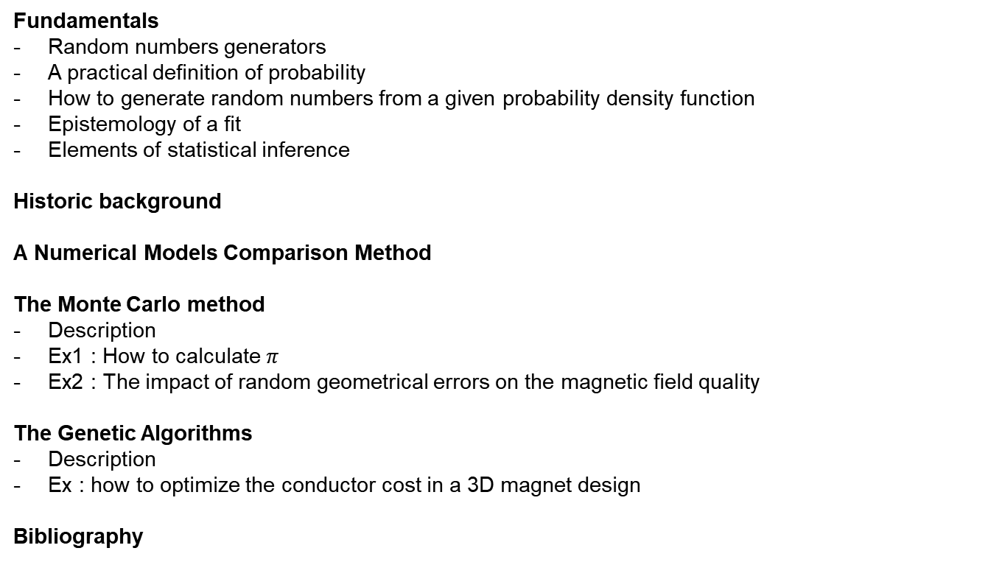
Summary
Fundamentals
Random numbers generators
A practical definition of probability
How to generate random numbers from a given probability density function
Epistemology of a fit
Elements of statistical inference
Historic background
A Numerical Models Comparison Method
The Monte Carlo method
Description
Ex1 : How to calculate $π$
Ex2 : The impact of random geometrical errors on the magnetic field quality
The Genetic Algorithms
Description
Ex : how to optimize the conductor cost in a 3D magnet design
Bibliography

Slide 3
Random Numbers,
Probability and Elements of Inferential Statistics

Slide 4
How to generate random numbers
Hardware random number generator (HRNG)
Use of physical phenomena to generate numbers by chance
Ex:
Thermal noise
Cosmic background radiation
Electro-magnetic noise
These are natural sources of random numbers
Generally used to assess the noise in a measure
Pseudo-random number generator (PRNG)
Use of mathematic formules to generate « look-like » random numbers
Used in simulations

Slide 5
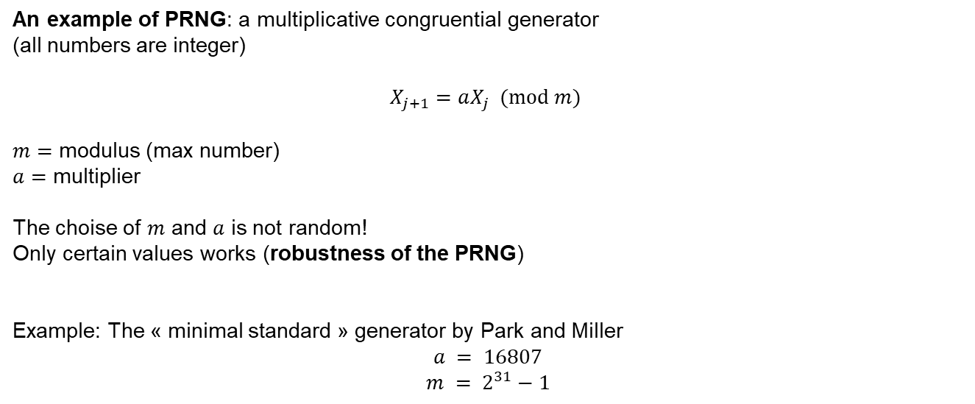
Pseudo-random number generators
An example of PRNG: a multiplicative congruential generator
(all numbers are integer)
$$X_{j+1}=aX_{j} (mod m)$$
$m=$ modulus (max number)
$a=$ multiplier
The choise of $m$ and $a$ is not random!
Only certain values works (robustness of the PRNG)
Example: The « minimal standard » generator by Park and Miller
$$a = 16807$$
$$m = 2^{31}−1$$
H. Press et all. (1992)

Slide 6
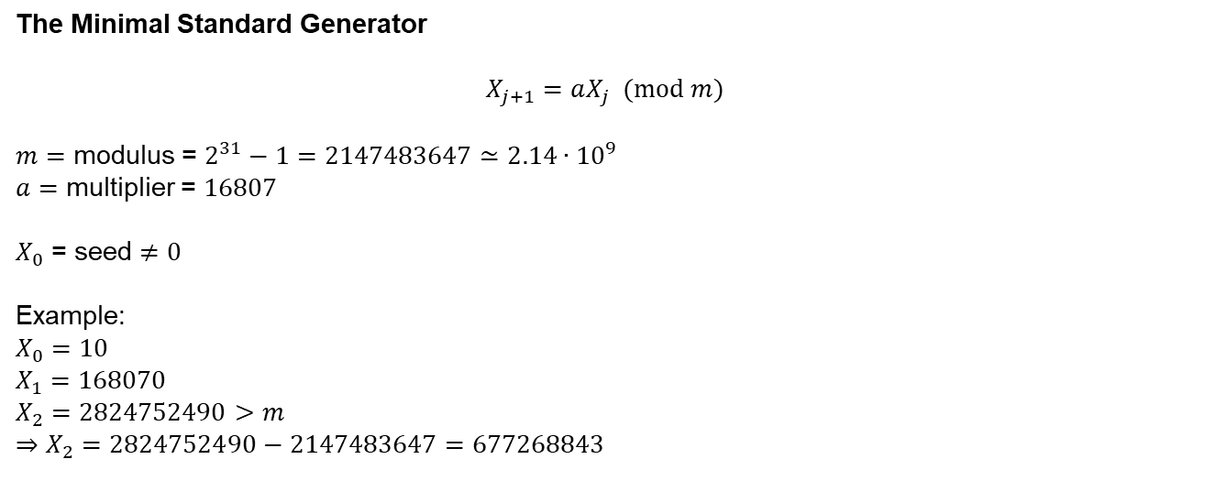
The Minimal Standard Generator: how it works
The Minimal Standard Generator
$$X_{j+1}=aX_{j} (mod m)$$
$m=$ modulus = $2^{31}−1=2147483647≃2.14∙{10}^{9}$
$a=$ multiplier = $16807$
$X_{0}$ = seed $≠0$
Example:
$$X_{0}=10$$
$$X_{1}=168070$$
$$X_{2}=2824752490>m \\ ⇒X_{2}=2824752490−2147483647=677268843$$

Slide 7
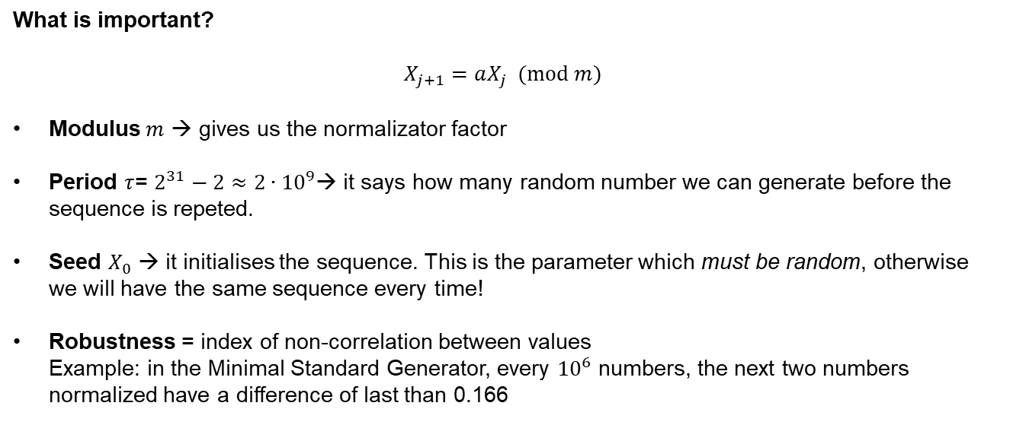
The Minimal Standard Generator: how it works
What is important?
$$X_{j+1}=aX_{j} (mod m)$$
Modulus $m$ → gives us the normalizator factor
Period $τ$= $2^{31}−2≈2∙{10}^{9}$→ it says how many random number we can generate before the sequence is repeted.
Seed $X_{0}$ → it initialises the sequence. This is the parameter which must be random, otherwise we will have the same sequence every time!
Robustness = index of non-correlation between values
Example: in the Minimal Standard Generator, every ${10}^{6}$ numbers, the next two numbers normalized have a difference of last than 0.166

Slide 8
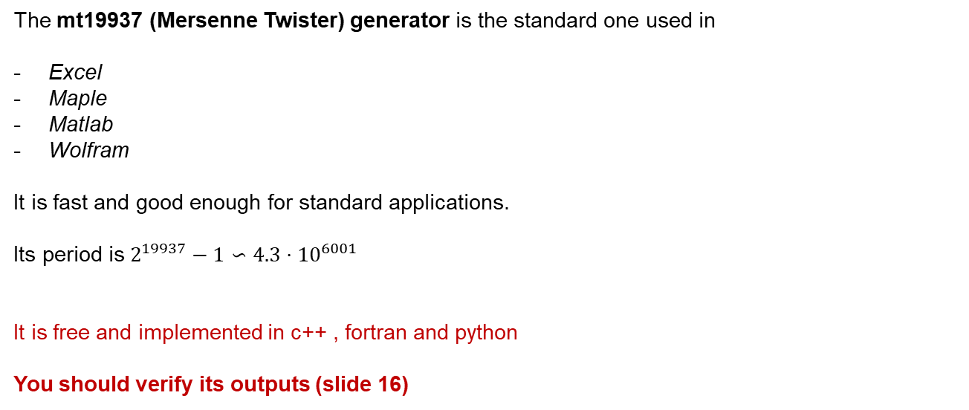
Best to use for standard applications
The mt19937 (Mersenne Twister) generator is the standard one used in
Excel
Maple
Matlab
Wolfram
It is fast and good enough for standard applications.
Its period is $2^{19937}−1∽4.3⋅10^{6001}$
It is free and implemented in c++ , fortran and python
You should verify its outputs (slide 16)
Matsumoto, M. (1998)

Slide 9
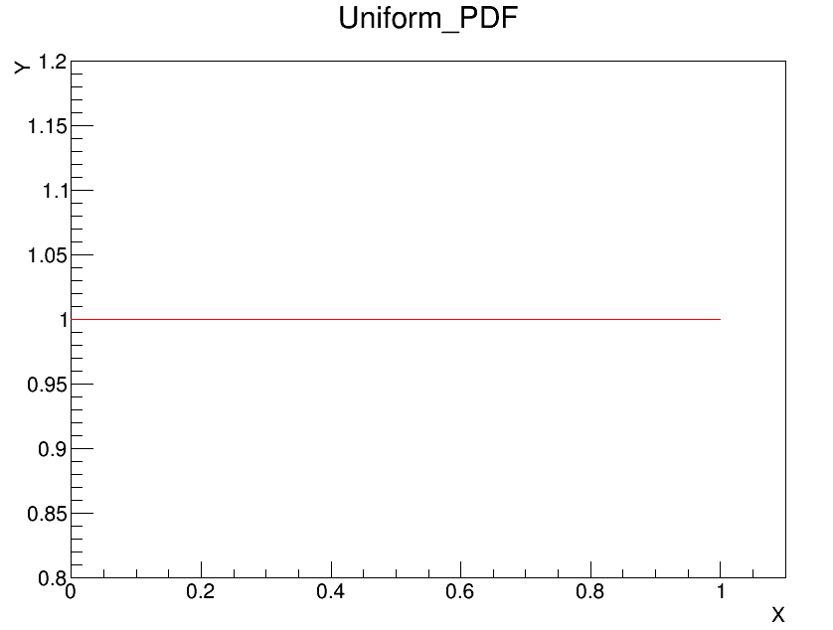
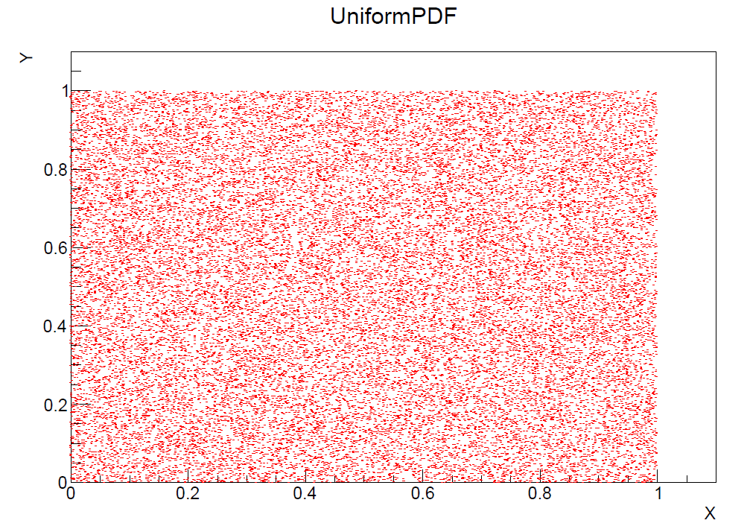
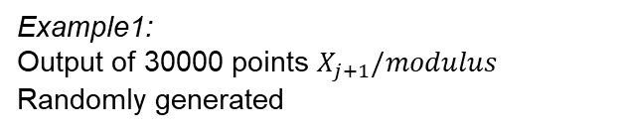
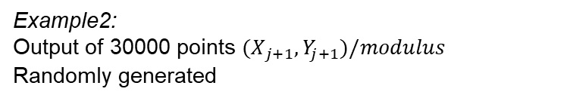
Towards probability distributions
Example1:
Output of 30000 points $X_{j+1}/modulus$
Randomly generated
Example2:
Output of 30000 points ${(X}_{j+1},Y_{j+1})/modulus$
Randomly generated
When we divide by modulus we obtain numbers between [0,1]

Slide 10
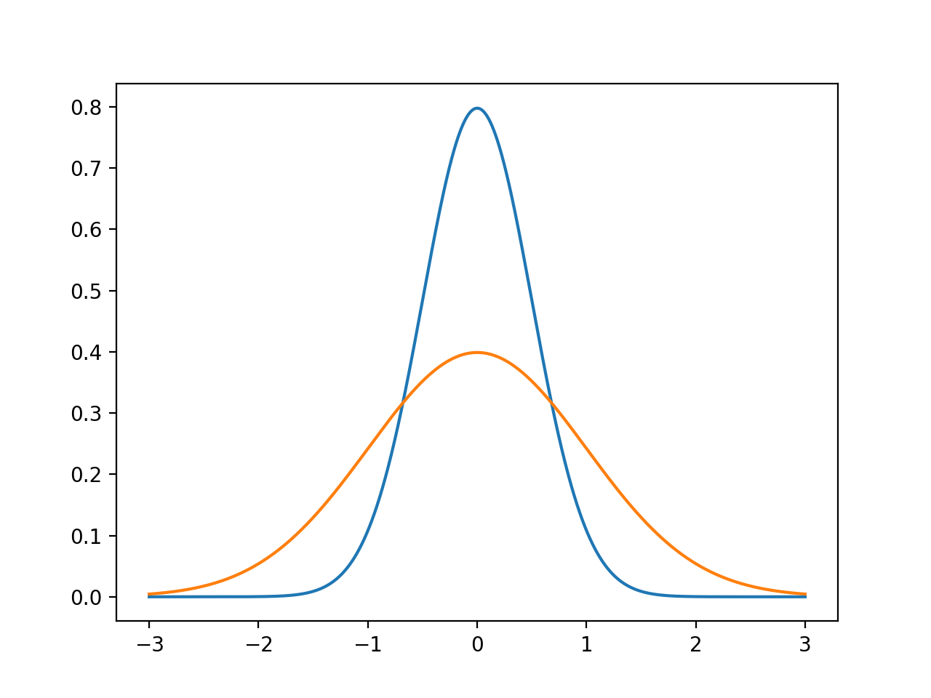


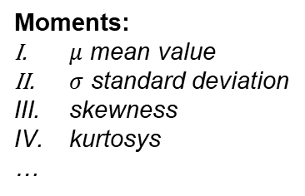
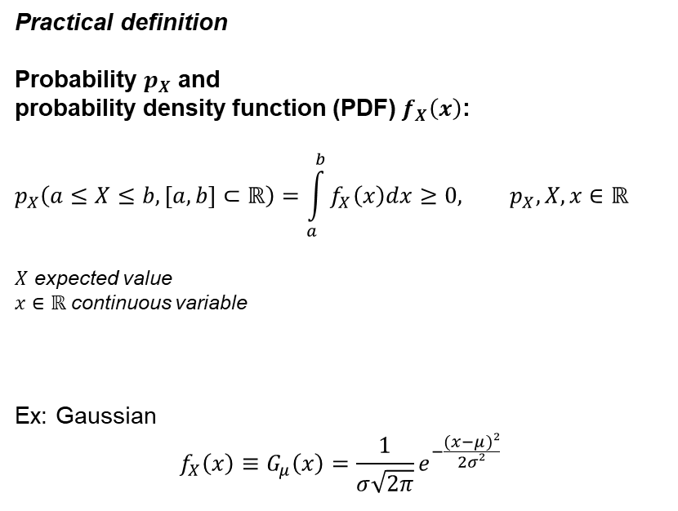





Random numbers and probability:
The probability density function
How to rely random numbers to probability?
$$μ$$
$$f_{X}(x)$$
Practical definition
Probability $p_{X}$ and
probability density function (PDF) $f_{X}\left(x\right)$:
$$p_{X}\left(a≤X≤b, [a,b]⊂ℝ\right)=\int_{a}^{b}{f_{X}\left(x\right)dx}≥0, p_{X},X,x∈ℝ$$
$X$ expected value
$x∈ℝ$ continuous variable
Ex: Gaussian
$$f_{X}\left(x\right)≡G_{μ}\left(x\right)=\frac{1}{σ\sqrt{2π}}e^{−\frac{(x−μ)²}{2σ²}}$$
$$σ→p_{X}=1/3$$
$$p_{X}$$
$$a$$
$$b$$
$$x$$
Moments:
$μ$ mean value
$σ$ standard deviation
skewness
kurtosys
…

Slide 11
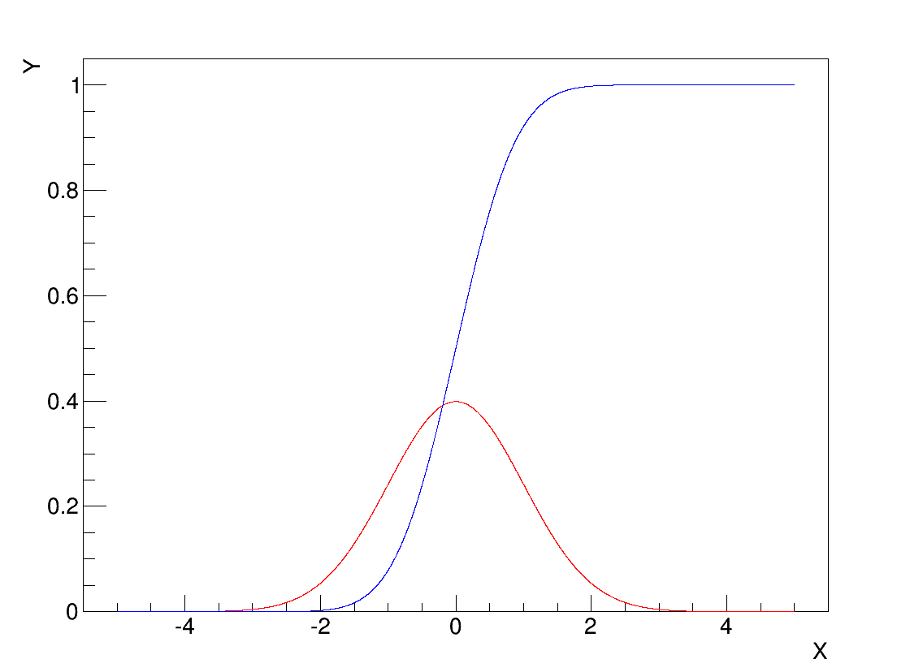
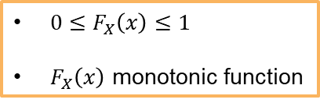
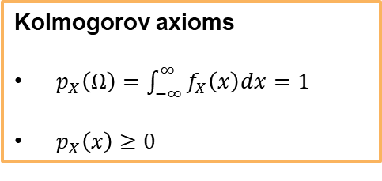
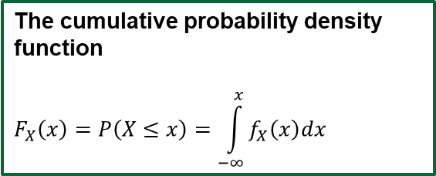
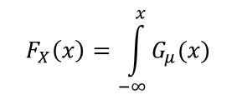

Random numbers and probability:
The cumulative probability density function
Kolmogorov axioms
$p_{X}\left(Ω\right)=\int_{−∞}^{∞}{f_{X}\left(x\right)dx}=1$
${ p}_{X}\left(x\right)≥0$
$0≤F_{X}\left(x\right)≤1$
$F_{X}\left(x\right)$ monotonic function
$$F_{X}\left(x\right)=\int_{−∞}^{x}{G_{μ}(x)}$$
The cumulative probability density function
$$F_{X}\left(x\right)=P\left(X≤x\right)=\int_{−∞}^{x}{f_{X}\left(x\right)dx}$$
$$G_{μ}\left(x\right)$$

Slide 12

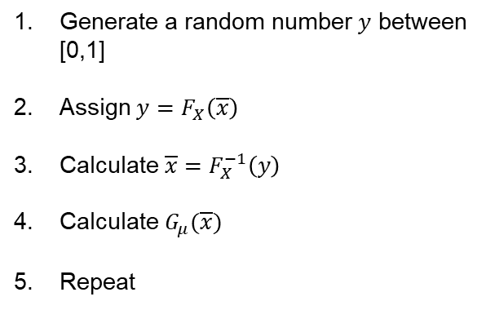

Random numbers and probability:
The transformation method
How to simulate a random probability distribution according to
a given probability density function?
$$F_{X}\left(x\right)$$
Generate a random number $y$ between [0,1]
Assign$y=F_{X}\left(\overline{x}\right)$
Calculate $\overline{x}=F_{X}^{−1}\left(y\right)$
Calculate $G_{μ}(\overline{x})$
Repeat
$$G_{μ}\left(x\right)$$

Slide 13
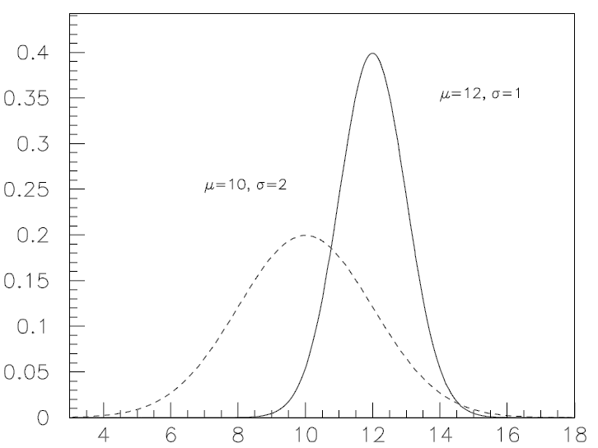
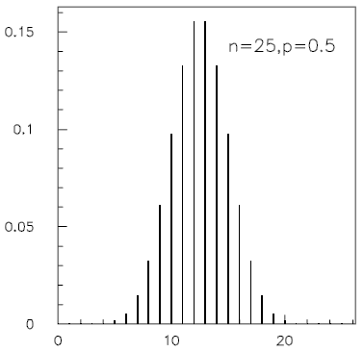

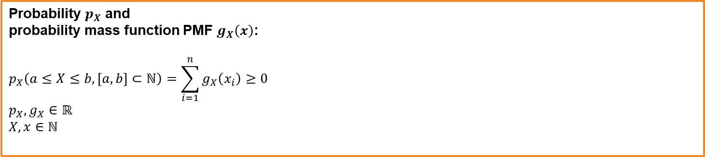
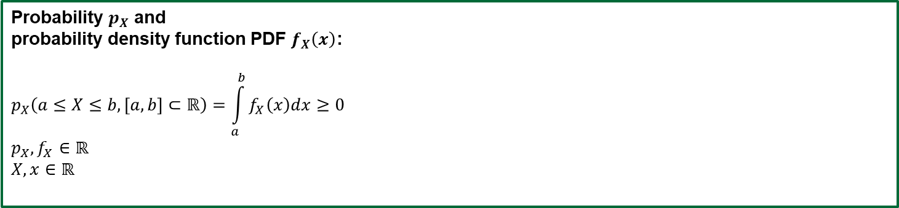

Probability / Distributions / Functions…
A problem of vocabulary ? Not only
Distribution of probability
Probability $p_{X}$ and
probability density function PDF $f_{X}\left(x\right)$:
$$p_{X}\left(a≤X≤b, [a,b]⊂ℝ\right)=\int_{a}^{b}{f_{X}\left(x\right)dx}≥0$$
$$p_{X},f_{X}∈ℝ$$
$$X,x∈ℝ$$
continuous variable
$$dp_{X}≡f_{X}\left(x\right)dx$$
Probability $p_{X}$ and
probability mass function PMF $g_{X}\left(x\right)$:
$$p_{X}\left(a≤X≤b, [a,b]⊂ℕ\right)=\sum_{i=1}^{n}{g_{X}\left(x_{i}\right)}≥0$$
$$p_{X},g_{X}∈ℝ$$
$$X,x∈ℕ$$
discrete variable
$$p_{X_{i}}≡g_{X}\left(x_{i}\right)$$

Slide 14
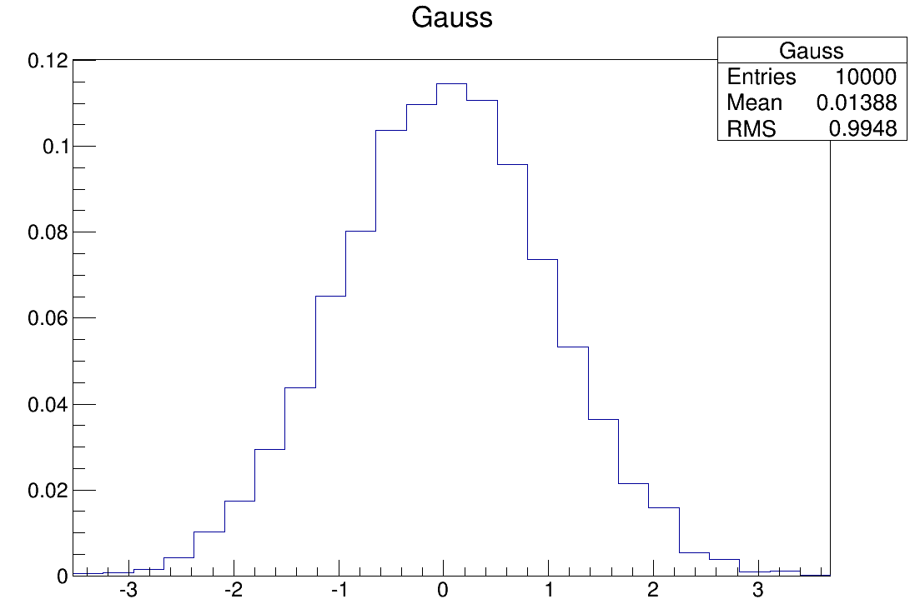
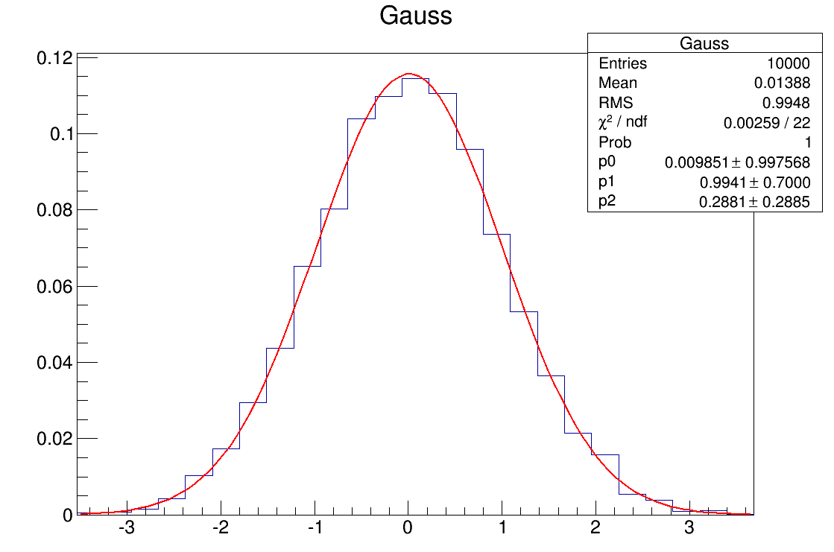


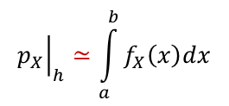


A Problem of Epistemology
In a « real » experiment :
We fit the representation of the data, not the data
Output of the experiment = raw data (sample)
B) Probability Distribution = histogram $h$
(normalized) of my data
C) Probability density function PDF = fit histogram
$$p_{X}≡h_{X}\left(x_{i}\right)$$
$x_{i}≡$ $i$-bin
Problem:
Depends on how good is your fit
bin
$${\left.p_{X}\right|}_{h}≃\int_{a}^{b}{f_{X}\left(x\right)dx}$$
Before saying B is a gaussian distribution, we must verify that $C≡B$

Slide 15


Epistemology of a Fit : a conceptual map
When we fit a series of data, we have 3 different objects:
 |  | FUNCTION | ROLE
A | Data | The real world | The object
B | Representation | How we see it | The subject
C | Fit Function | How we describe it | The language
Hypothesis : $A⟺B$
Logic operation:
Thesis : if $A⟺B$ and $C≡B⟹C⟺A$

Slide 16
Epistemology of a Fit
Same data
Different representation
Same fit
in the cartesian plane every geometric transformation is bijective

Slide 17
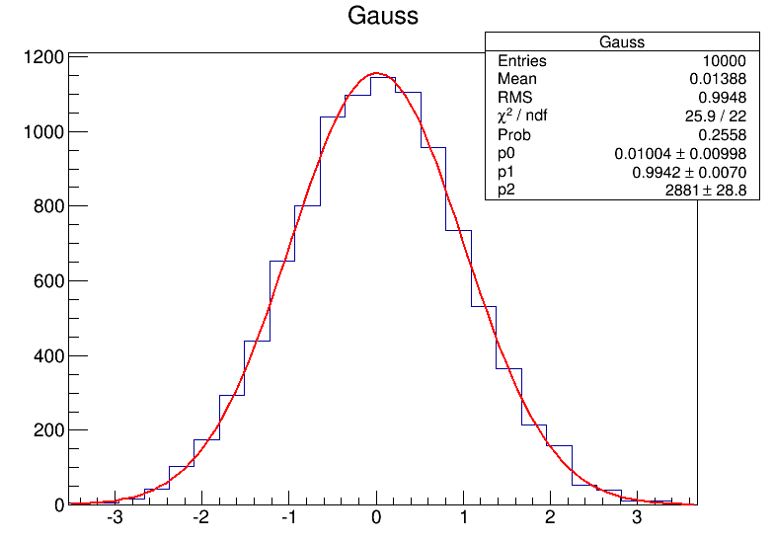
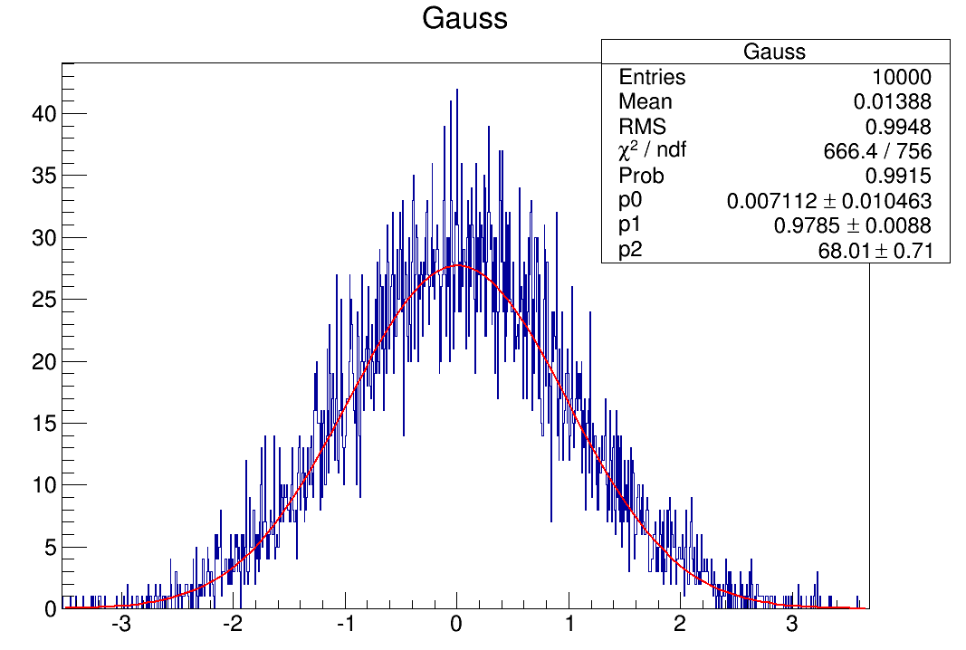
Epistemology of a Fit
Same data
Different representation
Different fit
Bad fit
Good fit
How can we evaluate if a fit is good or not?
Inferential statistic

Slide 18
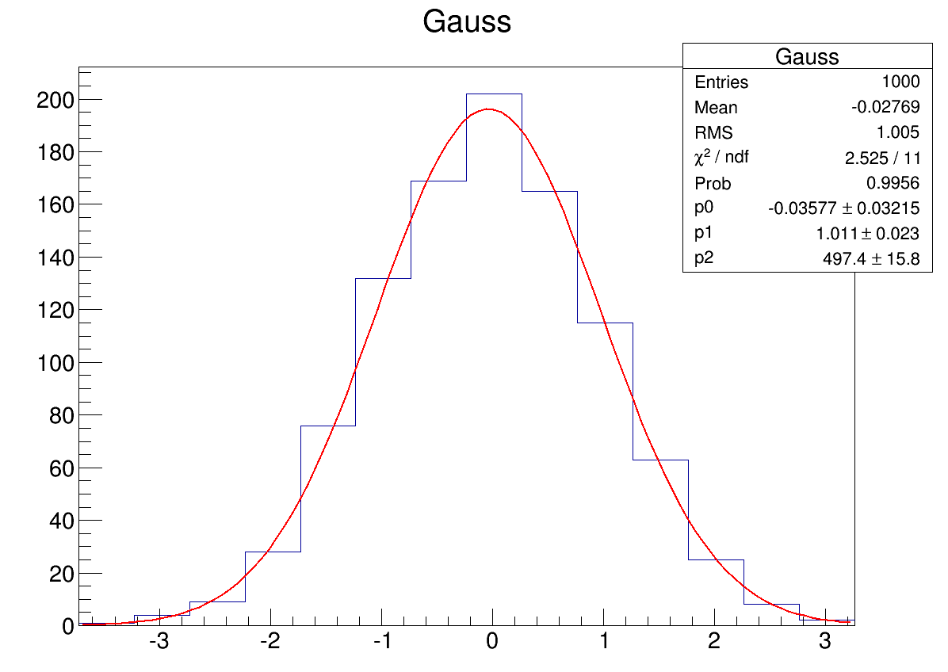
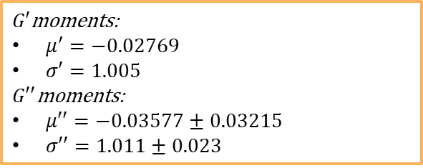


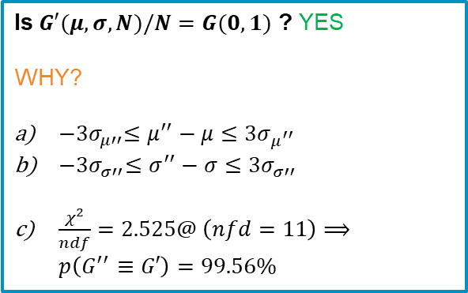
Random numbers and probability:
A Critical Analysis using Inferential Statistic
Let’s simulate a Gaussian distribution $G′(μ,σ,N)$
using a pdf $G(μ=0,σ=1)$ and mt19937 - fit with a pdf Gaussian$G′′(μ,σ,N)$
$G′$moments:
$μ^{′}=−0.02769$
$σ′=1.005$
$G′′$moments:
$μ′′=−0.03577±0.03215$
$σ′′=1.011±0.023$
Result for 1000 random numbers:
$$G′$$
Is$G′(μ,σ,N)/N=G(0,1)$ ? YES
WHY?
${−3σ}_{μ′′}≤μ^{′′}−μ≤3σ_{μ^{′′}}$
${−3σ}_{σ′′}≤σ^{′′}−σ≤{3σ}_{σ′′}$
$\frac{χ^{2}}{ndf}=2.525@ \left(nfd=11\right)⟹p\left(G^{′′}≡G′\right)=99.56\%$
$$G′′$$

Slide 19
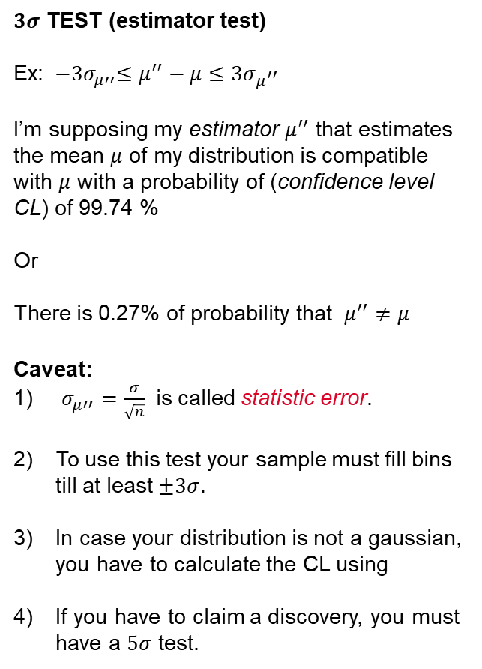
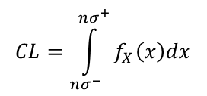


Test to evaluate if the distribution fits a pdf
$3σ$ TEST (estimator test)
Ex: ${−3σ}_{μ′′}≤μ^{′′}−μ≤3σ_{μ^{′′}}$
I’m supposing my estimator $μ^{′′}$ that estimates the mean $μ$ of my distribution is compatible with $μ$ with a probability of (confidence level CL) of 99.74 %
Or
There is 0.27% of probability that $μ^{′′}≠μ$
Caveat:
$σ_{μ′′}=\frac{σ}{\sqrt{n}}$ is called statistic error.
To use this test your sample must fill bins till at least $±3σ$.
In case your distribution is not a gaussian, you have to calculate the CL using
If you have to claim a discovery, you must have a $5σ$ test.
$$G′$$
$$−3σ$$
$$+3σ$$
$$G′′$$
$$CL=\int_{nσ^{−}}^{nσ^{+}}{f_{X}\left(x\right)dx}$$

Slide 20

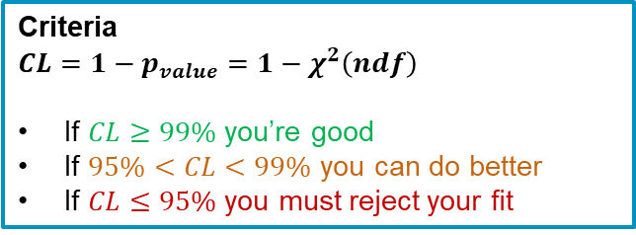

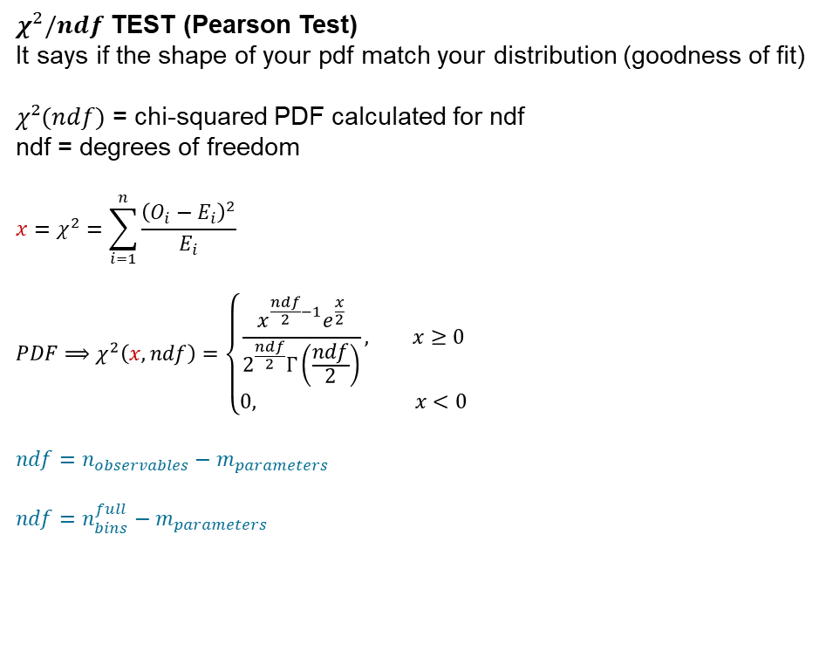

Test to evaluate if a pdf fits a distribution
$χ^{2}/ndf$ TEST (Pearson Test)
It says if the shape of your pdf match your distribution (goodness of fit)
$χ²(ndf)$ = chi-squared PDF calculated for ndf
ndf = degrees of freedom
$$x=χ^{2}=\sum_{i=1}^{n}{\frac{{\left(O_{i}−E_{i}\right)}^{2}}{E_{i}}}$$
$${PDF⟹χ}^{2}\left(x,ndf\right)=\left\{\begin{aligned}\frac{x^{\frac{ndf}{2}−1}e^{\frac{x}{2}}}{2^{\frac{ndf}{2}}Γ\left(\frac{ndf}{2}\right)}, x≥0 \\ &0, x<0\end{aligned}\right.$$
$$ndf=n_{observables}−m_{parameters}$$
$$ndf=n_{bins}^{full}−m_{parameters}$$
$$E_{i}$$
$$O_{i}$$
14 bins
3 fit parameters
Here $χ^{2}\left(11\right)=2.525⟹p_{fit}^{good}=99.56\%$
Criteria
$$CL=1−p_{value}=1−χ^{2}\left(ndf\right)$$
If $CL≥99\%$ you’re good
If $95\%<CL<99\%$ you can do better
If $CL≤95\%$ you must reject your fit

Slide 21
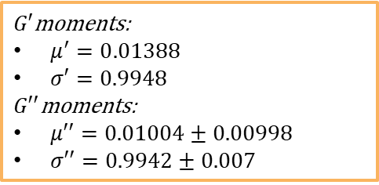

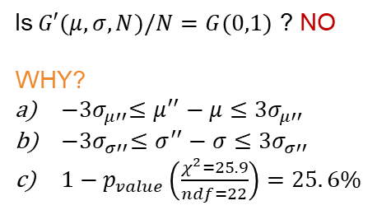


Random numbers and probability:
A Critical Analysis
Let’s do it again with 10000 random number
$G′$moments:
$μ^{′}=0.01388$
$σ′=0.9948$
$G′′$moments:
$μ′′=0.01004±0.00998$
$σ′′=0.9942±0.007$
25 bins
3 fit parameters
$$G′$$
Is$G′(μ,σ,N)/N=G(0,1)$ ? NO
WHY?
${−3σ}_{μ′′}≤μ^{′′}−μ≤3σ_{μ′′}$
${−3σ}_{σ′′}≤σ^{′′}−σ≤{3σ}_{σ′′}$
$1−p_{value}\left(\frac{χ^{2}=25.9}{ndf=22}\right)=25. 6\%$
$$G′′$$
Your $G′$ is similar to a Gaussian, but it isn’t (in this representation)

Slide 22
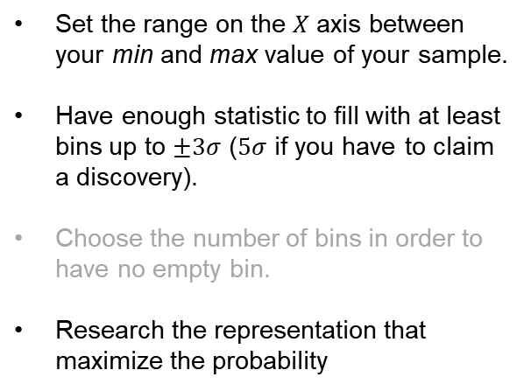
Random numbers and probability:
The binning criteria
How to choose the correct representation? (The Rebinning Problem)
Set the range on the $X$ axis between your min and max value of your sample.
Have enough statistic to fill with at least bins up to $±3σ$ ($5σ$ if you have to claim a discovery).
Choose the number of bins in order to have no empty bin.
Research the representation that maximize the probability
$$G′$$
$$G′′$$

Slide 23


Random numbers and probability:
A Critical Analysis
What to use to check everything without driving mad (freeware)?
What CERN uses for particle physics analysis
https://root.cern/
We already have it on iclust
What math universities and Google use
https://www.r-project.org/

Slide 24
From Drawings to Artificial Intelligence:
The importance of Representation

Slide 25
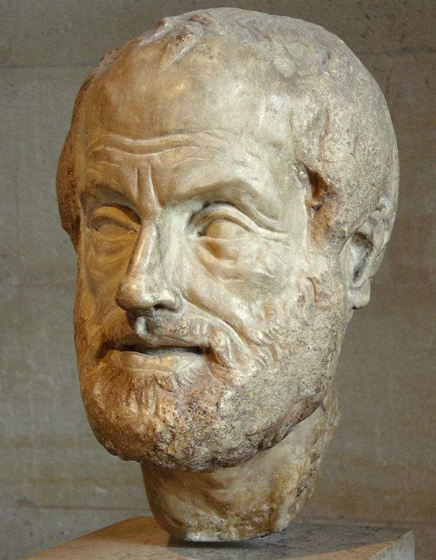
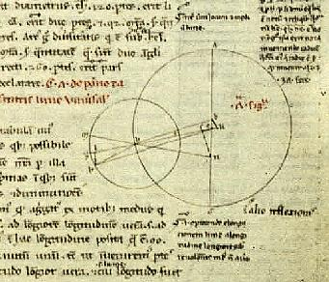
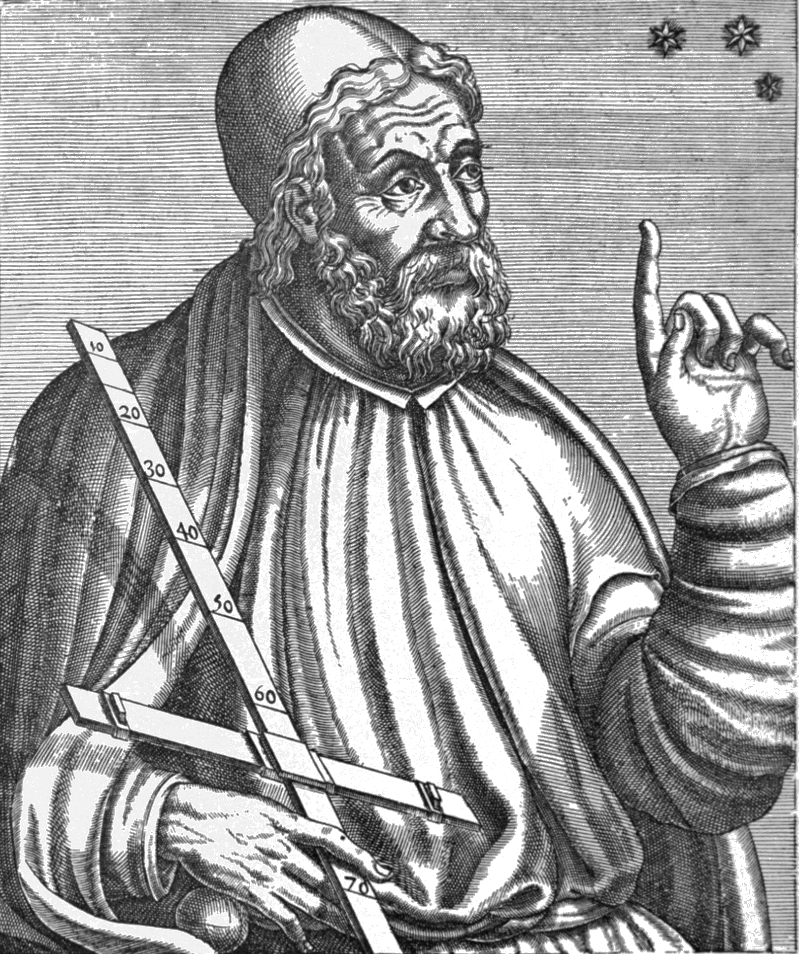
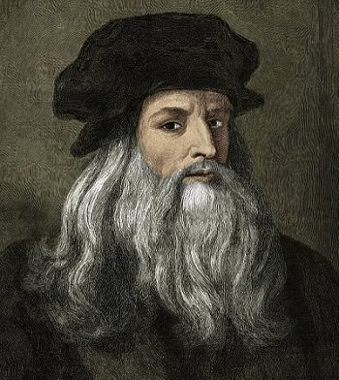
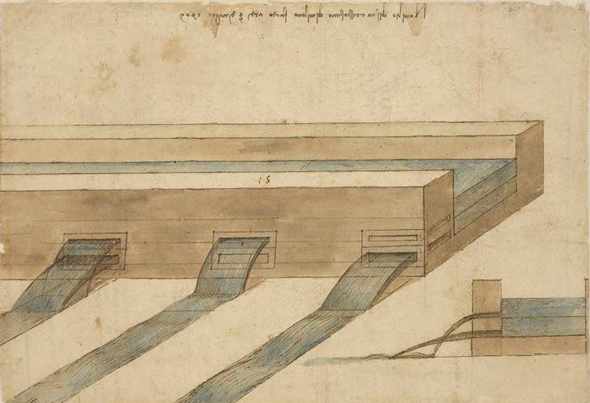
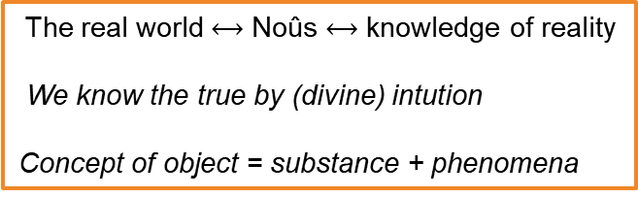
From Drawings to Artificial Intelligence
The real world $⟷$ Noûs $⟷$ knowledge of reality
We know the true by (divine) intution
Concept of object = substance + phenomena
Aristote
IV sec A.D
Μετὰ τὰ φυσικά
 |  | FUNCTION | ROLE
A | Data | The real world | The object
B | Representation | How we see it | The subject
C | Fit Function | How we describe it | The language
C. Ptolemy
II sec A.D
Almagest
L. Da Vinci
1518
Codice Atlantico
Representation : drawings
Language : words description
Data : words description

Slide 26
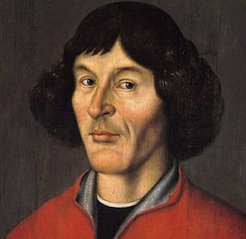
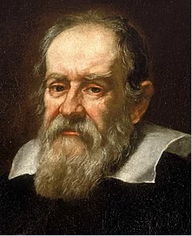
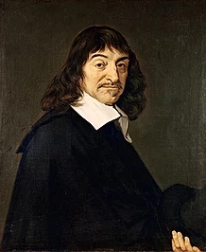
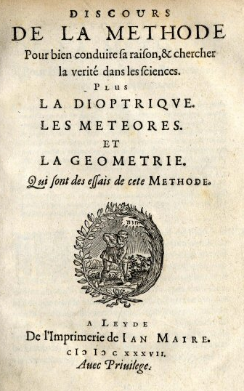
From Drawings to Artificial Intelligence
M. Kopernik
1530
De Revolutionibus Orbium Celestium
 |  | FUNCTION | ROLE
A | Data | The real world | The object
B | Representation | How we see it | The subject
C | Fit Function | How we describe it | The language
G. Galilei
1633-1638
Discorsi e dimostrazioni matematiche intorno a due nuove scienze attenenti alla meccanica e i movimenti locali
Born of Physics
Scientific and experimental method
Language : maths
Data : numbers
Representation : cartesian plane
Y
X
R. Décartes
1637
Discours de la Méthode
Rationalism
Cogito ergo sum
Rejection of sensations as correct way of knowing

Slide 27
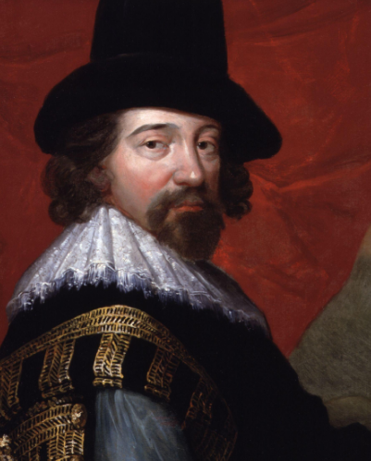
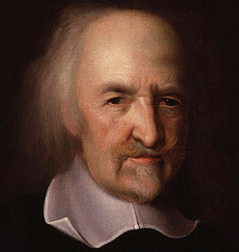
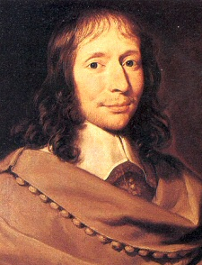






From Drawings to Artificial Intelligence
F. Bacon
1620
Novum Organum
T. Hobbes
1651
Léviathan
Application of the scientific method in all fields
Humanities
Comparative method of knowledge
Empirism: we know by sensations.
1° concept of sensitivity error
Formalisation of probability
$$p_{X}(x)$$
B. Pascal
Traité du triangle arithmétique
1654
C. Huygens
De ratiociniis in ludo aleae
1657
W. Petty
1676
Political Arithmetic
Born of Statistics
& Modern Economy
Mathematical Induction
I. Newton
1687
Philosophie Naturalis Principia Mathematiqua
Calculus
F(x), d/dx, $\int{dx}$
G. W. Leibniz
All opera
Binary system
Kinetic Energy
 |  | FUNCTION | ROLE
A | Data | The real world | The object
B | Representation | How we see it | The subject
C | Fit Function | How we describe it | The language
Determinism
Cause - effect

Slide 28







From Drawings to Artificial Intelligence
Illuminism
T. Mayer
1750
Kosmographische Nachrichten
Study of lunar librations and problems of latitude
Definition of error ($x±ε$)
 |  | FUNCTION | ROLE
A | Data | The real world | The object
B | Representation | How we see it | The subject
C | Fit Function | How we describe it | The language
L. Euler
Lagrange interpolation
1783
G.L. Lagrange
1805
Traité de la mécanique celeste
C.F. Gauss
1809
Theoria motvs corporvm coelestivm in sectionibvs conicis Solem ambientivm
Normal Distribution
Y
Least square method
Fit
Trajectory of Ceres
X
Positivism
P. S. Laplace
1814
Essay Philosophique sur la Probabilité
Central Limit Theorem

Slide 29

From Drawings Data to Artificial Intelligence
Verificationism (1918 – 1934) – Logistic Empiricism
Theory of relativity
Representation
Vienna Circle: Gödel, Mach, von Mises, Hilbert, Einstein, Russell, Wittgenstain,...
Modern (Simbolic) Logic,
Analitic Philosophy
Principle of verification (in all fields): we can state something is true if we can verify it (indipendently from the subject)
Principle of Induction is compatible
Probabilistic Empiricism (1910 - now)
Quantum physics / Biology
Reichenbach (philosophy), Schrodinger, Bohr, Heisemberg, de Broglie
Fisher (eugenetics), Pearson, Gosset (t-Student),...
The subject alters the reality in an irriversible way
Copenhagen interpretation of quantum mechanics (Schrodinger cat)
We can only express a probability about the truth of a theory
Inferential statistics (tests) + other fit methods (likelihood,...)
Probability = 99%
Critical Rationalism or Popperism (1934 - now)
Artificial Intelligence
K. Popper
Principle of Falsification : 1 event is enough to determine if a theory is false
The process of knowledge is :
problem -> essay of solution -> experiment -> error -> change of theory
We know by comparison also in science (weak need of representation)
Idea for the Apprentissage Automatique (Artificial Intelligence)

Slide 30
From Drawings Data to Artificial Intelligence
A numerical models comparison method
Compare different models
The MonteCarlo method
Study the limits / tolerances / expected results of a problem
Genetic Algorithms
Forecast a result when we don’t know how to express the problem (i.e. We don’t know the best way to represent it)

Slide 31
A Numerical Models Comparison Method

Slide 32
A Numerical Models Comparison Method
Problem
How to correctly compare two different numerical models (Finite Elements, Finite Volumes, etc.)
Reasons
Validation of a model
Coherence in different calculations
Understanding the possible differences and if they are important or not
Reasons for F2D2
Compare COMSOL, ANSYS and OPERA performances
Validate the MAG COMSOL model to be used in the protection calculations

Slide 33

A Numerical Models Comparison Method
Part 1
Probabilistic method using linear regression to compare scalar magnitudes
Hypothesis:
A is the validated model
B is the model to be validated
G is the magnitude
Method:
For both model, extract the value of the magnitude on the same pattern of space-time coordinates ($k$ points)
- if the two models are « complex » (3D models, 2D with many bodies, etc) a random extraction of points with $k≥1000$ can be performed
- if the two models are « simple » or there is a special interest over a certain region, an uniform pattern can be used (again preferably with $k≥1000$)
Plot $G_{B}$ as a function of $G_{A}$
Fit $G_{B}=f(G_{A})$ with $G_{B}=mG_{A}+q$ (linear regression)
Limit case: If $G_{B}=G_{A}⟹m=1,q=0$
If A and B are compatible over G $⟹m=1±nσ_{m},q=0±nσ_{q}$

Slide 34



Example for F2D2
Same pattern of points for OPERA, COMSOL and ANSYS
Resolution 1 mm
Up to the radius of the yoke (247 mm)
61504 points
Calculation of
Bx, By
A model = OPERA
B model = COMSOL
C model = ANSYS
OPERA
ANSYS
COMSOL
Example with a good fit (AB)
Example with a bad fit (AC)
Useful Statistical Methods in Designing Superconducting Magnets

Slide 35


Results from comparison of Bx –
Opera vs Comsol
COMSOL (OPERA)
********************************
Fit for Bx
********************************
m = 0.99904 +/- 0.00016
q = -0.0044 +/- 0.0003
Very good fit between the two models but:
No compatibility with $m=1$ and $q=0$ within $3σ$
Figure out of noise (see part 2)
Useful Statistical Methods in Designing Superconducting Magnets

Slide 36

Results from comparison of By -
Opera vs Comsol
COMSOL (OPERA)
********************************
Fit for By
********************************
m = 1.00081 +/- 0.00002
q = 0.0031 +/- 0.0005
Very good fit between the two models but:
No compatibility with $m=1$ and $q=0$ within $3σ$
Figure out of noise (see part 2)
Useful Statistical Methods in Designing Superconducting Magnets

Slide 37

A Numerical Models Comparison Method
Part 2
Radiography of the models to investigate the figures out of noises
Method:
Plot over a 2D histogram of coordinates $x,y$ the magnitudes $G_{A}$, $G_{B}$ and $dG=G_{B}−G_{A}$
Look at the differences and localize the coordinates out of noise

Slide 38

A Numerical Models Comparison Method – Opera vs Comsol
COMSOL (OPERA)
1 bin difference on Y
BX OPERA
Bx COMSOL
Useful Statistical Methods in Designing Superconducting Magnets

Slide 39

A Numerical Models Comparison Method - Opera vs Comsol
COMSOL (OPERA)
1 bin difference on X
By OPERA
By COMSOL
Useful Statistical Methods in Designing Superconducting Magnets

Slide 40
A Numerical Models Comparison Method - Opera vs Comsol
The two areas with a difference:
- 1 bin in dX
- 1 bin dY
Geometric check performed
The different propagation of the magnetic field in the iron is due to the mesh interface of the two models
(the points are iron for OPERA, air for COMSOL)
No notable difference in the conductor region between the two models
The difference between the two models has no effect from the protection point of view → the COMSOL model is compatible and can be used to perform the protection calculations.
Useful Statistical Methods in Designing Superconducting Magnets

Slide 41


A Numerical Models Comparison Method – Opera vs Ansys
ANSYS (OPERA)
********************************
Fit for Bx
********************************
m = 0.9966 +/- 0.0004
q = -0.0319 +/- 0.0009
********************************
Fit for By
********************************
m = 0.9996 +/- 0.0002
q = -0.1411 +/- 0.0008

Slide 42

A Numerical Models Comparison Method - Opera vs Ansys
ANSYS (OPERA)
Bx_A
dBx
Bx_B
Bx OPERA
Bx ANSYS

Slide 43

A Numerical Models Comparison Method - Opera vs Ansys
ANSYS (OPERA)
By_A
dBy
By_B
By OPERA
By ANSYS

Slide 44
A Numerical Models Comparison Method -Opera vs Ansys
The two models strongly differs at the interface between iron and air
The two models are not compatible
ANSYS (OPERA)
But they don’t differ too much in the coil region:
→ We should not use ANSYS model for quality field calculations
→ We can use the ANSYS model for mechanical calculations

Slide 45
The Monte Carlo Method

Slide 46

The Monte Carlo Method : Some History
One of the most important outcome of the Manhattan Project
Invented by Enrico Fermi in the ‘30s to study how neutrons interact with nuclei → first step towards the discovery of the weak interation.
Developed by von Neumann and Ulam during the Manhattan Project to understand how to be shield from the bomb radiation (neutrons in particular). Monte Carlo is the secret name of the work package.
Feymann used it to understand the physical interpretation of the neutron-chain reaction → first step towards the Feynman diagram and tools for describing particle physics.
Nuclear, finance and particle physics applications use it the most.
Every discovery in particle physics of the last 70 years has been done using it.

Slide 47


The Monte Carlo Method : Principles
$M(x,y,z,…)$ computable function of variables $x,y,z,…$
Step 1
Generate a set of random numbers for $x,y,z,…$
Ex:
$$g_{1}=\left(x_{1},y_{1},z_{1},…\right)$$
$$g_{2}=\left(x_{2},y_{2},z_{2},…\right)$$
…
Step 2
Calculate $M(x,y,z,…)$
for each set $g_{i}$
Ex:
$$M_{1}=M\left(g_{1}\right)$$
$$M_{2}=M\left(g_{2}\right)$$
…
Step 3
Analyse the results altogether

Slide 48



The Monte Carlo Method : $π$ calculation
Variables : $x,y$
Set (point of the surface) : $g\left(x,y\right)$
Function :
$$M\left(x,y\right)=\frac{4A_{c}}{A_{sq}}=4\frac{\frac{π}{4}r²}{r²}=π$$
$$A_{c}=\sum_{i=1}^{n}{{\left.g_{i}(x,y)\right|}_{x^{2}+y^{2}≤r²} }$$
$$A_{sq}=\sum_{i=1}^{n}{g_{i}(x,y)}$$

Slide 49


The impact of random geometrical errors on the magnetic field quality
The impact of random geometrical errors during winding and assembly can be very well evaluated with a Monte Carlo.
The main questions are:
What are the variables $x,y,z,…$?
What is my function $M\left(x,y,z,…\right)$?
How do I read the results?
Example case : F2D2

Slide 50

The impact of random geometrical errors on the magnetic field quality : Variables
Hypothesis (make it simple):
3 kind of geometric deviation from nominal design for each block
Displacements along X
Displacements along Y
Angular Displacement respect to the center of mass
How many variables?
8 blocks per sector = 24
3 parameter per block = 3
Tot variables = 72
In general, your variables are the degree of freedom of your system,
i.e. indipendent parameters

Slide 51


The impact of random geometrical errors on the magnetic field quality : Function
Function : magnetic field
$$M\left(g_{i}(x_{i},…,)\right)=B_{y}\left(R_{REF},θ\right)$$
I calculate it changing the coils positions according to $g_{i}(x_{i},…,)$
For each simulation, I calculate the harmonics
$$B_{y}\left(R_{REF},θ\right)=\frac{b_{1}}{2}+\sum_{n=2}^{∞}{b_{n}\cos\left(2(n−1)θ\right)}$$
$$b_{n}=\frac{4}{π}∙\frac{10000}{B_{REF}}\int_{0}^{π/2}{B_{y}\left(R_{REF},θ\right)\cos\left((n−1)θ\right)dθ}$$

Slide 52



Problems : Sets${ g}_{i}(x_{1},…,)$ and variables
How to generate the sets $g_{i}$ ?
Hypothesis:
Each parameter $∆x,∆y,∆α$ can be tought as a tolerance $⟹$
I need to set $∆x_{max},∆y_{max},∆α_{max}$
What is the shape of $∆x,∆y,∆α$ ? $⟹$
What is the probability distribution that represents my errors?
Which pfd should I use to best match it?
How many random numbers should I generate?

Slide 53



Problems : Sets${ g}_{i}(x_{1},…,)$ and variables
How to generate the sets $g_{i}$ ?
In this study :
Tolerances:
$$∆x_{max}=0.15 mm \\ ∆y_{max}=0.15 mm$$
$$∆α_{max}=1°$$
What is the distribution of $∆x,∆y,∆α$ ? $⟹$
$k$ number of magnets considered:
- $k>100$ Gaussian distribution, $G_{∆x}=G\left(0,\frac{∆x_{max}}{\sqrt{2}}\right)$*
- $3<k<100$ t-Student distribution
- $k≤3$ Uniform distribution
How many random numbers should I generate?
- for the central limit theorem $n>100$
- the statistical error of the standard deviation $σ$ of my fit scales up as $\frac{1}{\sqrt{n}}$ (law of large numbers)
- how long does it take to run a simulation? (here 81 s)
Decision is $n=500$ (1000) for each variable.
T-Student PDF
$ν$ degree of freedom
*rule to transform an absolute error (uniform distribution) to a statistic error

Slide 54
Problems : Function
Should I consider the iron or not ?
In this case:
Iron dimensions are not considered as variables in the simulations
(changing iron positions of less than 0.3 mm has marginal effect on the harmonics)
Iron changes the harmonics of the nominal design-> has a major effect
Answer 1: Yes, I should. But not as an active part of the Monte Carlo simulation.
Answer 2: Let’s make different cases considering iron or not.

Slide 55




Results for B3 – Uniform PDF
Uniform Iron
Uniform NoIron
Gaussian = good fit
 | Uniform Iron | Uniform No Iron
Nominal b3 value | $$2.973$$ | $$5.301$$
$$μ @ 99\% CL (μ±3σ_{μ})$$ | $$2.788≤2.941≤3.094$$ | $$5.111 ≤5.309≤5.507$$
$$σ @ 99\% CL (σ±3σ_{σ})$$ | $$0.989≤1.103≤1.217$$ | $$1.252 ≤1.387≤1.522$$
$μ$ is a good estimator for $b_{3}$ in both cases (well between $3σ$)
$σ_{iron},σ_{noiron}$are not compatible (i.e. there is less than 1% of probability they are the same)$⟹$
iron reduces the amplitude of b3 distribution of ~23%
I should not use the non-iron case

Slide 56




Results for B3 – Gaussian PDF
Gauss Iron
Gauss NoIron
Bad fit
Need to increase the entries
Good fit
$μ_{gauss}$ is a good estimator for $b_{3}$ (but worse than $μ_{unif}$)
$σ_{gauss},σ_{unif}$ are within $3σ$ $⟹$ statistically I cannot exclude the two distributions are different.
I am more conservative with the Gaussian distribution
 | Uniform No Iron | Gauss No Iron
Nominal b3 value | $$5.301$$ | $$5.301$$
$$μ @ 99\% CL (μ±3σ_{μ})$$ | $$5.111 ≤5.309≤5.507$$ | $$5.271 ≤5.415≤5.559$$
$$σ @ 99\% CL (σ±3σ_{σ})$$ | $$1.252 ≤1.387≤1.522$$ | $$1.378 ≤1.489≤1.600$$

Slide 57

Possible Uses
MAGNETIC DESIGN
Field quality (harmonics, Bpeak,…)
Impact of different ferromagnetic materials when BH is unknown
Accelerator designs
GANT designs
Deflecting magnets design
Stability studies
…
HOW TO EXPRESS RESULTS
Gaussian (symmetrical distribution)
$$b_{3}±3σ$$
In order to have a confidence level of 99%
Non symmetrical distribution
$${b_{3}}_{−σ_{−}}^{+σ^{+}}$$
Where $σ^{+},σ_{−}$ are values at $±49.5 \%$ of probability (confidence level of 99%)
MECHANICAL DESIGN
Impact of uncertainties on the Young’s module
Impact of different materials
Impact of different friction coefficients
…

Slide 58
The Genetic Algorithm

Slide 59
Genetic Algorithms: Some History
One of the first AI methods
Invented by John Henry Holland, prof. at University of Mitchigan, in Adaptation in Natural and Artificial Systems (1975, MIT Press)
They mock the darwinian evolution
Used in physics, engineering, finance… to find maximum/minimum of unknown functions
Example
https://twitter.com/Rainmaker1973/status/1020273446884970496

Slide 60
Genetic Algorithms
Concepts:
Each parameter = GENES
Set of parameters = INDIVIDUAL
Set of individuals = POPULATION
Evolution of the population = GENERATION
Working Principles
N - Generations
M - Individual
Reproduction
(mutations to avoid local min/max)
Rank of the best
Individuals
(natural selection)
Initial Population
Simulation
New Population
Results

Slide 61


Genetic Algorithms
Initial Population
Step 1
Choose the parameters (genes) and their range
Ex:
$$L_{xy1}∈\left[−2,1\right] \\ L_{xy2}∈\left[−3,4\right] \\ …$$
Step 2
Build an individual (by randomic PDF generation). 1 number for each gene
$L_{x1}=\left(\begin{aligned}L_{x11}=0.5 \\ L_{x12}=1.2 \\ …\end{aligned}\right)$
Step 3
Build a population
$$L_{1}=\left(\begin{aligned}L_{11}=(L_{111},L_{112},…) \\ L_{12}=(L_{121},L_{122},…) \\ …\end{aligned}\right)$$
How to choose correctly
$ν$ number of parameters (degree of freedom) of the problem
$m$ number of individuals $≥D_{v,2}=\frac{v!}{\left(v−2\right)!}$
$n$ generations* ${>2}^{ν−1}$
Minimal number of simulations
$$m×n=2^{ν−1}\frac{v!}{\left(v−2\right)!}$$
Limit the number of parameters
*criteria (n actually depends on how fast the function goes to min / max)

Slide 62




Example: MADMAX Block Dipole
B6
$$∆L$$
B1
GA paramaters:
$0<∆L<300$ mm B1→B4
$0<∆L<400$ mm B5
$0<∆L<500$ mm B6
Population = 30 individuals
Generations = 32
Tot forecast 3D simulations = 960

Slide 63



Genetic Algorithms
Simulation
Step 1 – Fitness Function
Choose what do you want to evaluate
Ex: Volume – Cost function for the conductor
$$\left\{\begin{aligned}C_{cond}=V_{cond}\left(C_{Cu}\left(1−\frac{J_{E}}{J\left(B_{peak}\right)}\right)+C_{NbTi}\left(\frac{J_{E}}{J(B_{peak})}\right)\right) \\ J\left(B_{peak}\right)=\left(1−m\right)J_{c}\left(\frac{B_{peak}}{1−m},T_{0}\right)\end{aligned}\right.$$
Where:
$V_{tot}$ conductor volume
$J_{E}$ engineering current density
$T_{0}$ operating temperature
$m=0.1$ LL margin
$C_{Cu}$ copper volume cost
$C_{NbTi}$ NbTi volume cost
Step 2
Evaluate the fitness function
(simulations) for each individual
$$C_{cond}\left(L_{11}\right),C_{cond}\left(L_{12}\right),…$$
10.65 T

Slide 64



Genetic Algorithms
Rank of the best individuals
Step 1 – Choose if you want to find min or max of your fitness function
Ex: min of $C_{cond}(V_{cond},B_{peak})$
Step 2 - Ranking
Rank the individual according to which one has the minimal value.
Ex:
$L_{11}=$ 2000
$L_{12}=$ 1500
$L_{13}=$ 1700
$L_{14}=$ 1900
$L_{15}=$ 1600
Step 3
Assign a probability of reproduction to the individuals according to the rank
Criteria:
$i$ rank position
$$p_{i}=\frac{\frac{m−i}{m}}{\sum_{i=1}^{m}{\frac{m−i}{m}}}$$
$${1. L}_{12}⟶p\left(L_{12}\right)=0.333$$
$${2.L}_{15}⟶p\left(L_{15}\right)=0.267$$
$${3.L}_{13}⟶p\left(L_{13}\right)=0.200$$
$${4.L}_{14}⟶p\left(L_{14}\right)=0.133$$
$${5.L}_{11}⟶p\left(L_{11}\right)=0.067$$
${1. L}_{12}=$ 1500
${2.L}_{15}=$ 1600
${3.L}_{13}=$ 1700
${4.L}_{14}=$ 1900
${5.L}_{11}=$ 2000

Slide 65




Genetic Algorithms
Reproduction
Step 1 – Coupling
Random extraction of two numbers $x_{1},x_{2}$ with an uniform PDF [0,1]
Ex: $x_{1}=0.3$, $x_{2}=0.7$
Calculate the cumulative function $\int{p_{i}}$, assigning the respective parameter
$${1. L}_{12}⟶[0,0.333]$$
$${2.L}_{15}⟶(0.333,0.6]$$
$${3.L}_{13}⟶(0.6,0.8]$$
$${4.L}_{14}⟶\left(0.8,0.933\right]$$
$${5.L}_{11}⟶(0.933,1]$$
Where $x_{1},x_{2}$ falls, you have your couple ;)
Step 2 – Cross-over
Random extraction of two numbers $c_{1},s_{2}$
$c_{1}$ uniform PDF [cross-over,1]
$s_{2}$ uniform PDF [0,1]
Generally, cross-over $>$ 0.7
If $x_{1}<c_{1}$ and $x_{2}<c_{1}$
Reproduction! ;))
Else
$$L_{21}=L_{12}$$
$$L_{211}=s_{2}∙L_{121}+\left(1−s_{2}\right)L_{131}$$
$$L_{212}=s_{2}∙L_{122}+\left(1−s_{2}\right)L_{132}$$
$$L_{213}=s_{2}∙L_{123}+\left(1−s_{2}\right)L_{133} \\ …$$
For every gene
Until we replace $L_{1}$

Slide 66

Genetic Algorithms
Bonus: Mutation
Step 1
For each gene,
Random extraction of one number
$x_{3}$ uniform PDF [0,1]
If $x_{3}<p_{mutation}$
Then rebuild the gene (step 1 Initial population)
Generally $p_{mutation}<0.1$
Repeat for each generation

Slide 67
Genetic Algorithms
Implementation in OPERA 3D
GA Random
(Initial population)
Automation of the process
Parallelization of the process
Interface between 5 different programs
Modeller
Geometry implementation
Post Processor
Analysis & Results
Solver
GA Engine
Individuals rank
Reproduction
New Population

Slide 68
Results on MADMAX Version 9.0
12 generations

Slide 69
When to Use?
GA can be used for :
Minimization problem
Maximization problem
When you don’t know how to write down a function (or a part of).
Warnings:
To be used with a limited number of variables (as a function of your resolution time)
How to rank the individuals is one of the hardest problem if you look for multiple fitness functions (ex: minimize both Bpeak and Volume)
They will always find an approximate solutions

Slide 70
References
Random numbers:
H. Press et all. (1992), « Numerical Recipes in C », Cambridge University Press
Matsumoto, M., Nishimura, T. (1998), « Mersenne twister: a 623-dimensionally equidistributed uniform pseudo-random number generator », ACM Transactions on Modeling and Computer Simulation
Probability, Statistics and Montecarlo:
CERN COURSE http://www.pp.rhul.ac.uk/~cowan/stat_cern.html
R. Monge (2008) « Corso di Laboratorio 1B », Lectures at Università di Genova
F. James (2011) « Statistics for Physicists », Presented in Stockholm, May 2011
S. Passaggio (2014) « Statistica per l’analisi dati », PHD course, Università di Genova
G. Cowan (1988) « Statistical Data Analysis », Clarendon, Oxford, 1988
F. James (2007) « Statistical Methods in Experimental Physics », 2nd ed., World Scientific
R.J. Barlow (1989) « A Guide to Use of Statistical in the Physical Science », Wiley
Comparison Method:
V. Calvelli, (2017) « Large Superconducting Magnets from High-Energy Physics to Space Applications », PHD Thesis
Useful Statistical Methods in Designing Superconducting Magnets

Slide 71
References
History and Phylosophy:
B. Russell (1946), « A History of Western Philosophy », NY, Simon & Schuster
A. Kaplan; M. Haenlein (1 jan 2019). "Siri, Siri, in my hand: Who's the fairest in the land? On the interpretations, illustrations, and implications of artificial intelligence". Business Horizons
J. Cat (6 dec. 2017) « How Viennese scientists fought the dogma, propaganda and prejudice of the 1930s », Nature
K. Sigmud (2017) « Exact Thinking in Demented Times: The Vienna Circle and the Epic Quest for the Foundations of Sciences » Basics Books
K. Popper (1934) « The Logic of Scientific Discovery » Springer
H. Reichenbach (1938) « Experience and Prediction: and analysis of the foundations and the structure of knowledge » University Chicago Press
https://writings.stephenwolfram.com/2013/05/dropping-in-on-gottfried-leibniz/
Genetic Algorithms:
R. L. Haupt; et all (2007) « Genetic Algorithms in Electromagnetics », Wiley
Useful Statistical Methods in Designing Superconducting Magnets

Slide 72

Thank you for your attention
Useful Statistical Methods in Designing Superconducting Magnets

