Slide 1



Jamie Boyd (CERN)
SACLAY Seminar
18/5/2020
Supported by:
FASER website: https://faser.web.cern.ch/

Slide 2
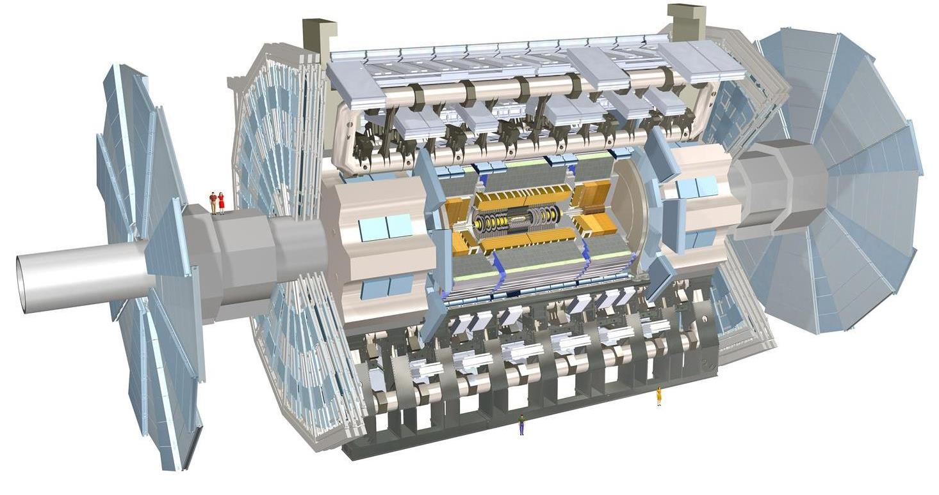
FASER: THE IDEA
arXiv:1708.09389
New physics searches at the LHC focus on high p_{T}. This is appropriate for heavy, strongly interacting particles
  σ ~ fb to pb → In Run-3 N ~ 10² – 10⁵, produced ~isotropically
However, if new particles are light and weakly interacting, this may be completely misguided. Instead can exploit
  σ_{inel} ~ 100 mb → In Run-3 N ~ 10¹⁶, θ ~ Λ_{QCD} / E ~ 250 MeV / TeV ~ mrad
FASER is a new experiment, to start running after LS2, designed to cover this scenario at the LHC
Detector to be placed 480m from IP1 directly on the beam collision axis line of sight (LOS) with transverse radius of only 10cm covering the mrad regime (η>9.1)

Slide 3
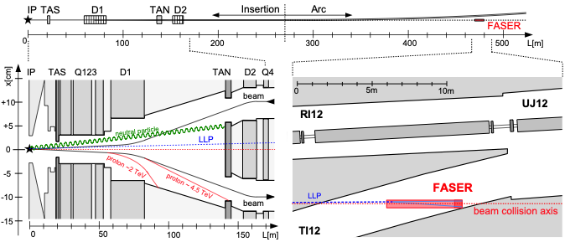
FASER LOCATION
FASER will be situated along the beam collision axis line of sight (LOS)
    ~480 m from IP
    after beams start to bend
    a few meters from the LHC beamline
TI12 unused tunnel, that intersects LOS 480m from IP1

Slide 4
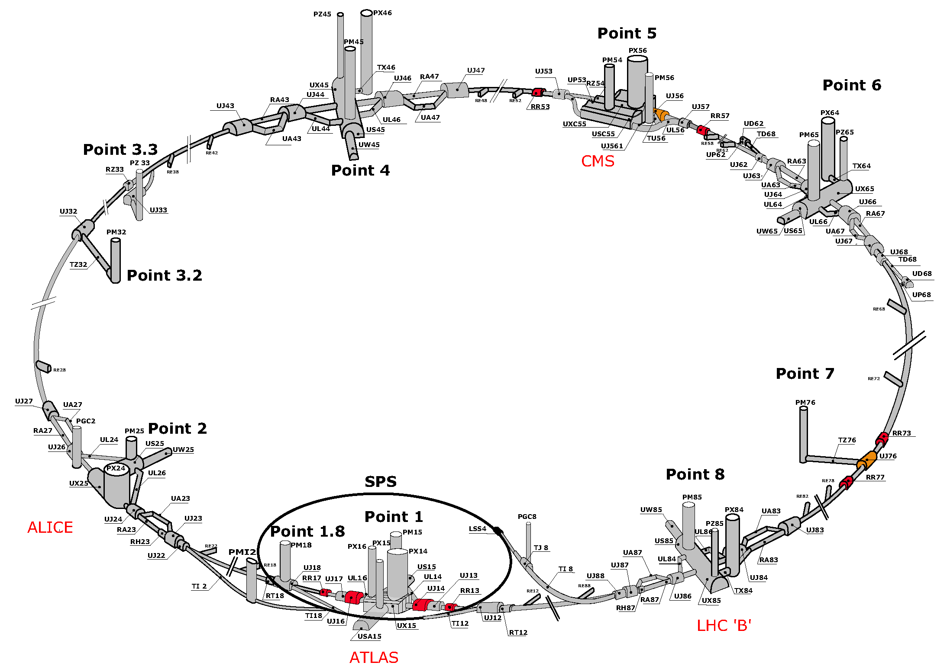
FASER LOCATION: TI12
TI18
FASER

Slide 5
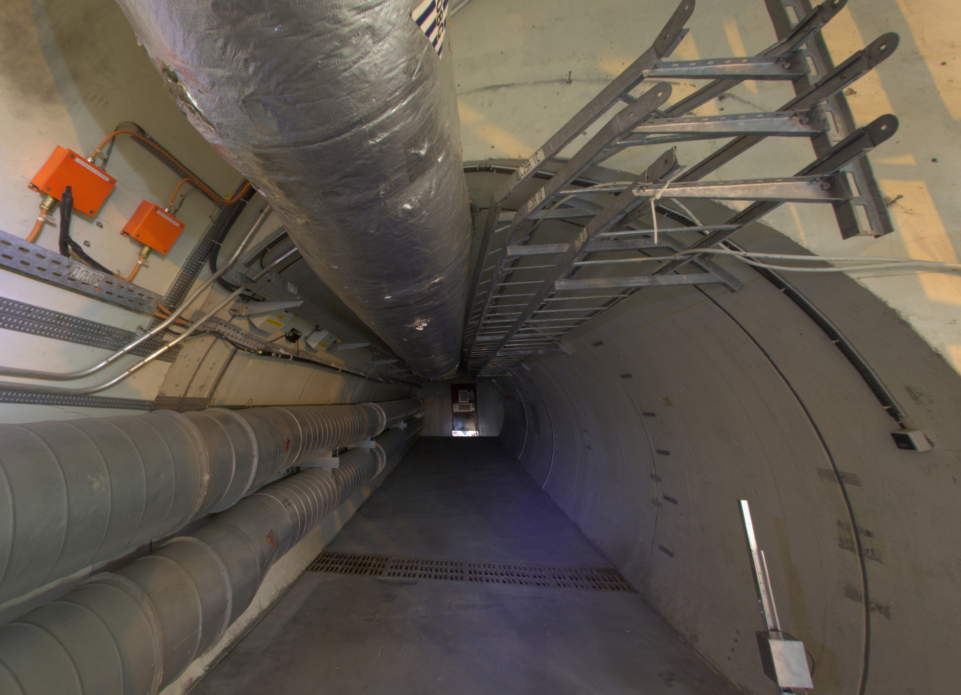
FASER LOCATION: TI12
TI18
LOS
Digging ~50cm deep trench needed to allow 5m long detector to be aligned with LOS.
FASER

Slide 6
EXAMPLE PHYSICS CASE (DARK PHOTONS)

Slide 7

DARK PHOTONS
Dark matter is our most solid evidence for new particles. In recent years, the idea of dark matter has been generalized to dark sectors
Dark sectors motivate light, weakly coupled particles (WIMPless miracle, SIMP miracle, small-scale structure, ..)
A prominent example: vector portal, leading to dark photons
The resulting theory contains a new gauge boson A’ with mass m_{A’} and εQ_{f} couplings to SM fermions f
SM
Hidden
U(1)

Slide 8
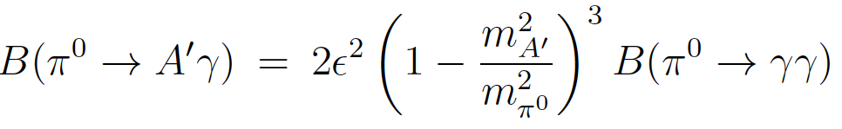
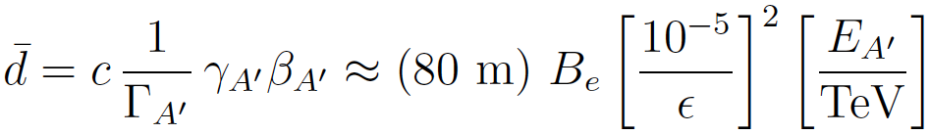

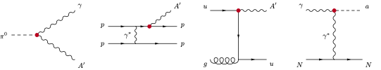
DARK PHOTON PROPERTIES
Produced (very rarely) in meson decays, e.g.,
                , ,
and also through other processes
Travels long distances through matter without interacting, decays to e⁺e⁻ , μ⁺μ⁻ for m_{A’} > 2 m_{μ} , other charged pairs
TeV energies at the LHC → huge boost, decay lengths of ~100 m are possible for viable and interesting parameters

Slide 9
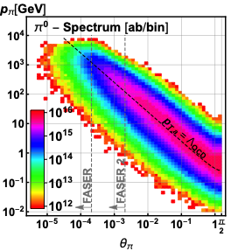
PRODUCTION AT LHC
FASER takes advantage of the the huge number of light mesons (π⁰,η,..) that are produced at the LHC, predominantly in the very forward direction.
For example for E(π⁰)≥ 10 GeV,
  2% of π⁰s fall in FASER acceptance;
  whereas the FASER acceptance covers just (2 × 10⁻⁶)% of the solid angle.

Slide 10
PRODUCTION AT LHC
FASER takes advantage of the the huge number of light mesons (π⁰,η,..) that are produced at the LHC, predominantly in the very forward direction.
For example for E(π⁰)≥ 10 GeV,
  2% of π⁰s fall in FASER acceptance;
  whereas the FASER acceptance covers just (2 × 10⁻⁶)% of the solid angle.
Run-3 (0.15/ab) will produce a huge number of π⁰s in FASER angular acceptance. Even with large suppression (ε² ~10⁻⁸ – 10⁻¹⁰ for relevant region of parameter space) can still have very large number of dark photons produced.
LHC can be a dark photon factory!

Slide 11
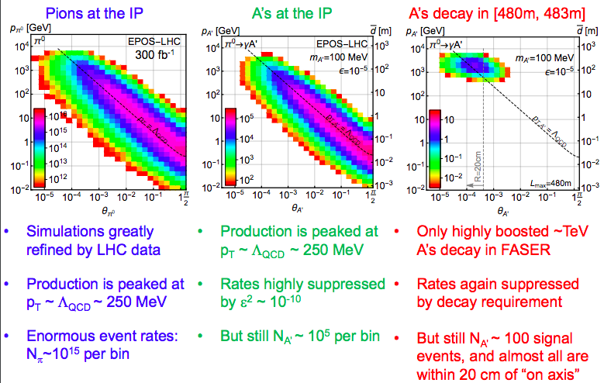
DARK PHOTONS IN FASER
note this is an old slide, and FASER volume R=10cm now!

Slide 12
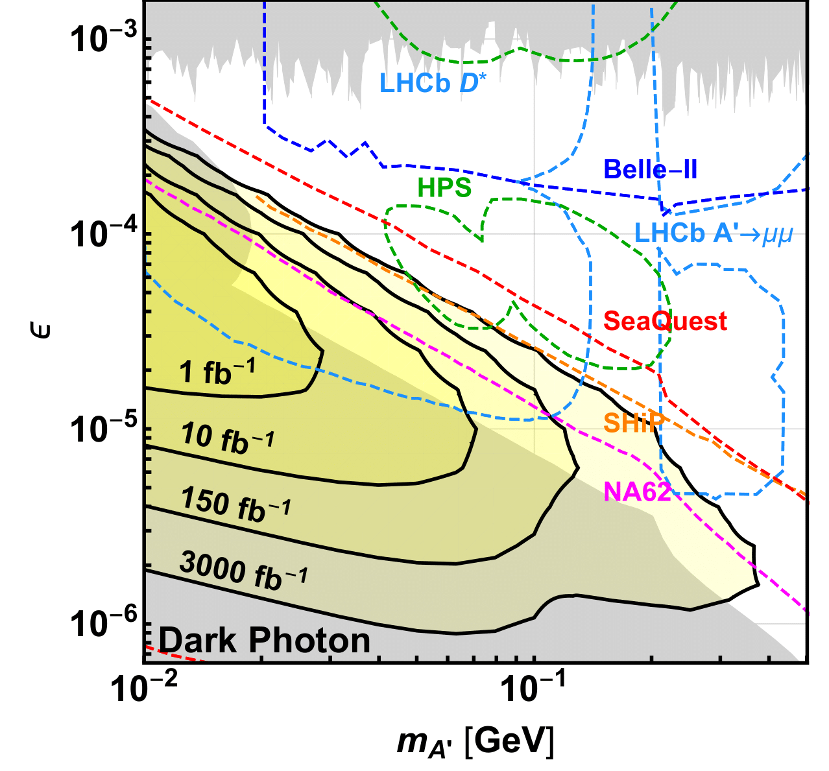
DARK PHOTONS IN FASER
Leads to a projected sensitivity (as a function of luminosity)
Start to explore unconstrained space even with 1/fb
Significant discovery potential with 150/fb (expected Run-3 dataset)
Plot assumes 0 background and 100% efficiency. However contours little effected by O(1) change in efficiency.
Signal topology striking, so believe that 0-background is reasonable assumption.

Slide 13
THE TI12 ENVIRONMENT

Slide 14
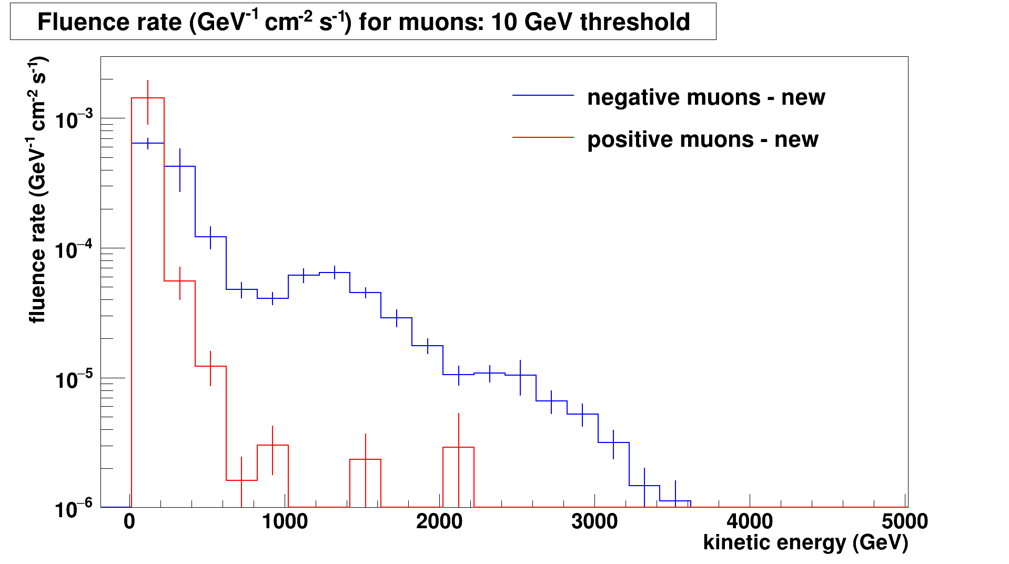
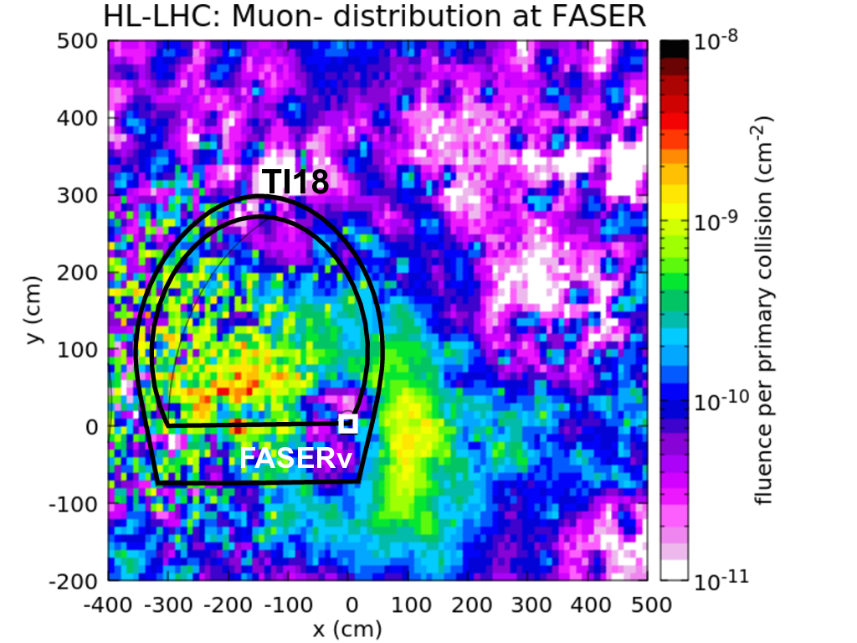
BEAM BACKGROUNDS
FLUKA simulations and in situ measurements have been used to assess the backgrounds expected in FASER
FLUKA simulations studied particles entering FASER from:
  IP1 collisions (shielded by 100m of rock)
  off-orbit protons hitting beam pipe aperture in dispersion suppressor (close to FASER) (following diffractive interactions in IP1)
  beam-gas interactions
Expect a flux of high energy muons (E>10 GeV) of 0.4cm⁻²s⁻¹ at FASER for 2e34cm⁻²s⁻¹ luminosity from IP1 collisions
  Confirmed by in situ measurements in 2018 running (emulsion detector and TimePix BLM)
Large muon charge asymmetry at FASER due to LHC bending magnets

Slide 15
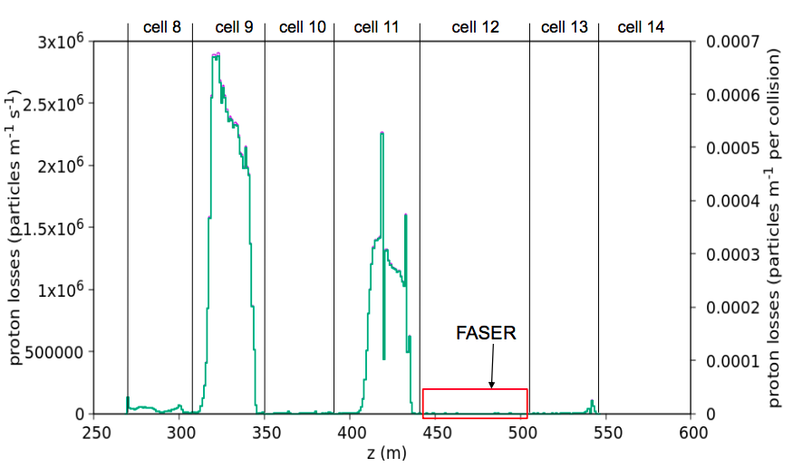
TI12 RADIATION LEVEL
Radiation level predicted to be very low in TI12 due to dispersion function of LHC at this location
  Radiation comes from off-momentum protons (following diffractive processes in IP1) hitting beam aperture, and causing showers
  Dispersion function defines where this happens – FASER location one of the quietest!
Measurements by BatMon radiation monitor in 2018 running confirm FLUKA expectations of:
  less than 5 x 10⁻³ Gy/year
  less than 5 x 10⁷ 1 MeV neutron equivalent fluence / year
FASER detector does not need radiation hard electronics

Slide 16
THE FASER DETECTOR
Technical Proposal: arXiv:1812.09139

Slide 17
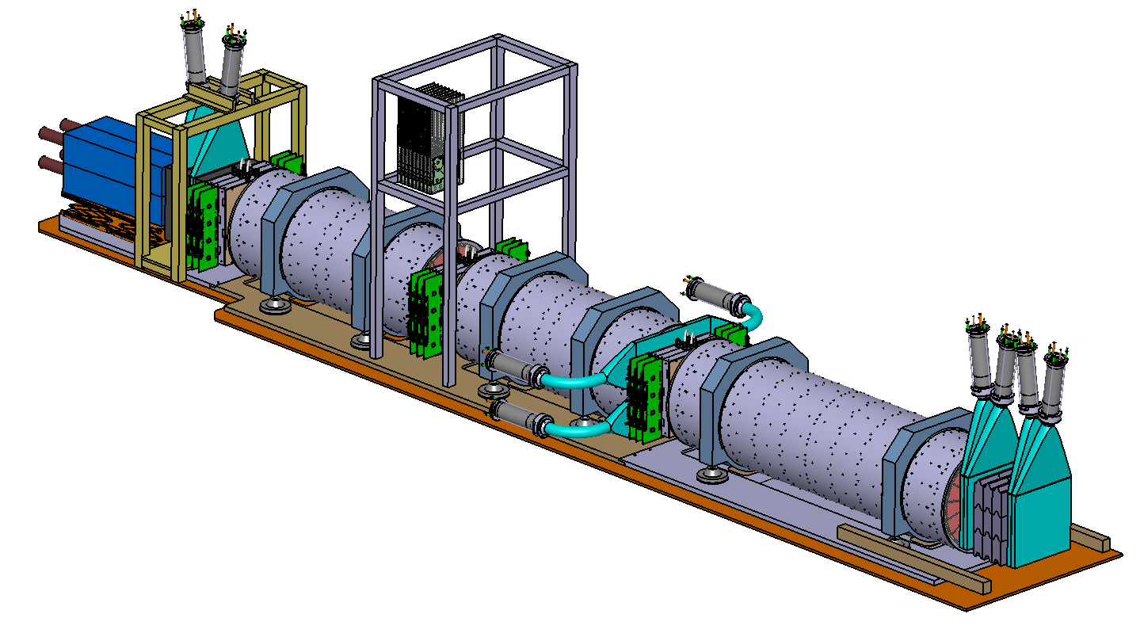
THE FASER DETECTOR
The detector consists of:
  Scintillator veto
  1.5m long decay volume
  2m long spectrometer
  EM calorimeter
Calorimeter
Spectrometer
DECAY
VOLUME
Veto
Incoming
particles

Slide 18
THE FASER DETECTOR
The detector consists of:
  Scintillator veto
  1.5m long decay volume
  2m long spectrometer
  EM calorimeter
Signal signature
A’
e⁺
e⁻
1. No signal in the veto scintillator;
2. Two high energy oppositely charged tracks, consistent with originating from a common vertex in the decay volume, and with a combined momentum pointing back to the IP;
3. For A’->e⁺e⁻ decay: Large EM energy in calorimeter. EM showers too close to be resolved.
Magnets needed to separate the A’ decay products sufficiently
to be able to be resolved in tracker

Slide 19
THE FASER DETECTOR
The detector consists of:
  Scintillator veto
  1.5m long decay volume
  2m long spectrometer
  EM calorimeter
FASER Detector Philosophy
Given the very tight timeline between experiment approval and installation & the limited budget we have focused on:
- Detector that can be constructed and installed quickly & cheaply
Have tried to re-use existing detector components where possible
Aimed for a simple, robust detector (access difficult)
Tried to minimize the services to simplify the installation and operations
Many challenges of the large LHC experiments not there for FASER:
trigger rate ~500Hz (mostly single muon events)
low radiation
low occupancy / event size
Signal signature
A’
e⁺
e⁻
1. No signal in the veto scintillator;
2. Two high energy oppositely charged tracks, consistent with originating from a common vertex in the decay volume, and with a combined momentum pointing back to the IP;
3. For A’->e⁺e⁻ decay: Large EM energy in calorimeter. EM showers too close to be resolved.
Magnets needed to separate the A’ decay products sufficiently
to be able to be resolved in tracker

Slide 20
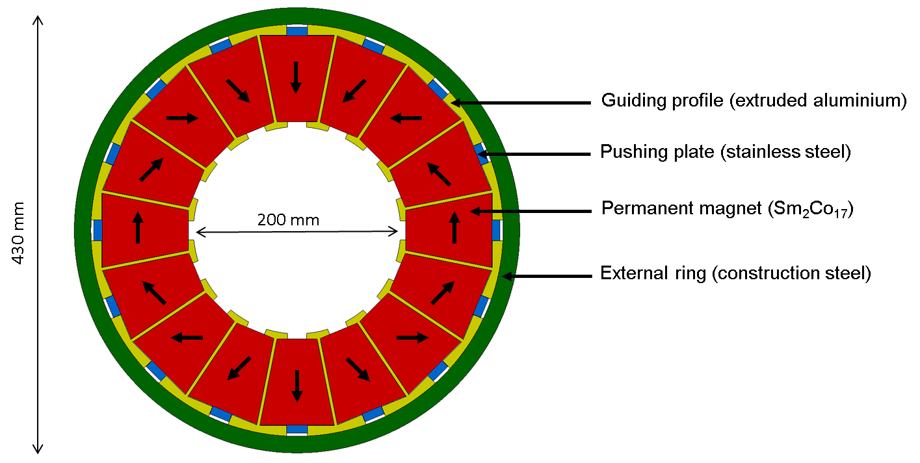
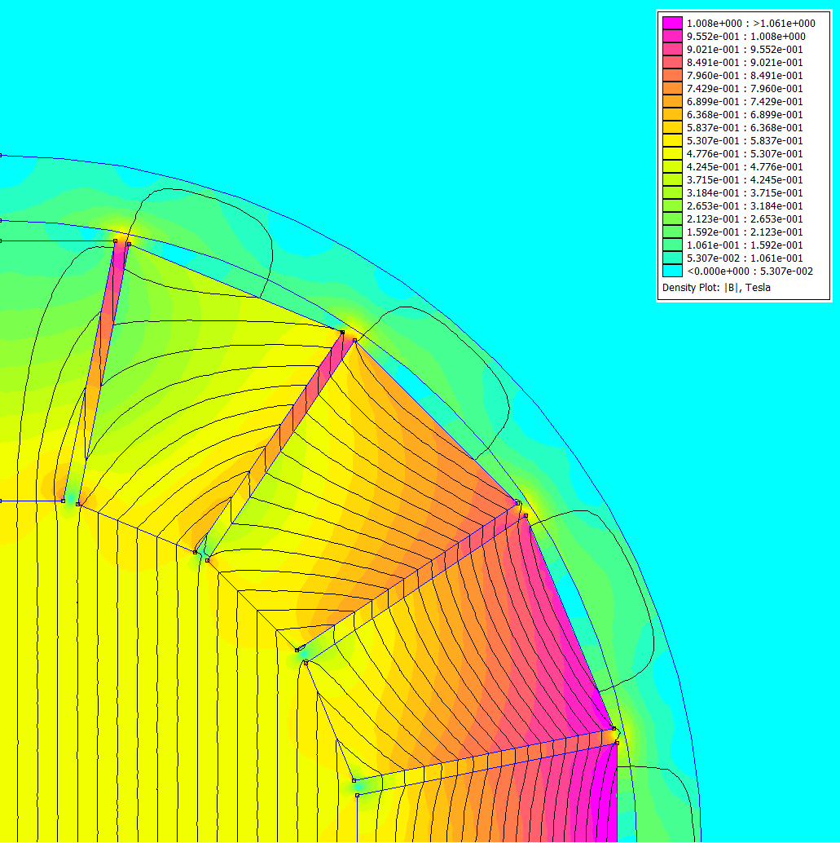
FASER MAGNETS
The FASER magnets are 0.55T permanent dipole magnets based on the Halbach array design
  Thin enough to allow the LOS to pass through the magnet center with minimum digging to the floor in TI12
  Minimize needed services (power, cooling etc..)
Designed and to be constructed by TE-MSC group at CERN

Slide 21
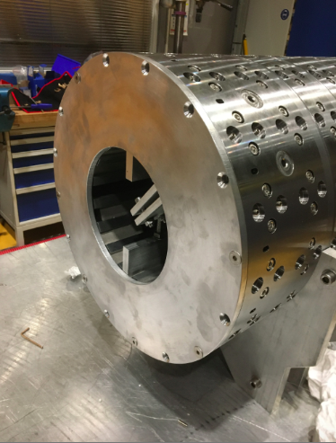
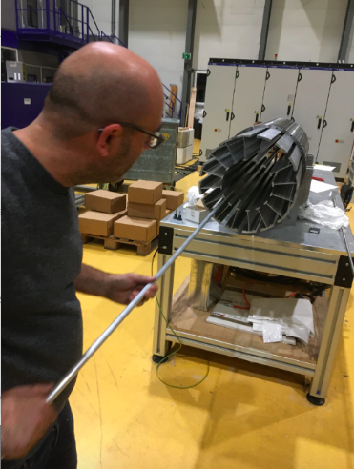
FASER MAGNETS
10% of magnetic blocks received in Nov 2019, used for QA and to test magnet production procedure.
Main order released in Dec 2019, magnetic blocks for first magnet produced and at CERN.

Slide 22
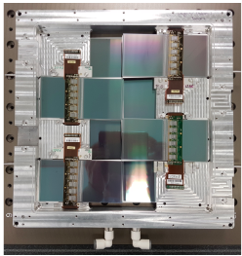
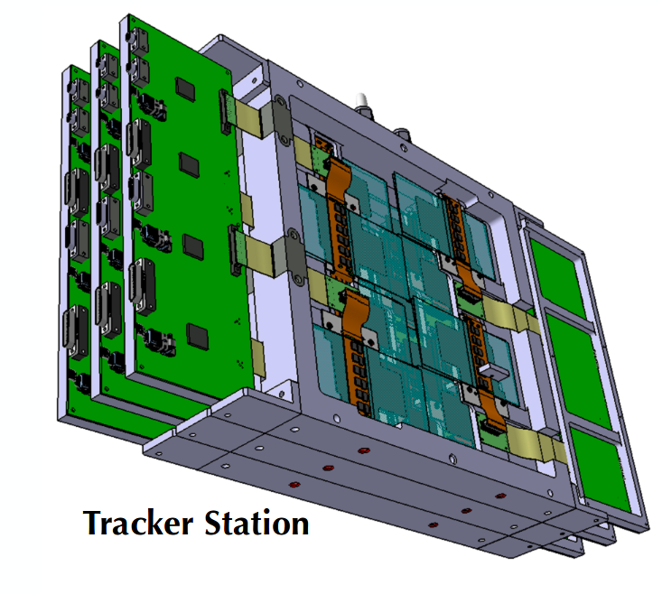
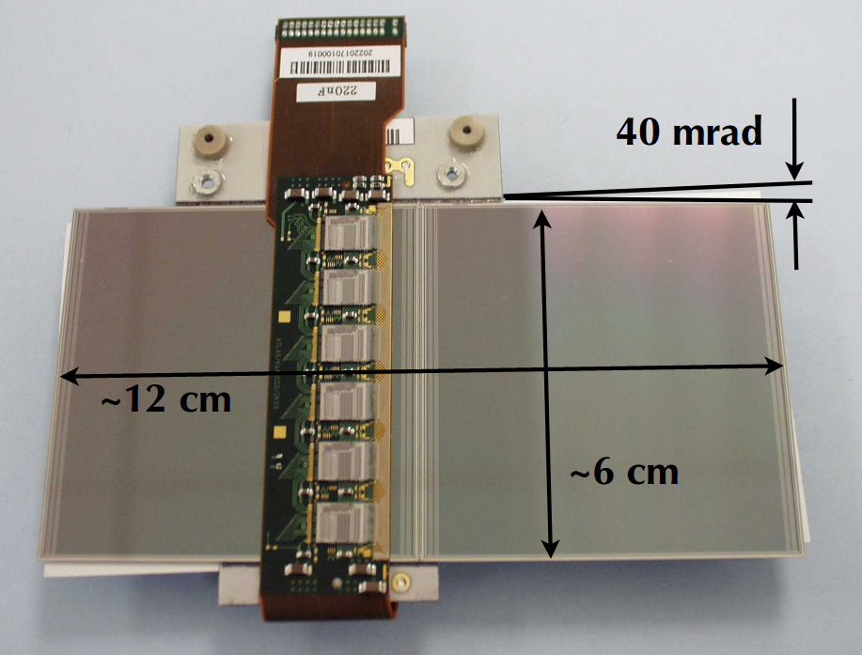
FASER TRACKER
FASER Tracker needs to be able to efficiently separate very closely spaced tracks
The FASER Tracker is made up of 3 tracking stations
Each containing 3 layers of two pairs of single-sided silicon micro-strip sensors
  Spare ATLAS SCT modules are used
    80μm strip pitch, 40mrad stereo angle (17μm / 580μm resolution)
      precision measurement in bending (vertical) plane
    Many thanks to the ATLAS SCT collaboration!
8 SCT modules give a 24cm x 24cm tracking layer
9 layers (3/station, 3 stations) => 72 SCT modules needed for the full tracker
  10⁵ channels in total
Due to the low radiation in TI12 the silicon can be operated at room temperature, but the detector needs to be cooled to remove heat from the on-detector ASICs
Tracker readout using FPGA based board from University of Geneva (already used in Baby MIND neutrino experiment)
SCT module
Tracking layer

Slide 23
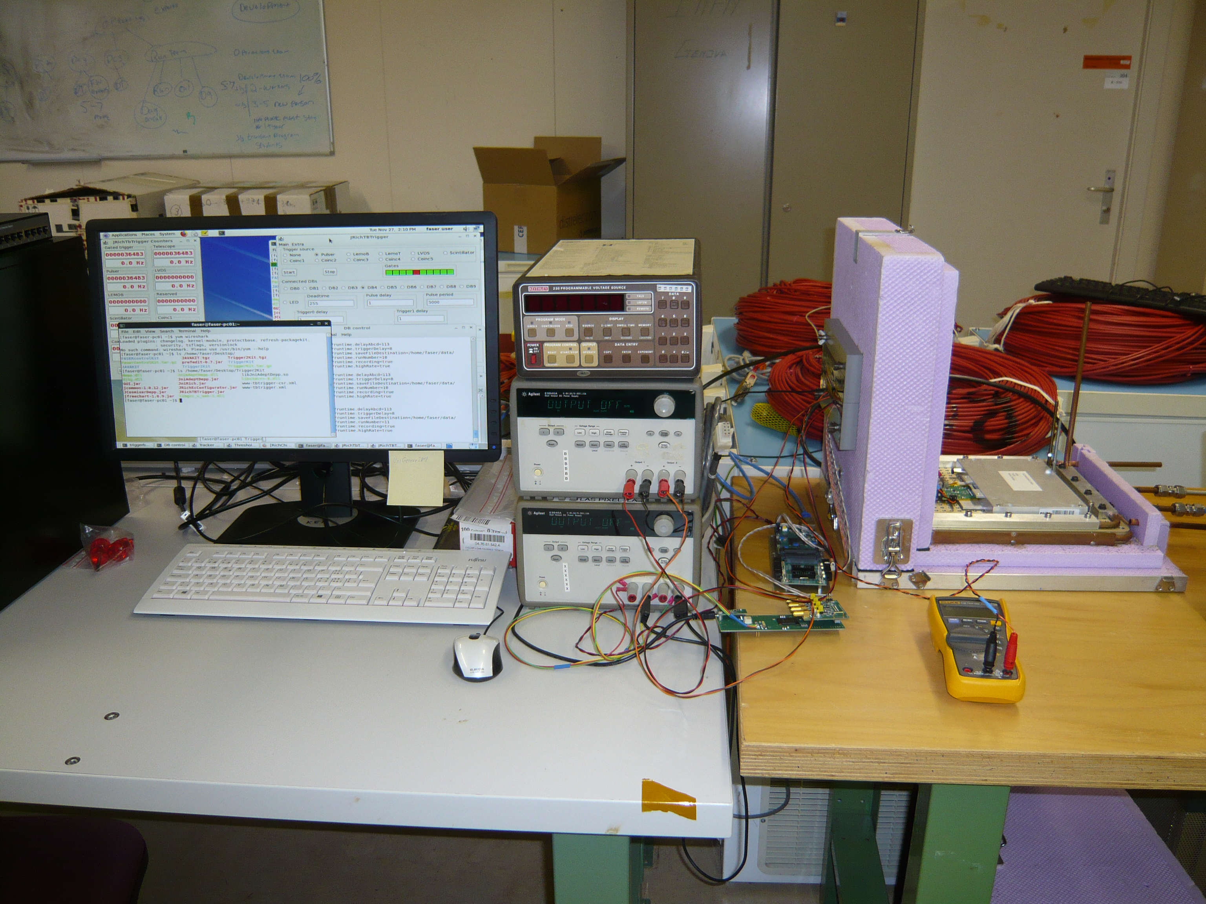
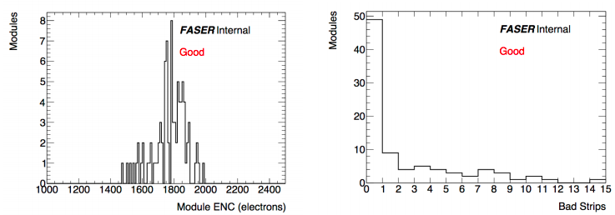
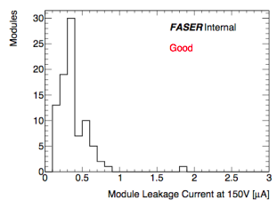
FASER TRACKER: MODULE QA
SCT modules used had passed ATLAS QA in ~2005 and then been kept in storage. Important to test their functionality.
SCT module QA at CERN in March 2019. Identified > 80 good spare modules – more than enough for FASER needs.
Performance seems not to be degraded by long term storage/age.

Slide 24
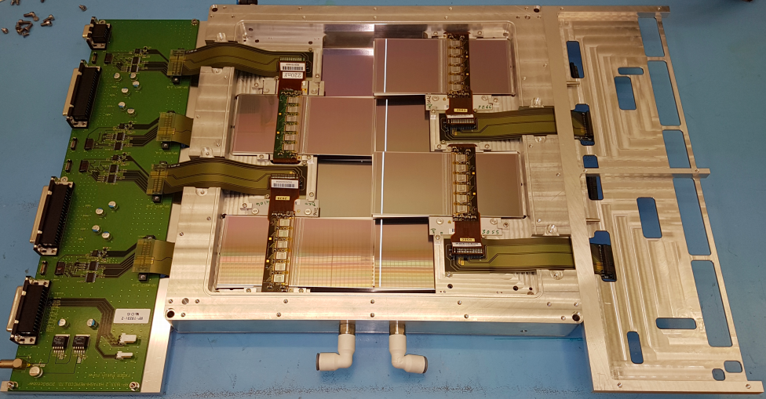
FASER TRACKER: READOUT/COOLING
Decided to not use the ATLAS SCT readout to simplify the system.
Custom made flex cable used to connect pigtail on SCT module to custom PCB patch panel which separates out power (HV, LV), readout, monitoring lines.
Data processed by custom FPGA-based readout board a few meters from the detector
Patch-panel
Flex cable
Cooling loop
Due to low radiation – silicon operated at room temperature. Still need to remove heat from on detector ASICS (5W/module => 360W for the detector). Use simple water chiller (temp ~10-15degrees) – cooling pipe around outside of aluminium frame. Thermal properties validated with FEE simulation and measurements.

Slide 25
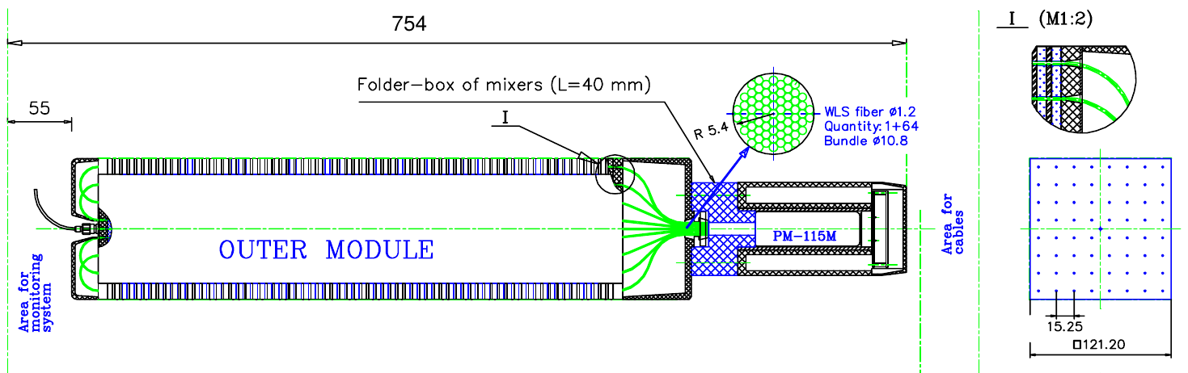
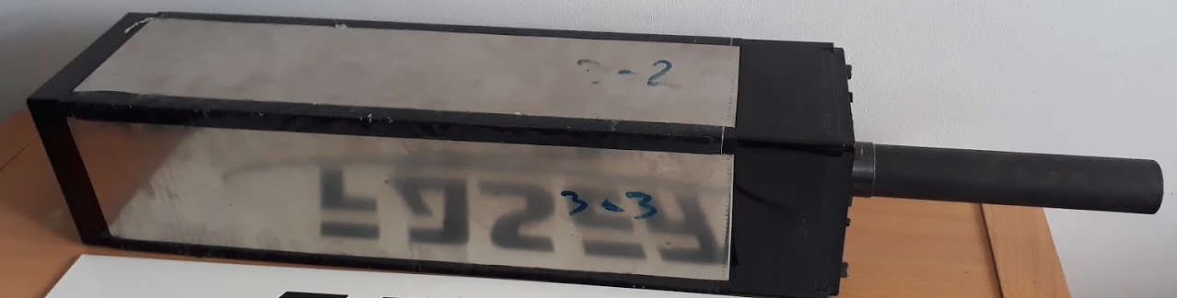
CALORIMETER
FASER EM calorimeter for:
  Measuring the EM energy in the event
  Electron/photon identification
  Triggering
Uses 4 spare LHCb outer ECAL modules
  Many thanks to LHCb for allowing us to use these!
    PMTs also from LHCb, although new voltage divider needed
  66 layers of lead/scintillator, light out by wavelength shifting fibers
    25 radiation lengths long
  Readout by PMT (no longitudinal shower information)
    Only 4 channels in full calorimeter
  Dimensions: 12cm x 12cm – 75cm long (including PMT)
  Provides ~1% energy resolution for 1 TeV electrons
    Resolution will degrade at higher energy due to not containing full shower in calorimeter; Energy scale will depend on the calibration

Slide 26
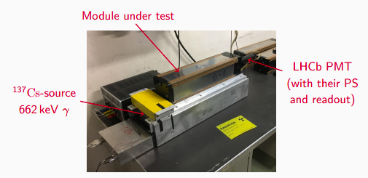
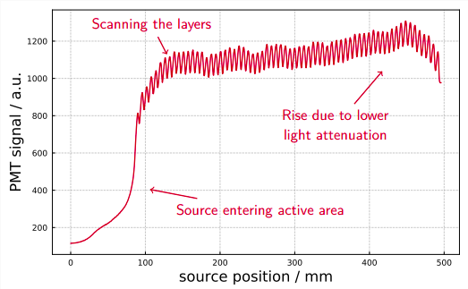
CALORIMETER – INITIAL QA
Testing of calorimeter modules at CERN in March 2019 with a source showed expected response in all modules tested.

Slide 27
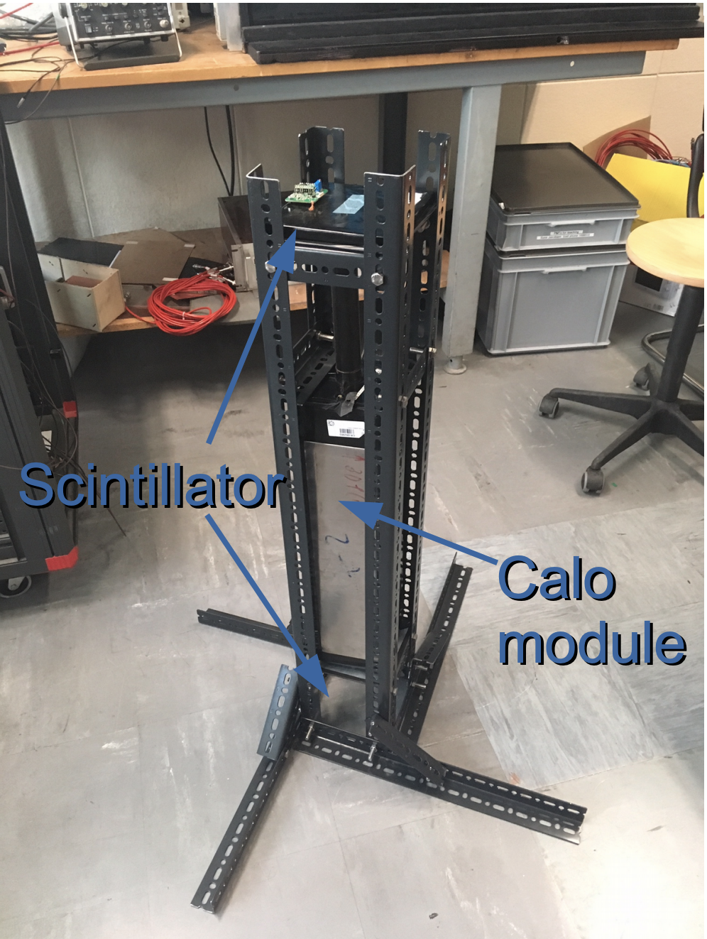
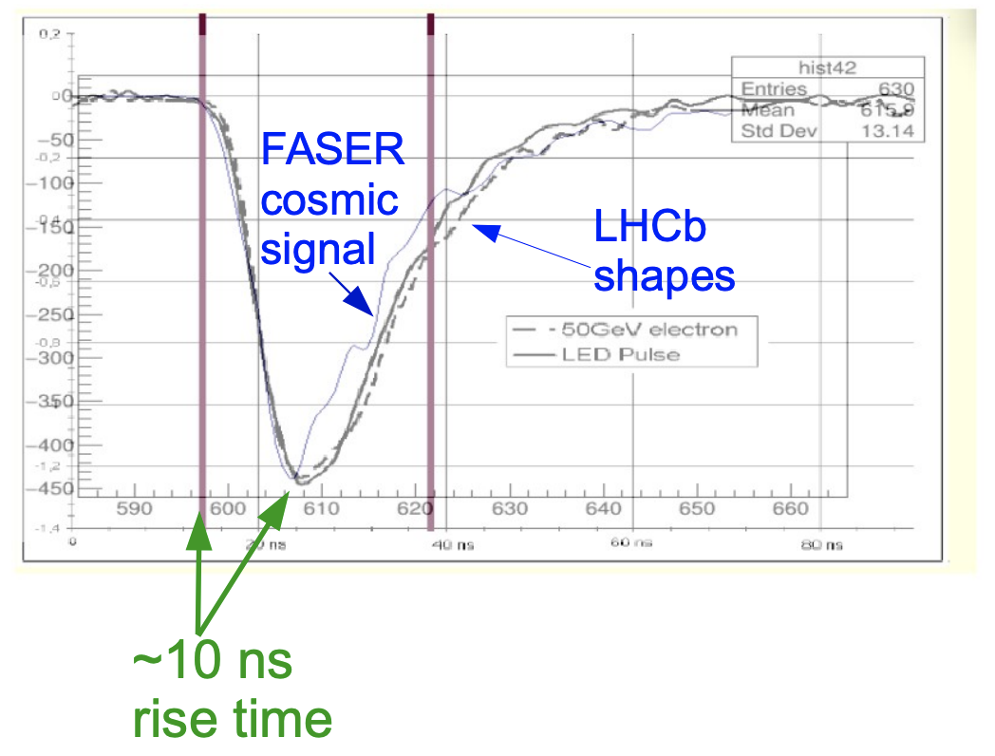
CALORIMETER – COSMIC RAY TESTS
Cosmic ray test stand used for testing calorimeter response and to calibrate PMTs
  Calorimeter signal is read when scintillators see
  coincident signals from cosmic muon
  Read-out very close to final design
Good agreement with LHCb pulses observed:
Rise time dominated by WLS fibres

Slide 28
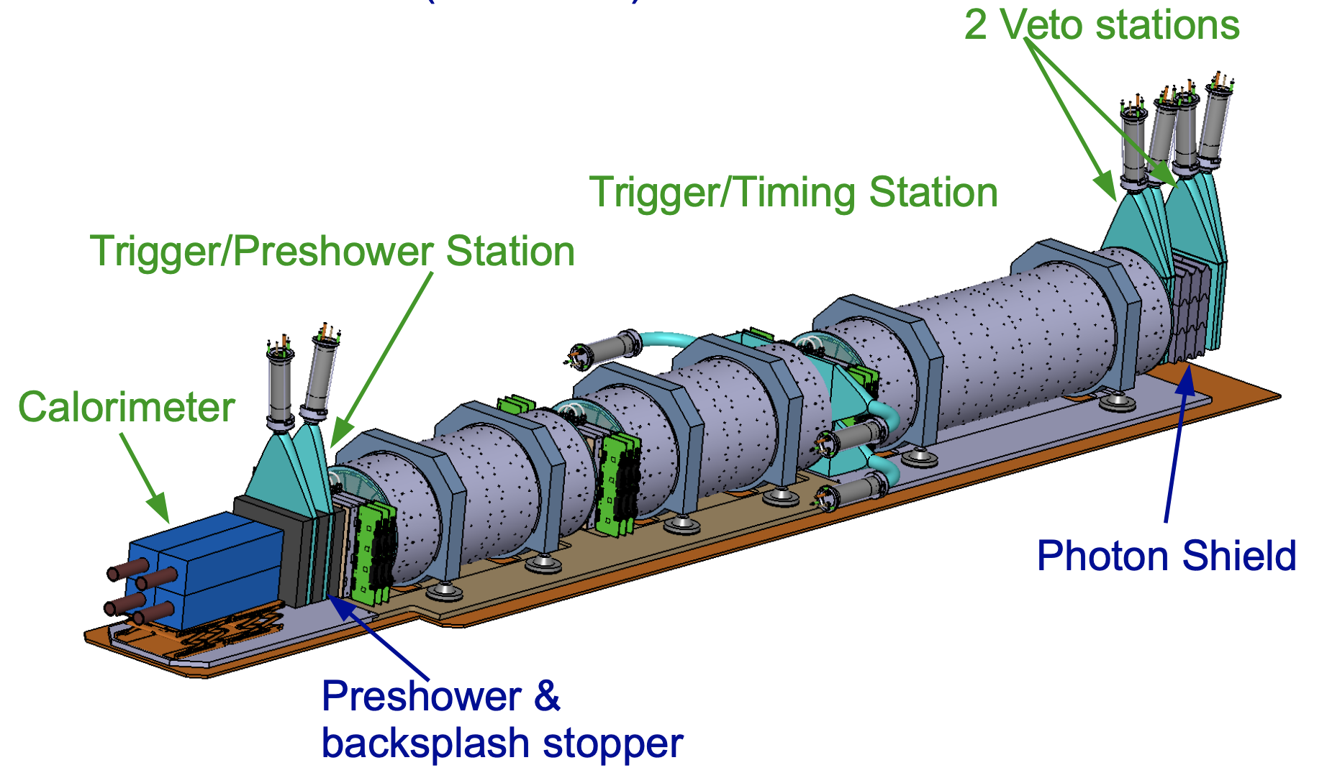
SCINTILLATOR SYSTEM
Scintillators used for:
Vetoing incoming charged particles
  Very high efficiency needed (O(10⁸) incoming muons in 150/fb)
Triggering
Timing measurement
  ~1ns resolution
Simple pre-shower for Calorimeter

Slide 29
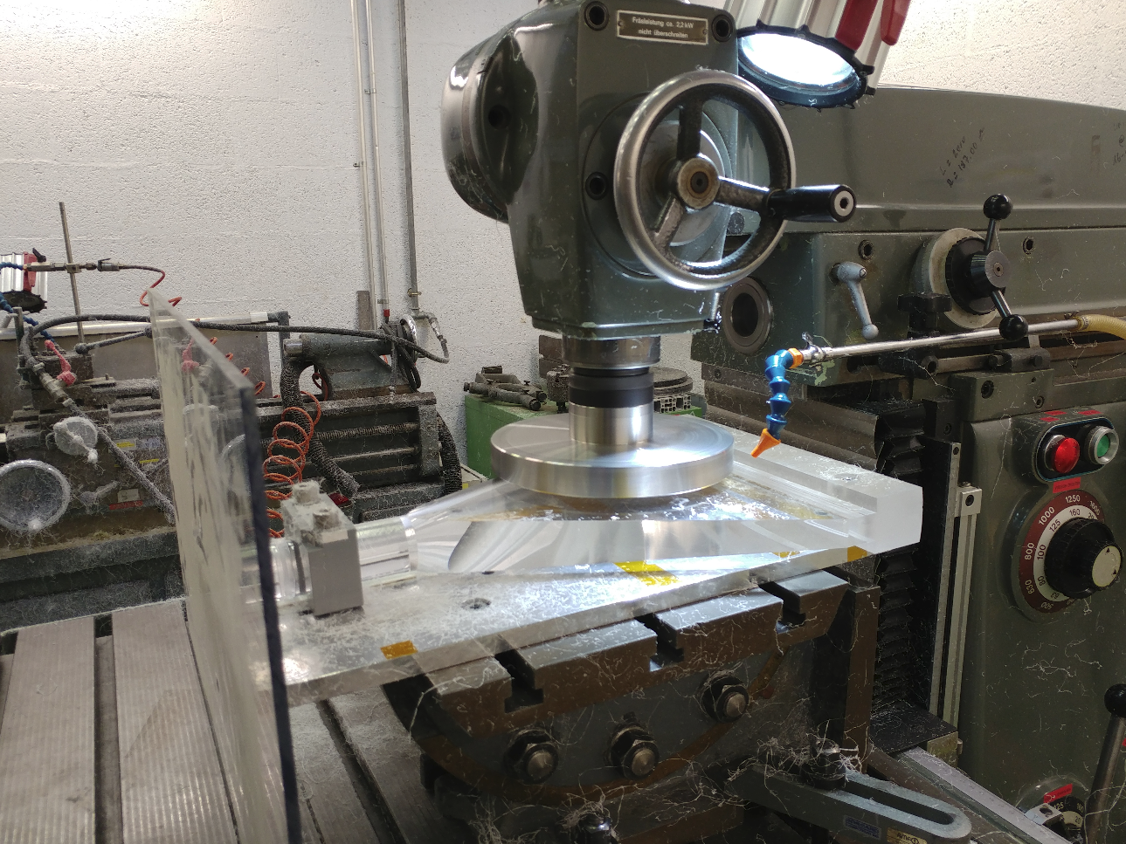
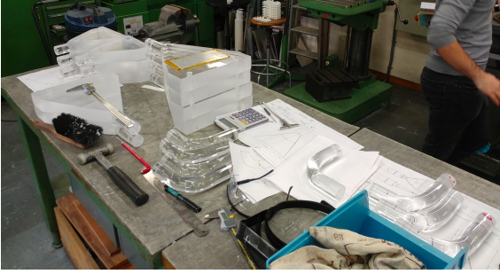
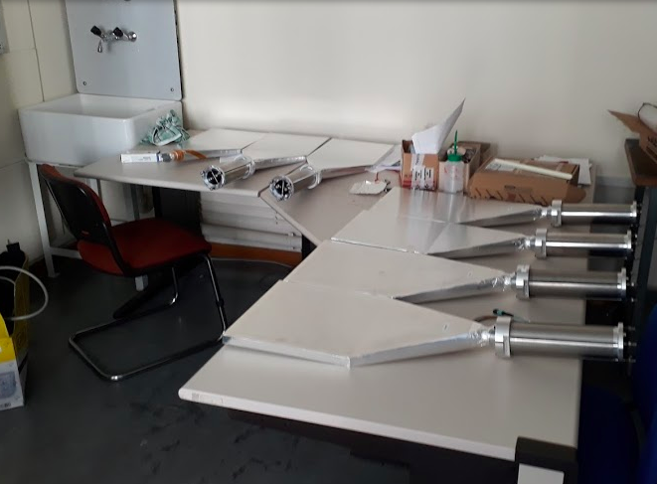
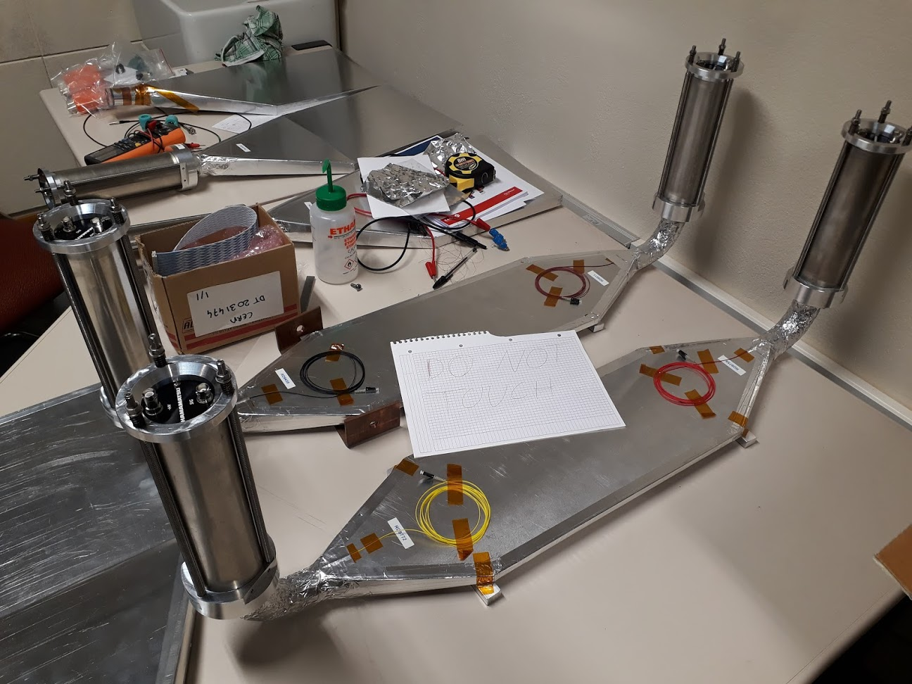
SCINTILLATORS - PRODUCTION
Many thanks to the CERN scintillator lab for producing the scintillators and light guides.

Slide 30
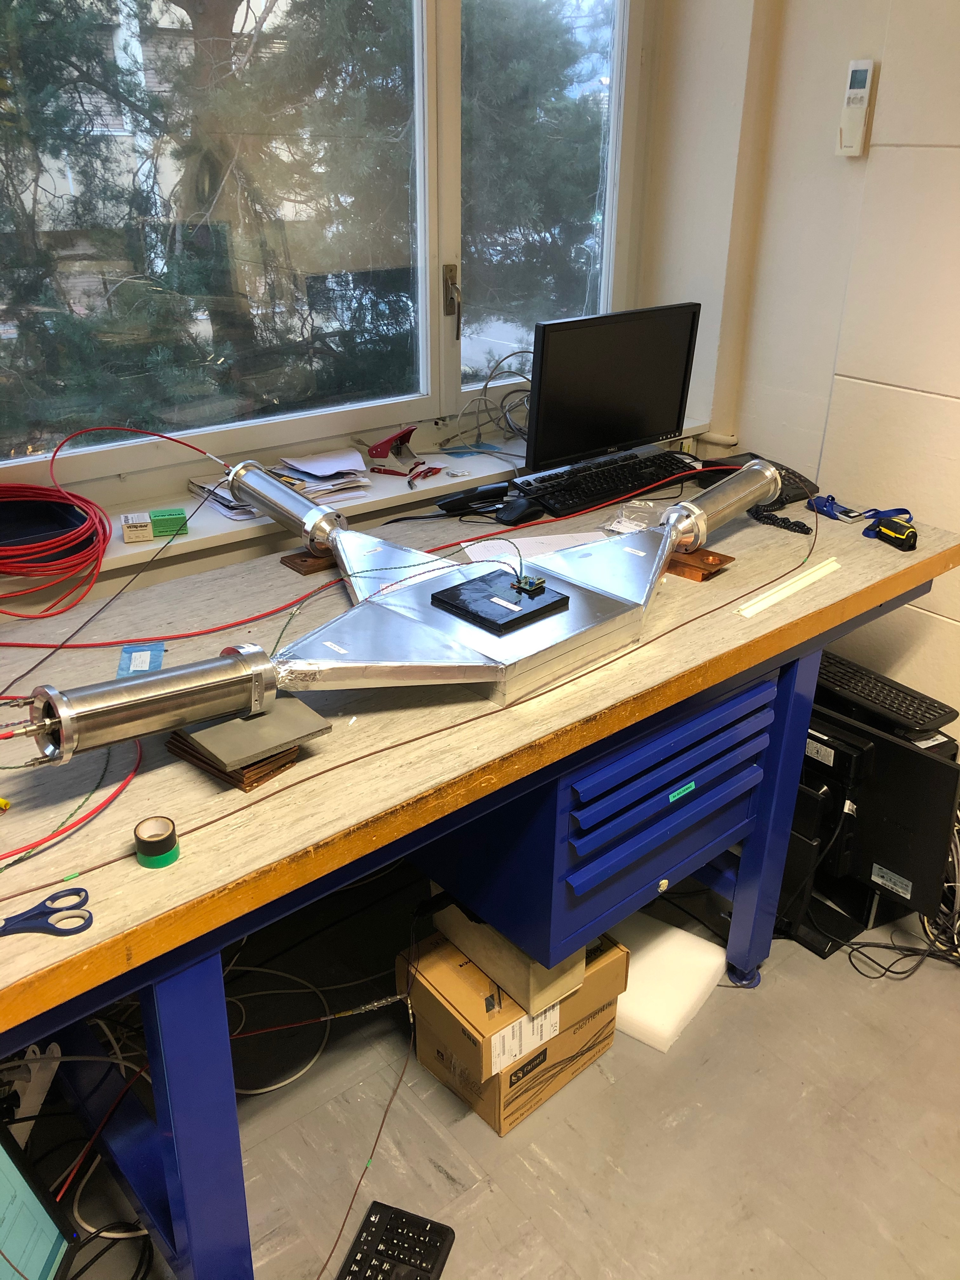
SCINTILLATORS - TESTING
Use cosmic muons to measure the scintillator response & inefficiency
Efficiency >99.9% measured
  Within specification

Slide 31
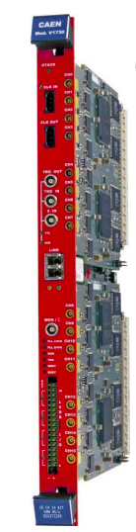
CALORIMETER/SCINTILLATORS – READOUT
The calorimeter and Scintillators use a common readout.
The PMT signals are digitized by a CAEN vx1730 digitizer board:
16 channels
500 MHz sampling frequency
14-bit precision
Provides 8 independent trigger outputs

Slide 32
TDAQ OVERVIEW
Trigger an OR of signals from scintillators and calorimeter
  Plan to trigger on all particles entering FASER, but could pre-scale events with incoming charged particle if needed
Expected maximum trigger rate ~500Hz from incoming muons
Expected maximum bandwidth ~15MB/s
  Event size (~25KB) dominated by PMT waveforms where readout a long time around pulse to allow offline quality checks (configurable)
Trigger Logic Board is same general purpose FPGA board as Tracker Readout Board but with different firmware/adapter-card
Readout and trigger logic electronics in TI12 tunnel
  Not sufficient time to send signals to the surface and back
  Event builder and DAQ s/w running on PC on surface (600m away)
No trigger signals sent/received from ATLAS

Slide 33
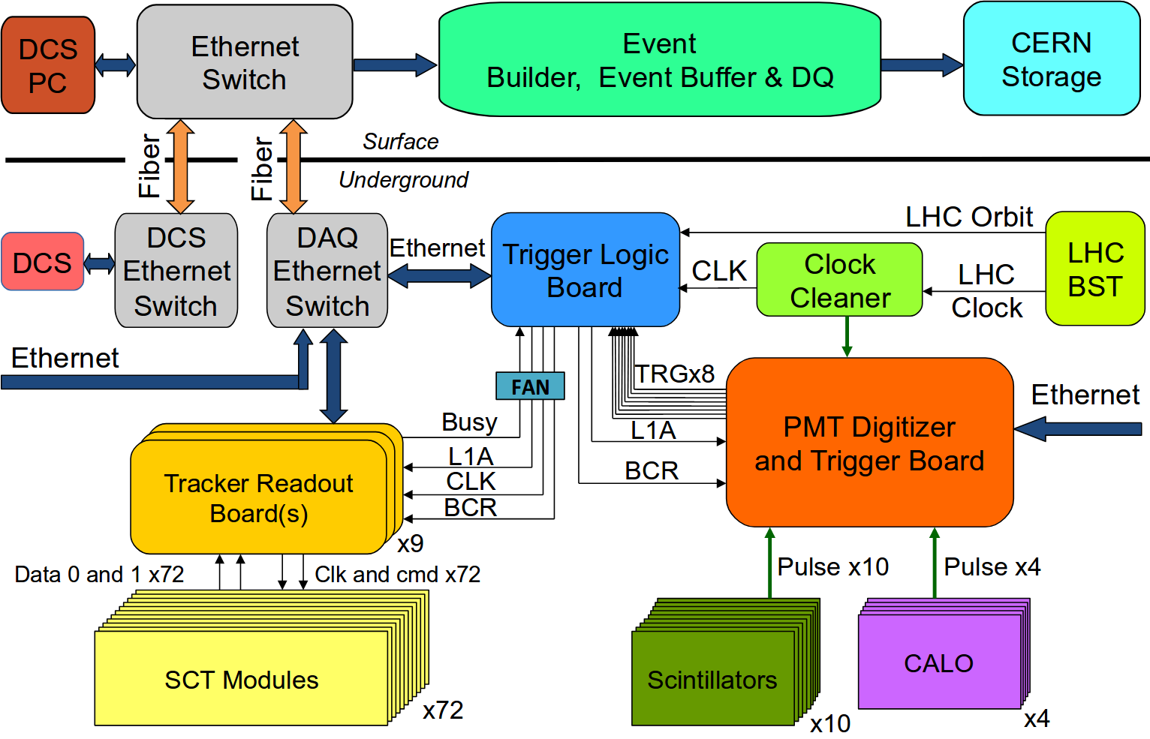
TDAQ ARCHITECTURE

Slide 34
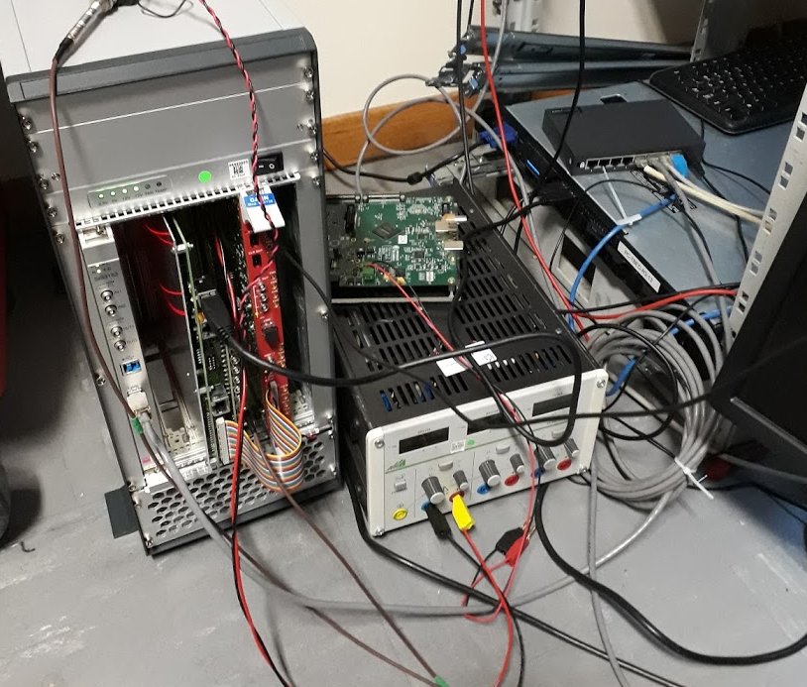
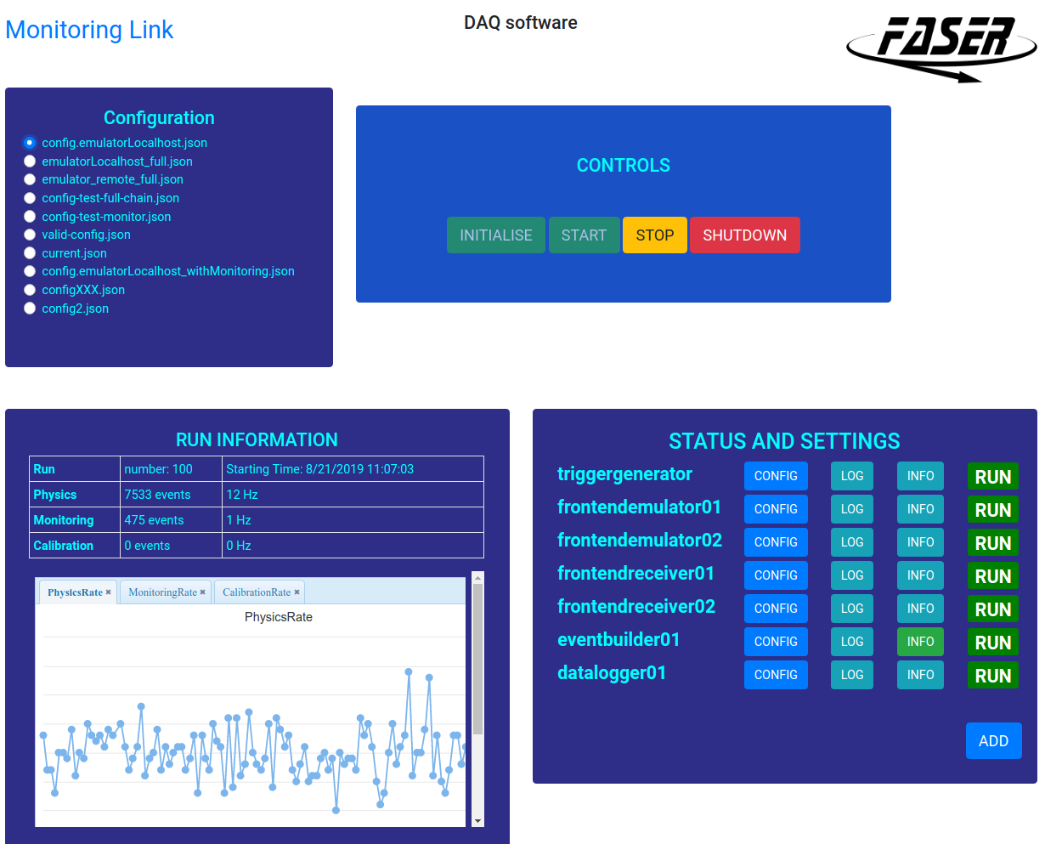
TDAQ STATUS
All hardware for Tracker Readout and Trigger Logic produced and tested
All firmware implemented and tested
DAQ s/w for all readout boards implemented and tested
Combined system tests had started before CERN shutdown
TDAQ test setup
Web-based run-control
Tracker
board
Digitizer
Trigger
board
VME to Ethernet
bridge

Slide 35
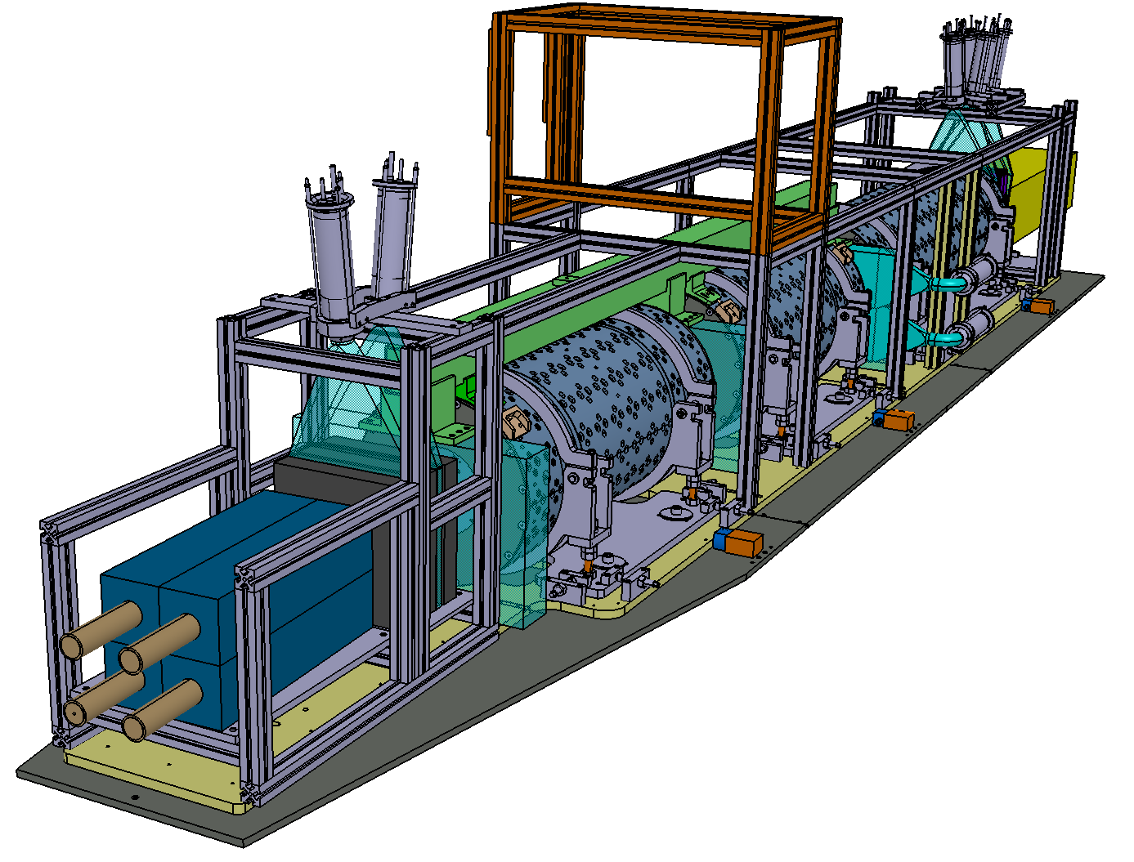
DETECTOR SUPPORT
Main requirements of detector support:
  Keep tracking stations well aligned in vertical plane (O(100µm))
  Align magnets to each other and LOS within a few mm
  Allow detector to follow changes in LOS due to changing crossing angle in IP1
    Crossing angle moves LOS by ~7cm
    Crossing direction can change in YETS
Upper Frame
(Bosch profiles)
Tracker
Backbone
(green)
Upper_BP
(yellow)
Lower_BP
(dark grey)

Slide 36
TUNNEL INFRASTRUCTURE

Slide 37
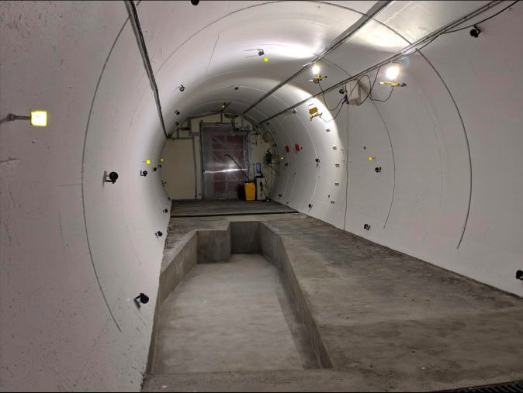
CIVIL ENGINEERING WORK
Civil engineering work in TI12 to allow FASER installation finished on schedule, just before CERN shutdown! Significant cleanup work in TI12 before digging could begin.
Many constraints in planning this:
Strong requirement on no dust in the LHC during LS2
Little available time for doing the work in LS2
Extremely important to not effect the tunnel stability during the works
The drainage must be maintained during and after the works

Slide 38
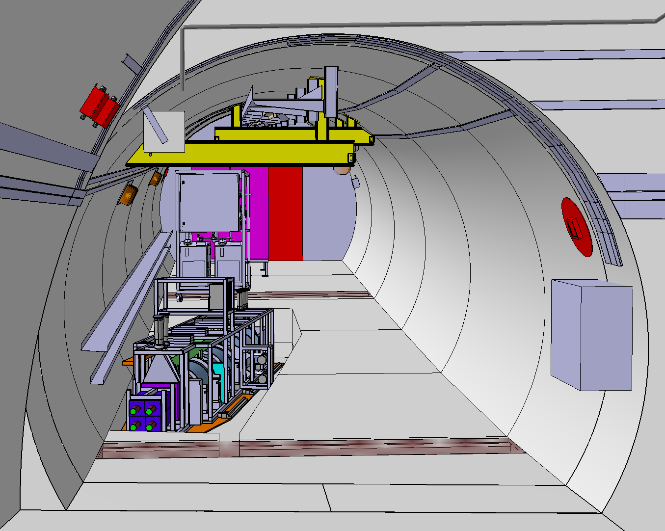
INFRASTRUCTURE WORK IN TI12
Next steps are to install:
Transport equipment
Lights
Racks
Power
Optical Fibers
Compressed Air
Cooling Unit
Cable Trays

Slide 39
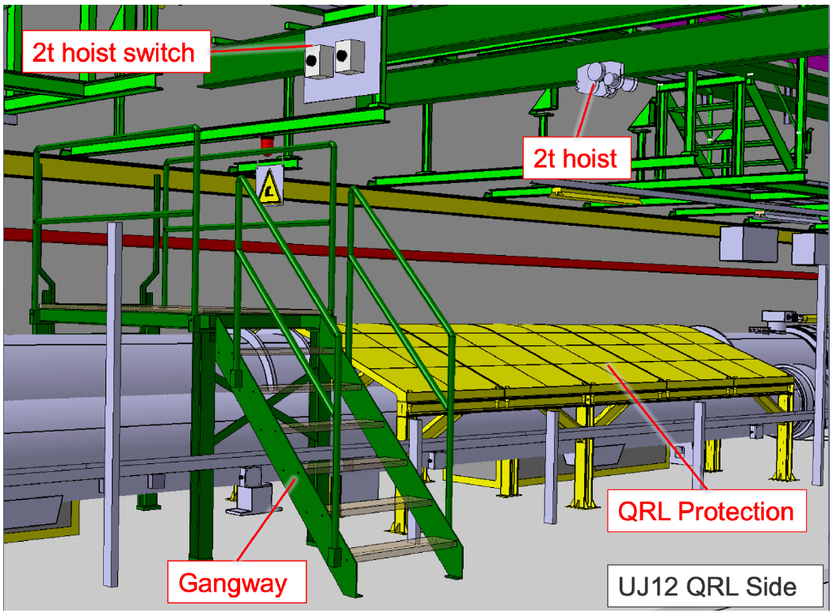
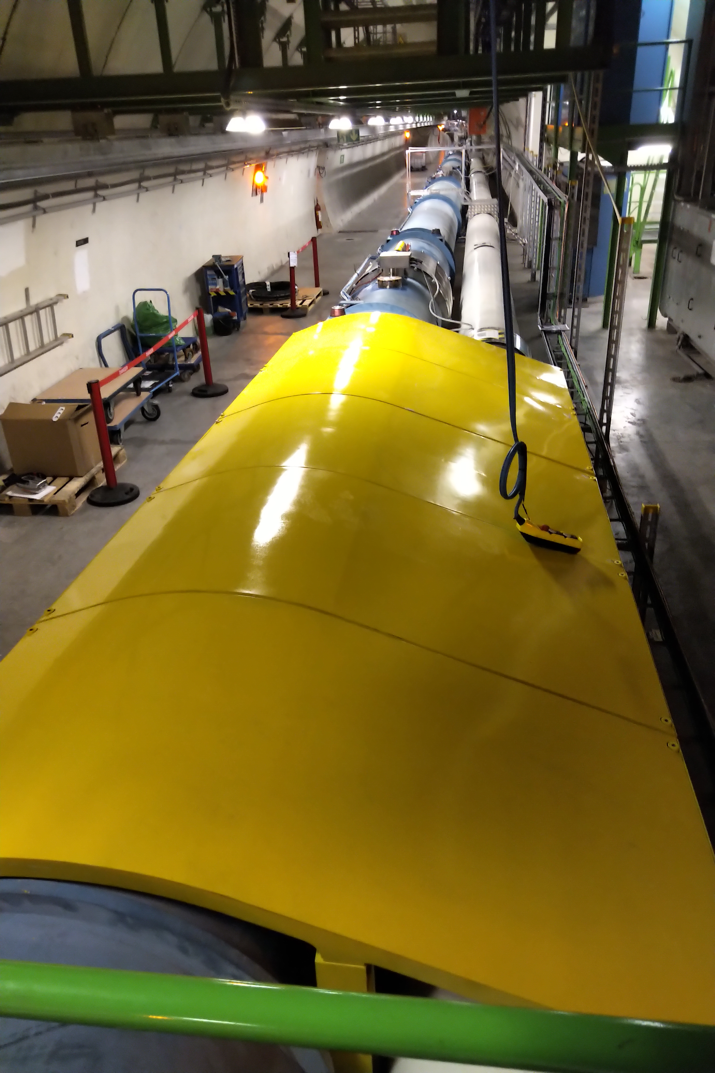
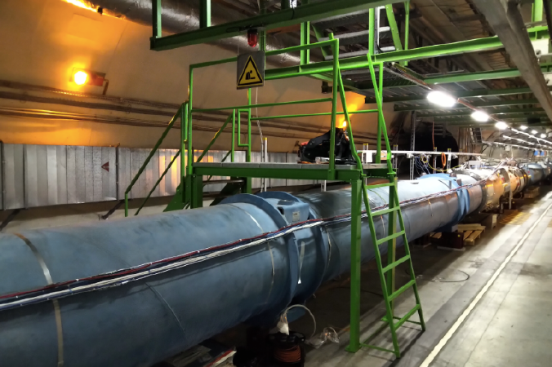
INFRASTRUCTURE WORK IN UJ12
Access to TI12 is over the LHC machine- complicates the transport & safety

Slide 40
FUTURE UPGRADE: FASER 2

Slide 41
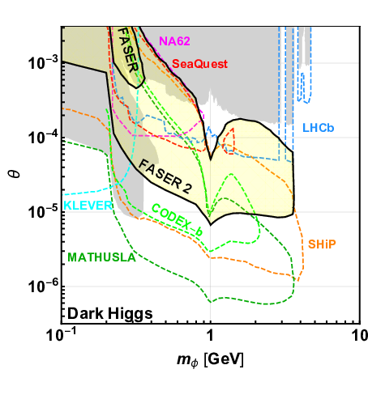
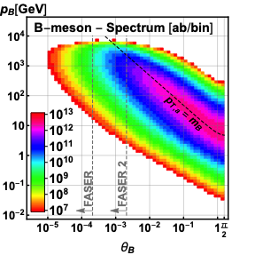
POSSIBLE FUTURE UPGRADE - FASER 2
A potential upgraded detector for HL-LHC running, would increase sensitivity further
Increasing detector radius to 1m would allow sensitivity to new physics produced in heavy meson (B, D) decays increasing the physics case beyond just the increased luminosity
FASER 2 therefore becomes very strong compared to low energy experiments for certain models (dark Higgs), due to large B/D production rates at LHC:
N_{B}/N_{π}~10⁻² (~10⁻⁷ at beam dump expts)

Slide 42
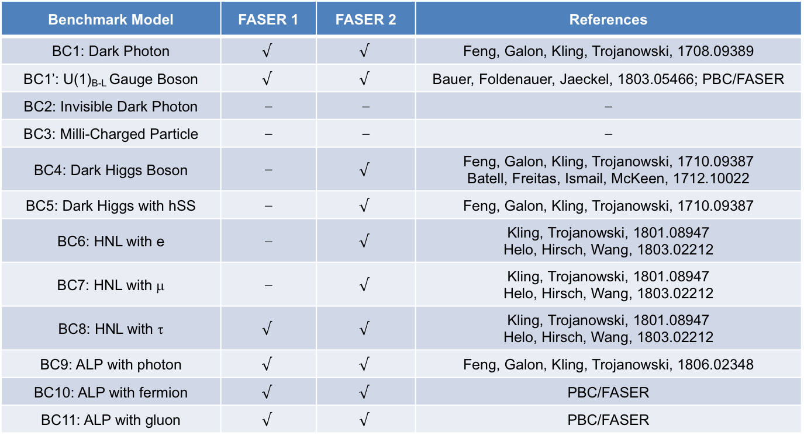
FASER 2 – Physics reach
1811.12522
FASER 2 increases the set of models that can be targeted
Sensitivity for all models with renormalizable couplings (dark photon, dark Higgs, HNL); ALPs with all types of couplings (γ, f, g); etc…
Benchmark Model | FASER 1 | FASER 2 | References
BC1: Dark Photon |  |  | Feng, Galon, Kling, Trojanowski, 1708.09389
BC1’: U(1)_{B-L} Gauge Boson |  |  | Bauer, Foldenauer, Jaeckel, 1803.05466; 1811.12522
BC2: Invisible Dark Photon | ⎼ | ⎼ | ⎼
BC3: Milli-Charged Particle | ⎼ | ⎼ | ⎼
BC4: Dark Higgs Boson | ⎼ |  | Feng, Galon, Kling, Trojanowski, 1710.09387 Batell, Freitas, Ismail, McKeen, 1712.10022
BC5: Dark Higgs with hSS | ⎼ |  | Feng, Galon, Kling, Trojanowski, 1710.09387
BC6: HNL with e | ⎼ |  | Kling, Trojanowski, 1801.08947 Helo, Hirsch, Wang, 1803.02212
BC7: HNL with μ | ⎼ |  | Kling, Trojanowski, 1801.08947 Helo, Hirsch, Wang, 1803.02212
BC8: HNL with τ |  |  | Kling, Trojanowski, 1801.08947 Helo, Hirsch, Wang, 1803.02212
BC9: ALP with photon |  |  | Feng, Galon, Kling, Trojanowski, 1806.02348
BC10: ALP with fermion |  |  | 1811.12522
BC11: ALP with gluon |  |  | 1811.12522

Slide 43
FASER 2 – Physics reach
1811.12522
FASER 2 increases the set of models that can be targeted
Sensitivity for all models with renormalizable couplings (dark photon, dark Higgs, HNL); ALPs with all types of couplings (γ, f, g); etc…
Benchmark Model | FASER 1 | FASER 2 | References
BC1: Dark Photon |  |  | Feng, Galon, Kling, Trojanowski, 1708.09389
BC1’: U(1)_{B-L} Gauge Boson |  |  | Bauer, Foldenauer, Jaeckel, 1803.05466; 1811.12522
BC2: Invisible Dark Photon | ⎼ | ⎼ | ⎼
BC3: Milli-Charged Particle | ⎼ | ⎼ | ⎼
BC4: Dark Higgs Boson | ⎼ |  | Feng, Galon, Kling, Trojanowski, 1710.09387 Batell, Freitas, Ismail, McKeen, 1712.10022
BC5: Dark Higgs with hSS | ⎼ |  | Feng, Galon, Kling, Trojanowski, 1710.09387
BC6: HNL with e | ⎼ |  | Kling, Trojanowski, 1801.08947 Helo, Hirsch, Wang, 1803.02212
BC7: HNL with μ | ⎼ |  | Kling, Trojanowski, 1801.08947 Helo, Hirsch, Wang, 1803.02212
BC8: HNL with τ |  |  | Kling, Trojanowski, 1801.08947 Helo, Hirsch, Wang, 1803.02212
BC9: ALP with photon |  |  | Feng, Galon, Kling, Trojanowski, 1806.02348
BC10: ALP with fermion |  |  | 1811.12522
BC11: ALP with gluon |  |  | 1811.12522
Due to short timescale for FASER installation, we have been concentrating on that, and have not thought about the design of the FASER 2 detector in detail.
It is clear that we can not just scale up the current detector to r=1m for a number of reasons (magnet, SCT modules etc..)

Slide 44
FASERnu
Technical Proposal: arXiv:2001.03073

Slide 45

NEUTRINO MEASUREMENTS IN FASER
A huge number of neutrinos produced in the LHC collisions (hadron decay) traverse the FASER location covering an unexplored neutrino energy regime.
FASERnu is a emulsion/tungsten detector to be placed in front of the main FASER detector to detect neutrino’s of all flavours.
150/fb @14TeV | ν_{e} | ν_{μ} | ν_{τ}
Main production source | kaon decay | pion decay | charm decay
# traversing FASERnu 25cm x 25cm | O(10¹¹) | O(10¹²) | O(10⁹)
# interacting in FASERnu (1.2tn Tungsten) | ~1300 | ~20000 | ~20

Slide 46

NEUTRINO MEASUREMENTS IN FASER
A huge number of neutrinos produced in the LHC collisions (hadron decay) traverse the FASER location covering an unexplored neutrino energy regime.
FASERnu is a emulsion/tungsten detector to be placed in front of the main FASER detector to detect neutrino’s of all flavours.
Primary physics goal – cross section measurements at high energy.
Projected results:
Uncertainty from neutrino production important
Neutrino energy reconstruction with resolution ~30% expected from simulation studies

Slide 47


EMULSION DETECTION
Emulsion film made up of ~80μm emulsion layer on either side of 200μm thick plastic
Emulsion gel active unit silver bromide crystals (diameter 200nm)
Charged particle ionization recorded and can be amplified and fixed by chemical development of film
Track position resolution ~50nm, and angular resolution ~0.35mrad
  But no time resolution!

Slide 48

THE FASERnu DETECTOR
FASERnu detector is 1.3m long, 25x25cm 1.2tn detector
Made from 1000 x 1mm tick tungsten plates, interleaved with emulsion films
Allows to distinguish all flavour of neutrino interactions and neutral hadron vertices
Emulsion film has excellent position/angular resolution for charged particle tracks
But no time resolution…
Detector needs to be replaced every 30-50/fb to keep the track multiplicity manageable
Will be replaced during Technical Stops during LHC running
  Take advantage of transport infrastructure installed in UJ12/TI12 for FASER

Slide 49


THE FASERnu DETECTOR
FASERnu detector is 1.3m long, 25x25cm 1.2tn detector
Made from 1000 x 1mm tick tungsten plates, interleaved with emulsion films
Allows to distinguish all flavour of neutrino interactions and neutral hadron vertices
Emulsion film has excellent position/angular resolution for charged particle tracks
But no time resolution…
Detector needs to be replaced every 30-50/fb to keep the track multiplicity manageable
Will be replaced during Technical Stops during LHC running
  Take advantage of transport infrastructure installed in UJ12/TI12 for FASER
FASERnu will be centered on the LOS (in the FASER trench)
  Maximises flux of all neutrino flavours
neutrino
beam
FASERnu

Slide 50

PILOT NEUTRINO DETECTOR
A 30 kg emulsion detector was installed in TI18 during 2018 running
  Used to validate FLUKA simulation of background particle flux
12.5/fb data collected
  ~30 neutrino interactions expected in detector
Emulsion data developed, reconstructed and analysis ongoing
Extremely valuable for validating the FASERnu concept, and optimizing the detector and reconstruction
Several neutral vertices identified, likely to be neutrino interactions, but could also be neutral hadrons – analysis ongoing…

Slide 51

PILOT NEUTRINO DETECTOR
A 30 kg emulsion detector was installed in TI18 during 2018 running
  Used to validate FLUKA simulation of background particle flux
12.5/fb data collected
  ~30 neutrino interactions expected in detector
Emulsion data developed, reconstructed and analysis ongoing
Extremely valuable for validating the FASERnu concept, and optimizing the detector and reconstruction
Several neutral vertices identified, likely to be neutrino interactions, but could also be neutral hadrons – analysis ongoing…

Slide 52
SUMMARY AND OUTLOOK
FASER is a proposed small, fast and cheap experiment to be installed in the LHC during LS2, to take data in Run 3
  Targeting light, weakly-coupled new particles at low p_{T}
  FASERnu: first measurements of neutrinos produced at a collider and in an unexplored energy regime
Detector designed to be affordable and fast to construct and install
  Utilizing spare modules from existing experiments
  Minimizing services needed where possible
  Total detector cost <2MCHF
  Host-Lab costs to be borne by CERN (civil engineering, transport, services)
Detector design, construction and testing progressing well, and on track for LS2 installation
  Effect of CERN shutdown on schedule needs to be understood (still hoping to install the detector in 2020)

Slide 53
SUMMARY AND OUTLOOK
FASER is a proposed small, fast and cheap experiment to be installed in the LHC during LS2, to take data in Run 3
  Targeting light, weakly-coupled new particles at low p_{T}
  FASERnu: first measurements of neutrinos produced at a collider and in an unexplored energy regime
Detector designed to be affordable and fast to construct and install
  Utilizing spare modules from existing experiments
  Minimizing services needed where possible
  Total detector cost <2MCHF
  Host-Lab costs to be borne by CERN (civil engineering, transport, services)
Detector design, construction and testing progressing well, and on track for LS2 installation
  Effect of CERN shutdown on schedule needs to be understood (still hoping to install the detector in 2020)
Many thanks to:
Heising Simons Foundation
Simons Foundation
CERN
for invaluable support!

Slide 54

THE FASER COLLABORATION
The FASER Collaboration consists of
62 members from 20 institutions and 8 countries
https://faser.web.cern.ch/

Slide 55

ACKNOWLEDGEMENTS
The FASER Collaboration gratefully acknowledges the contributions of many people

Slide 56


BACK UP

Slide 57

TIMELINE

Slide 58
MORE INFORMATION…
FASER | LOI | 1811.10243
 | TP | 1812.09139
 | Physics Summary | 1811.12522 | Phys. Rev. D 99, 095011
FASERnu | LOI | 1908.02310 | EPJC 80 61 (2020)
 | TP | 2001.03073

Slide 59

EFFECT OF LHC CROSSING ANGLE
To avoid parasitic collisions and beam-beam effects in the common beampipe close to the IP, the LHC runs with a crossing-angle
  The half crossing angle is ~150μrad, which moves the collision axis by ~7.5cm at the FASER location
  Such a change reduces the signal acceptance in FASER by ~25%
  Leads to very small changes in physics sensitivity

Slide 60
Tracker alignment issues
Momentum resolution will be limited by the relative alignment of the 3 tracking stations in the bending plane.
Significant rate of muons going through FASER tracker, but since we don’t know their momentum they can not be used to constrain this alignment (no standard candles (Z, J/psi etc..) in FASER.
Since we use a permanent magnet we cannot use the trick (used in ATLAS MS) of taking straight track data with the field off to constrain the alignment.
A 100um precision of the relative position of the tracking stations in the bending plane, leads to 100% uncertainty on the momentum for track momenta above ~650 GeV.
For FASER physics good track momentum resolution not needed, but of course for many reasons (background measurements, auxiliary physics measurements etc..) we want as good resolution as possible.

Slide 61

OTHER PRODUCTION MECHANISMS

Slide 62
ANOTHER EXAMPLE: Axion-Like-Particles (ALPs)
1806.02348
ALP production using the LHC as a beam-dump experiment.
Very high energy photons produced in LHC collisions, interacting with material in the TAN can produce ALPs.
The ALPs (with ~TeV energy) then propagate in a straight line, and can decay inside FASER (480-140 = 340m from their production point).
ALP production via the Primakoff process from photons scattering in the TAN

Slide 63

1806.02348
ANOTHER EXAMPLE: Axion-Like-Particles (ALPs)
ALP production using the LHC as a beam-dump experiment.
Very high energy photons produced in LHC collisions, interacting with material in the TAN can produce ALPs.
The ALPs (with ~TeV energy) then propagate in a straight line, and can decay inside FASER (480-140 = 340m from their production point).
ALP production via the Primakoff process from photons scattering in the TAN
Assuming angular coverage of TAN is <1mrad
note this old plots, and FASER volume R=10cm and decay length 1.5m now!

Slide 64

EXPECTED PERFORMANCE – 2 photon signature
For ALP->γγ decay, magnetic field does not help separate closely spaced decay products
We investigated calorimeter / pre-shower to allow to be able to resolve closely spaced (~1mm) high energy photons (>500 GeV) - seems very challenging
ALP production via the Primakoff process from photons scattering in the
LHC infrastructure material (TAN)
truth level studies

Slide 65
EXPECTED PERFORMANCE – 2 photon signature
For ALP->γγ decay, magnetic field does not help separate closely spaced decay products
We investigated calorimeter / pre-shower to allow to be able to resolve closely spaced (~1mm) high energy photons (>500 GeV) - seems very challenging
Preliminary studies suggest that events with no tracks and a large amount of EM energy in the calorimeter would be ~background free => an ALP signal would be detectable without the need to resolve the 2 photons.
Further studies show an interesting background would be high energy neutrino’s interacting in the calorimeter to give large EM showers
- either muon neutrinos leading to hadronic showers with pi0,
- or (more rarely) electron neutrinos interacting to give electrons
First time I have heard of neutrino interactions in the detector being a background for a collider search!
We are considering to have a scintillator pre-shower to give a small amount of longitudinal information which could be used to veto such neutrino interaction events.
In longer term investigating installing a fine granularity silicon pre-shower to be able to separate close-by photons.

Slide 66

AXION LIKE PARTICLES (ALPs)
Assuming background free single-photon like search for ALPs sensitivity for 10/fb and 150/fb

Slide 67


Slide 68


STRAY MAGNETIC FIELD
More detailed calculation of stray field, also going to larger distance
  3mT limit (for signage at CERN) always within 50cm of magnet centre (so enclosed in trench, does not impact access)
5cm outside magnet opening
inside magnet
outside magnet
1mT field 50cm from magnet centre

Slide 69


Slide 70

FASER TRACKER: COOLING
Due to the low radiation in TI12 the silicon can be operated at room temperature, but the detector needs to be cooled to remove heat from the on-detector ASICs
  ~5W per module => 40W/plane => 360W in full detector
Tracking layer designed to give sufficient thermal and mechanical properties, whilst minimizing material in tracking volume
Use simple water chiller with inlet temperature 10-15 degrees
  Tracking stations flushed with dry air to avoid condensation
  Hardware interlock to turn off tracker if cooling / humidity control fails
ASICs
Tracking layer frame, CNC machined from single Al block.
Frame contains 5mm cooling pipe running around the outside.
Thermal performance validated by FEA simulations and measurements (NTC on each SCT module, and 2 on frame)
SMC chiller

Slide 71

FASER TRACKER: COOLING
Due to the low radiation in TI12 the silicon can be operated at room temperature, but the detector needs to be cooled to remove heat from the on-detector ASICs
  ~5W per module => 40W/plane => 360W in full detector
Tracking layer designed to give sufficient thermal and mechanical properties, whilst minimizing material in tracking volume
Use simple water chiller with inlet temperature 10-15 degrees
  Tracking stations flushed with dry air to avoid condensation
  Hardware interlock to turn off tracker if cooling / humidity control fails
ASICs
Tracking layer frame, CNC machined from single Al block.
Frame contains 5mm cooling pipe running around the outside.
Thermal performance validated by FEA simulations and measurements (NTC on each SCT module, and 2 on frame)
SMC chiller

Slide 72


FASER TRACKER: READOUT
Decided to not use the ATLAS SCT readout to simplify the system.
Custom made flex cable used to connect pigtail on SCT module to custom PCB patch panel which separates out power (HV, LV), readout, monitoring lines.
3m-long Twinax cables used to send data from patch- panel to Tracker Readout Board (TRB)
TRB is General Purpose FPGA board developed in University of Geneva for other experiments – with dedicated adapter card to handle connections
1 TRB / tracker plane (9 in full detector)
TRB logic implemented in firmware:
  Simple DAQ functionality (error checking, header etc…)
  Data send via ethernet to DAQ PCs on surface (600m from FASER)
Tracker Readout Board

Slide 73


FASER TRACKER: POWERING
Power requirements of Tracker are:
Chosen solution Wiener MPOD Power Supplies (ISEG cards for HV).
In order to save money split HV such that 1 channel serves 4 modules. 18 MPV 8008I LV cards serve 72 SCT modules in the system.
Only 3 ISEG EHS 8405p HV cards needed.
Radiation level in TI12 measured to be very low for LHC environment, still higher than on surface.
To avoid problems from SEU in PS we have implemented a HW protection circuit on the LV, where any over voltage will be cut by dedicated circuit.
Cables constructed by CERN EP-DT (many thanks)

Slide 74




FASER TRACKER: COMMISSIONING EXAMPLES
Noise versus channel:
Before Trimming
After Trimming
Comparison of noise in single module QA setup and final setup
IV curve in final setup

Slide 75
FASER TRACKER: CURRENT STATUS
1st prototype plane produced and assembled Sept. 2019
  Used for extensive testing since then
2nd prototype produced January 2020
  Small updates in design based on 1st prototype
  Design validated with many tests
Production of final tracker frames ongoing at University of Geneva
All other needed components produced and available
Assembly and metrology procedure well defined
Validation procedure for each layer well defined and exercised on prototype planes
All infrastructure for testing and validation of tracker setup in our labs at CERN
Waiting for CERN to re-open…

Slide 76


CALORIMETER - PMTs
R7899-20 Hamamatsu PMTs provided by LHCb
PMT Non-linearity
Gain ~3000
Non-linearity [%]
Digitizer
range
Gain ~300
New HV divider
Testing lab with LED pulser and cosmic ray test stand setup at CERN
Used to characterize and determine HV working point
Low gain needed to have sufficient range for largest signals
Energy calibration:
  Using in situ muons (MIPs)
  Plan to also have test-beam during Run-3 for spare modules

Slide 77

SCINTILLATOR SYSTEM
Scintillators used for:
Vetoing incoming charged particles
  Very high efficiency needed (O(10⁸) incoming muons in 150/fb)
Triggering
Timing measurement
  ~1ns resolution
Simple pre-shower for Calorimeter
Design:
EJ-200 plastic scintillator from ELJEN Technology
Most scintillators 20x300x300mm – gives ~200 photo-electrons/MIP
Timing station uses different design to improve time resolution
  two 10x200x400mm – gives ~80 photo-electrons/MIP
All use Hamamatsu H6410 PMT
  Large diameter (46mm)
  Large gain (10⁶ – 10⁸)
Scintillators, light-guides and PMT holders designed and manufactured at CERN
Hamamatsu H6410 PMT

Slide 78

CALORIMETER/SCINTILLATORS – POWER/READOUT
The calorimeter and Scintillators use a common power and readout.
The PMT HV needs are:
PMT HV is provided by 16 channel ISEG HV Module (EHS F030n) which is integrated into the MPOD system used for the Tracker powering.
The PMT signals are digitized by a CAEN vx1730 digitizer board:
16 channels
500 MHz sampling frequency
14-bit precision
Provides 8 independent trigger outputs

Slide 79


DETECTOR SUPPORT
Magnet support and tuning system

Slide 80

DETECTOR SUPPORT – UPPER FRAME
Upper frame to support:
Scintillators (including PMTs)
Calorimeter
On-detector cables and electronics
Constructed from 40 mm² aluminum profiles (Bosch profiles)
Easy to construct and flexible

Slide 81


COST ESTIMATES
FASER:
Biggest single costs:
Magnet
Power Supplies (~100kCHF)
FASERnu:
Biggest single costs:
Tungsten plates (~350kCHF)
Emulsion Gel (~300kCHF)

Slide 82

THE TI12 TUNNEL
FASER is situated at the bottom of the TI12 tunnel close to the LHC.
TI12 was the old injection line for LEP, and is now unused.
TI12 slopes upwards, and the LOS emerges from the tunnel floor.
In order to install the FASER detector on the LOS a small amount of civil engineering work needs to be done, to lower the floor of the tunnel (50cm maximum).
After such digging a 5m long detector can be situated along the LOS.

Slide 83



FLUKA SIMULATIONS: MUON MAP
Due to bending from LHC magnets, muon flux on LOS is reduced:
μ⁻ tend to be bent to the left, μ⁺ to the right of FASER.
Expected charged particle rate for different energy thresholds (2e34cm⁻²s⁻¹)

Slide 84


BEAM BACKGROUNDS
Measurements using emulsion detectors installed in TI12 in 2018 running confirm expected particle flux
Measurements using TimePix BLM in TI12 confirm that particle flux is correlated with luminosity in IP1
particles from IP1
particles from LHC beam line
Measured angle in emulsion detector

Slide 85


Slide 86

Linking FASERν with FASER
Possibility to connect FASERν with rest of FASER for:
  Charge identification
  Improved energy resolution
  Better background rejection
Would require interface detector in front of FASER
  Precision tracker to link FASERν and FASER tracks
  Most likely a fourth station of spare ATLAS SCT modules
To not jeopardize FASER schedule, this would only be installed in 2021/22 YETS
  Most data anyway expected after that
Simulation studies on-going
to quantify possible gains

Slide 87


Track Momentum Reconstruction
High granularity, high precision tracking allows momentum measurement using multiple columb scattering estimate
Expect sub-micron alignment of layers thanks to large rate of high energy muons
Reco momentum vs truth
Max momentum vs position res.
Assumes 0.4μm resolution
and 100 traversed layers

Slide 88

Neutrino Energy Reconstruction
Neutrino energy can be estimated from sum of visible energy
Improved resolution under study using ANN to also combine with angular information
Sum of visible energy
ANN method
ΔE/E

Slide 89

Emulsion Detector Structure

Slide 90

Emulsion Detector Sequence

Slide 91

Emulsion Readout System

Slide 92

FASERnu Muon ID
Track length (cm) | Tungsten length (cm) | Plastic length (cm) | Prob. of pion flying through
130 | 97 | 33 | 0.00004
110 | 82 | 28 | 0.00018
90 | 67 | 23 | 0.00087
70 | 52 | 18 | 0.00417
50 | 37 | 13 | 0.01995
30 | 22 | 8 | 0.09549
10 | 7 | 3 | 0.45708
80% of detector volume allows > for muon ID.

