Slide 1
MARCO, the solenoid for the ePIC detector at EIC
Valerio CALVELLI (CEA/IRFU)
On Behalf of EIC Detector Magnet team
2022-10-14

Slide 2



Outline
The EIC and the Detectors forecast
Why MARCO
Design Requirements
Magnetic Design
Conductor Design
Mechanical Design
Cryogenics Design
Protection Studies
Conclusions
TEAMS & CONTRIBUTORS
V. Calvelli, H. Reymond, F. Stacchi, F.P. Juster, M. Segreti, C.Berriaud, D. Simon, J.P. Lottin, L. Boccardo, L. Quettier
R. Rajput-Ghoshal, S. Gopinath, P. Ghoshal, E. Sun, D. Young, K. Hall, R. Ent, M. Lainey, J. Tenbusch
E. Aschenauer, R. Sharma, R. Wimmer, T. Lewis, R. Than

Slide 3
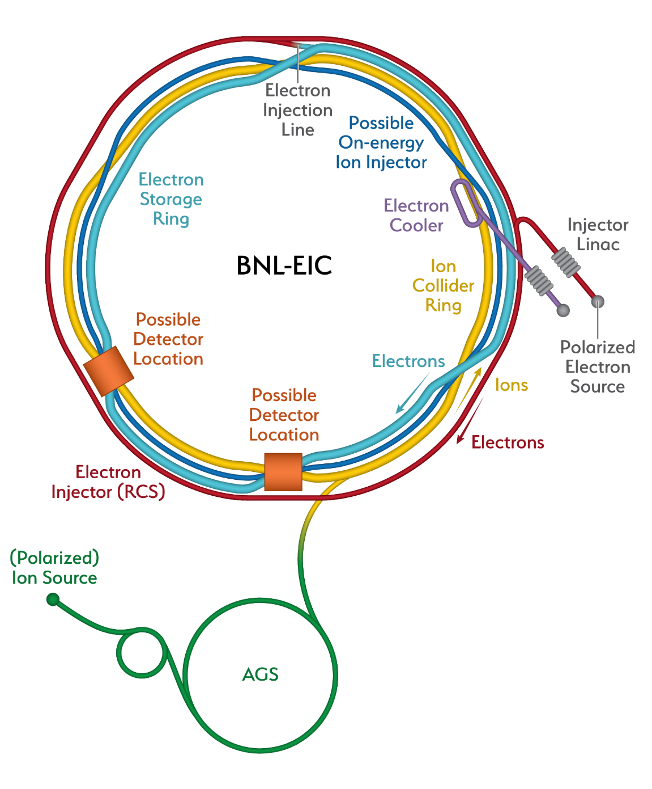
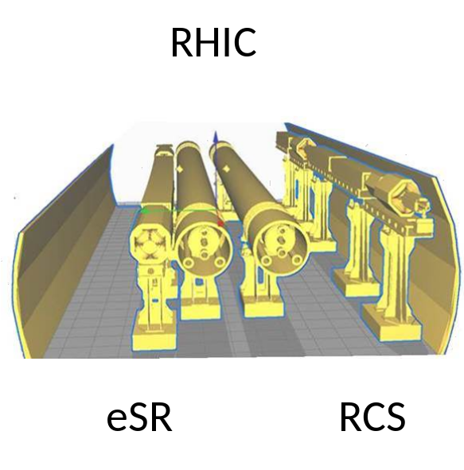
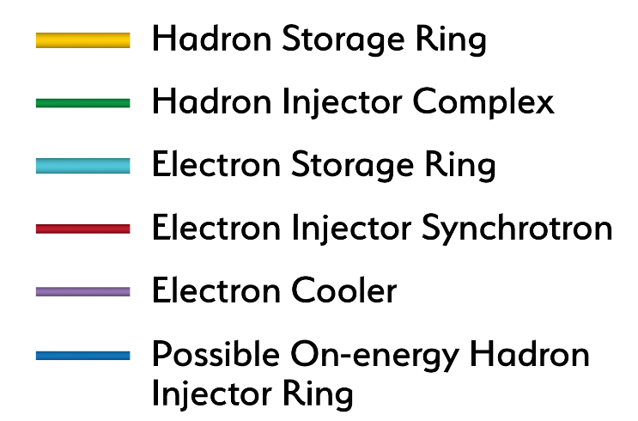
The Electron – Ion Collider
Design based on existing RHIC
Hadron storage ring 40-275 GeV (existing)
Electron storage ring (2.5–18 GeV (new))
Electron rapid cycling synchrotron (new)
High luminosity interaction region(s) (new)

Slide 4
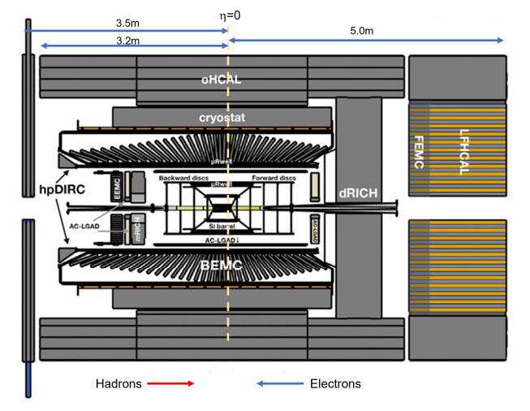
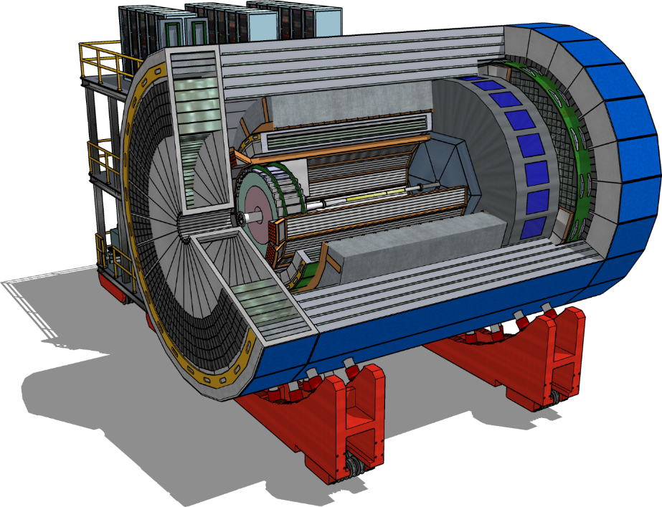
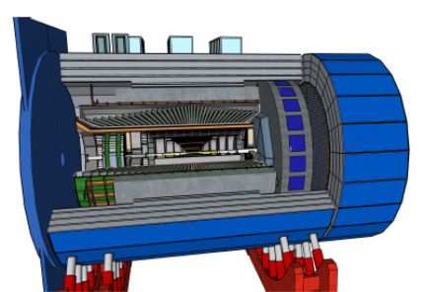
ePIC
ATHENA
ECCE
ePIC
Not recommended due to the high costs but discussions are ongoing
it has the best performances
UE countries contribute for 1/3
Approved in March 2022
Only US & Asia countries + Orsay
Approved and financed in September 2022
94 institutions (CEA included)
96 institutions
160 institutions (CEA included)
ATHENA
Location | IP6
Detector Length | 9.5 meter
Magnet Field | 3 Tesla
Magnet Bore | 3.2 meter
Magnet Length | 3.6 meter
ECCE
Location | IP6 (or IP8)
Detector Length | 8.5 meter
Magnet Field | 1.5 Tesla
Magnet Bore | 2.8 meter
Magnet Length | 3.51 meter
ePIC
Location | IP6
Detector Length | 8.5 meter
Magnet Field | 1.7 Tesla
Magnet Bore | 2.8 meter
Magnet Length | 3.51 meter

Slide 5

Why MARCO?
ECCE
Reuse of BaBar @ 1.4 T
25y operative life + 30y of operation forecast
Sensors problems
New solenoidal magnet @ 1.5 T for replacement as contingency plan
ePIC
MAgnet with Renewed COils
New solenoidal magnet @ 1.5 T (minimum), possibly 2.0 T
Waiting for approval

Slide 6
The Requirements
Geometric
- Must fit into BaBar’s volume
Magnetic
B @ IP = 1.5 T to 2.0 T
Field Uniformity < 12.5%
Projectivity < 10 T/Amm⁻²
Transparency
- Thickness / interaction length < 1
Stray field
B < 10 G in the focalising magnets zone

Slide 7
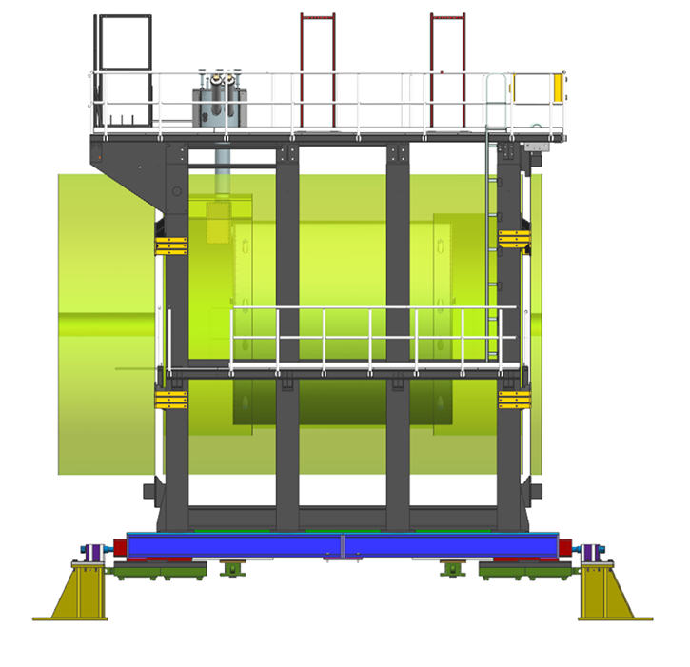
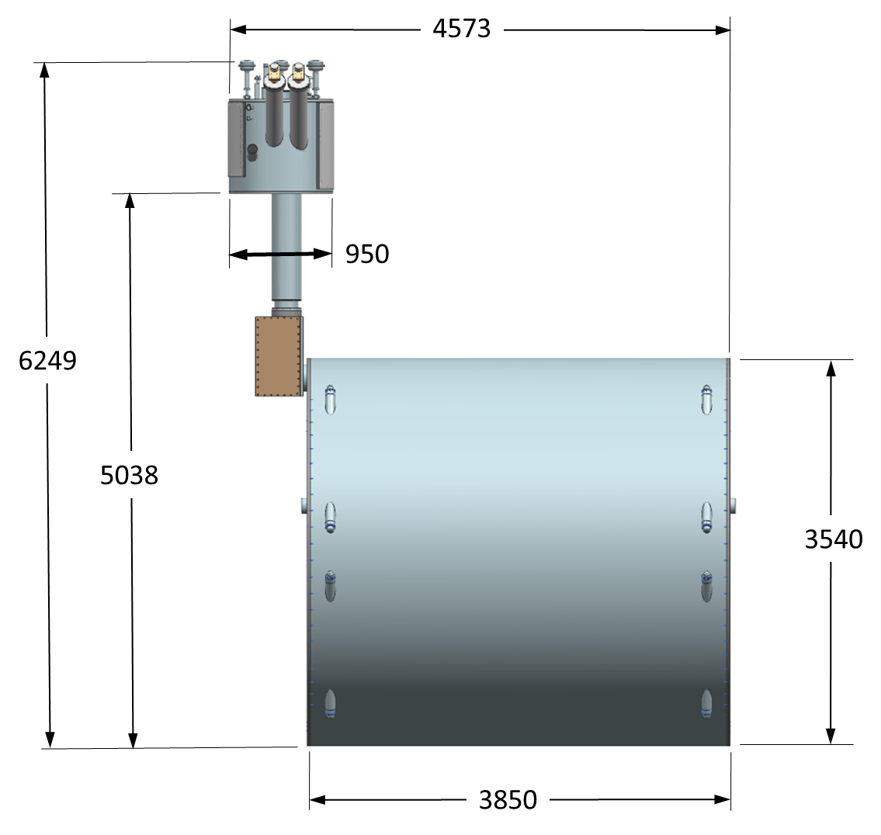
Geometric Requirements
Parameter | Value
Coil length | 3512 mm
Warm bore diameter | 2840 mm
Cryostat length | < 3850 mm
Cryostat outer diameter | < 3540 mm
MARCO must fit into BaBar’s Volume
We adopted BaBar’s cryostat dimensions as reference
MARCO Cryostat preliminary design
MARCO Cryostat surrounded by the supporting mechanical structure of ePIC

Slide 8
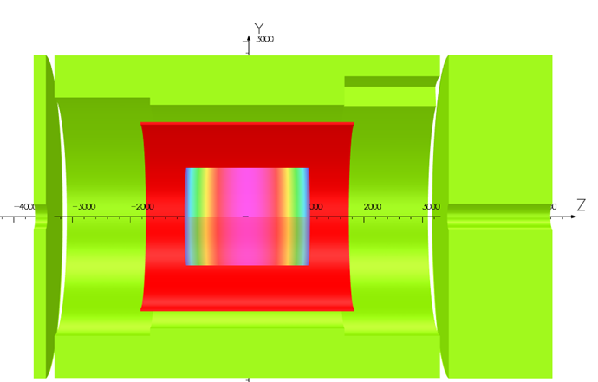
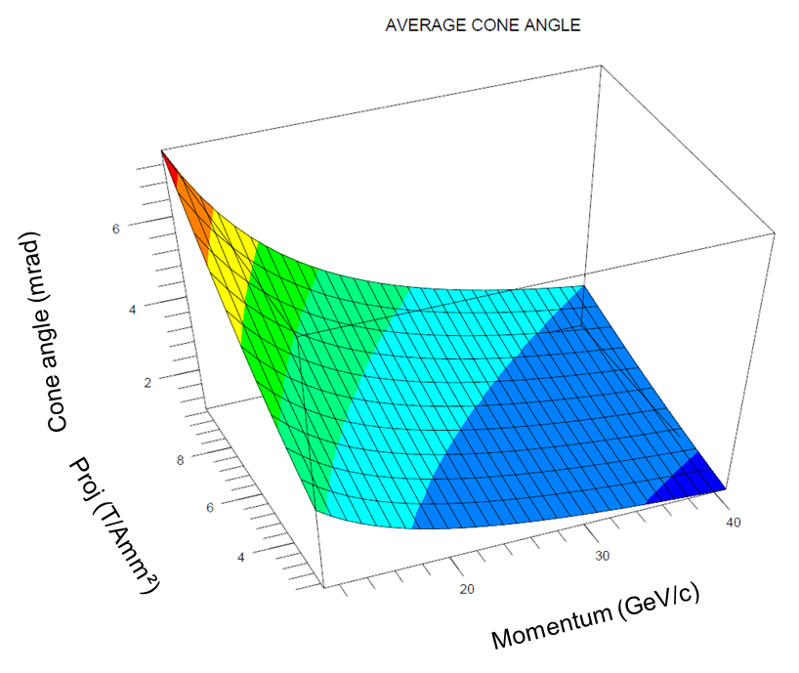
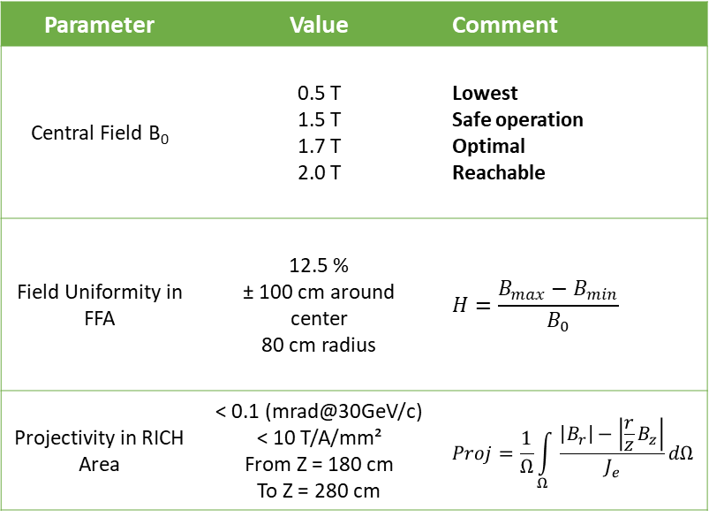

Magnetic Field Requirements
Lepton HCAL
sPhenix iron yoke
Parameter | Value | Comment
Central Field B₀ | 0.5 T 1.5 T 1.7 T 2.0 T | Lowest Safe operation Optimal Reachable
Field Uniformity in FFA | 12.5 % ± 100 cm around center 80 cm radius | $$H=\frac{B_{max}−B_{min}}{B_{0}}$$
Projectivity in RICH Area | < 0.1 (mrad@30GeV/c) < 10 T/A/mm² From Z = 180 cm To Z = 280 cm | $$Proj=\frac{1}{Ω}\int_{Ω}{\frac{\left|B_{r}\right|−\left|\frac{r}{z}B_{z}\right|}{J_{e}}}dΩ$$
Hadron HCAL
FFA
Barrel HCAL
If $Proj≅10 T/Amm²$protons of 30 GeV/c stay within a cone of 1 mrad (plus incertainties)
1 mrad

Slide 9
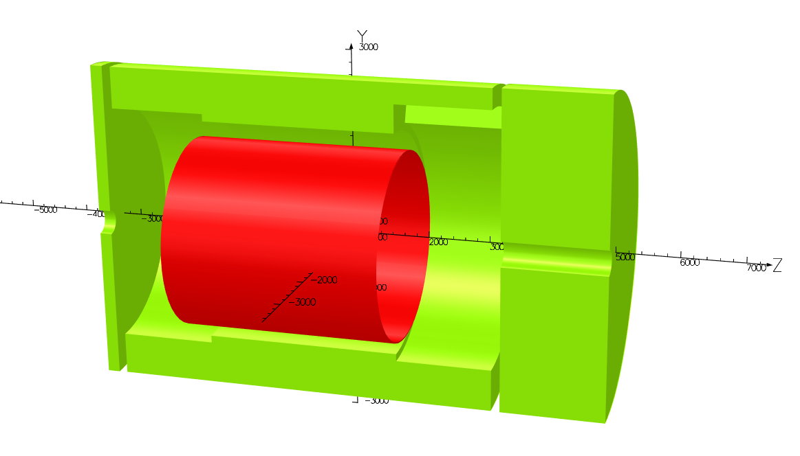
Stray Field Requirements
Lepton HCAL
B3400
sPhenix iron yoke
Parameter | Value | Comment
B5300 (B @ Z= -5300 mm) | < 10 G | Stray field requirement is based on IR magnet location
B7400 (B @ Z= 7400 mm) | < 10 G
B3400 (B @ R= 3400 mm) | < 10 G
B5300
B7400
Hadron HCAL
Barrel HCAL
These requirements depend on the magnet and the iron yoke around it

Slide 10
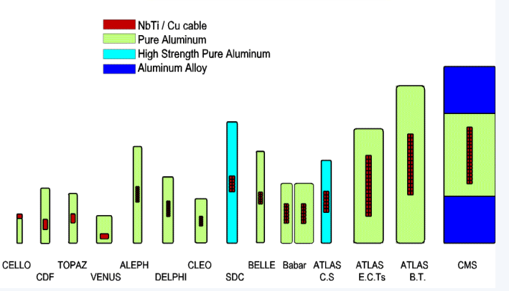
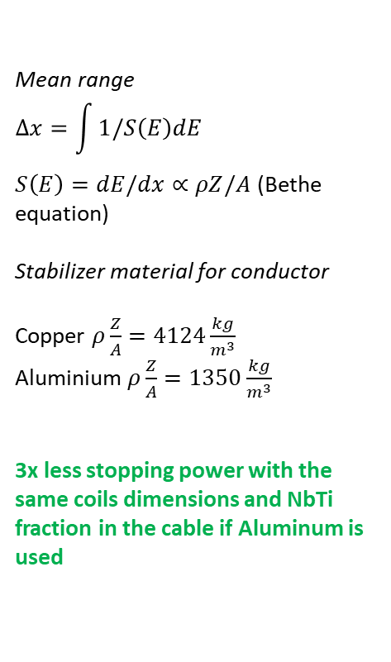
Interaction Length Limits
No existing extrusion line in the world
NbTi Rutherford Cable
Pure aluminium
Doped aluminium
Aluminium alloy
TRANSPARENCY
for the transverse momentum
Mean range
$$∆x=\int{1/S\left(E\right)dE }$$
$S\left(E\right)=dE/dx∝ρZ/A$ (Bethe equation)
Stabilizer material for conductor
Copper $ρ\frac{Z}{A}=4124\frac{kg}{m^{3}}$
Aluminium $ρ\frac{Z}{A}=1350\frac{kg}{m^{3}}$
3x less stopping power with the same coils dimensions and NbTi fraction in the cable if Aluminum is used
Aluminum stabilized for detector magnet
Conclusions from Workshop on Superconducting Detector Magnets @ CERN, 12/14 Sept 2022
We will not be able to use Aluminum stabilized conductors for long long time

Slide 11
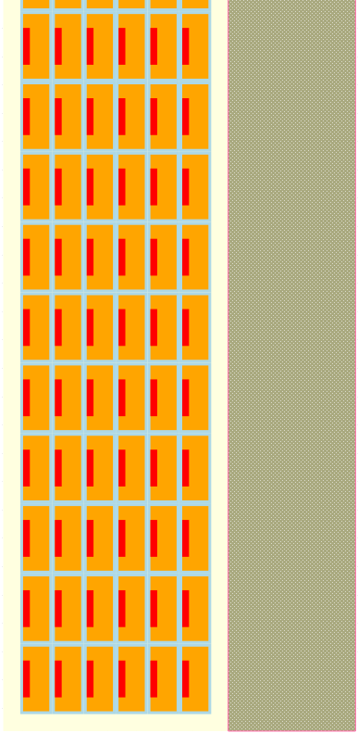
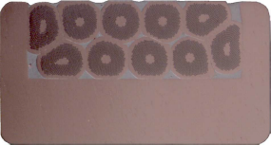
Interaction length optimization
& MARCO Layout
33.6 mm
30 mm
Material | Thickness/Nuclear interaction length
 | BaBAR 1.4 T | Marco 1.5 T (4 layers) | Marco 2T (6 layers)
Al | 0.382 | 0.113 | 0.113
Cu | 0.011 | 0.114 | 0.166
SS/Brass | 0.000 | 0.136 | 0.181
NbTi | 0.007 | 0.003 | 0.008
G10 |  | 0.009 | 0.028
Total | 0.400 | 0.372 | 0.468
 | Copper
 | NbTi/Cu
 | Brass
 | G10
 | Fiber-glass
mandrel
Normal winding side
Increase the mechanical inertia
How could we achieve that?
RIC: Rutherford cable In Copper Channel
RIC conductor for Iseult (MRI magnet)
  Designed at CEA Saclay
  Cable insertion by Luvata at Waterbury*
Winding on the large side reduce the thickness of the coil
Copper has wonderful mechanical properties!
*The insertion line still exists !

Slide 12

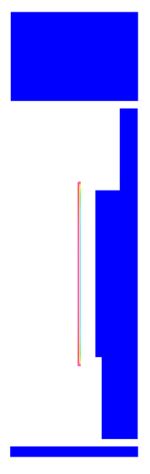


Iron Yoke evolution
Version 0
Version 1
Version 2
Asym case
100 % iron
Sym case
Different iron
Iron yoke is evolving according to the physics needs
It has a moderate impact on the magnet
But
It has a strong impact on the stray field
sPhenix / ECCE
ePIC
Used for all the analysis except for the stray field
Interaction with the Physics groups ongoing

Slide 13
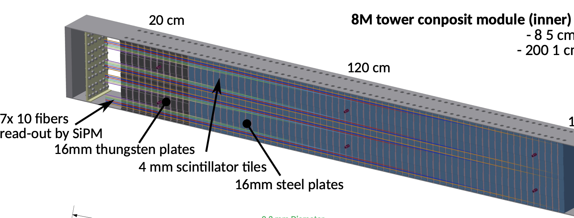
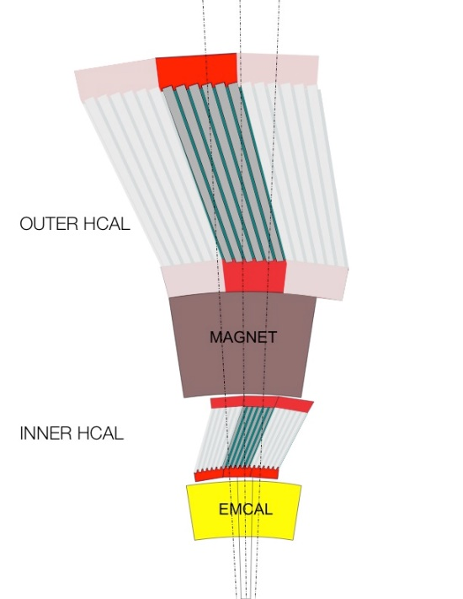
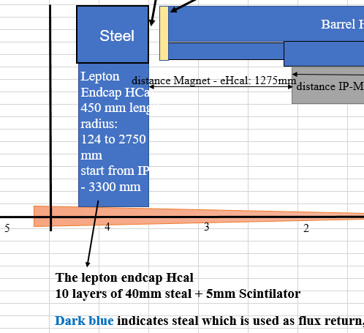
Iron Yoke layout
Hadron Hcal composition
Barrel Hcal composition
Iron fraction = 70.0 %
32 assembled and tested sectors - 1.9m inner radius, 2.6m outer radius
10 rows of 8mm scint. tiles (24 tiles per row), 12º tilt angle
Tapered 1020 steel plates ~26.1mm - ~42.4mm
Iron fraction = 75.0 %
Lepton Hcal composition
Iron fraction = 87.5 %
Versions largely vary for shape and dimensions, but the iron fraction not

Slide 14
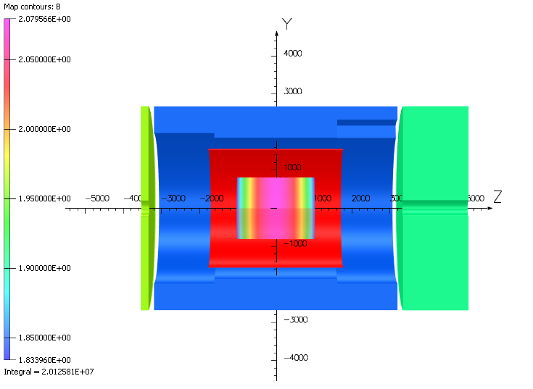
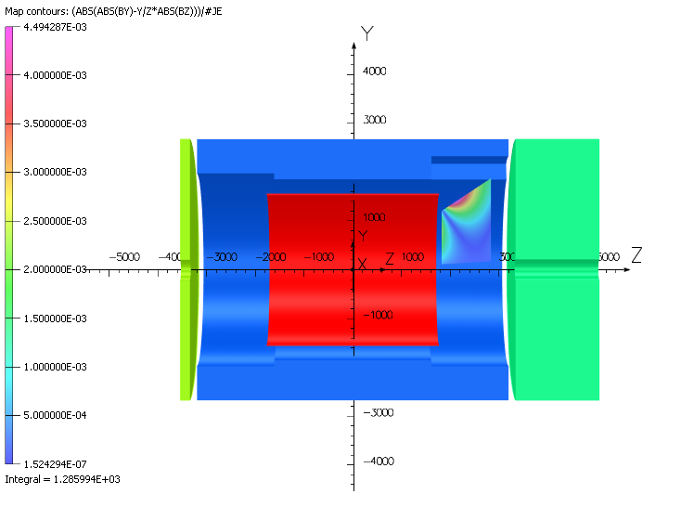
Marco Magnetic Design Results
Value | 1.5 T | 1.7 T | 2.0 T | Units | Criterion
Current | 2900 | 3296 | 3924 | A
B₀ | 1.500 | 1.704 | 2.023 | T | 2.0
B_{peak} | 1.925 | 2.187 | 2.602 | T
Energy | 25.050 | 32.344 | 45.732 | MJ
Energy mass density | 1.5 | 1.9 | 2.7 | KJ/Kg
Energy mass density | 11.636 | 15.024 | 21.243 | MJ/m³
Uniformity | 12.3 | 12.3 | 12.3 | % | < 12.5%
Projectivity | 1.806 | 2.047 | 2.408 | T/Amm² | < 10
2.08 T
Homogeneity region
1.72 T
B field along Z axis
MARCO respects the criteria on
The magnetic field at center
The uniformity
The projectivity
RICH Projectivity

Slide 15
Impact of the Yoke
Version 0
Version used for MECH analysis
Version 1
Version 2
sPhenix / ECCE @ 2.0 T
Hadron HCAL
ePIC
Asym cut
Sym cut
Any of the proposed configurations satisfies the criteria on the stray field.
Why?
MARCO is moved of 10 cm towards the Lepton HCAL
Barrel HCAL
-458 kN
-11 kN
-172 kN
-296 kN
Parameter | Value
B5300 | 33.5 G
B7400 | 20.2 G
B3400 | 9.4 G
Lepton HCAL
Parameter | Value
B5300 | 61.8 G
B7400 | 37.2 G
B3400 | 61.5 G

Slide 16
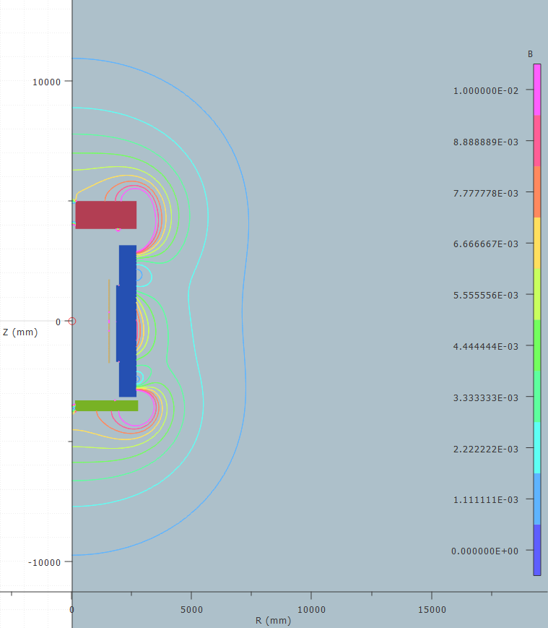
Impact of the Yoke – Version 2
Need to close these holes
Need to close these lines before
7400
We need a lot more of iron for this yoke configuration
5300
Flux lines escaping from the barrel
Need to increase the dimensions
3400

Slide 17
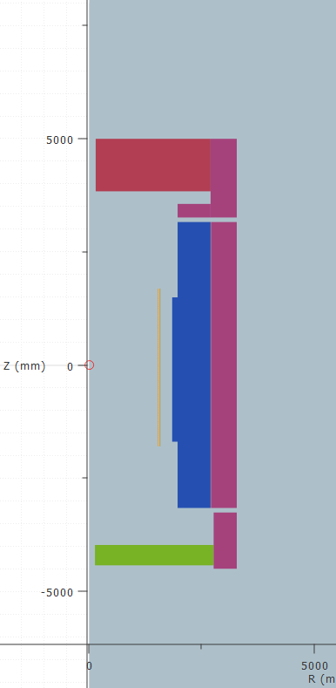
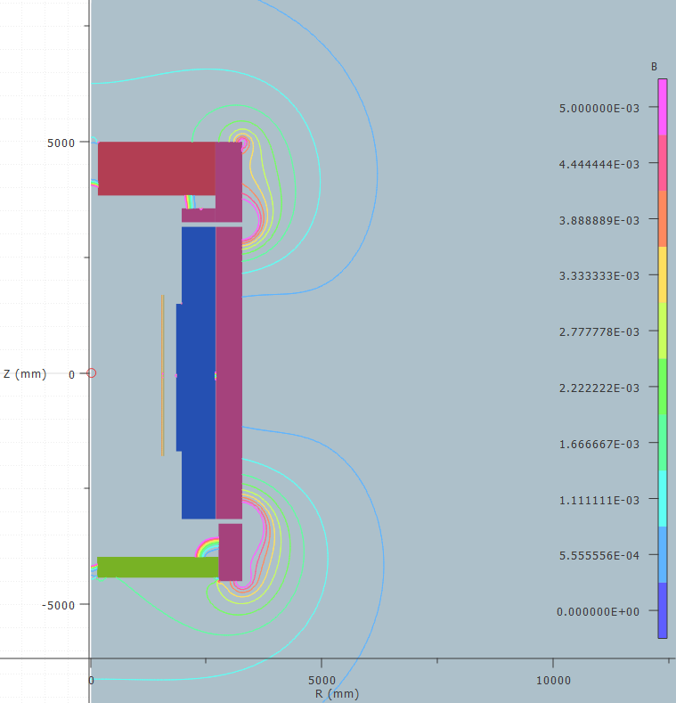
Yoke – Version 3
Under discussion with BNL
Distance between Barrel HCAL and Iron Yoke = 8 mm as indicated by BNL
Parameter | Value
B5300 | 15.1 G
B7400 | 8.8 G
B3400 | 1.5 G
FZ | +37 kN
37kN
Outer radius = 3262 mm
Lepton HCAL moved of Δz = - 679 mm
Possible solutions to reduce B5300:
- Local yoke around the holes

Slide 18
Conductor definition (6 layers)
 | Parameters | Values | Units
Strand | Strand diameter | 0.7 | mm
 | Cu/NbTi | 1.3
 | Ic @ 2.6T & 4.7K | >680 | A
 | Filament diameter | <70 | µm
 | RRR Cu | >80
Cable | NbTi strands | 20
 | Transposition pitch | 50 | mm
Channel | RRR Cu | >100
 | Copper section (Final) | 43.7 | mm²
Conductor | Nominal current | 3924 | A
 | Temp. margin @ 2.6T & 4.7K | 2.5 | K
 | Hot spot Temperature | 71.2 | K
 | σ_{0.2%} @ 293K | >165 | MPa
 | Total length | 16.2 | km
 | Unit length (supposed) | 2 | km
 | Coils weight (impregnated) | 7.9 | t
Fiber Glass Insulation
20×Ø=0.7
R~0.3
1.26
(2.31)
5.6
4.6
6.78
Copper
11.4
12.4
Dimensions are in mm
Technical Feedback from Luvata on this design: OK

Slide 19
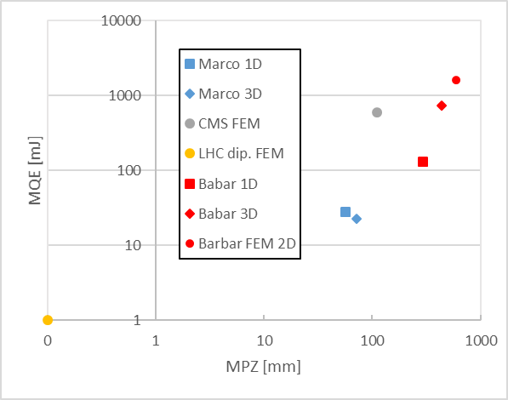
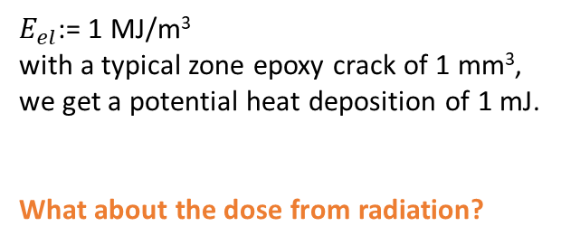
Margin @ 4.7 K
B₀ | 1.5 T | 1.7 T | 2.0 T | Units
Current | 2900 | 3296 | 3924 | A
B_{peak} | 1.925 | 2.187 | 2.602 | T
Temp. margin | 3.1 | 2.9 | 2.5 | K
Enthalpy margin |  |  | 7.4 | kJ/m³
Load line margin | 60.6 | 55.3 | 46.8 | %
I / Ic(T_{m},B_{peak}) | 17.3 | 21.3 | 28.8 | %
Stability
$E_{el}$:= 1 MJ/m³
with a typical zone epoxy crack of 1 mm³, we get a potential heat deposition of 1 mJ.
What about the dose from radiation?

Slide 20
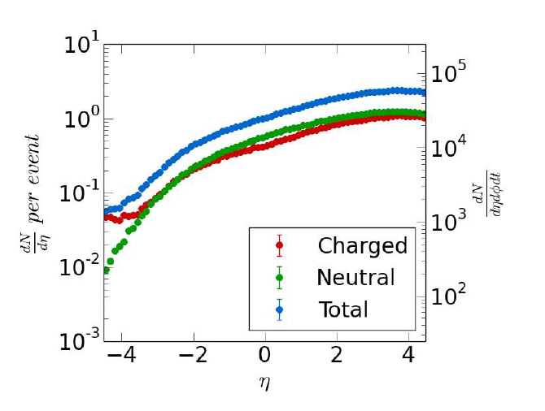
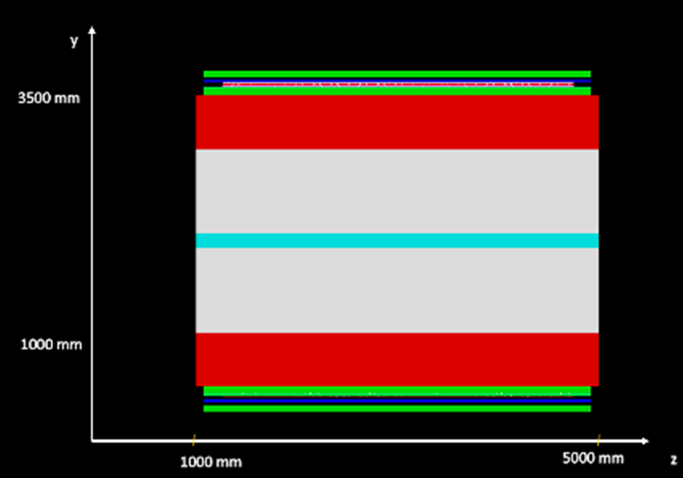
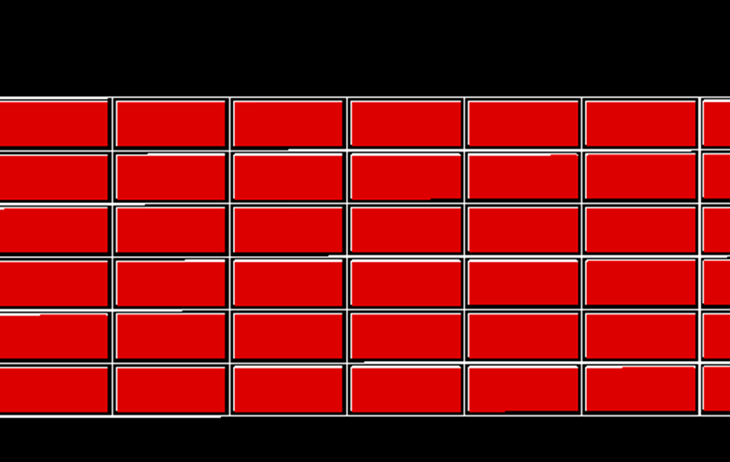
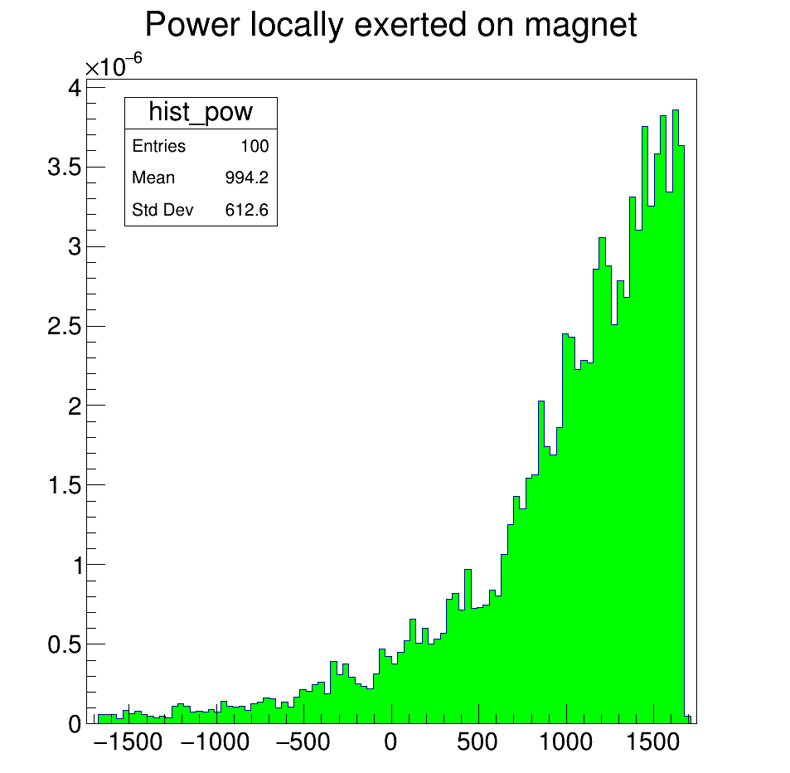
Geant4 Simulations
Particles profile over η
The simplified geometry of the tracker & ECAL
The detailed geometry of the coil
MARCO is here
RESULTS
Results for 1 fb⁻¹ (10⁵s)
Total dose | 0.00112662 Gy
Dose per second | 1.13E-08 Gy s⁻¹
Total energy | 9.47 J
Power | 9.5E-05 W
Power density | 7.14E-11 W cm⁻³
No issue from radiation
Stability is assured
Resin degradation is negligible
Z (mm)

Slide 21
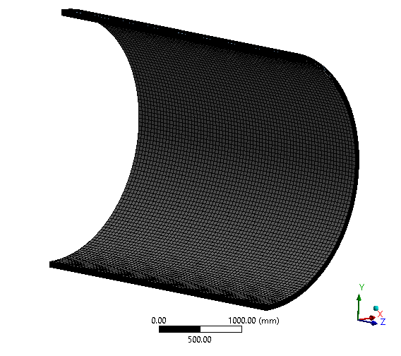
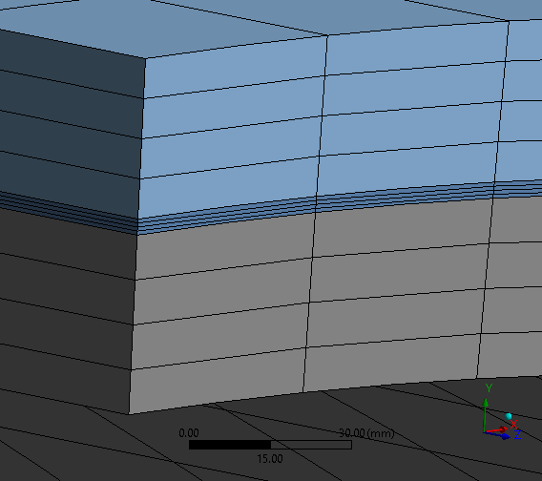
Mechanical Analysis and Design
Brass
G10
Homogenized coil
What is it missing?
The tie-rods
We need to fix the iron yoke to design them

Slide 22
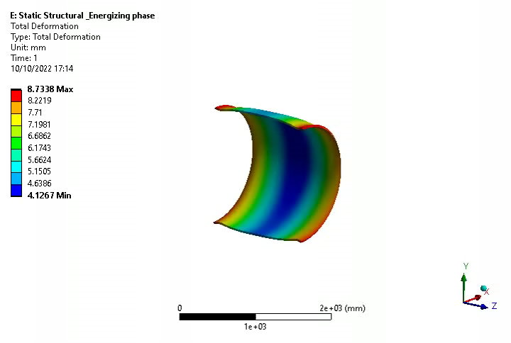
Results for “Cool down + Energizing”
Visu x150

Slide 23
General Mechanical Behaviors – 3D
Cool down
EM forces
Energizing
Cool down
EM forces
Energizing
Gravity
Gravity
Cool down
EM force
Energizing
Cool down
EM force
Energizing
Gravity
Gravity

Slide 24
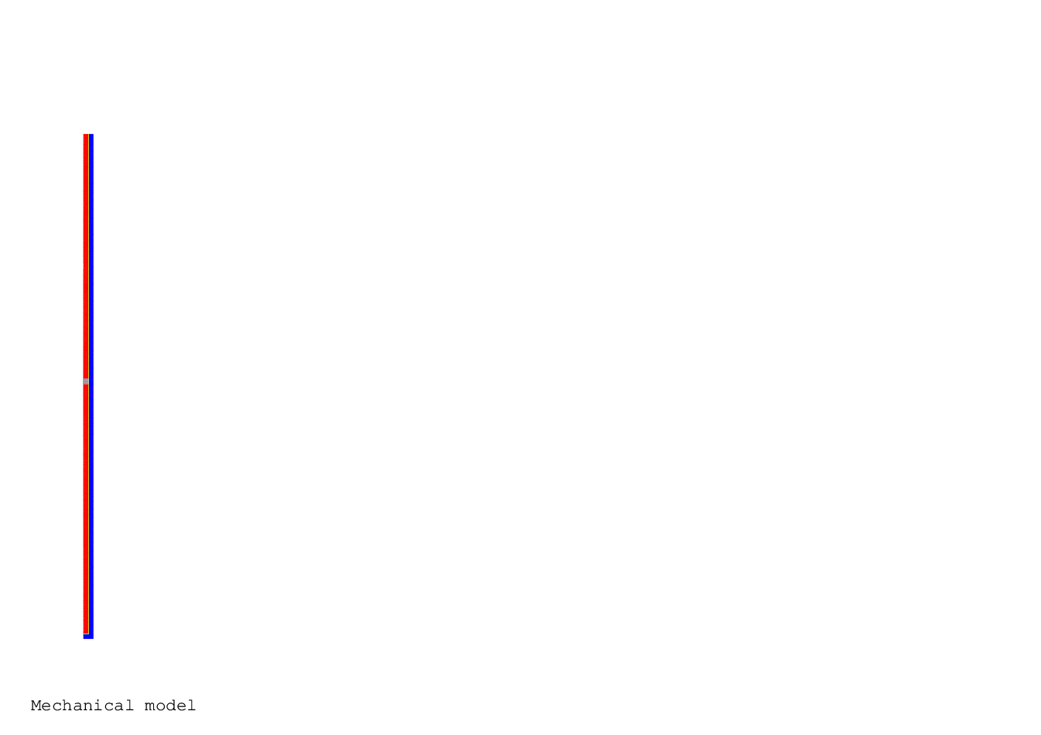
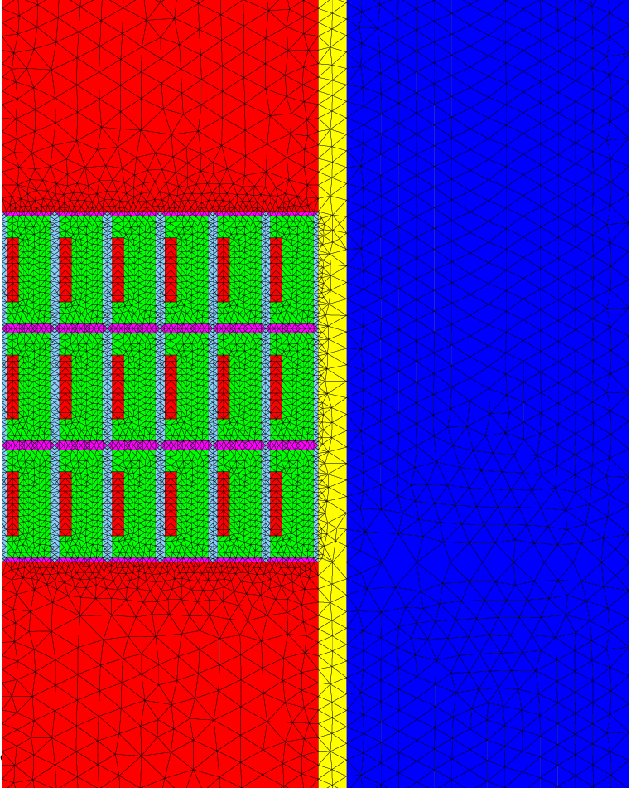
Detailed conductor analysis
Z
Homogenized conductors
Axial middle zone
R
2D-axi mechanical model with Cast3m
Homogenized conductors
Uz = 0

Slide 25
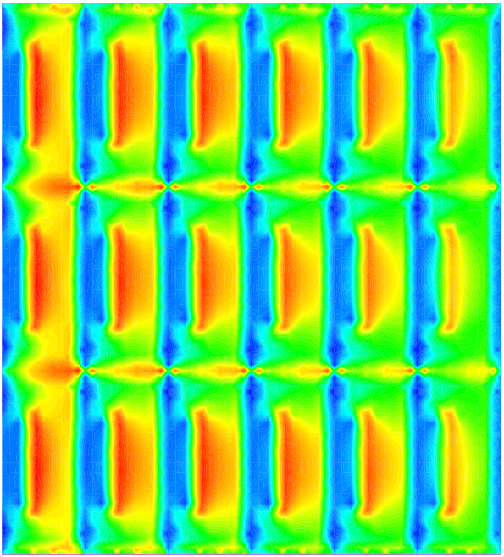
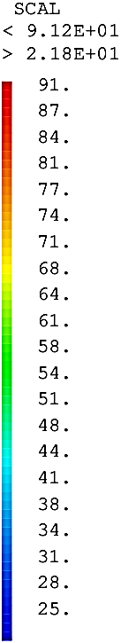
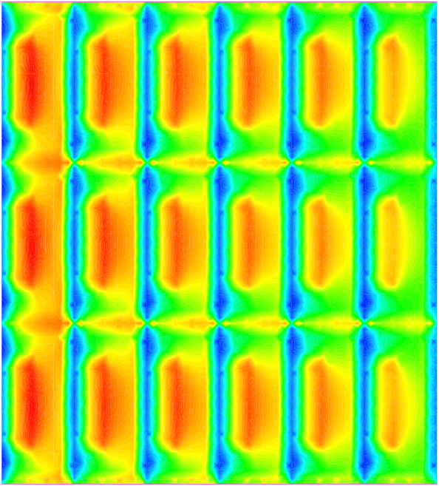

Detailed conductor analysis
Cool-down
Energization
Peak Von Mises stress (MPa):
in cable = 72 < 150
in Cu stabilizer = 91 < 133
in glass fiber = 89 < 198
Peak Von Mises stress (MPa):
in cable = 114 < 150
in Cu stabilizer = 125 < 133
in glass fiber = 108 < 198

Slide 26
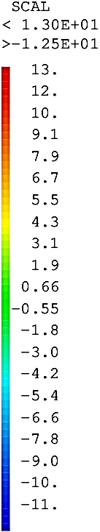
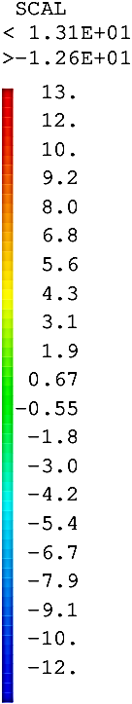

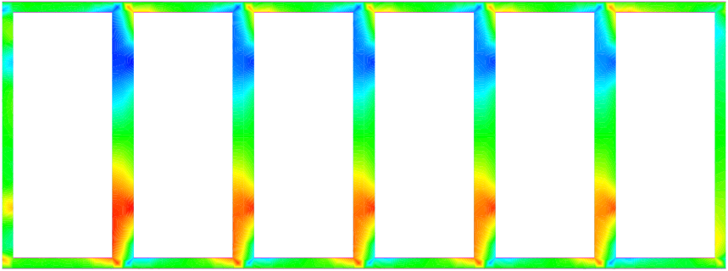
Detailed conductor analysis
Cool-down
Energization
Peak SIGMA RZ in conductor insulation (MPa) = 13 < 14
Z
Peak SIGMA RZ in conductor insulation (MPa) = 13 < 14
R

Slide 27
Detailed conductor analysis
Cool-down
Energization
Peak SIGMA RZ in conductor insulation (MPa) = 13 < 14
Z
Peak SIGMA RZ in conductor insulation (MPa) = 13 < 14
R

Slide 28
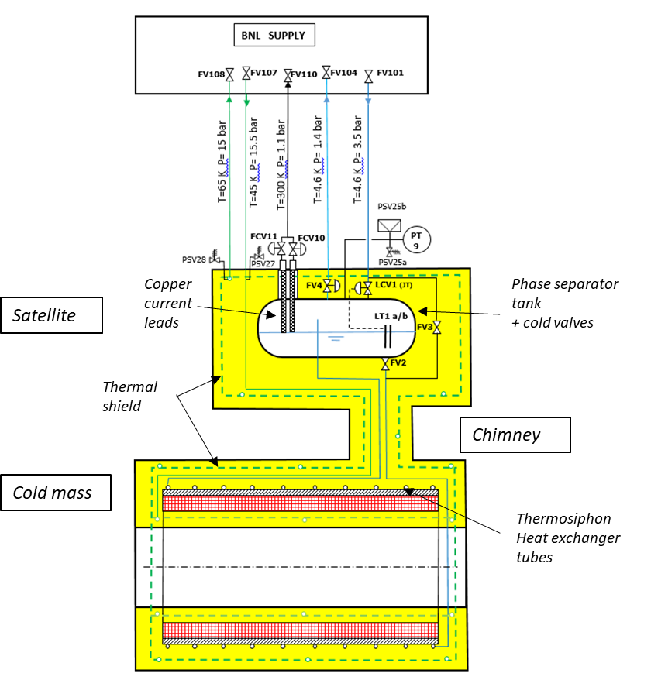
Cryogenics Design and Heat loads
Heat Loads
Cold mass heat load @ 4.6 K | 36 W
Cold valves @ 4.6 K | 5 W
Phase separator tank @ 4.6 K | 5 W
Copper current leads @ 4.6 K-300 K | 12 W - 0.67g/s
Thermal shield supports + thermalisation @ 45 K - 65 K | 80 W
Thermosiphon power available
100 W @ 4.55K

Slide 29
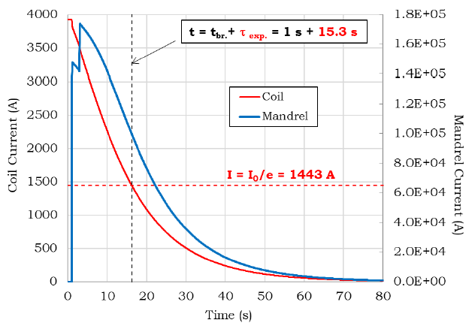
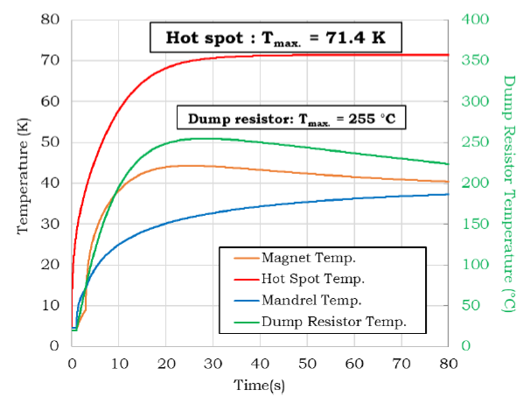
Quench and Hot-Spot
Quench caracteristic time = 15.3 s
3/4 of the energy in the dump resistance
1/4 in the coil + mandrel
Hot-spot temperature is well within the usual limits considered (100K)
Quench-back in the mandrel plays a fundamental role (reducing of 20 K the hotspot)

Slide 30
Conclusions
MARCO is mature to start the detailed phase design, to be achieved by the end of 2023.
This includes the procurement of the first conductor’s length (by JLAB)
It respects all the magnetic requirements and even beyond (2.0 T instead of 1.7 T)
No show-stopper on the mechanics
No show-stopper on the conductor
No show-stopper on cryogenics and protection
Iron yoke will be finalized in the next weeks
Next week first design review for this phase

Slide 31
Proposition de Stage
« Etude de l’impact de l’utilisation des conducteurs stabilisés en cuivre sur la transparence des aimants pour détecteurs de particules »
En considérant différents aimants supraconducteurs déjà construis, la/le stagiaire reproduira leur design magnétique et mécanique sur un logiciel multi-physiques aux éléments finis et réadaptera leur design en recherchant la meilleure géométrie possible d’un conducteur en cuivre à l’aide des algorithmes génétiques ou autres algorithmes d’intelligence artificielle.
L’évaluation de la transparence sera faite avec Geant4, le logiciel du CERN utilisé pour étudier la propagation des particules dans les matériaux.
Telles simulations, qui impliquent le traitement d’une grande mole de données, seront faites avec un super-ordinateur en calcul parallèle.
Contact : valerio.calvelli@cea.fr

