Slide 1

Séminaire SACM
31 mars 2010
Préparation de la revue du design des multiplets FAIR Super-FRS
M. Bruchon (SACM), P. Fazilleau (SACM), C. Mayri (SACM), G. Olivier (IPNO)

Slide 2
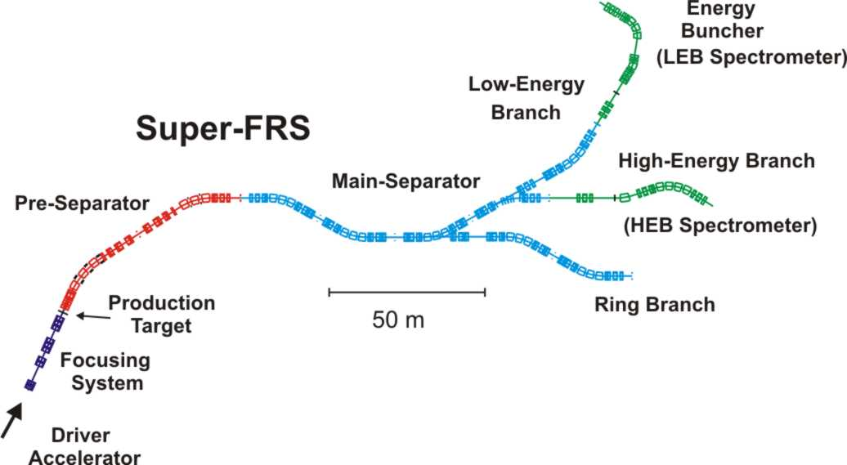
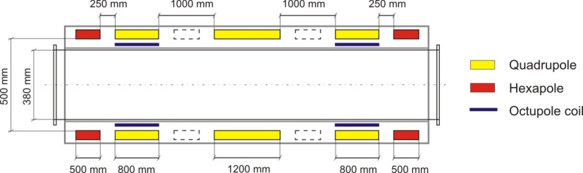
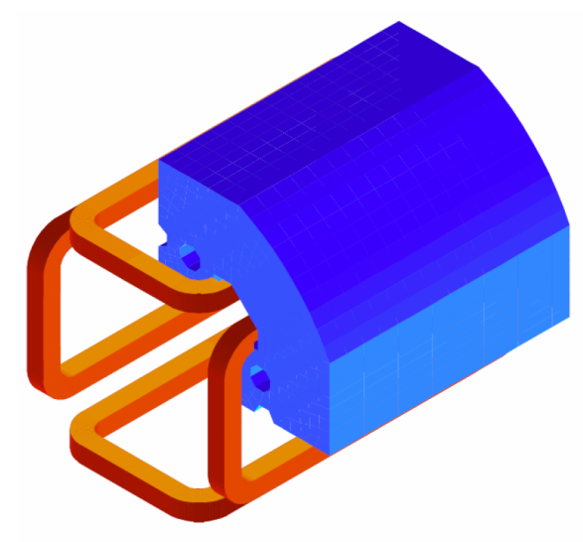
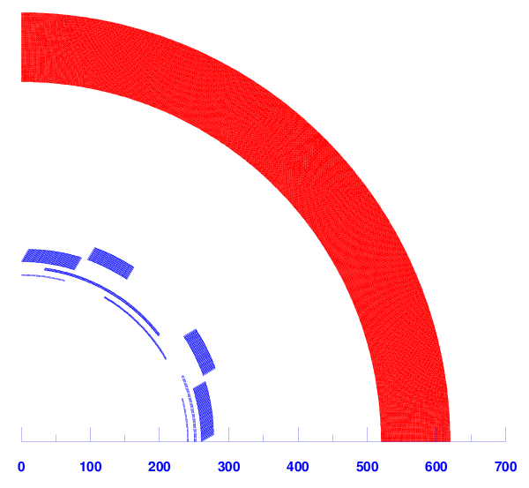
Présentation général
Ciemat proposal
Saclay proposal

Slide 3
Sommaire
Approche magnétique (M. Bruchon) 15’
Etude des protections (P. Fazilleau) 10’
Aspect mécanique (C. Mayri) 15’
Cryostat (IPNO- G. Olivier) 20’
Cryogénie (C. Mayri) 5’
Prototype / planning/industrialisation (C. Mayri) 5’
Conclusion (C. Mayri) 5’

Slide 4
Magnetic overview

Slide 5
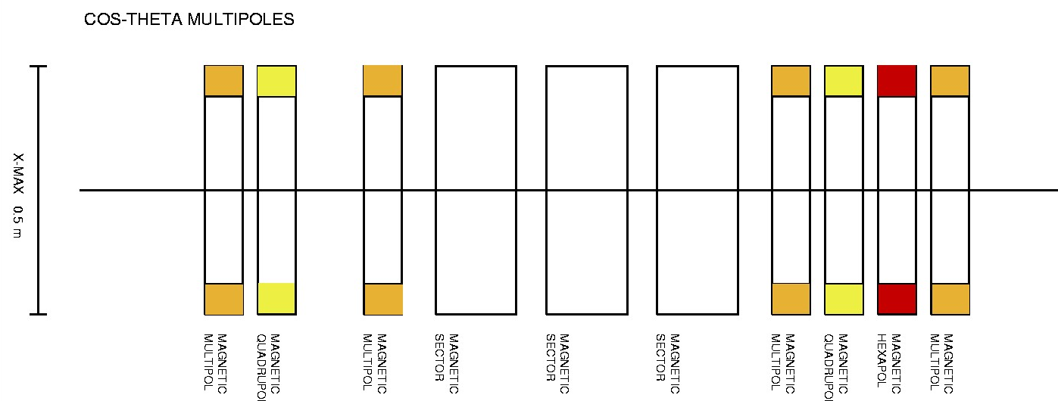
Magnetic design
Design based on the optical proposal of John Winfield presented in the March 11th 2009 meeting
Quadrupoles, sextupoles and octupoles embedded
Cosine magnetic configuration with warm iron shield:
  Very low sensibility to saturation effects
  A compact cold mass with a low volume of helium bath
  Drastic decrease of iron volume comparing to superferric case

Slide 6
Magnetic requirements
Multipole magnetic specifications:
Requirements on field quality:
  8.10⁻⁴ at low gradient (1 T/m)
  5.10⁻⁴ at medium gradient (8 T/m)
  60.10⁻⁴ at nominal gradient of 12.1 T/m
 | Quadrupole | Sextupole | Octupole
Field component | 12.1 T/m | 17.30 T/m² | 84 T/m³
Field strength | 12.1 T/m | 8.65 T/m² | 14 T/m³
Magnetic length | 1 m | 1 m | 1 m
Field at r = 190 mm | 2.3 T | 0.31 T | 0.096 T

Slide 7
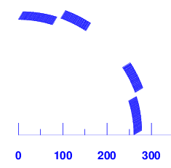
Preliminary study
First analytical formula:
  700 000 A.t are needed to create the main quadrupole gradient
  → For 700 A, 1000 turns are required
  → Considering a usable surface of 2000 mm²,
  S_{insulated conductor} = 2 mm² for a current density of 350 A/mm²
A usual cosine theta with one block: very high forces
→ Design based on 2 stages of 20 mm thick and 15° each, shifted in azimuth (Suggestion of Pavel Vobly in his final report Conceptual design Study of a superconducting quadrupole for FAIR Multiplets, December 20th 2008)

Slide 8
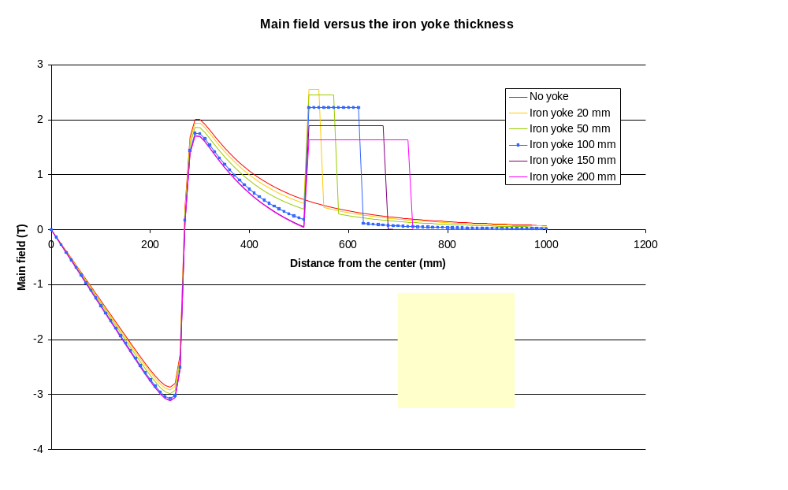
Yoke sizing (1)
Internal radius of yoke : 520 mm (needed space for the cryostat)
Study of the effect of the iron thickness on the radial fringe field for a current of 700 A)

Slide 9
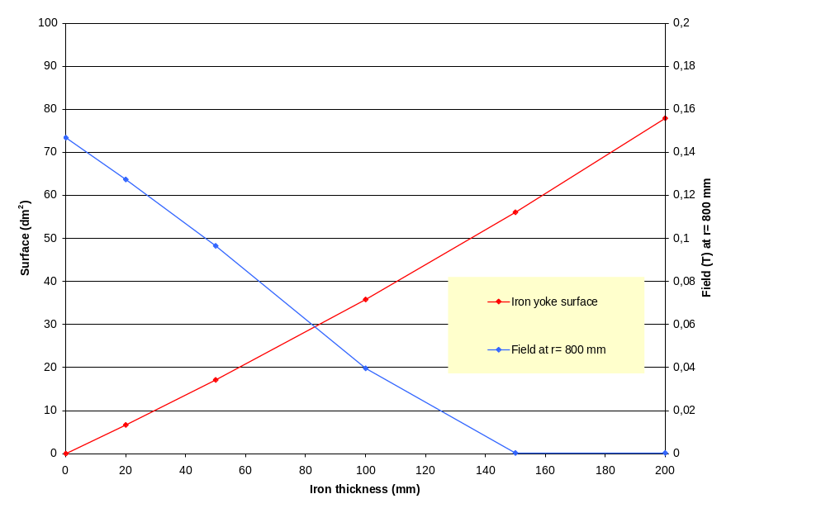
Yoke sizing (2)
Study of the iron thickness versus the field at r= 800 mm and the surface (dm²)
→ The optimal thickness is 100 mm.
→ Linear weight of the yoke : 3 tons/m

Slide 10
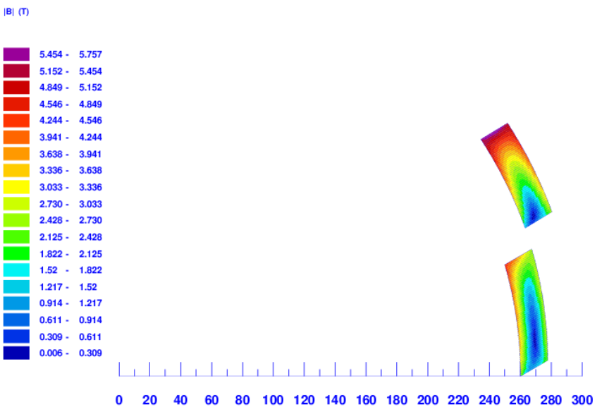
Quadrupole alone
Ends not efficient for the main field, 2D computations: 14 T/m
→ 734 A in the conductor is needed
Insulated superconducting conductor: 1,18 x 2 mm²
    → Engineering current density: 311 A/mm²
    → Current density in the superconducting filaments : 1073 A/mm²
    Peak field with a 100 mm yoke = 5.8 T
540 turns (10 x 54)
570 turns (10 x 57)

Slide 11
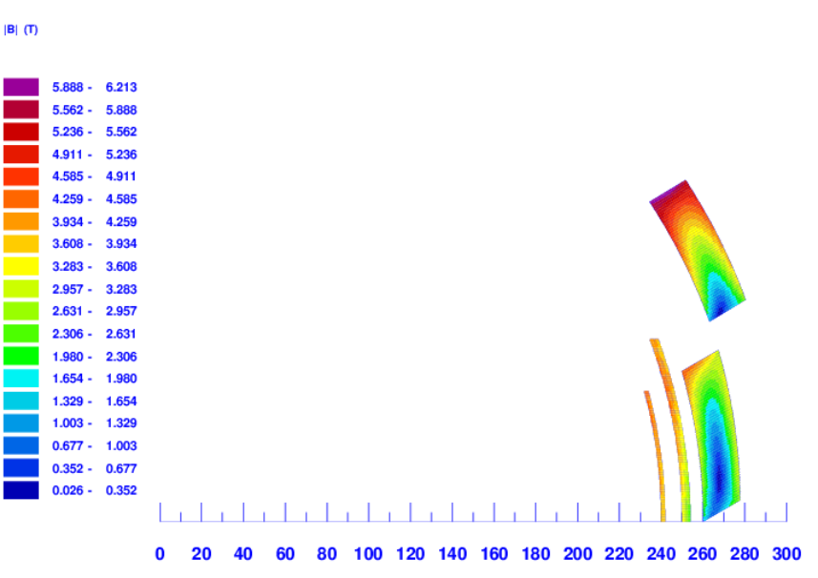
Magnet with correctors
Embedded sextupole and octupole
Same conductor as quadrupole
  → sextupole thickness: 4 mm with a current of 560 A
  → octupole thickness: 2 mm with a current of 392 A
  Additional field due to correctors: peak field increases from 5.8 T to 6.2 T (8% of growth)

Slide 12
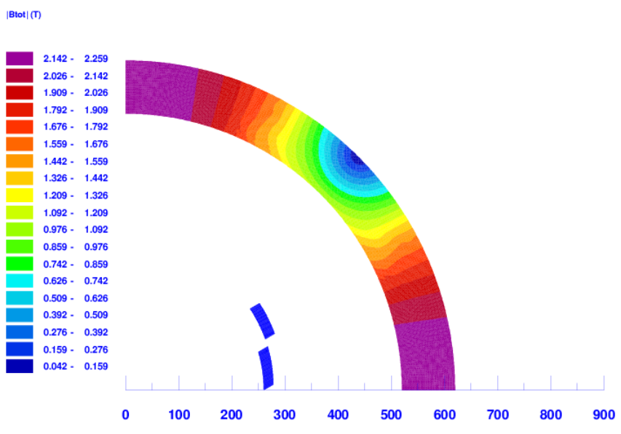
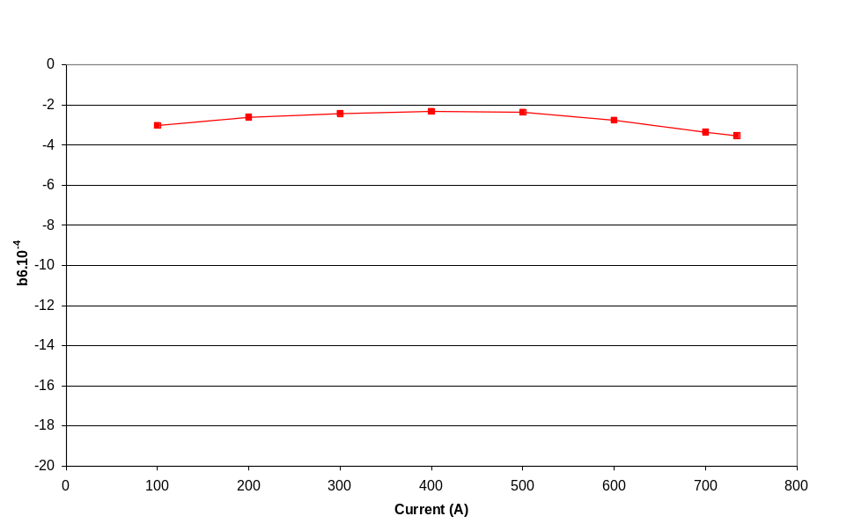
Harmonics analysis
2D study of b6 versus current and yoke field at the nominal current
Saturation effect very low
b6 term can be arranged by the end arrangement (3D computation)

Slide 13
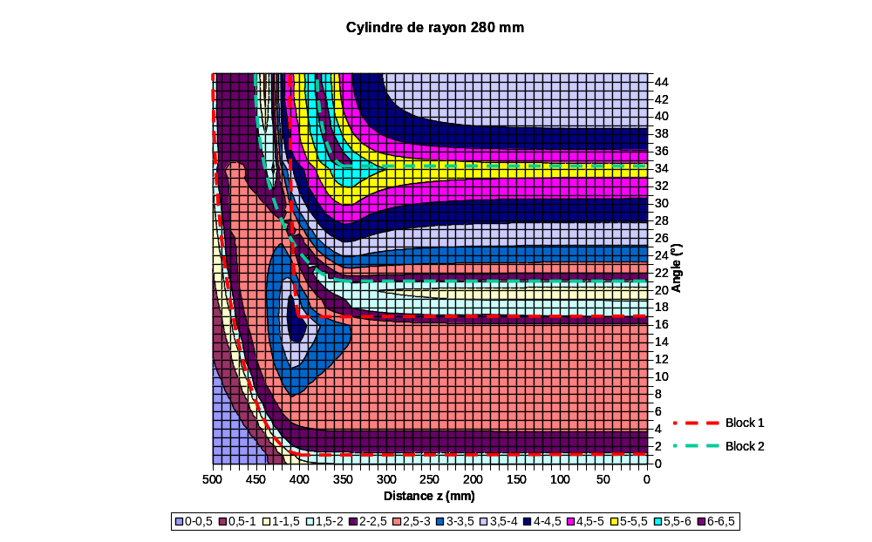
Peak field: 3D computation
Study of the coil ends
Field (T)
0-0,5
0,5-1
1-1,5
1,5-2
2-2,5
2,5-3
3-3,5
3,5-4
4-4,5
4,5-5
5-5,5
5,5-6
6-6,5
Peak field in the external block: 6.3T
End reduction of the external block cancels the b6 term and decreases the peak field in the end of the internal block
Estimation of a peak field of 7.7 T (with end and corrector contribution)
Margin of 20 %(report) in reality 2%...

Slide 14
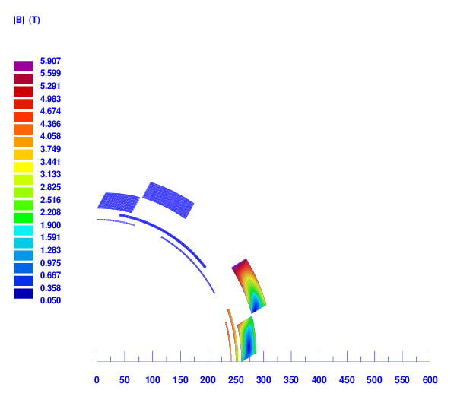
Solution envisagée…
Augmenter le nombre de conducteurs en radial (étude paramétrique en cours)
Ici 15 conducteurs en radial (au lieu de 13): diminution de la densité de courant
Diminution du Cu/SC: 2 -> 1.5

Slide 15
Protection studies

Slide 16
Calculation hypothesis
Stored energy | 1.24 MJ | Current | 734 A
Detection | Ud = 50 mV | td = 50 ms
Internal discharge with heaters
Calculated propagation velocities |  | vtransverse = 0.8 m/s | vlongi = 20 m/s
Calculations performed with code QTRANSIT Quench propagation program based on earlier ‘QUENCH’ (M.Wilson) Takes into consideration thermal properties and exchanges, electrical circuit, RRR, magnetoresistance…
Worst case occurs during a transition of one internal block
1.18 mm
Cu / Sc
=
2
2 mm
Insulation thickness
50 µm
Conductor
Electrical circuit

Slide 17
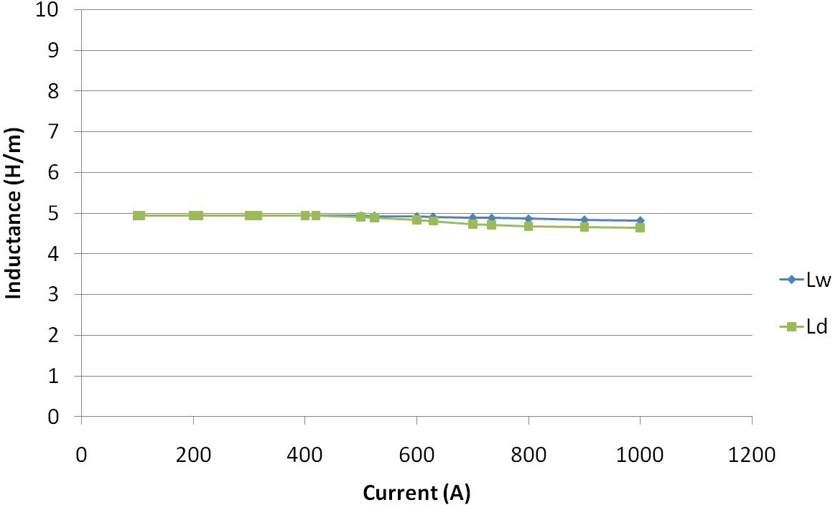
Which Inductance ?
“secant” inductance L_{s} = φ/I
“work” inductance : L_{w}= 2 Emag/In²
“differential” inductance : L_{d}= dφ/dI

Slide 18
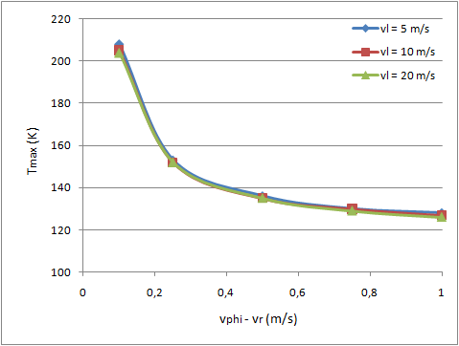
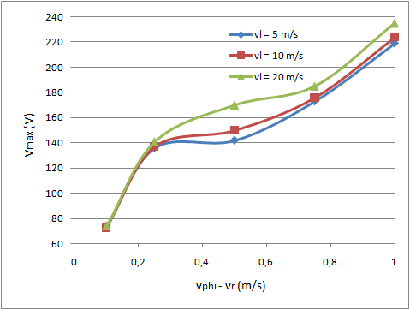
Case 1
Heater location

Slide 19
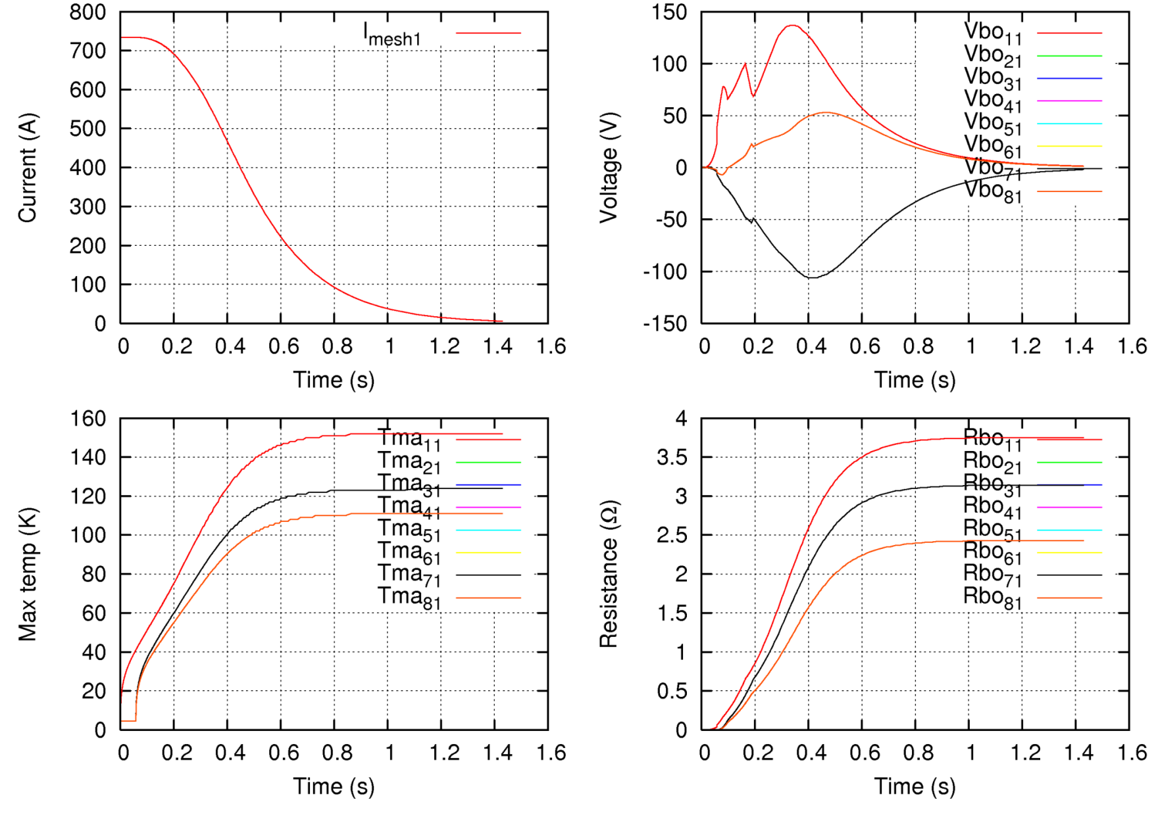
Referent scenario : vϕ = vr = 0.25 m/s, vl = 10 m/s
Vmax = 137 V
Time constant
τ = 0.553 s
Tmax = 152 K

Slide 20
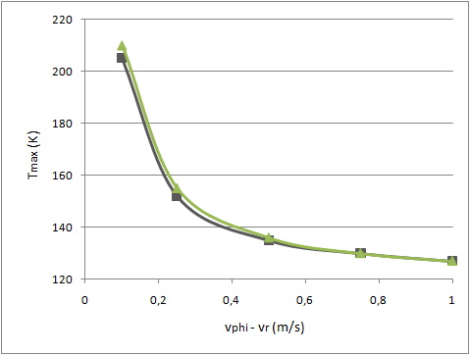
Case 2
vl = 10 m/s

Slide 21
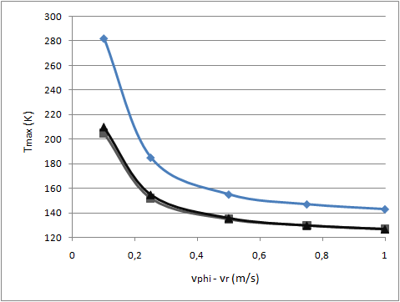
Case 3
vl = 10 m/s

Slide 22
Influence of Ud, td and RRR
 | Tmax (K) | Vmax (V)
Referent scenario vϕ = vr = 0.25 m/s vl = 10 m/s Ud = 50 mV td = 50 ms RRR Cu = 100 | 152 | +137 / -106
Ud = 100 mV | 153 | +143 / -107
Ud = 200 mV | 155 | +154 / -109
td= 100 ms | 152 | +137 / -106
td = 200 ms | 152 | +137 / -106
RRR Cu = 200 | 152 | +139 / -99
RRR Cu = 280 | 152 | +142 / -96

Slide 23
Fault scenario
Tmax (K) | Referent scenario | ¼ of heaters effective | ½ of heaters effective | No heaters (# no detection)
Vtransverse = 0.25 m/s | 152 | 235 | 187 | *
Vtransverse = 0.5 m/s | 135 | 204 | 163 | 350
Vmax (V) | Referent scenario | ¼ of heaters | ½ of heaters | No heaters
Vtransverse = 0.25 m/s | +137/-106 | +1075/-855 | +483/-987 | *
Vtransverse = 0.5 m/s | +150/-98 | +1235/-860 | +518/-986 | +3513/-634

Slide 24
Mechanical aspects

Slide 25
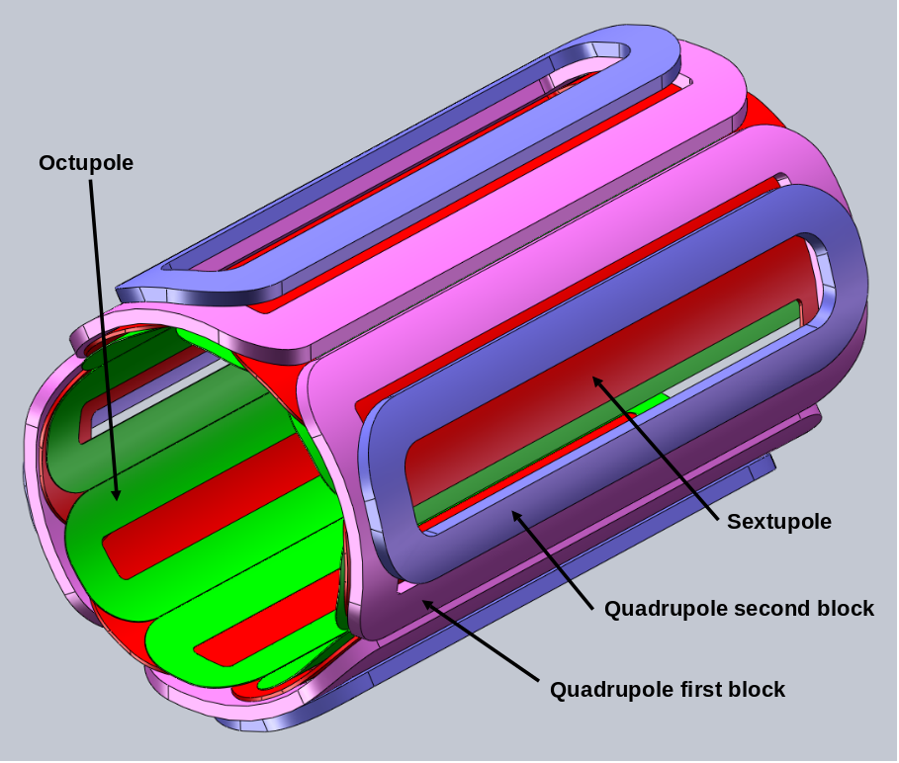
Winding design
Winding in two blocks with a rectangular conductor of 1.18 x 2 mm²
Block lengths: 1 m (quadrupole external block slightly shorter)
No junction between the two blocks by continuous winding

Slide 26
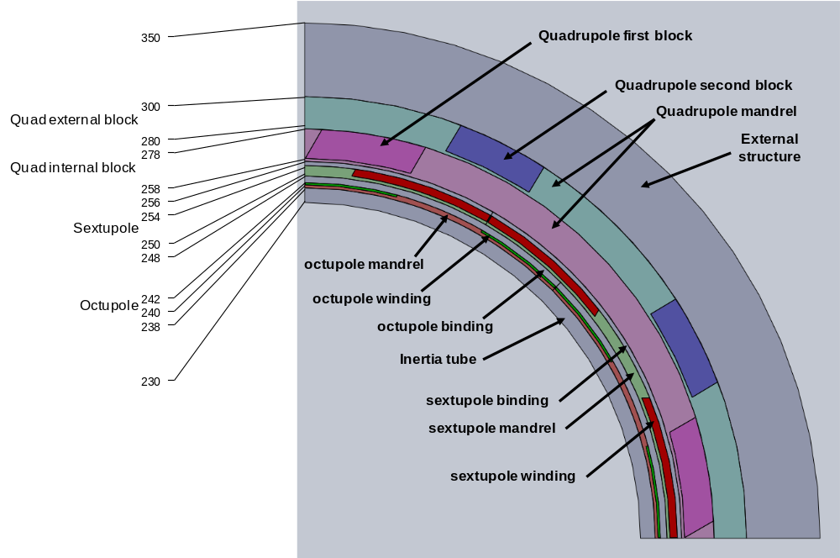
Cold mass design
Winding of each pole on individual mandrel
Assembly of individual poles around an inertia tube
Junction between windings at the cold mass extremity
Cold mass length with the end wedges and the junctions: 1.4 m (compatible with the space available between multipoles)
Pre-stress given by an external structure to define (binding, collars)

Slide 27
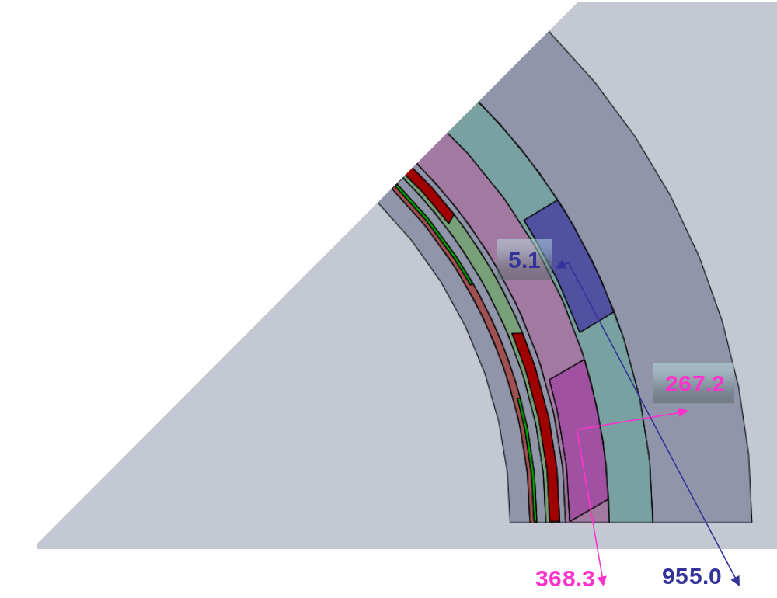
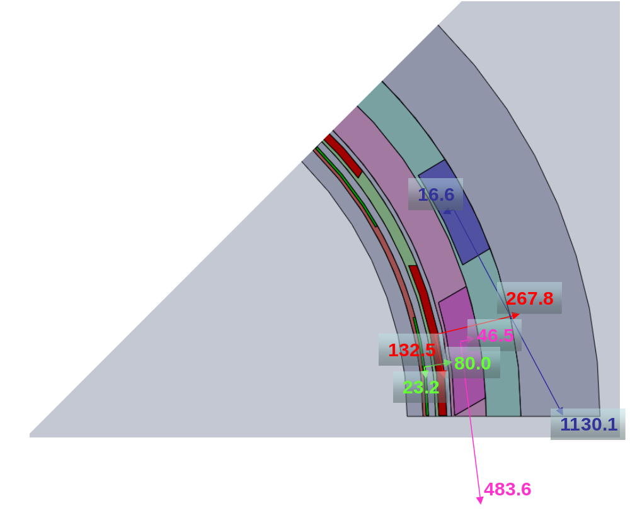
Magnetic forces
The relatively high forces are different if the correctors are off or on
Correctors off
Correctors on

Slide 28
Stress analysis (1)
The blocks must be always in compression:
    Thermal shrinkage has to be compensated
    The magnetic compression has to be taken into account
The material data are:
    Ewinding: 100 GPa
    Estructure: 190 GPa
    ∫αwinding: 3.5 mm/m
    ∫αstructure: 3.1 mm/m
The shrinkage difference leads to an equivalent compression of 40 MPa [(3.5-3.1)*100]

Slide 29
Stress analysis (2)
The magnetic loads are:
Windings | Correctors | Direction | Force (kN/m) | Compression (MPa)
Quadripole internal block | On | Radial | 46.5 | 0.6
 | Off |  | 267.2 | 3.5
 | On | Circumferential | 483.6 | 24.2
 | Off |  | 368.3 | 18.4
Quadripole external block | On | Radial | -16.6 | 0.3
 | Off |  | -5.1 | 0.1
 | On | Circumferential | 1130.1 | 56.5
 | Off |  | 955.0 | 47.7
Sextupole | On | Radial | 267.8 | 3.0
 | On | Circumferential | 132.5 | 33.1
Octupole | On | Radial | 80.0 | 1.3
 | On | Circumferential | 23.2 | 11.6

Slide 30
Stress analysis (3)
The needed pre-stress is:
Windings | Direction | Correctors | Magnetic load (MPa) | Thermal load (MPa) | Equivalent von Mises (MPa)
Quadripole internal block | R | On | 0.6 | 40 | 91.5
 | θ |  | 24.2 | 40
 | R | Off | 3.5 | 40 | 88.6
 | θ |  | 18.4 | 40
Quadripole external block | R | On | 0.3 | 40 | 121.8
 | θ |  | 56.5 | 40
 | R | Off | 0.1 | 40 | 113.2
 | θ |  | 47.7 | 40
Sextupole | R | On | 3.0 | 40 | 101.7
 | θ |  | 33.1 | 40
Octupole | R | On | 1.3 | 40 | 80.6
 | θ |  | 11.6 | 40

Slide 31
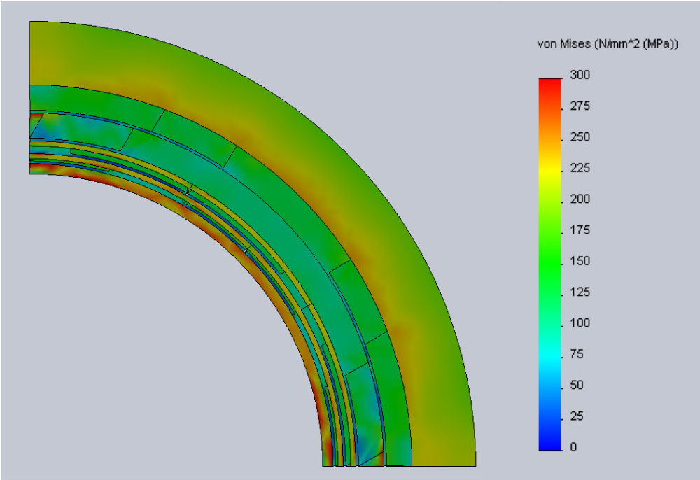
Preload stress
The preload is obtained thinks to the external structure via azimutal keys
Keys

Slide 32
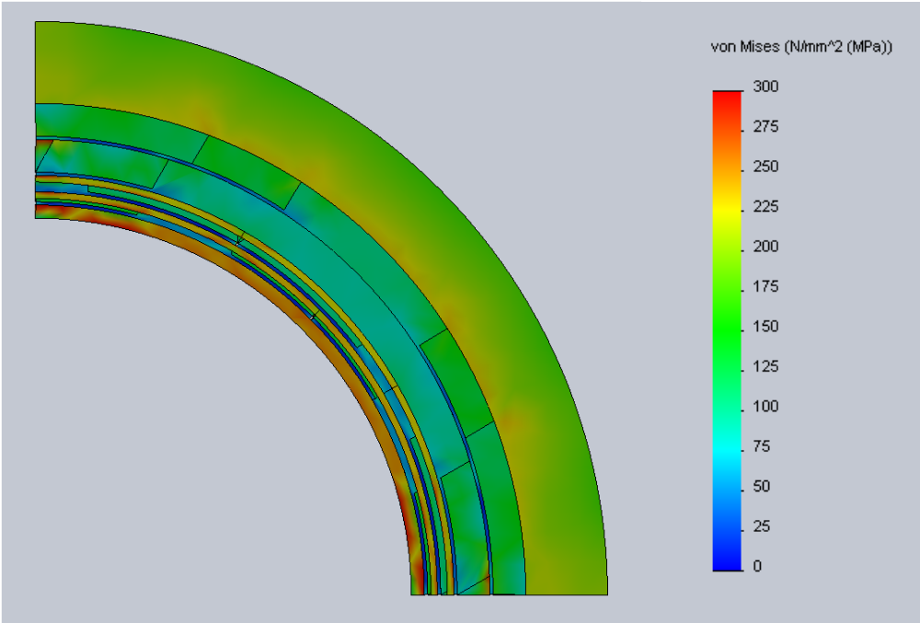
Cool-down stress
After preloading, the cold mass is cooled down to 5 K
  → Stress relaxation

Slide 33
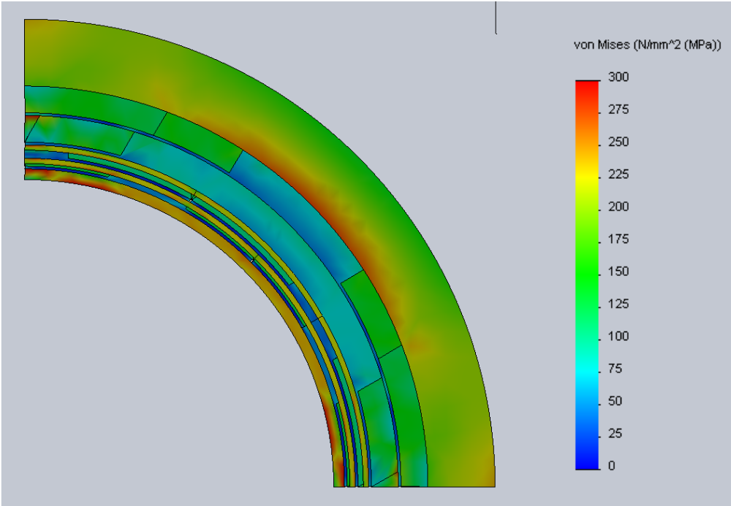
Stress under magnetic loads
With all the magnets at their nominal current, the block compression decreases the stress in the structure but increases it in the blocks

Slide 34
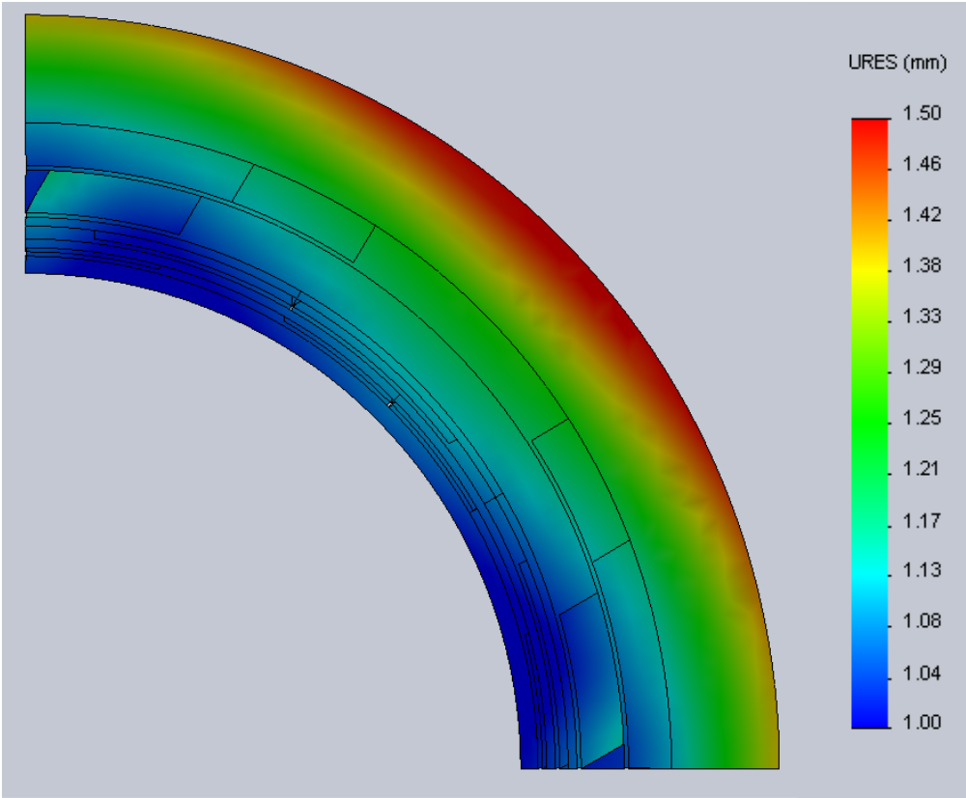
Displacements under magnetic loads
The radial growth during the energisation is around 1 mm

Slide 35
Cryostat concept design
for a cos (2θ) magnet solution

Slide 36
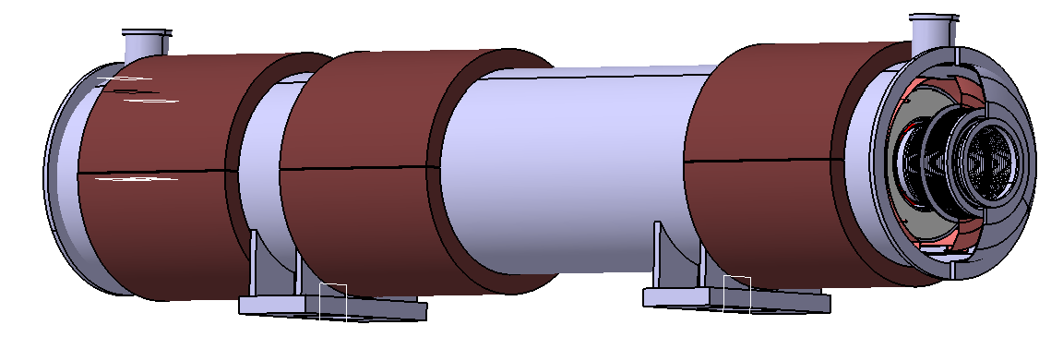
Complete multiplet
Several chimneys for current and cryogenic connections (not drawn)
Vacuum vessel
Magnetic shield Pure Iron (Armco) 100 mm thickness 2865 kg x Qty 3
End cover (x2) (dished heads)
Support (x2)

Slide 37
Multiplet main features
 | COS (2θ) SOLUTION | SUPERFERRIC SOLUTION
Length | About 6.3m (to be defined) | idem
External diameter | 1240 mm | 1500 mm
Weight | 20 tons (including 8.6 t for magnetic shield and 8 t for cold mass) | About 36 tons (including 30 t for cold mass)
Beam axis height (from the vacuum vessel support bottom) | About 0.7m | About 0.9m

Slide 38
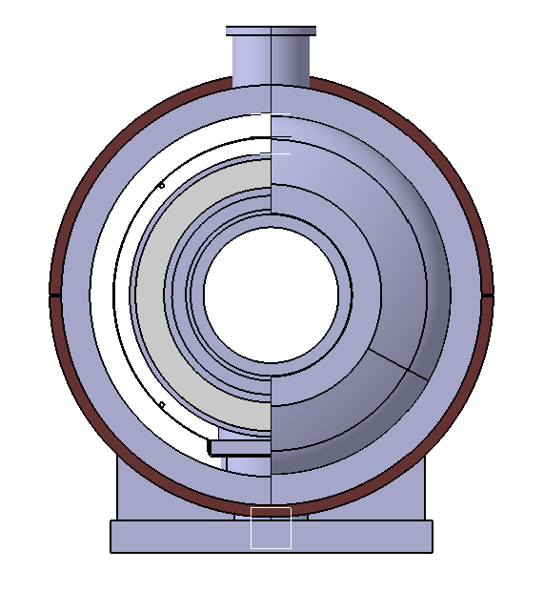
Front view
Vacuum vessel Ø 1015x1040 Low alloyed carbon steel
External iron shield Ø 1040x1240 mm
50/80K screen Ø 880x884
Extremity cover (dished head)
The cold mass is perfectly centered in the vacuum vessel and the magnetic shield
Composite support post in 2 parts (Glass fibre reinforced epoxy)
Partially positioned in the vacuum vessel support

Slide 39
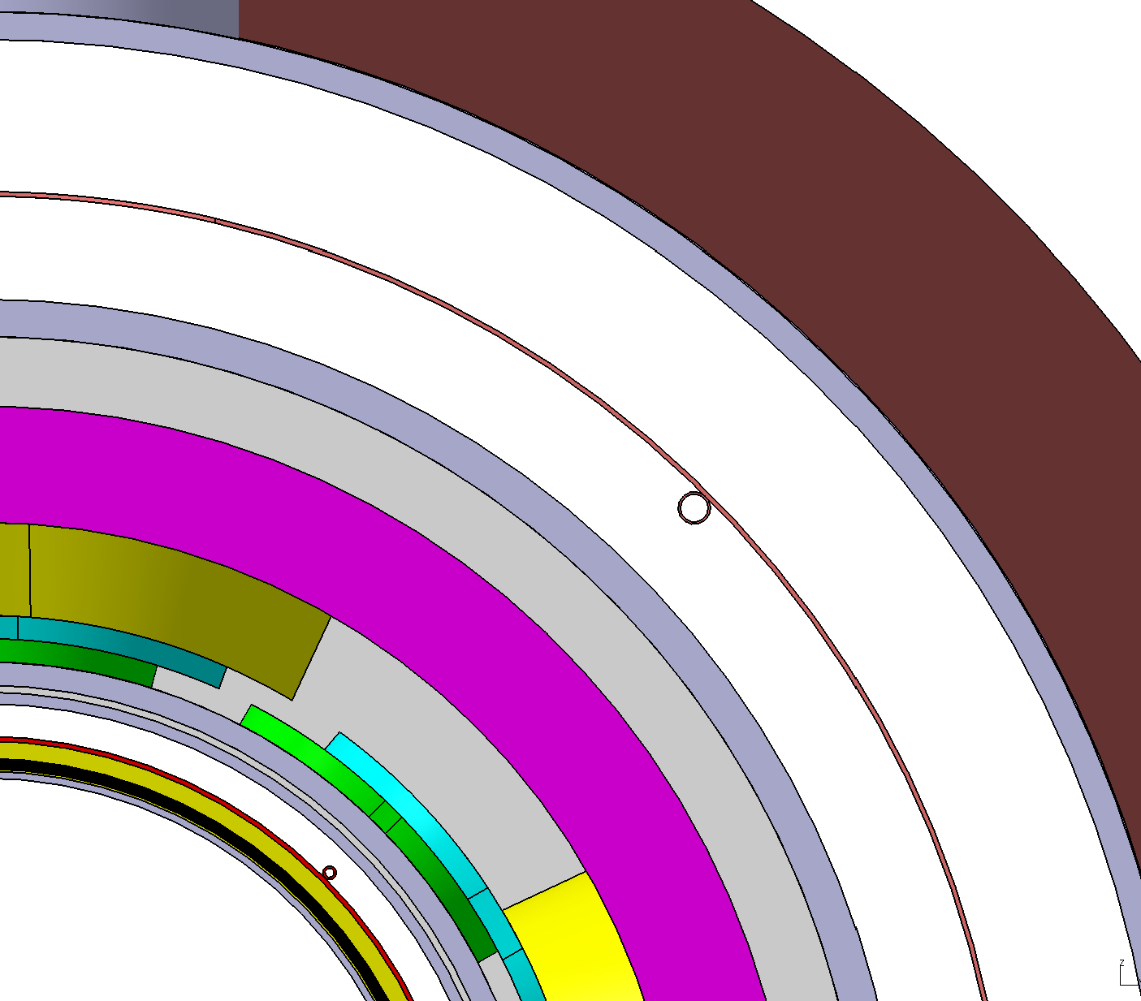
Cross section (1)
50/80K screen + MLI
External iron shield Ø 1040x1240 mm
-Pure iron (Armco)
Positioned and fixed around the vacuum vessel
Accurate concentricity with the cold mass.
COLD MASS
Beam pipe 380mm Internal diameter
Vacuum vessel Ø 1015x1040mm

Slide 40
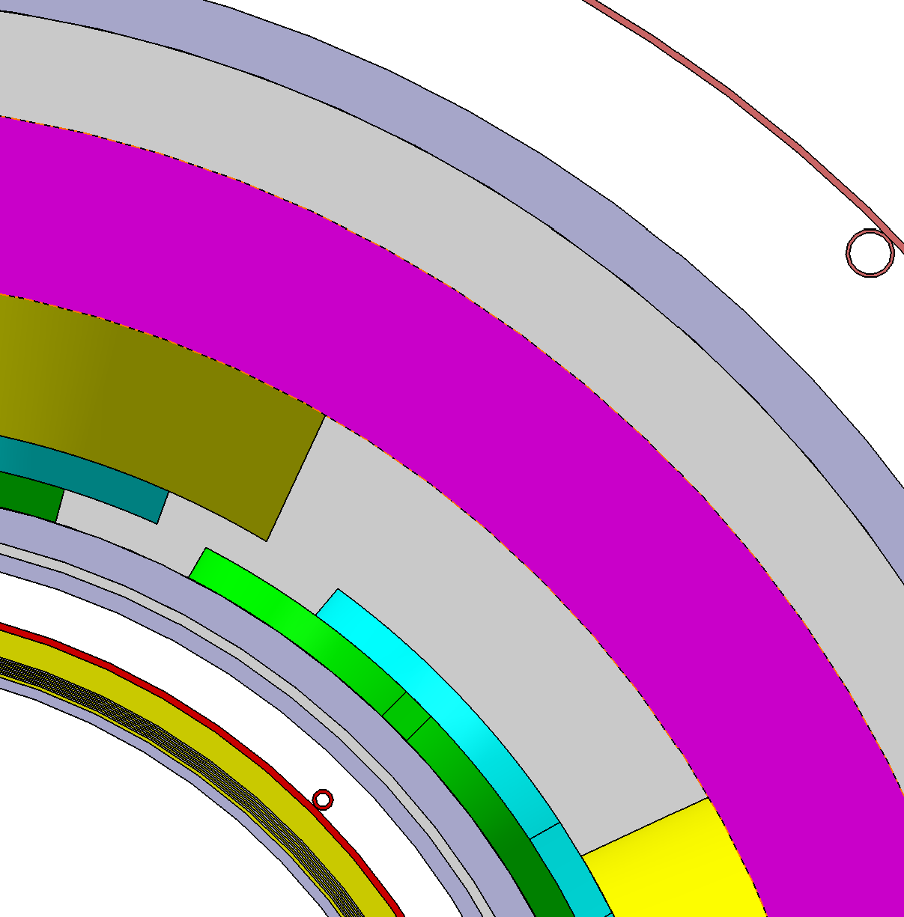
Cross section (2)
Ø_{ext} 884 screen (50/80K) Aluminium or stainless steel + Multi-layer insulation (30 layers, not drawn)
Vacuum
Magnet helium tank Ø_{ext} 792 + MLI (10 layers, not drawn)
Screen 50/80K
Multi-Layer Insulation
Magnet helium tank Ø_{int} 444
Beam pipe Ø_{int} 380

Slide 41
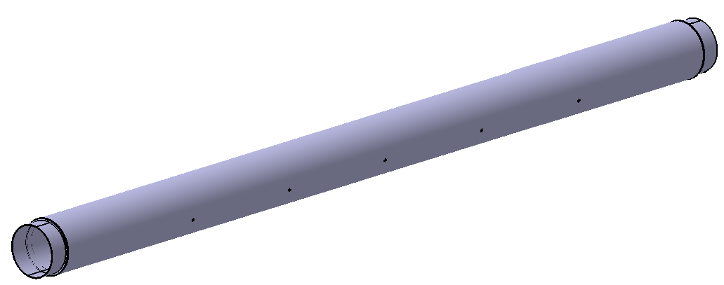
Beam pipe (1)
- Separate and insulated from the cold mass.
- Sustains its own 50/80K screen and MLI.
- Can be removed separately.
- Introduced in the cryostat after the cold mass

Slide 42
Beam pipe (2)
Cold or warm pipe
 | ADVANTAGES | DISADVANTAGES
COLD PIPE (Stainless steel) | - Less power consumption - Stainless steel flanges | - Icing without vacuum (measures) - Additional bellows to take into account the thermal shrinkage - Heavy stainless steel pipe
WARM PIPE (Aluminium) | - Dry without vacuum - Very moderate thermal expansion - Light weight (aluminium) | - More power consumption - Aluminium flanges for vacuum seal - Eddy currents ?

Slide 43
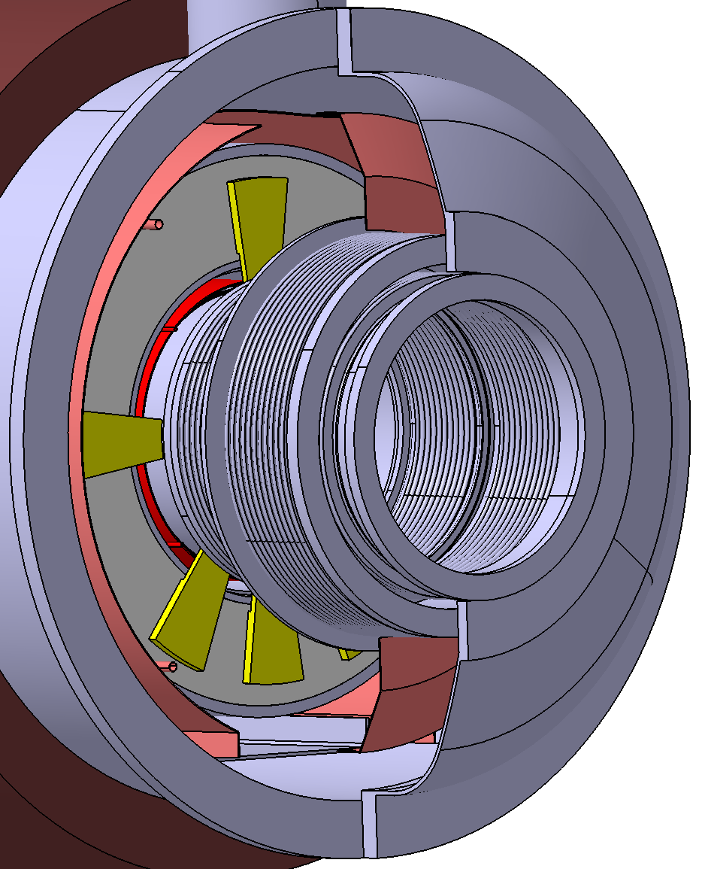
Cold beam pipe (1)
Extremity 50/80K screen
External flange
Bellows assembly (compensate the thermal shrinkage and increase the thermal resistance)

Slide 44
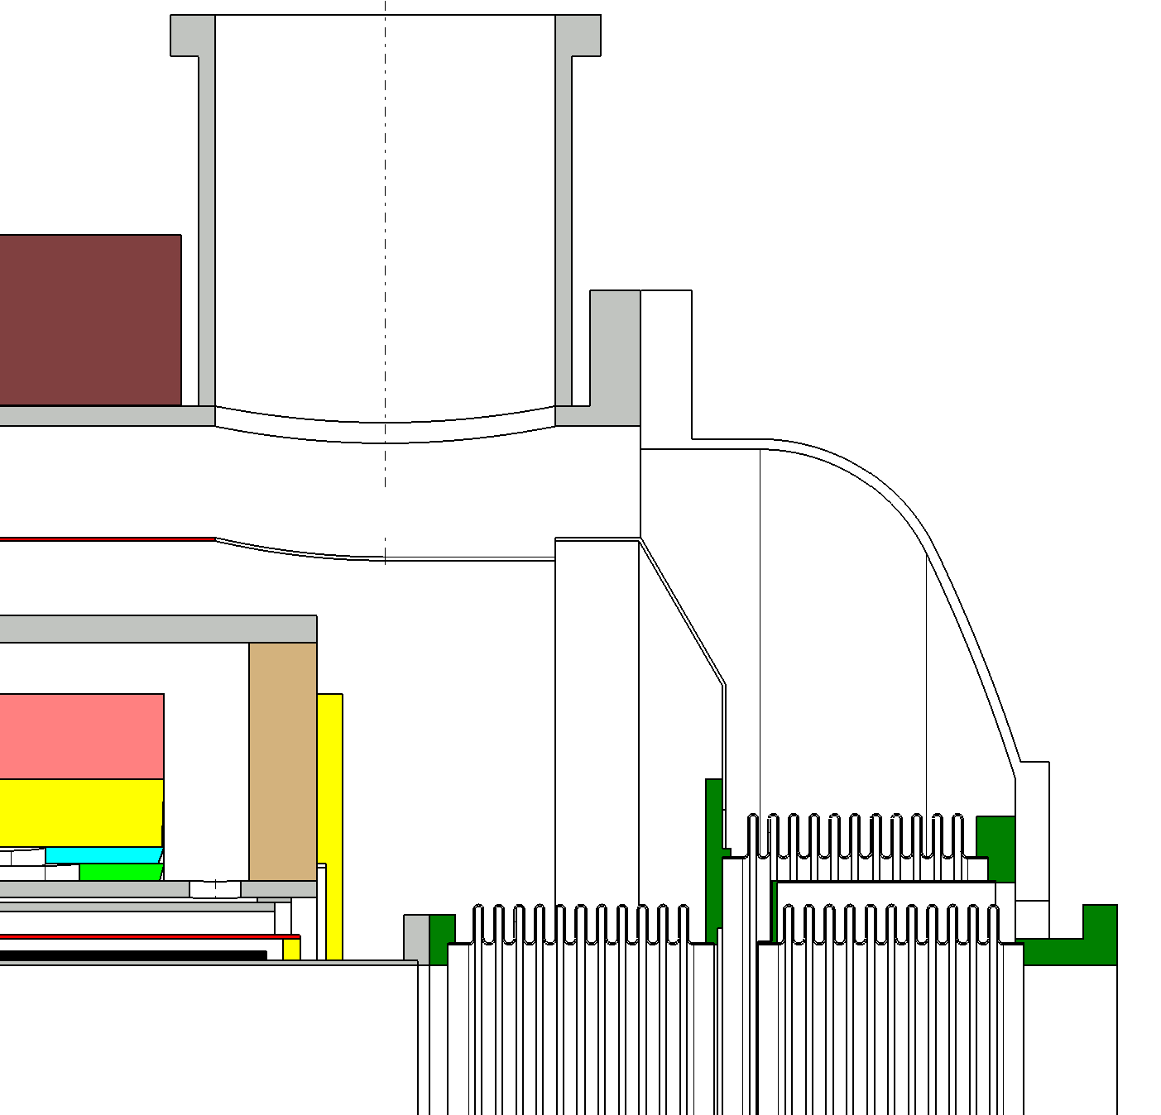
Cold beam pipe (2)
Dished head
COLD MASS
Bellows

Slide 45
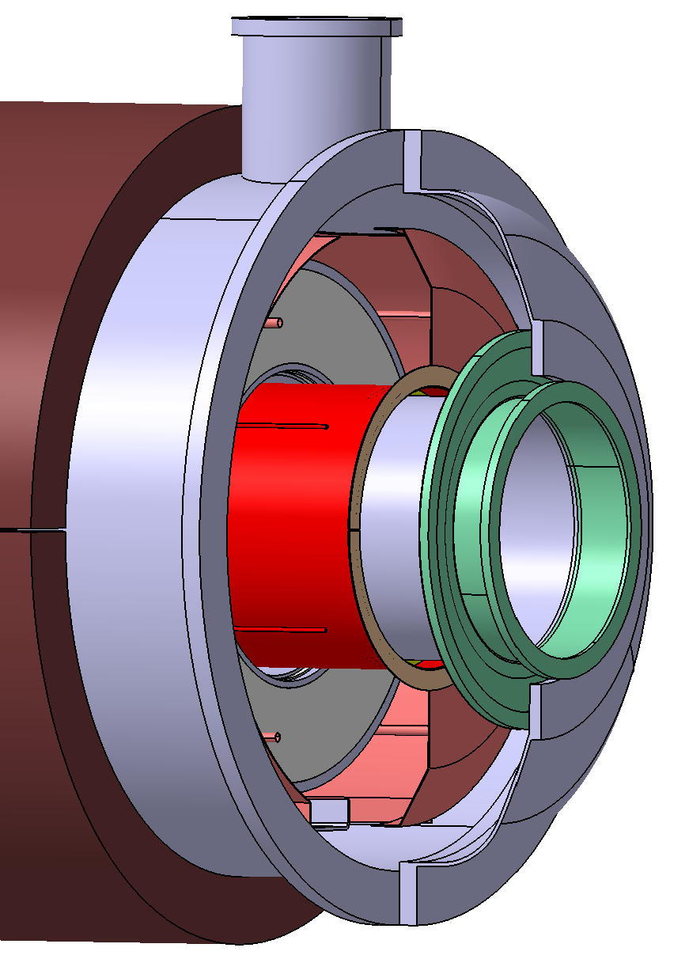
Warm beam pipe (1)
Flexible membrane
Stainless steel pipe interface
Aluminium beam pipe

Slide 46
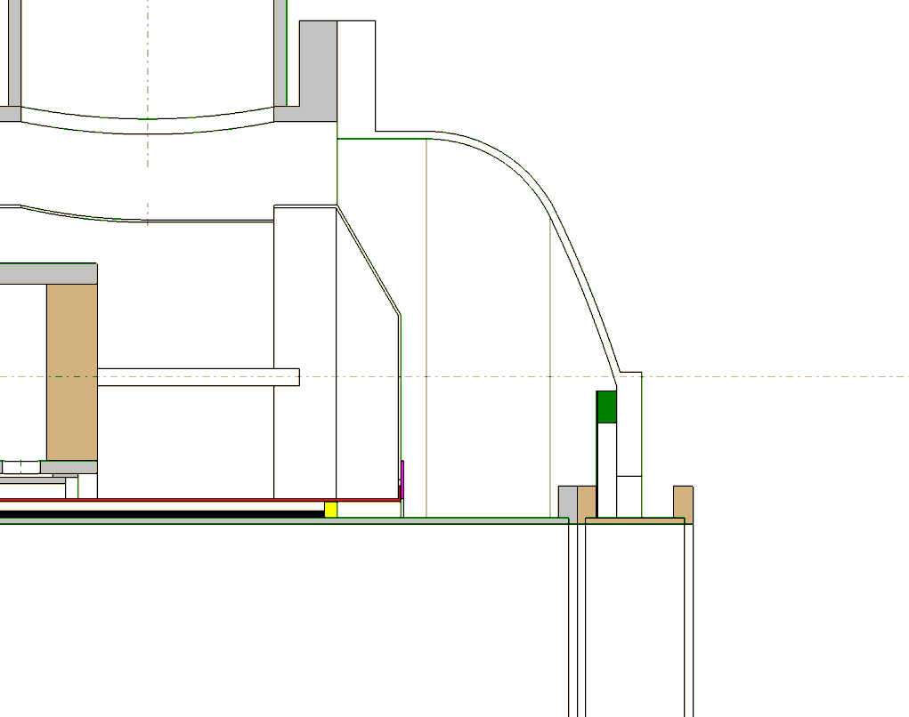
Warm beam pipe (2)
50/80K external and beam screens are linked at the cold mass extremity
Flexible membrane . Compensate thermal shrinkage differences and dimensions tolerances between vacuum vessel and pipe (Rigid assembly on the other side)

Slide 47
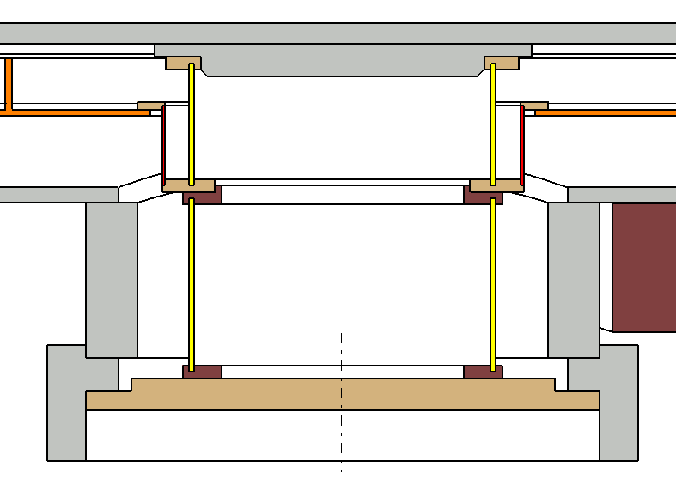
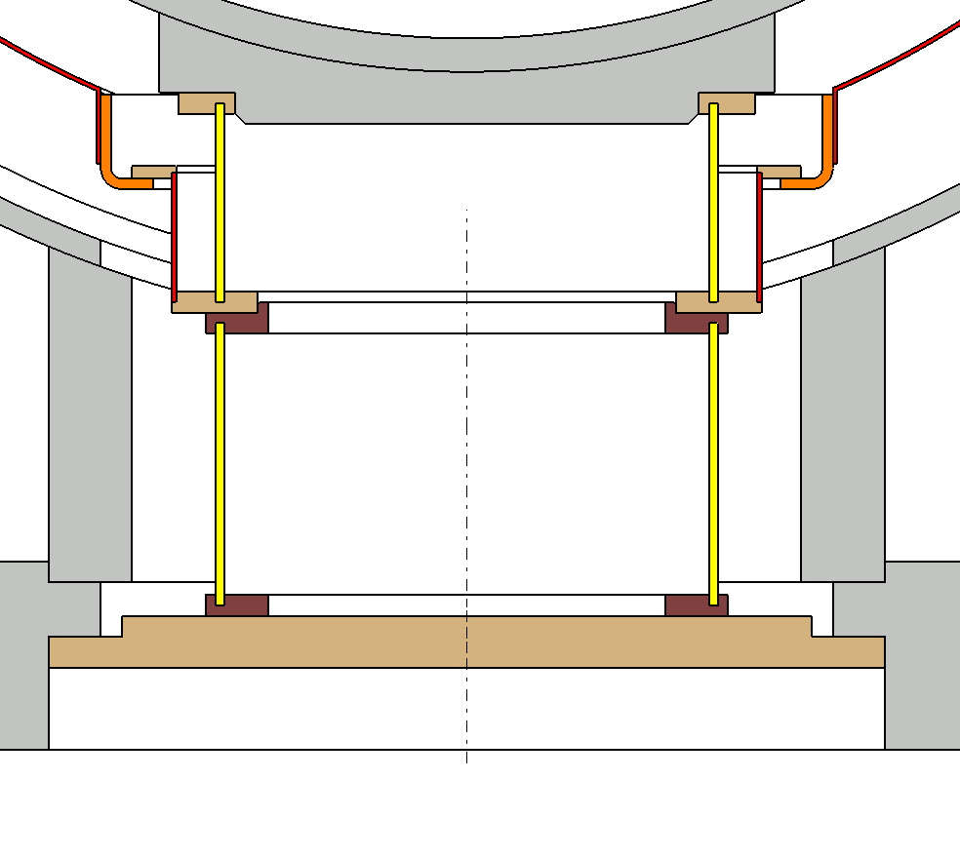
Support posts
- The cold mass is supported by 2 composite posts : one fixed and one sliding.
- Made from glass fibre reinforced with epoxy.
- 2 parts
- Intermediate stage cooled at 50/80 K
LONGITUDINAL SECTION TRANSVERSAL SECTION
Cold mass
Screen support
Upper support post
50/80K screen
Vacuum vessel support
Lower support post
Magnetic shield

Slide 48
Multiplet assembling
and tooling

Slide 49
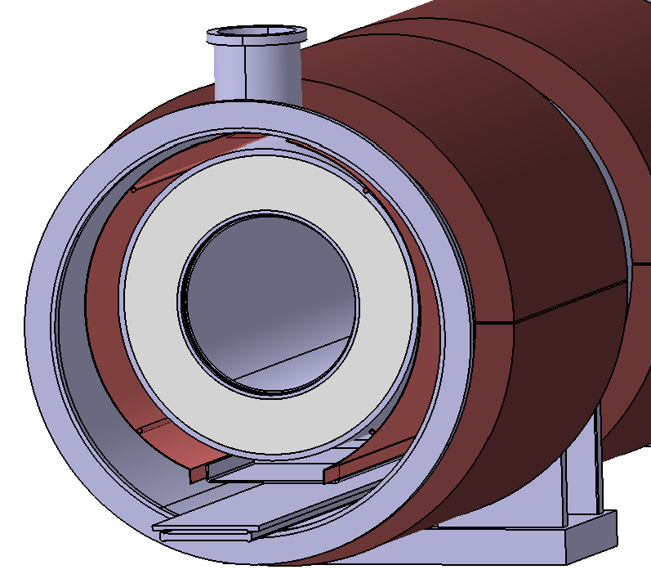
Assembling (1)
COLD MASS INTRODUCTION
- Similar procedure as LHC dipoles with specific tooling
- Cold mass, screen and MLI are assembled separately on the sledge
- The lower parts of the support posts are removed
- The sledge is gliding on the fixed plate
- The cold mass is pulled with a winch inside the vacuum vessel
Fixed plate
Sledge with low Friction blocks

Slide 50
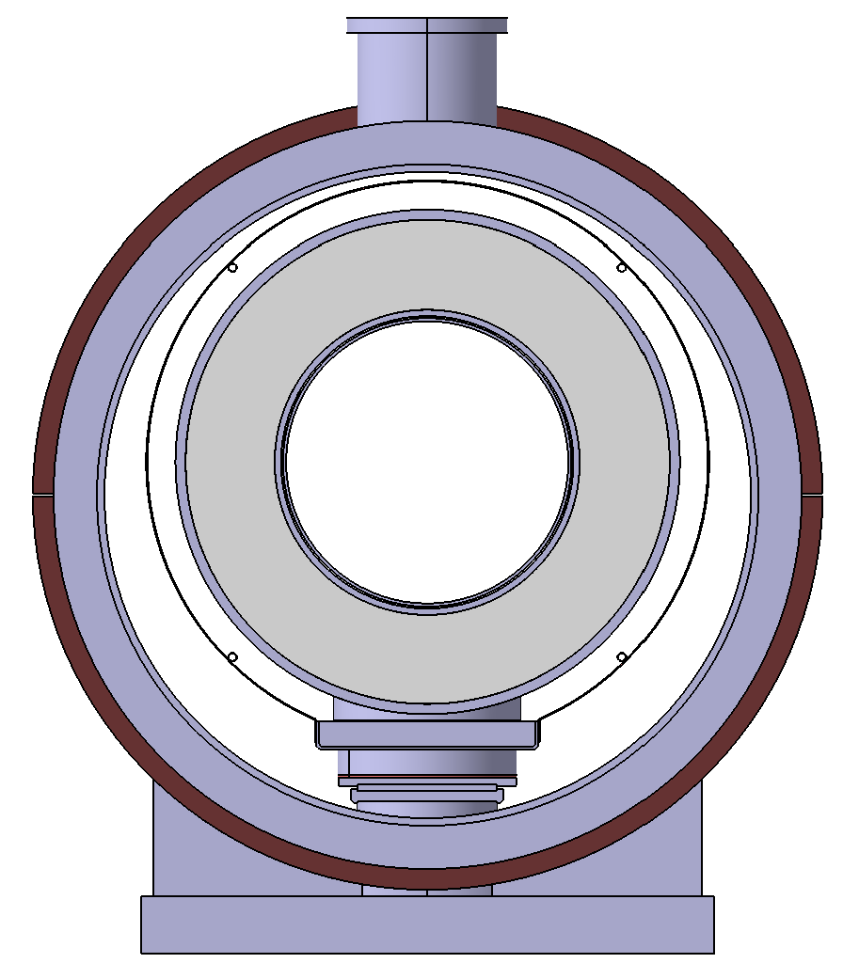
Assembling (2)
COLD MASS POSITIONING
- The cold mass is lifted by 2 jack equipments at each extremity
- The lower part of the support posts is fixed after tools removal
- The cold mass is put down on its supports located on the vacuum vessel bottoms
- Ability of transversal adjustment.

Slide 51
IPNO practice and skills
-
Cryostat manufacturing

Slide 52
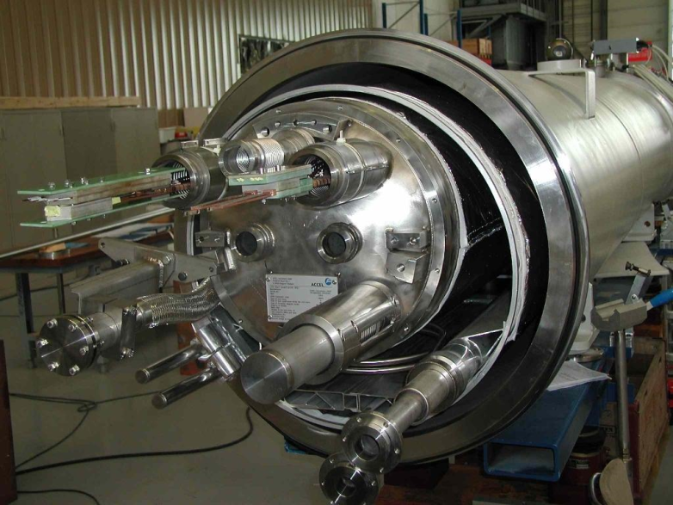
IPNO know-how : LHC project
Design of cryostats for SSS Arcs (56 variants), MS and DS multiplets.
Tooling design for cold mass insertion.
        Currently :
Design of cryostats for the triplet upgrade.
Tooling modifications.

Slide 53
IPNO know-how : Industrialization
Realization according to French pressure code CODAP (similar to German AD-MERKBLATT).
Manufacture follow-up of LHC dipoles and quadrupoles.
Current market survey for the triplet upgrade suppliers (about 20 societies selected for the vacuum vessel). Available for the S-FRS project.

Slide 54
Cryogenics

Slide 55
Principle
Common 4.5 K saturated helium liquid tank for the multiplet
50 K helium gas forced flow in the thermal shield pipes
At 50 K level
2 W/m² on thermal shield surface of 23 m² | 46 W
10 W per cryogenic post | 20 W
Total | 66 W
At 4.5 K level
0.2 W/m² on helium tank surface of 20 m² | 4 W
1 W per cryogenic post | 2 W
0.1 g/s per each current lead pair | 18 W
Total | 24 W
As the current leads represent 75% of the global loads, the use of HTC current leads seems reasonable

Slide 56
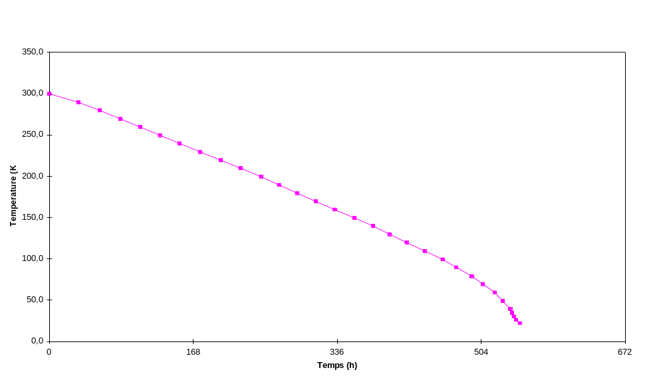
Cool-down
As the yoke is warm, the stored enthalpy in the cold mass is only 700 MJ.
The needed mass flow of helium (19 bars) with an imposed temperature decrease of 40 K is 3 g/s for a cool-down in 3 weeks.

Slide 57
Parameter list

Slide 58
Main parameter comparison
 | Cos (2θ) | Toshiba
Current (A) | 734 | 292
Ampere-turns | 814740 | 365000
Current density (A/mm²) | 311 | 133
Insulated conductor surface (mm²) | 2.36 | 1.94
Iron mass (ton) | 2.8 (warm) | 12 (cold)
Margin on the load line (%) | 20 | 41
Discharge voltage (V) | 893 | 1163
Outer diameter (m) | 1.24 | 1.72

Slide 59
Prototype

Slide 60
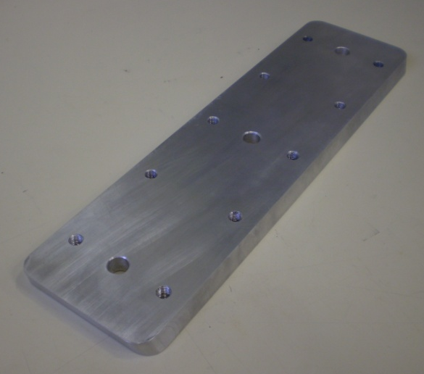
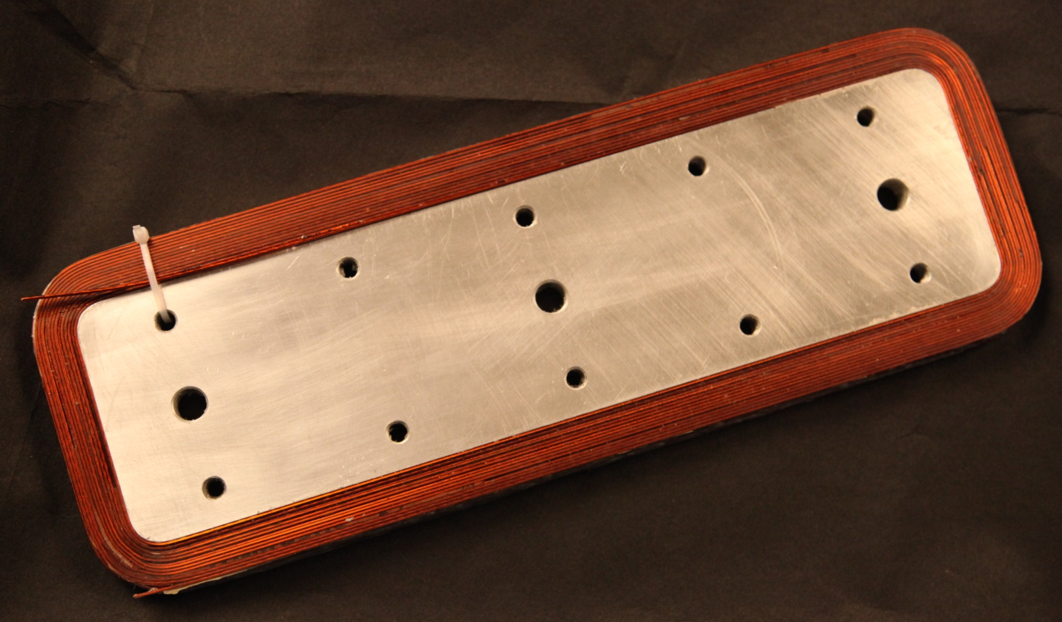
Mock-up winding test
We realized a flat winding test (6 layers, 14 turns) with a similar conductor in order to manage the 15° coil angle
→ It clearly showed that an inverse angle (10°) at the winding ends is needed to succeed in the winding.

Slide 61
Description
The prototype of one cold mass (quadrupole + correctors) has to be build to check the feasibility
This prototype will be tested to control the magnetic performance, and the mechanical and electrical behavior
Two additional cold masses would be realized then integrated in a full scale cryostat

Slide 62
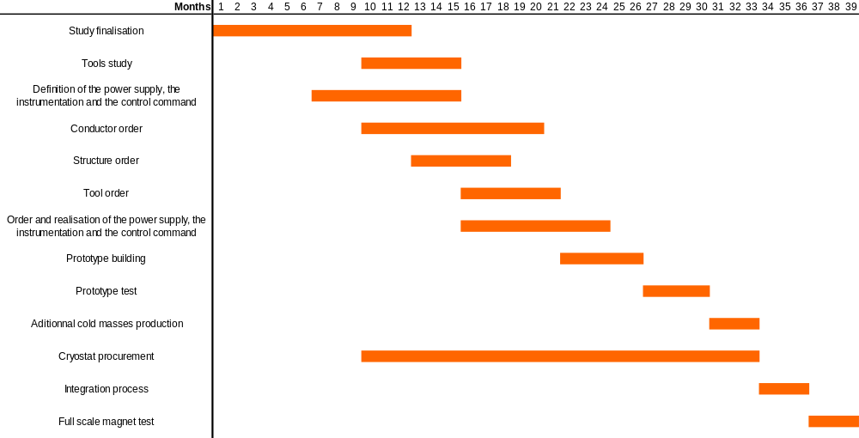
Schedule

