Slide 1
Introduction to China-ADS and the driver accelerator
Jingyu Tang
Institute of High Energy Physics, CAS
Beijing, China
CEA-Saclay Seminar, March 29, 2012

Slide 2
Contents
Some information about Chinese nuclear power development
Roadmap of the C-ADS program
Organization of the C-ADS project phase I
Design considerations for the C-ADS accelerator
Key technology R&D on the C-ADS accelerator

Slide 3
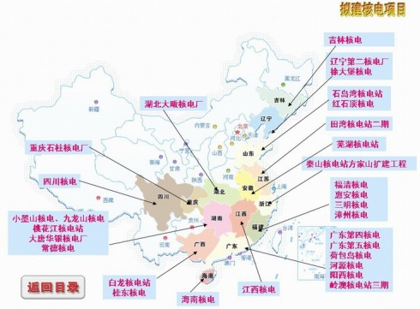
Nuclear Power in China
In 2010:
Operating reactors ： 10.23 GW_{e}/13 sets
Constructing reactors ： 25.90 GW_{e}/23 sets
Prepare to construct ： 44.27 GW_{e}/39 sets
Propose to construct： 120.0 GW_{e}/120 sets
Probably too ambitious and affected by Fukushima nuclear accident
2020
70GWe ( 5% total electricity )
2030
200GWe ( 10% total electricity )
2050
400GWe ( 22% total electricity )
May be more than total nuclear power in the world right now !
Notes:
3

Slide 4
Nuclear waste accumulated by 2050 in China
Year | 2000 | 2010 | 2020 | 2050
Power (GW) | 6 | 20 | 40 | 240
Spent fuel (t) |  |  | 7200 | >50000
Minor actinides (t) |  |  | 4 | >30
Long live fission products (t) |  |  | 17 | >120

Slide 5
Advanced Nuclear Energy Programs in China
  The strategy of sustainable fission energy in China consoled by top Chinese scientists:
    Gen-IV reactors for nuclear fuel breeding
    ADS for transmutation
      Nuclear waste is a bottleneck for nuclear power development.
      ADS has been recognized as a good option for nuclear waste transmutation.
As a long-term program, ADS and TMSR (Thorium-based Melten Salt Reactor) R&Ds will be supported by CAS.
Budgets for C-ADS and TMSR (both Phase 1) have been allocated by the central government.

Slide 6
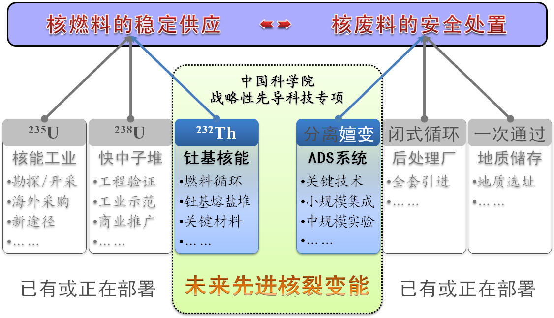
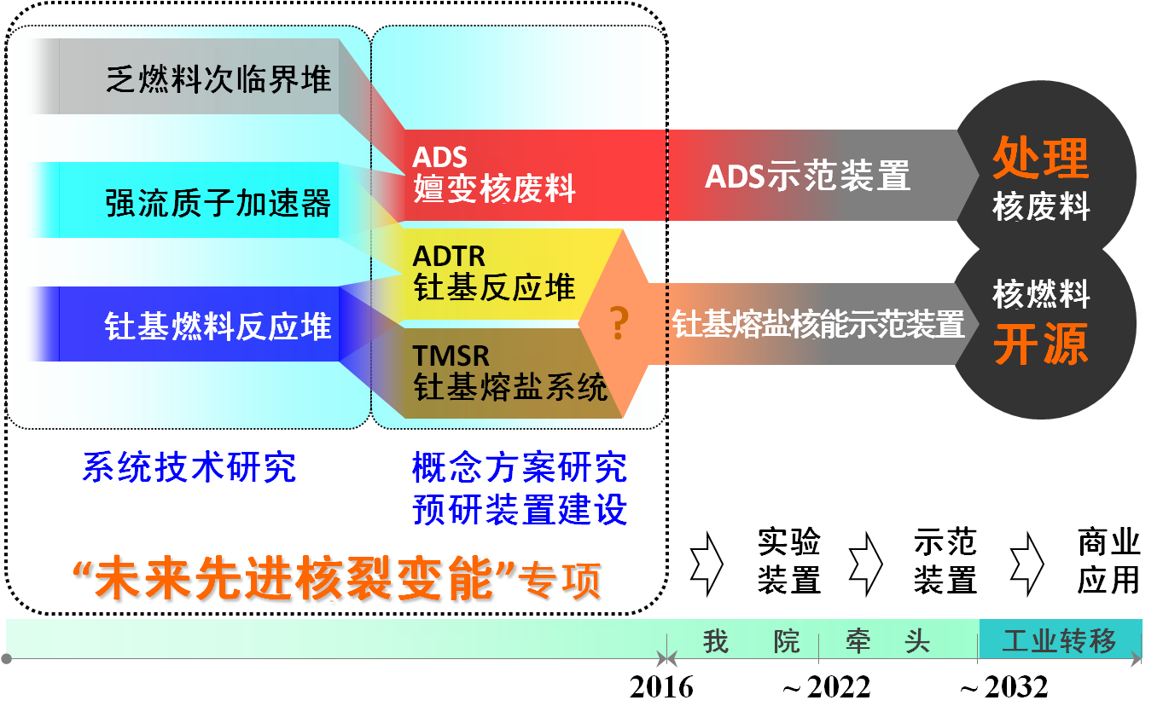
Special Nuclear Energy Program in CAS
TMSR
- Diversify nuclear fuel resource
(Thorium is richer than uranium and more dispersed on the earth, less waste etc.)
ADS
- Transmutation of long-lived nuclear waste
~2032,
- Demo facilities for industrial applications
Notes:
Strategic pilot projects on science and technology, most of the eight are hosted by CAS

Slide 7


Schematic of C-ADS
Proton
Neutron
Proton Linear Accelerator (IHEP, IMP)
Liquid-metal Target (IMP)
Reactor (PbBi coolant )
(IPP, USTC)

Slide 8
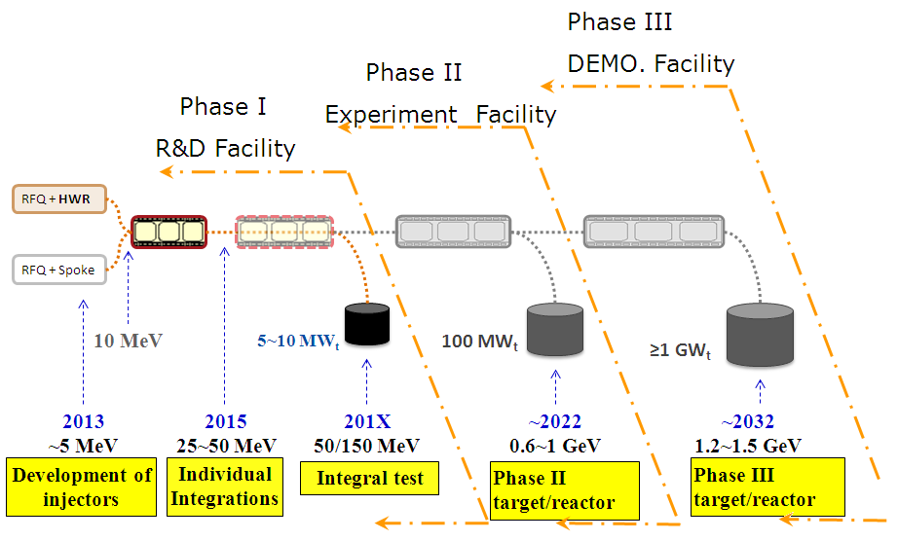
Roadmap of C-ADS program
Notes:
8

Slide 9
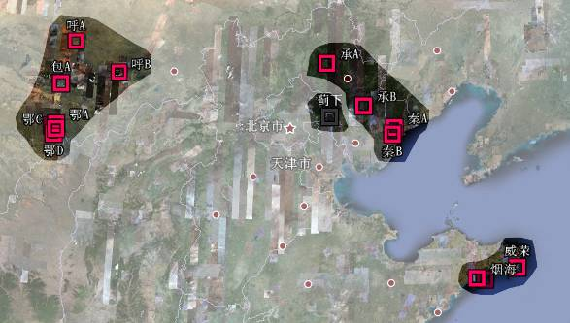
R&D Team & Sites for C-ADS
Team
  CAS: IHEP, IMP, IPP, USTC, …
  3 NP Com. + Univ.
  Local government cooperation
  International collaboration
Host of the future facility
  A new CAS institute will be established to host the C-ADS facility
  Site candidate: Erdos (Inner Mongolia)
R&D infrastructure
  Labs and infrastructure at the home institutes before the new institute is ready

Slide 10
Organization of C-ADS Phases I
Three major systems
  Accelerator:
  IHEP as leader, responsible for Injector Scheme-I R&D and the main linac
  IMP as collaborator, responsible for Injector Scheme-II R&D
  Joint IHEP-IMP group on accelerator physics
  Target: IMP as leader
  Reactor: IPP (Institute of Plasma Physics, as leader) and USTC (University of Science and Technology of China)

Slide 11
Infrastructure (to be built in leading institutes)
  Superconducting RF test platform
  Radio-chemistry study platform
  Pb-Bi core simulation and mock-up platform
  Nuclear database
  Integrated test and general technical support platform

Slide 12
Main specifications of the C-ADS driver linac
Particle | Proton
Energy | 1.5 | GeV
Current | 10 | mA
Beam power | 15 | MW
Frequency | 162.5/325/650 | MHz
Duty factor | 100 | %
Beam loss | <1 (or 0.3) | W/m
Beam trips /year | <25000 <2500 <25 | 1s<t<10s 10s<t<5m t>5m

Slide 13
Design philosophy
Accelerator choice: superconducting linac is preferred (only RFQ is room-temperature).
  Straight trajectory: easy extraction and injection.
  Easy upgrading: long term project by steps
  Large aperture: low beam loss
  Low power consumption: reducing RF cost and easing cooling problems.
  Independently powered structures: increasing availability.
To meet the very strict reliability requirement
  De-rating of critical components (over-design).
  Component redundancy and spares on line.
  Component failure tolerance.

Slide 14
Lattice design requirements
Zero current phase advance per cell should be kept below 90º for both transverse and longitudinal to avoid parametric resonance.
Transverse and longitudinal focusing must change adiabatically.
Avoid energy exchange between the transverse and longitudinal planes via space-charge resonances.
Provide proper matching in the lattice transitions to avoid serious halo formation.
  Low longitudinal emittance at RFQ exit: favored to obtain higher acceleration when keeping acceptance to emittance ratio

Slide 15
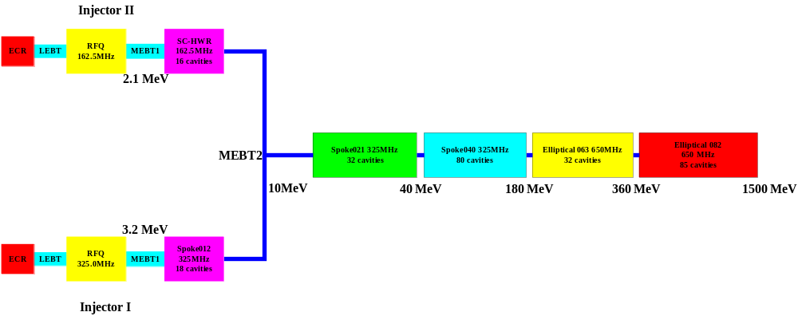
Layout of the C-ADS linac
Main linac
Local compensation
‘Hot stand-by’
Two identical injectors on line, either with scheme injector-1 or with scheme injector-2

Slide 16
RF cavities
RF cavities based on Injector Scheme-I
  RFQ frequency: 325 MHz
  Single-cell spoke cavities (three types: one in injector, two in main linac)
  RFQ output energy: 3.2 MeV, trade-off between RFQ and low-beta spoke cavities
  After about 150 MeV, two 5-cell elliptical cavities (650 MHz) to reach 1.5 GeV
RF cavities in Injector Scheme-II
  RFQ frequency: 162.5 MHz
  HWR cavities to reach 10 MeV
  RFQ output energy: 2.1 MeV, reducing radiation and RFQ requirement (length and vane voltage)

Slide 17
Merits for Injector-I
  Better for main linac, only one time frequency jump
  Half bunch charge compared with Injector-II
  Consistent to spoke cavities in the main linac
Merits for Injector-II
  RFQ looks easier to success, lower heat deposit density
  HWR is more mature than Spoke cavities, more collaboration chance with the international community
  More efficient in low-beta acceleration

Slide 18
Low-beta acceleration: very difficult
  Low-beta SC spoke cavities: no experience
  Large phase advance per cell: low acceleration rate, sensitive to errors
  Separation space between cryomodules: periodicity broken, resulting in emittance growth (long uninterrupted cryostat preferred for lowest-energy part)

Slide 19
The RFQs
RFQs are the only accelerating components in room- temperature
  It is very difficult to develop a CW proton RFQ due to very large heat load density
  Four-rod structure
  Different choice on RF frequency: 162.5 or 325 MHz
Design constraints from the previous RFQ experience at IHEP:
  Section length: <1.2
  Number of sections: <4

Slide 20
Parameters | Value
Frequency (MHz) | 325
Injection energy (keV) | 35
Output energy (MeV) | 3.2128
Pulsed beam current (mA) | 15
Beam duty factor | 100%
Inter-vane voltage V (kV) | 55
Beam transmission | 98.7%
Average bore radius r₀ /Vane tip curv. (mm) | 2.775 /2.775
Maximum surface field (MV/m) | 28.88 (1.62Kilp.)
Cavity power dissipation (kW) | 272.94 [1.4* Psuperfish]
Total power (kW) | 320.94
Avg. Copper power/Length (kW/m) | 41.68
Avg. Copper power/Area (W/cm²) | 3.25
Max. copper power/Area (W/cm²) | 3.77
Input norm. rms emittance(x,y,z)(πmm.mrad) | 0.2/0.2/0
Output norm. rms emittance(x/y/z) (πmm.mrad/MeV-deg) | 0.2/0.2/0.0612
Vane length (cm) | 467.75
Gap (entrance/exit) (cm) | 1.10 / 1.10
Accelerator length (cm) | 469.95
Main design parameters for RFQ-I

Slide 21
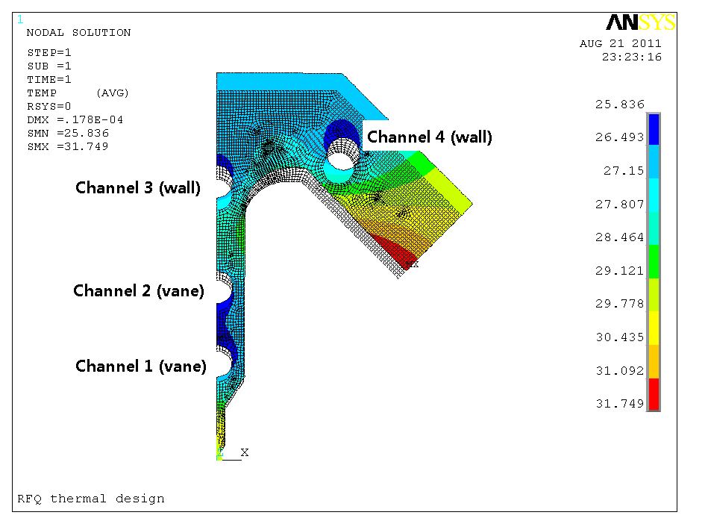
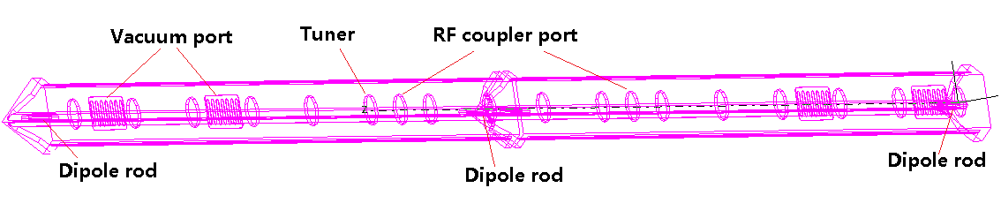
Water cooling
Tuning

Slide 22
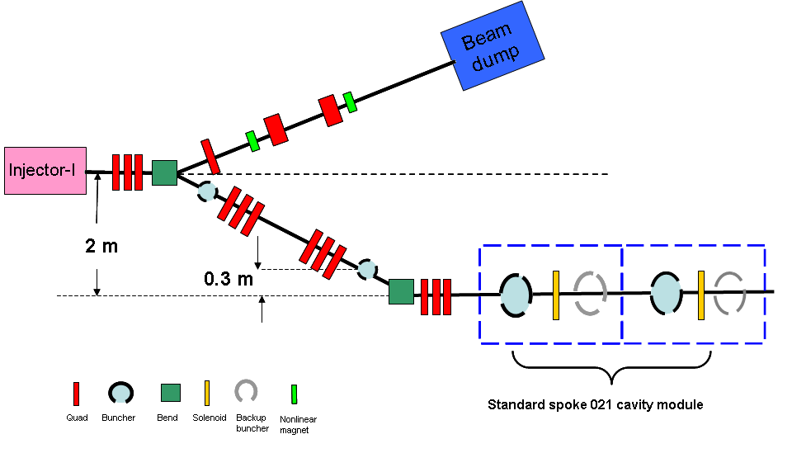
MEBT2 Design
Two injectors: one on-line, one hot-spare
  Both longitudinal and transverse collimation needed
  Achromatic to control emittance growth and beam jitter
  Longitudinal matching difficult, cavity within the bending section makes dispersion matching much complicated, together with space charge effect.

Slide 23
Main linac design
General design aspects
  Derated performance for the nominal setting (local compensation)
  Warm transitions between cryomodules
  SC solenoids in spoke sections
  Warm quadrupole triplets in elliptical sections
  Keep phase advance per cell between 20° and 90°
  Working point (Qx/Qy) resonant-free region (Hofmann chart)
  Acceptance to emittance (6D water-bag) ratio: >10

Slide 24
Specifications for SC cavities in main linac
Cavity type | βg | Freq. | Uacc. Max | Emax | Bmax
 |  | MHz | MV | MV/m | mT
Single spoke | 0.21 | 325 | 1.32 | 25/32.5 | 44.8/58.2
Single spoke | 0.40 | 325 | 2.79 | 25/32.5 | 49.4/64.2
5-cell elliptical | 0.63 | 650 | 7.68 | 35/45.5 | 48.3/62.8
5-cell elliptical | 0.82 | 650 | 15.47 | 35/45.5 | 60.4/78.5

Slide 25
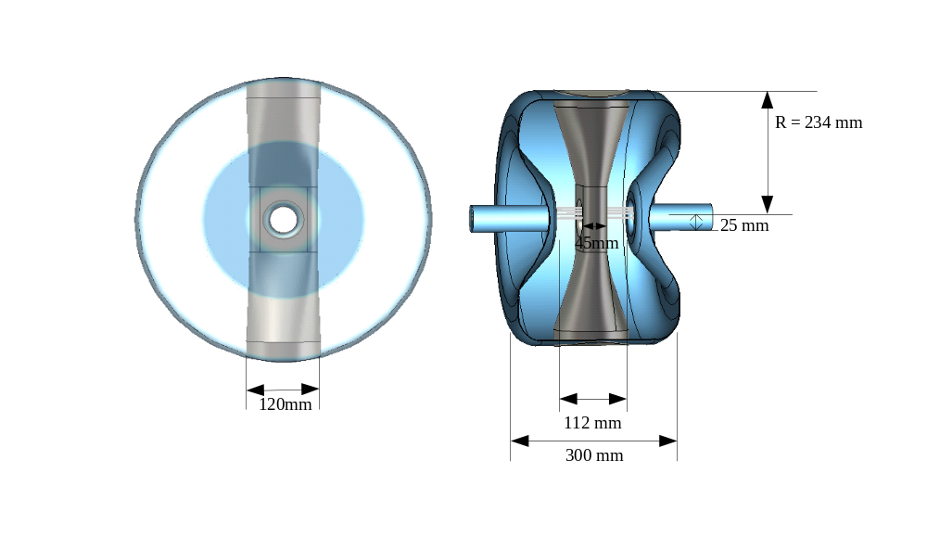
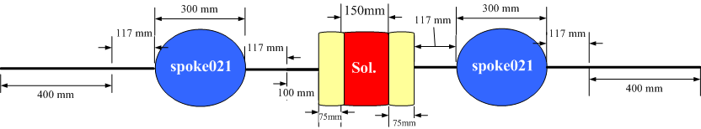
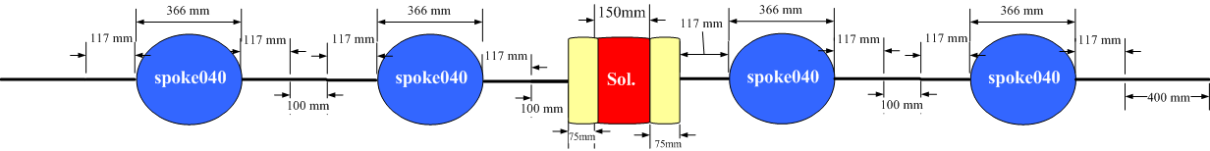
Two spoke sections (Spoke021 and Spoke040) to cover energy from 10 MeV to 150-180 MeV
  Transverse lattice: RSR (Spoke021), RRSRR (Spoke040)

Slide 26
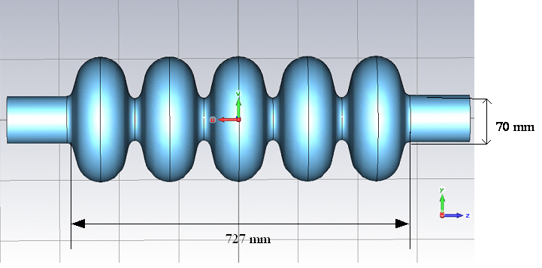
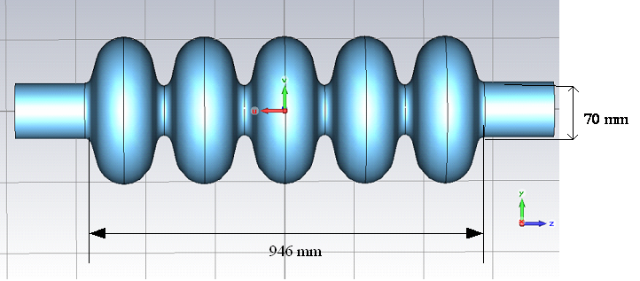
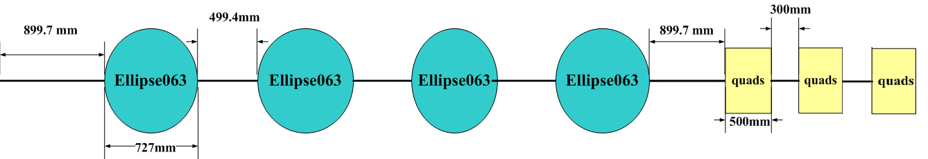
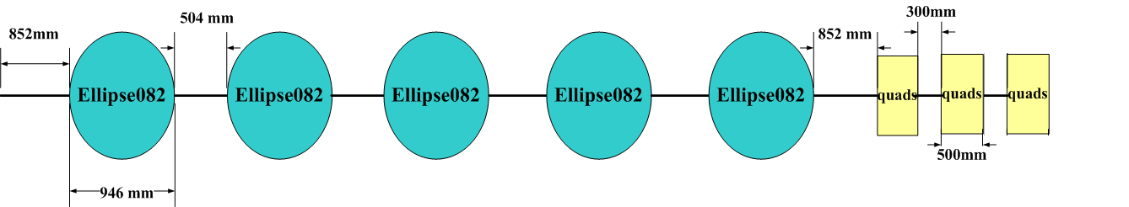
Two elliptical cavity sections (Ellip063 and Ellip082) to cover energy from 150-180 MeV to 1.5 GeV
  Transverse lattice: RRRRT (Ellip063), RRRRT (Ellip082)

Slide 27
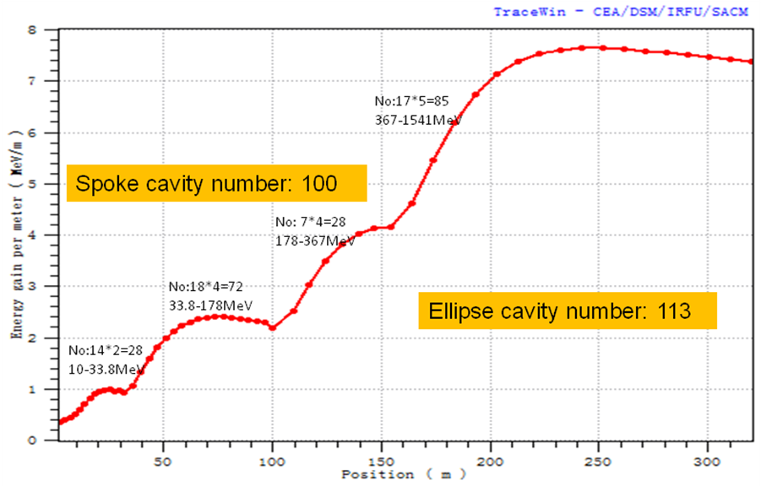
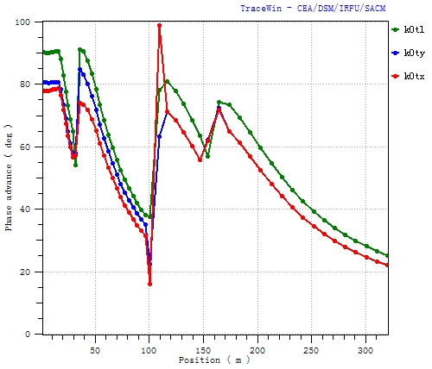
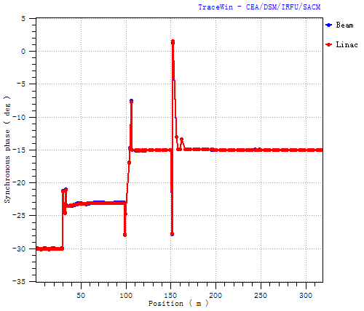
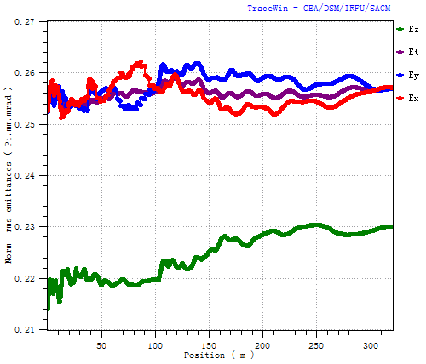
Simulation results

Slide 28
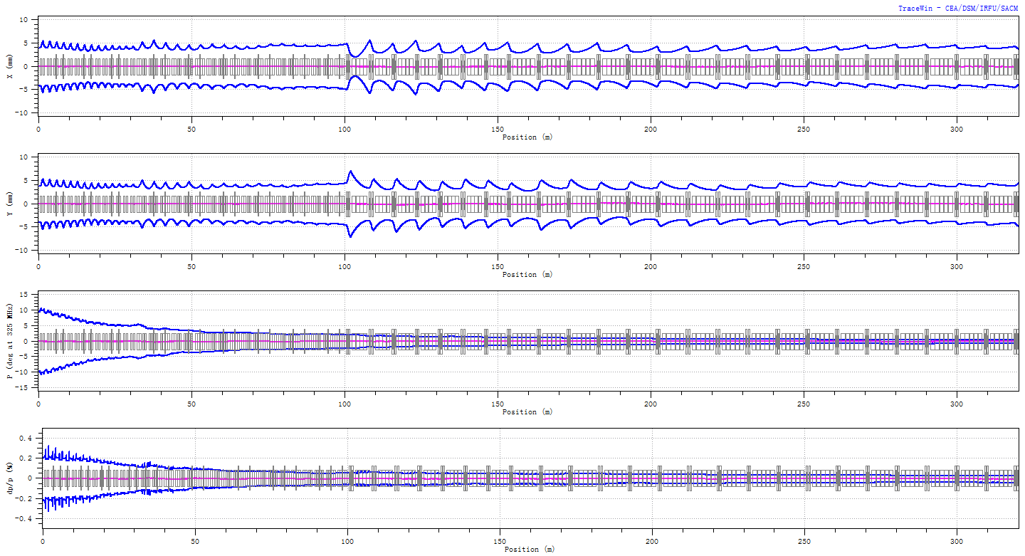
RMS envelope along the main linac

Slide 29
Local compensation
Beam trips are very critical in ADS system. Short beam trips less than 1 s are almost tolerated, but longer beam trips should be controlled very strictly.
A very important measure to deal with beam trips due to component failures such RF cavities (different causes) and focusing elements, is “local compensation method”
  Fast diagnosis of component failures, switch off beam
  Detuning the failed cavity
  Finding the compensation setting stored in database
  Assign the data setting to relevant devices, switch on beam

Slide 30
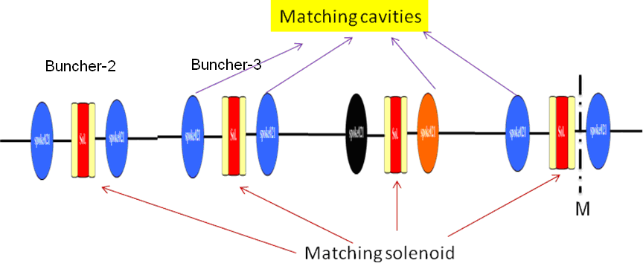
Local compensation
  Allowing fast setting (a few devices involved), and multiple local compensations along the linac
  Spoke cavity failure is compensated by 4 neighbor cavities and 4 solenoids
  Solenoid failure is compensated also by 4 neighbor cavities and 4 solenoids
  Elliptical cavity failure is easier to be compensated due to its weak focusing effect
  Quadrupole failure within a triplet is mainly compensated by the remaining two (doublet).

Slide 31
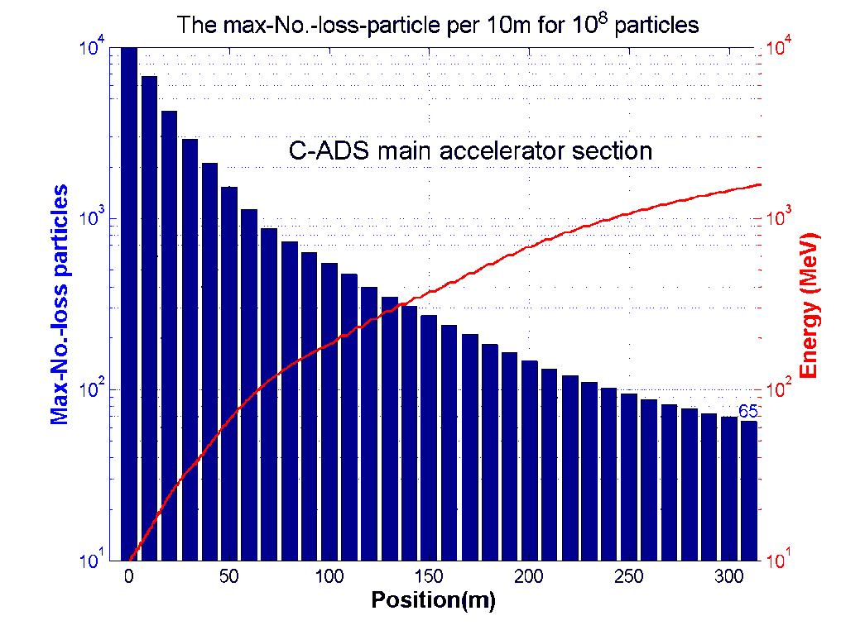
Beam loss control
With a beam power of 15 MW, beam loss should be controlled very strictly, or 1 W/m in RT devices or 0.3 W/m in cryomodules
  All the mechanisms leading to beam losses should be studied very carefully: 10^8 particles for simulations of halo particles
  Minimize emittance growth (halo)
  Effective orbit correction
  Collimation at low energy
  No beam loss in cryomodules

Slide 32
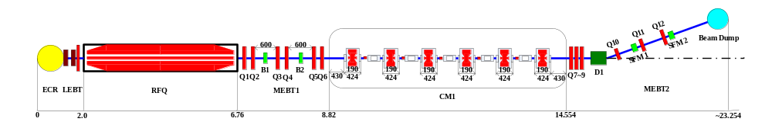
5/10 MeV Test Stand for Injector-I
A 5-MeV test stand for Injector-I is to be built at IHEP, which can be extended to 10 MeV with an additional cryostat.
With the nominal cavity settings, it can accelerate the beam to 5.38 MeV with 6 cavities.
With reduced cavity performance or even one cavity less, one can still obtain the output energy of 5 MeV by large synchronous phases (smaller -φs) with the tolerance of larger emittance growth.
The beam line to the beam dump takes the same design in MEBT2.

Slide 33
Key technology R&D for C-ADS linac
Strategy
  Parallel developments of different schemes or technical solutions for the injector (IHEP and IMP)
  Development by steps (Phase I, II, III)
Some key technology R&D
  Ion Source: stable operation
  CW RFQ: cooling problem
  SC Spoke cavities: development, unproven performance
  High power couplers: especially for CW RFQ
  Cryomodule: long cryomodule with many cavities and solenoids
  RF power source (CW Klystron, CW SSA, LLRF)
  Control & Instrumentation
  …

Slide 34
R&D studies (Phase I)
The budget has been approved (1.8 BCHY or 280 M$ in total)
  Accelerator: 640 MCHY (425 M for IHEP and 215 M for IMP)
2011-2013
  Physics design and technical designs
  Developing CW RFQ, SC cavity prototypes (spoke, HWR and CH) for the injectors
  CW test of first 5 MeV of two injectors
  Infrastructure or laboratory building-up
2014-2016
  Two different injectors testing with CW, 10-MeV and 10-mA
  Construction of main linac section (10-50 MeV)
  CW test of the 50-MeV linac

Slide 35
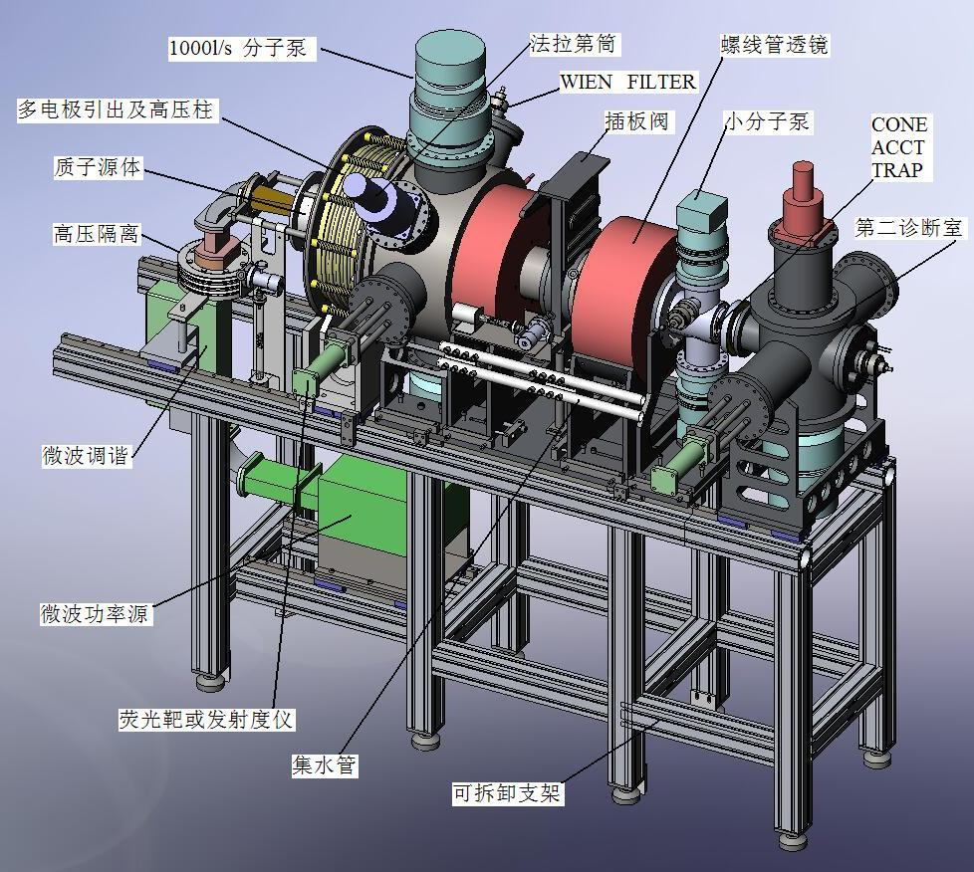
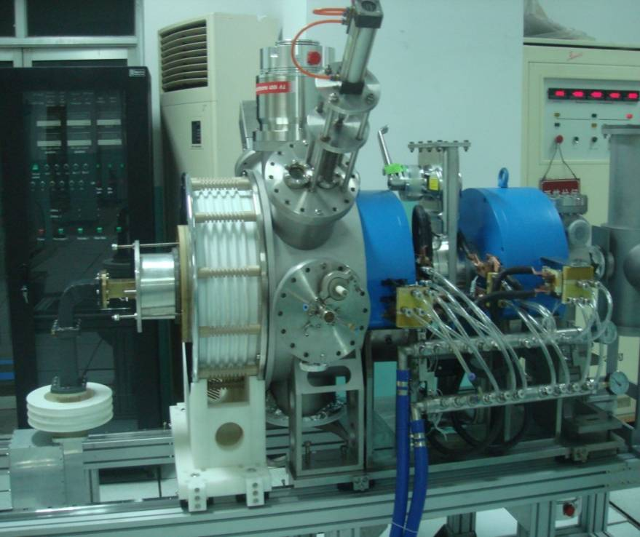
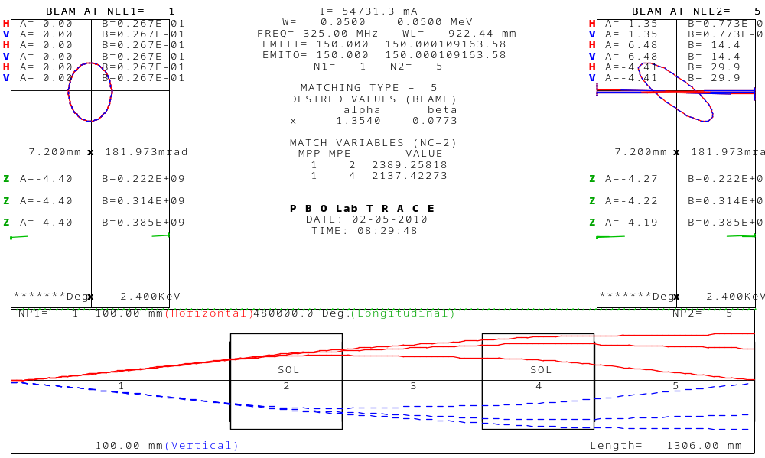
Some R&D work already carried out
Ion Source: ECR & LEBT (IMP)
H⁺、H₂⁺ & H₃⁺ Beam profile
35

Slide 36
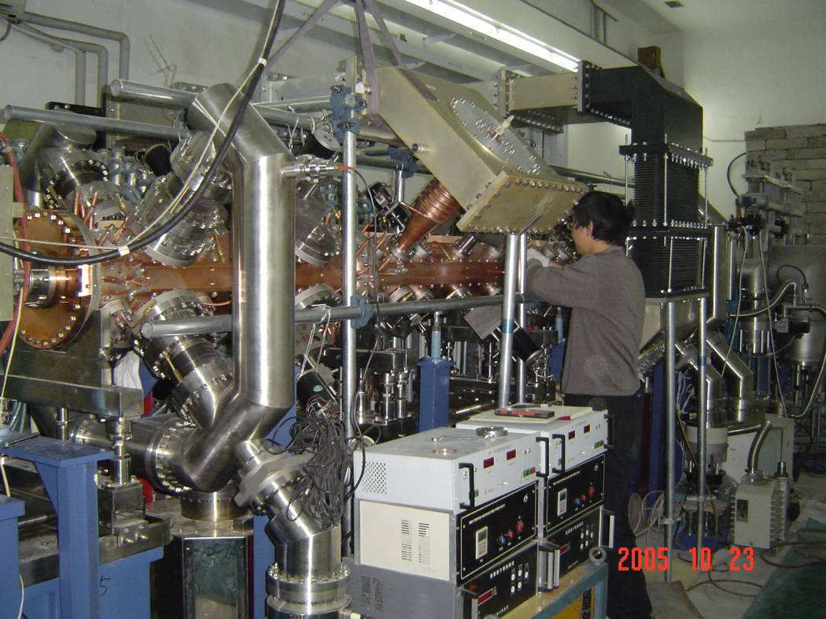
High-duty factor RFQ (IHEP)
A 3.5 MeV - 40 mA RFQ of 7-15% duty factor (supported by “973” program) was constructed and commissioned at IHEP, one of the most powerful RFQs under operation condition.
 | 973 RFQ | ADS RFQ
Frequency | 352MHz | 325MHz
Energy | 3.5MeV | 3MeV
Duty Factor | ~15% | CW
Operating | Short time | Long time
36

Slide 37
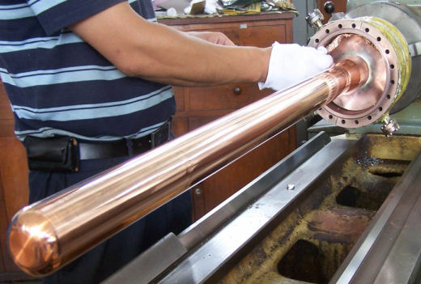
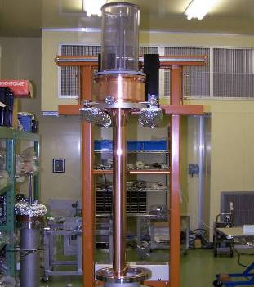
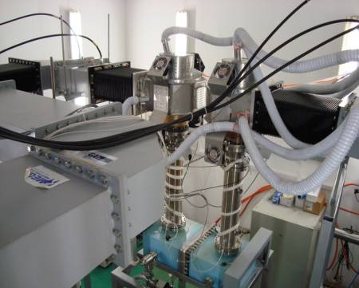
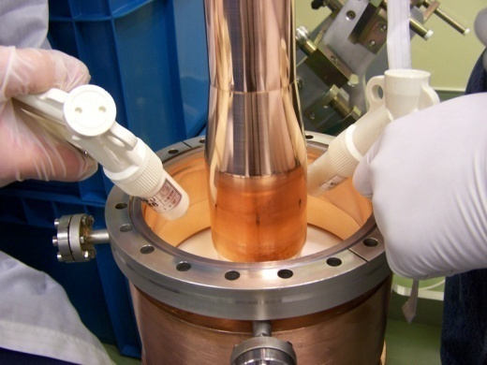
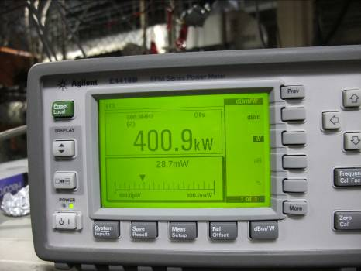
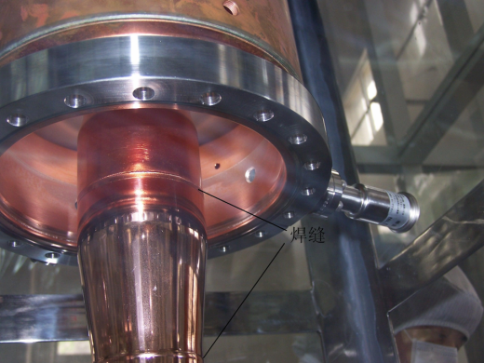
High power input couplers (IHEP)
(Supported by the BEPC SC cavity development program)
≥400kW
37

Slide 38
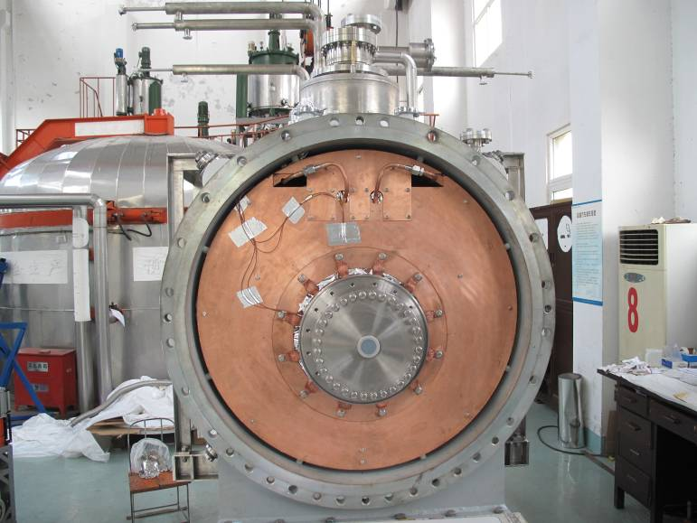
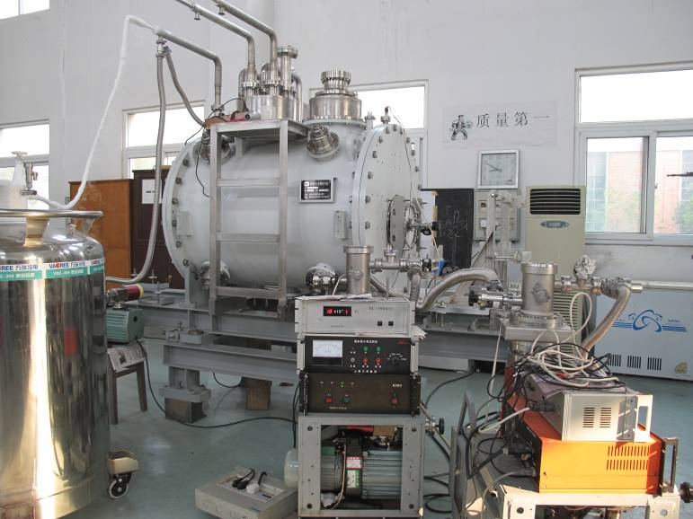
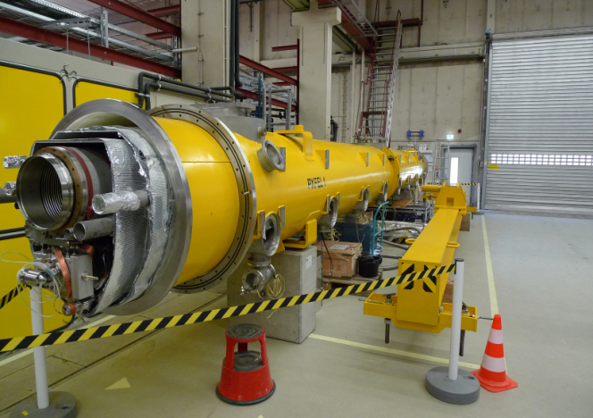
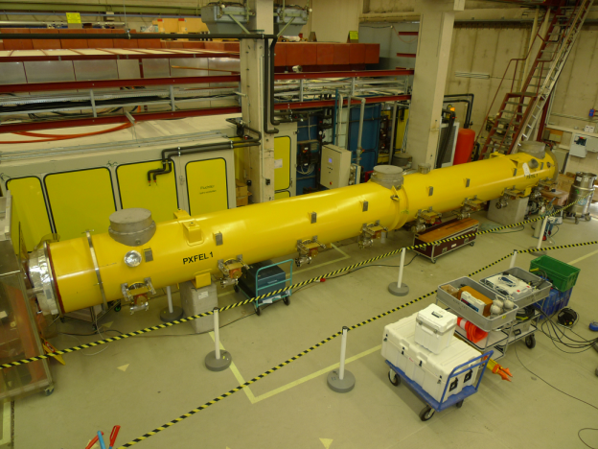
Cryomodules (IHEP)
Cryomodule for BEPCII 500MHz SC Cavity
Cryomodule named PXFEL1 was passed the cryogenic test at DESY in July. 2009. Contract for delivering 50 for EXFEL
38

Slide 39
Control & Instrumentation (IHEP)
Controls:
  Digitalized control system has been developed for the CSNS project, and can be used in the C-ADS
  EPICS, XAL etc. developed with the CSNS project (BEPCII)
Instrumentation
  Many beam diagnostic devices have been developed or are under development under the “973” program and the CSNS project. They can be used in the C-ADS, such as BLM (including ion chamber, FBLM), BPM, BCT, Wire Scanner, double-slit emittance measurement system.
39

Slide 40
Summary
Sustainable nuclear energy has high priority in China.
The C-ADS program has been officially started under the coordination of CAS, and is led by three CAS institutes.
The R&D phase for the driver linac is to build a SC linac with a CW beam of 50-MeV and 10-mA, and relevant infrastructure.
It is a great challenge to build a high-performance CW proton linac. Strong collaboration with international leading laboratories is very important. This is not only an important step towards the ADS but also a contribution to the accelerator community.
40

Slide 41
Thanks for your attention！
41

