Slide 1
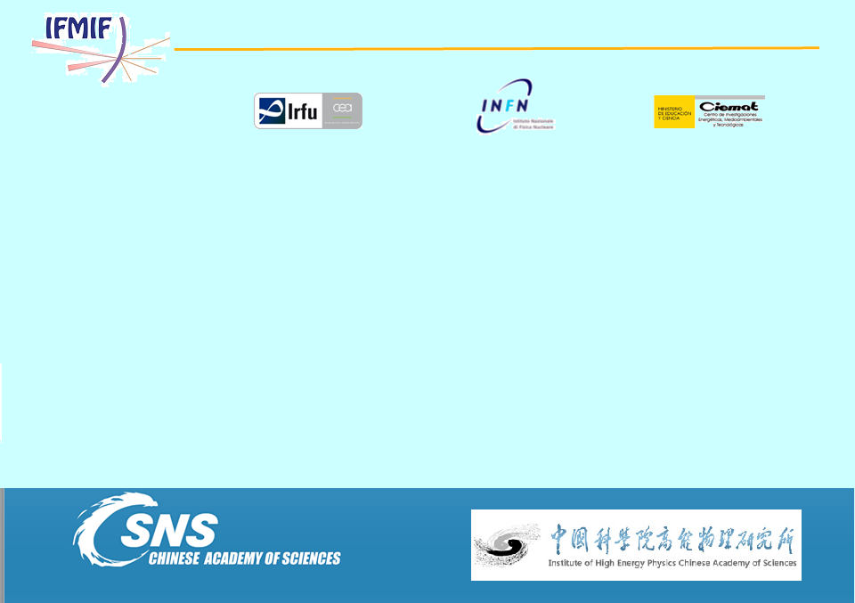
Using step-like nonlinear magnets for beam uniformization at target in high intensity accelerarors
Zheng Yang, Jing-Yu Tang, IHEP, China
P.A. Phi Nghiem, Nicolas Chauvin, CEA/Saclay/IRFU, France

Slide 2
Topics
Introduction to CSNS C-ADS IFMIF accelerators
Beam spot uniformization
Introduction of the step-like magnet
Application on the CSNS C-ADS IFMIF
Introduction to the Simplified high-order field magnet

Slide 3
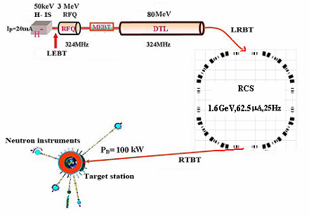
CSNS high power proton accelerator
CSNS (China Spallation Neutron Source) is a high-power proton accelerator based multi-disciplinary facility for research, mainly relying on neutron scattering techniques.
Construction: 2011-2017
Site: Dongguan, Guangdong
IHEP and IOP
Phase | I | II | II’ or III
Beam power on target [kW] | 100 | 200 | 500
Beam energy on target [GeV] | 1.6 | 1.6 | 1.6
Ave. beam current [mA] | 63 | 125 | 315
Pulse repetition rate [Hz] | 25 | 25 | 25
Protons per pulse [10¹³] | 1.6 | 3.1 | 7.8
Linac energy [MeV] | 80 | 132 | 250
Linac type | DTL | DTL | +SCL

Slide 4


China ADS high power proton accelerator
China is pursuing an ADS (Accelerator-Driven Subcritical System) program strongly, under CAS (IHEP, IMP, IPP and USTC)
Accelerator: 10mA, CW proton beam
Phase III
DEMO. Facility
Phase II
Experiment Facility
Phase I
R&D Facility
RFQ+CH
RFQ+Spoke
10 MeV
5~10 MW_{t}
100 MW_{t}
≥1 GW_{t}
2013
~5 MeV
2015
25~50 MeV
201X
50/150 MeV
~2022
0.6~1 GeV
~2032
1.2~1.5 GeV
Verification of two ways
Integration
Integral test
Phase II target
Phase III target

Slide 5
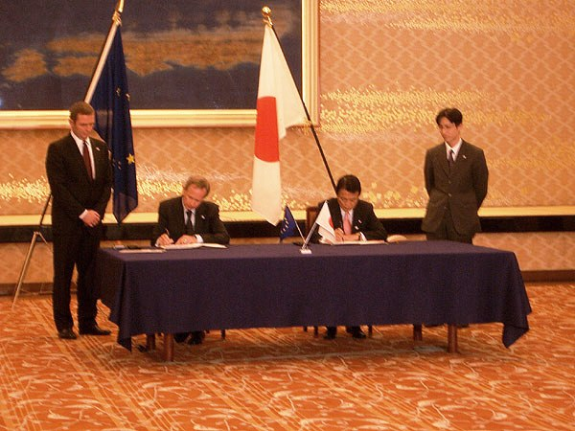
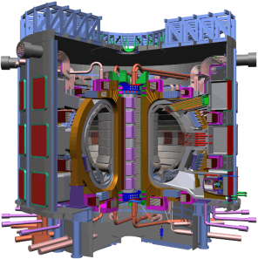
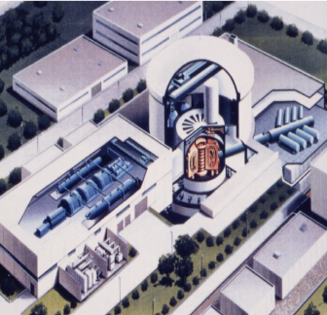
Introduction to IFMIF accelerator
IFMIF (International Fusion Material Irradiation Facility) is one part of Broader Approach signed between Europe and Japan
in parallel to the decision of ITER construction.

Slide 6
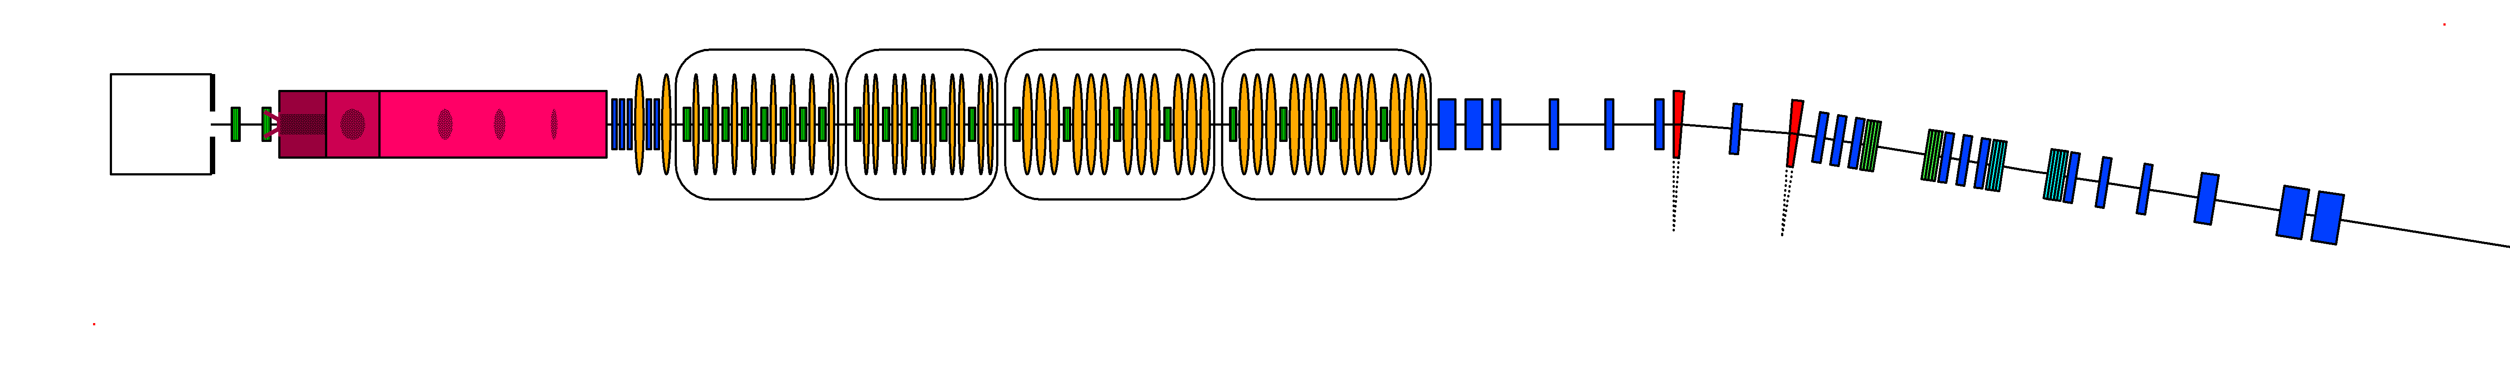
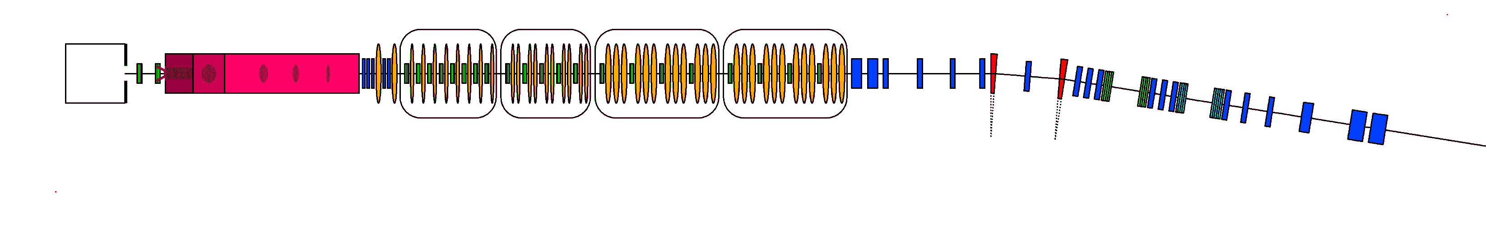
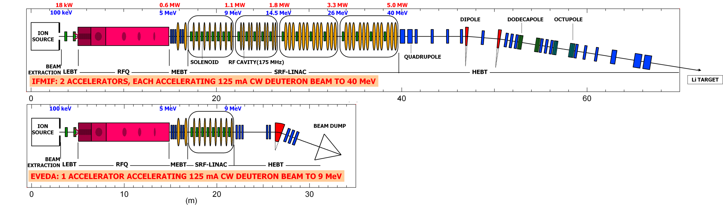
IFMIF: International Fusion Materials Irradiation Facility
Lithium Target
25 mm thick, 15 m/s
L
M
2 accelerators, 2x125 mA, 2x5MW
D⁺
H
Test Cells
High (>20 dpa/year, 0.5 L)
Medium (>1 dpa/year, 6 L)
Low (<1 dpa/year, > 8 L)
Typical reactions ⁷Li(D,2n)⁷Be ⁶Li(D,n)⁷Be ⁶Li(n,T)⁴He

Slide 7
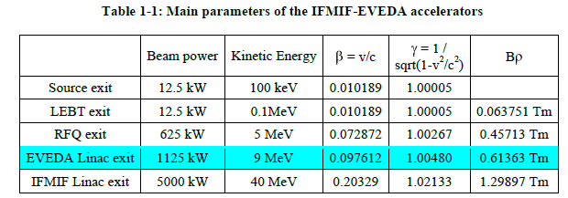
IFMIF-EVEDA is studied and constructed in Europe, and to be installed in Japan.
The highest average current linac under developing in the world, pose many challenges
  Based on CW RFQ and superconducting HWR linac

Slide 8
Beam spot uniformization
One of the critical issues concerning the interface between a high-power beam and its irradiation target is the spot uniformity to reduce the peak current density at the target and reduce the beam halo
  CSNS
  Beam footprint in rectangular shape: 12 cm (H) x 5cm (V)
  Ratio of the peak current density to the average: <3
  C-ADS
  Beam footprint in rectangular shape: 4.4cm (H) x 4.4cm (V)
  Ratio of the peak current density to the average: <2.5
IFMIF (to be revised)
    Beam footprint in rectangular shape: 20 cm (H) x 5 cm (V)
    Current density across the flat top is uniform (±5%)
    Current density: < 0.5 μA/cm² (for |x|>11 cm)

Slide 9
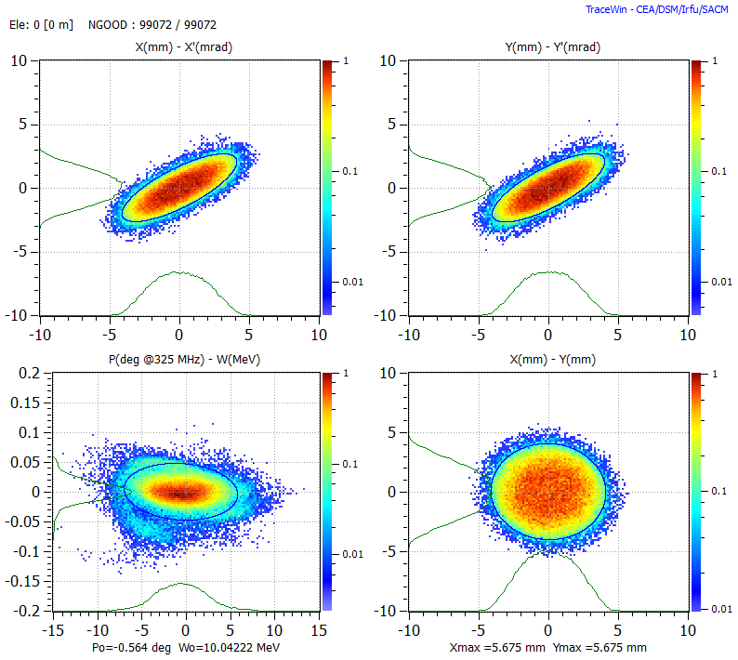
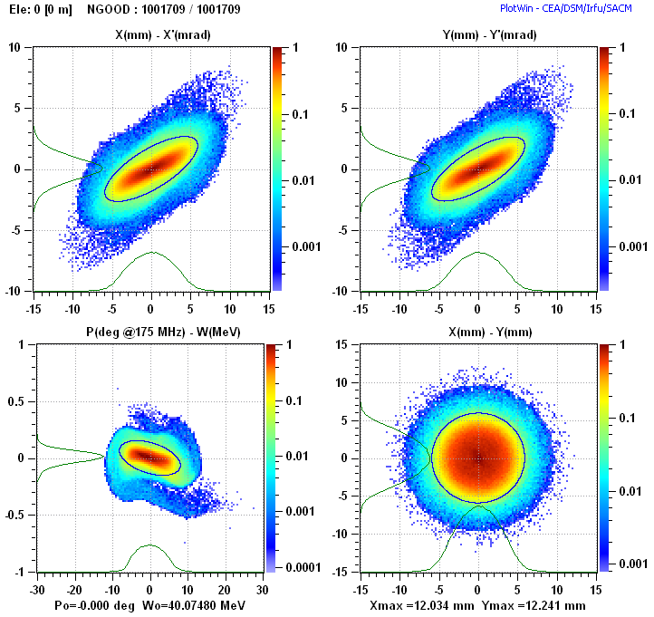
Input beam of C-ADS beam transfer line
Input beam of IFMIF-HEBT

Slide 10
Nonlinear magnets are needed for the beam spot uniformization at target
  More conventional: single octupole or pair of octupole and dodecapole for each plane (horizontal or vertical)
  New concept-1: step-like field magnets, initially proposed for ESS and CSNS
  New concept-2: simplified multipole magnets including different combinations of anti-symmetric second-order, third-order, fourth-order and fifth-order field magnets, recently proposed at IHEP

Slide 11
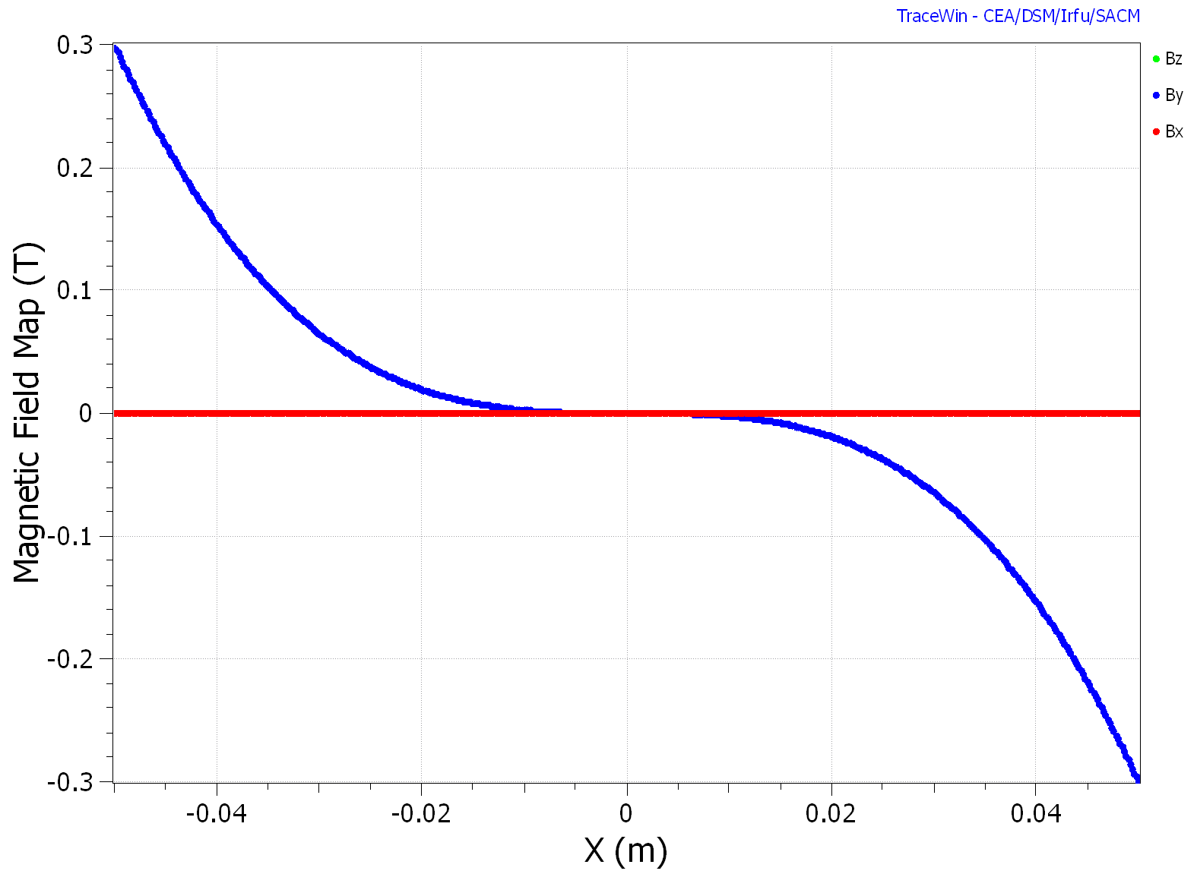
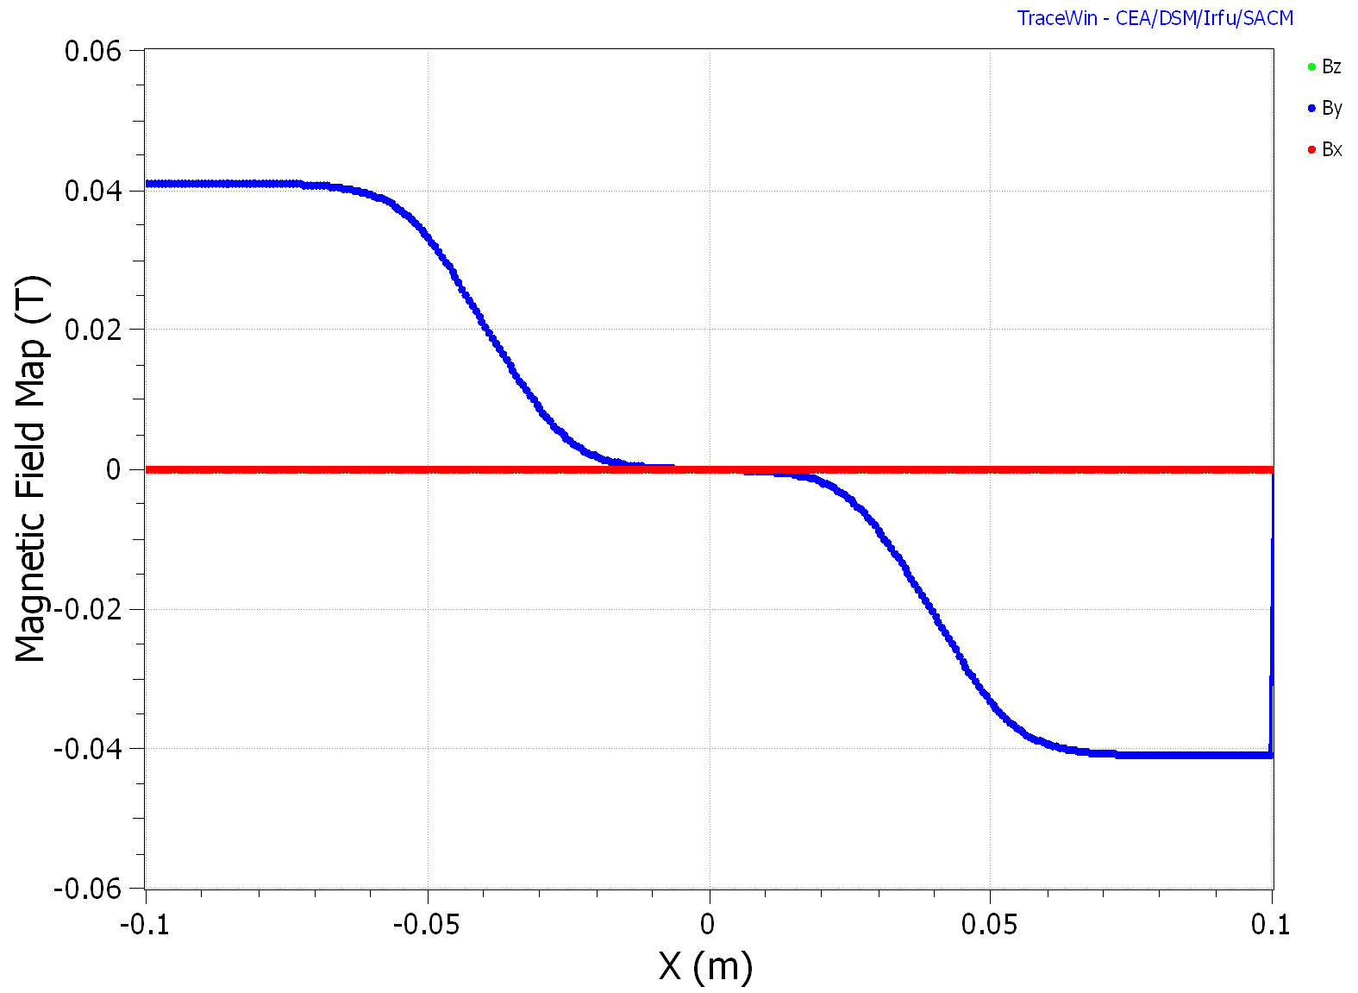
Introduction of the step-like magnet
8 poles -r50 mm
Field on pole 0.30 T
Octupole
2 dipoles-r100 mm
Field on pole 0.040 T
Step-like magnet

Slide 12
Advantage
Flexibility
uniformization of beam core and beam halo can be done separately by two steps
Cheaper
standard multipoles: 100 thousand dollars
step-like magnets : 20-40 thousand dollars

Slide 13
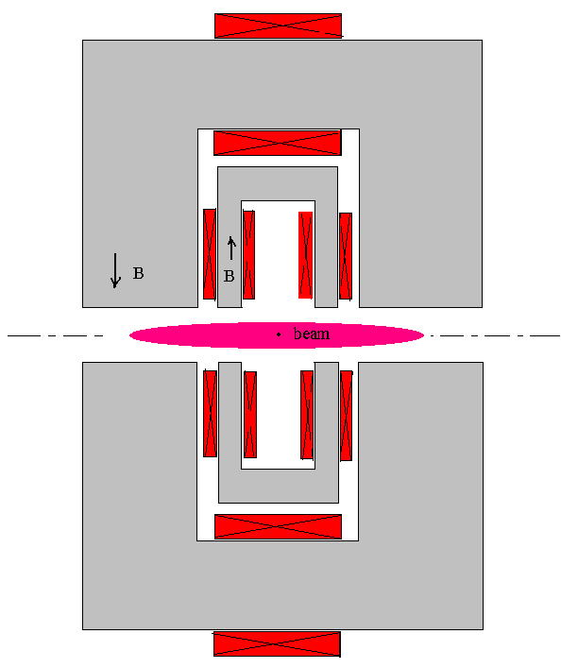
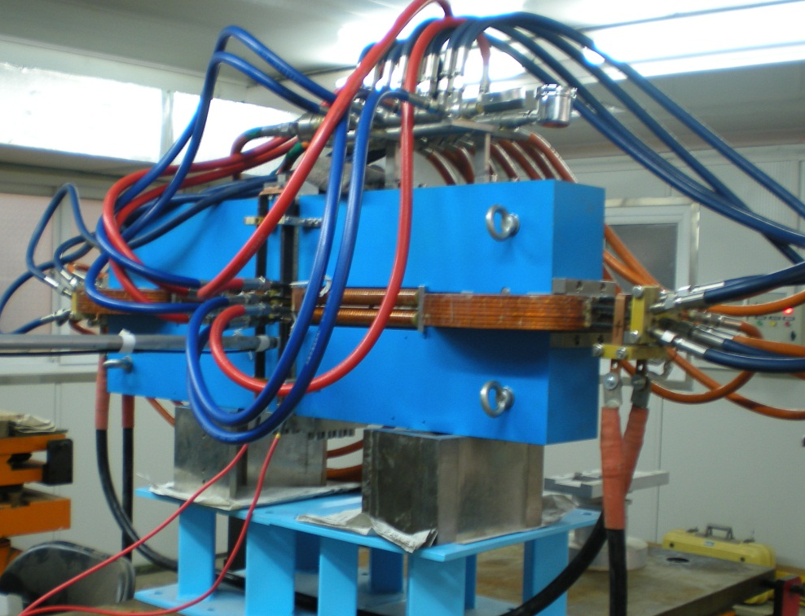
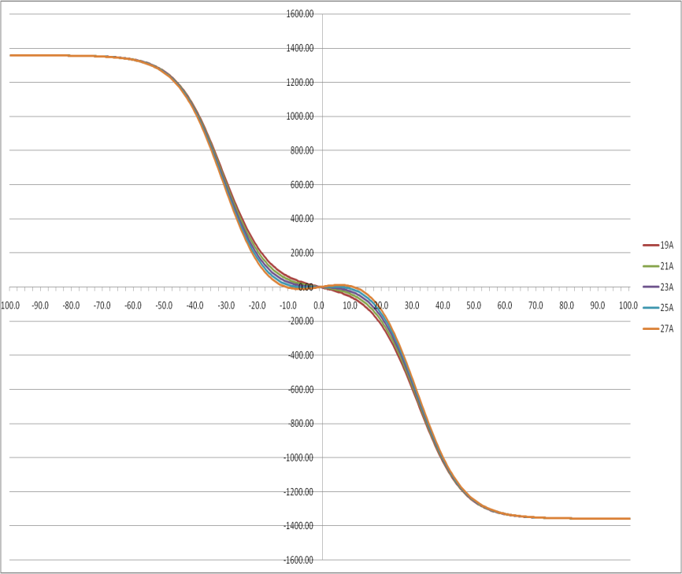
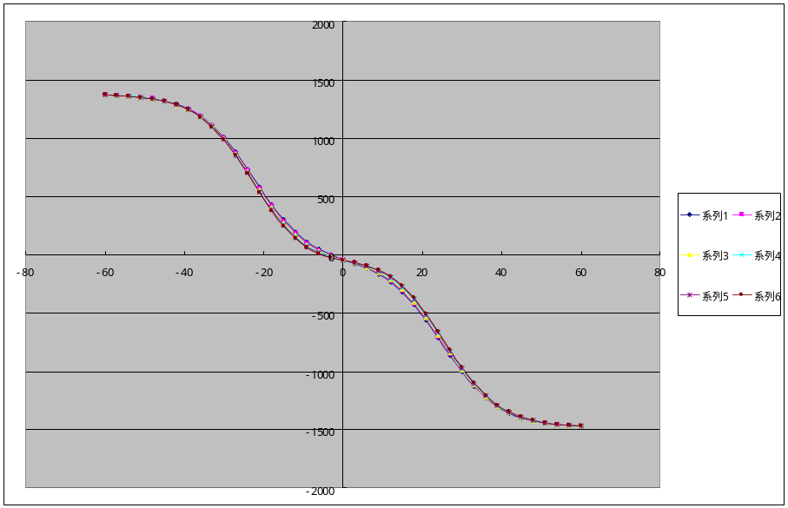
Step-like field magnet prototyping

Slide 14
Optimization principle
1. Change the last four or six quadrupoles and the length of drift to get a larger beam spot on the target and fulfill the request of the flat beams and phase advances (linear optics)
2. Adjust the parameters of the step-like magnets to obtain a good beam spot on the target (nonlinear optics)
3. Repeat 1. and 2. several times to find the best result

Slide 15
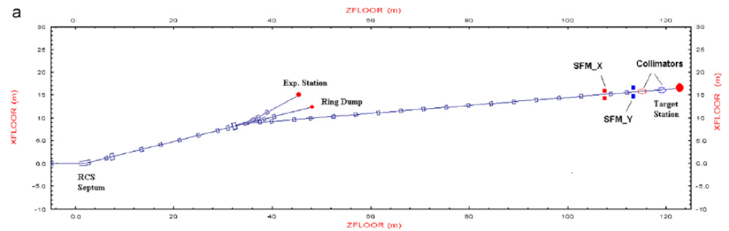
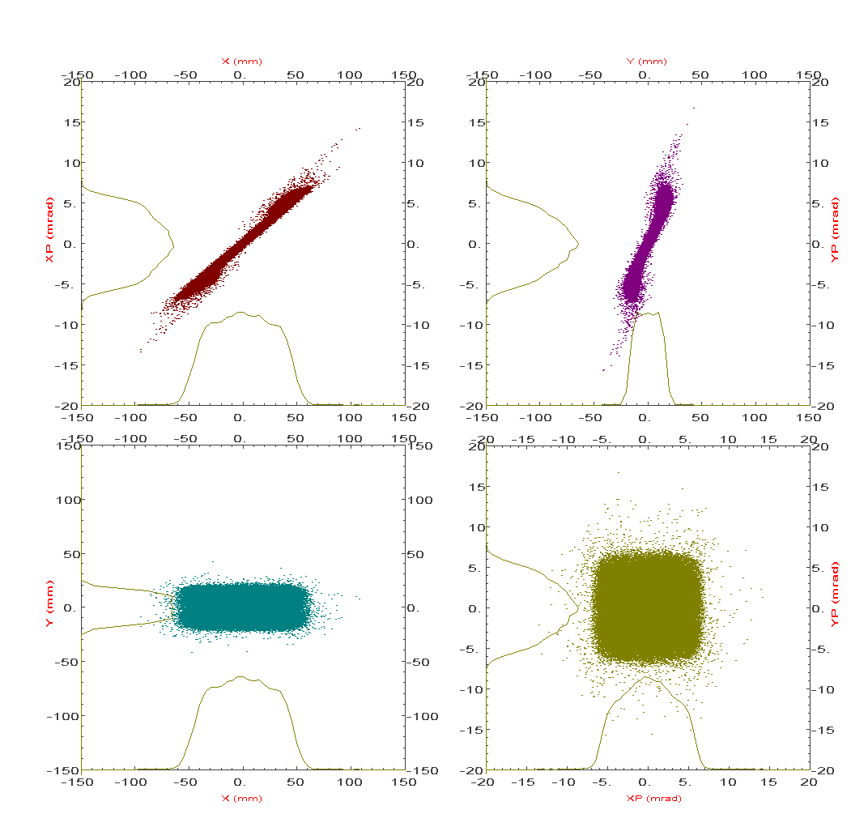
Studies at IHEP:
Using step-like field magnets (SFM) for spot uniformization at CSNS
100000particles

Slide 16
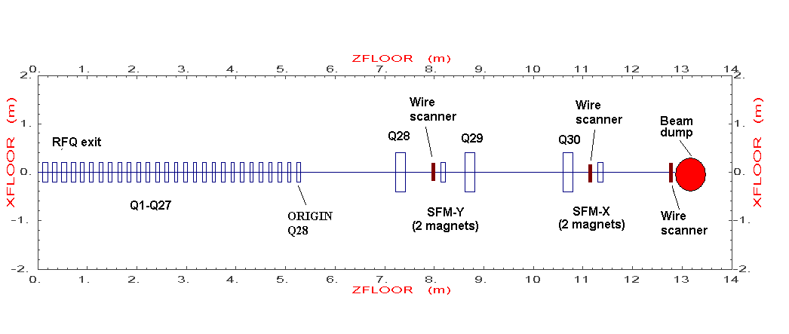
Tests with beam for spot uniformization
A test beam line using the ADS-RFQ is being set up for studies on both halo development and spot uniformization (plan under modification)
SFM can be step-like field magnets or simplified high-order magnets

Slide 17
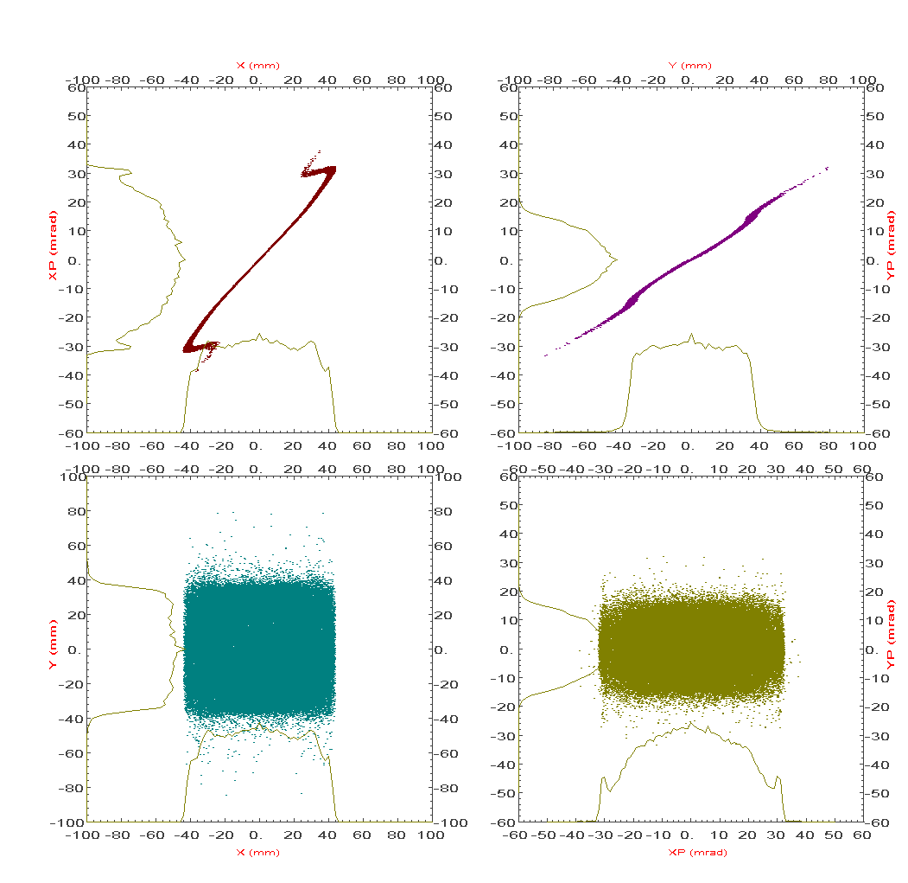
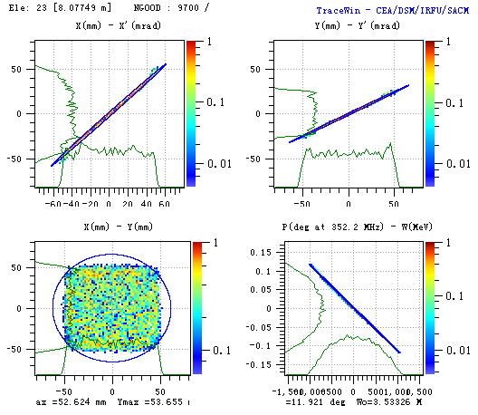
100000particles
10000particles
Simulation results at ADS RFQ beam test line:
Left: not concern about the space charge effect; Right: concern about the space charge effect

Slide 18
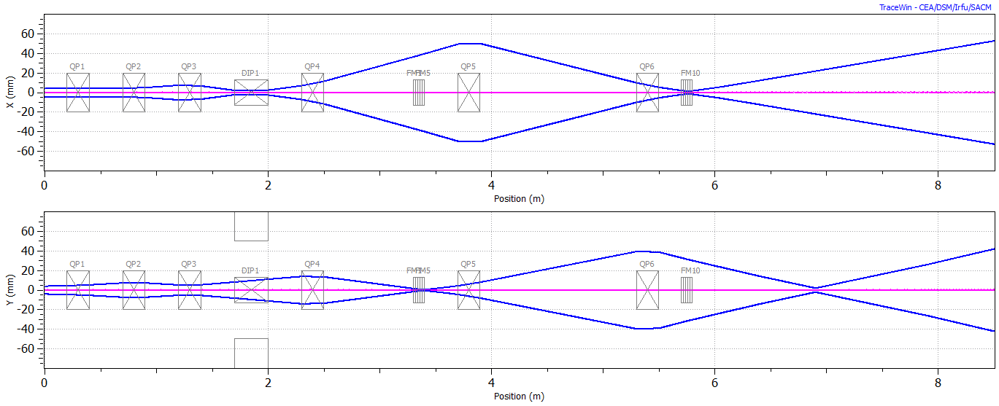
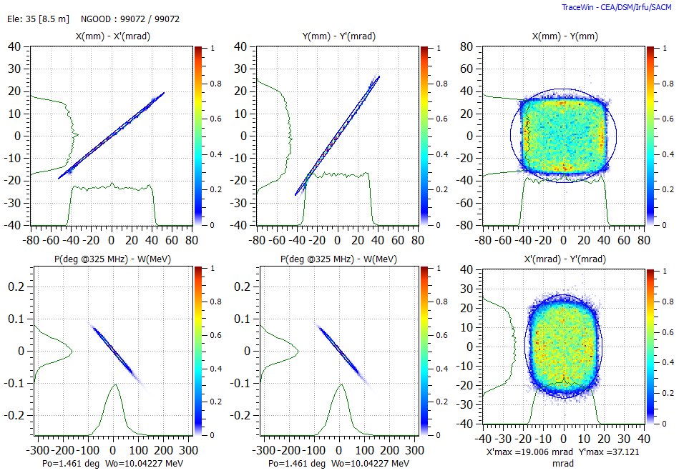
Studies at ADS beam line (dump):
Using step-like field magnets (SFM) for spot uniformization

Slide 19
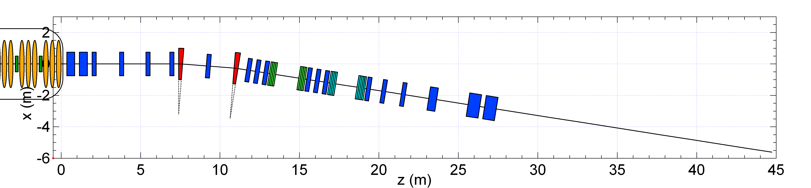
"Classical" HEBT structure
Dipoles
Quadrupoles
Duodecapoles
Octupoles
Adaptation,
9° achromat
Non-linear lenses
Beam homogenisation
Beam expander
Li Target
Superconducting Linac
R. Duperrier, J. Payet, D. Uriot, Proc. of EPAC 2004

Slide 20
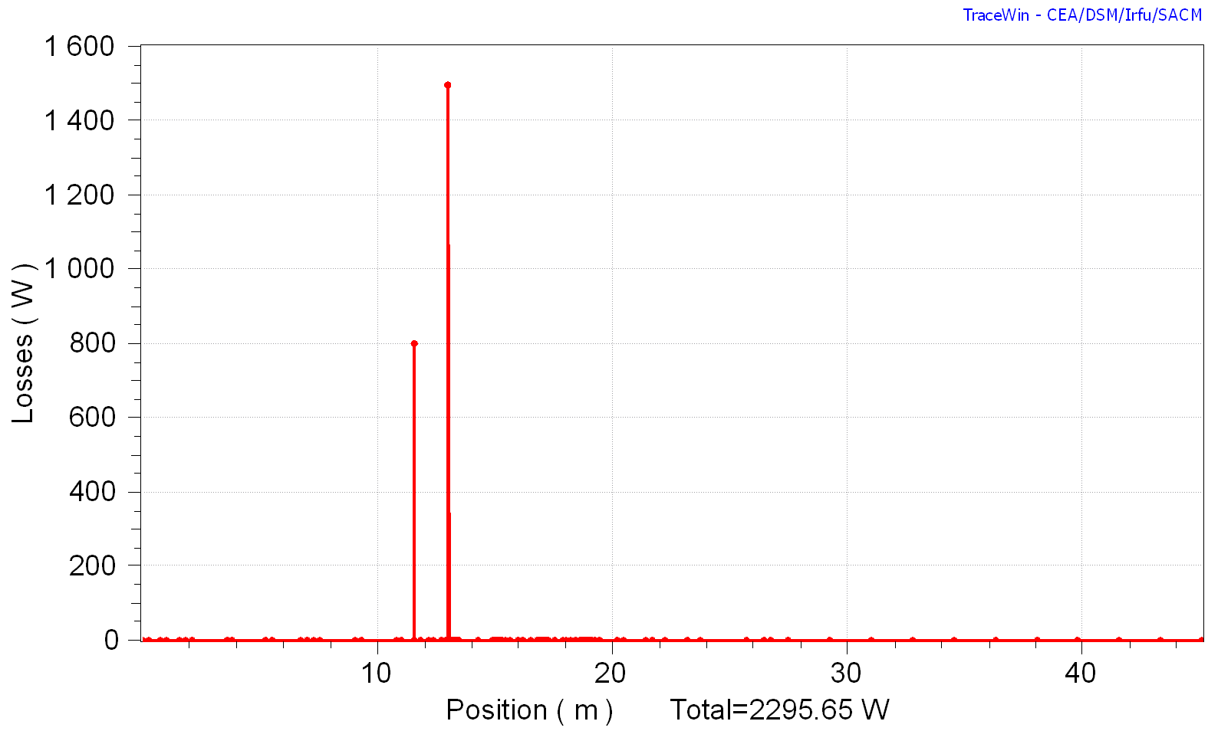
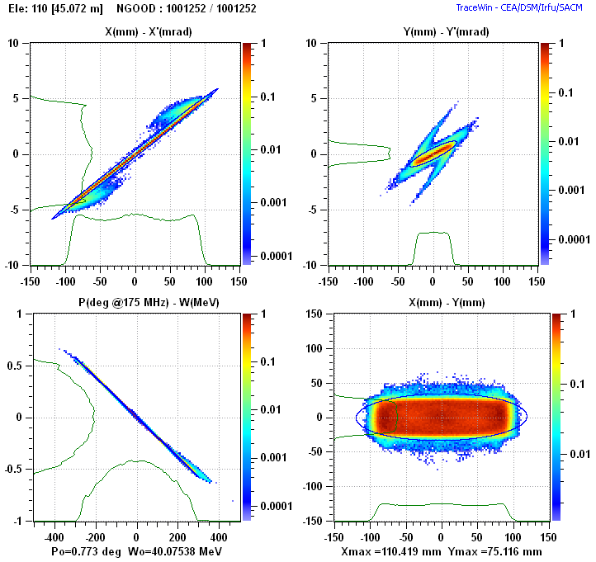
Beam losses
Beam distribution at Li Target
scrapers 2.3 kW
(to be optimised)
To be improved
Tuning strategy to be defined

Slide 21
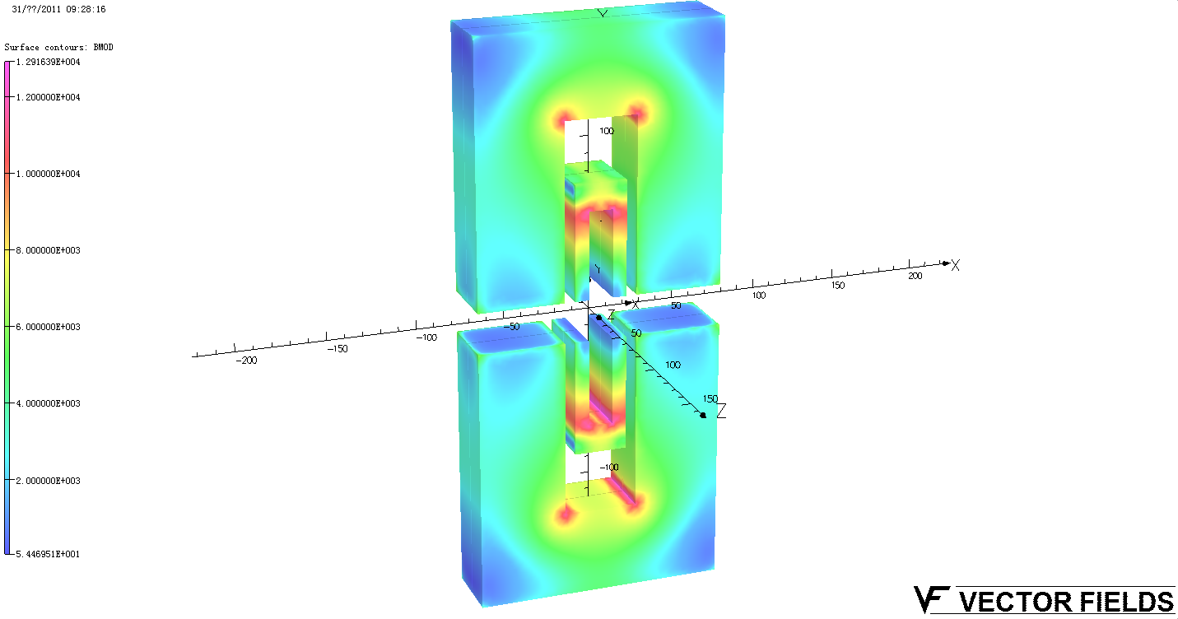
Dipoles
Quadrupoles
Test (temporary) structure with SFM
Duodecapoles
Octupoles
Adaptation,
9° achromat
Li Target
Superconducting Linac
Step-like Field Magnet
J.Y.Tang, H.H. Li, S.Z. An, R. Maier
NIMA, 2004

Slide 22
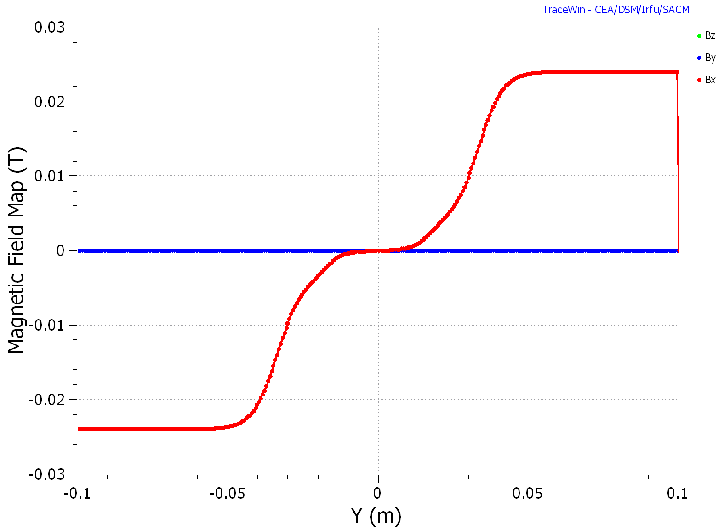
2 dipoles-r100 mm
Field on pole 0.040 T
2 dipoles-r100 mm
Field on pole 0.025 T

Slide 23
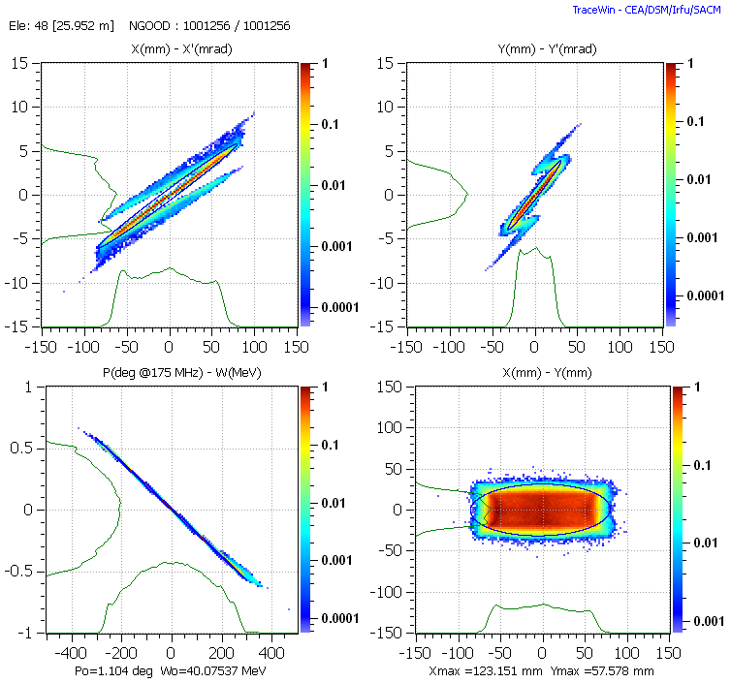
Beam losses
Beam distribution at Li Target
scrapers 2.3 kW
(to be optimised)
To be improved
Larger Footprint
Tuning strategy to be defined

Slide 24
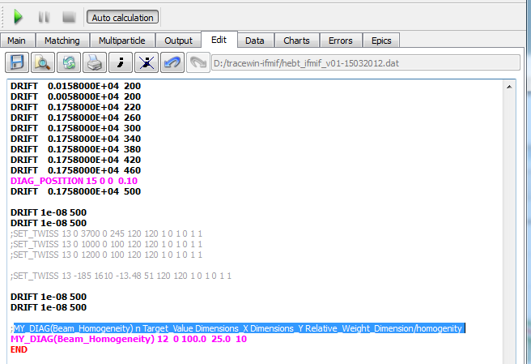
Automatic procedure for obtaining flat rectangular beam
The Command :
MY_DIAG(Beam_Homogeneity) n Target_Value Dimensions_X Dimensions_Y Relative_Weight_Dimension/homogenity
Notes:
这里应该强调是在Trace-Win中进行的程序功能改进工作.

Slide 25
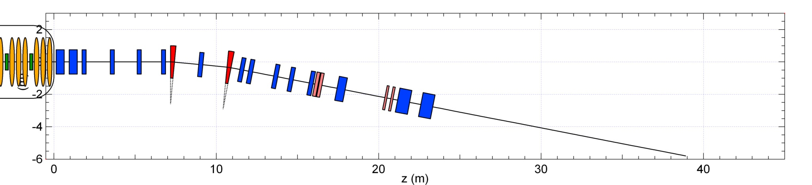
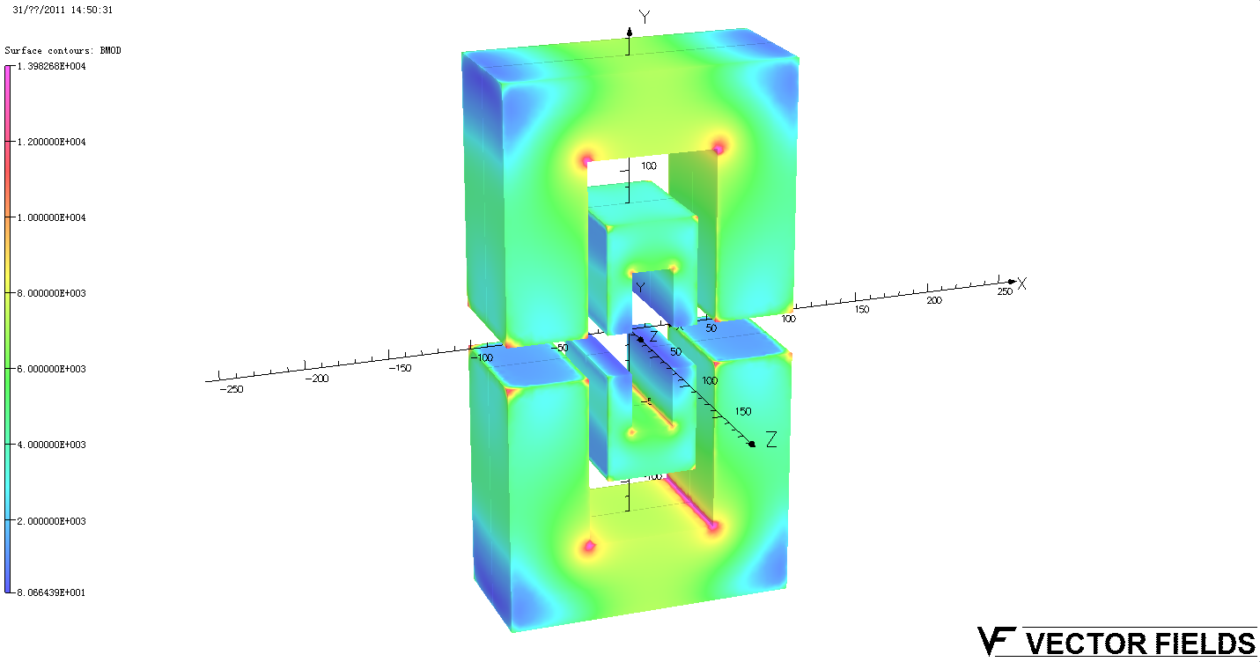
Dipoles
Shorter structure with SFM
Quadrupoles
Adaptation,
11° achromat
Li Target

Slide 26
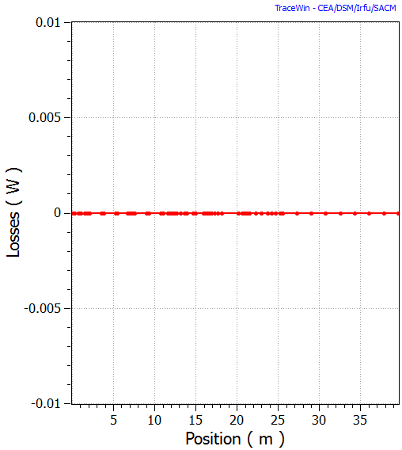
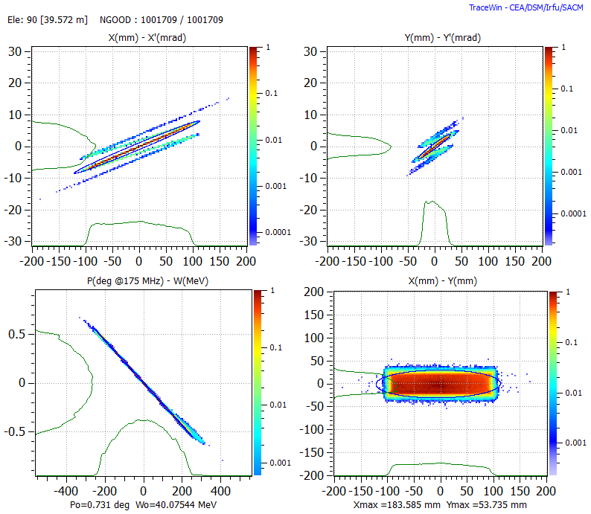
No beam loss

Slide 27
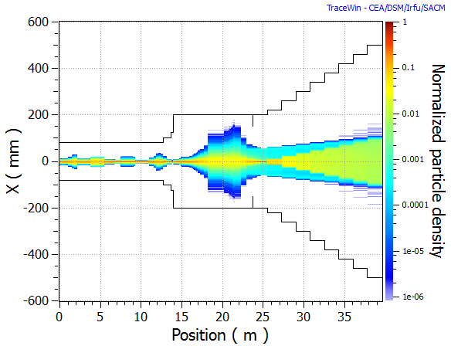
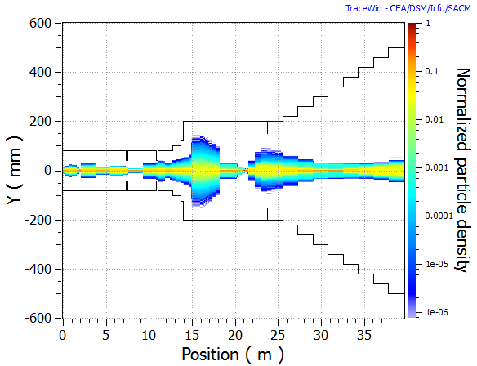
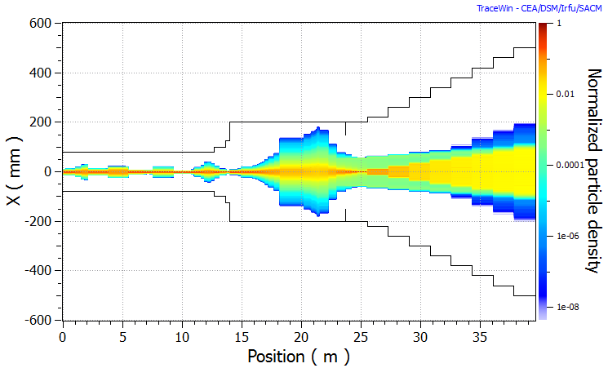
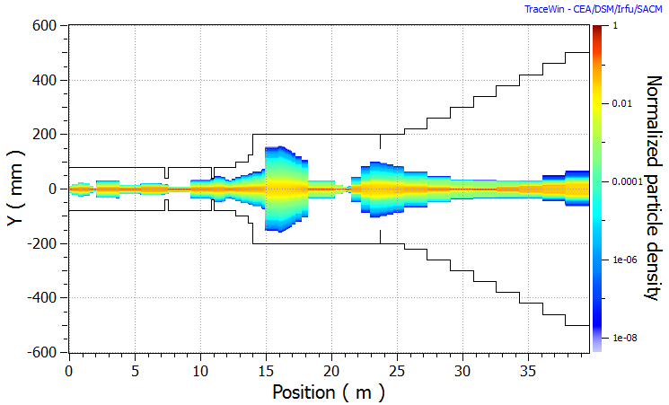
Density
Start-to-end without errors
Density
Start-to-end with errors

Slide 28
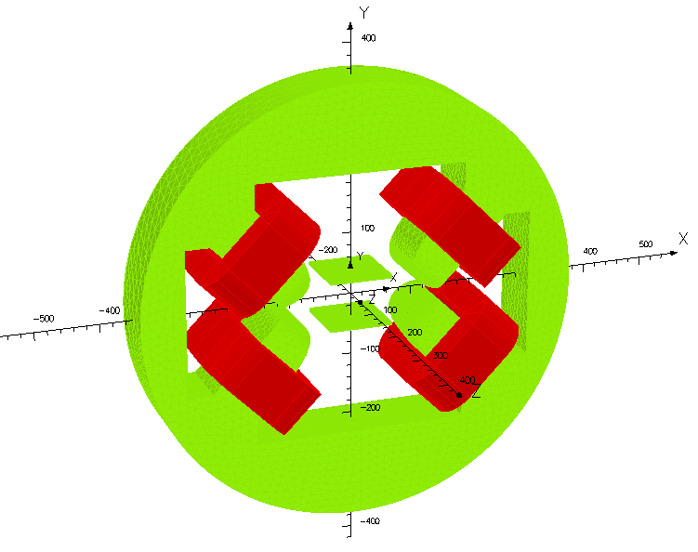
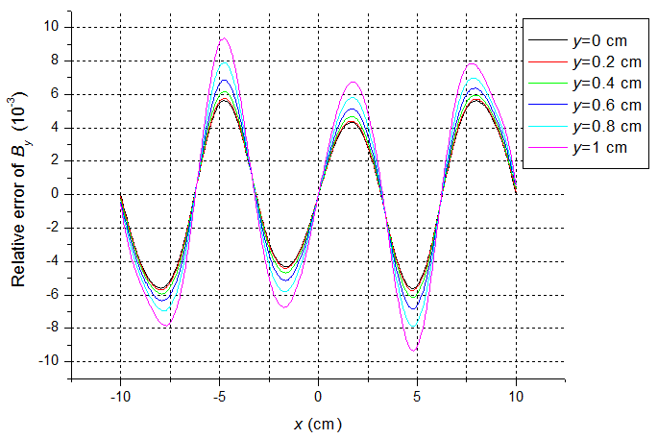
Simplified high-order field magnets
  Used for a flat good field region
  Available for any order of anti-symmetric field or symmetric field
  Right: simplified 3rd order field magnet (model and relative difference to theoretical distribution)

Slide 29
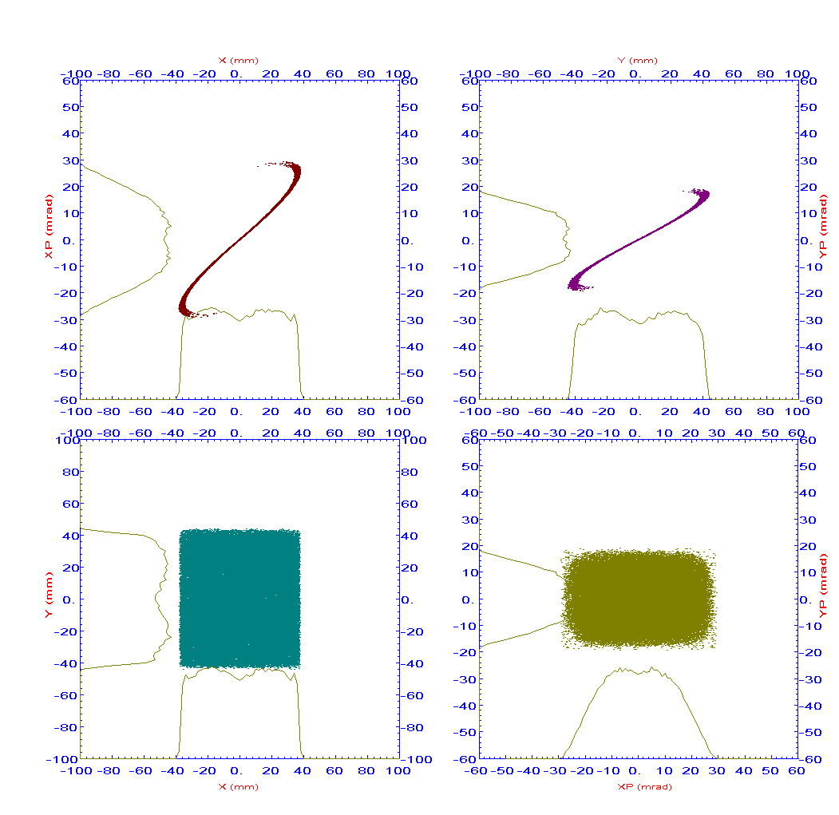
Studies at IHEP:
Using simplified high-order field magnets (2nd+4th) for spot uniformization at ADS-RFQ

Slide 30
Thank you

