Slide 1

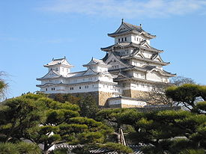
Marui Galvanizing Co ., Ltd.
Corporate History
Established in 1957
55 Years of Metal Surface Process Experiences
Location
HQ = Hyogo, Japan
Himeji Factory = Hyogo, Japan
Kashiwa Factory = Chiba, Japan
Tohoku Factory = Aomori, Japan
Subsidiary
South Korea
China
Himeji Castle

Slide 2
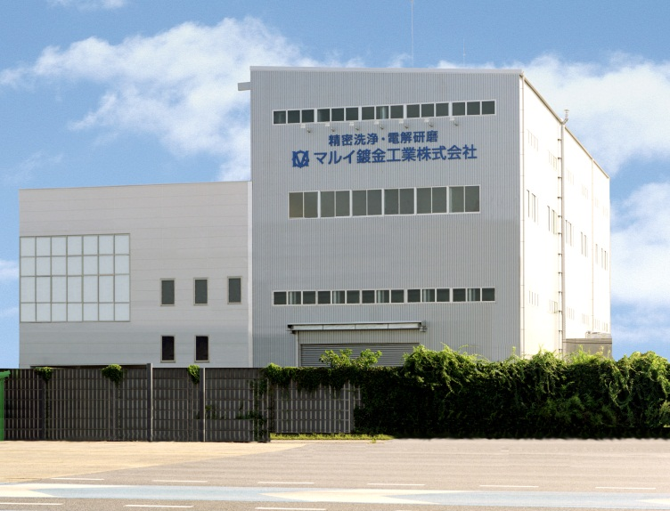
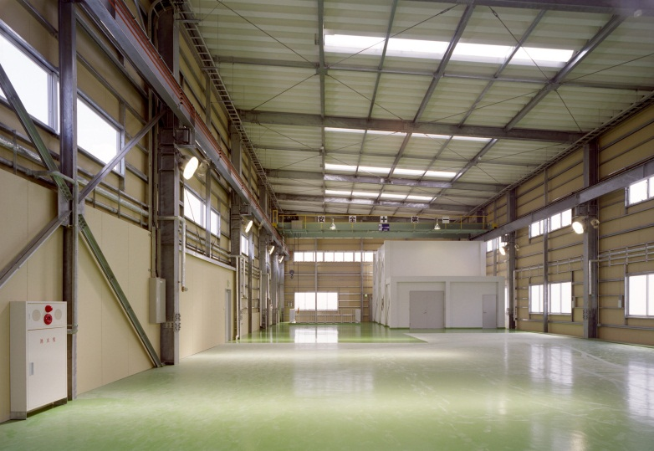
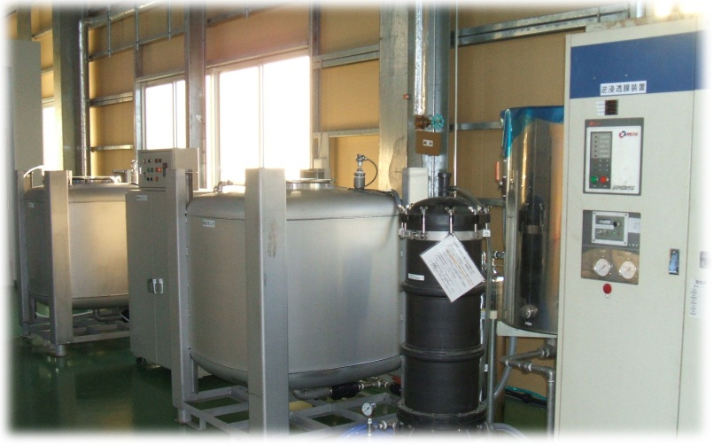
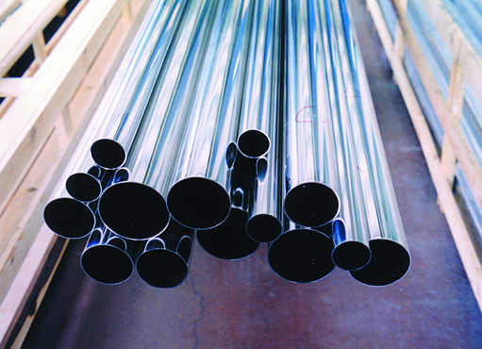
Factory & Facility
Kashiwa Factory
Reuse
Recycle
Reduce
Inside the Factory
RO Facility
Recycled Metal

Slide 3
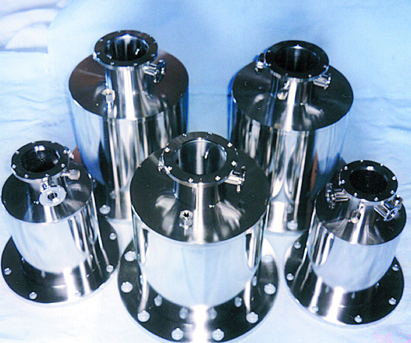
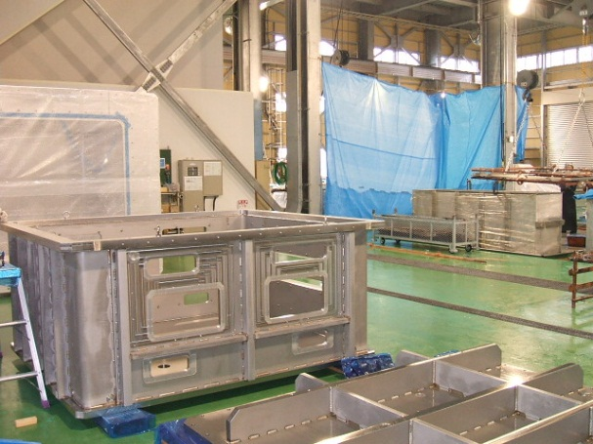
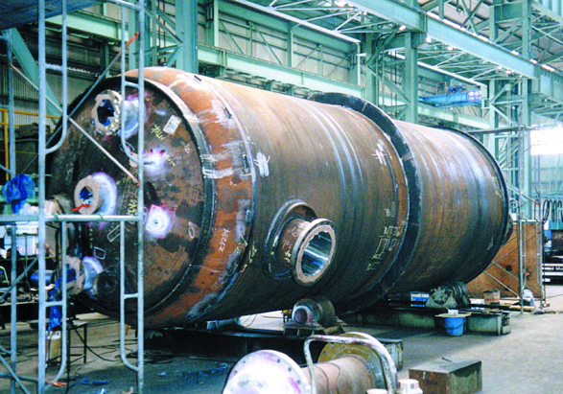
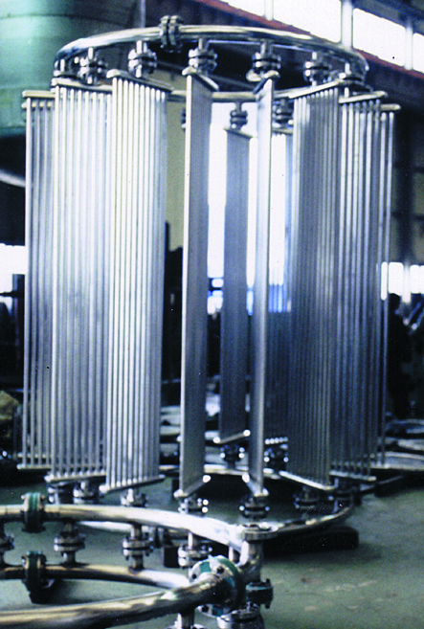
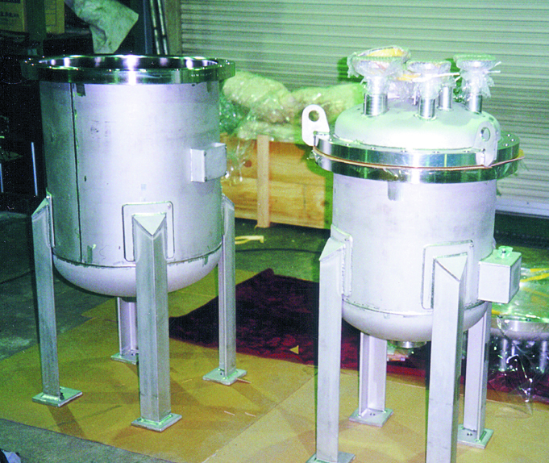
Varieties of Electro-polishing
Vacuum EQPT
Chamber for display
Chemical Tank
Heat Exchanger
Medical Use

Slide 4
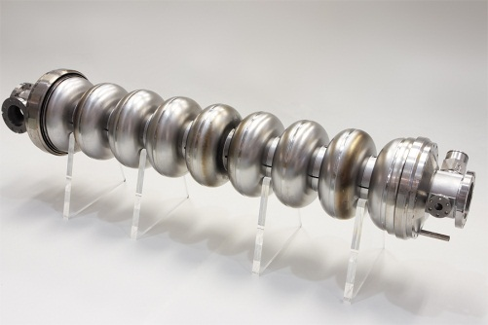
We are heading for
Highest Electro-polishing Technology on
Metal Surface: SUS, Al, Ti, FeO, Nb & etc.
Participate as an EP Supplier into the Linear Accelerating World
Vertical EP Mass-Production in the most efficient & appropriate way

Slide 5
New Method of Vertical Electro-Polishing on ILC Cavity
As a Result of Joint Research with KEK.
Marui Galvanizing Co.,Ltd.

Slide 6
Introduction
Thanks to the joint research with KEK on ILC, we have been studying vertical electro-polishing on ILC cavity since June 2012.
We, Marui Galvanizing Co. Ltd, are under development of very unique new vertical electro-polishing method herein in cooperation with KEK/ILC group.

Slide 7
Contents
1. Outstanding issues (by using SUS model)
Removal of hydrogen gas generated while EP.
2. Approach & effort
Development of i-cathode “Ninja” TM
Features of the i-cathode “Ninja” TM
Features of integrated new VEP system.
3. Next step plan 1 & 2

Slide 8
1. Outstanding Issues
According to our past several experiments by using SUS Cavity, lower part of cavity was well electro-polished, however, upper part of cavity was not well polished.
We suppose this because the electric current did not flow evenly due to the hydrogen gas generated during EP process.

Slide 9
2. Approach & Effort
Features of i-cathode “Ninja” TM Already applied International Patent
Rotatable Variable Wings
Insert i-cathode
“Ninja” TM
Unfold i-cathode
“Ninja” TM and
rotate while EP

Slide 10
A part of features : Integrated New VEP System
EP electrolyte circulation
Flow direction
To remove hydrogen gas generated during EP process by the method of fluid circulation.
Pump
Acid bath

Slide 11
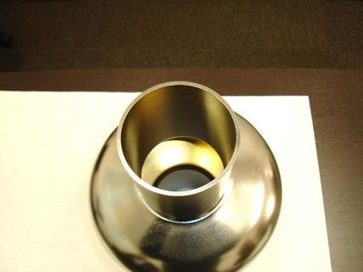
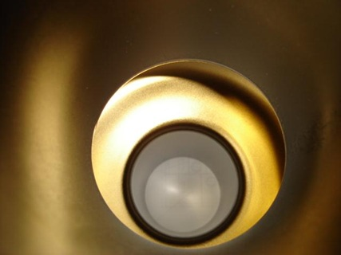
3. Next Step Plan 1 – EP on Nb. Cavity
Trial vertical EP on Nb single-cell cavity by MG – the end of April 2013
Flanges needs to be set up by KEK on this cavity.
We hope this to be evaluated by KEK / CEA Saclay.
Furthermore, we would like to challenge EP of Nb 9-cell cavity around July 2013 in vertical manner. Currently looking for available Nb 9-cell cavity for next trial VEP.
MG purchased from RI GmbH
Inside the Nb.One Cell Cavity

Slide 12
3. Next Step Plan 2 – Development of total system
1. Manufacturing In Process Pre-EP (MIPPEP) TM
Each dumbbell prior to welding to be pre-electro-polished
for the purpose of minimizing material defects.
2. Development of pure steam cleaning.
3. Development of total package on vertical electro-polishing by adopting computerized control system.
4. Development of wastewater disposal system.

