Slide 1
Summary of STF-EP facility at KEK.
Motoaki.Sawabe
Radiation Science Center, Applied Research Laboratory, KEK

Slide 2
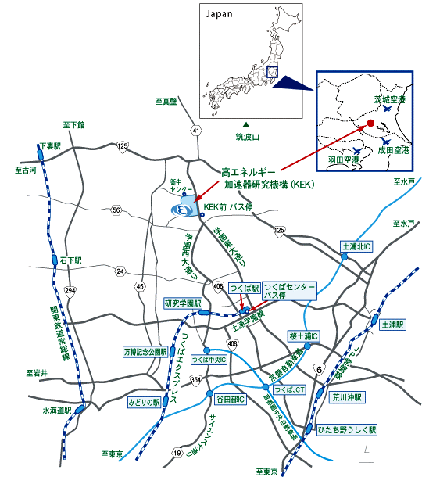
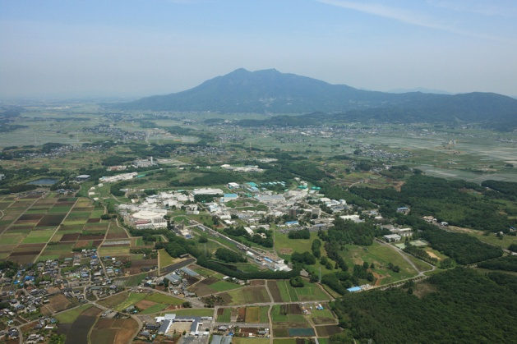
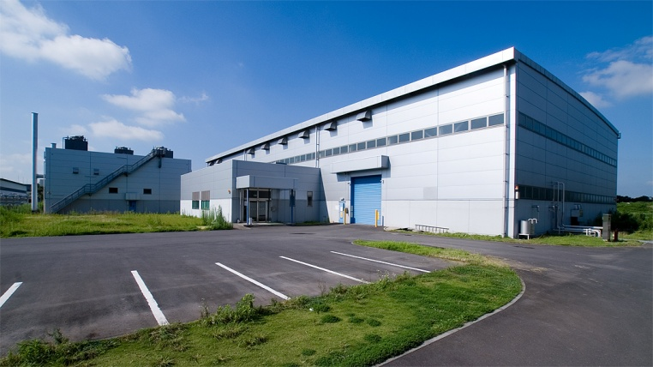
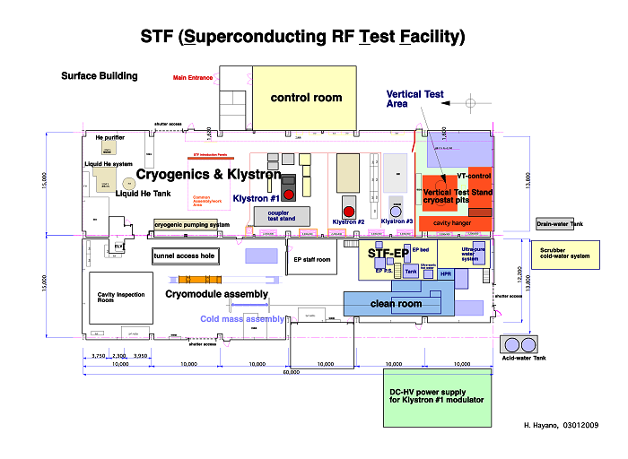
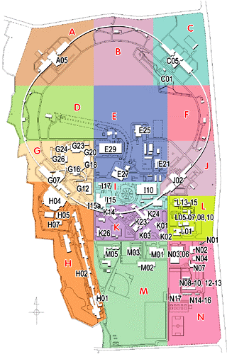
1. Location of STF-EP facility at KEK.
STF building.
STF

Slide 3
2. List of main equipments.
Equipment | Amount | Note
EP bed | 2 | No.1 , No.2
EP-electrolyte reservoir tank | 2 | No.1 (2000L) , No.2 (500L)
Heat exchange | 2 | No.1 , No.2
Current rectifier | 2 | No.1 , No.2 50V,1000A
Ultra sonic washing bath | 2 | No.1 , No.2 2m³ , 36kHz, 600W×8
Ultra pure water unit | 2 | No.1 , No.2
High pressure rinse unit (HPR) | 1 | 8MPa , Ultra pure water
Absorption tower | 1 | Two tower type , For exhaust gas.
Waste water tank | 2 | 10m³×2
EP equipment for examination | 1 | We call “ Lab.EP” , 30V,50A

Slide 4
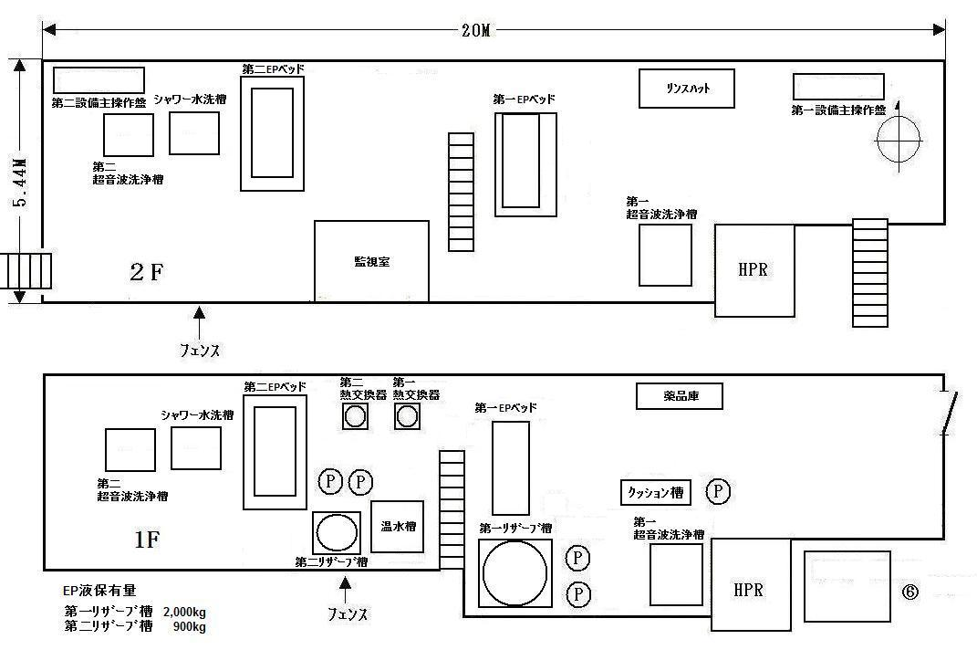
3.Equipments installation.
No.1 EP area
No.2 EP bed
Control room
No.1 Ultrasonic washing bath
No.2 Ultrasonic washing bath
No.1 EP bed
Height 2.5M
HPR
Heat exchange
No.2 Reservoir tank (500L)
No.1 Reservoir tank (2000L)

Slide 5
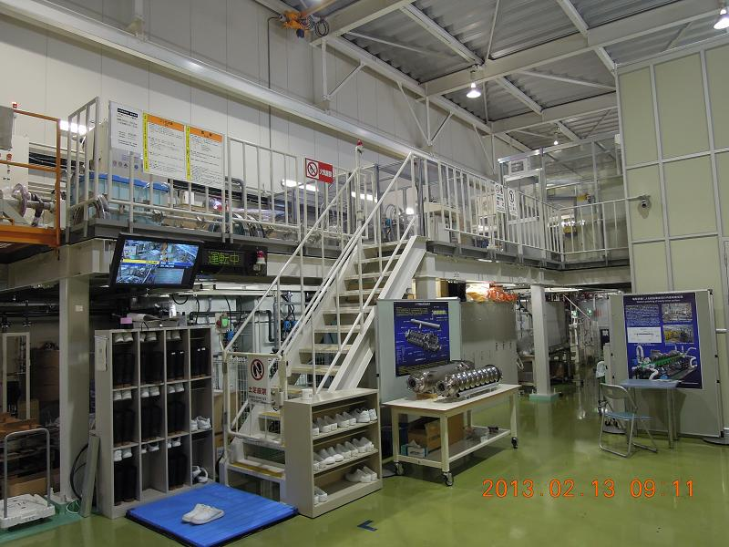
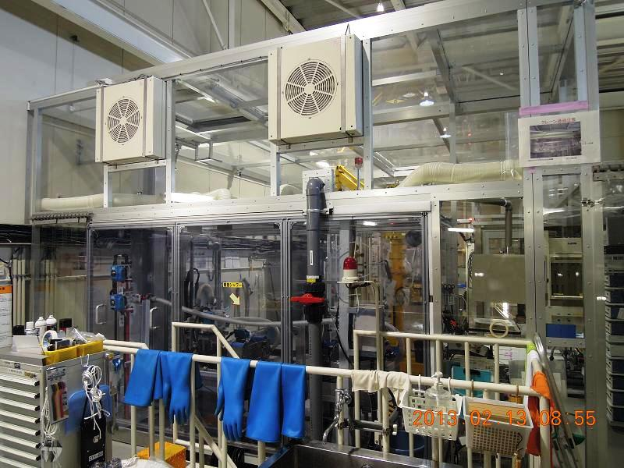
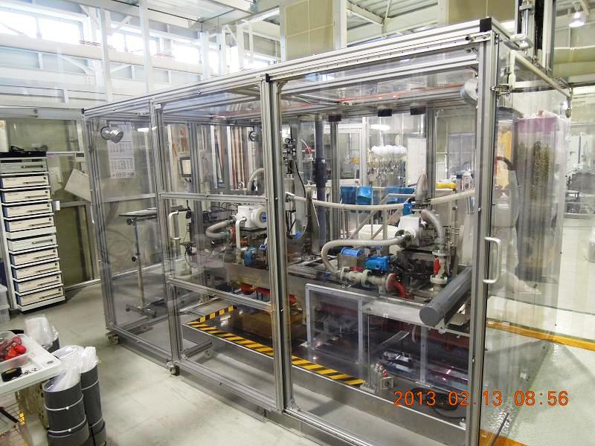
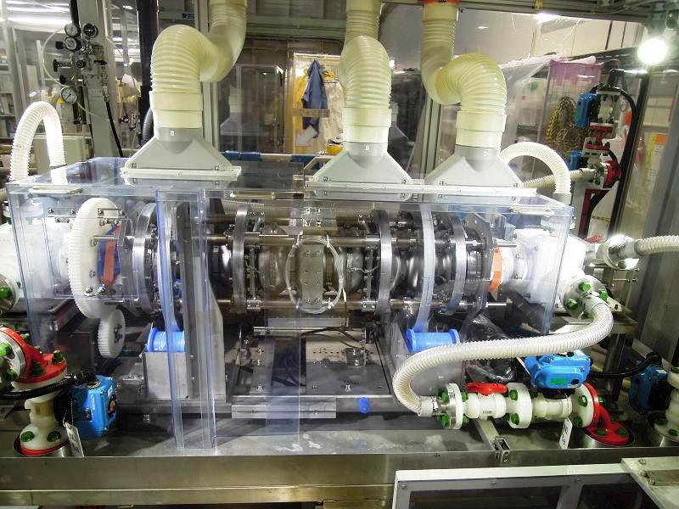
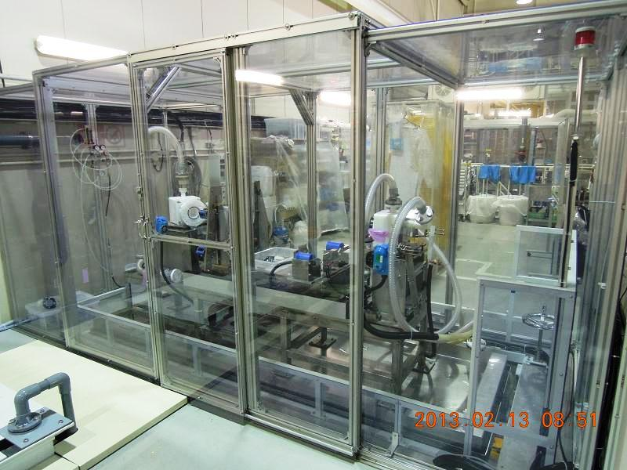
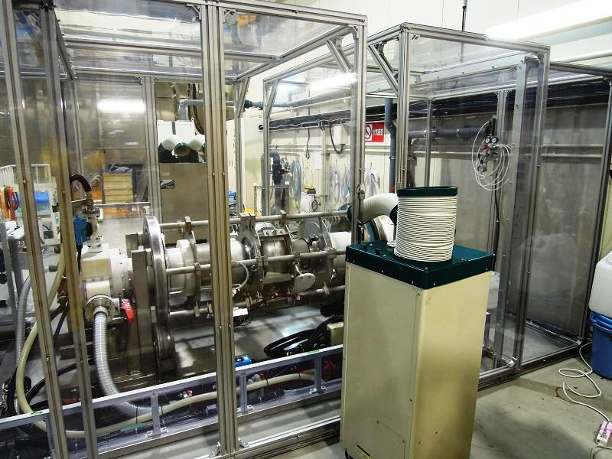
4. Picture of main equipments. (1)
Air filter
STF-EP facility area.
No.1 EP area.
The area is cleaned by four air filters.
No.1 EP hut.
Cooling air duct
Cooling air cover
Cooling air fan
No.1 EP bed and 9cell cavity.
No.2 EP hut.
No.2 EP bed and 500MHz Single cell cavity.

Slide 6
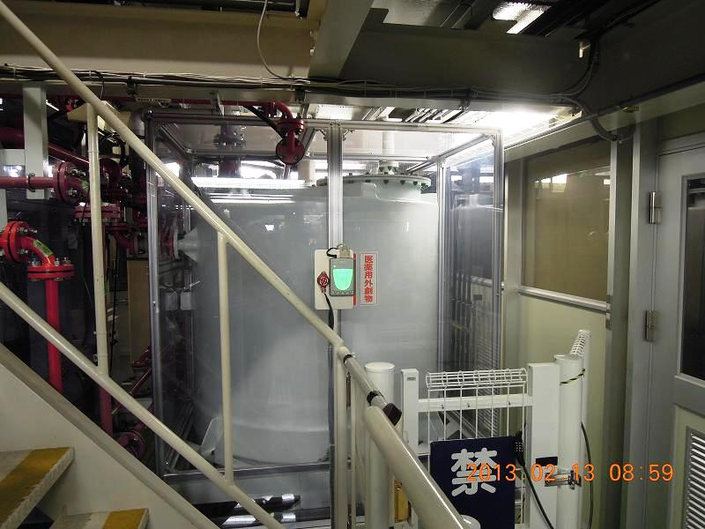
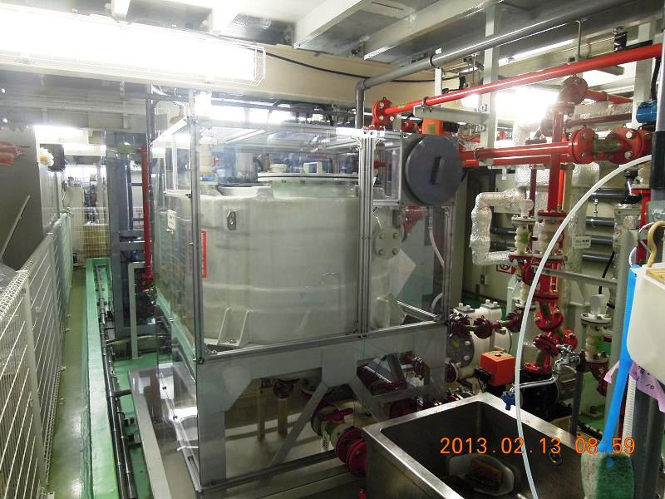
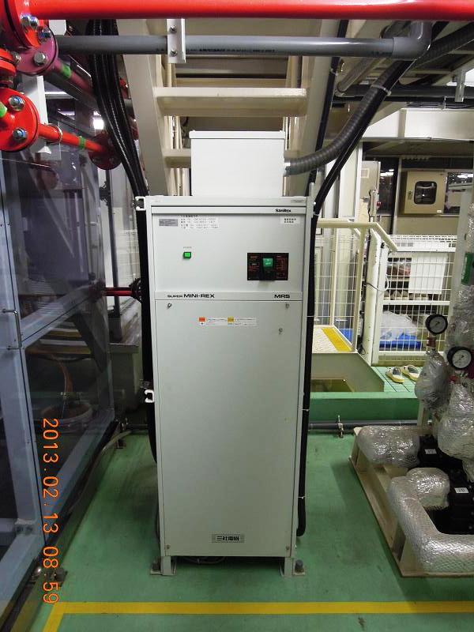
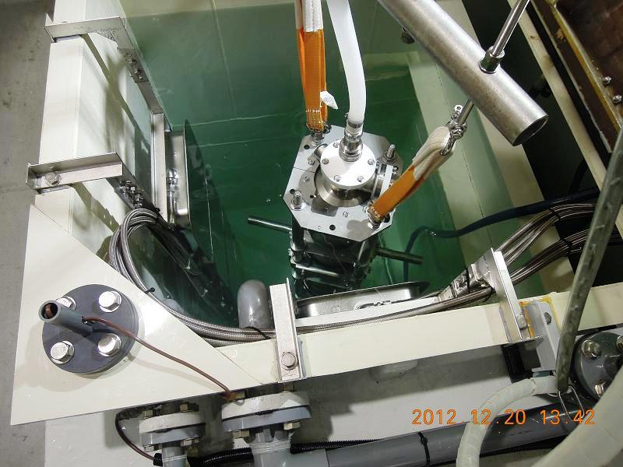
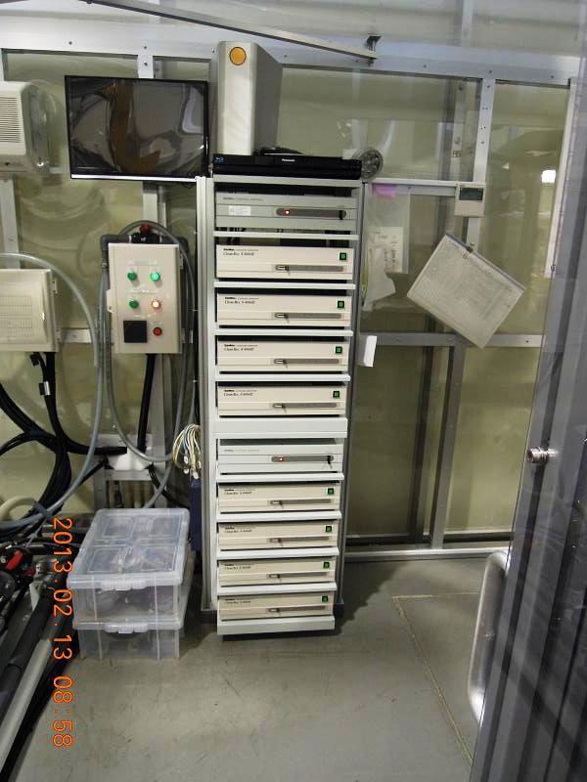
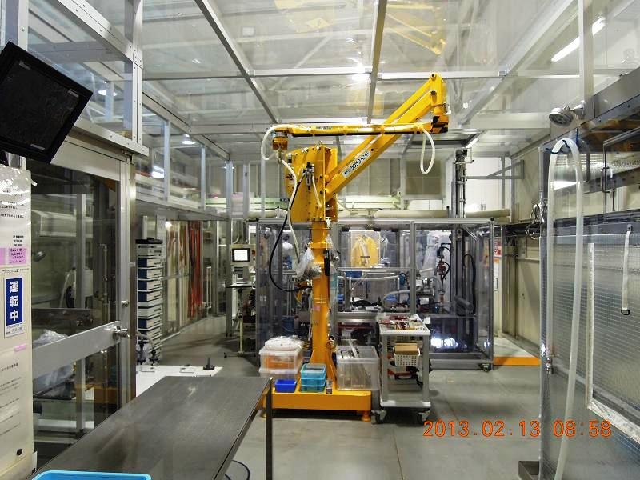
4. Picture of main equipments. (2)
No.1 Reservoir tank .( Max.2000L )
No.2 Reservoir tank .( Max. 500L )
No.1 Current rectifier.
Max. 50V, 1000A
No.1 Ultrasonic washing bath and 9cell cavity.
Robot arm. (for cavity movement. )
In No.1 EP area.
No.1 Ultrasonic oscillators
36kHz , 600W ×8.

Slide 7
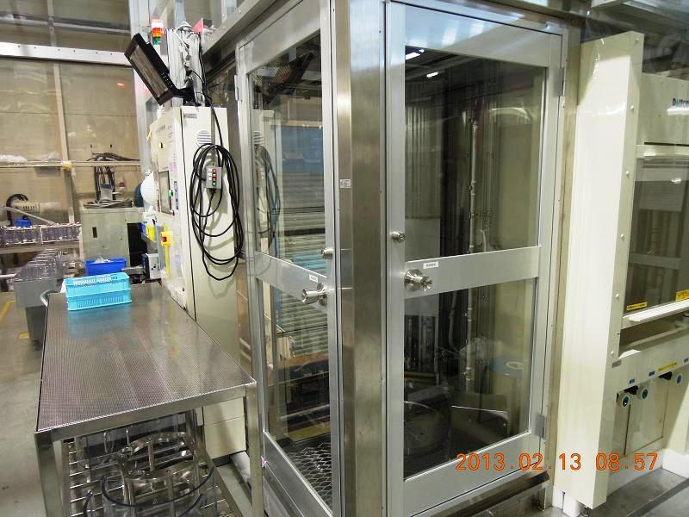
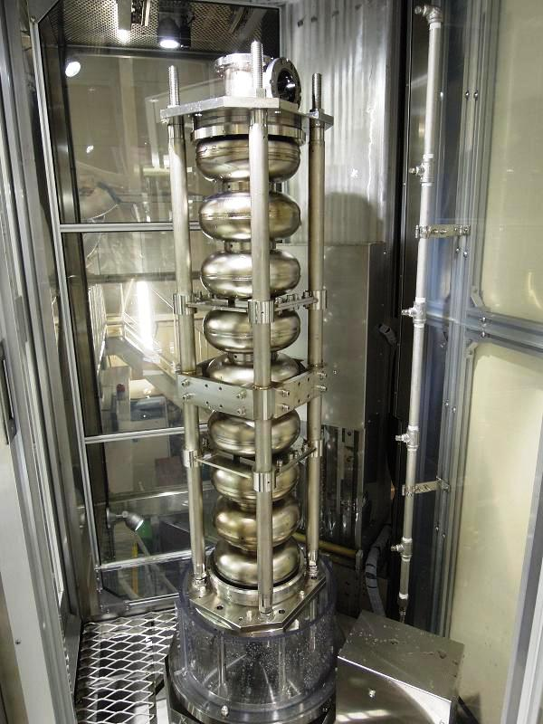
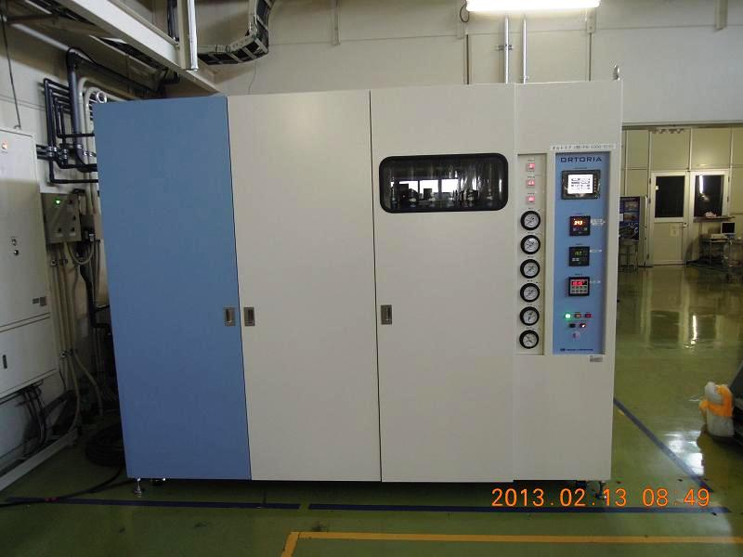
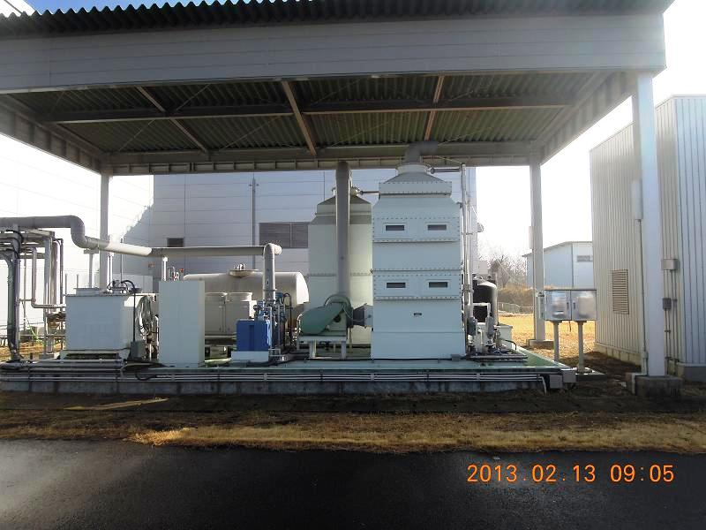
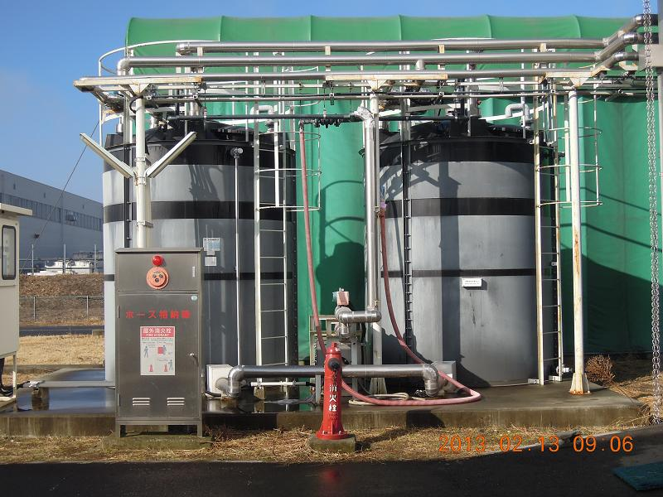
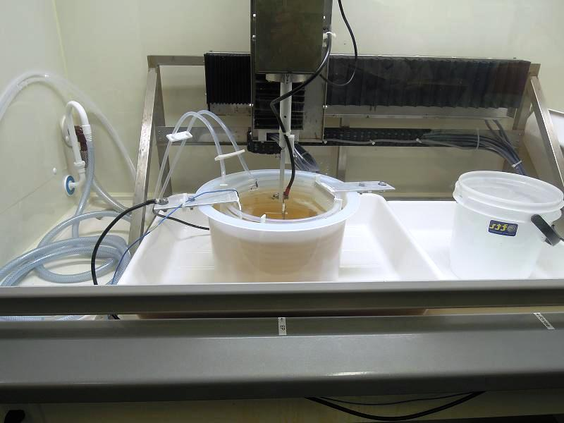
4. Picture of main equipments. (3)
High pressure rinse unit. ( HPR )
No.2 Ultra pure water unit.
About 25L/min. (Ultra pure water)
HPR and 9cell cavity.
Absorption tower. ( for exhaust gas.)
Alkaline water washing. (pH 10 )
Waste water tanks. (10m³×2 )
We call “ Lab.EP “.

Slide 8
5. Flow of the EP processing.
1) In the case of EP1 ( Bulk EP )
100μm,Electric current density 50mA/cm², at No.2 EP-bed or No.1
1st coarse pure water washing 60min.
After open the cavity ,pure water rinsing.
Ultrasonic washing by detergent ( 2% FM-20) at 50℃,15min.
After open the cavity ,pure water rinsing.
High pressure rinsing 1Hr.

Slide 9
2) In the case of EP2 ( Finish EP )
5～20μm,Electric current density 35～40mA/cm², at No.1 EP-bed,
Cavity surface temperature <35℃
1st coarse pure water washing 90min.(Filled with water, and vibration.)
After open the cavity ,pure water rinsing.
Detergent brush washing by hand in beam pipes.
After open the cavity ,pure water rinsing.
Ultrasonic washing by detergent ( 2% FM-20 ) at 50℃,15min.
After open the cavity ,pure water rinsing.
High pressure rinsing 8Hr.

Slide 10
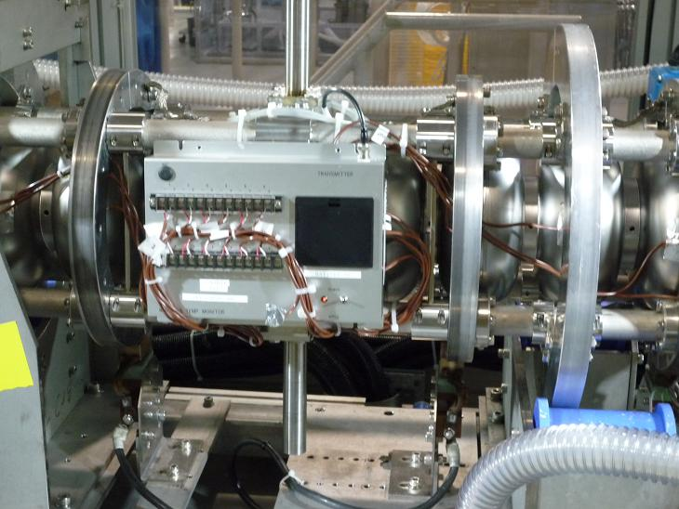
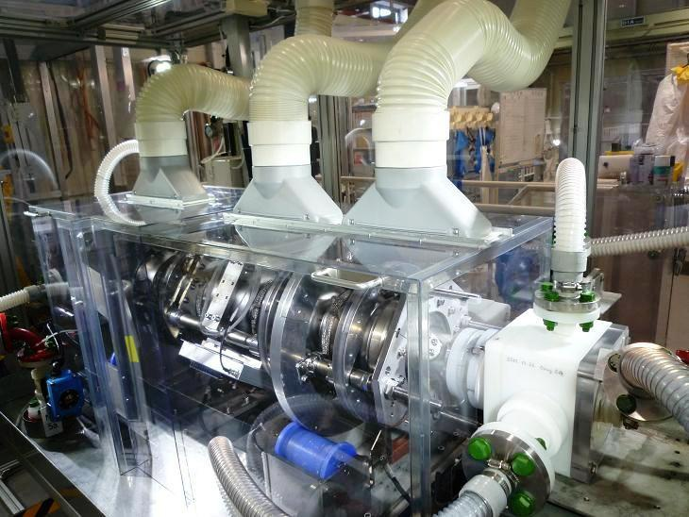
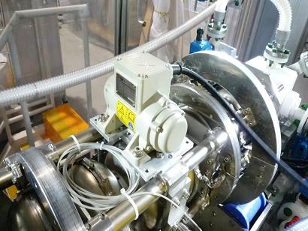
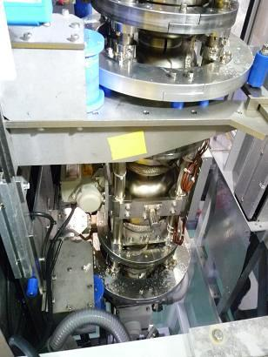
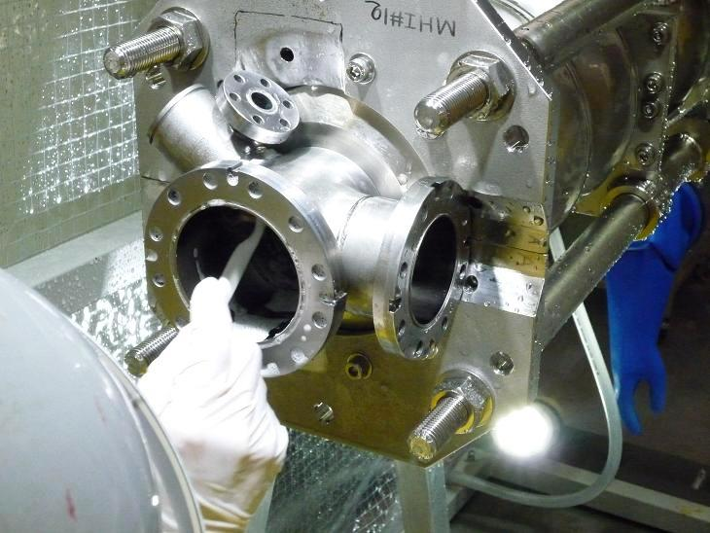
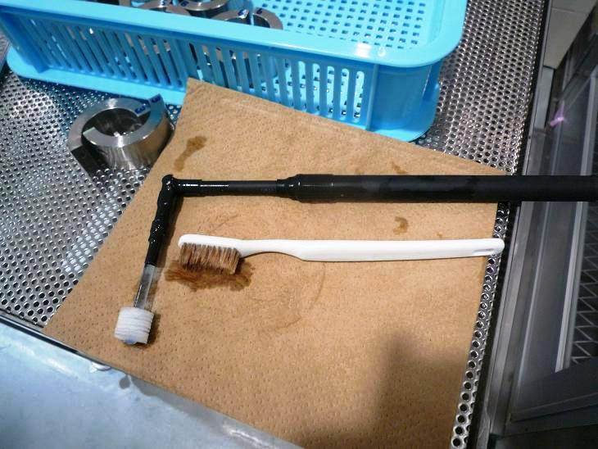
Vibrator.
Thermocouples and transmitter for cavity surface temperature. ( 12ch. )
Air cooling ducts and cover.
Vibrator.
Vibrator.
Brush washing by hand in beam pipes and antennas.
Exclusive brushes.
Vibration at pure water washing.

Slide 11
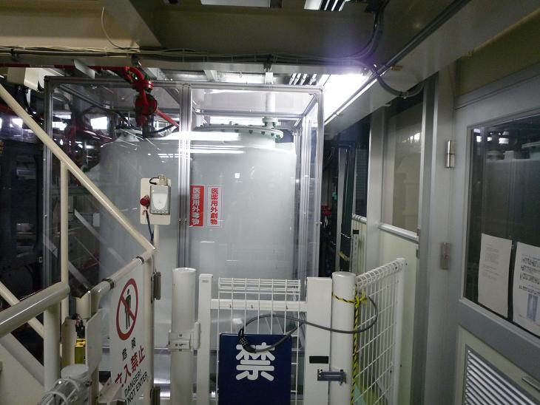
6. History of STF-EP facility at KEK.
The electro-polishing (EP) facilities in KEK were completed at STF (Super conducting RF Test Facility) area in Dec, 2007. And we have begun to operate in Feb, 2008.
In this facility, the capacity of the electrolyte reservoir tank is 2,000 L (Figure 1). It is very large. We put the EP-electrolyte of 2,000kg (≒ 1,100L) into this tank. And we use it repeatedly many times.
The laboratory doing such a usage is only here.
We changed the EP-electrolyte four times until
now.
And we are using the 5th-period EP-electrolyte.
No.1 reservoir tank ( 2,000L )

Slide 12
Lower list shows the history of EP-electrolyte that had been used until now.
EP-electrolyte | The period of EP | The number of times of EP-processing （Except Pre EP） | Total theoretical removal weight（g） | Final niobium concentration（g/L）
1st period EP-electrolyte | Feb, 2008 ～ May 2009 | 41 | 9,433 | 8.6
2nd period EP-electrolyte | May 2009 ～ July 2010 | 59 | 10,174 | 9.8
3rd period EP-electrolyte | July 2010 ～ July 2011 | 43 | 13,032 | 12
4th period EP-electrolyte | July 2011 ～ May 2012 | 38 | 11,708 | 12
5th period EP-electrolyte | May 2012 ～

Slide 13
7. The cavity performance result by the aging.
Lower list shows the cavity performance results by the 3rd-period EP-electrolyte.
In this electrolyte, we could achieve ILC spec in the four cavities.
We could achieve it by the EP-electrolyte aged enough.
Niobium concentration at this time was about 10 g/L.
And in the 4th EP-electrolyte, we could achieve it at 11g/L.
In thinking about the life (exchange time) of EP-electrolyte, it will be the big result.
Date | Cavity | Performance (MV/m) | Notice
July.28,2010 | ERL2cell#2 | 38.4
Oct.20,2010 | MHI9cell#A | 29.1 | Non HOM
Nov.04,2010 | MHI9cell#12 | 37.7
Nov.17,2010 | MHI9cell#13 | 36.4 | Achievement of ILC spec.
Dec.01,2010 | MHI9cell#12 | 40.7 | Achievement of ILC spec.
Dec.15,2010 | MHI9cell#13 | 33.1
May.25,2011 | MHI9cell#17 | 39.2 | Achievement of ILC spec.
Jun.08,2011 | MHI9cell#14 | 36.6 | Achievement of ILC spec. at niobium concentration about 10g/L
Jun.22,2011 | ERL2cell#3 | 30.3
Fine.

