Slide 1
The problem of incrustation on Nb surface after CP or EP processing.
STF Surface Research Group.
M.Sawabe, H.Hayano, H.Monjushiro, S.Kato, T.Saeki,
& T.Kubo

Slide 2
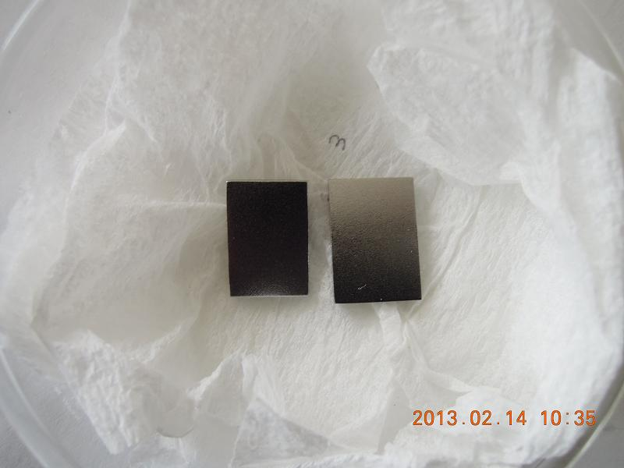
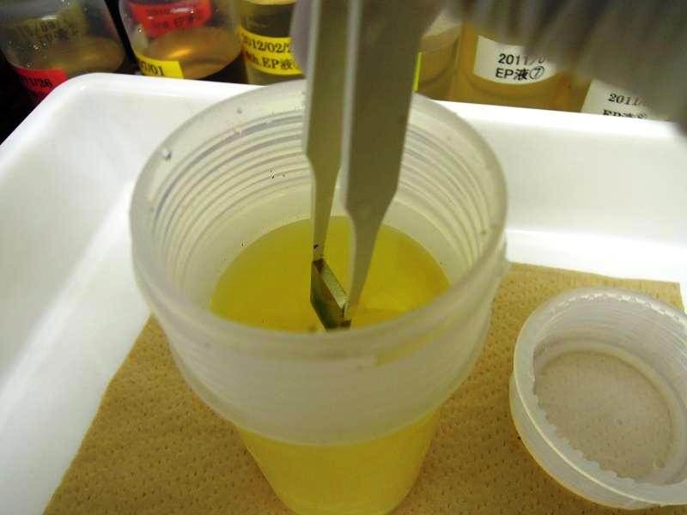
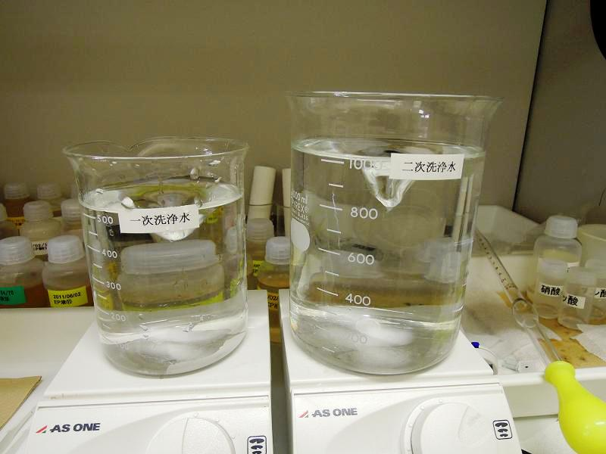
1. The procedure of sample CP.
Nb sample : 20×14×2.8
(1+1+1)※ CP 2min. → 1st Pure water washing 3min. → 2nd Pure water washing 3min. → Pure water rinsing by washing bottle → drying at 30℃
※48% HF_{(v)}+65%HNO3_{(v)}+ 85%H₃PO_{4(v)}
Nb samples.
During CP processing of Nb sample.
1st Pure water washing.(500mL)( Left)
2nd Pure water washing.(1000mL)(Right)
With stirrer.

Slide 3
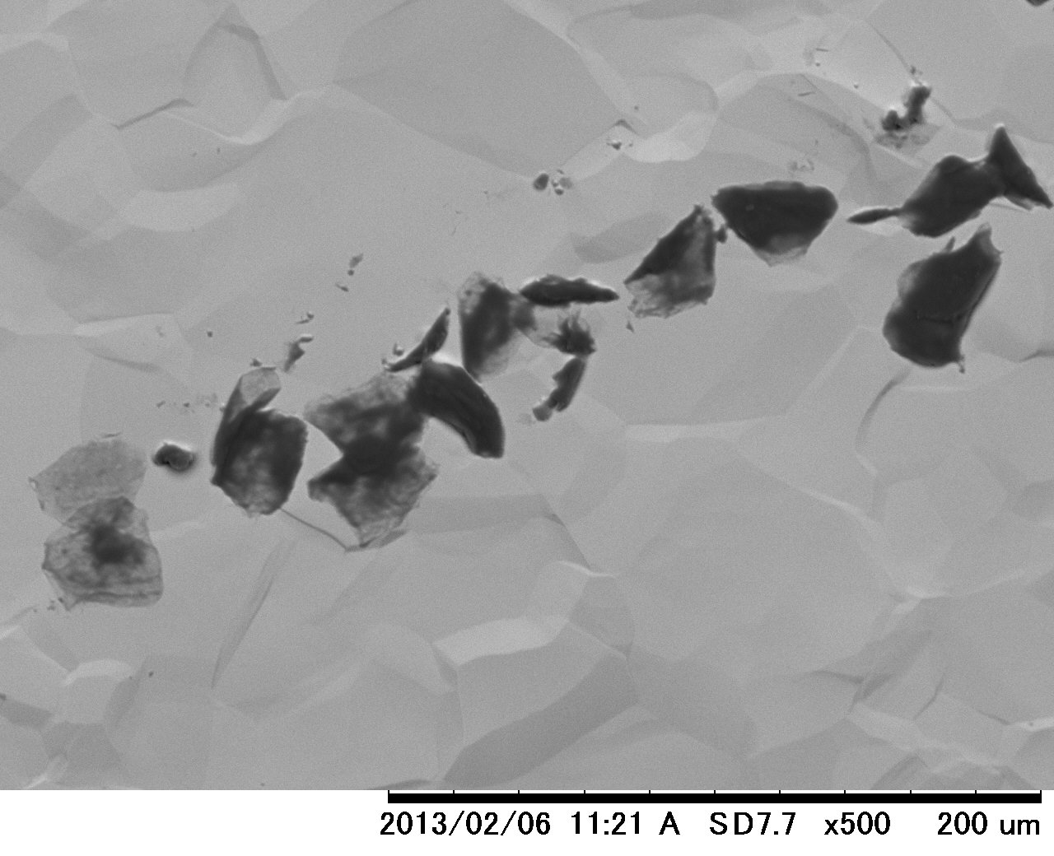
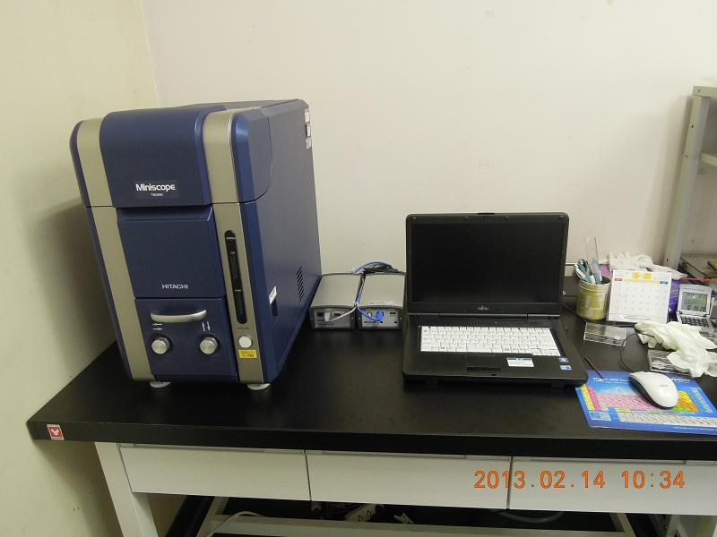
2. The incrustation of Nb surface after CP processing.( by SEM )
SEM & EDX

Slide 4
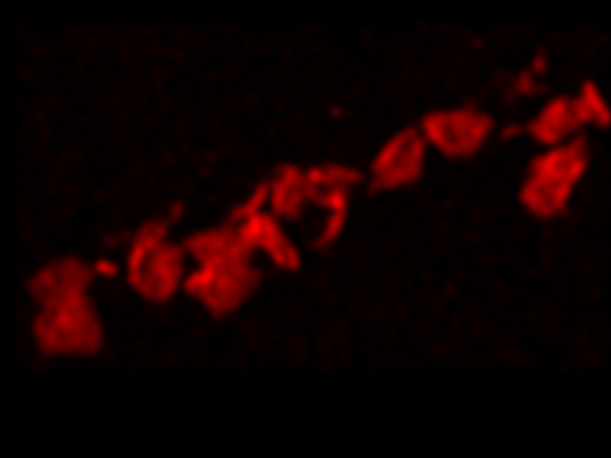
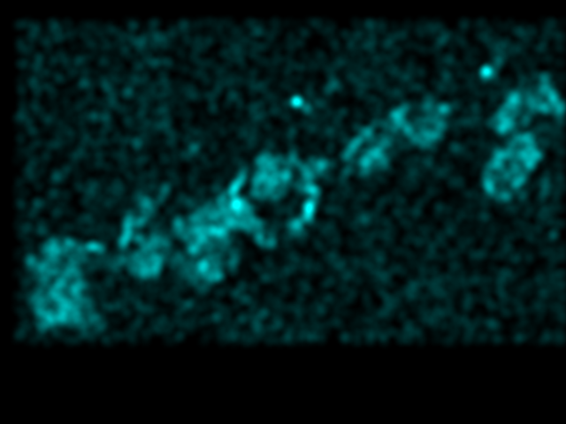
The incrustation of Nb surface after CP processing.( by SEM & EDX )
Color mopping CKα and OKα
Color mopping CKα (Red)
Color mopping OKα (Blue)

Slide 5
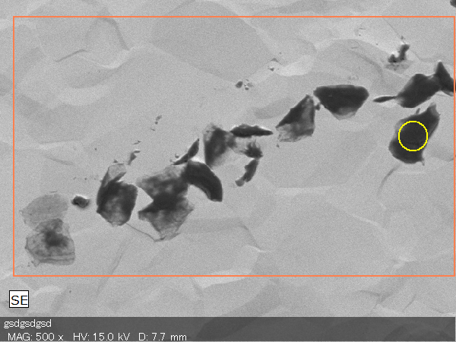
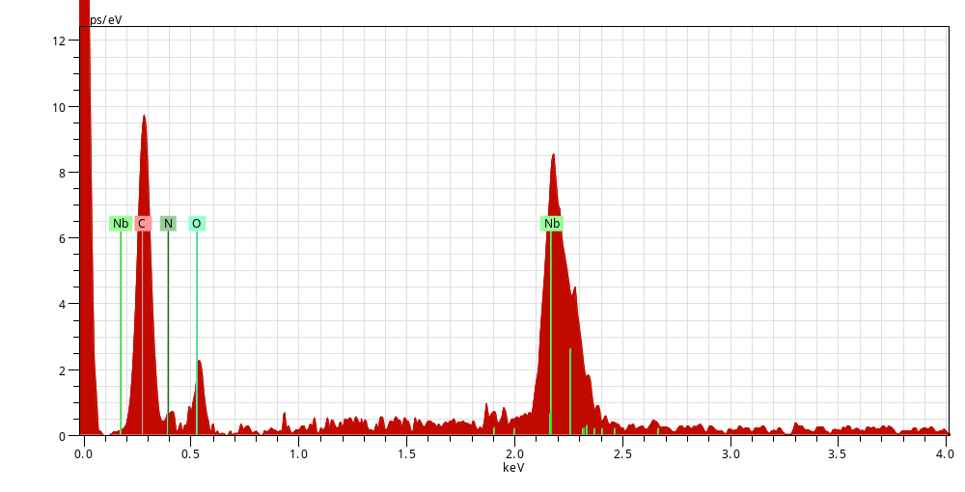
The incrustation of Nb surface after CP processing.( by SEM & EDX )
Spectrum: Point
Element AN Series norm. C Atom. C
[wt.%] [at.%]
-----------------------------------
Carbon 6 K-series 64.48 70.75
Oxygen 8 K-series 35.52 29.25
-----------------------------------
Total: 100.00 100.00
C Kα
Nb Lα
O Kα
N Kα

Slide 6
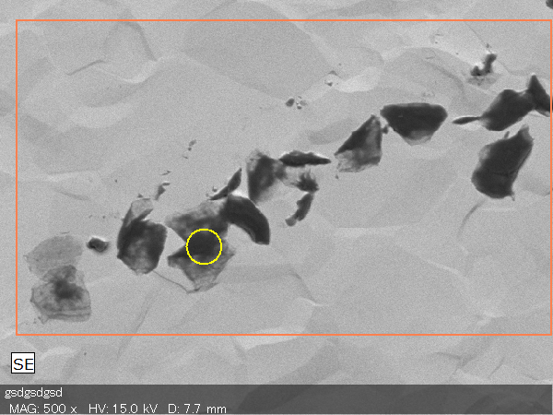
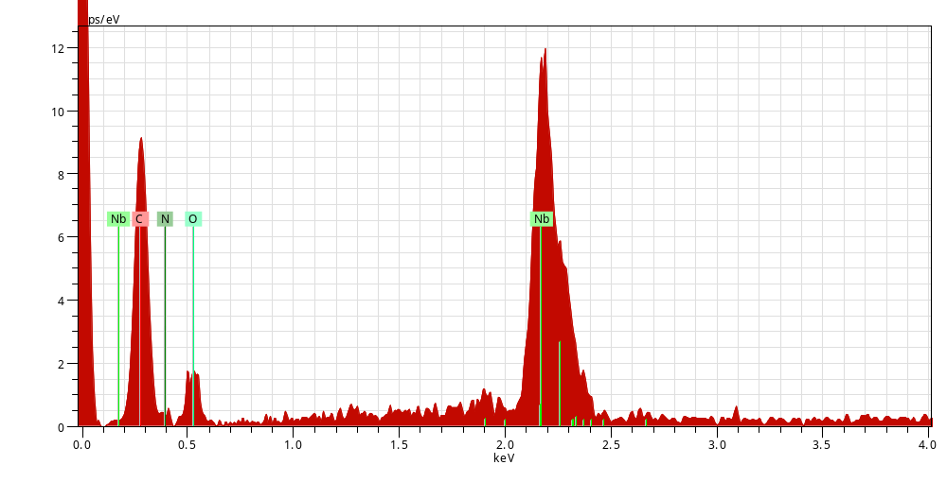
The incrustation of Nb surface after CP processing. ( by SEM & EDX )
Spectrum: Point
Element AN Series norm. C Atom. C
[wt.%] [at.%]
-----------------------------------
Carbon 6 K-series 64.28 70.57
Oxygen 8 K-series 35.72 29.43
-----------------------------------
Total: 100.00 100.00

Slide 7
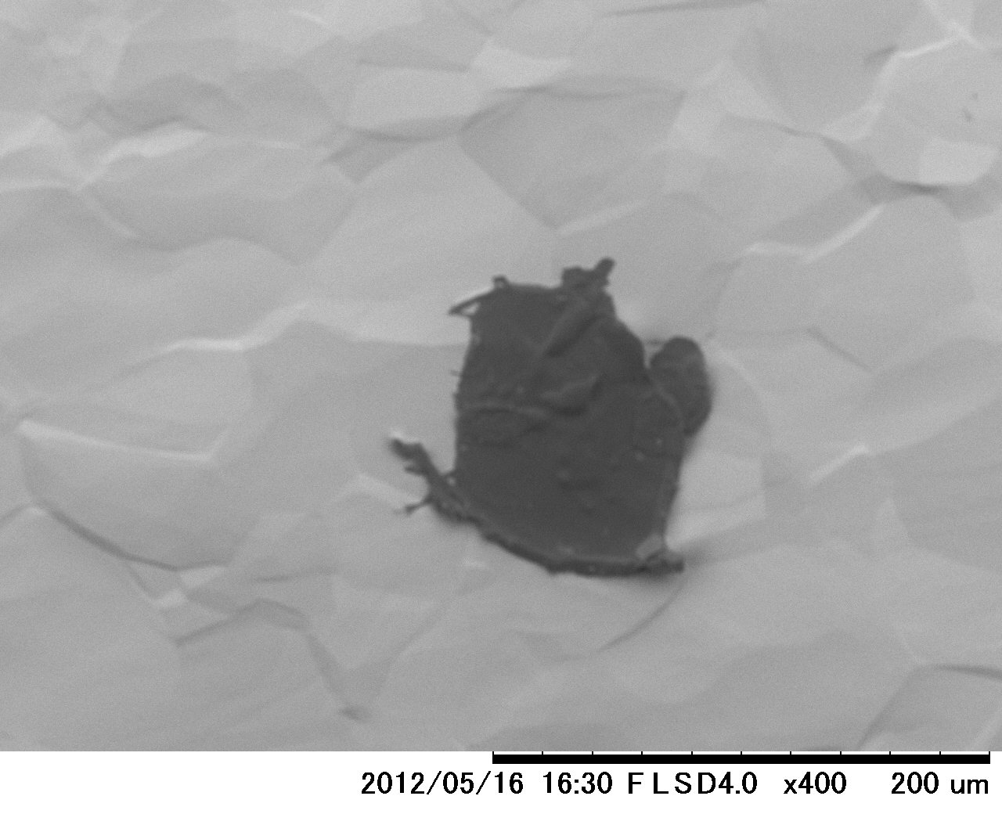
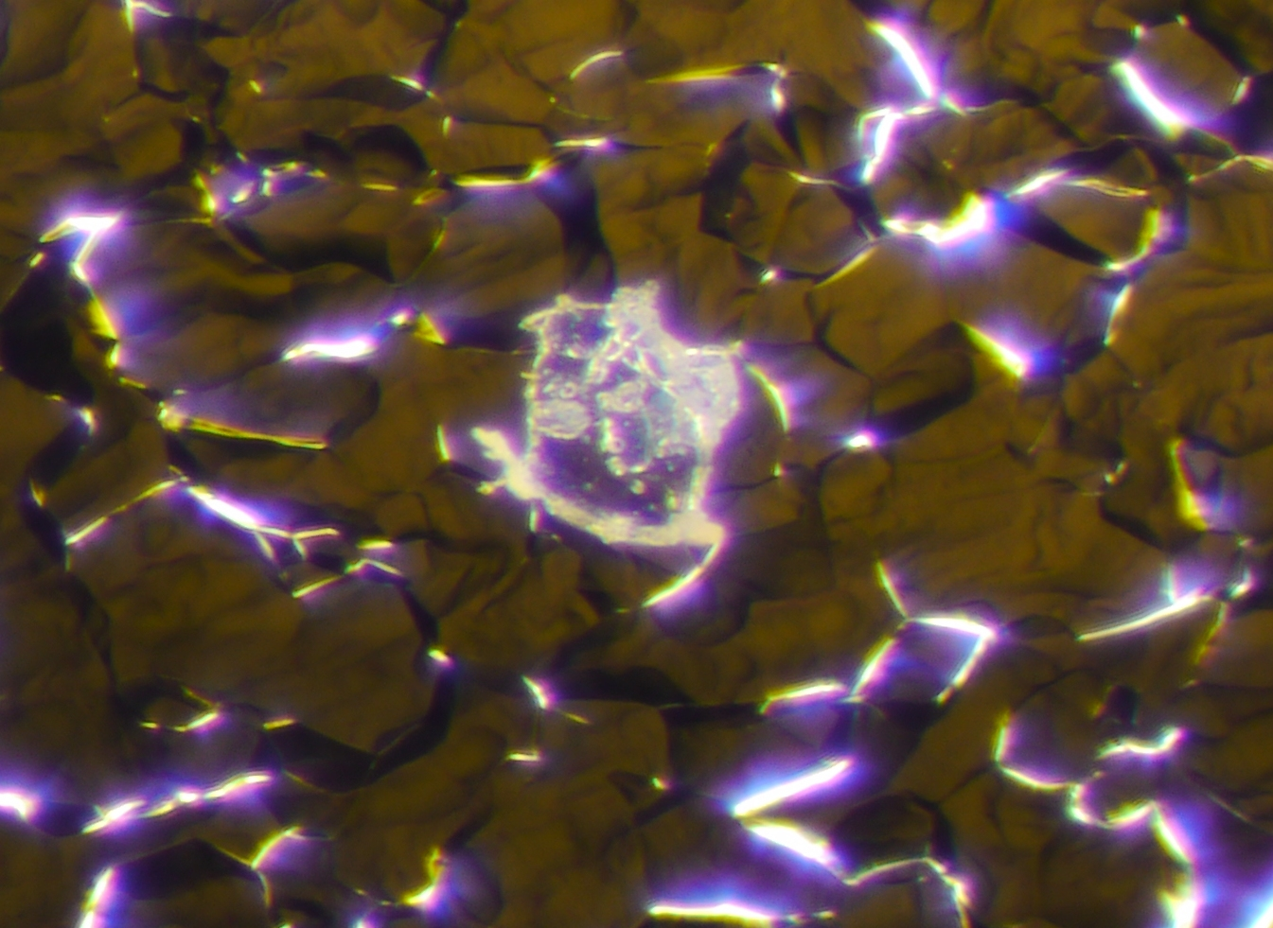
The incrustation of Nb surface after CP processing. ( by SEM & Optical micrograph)
It seems that the incrustation is transparent like a jellyfish.

Slide 8
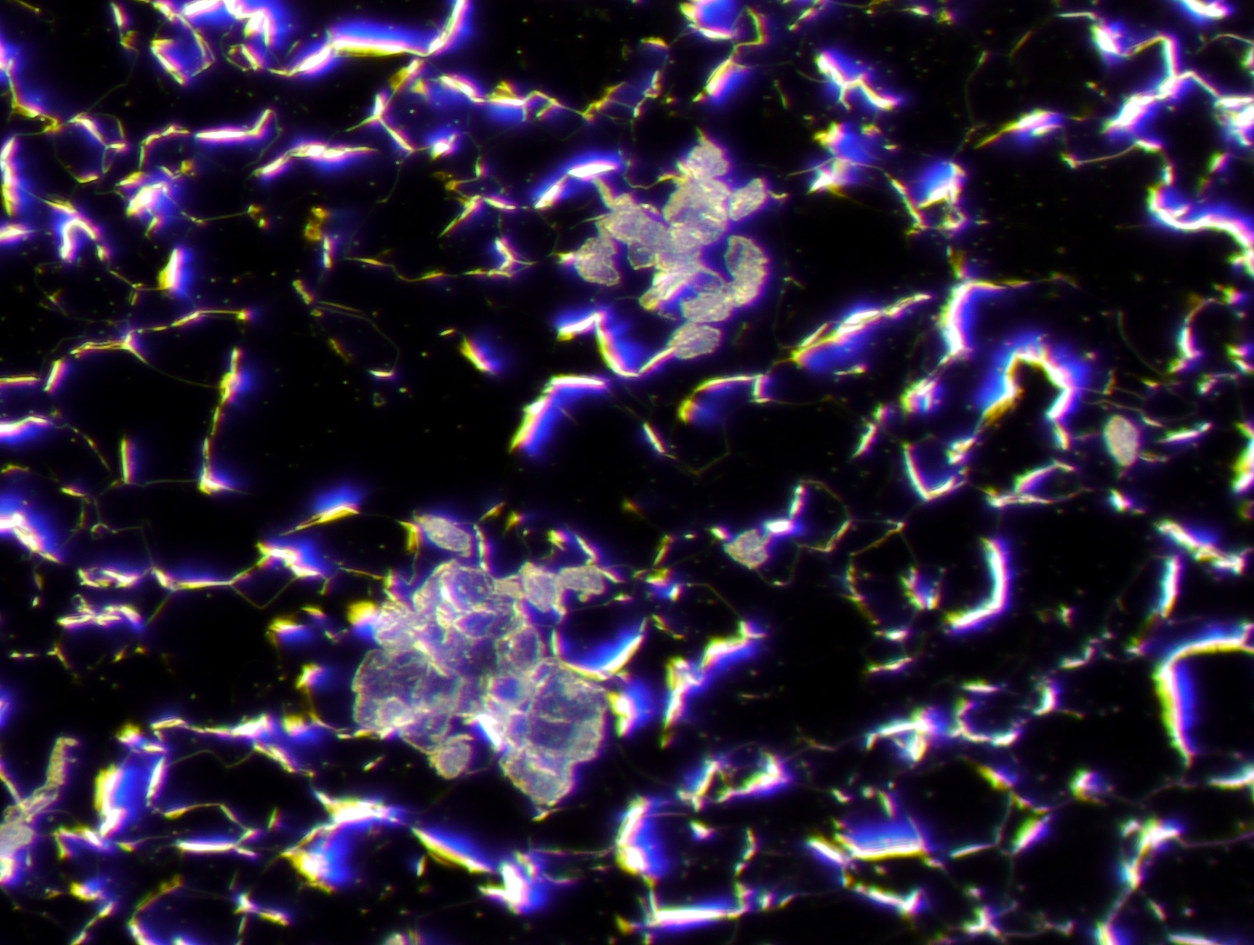
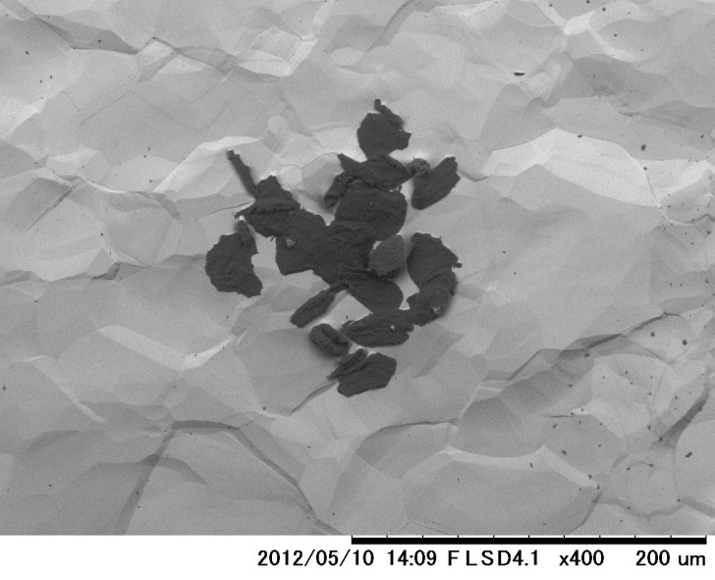
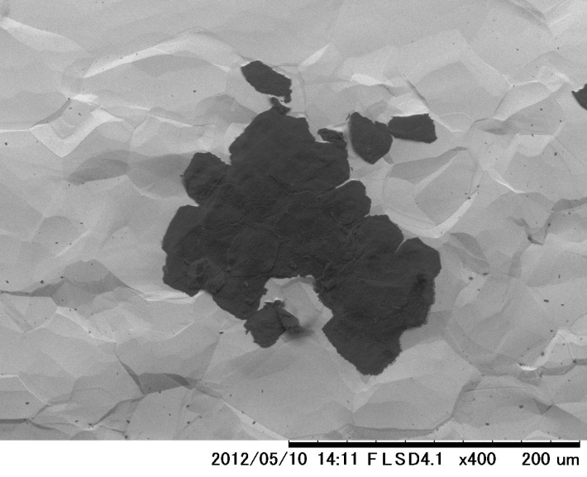
The incrustation of the Nb surface after CP processing.( by SEM & Optical micrograph)

Slide 9
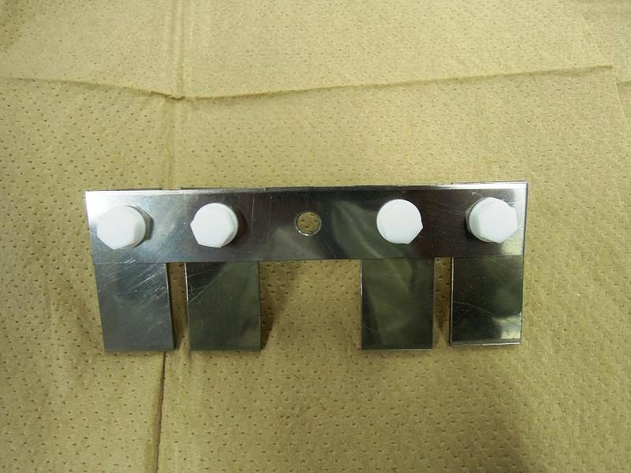
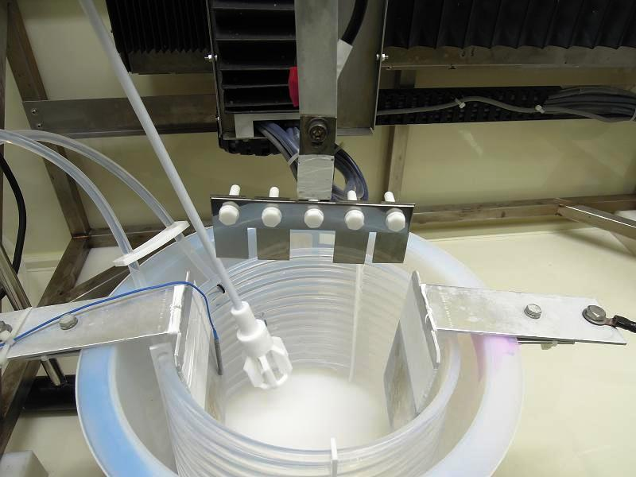
3. The procedure of sample EP.
Nb sample : 100×50×2.8 4 pieces
EP-electrolyte : 1 (46% HF ) +9 (98% H₂SO₄ )
Removal : 100μm
Electric current density : about 50mA/cm²
Temperature : about 27℃
Stirrer
Nb anode
Al cathode
Cooling coil
4 pieces Nb samples.
Setting to “ Lab.EP”

Slide 10
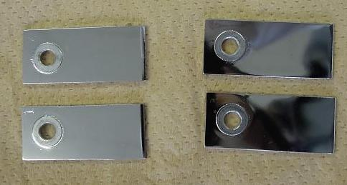
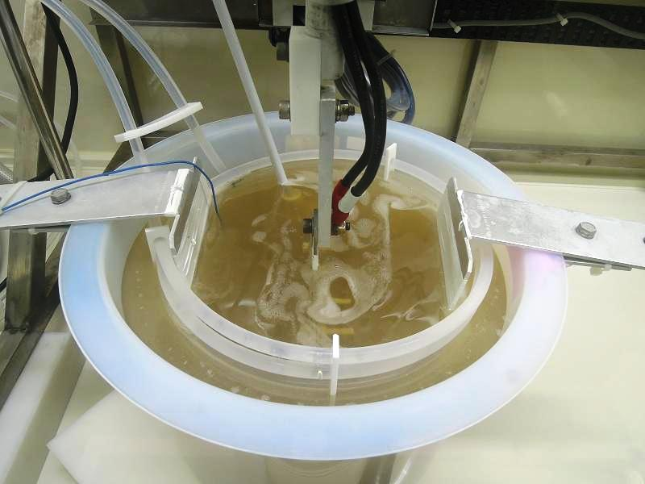
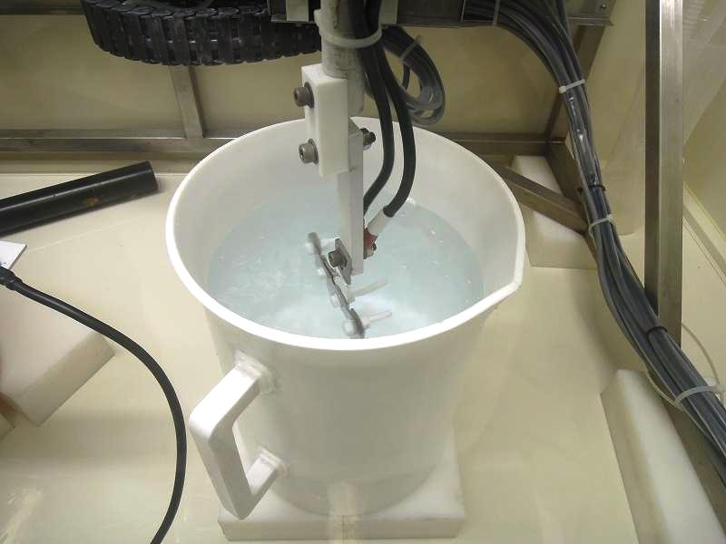
Nb samples after EP processing.
During EP processing of Nb samples.
Pure water washing. (10min.×3 times )

Slide 11
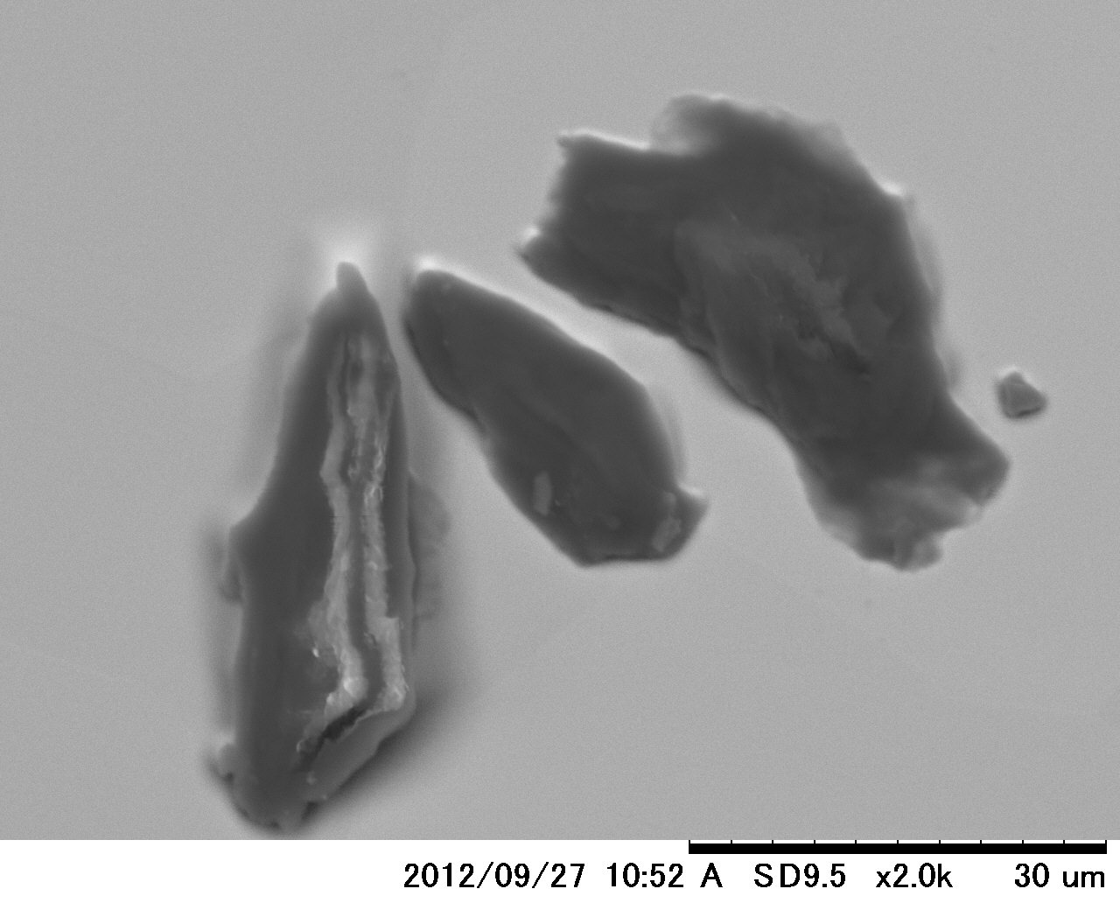
4. The incrustation of Nb surface after EP processing. ( by SEM )

Slide 12
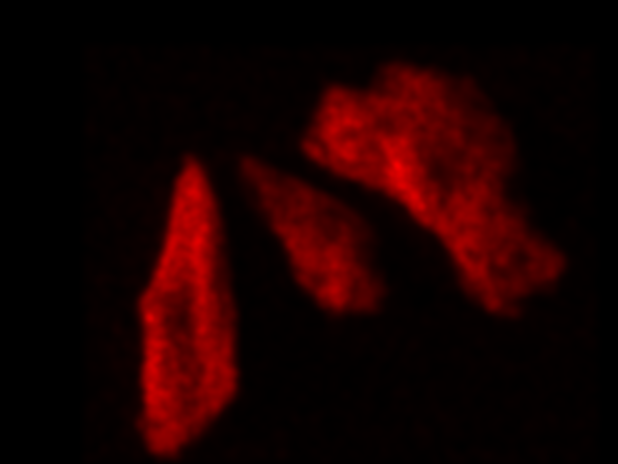
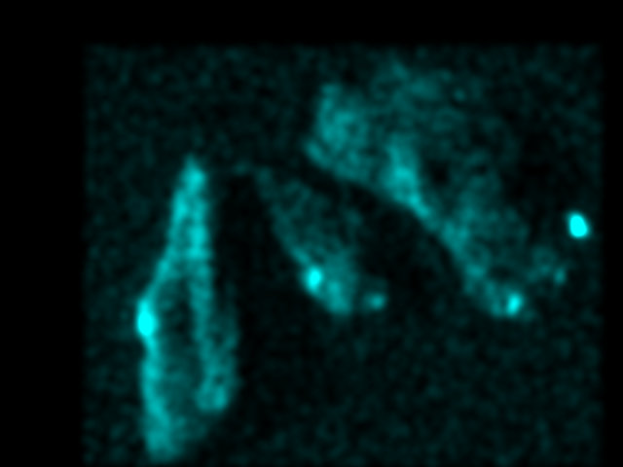
The incrustation of Nb surface after EP processing.( by SEM & EDX )
Color mopping CKα and OKα
Color mopping CKα (Red)
Color mopping OKα (Blue)

Slide 13
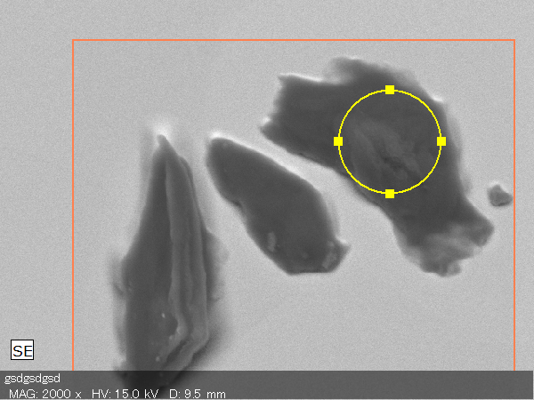
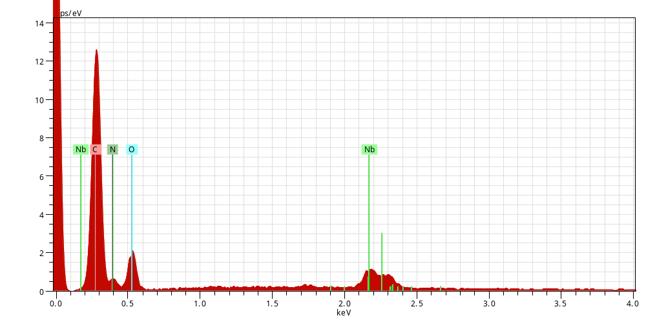
The incrustation of Nb surface after EP processing.( by SEM & EDX )
Spectrum: Point
Element AN Series norm. C Atom. C
[wt.%] [at.%]
-----------------------------------
Carbon 6 K-series 67.44 73.39
Oxygen 8 K-series 32.56 26.61
-----------------------------------
Total: 100.00 100.00

Slide 14
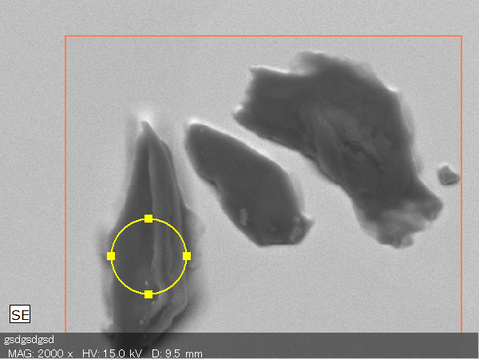
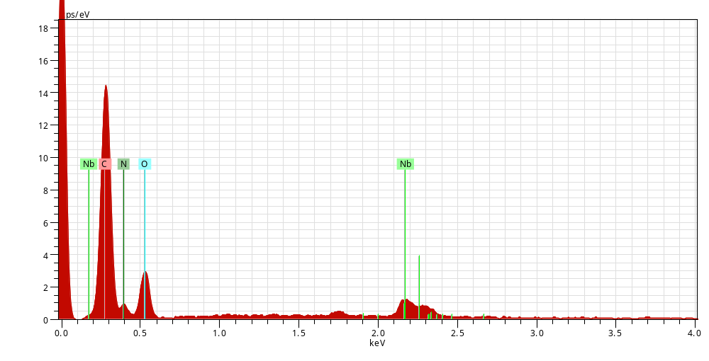
The incrustation of Nb surface after EP processing.( by SEM & EDX )
Spectrum: Point
Element AN Series norm. C Atom. C
[wt.%] [at.%]
-----------------------------------
Carbon 6 K-series 63.75 70.08
Oxygen 8 K-series 36.25 29.92
-----------------------------------
Total: 100.00 100.00

Slide 15
5. Classification of the carbon incrustation.
SEM-EDX analysis of the Nb samples surface incrustation after EP processing.
Sample No. | Atom.C（％） |  | Other elements | Remarks | Atom.C（％） |  | Other elements | Remarks
 | Carbon | Oxygen |  |  | Carbon | Oxygen
1-001-800 |  |  |  |  | 50.7 | 49.3
1-001-1200 |  |  |  |  | 51.7 | 48.3
1-002-1000 |  |  |  |  | 52.2 | 47.8
1-003-1800 | 73.3 | 26.7 | N
1-004-1000 |  |  |  |  | 51.5 | 48.5
1-004-1500 |  |  |  |  | 53.4 | 46.4
1-004-1500-2 |  |  |  |  | 54.0 | 46.0
1-005-400 |  |  |  |  | 51.4 | 48.6 |  | Form of flat ribbon
1-006-800 |  |  |  |  | 51.5 | 48.5
1-006-1000 |  |  |  |  | 52.1 | 47.9
1-006-1500 | 73.5 | 26.5 | N
1-007-1000 |  |  |  |  | 51.7 | 48.3 |  | Form of flat ribbon
1-009-1500 | 72.5 | 27.5 | N
2-001-1000 | 74.5 | 25.5 | N
2-001-1000-2 | 70.8 | 29.2 | N
2-002-1800 | 76.0 | 24.0 | N
2-005-1800 |  |  |  |  | 57.3 | 42.7
2-006-1800 | 70.3 | 29.7 | N
009-1500 | 69.6 | 30.4 | N
n | 8 | 8 |  |  | 11 | 11
Average | 72.6 | 27.4 |  |  | 52.5 | 47.5
σ | 2.2 | 2.2 |  |  | 1.8 | 1.8

Slide 16
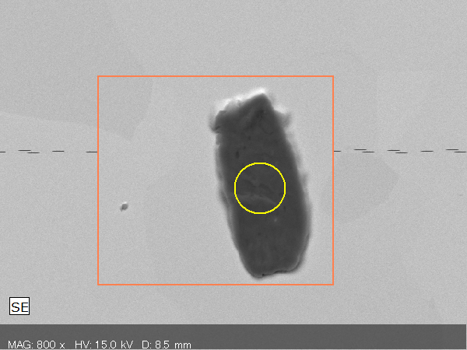
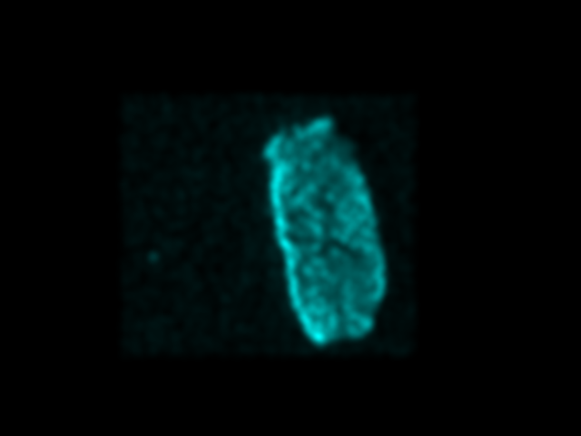
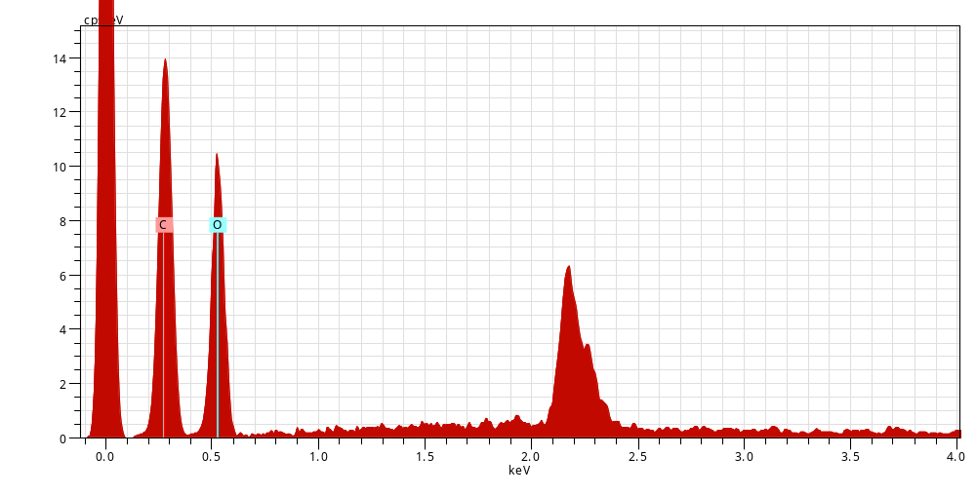
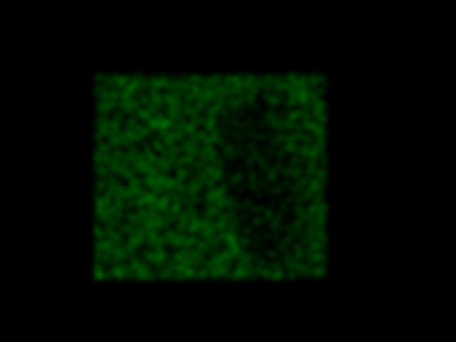
The incrustation of Nb surface after EP processing.( by SEM & EDX )
Spectrum: Point
Element AN Series norm. C Atom. C
[wt.%] [at.%]
-----------------------------------
Oxygen 8 K-series 55.30 48.16
Carbon 6 K-series 44.70 51.84
-----------------------------------
Total: 100.00 100.00
C Kα
Color mapping O Kα (Blue)
Nb Lα
O Kα
Color mapping N Kα (Green)

Slide 17
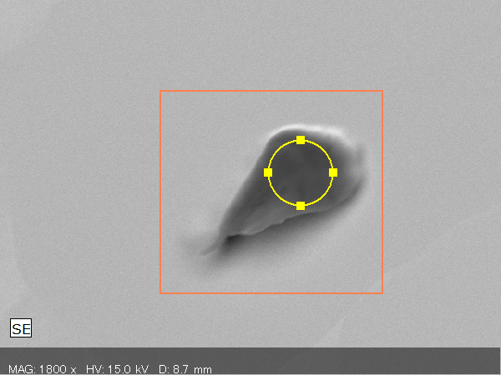
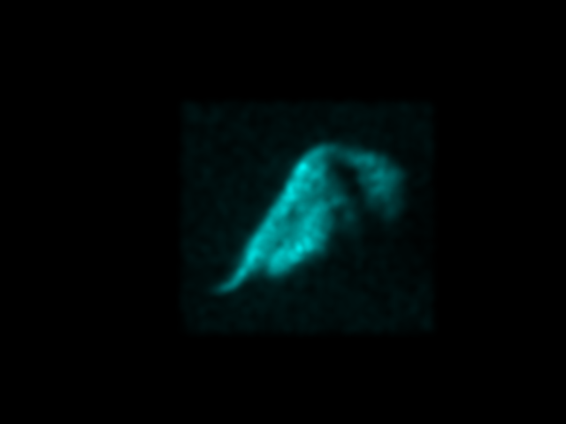
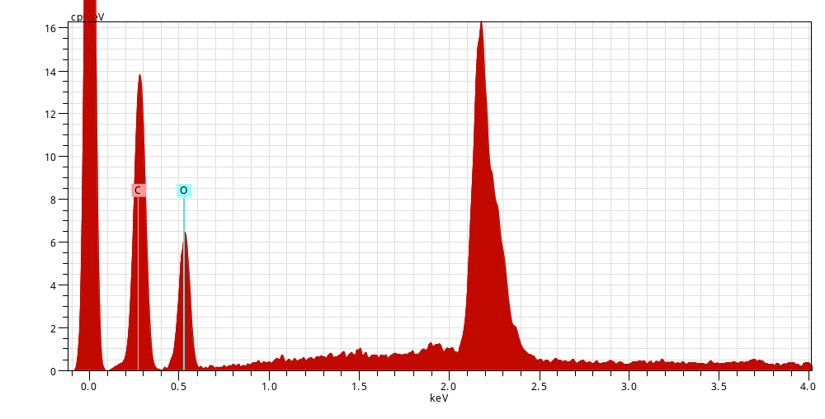
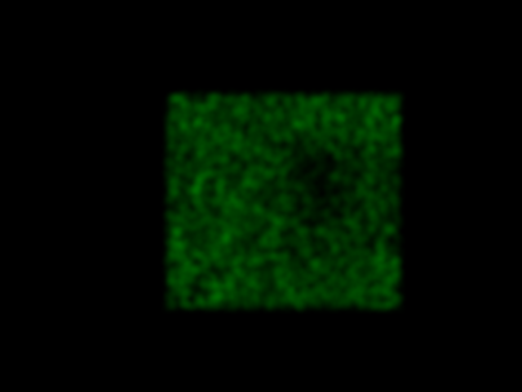
The incrustation of Nb surface after EP processing.( by SEM & EDX )
Spectrum: Point
Element AN Series norm. C Atom. C
[wt.%] [at.%]
-----------------------------------
Carbon 6 K-series 50.15 57.26
Oxygen 8 K-series 49.85 42.74
-----------------------------------
Total: 100.00 100.00
Color mapping O Kα (Blue)
Color mapping N Kα (Green)

Slide 18
6. The characteristic of carbon incrustation on Nb sample surface.
The carbon incrustations are classified into the next two kinds by carbon content.
Carbon content is 75-70 atom.% and including nitrogen. Relatively small .
（Normal type）
2) Carbon content is 55～51atom.% and not including nitrogen. Relatively large.
（Oxygen rich type）
1) Carbon content of Normal type （atom.%）
2) Carbon content of oxygen rich type（atom.%）
 | MAX. | MIN.
Av.±σ | 74.8 | 70.4
Av.±2σ | 77.0 | 68.2
Av.±3σ | 79.2 | 66.0
 | MAX. | MIN.
Av.±σ | 54.3 | 50.7
Av.±2σ | 56.2 | 48.8
Av.±3σ | 58.0 | 47.0

Slide 19
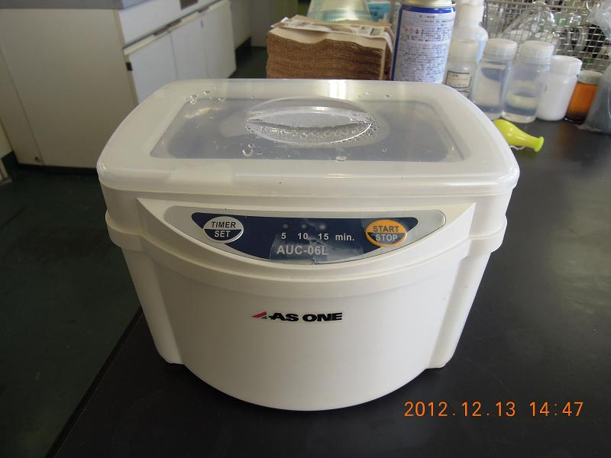
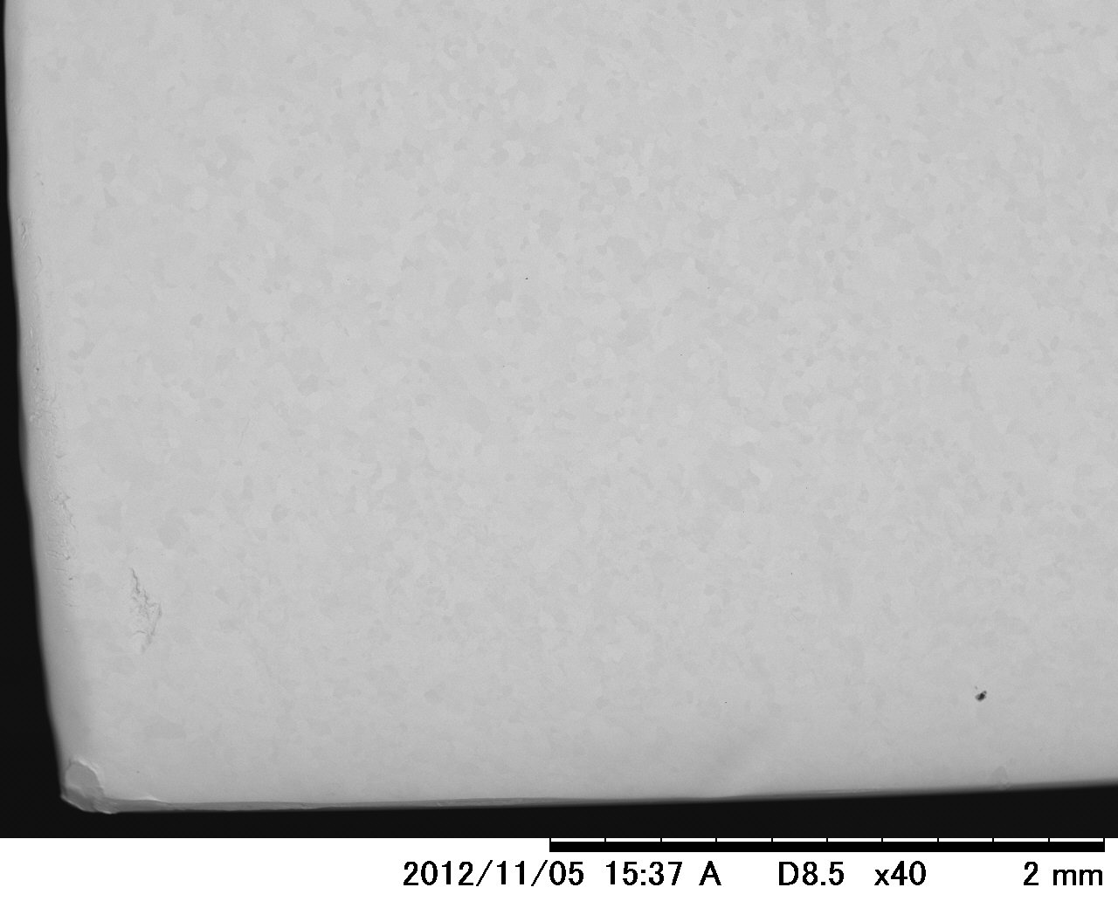
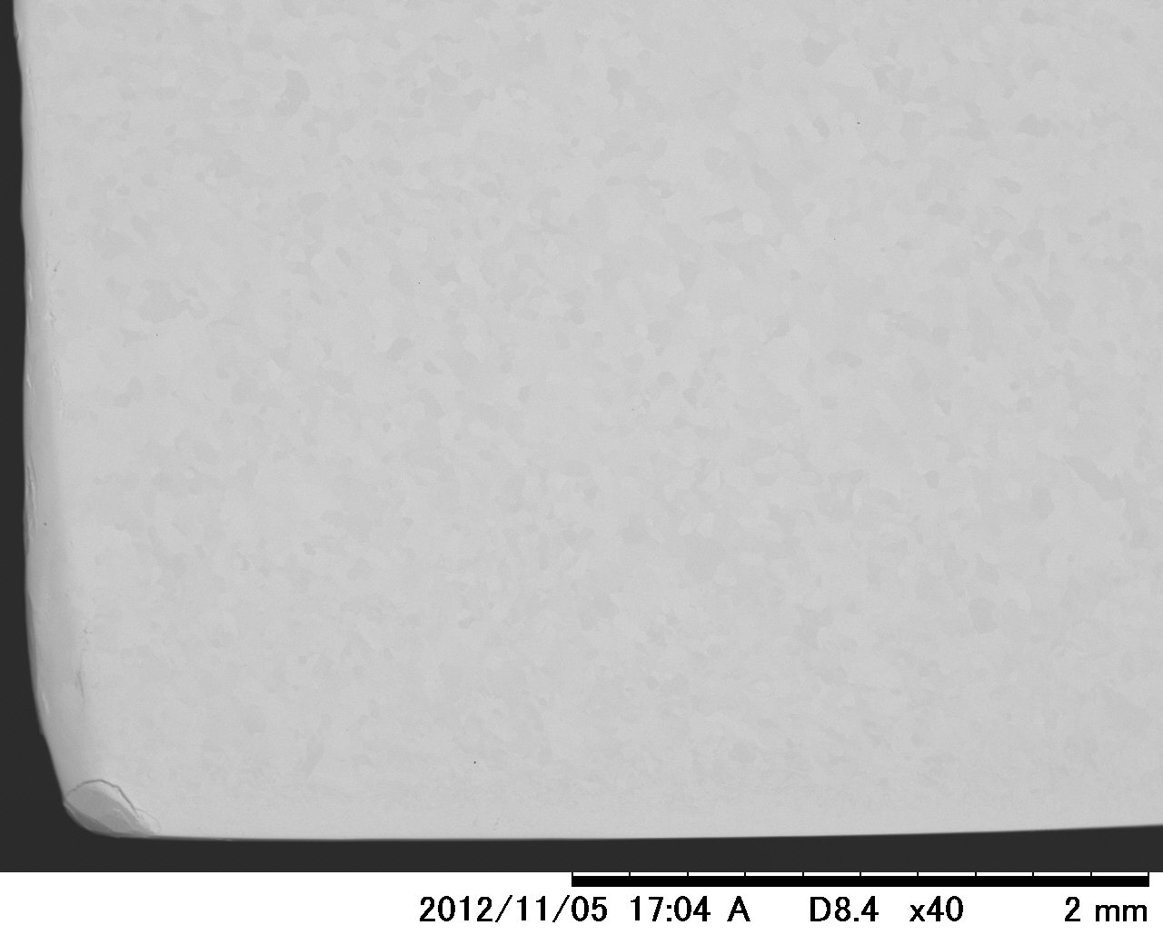
7. Ultrasonic washing examination by detergent .
(2% FM-20 )
The procedure of examination.
Ultrasonic washing by detergent 30min. → Pure water rinse by washing bottle → Ultrasonic washing by pure water 15min.
→ Pure water rinsing by washing bottle → drying at 30℃
Ultrasonic washer
After washing Nb sample by SEM.
After washing Nb sample by SEM.

Slide 20
The Nb sample surface carbon incrustation considerably decreased by ultrasonic washing by detergent (2% FM-20 ).
Some normal type incrustations remained after ultrasonic washing.
Oxygen rich type incrustations were almost washed.
SEM-EDX analysis of the Nb sample surface encrustation after ultrasonic washing by detergent (2% FM-20 ).
Sample No. | Atom.C（％） |  | 含有元素 | 形状 | Atom.C（％） |  | 含有元素 | 形状
 | Carbon | Oxygen |  |  | Carbon | Oxygen
1-001-1800 | 69.8 | 30.2 | N
1-003-1500 | 70.2 | 29.8 | N
1-004-1800 | 73.9 | 26.1 | N
1-005-1800 | 69.7 | 30.3 | N
1-006-1800 | 72.0 | 28.0 | N
2-001-1800 | 66.7 | 33.3 | N
2-002-1800 | 72.4 | 27.6 | N
2-003-1800 | 71.1 | 28.9 | N
2-008-800 | 70.2 | 28.8 | N
2-008-800-2 | 71.7 | 28.3 | N
n | 10 | 10 |  |  | 0 | 0
Average | 70.8 | 29.1
σ | 2.0 | 1.9

Slide 21
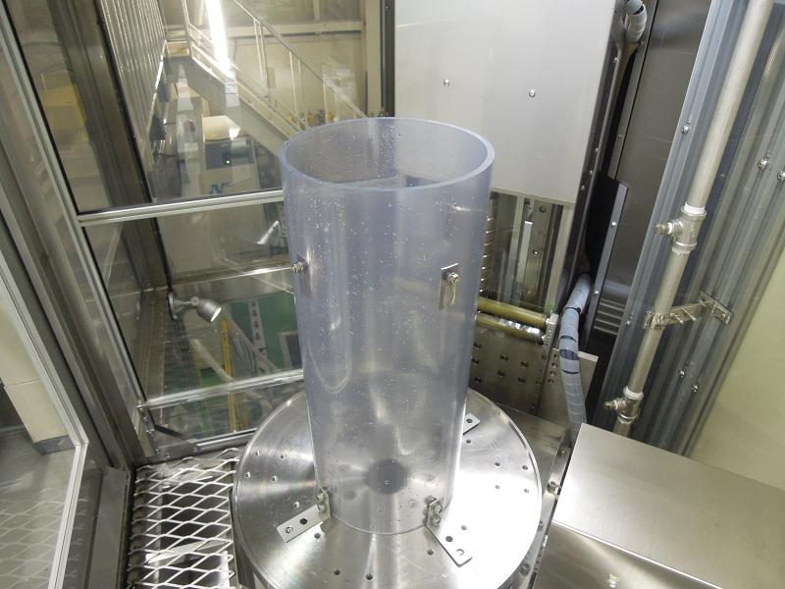
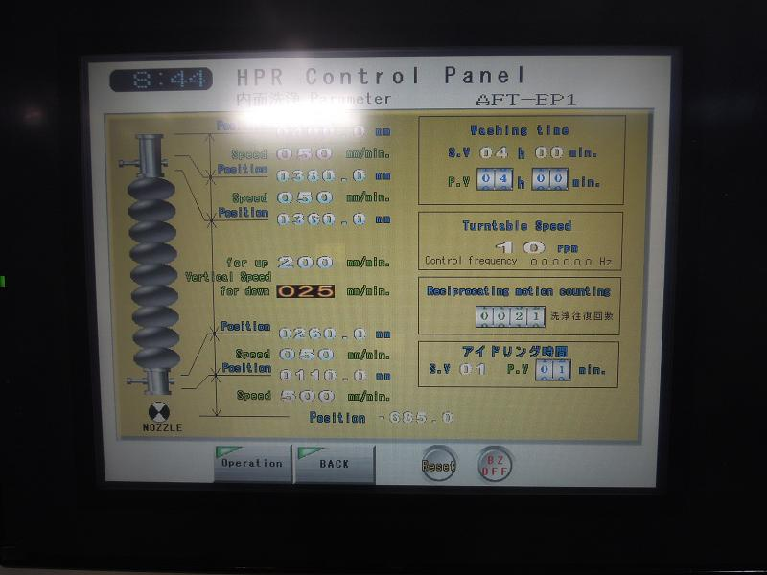
8. High pressure rinse examination by ultra pure water.
The procedure of examination.
Water pressure : 8Mpa
Rinsing time : 4Hr.
Setting 4 pieces Nb samples to HPR.
HPR control panel.

Slide 22
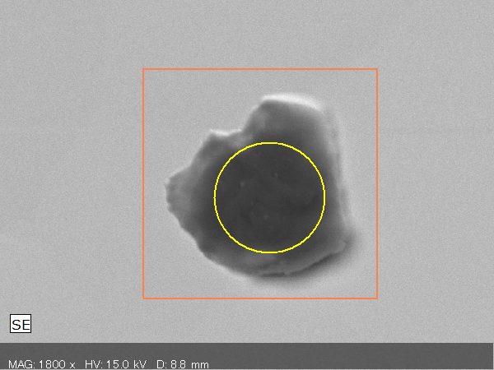
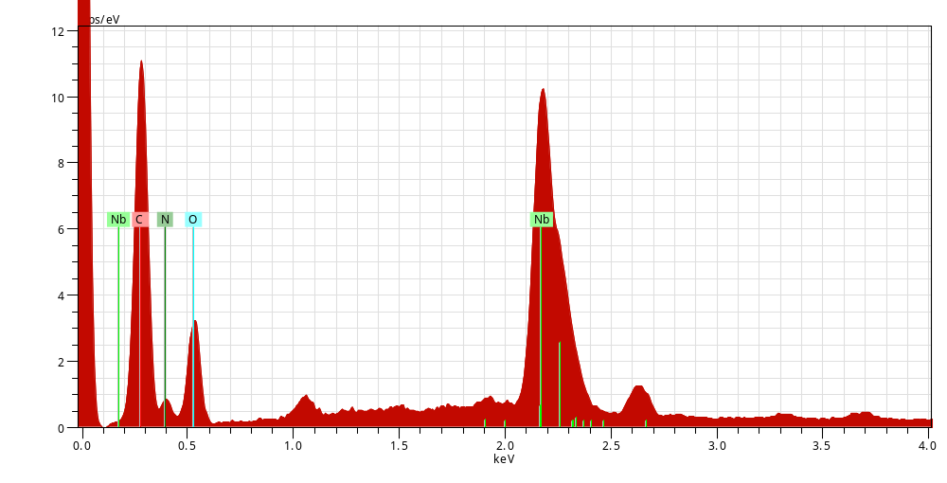
The incrustation of Nb surface after HPR.( by SEM & EDX )
Spectrum: Point
Element AN Series norm. C Atom. C
[wt.%] [at.%]
-----------------------------------
Carbon 6 K-series 58.41 65.17
Oxygen 8 K-series 41.59 34.83
-----------------------------------
Total: 100.00 100.00
Some incrustations remained after high pressure rinse by ultra pure water.

Slide 23
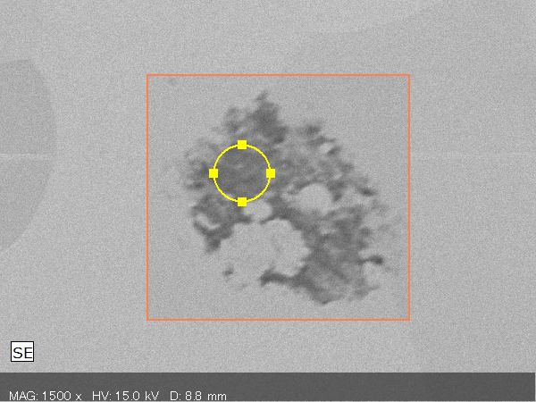
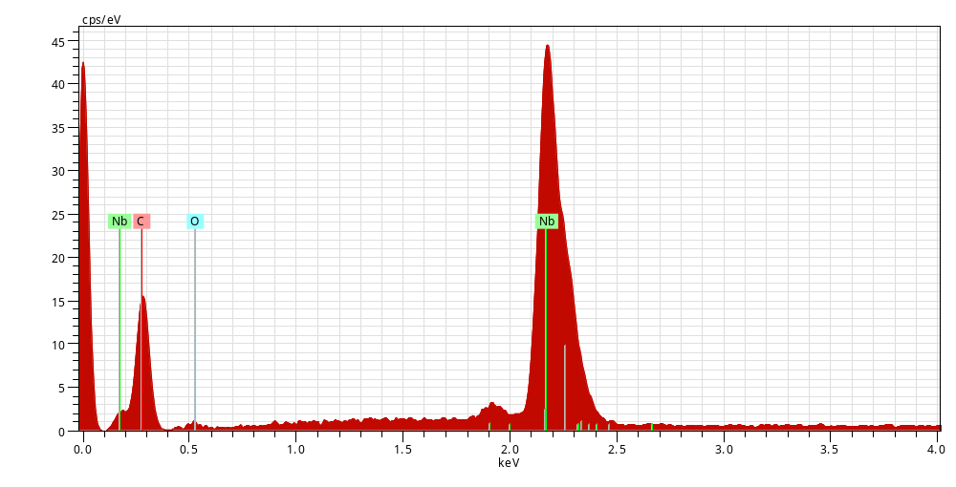
The incrustation of Nb surface after HPR.( by SEM & EDX )
Spectrum: Point
Element AN Series norm. C Atom. C
[wt.%] [at.%]
-----------------------------------
Carbon 6 K-series 81.58 85.51
Oxygen 8 K-series 18.42 14.49
-----------------------------------
Total: 100.00 100.00
Some incrustations remained after high pressure rinse by ultra pure water.

Slide 24
Summary
An incrustation including carbon and oxygen was detected on Nb surface after CP or EP processing.
The incrustation is distinguished to two kinds of the next by carbon content.
(1) Carbon content is 75-70 atom.% and including nitrogen. Relatively small .
( Normal type. )
(2) Carbon content is 55～51atom.% and not including nitrogen. Relatively large.
( Oxygen rich type. )
3) As a result of ultrasonic washing using detergent ( 2% FM-20 ), we could wash
almost the oxygen rich type incrustation, but could not wash some the normal
type incrustation.
4) Some normal type incrustations were not washed by HPR either.

Slide 25
Discussion
What is carbon of the incrustation caused by?
Teflon? (It has been examined.) “ No. “ , Carbonic acid in pure water? “No.”
We think carbon in Nb materials, but do not examine it.
2) Does this incrustation cause cavity field emission?
3) What is the method to wash this incrustation?
Ethanol, acetone, hydrofluoric acid, phosphoric acid, etc.
We experimented on various washing method, but do not succeed.

