Slide 1
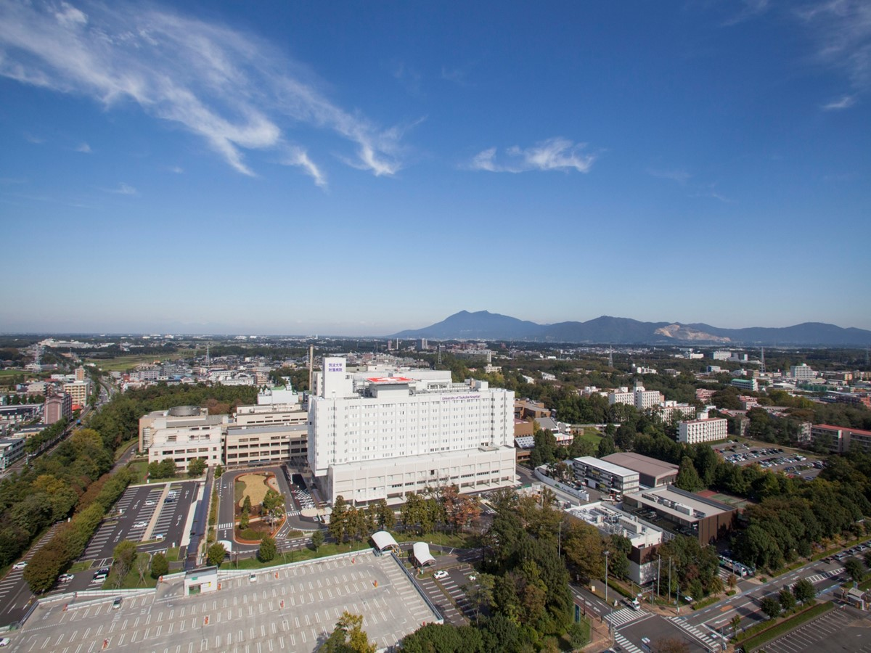
The current status and future plan of LINAC based
Boron Neutron Capture Therapy (iBNCT) in Tokai. Ibaraki, Japan
Shin-ichi Kurokawa
KEK/ Cosylab
June 23, 2014 at CEA Saclay
Notes:
Thank you chairman and thank very much for the invitation to this BNCT conference.
I’m engaging in BNCT research field since the latter 1990s.
I have engaged in reactor based BNCT for JRR-4 in Japan Atomic Energy Agency.
And now I join to a project for development of the accelerator based BNCT in University of Tsukuba.
Today, I introduce my experiences for the reactor BNCT in JRR-4 as well as the accelerator based BNCT.

Slide 2
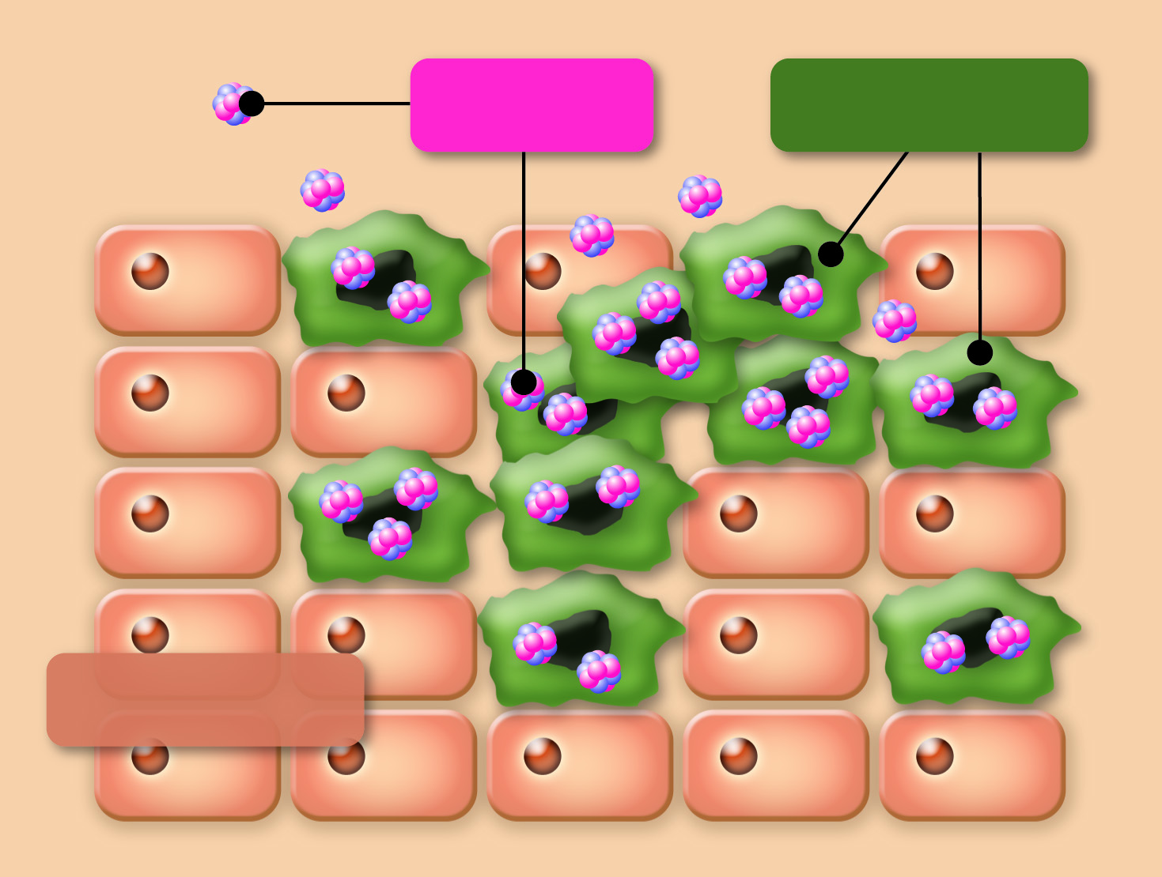
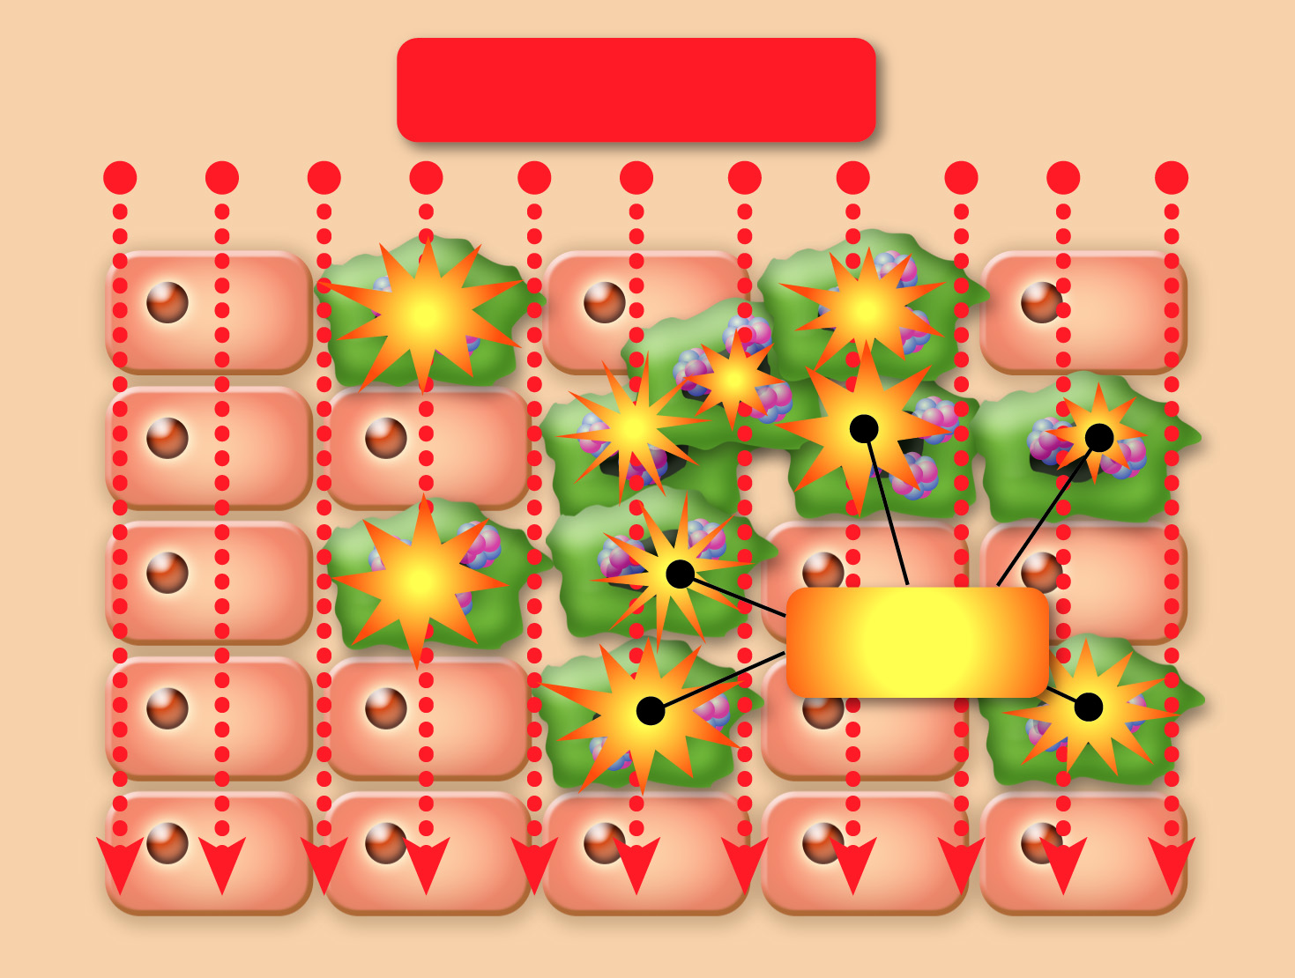
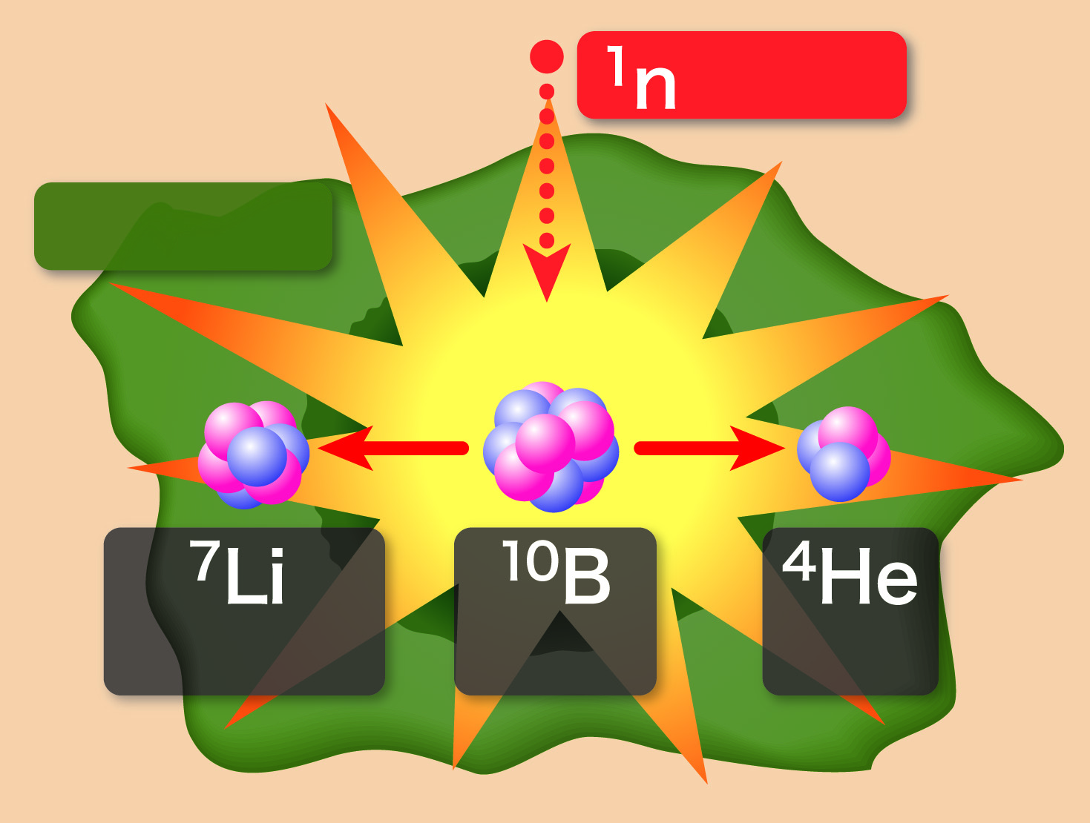
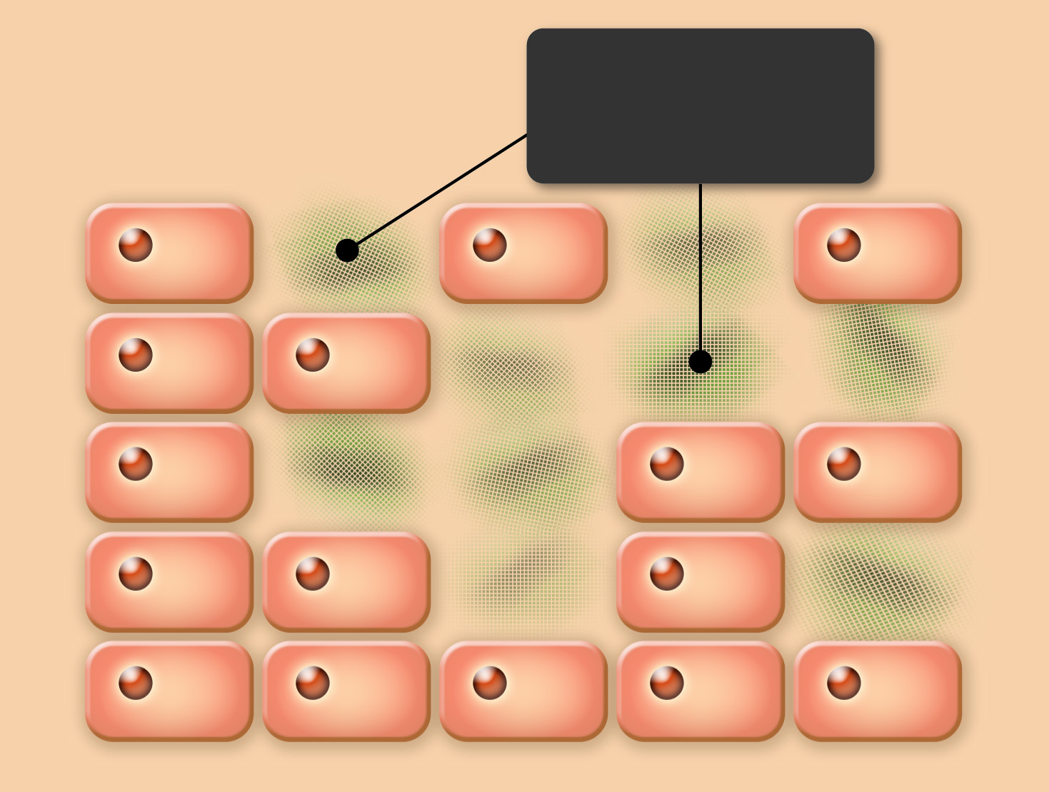
Boron Neutron Capture Therapy, BNCT
Mechanism of the treatment
Administer boron
-containing drug:
Neutron irradiation:
Neutron react with boron:
Cancer cells are destroyed:
Boron
Cancer Cells
Neutron Beam
Neutron
Destroyed
cancer cells
Nuclear
reaction
Normal Cells
Lithium
Boron
Alpha
Particle
A boron-containing drug that selectively accumulates in cancer cells is used.
The affected site is irradiated with an energy-adjusted neutron beam.
Emitted alpha particles and lithium particles destroy cancer cells
These particles only travel a distance of one cell width (about 10μm), allowing for cell-level treatment.
Features of BNCT
Pinpoint treatment at cell level
Alpha particles and lithium particles, with energy three times higher than regular radiation,
selectively destroy the DNA helixes of cancer cells.
New treatment of refractory cancer
Including invasive cancer, multiple cancer, recurrent cancer, radiation-resistant cancer,
cancer patents not indicated for surgery or radiation therapy, etc.
Causes minimal stress and provides high quality of life to patients
Treatment is completed in only one session of 30 minute irradiation without incision.
Indication for medication can be determined in advance.
Notes:
First, this slide shows principle of BNCT and its advantages, though Prof. Tanaka introduceｄ before.
As you know, BNCT can destroys cancer cells selectively using alpha particle and lithium nucleus as heavy particles.
So, BNCT is called “Cancer cell selective heavy-ion therapy”.
BNCT can be applied to refractory cancers as invasive cancer, multiple cancer and radiation resistant cancers and so on. And recurrent cancer after conventional radiotherapy are also applied.
Further advantage is that the treatment completes in only one session of 30 minute irradiation because neutron dose for healthy tissue is limited.
So, it provides highly quality of life to patient.
Furthermore, by combination with PET diagnosis, treatment efficiency and applicability of BNCT for each patient can be estimated in advance.

Slide 3
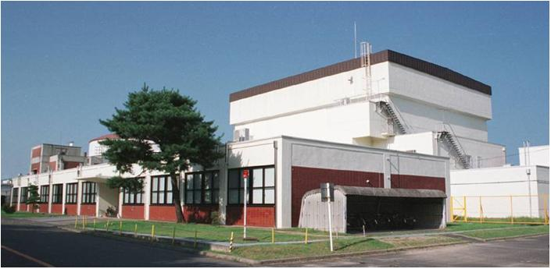
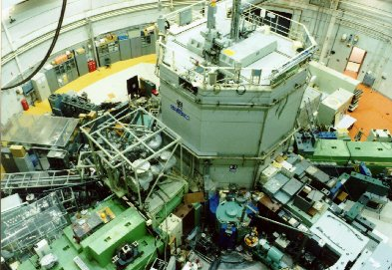
BNCT facility in Japan
BNCT Facilities in Japan
JAEA, JRR-4
Japan Atomic Energy Agency(JAEA)
Japan Research Reactor No.4
（Tokai Villa., Ibaraki）
KURRI, KUR
University of Tsukuba
Kyoto Univ. Research Reactor Institute
(KURRI) Research Reactor, KUR”(Osaka）
Notes:
To perform BNCT, we have to prepare high neutron intensity source. Thus at present the clinical trials of BNCT are being conducted using nuclear reactor.
In Japan, there were two reactors for BNCT.
One is KUR, a research reactor of Kyoto university located in Osaka Prefecture in Western place.
And another one is JRR-4 as a research reactor of Japan Atomic Energy Agency in Tokai village in Eastern place.
Distance from Tsukuba to Tokai is about 70km.
Clinical group of Tsukuba university were performed clinical trial of BNCT for malignant brain tumor using JRR-4.
When the team performed BNCT, they took a patient for the reactor from here.
☞
However unfortunately, JRR-4 reactor halted in 2011 due to the huge earthquake. And finally JAEA decided that JRR-4 is shut down permanently.
Therefore at present in Japan, we perform clinical trial of BNCT using only KUR.

Slide 4

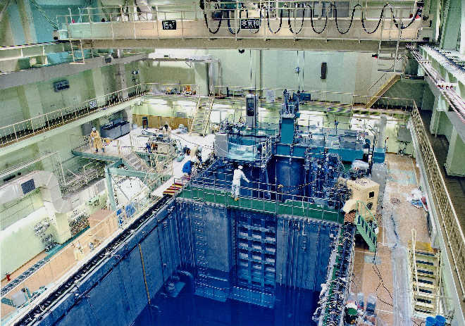
Outline of JRR-4
・First Critical :28th January, 1965
14th July,1998 (Low Enriched)
・Max.Thermal Power : 3.5MW
・Max.Thermal Neutron Flux : 5x10¹³ n/cm²･s
・Operation Mode : Daily Operation,
6hrs/Day
Notes:
JRR-4 is a research reactor in Japan Atomic Energy Agency.
The reactor was constructed to research reactor shielding of the first Japanese nuclear ship “Mutsu” in 1965.
And the reactor was renewal for enrichment reducing, and new facility for medical irradiation was installed in 1997. Then the reactor was achieved critical again in 1998.
Maximum thermal power is 3.5MW, and the maximum thermal neutron flux in the core is approximately 5x10¹³.
Operation mode is daily Operation. The reactor start up at about 10 o’clock, and the reactor shut down after operating 6 hours.

Slide 5
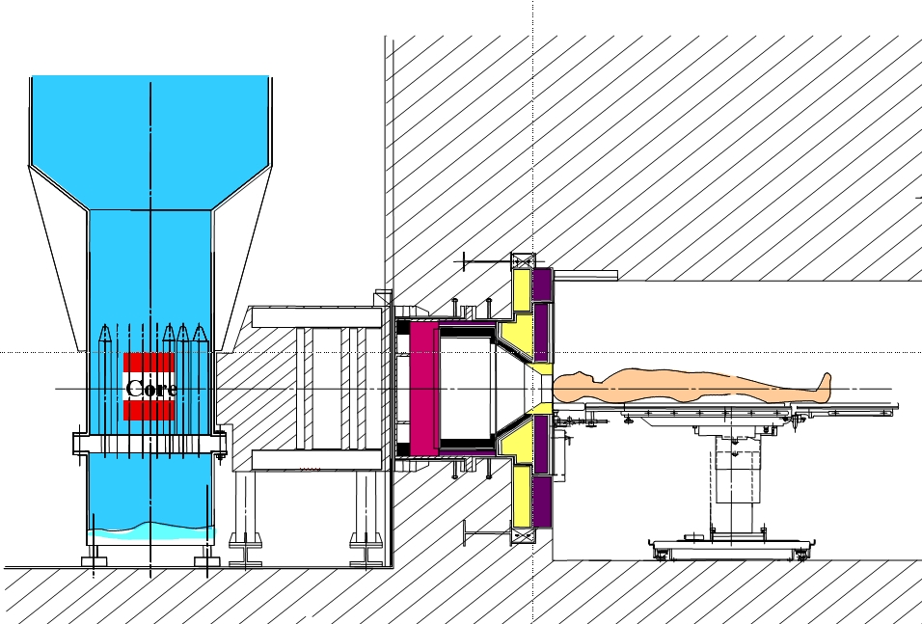
Cross Section View of JRR-4
Thermal Neutron Beam-2 Mode
Epithermal Neutron Beam Mode
Thermal Neutron Beam-1 Mode
Cadmium Shutter
Heavy
Water Tank
Reactor
Core
Neutron
Beam
Epithermal
Neutron
Beam
Thermal
Neutron
Beam-1
Thermal
Neutron
Beam-2
Notes:
This figure shows cross section view of medical irradiation facility of JRR-4.
JRR-4 has spectrum shifter device consisted of heavy water tank and cadmium shutter.
The facility allows to change neutron beam spectrum depending on depth of cancer by changing the thickness of heavy water in the heavy water tank and by switching the cadmium shutter installed in neutron beam path.
At first, this is the TNB-2 mode. All heavy water layers in the tank are filled with heavy water. Cadmium shutter is putted out. This condition makes pure thermal neutron beam.
☞
Next, this mode is TNB-1 mode. Heavy water are filled in 4cm layer and 8cm layer in the tank. Cadmium shutter is out.
☞
Last, this mode is Epithermal neutron beam mode. Heavy water is filled only 8cm layer. To cut the thermal neutrons, cadmium shutter is putted in the neutron beam pass.

Slide 6
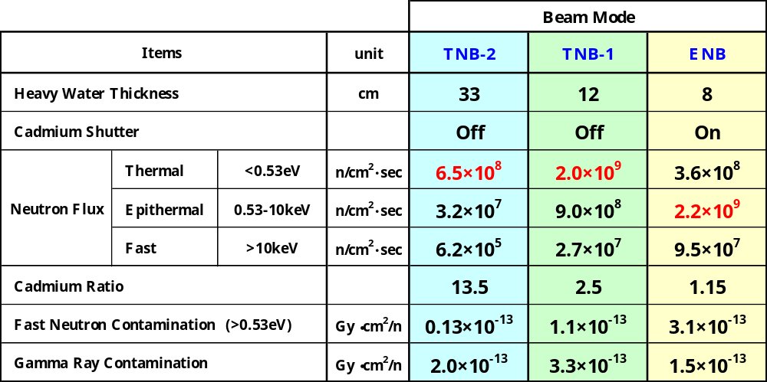
Beam performance in free-air conditions
for each mode
・Reactor Power ： 3.5MW
・Beam Collimator : φ15cm
・Condition ：In free-air
Notes:
アドリブOK
We measured characteristics of the neutron beams for each mode. The experiments had been carried out in free-air conditions. The reactor power was set as 3.5 MW as a maximum operation. This table shows beam performances obtained from the experiments and calculations.
For TNB-2 mode as pure thermal neutron beam, maximum thermal neutron flux at the center of beam aperture is about 6.5x 10⁸, cadmium ratio is about 13.5. The fast neutron contamination is lower than other beam modes.
For TNB-1 mode, maximum thermal neutron flux is approximately 2.0 x 10⁹, and cadmium ratio is about 2.5. The gamma-ray dose contamination is the highest in these beams.
For Epithermal neutron beam mode, we have estimated epithermal neutron flux in free-air condition. The maximum epithermal neutron flux is about 2.2x10⁹. Cadmium ratio is 1.15. Fast neutron contamination of the mode is higher than the other.

Slide 7
Clinical trials performed at JRR-4

Slide 8
BNCT clinical trials in JRR-4
JRR-4
Reactor
Core
Heavy
Water Tank
Cd Shutter
Irradiation Room
症例に応じて熱中性子ビーム～熱外中性子ビームを発生できる“JRR-4医療照射設備”を開発
Neutron
Beam
Epithermal
Neutron
Beam
Neutron Beam Facility in JRR-4
1999～ :Intra-operative BNCT with TNB-1 beam
2003～ :Intra-operative BNCT with epithermal neutron beam
2004～ :BNCT (non-craniotomy) with epithermal neutron beam
2005～ :BNCT for Melanoma and Head-&-Neck cancer
2006～ :BNCT for Brain Meningioma (mixed neutron beam)
2006～ :BNCT for Lung Cancer

Slide 9
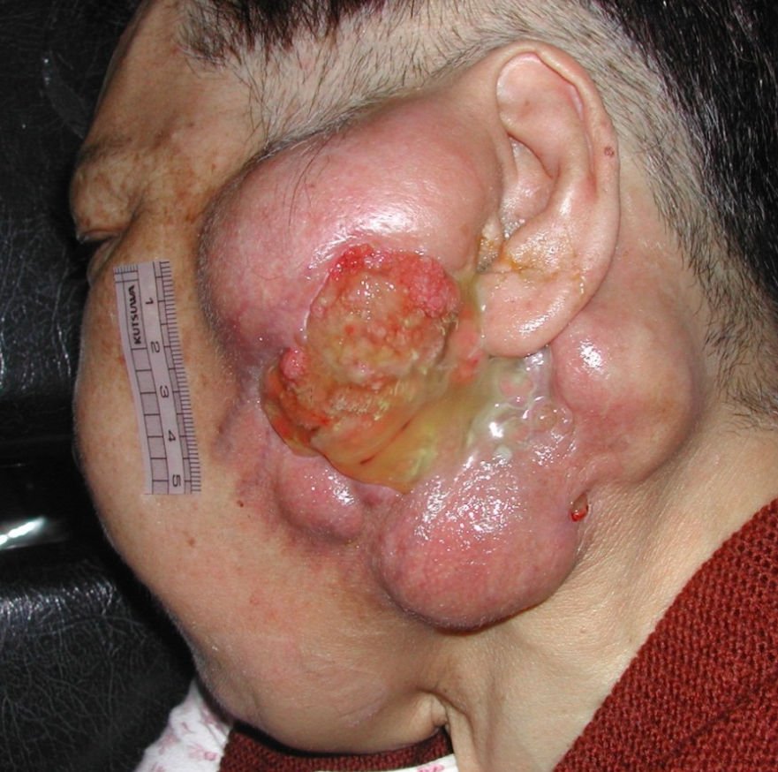
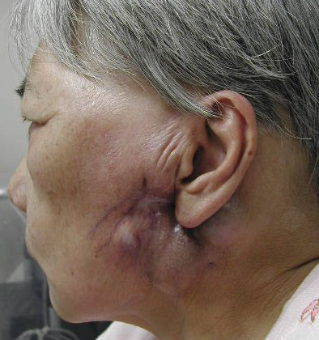
BNCTの臨床実績 ②頭頸部がん
写真提供：大阪大学
BNCT実施前
BNCT実施後
世界で最初の頭頸部がんに対するBNCT
BNCT分野の大きなブレイクスルー

Slide 10
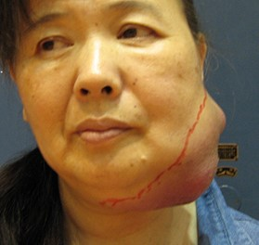
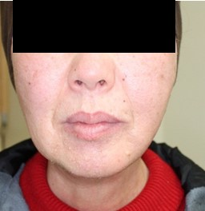
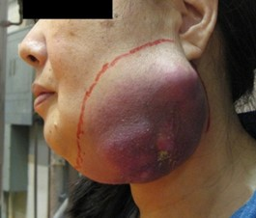
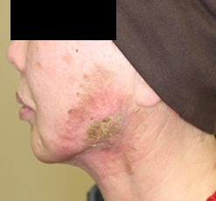
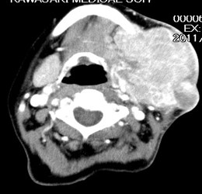
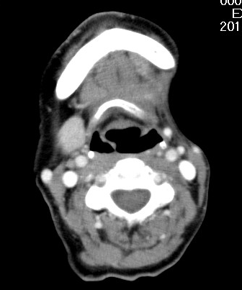
BNCTの臨床実績 ③頭頸部がん（悪性黒色腫）
BNCT
川崎医科大学提供

Slide 11
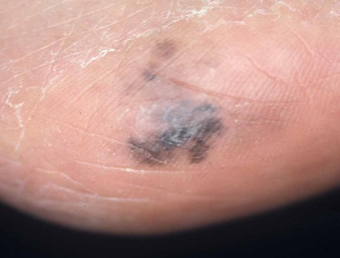
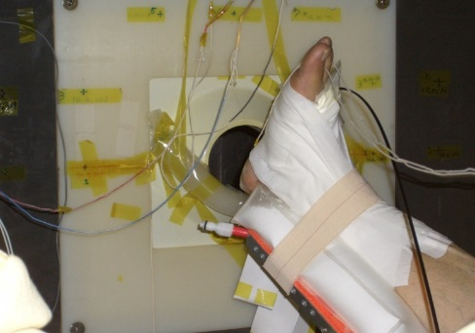
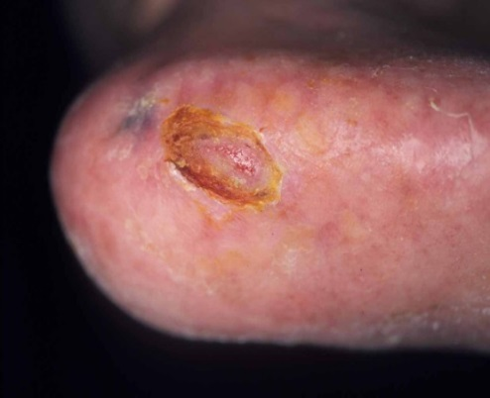
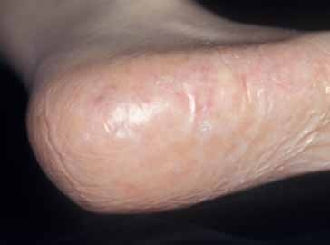
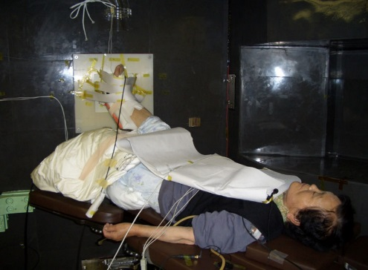
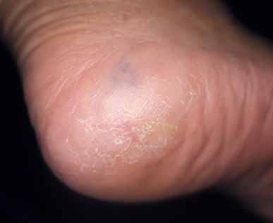
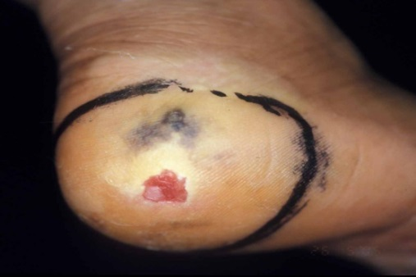
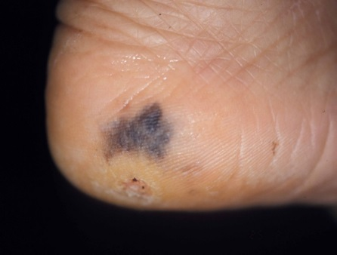
Clinical trial for Melanoma
Before BNCT
BNCT
（Irradiation）
After 3 month
After 6 month
S-1
S-2
JRR-4
Kawasaki Medical School

Slide 12
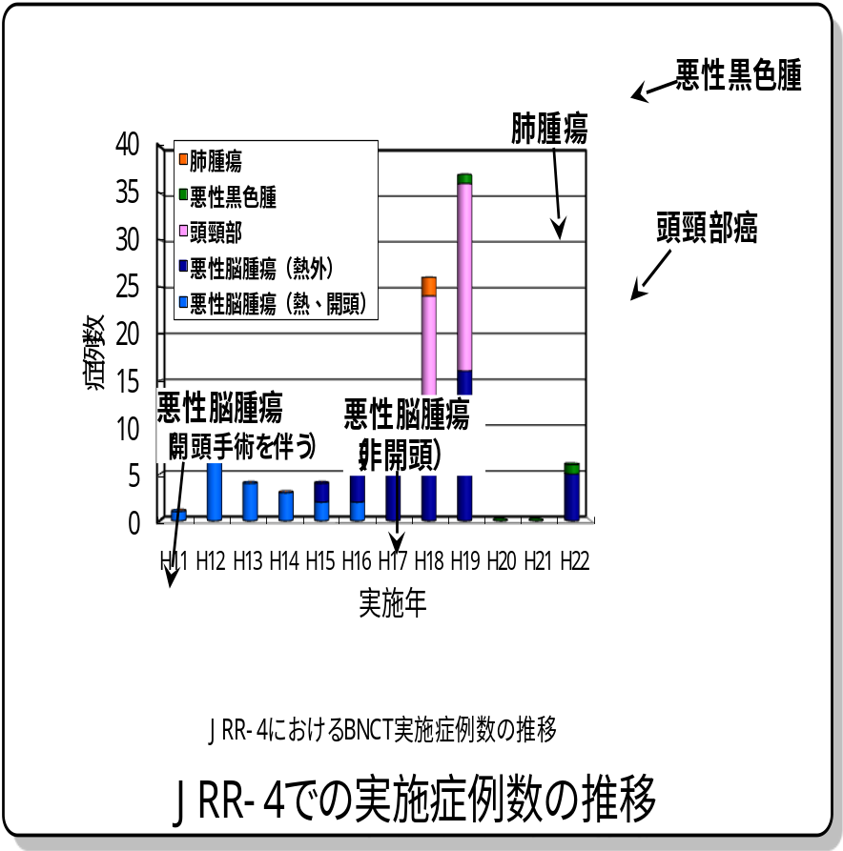
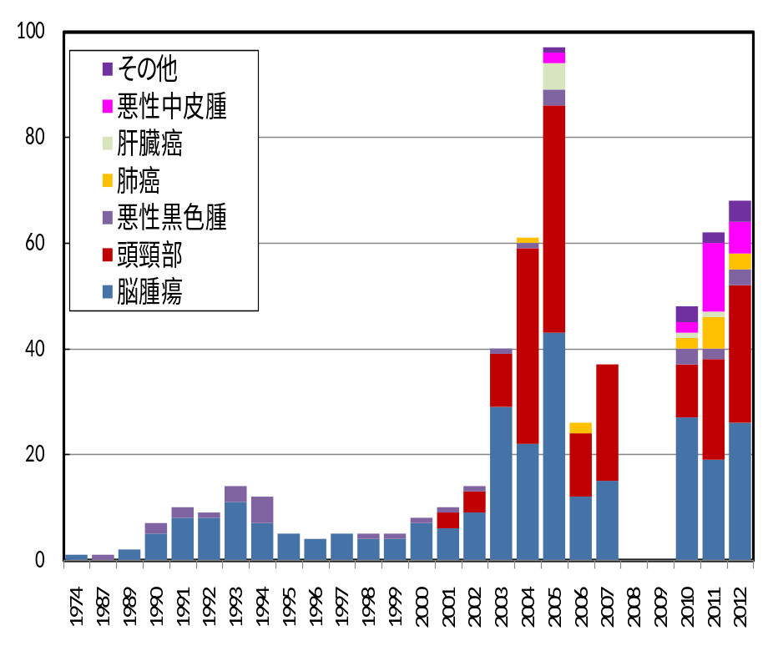
Number of clinical trials in JRR-4 and all Japan
Number of clinical trials
炉心破損
により停止
Year
JRR-４＋KUR Total
Foreign countries for BNCT clinical trials：
On going：Japan, Argentina, Taiwan
Stop： Finland, USA, Netherland, Italy, Chez,
Planning：China, Korea, England(Acc.), Italy(Acc.)
Notes:
12

Slide 13
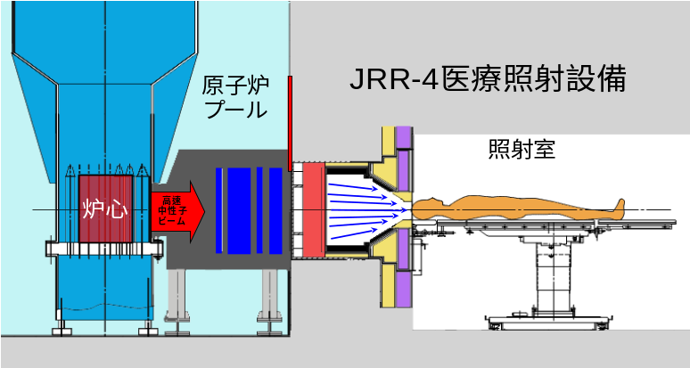

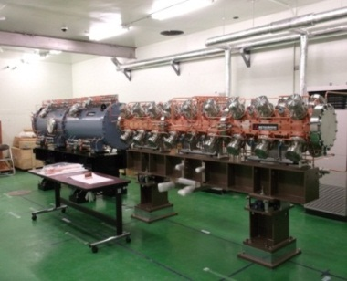
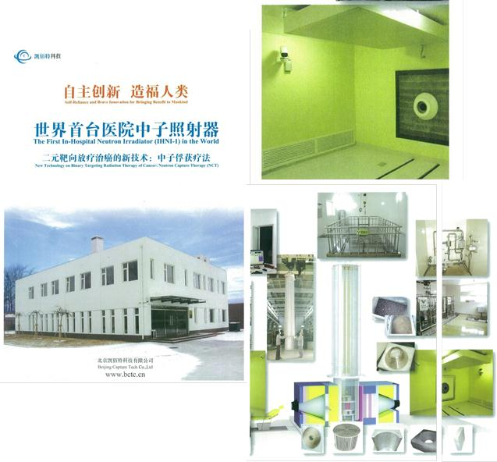
Status of Reactor Based BNCT
Reactor based BNCT
Accelerator based neutron
Source for BNCT
BNCT reactor installed in a hospital in China
It is need to alternate Neutron source for BNCT
●Accelerator is not subject to
as many legal restrictions for
Japanese nuclear regulations
⇒ Patients can receive BNCT
treatment everyday.
● BNCT can be performed in a
hospital, and thus multi-field
irradiation and fractionated
irradiation become to possible.
● The treatment can upgrade
to advanced medical care.
●It is impossible for establishment
to medical car. (Study only)
●Reactor has to be stopped about
a few month due to maintenance.
● In Japan, the number of the BNCT
facilities was only two, and
unfortunately JRR-4 has stopped by
the huge earthquake in this year.
●It is difficult to develop new
reactor based BCNT facility
Notes:
At present, BNCT clinical trials are performed using research reactors in world-wide.
As I said, results obtained from the clinical trials proved effectiveness of BNCT for the intractable cancer.
However, the reactor based BNCT has many concerns.
First of the reasons, it is impossible to establish to medical care as advanced medical treatment and insurance medical treatment because reactor can not be certified to official medical device.
And in particular in Japan, operation of reactor has to be stopped a few month after 1 year operation in order to get a next operation license. So, clinical trials can not be continued, even if patient is waiting.
In Japan, two BNCT facilities as KUR in Kyoto university and JRR-4 in JAEA were operated. But unfortunately JRR-4 has stopped by the huge earthquake befallen Japan in this year.
Thus at present, the only remaining BNCT facility is KUR.
Under the Japanese regulation for the nuclear and reactor and the social situation, it is so difficult to build a new reactor in particular research reactor in Japan.
In present status depending on reactor, we might not be able to continue BNCT study.
☞ 続き有り
So, alternative neutron source for BNCT are needed.
In response to this situation, development and practical realization of accelerator base neutron source is expected.
Accelerator based neutron source is not subject to as many legal restrictions for the nuclear regulations in Japan.
So, we can operate the facility continuously and then BNCT treatment can be performed everyday.
And development of a neutron source with a compact accelerator enables to perform BNCT in a hospital,
and hereby BNCT in the hospital allows to carry out sophisticated treatment method as multi-field irradiation and fractionated irradiation.
Finally I believe BNCT will establish and can upgrade to advanced medical care and insurance medical treatment in the near future.

Slide 14
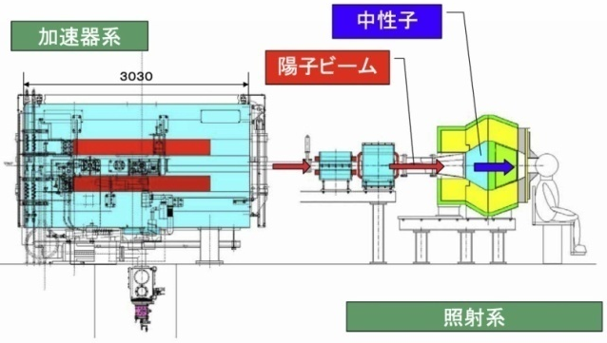
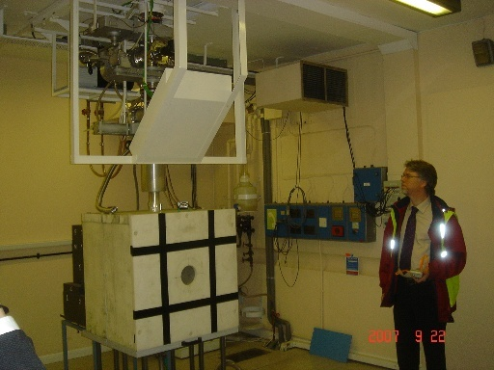
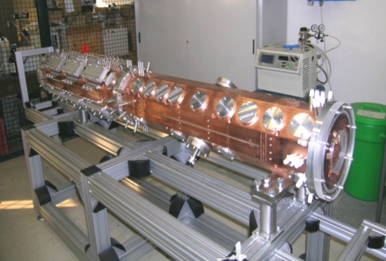
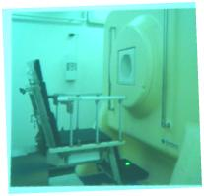
Development of Accelerator based BNCT facility
Some accelerator base BNCT projects are being progressed.
●Cyclotron based epithermal neutron source (C-BENS) in Kyoto University
☞ The BNCT clinical study is being performed using the device!
● Birmingham University in UK: Lithium target + Dynamitron
●INFN in Italy: Linac + Be target
●CNEA in Argentina: Tandem accelerator based neutron source
●National Cancer Center Hospital in Japan : Linac + Lithium target
●Southern TOHOKU Hospital in Fukushima Pre.: C-BENS
●University of Tsukuba in Japan: Linac ☞
C-BENS
in Kyoto
University
TRASCO-BNCT Project
at INFN in Italy
Birmingham University
Notes:
Recent progress of technology for neutron source with accelerator makes it possible to generate enough neutrons for performing BNCT treatment.
So, at present some developments for accelerator based neutron source for BNCT are being worked out in world-wide.
In Kyoto university, cyclotron based BNCT facility has completed as introduced by Dr. Tanaka.
The picture in the middle is neutron beam facility in Birmingham University.
And the right picture shows linac type accelerator of TRASCO-BNCT project in Italy. Maybe, the proton energy of the linac is 5 MeV and maximum power is 150 kW.
In Japan also, some accelerator based BNCT project in addition to the Kyoto University are being progressed.
And national cancer centre hospital in Tokyo and Southern TOHOKU hospital in Fukushima prefecture are being developed accelerator BNCT
And our university of Tsukuba also are being developed a linac based BNCT device.
I show you our development later.

Slide 15
Development of Accelerator based BNCT facility
Location | Machine (Status) | Target & reaction | Beam Energy (MeV) | Beam current (mA)
Budker Institute (Russia) | Vacuum insulated Tandem (Ready) | Solid ⁷Li(p, n) | 2 | 2
iPPE-Obninsk (Russia) | Cascade generator KG- 2.5 (Ready) | Solid ⁷Li(p, n) | 2.3 | 3
Birmingham Univ. (UK) | Dynamitron (Ready) | Solid ⁷Li(p, n) | 2.8 | 1
Soreq (Istael) | RFQ-DTL (Ready) | Liquid ⁷Li(p, n) | 4 | 1
Legnaro INFN (Italy) | RFQ (Under construction) | Be(p, n) | 4-5 | 30
CNEA Buenos Aires (Argentina) | Single ended Tandem Electrostatic Quadrupole (TESQ) (Under construction) | Be(d, n) | 1.4 | 30
 |  | Solid ⁷Li(p, n) | 2.5 | 30
KURRI (Japan) | Cyclotron (Clinical Trial) | Be(p, n) | 30 | 1
Tsukuba (Japan) | RFQ-DTL (Under construction) | Be(p, n) | 8 | 10
NCCenter, CICS (Japan) | RFQ (Under construction) | Solid ⁷Li(p, n) | 2.5 | 20
Fukushima South Tohoku Hospital (Japan) | Cyclotron (Under construction) | Be(p, n) | 30 | 1
Tokyo Institute of Technology (Japan) | Neutron target system only (Under construction) | Liquid ⁷Li(p, n) | ~2.5 | -
Osaka University (Japan) | Neutron target system only (Under construction) | Liquid ⁷Li(p, n) | ~2.5 | -
Reference:ICNCT-15, “Accelerator-Based BNCT”, A. J. Kreiner
Notes:
Basic of this table was shown by Prof. Kreinaer in Argentina in ICNCT-15 as the international congress of BNCT.
Kyoto university group with Sumitomo Heavy Industry and Stella-pharma corporation is already performing clinical trials with the cyclotron based BNCT facility.
Both projects of groups of Tsukuba university and national cancer center are being ran smoothly. Regarding the Tsukuba university, I show you in detail later.
And cyclotron based BNCT device of Sumitomo Heavy Industry will be also installed into South TOHOKU hospital in Fukushima Prefecture. At present, building and device are being produced, the accelerator will be installed to the building next year.
In last year, we were surprised with an announcement released by Osaka university and Sumitomo Corporation. They developed an neutron source system with liquid lithium target, and then performed to generate neurons with the device combined with an accelerator in Birmingham university.

Slide 16
Selection for target material and proton energy
The technology chosen for the accelerator should be based on a feasibility study of the target system.
Several combinations of accelerator and target system have been proposed to realize an accelerator-based BNCT.
Typical combinations can be classified into three groups in Japan:
Low energy (<3 MeV), high current Linac with a lithium target,
A 30 MeV cyclotron with a beryllium (Be) target.
Low energy and high current proton with beryllium target
For the case (b) approach, Kyoto University and Sumitomo Heavy Industries Ltd. have employed. They began clinical investigations on patients.
We selected (C) methodology. At first we have selected Beryllium as neutron target material. And the proton beam energy and power have been set 8MeV and 80kW in order to achieve the goals of neutron intensity described above.
Notes:
The technology chosen for the accelerator should be based on a feasibility study of the target system.
Several combinations of accelerator and target system have been proposed to realize an accelerator-based BNCT.
In Japan, typical combinations can be classified into two groups:
(a) Low energy as less than 3 MeV with high current proton and a lithium target
(b) High energy proton as 30 MeV with a beryllium (Be) target.
(c) Low energy and high current proton with beryllium target
For case (a), direct production of epithermal neutrons at the target is possible and the moderator can be eliminated or be reduced the volume.
But we arrived a conclusions that management and handling of the lithium target are not easy due to its physical characters, and the activated target brings problems which have not been solved in a way practical for use outside of research facilities.
On the other hand, For the case (b) approach, Kyoto University and Sumitomo Heavy Industries Ltd. have employed. They began clinical investigations on patients.
University of Tsukuba selected (C) methodology. At first we have selected Beryllium as neutron target material. And the proton beam energy and power have been set 8MeV and 80kW in order to achieve the goals of neutron intensity described above.

Slide 17
Selection for target material and proton energy
Goal of neutron beam of our facility
To produce a high flux of epithermal neutrons,
of more than 10⁹ n/cm²/s at beam port,
(b) To keep radiation and activation of components
as low as possible,
(c) To lower the production rate of fast neutrons to reduce
needed shielding materials,
(d) To lower the production rate of gamma ray to reduce
incidental dose to healthy tissue.
These factors are essential that the facility could be built in a hospital. For contaminations of fast neutrons and gamma rays in the beam as the factor (c) and (d), specific target levels are values of international recommendations on IAEA-TECDOC
Notes:
First, to achieve the BNCT treatment in hospital using accelerator, strategic goals and concept of our development has been decided.
(a) To produce a high flux of epithermal neutrons, of more than 10⁹ n/cm²/s at beam port,
(b) To keep radiation and activation of components as low as possible,
(c) To lower the production rate of fast neutrons to reduce needed shielding materials,
(d) To lower the production rate of gamma ray to reduce incidental dose to healthy tissue.
These factors are essential that the facility could be built in a hospital.
For contaminations of fast neutrons and gamma rays in the beam as the factor (c) and (d), specific target levels are values of international recommendations on IAEA-TECDOC.

Slide 18
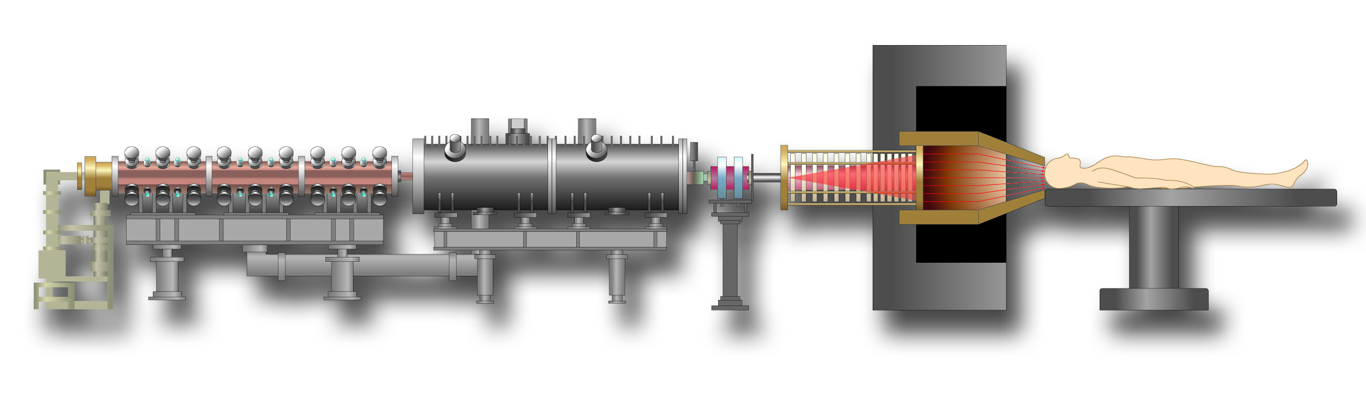
Tsukuba Accelerator based BNCT Project
Project Team : Univ. of Tsukuba, KEK, JAEA, Hokkaido Univ., Ibaraki Pref., Mitsubishi Heavy Industry, etc.
Concept：Realization of BNCT with Safety, Stable & Easy in a Hospital
Research & Development;
● Compact & high power proton accelerator
● Neutron generator with neutron target device, moderator, Collimator and
Shield applicable to NCT treatment.
● Treatment planning system, patient setting, neutron monitor & PG-SPECT.
Moderator
Beryllium Target System
Collimator
DTL
Ion Source
RFQ
Proton
Neutron
Shield
Proton Accelerator
Neutron Source Device
Notes:
So, I introduce you our accelerator based BNCT project.
The project team is formed by specialists in University of Tsukuba, High Energy Accelerator Research Organization (KEK), Japan Atomic Energy Agency (JAEA), Hokkaido University. And Ibaraki Prefecture is supporting us and the prefecture supplied a building for BNCT, I introduce it later. So, we named our project as “iBNCT”. And Accelerator tubes and neutron target system as main equipment of the device are produced by Mitsubishi Heavy Industry corporation.
Concept of our project is “Realization of BNCT in a hospital with safety, stable and easy”.
To develop the accelerator and neutron generator as an expensive devise, we have obtained several national grants.
In the project, we produce a compact & high power proton accelerator as well as neutron generator consisted of neutron target system, moderator and collimator.
And we develop not only accelerator based neuron source but also several devices required BNCT operation such as treatment planning system, patient setting device and PG-SPECT.

Slide 19
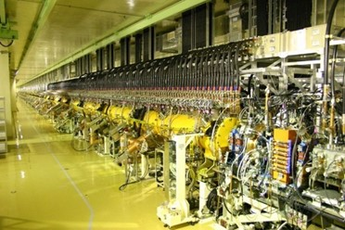
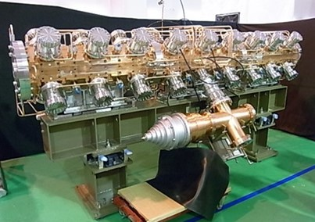
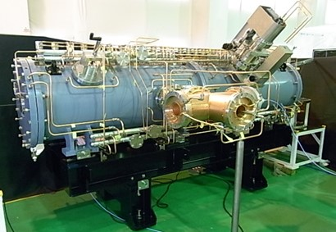
Key Technology1 : Compact Accelerator
Type | RFQ＋DTL Type Linac
Proton Energy | 8MeV
Peak Current | 50mA
Average Current | >5mA （Max.10mA）
Beam plus | 1msec.
Duty | 20%
Power to Target | >40kW （Max. 80kW）
Dimension | Length: <7m, Footprint: <50m²
J-PARC Linac
＋
RFQ Type Accelerator
DTL Type Accelerator
Notes:
Primary subject of the project is development of the accelerator which can drive high current protons.
We selected RFQ and DTL type linac as the accelerator for BNCT.
The linac has been employed technologies of J-PARC as a multi-purpose high performance accelerator installed in Tokai village.
Our linac accelerates protons to 8MeV.
And average beam current is 10mA.
So, the device generates huge beam power as 80kW.
Length of the linac is about 7 meter and footprint is less than 50 square meter.
Design of the linac was carried out by KEK.
And the linac has been manufactured by Mitsubishi Heavy Industry.

Slide 20
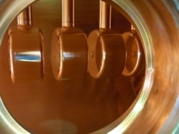
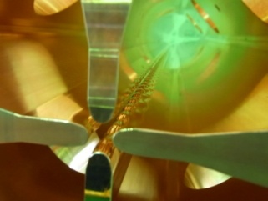
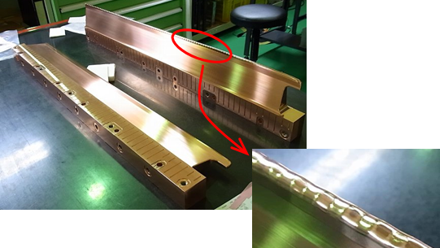
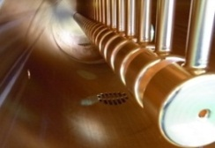
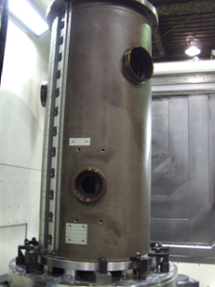
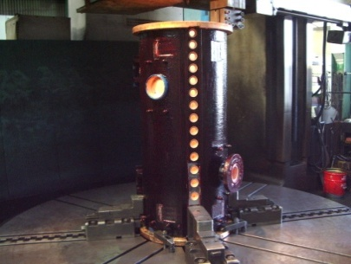
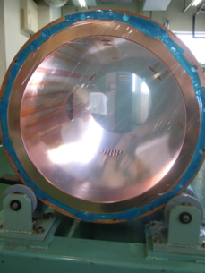

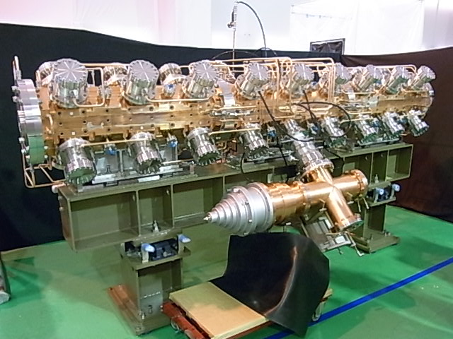
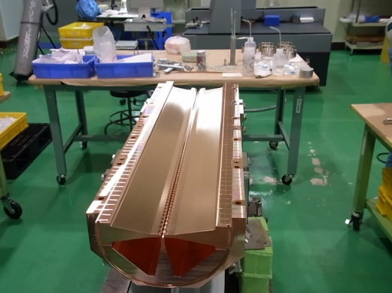
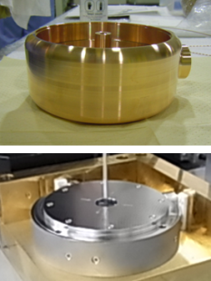
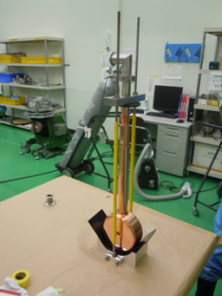


RFQ + DTL of Tsukuba Linac
]]
Inside view of RFQ
Inside view of DTL
Drift Tube
Tuner(Fixed)
RFQ modulation
Machining
Machining and Welding
Copper Plating
Electropolishing
Tuner(Fixed)
RF Coupler
Variable Tuner
RFQ Tank
DTL Tank
Parameters of the DTL
Structure : Drift Tube Linac
Injection energy : 3MeV
Output energy : 8MeV
Length : 3.2m
Number of cell : 31
DT type : Permanent Magnet
RF Frequency : 324MHz
RF Power : 530kW(peak),20%duty
RF Coupler
Parameters of the RFQ
Structure : 4-vane type RFQ
Injection energy : 50keV
Output energy : 3MeV
Length : 3.2m
RF Frequency : 324MHz
RF Power : 570kW(peak),20%duty
Assembling
DT Cell and Magnet
Chemical polishing
Assembling of RFQ tank
Manufacturing process of RFQ
Manufacturing process of DTL
Notes:
These pictures shows manufacturing process of the RFQ tube.
The RFQ was produced in a factory of Mitsubishi heavy industry corporation. Finally the RFQ tube was completed in this year.
Length of the RFQ tube is 3.2 meter.
The output energy of proton through the RFQ is 3MeV.
☞
Next I shows manufacturing process of the DTL tube.
The DTL has 31 cell inside the tube. And to reduce production costs, permanent magnets have been employed.
The proton with 3MeV energy from the RFQ is accelerated further through the DTL, finally the energy of the proton is reached to 8MeV.

Slide 21


Design of Moderator, Collimator & Shield
Neutron
Generator
Beam Performance in Free Air | Neutron Flux (n/cm²/s) |  |  | Gamma-ray Dose (Gy/h) | Contamination Rate (Gycm²/n)
 | Thermal (<0.5eV) | Epithermal (0.5eV<E <10keV | Fast (>10keV) |  | Fast neutron dose per epithermal neutron | Gamma-ray dose per epithermal neutron
Tsukuba Linac （at 80kW) | 8.78x10⁷ | 4.31x10⁹ | 5.17x10⁸ | 0.44 | 5.61x10⁻¹³ | 2.83x10⁻¹⁴
JRR-4 (3,500kW) | 2.94x10⁸ | 1.27x10⁹ | 4.97x10⁷ | 0.50 | 3.10x10⁻¹³ | 3.00x10⁻¹³
Conceptual Design with
Monte-Carlo analysis
Accelerator
Tsukuba Acc. NCT
JRR-4
Fast Neutron Filter
Moderator
Collimator
Beryllium
Target
Beam Port
Proton Beam
Thermal
Neutron Filter,
Gamma Shield
Spectrum for both of JRR-4 and a test
model of Tsukuba Acc. NCT Device.
Shield
Notes:
We are also designing not only beryllium target system but also moderator, collimator and radiation shield.
Below left figure shows schematic of cross section view of the neutron generator.
Monte-Carlo analysis to determine conceptual design of the device is being performed.
In the analysis, first, neutron spectra at beam port are determined by Monte-Carlo calculation while changing the parameters of material, dimension and shape of each component of the device.
Right figure shows a neutron spectra of both of JRR-4 epithermal neutron beam and our neutron source under a condition.
⇒
This table is comparison data with JRR-4’s beam performance.
We recognized from the calculations that the neutron generator with 80kw proton can provide enough epithermal neutron flux. In case of that the 10mA proton is irradiation to the device, the maximum epithermal neutron flux at the center of beam port is about 4.3 x 10⁹.
Almost of the moderator design has been fixed in this month.
We start to produce the neutron generator device.
And initial version of beryllium target system is also producing now.

Slide 22





Tsukuba’s BNCT facility “iNMRC”
Irradiation
Room
Ion Source
Irradiation Room
RFQ
Accelerator Room
Klystron installed in
Power supply room
DTL
Proton
beam
Ibaraki Neutron Medical
Research Center
(iNMRC)
Accelerator installed in
Accelerator room
Notes:
We has acquired a building to perform BNCT clinical trials using the accelerator. The building where locates in Tokai Village is managed by Ibaraki prefecture.
The building has some room with sufficient shield because the rooms had been utilized to RI production using baby cyclotron in past days.
Tsukuba University is borrowing it and now the devices are being installed.
Middle figure is schema of cross section view of the facility
Accelerator room is here. レーザーポインター
Linac has been installed in the room.
Irradiation room is here. レーザーポインター
Proton beam emitted from the Linac is bended to right and delivered to irradiation room through a separation wall. The proton beam bends to right again and finally the beam is irradiated to beryllium target.

Slide 23
Development of a new multi-modal radiation
treatment planning system
Notes:
Next, I introduce current status of the development of our treatment planning system briefly.

Slide 24





Treatment Planning System for BNCT
JCDS (JAEA Computational Dosimetry System)
User Input
医療画像
Medical Images
Clinical
Trials
CT Data
Neutron
beam
MRI Data
Treatment
Planning
MRI Data
Create a Detailed Three
Dimensional Head Model
JAEA Computational
Dosimetry System
(JCDS)
Dose distributions
140
Normal
Tissue
Neutron
beam
120
CT Data
100
80
Volume
BNCT
Calculation
Conditions
Beam Spectrum
Head Position
･Distance
･Radiation Area
･Direction etc.
60
Tumor
40
20
0
1
2
3
4
5
6
7
8
9
Dose
10
11
12
13
14
15
16
17
18
19
20
21
Dose Volume Histogram
Convert to Voxel Model
Generate a
Calculation Data
Output of the Dose
Calculation Results
Monte-Carlo Code MCNP
Notes:
In order to perform BNCT treatment based on an optimum treatment plan, JAEA had developed JCDS, as a Monte-Carlo based treatment planning system for BNCT.
This flow chart indicates process of the treatment planning of BNCT using JCDS.
→
To simulate the BNCT irradiation, JCDS creates a three-dimensional model using CT and MRI images of a patient.
Then, the three-dimensional model is converted into a voxel calculation model in order to perform transport calculations effectively.
→
Several neutron doses and gamma-ray dose are computed by Monte-Carlo transport code, MCNP.
Finally, JCDS determines dose distributions and dose volume histogram which are required to dosimetry of the treatment.

Slide 25
iBNCT group:
industry-government-academia research group
Tsukuba University
Project management
JRR-4
Medical system
Monitoring
KEK
Accelerator
Target
Moderator
Collimator
Rad. shielding
Hokkaido University
Neutron science, moderator
JAEA
JRR-4
moderator design
Radiation safety
Mitsubishi heavy industries LTD.
Manufacturing
NAT, ATOX, CosyLab, Taiyo Valve, Toyama, Nihon Koshuha, NEC/Tokin,,,,,many companies are involved
Ibaraki prefecture

Slide 26




Basic idea of i-BNCT
Spin off of J-PARC frontend injector linac technology
RF design is based on J-PARC design
DTL: Drift Tube Linac
RFQ
DTL
RFQ
i-BNCT linac

Slide 27


Ibaraki BNCT Construction Site: Ibaraki Neutron Medical Research Center, adjacent to J-PARC site (but not J-PARC)

Slide 28


Ibaraki Neutron Medical Research
Center
Klystron & power supply room
Irradiation room
Accelerator room
Ibaraki prefectural building
Neutron Medical Research Center,
A remodeling building from tele-com. Company, NTT
➔ Building is Not optimized for BNCT

Slide 29


Main parameters of i-BNCT linac;
8MeV, 80kW High duty proton Linac
Peak current: 50mA
Pulse width: 1ms
Repetition rate: 200Hz
Duty factor: 20%
RF frequency: 324MHz
RFQ + DTL + 1.2MW klystron
Beam size expansion
Beryllium target
Moderator
Collimator
Radiation shielding

Slide 30
Aiming "hospital friendly BNCT"
:very low residual radioactivity

Slide 31


Beryllium or Lithium?
In case of Li, the cross section is very attractive,
Sharp rise below 2.5MeV
Neutron energy spectrum is fine (< 300keV)

Slide 32
target material: priority: hospital friendly
Beryllium: No residual radioactivity
for 8 MeV proton
Lithium : ⁷Li(p,n)⁷Be & ⁶Li(n,t)⁴He
⁷Be has 53 days T_{1/2} and high radioactivity
Tritium should be avoided for hospital use
Melting temperature is only 180 ℃
Chemically very active
our decision: Beryllium target +8-MeV proton

Slide 33
Energy selection
How we decide the beam energy

Slide 34
IAEA GUIDELINE
Epithermal (0.5eV-10keV): 10⁹n/(s・cm²)
to get moderate irradiation time.
need to reduce following accompanying beam:
IAEA-TECDOC-1223
Fast neutron >10 keV
2x10⁻¹³ Gy cm² per epithermal neutron
Gamma rey
2x10⁻¹³ Gy cm² per epithermal neutron
Ratio between thermal flux and epithermal flux
0.05

Slide 35


Energy and neutron production
Neutron flux
higher energy: produce higher neutron flux
lower energy: better epi-thermal efficiency
by Y. Hashimoto, Hokkaido Univ.

Slide 36
Residual Radioactivity vs Proton Energy
Copper case
62Cu
60Co
64Cu

Slide 37



steel
lead
8MeV proton ➔ neutron energy < 6MeV
We can avoid many nuclear reaction channels
Low residual radiation

Slide 38
Energy selection
8 MeV was chosen

Slide 39

residual radiation
operation
daily op. ： 2hour（30min×2、1hour×1） / day
week ： 5days （except weekend）/ week
year ： 50weeks（350days）
Beam power
・・・・
Time

Slide 40


residual radiation
Patient side
during operation
100μSv/h

Slide 41
Target development
  Crucial items for 8-MeV proton and Beryllium Target
  blistering
  heat removal

Slide 42

Target thickness of i-BNCT: 0.5mm ➔ not enough mechanical strength as a beam window
Bragg peak depth for various proton energy
8MeV
13MeV
Target thickness of Kyoto: 5.5mm
Mechanical strength is enough as
a beam window
30MeV

Slide 43


Kyoto-Sumitomo
Kyoto system
Be
5.5mm
Cooling
Water
Be target strength is enough for a beam window
Beam stops in cooling water, blistering free!!
Proton beam
Easy fabrication & blistering free

Slide 44


Ibaraki target (separated function)
Target thickness is 0.5mm
➔ needs backup plate for beam window
Backup layer
Proton beam
Heat sink
with cooling
water channel
Be
Blistering
mitigation metal

Slide 45
8-MeV Target
Separated function target
top: neutron production
middle: beam stop and blistering mitigation
back: heat sink (water cooling)
Three layer target

Slide 46



Close-up SEM picture
of diffusion bonding
layer boundary
A kind of
diffusion bonding
Very thin reaction zone
①
②
③
Bragg peak depth
50 μm

Slide 47


Thermal conductivity measurement
thermometer
Laser pulse
Be
Cu
Direct measurement of heat conductivity of three layer metals
with laser-flash method
200 W/(m/K) ➔ Good enough for the practical use

Slide 48
Water cooling of high-density heat load
Surface temperature of the top layer is determined with
steady state energy flow from the surface to the heat sink
80kW
Cooling water
150 l/min., 30℃
Heat sink
30℃+8℃=38℃
heat load 4.5MW/m²,
heat transfer in nucleate boiling region.

Slide 49


Simulation of target temperature
316 ℃
x
②
z
①
Temperature: surface to cooling pipe

Slide 50


Target manufacturing
180mm
Target and moderator
Three layer target

Slide 51
IAEA GUIDELINE
Epithermal (0.5eV-10keV): 10⁹n/(s・cm²)
to get moderate irradiation time.
need to reduce following accompanying beam:
IAEA-TECDOC-1223
Fast neutron >10 keV
2x10⁻¹³ Gy cm² per epithermal neutron
Gamma rey
2x10⁻¹³ Gy cm² per epithermal neutron
Ratio between thermal flux and epithermal flux
0.05

Slide 52

air
Radiation shield
moderator
γ,n absorber
reflector
heavy-metal
Heavy-metal
Radiation shield
Reflector
Radiation shield
Radiation shield
Radiation shield
Moderator design (Plan view)

Slide 53

i-BNCT, much better than JRR-4 (more than 4-times)
Simulation:
4.66×10⁹ n/s/cm²
Real data

Slide 54



Characteristics of BNCT linac:
High duty linac
J-PARC: 2.5%
BNCT: 20%
High current linac
50mA peak
10mA average
Construction started 2011

Slide 55


Accelerator status
Installation has just finished
Ion source tuning has started

Slide 56

Irradiation room

Slide 57



Main parameters of i-BNCT linac;
8MeV, 80kW High duty proton Linac
Peak current: 50mA
Pulse width: 1ms
Repetition rate: 200Hz
Duty factor: 20%
RF frequency: 324MHz
RFQ + DTL + 1.2MW klystron
Beam size expansion
Beryllium target
Moderator
Collimator
Radiation shielding

Slide 58



Klystron modulator by DAWONSYS in Korea
High repetition rate (200Hz)
Long flat pulse with droop compensation circuit (1ms)

Slide 59
Conclusions
● iBNCT project team headed by Tsukuba university is
developing a new accelerator based BNCT device together with
several organizations and Mitsubashi Heavy Industry Co.
● The device allows to installed in a hospital and to generate
enough neutrons for BNCT.
● We will begin to conduct BNCT using the device
as advanced medical care in the near future.
Schedule:
2014 Spring : Assembling the accelerator
2014 Autumn : Commissioning of the accelerator
2015 Spring : Generating neutrons
2015 Autumn : Cell and animal irradiation
2016 Spring : Clinical trials of BNCT
ご清聴有難うございました。
Thank you for your attentions!!
Notes:
I summarize my presentation.
iBNCT project team headed by University of Tsukuba is developing a new linac based BNCT device together with several organizations.
The proton linac was just assembled in this Spring. Now we are doing commissioning work of the accelerator.
The neutron source for BNCT with the linac will be completed by next Spring.
After several measurements and verifications, we expect to begin performing clinical trials of BNCT using the device.
Don’t miss it!
☞
Thank you for your attentions

