Slide 1
ESRF Operation Status Report & Phase I and II
Accelerator Upgrade Programme
P. Raimondi
On behalf of the Accelerator & Source Division
Saclay, September 25 - 2014

Slide 2
Accelerator and source division (ASD) programme
Deliver the X-ray Beam to the USERs > 5000 hours/year
Deliver the Accelerator Phase I Upgrade Programme
Implement the proposed Accelerator Phase II Upgrade Project
The ASD has the additional duty of constantly improving
the performances and reliability of the Source independently
from the Upgrade Programmes.
Page 2

Slide 3
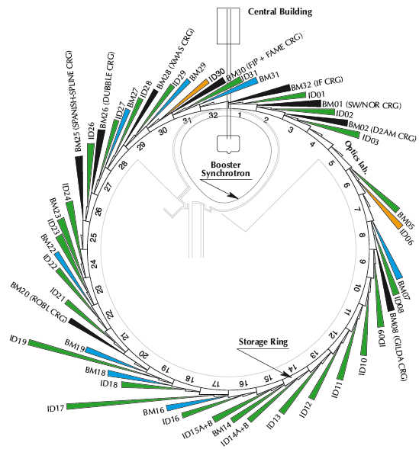
The ESRF today
Storage ring
6GeV, 844 m
Energy | GeV | 6.04
Multibunch Current | mA | 200
Horizontal emittance | nm | 4
Vertical emittance | pm | 3.5
Booster synchrotron
200 MeV ➔ 6 GeV
300m, 10 Hz
32 straight sections
DBA lattice
42 Beamlines
12 on dipoles
30 on insertion devices
72 insertion devices:
55 in-air undulators, 6 wigglers,
11 in-vacuum undulators, including 2 cryogenic
E- Linac
200 MeV

Slide 4
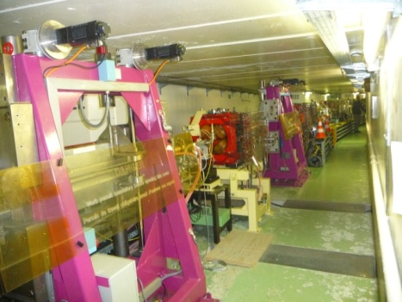
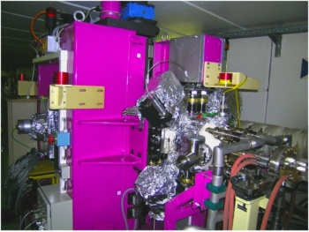
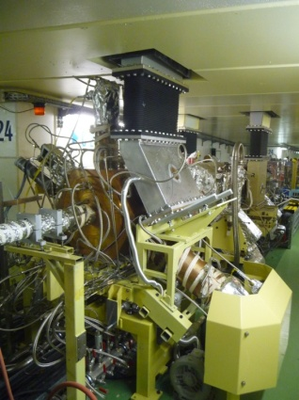
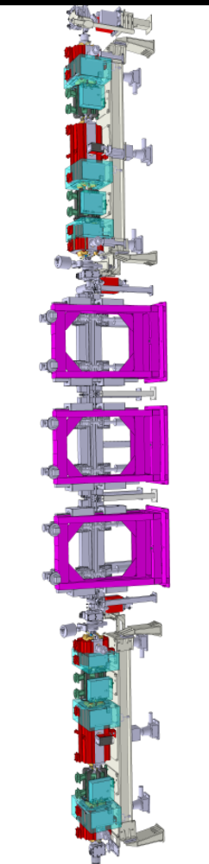
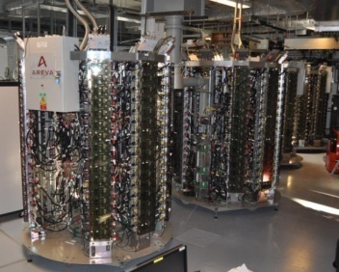
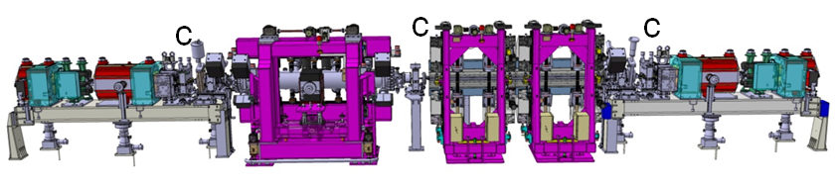
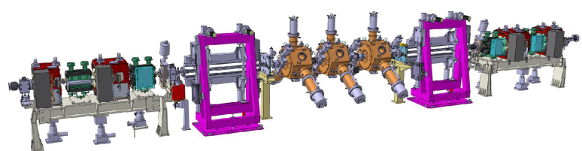
Accelerator Upgrade Phase I 2009-2015 Main Projects
Done
Upgrade of BPM electronics
  Improvement of the beam position stability
  Coupling reduction
6 m long straight sections
Cryogenic in-vacuum undulators
7 m straight sections
New RF SSA Transmitters
New RF Cavities
Top-up operation
Studies for the reduction of the horizontal emittance
Done
Done (4pm)
CPMU
7 metre
ID23
Done
Single cell HOM damped cavity
Done
Done
Done
Done
SSA
Project ongoing
Standard cell
TDS completed
6 metre canted ID16
7 metre ID23
Page 4

Slide 5
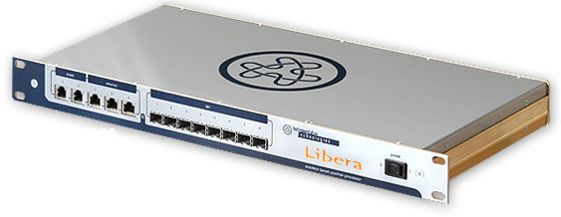
Upgrade of BPM Electronics
Slow Acquisition
(10 Hz, orbit correction)
Turn by Turn
(355 kHz, for lattice studies)
First Turn mode
(For injection tuning)
224 Libera
Brillance
Post-Mortem
(Data loging on trigger)
Fast Acquisition (10 kHz)
For fast global orbit correction
Sum signal of the 4 buttons:
  Lifetime monitor
  Instant Fractional-Beamloss monitor

Slide 6
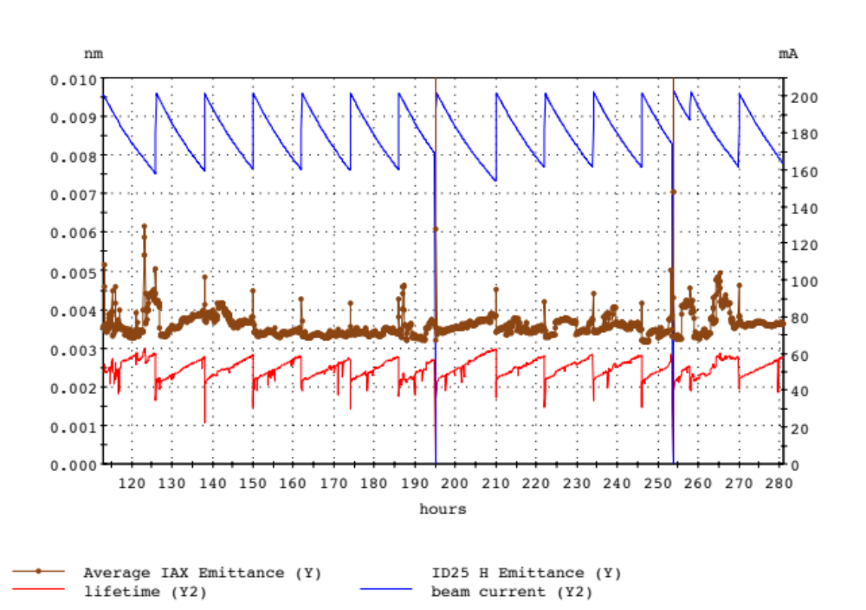
Coupling reduction
Maintaining low emittance during USM: 1 week delivery
Current
200 mA
Vertical emittance
3.5 pm
50 hours
Lifetime
@ Vertical Diffraction Limit reached routinely

Slide 7
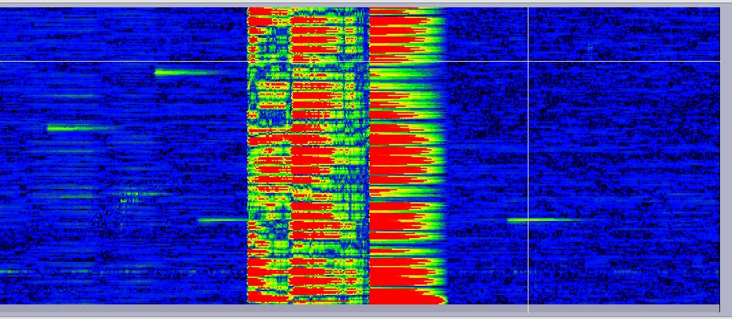
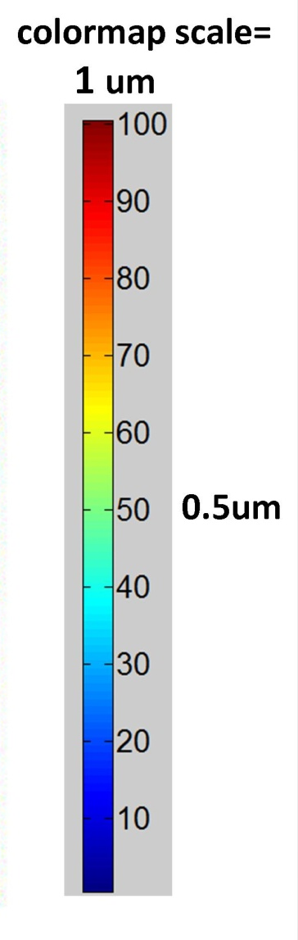
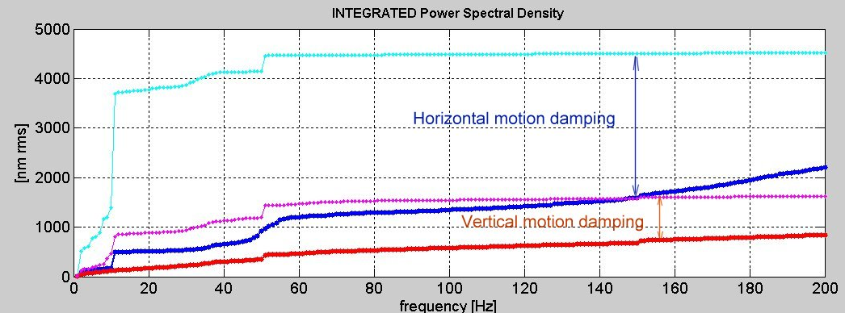
New orbit feedback
Cell1
rms
ID11
ID17
224 BPM
Feedback OFF
ID27
Cell32
8 mn
Horizontal OFF
Horizontal ON
Vertical OFF
Vertical ON
2.5 μm
0.9 μm
~0.1μm stability routinely achieved in V
~1.0μm stability routinely achieved in H

Slide 8
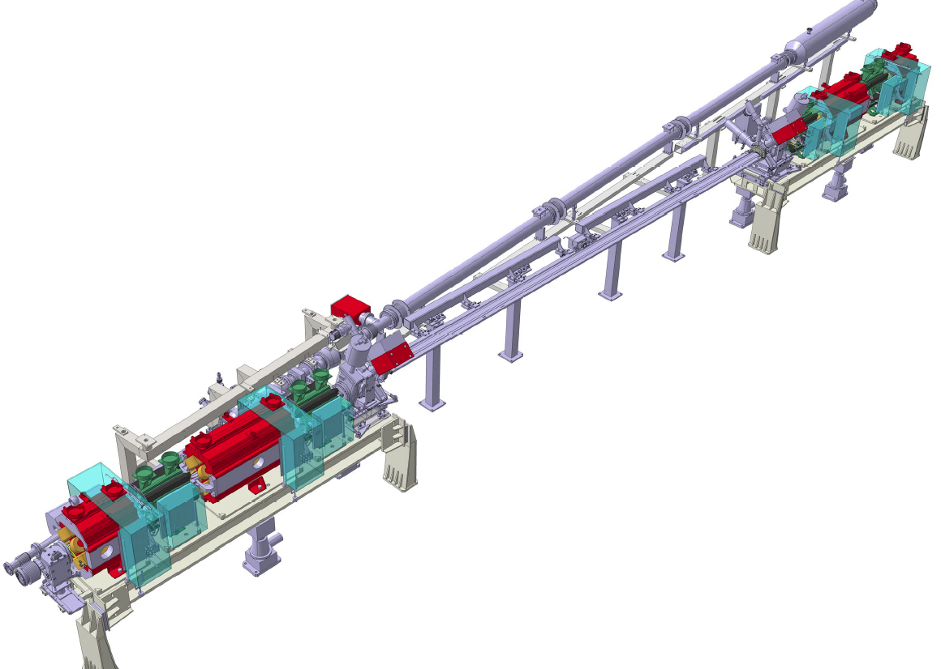
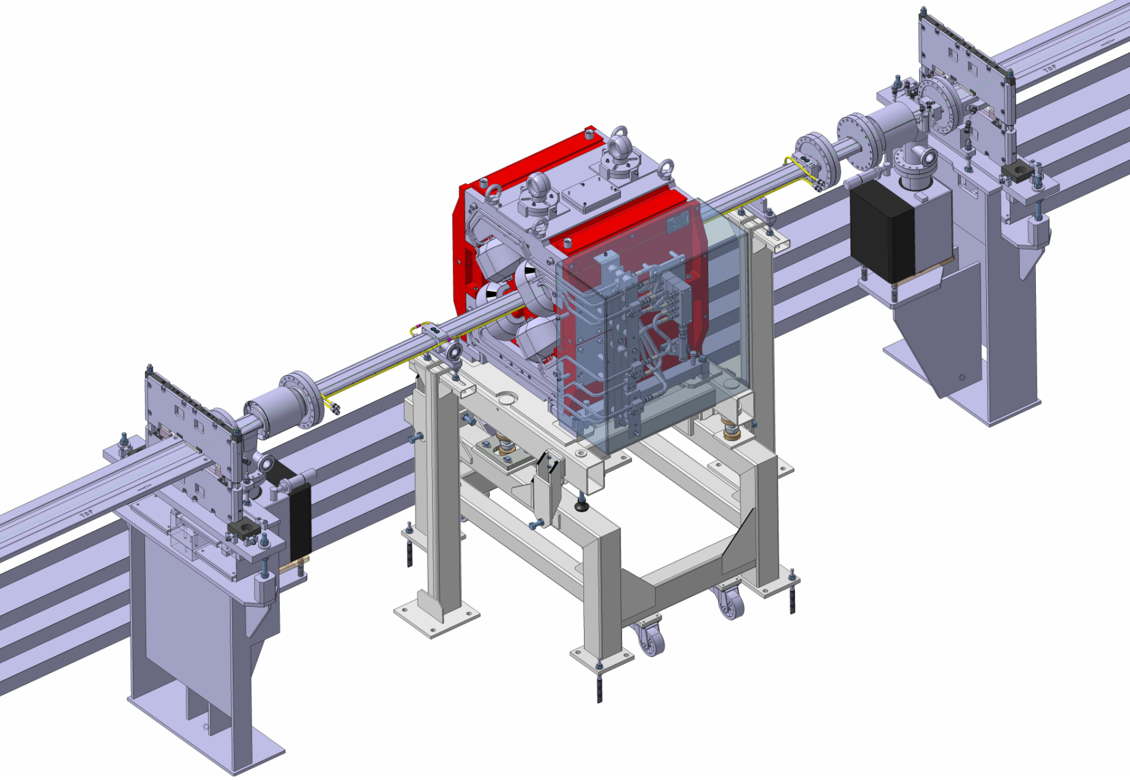
6&7 m straight sections
5 metre standard Section
7 straight sections already converted to 6 metres
First large canting installation this summer
6 metre Section (6173 mm)
7 metre Section
First 7 m straight section next winter shutdown
Test of mini beta optics during first half 2013
Installation of the RF cavities during second half 2013

Slide 9
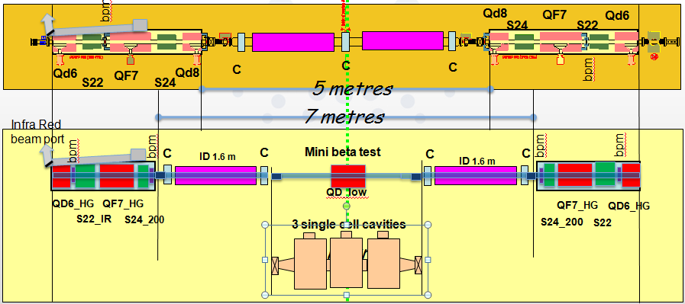

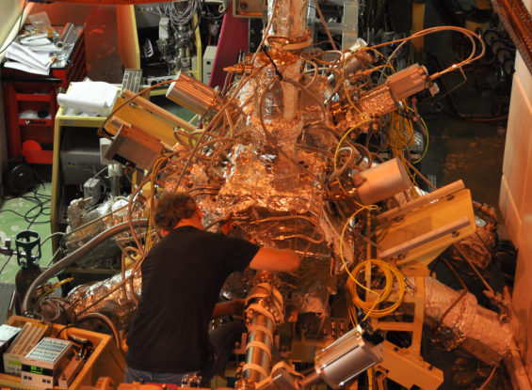
PHASE 1: 7 meters long straight section
Courtesy of JL Revol
Test of mini beta optics during first half of 2013
Two Mono-cell cavities installed in August 2013
First 7 m straight section operational in January 2013
Create 2 lower vertical beta points to reduce the in-vacuum undulator gap from 6 to 4 mm
Redistribute RF cavities to install undulators in the present dedicated RFstraight sections

Slide 10
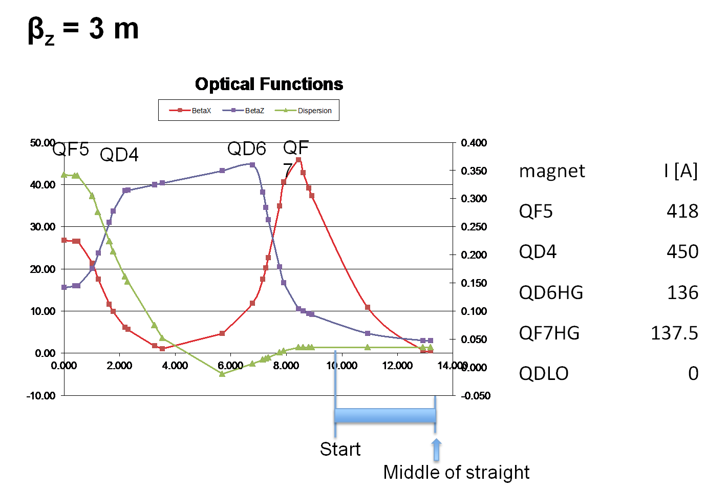
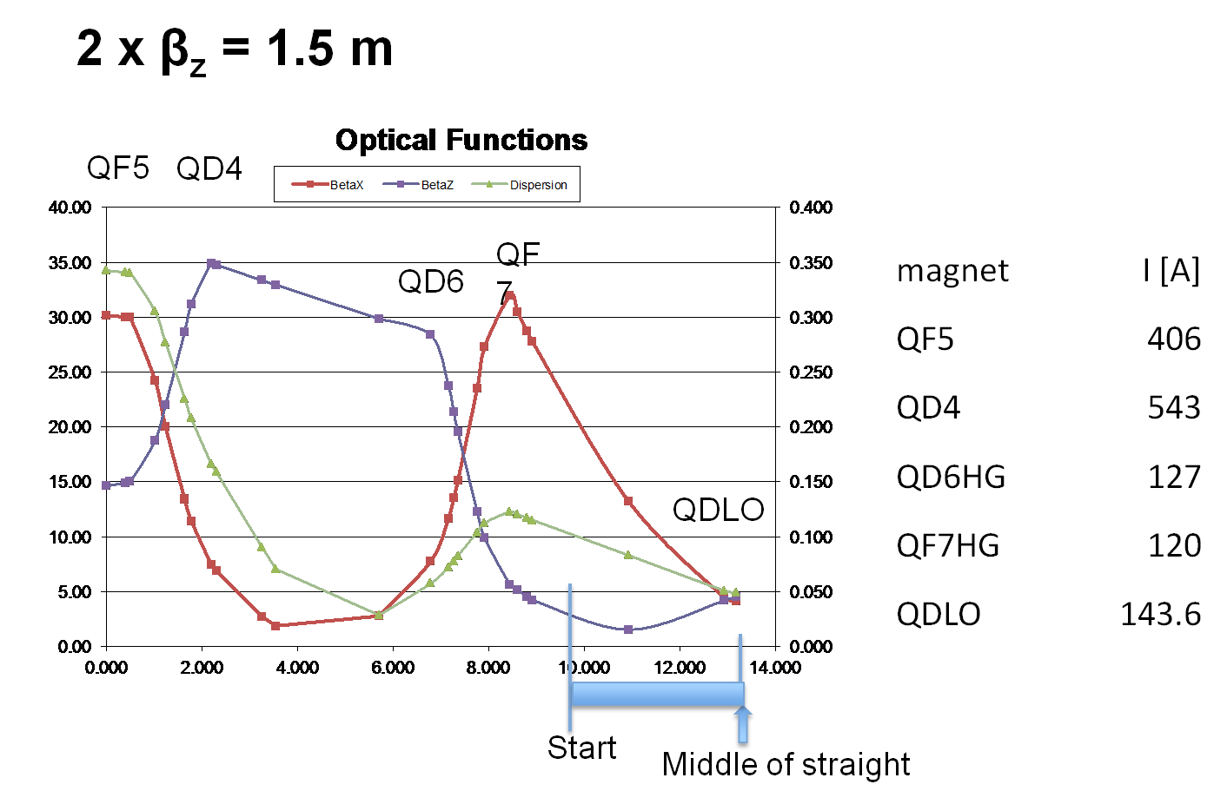
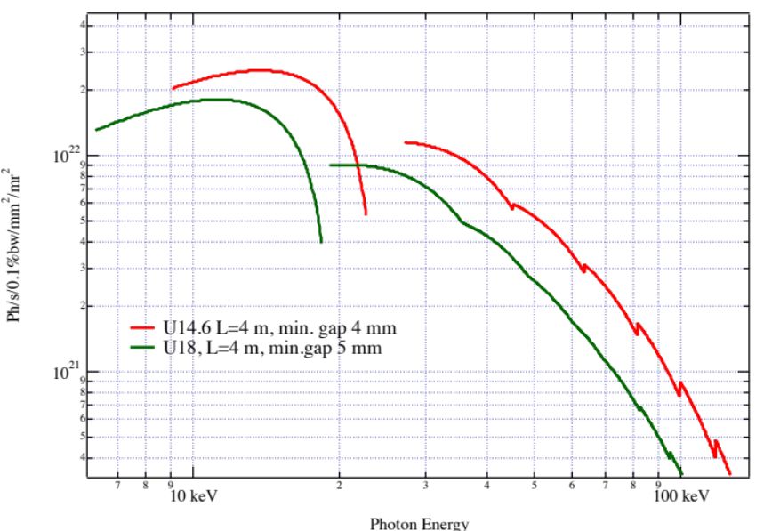
MINI BETA TEST VERY SUCCESSFUL
Possible to break the lattice periodicity with small reduction in lifetime ( 20% according to predictions)
Mini beta means that the vertical size across the undulator is smaller =>
ID gap and ID period reduction =>
Brightness Increase
Page 10

Slide 11
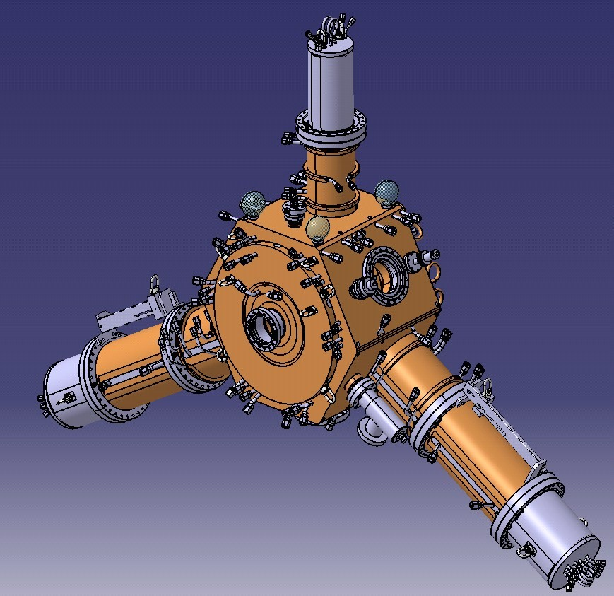
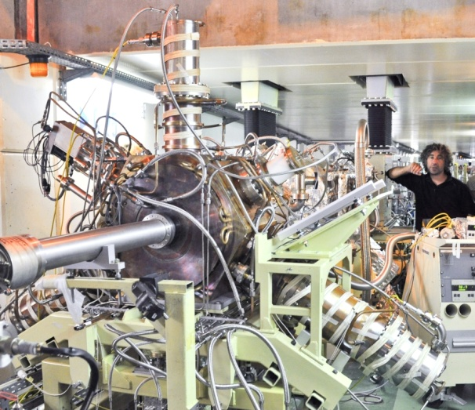
Single cell NC HOM damped cavity
9 MV with 12 to 18 cavities (4.7 ± 0.4 MΩ)
Planned operation at 300 mA
Power capability to sustain up to 500 mA
No HOM up to 1 A
Goal:
RF distribution to create a new experimental station
Prepare future upgrades
HOM absorbers:
Ferrite loaded tapered ridges
3 power prototypes
under test at ESRF
352 MHz
HOM dampers = ridge waveguides
Based on 500 MHz BESSY, MLS, ALBA design [E. Weihreter et al.]
ESRF 352.2 MHz design: several improvements

Slide 12
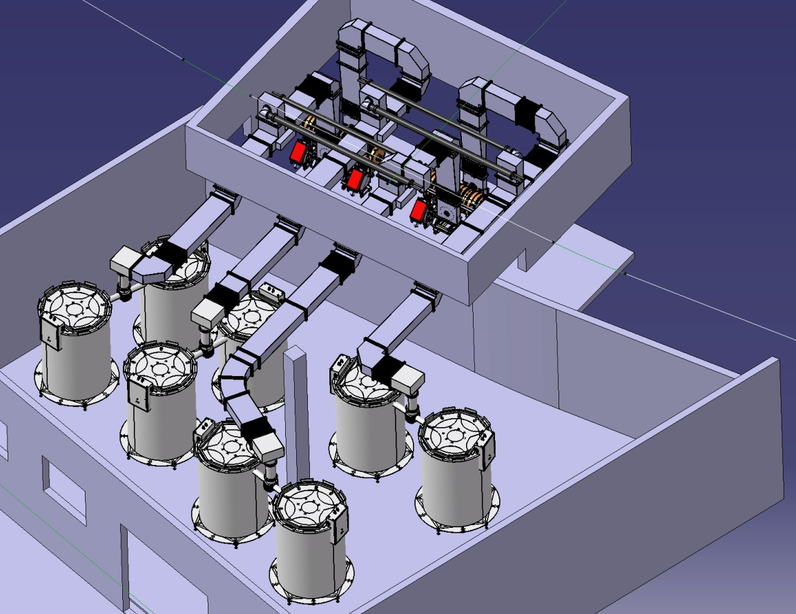
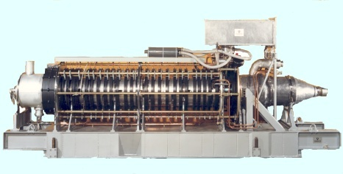

Solid State RF transmitters
Klystrons at l’ESRF
2 five-cell cavities
x 2 couplers
1.3 MW -352MHz
4 Waveguide switches to
4 water loads
Goal:
Prevent klystron obsolescence
Prepare future upgrades
SY: Booster Synchrotron
75 kW tower of
128 RF modules
Booster RF :
Four 150 kW amplifiers in operation
Replacing one 352.2 MHz 1.3 MW
klystron booster transmitter
SYRF now ready for TopUp operation,
(Electrical power reduced from 1200 to 400 kW).

Slide 13
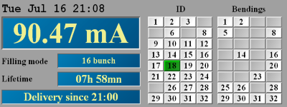
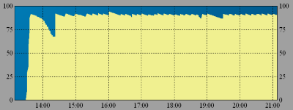
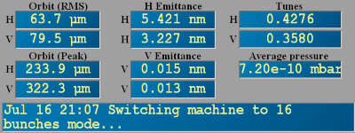
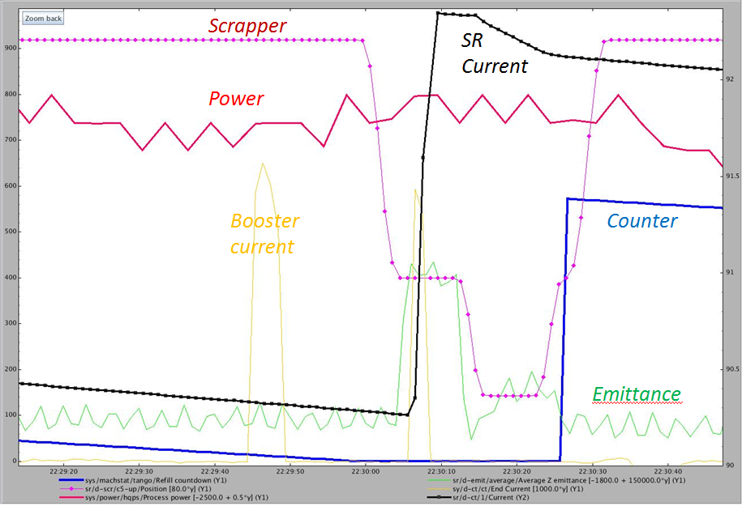
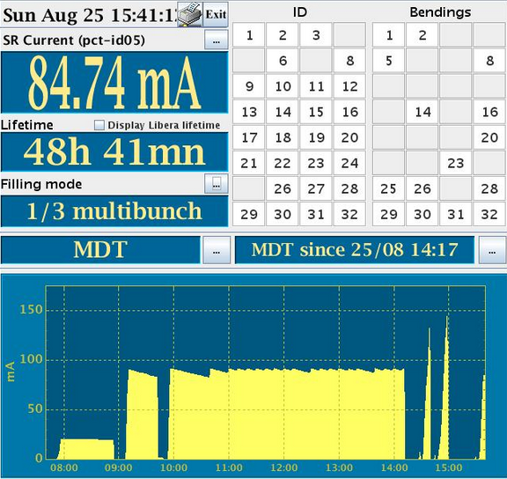
PHASE I: top-up feasibility
Optimise the topping sequence
Check the injector reliability
Reduce the injection time
20 seconds
Top-Up Operations will start at
beginning of 2016
Page 13

Slide 14
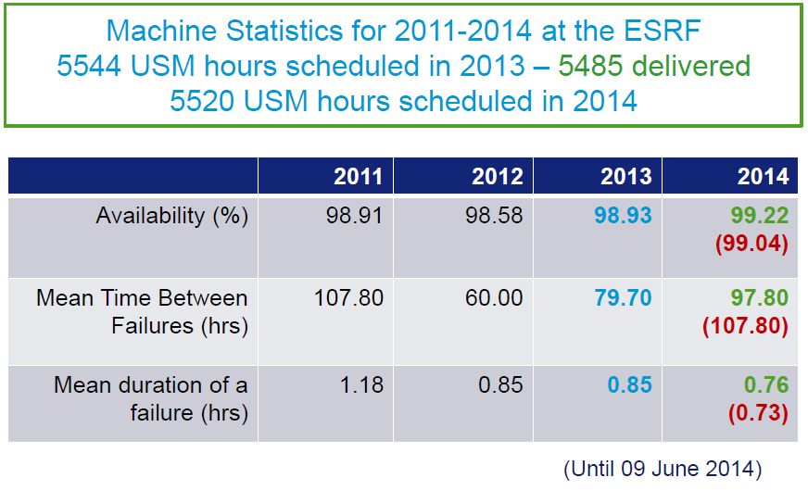
Operation statistics through phase I Up implementation
Despite the Phase I activities…
machine performances kept to record levels!
Page 14

Slide 15
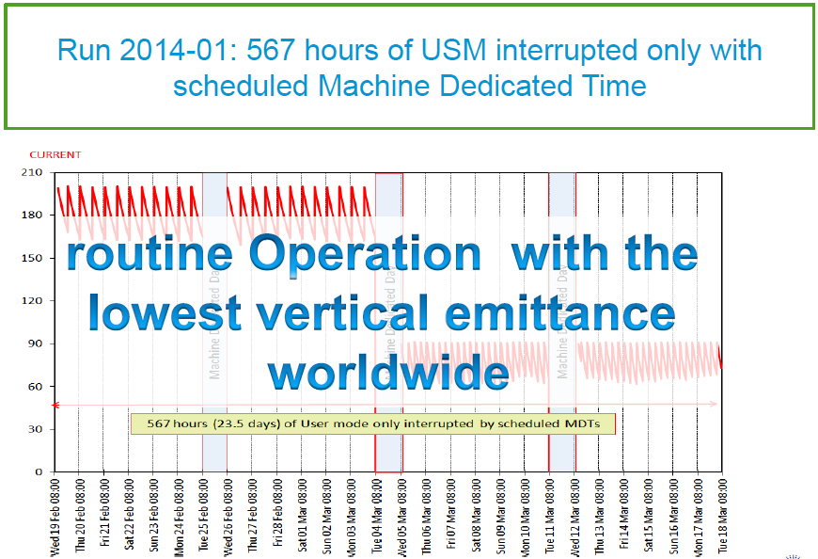
OPERATION STATISTICS

Slide 16
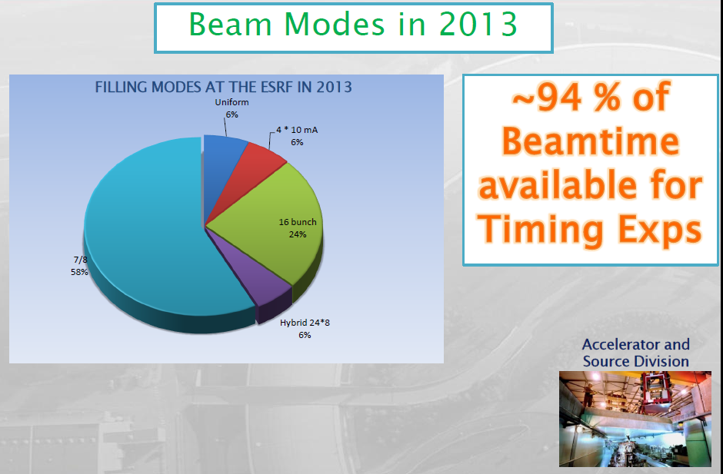
OPERATION STATISTICS

Slide 17
Main hardware activities programmed for the period 2014-2016
Spares: Linac Modulator, Buncher, Accelerating Structures
2 Extra cavities in the Booster
Bunch cleaning in the Booster
New Bpms electronics and orbit control (movers) in the Booster
New Booster Power Supply
12 HOM Cavities in the SR
Phase II prototyping: Magnets, Vacuum Components, Diagnostic etc…
Conditioned to maintain
Record Performances Operations!
Page 17

Slide 18
Accelerator Upgrade Phase II
The Accelerator Upgrade Phase II aims to:
- Substantially decrease the Store Ring Equilibrium Horizontal Emittance
Increase the source brilliance
Increase its coherent fraction.
In the context of the R&D on “Ultimate Storage Ring”, the ESRF has developed a solution, based on the following requirements and constraints:
Reduce the horizontal equilibrium emittance from 4 nm to less than 150 pm
Maintain the existing ID straights and beamlines
Maintain the existing bending magnet beamlines
Preserve the time structure operation and a multibunch current of 200 mA
Keep the present injector complex
Reuse, as much as possible, existing hardware
Minimize the energy lost in synchrotron radiation
Minimize operation costs, particularly wall-plug power
Limit the downtime for installation and commissioning to 19.5 months.
Maintain standard User-Mode Operations until
the day of shut-down for installation
Page 18

Slide 19
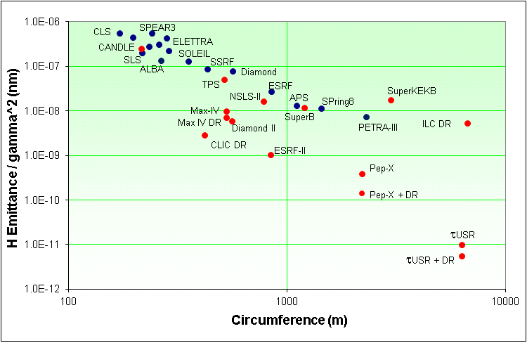
Low Emittance Rings Trend
Based on 1980 KnowHow
Based on state of the art
technologies
Sirius
APS
SPring8
Existing machines
In Construction
Advanced Projects
Concept stage
Several facilities will implement
Low Horizontal Emittance Lattices
by the next decade
Page 19

Slide 20
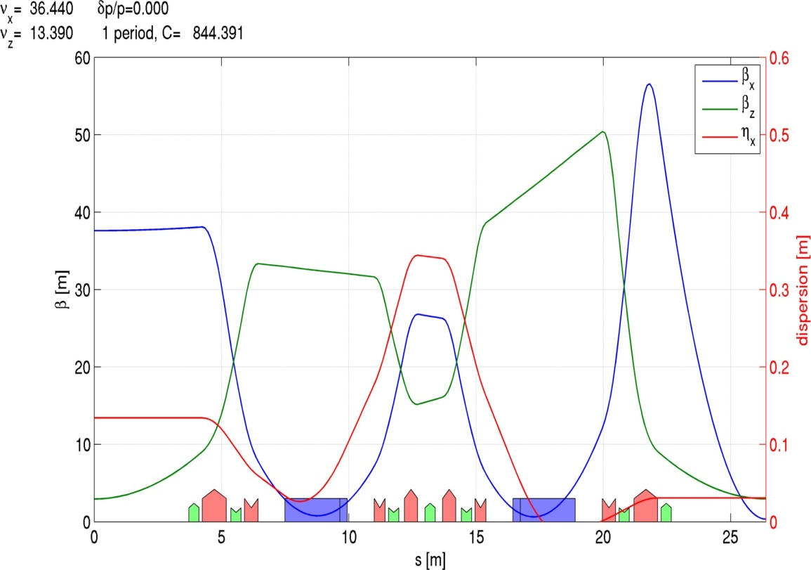
The evolution to Multi-Bend Lattice
Double-Bend Achromat (DBA)
  Many 3rd gen. SR sources
  Local dispersion bump (originally closed) for chromaticity correction

Slide 21
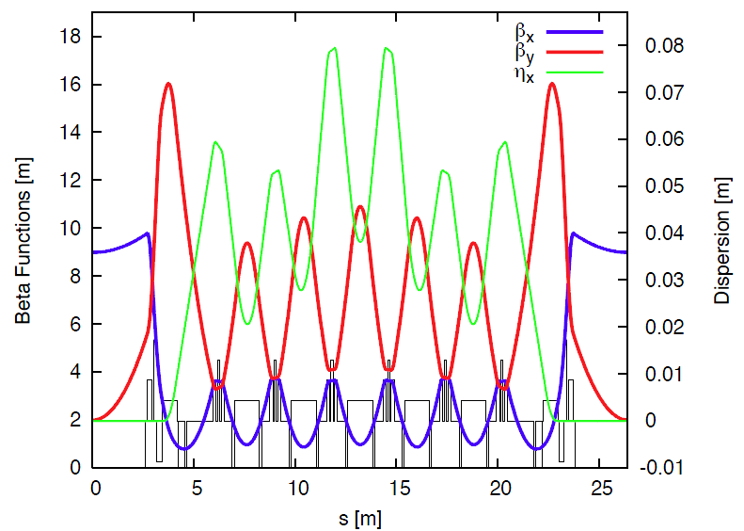
The evolution to Multi-Bend Lattice
Double-Bend Achromat (DBA)
  Many 3rd gen. SR sources
  Local dispersion bump (originally closed) for chromaticity correction
Multi-Bend Achromat (MBA)
  MAX IV and other USRs
  No dispersion bump, its value is a trade-off between emittance and sextupoles (DA)

Slide 22
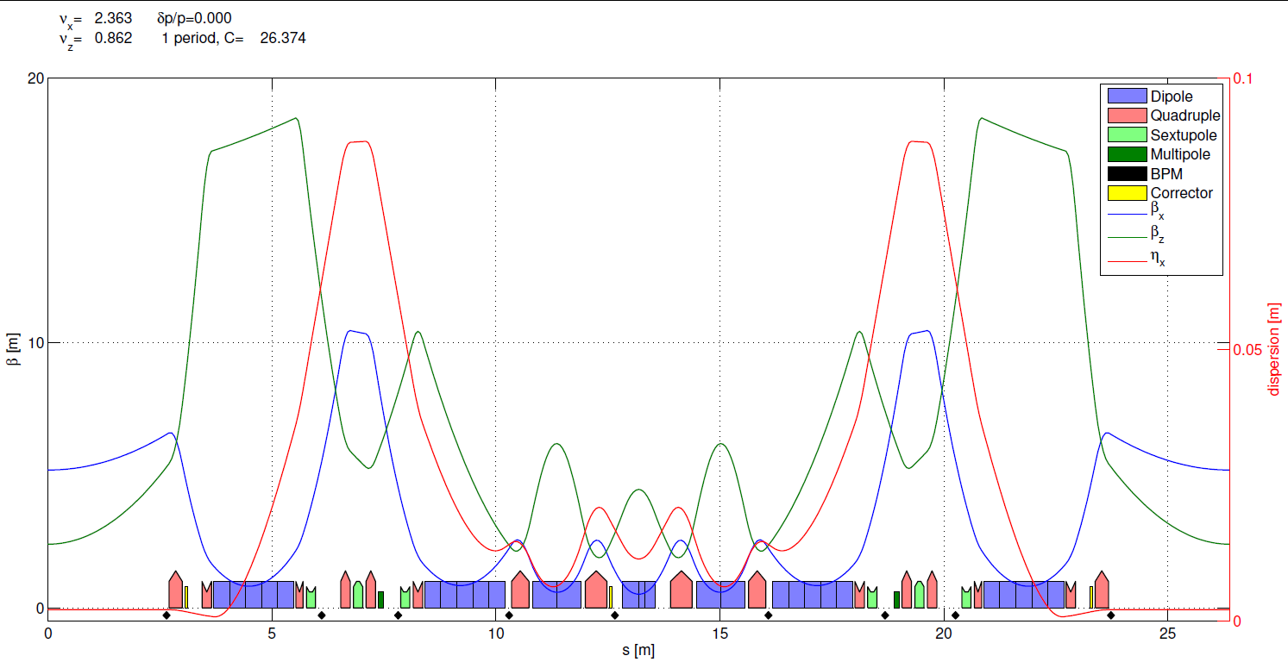
The Hybrid Multi-Bend (HMB) lattice
ESRF existing (DBA) cell
  Ex = 4 nm•rad
  tunes (36.44,13.39)
  nat. chromaticity (-130, -58)
  Multi-bend for lower emittance
  Dispersion bump for efficient chromaticity correction => “weak” sextupoles (<0.6kT/m)
  Fewer sextupoles than in DBA
  Longer and weaker dipoles => less SR
  No need of “large” dispersion on the inner dipoles => small Hx and Ex
Proposed HMB cell
  Ex = 140 pm•rad
  tunes (75.60, 27.60)
  nat. chromaticity (-92, -82)

Slide 23
HMB and Source Parametes
 | Parameter | S28A | Current lattice | Symbol | Unit
Lattice | Energy | 6.00 | 6.04 | E | GeV
 | Circumference | 843.98 | 844.39 | C | m
 | Number of cells | 32 | 32
 | Horizontal emittance | 147 | 4000 |  | pm·rad
 | Energy loss per turn | 2.6 | 4.9 | U0 | MeV
 | Energy loss from IDs | 0.5 | 0.5 | U0 | MeV
 | Horizontal tune | 75.6 | 36.44 | νx
 | Vertical tune | 27.6 | 13.39 | νy
 | Longitudinal tune | 0.00352 | 0.00592 | νs
 | Horizontal damping time | 8.51 | 7 | τx | ms
 | Vertical damping time | 13.02 | 7 | τy | ms
 | Longitudinal damping time | 8.86 | 3.5 | τs | ms
 | Horizontal natural chromaticity | -100 | -130 | ξx0
 | Vertical natural chromaticity | -84 | -58 | ξy0
 | Momentum compaction | 8.7E-05 | 17.8 E-5
 | Energy spread | 0.0009 | 0.0011 | σδ
 | Beam current (multibunch) | 200 | 200 | I | mA
 | Emittance growth | 2.5 | 0 |  | %
 | Vertical emittance | 5 | 4 |  | pm·rad
 | Bunch length | 23 | 20 | σz | ps
 | Lifetime | 7.5 | 45 | t | h
RF | RF voltage | 6 | 9 | VRF | MV
 | RF energie acceptance (5% for tlife) | 4.9 | 4 | ∆E/E | %
 | RF frequency | 352.371 | 352.200 | fRF | MHz
 | Harmonic number | 992 | 992
 | Synchrotron frequency | 1.25 | 2.10 | fs | kHz
 | Number of 5-cell cavities | 0 | 6
 | Number of mono-cell cavities | 14 | 0
 | Total RF power (incl. 10% transm. loss) | 0.98 | 1.5 |  | MW
 | RF power/cavity | 70 | 266 |  | kW
 | Copper loss per cavity | 19.2 | 47 |  | kW
 | Cavity coupling | 3.2 | 4.4 | β
 | Parameter | S28A | Current high beta | Current low beta | Symbol | Unit
ID source
 | Horizontal beta at ID centre | 5.2 | 37.6 | 0.4 | βx | m
 | Horizontal dispersion at ID centre | 2.0 | 134 | 31 | Dx | mm
 | Vertical beta at ID centre | 2.4 | 3.0 | 3.0 | βy | m
 | Horizontal beam size at ID centre | 27.2 | 387.8 | 37.4 | σx | μm
 | Vertical beam size at ID centre | 3.4 | 3.5 | 3.5 | σy | μm
 | Horizontal beam div. at ID centre | 5.2 | 10.3 | 106.9 | σx’ | μrad
 | Vertical beam div. at ID centre | 1.4 | 1.2 | 1.2 | σy’ | μrad
 | Relative source point transverse disp. | 0 |  |  |  | mm
 | Relative source point longitudinal disp. | 0 |  |  |  | m
BM source
Hard | Magnetic field | 0.47 to 1.1 | 0.86 | 0.86 | Bz | T
 | Horizontal beta at BM | 1.40 | 1.06 | 1.61 | βx | m
 | Horizontal dispersion | 17 | 51 | 75 | Dx | mm
 | Vertical beta at BM | 2.8 | 42.0 | 32.2 | βy | m
 | Horizontal beam size at BM | 21.3 | 77.9 | 112.1 | σx | μm
 | Vertical beam size at BM | 3.7 | 12.9 | 11.3 | σy | μm
 | Horizontal beam div. at BM | 24.2 | 110.9 | 98.5 | σx’ | μrad
 | Vertical beam div. at BM | 3.0 | 0.5 | 0.4 | σy’ | μrad
 | Source point transverse disp. | -25.1 |  |  |  | mm
 | Source point longitudinal disp. | -2.9 |  |  |  | m
Soft | Magnetic field | 0.43 | 0.4 | 0.4 | Bz | T
 | Horizontal beta at BM | 0.6 | 1.3 | 2.1 | βx | m
 | Horizontal dispersion | 11 | 62 | 89 | Dx | mm
 | Vertical beta at BM | 4.3 | 41.7 | 32.1 | βy | m
 | Horizontal beam size at BM | 14.4 | 98.3 | 131.7 | σx | μm
 | Vertical beam size at BM | 4.6 | 12.8 | 11.3 | σy | μm
 | Horizontal beam div. at BM | 17.8 | 115.5 | 103.1 | σx’ | μrad
 | Vertical beam div. at BM | 1.5 | 0.5 | 0.4 | σy’ | μrad
 | Source point transverse disp. | -6.4 | 0 |  |  | mm
 | Source point longitudinal disp. | -3.3 |  |  |  | m
Very well defined lattice and
X-ray Beams Properties

Slide 24
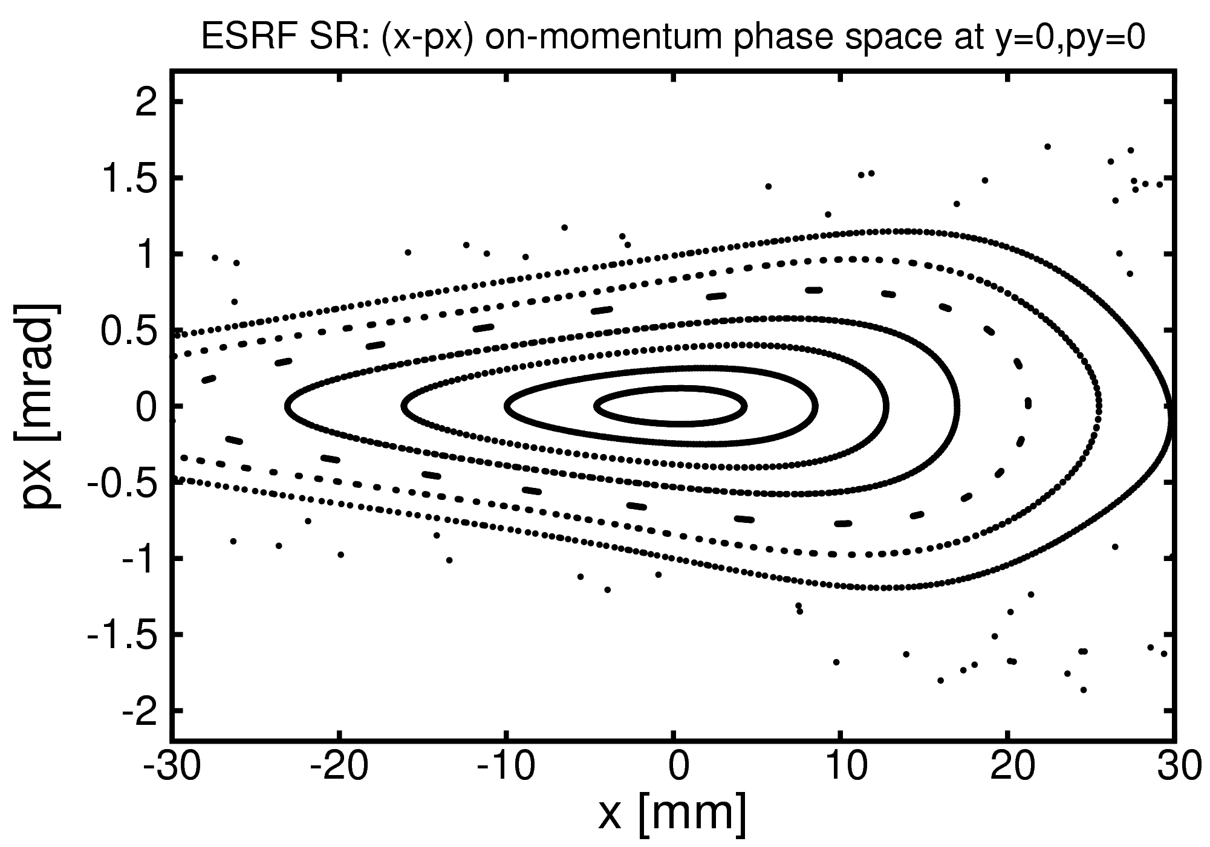
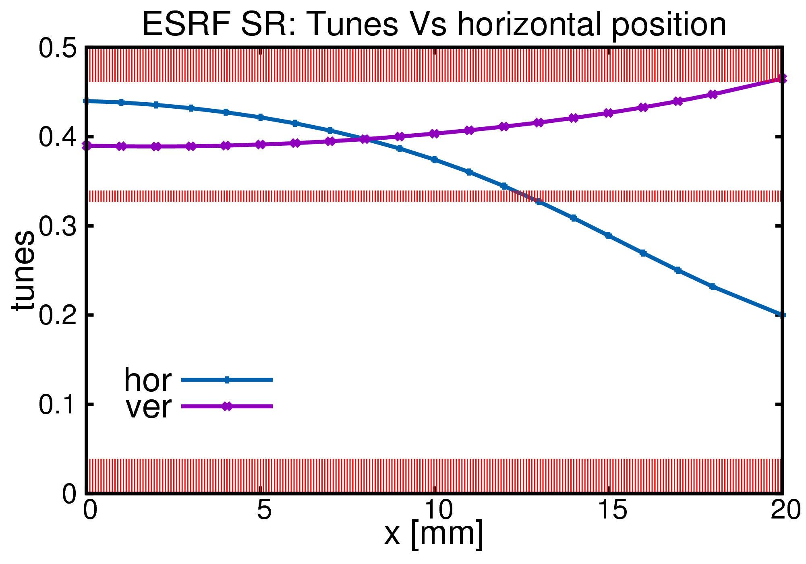
Nonlinear optics: existing ESRF SR Vs HMB lattice
dQx/dJx = -15x10³ d²Qx/dJx²= 0.3x10⁹
dQy/dJx = -11x10³ d²Qy/dJx²= 0.2x10⁹
dQy/dJy = 12x10³ d²Qy/dJy²= 0.2x10⁹
ESR (DBA) Storage Ring
  3 chromatic and 4 harmonic sextupoles
septum blade @ -5mm (20σ) with inj bump
3σ contour
inj. beam
Present ESRF Lattice

Slide 25
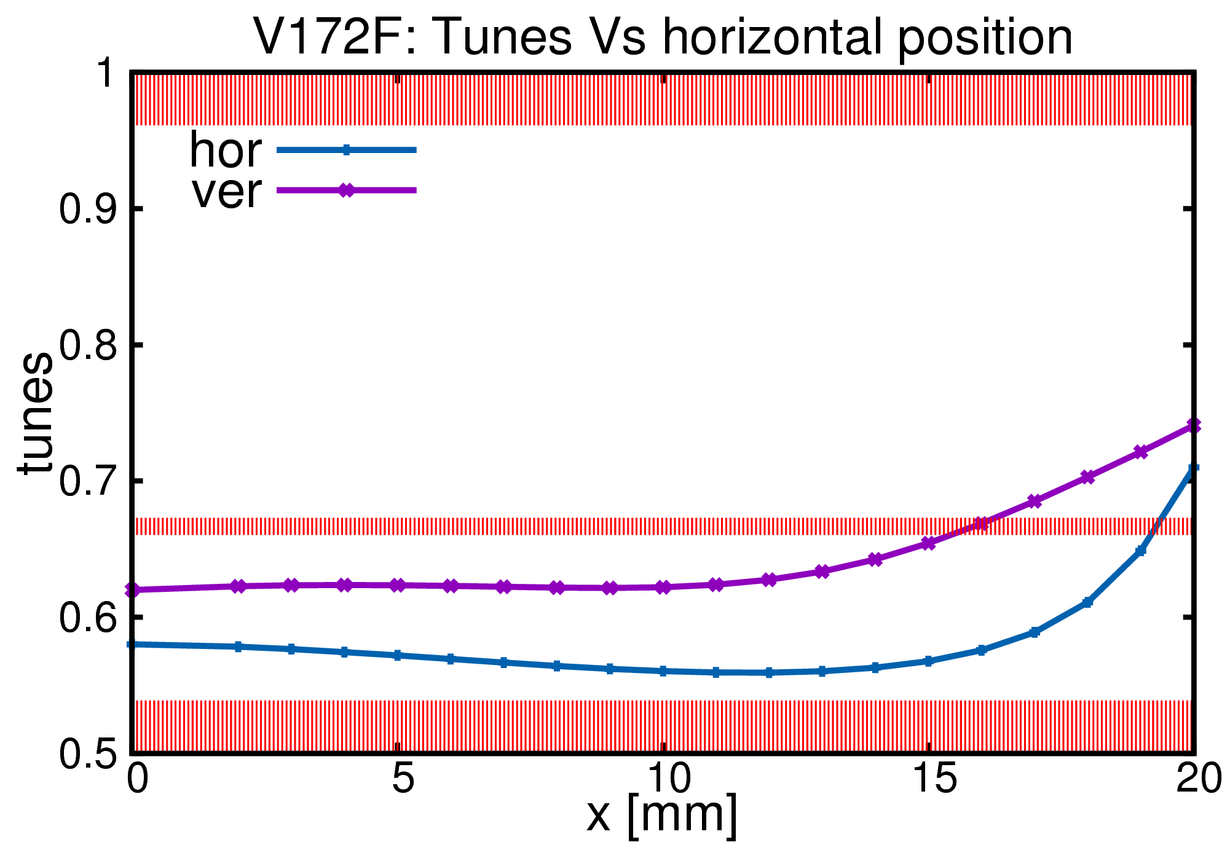
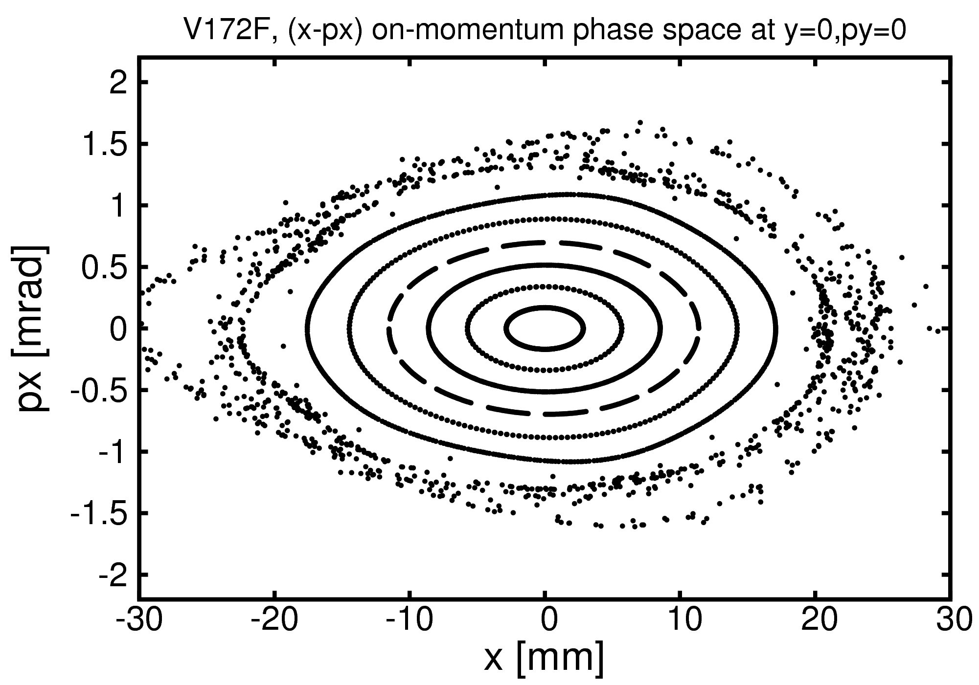
Nonlinear optics: existing ESRF SR Vs HMB lattice
dQx/dJx = -4x10³ d²Qx/dJx²= 0.5x10⁹
dQy/dJx = -3x10³ d²Qy/dJx²= 0.1x10⁹
dQy/dJy = -5x10³ d²Qy/dJy²= 1.0x10⁹
Octupoles added
Longitudinal gradient in dipoles
Lower cross-term detuning
septum blade @ -2mm (50σ) with inj bump
3σ contour
inj. beam
New HMBA ESRF Lattice

Slide 26
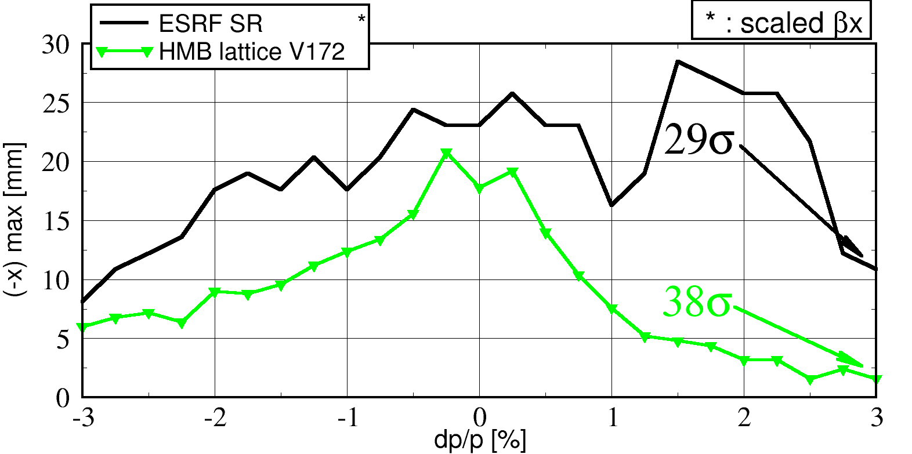
Nonlinear optics: existing ESRF SR Vs HMB lattice
good for injection efficiency
Δφ_{x}< π
good for Touschek lifetime >10Hrs

Slide 27
The ESRF Low Emittance Lattice
Proposed hybrid 7 bend lattice Ex = 146 pm.rad
Design virtually finalized. Only minor modifications (~cm) are expected upon complete engineering of all the elements
Several iterations made between:
Optics optimization: general performances in terms of emittance, dynamic aperture, energy spread etc…
Magnets requirements: felds, gradients…
Vacuum system requirements: chambers, absorbers, pumping etc
Diagnostic requirements
Bending beam lines source
Page 27

Slide 28
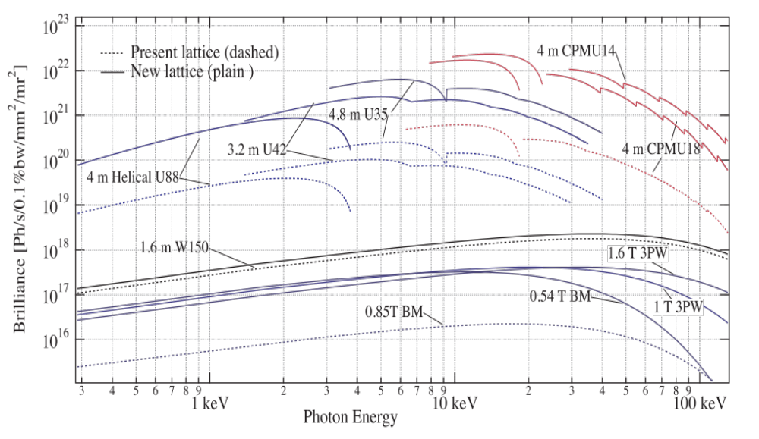
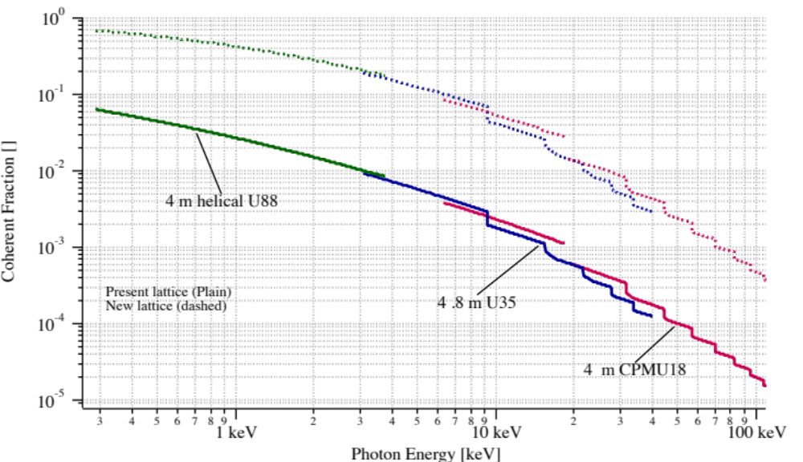
Improved Coherence
brilliance and coherence increase
Brilliance
Hor. Emittance [nm] | 4 | 0.15
Vert. Emittance [pm] | 3 | 2
Energy spread [%] | 0.1 | 0.09
β_{x}[m]/β_{z} [m] | 37/3 | 4.3/2.6
Coherence
Page 28

Slide 29
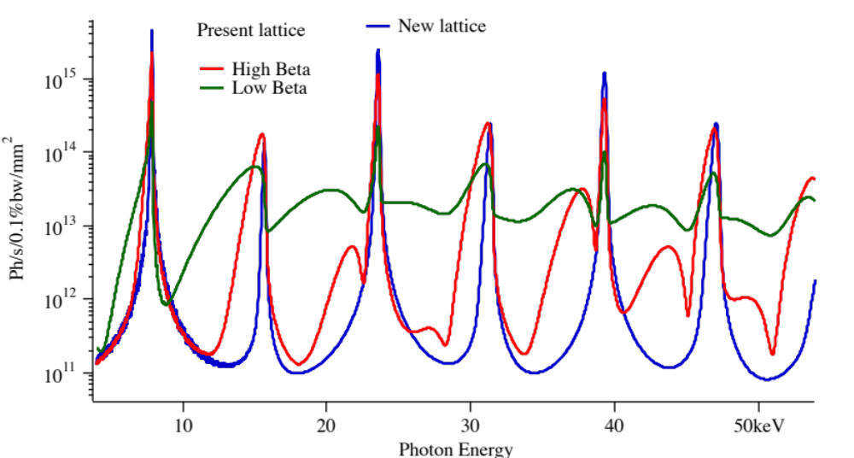
Improvement of undulator X-ray beam
Undulator: CPMU18,
K=1.68
L=2m
Hor. Emittance [nm] | 4 | 0.15
Vert. Emittance [pm] | 3 | 2
Energy spread [%] | 0.1 | 0.09
β_{x}[m] High/Low | 37/0.3 | 5.2
β_{z} [m] | 3.1 | 2.6
Page 29

Slide 30
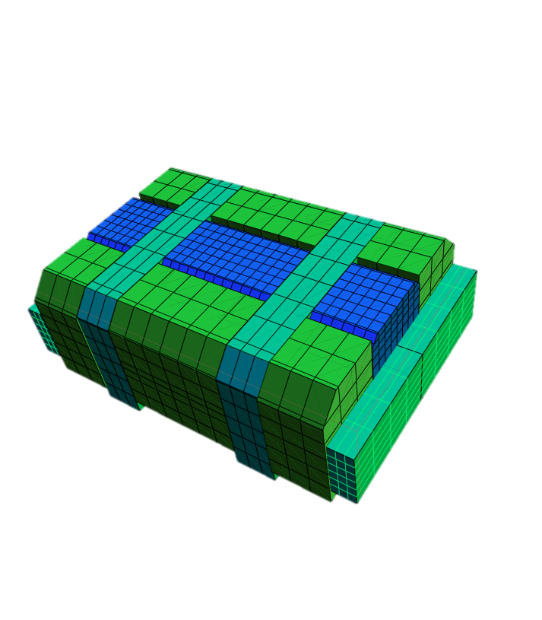
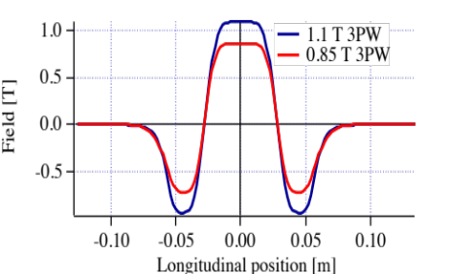
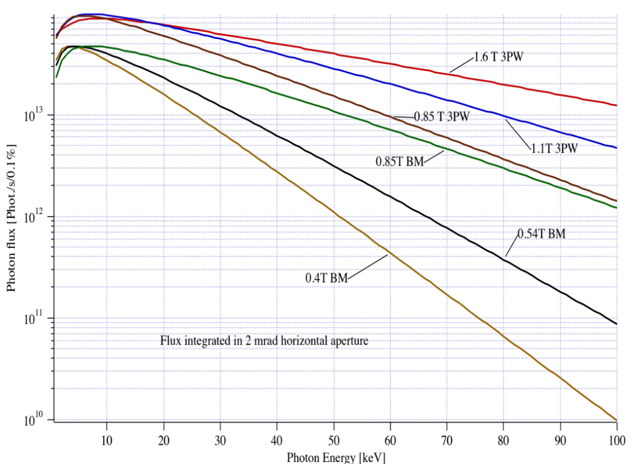
Bending magnets source: 3-Pole wiggler
Field Customized
Large fan with flat top field
2 mrad feasible for 1.1 T 3PW
2 mrad difficult for 0.85 T version
Mechanical length ≤ 150 mm
Half assembly
All new projects of diffraction limited storage rings have to deal with:
Increased number of bending magnets / cell => BM field reduction
Cconflict with hard X-ray demand from BM beamlines
ESRF will go from 0.85 T BM to 0.54 T BM
The BM Source can be replaced by a dedicated 3-Pole Wiggler
Flux from 3PW

Slide 31
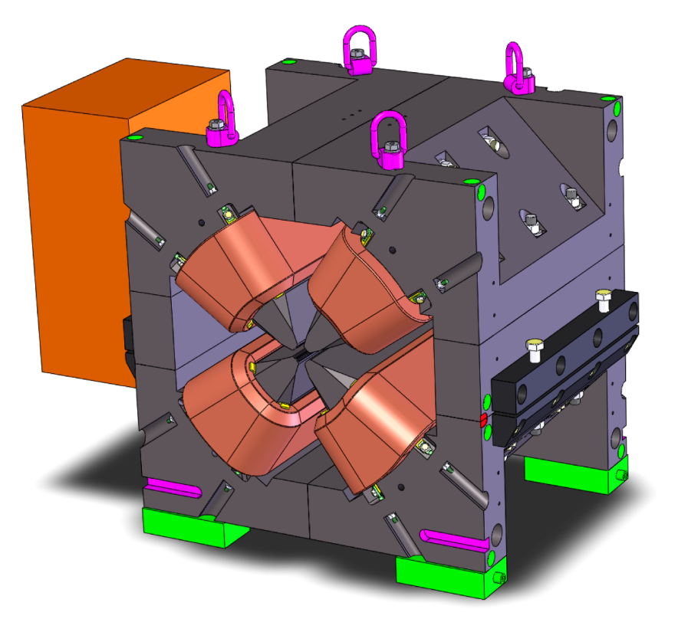
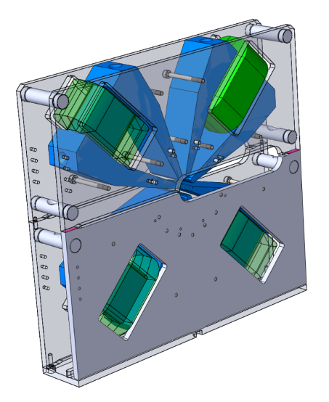
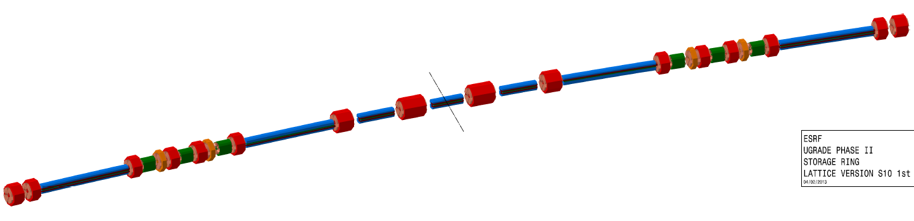



Technical challenge: Magnets System
Mechanical design final drawing phase
Soft iron, bulk yoke
Large positioning pins for opening repeatability
Tight tolerances on pole profiles
Prototypes to be delivered in the period:
September 2014-Spring 2015
Quadrupole
Around 52Tm⁻¹
D₇
D₆
High gradient quadrupoles
D₂
D₅
Gradient: 90 T/m
Bore radius: 12.5 mm
Length: 390/490 mm
Power: 1-2 kW
D₃
D₄
D₁
Sextupoles
Length 200mm
Gradient: 3500 Tm⁻²
Combined Dipole-Quadrupoles
0.54 T / 34 Tm⁻¹ & 0.43 T / 34 Tm⁻¹
Permanent magnet (Sm₂Co₁₇) dipoles
longitudinal gradient 0.16 − 0.65 T, magnetic gap 25 mm
1.8 meters long, 5 modules
Page 31

Slide 32



Technical challenge: Vacuum System
Vacuum System Design very advanced
System solutions very similar to the present ones
Expected performances similar or better than the present ones
Antichambers everywhere
Synchrotron Radiation handling by lumped absorbers
Page 32

Slide 33

Preparing the Upgrade phase II
Technical Design Study (TDS)
Completed and submitted to:
Science Advisory Committee (SAC)
Accelerator Project Committee (APAC)
Cost Review Panel (CRP)
ESRF Council
All committees very positive to go ahead

Slide 34

Accelerator Project Roadmap
Project Schedule:
◊ Nov 2012 White paper
Nov 2012- Nov 2014 Technical Design Study
◊ June 2014 Project approved by Council
Jan 2015 – Oct 2018 Design finalized, Prototypes,
Procurement, Pre-Assembly
Oct 2018 – Sep 2019 Installation
Sep 2019 – Jun 2020 Commissioning
◊ Jun 2020 User Mode Operation
Done
TDS submitted for review
Design very advanced
Prototyping in progress
10 Work Packages defined in the TDS:
WP0: Installation
WP1: Beam dynamics
WP2: Magnets
WP3: Mechanical and Vacuum Engineering
WP4: Power supplies
WP5: Radiofrequency
WP6: Control System
WP7: Diagnostics and feedbacks
WP8: Photon source
WP9: Injector upgrade
Accelerator Project Budget:
103.5 M€ Construction and commissioning of the new storage ring

Slide 35

Time scale
4 years
Start shutdown:
15 October 2018
Today
Notes:
35

Slide 36



Installation: 15 October 2018 – 01 June 2020
5352 hours of user mode in 2018
Commissioning start beginning September 2019
Yellow =machine
Green = beamlines
Start User mode beginning June 2020
End USM and start installation on 15 October 2018
All hardware installed by
mid June 2019
3 months contingency
1.5 month contingency

Slide 37
Accelerator and Source Division Challenges
Through the years ASD has delivered very high quality beam that have greatly contributed to maintain ESRF as the leader of the SR facilities.
Phase I has been the opportunity to further push the Source performances, The ASD has successfully accomplished its projects while maintaining the beam delivery with the very high standards of ever.
Phase II Accelerator Upgrade will further expand the ESRF frontiers and will insure the continuation of its leadership in Science and in Synchrotron Accelerators for the next decade(s).
Page 37

Slide 38
Upgrade Foreward
In the June 2014 ESRF Council Meeting:
- The Phase II Upgrade Programme was approved and launched
- The Accession of Russian to the ESRF was approved as well. This greatly help to secure the financial aspect of the Upgrade
ESRF is building collaborations with many labs:
Established an MOU with INFN, to be followed by
collaboration contracts for designing and building critical components
Under finalization an MOU with Advanced Photon Source (APS),
in order to share expertise and know (APS has decided to cut-and-paste
the ESRF upgrade scheme)
Collaboration with Diamond on many topics of common interest…
Possible involvement of BINP on design and fabrication phases.
Page 38

Slide 39




UP PI: Preparing the UP Phase II
ESRF push toward higher performances
X-ray Brilliance Curve
Future SR-SR 10²³
ESRF (2011)
ESRF (2007)
photons/s/mm²mrad²/0.1%BW
ESRF (2000)
ESRF (1994)
Second generation
First generation
Present ESRF Lattice: Ex=4nm
Synchrotron
Radiation
X-ray
tubes
Low Emittance Lattice: Ex=0.15nm
1900 1920 1940 1960 1980 2000

Slide 40

Many thanks for your attention

