Slide 1
LCLS-II: Plans at FNAL
Camille M Ginsburg (FNAL)
FNAL Deputy Team Lead (Cryomodules) and Cryomodule Control Account Manager
CEA Saclay Seminar
7. November 2014

Slide 2
Outline: LCLS-II Plans at FNAL
  LCLS-II and the Scope of Work at Fermilab
  Cryomodule design and production
      1.3 GHz cryomodules
        Modifications to XFEL CM needed for CW operation
          Component design
          Cryo-mechanical design
        Prototype cryomodules
      3.9 GHz cryomodules
  FNAL cryomodule production infrastructure readiness
  System integration and reviews
  Near term plans
  Conclusions

Slide 3
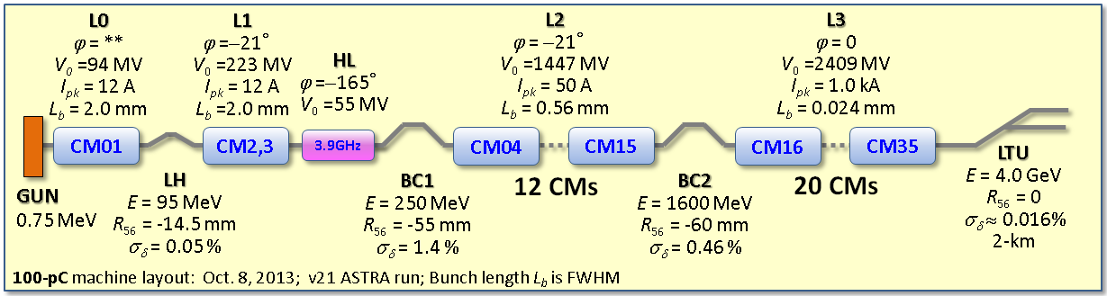
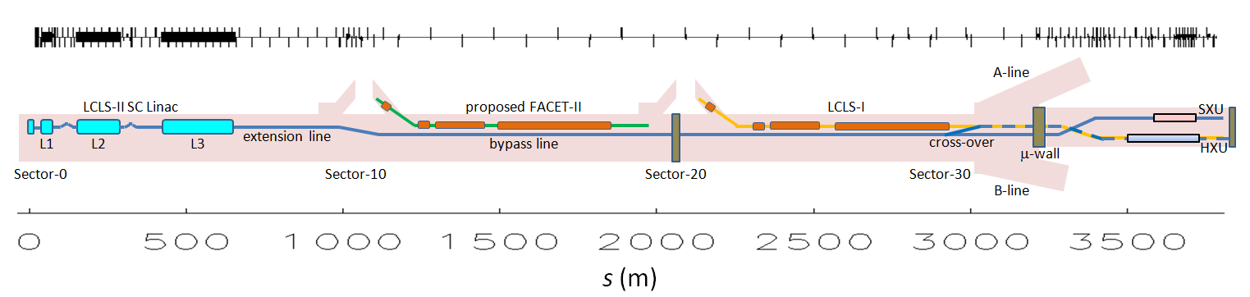
LCLS-II (LINAC Coherent Light Source) at SLAC
  Light source located at SLAC; an upgrade to the existing LCLS-I
    Adds two new X-ray laser beams and space for additional new instruments, greatly increasing the number of experiments
  4 GeV superconducting CW electron linac based on XFEL/ILC SRF

Slide 4
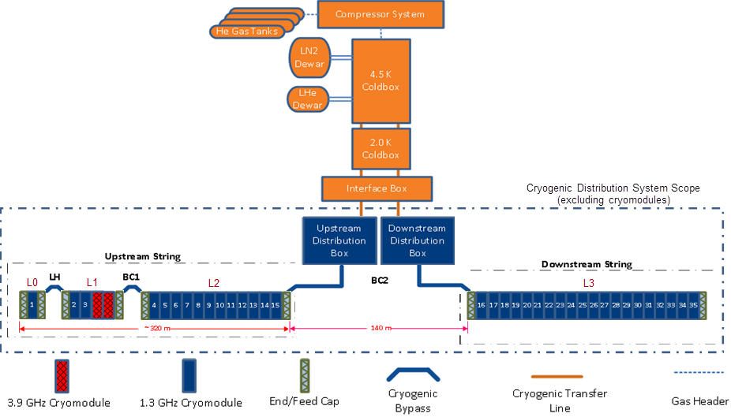
The Cryogenic System

Slide 5
LCLS-II cryomodules: top level parameters
Cryomodule (CM) Parameters | Symbol | nom.value | Units
Cavity operating temperature | T­_{cryo} | 2 | K
# 9-cell cavities per cryomodule (1.3 GHz) | N_{cav} | 8 | -
# installed cryomodules (1.3 GHz) | N_{CM} | 35 | -
# 3.9-GHz cavities per 3.9 GHz CM | - | 8 | -
# 3.9 installed GHz cryomodules | - | 2 | -
# installed 1.3 GHz cryomodules in L0 | N_{CM0} | 1 | -
# installed 1.3 GHz cryomodules in L1 | N_{CM1} | 2 | -
# installed 3.9-GHz cryomodules as linearizer | N_{CMLH} | 2 | -
# installed cryomodules in L2 | N_{CM2} | 12 | -
# installed cryomodules in L3 | N_{CM3} | 20 | -
Notes:
Magnet:
Conductively-cooled, split magnet prototypes have been tested
LCLS-II will include a quad/corrector dipoles / BPM package
Detailed magnetic design(s) will be made specific for LCLS-II

Slide 6




LCLS II Project Collaboration for Cryogenic Systems
Cryomodule engineering/design
50% 1.3 GHz, 100% 3.9 GHz cryomodules
Cryogenic distribution system
High Q0 (FNAL-invented gas doping)
50% of cryomodules: 1.3 GHz
Cryoplant selection/design
High Q0
FNAL/ANL SCRF cleaning facility
Cryomodule design support
High Q0

Slide 7
In less than one year, the LCLS-II Cryo Systems Team:
Formed LCLS-II inter-lab partnership
Commissioned and executed High Q0 R&D
Adapted TESLA / XFEL/ILC CM design for CW operation
Launched formal procurement process
  niobium/NbTi – awarded (FNAL)
  ~280 cavities – in bid process (JLab)
  Several prototype cryomodule procurements (both) …
Successfully passed two reviews by U.S. Department of Energy, Office of Science, Office of Project Assessment
Prepared a “baseline” plan (scope/cost/schedule) to be formally established as Project Baseline in Spring 2015

Slide 8
FNAL LCLS-II Scope of Work
    High Q0 development (FNAL led effort on N-doping)
      Establish <Q0>= 2.7 E10 feasibility in a cryomodule
      Establish processing recipe transferable to industry
    Design, fabricate & test seventeen 1.3 GHz cryomodules
      8 cavities and one SC magnet/BPM per cryomodule (CW)
      Cold/RF testing of first half of the CM’s
    Design, fabricate & test two 3.9 GHz cryomodules
      16 cavities total
      CM based on 1.3 GHz design, cavities on FNAL design for FLASH
    Design & fabricate cryogenic distribution system
      Interfaces with cryomodules, cryoplant and SLAC tunnel
    Support CM/CDS installation and commissioning at SLAC
    Support accelerator physics and LLRF control (as requested)

Slide 9
Cryomodule Design Model
Use existing designs to the extent possible to optimize cost and schedule
    LCLS-II SRF linac closely based on EuXFEL / ILC / TESLA design
    Under development ~ 20 years with > 1000 cavities to be made and tested (incl. 800 for EuXFEL – completed 2015)
FNAL has been working with these designs for ~10 years in ILC context
    Two 1.3 GHz cryomodules built and tested: CM1 and CM2
    80 9-cell cavities procured
    >300 bare 9-cell cavity tests (vertical test)
    >30 dressed 9-cell cavity tests (horizontal test)
FNAL responsible for the CM design, working closely with JLab & SLAC
Cooperation and assistance from DESY/XFEL extremely beneficial

Slide 10
ILC Type 3+ CM Modifications for LCLS-II (components)
Component design – leverage existing designs optimally
  Cavities – XFEL identical
  Helium vessel – XFEL-like
  HOM coupler – XFEL-like or -identical
  Magnetic shielding – increased from XFEL/ILC to maintain high Q₀
  Tuner – XFEL or XFEL-like end-lever style
  Magnet – Fermilab/KEK design split quadrupole
  BPM – DESY button-style with modified feedthrough
  Coupler – XFEL-like (TTF3) modified for higher Q_{L} and 7 kW CW
Concerns based on global experience
  Tuner motor and piezo lifetime: Consider access ports
  Maintain high Q₀ by minimizing flux trapping: Consider cooldown rate and magnetic shielding
  Coupler fabrication: Consider especially copper plating quality of bellows

Slide 11
ILC Type 3+ CM Modifications for LCLS-II (cryo-mech)
Cryo-mechanical design – increased pipe sizes
  Larger chimney pipe from helium vessel to 2-phase pipe
  Larger 2-phase pipe (~100 mm OD) for low velocity vapor flow
Both high heat load & 0.5% slope of the SLAC tunnel require
  Closed-ended 2-phase pipe providing separate 2 K liquid levels in each cryomodule
  2 K JT (liquid supply) valve on each cryomodule
Cost savings: Omit 5 K thermal shield
  Simplification since large dynamic heat at 2 K makes such a thermal shield of marginal value
  Retain 5 K intercepts on input coupler

Slide 12
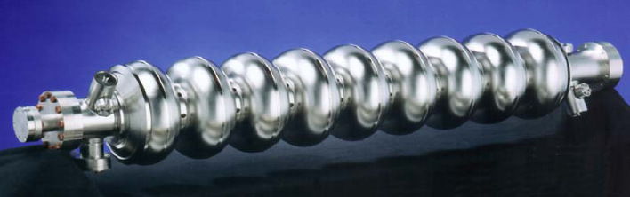
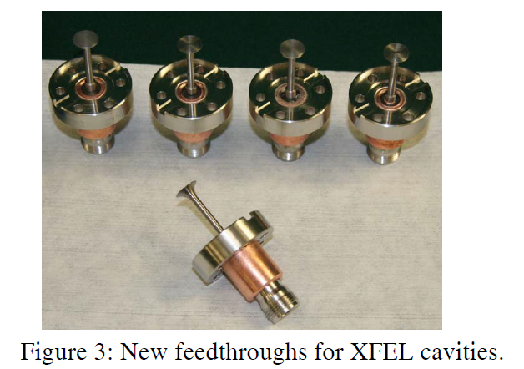
Cavities, Helium Vessel, HOM coupler
Cavity: XFEL/TESLA (long-short endgroups)
Helium vessel
  Modifications from XFEL
    Larger-diameter chimney to accommodate larger heat flow
    Chimney shift to low-H region to improve magnetic shielding efficiency
    Titanium to SS transition on chimney and fill lines
  Prototype CM dressed cavity: full drawing package available
  Baseline for production CM is a modified XFEL He vessel; partial drawings appropriate for procurement available
HOM coupler: two good choices
  XFEL-modified (proven >22.6 MV/m, cw at FNAL)
  JLab design
  No change to F-part

Slide 13
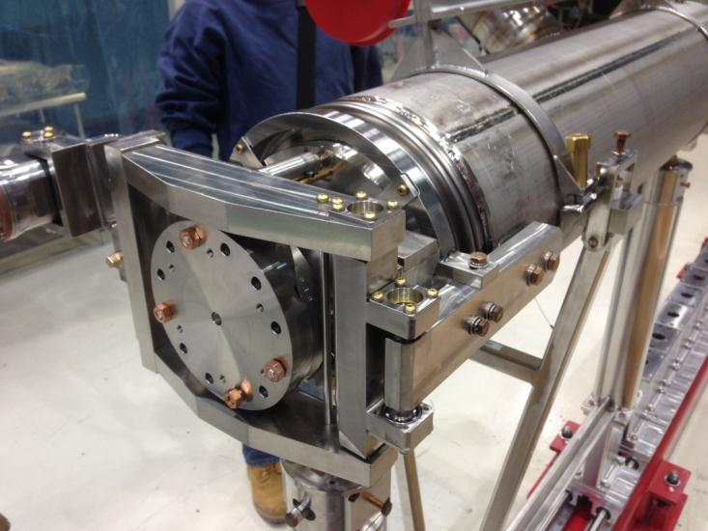
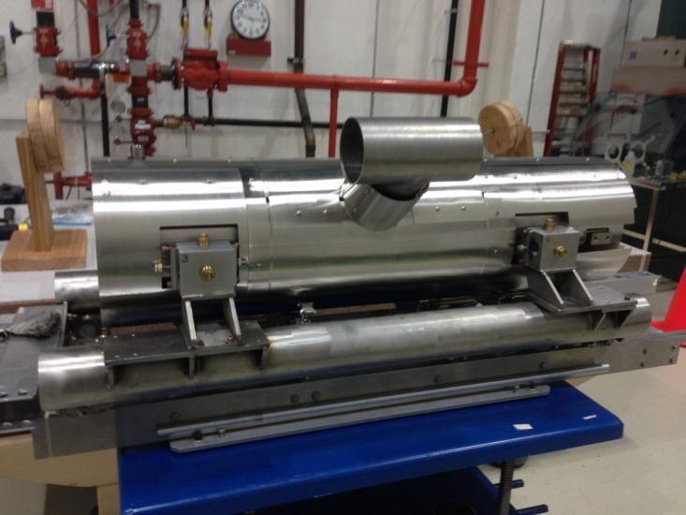
LCLS-II prototype dressed cavity
Cavity is identical to XFEL except for helium vessel details
Photos show test fit-up of FNAL lever tuner, dual layer magnetic shields
Ginsburg - Saclay Seminar, 7 Nov 2014

Slide 14
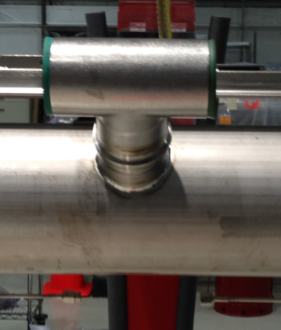
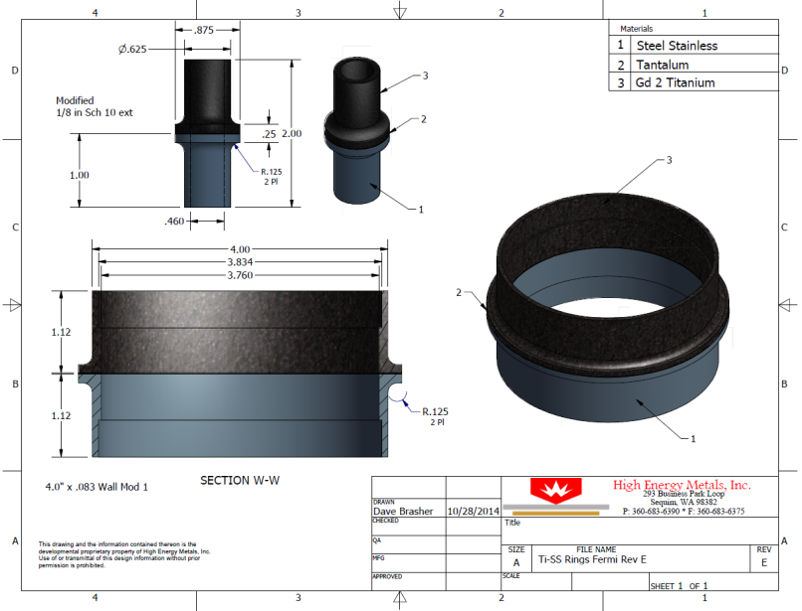
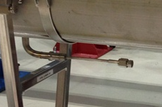
Helium vessel: Stainless steel to titanium transitions
Bi-metallic transition qualification
  Cold shock test sample
  Charpy impact test
  Tensile test
  FEA analysis – at FNAL
On samples
at a company
Ginsburg - Saclay Seminar, 7 Nov 2014

Slide 15
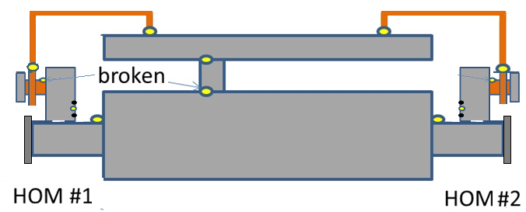
HOM coupler
Two good options: XFEL design and JLab design, both with sapphire feedthroughs; XFEL feedthroughs were tested in horizontal test (HTS)
  Standard ILC dressed cavity, except
    High-Q_{ext} variable coupler
    XFEL-style HOM feedthrough (sapphire window)
  Good thermal connections are important (double strips soldered, copper clamps, glued T-sensors, etc.)
  No impact on cavity performance up to 25 MV/m (chimney heat flow limit)
  No HOM coupler overheating observed up to 24 MV/m
    1° on HOM body, 0.5° on feedthrough

Slide 16
Slow/Fast Tuner Goals
Cavity has narrow bandwidth (~30Hz) → tight requirements for slow/coarse & fast/fine tuning resolution
  1 Hz fast tuning resolution calls for 2 nm stroke resolution: an order of magnitude smaller than XFEL
For prototype CM
  Tuner fits existing inventory of cavities at FNAL
    Cavities are “short-short” (INFN slim blade tuner)
    SACLAY-I tuner designed for “short-long” cavity
  Tuner adopts major features from XFEL tuner; primary differences are related to Fast Tuner modifications
  To mitigate risk of active tuner component failure (electromechanical actuator & piezostack), ports in vacuum vessel allow for replacement
For production CM
  Baseline design for production CM is Saclay-I tuner
All tuners require high component reliability, especially electromechanical actuator and piezo-actuator; tests underway

Slide 17
Tuner Design Status
First (2) Tuner prototypes for horizontal (HTS) testing
  Drawings completed
  Phytron delivered 3 units of electromechanical actuators
  PI Ceramic is delivered 4 units of encapsulated piezos
  FNAL assembled at HTS first tuner prototype; pressure test failed; small modifications underway for next test in a few weeks
Program for Tuner component reliability study is underway
  Test stand for motor/actuators lifetime tests
  Cold stand for piezo lifetime tests
  Radiation hardness of piezo program
Original XFEL (SACLAY I) tuner must also be tested at HTS with 30Hz bandwidth cavity to confirm compliance with LCLS II specs

Slide 18
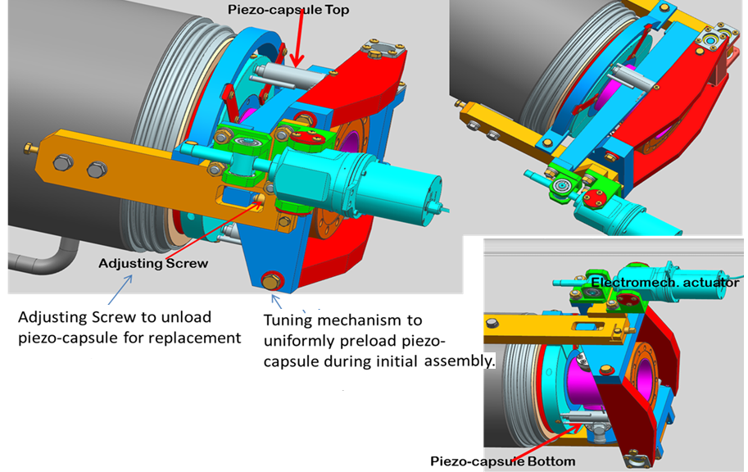
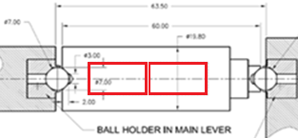
LCLS-II prototype end-lever tuner
Capsulated and preloaded piezo (two 18mm glued) from PI ceramics

Slide 19
Tuner access ports
Cornell ERL injector cryomodule successfully incorporated access ports
Allow access to tuner motor, drive mechanism, and piezos without pulling the cavity string out of cryostat.
  Fermilab tuner designed to allow access to critical components via access ports
  Ports must be on opposite side from input couplers, which is the wall side in the SLAC tunnel
  Ports available during initial CMTS tests
  Ports would not enable access to XFEL end-lever tuner
Definitely include access in prototype cryomodules
  These will incorporate Fermilab tuner
  Mitigates risk of problems with new tuner design
Include access ports in production cryomodule?
  Decision based on cost / risk analysis following initial tuner tests in HTS.
  Assemble a mechanical mock-up including thermal shield and MLI to check access port utility.

Slide 20
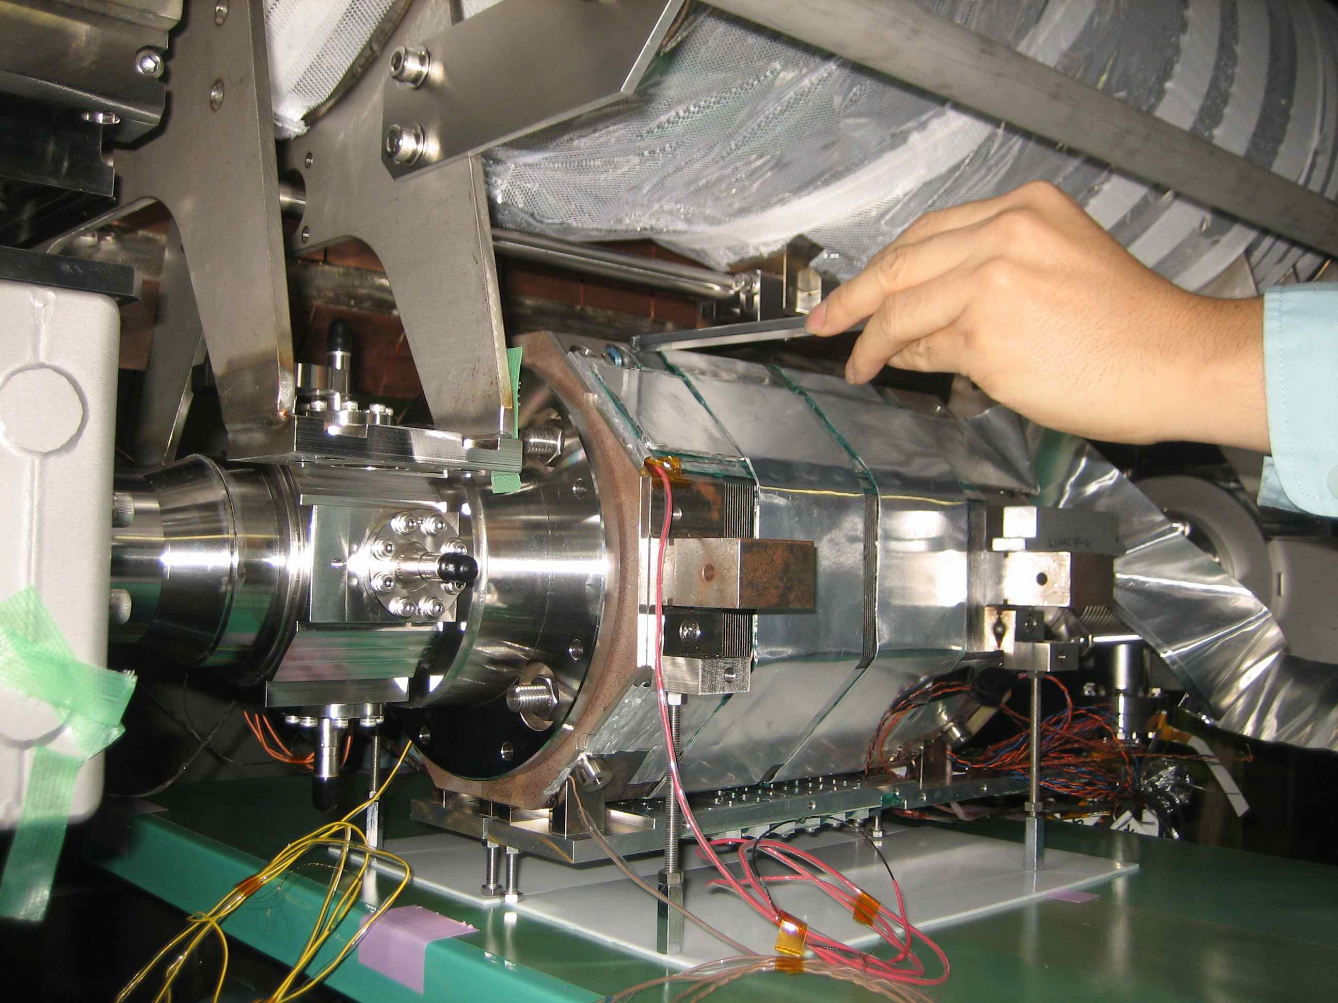
Magnet
Magnet based on conductively cooled, splittable quadrupole designed for ILC, and built for US-Japan collaboration; one prototype was installed at KEK-STF
  Magnet assembled around beam tube to avoid contaminating UHV SRF cavity volume
Update design to fit LCLS-II specification
  Quadrupole with vertical and horizontal dipole correctors
  Incorporate test results of US-Japan prototype into LCLS-II design
  Magnet parameters specified in 1.3 GHz CM PRD
Magnet test program to address/confirm primary design requirements
    Helium bath cooled test at FNAL soon
    Integrated test at KEK/STF CM also soon
Alternative design with separate quad/dipoles is ready for engineering, if combined design not to spec
R. Carcagno et al., MT23, Boston, 2013, and references therein.
http://lss.fnal.gov/archive/2013/conf/fermilab-conf-13-278-td.pdf

Slide 21
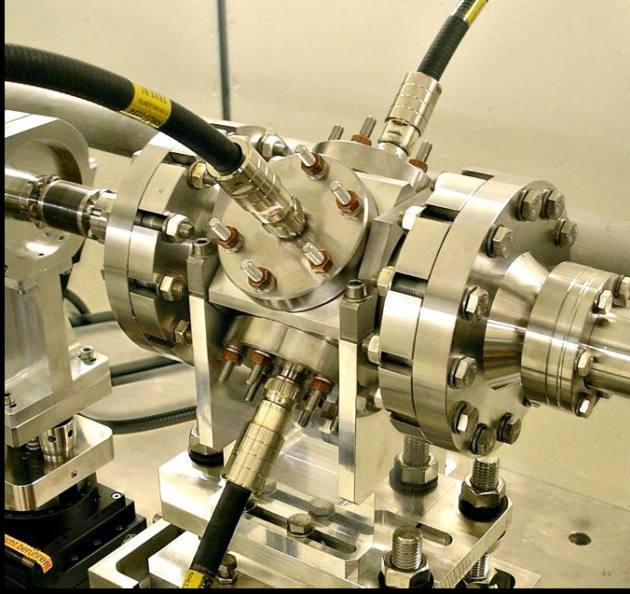
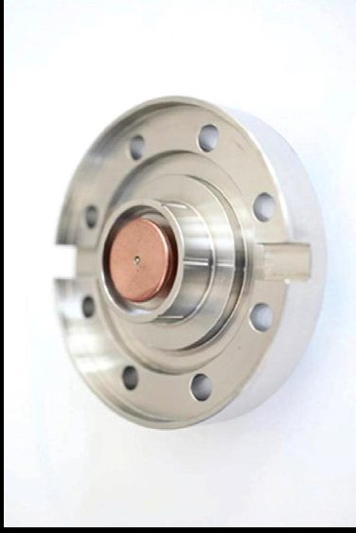
BPM
BPM design is DESY button BPM used at FLASH, with modified feedthrough for higher heat load
  Design verified in beam tests at FLASH and PSI (XFEL feedthrough)
BPM IP agreement was signed off FNAL/DESY this week
D.M. Treyer et al., Proc. IBIC2013, Oxford, UK
http://accelconf.web.cern.ch/AccelConf/ibic2013/papers/wepc21.pdf

Slide 22
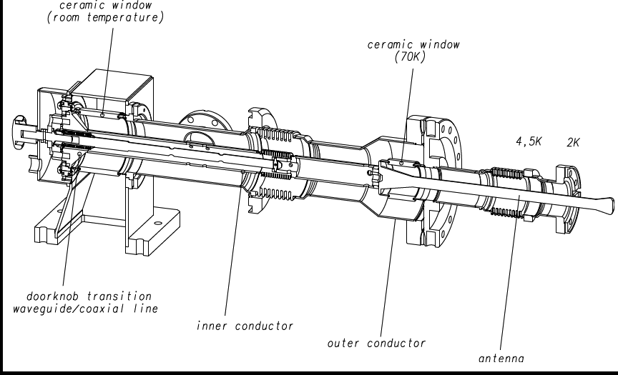
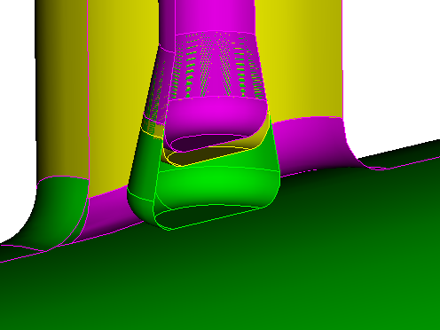
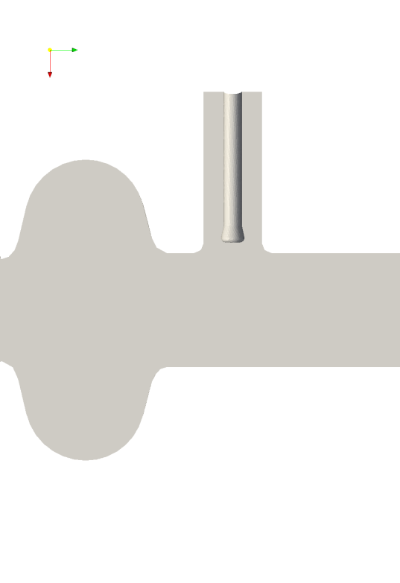
Forward Power Coupler
  NB: Coupler NOT in Cryo System; included here for completeness
  Modified TTF3 coupler
      Shortened antenna for higher Q_{L} 4E7
      Thicker Cu plating 150 um on warm bellows for 7 kW CW w/ full reflection
      Ongoing testing warm & cold parts separately, then together, at FNAL
d
DESY TTF3 coupler

Slide 23
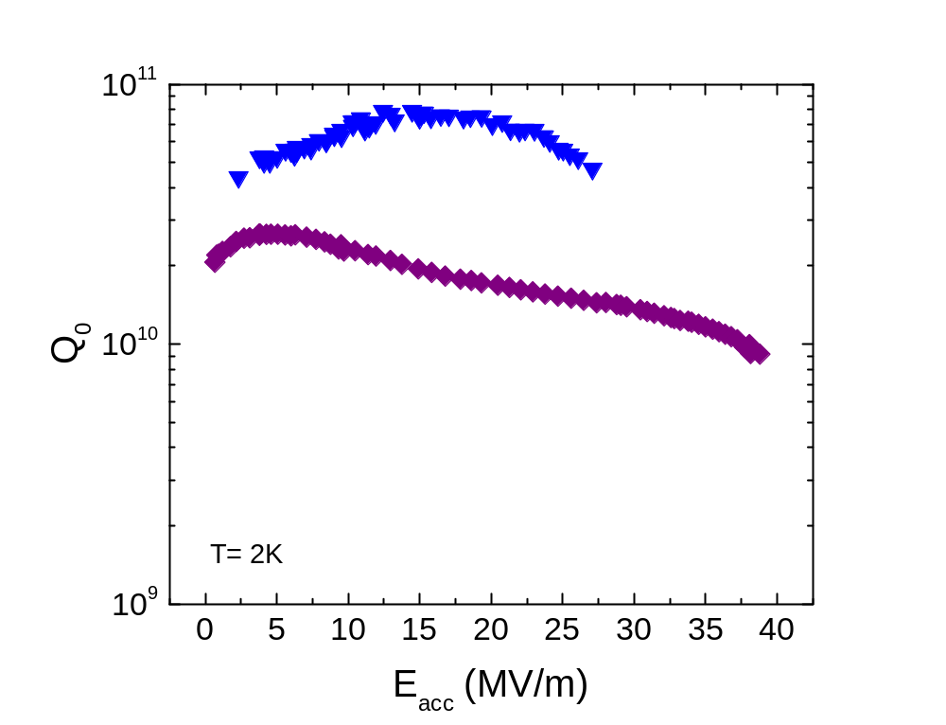
Nitrogen doping: a breakthrough in Q
Grassellino
Record after nitrogen doping – up to 4 times higher Q!
This was the highest Q possible up to last year
Standard state-of-the art preparation
1.3 GHz
A. Grassellino et al, 2013 Supercond. Sci. Technol. 26 102001 (Rapid Communication)

Slide 24
LCLS II vs. XFEL Industrial Cavity Processing Recipes
Rowe
Cavity after Equator Welding
Ship to FNAL/JLab
Ship to DESY
Cavity after Equator Welding
HOM Tuning
External 20 um BCP
HOM Tuning
X
EP 140 um
120C bake
Leak Check
Short HPR
US Degrease
Final Assembly
Leak Check
LCLS II
External 20 um BCP
Final Assembly
XFEL
EP 140 um
Long HPR
VT Assembly
Long HPR
Ethanol Rinse
US Degrease
Long HPR
VT Assembly
Short HPR
800C HT Bake
Helium Tank Welding Procedure
Helium Tank Welding Procedure
800C HT Bake + N2 Doping
RF Tuning
Long HPR
Long HPR
EP 40 um
RF Tuning
EP 5-20 um
US Degrease
Ethanol Rinse
HPR

Slide 25
Origin of the Q improvement – in numbers
Grassellino
Surface treatment | R_{BCS} (16 MV/m,2K) [nΩ] | R₀ (16 MV/m) (total, measured in vertical test, under low remnant fields) [nΩ]
EP + 120C (fine grain) | 8-10 | ~4-8
EP+120C + HF rinse | 8-10 | <3
EP + 120C (large grain) | 8-10 | <3
Nitrogen bake | 3.5-4.5 | <3
Q=G/Rs → for Q = 2.7e10 (2K) max total Rs=10 nΩ
With any standard processing margin on residual close to ZERO
Gas bake ONLY processing giving margin on residual to reach 2.7e10
@ 2K : Margin on residual (with gas bake) → 5.5-6.5 nΩ
Goal of the high Q work:
guarantee BCS ~ 4 nΩ (successful/reproducible doping) +residual < 6 nΩ in CM (trapped flux)

Slide 26
 | First pass | Second pass | Q (2K, 16MV/m) | Quench [MV/m] | Status
TB9AES011 | OK | OK | 3.4e10 | 21.5 | In ILC vessel for HTS studies
TB9ACC015 | OK | OK | 3.5e10 | 24 | Lined up for CM
TB9ACC012 | Quench (small removal for R&D) | ~Ok | 3.4e10 | 15.6 | In ILC vessel for Cornell HTC
TB9AES026 | OK |  | 2.75e10 | 21.5 | Lined up for CM
TB9AES003 | OK | OK | 2.5e10 | 27 | Long-short, R&D
TB9AES027 | OK |  | 4e10 | 21 | Lined up for CM
TB9AES028 | Q-switch/quench @ 14.5 (defect) | OK | 4e10 | 25.5 | Lined up for CM
TB9AES020 | Quench @ 14 (defect) | ~ Ok | 4.1e10 | 15.5 | Set aside backup for CM
TB9AES024 | OK |  | 4.75e10 | 25 | Lined up for CM
TB9AES021 | OK |  | 3.35e10 | 24 | Lined up for CM
Success of High Q0 R&D in FNAL vertical test: 8 cavities in FY14 (one more remains)

Slide 27
Design Verification Studies in Horizontal Test
Validate critical technical decisions needed for CM design complete
Dressed high-Q0 cavity in cryomodule (Q0 > 2.7e10 @16 MV/m)
High Q0 preservation (magnetic shielding and cooldown scheme)
Helium vessel (pressure notes, heat transport, cooldown scheme)
HOM coupler and feedthrough designs @ 16 MV/m CW (heating)
Main coupler design: Q_{L}=4E7; RF cw power = 7 kW with full reflection
End-lever slow/fast tuner (performance)
Resonance frequency control and microphonics studies (hardware, algorithm)
Other design verification tests (magnet, tuner lifetime) have dedicated test stands

Slide 28
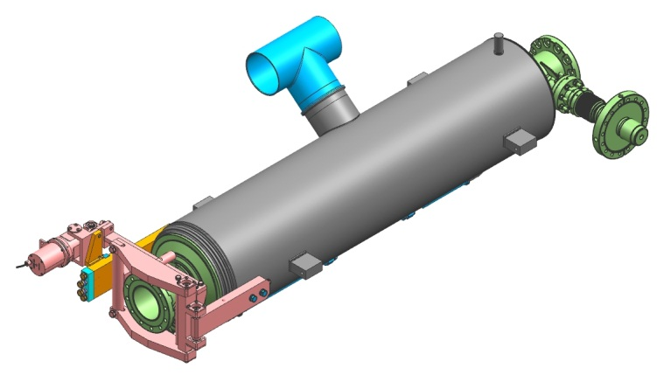
Prototype 1.3 GHz cryomodules
Purpose of prototypes
  Test out the design modifications as soon as possible
  Prove out the JLab infrastructure modifications
  Develop procedures and travelers, train staff, etc.
Build two prototype cryomodules, one each at FNAL and JLab
  Use 16 existing FNAL ILC 9-cell short-short cavities (beam tube lengths)
  Adapt XFEL-style end-lever tuner to short-shorts, and to permit access through ports
  Design new helium vessel to accommodate end-lever tuner and larger heat load
  Titanium to SS transition on chimney and fill lines
Prototype CM’s will go in the beamline and must
perform to specification
He vessel and tuner may be different wrt production CM

Slide 29
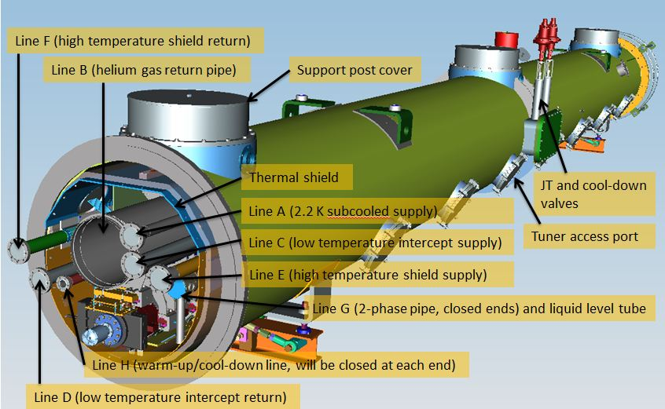
LCLS-II Cryomodule in 3-D
90 W (2K) nominal

Slide 30
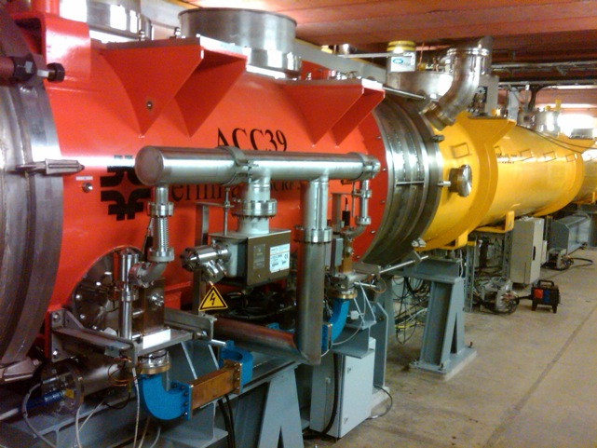
3.9 GHz CM DESY/FLASH experience
4-cavity 3.9 GHz pulsed-operation linearizer cryomodule designed and built at FNAL, installed at DESY/FLASH
  Cavities routinely operate (pulsed) at 18.9 to 19.7 MV/m
Cavities tested at FNAL both bare (vertical) and dressed (horizontal)
Cryomodule first tested at DESY CMTB prior to installation in FLASH
  Successful assembly
  Successful transatlantic shipment
  Some rework at DESY
    Longitudinal realignment
    Instrumentation terminations
Inter-lab effort and coordination
  Engineering Notes
  Welding certification, esp. He vessels
  Operational Readiness Clearance
  Transatlantic CM transport

Slide 31
3.9 GHz CM Functional Requirements
Less developed than 1.3 GHz CM; needed later
Based on FNAL DESY/FLASH design and LASA Milan XFEL design
Two eight-cavity CM’s
Cavity nominal operation E_{acc} = 15.5 MV/m at <Q₀>=2.5E9
Longitudinal cavity spacing TBD
Same vacuum vessel diameter as for 1.3 GHz CM’s: similar cryogen transport cross section, thermal shielding, interconnect & cooling scheme
Rotate every other cavity 180 degrees about beam axis to minimize RF coupler kicks; power couplers will extend out both sides of the CM
No magnets; no BPM’s

Slide 32
LCLS-II 3.9 GHz CM design issues (components)
Input coupler power capability/cooling
  Current design should be good to ~2kW CW but needs to be re-analyzed
    Existing coupler stand at A0 with CW amplifier available
  Evaluate need for variable coupling wrt existing ‘fixed’ design
HOM coupler and feedthrough
  Evaluate for LCLS-II operation
Microphonics/Fast tuning
  Current tuner is slow (blade) tuner only
    Modify to incorporate fast piezo tuners
  Cavities are already fairly stiff – resistant to microphonics/LFD

Slide 33
LCLS-II 3.9 GHz CM design issues (cryo-mech)
Use essentially Fermilab FLASH 3.9 GHz cryomodule dressed cavities in a shortened LCLS-II 1.3 GHz cryomodule
Similarities
  Vacuum vessel diameter, support structure, cryogenic piping
  Cool-down and operational arrangement
  Closed 2-phase pipe and JT valve on each cryomodule
Differences
  Shorter, smaller diameter cavities: modified connections to support structure, shorter coupler-to-coupler spacing
  Couplers alternate sides of the cryostat,
Cavity dynamic heat load
    Heat load 15.3 W/cavity @ 15.5 MV/m and Q₀=2.5E9 (nominal operational spec)
    Typical Q0 currently 2E9
    High Q₀ R&D may be advantageous, not currently baselined

Slide 34
Cryomodule production
1.3 GHz cryomodules (35)
  Produce two streams of identical 1.3 GHz production CM at FNAL&JLab
    Tightly coordinated activity among partner labs
    Common procedures, common test performance database, common travelers, etc. (within infrastructure limits)
    Split procurements between the two labs
    Assemble two prototypes in advance of production
        Prototype designs optimized to use existing components to confirm design concepts on a rapid schedule
    Design, engineering development, R&D, validation of parameters, core staff training, and infrastructure updates are complete before production starts
    Test 50% of cryomodules prior to delivery to SLAC
3.9 GHz cryomodules (2)
  Designed, produced and tested at FNAL
All cavities and cryomodules go in the linac
  1st two 1.3 GHz cryomodules (prototypes) work to specification
  No spare cavities or CM’s

Slide 35
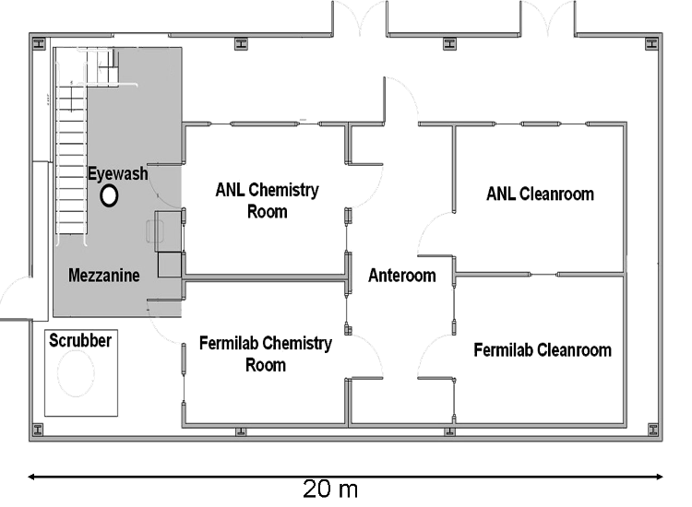
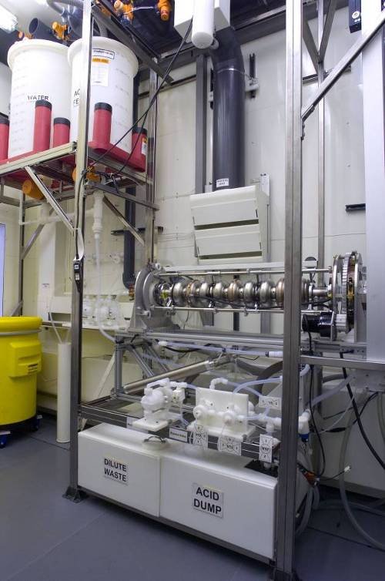
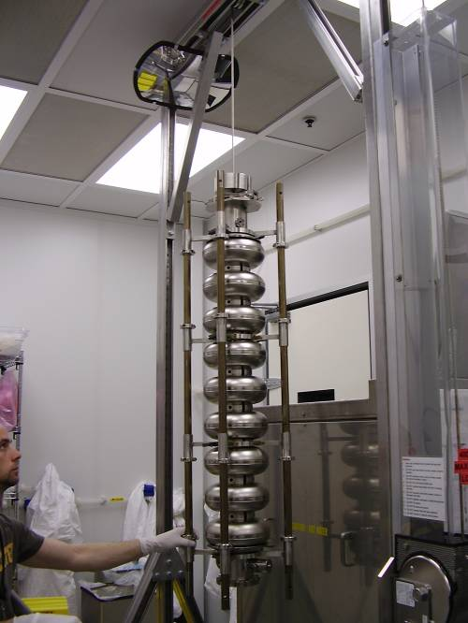
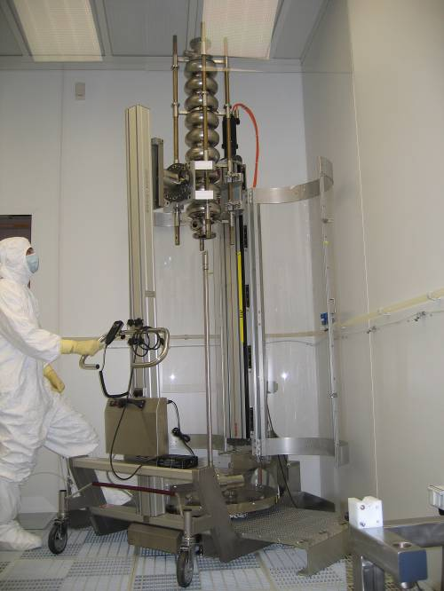
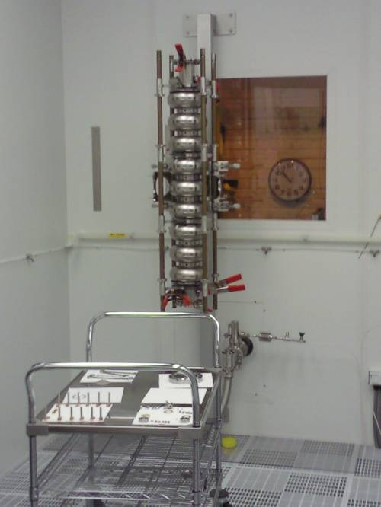
Capabilities and Infrastructure: FNAL/ANL Cavity Processing
Electropolishing
Ultrasonic degreasing
Dressed cavity prep for CM or HT ass’y
Re-processing
High-pressure rinse
Ass’y & Leak check
Notes:
This infrastructure is for re-processing activities, dressed cavity preparation for string/HTS and possibly 3.9 GHz processing

Slide 36
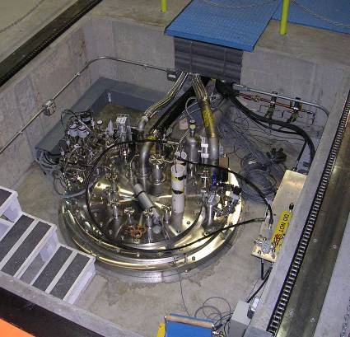
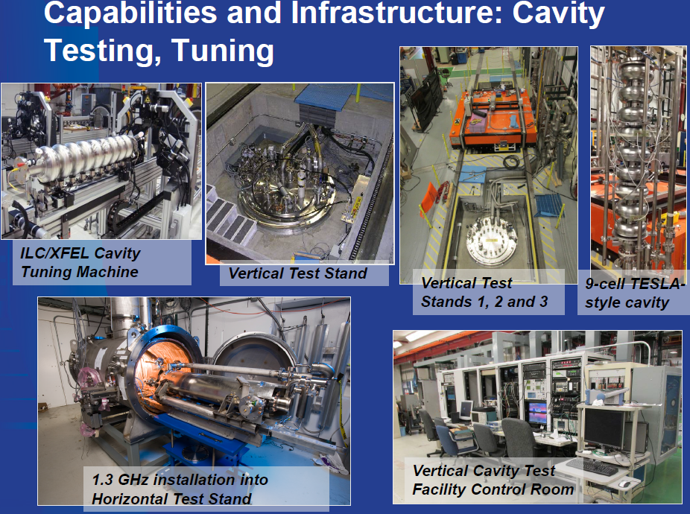
Capabilities and Infrastructure: FNAL cavity tests
Vertical Test Stands

Slide 37
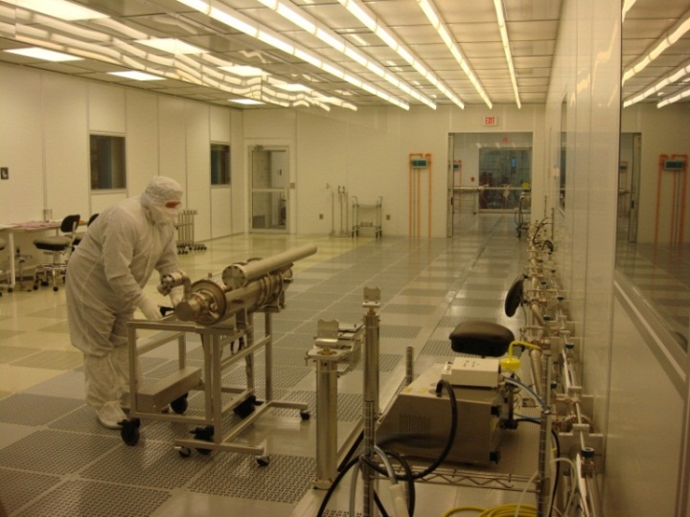
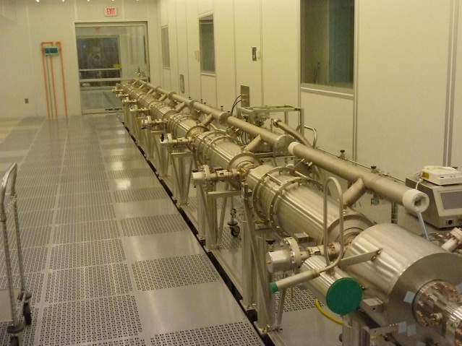
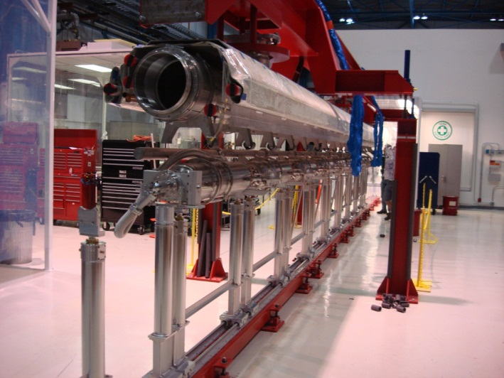
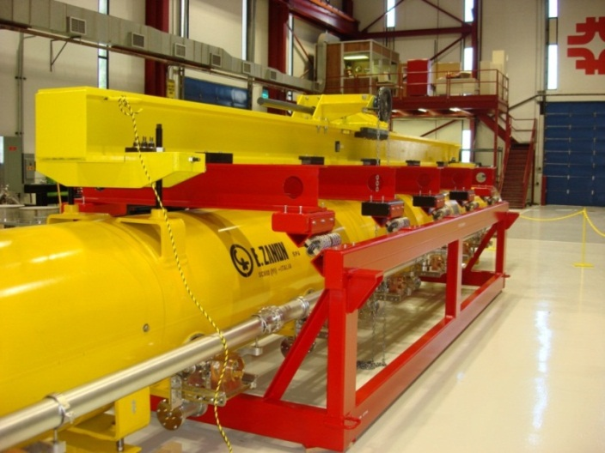
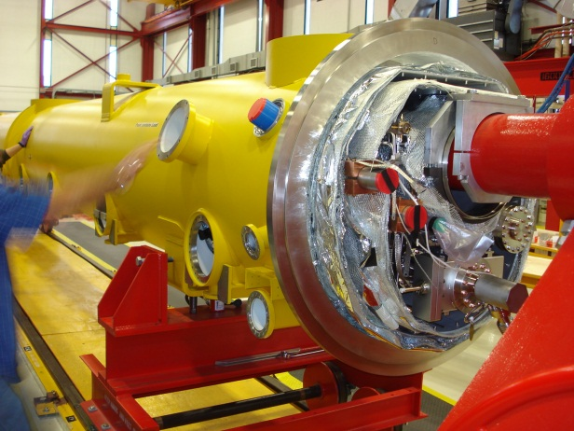
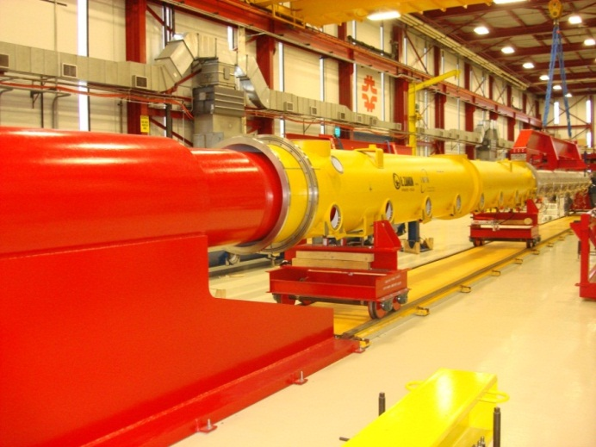
Capabilities and Infrastructure: FNAL CM assembly
Class 100
Class 10
Cavity String Assembly Clean Room
Cavity String Assembly
Cold Mass Assembly
Cryomodule Transport
Final Assembly
Final Assembly

Slide 38
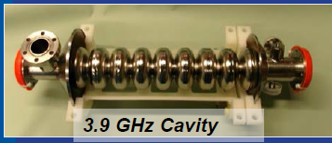
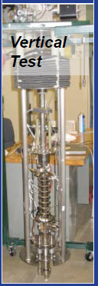
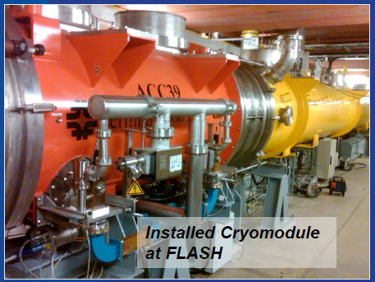
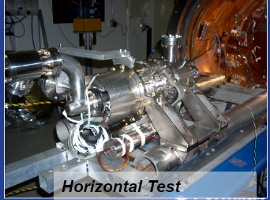
Capabilities and Infrastructure: FNAL 3.9 GHz CM

Slide 39
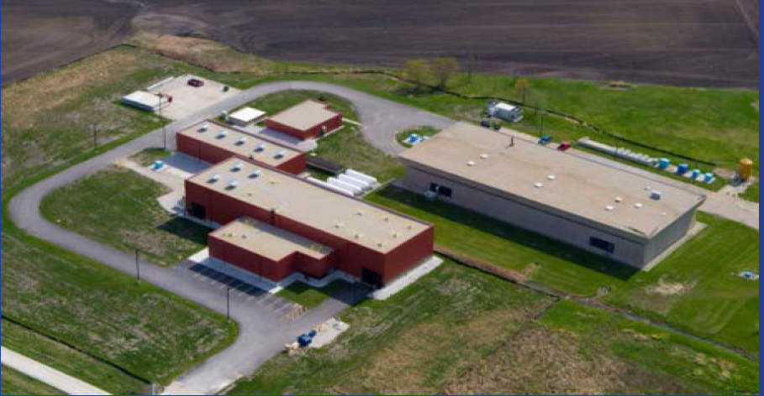
Capabilities and Infrastructure: FNAL CM Test
~100M investment 2006-2012

Slide 40
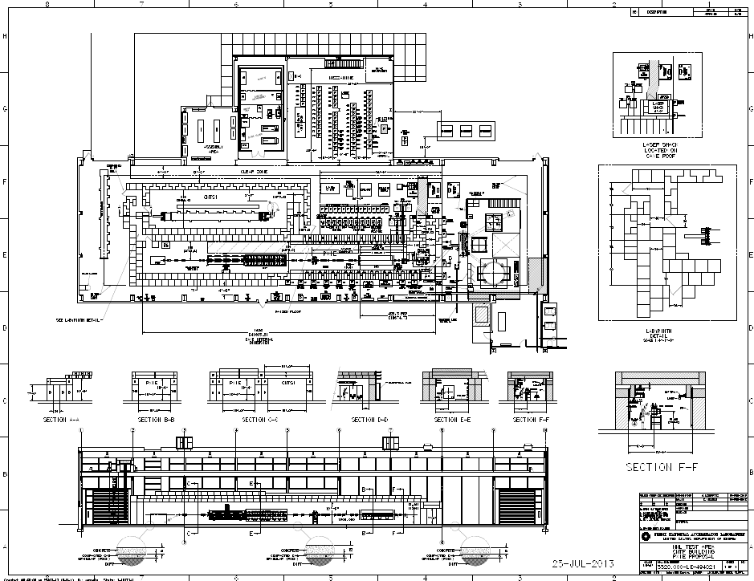
Cryomodule Test Facility (CMTF)
Cryoplant (blue)
Distribution box (silver)
Cryomodule Test Stand (CMTS)
H⁻ beam test cave
Notes:
Don’t say PXIE because the audience won’t know what that is. It is a test cave for an H- source.

Slide 41
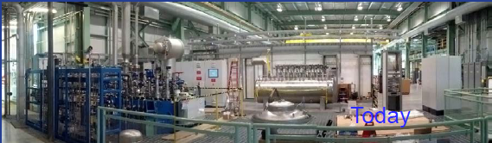
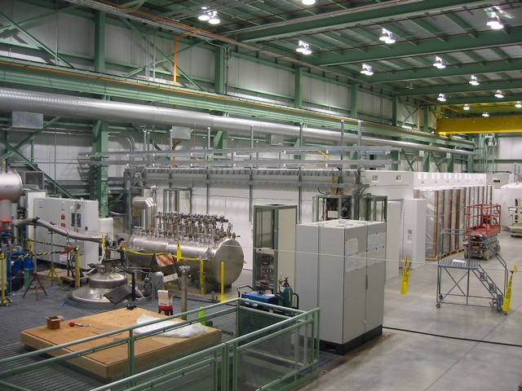
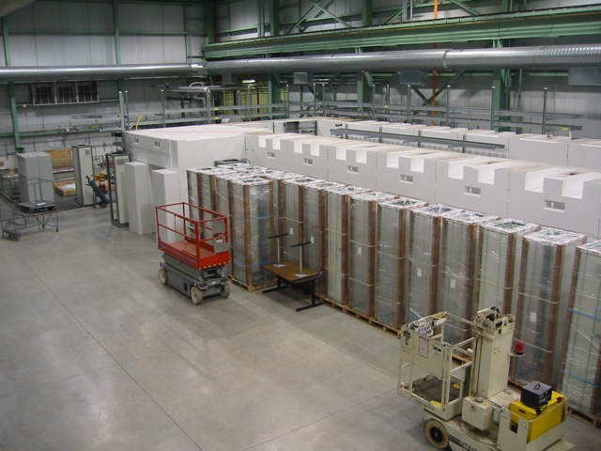
Capabilities and infrastructure: FNAL CM test facility
Existing infrastructure for one cryomodule test stand (CMTS)
  Project to provide RF source/distribution, and cryo distribution in cave
Cryoplant (blue)
Distribution box (silver)
H⁻ beam test cave
CMTS here

Slide 42
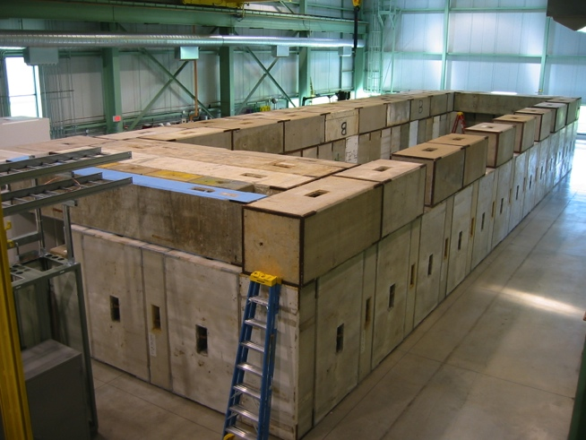
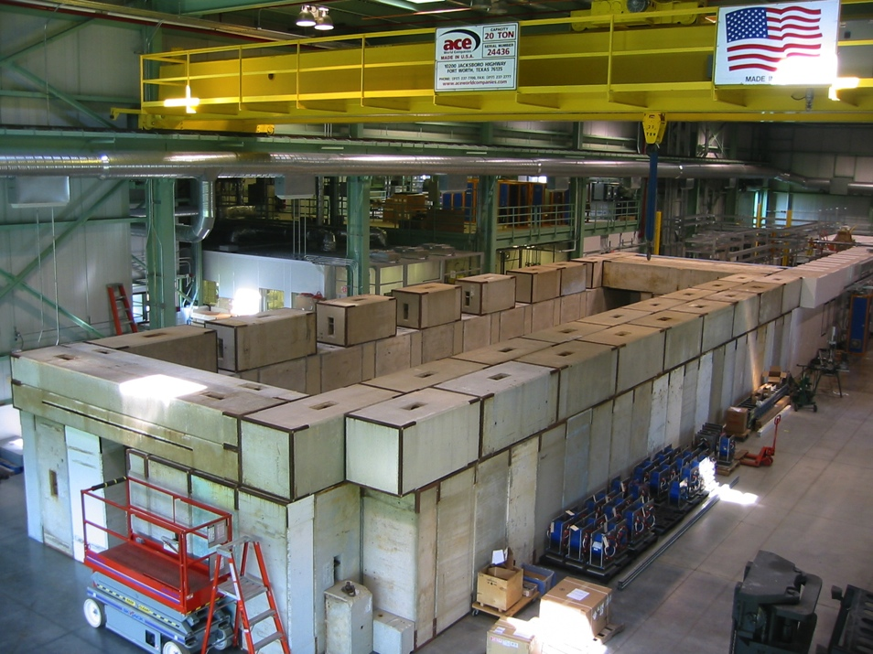
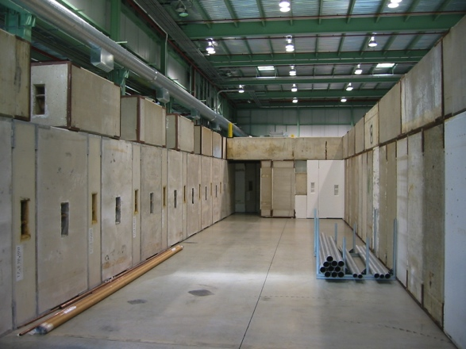
FNAL CMTS1: Cave assembly status October 1, 2014
1st two layers (walls, labyrinths and penetrations) are complete
Next steps – paint blocks and epoxy coat floor, followed by elec. & lighting

Slide 43
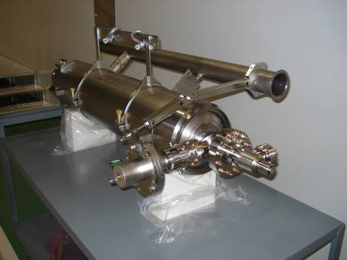
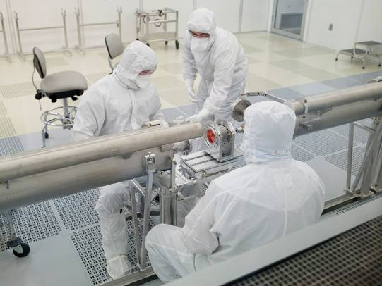



CM Assembly Workflow @ CAF-MP9
Receive dressed Cavities
Receive peripheral parts
Assemble dressed Cavities to form a String in the Cavity String Assembly Area (Clean Room)
Install String Assembly to Cold Mass in the Cold Mass Assembly Area
Transport the Cold Mass to CAF-ICB

Slide 44





CM Assembly Workflow @ CAF-ICB
Install the Cold Mass back to the Cold Mass Assembly Fixture in Cold Mass Assembly Area
Align Cavity String to the Cold Mass Support
Install the String assembly with the cold mass into the Vacuum vessel in the Vacuum Vessel Assembly area
Ship Completed Cryomodule to CMTS for testing

Slide 45


Capabilities and Infrastructure: FNAL 1.3 GHz CM Ass’y
WS2:7d (7)
WS1: 9d (6)
WS0: 5d (2)
WS3: 5d (10)
WS5: 10d (8)
WS4:5d (10)
WS6: 4d (4)
Total = 45 days
Workstation: duration (#people)
Notes:
# people not necessarily working full time for the full duration
Not shown: 1.5 days (4 techs) for cold mass transport between buildings
WS0: Cold-end coupler assembly
WS1: Cavity string assembly
WS2: Cold mass assembly at MP9
WS3: Cold mass assembly at ICB
WS4: Assembly on Big Bertha
WS5: Final assembly
WS6: Cryomodule transport preparation

Slide 46
FNAL Cryomodule Production Infrastructure Status
Most infrastructure already exists, and requires some modifications to accommodate LCLS-II throughput
  Vertical test, horizontal test, cavity surface (re-)processing
  1.3 GHz and 3.9 GHz
CM test stand (CMTS1) is major new infrastructure
  Functional reqts approved
  3-D model of cave (penetrations, 1.3GHz CM, RF/cryo dist) advanced
  Cave1st two layers (walls, labyrinths and penetrations) complete; next: paint blocks and epoxy coat floor, install electrical & lighting

Slide 47
Cryogenic System Integration
  Regular teleconferences
    JLab & SLAC personnel work closely with FNAL for procurement and fabrication of the 1.3 GHz cryomodules
Documentation
  Physics Requirements Documents
  Functional Requirements Specification
  Engineering Specification Documents
  Interface Controls Documents
Quality assurance is incorporated into all procurements and assembly travelers

Slide 48
Design Review Definitions (LCLSII-1.1-QA-0009-R0)
Preliminary Design Review [~30-50% Design Maturity]
  Documented technical and interface requirements
  Mechanical/structural/thermal design and analyses
  Preliminary layouts, drawings
  Reliability, maintainability
  Assessment of risk areas
  Plan for obtaining safety approval
Final Design Review [~90-100% Design Maturity]
  Requirements of PDR plus…
  Final detailed design
  Final implementation plans including engineering models, prototypes and spares
  Engineering model test results and design margins
Readiness Review
  Needed for authorization prior to construction activities
  Objectives, documentation, QA, safety, residual risk

Slide 49
Past CM Design Reviews (Engineering Peer Reviews)
  Prototype 1.3 dressed cavity - 4/5/14 https://indico.fnal.gov/conferenceDisplay.py?confId=8598
  Technical issues, status, and schedule
  Ed Daly, Timergali Khabiboulline, Tom Nicol (chair), Joe Preble and Leonardo Ristori
  Report – executive summary
    Designs for the prototype cavity, helium vessel, tuning bellows (with a couple caveats), Ti/SS transitions, etc. are sufficiently mature that long lead procurements can begin.
    Tuner and magnetic shield designs are less complete and require further work.
Prototype 1.3 GHz Cryomodule – 6/6/14https://indico.fnal.gov/conferenceDisplay.py?confId=8398
  CM cryostat thermal and mechanical design technical issues, status, schedule
    NOT: dressed cavity, tuner, couplers, magnet, beamline components
  Joel Fuerst, Elvin Harms (chair), Jerry Makara, John Mammosser, and Tom Nicol
  Report – executive summary
    Strategy of adopting the TESLA/XFEL concept with minimal changes works
    Areas requiring more attention include the Ti-SS transition joints in the helium vessel to 2-phase pipe interface, warm vs. cold alignment offsets, the mechanical stability of the beam pipe interconnect between cryomodules, and possible changes in microphonics due to capped 2-phase pipe.
    Requirements documents are lagging
Notes:
Timergali Khabiboulline, T. Nicol (chair), Leonardo Ristori, Ed Daly, J. Preble
Elvin Harms (chair), John Mammosser, Joel Fuerst, Tom Nicol, and Jerry Makara

Slide 50
Next CM Design Reviews
1.3 GHz Prototype CM FDR 23 Jan 2015
1.3 GHz Production CM FDR 24 Apr 2015
1.3 GHz CM Production Readiness Review 26 Jun 2016
3.9 GHz CM PDR 06 Oct 2015
3.9 GHz CM FDR 08 Jun 2016
CM Design Complete 30 Sep 2016
PDR=preliminary design review
FDR=final design review

Slide 51
Schedule: A few key upcoming milestones
A full schedule has been developed
  Takes into account the CD milestones, facility throughput, lead time on procurements
Prototype CM
  Begin assembly May 2015
Production CM
  Niobium procurement (XFEL identical model)
    Final drawings and specifications complete, contract was awarded October 2014
Production dressed cavity procurement (XFEL-similar model)
    Final drawings were complete July 2014; solicitation Sept. 2014
    Driven by need to start production CM: Dressed cavity vertical tests start March 2016

Slide 52
Near-term plans
Prototype Cryomodule
  Substantial work on infrastructure and tooling for prototype assembly
  Engineering and design, including support of reviews
  Cryomodule test stand (CMTS1) design, begin major procurements and assembly
Component design reviews: magnet, BPM, HOM feedthrough, HOM absorber, tuners
Procurements: FNAL-led, and support for JLab-led
  Niobium and cavities are the major ones; prototype cryomodule components
Complete design verification tests
  Horizontal dressed cavity tests at FNAL HTS for system tests of the high power coupler, HOM feedthroughs, and tuner
  Dedicated reliability & longevity studies of slow/fast tuner components in cold vacuum environment
  Development of resonance control hardware, software, and algorithms
  Magnetic shielding and cool down scheme

Slide 53
Conclusions
Design changes are minimized; required effort is still substantial
  Design structure and form very much the TESLA concept with minimal modifications for CW operation
  Component design effort and technical risk minimized by using existing designs with minimal modification
  Prototype designs optimized to use existing components to confirm design concepts on a rapid schedule
  Substantial requirements documentation progress since May
Design verification test program set up to confirm the modifications
Availability of existing designs and prototype CM components have led to an advanced cryomodule design for this stage of the project
A comprehensive project structure has been set up to accomplish the necessary tasks
Project is substantially underway after only one year

Slide 54
Acknowledgments
Tug Arkan, Evgueni Borissov, Anna Grassellino,
Chuck Grimm, Elvin Harms, Marc Kaducak, Josh Kaluzny, Vladimir Kashikhin, Arkadiy Klebaner, Yuriy Orlov,
Tom Peterson, Yuriy Pischalnikov, Ken Premo, Marc Ross, Allan Rowe, Nikolay Solyak, Rich Stanek,
and Jay Theilacker provided information and slides for this presentation
I am grateful for their assistance.

Slide 55
Backup slides

Slide 56

FNAL LCLS-II Organization
Stanek

Slide 57
LCLS-II Documents Definitions (L. Plummer)
Global Requirements Document (GRD)
  A single global-level requirements document that specifies the performance requirements for the LCLS-II x-ray free electron laser.
Physics Requirements Documents (PRD)
  PRDs are a flow-down from the GRD. PRDs typically specify the performance requirements for each LCLS-II System. These documents cover how a system needs to perform and what criteria the system needs to meet to satisfy the GRD. This is a physics specification generally used as a starting point in the engineering design.
Functional Requirements Specification (FRS)
  Describes the programmatic or project needs and/or requested behavior of a system or component. The document typically outlines what is needed by the end user as well as the constraints, assumptions, technical requirements and requested properties of inputs and outputs.
Interface Control Documents (ICD)
  ICDs are interface or boundary documents that define the boundaries between two systems. ICDs can be written to define vertical interfaces (Inj-Lin, Lin-Und, etc.) or horizontal (Vacuum-Controls, Diagnostics-Controls, etc.). ICDs are use to describe the boundaries or endpoints of one specific system with respect to another system, the physical interface between the two, and the limits of responsibilities for the two.
Engineering Specification Documents (ESD)
  ESDs typically define system and/or component level specifications or parameters. The ESDs are typically engineering specifications and can be used as a 'design-to' specification for outside or inside fabrication.

Slide 58
LCLS-II Released Documentation
Physics Requirements Document, “SCRF 1.3 GHz Cryomodule,” LCLSII-4.1-PR-0146-R0, 4/30/2014. [includes magnet]
Physics Requirements Document: “SCRF 3.9 GHz Cryomodule,” LCLSII-4.1-PR-0097-R0, 6/23/2014.
Physics Requirements Document: “Beam Position Monitor Requirements,” LCLSII-2.4-PR-0136-R0, 4/7/2014 [to be updated for button BPM]
Functional Requirements Specification, “SCRF 1.3 GHz,” LCLSII-2.5-FR-0053-R0, 6/23/2014.
Functional Requirements Specification, “Fermilab Cryomodule Test Stand 1,” LCLSII-4.5-FR-0246-R0, 8/27/2014.
Engineering note: “Cryogenic System – Cryomodule Design Methodology,” LCLS-II-4.5-EN-0186-R0, 5/19/2014.
Engineering note: “”Cryogenic Heat Load,” LCLSII-4.5-EN-0179-R0, 8/7/2014.
Engineering Note: “Cryogenic System – Operating Temperature,” LCLSII-4.5-EN-0185, 5/19/2014
Interface Control Document: “Cryogenic Distribution System,” LCLSII-4.9-IC-0058-R0, 8/4/2014.
Interface Control Document: “Accelerator Systems to Cryogenic Systems,” LCLSII-2.5-IC-0056-R1, 9/9/2014.

Slide 59
LCLS-II Draft Documentation
Functional Requirements Specification: “SCRF 3.9 GHz Cryomodule,” draft released.
Interface Control Document: “Fundamental Power Coupler,” LCLSII-4.5-IC-0237, in preparation.
Engineering Specification Document: “Fundamental Power Coupler,” LCLSII-4.5-ES-0055, in preparation.

Slide 60
2 Kelvin helium vessel connections
Chimney from helium vessel to 2-phase pipe larger than for XFEL to permit heat transport for high heat loads
  Heat load of as much as 15 Watts in a single cavity for CW operation with relatively low Q0
  Chimney inner diameter increased from 55 mm to 95 mm
2-phase pipe larger than for XFEL
  Vapor over liquid velocity less than 5 meters/sec to avoid liquid entrainment in the vapor
  Also retain option for 1.8 K in all piping
  2-phase pipe inner diameter increased from 72 mm to 95 mm (4-inch OD)
Venting flow requirements have been checked, and these pipe sizes are more than adequate for worst-case (loss of vacuum) venting from the helium vessel

Slide 61
Conclusion regarding cool-down
Required cool-down rate is feasible
  “Fast” cool-down is not impossibly fast in a cryomodule
  Cryogenic plant can provide the flow for a few cryomodules at a time
  Capillary tubes and other pipes can carry the flow – helium vessel ports are properly sized for fast cool-down
  Heaters externally attached to each helium vessel in the insulating vacuum space may be used to hold cryomodules warm until fast cool-down
  Cool-down requirements and concepts are under development, further analysis and testing needed
    Fast cooling requirements and results in horizontal configuration are still unknown, particularly a series of cryomodules
    Use of heaters, flow rates, etc., to be confirmed

Slide 62

Cryomodule pipe schematic including modification for fast cool-down (cool-down valve on each cryomodule)

