Slide 1
Study of the heat transfer of superfluid helium through micro-channels
Carlos A. Vendramini
ENSTA tutor:
Patrice Paricaud
CEA tutor:
Bertrand Baudouy

Slide 2
Planning
Introduction
Experiment
FreeFem++ simulations
Fluent’s simulations
Conclusion and Next steps

Slide 3
Introduction
Helium is the only substance that behaves as a liquid at near zero temperatures;
Used as cooling for supraconducting magnets;
Behaves as a quantum fluid;
A model in which the helium is composed of a normal component and a superfluid component is used as a model;

Slide 4

Introduction
The normal component behaves as a normal fluid, it’s the component responsible for the heat transfer;
The superfluid component has no entropy and no viscosity;
The interaction between these two fluids is different from normal two fluid interactions;

Slide 5
Introduction
The flow of this two components has two main regimes known, a laminar one called Landau’s regime and a turbulent one called Gorter-Mellink regime that takes place when velocities exceed a critical value;
Heat flows for each one of the regimes have already been studied for several geometries with great success;

Slide 6


Introduction
Heat flow through a channel, Landau’s model:
Heat flow, general case, Gorter-Mellink:

Slide 7


Experiment, concept
Find the behavior of q to respect to the temperature:
The conditions of the exeriment difficult mesure of
temperature profiles, so there is an approximation:

Slide 8
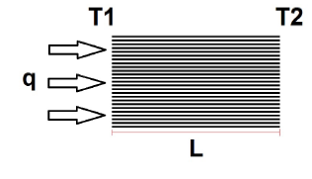
Experiment, concept
Experimental Scheme:

Slide 9
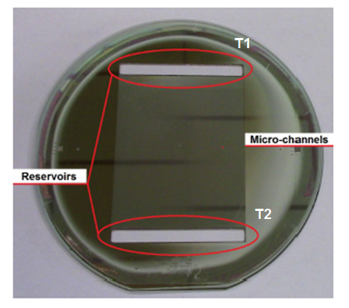
Experiment, set up
Real micro-channels:
Pyrex plates are used,
Because of low thermal
Expansion coefficient.

Slide 10
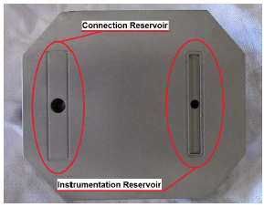
Experiment, set up
Invar support:
Invar is used because
it’s thermal expansion
is compatible with the
Pyrex expansion,
avoiding cracking
because of contraction.

Slide 11
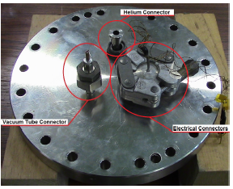
Experiment, set up
Vacuum can, upper lid:
Three connections,
passage of helium,
passage of wires,
vacuum generation.

Slide 12
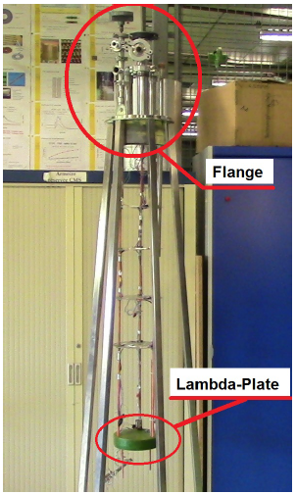
Experiment, set up
Insert:
Skeleton of the experiment,
allows the connection between
the exterior and the interior
of the experiment.
Lambda-plate separates the
superfluid helium from helium
at 4.2 K.

Slide 13
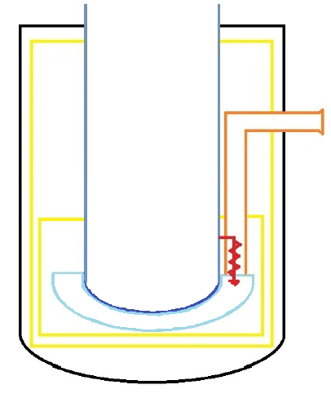
Exeriment, set up
Cryostat, isolated
by radiation
barriers and vacuum.

Slide 14
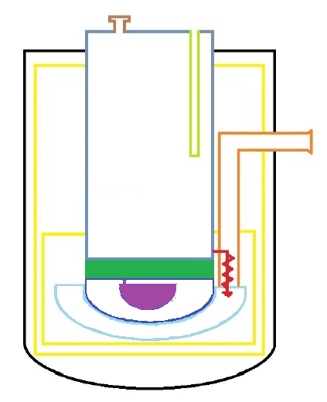
Exeriment, set up
Insertion of the insert.

Slide 15
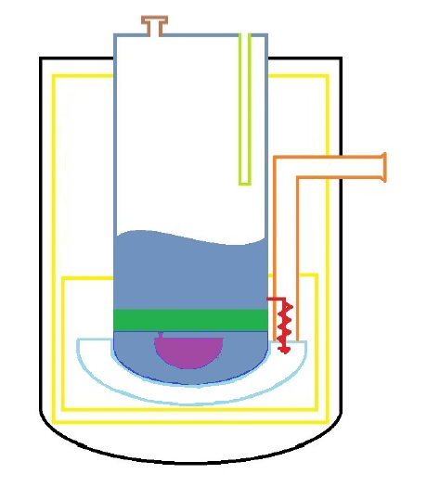
Exeriment, set up
Filling with
liquid helium.

Slide 16
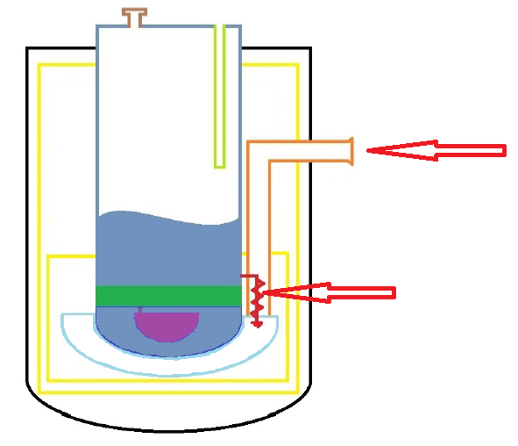
Exeriment, set up
Activation of the
pumpimg and
of the valve.

Slide 17
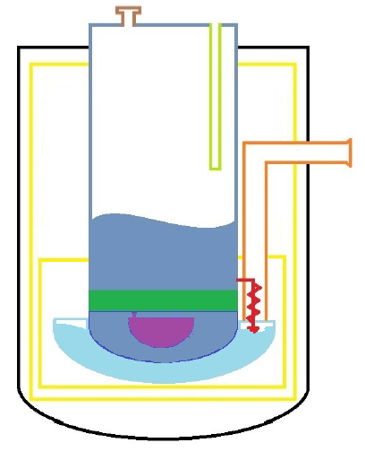
Exeriment, set up
Aparition of superfluid
helium.

Slide 18
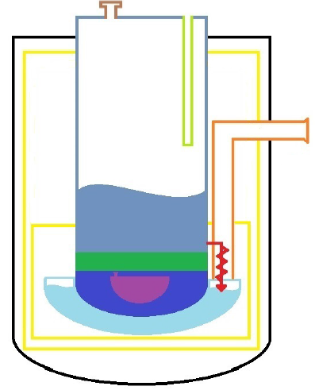
Exeriment, set up
Cooling by contact.

Slide 19
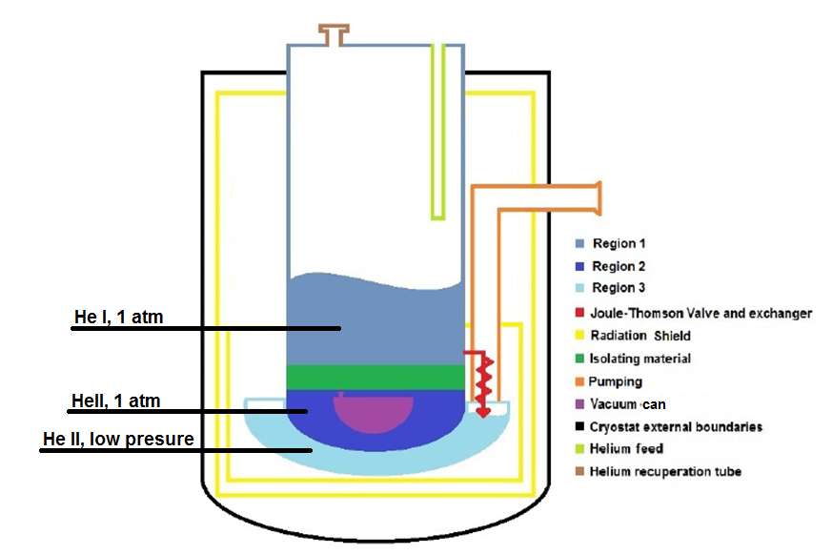
Experiment, schematics

Slide 20
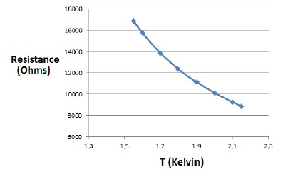
Experiment, preparation
Calibration of the heat sensors.
Calibration by curve
that relies resistance
to temperature.

Slide 21
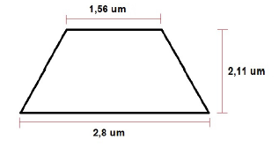
Experiment, first results
Micro-channel used:
Equivalent hydraulic
dyammeter of 2.2
micro meters.
1666 channels.

Slide 22
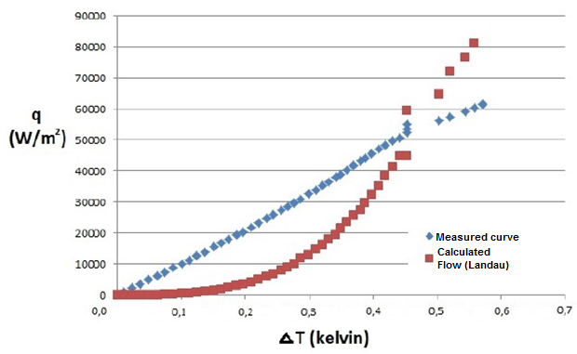
Experiment, first results
Measured VS expected heat transfer, considering the flow through helium:

Slide 23
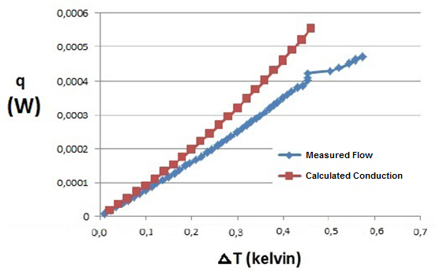
Experiment, first results
Expected heat transfer through the solid components VS measured heat transfer:

Slide 24
Experiments, first result
Clear that the heat transfer measured is controled by the conduction through the solid parts;
Although the value of the heat transfer through the helium was not measured, several informations were acquired.

Slide 25

FreeFem++, model
Total fluid momentum equation:
Total fluid continuity equation:
Variables with « n » are in respect to the normal component of the
two fluid model. The ones with « s » refer to the superfluid
component.

Slide 26

FreeFem++, model
Superfluid component momentum equation:
Normal component momentum equation:
Negliged term:

Slide 27

FreeFem++, model
Heat equation:

Slide 28


FreeFem++, variational formulation
Use of the « fixed-point » method, in which auxiliar variables are caracterized by an added « p » to them.
Use of Greens theorem:

Slide 29
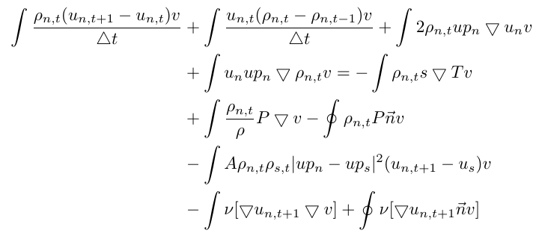
FreeFem++, variational formulation
Normal fluid equation:

Slide 30
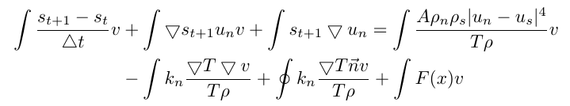
FreeFem++, variational formulation
Heat equation:

Slide 31
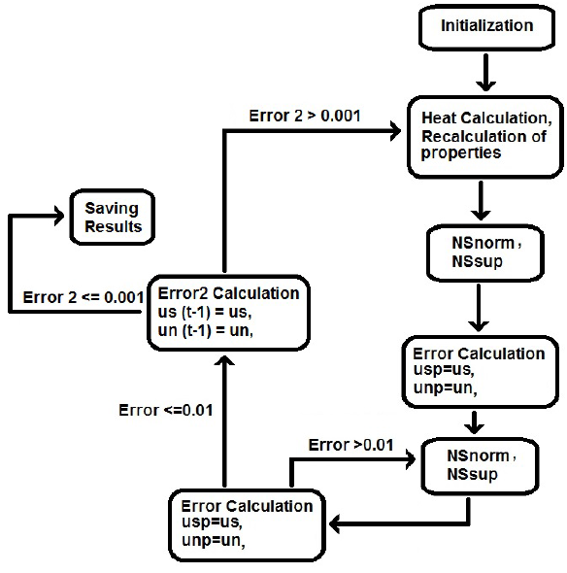
FreeFem++, routine

Slide 32
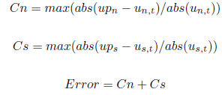


FreeFem++, error calculation
Fixed-point error:
Temporal error:

Slide 33
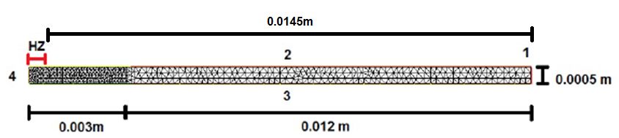
FreeFem++, simulation conditions
Heat zone equation:

Slide 34
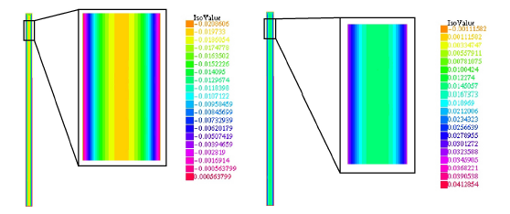
FreeFem++, results
Imposed temperature:
Normal component velocity
Superfluid component velocity

Slide 35
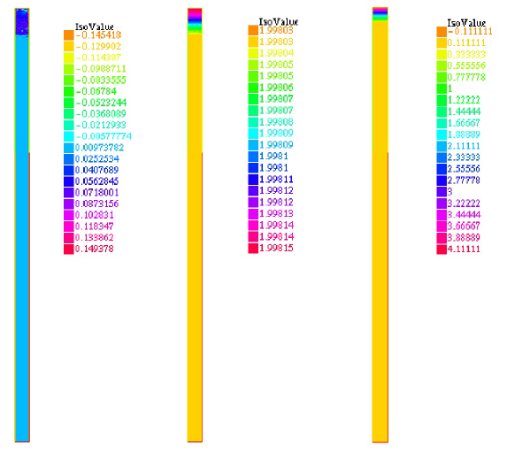
FreeFem++, results
Superfluid component velocity, temperature and heat source.

Slide 36


Fluent, evaporation
Equations already present in Fluent:
Where:
Problems to determinate the coefficient.

Slide 37


Fluent, evaporation
Temperature inside a cell in phase change is constant, exceeding heat received is used for evaporation.

Slide 38
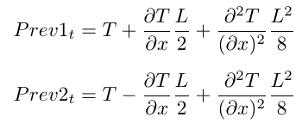

Fluent, grid refinning
Using dynamic prevision to refine only when needed:

Slide 39
Fluent, minor changes
Gas phase added;
Implementation of funtions to calculate fluid properties instead of reading documents to make the code faster;
Adaptation of the code for the new speed profiles present;
Implementation of a CFL condition.

Slide 40
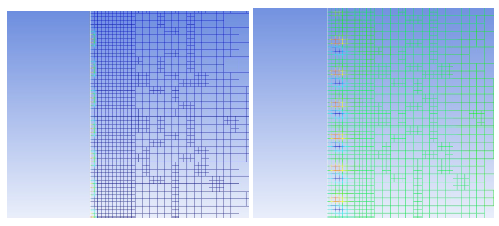
Fluent, results
Evaporation seems to work:

Slide 41
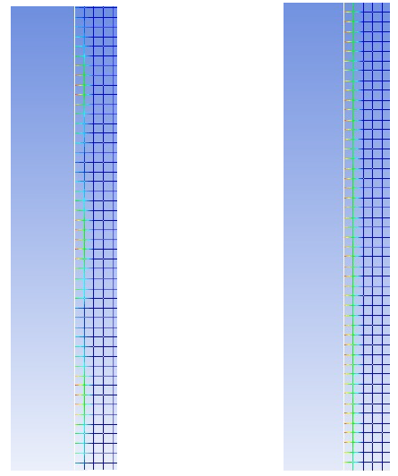
Fluent, results
Variation given wall adhesion angles can be seem:

Slide 42
Conclusion
The experiment gave important information but can’t be used to validate or disprove the literature;
The enhancement of the code using the software Ansys Fluent seems to have worked, needing now a physical comparison case;
The code using FreeFem++ also show promising results, although the calculation time is too big to give results of complex cases;

Slide 43
Conclusions
Multi processor coding will have to be implemented in FreeFem++ codes to allow the effective use of the code for validation of experiments;
Other experimental cases are being produced and will be realised.

