Slide 1
A Micromegas TPC for the ILC
Wenxin Wang
CEA-Saclay

Slide 2
Outline
Introduction: Micromegas & TPC
Micromegas ILC-TPC
    ILC & LP-TPC
    Beam test with Micromegas modules
    Test bench
    Ion backflow measurement
Other Micromegas TPC application
  Imaging by neutrons
Conclusion
Introduction: Micromegas & TPC
Micromegas ILC-TPC
    ILC & LP-TPC
    Beam test with Micromegas modules
    Test bench
    Ion backflow measurement
Other Micromegas TPC application
  Imaging by neutrons
Conclusion

Slide 3
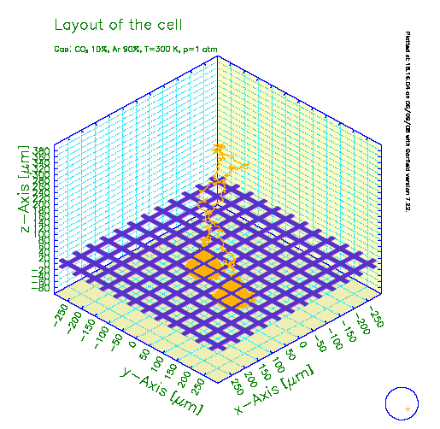
Micromegas
MICROMEsh GAseous Structure
Invented by Y. Giomataris et al, (CEA/Saclay) 1996
E_{amplif} / E_{drift} ~ 200
Characteristics:
Spatial resolution (<100μm)
Small gap: fast rise time (<1ns) and fast collection of ions (<100ns)
High gain (up to 10⁵ or more)
Low ion back-flow into drift space
Cathode
Amplification gap
~50-100 µm ~50 kV/cm
Drift gap
~0.3 kV/cm
Mesh
PCB

Slide 4
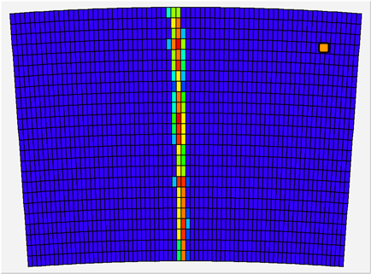
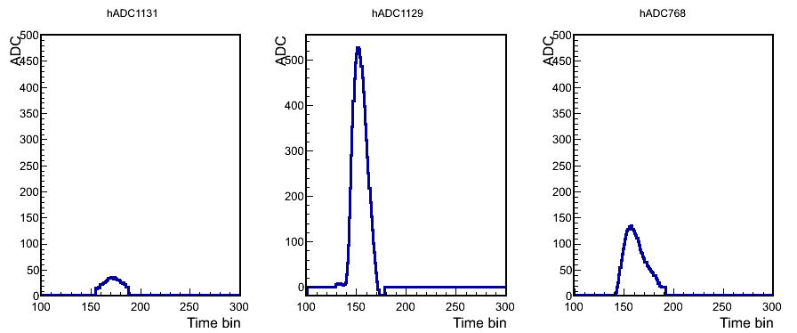

TPC: Time Projection Chamber
( Micromegas TPC )
Ionization energy loss(dE/dx)
3D track points reconstruction
Electrons diffuse and drift due to the E-field
t
B
E
A magnetic field reduces electrons diffusion
y
Micromegas TPC : the position-sensitive electron collection system is made by Micromegas
x
Localization in time and position

Slide 5
Outline
Introduction: Micromegas & TPC
Micromegas ILC-TPC
    ILC & LP-TPC
    Beam test with Micromegas modules
    Test bench
    Ion backflow measurement
Other Micromegas TPC application
  Imaging by neutrons
Conclusion

Slide 6
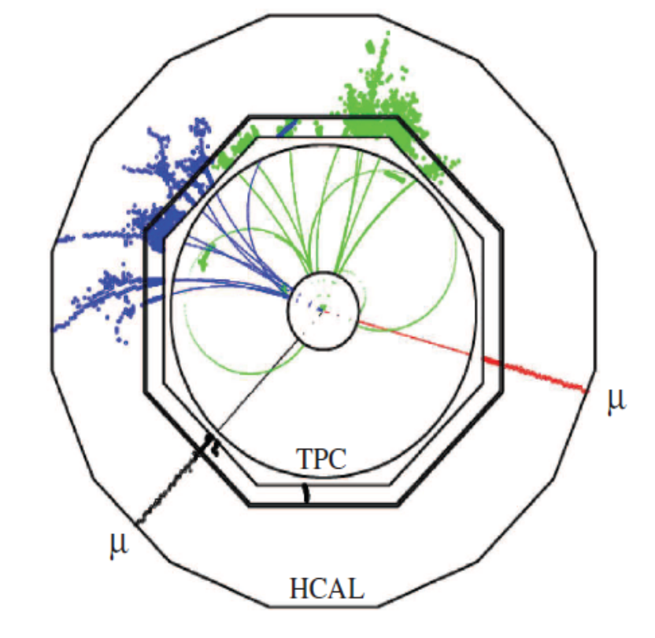
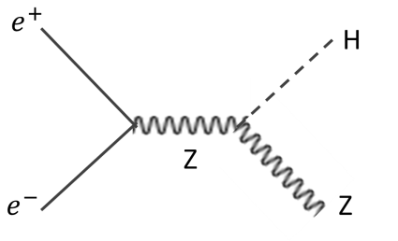
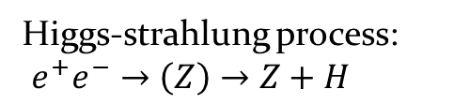

Higgs boson & ILC
(International Linear Collider)
Higgs 125 GeV has been discovered at LHC
It can be studied in detail at ILC where it is produced by Higgs-strahlung.
$HZ→b\overline{b}μ^{+}μ^{−}$
This allows an unbiased selection by Z recoils, to measure mass and all possible decay modes.
This sets the goal resolution of 100 μm per pad row.
Higgs-strahlung process:
$e^{+}e^{−}→\left(Z\right)→Z+H$

Slide 7
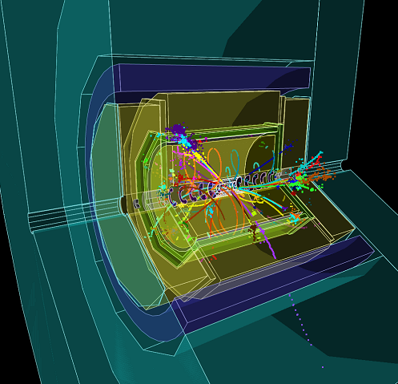
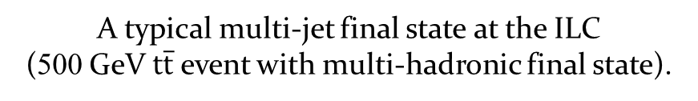
Top quark & ILC
Many interesting processes have many jets and many charged tracks.
TPC provides 3D continuous tracking with low material budget. This is important for pattern recognition .
A typical multi-jet final state at the ILC
(500 GeV $t\overline{t}$ event with multi-hadronic final state).

Slide 8
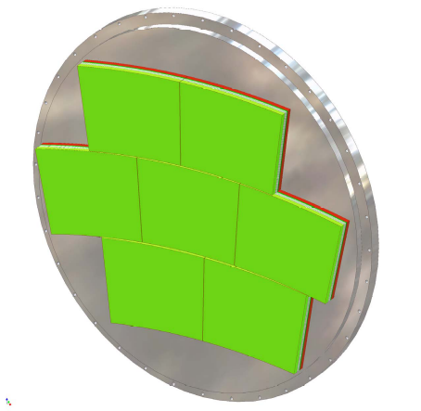
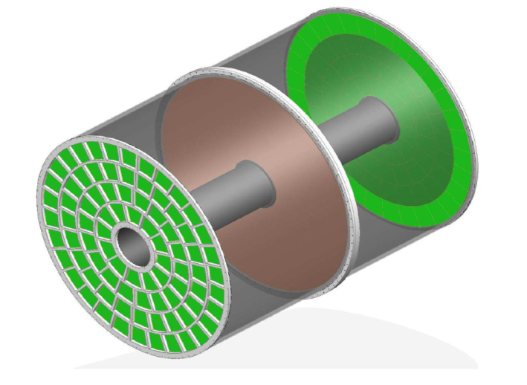

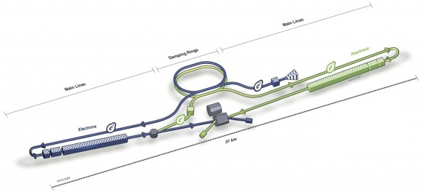
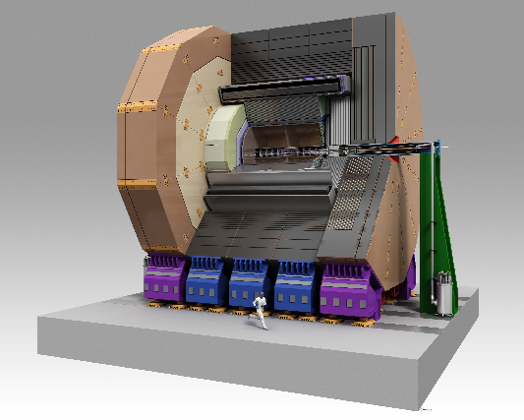
ILD-TPC for ILC
Design for an ILD TPC in progress:
Each endplate: 80 modules with 8000 pads
L: 4.7m
φ: 3.6m
Spatial Resolution (in a B=3.5T magnetic field):
δ(x) ~ 100μm for the full 2.3m drift
Low material budget in front of the calorimeters:
Barrel: 5% X0
Endplates: ~25% X0
31 km
ILD

Slide 9
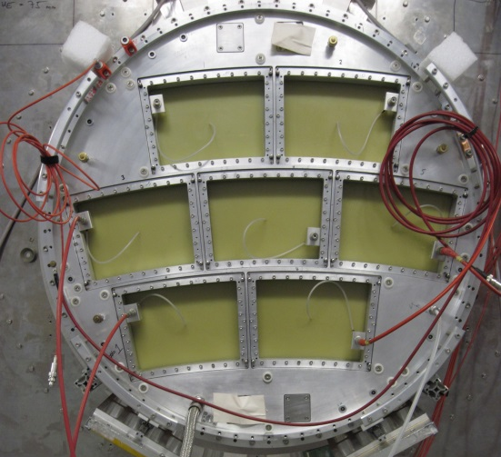
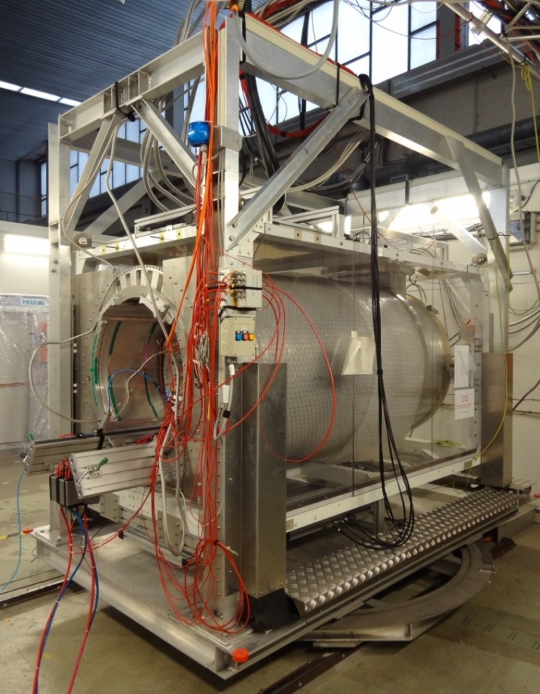
Large Prototype-TPC (LP-TPC)
EUDET setup at DESY
Magnet up to 1.2T
Field cage: 61 cm length and 72 cm diameter
7 interchangeable modules with keystone shape
Gaseous mixture: T2K gas (Ar:CF₄:iC₄H₁₀ =95%:3%:2%)

Slide 10
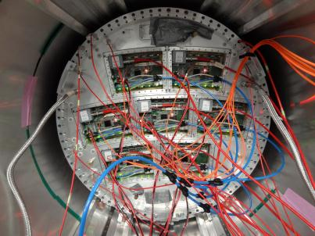
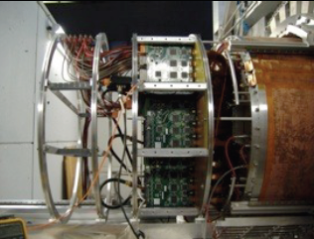
MPGD: Micromegas & GEM
Several Micro-Pattern Gaseous Detectors types of readout modules are studied
Readout |  | Pad Size | Electronics | Groups
MPGDs | Micromegas (Resistive anode) | (~ 3 × 7 mm² Pad) | AFTER | Saclay-Carleton
Readout |  | Pad Size | Electronics | Groups
MPGDs | Micromegas (Resistive anode) | (~ 3 × 7 mm² Pad) | AFTER | Saclay-Carleton
 | Double GEMs (Laser-etched) | (~ 1 × 6 mm² Pad) | ALTRO | Asia
 | Triple GEMs (wet-etched) |  |  | Desy
GEM
(test with 3 modules)
Micromegas
(test with 7 modules)

Slide 11
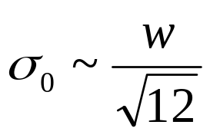

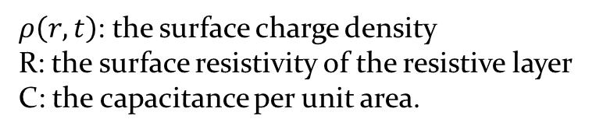
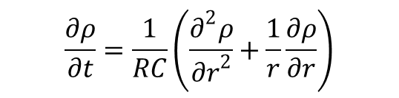
Micromegas with Resistive Anode
Pad width limits MPGD TPC resolution
Charge dispersion technique with a resistive anode
w : pad width
σ₀ : resolution at Z=0 without diffusion
Equation for surface charge density function on the 2D continuous RC network:
mesh
$$\frac{∂ρ}{∂t}=\frac{1}{RC}\left(\frac{∂^{2}ρ}{{∂r}^{2}}+\frac{1}{r}\frac{∂ρ}{∂r}\right)$$
B
E
mesh
Amplification gap: ~100μm
B
Amplification gap: ~100μm
E
resistive foil: ~75μm
insulator: ~100μm
pads
pads
$ρ\left(r,t\right)=\frac{RC}{2t}exp\left(\frac{−r^{2}RC}{4t}\right)$
$ρ\left(r,t\right)$: the surface charge density
R: the surface resistivity of the resistive layer
C: the capacitance per unit area.
Direct signal readout technique
Resistive foil also provides
anti-spark protection

Slide 12
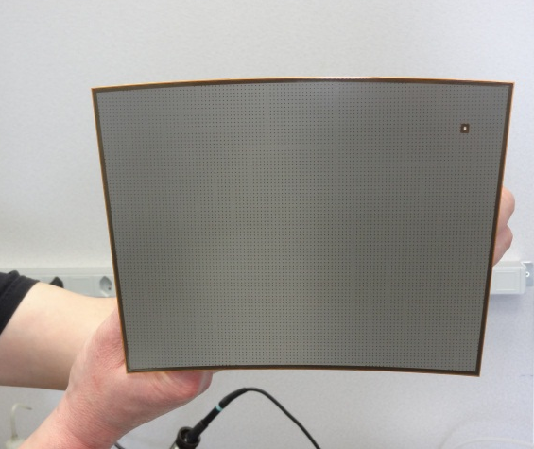
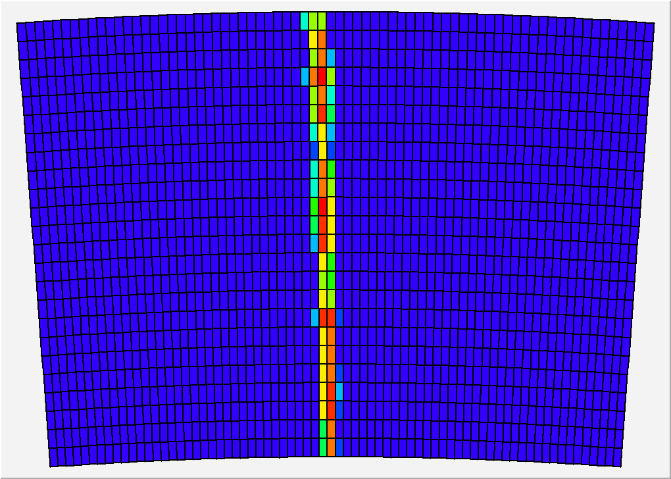
Micromegas module
Module size: 22 cm × 17 cm
24 rows × 72 columns
Readout: 1726 Pads
Pad size: ~3 mm × 7 mm

Slide 13
2008~2011:
Test with one module at the center of LP-TPC
2012~2013:
Test with multi-modules at the endplate of LP-TPC

Slide 14
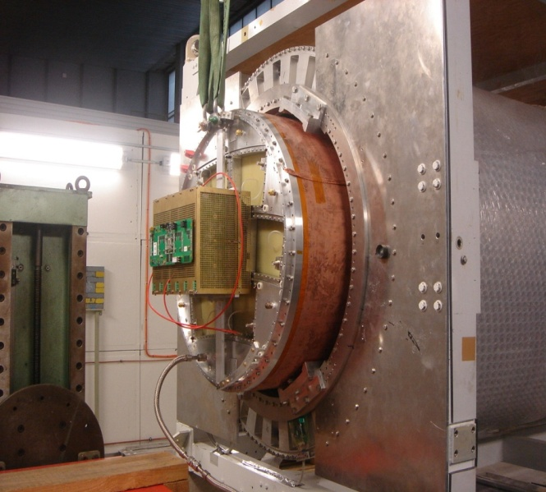
Tests with one single module
(2008~2011)
At the center of LP-TPC

Slide 15
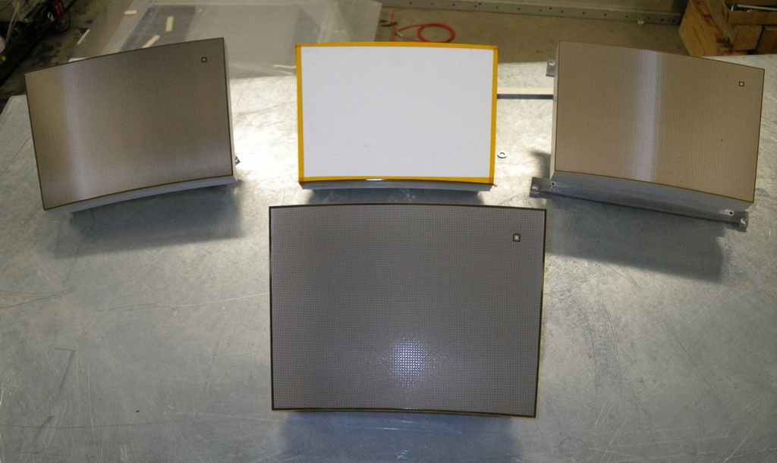
Micromegas modules
Module 4 &
Module 5
Module 3
Module 1
Resistive Kapton
~3 MΩ/□
Resistive Kapton
~5 MΩ/□
Standard
(no resistive layer)
Module 2
Resistive ink
~3 MΩ/□

Slide 16
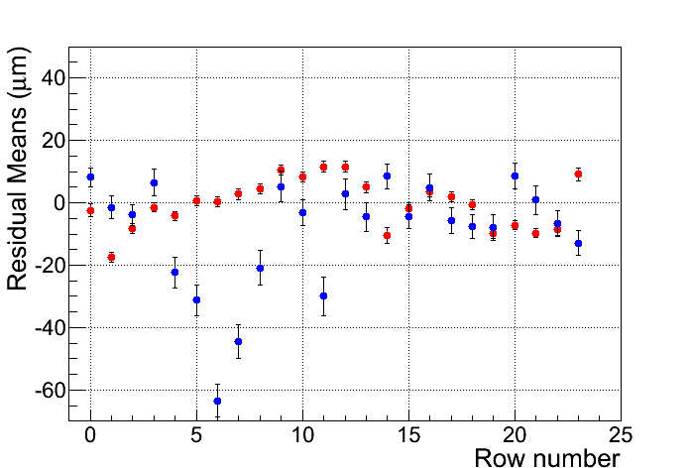
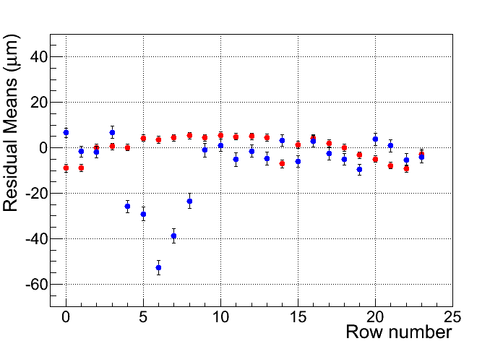
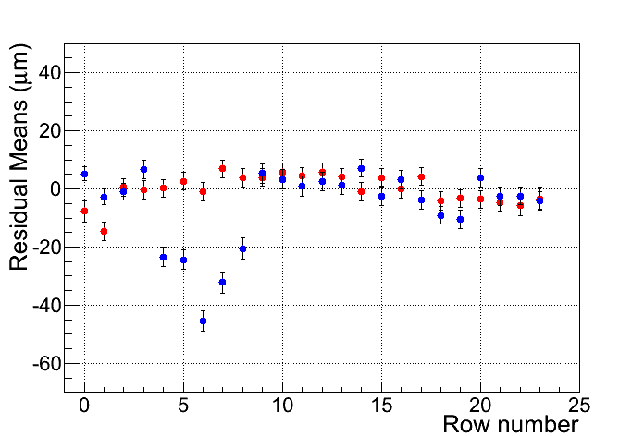
Uniformity
Resistive CLK Module
Resistive ink Module
Z=5cm
Mean Residual vs Row Number
Z-independent distortions
Distortions up to 50 microns for resistive ink (blue points)
Rms 7 microns for CLK film
(red points)
Z=35cm
Z=50cm
Row number

Slide 17
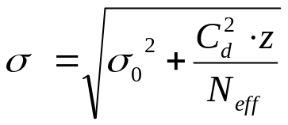
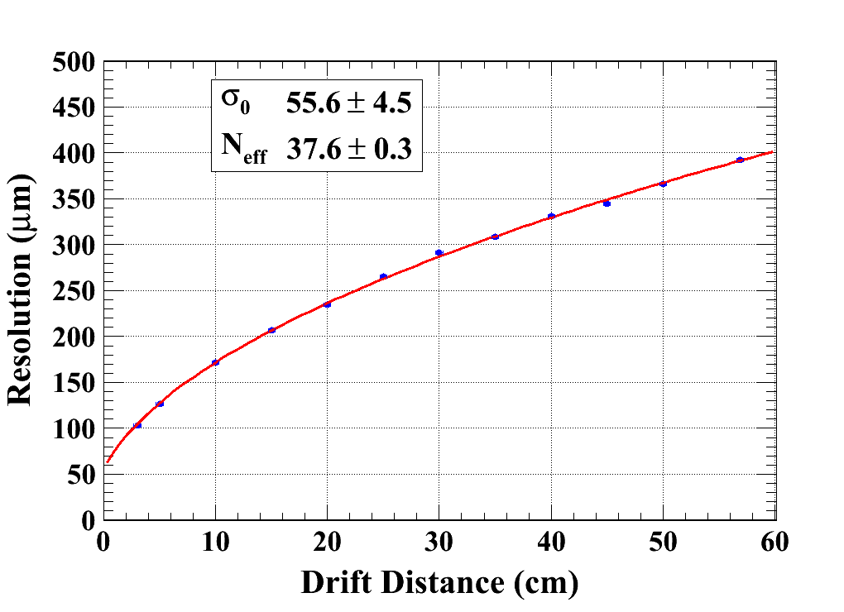

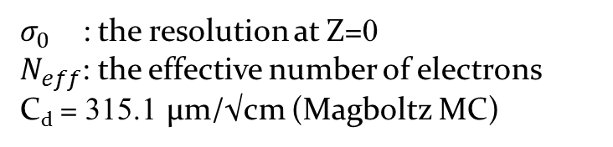
Spatial resolution
(B = 0T)
$σ_{0}$ : the resolution at Z=0
$N_{eff}$: the effective number of electrons
C_{d} = 315.1 µm/√cm (Magboltz MC)
Module 4
Module 5

Slide 18
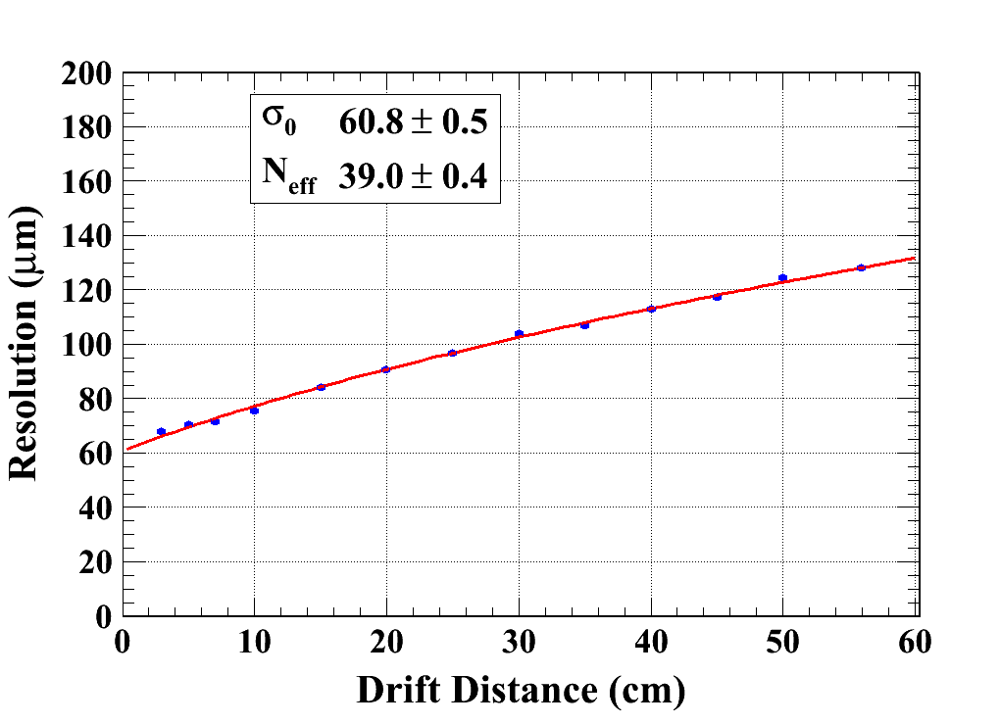
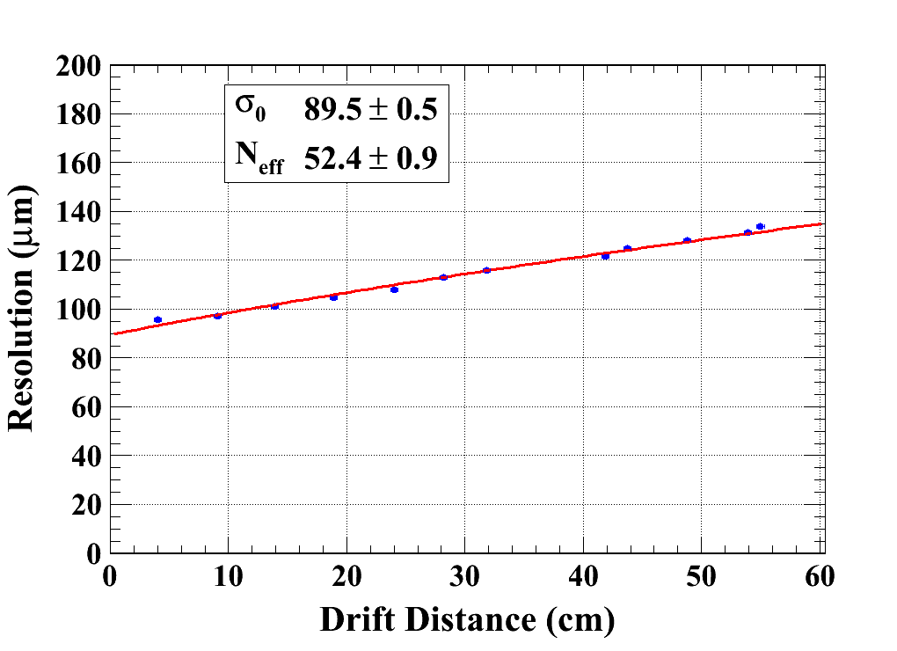
Spatial resolution
(B = 1T)
C_{d} = 94.2 µm/√cm (Magboltz MC)
Module_CLK
Module_INK

Slide 19
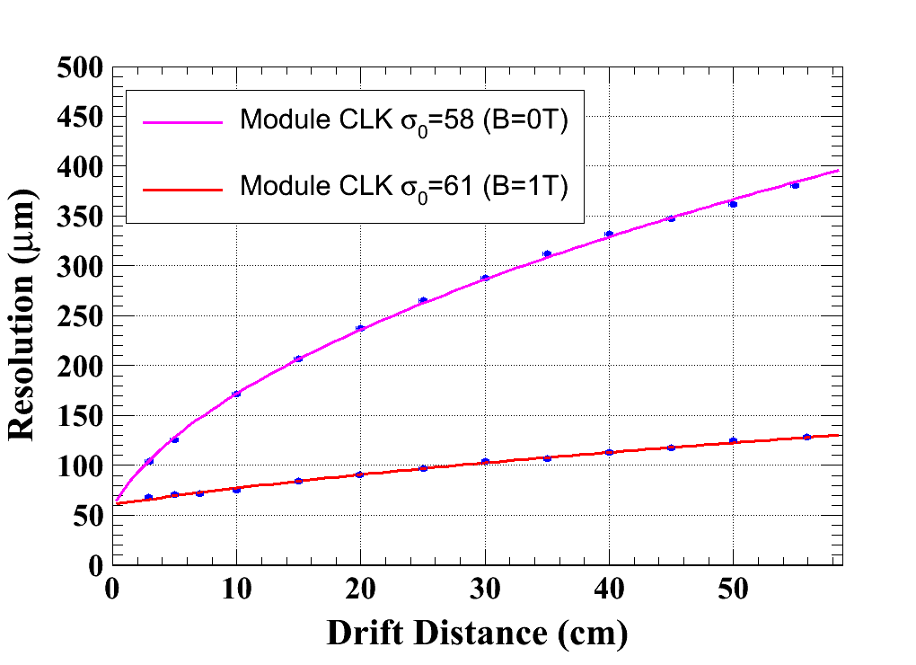
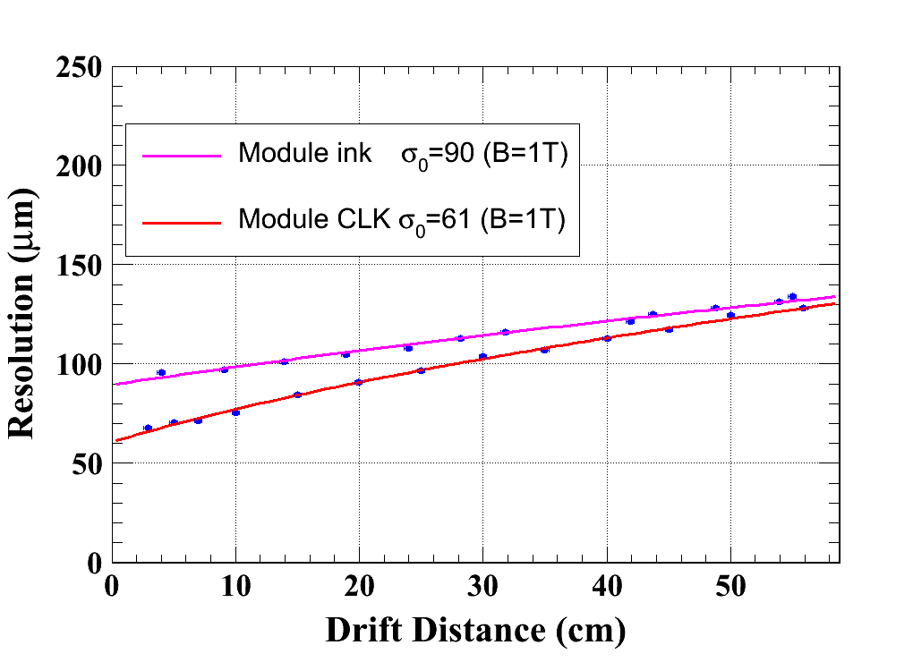
Spatial resolution

Slide 20
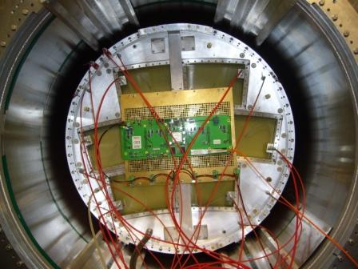
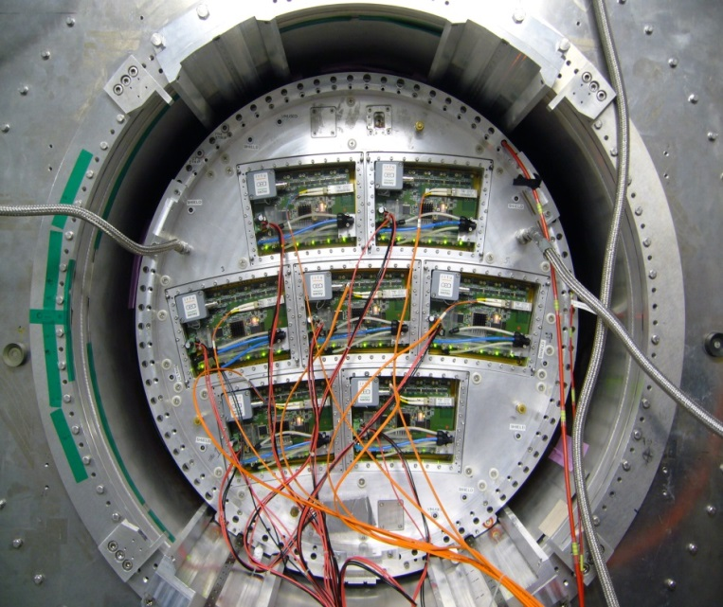
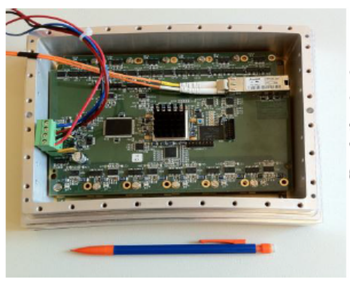
Tests with multi-modules
(2012~2013)
Fully cover the endplate of LP-TPC
Using a quasi-industrial production chain

Slide 21
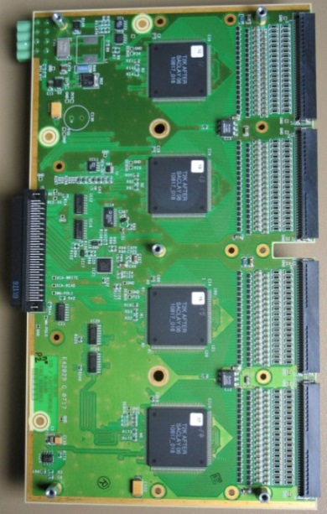
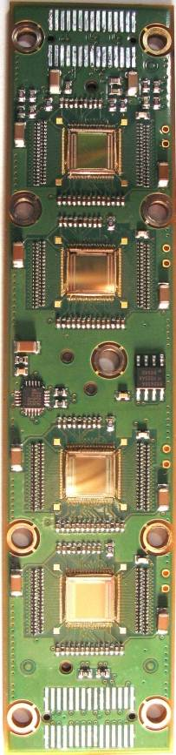
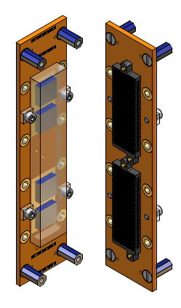
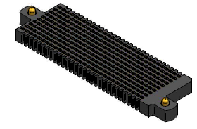
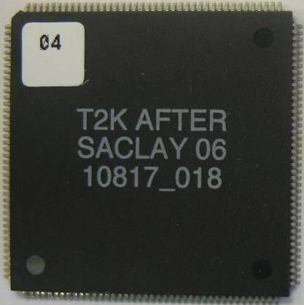
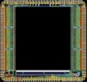
Integrated electronics
Remove packaging and protection diodes
Wire-bond AFTER chips
Use two 300-point connectors
Front-End Card
(FEC)
25 cm
4.5 cm
12.5 cm
14 cm
3.5 cm
2.8 cm
3.5 cm
0.78 cm
AFTER Chip
0.74 cm
  The resistive foil protects against sparks

Slide 22
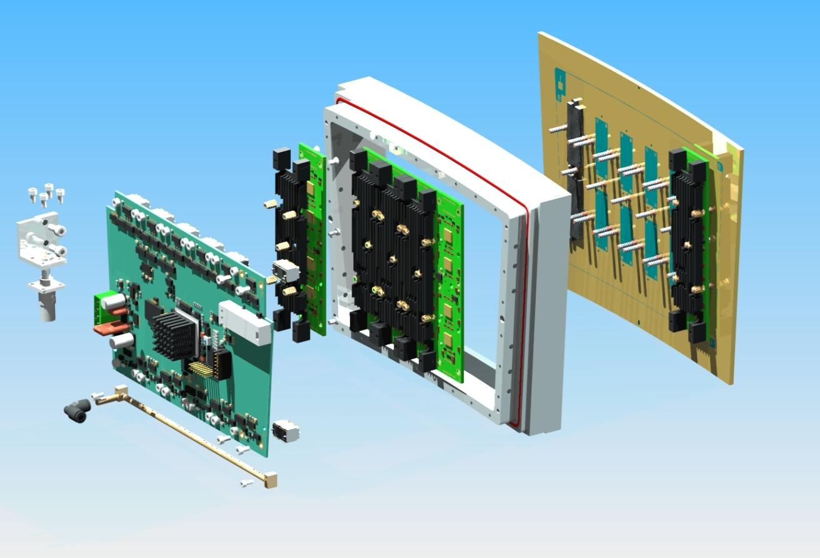
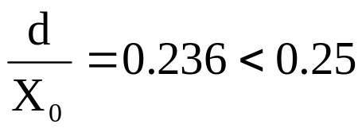
Material budget of a module
 |  | M (g) | Radiation Length (g/cm²)
Module frame + Back-frame + Radiator (×6) | Al | 714 | 24.01
Detector + FEC PCB (×6) + FEM | Si | 712 | 21.82
12 ‘300-point’ connectors | Carbon | 30 | 42.70
screws for FEC + Stud screws+ | Fe | 294 | 13.84
Air cooling | brass | 12 | 12.73
 | Plexiglas | 128 | 40.54
Average of a module |  | 1890 | 21.38
Front-End Card (FEC)
‘300-point’ connectors
Pads PCB +
Micromegas
Cooling system
Front-End Mezzanine (FEM)
Low material budget requirement for ILD-TPC:
Endplates: ~25% X₀
(X₀: radiation length in cm)

Slide 23
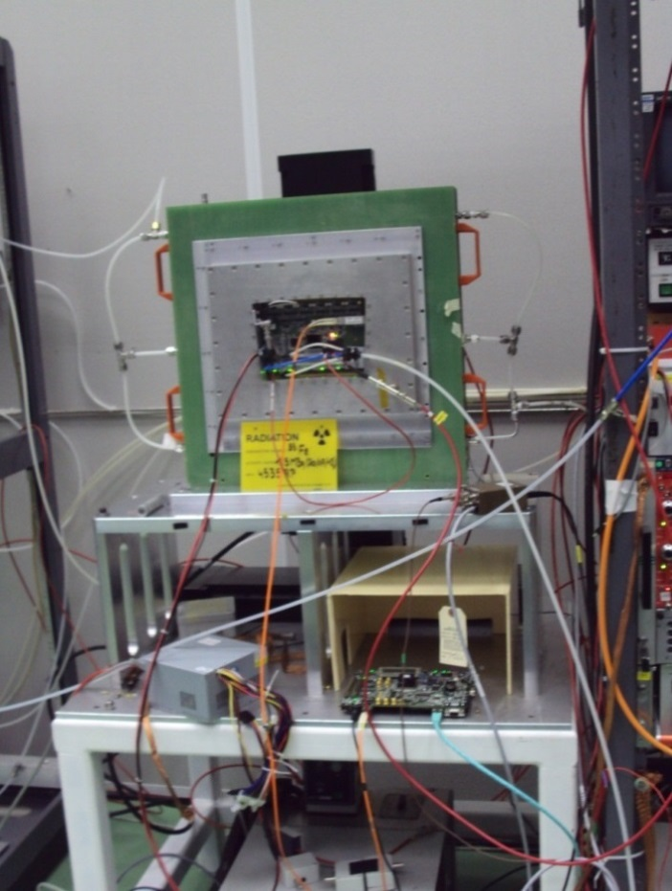
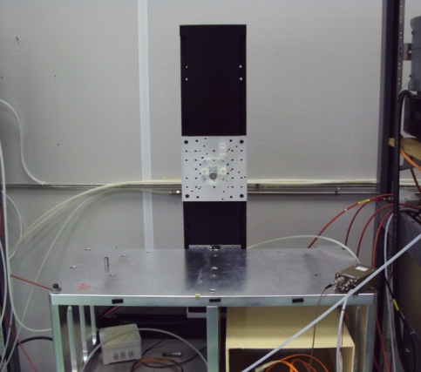
Test bench
A ⁵⁵Fe source is put in an aluminum collimation tube and fixed on a set of two mechanical arms (X-Y).

Slide 24
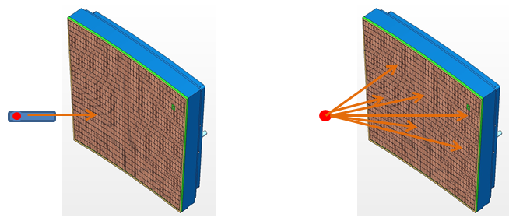
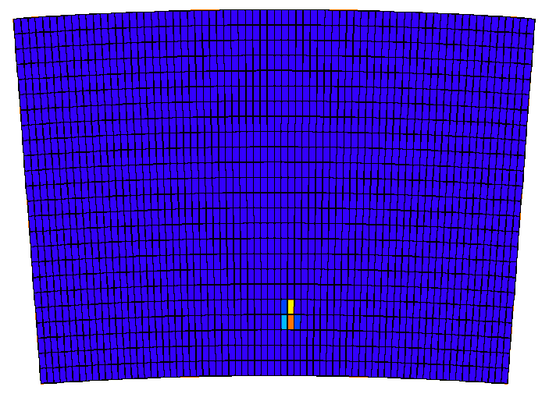
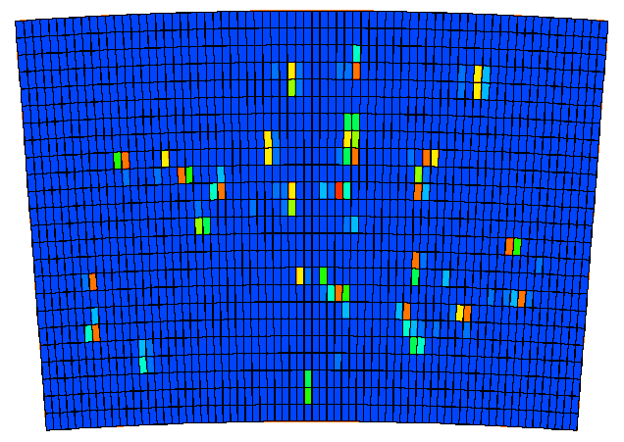
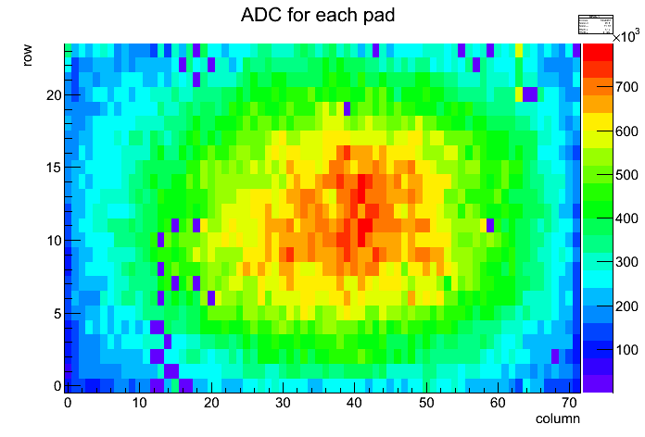
Test bench
Test without collimator
to check the map of missing pads
Test with collimator

Slide 25
Modules comparison
At V_{mesh} = 380 V, Energy resolution ~12% r.m.s

Slide 26
Modules comparison
At V_{mesh} = 380 V, average gain ~ 2630, gain spread ~15%

Slide 27



Gain Study using beam events
Charge per row
For 6.84 mm pitch & 5 GeV e-
N_{electron} (MPV) expected = 45
(from HEED simulation)
2500 at V_{mesh}=380V
( 2700 at V_{mesh}=380V
From test bench)

Slide 28


Beam events display
Online monitor
2D or 3D display from ILC software
Offline monitor

Slide 29
Analysis Framework: MarlinTPC
MarlinTPC
Marlin based simulation, digitization, reconstruction and analysis code for the TPC.
KalDet &KalTest: (installed in Marlin)
    A ROOT-based Kalman Filter Package.
    Used to reconstruct tracks.

Slide 30


Spatial resolution
Event selection
→ only single track event

Slide 31





Spatial resolution
Hit selection
Fit track with all rows
$σ_{i}$ : supposed residual of the detector
$X_{i}$: the fitted hit position in test row
$\overline{X}$ : the position of track crossing the test row

Slide 32


Spatial resolution
Pad size
(mm)
(mm)
(mm)
(mm)
Profile histogram of the residual with the track in one row before bias correction
Profile histogram of the residual with the track in one row after bias correction

Slide 33






Spatial resolution
Distribution of the residuals (z = 15 cm)
$$∆_{in}$$
$$∆_{ex}$$
$$σ=\sqrt{σ_{include}×σ_{exclude}}$$
$$\left(\begin{aligned}∆_{in}=x_{track}^{in}−x_{hit} \\ ∆_{ex}=x_{track}^{ex}−x_{hit} \end{aligned}\right)$$

Slide 34



Spatial resolution
B=1 T C_{d} = 94.2 µm/√cm (Magboltz MC)
24 rows of a module

Slide 35



Extrapolation of the spatial resolution
Extrapolate to 2.3m & B=3.5T
B=1T
--- Micromegas with
3 mm width pads
--- GEM with 1 mm
width pads
B=0T
B=1T
B=3.5T

Slide 36




Distortions
B=1T
After alignment B=0T
B=0T

Slide 37


Field distortions
Distortions in B=0T or B=1T
at different drift distances z (15cm~50cm)
B=0T
B=1T

Slide 38

Ion backflow measurement

Slide 39



Ion backflow measurement
A 10 cm ×10 cm T2K prototype
Bulk Micromegas
T2K gaseous mixture
Ar/CF₄/Isobutane (95:3:2)
I_{d} : Current on the cathode
I_{a} : Current on the mesh
I_{p} : Current on the cathode without amplification applied in the amplification gap

Slide 40


Gain
A measured ⁵⁵Fe spectrum
(at V_{mesh} = 350 V and V_{drift} = 400 V)
Gain as a function of V_{mesh}
(E_{drift} = 0.2 kV/cm at atmospheric pressure)

Slide 41

Electron transparency

Slide 42


Ion backflow
For our Micromegas modules tested in LP-TPC, the field ratio is set around 200. The ion backflow will be of the order of ∼ 6×10⁻³.

Slide 43
Outline
Introduction: Micromegas & TPC
Micromegas ILC-TPC
    ILC & LP-TPC
    Beam test with Micromegas modules
    Test bench
    Ion backflow measurement
Other Micromegas TPC application
  Imaging by neutrons
Conclusion

Slide 44



Micromegas TPC for neutron imaging
Detector layout: 1728 (48×36) pads of 1.75 mm×1.50 mm
+ bulk Micromegas
Elastic scattering on hydrogen n → p
+ masks (PE)
n
Aluminized polyethylene 1 mm
between 2 layers (0.5 µm) of Al
PE
Gas: Argon + 5% Isobutane
HV_{drift}
15 mm
p
E_{drift} ~ 160 V/cm
128 µm
HV_{mesh}
E_{amp} ~ 23 kV/cm
57.4 mm
88.6 mm
(x, y, t)
Cosmics
PCB
Micromegas

Slide 45


Simulation for converter efficiency
Neutron→proton recoiling efficiency in a polyethylene [C₂H₄]_{n} layer coming from ²⁴¹Am-⁹Be source
Incident neutron spectrum
According to ISO 8529^{(*)}
* INTERNATIONAL STANDARD ISO 8529. Reference neutron radiations – Part 1: Characteristic and methods of productions. International Standard ISO 8529-1 (2001).

Slide 46




Reconstruct track
\\
Garfield
Drift lines from primary ionization e-
Proton track
Avalanches

Slide 47



Test with a ²⁴¹Am-⁹Be neutron source
4 mm
3.5mm
3 mm
2.5mm
Letters “CEA” or “LZU”
8 cm thickness
4-4.5mm width

Slide 48




Neutron imaging
Integrating the ADC of all events in one pad.
Reconstructed using the time information.

Slide 49
Outline
Introduction: Micromegas & TPC
Micromegas ILC-TPC
    ILC & LP-TPC
    Beam test with Micromegas modules
    Test bench
    Ion backflow measurement
Other Micromegas TPC application
  Imaging by neutrons
Conclusion

Slide 50
Conclusion
A lot of experience has been gained in building and operating Micromegas TPC panels.
The characteristics of the Micromegas modules, such as the uniformity, energy resolution, stability have been studied in detail.
7 modules have been successfully tested with full integration of the electronics at the same time.
Thanks to the resistive technology, the measured resolution is about 60 microns at zero drift distance with 3 mm wide pads. This meets ILC needs.
Distortions are observed. Their detailed study will allow to correct them and improve the design to minimize them.

Slide 51


