Slide 1


Understanding avalanches in Micro-Pattern Gaseous Detectors from single-electron response measurement

Slide 2
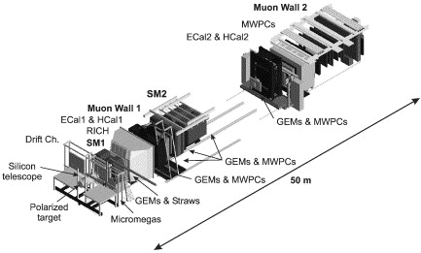
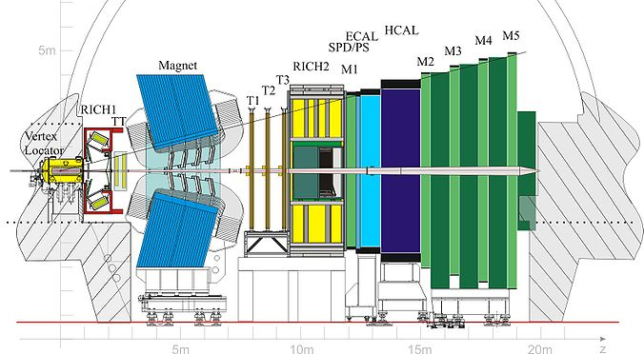
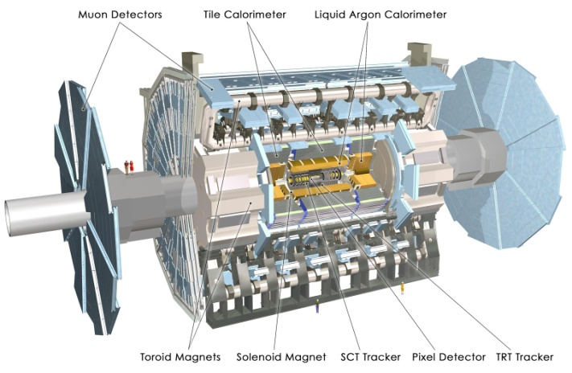
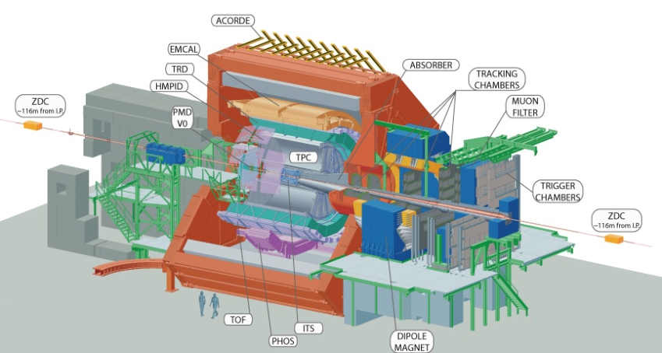
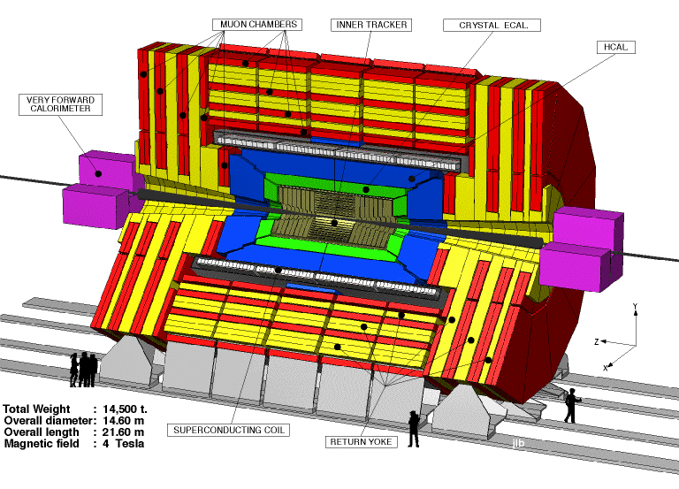
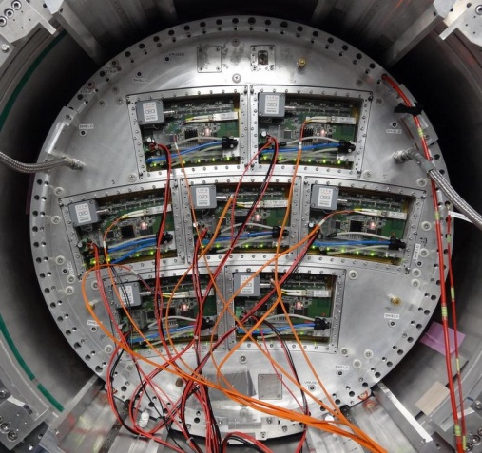

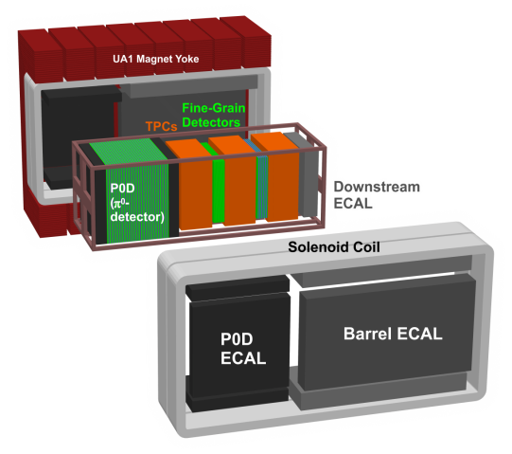
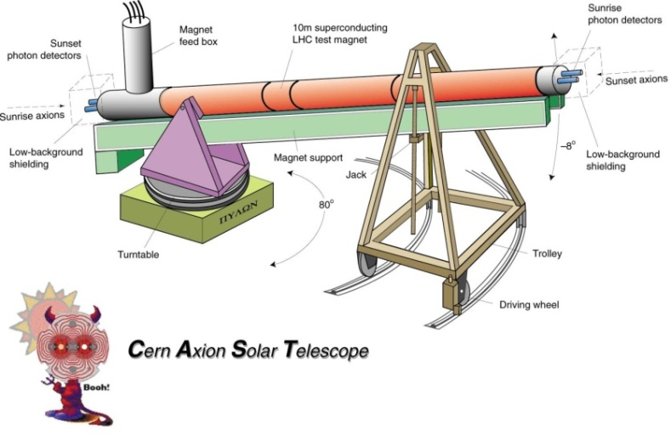
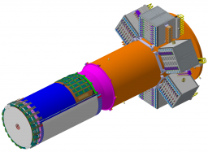
MPGDs: powerful devices for high-energy physics
COMPASS
LHCb
ATLAS
upgrade
NSW
ALICE upgrade
CMS
upgrade
T2K
CLAS12
Micromegas
vertex detector

Slide 3
Summary
- Active Target Detectors
- Statistical models of avalanche multiplication in gaseous detectors
- MPGD single-electron response (SER) measurement: examples
- The IPN Orsay laser test-bench
- Comparison with Monte-Carlo calculations

Slide 4
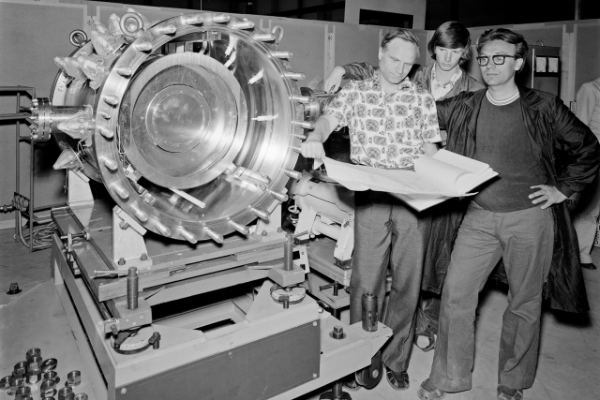
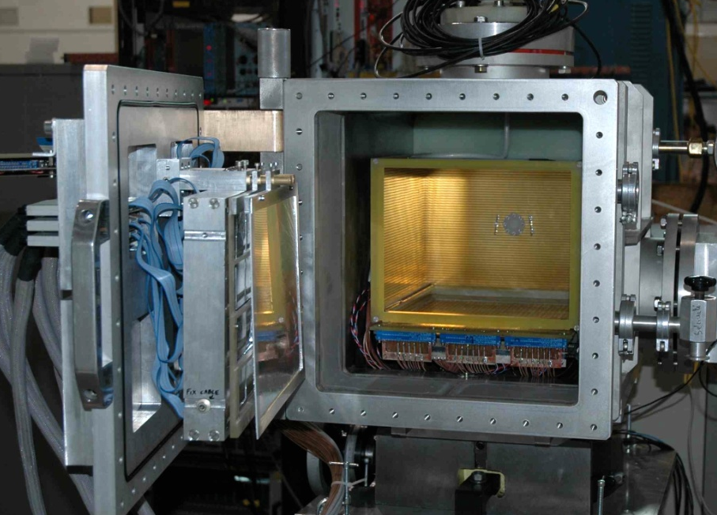
Active Target Detectors
TPC-like detector where the gas is the reaction target and the detection medium
for 3D trajectory-reconstruction of the incoming ion-beam and the reaction products
IKAR ionisation chamber
MAYA @ GANIL
Study of hadron elastic scattering in the H3
beam @CERN (1976)
28x26x20cm³ filled gas volume (P_{max} 3 bars)
Segmented cathode with 35x35 5mm hexagonal pads read by Gassiplex chips, amplification MWPC
A.A. Vorobyov et al., NIM A 270 (1988) 419-430.
C.E. Demonchy et al., NIM A 573 (2007) 145-148
R&D efforts to build new active target detectors with higher granularity pad planes using a MPGD as amplification device to improve luminosity, efficiency, energy and spatial resolution.

Slide 5
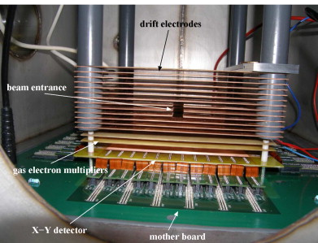
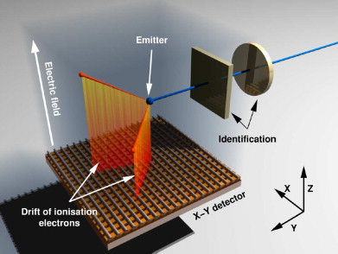
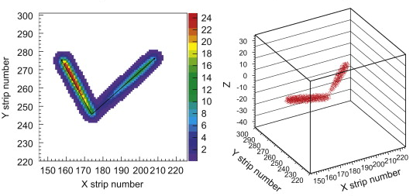
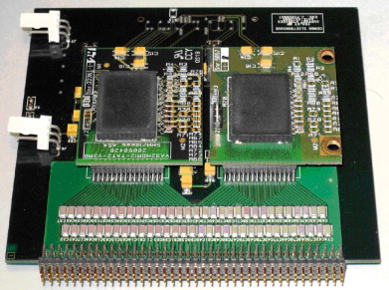
The CENBG Time-Projection Chamber
A time-projection chamber for the 3D reconstruction of 2p radioactivity events
Isotope identification + implantation in the gas
+ 3D reconstruction of protons trajectory
View of the TPC interior
Active
volume:
13.8x13.8x6
cm³
Gas: P10,
500mbar
384x384
channels
Daughterboard equipped with two 32ch
VA/TA IDEAS ASICs
Reconstruction of a ⁴⁵Fe decay event
64 energy
and time
channels
B. Blank et al., NIM A 613 (2010) 65-78

Slide 6
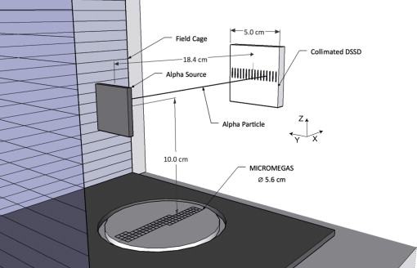
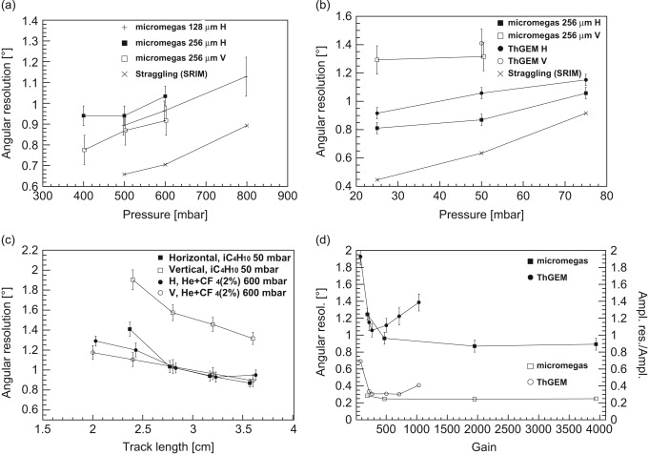
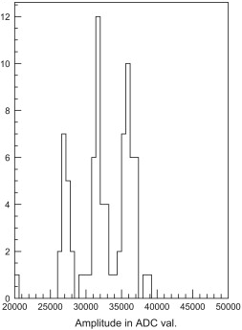
ACTAR-TPC prototype
Collaboration: GANIL Caen, CENBG Bordeaux, IPN Orsay, CEA/Irfu Saclay, University of Leuven (Belgium),
Universidade de Santiago de Compostela (Spain)
Toward a next generation of active target TPC for experiments @ GANIL SPIRAL2
Prototype MPGDs (Micromegas 128µm and 256µm, THGEM 600µm)
Circular PCB pad plane φ 5.6cm in the MAYA drift field cage
2x2mm² square pads – AFTER card 288 channels – Track length: 3.8cm
Angular resolution ~ 1º FWHM
He+CF₄ 2%
iC₄H₁₀
Micromegas 256µm
iC₄H₁₀ 50mbar
5.15, 5.48 and 5.8keV α
Energy resolution:
5, 4.5 and 6% FWHM
Ar+CF₄ 2%
1100mbars
Micromegas 256µm
J. Pancin et al., NIM A 735 (2014) 532-540
Next: demonstrator with a 2048 pixels anode PCB
equipped with the new electronics GET for TPC

Slide 7
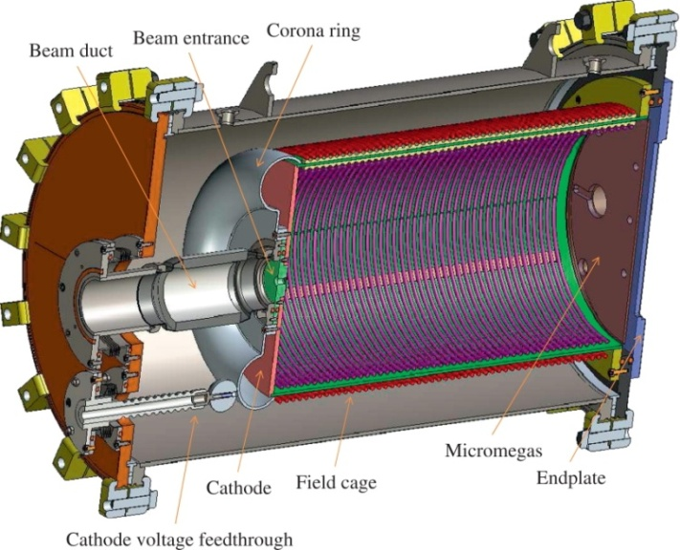
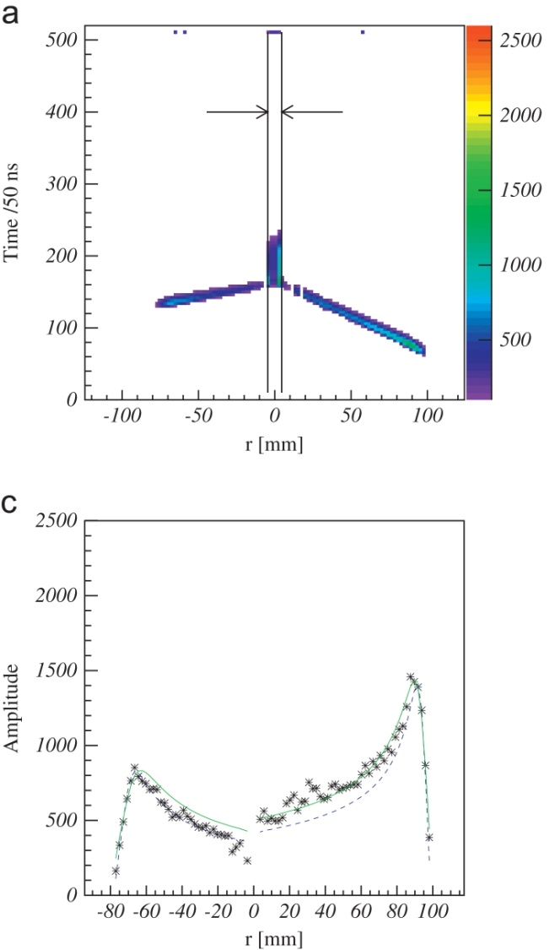
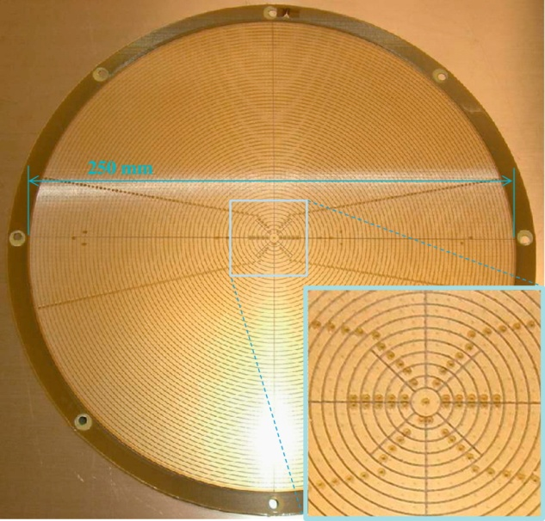
Prototype AT-TPC
Active target detector under development @NSCL-MSU
Cylidrincal field cage
φ 28 cm, length 50cm
Dual gas volume structure
Micromegas bulk 128µm
Commissionning
with a radioactive ⁶He beam
He 90% CO₂ 10% 1 bar
Drift: 0.8kV/cm , Mesh: -320V
Anode PCB
253 pads
Beam
⁴He
⁶He
Electronics:
Mesh: Canberra 2001 Preamp
Anode pads: AFTER (CEA/Saclay)
Pads biasing possible to avoid
saturation and reduce risk
of discharge
⁶He
⁴He
D. Suzuki et al., NIM A 691 (2012) 39-54

Slide 8
Summary
- Active Target Detectors
- Statistical models of avalanche multiplication in gaseous detectors
- MPGD single-electron response (SER) measurement: examples
- The IPN Orsay laser test-bench
- Comparison with Monte-Carlo calculations

Slide 9
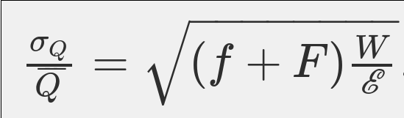
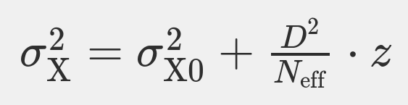
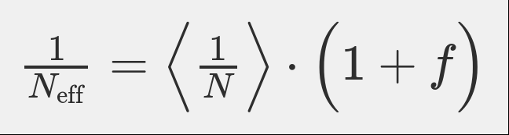
Energy and spatial resolutions
Energy resolution :
F: Fano factor (primary ionisation
fluctuations)
f: relative gain variance
(avalanche charge fluctuations)
W : Mean energy to create an ion-e⁻
pair in the gas
E : Particle energy
Spatial resolution :
σ_{X}: spatial resolution along the
pad-row direction
σ_{X0}: intrinsic resolution (=0 for
particle tracks perpendicular to
the pad row)
D: transverse diffusion
z: drift distance
N: total number of drift electrons
detected by the pad row
with:
M. Kobayashi, NIM A 562 (2006) 136-140
Avalanche charge fluctuations f set a limit
to energy and spatial resolutions.
Predictions ? Measurements ?

Slide 10
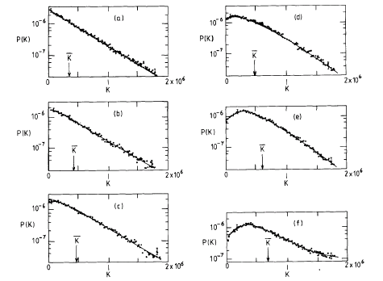
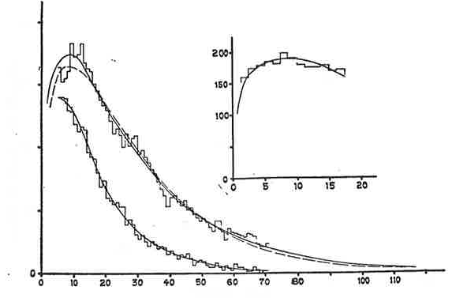
Analytic models (I)
Furry (1937), Snyder (1947), Wijsman (1949), & others:
- Probability to ionise over a distance d is αd (α first Townsend coefficient)
- α is constant
- No attachment losses
For large mean size avalanches, avalanche charge fluctuates exponentially and
f =1.
Data from Curran (1949)
Data from Cookson and Lewis (1966)
E/p=120V/cm/torr
CH₄
Hump in the
avalanche charge
distribution !!!
Ar 50% CH₄ 50%
670mbars
3550V
3550V
E/p=156V/cm/torr
3280V
Cylindrical counter
E/p=218V/cm/torr
Parallel plate

Slide 11

Analytic models (II)
Several alternative analytic models to explain this departure from an exponential
distribution:
Raether’s group: after ionisation, electrons have to travel a minimum distance before their energy
suffices to ionise
Mean distance between ionisation: 1/α
κ >>1
exponential
κ = E/ αU
Minimum distance between ionisation: U/E
κ ∼1
hump
Models based on a parameterisation of the first Townsend coefficient α:
Byrne (1962): α(r,n) = f(r) (a₀ + a₁/n) , r: electron position in the avalanche, n number of electrons
in the avalanche
Polya distribution follows for on-average-large avalanches,
in agreement with Curran’s measurement but not with Cookson and Lewis’s
Lansiart & Morucci (1962): α depends on the avalanche charge n following α(n) = α(0) (1 + k/n²)
(σ /
n
) = 1/(1+k)
< 1 in agreement with Curran’s measurement
Such an approach neglects relaxation effects (Legler 1967)
This model is unsuitable to describe electron avalanche statistics
(Alkhazov 1970)

Slide 12
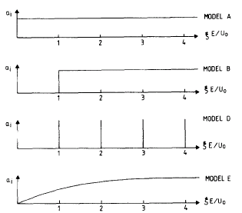
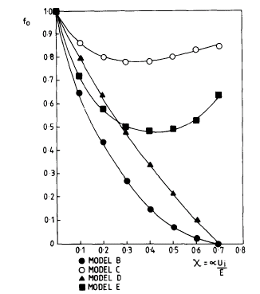
Analytic models (III)
Legler’s model (1961): Introduction of ξ , distance since last ionisation, and a(ξ), probability to ionise
again. From this parameterisation, the relative gain variance can be calculated
Snyder’s model (exponential distribution)
Legler’s model (Model gas P(n) = 1/
n
)
Φ(n/
n
)
Alkhazov’s
analysis (1970):
f = f₀ (1- 1/
f₀
n
)
G.D. Alkhazov,
NIM 89 (1970), 155-165.
J. P. Sephton et al.,
NIM 219 (1984), 534-542.
See also Rob Veenhof’s talk @ IWAD 2014
http://indico.vecc.gov.in/indico/conferenceOtherViews.py?view=standard&confId=31#2014-10-28
1/κ

Slide 13
Monte-Carlo approach
A Monte-Carlo approach is more practical than analytic models to describe
electron avalanche mechanisms in gas mixtures.
Elastic collision
Inelastic collisions (vibrations, rotations)
Ionisation
Excitation
Attachment
All these processes are ruled by cross-sections which depend on the nature of
the gas and the electron energy.
Steve Biaggi’s Magboltz program relies on this approach
Improvement needed: Inclusion of Penning effect

Slide 14
Excitation-ionisation transfer
In certain atoms, metastable excited states are unable to deexcite immediately
by emission of a photon. A deexcitation may occur through a collision with
another atom resulting in the ionisation of the latter.
Penning effect
Example: Argon + iC₄H₁₀ mixture
ARGON
iC₄H₁₀
ion: 15.7eV
D-exc: 14.0eV
P-exc: 13.0eV
Ar* + iC₄H₁₀
Ar + iC₄H₁₀⁺ + e⁻
S-exc: 11.55eV
ion: 10.7eV
The transfer rate r_{p} is the probability
that an excited state produces a new
electron by Penning effect
Exc 2: 9.7eV
Exc 1: 7.4eV
Courtesy of Özkhan Sahin

Slide 15
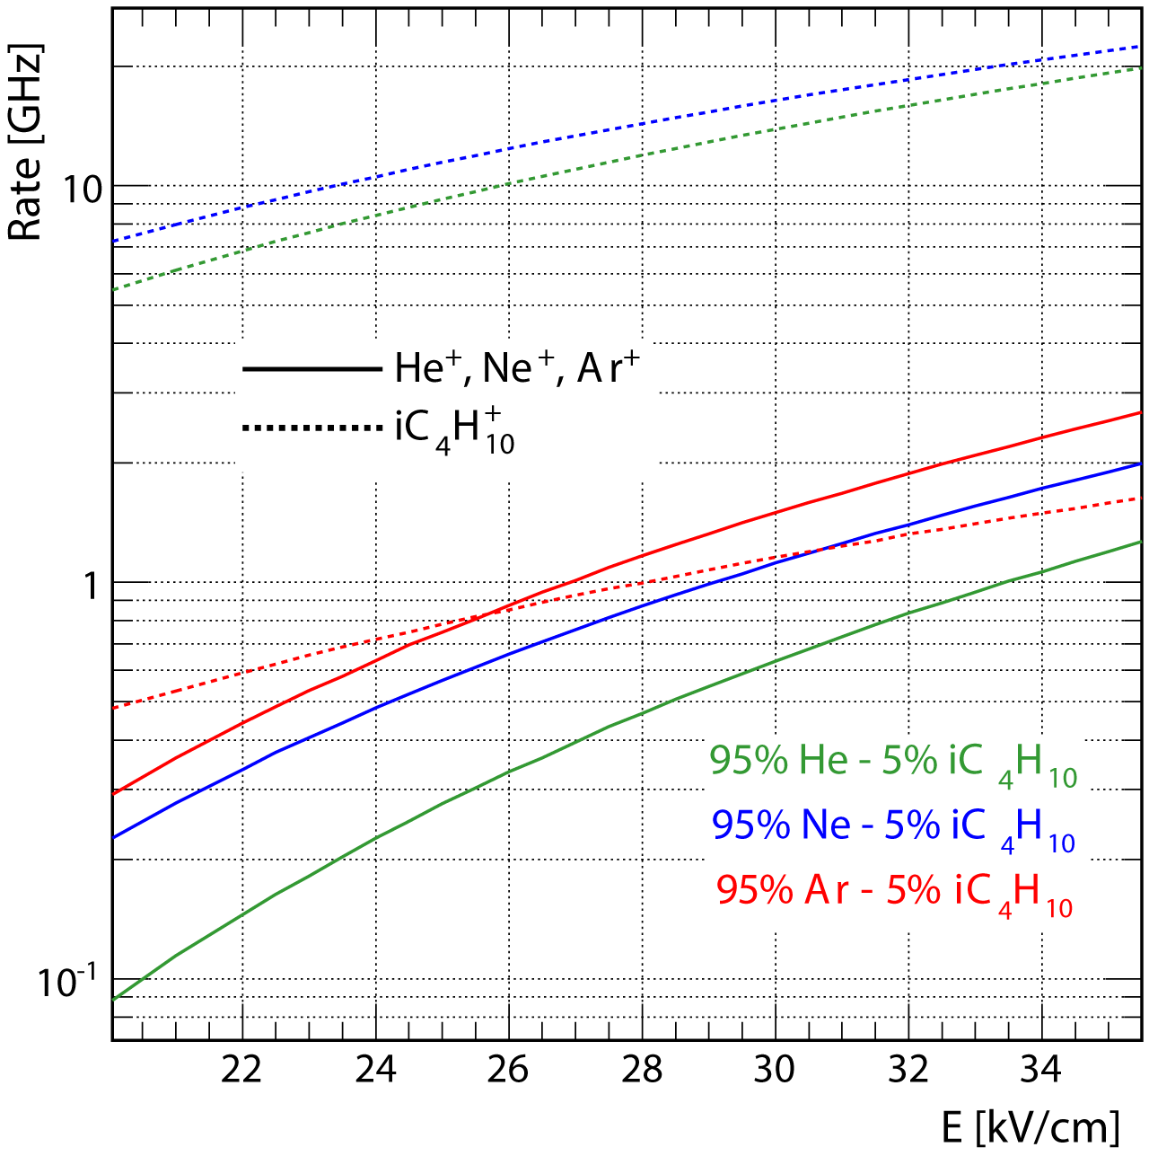
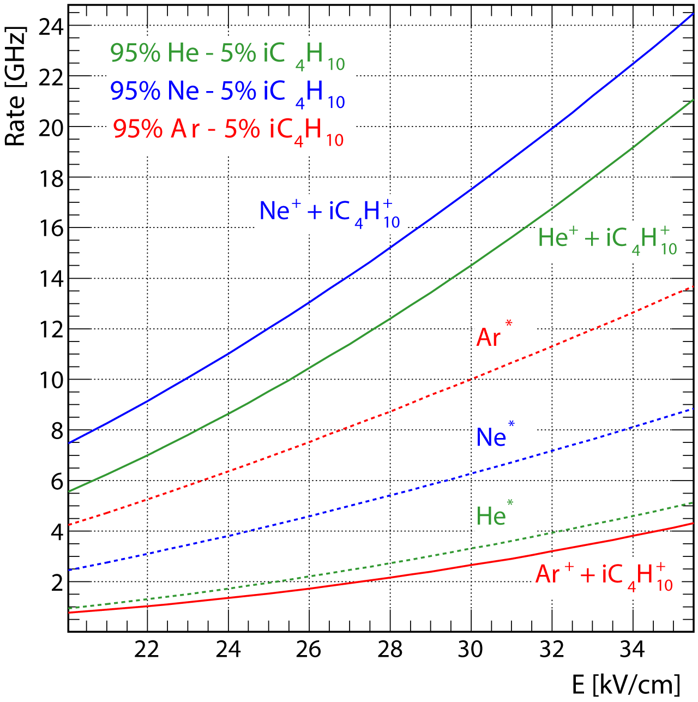
Direct ionisation and excitation rates (I)
Direct ionisation rate
Total direct ionisation
rate (iC₄H₁₀ + rare gas)
Excitation rate
of rare gas
Magboltz 10.1
- The direct ionisation rate of iC₄H₁₀ is one
order of magnitude higher than the direct
ionisation rate of noble atoms in the Ne and
He-based mixtures
The total direct ionisation rate is much
higher than the excitation rate of He or Ne.
Excitation rate of Ar dominates the total
direct ionisation rate of the Ar-based mixture.
-The direct ionisation rate of iC₄H₁₀ is comparable
to that of Ar in the Ar-based mixture
Penning transfers of excited Ar* atoms are
expected to contribute more significantly to
the gain than in the Ne or He-based mixture

Slide 16
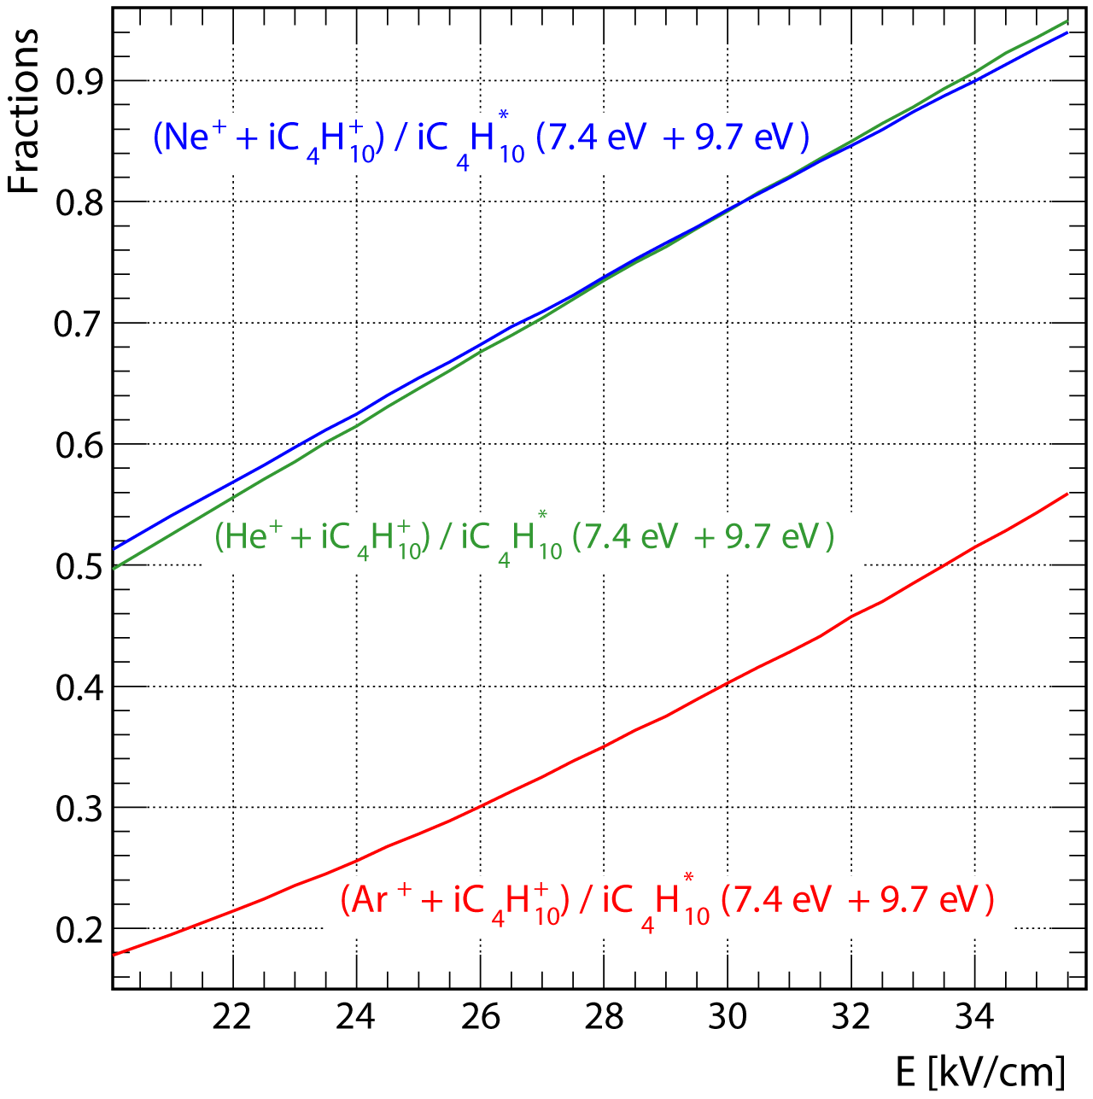
Direct ionisation and excitation rates (II)
Ratio of total ionisation rate to the excitation rate of the states at 7.4 and 9.7eV in iC₄H₁₀
Ionisation potential:
Ar: 15.8eV
Ne: 21.6eV
He: 24.6eV
iC₄H₁₀: 10.7eV
Penning transfer
from the 7.4 and 9.7eV
excited states of
iC₄H₁₀ forbidden !!
Energy transferred to populate the 7.4 and 9.7eV excited states in iC₄H₁₀
is lost for ionisation.
Consequently, avalanche charge fluctuations are expected to increase for
gas mixtures with the lowest ratio (i.e the Ar-based mixture).

Slide 17
Summary
- Active Target Detectors
- Statistical models of avalanche multiplication in gaseous detectors
- MPGD single-electron response (SER) measurement: examples
- The IPN Orsay laser test-bench
- Comparison with Monte-Carlo calculations

Slide 18
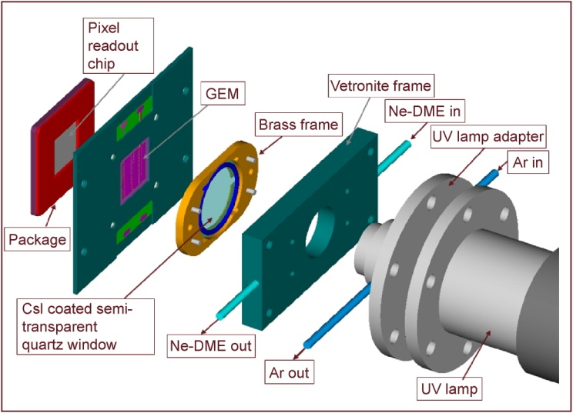
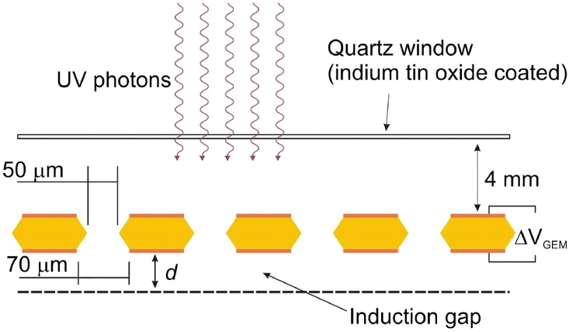
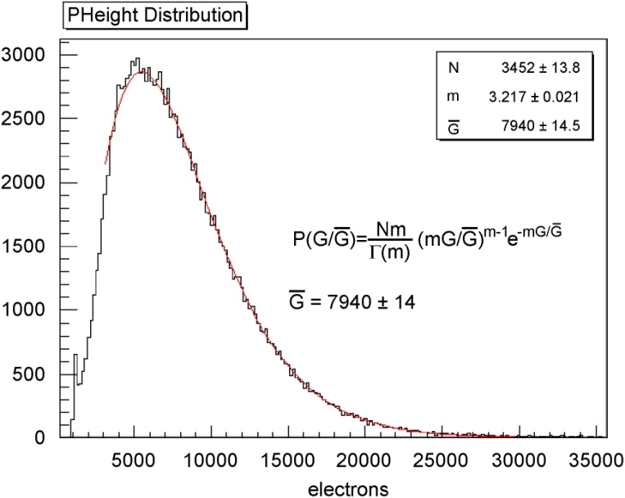
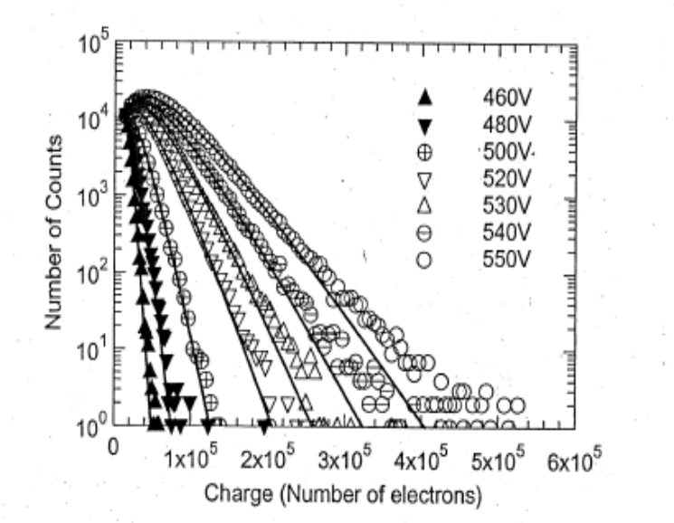
Single-electron response of a single GEM
CMOS VLSI chip
Threshold: 2200 e⁻
GEM-MIGAS in single GEM mode
E_{d}
Micromesh at 0V
E_{I}
He 85% iC₄H₁₀ 15%
d = 50 µm
E_{d}=0.25kV/cm
E_{I}= 6kV/cm
Electronics noise:
1.4x10⁴ e⁻ r.m.s.
Ortec
142A
Ne 50% DME 50%
ΔV_{GEM}
Polya distribution
Feedback
Polya
distribution
f = 0.31
0.3 ≤ f ≤ 0.4
R. Bellazzini et al., NIM A 581 (2007) 246-253
J.A. Mir et al, IEEE Trans. Nucl. Sci. NS-55 (2008) 2334-2340.

Slide 19
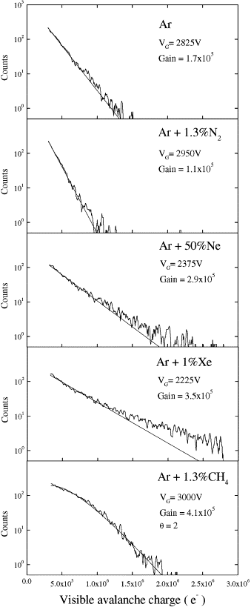
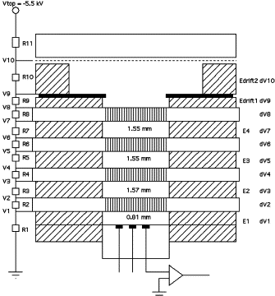
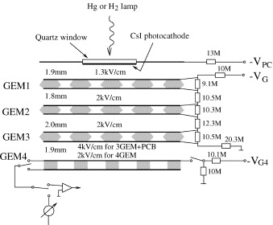
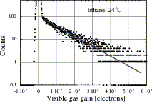
Single-electron response of multi-GEMs
UV light
4-GEM
Mesh
Exponential
Exponential
Charge preamp, 0.45V/pC,
14µs time constant
Exponential
Charge preamp
Gain: 2.7µV/e⁻
Sh. Time: 65ns
σ_{Noise}: 2100 e⁻
Active area: 2.5x2.5cm²
Active area:122mm²
Exponential
3GEM +PCB configuration
Gains ~ few 10⁵
Exponential
Visible gain ~ 2.10⁵
A.Buzulutskov et al.,
NIM A 443 (2000) 164-180.
Polya
f = 0.33
J. Va’vra and A. Sharma, NIM A 478 (2002) 235.

Slide 20
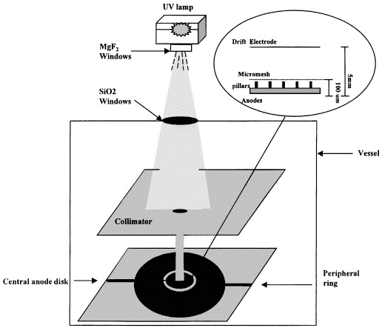
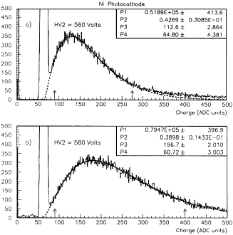
Single-electron response of a Micromegas
Polya distribution
f ~ 0.4
He 90% iC₄H₁₀ 10%
Gain > 10⁶
Detection threshold: 3x10⁴ e⁻
J. Derré et al., NIM A 449 (2000), 314-321.

Slide 21
Summary
- Active Target Detectors
- Statistical models of avalanche multiplication in gaseous detectors
- MPGD single-electron response (SER) measurement: examples
- The IPN Orsay laser test-bench
- Comparison with Monte-Carlo calculations

Slide 22
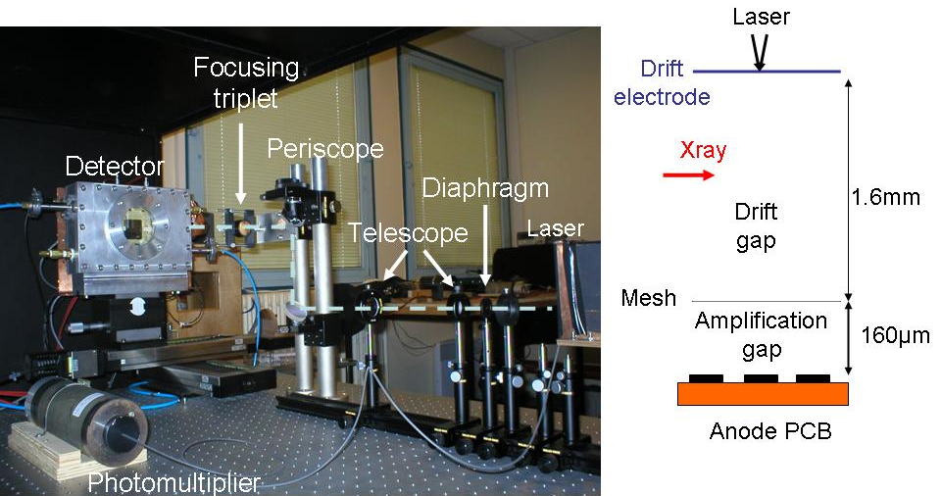
Laser test-bench for SER measurement
Detector primarily designed for tests at low pressure for the ACTAR project
T. Zerguerras et al., NIM A 608 (2009) 397-402
Drift electrode: Quartz window with a
0.5 nm thick Ni-Cr layer
Mesh: 333lpi Buckbee-Mears©
70% optical transmission
Nickel
Measurements with a set of 9 pads (3*3),
size of 4*4mm²
Electronics:
  Pads: Gassiplex chips (noise: 2 000 e⁻ r.m.s,
  gain 2.2mV/fC, dynamic range 500fC)
  Mesh: gain 100 voltage amplifier
Trigger:
  Mesh signal in ⁵⁵Fe source mode.
  Photonis© XP2282B photomultiplier anode signal
  in laser mode
Measurement of the charge on the central pad.
SER detection threshold of 10⁴ e⁻
Laser light attenuated to reach a proportion of events
with charge above threshold of ~7%
Ne 95% iC₄H₁₀ 5% @ 1 bar
Drift field: 1kV/cm

Slide 23

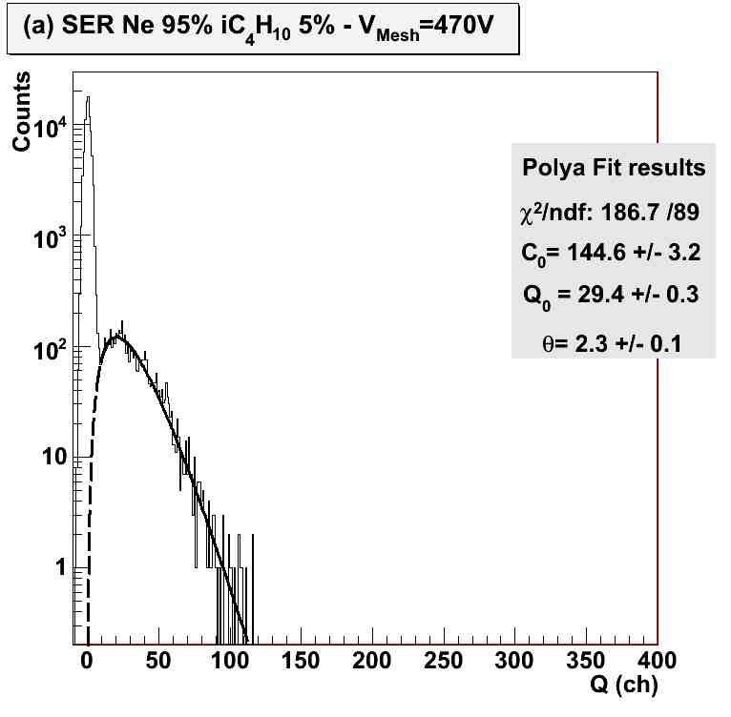
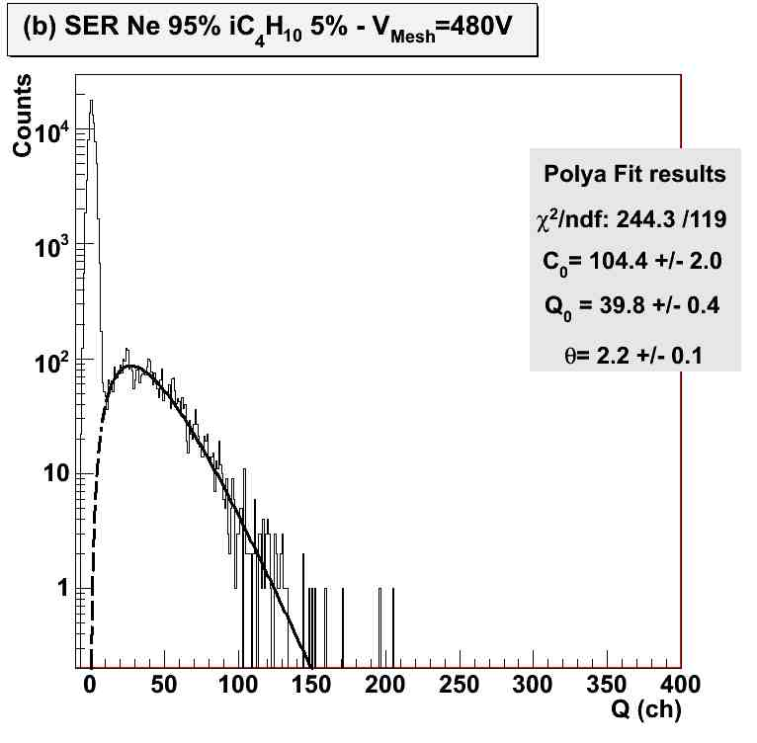
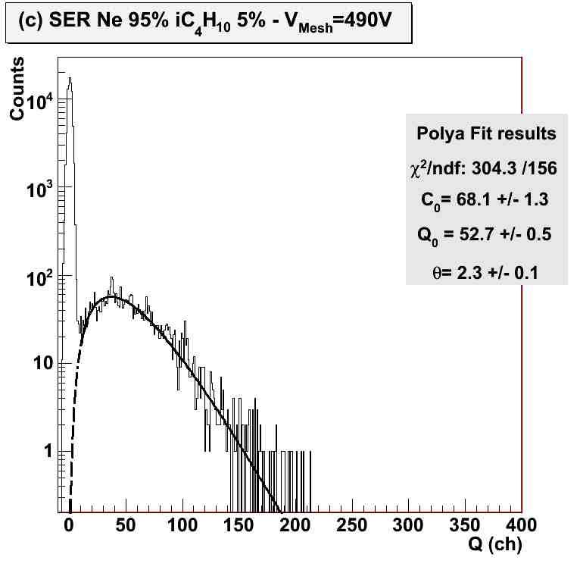
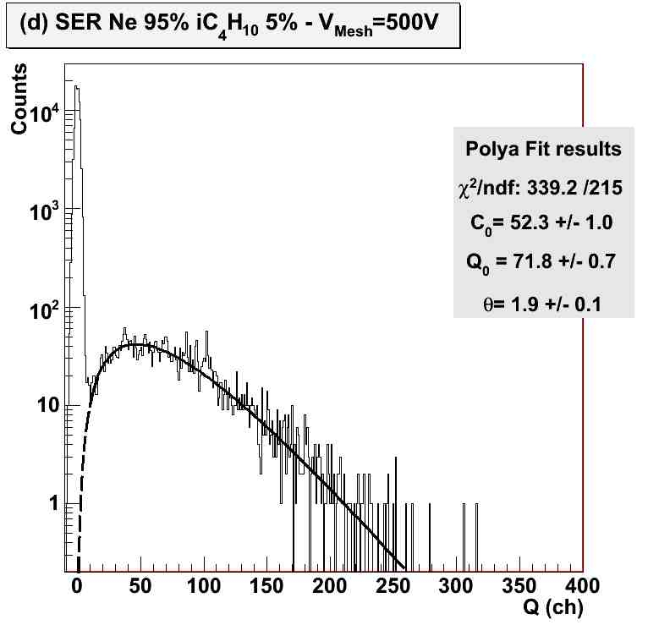
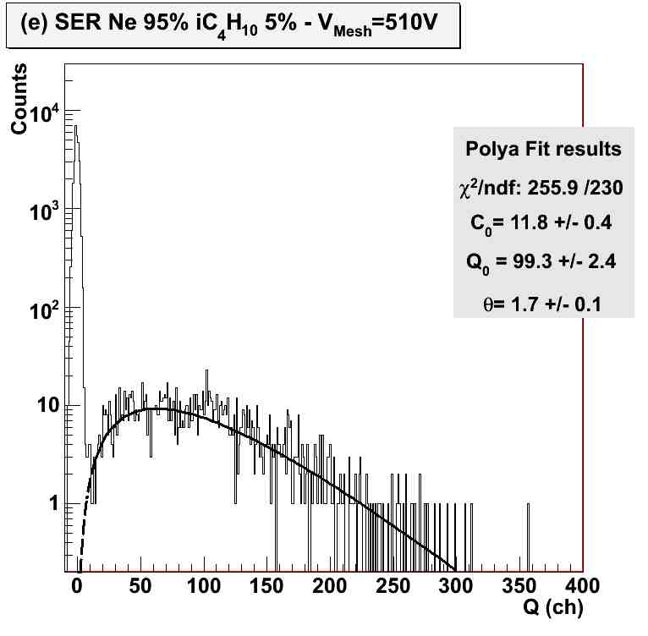
Single-electron response measurement
Polya :
f = (σ_{Q} / Q )² = 1/(1+θ)
E= 29.38 kV/cm
G= 3.7 10⁴
E= 30 kV/cm
G= 5.0 10⁴
E= 30.63 kV/cm
G= 6.0 10⁴
V_{Mesh} <500V
θ = 2.3 ± 0.1
f = 0.30 ± 0.01
θ = 2.2 ± 0.1
f = 0.31 ± 0.01
θ = 2.3 ± 0.1
f = 0.30 ± 0.01
V_{Mesh} ≥ 500V
E= 31.25 kV/cm
G= 7.6 10⁴
E= 31.88 kV/cm
G= 10⁵
θ = 1.9 ± 0.1
f = 0.34 ± 0.01
θ = 1.7± 0.1
f = 0.37 ± 0.01
Relative gain variance increase
Secondary avalanches
due to photon feedback

Slide 24
Improvements in 2013
Simplified geometry :
- Complex anode pad plane geometry
- Position of the ⁵⁵Fe source
2009
Redesigned detector
2013
Simplification of the anode plane segmentation
Lower noise level:
- Lower limit of gain at ~ 3. 10⁴ for SER measurements
- Only for high-gain gas mixtures (ex: Ne:iC₄H₁₀ 95:5)
2009
Change Front-End Electronics
2013
Adapt the electronics chain
Lower pressure:
Pressure regulation and control system for studies at lower
pressure.
2013

Slide 25
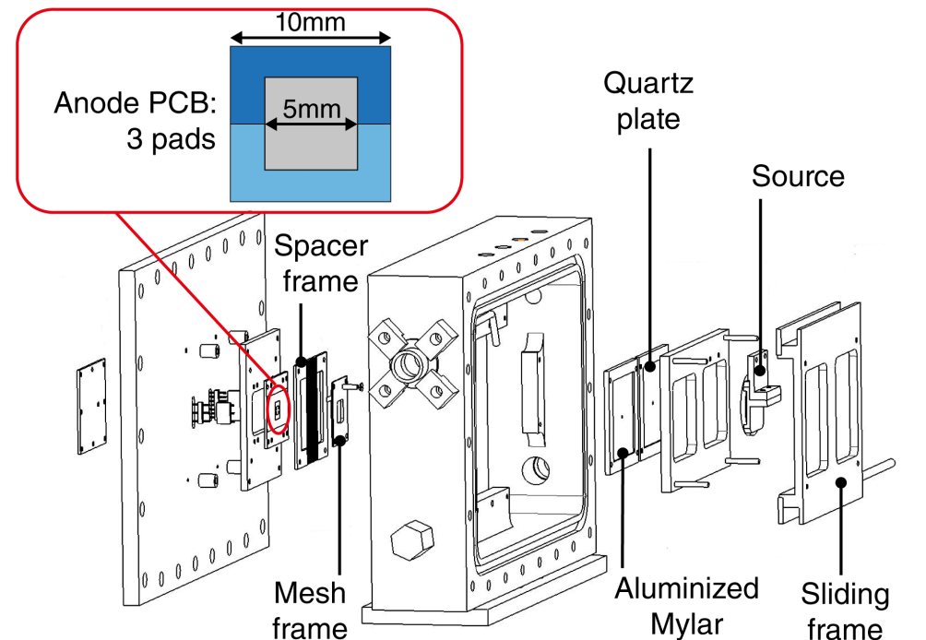
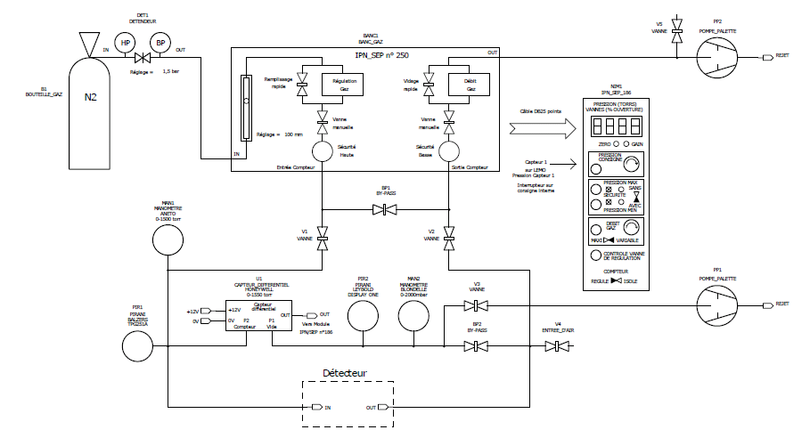
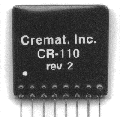
Improved detector
Change of mechanics and simplification
of the anode pads plane
Conversion gap: 3.2mm
Amplification gap: 160µm
Mesh: Buckbee Myers©
333 lpi nickel electroformed
micromesh
Improvement of electronics S/N ratio
Cremat CR-110 PAC
Gain: 1.4V/pC
Noise : 200 e⁻ RMS (table)
380 e⁻ RMS (detector)
Regulation
+
CAEN N568B
Spectroscopy Amplifier
(CG, FG fixed, SH=3µs, PZ fixed, Offset fixed)
Calibration through a high-precision
1pF capacitance at the channel test-input
Measurement
Detector
Pressure control system

Slide 26


⁵⁵Fe spectrum
Ar 95% iC₄H₁₀ 5%
E_{d} = 900 V/cm, E_{a} = 28.12 kV/cm, CG 4
Ne 95% iC₄H₁₀ 5%
E_{d} = 900 V/cm, E_{a} = 26.9 kV/cm, CG 2
Energy resolution @5.9keV: 20% FWHM
Energy resolution @5.9keV: 14% FWHM

Slide 27
Method for Single-Electron Response (SER) measurement
The laser is focused on the drift electrode (quartz) in front of the central pad
- Trigger: XP2282B PMT anode signal
- Proportion of events above charge threshold (2. 10³ e⁻) < 5%
- The PMT anode charge is measured to monitor the laser light intensity
(variation < 4%)
- The CG of the N568B Spectroscopy Amplifier is adjusted depending on
the mesh voltage, all the other parameters being fixed
The drift field is of 900V/cm
Gas mixtures: Ar 95% iC₄H₁₀ 5%, Ne 95% iC₄H₁₀ 5%, He 95% iC₄H₁₀ 5%
@ 748 torrs
To avoid any damage on the CR-110 chips, the maximum voltage
applied on the mesh was 10V below the sparking limit voltage

Slide 28




Single-electron response measured with improved detector
f = 0.56 +/- 0.04
f = 0.30 +/- 0.01
E = 28.12 kV/cm
E = 26.25 kV/cm
Gain N_{e} and
relative gain
variance f
deduced from
the fit
SP fit: Polya
SGP fit: Gaussian + Polya
f = 0.37 +/- 0.03
Polya :
E = 26.25 kV/cm
f = (σ_{Ne} / N_{e})² = 1/(1+θ)

Slide 29

Experimental gain curves
The maximum gain before sparking
is reached with the Ne-based mixture
The maximum gain reached with the
Ne-based mixture is one order of
magnitude higher than with Ar
At a given E, the gain of the Ne-based
mixture is 7 times larger than in the
Ar-based mixture
At a given E, the gain of the Ne-based
mixture is twice larger than in the
He-based mixture

Slide 30

Experimental relative gain variances
For the three gas mixtures,
f is almost unchanged in the
measured range of E
Ne and He-based mixtures
have very close f .
f is almost twice larger in the
Ar-based mixture than in Ne
or He.
Consistent with models, valid
in uniform E, predicting larger
f for gas with lower ionisation
rate.

Slide 31
Summary
- Active Target Detectors
- Statistical models of avalanche multiplication in gaseous detectors
- MPGD single-electron response (SER) measurement: examples
- The IPN Orsay laser test-bench
- Comparison with Monte-Carlo calculations

Slide 32

SER simulation with Garfield++
SER events have been simulated in a microscopic avalanche model, using a two volume
simulation for the electron drift and the avalanche development / amplification.
All electrical fields are assume to be homogeneous and adopted as analytic fields. (Parallel plate approximation)
Simulation of the drift process respects the starting conditions of the electron initiating the avalanche.
Microscopic approach yields mean amplification and variance of the gain, spectra are available.
The individual treatment of each electron requires huge calculation time, sufficient statistic can not be simulated for high fields.
avalanche
ending plane
Drift region
3,2mm - 0.9kV/cm
✓
Amplification region
160µm - 20-35kV/cm
electron starting
point
↯
Courtesy of Fabian Kuger

Slide 33

Avalanche extrapolation
How to access mean and variance for huge avalanches (> 10⁵ e⁻) with significant statistics ?
Approach: Avalanche development is a statistical process. As soon as the avalanche has
sufficiently grown, single fluctuations in further amplification processes are averaged out.
First amplification step dominates the size of the avalanche and has to be fully simulated until avalanche reaches sufficient size (~100 e⁻).
The further (CPU-consuming) amplification steps are dominated by statistics and can be handled with an mathematical extrapolation.
full (physics) simulation
mathematical extrapolation
Courtesy of Fabian Kuger
Justifications:
Full avalanche development consists of a series of independent steps, p_{i}(k) is the probability of a single-electron to create an avalanche of k electrons at the i-th step.
p_{i}(k) depends on the spatial step length , the electric field and the gas mixture.
→ same conditions during different steps lead to equal p_{i}(k) within each step.

Slide 34


Simulation studies
For all simulations, the ‘full avalanche’ has been computed for low E-fields (≤ 27kV/cm) and ‘first-half-simulations’ in the full range (20-35kV/cm).
→ The step-number-exponent ξ is determined in a control region (25-27kV/cm)
(ξ ~ 2)
→ Mean and relative gain variance ,
Two kinds of simulations have been performed:
‘Without Penning transfer’ and ‘Penning-transfer included’
Only combination of both yields the impact of Penning
transfer on the avalanche size.
Gas mixture | E (kV/cm) | r_{p}
Ar iC₄H₁₀ 5% | 28.12 | 0.321 +/- 0.003
Ne iC₄H₁₀ 5% | 26.25 | 0.482 +/- 0.017
He iC₄H₁₀ 5% | 26.25 | 0.175 +/- 0.025
Feedback is not included
r_{p} is assumed to be identical for all excited states
Courtesy of Fabian Kuger

Slide 35



Comparison of calculated and experimental SER
f = 0.56 +/- 0.04
f = 0.30 +/- 0.01
E = 28.12 kV/cm
E = 26.25 kV/cm
Calculations reproduce the experimental SER of the Ne
and He-based mixture.
The calculated SER of the Ar-based mixture
underestimates the experimental spectrum tail.
f = 0.37 +/- 0.03
E = 26.25 kV/cm
T. Zerguerras et al., NIM A 772 (2015) 76-82

Slide 36

Comparison of calculated and experimental gains
Calculations reproduce data
up to E ~ 30kV/cm
For E > 30kV/cm, the difference
between the calculated curve and
the experimental data increase
Significant contribution due
to secondary avalanches not
included in the calculation model
T. Zerguerras et al., NIM A 772 (2015) 76-82
Experimental points used for r_{p} determination

Slide 37

Comparison of calculated and experimental relative gain variance
The hierarchy of calculated f
is consistent with experimental
data and expectations from
considerations on ionisation rates
Good agreement up to 30kV/cm
with experimental data of Ne and
He-based mixtures despite the
model approximations
Discrepancy between calculations
and experimental data for the
Ar-based mixture and above
30kV/cm for Ne and He-based
mixtures
Feedback not included
in the model
T. Zerguerras et al., NIM A 772 (2015) 76-82

Slide 38
Summary
A laser test-bench has been developed at the IPN Orsay to measure the
single-electron response (SER) of MPGDs.
Gain and relative gain variances of three binary gas mixtures (Ar, Ne,
He + 5% iC₄H₁₀ @ 748 torrs ) are deduced from the SER of a Micromegas detector.
Thanks to recent improvements, the SER measurement threshold is lowered
down to gains of ~ 5. 10³
The Argon-based mixture has the lowest performance in terms of gain, relative gain
variance and breakdown limit
A microscopic Monte-Carlo model is developed and includes all processes
occuring during an avalanche, according to their cross-sections, together with
excitation-ionisation transfer (Penning effect)
Calculations reproduce the gas hierarchy in terms of gain and relative gain
variance and are consistent with the expectations of models based on ionisation
rate consideration
For the Ar-based mixture and for E > 30kV/cm, discrepancies are observed because
of a significant feedback, not included in the model

Slide 39
Collaboration
Thomas Zerguerras ª, Bernard Genolini ª, Fabian Kuger ^{b,c}, Miktat Imré ª,
Michaël Josselin ª, Vincent Lepeltier ^{d,3}, Alain Maroni ª, Thi Nguyen-Trung ª,
Jean Peyré ^{a,2}, Joël Pouthas ^{a,1}, Philippe Rosier ª, Özkhan Sahin ^{e},
Lucien Séminor ª , Daisuke Suzuki ª, Claude Théneau ª, Rob Veenhof ^{e,f}
ª Institut de Physique Nucléaire (UMR 8608), CNRS/IN2P3-Université Paris-Sud,
F-91406 Orsay Cedex, France
^{b} University of Würzburg, 97070 Würzburg, Germany
^{c} CERN, Geneva, Switzerland
^{d} Laboratoire de l’Accélérateur Linéaire (UMR 8607), CNRS/IN2P3-Université Paris-Sud,
91898 Orsay Cedex, France
^{e} Department of Physics, Uludag University, 16059 Bursa, Turkey
^{f} RD51 Collaboration, CERN, Geneva, Switzerland
¹ Present address: Laboratoire de Physique Corpusculaire, ENSICAEN, Bvd
Maréchal Juin, 14050 Caen, France
² Present address: Centre de Sciences Nucléaires et de Sciences de la Matière
(UMR 8609), CNRS/IN2P3- Université Paris-Sud, 91406 Orsay, France
³ Deceased

Slide 40
Thank you for your attention

Slide 41
Back-up slides

Slide 42

AT-TPC prototype
Readout circuit for the Micromegas

Slide 43



IKAR

Slide 44
Single-electron response of multi-GEMs
J. Va’vra and A. Sharma, NIM A 478 (2002) 235.
A.Buzulutskov et al.,
NIM A 443 (2000) 164-180.
Active area:122mm²
Double conical hole pattern
Thickness: 50µm
Pitch: 120µm pitch
Metallic hole φ 80µm
Kapton hole φ 40µm
GEM thickness: 50µm
GEM1, GEM2 and GEM3 pitch: 140µm
Double conical hole pattern:
Metallic hole φ: 80µm
GEM1 and GEM3 kapton hole φ 30µm
GEM2 kapton hole φ 50µm
GEM4 active area: 2.5x2.5cm²

Slide 45
Regulation
Measurement
Pressure control system
Detector

Slide 46




Measurements @ different CG values
CG 2
CG 3
G = 7.7 10⁴
θ = 2.3 ± 0.1
f = 0.30 ± 0.01
G = 7.3 10⁴
θ = 2.2 ± 0.1
f = 0.31 ± 0.01
Ne 95% iC₄H₁₀ 5%,
V_{mesh}= 480V, 750 torrs
CG 4
CG 5
G = 7.7 10⁴
θ = 2.0 ± 0.1
f = 0.33 ± 0.01
G = 8.1 10⁴
θ = 2.2 ± 0.1
f = 0.31 ± 0.01

Slide 47
Electronic chain calibration
A pulse signal is injected on the test input of the central pad (Pad_C) through a 1pF capacitance

Slide 48
Electronic chain calibration

