Slide 1
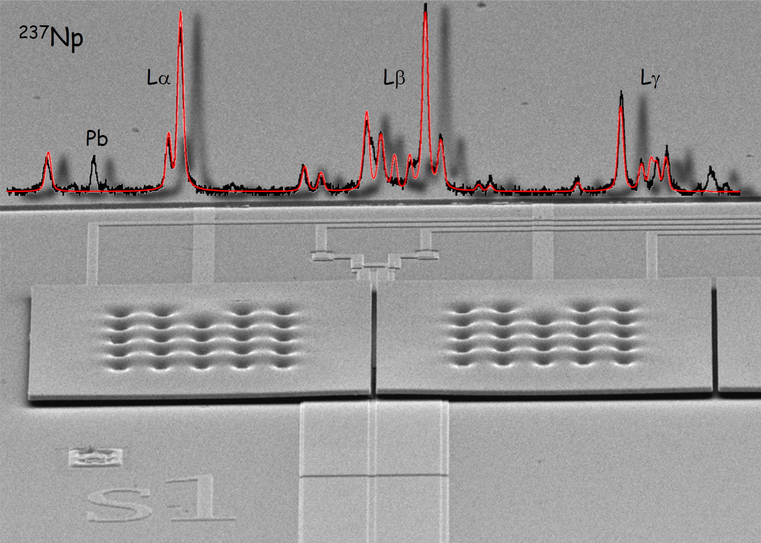
Magnetic Micro-Calorimeters
for Astro-Particle Physics
Loredana Gastaldo
Kirchhoff-Institute for Physics, Heidelberg University

Slide 2

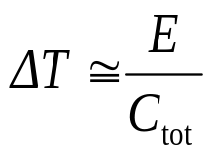


Low temperature micro-calorimeters
E
E = 10 keV
→∼ 1 mK
C_{tot} = 1 pJ/K
C_{tot}
G
T
Thermal bath
t
Very small volume
Working temperature below 100 mK
small specific heat
small thermal noise
Very sensitive temperature sensor

Slide 3
Temperature sensors
Resistance of highly doped semiconductors
R
T
Resistance at superconducting transition,TES
R
T
Magnetization of paramagnetic material
M
T

Slide 4
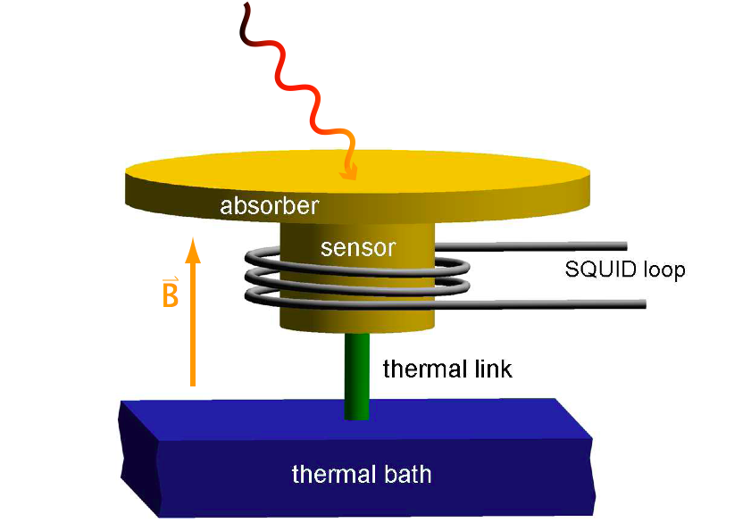
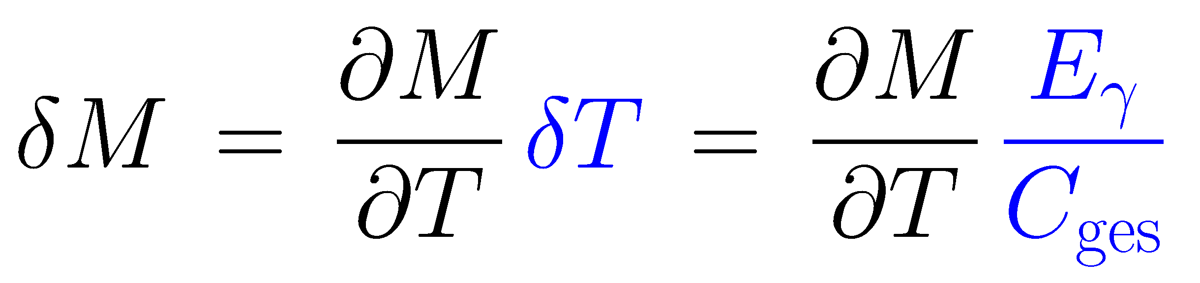
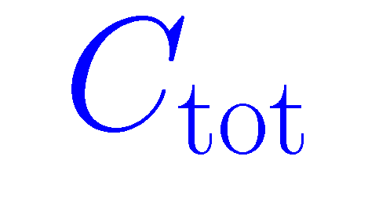
Metallic Magnetic Calorimeters - MMC
Paramagnetic sensor: Au:Er_{500ppm}
M
T
Signal size:
main differences to calorimeters with resistive thermometers
no dissipation in the sensor
no galvanic contact to the sensor

Slide 5
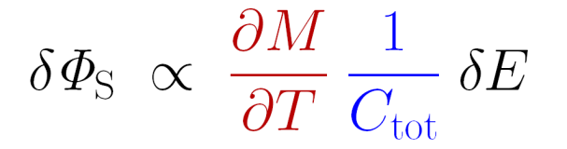
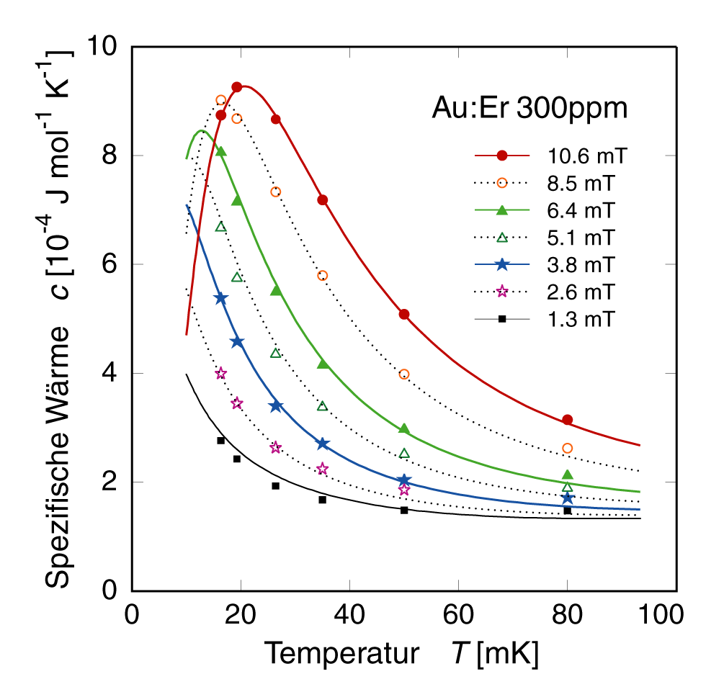
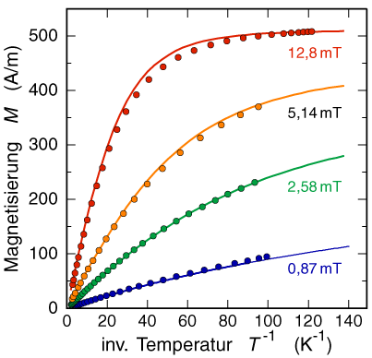
MMC: signal size
Numerical calculations based on mean field approximation are used to describe thermodynamical properties of interacting spins (RKKY)
Au:Er 300 ppm
Au:Er 300 ppm
Au:Er 300 ppm
Specific heat C [10⁻⁴ J mol⁻¹K⁻¹]
Magnetization M [A/m]
Inverse Temperature T⁻¹ [K ⁻¹]
Temperature T [mK]

Slide 6
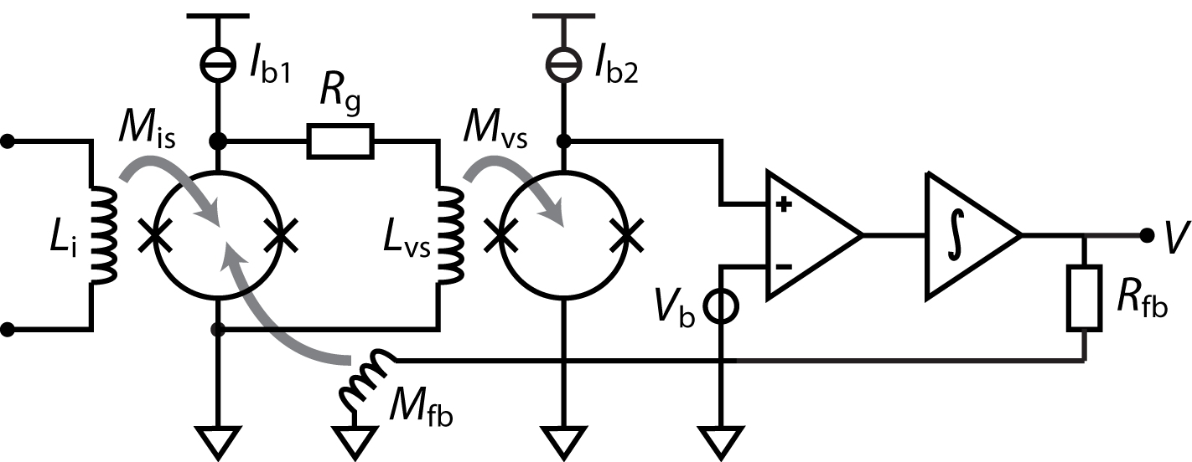
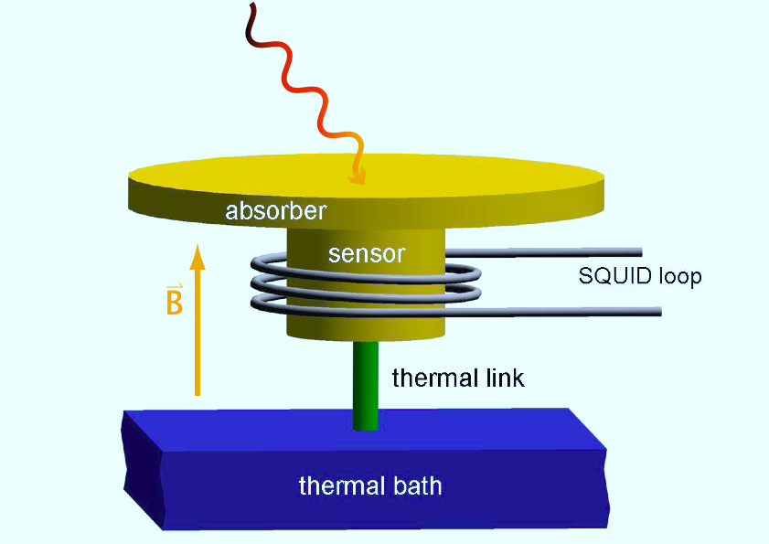
MMCs: Readout
T ~ 30 mK
T ~ 300 mK
Two-stage SQUID setup with flux locked loop allows for:
low noise
large bandwidth / slewrate
small power dissipation on detector SQUID chip (voltage bias)

Slide 7
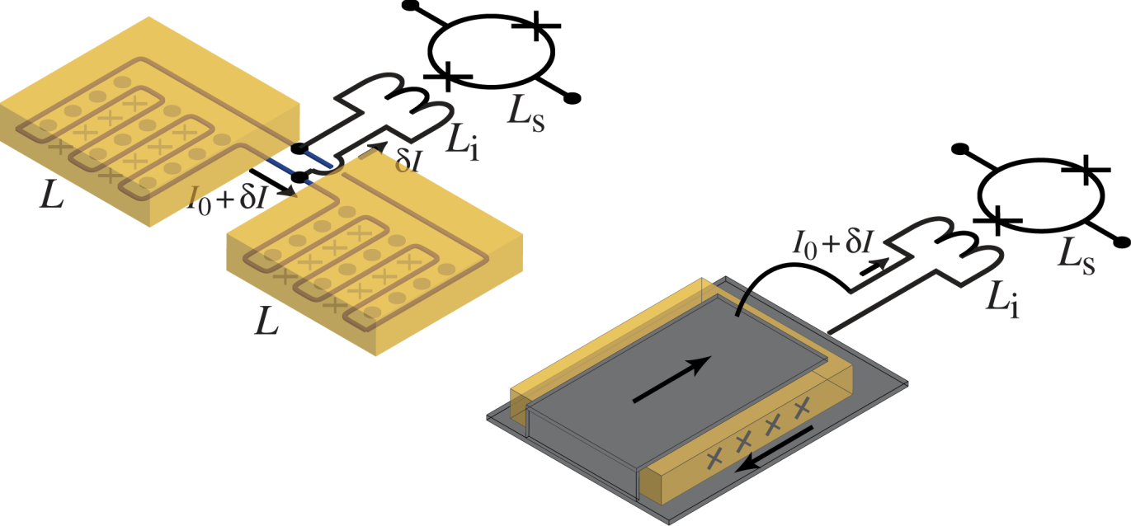
MMCs: Geometries
Well established:
planar T-sensor
superconducting meander shaped pickup loop
B-field generated by persistent current
transformer coupled to SQUID
New sandwich geometry:
best magn. flux coupling,
planar sensor
sandwiched between stripline

Slide 8
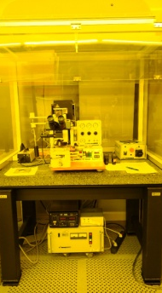
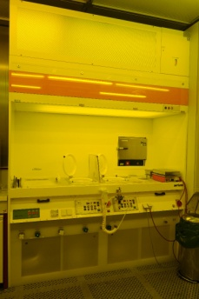
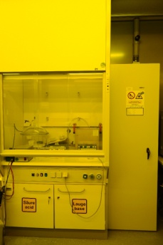
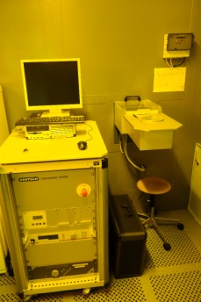
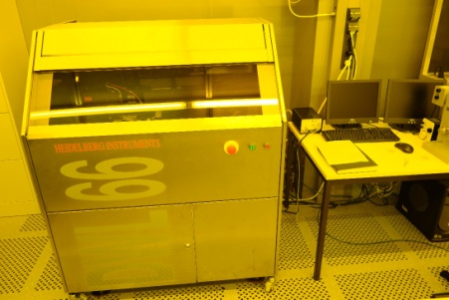
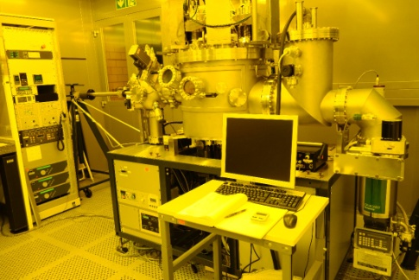
MMCs: Microfabrication
Cleanroom facilities at KIP
Mask writer
Mask aligner
UHV sputtering
Wet bench
Chemistry
Dry etching
Flexibility in design and fabrication
Reliable processes for thin films
Presently 10 different designs (6-16 layers) processed in parallel

Slide 9
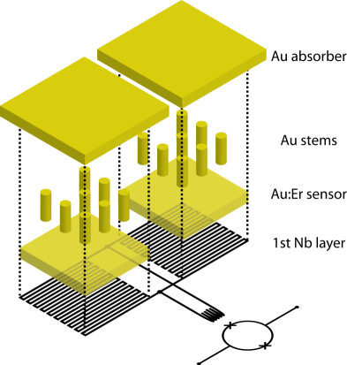
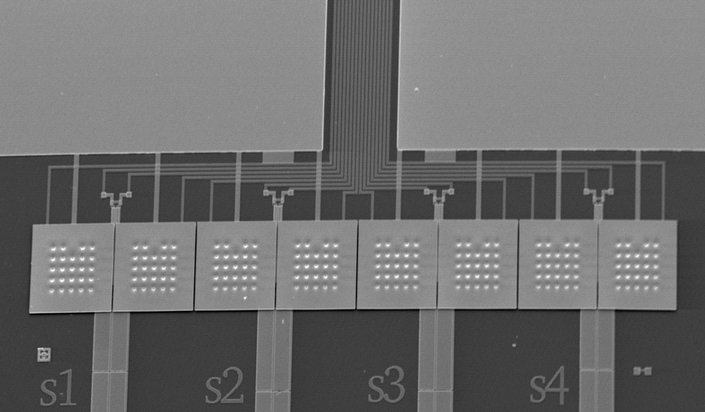
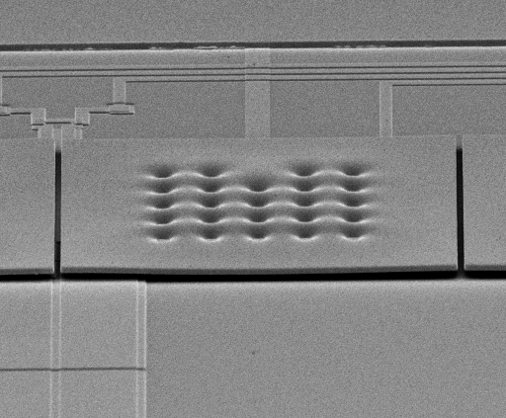
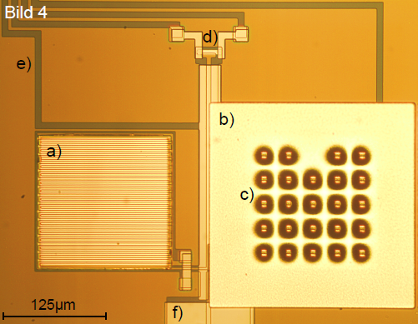
maXs20: 1d-array for soft x-rays
1×8 x-ray absorbers
  250μm×250μm gold, 5μm thick
  98% Qu.-Eff. @ 6 keV
  electroplated into photoresist mold (RRR>15)
  mech/therm contact to sensor by stems
  to prevent loss of initially hot phonons
Au:¹⁶⁶Er_{300ppm} temperature sensors
  co-sputtered from pure Au and high conc. AuEr target
Meander shaped pickup coils
  2.5 μm wide Nb lines
  I_{c} ≈ 100mA
On-chip persistent current switch (AuPd)
Typical non-linearity:
1-3% at 6 keV
Au:Er
on
Nb meander
250 μm

Slide 10
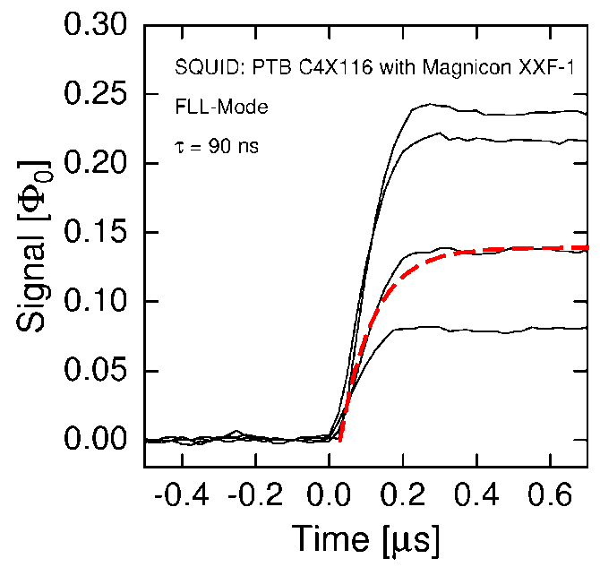
maXs20: 1d-array for soft x-rays
rise time: 90 ns @ 30 mK,
as expected for the spin-electron-relaxation
from Korringa-constant of Er in Au
Typical non-linearity:
1-3% at 6 keV
Fastest rise-time among
µ-cal for x-ray detection

Slide 11
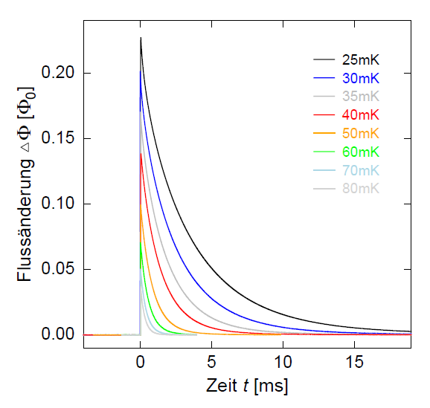
maXs20: 1d-array for soft x-rays
decay time here: 3 ms @ 30 mK
nearly single exponential decay
On-chip thermal bath
G
Typical non-linearity:
1-3% at 6 keV
magnetic flux
adjusted by sputtered
thermal link (Au)
time

Slide 12
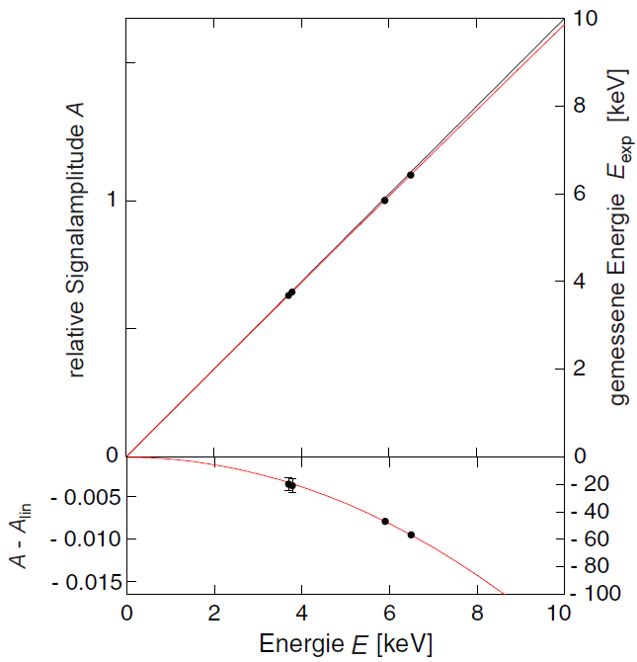
maXs20: 1d-array for soft x-rays
non-linearity: 1% at 6 keV
as expected from thermodynamical properties
well described by quadratic term
Relative signal amplitude A
Measured energy E [keV]
Typical non-linearity:
1-3% at 6 keV
The energy scale is defined
with high precision
∼ 1 %
ΔE [eV]
Photon energy E [keV]

Slide 13
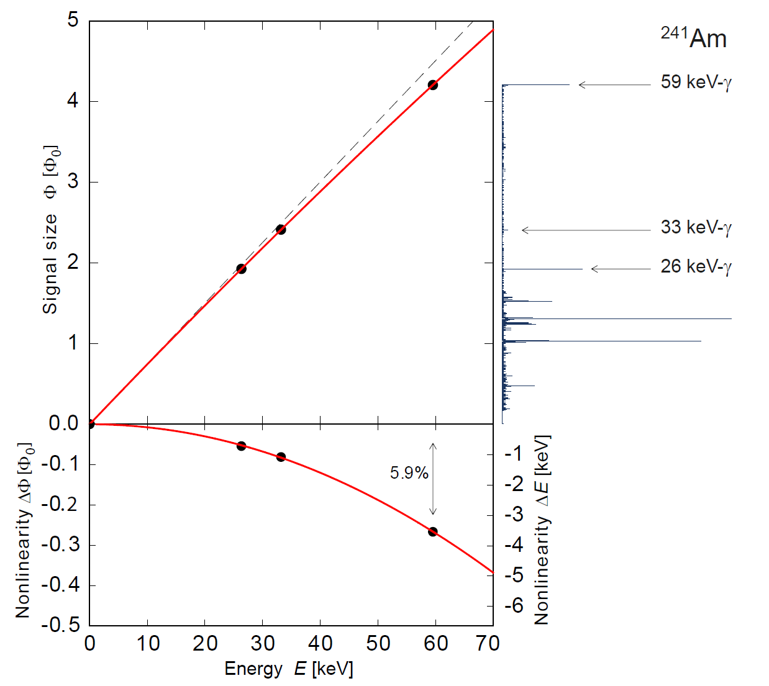
maXs20: 1d-array for soft x-rays
²⁴¹Am
non-linearity: 6% at 60 keV
as expected from thermodynamical properties
well described by quadratic term

Slide 14
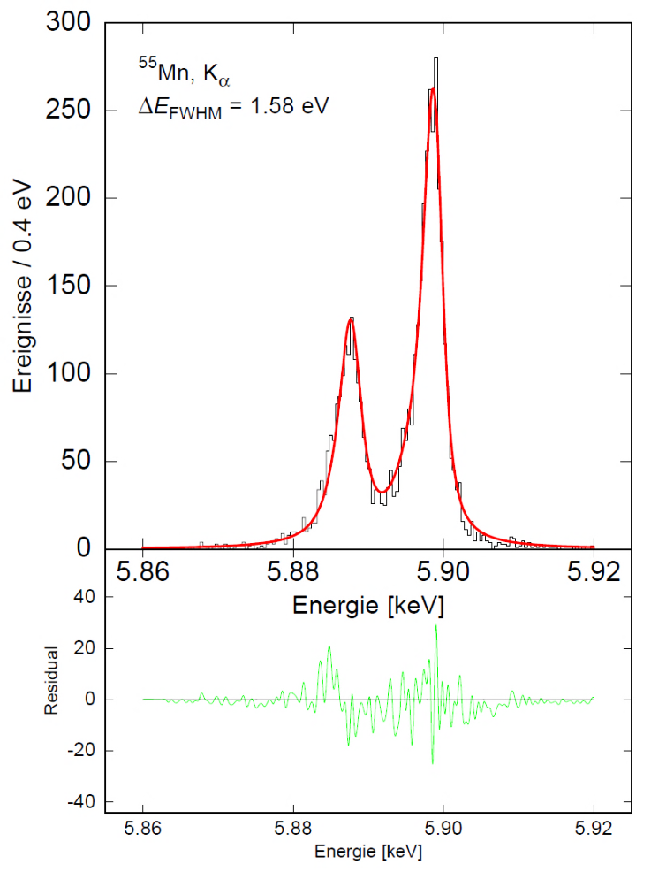
maXs20: 1d-array for soft x-rays (T=20 mK)
Very good energy resolution
ΔE_{FWHM}= 1.6 eV @ 6 keV
Typical non-linearity:
1-3% at 6 keV

Slide 15
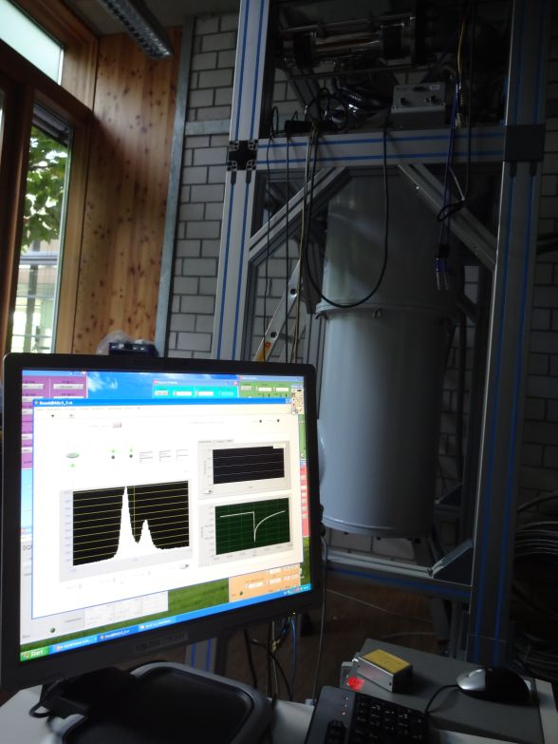
maXs20: 1d-array for soft x-rays (T=20 mK)
Live !
ΔE_{FWHM} = 1.5 eV @ 0 keV

Slide 16
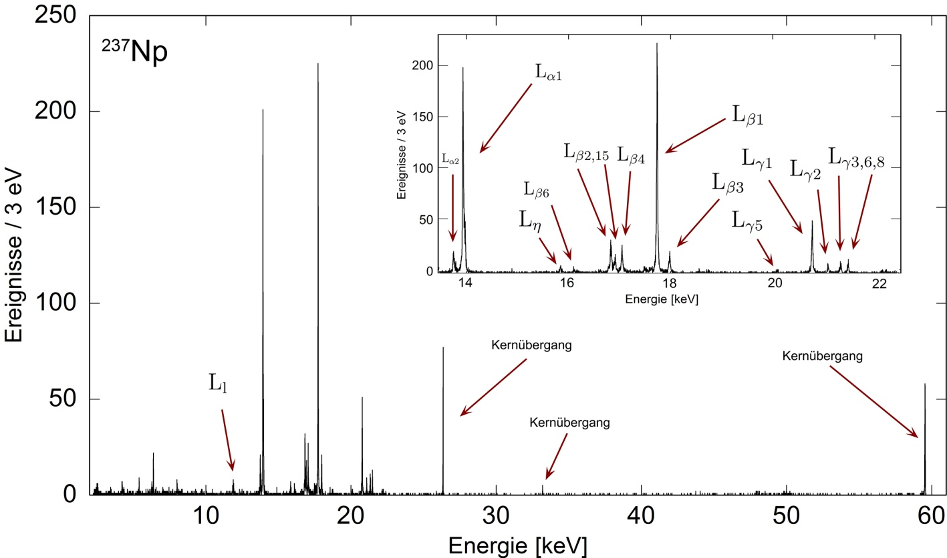
maXs20: 1d-array for soft x-rays (T=20 mK)
Large dynamic range

Slide 17
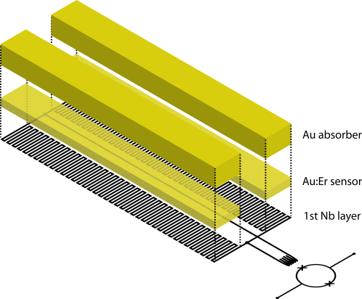
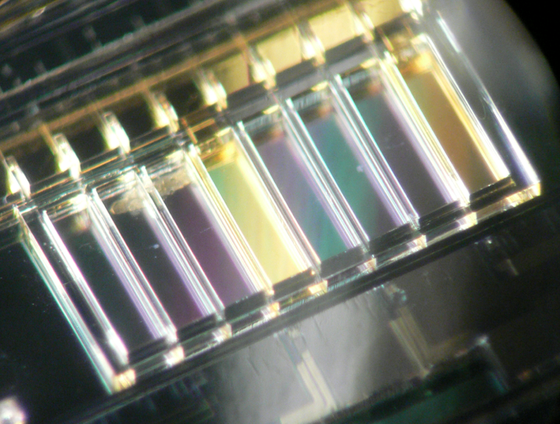
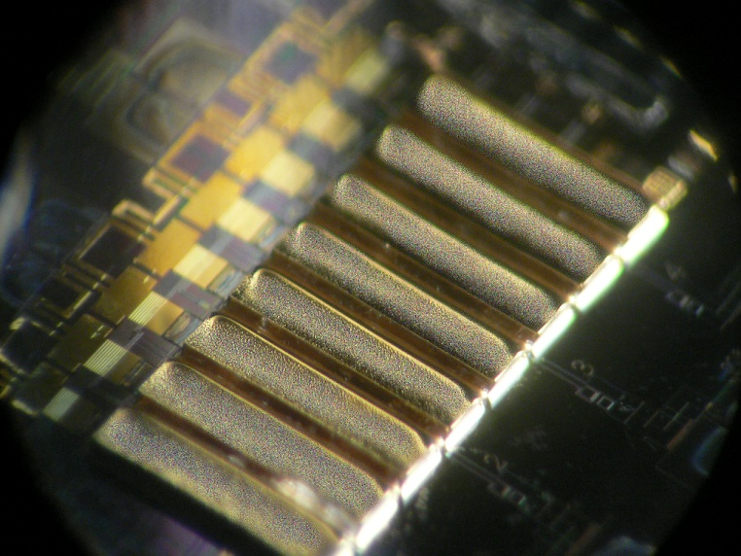
maXs200: 1d-array for hard x-rays
1x8 x-ray absorbers
2 mm x 0.5 mm
200 μm thick electroplated Au
80% QE at 100 keV
ΔE_{FWHM} < 50 eV
photo resist
mold
electroplated
Au absorbers

Slide 18
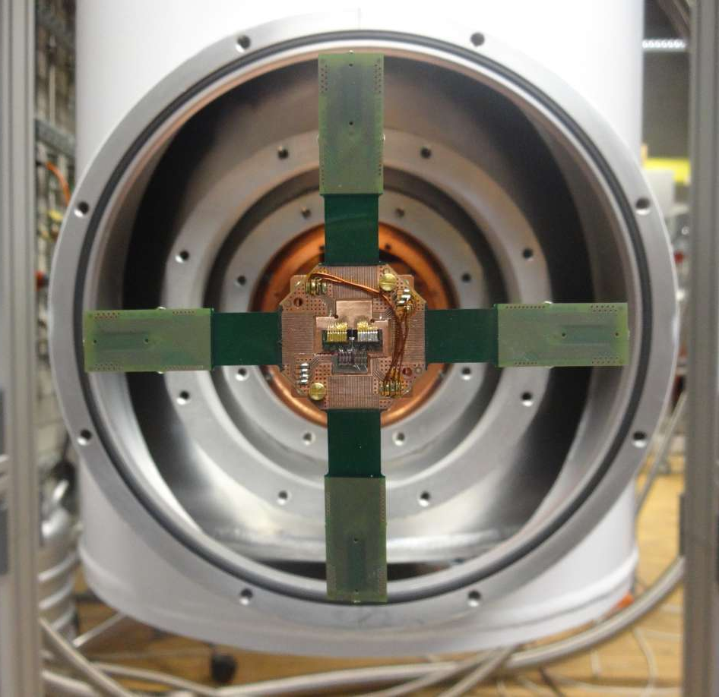
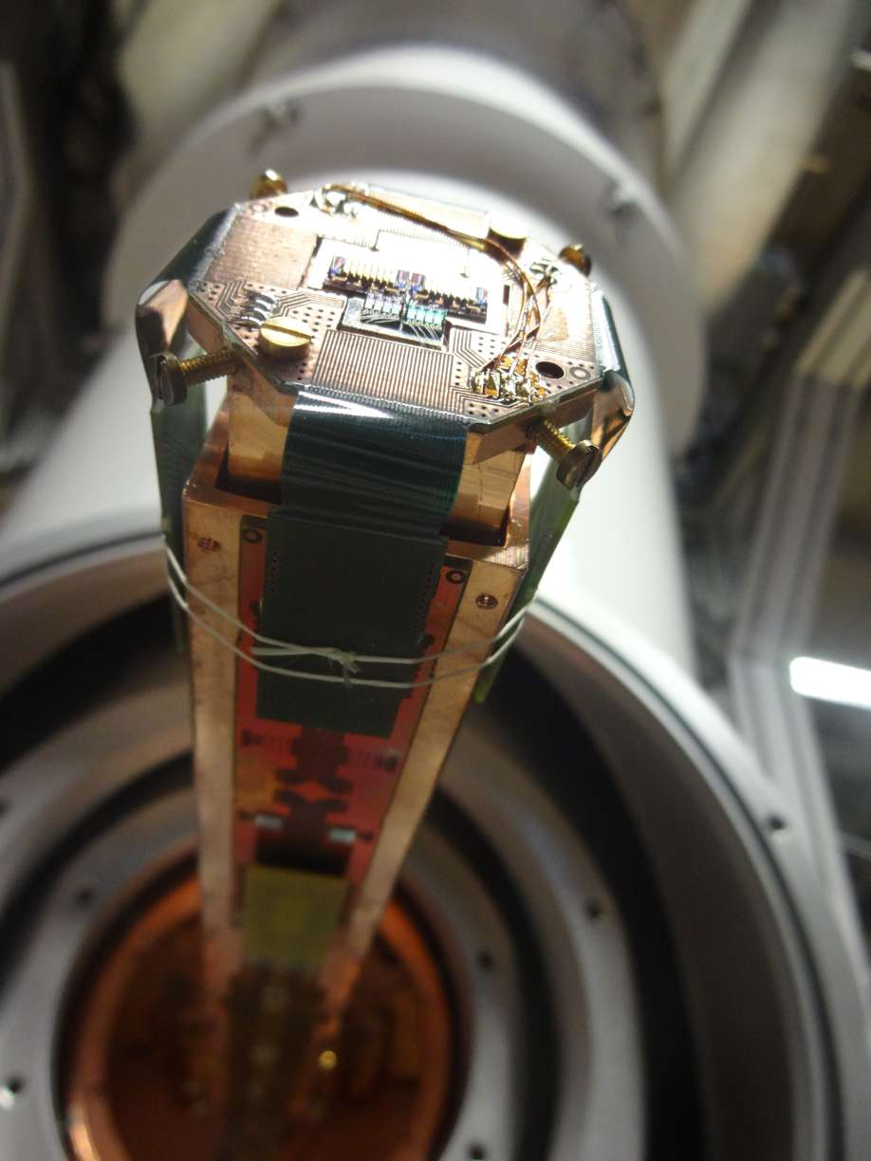
maXs200 on cold finger of a dry cryostat
16 pixels maXs-200 on detector platform
side arm without radiation shields
maXs-200
Amplifier SQUIDs

Slide 19
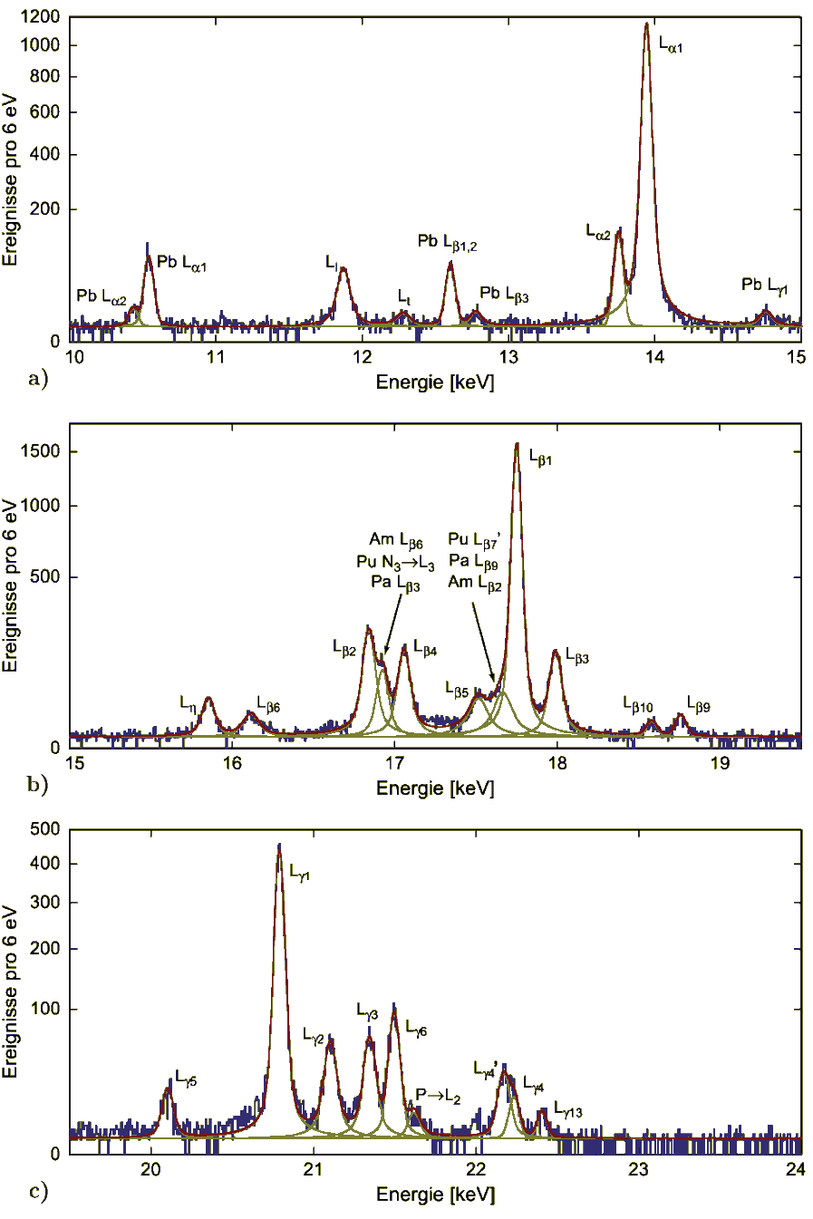
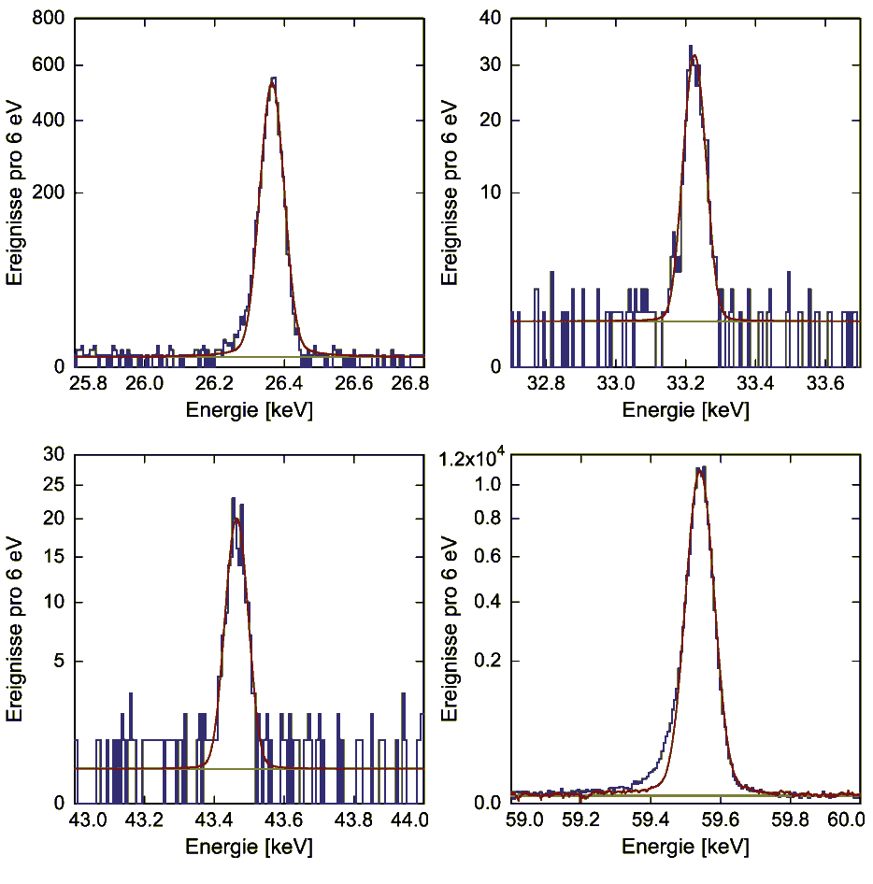
maXs200 – ²⁴¹Am calibration source
²³⁷Np
²³⁷Np
²³⁷Np
ΔE_{FWHM} = 60 eV @ 60 keV
Slight degradation towards higher energies
due to position dependence,
Meanwhile fixed by stems between absorber and sensor
ΔE_{FWHM} = 40 eV @ 0-20 keV

Slide 20
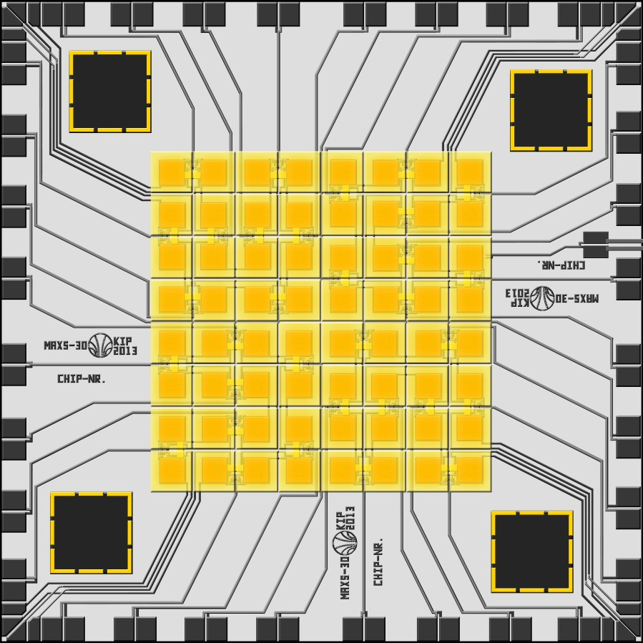
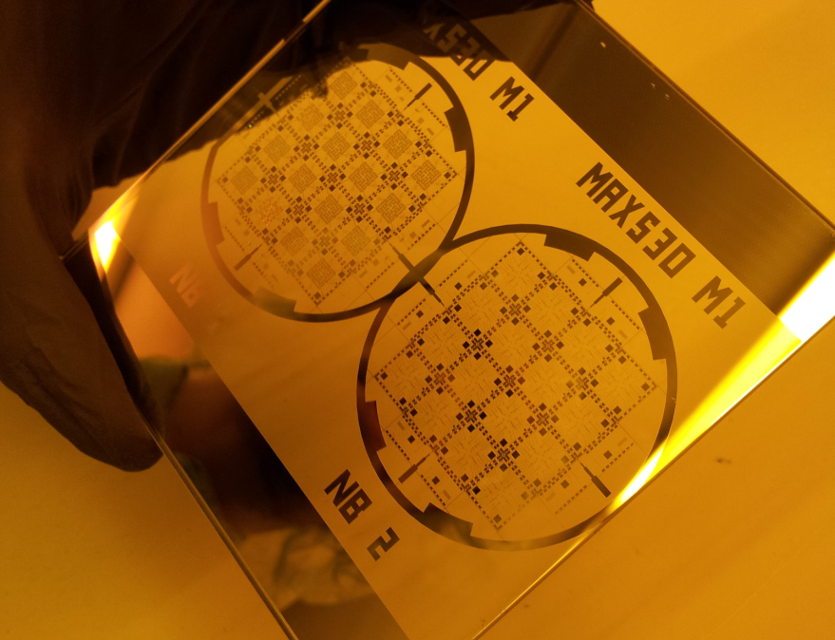
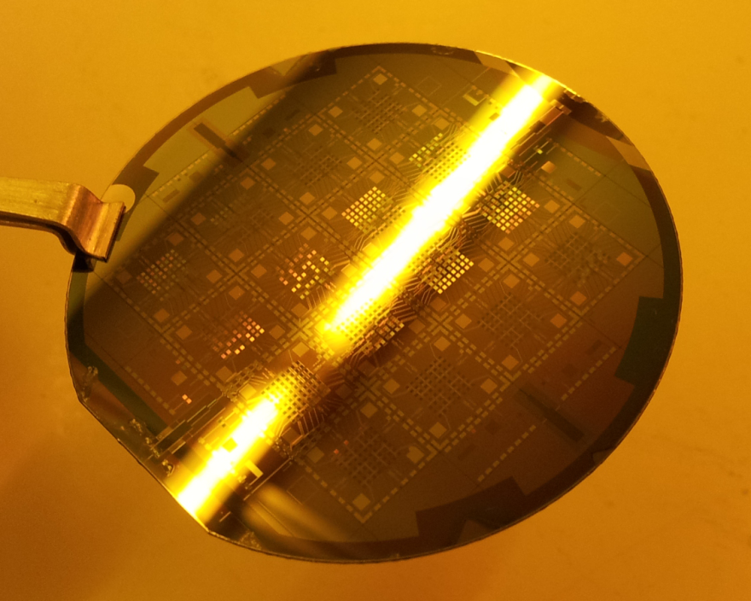
Large Arrays – parallel read-out
2, 4, 8 mm
maXs-20/30/200:
8×8 pixels for photons up to 20/30/200 keV
with ΔE_{FWHM} = 2/5/30 eV
32 two-stage dc-SQUIDs

Slide 21
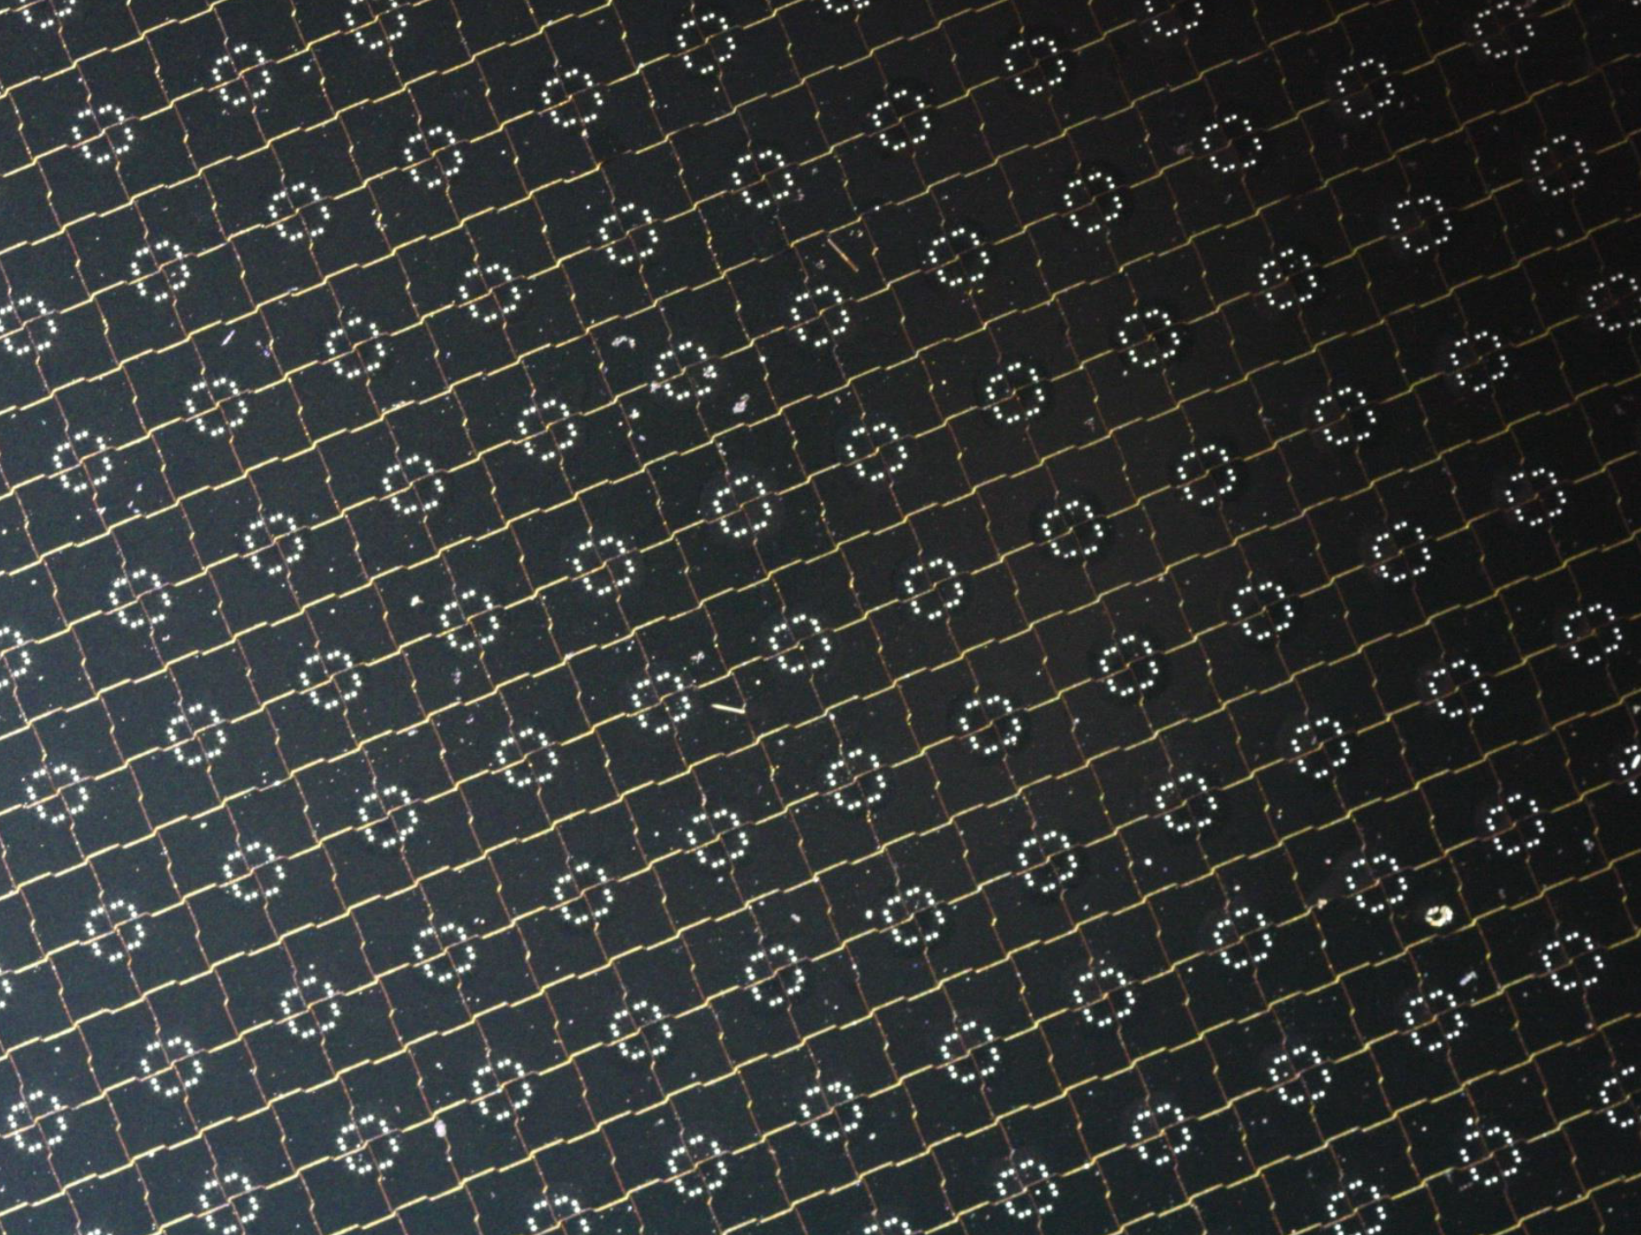
Large Arrays – parallel read-out
How could one increase the number of pixels?

Slide 22
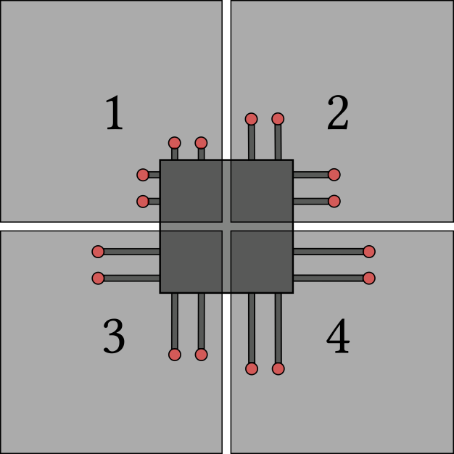
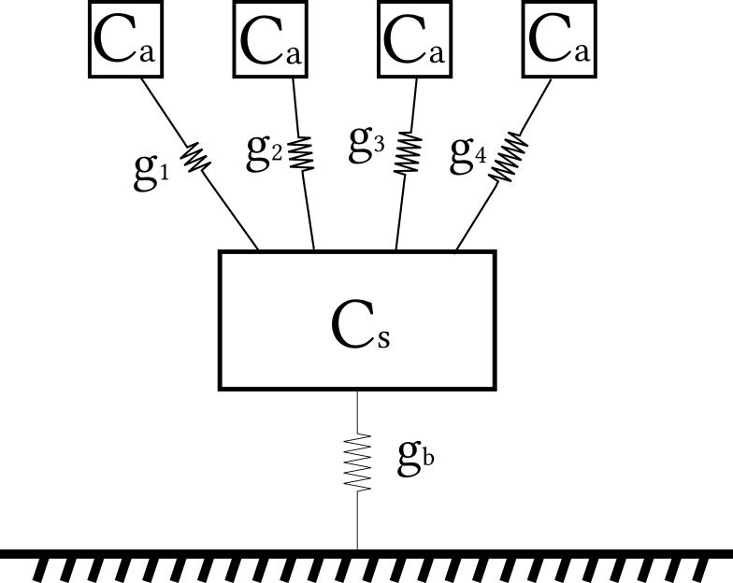
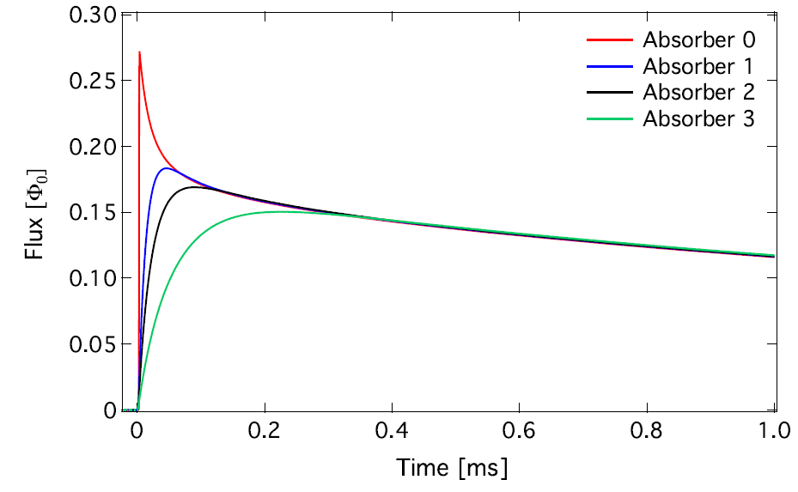
The Hydra principle
absorber
thermal link
sensor
stems
heat bath
Pixel identification
via rise-time
of the detector signal
Porst et al., AIP Conf. Proc. 1185 (2009) 599

Slide 23
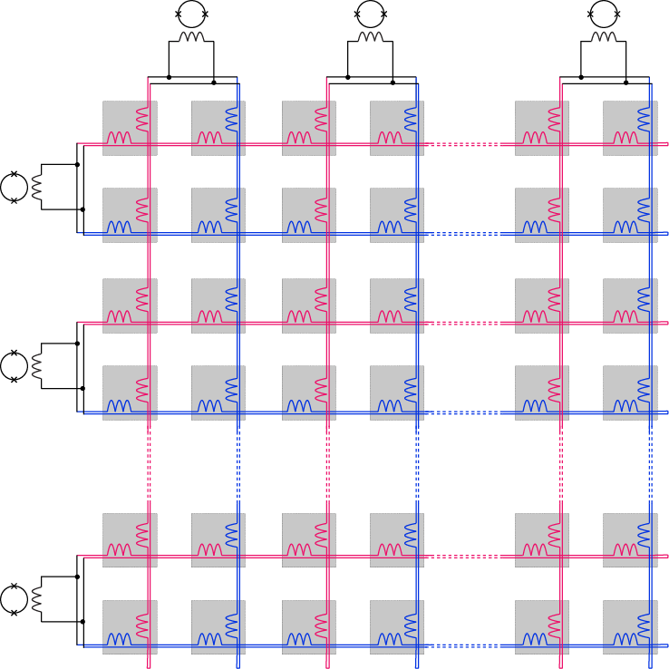
Read out scheme

Slide 24
Read out scheme

Slide 25
Read out scheme

Slide 26
Read out scheme
+
-
+
-

Slide 27
Read out scheme
+
-
+
-

Slide 28
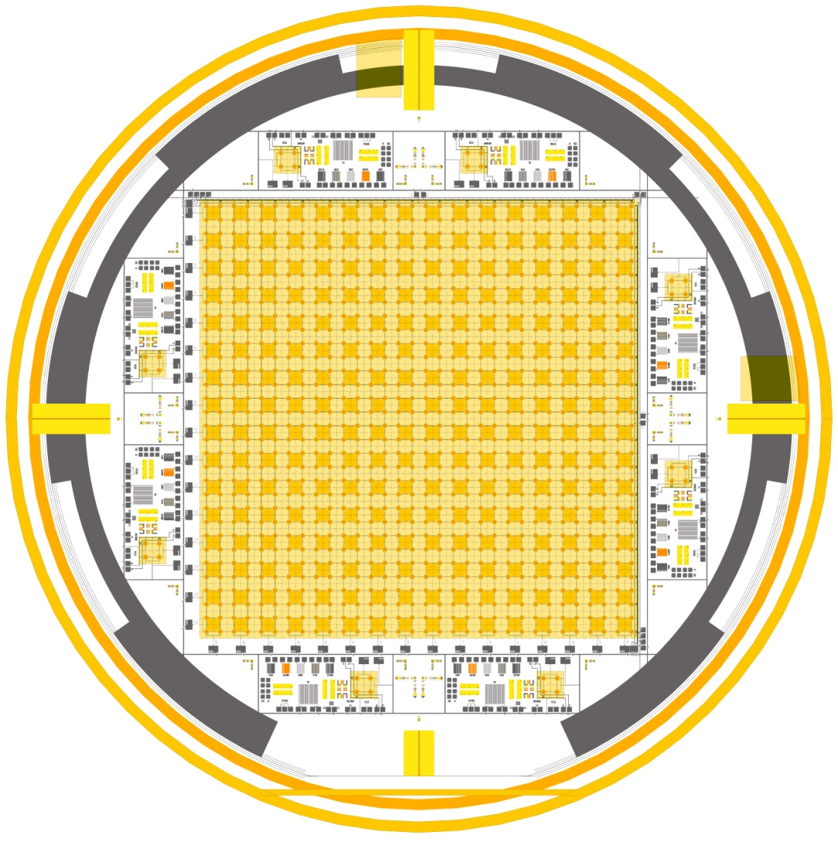
MOCCA: a 4k-pixel MMC camera
~
4.5 cm
64 × 64 pixels
200 eV (FWHM)
32 × 32 temperature sensors
Read out by 16 + 16 SQUIDs

Slide 29
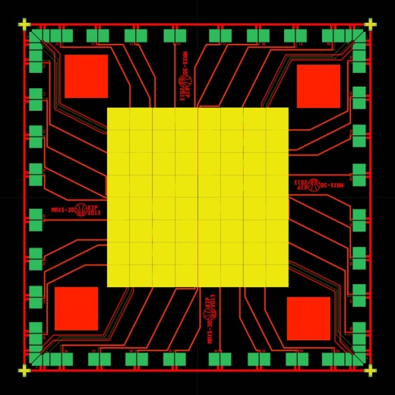
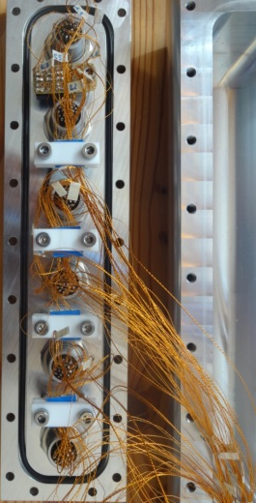

How to read-out 1000s of high-res detectors?
Simplest idea: duplicate single channel readout
Brute force read-out of 8x8 x-ray detectors
But:
  number of wires
  parasitic heat load
  costs
  complexity
∼N
multiplexing scheme required
(TDM, FDM, CDM, …)

Slide 30
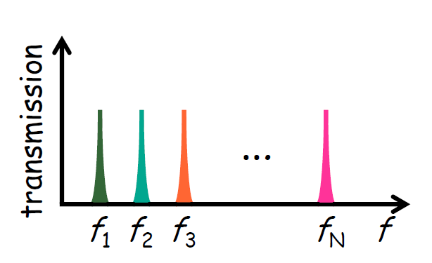
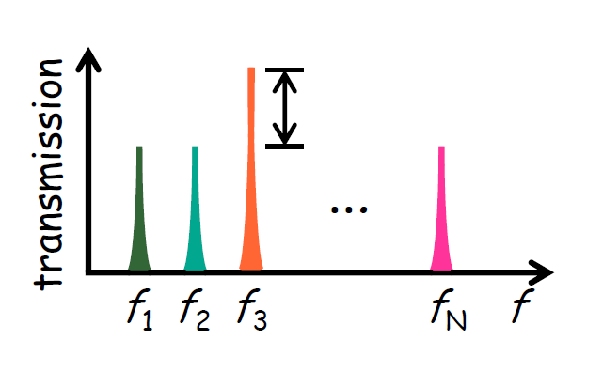
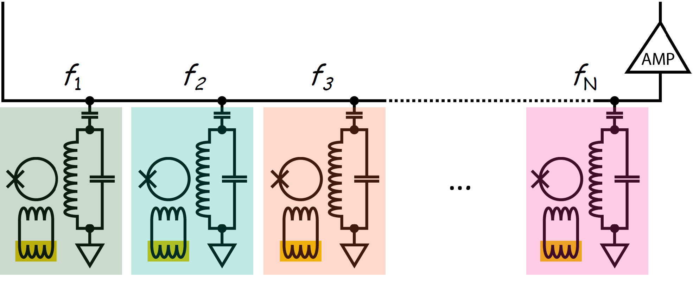
MMCs: Microwave SQUID multiplexing
Single HEMT amplifier and 2 coaxes
to read out 100 - 1000 detectors
No events
Event in 3
IN
OUT
Microwave SQUID Multiplexer for the Readout of Metallic Magnetic Calorimeters
S.Kempf et al., J. Low. Temp. Phys. 175 (2014) 850-860

Slide 31
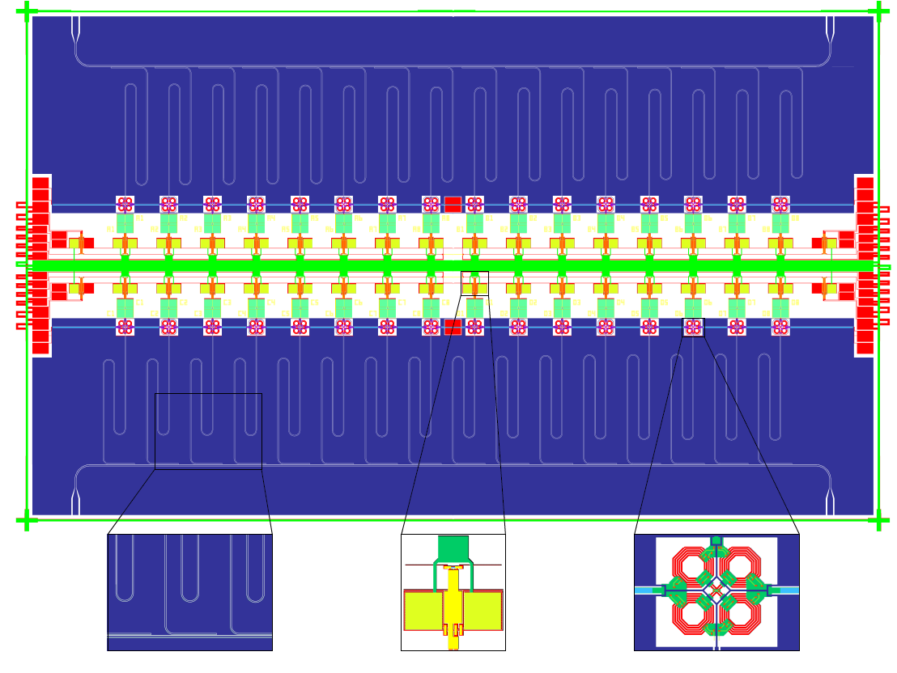
MMCs: Microwave SQUID multiplexing
15.5 mm
9.1 mm
Elbow coupler
MMC
rf-SQUID

Slide 32


MMCs: Microwave SQUID multiplexing
Successful production and
test of the first prototype
M. Wegner et al., in preparation

Slide 33


Neutrino mass determination
1 meV
ν
10 meV
1 eV

Slide 34

The Electron Capture in ¹⁶³Ho experiment
Department of Nuclear Physics, Comenius University, Bratislava, Slovakia
Fedor Simkovic
Department of Physics, Indian Institute of Technology Roorkee, India
Moumita Maiti
Goethe Universität Frankfurt am Main
Udo Kebschull, Panagiotis Neroutsos
Institute for Nuclear Chemistry, Johannes Gutenberg University Mainz
Christoph E. Düllmann, Klaus Eberhardt, Holger Dorrer, Fabian Schneider
Institute of Nuclear Research of the Hungarian Academy of Sciences
Zoltán Szúcs
Institute of Nuclear and Particle Physics, TU Dresden, Germany
Kai Zuber
Institute for Physics, Humboldt-Universität zu Berlin
Alejandro Saenz
Institute for Physics, Johannes Gutenberg-Universität
Klaus Wendt, Sven Junck, Tom Kieck
Institute for Theoretical and Experimental Physics Moscow, Russia
Mikhail Krivoruchenko
Institute for Theoretical Physics, University of Tübingen, Germany
Amand Fäßler
Institut Laue-Langevin, Grenoble, France
Ulli Köster
Kirchhoff-Institute for Physics, Heidelberg University, Germany
Christian Enss, Loredana Gastaldo, Andreas Fleischmann,
Clemens Hassel, Sebastian Kempf, Mathias Wegner
Max-Planck Institute for Nuclear Physics Heidelberg, Germany
Klaus Blaum, Andreas Dörr, Sergey Eliseev, Mikhail Goncharov,
Yuri N. Novikov, Alexander Rischka, Rima Schüssler
Petersburg Nuclear Physics Institute, Russia
Yuri Novikov, Pavel Filianin
Physics Institute, University of Tübingen, Germany
Josef Jochum, Stephan Scholl
Saha Institute of Nuclear Physics, Kolkata, India
Susanta Lahiri
The Electron Capture ¹⁶³Ho Experiment: ECHo
L. Gastaldo et al., JLTP 176 - 5 (2014) 876-884

Slide 35




¹⁶³Ho and neutrino mass
τ_{1/2} ≅ 4570 years
Q_{EC} = (2.555 ± 0.016) keV
(2*10¹¹ atoms for 1 Bq)
M. Wang, G. Audi et al., Chinese Phys. C 36, 1603, (2012)
e⁻
e⁻
n
p
p
p
n
p
n
e⁻
e⁻
A non- zero neutrino mass affects the de-excitation energy spectrum
e⁻
e⁻
n
p
n
p
n
p
n
e⁻
e⁻
e⁻
Atomic de-excitation:
X-ray emission
Auger electrons
Coster-Kronig transitions
.
.
.
.
.
Source
.
.
Calorimetric
measurement

Slide 36

¹⁶³Ho Q_{EC}-value
τ_{1/2} ≅ 4570 years
Q_{EC} = (2.555 ± 0.016) keV
(2*10¹¹ atoms for 1 Bq)
M. Wang, G. Audi et al., Chinese Phys. C 36, 1603, (2012)
Calorimetric measurements
Gatti et al., 1997
Measurements of x-rays
ECHo, 2012

Slide 37
¹⁶³Ho Q_{EC}-value
τ_{1/2} ≅ 4570 years
Q_{EC} = (2.555 ± 0.016) keV
(2*10¹¹ atoms for 1 Bq)
M. Wang, G. Audi et al., Chinese Phys. C 36, 1603, (2012)
Calorimetric measurements
Gatti et al., 1997
Measurements of x-rays
Independent of ¹⁶³Ho decay parameters
ECHo, 2012
Penning Trap Mass Spectroscopy
Q_{EC} = (2.833 ± 0.030^{stat} ± 0.015^{syst}) keV
“Direct measurement of the mass difference of ¹⁶³Ho and ¹⁶³Dy
as prerequisite to a determination of the electron neutrino mass”
S. Eliseev et al., Phys. Rev. Lett., 115, 062501 (2015)

Slide 38
¹⁶³Ho Q_{EC}-value
τ_{1/2} ≅ 4570 years
Q_{EC} = (2.555 ± 0.016) keV
(2*10¹¹ atoms for 1 Bq)
M. Wang, G. Audi et al., Chinese Phys. C 36, 1603, (2012)
Calorimetric measurements
Gatti et al., 1997
Measurements of x-rays
Independent of ¹⁶³Ho decay parameters
ECHo, 2012
Penning Trap Mass Spectroscopy
Q_{EC} = (2.833 ± 0.030^{stat} ± 0.015^{syst}) keV
To reduce uncertainties in the analysis:
Q_{EC} determination within 1 eV
→ PENTATRAP (MPIK HD)
“Direct measurement of the mass difference of ¹⁶³Ho and ¹⁶³Dy
as prerequisite to a determination of the electron neutrino mass”
S. Eliseev et al., Phys. Rev. Lett., 115, 062501 (2015)

Slide 39



¹⁶³Ho and neutrino mass
OI
OI
OII
NII
NI
MI
MII

Slide 40

Requirements for sub-eV sensitivity in ECHo
Statistics in the end point region
N_{ev} > 10¹⁴ → A ≈ 1 MBq
Unresolved pile-up (f_{pu} ~ a ⋅ τ_{r})
f_{pu} < 10⁻⁵
τ_{r} < 1 µs → a ~ 10 Bq
10⁵ pixels
Precision characterization of the endpoint region
ΔE_{FWHM} < 3 eV
f_{pu} = 10⁻⁵ ΔE_{FWHM} = 3 eV
Low temperature
Metallic Magnetic Calorimeter

Slide 41



First detector prototype
Absorber for calorimetric measurement
→ ion implantation @ ISOLDE-CERN
About 0.01 Bq per pixel
Operated over more then 4 years
Absorber
Source
Sensor
Meander
L. Gastaldo et al.,
Nucl. Inst. Meth. A, 711 (2013) 150
P. C.-O. Ranitzsch et al.,
http://arxiv.org/abs/1409.0071v1

Slide 42

Calorimetric spectrum
Rise Time ~ 130 ns
ΔE_{FWHM} = 7.6 eV @ 6 keV (2013)
ΔE_{FWHM} = 2.4 eV @ 0 keV (2014)
Non-Linearity < 1% @ 6keV
Synchronized measurement of 2 pixels
Presently most precise ¹⁶³Ho spectrum
NI
First calorimetric measurement of the OI-line
OI
MI
¹⁴⁴Pm
 | E_{H} bind. | E_{H} exp. | Γ_{H} lit. | Γ_{H} exp
MI | 2.047 | 2.040 | 13.2 | 13.7
MII | 1.845 | 1.836 | 6.0 | 7.2
NI | 0.420 | 0.411 | 5.4 | 5.3
NII | 0.340 | 0.333 | 5.3 | 8.0
OI | 0.050 | 0.048 | 5.0 | 4.3
NII
MII
Q_{EC} = (2.843 ± 0.009^{stat} - 0.06^{syst}) keV
P. C.-O. Ranitzsch et al ., http://arxiv.org/abs/1409.0071v1)
L. Gastaldo et al., Nucl. Inst. Meth. A, 711, 150-159 (2013)

Slide 43



Where to improve
Detector design and fabrication:
Increase activity per pixel
Remove low energy tail
¹⁴⁴Pm
High purity ¹⁶³Ho source:
Background reduction
NI
NI
Understanding of the ¹⁶³Ho spectrum:
Investigate undefined structures
OI
MI
¹⁴⁴Pm
MII
NII

Slide 44



Source production and separation
: (n,γ)-reaction on ¹⁶²Er
High purity ¹⁶³Ho source
Requirement : >10⁶ Bq → >10¹⁷ atoms
(n,γ)-reaction on ¹⁶²Er
- High cross-section
- Radioactive contaminants → need of chemical separation
Summer 2013: Two irradiations at ILL
- Treatment of Er prior to irradiation:
- Treatment of Er after irradiation:
- 30 mg for 55 days ⇒ 1.6•10¹⁸ atoms ¹⁶³Ho
- 7 mg for 7 days ⇒ 1.4•10¹⁶ atoms ¹⁶³Ho
Thermal neutron flux
(Φ): 1.3x10¹⁵ cm⁻²s⁻¹

Slide 45
Source production and separation
: (n,γ)-reaction on ¹⁶²Er
High purity ¹⁶³Ho source
Requirement : >10⁶ Bq → >10¹⁷ atoms
(n,γ)-reaction on ¹⁶²Er
- High cross-section
- Radioactive contaminants
Excellent chemical separation
Available ¹⁶³Ho source:
~ 10¹⁸ atoms
ECHo requirements:
^{166m}Ho/ ¹⁶³Ho < 10⁻⁹
Offline mass separation:
RISIKO, Mainz University
ISOLDE-CERN
Only ^{166m}Ho

Slide 46


High purity ¹⁶³Ho source: Mass separation
- RISIKO mass-separator @ Uni-Mainz: successful tests with natural Ho:
Optimized resonant laser ionization for Ho
Focalization of the beam for implantation onto sub-mm detector absorber
Separation at CERN/ISOLDE December 2014
Chemically purified ¹⁶³Ho source
Offline implantation @ISOLDE-CERN using GPS and RILIS

Slide 47

New detectors: first results
NEW ( about 2 days)
OLD (more then 1 month )
NI
NI
preliminary
OI
MI
MI
OI
NII
MII
NII
MII
Activity per pixel A ~ 0.2 Bq
Baseline resolution ΔE_{FWHM} ~ 5 eV
Symmetric detector response
No strong evidence of radioactive contamination in the source

Slide 48


Background
Background sources:
Environmental radioactivity Material screening
Cosmic rays Underground labs
Induced secondary radiation by cosmic rays μ-Veto
Radioactivity in the detector
Underground
measurements in Modane
on going
Background level
5×10⁻⁵ counts/eV/det/day
Study of background sources through:
Monte Carlo simulations
Dedicated experiments
Screening facilities
Uni-Tübingen
Felsenkeller

Slide 49

ECHo outlook
Prove scalability with medium large experiment ECHo-1K
  A ∼ 1000 Bq High purity ¹⁶³Ho source (produced at reactor)
  ΔE_{FWHM} < 5 eV
  τ_{r}< 1 µs
  multiplexed arrays → microwave SQUID multiplexing
  1 year measuring time →10¹⁰ counts = Neutrino mass sensitivity m_{ν} < 10 eV
ECHo-1M towards sub-eV sensitivity
Research Unit FOR 2202/1
„Neutrino Mass Determination by Electron Capture in Holmium-163 – ECHo“

Slide 50

Search for neutrinoless double beta decay
?

Slide 51




Neutrinoless double beta decay
If conservation rules don´t allow simple beta decay:
2νββ: (A,Z) → (A, Z+2) + 2e⁻ + 2ν_{e}
τ_{1/2} ≈ 10²⁰ years
If ν = ν :
0νββ: (A,Z) → (A, Z+2) + 2e⁻
τ_{1/2} > 10²⁵ years
Measured for several nuclides
Never observed

Slide 52
Neutrinoless double beta decay
If conservation rules don´t allow simple beta decay:
2νββ: (A,Z) → (A, Z+2) + 2e⁻ + 2ν_{e}
τ_{1/2} ≈ 10²⁰ years
If ν = ν :
0νββ: (A,Z) → (A, Z+2) + 2e⁻
τ_{1/2} > 10²⁵ years
Measured for several nuclides
Never observed
Identification and reduction of background sources

Slide 53


Scintillating crystals
The energy of an interacting particle
is converted into heat and light
The fraction of light depends on the mass of the particle
Measure both fractions of energy
→ discrimination
→ rejection of background events
photon sensor
phonon sensor
D.V. Poda et al., LUMINEU EDELWEISS Collaboration
arXiv:1502.01161 [physics.ins-det]

Slide 54
Scintillating crystals
The energy of an interacting particle
is converted into heat and light
The fraction of light depends on the mass of the particle
Measure both fractions of energy
→ discrimination
→ rejection of background events
photon sensor
phonon sensor
Low T thermal detectors are the best
candidate for these measurements

Slide 55



AMoRe and LUMINEU
Investigation of with scintillating crystals
AMoRE
Advanced Mo-based Rare process
Experiment
CaMoO₄ scintillating crystals
MMC for photon and phonon channel
LUMINEU
Luminescent Underground Molybdenum Investigation for NEUtrino mass and nature
ZnMoO₄ scintillating crystals
NTD-Ge baseline for photon and phonon channel
MMC R&D for photon channel

Slide 56


MMC-based photon detector
Substrate: Ge or Si
2´´ wafer
AuEr sensor with
Au phonon collector
Load inductor
Photon absorber
= Ge/Si island
3 Si/Ge bridges
define link to bath
Energy resolution ΔE_{FWHM} = 3 -10 eV
Rise time τ_{R} < 50 µs

Slide 57



MMC-based photon detector: P1 design
To be done: - dry-etching of trenches to define absorber island
- recipe already tested:
3 hours of SF₆ + O₂ (14:1), T = -90 °C, and 500W ICP power
2 wafers without trenches tested in Heidelberg and Saclay

Slide 58


MMC-based photon detector: P1 design
high aspect ratio
on etch test wafer
To be done: - dry-etching of trenches to define absorber island
- recipe already tested:
3 hours of SF₆ + O₂ (14:1), T = -90 °C, and 500W ICP power
2 wafers without trenches tested in Heidelberg and Saclay

Slide 59




P1 photon detector in Saclay
α and muons particles give a different scintillation pulse shape to X-ray pulse
X-ray rise time ~ 25-30 µs
Light rise time ~ 250–350 µs
Measurement of the scintillation
time constant

Slide 60


P1 photon detector in Heidelberg
Copper holder for detectors with trenches
LED light
⁵⁵Fe calibration source
Risetime less than 20 µs
→ confirmation of Saclay results
P1 is 100 times faster than
Ge-NTD based photon sensors
Improve background rejection

Slide 61

MMC-based phonon sensors
Photon detector
3 micro-fabricated gold cones:
mechanical support of crystal
thermal contact to sensors
Scintillating Molybdate
Crystal
3 AuEr temperature sensors
about 1nJ/K
Phonon collectors:
evaporated Au
1-3 independent Nb pickup coils
Energy resolution ΔE_{FWHM} = 50 -100 eV
Rise time τ_{R} < 200 µs

Slide 62

Combined photon and phonon detector: P2
copper holder

Slide 63

Combined photon and phonon detector: P2
copper holder

Slide 64

Combined photon and phonon detector: P2
copper holder

Slide 65




Searching for …
AXIONS
AXIONS
Axions couple to photons via the Primakoff effect
I. Irastorza IAXO LoI CERN 2013

Slide 66


Searching for Axions: Helioscope
I. Irastorza IAXO LoI CERN 2013
Microbulk Micromegas @RT
Interantional Axions Observatory : IAXO
- Detector requirements
Low rate OK for MMC
High QE OK for MMC
Low dark count rate Ok for MMC
Threshold energy OK for MMC

Slide 67
MMCs @ IAXO
4.5 cm
MOCCA-like detector:
32 readout channel
ΔE_{FWHM} ∼ 200 eV
4.5 × 4.5 cm²
4096 pixels → 700 µm position resolution
g_{aγ} = 10⁻¹² GeV⁻¹
I. Irastorza IAXO LoI CERN 2013
Possibility to be coupled to one of the 8 ports

Slide 68
MMCs @ IAXO
4.5 cm
MOCCA-like detector:
32 readout channel
ΔE_{FWHM} ∼ 200 eV
4.5 × 4.5 cm²
4096 pixels → 700 µm position resolution
g_{aγ} = 10⁻¹² GeV⁻¹
I. Irastorza IAXO LoI CERN 2013
Possibility to be coupled to one of the 8 ports
About same performance of Micromegas but
different systematics

Slide 69
MMCs @ IAXO
4.5 cm
MOCCA-like detector:
32 readout channel
ΔE_{FWHM} ∼ 200 eV
4.5 × 4.5 cm²
4096 pixels → 700 µm position resolution
g_{aγ} = 10⁻¹² GeV⁻¹
I. Irastorza IAXO LoI CERN 2013
Possibility to be coupled to one of the 8 ports
About same performance of Micromegas but
different systematics
Detection area large that focused spot→
in-situ background measurements

Slide 70


MMCs @ IAXO
2 mm
maXs-20 detector:
32 readout channel
ΔE_{FWHM} = 2 eV
2 × 2 mm²
64 pixels
g_{ae} = 10⁻¹³
I. Irastorza IAXO LoI CERN 2013
Allow to investigate fine structures in the spectrum
originating from processes involving electrons,
bremsstrahlung, Compton and axio-recombination

Slide 71



MMCs on the road to GSI- Darmstadt
Heidelberg University, Friedrich-Schiller University Jena
and Helmholtz-Institute Jena for SPARC
H-like K_{α1}
preliminary
H-like K_{α2}
He-like K_{α1}
H-like K_{β1,2}
He-like K_{α2}
Xe target
He-like K_{β1,2}
Xe gas jet
Experimental Storage Ring at GSI
maXs-200
Xe⁵⁴⁺ ions

Slide 72

MMCs meet massive particles from CSR at MPIK
Creation of lattice defects might spoil energy resolution drastically !
→ first linewidth tests with ions onto maXs-200 detectors at MPI-K
maXs-200
@ 20 mK
atomic ions H⁺, C⁺, O⁺, Ar⁺
molecular ions N₂⁺, Ar₂⁺, CH₃⁺, Acetone⁺
… accellerated by 0…150 kV

Slide 73

methyl cation CH₃⁺ and its neutral fragments stopped in gold
MMCs meet massive particles from CSR at MPIK
accellerated CH₃⁺ ions
or
neutralized CH₃
neutral molecule fragments
produced in
dissociative reactions
with restgas
All fragments clearly identified by mass (= kinetic energy)
ΔE_{FWHM}=750eV @ 150keV allows full identification for molecule masses up to 200

Slide 74

MMCs move to the mountains
Modane, France - 15th of September 2015

Slide 75



….or better under the mountains
Study intrinsic background of MMCs
Test P1 coupled with a scintillating crystals

Slide 76



Summary and Outlook
metallic magnetic calorimeters
  are versatile low temperature detectors
  high resolution for all kinds of particles
  wide range of energies
  impressive resolving powers in reach
micro-farbrication works
  first detector arrays fabricated
  designed performance is reached
  2d arrays are on the way
multiplexing
  demonstrated principles

Slide 77

Low temperature physics @KIP
Thank you!

Slide 78

MMCs @ „ALPS“: Towards sub-eV resolution
Problem: parassitic inductance of bonding wires:
SQUID microstructured on detector chip
Decrease width of meander lines
Insert sensor in SQUID loop

Slide 79


Cold chemistry @ CSR MPI-K
ΔE_{FWHM} ∼ O(10²) eV
Study the complex chemistry
in cold interstellar clouds
with
O.Novotný, D.W.Savin, C.Krantz, A.Wolf, K.Blaum,
MPI-K Heidelberg, Columbia Astrophysics Lab NY
Junction
…e.g. by observing neutral reaction products
of molecular ions after neutralizing
with an electron in the e-cooler

Slide 80


Energy resolution
Is there an intrinsic limit?
- Simple model → NO
- Realistic model
Absorber and thermometer are separate systems
Thermalization within the absorber is fast (t < 100ns)
Relaxation time absorber-thermometer finite!
C_{Absorber} (e⁻)
Signal
C_{Spin}
τ₀
τ₀
τ₁
Noise
τ₁
E(t) = m(t) B

Slide 81

Energy resolution
Is there an intrinsic limit?
- Simple model → NO
- Realistic model → YES
Absorber and thermometer are separate systems
Thermalization within the absorber is fast (t < 100ns)
Relaxation time absorber-thermometer finite!
C_{Absorber} (e⁻)
Signal-to-noise is not constant!
Signal
C_{Spin}
f_{max}
τ₀
τ₀
τ₁
Noise
τ₁
E(t) = m(t) B
Optimum bandwidth f_{max} is finite

Slide 82

Energy resolution

Slide 83



Energy resolution
fluctuations of energy between sub-systems
(optimum for C_{abs} = C_{spins})
flux noise of SQUID-magnetometer
S_{Φ} = 2 ε L, required:
magnetic Johnson noise
- thermal currents in the metallic components
- marginal in all present detectors
excess noise S_{Φ} ~ N_{Er}
S_{Φ} ~ 1/f, S_{m}|_{1Hz} ≈ 0.023 μ_{Er}²/Hz
temperature independent (20mK – 4K)
C_{abs}
C_{spins}
sensor
SQUID

Slide 84


Q_{EC} determination of ¹⁶³Ho
Penning Trap mass spectrometry
First experiments at TRIGATRAP (Uni-Mainz) in 2014 *
  Development of efficient Ho ion source using laser ablation
  Uncertainties on ¹⁶³Dy and ¹⁶³Ho mass
  reduced by a factor of 2
  Know-how to be applied in SHIPTRAP
In a few months: SHIPTRAP (GSI)
Q_{EC} determination within 30 - 100 eV
In a few years: PENTATRAP (MPI-K HD)
Q_{EC} determination within 1 eV
*Preparatory studies for a high-precision Penning trap
measurement of the 163Ho electron capture Q-value
F. Schneider et al., submitted to EPJ

Slide 85



P1 photon detector in Saclay and Heidelberg
      Copper holder developed for detectors with trenches
Saclay
⁵⁵Fe calibration source
LED light
Coupled to a ZnMoO₄ small crystal
Heidelberg
⁵⁵Fe calibration source
LED light

