Slide 1

Status of Planning
Presentation at CEA/IRFU
Saclay, 06 October 2016
Markus Nordberg (CERN RCS-PRJ-DI)
www.attract-eu.org

Slide 2
What is ATTRACT? Brief Reminder…
  ATTRACT is a new, open, pan-EU initiative to accelerate the development of high-performance detector and imaging technologies
  It involves European Research Infrastructures (ERIs), European research institutes and RTOs, small and medium enterprises (SMEs), companies, universities and business and innovation specialists
http://www.attract-eu.org/

Slide 3
Why ATTRACT?
  Detection & imaging has not been visible on European R&D roadmap(s)
  Research infrastructures can act as engines of innovation, in co-development with RTOs, universities, industries and innovation experts
  Open Science, Open Innovation and Open Access is expected to contribute to breakthrough innovation and economic growth

Slide 4
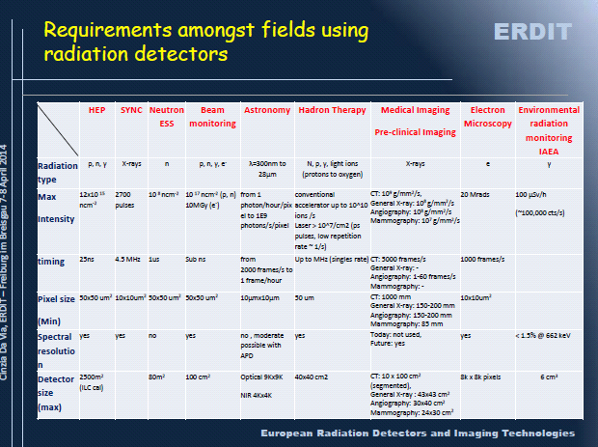
What type of ATTRACT technologies?
http://erdit.eu/ . Courtesy of Cinzia da Via

Slide 5
Examples of Projects for ATTRACT?
  (Integrated) 3D detectors for photon and electron identification (<< 1 ps, 1micron spatial resolution)
  Fast (< 1ps, 100Mcounts/s) preamplifiers and TDC electronics, with potential for medical imaging
  New Additive Manufacturing tools for integrated manufacturing of detector support structures, with potential for compact (customized) electronic systems for eg. avionics

Slide 6
“Mini-ATTRACT” Phases 1 and 2 – When?
Phase 1 (2018-2019), 20ME
A wide scope of technologies with breakthrough potential (TRL 2 to 4). Planting of the “Flowers”, 100 kE each for 1 year
Selection process based on excellence (scientific merit, industrial scalability and social added value)
Phase 2 (2019+), 30ME+
Scalability of projects selected from Phase 1 towards industrial deployment (TRL 5 to 7). Select and fund up to 10% of Phase 1 projects, depending on funding available
Construction and preparing for a self-sustained initiative (“Maxi” ATTRACT)
Start to repeat the “Flowers” in parallel

Slide 7
Funding Cycles & Scaling Up to Maxi-ATTRACT
“seed-scale” innovation cycle mechanism
Mini Phase 1
«Flowers»
Mini Phase 2
-> Maxi
Large Number of
visionary projects
100k Euros/project
Small Number of selected
projects
~2 to 4 M Euros/project
Seed Funding
(1 year)
Scale Funding
(3 to 4 years)
Seed funding
Scale funding
Open call
Seed funding
Scale funding
Open call
Open call
Evaluation by
Independent R&D&I
Committee
Evaluation by
Independent R&D&I
Committee
Evaluation by
Independent R&D&I
Committee

Slide 8
Mini-ATTRACT Submission H2020 WP 16-17 Call
Call: INFRAINNOV-1-2017 – Fostering co-innovation for future detection and imaging technologies
Budget up to 20 M Euros; call dead-line 29/03/2017
The call text encourages the ATTRACT Core Consortium to apply for the above call (Mini Phase 1), provided a sensible scheme can be found together with EC to pave way for scaling up to 1 billion Euros in the next Framework Program (FP9)

Slide 9
Mini-ATTRACT Core Consortium
A Core Consortium has been created to administrate the ATTRACT call(s) to be launched late 2017 or early 2018, depending if/when EC decides on the INFRAINNOV-1-2017 call:
      18 ME will be redistributed in 100 kE grants, based on received and selected short, few-page proposals;
              2 ME (10%) will be used for administrating the call(s), relying on in-kind contributions from the Core Consortium partners (legal, financial, project office support);
      Proposals selected by an independent scientific advisory committee (IC; coordinated by prof. S. Bertolucci);
      Some 20 distinguished, publicly identified members from the detection & imaging communities, supported by reviewers selected by the members (but not made public).
Funded projects have 12 months to develop & prepare their ideas/prototypes for the next funding stage (Phase 2). Big event in Brussels in early 2019.
An ad-hoc advisory body has been set up to prepare the way for “Maxi“, soon to merge with Mini-ATTRACT Project Advisory Committee (PAC). Chaired by prof. J. Wood

Slide 10
Mini-ATTRACT Phase 1: Proposed Governance
Mini-ATTRACT is implemented with a simple governing structure in line with H2020 rules
Unique Governing body (PCB)
Purely Admin body (PAO)
Project Consortium Board
(PCB)
Coordinator/ Project
Administrative Office
(PAO)
EC
Contact with EC
Ad-hoc independent Advisory body
(long term perspective)
Project Advisory Committee (PAC)
Ad-hoc independent Committee
(funding)
Independent R&D&I Committee (IC)

Slide 11
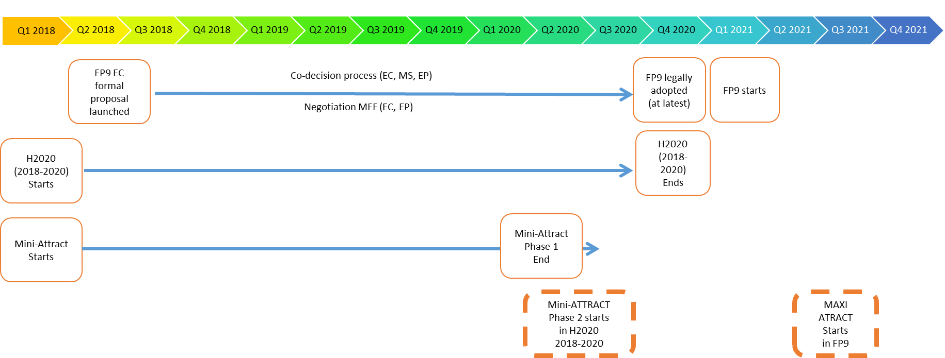
Estimated Time-line From Mini to Maxi-ATTRACT

Slide 12
Symposium: Trends, Wishes and Dreams 4-5.11
A dedicated Symposium was organized on June 30 - July 1st in Barcelona to collect first ideas to show EC what Mini-ATTRACT could fund in 2018
            https://indico.cern.ch/event/470460/
      Due to over-subscription, a 2nd TWD is organized after NSS in Strasbourg, November 4-5, 2016 (M. Titov has played a major role in it)
      http://indico.cern.ch/event/542659/
      Short, 10 minute pitches of raw ideas in: sensors; FE/BE; data acquisition and processing & computing; software; integration & engineering
      Presentations also about what type of scientific instruments could be available by 2025
      Dead-line for abstracts is October 8 – please participate!
      A summary will be annexed to the Mini-ATTRACT submission in March 2017
      Additional input is also very welcome from the R&D communities (roadmaps, position papers etc.)
      Other events planned (pls follow web site)

Slide 13
Thanks and questions

